Slide 1
Study of CEPC ECAL Calibration
Xiang Li, Zhen Wang, Jiaxuan Wang
2025.3.18
Notes:
Thank you for joining me today. This presentation focuses on the energy calibration data processing of the CEPC ECAL. I will explain the challenges we faced with muon-based MIP calibration and how we transitioned to using electrons for a more accurate and reliable calibration.

Slide 2
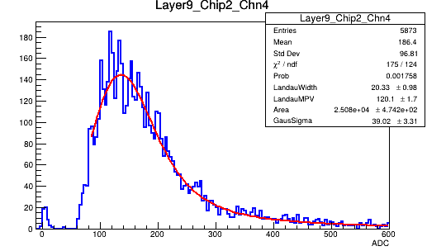
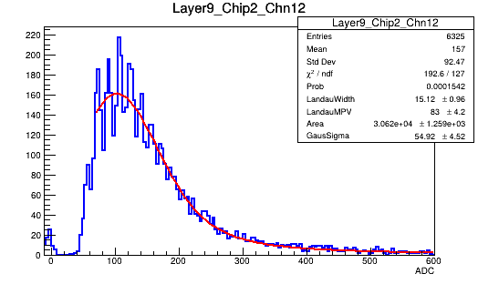
Motivation：
MIP calibrations are not optimal.
Electrons are used as a substitute.
Strategy :
Energy/ADC studied where the beam hits layer center
Determine scale factors to rescale channels.
Notes:
Initially, we attempted to use muons for MIP calibration。but they are not optimal for achieving the desired accuracy. To address this, electrons are used as a substitute.
First, we examine the energy and ADC distribution of central cells to understand their response. Based on this analysis, we determine scale factors to rescale individual channels, ensuring uniformity and accuracy across the system.
This approach allows us to improve calibration precision and achieve more reliable results moving forward.

Slide 3
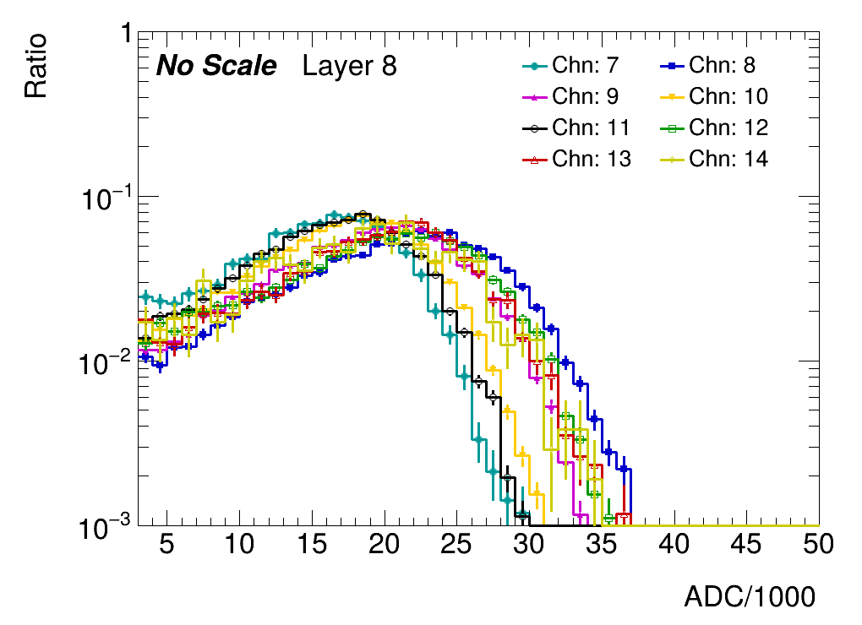
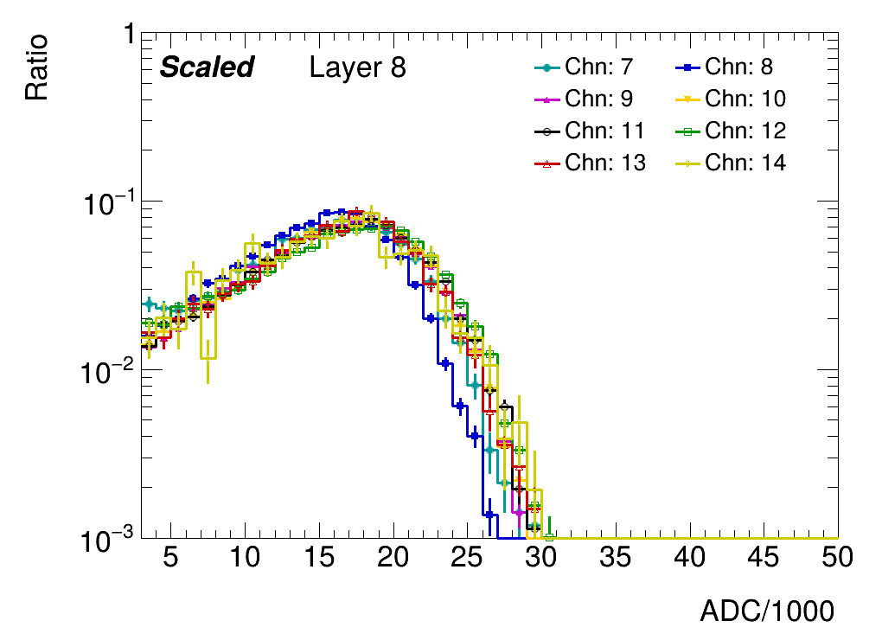
Methodology:
For each layer:
Select a standard channel (denoted as hstd)
For h in remaining channels:
Find the sf minimizes chi2(h,hstd)
Parameter ranged modified
Standard selection:
MIP calibration
Statistics
SF

Slide 4
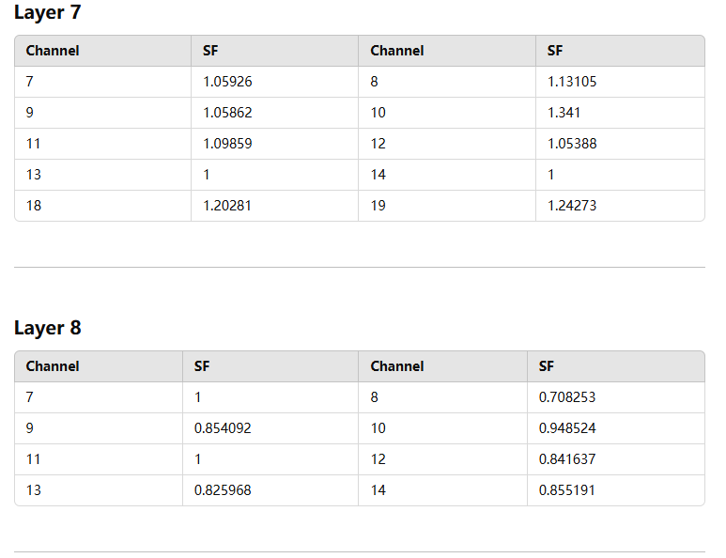
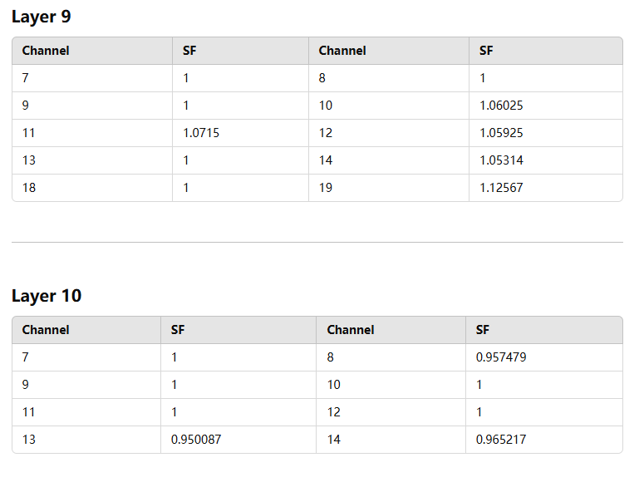
Scale Factor
The calculated scale factors are all close to 1
*
*
*
*

Slide 5
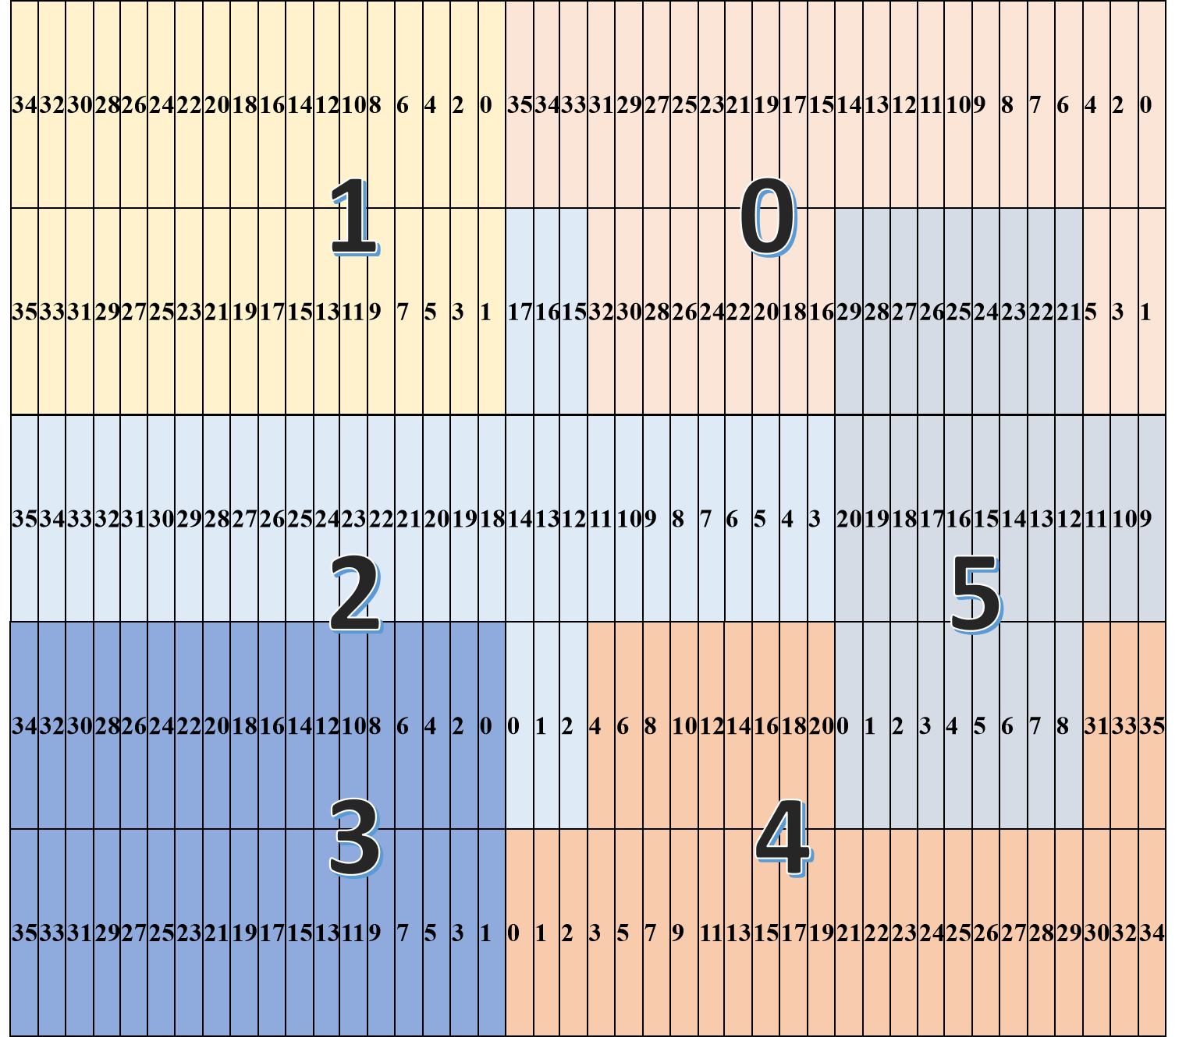
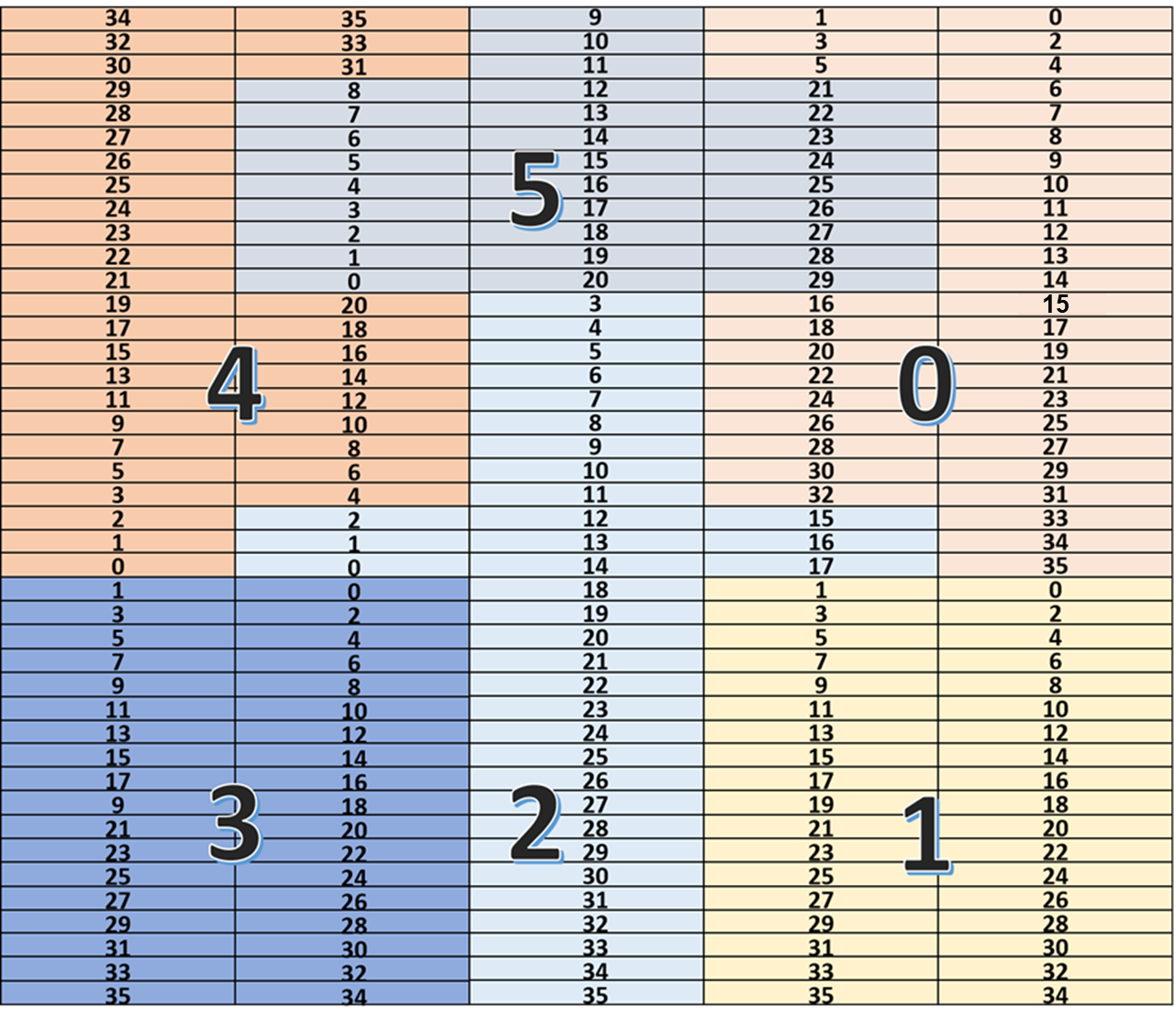
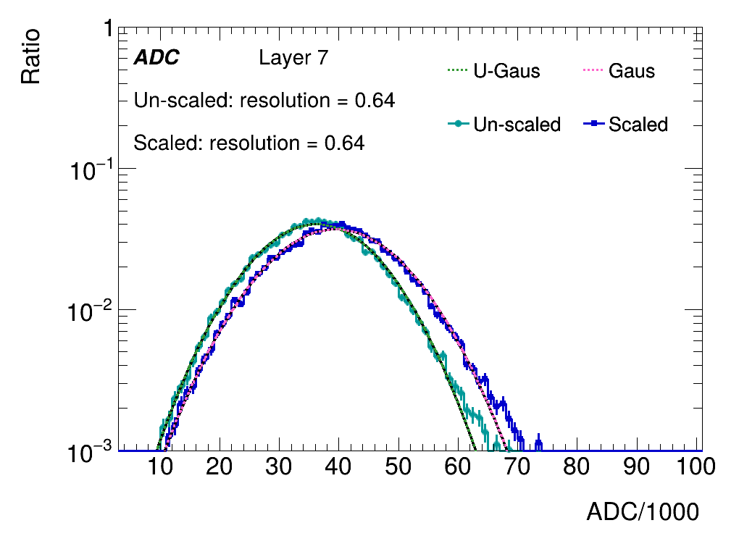
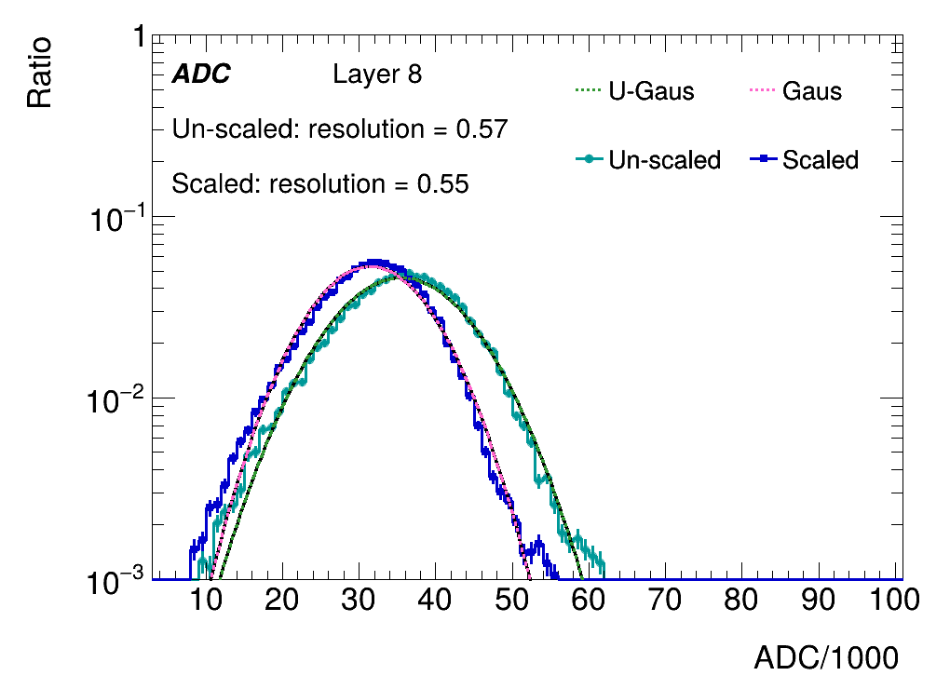
Sum of ADC within one layer
Layers with weighted center falls into beam center
ADCs are summed for comparison

Slide 6
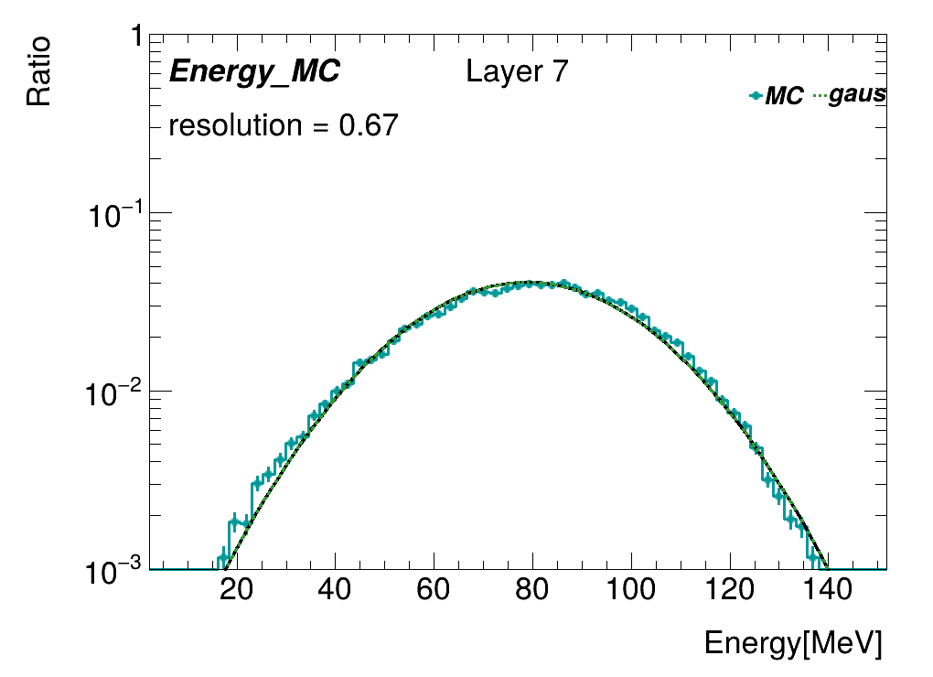
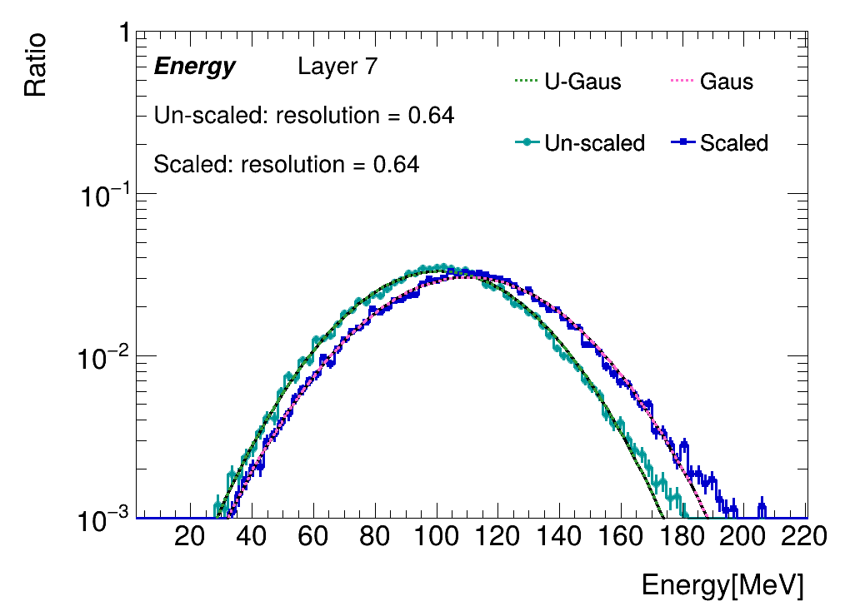
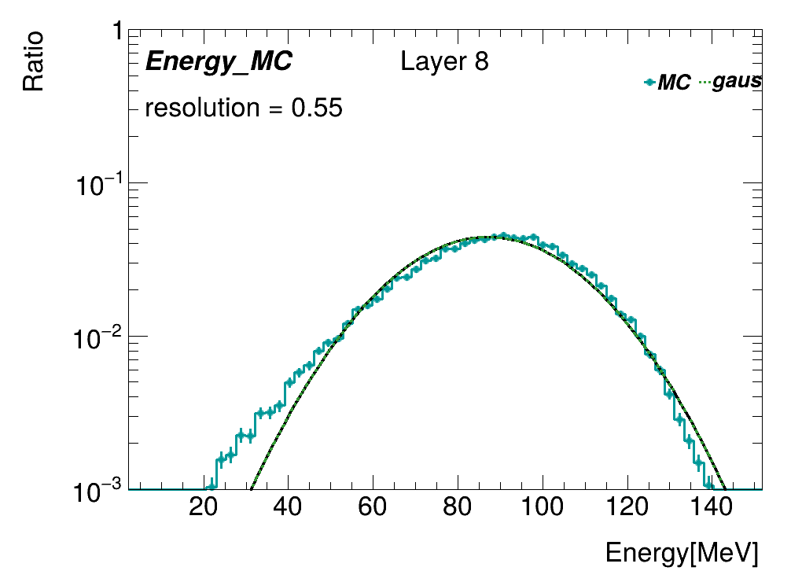
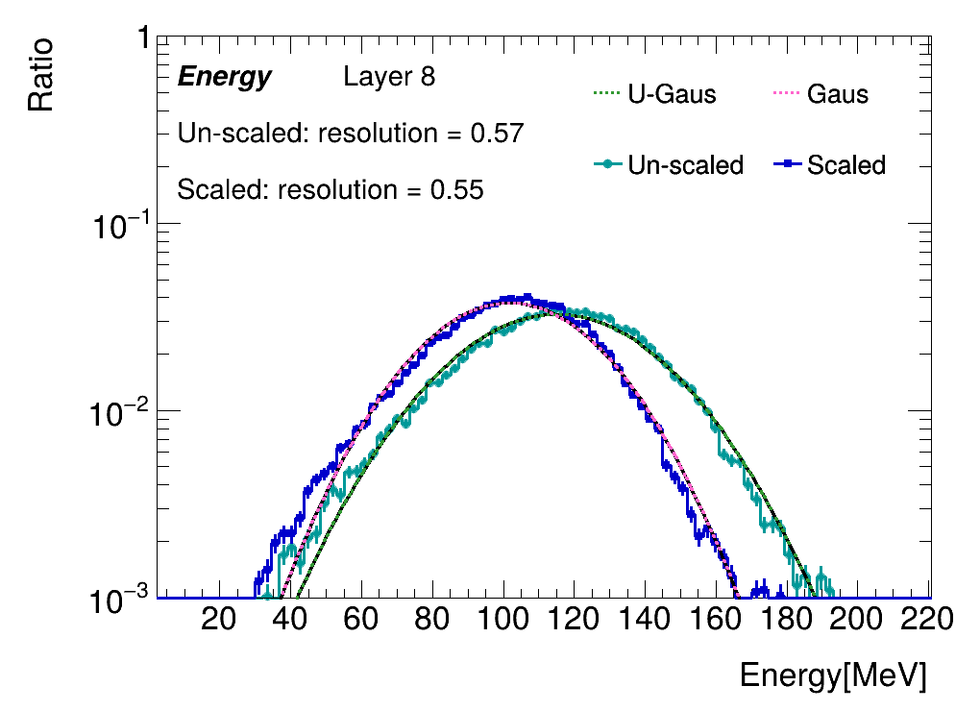
Sum of energy within one layer
Energy=ADC_{scaled}/MPV_{std}*0.305(MeV)
Layers with weighted center falls into beam center
MPV of standard channels are applied for all channels
Compare with MC

Slide 7
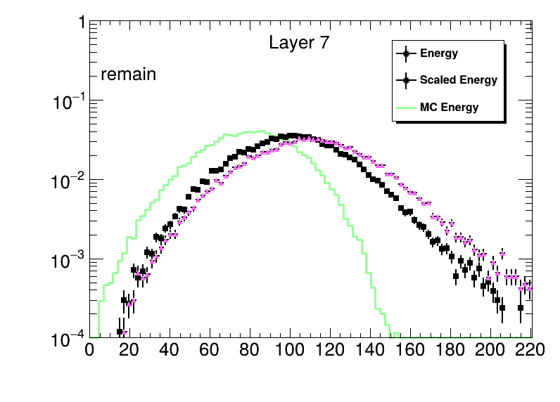
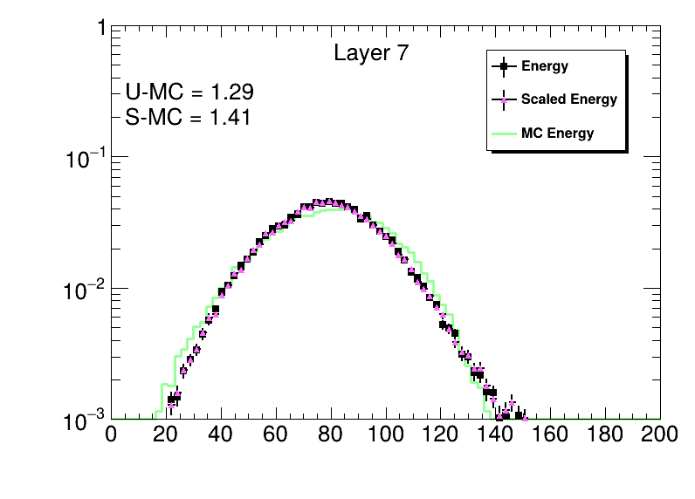
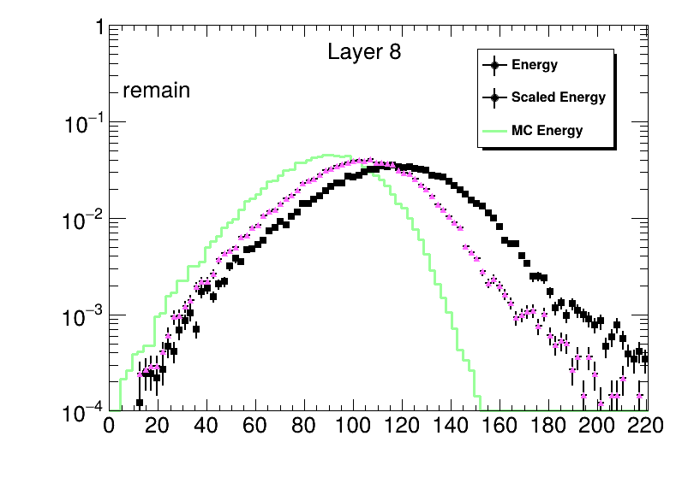
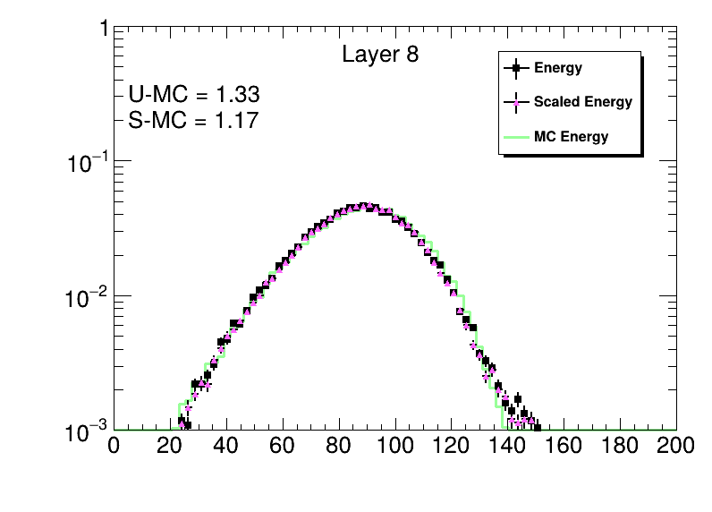
Scale to MC
Energy=ADC_{scaled}/MPV_{std}*0.305(MeV)
Layers with weighted center falls into beam center
MPV of standard channels are applied for all channels
Compare with MC
Using a factor to scale to the MC

Slide 8
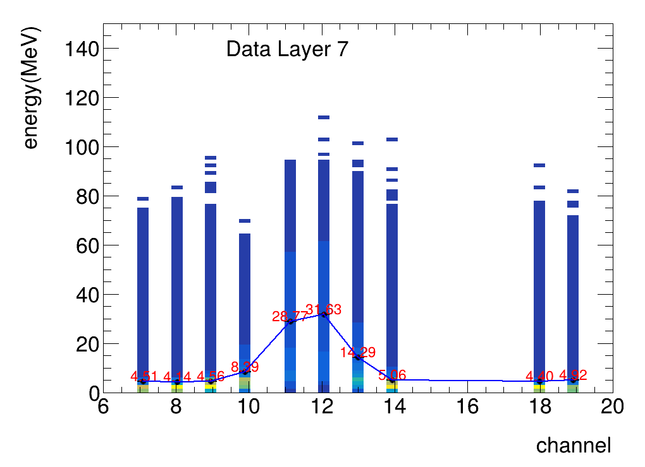
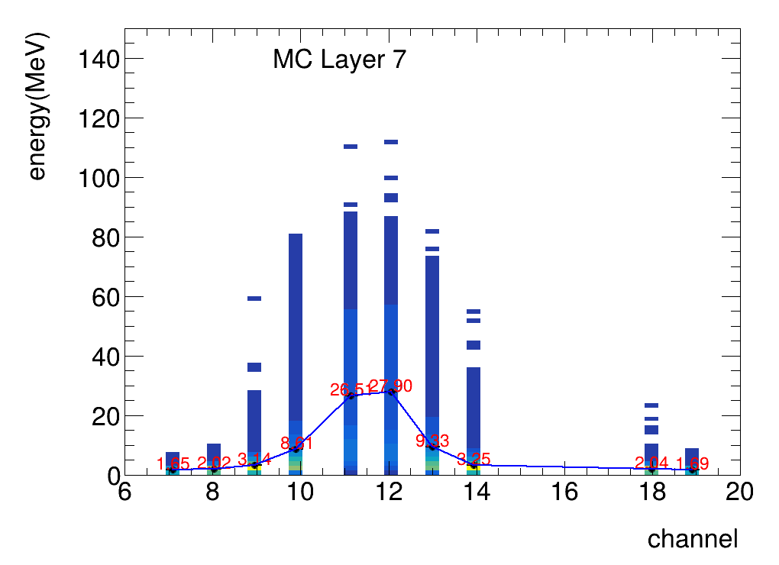
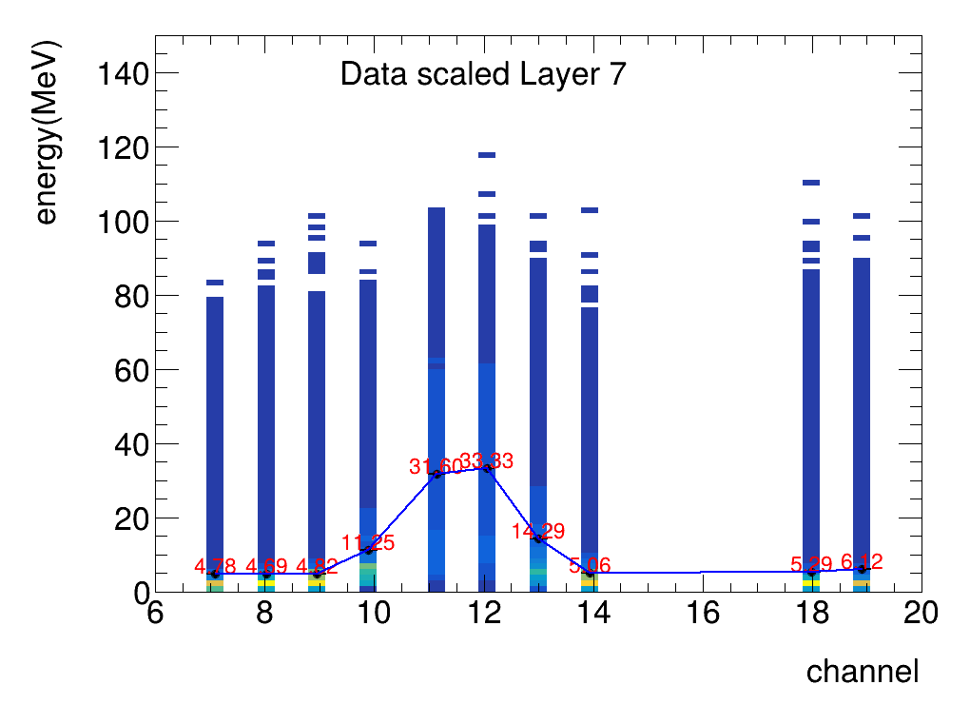
Distribution of energy within one layer
Layers with weighted center falls into beam center
MPV of standard channels are applied for all channels
standard channel :13
Energy=ADC/MPV*0.305(Mev)

Slide 9
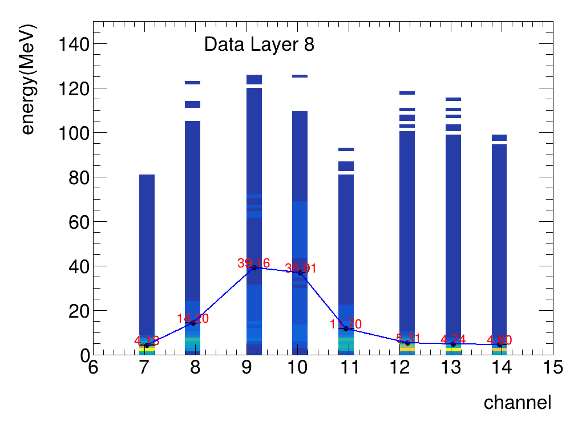
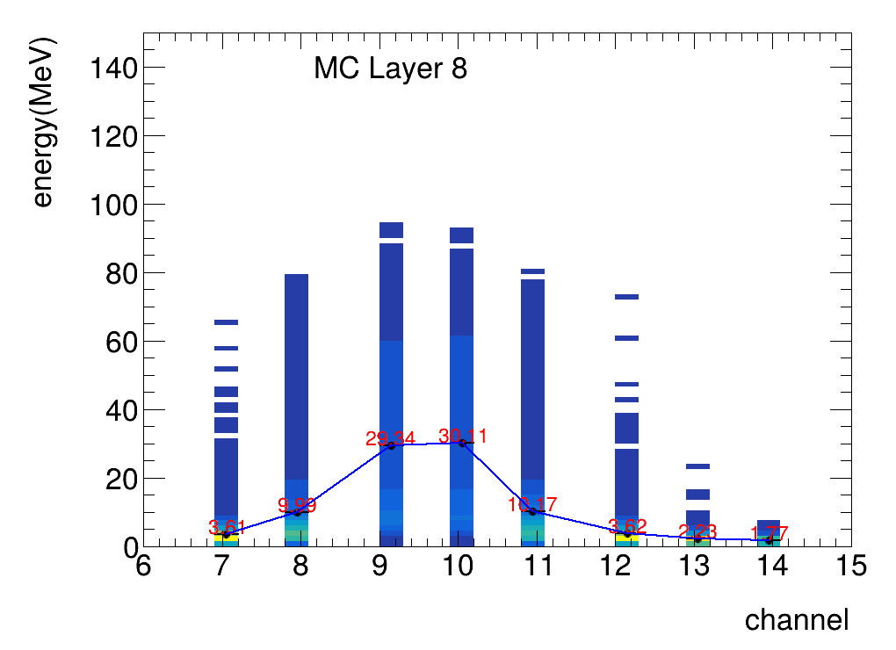
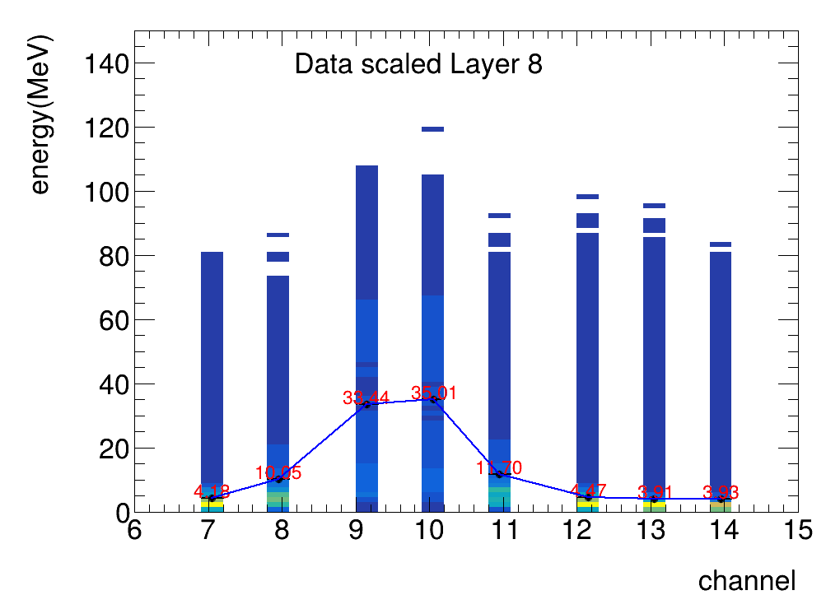
Distribution of energy within one layer
Layers with weighted center falls into beam center
MPV of standard channels are applied for all channels
standard channel :11
Energy=ADC/MPV*0.305(Mev)

Slide 10
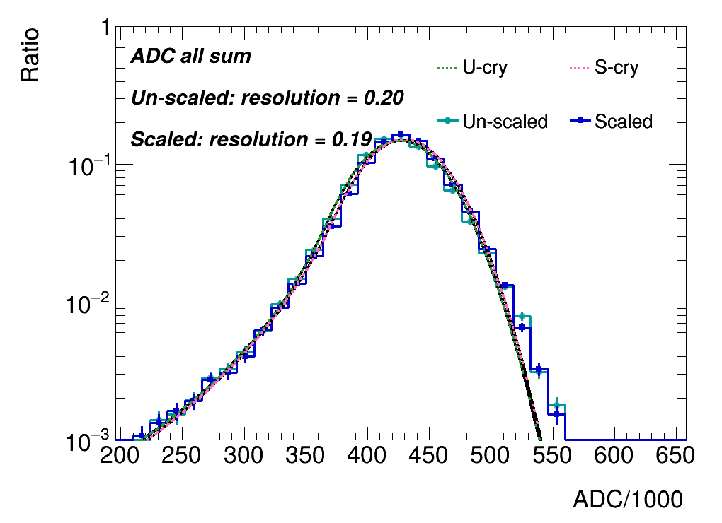
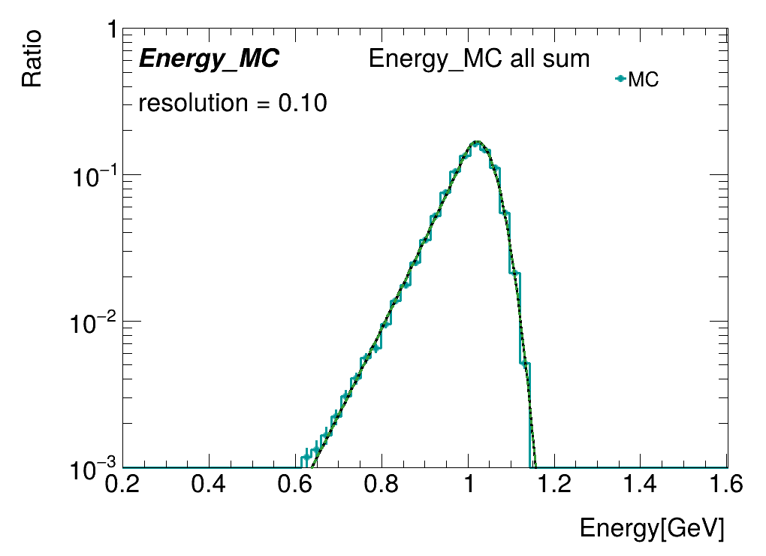
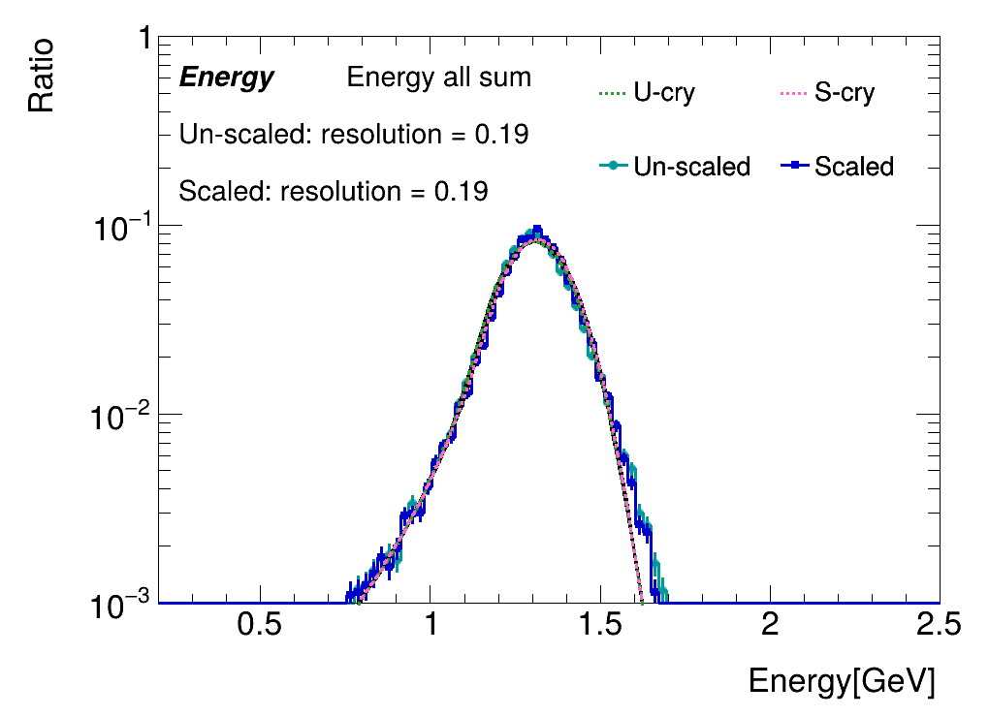
Sum of energy/ADC of single events
Events selected when center of layer 9 and 10 hit
ADC/Energy summed for all layers
No obvious deviation found after scaling

Slide 11
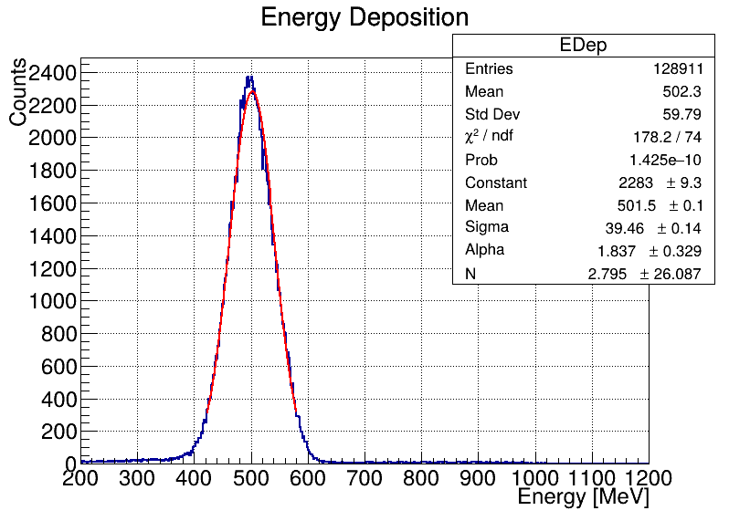
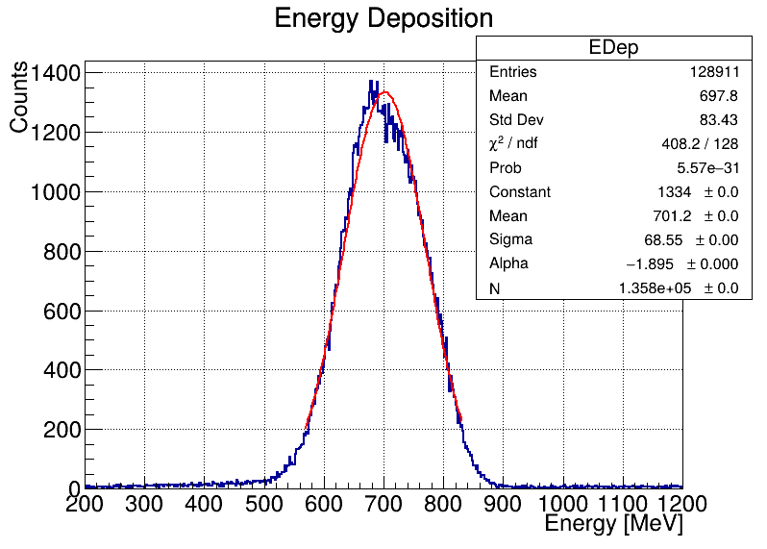
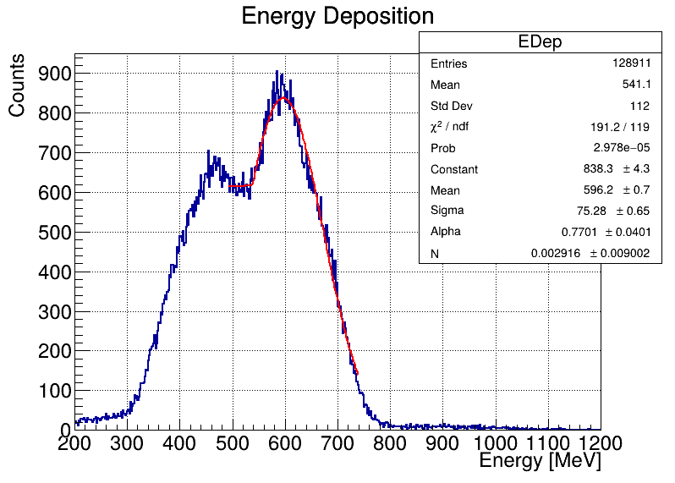
Cosmic Ray Test VS Beam Test
Using cosmic ray test MIP and beam test MIP
Calculate the 20 GeV electron energy deposition
beam test MIP selected
cosmic ray test MIP
beam test MIP
selected beam test good channel

Slide 12
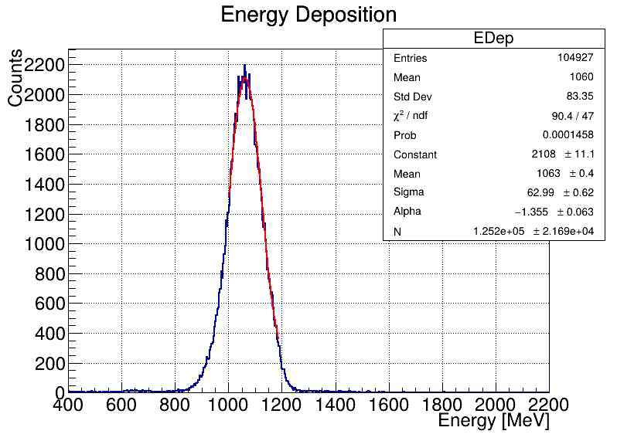
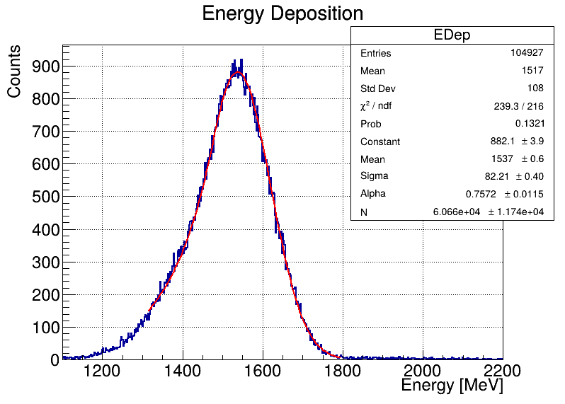
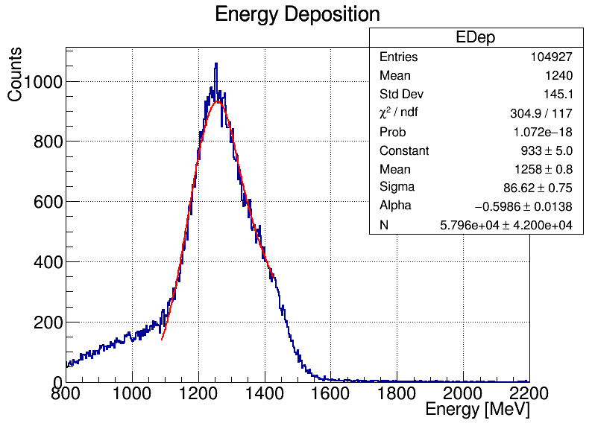
Cosmic Ray Test VS Beam Test
Using cosmic ray test MIP and beam test MIP
Calculate the 40 GeV electron energy deposition
beam test MIP selected
cosmic ray test MIP
beam test MIP
selected beam test good channel

Slide 13
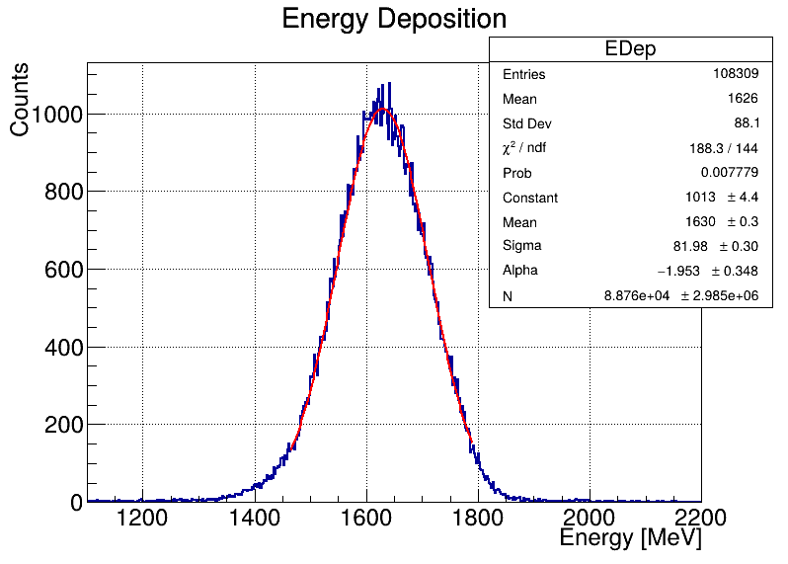
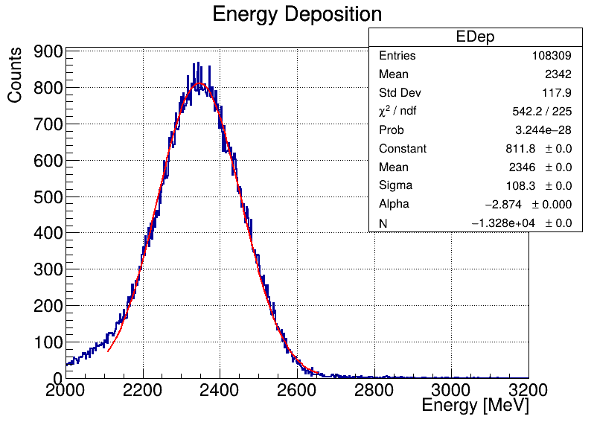
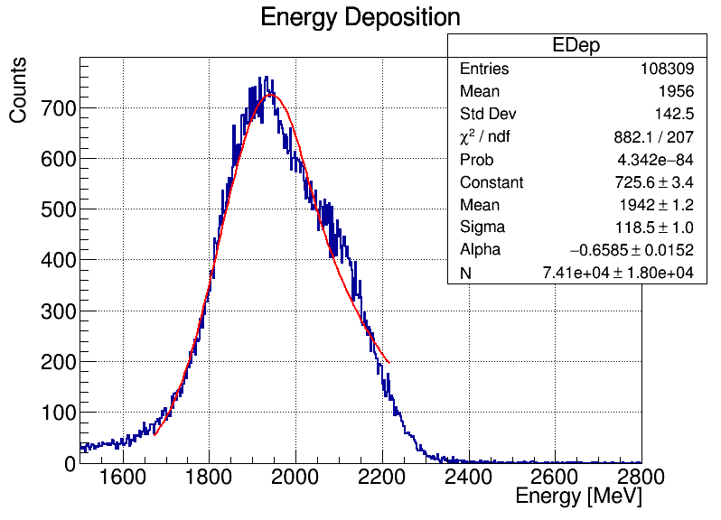
Cosmic Ray Test VS Beam Test
Using cosmic ray test MIP and beam test MIP
Calculate the 60 GeV electron energy deposition
beam test MIP selected
cosmic ray test MIP
beam test MIP
selected beam test good channel

Slide 14
Summary & Todos
Sum of ADC/Energy studied (per layer / all layers)
Study of energy/ADC from MC
No obvious deviation found after scaling
Compere data and MC
Todos:
Optimization of fitting strategy

Slide 15
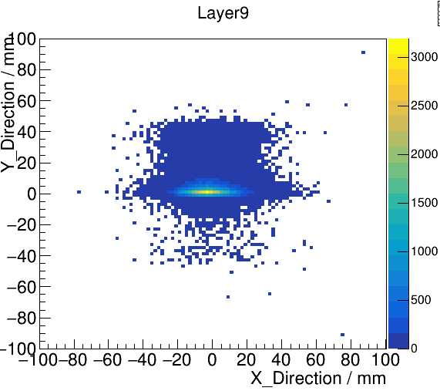
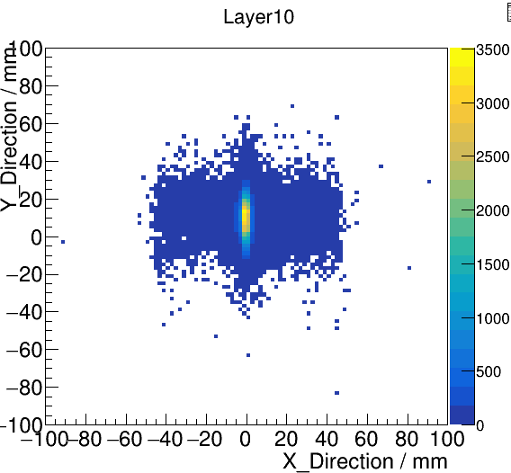
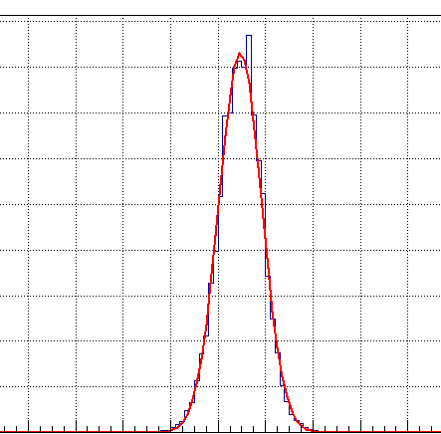
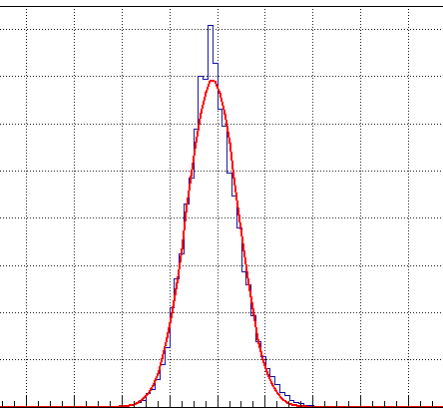
back up: the shape of electron beam

Slide 16
back up: the position of channels

Slide 17
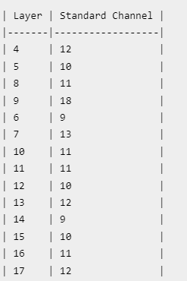
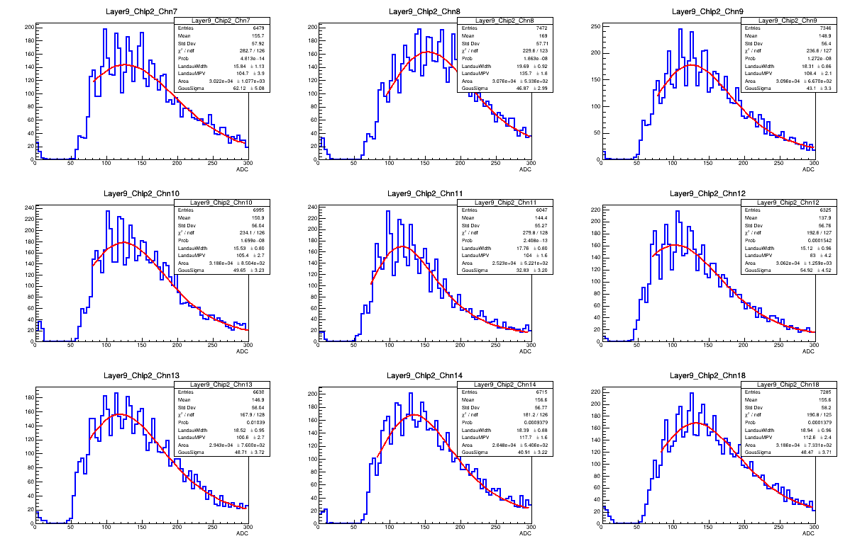
back up: the MIP of standard channel

Slide 18
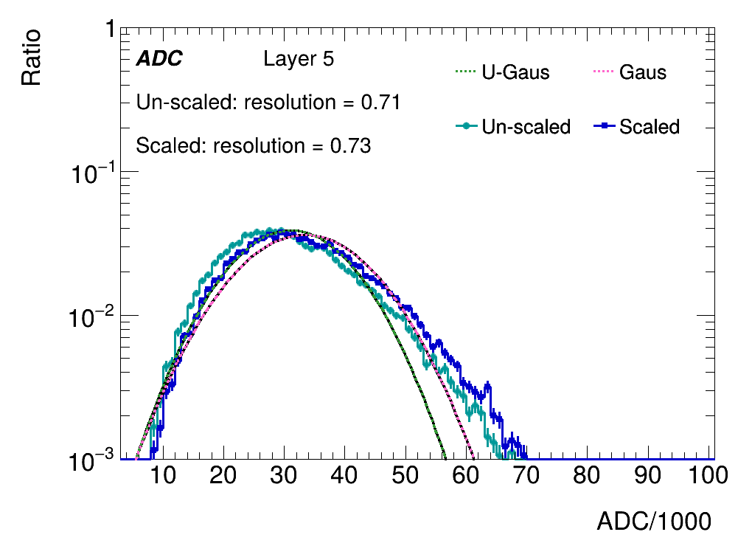
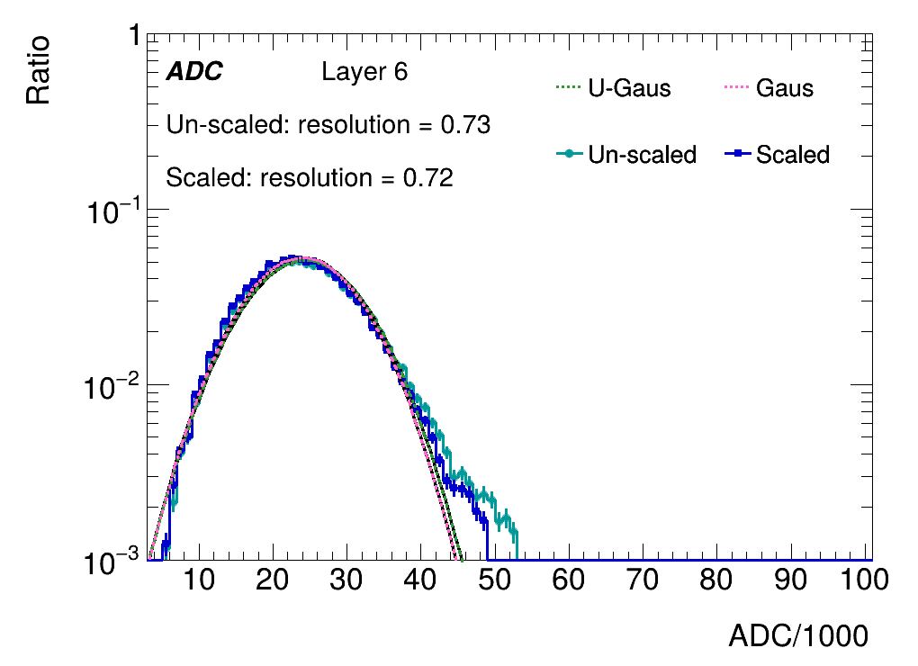
Sum of ADC within one layer
Layers with weighted center falls into beam center
ADCs are summed for comparison

Slide 19
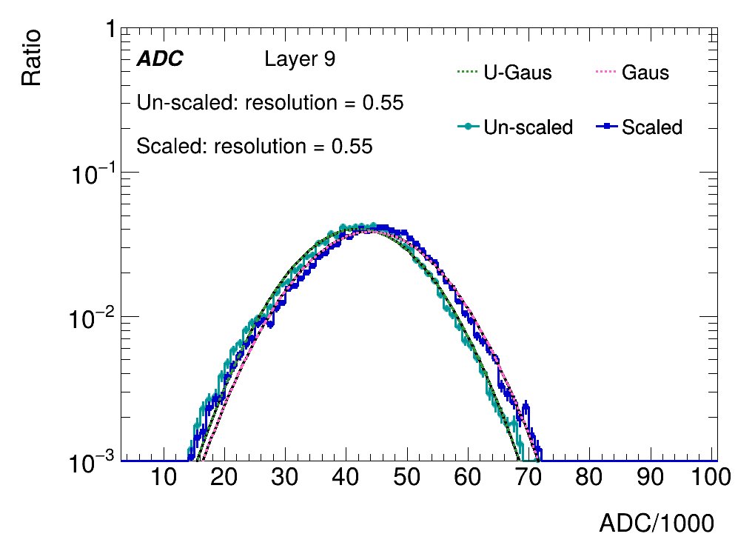
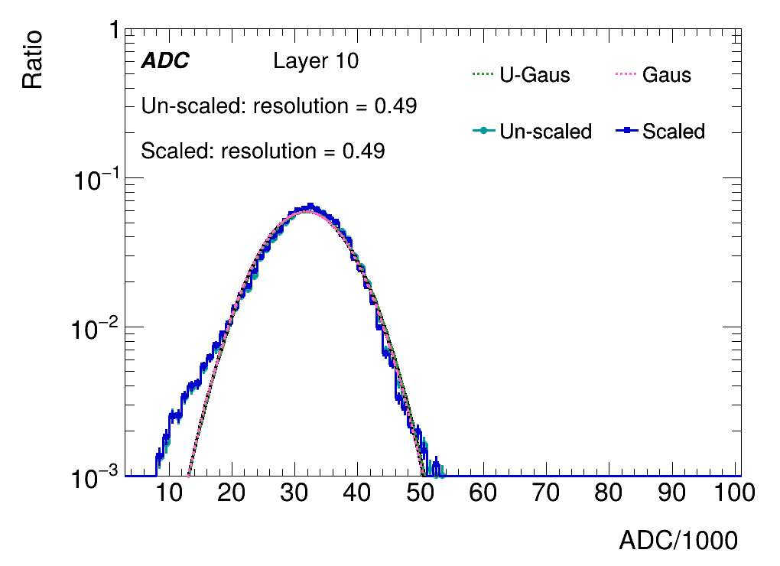
Sum of ADC within one layer
Layers with weighted center falls into beam center
ADCs are summed for comparison

Slide 20
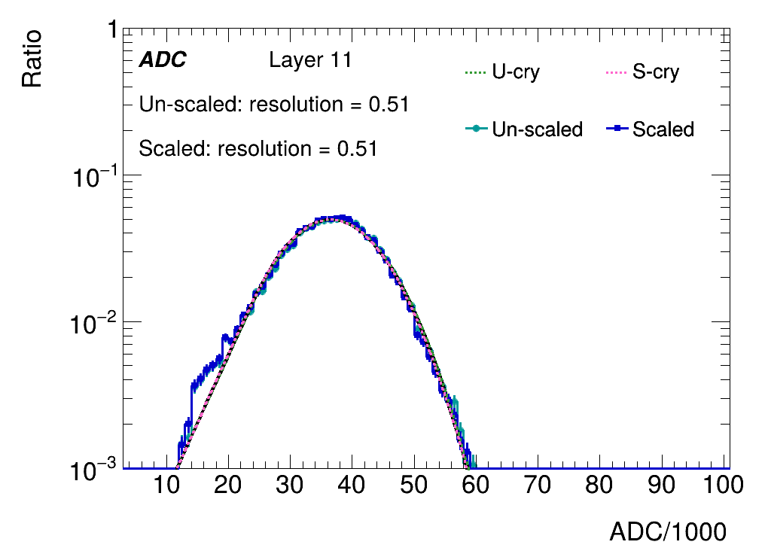
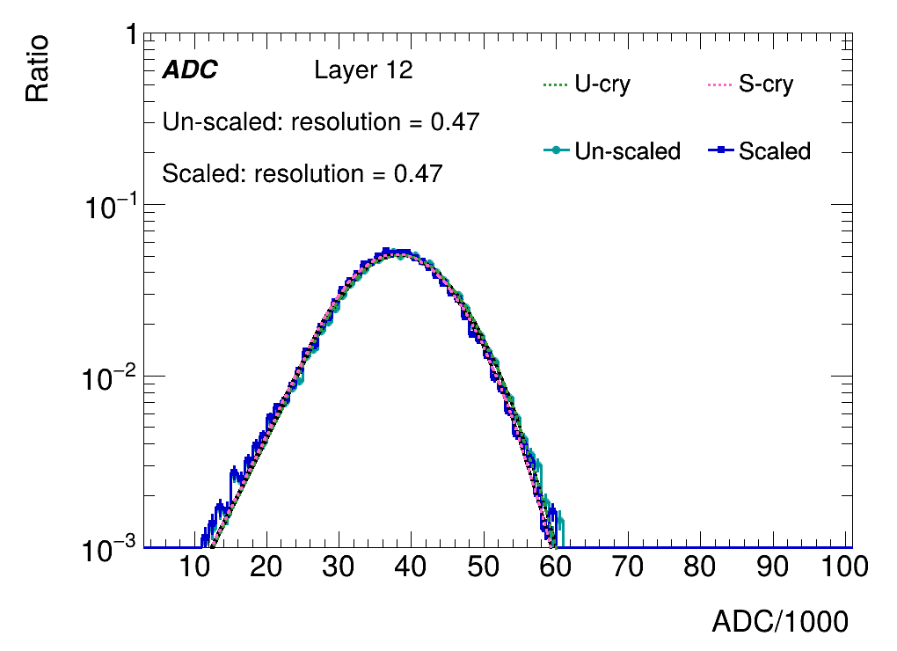
Sum of ADC within one layer
Layers with weighted center falls into beam center
ADCs are summed for comparison

Slide 21
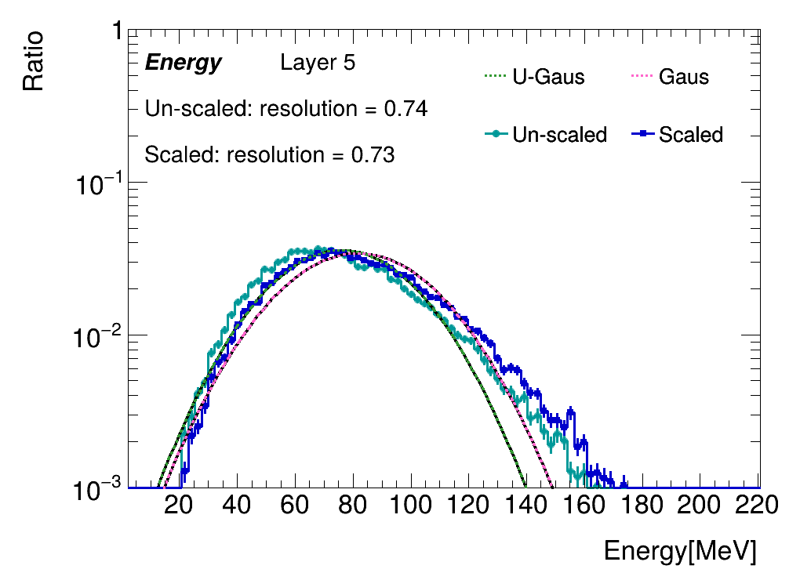
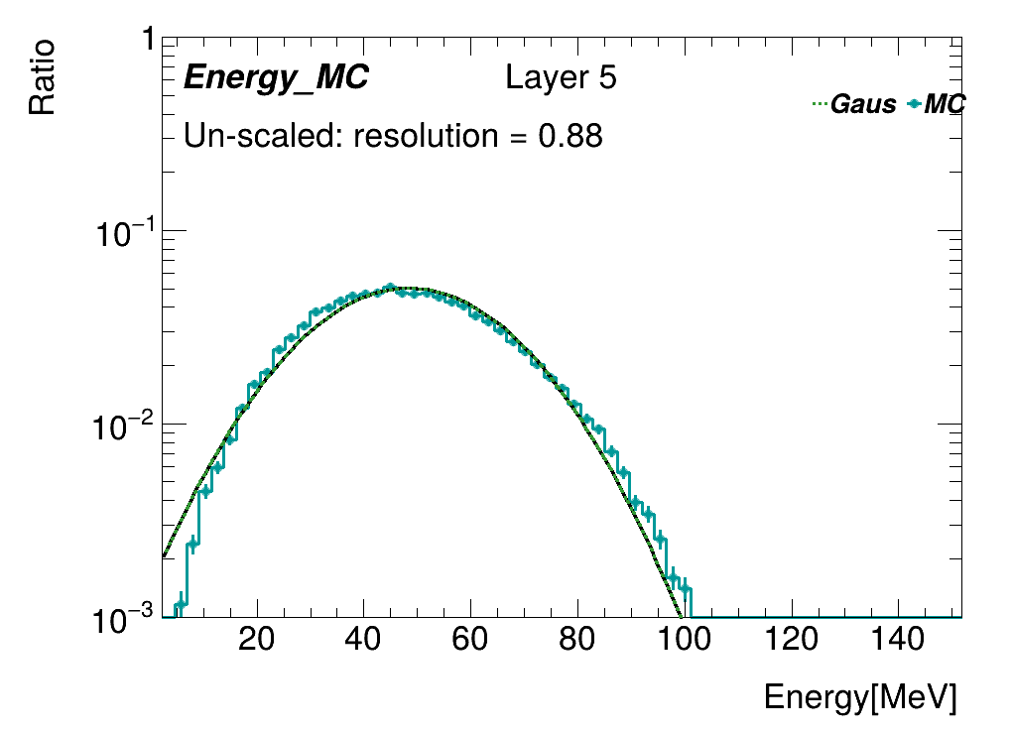
Sum of energy within one layer
Layers with weighted center falls into beam center
MPV of standard channels are applied for all channels
Energy=ADC/MPV*0.305(Mev)

Slide 22
Scale to MC
Layers with weighted center falls into beam center
MPV of standard channels are applied for all channels
Energy=ADC/MPV*0.305(Mev)

Slide 23
Sum of energy within one layer
Layers with weighted center falls into beam center
MPV of standard channels are applied for all channels
Energy=ADC/MPV*0.305(Mev)

Slide 24
Scale to MC
Layers with weighted center falls into beam center
MPV of standard channels are applied for all channels
Energy=ADC/MPV*0.305(Mev)

Slide 25
Sum of energy within one layer
Layers with weighted center falls into beam center
MPV of standard channels are applied for all channels
Energy=ADC/MPV*0.305(Mev)

Slide 26
Scale to MC
Layers with weighted center falls into beam center
MPV of standard channels are applied for all channels
Energy=ADC/MPV*0.305(Mev)

Slide 27
Sum of energy within one layer
Layers with weighted center falls into beam center
MPV of standard channels are applied for all channels
Energy=ADC/MPV*0.305(Mev)

Slide 28
Scale to MC
Layers with weighted center falls into beam center
MPV of standard channels are applied for all channels
Energy=ADC/MPV*0.305(Mev)

Slide 29
Sum of energy within one layer
Layers with weighted center falls into beam center
MPV of standard channels are applied for all channels
Energy=ADC/MPV*0.305(Mev)

Slide 30
Scale to MC
Layers with weighted center falls into beam center
MPV of standard channels are applied for all channels
Energy=ADC/MPV*0.305(Mev)

Slide 31
Sum of energy within one layer
Layers with weighted center falls into beam center
MPV of standard channels are applied for all channels
Energy=ADC/MPV*0.305(Mev)

Slide 32
Scale to MC
Layers with weighted center falls into beam center
MPV of standard channels are applied for all channels
Energy=ADC/MPV*0.305(Mev)

Slide 33
Distribution of energy within one layer
Layers with weighted center falls into beam center
MPV of standard channels are applied for all channels
standard channel :10
Energy=ADC/MPV*0.305(Mev)

Slide 34
Distribution of energy within one layer
Layers with weighted center falls into beam center
MPV of standard channels are applied for all channels
standard channel :10
Energy=ADC/MPV*0.305(Mev)

Slide 35
Distribution of energy within one layer
Layers with weighted center falls into beam center
MPV of standard channels are applied for all channels
standard channel :9
Energy=ADC/MPV*0.305(Mev)

Slide 36
Distribution of energy within one layer
Layers with weighted center falls into beam center
MPV of standard channels are applied for all channels
standard channel :9
Energy=ADC/MPV*0.305(Mev)

Slide 37
Distribution of energy within one layer
Layers with weighted center falls into beam center
MPV of standard channels are applied for all channels
standard channel :9
Energy=ADC/MPV*0.305(Mev)

Slide 38
Distribution of energy within one layer
Layers with weighted center falls into beam center
MPV of standard channels are applied for all channels
standard channel :9
Energy=ADC/MPV*0.305(Mev)

Slide 39
Distribution of energy within one layer
Layers with weighted center falls into beam center
MPV of standard channels are applied for all channels
standard channel :9
Energy=ADC/MPV*0.305(Mev)

Slide 40
Distribution of energy within one layer
Layers with weighted center falls into beam center
MPV of standard channels are applied for all channels
standard channel :9
Energy=ADC/MPV*0.305(Mev)

Slide 41
Distribution of energy within one layer
Layers with weighted center falls into beam center
MPV of standard channels are applied for all channels
standard channel :9
Energy=ADC/MPV*0.305(Mev)

Slide 42
Distribution of energy within one layer
Layers with weighted center falls into beam center
MPV of standard channels are applied for all channels
standard channel :9
Energy=ADC/MPV*0.305(Mev)

Slide 43
Distribution of energy within one layer
Layers with weighted center falls into beam center
MPV of standard channels are applied for all channels
standard channel :9
Energy=ADC/MPV*0.305(Mev)

Slide 44
Distribution of energy within one layer
Layers with weighted center falls into beam center
MPV of standard channels are applied for all channels
standard channel :9
Energy=ADC/MPV*0.305(Mev)

Slide 45
sf
*

Slide 46
sf
*

Slide 47
sf
*

Slide 48
sf
*

Slide 49
sf
*

Slide 50
sf
*

Slide 51
sf
*
*

Slide 52
sf
*

