Slide 1
VLAST-P ECAL on-orbit MIP calibration
2025/03/18
Speaker : Jiaxuan Wang

Slide 2
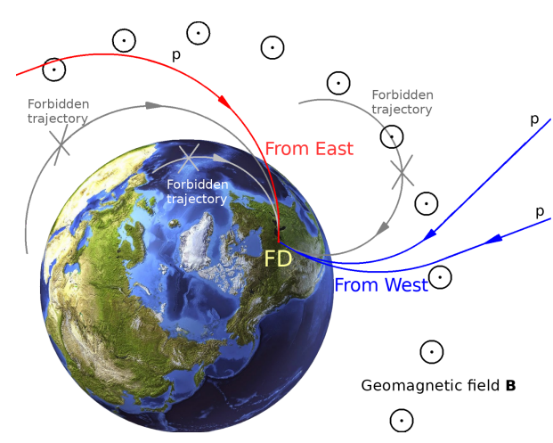
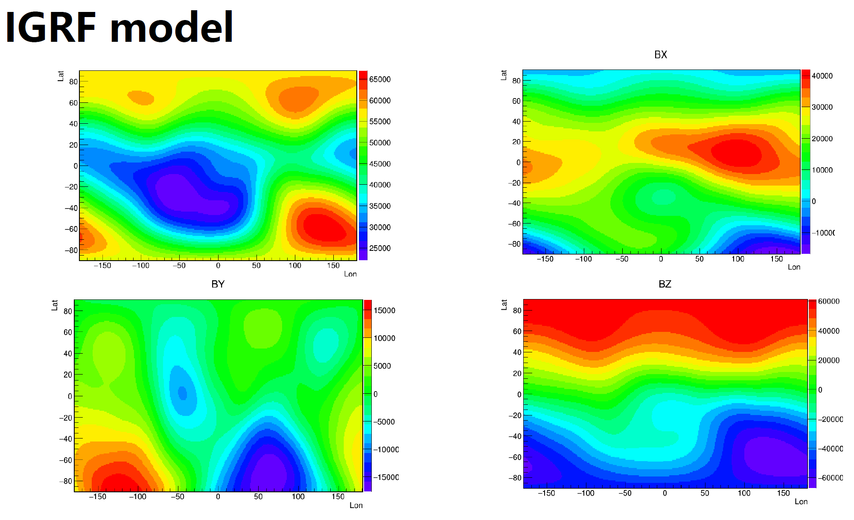
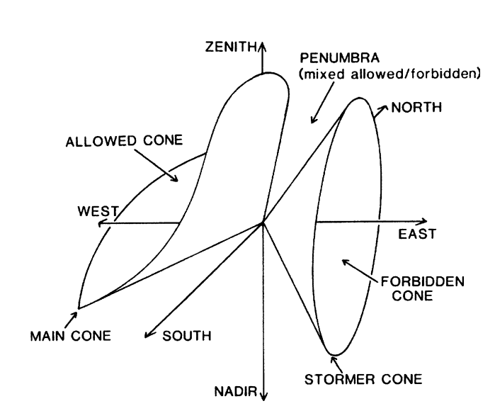
Motivation
Geomagnetic cutoff -> On-orbit calibration with different proton spectrum
IGRF13 geomagnetic field update -> Backtracing Json library

Slide 3
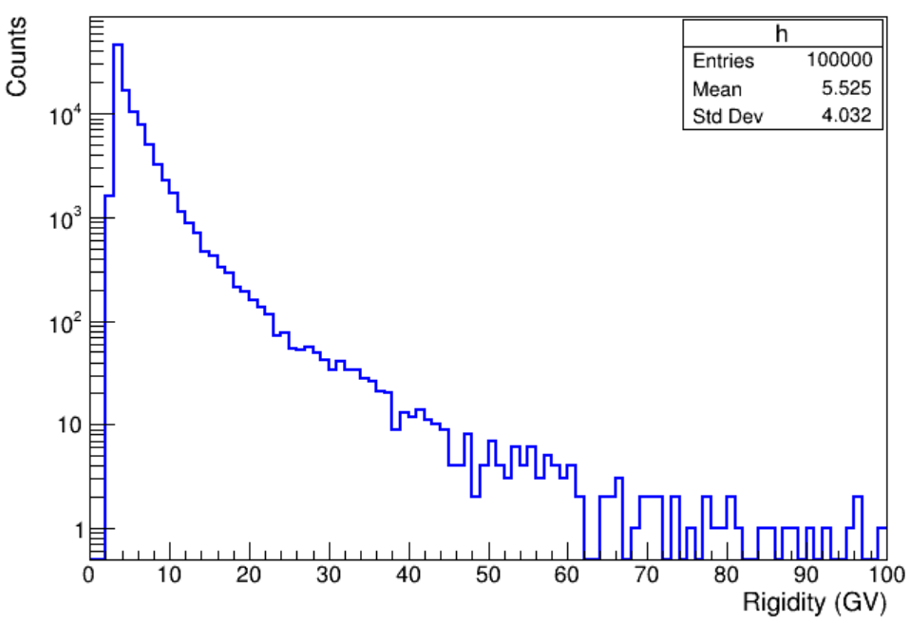
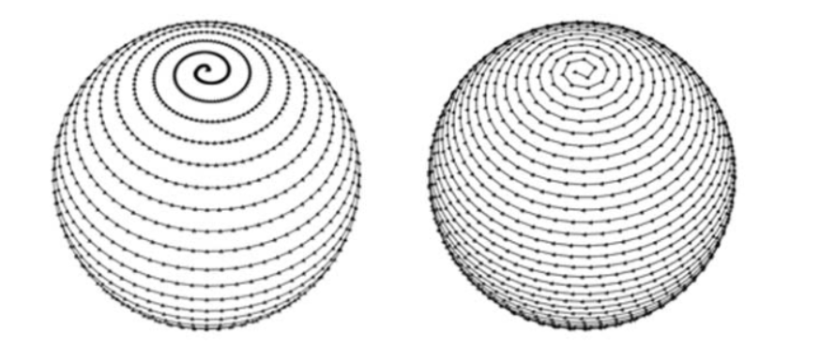
Geomagnetic cutoff MC analysis
Proton properties
Rigidity: sampled from AMS-02 proton flux
Direction: sampled from 4$π$
Time-reversal approach
Difficult to evolve forward
Backtracing Json library
Spiral grid method: theta, arc
Json library indicate whether allowed directly

Slide 4
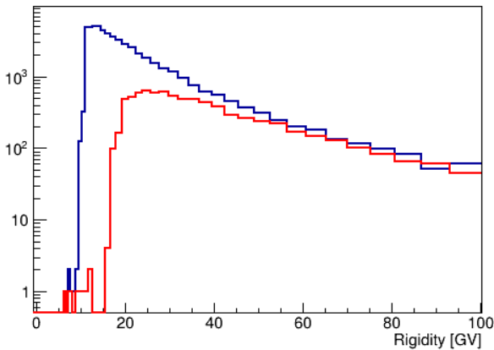
Proton spectrum
Proton spectrum from east and west
Particle selection: along Y axis with 60 degrees cone angle
Block selection: Particle Earth block and geomagnetic cutoff
Next step
1. Spectrum update with all longitude
2. Apply proton spectrum to VLAST-P ECAL standalone geometry
Red: from east
Blue: from west

Slide 6
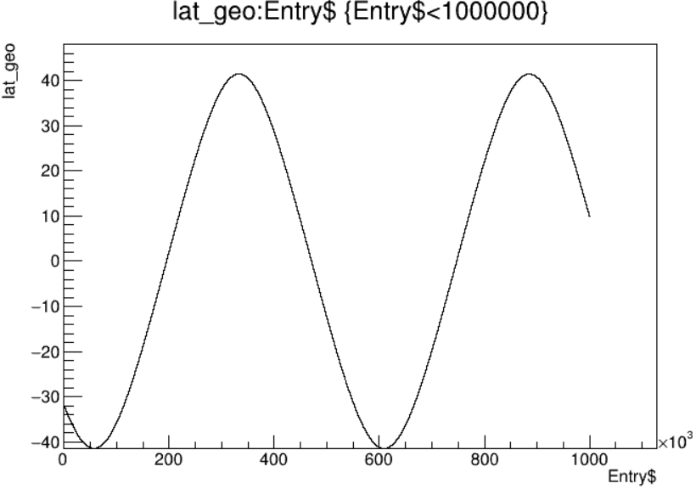
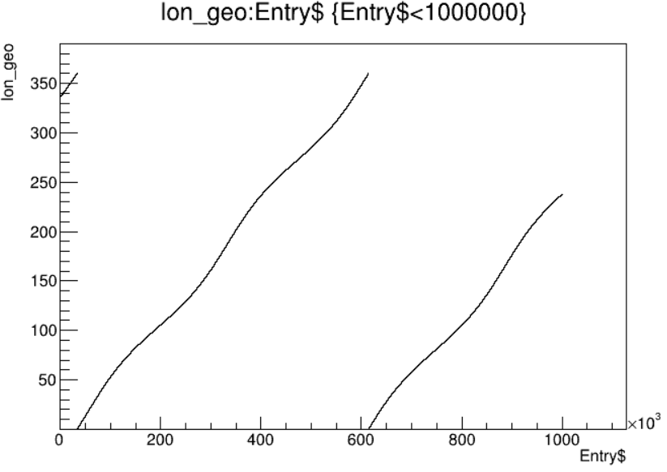
Lat and lon

Slide 7
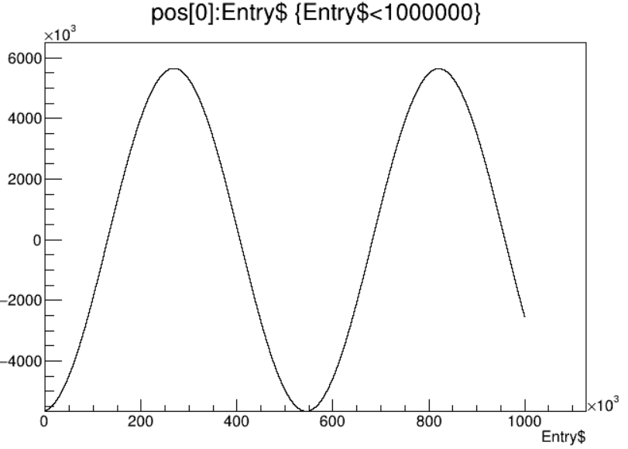
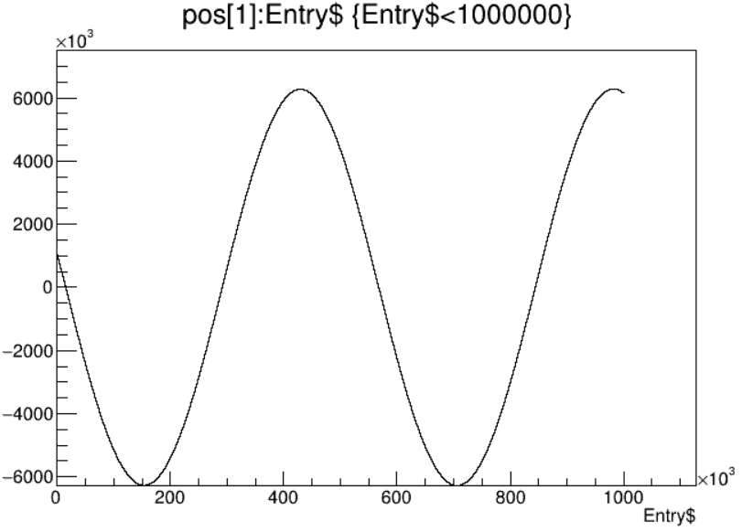
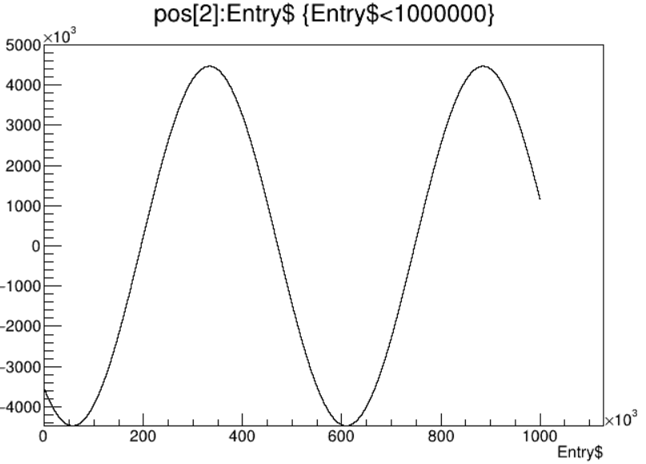
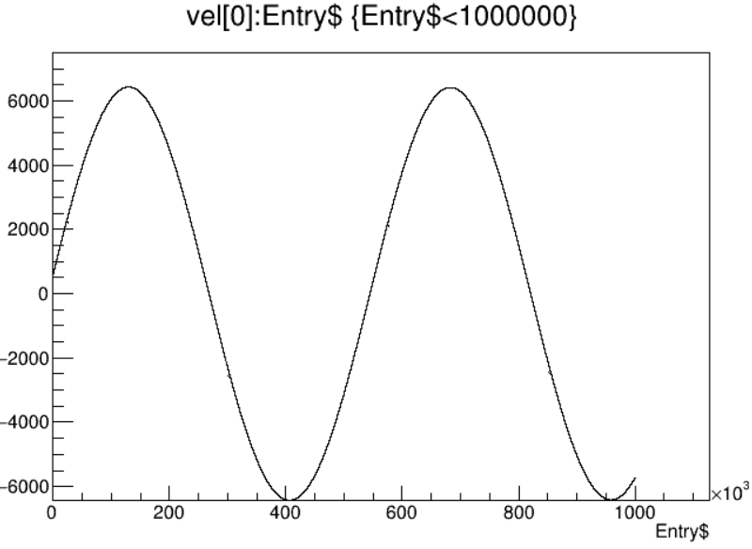
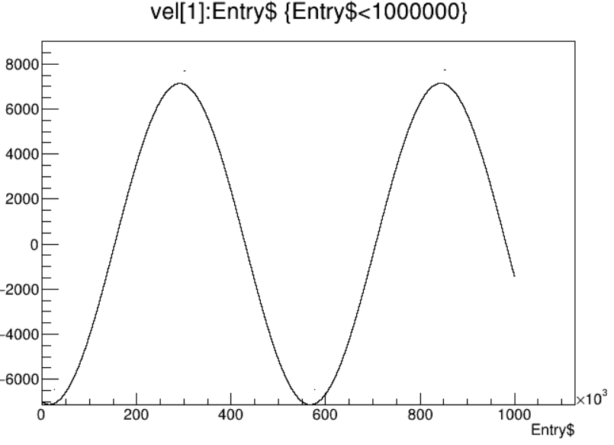
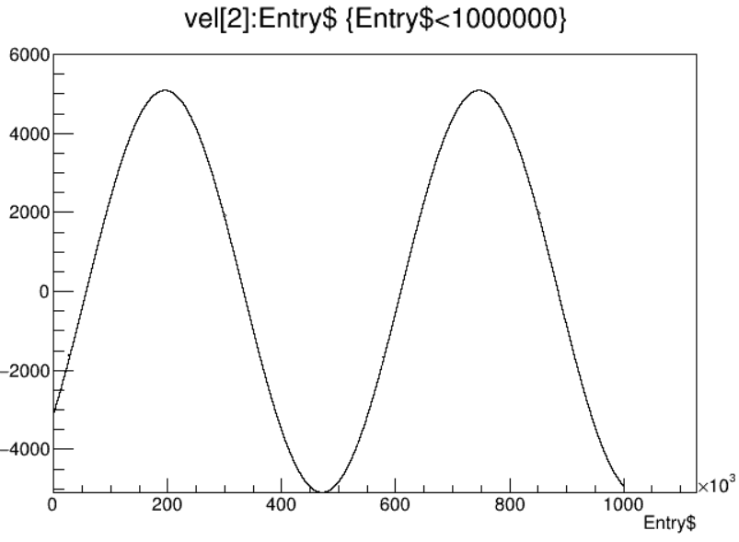
Pos and vel

Slide 8
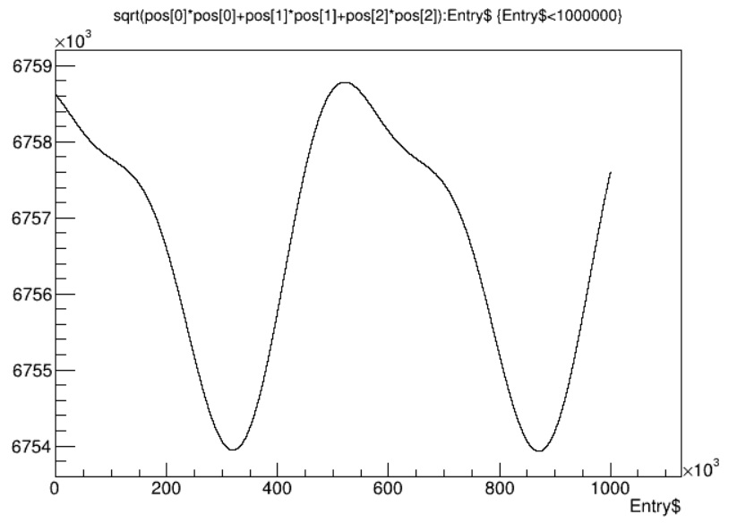
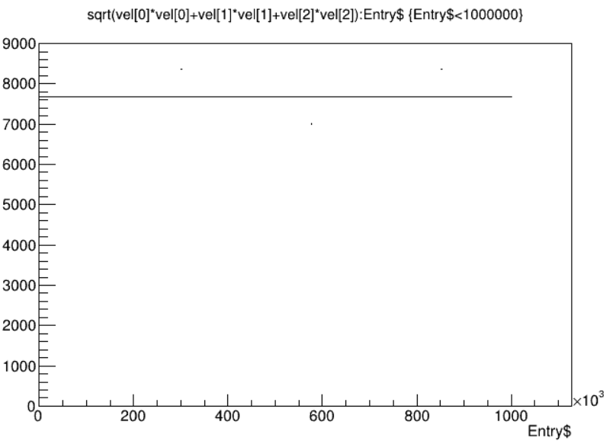
Pos and vel

