Slide 1
AHCAL Digitization Tuning
Hongbin Diao
State key laboratory of particle detection and electronics
University of Science and Technology of China

Slide 2
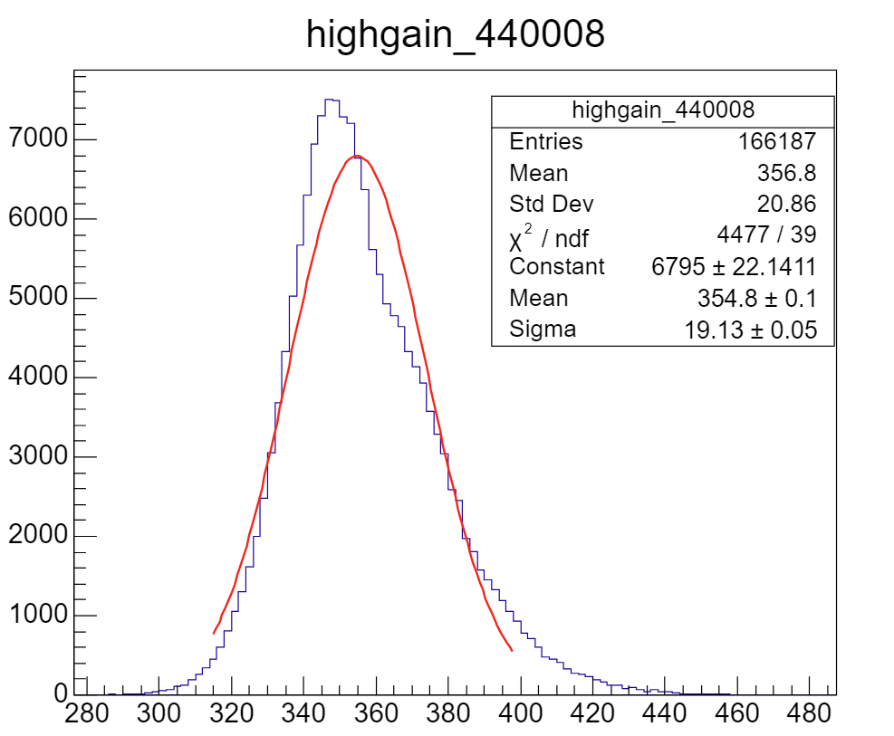
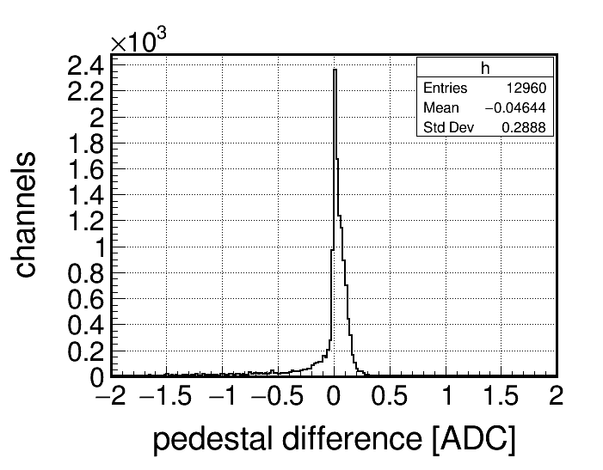
highgain pedestal width
refit the highgain pedestal to get more accurate pedestal sigma
difference is not very big
lowgain has no change basically, due to it’s more gaussian
mean
sigma

Slide 3
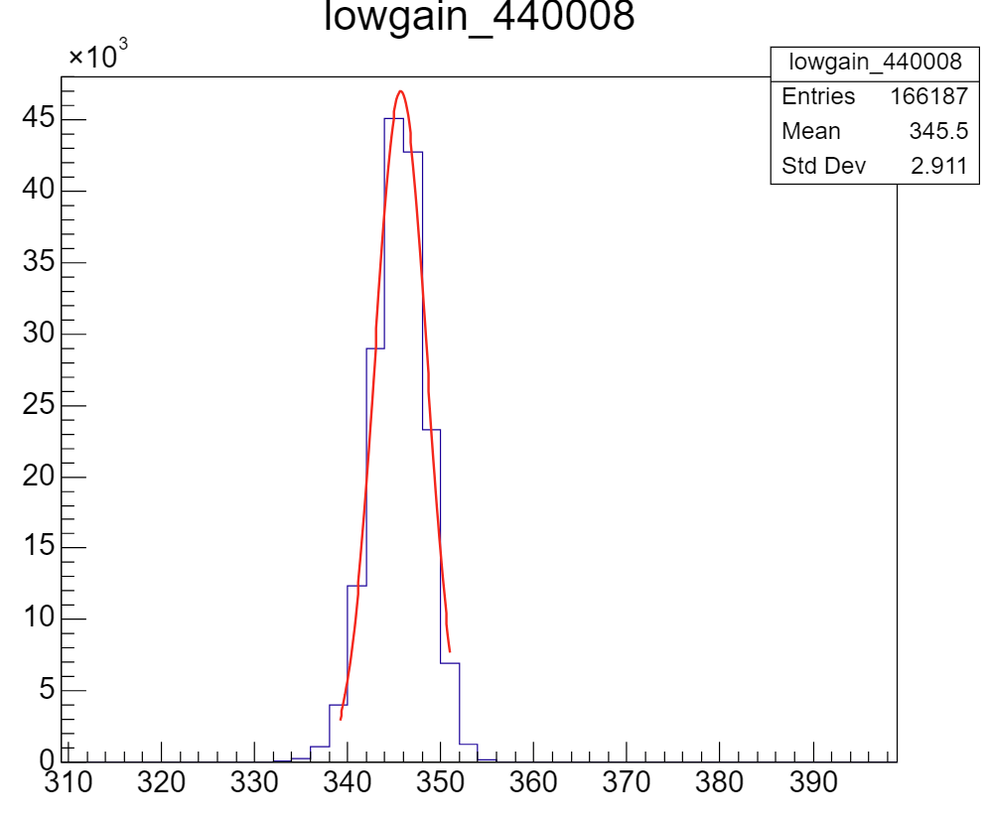
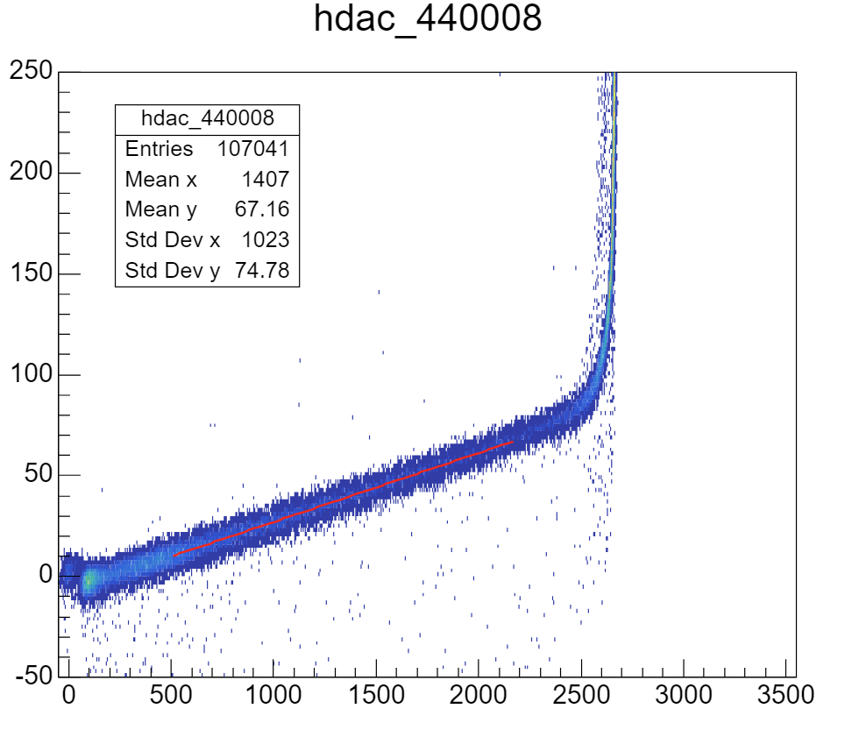
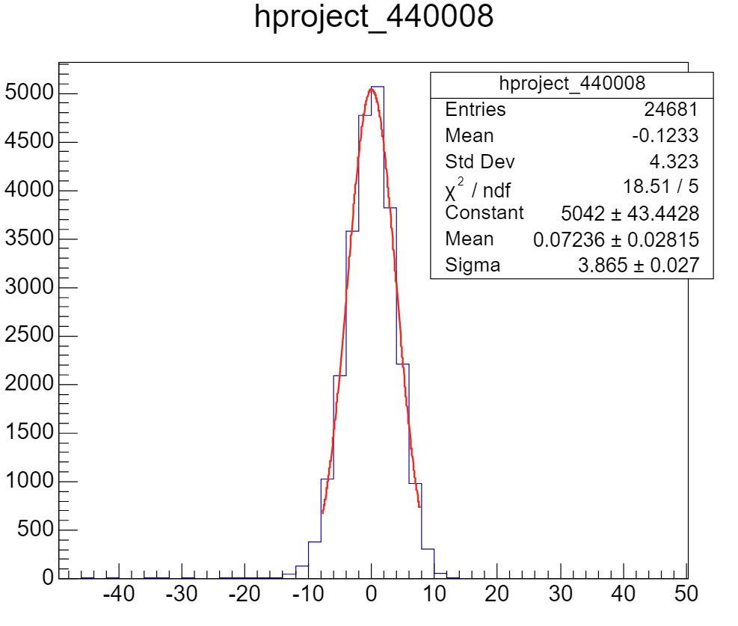
lowgain pedestal width
high-low gain ratio band is wider than pedestal
because a very small slope, lowgain pedestal dominate width of band
most channels don’t have adequate statistics
so I just do a multiplicant on the original sigma
pedestal
band width

Slide 4
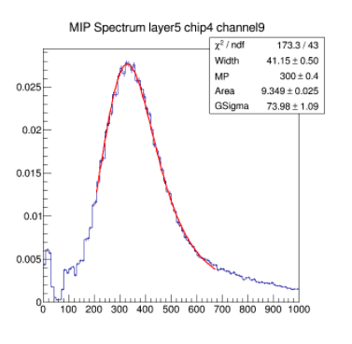
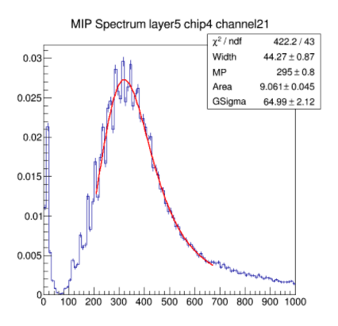
p.e. width
use a bigger p.e. width (before, it was 3)
p.e. width significantly varies in different channels, even in one chip
possible factor: non-uniformity between different channels
discrepancy between fitted MPV and ture MPV

Slide 5
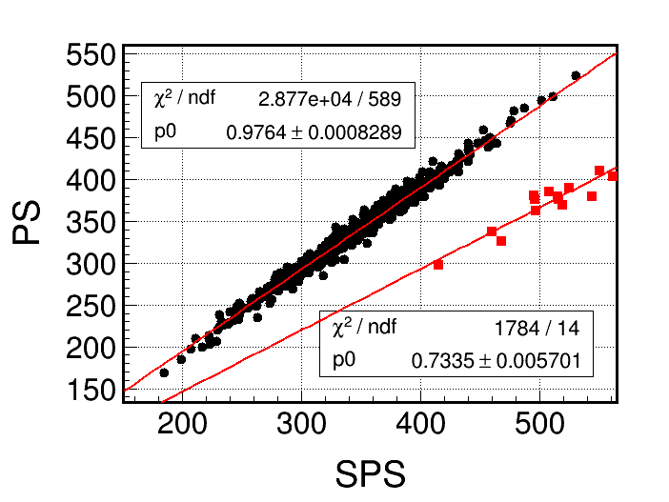
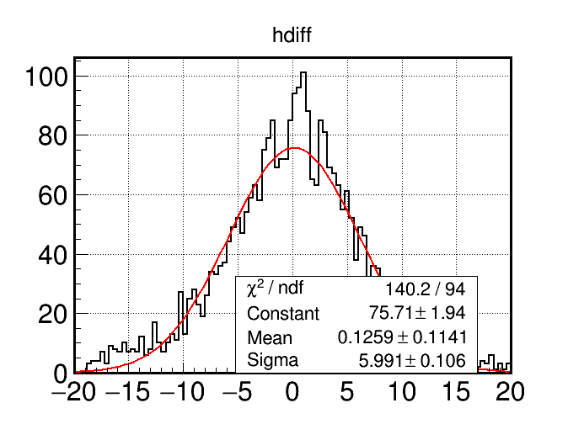
MIP Uncertainty
split muon events into two parts, fit them individually
distance between points to fitted line
MPV difference between two parts

Slide 6
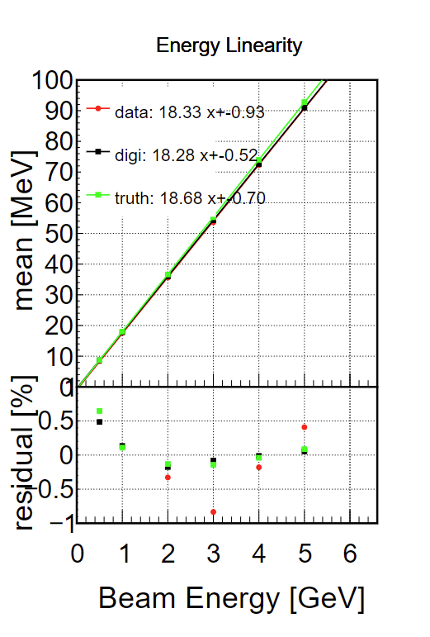
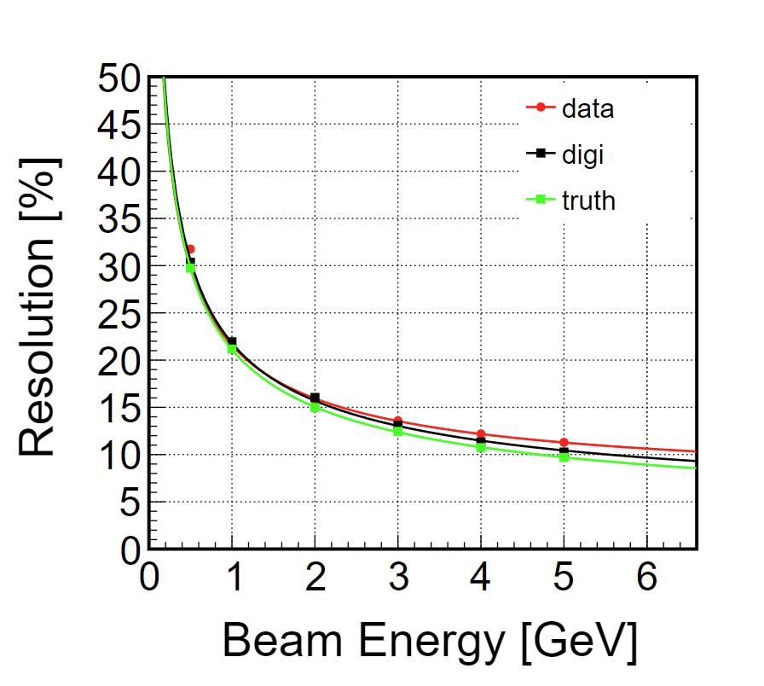
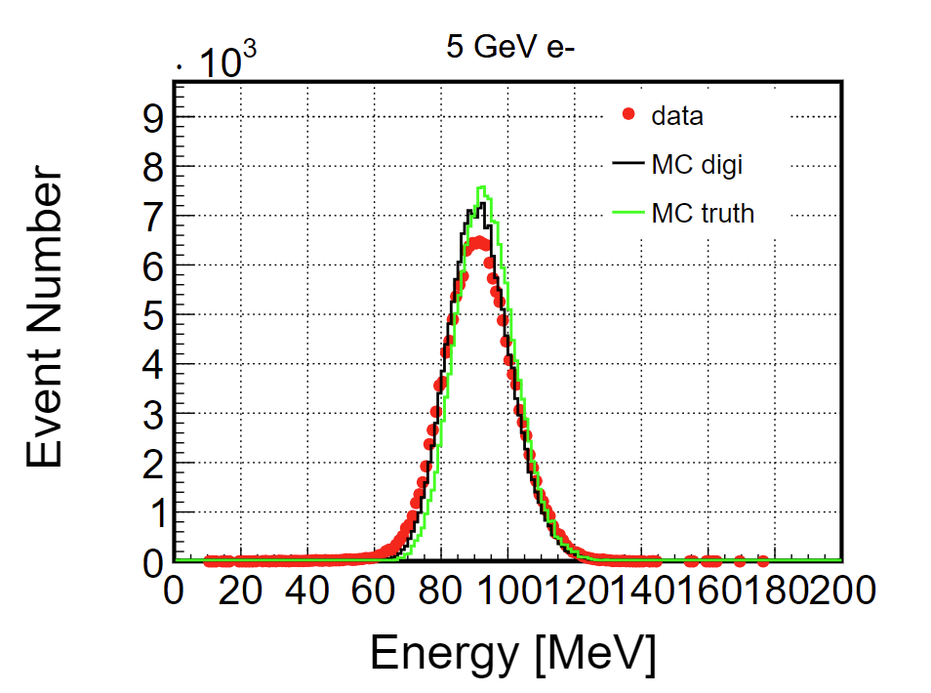
result
after these tuning，MC become wider (not enough)

Slide 7
Summary
some tuning have been done, still ongoing
it works, but not much

