Slide 1
Study of CEPC ECAL Calibration
Xiang Li, Zhen Wang, Jiaxuan Wang
2025.3.4
Notes:
Thank you for joining me today. This presentation focuses on the energy calibration data processing of the CEPC ECAL. I will explain the challenges we faced with muon-based MIP calibration and how we transitioned to using electrons for a more accurate and reliable calibration.

Slide 2
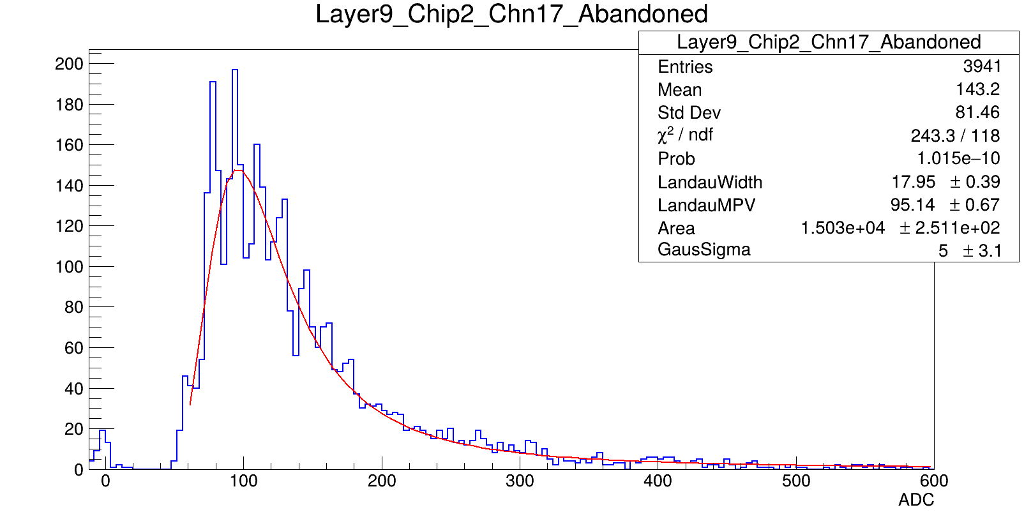
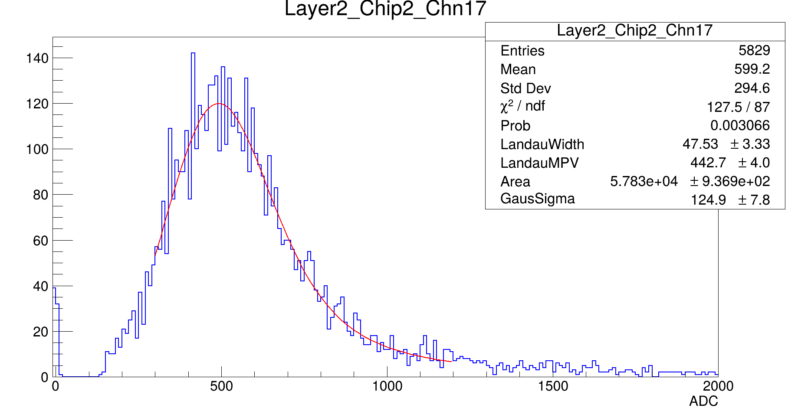
Motivation：
MIP calibrations are not optimal.
Electrons are used as a substitute.
Strategy :
Energy/ADC studied where the beam hits layer center
Determine scale factors to rescale channels.
Notes:
Initially, we attempted to use muons for MIP calibration。but they are not optimal for achieving the desired accuracy. To address this, electrons are used as a substitute.
First, we examine the energy and ADC distribution of central cells to understand their response. Based on this analysis, we determine scale factors to rescale individual channels, ensuring uniformity and accuracy across the system.
This approach allows us to improve calibration precision and achieve more reliable results moving forward.

Slide 3
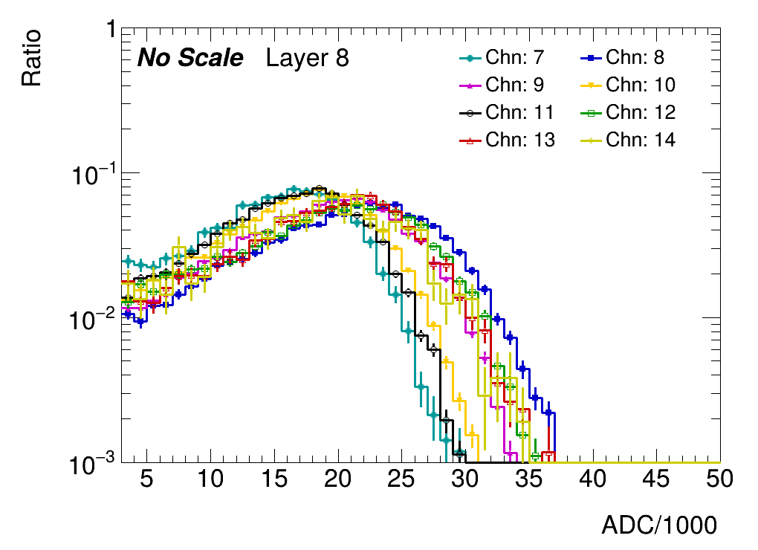
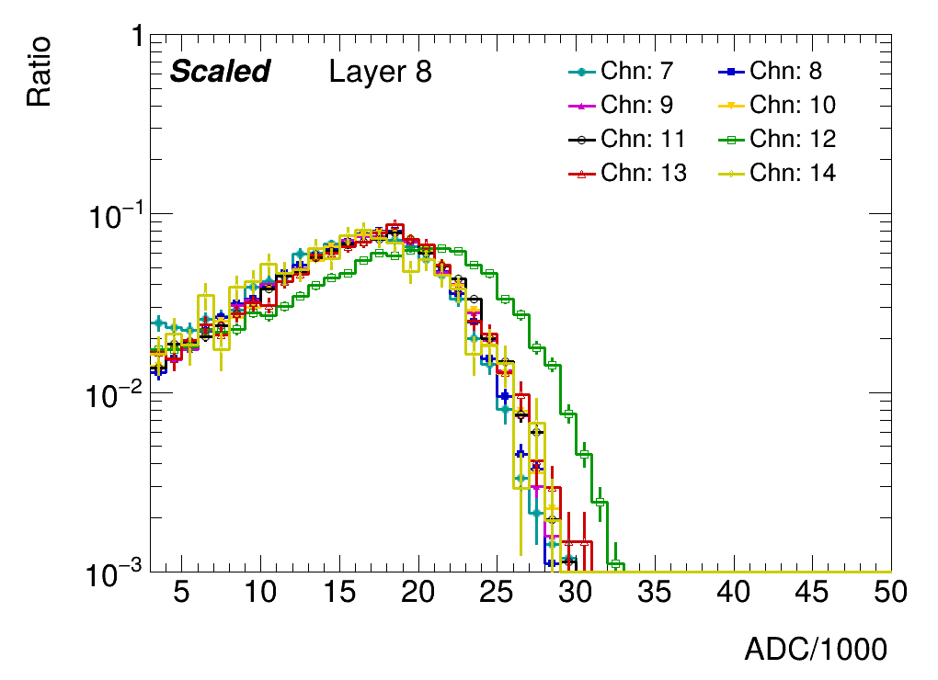
Methodology:
For each layer:
Select a standard channel (denoted as hstd)
For h in remaining channels:
Find the sf minimizes chi2(h,hstd)
Standard selection:
MIP calibration
Statistics
SF

Slide 4
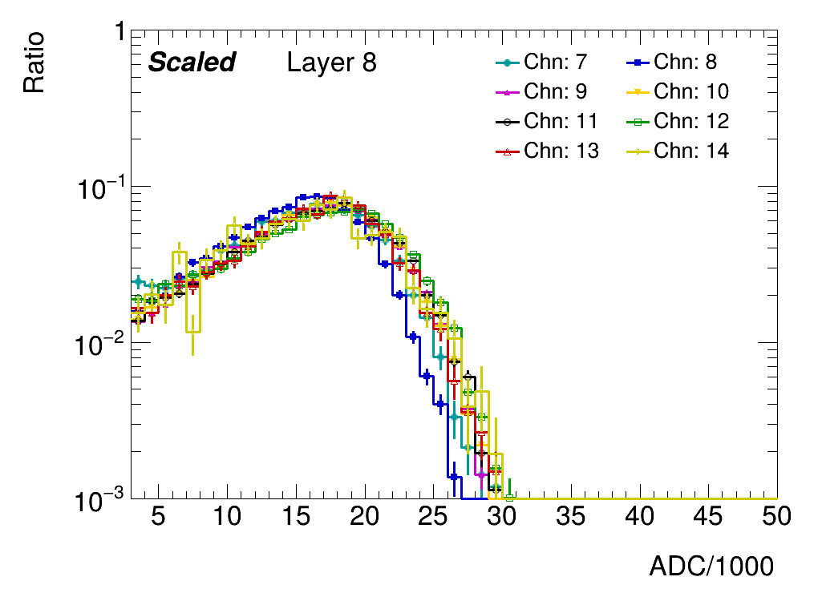
Strategy optimization
Parameter ranged modified
More reasonable SF found
$$SF_{new}$$

Slide 5
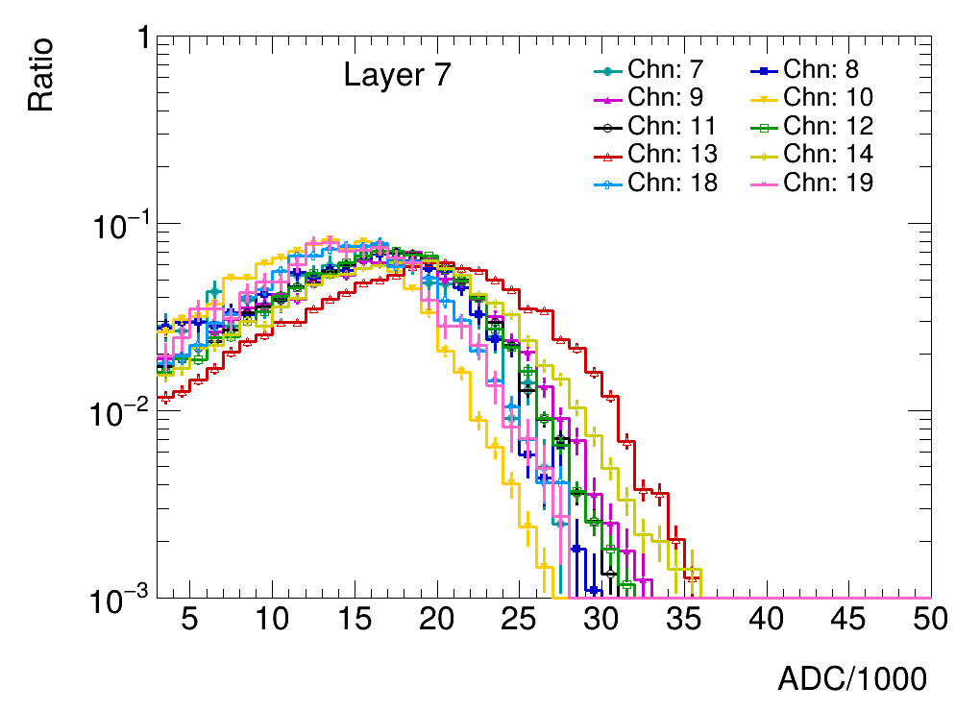
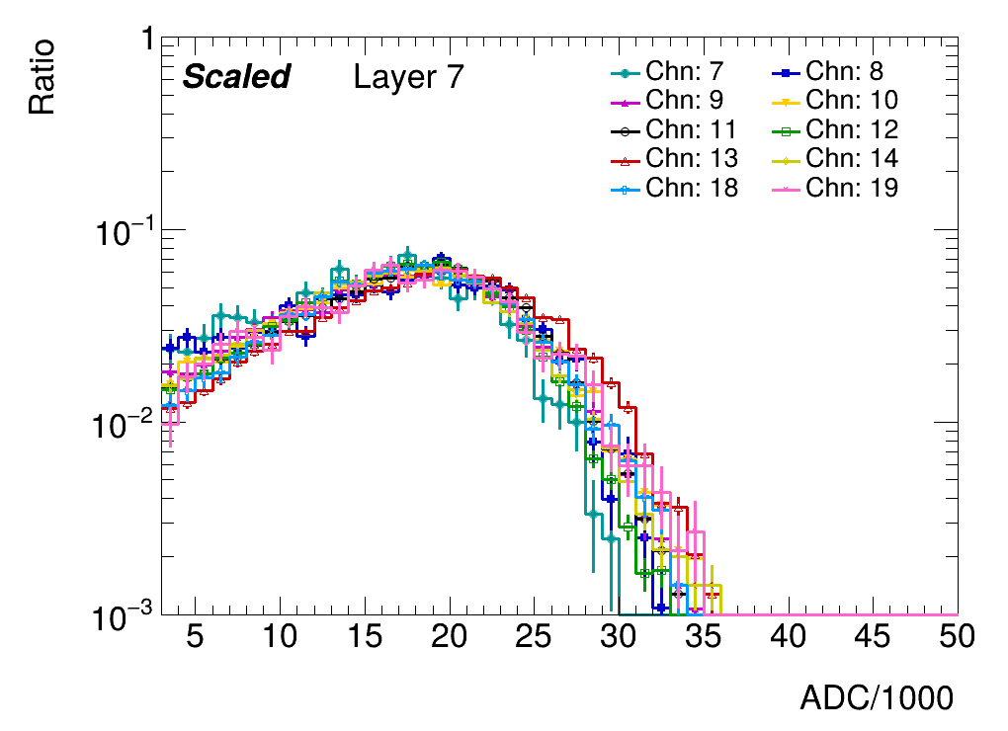
Strategy optimization
Parameter ranged modified
More reasonable SF found
$$SF_{new}$$

Slide 6
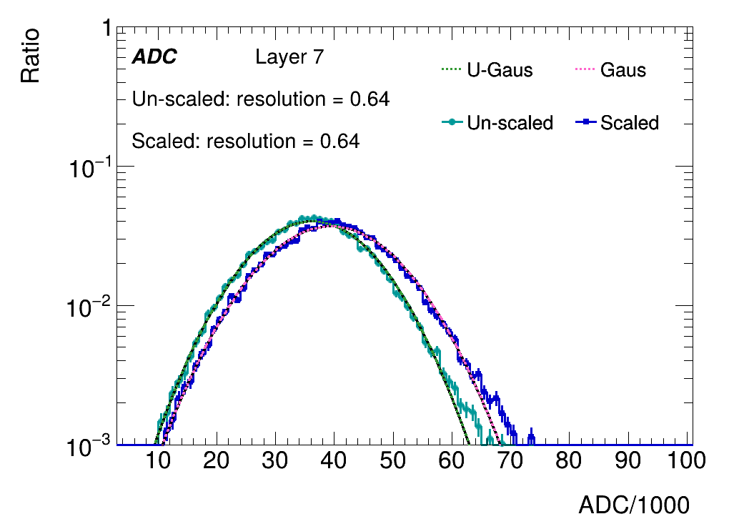
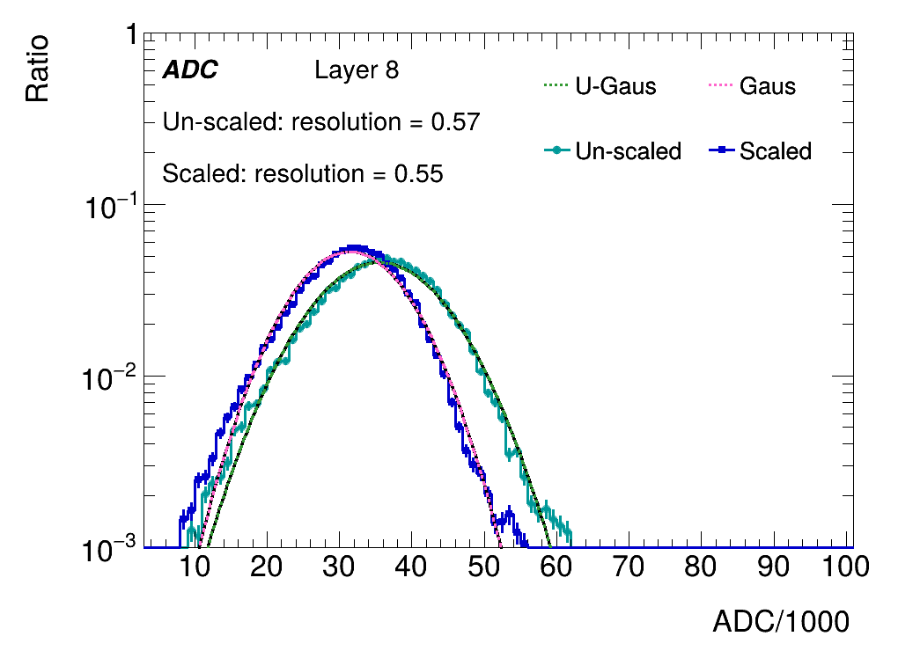
Sum of ADC within one layer
Layers with weighted center falls into beam center
ADCs are summed for comparison

Slide 7
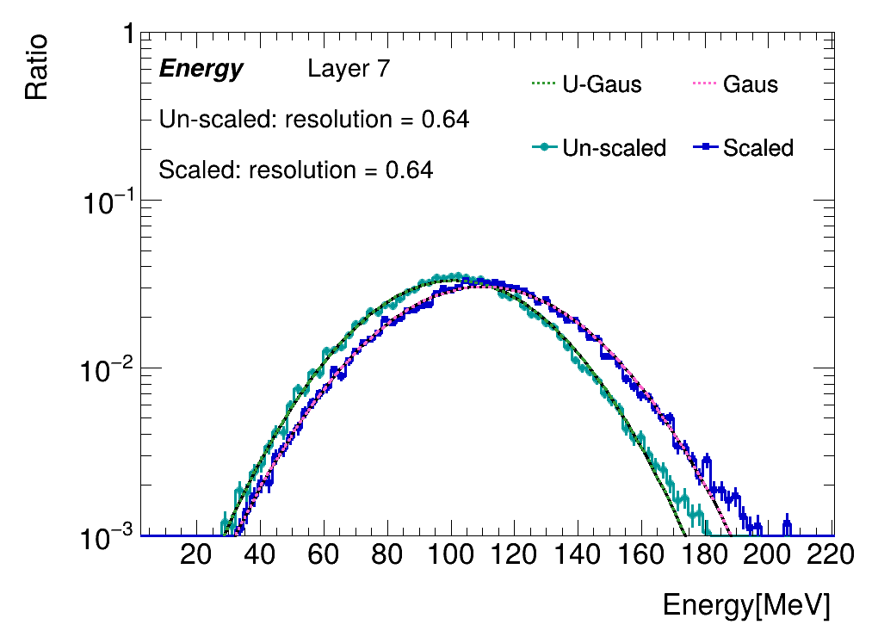
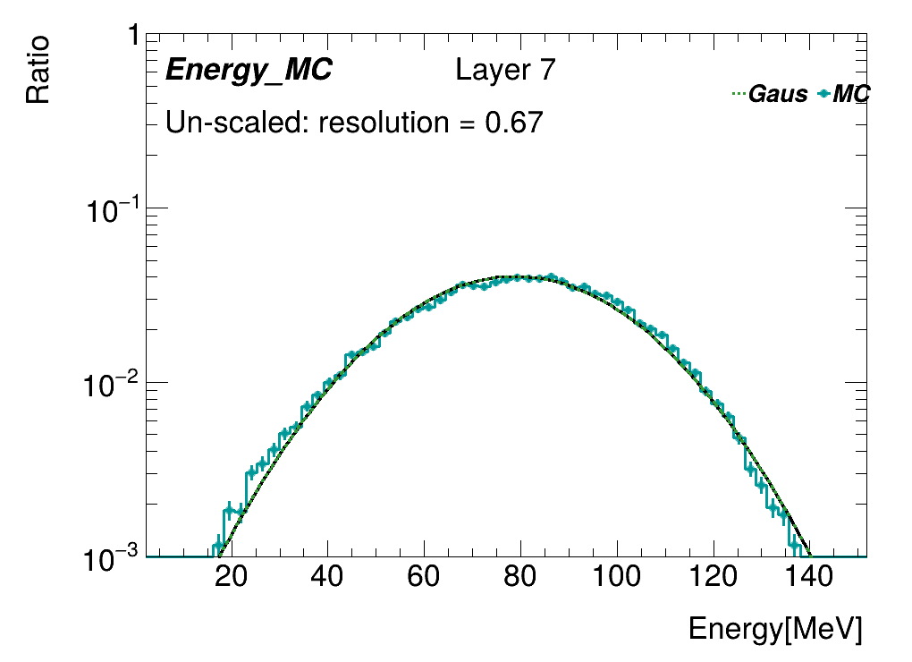
Sum of energy within one layer
Layers with weighted center falls into beam center
MPV of standard channels are applied for all channels
Energy=ADC/MPV*0.305(Mev)

Slide 8
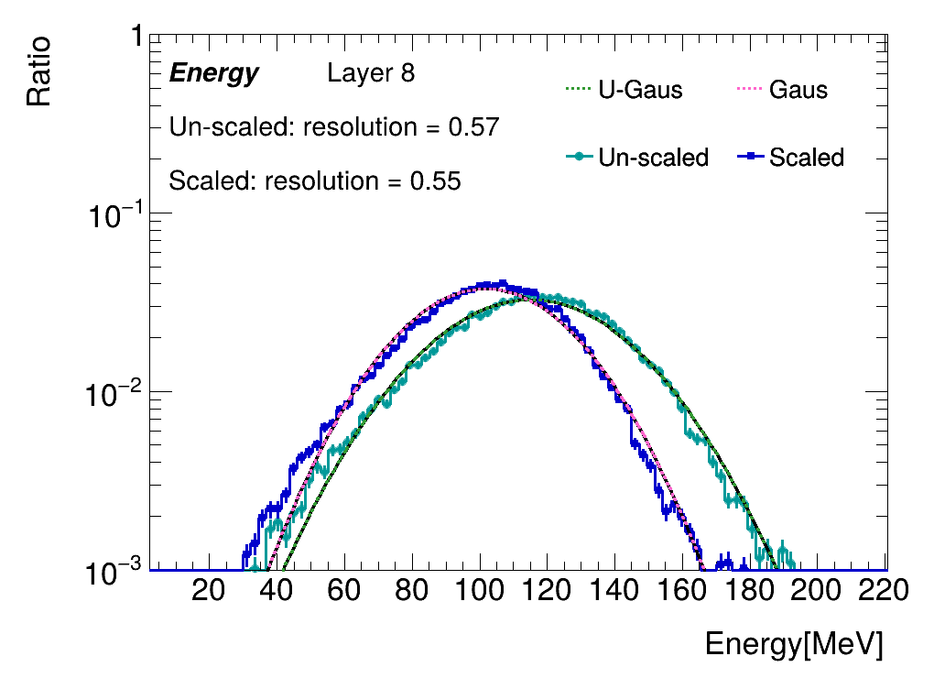
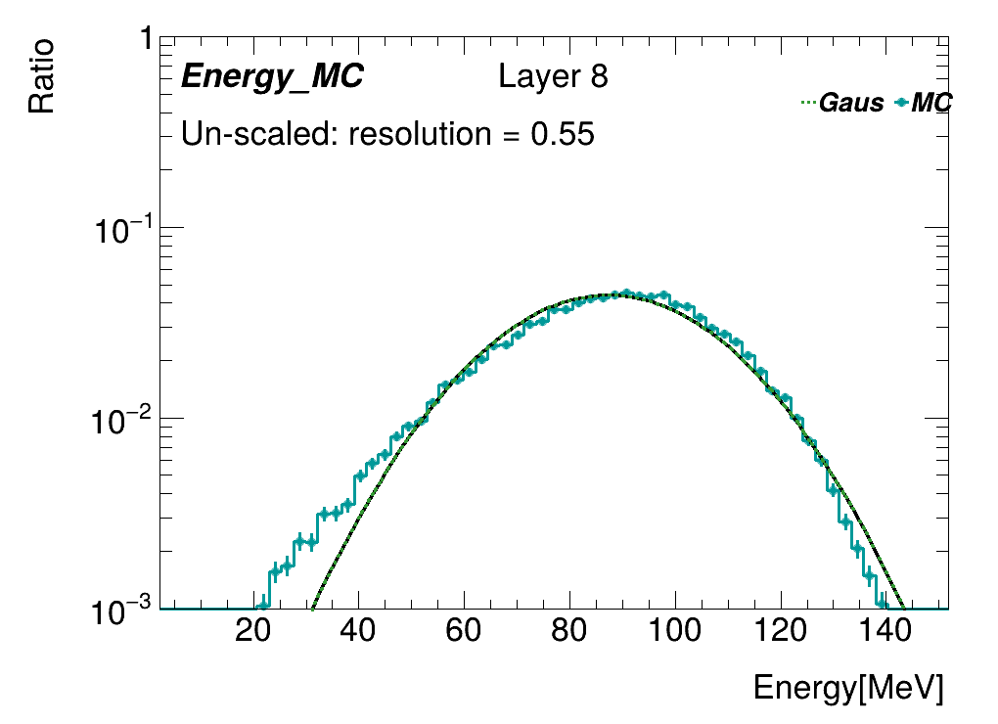
Sum of energy within one layer
Layers with weighted center falls into beam center
MPV of standard channels are applied for all channels
Energy=ADC/MPV*0.305(Mev)

Slide 9
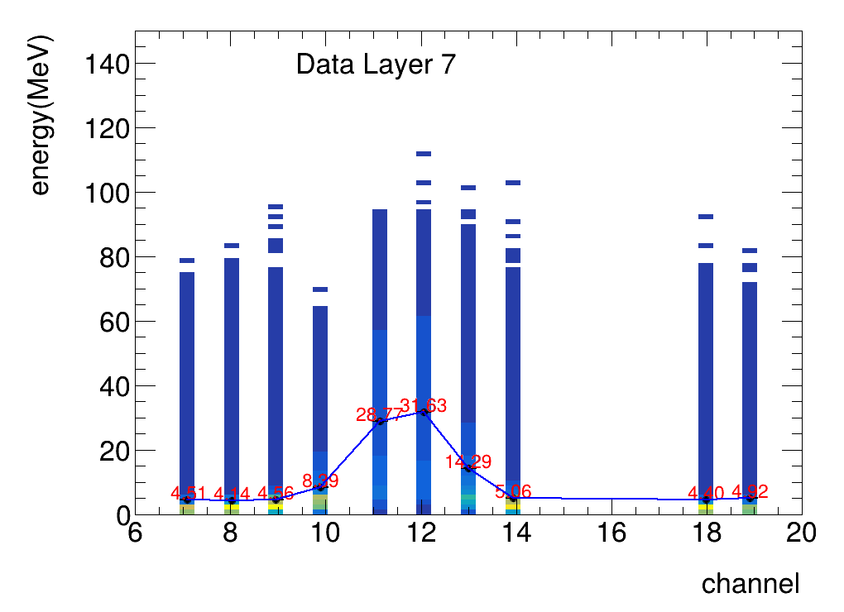
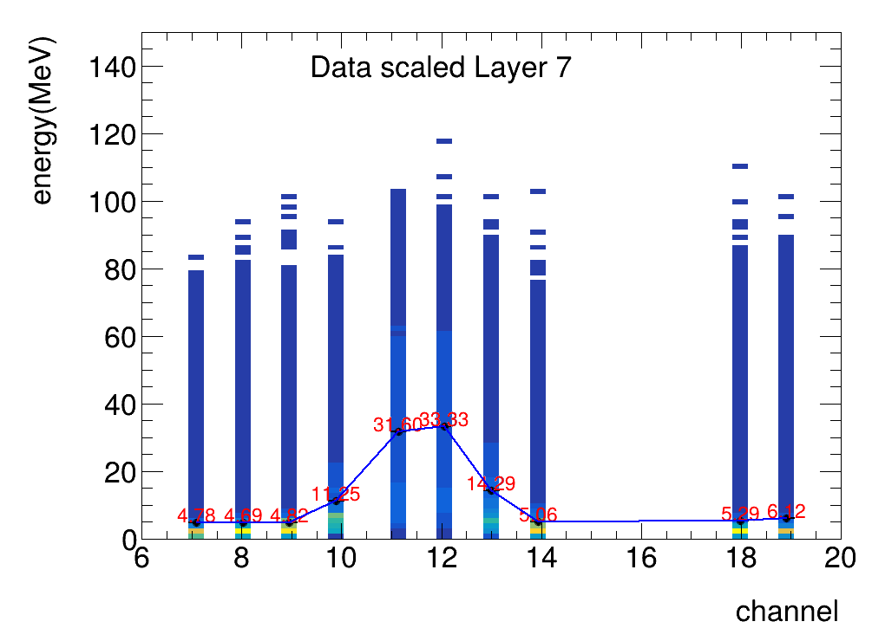
Distribution of energy within one layer
Layers with weighted center falls into beam center
MPV of standard channels are applied for all channels
standard channel :13
Energy=ADC/MPV*0.305(Mev)

Slide 10
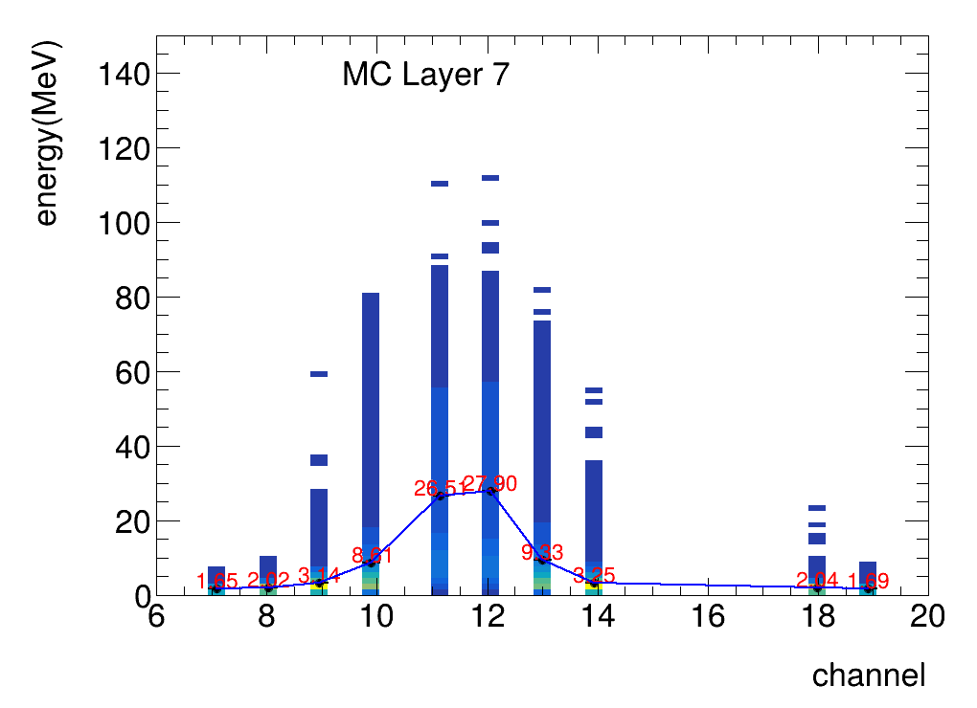
Distribution of energy within one layer
Layers with weighted center falls into beam center
MPV of standard channels are applied for all channels
standard channel :13
Energy=ADC/MPV*0.305(Mev)

Slide 11
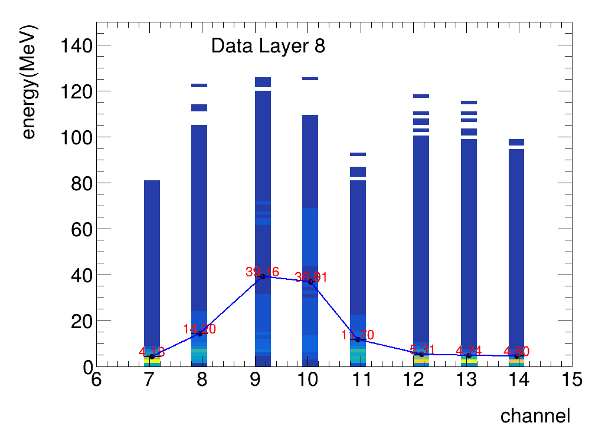
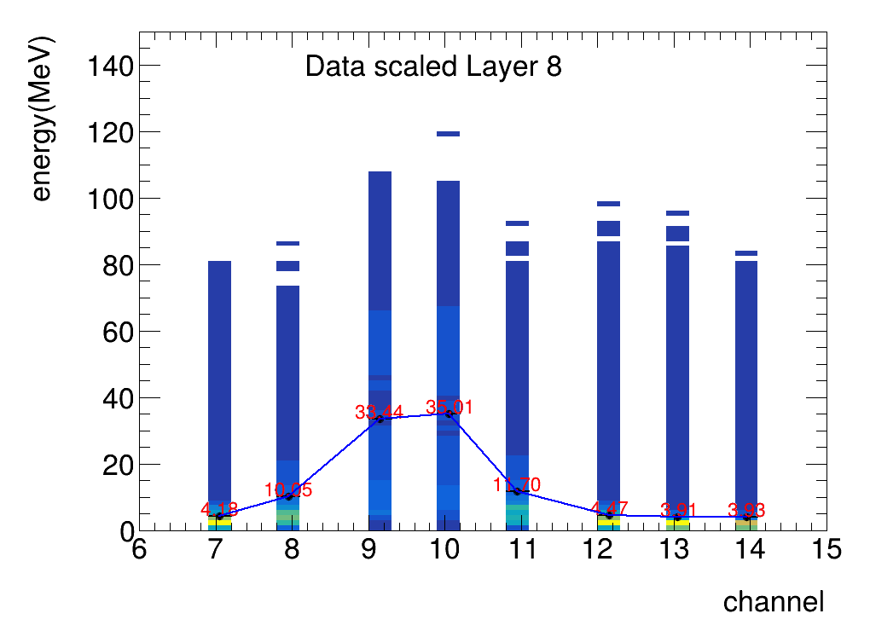
Distribution of energy within one layer
Layers with weighted center falls into beam center
MPV of standard channels are applied for all channels
standard channel :11
Energy=ADC/MPV*0.305(Mev)

Slide 12
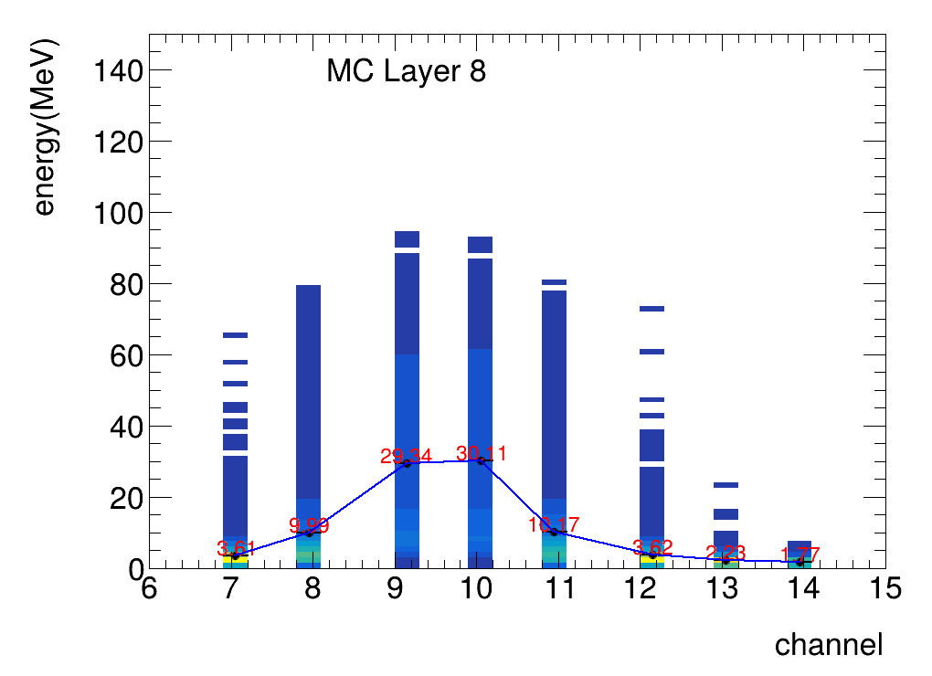
Distribution of energy within one layer
Layers with weighted center falls into beam center
MPV of standard channels are applied for all channels
standard channel :11
Energy=ADC/MPV*0.305(Mev)

Slide 13
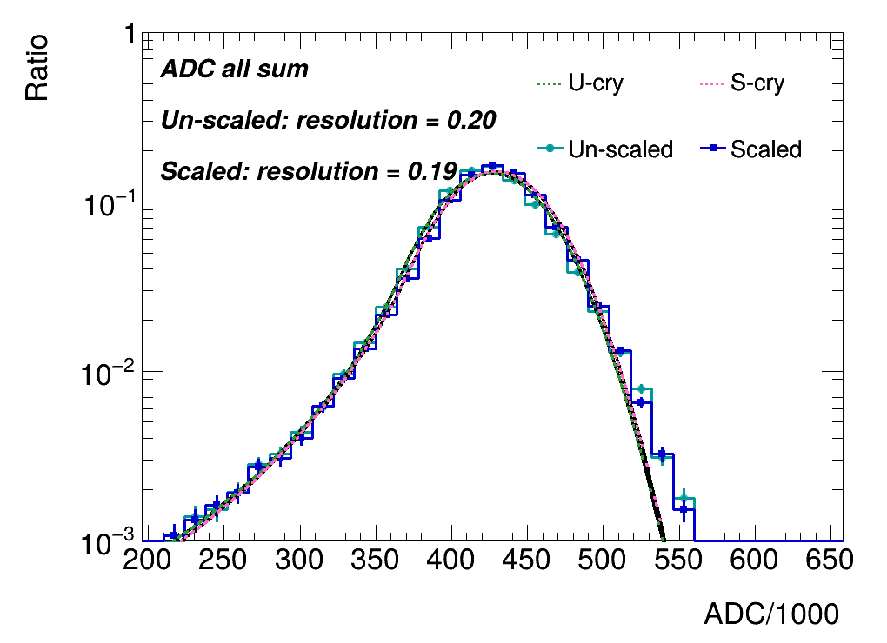
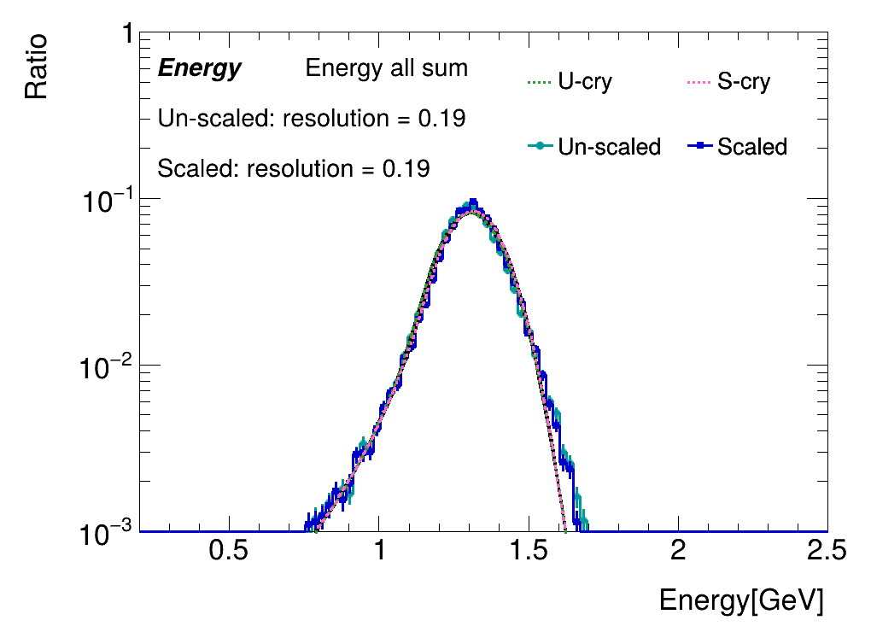
Sum of energy/ADC of single events
Events selected when center of layer 9 and 10 hit
ADC/Energy summed for all layers
No obvious deviation found after scaling

Slide 14
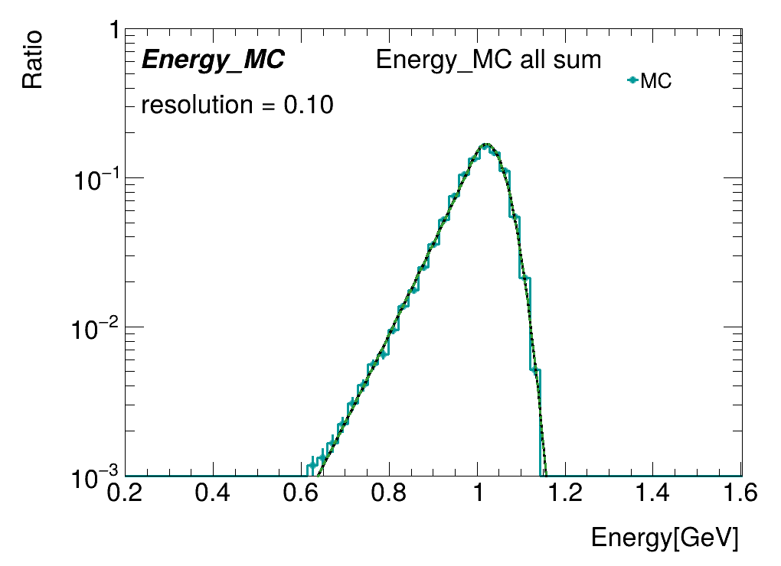
Sum of energy/ADC of single events
Events selected when center of layer 9 and 10 hit
ADC/Energy summed for all layers
No obvious deviation found after scaling

Slide 15
Summary & Todos
Non-uniformity reduced with modified fitting strategy
Sum of ADC/Energy studied (per layer / all layers)
Study of energy/ADC from MC
No obvious deviation found after scaling
Todos:
Optimization of fitting strategy

Slide 16
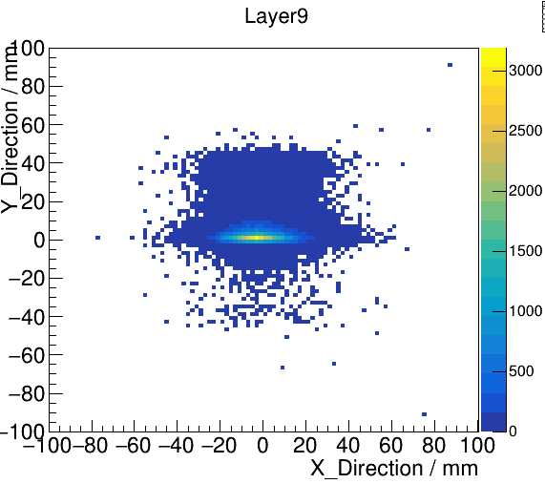
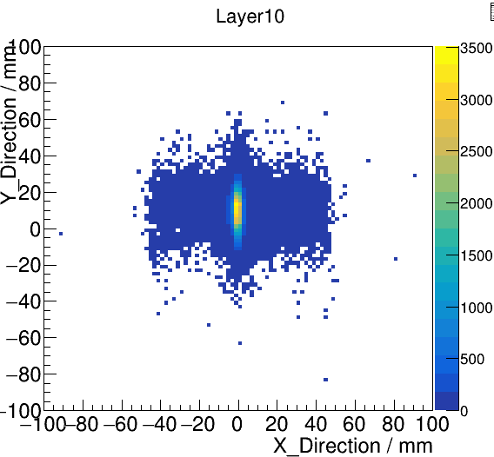
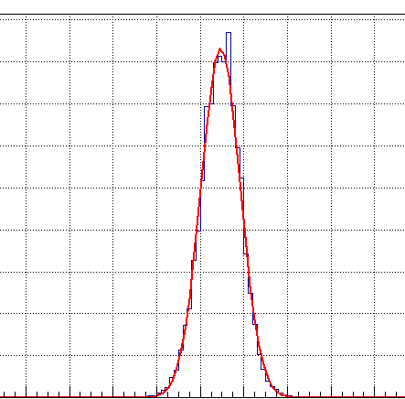
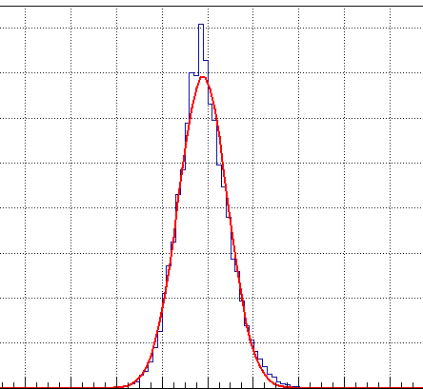
back up: the shape of electron beam

Slide 17
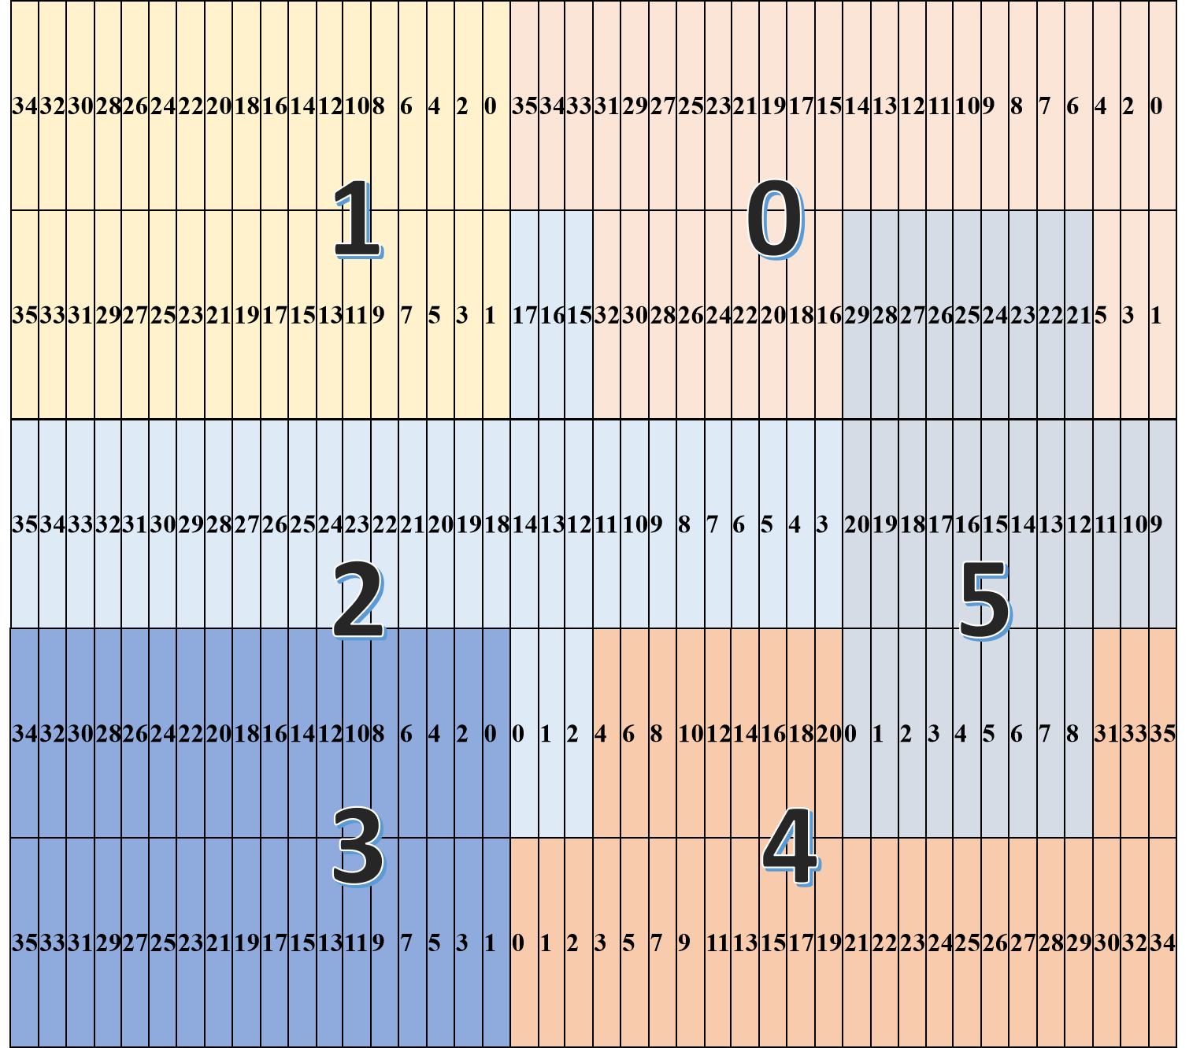
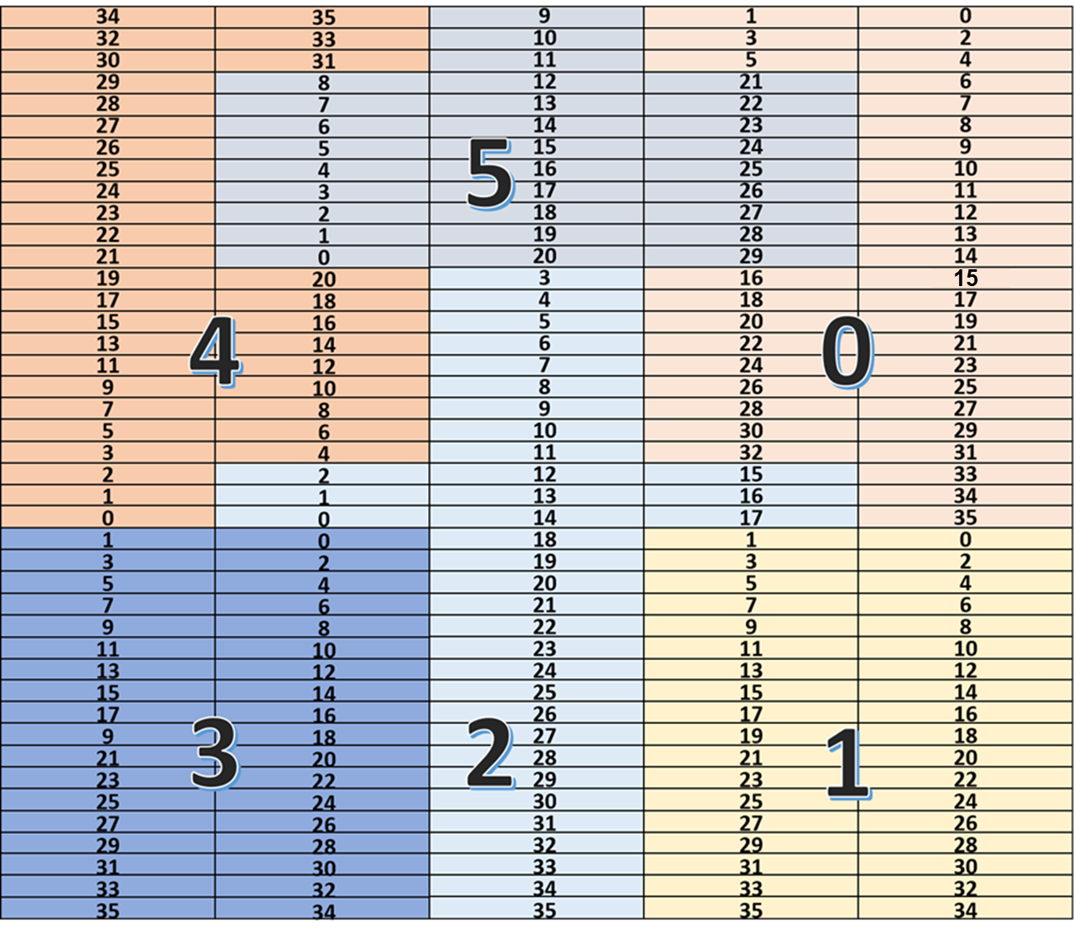
back up: the position of channels

Slide 18
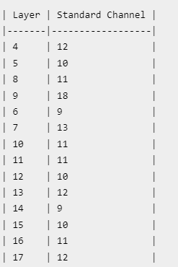
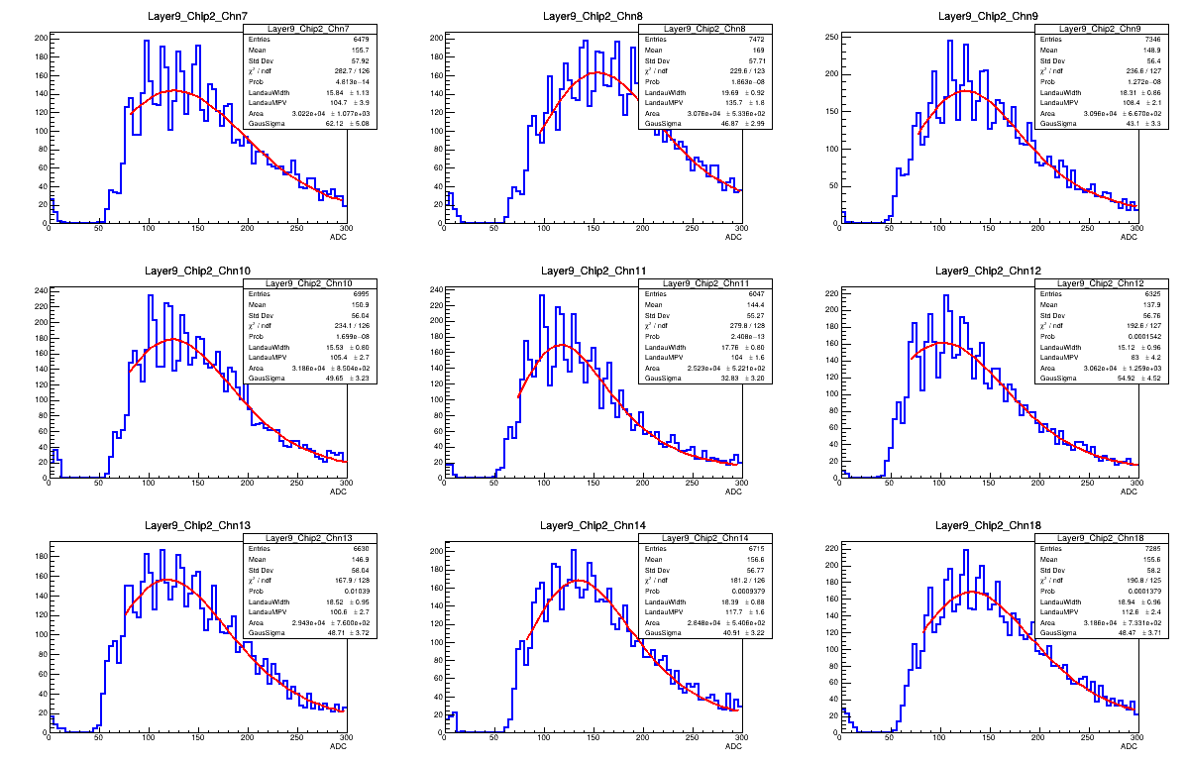
back up: the MIP of standard channel

Slide 19
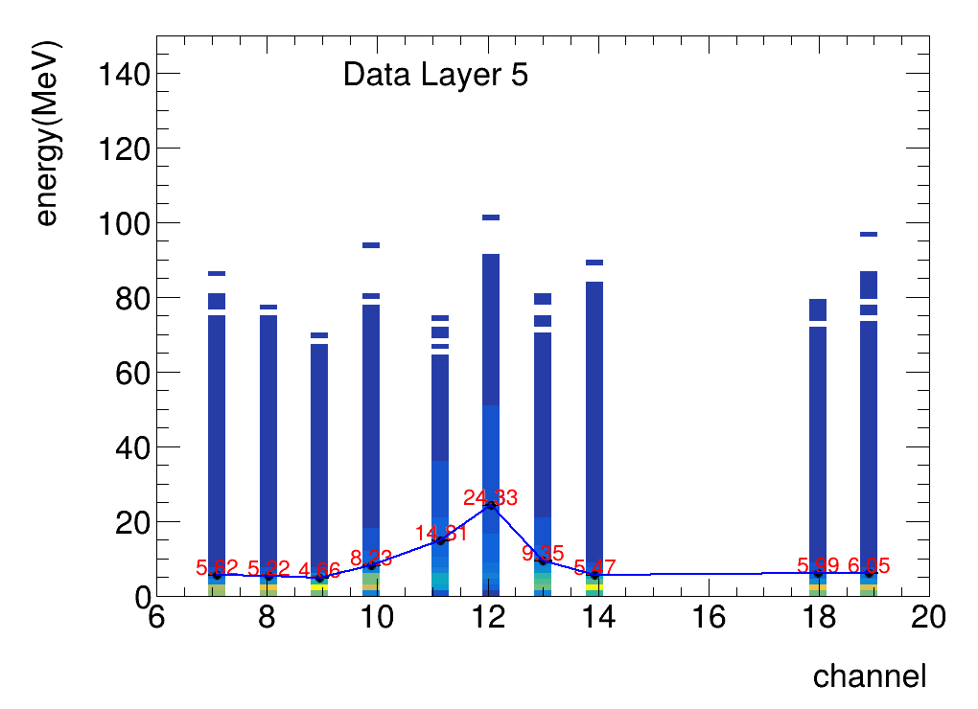
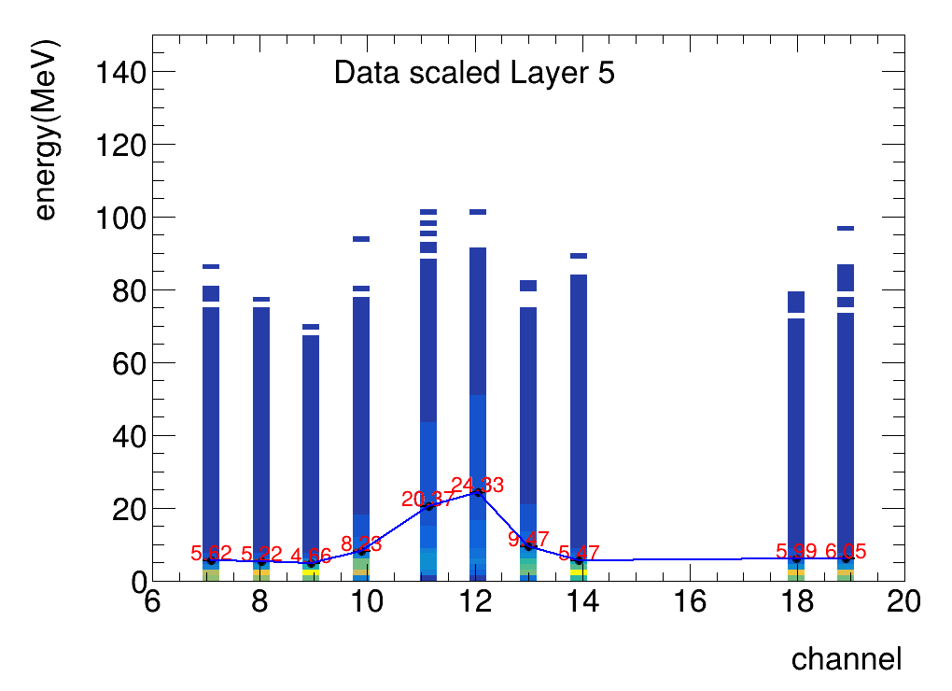
Distribution of energy within one layer
Layers with weighted center falls into beam center
MPV of standard channels are applied for all channels
standard channel :10
Energy=ADC/MPV*0.305(Mev)

Slide 20
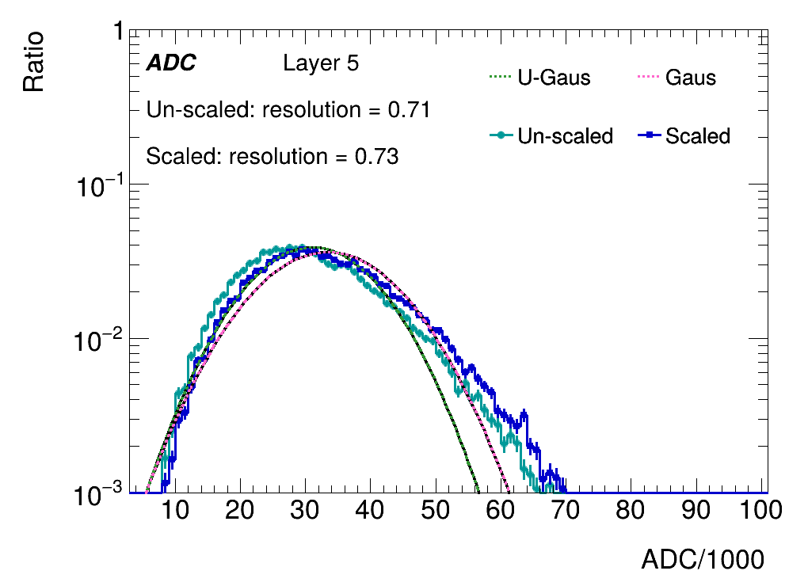
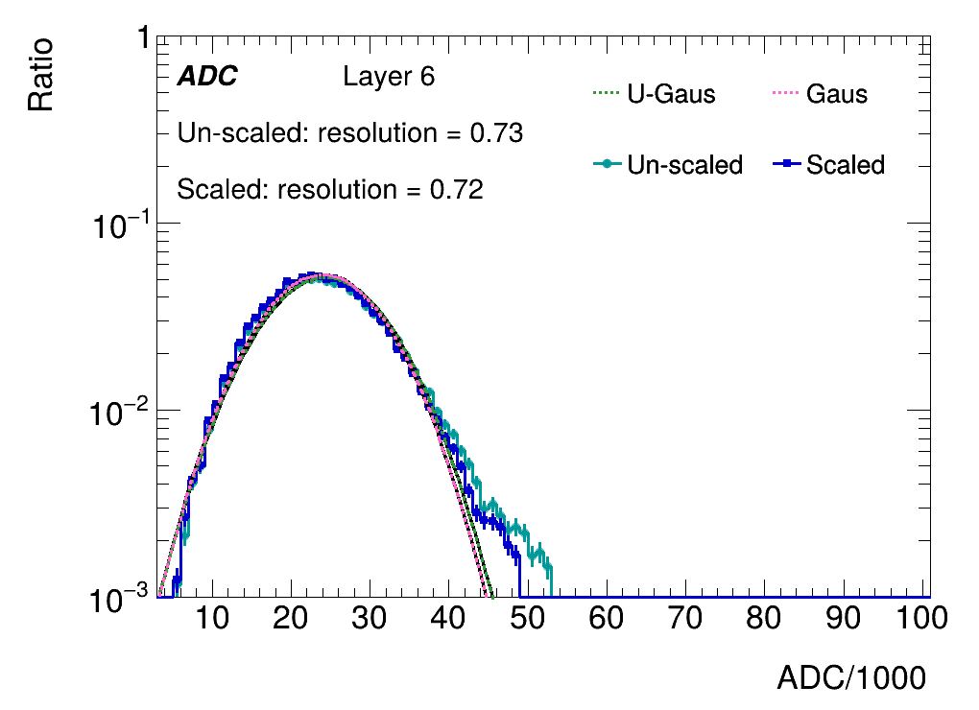
Sum of ADC within one layer
Layers with weighted center falls into beam center
ADCs are summed for comparison

Slide 21
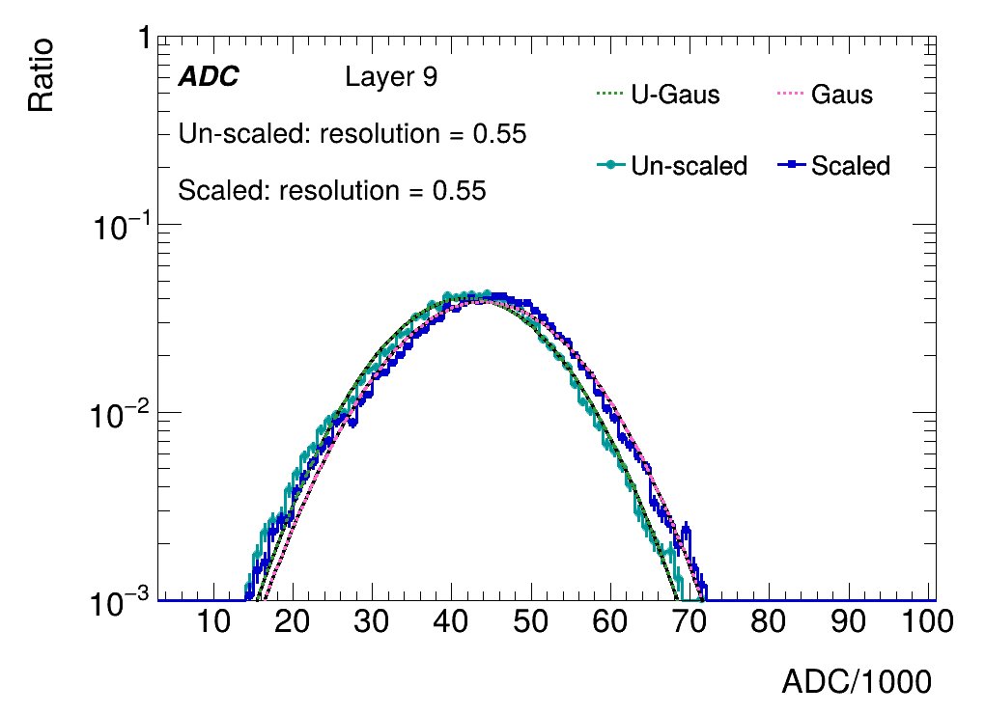
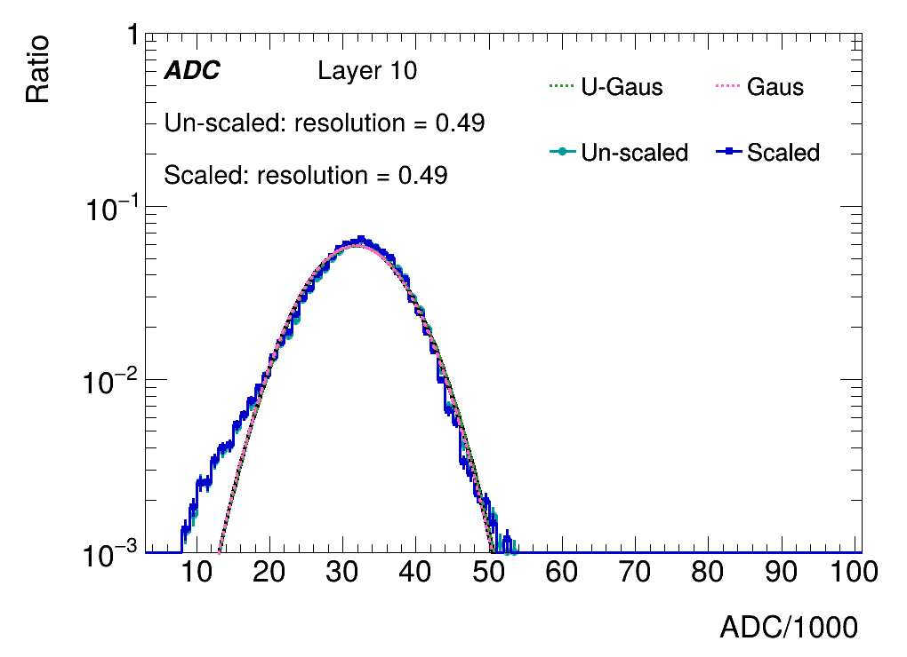
Sum of ADC within one layer
Layers with weighted center falls into beam center
ADCs are summed for comparison

Slide 22
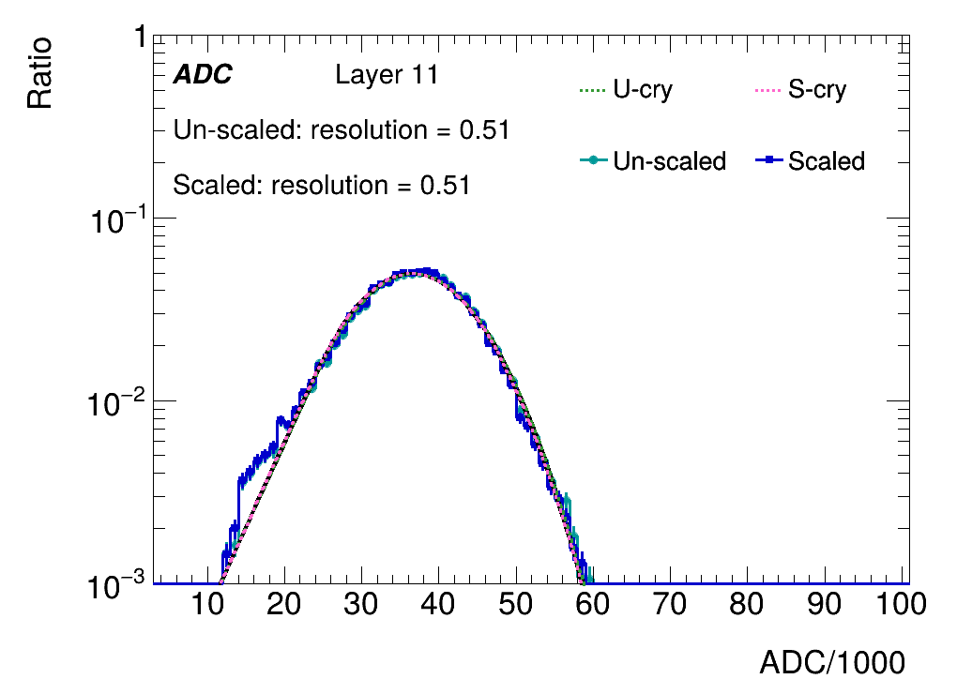
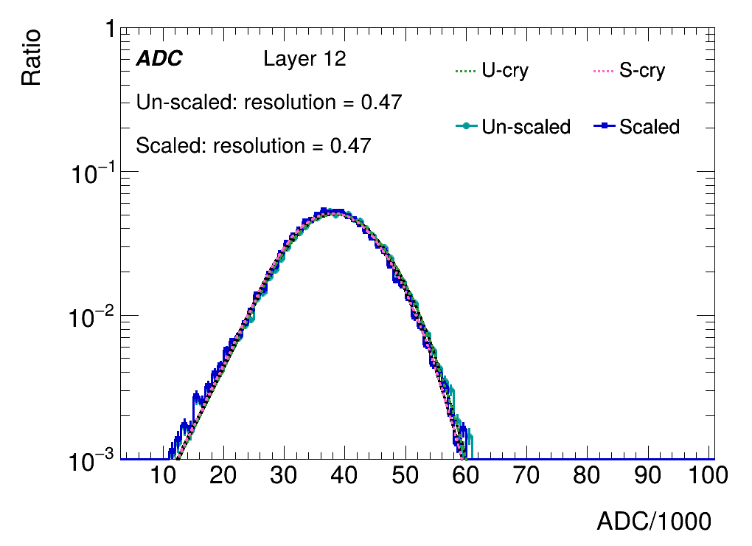
Sum of ADC within one layer
Layers with weighted center falls into beam center
ADCs are summed for comparison

Slide 23
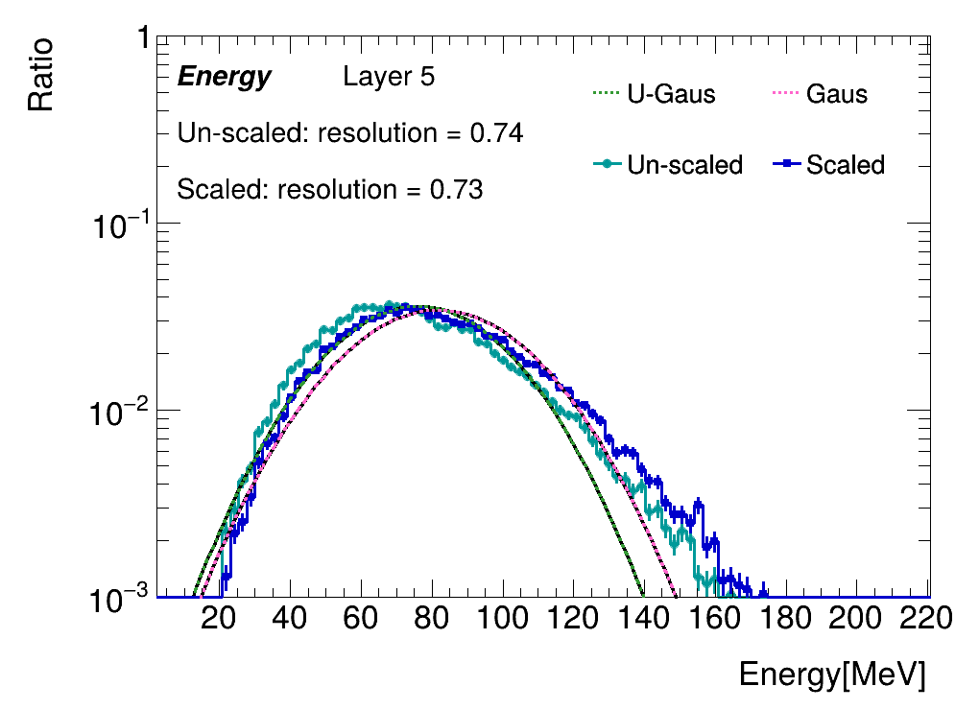
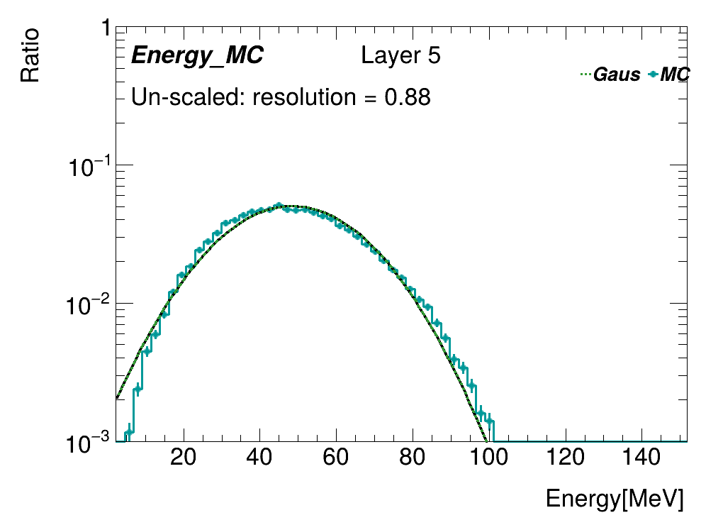
Sum of energy within one layer
Layers with weighted center falls into beam center
MPV of standard channels are applied for all channels
Energy=ADC/MPV*0.305(Mev)

Slide 24
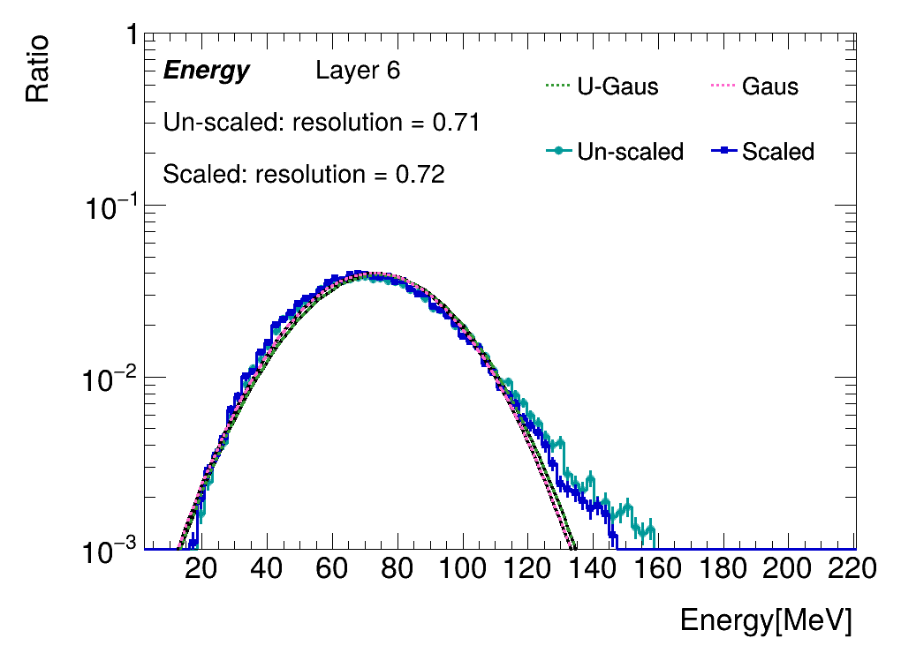
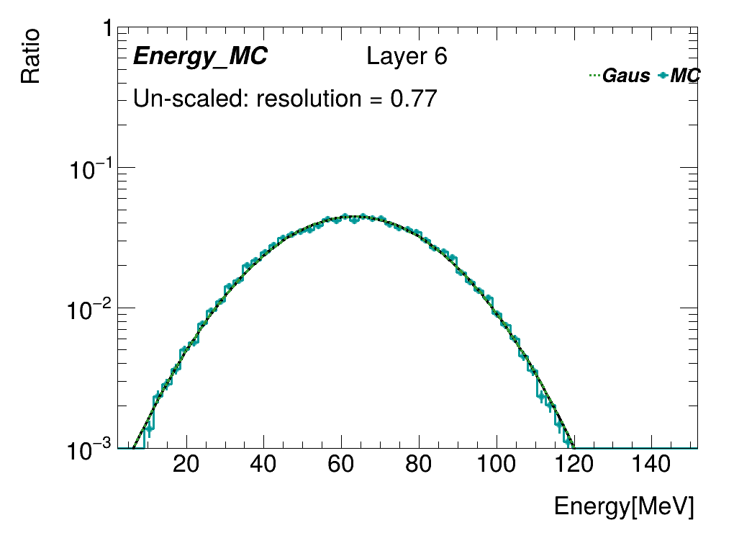
Sum of energy within one layer
Layers with weighted center falls into beam center
MPV of standard channels are applied for all channels
Energy=ADC/MPV*0.305(Mev)

Slide 25
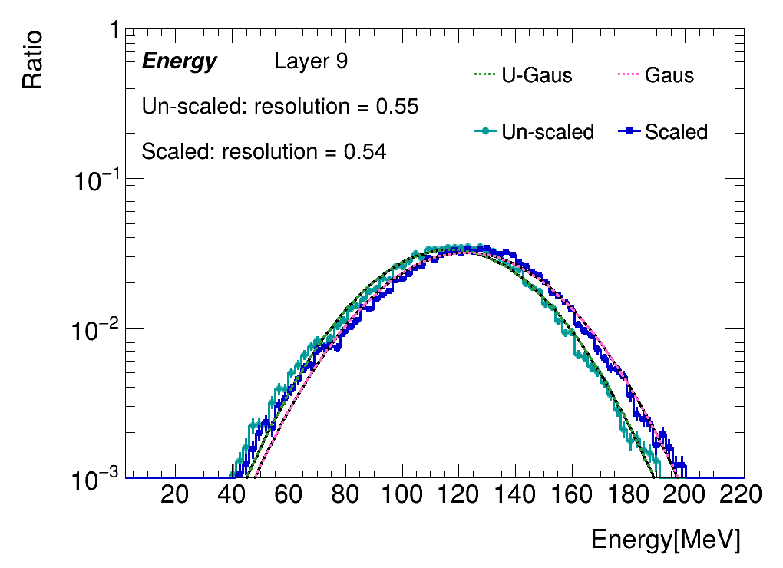
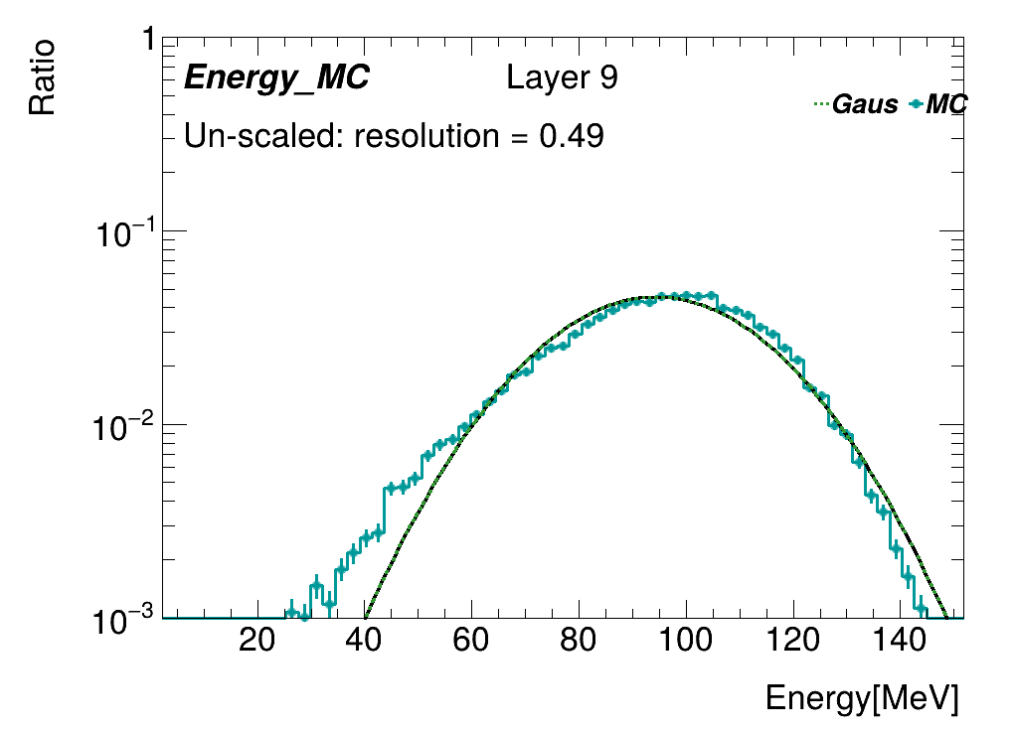
Sum of energy within one layer
Layers with weighted center falls into beam center
MPV of standard channels are applied for all channels
Energy=ADC/MPV*0.305(Mev)

Slide 26
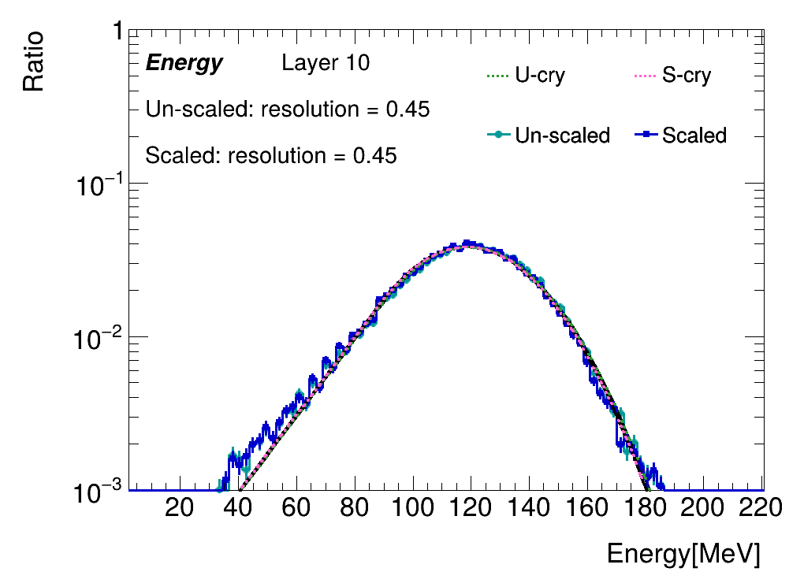
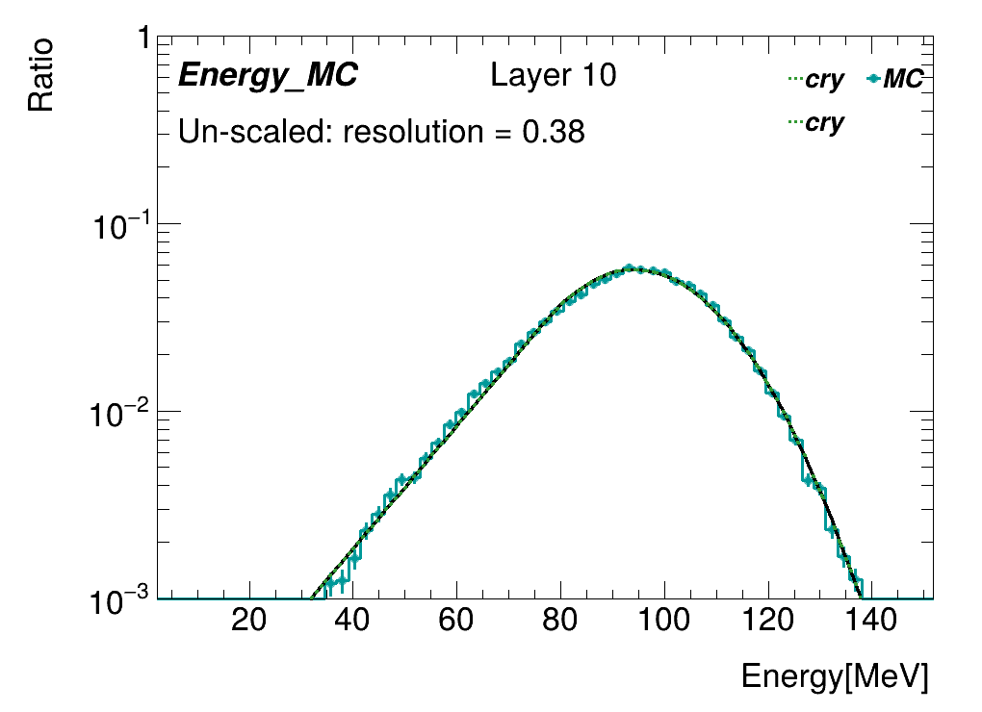
Sum of energy within one layer
Layers with weighted center falls into beam center
MPV of standard channels are applied for all channels
Energy=ADC/MPV*0.305(Mev)

Slide 27
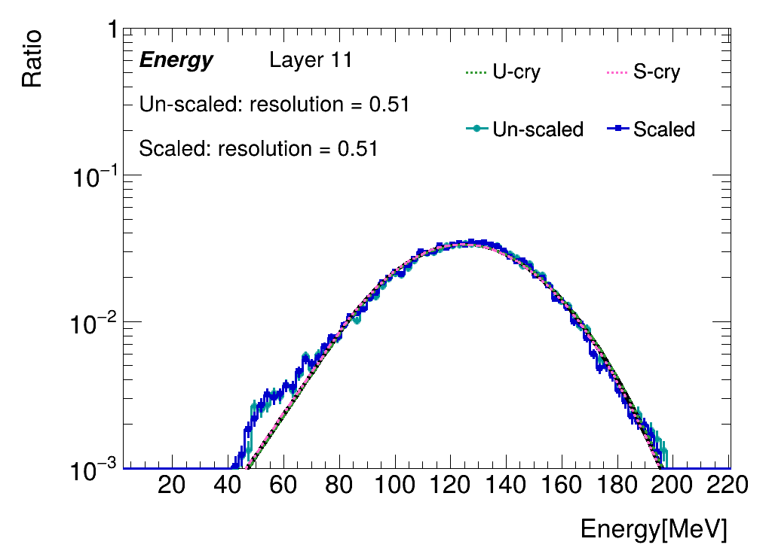
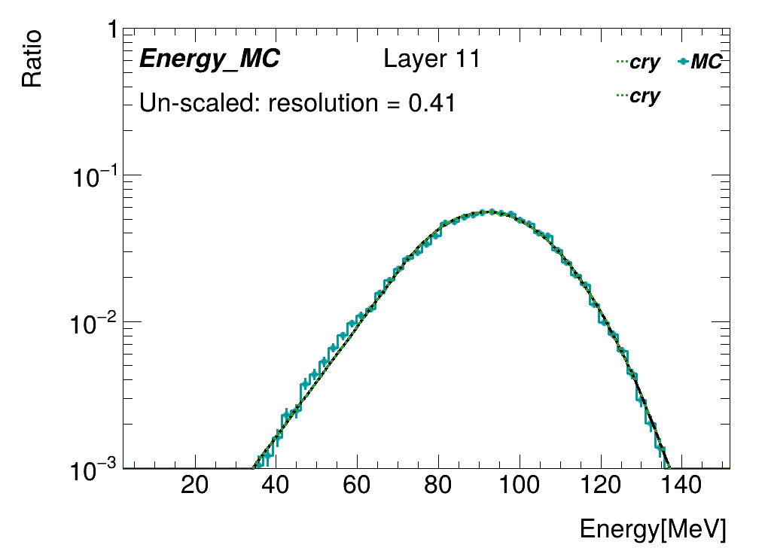
Sum of energy within one layer
Layers with weighted center falls into beam center
MPV of standard channels are applied for all channels
Energy=ADC/MPV*0.305(Mev)

Slide 28
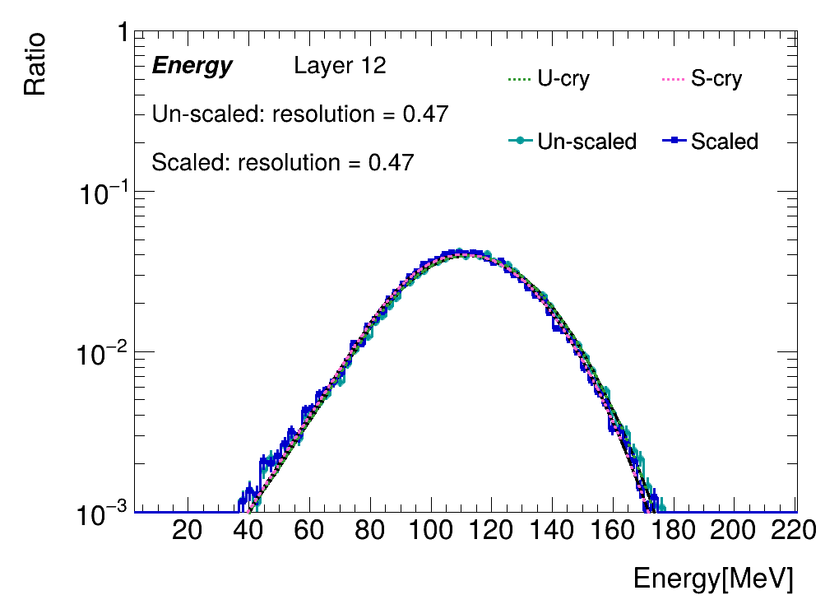
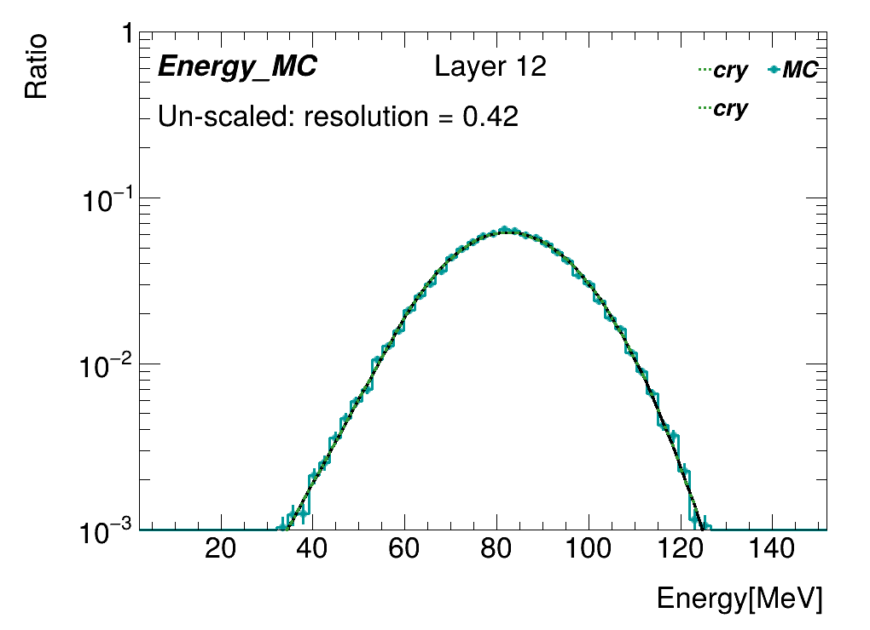
Sum of energy within one layer
Layers with weighted center falls into beam center
MPV of standard channels are applied for all channels
Energy=ADC/MPV*0.305(Mev)

Slide 29
Distribution of energy within one layer
Layers with weighted center falls into beam center
MPV of standard channels are applied for all channels
standard channel :10
Energy=ADC/MPV*0.305(Mev)

Slide 30
Distribution of energy within one layer
Layers with weighted center falls into beam center
MPV of standard channels are applied for all channels
standard channel :9
Energy=ADC/MPV*0.305(Mev)

Slide 31
Distribution of energy within one layer
Layers with weighted center falls into beam center
MPV of standard channels are applied for all channels
standard channel :9
Energy=ADC/MPV*0.305(Mev)

Slide 32
sf
*

Slide 33
sf
*

Slide 34
sf
*

Slide 35
sf
*

Slide 36
sf
*

