Slide 1
cepc ecal 数据分析
李想 王震 王家轩
2025.2.17

Slide 2
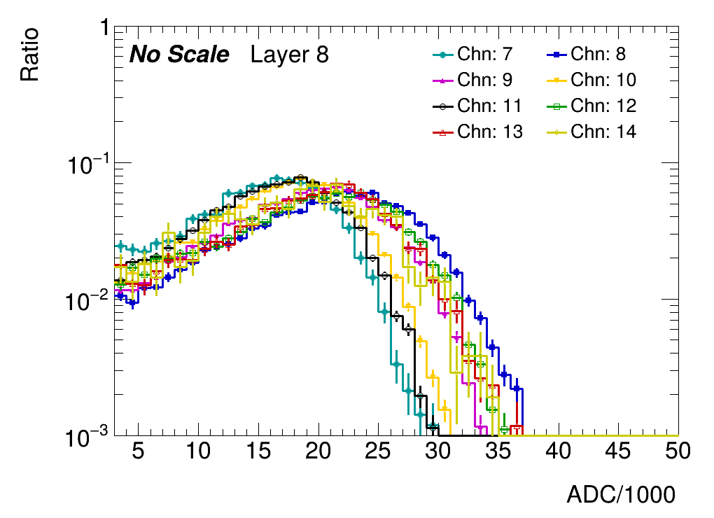
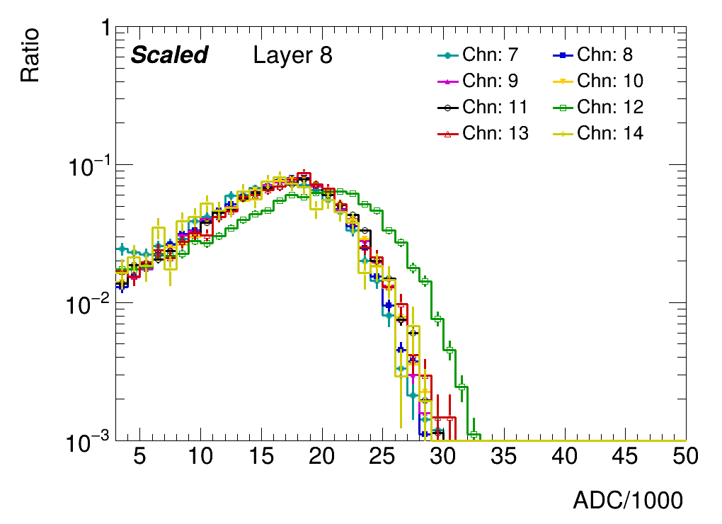
motivation：
Electron events as one of the substitutions
Look at the weighted energy(ADC) distribution of center cells
Find scale factors to scale channels back
When the scale factor least squares method is fitted, some channels with some layers are deviated

Slide 3
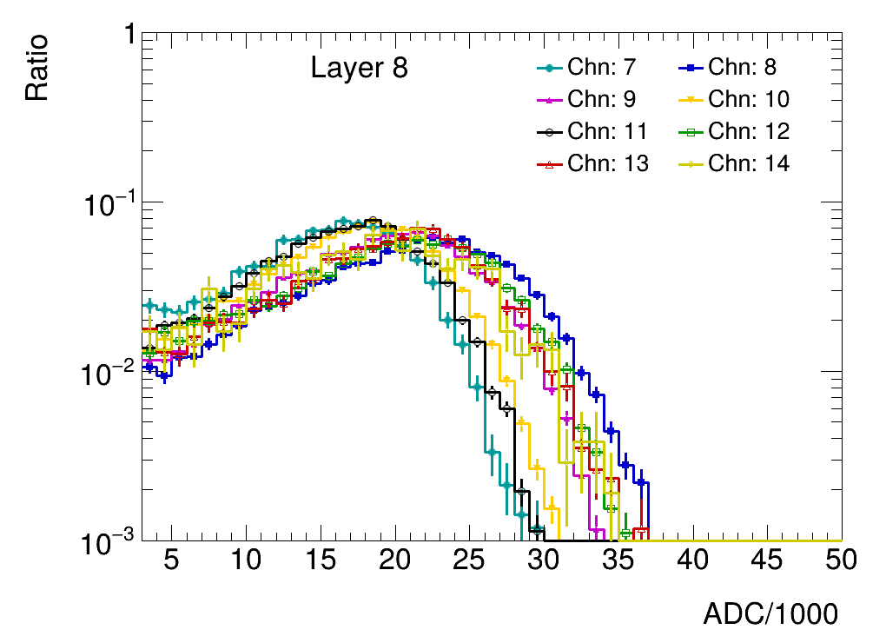
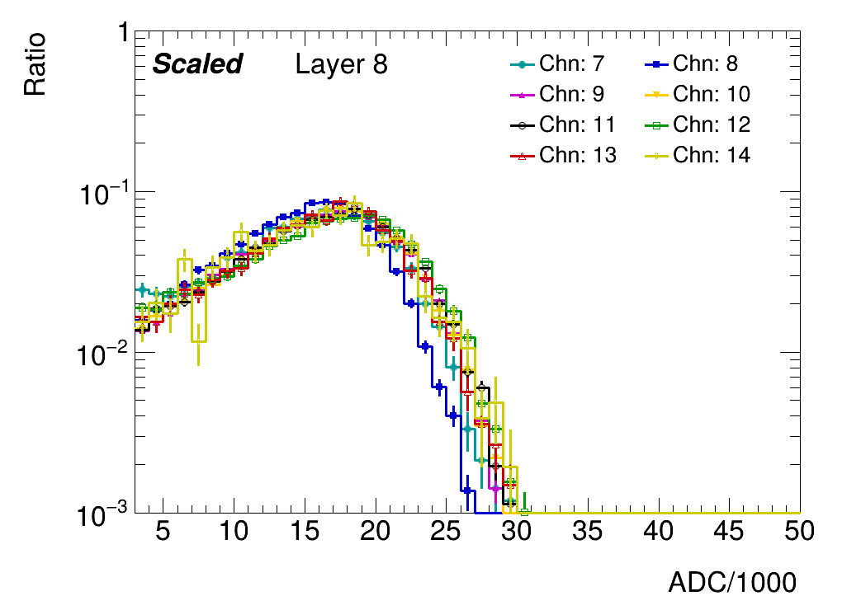
strategy：
Improve the least square fitting, improve the fitting accuracy, obtain a new scale factor, and correct the deviated channel

Slide 4
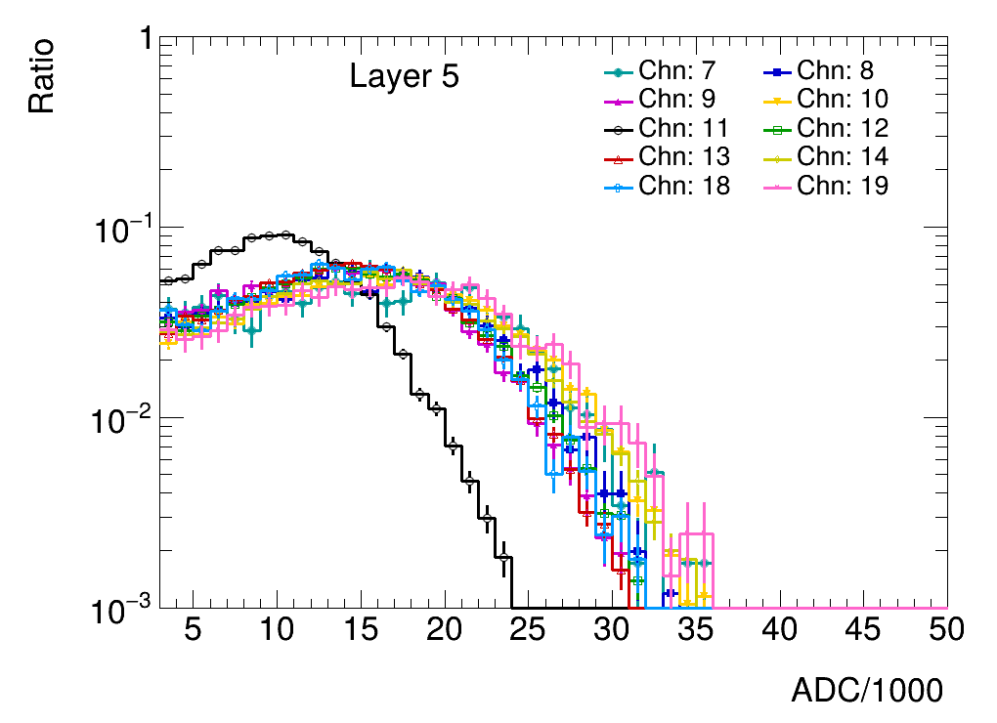
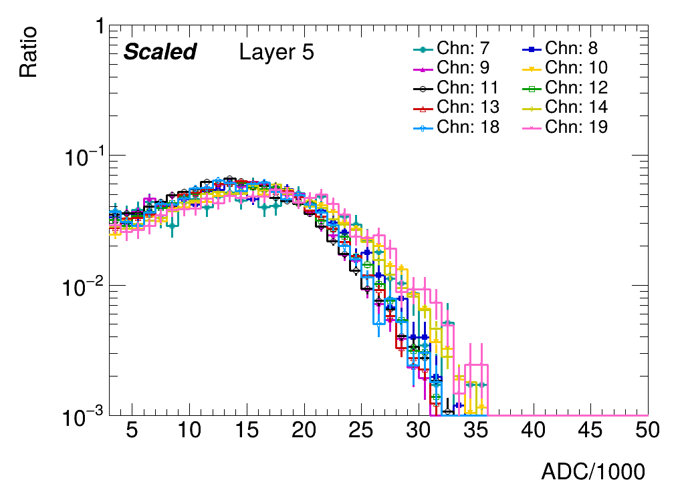
strategy：
Improve the least square fitting, improve the fitting accuracy, obtain a new scale factor, and correct the deviated channel

Slide 5
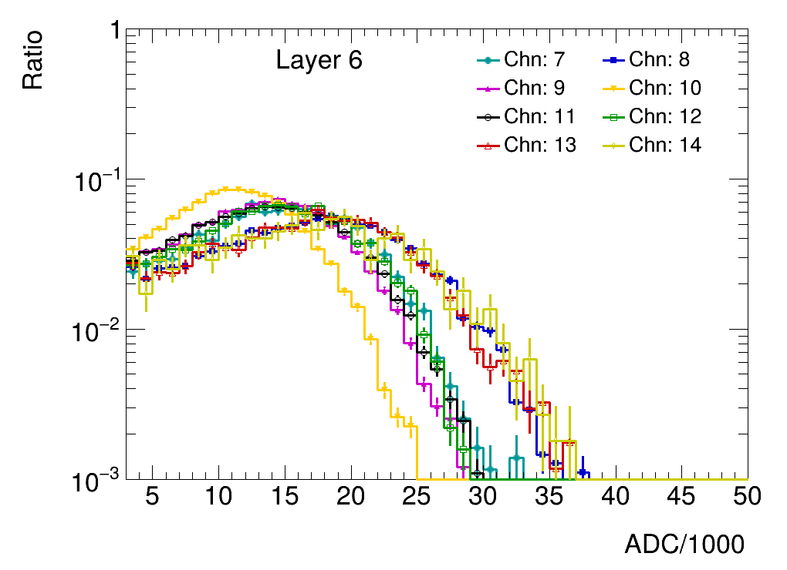
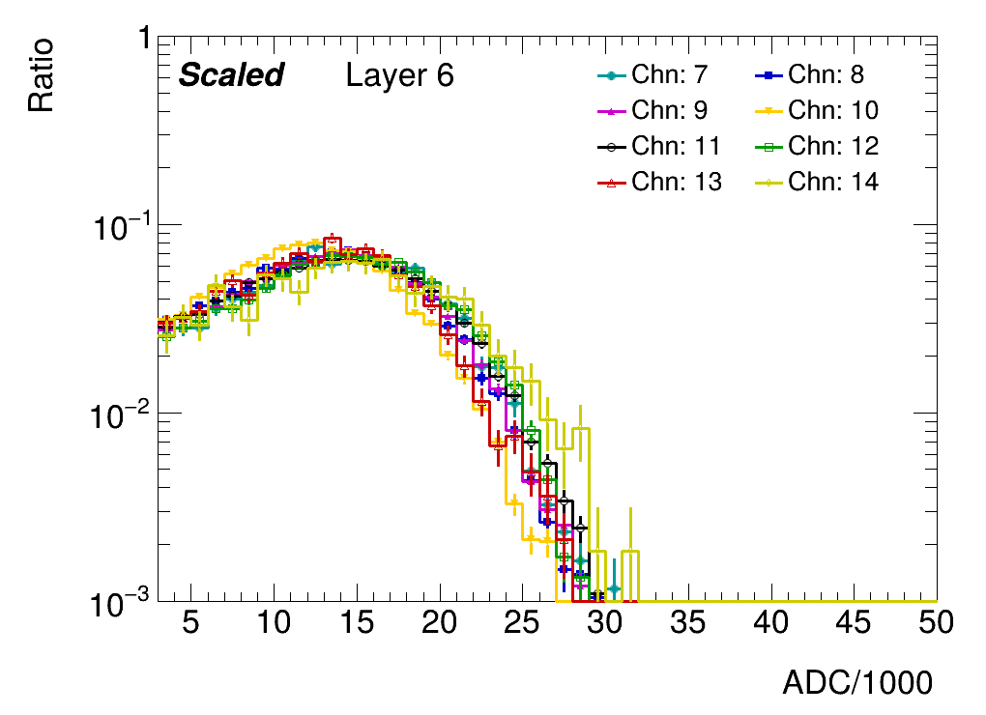
strategy：
Improve the least square fitting, improve the fitting accuracy, obtain a new scale factor, and correct the deviated channel

Slide 6
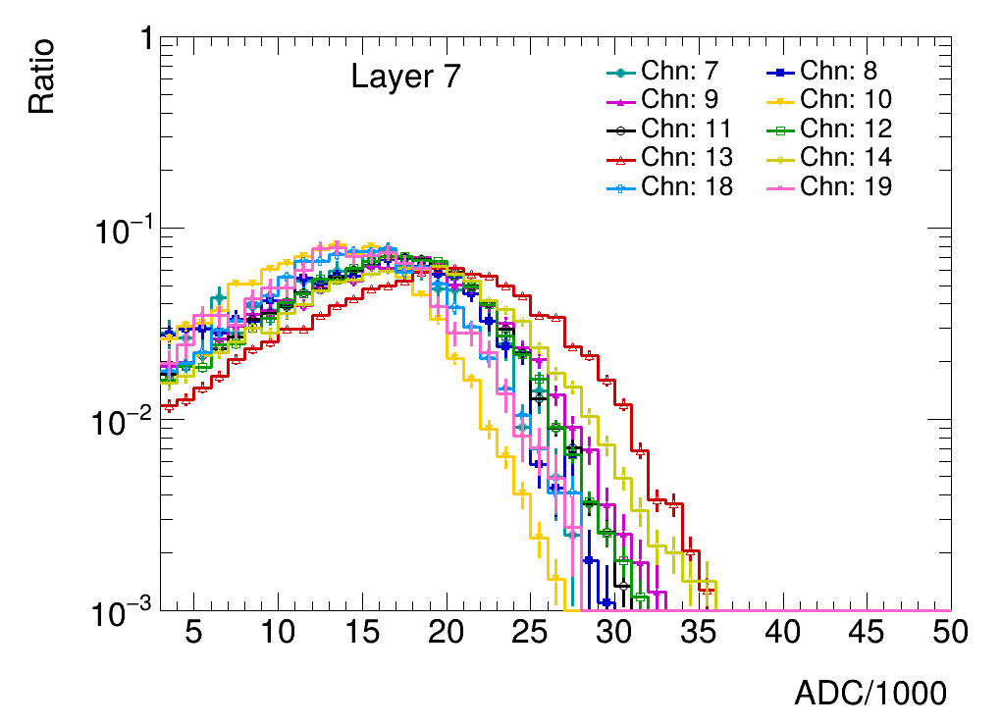
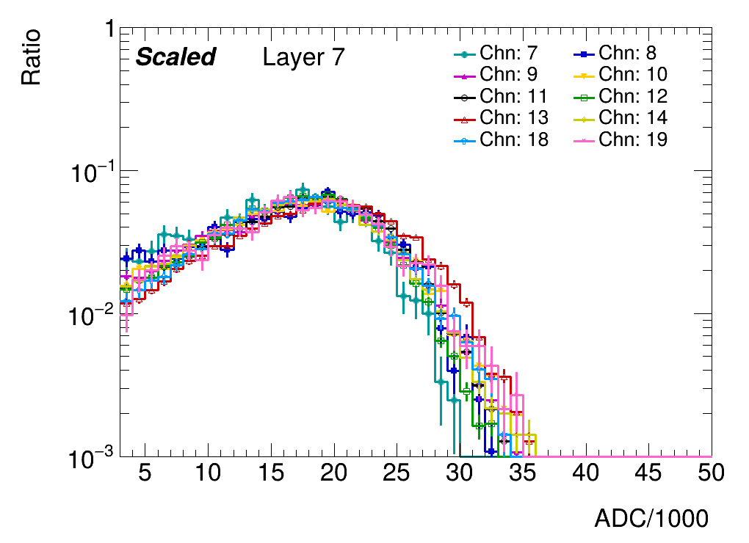
strategy：
Improve the least square fitting, improve the fitting accuracy, obtain a new scale factor, and correct the deviated channel

Slide 7
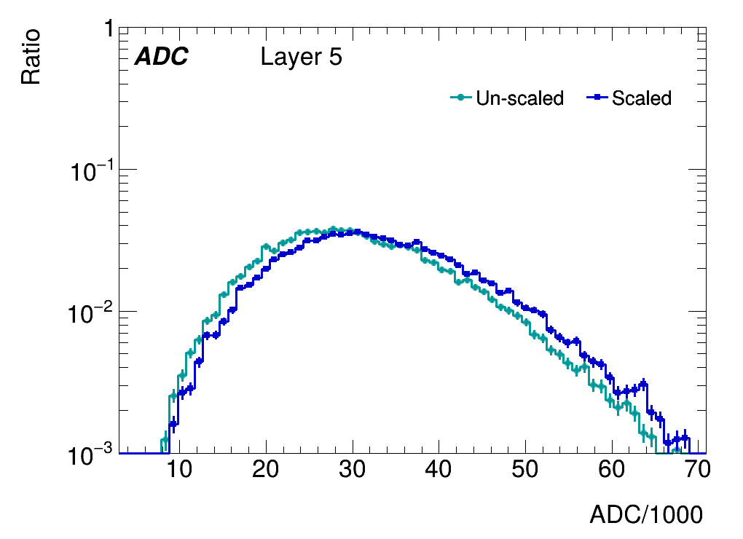
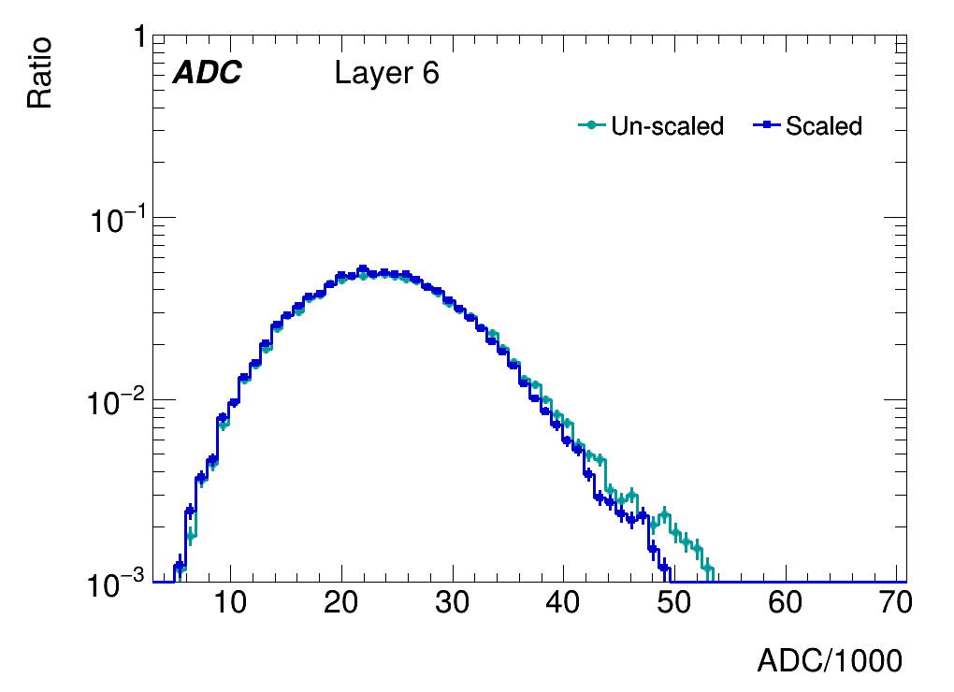
sum_ADC：
• ADCs of different channels are summed when the weighted center falls
into beam center

Slide 8
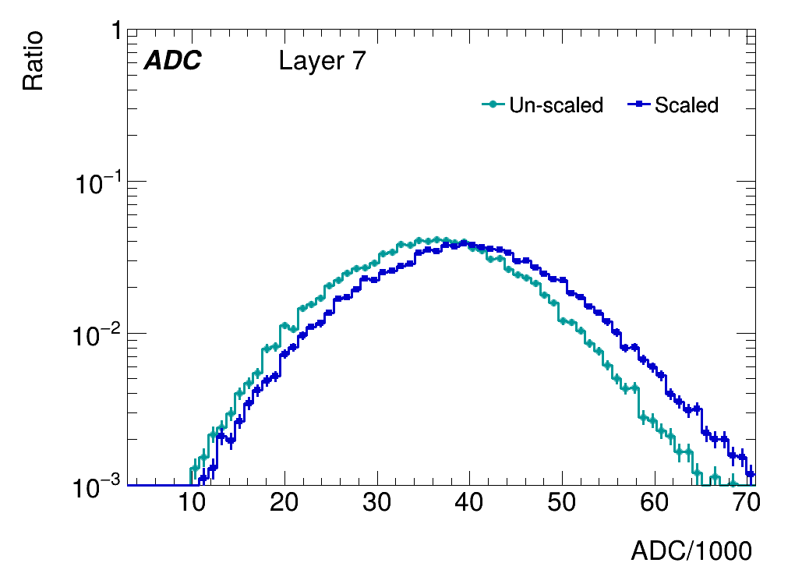
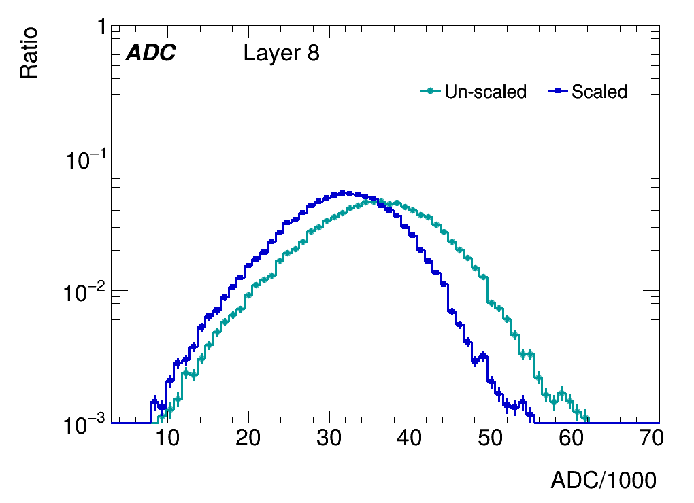
sum_ADC：
• ADCs of different channels are summed when the weighted center falls
into beam center

Slide 9
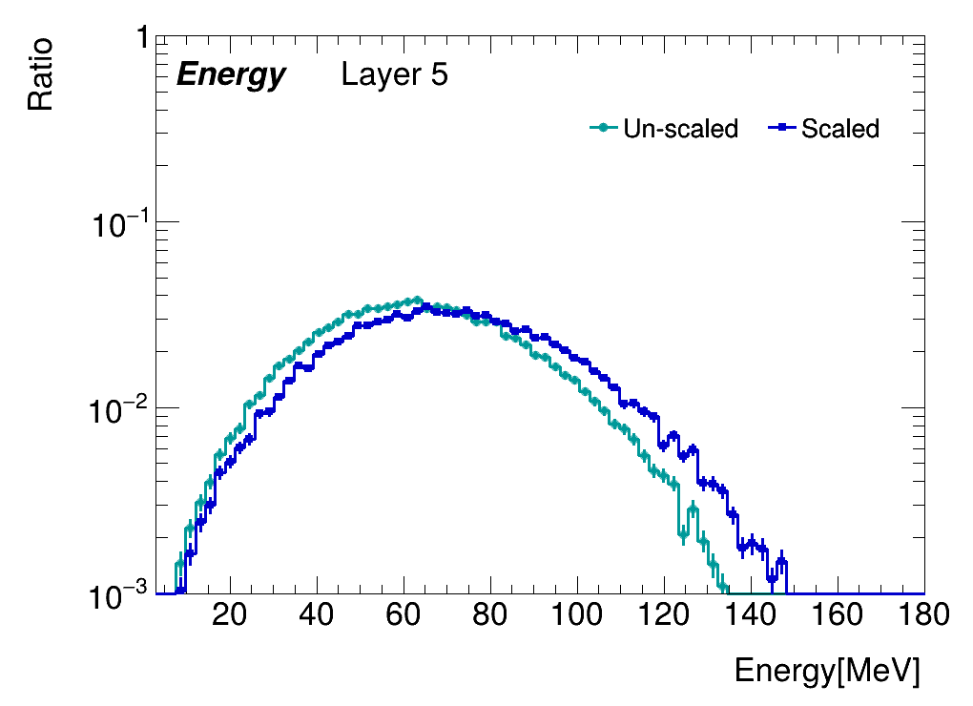
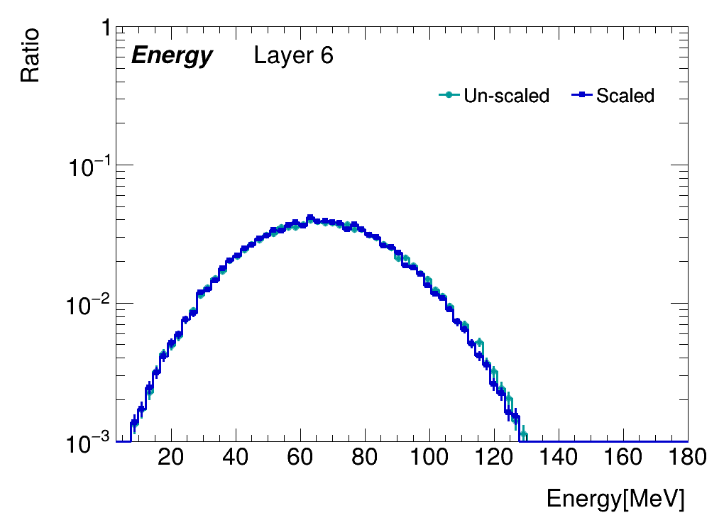
sum_Energy：
Energys of different channels are summed when the weighted center falls
into beam center

Slide 10
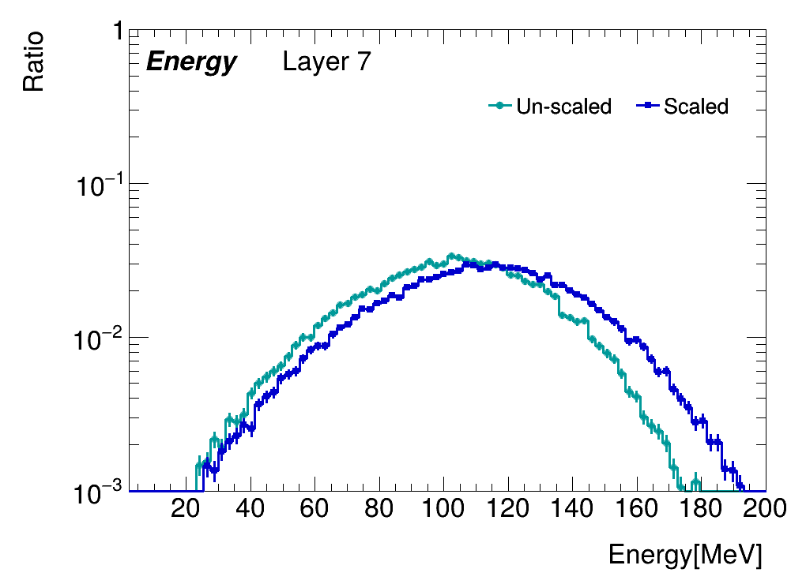
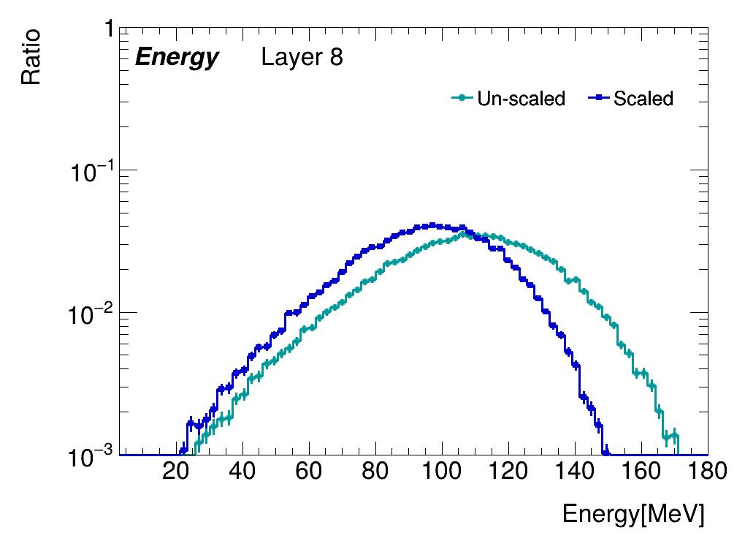
sum_Energy：
Energys of different channels are summed when the weighted center falls
into beam center

Slide 11
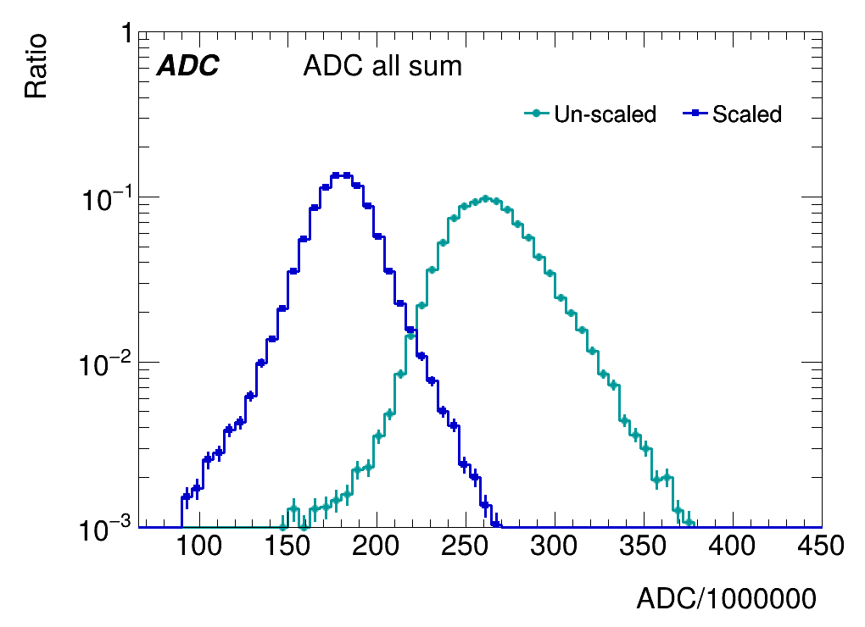
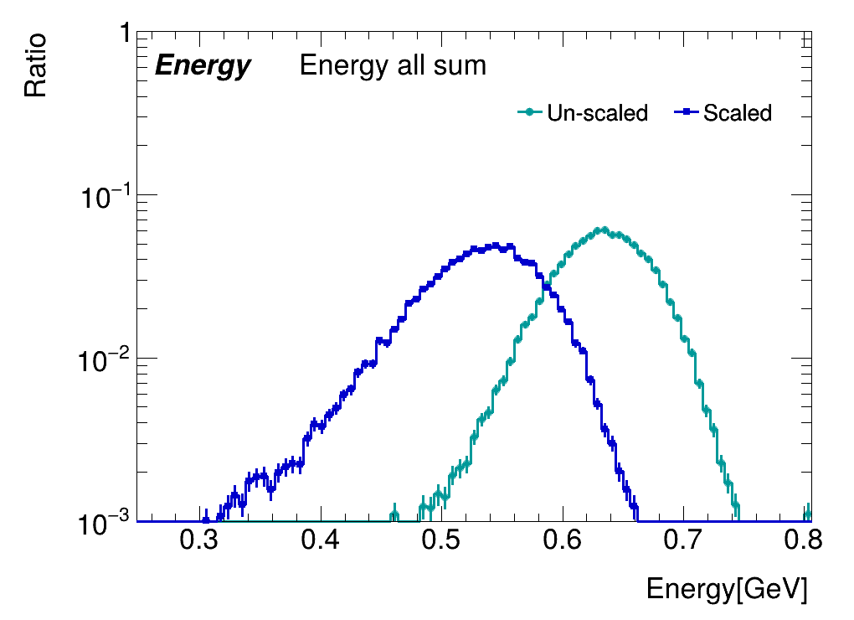
sum_all_Energy and sum_all_ADC：
Energys and ADC of different channels and layers are summed when the weighted center of layer 9 and layer10 falls into beam center

Slide 12
summary：
Reduce the unevenness between different channels by calculating scale factor
Obtain a more accurate scale factor by improving the fitting accuracy.
Calculate the sum_ADC and Energy at the center of the energy center
:The spread of sum ADC decreases, but the energy spread is not improved

Slide 13
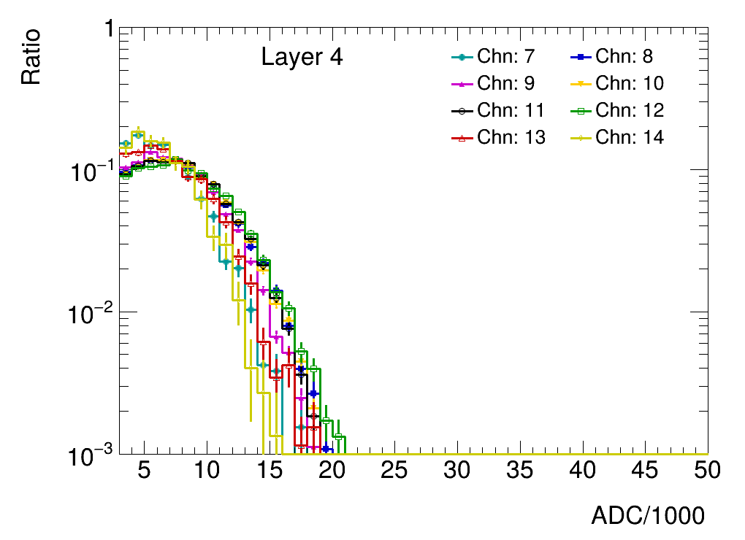
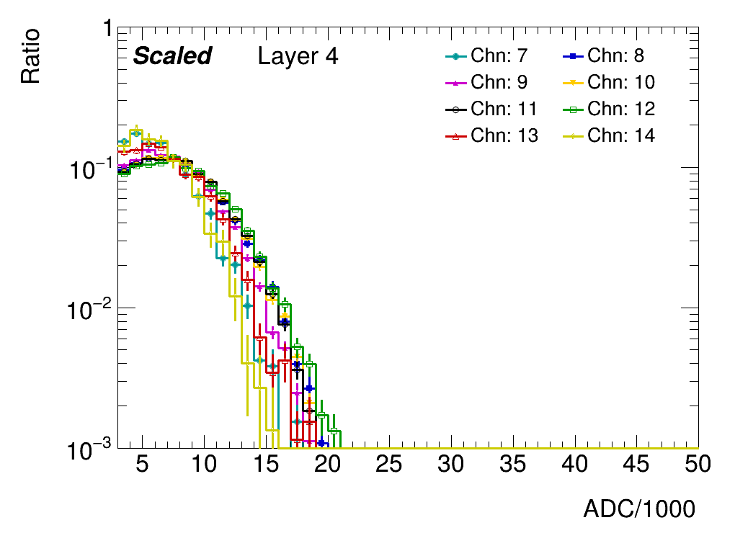
back up:scale

Slide 14
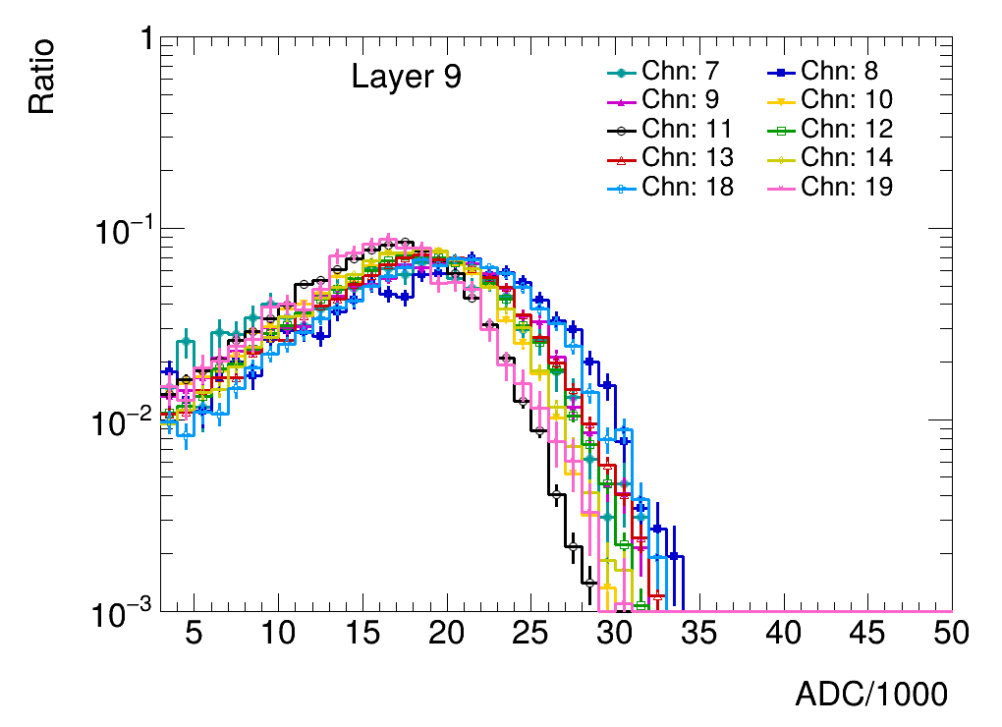
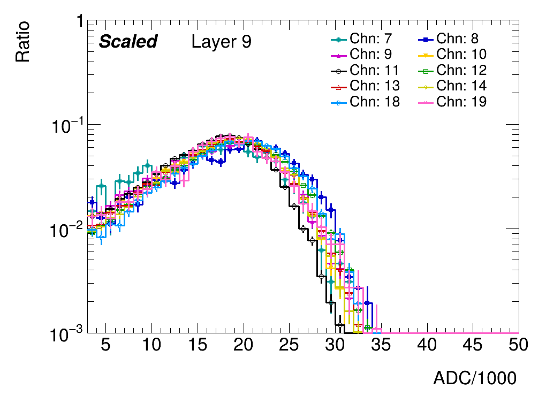
back up:scale

Slide 15
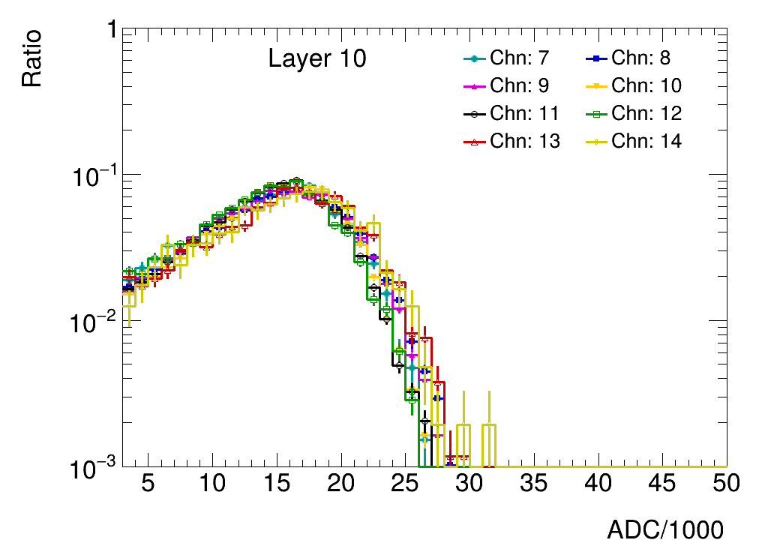
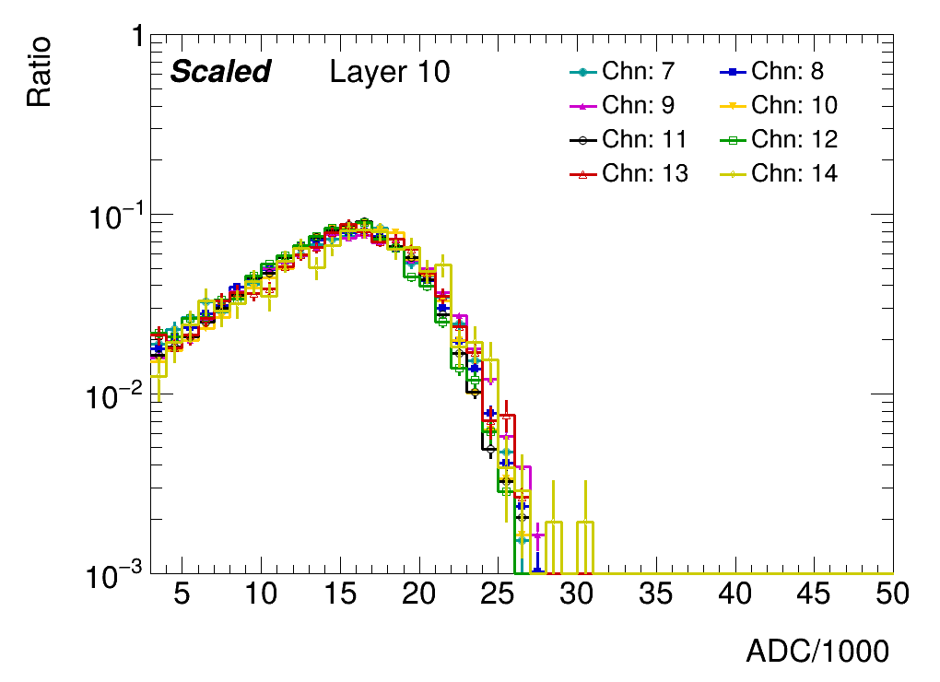
back up:scale

Slide 16
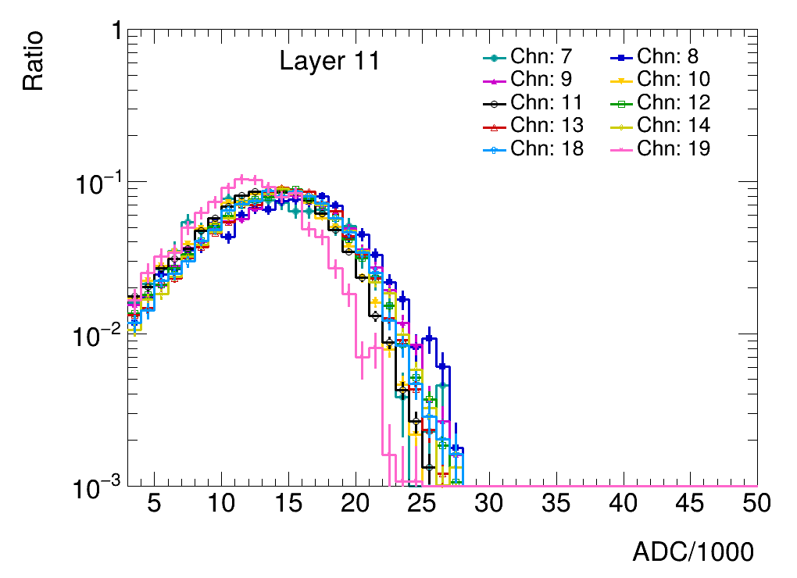
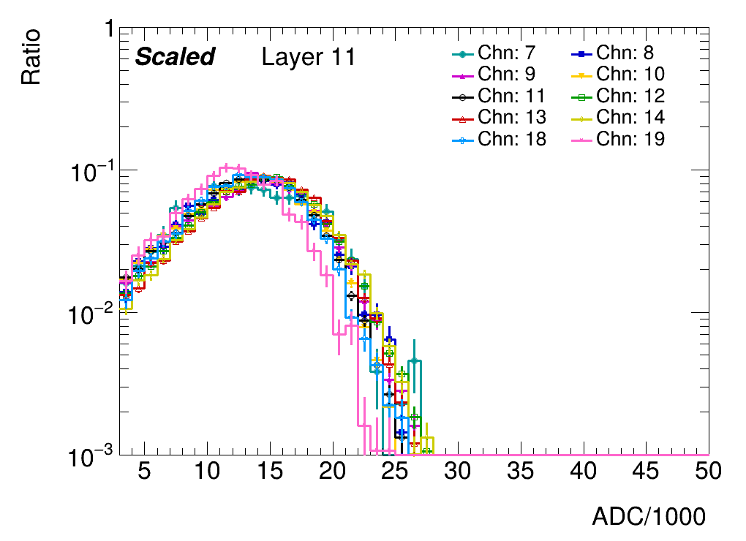
back up:scale

Slide 17
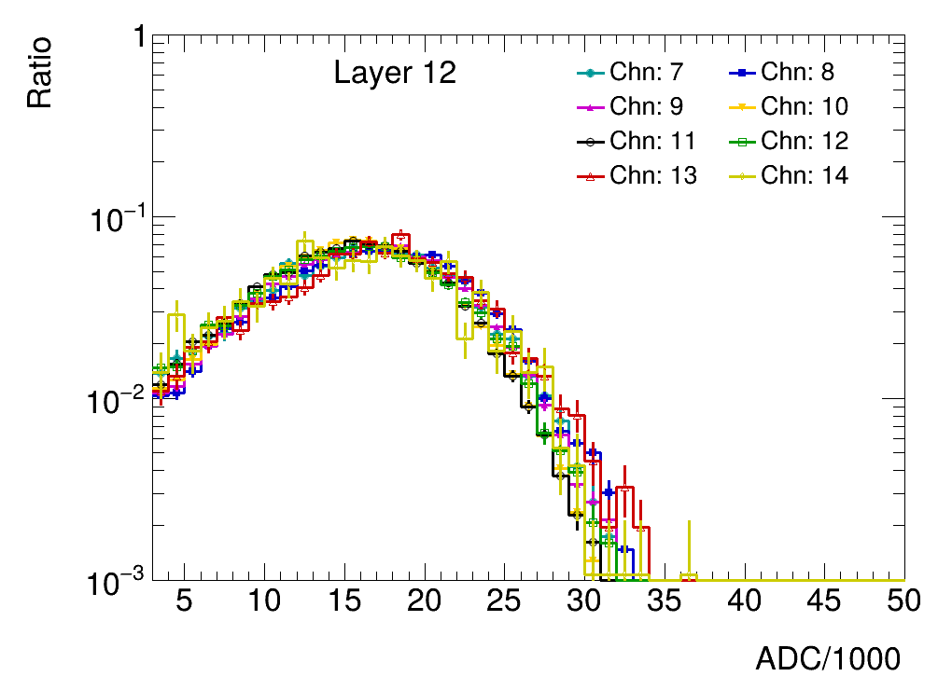
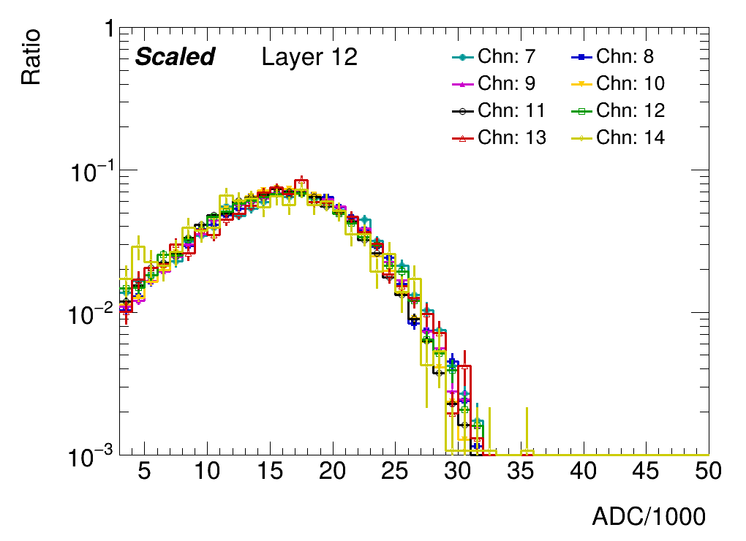
back up:scale

Slide 18
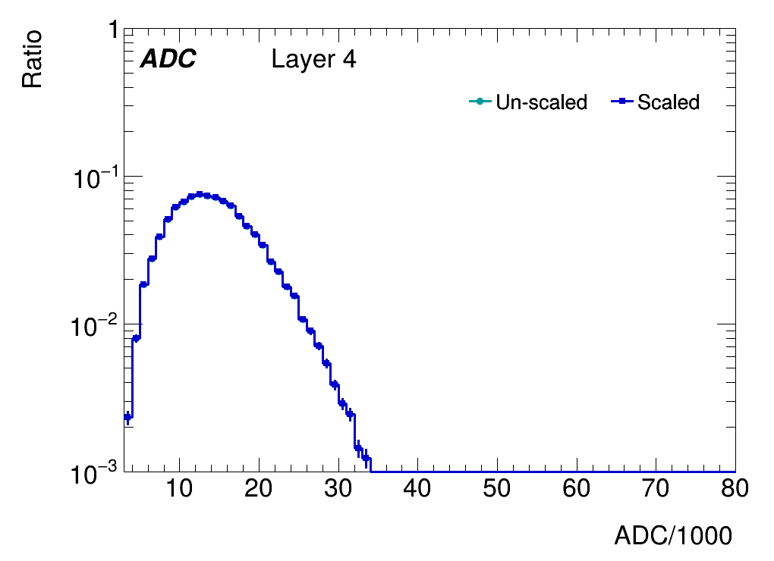
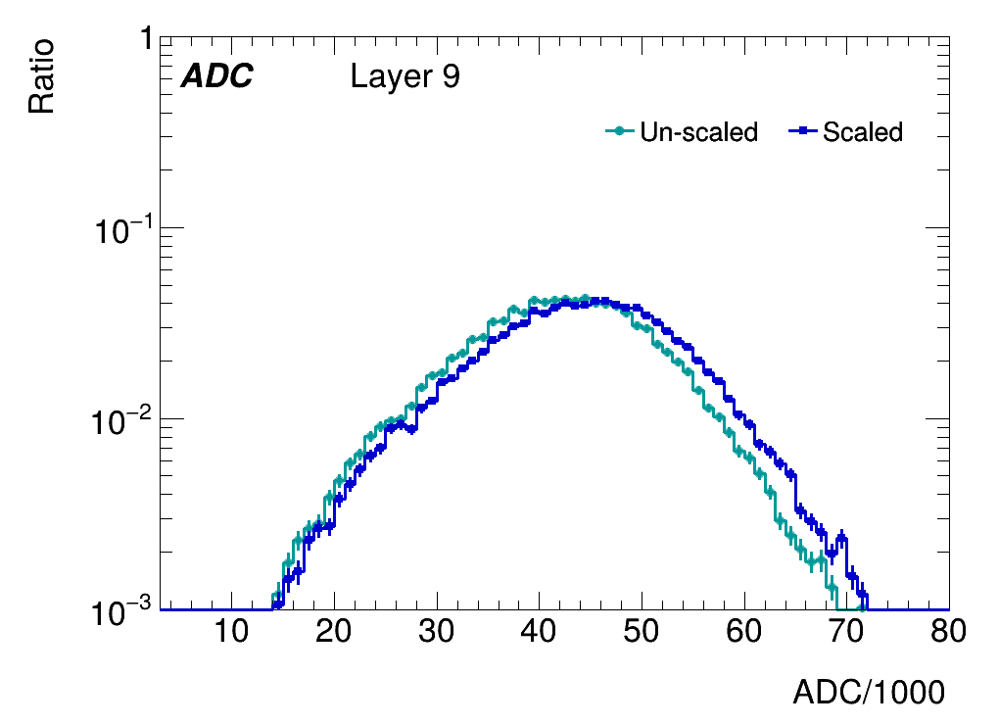
back up:sum_ADC

Slide 19
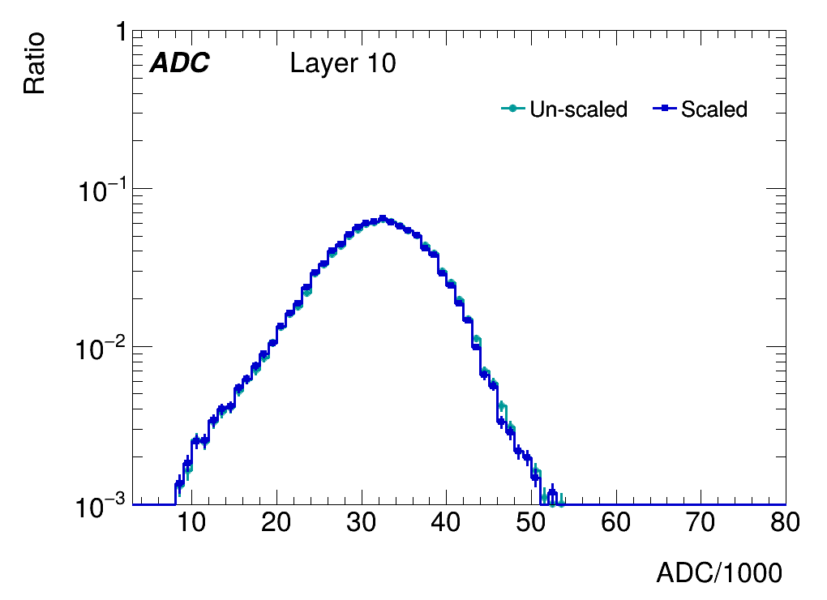
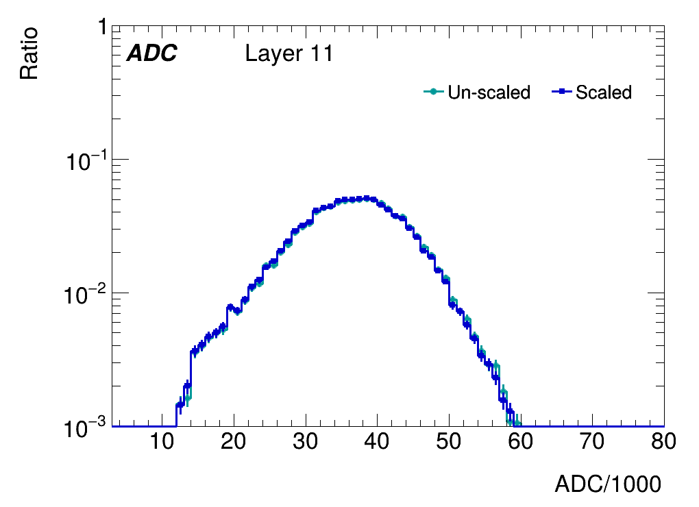
back up:sum_ADC

Slide 20
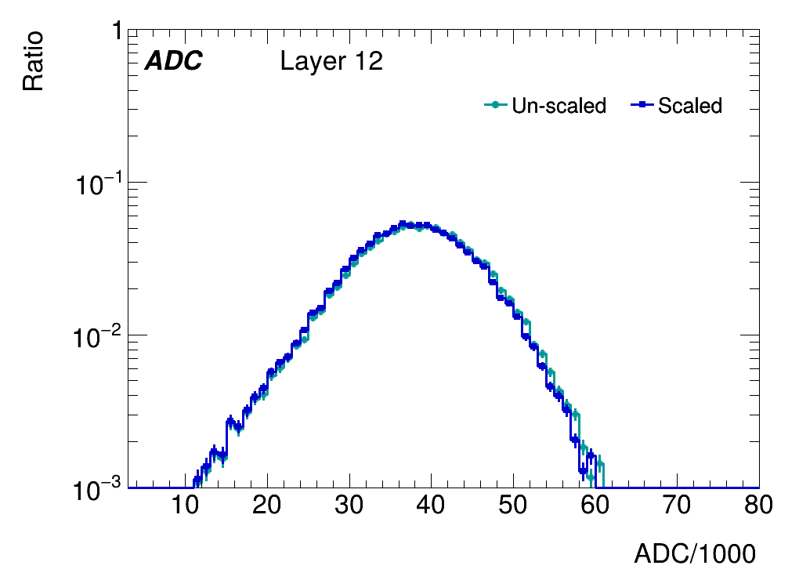
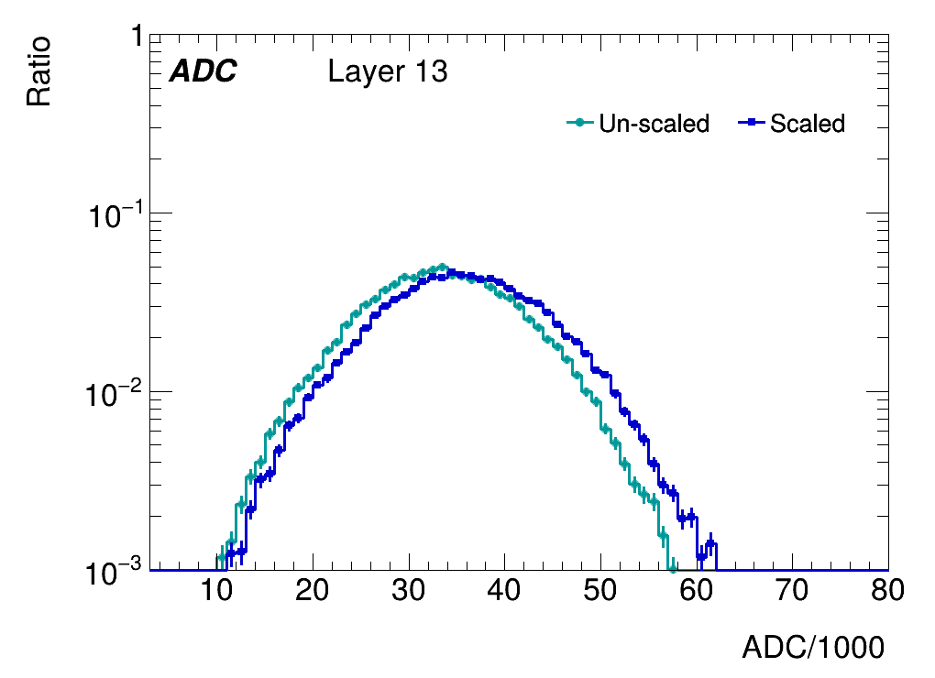
back up:sum_ADC

Slide 21
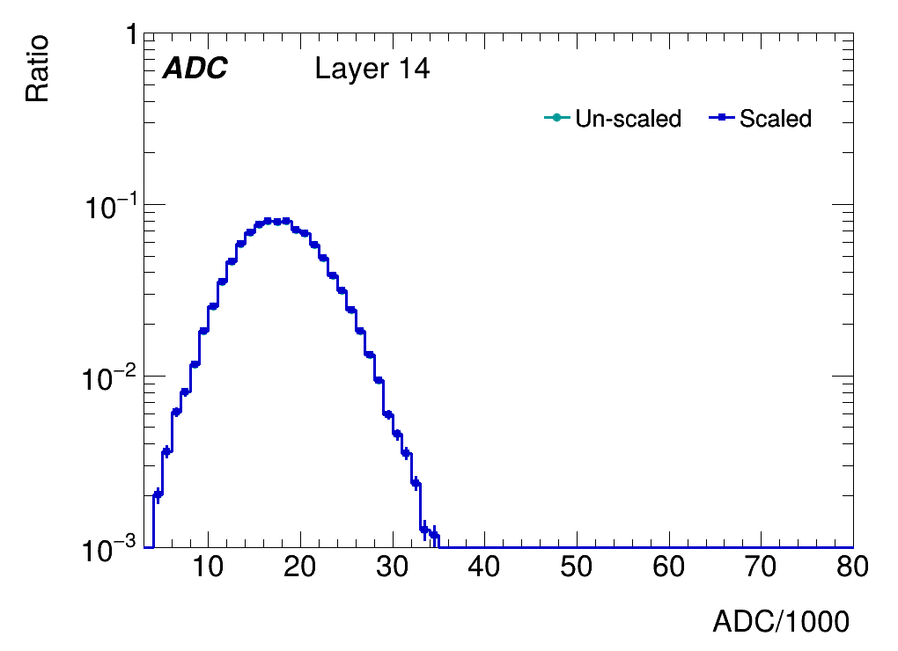
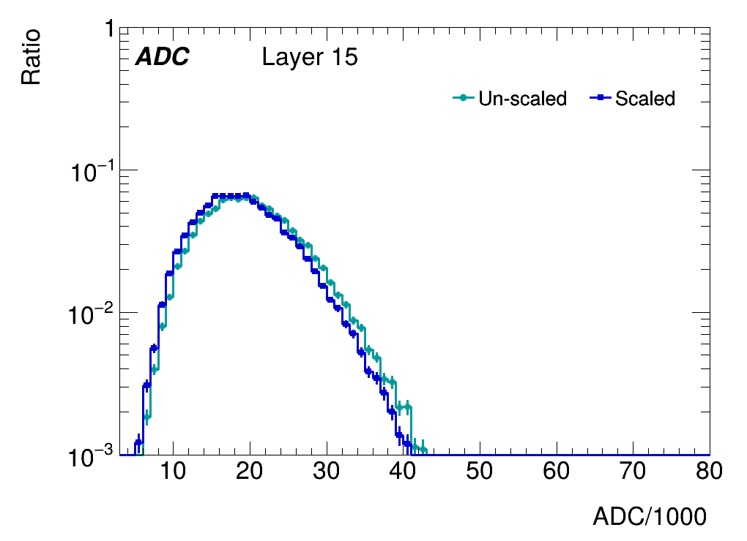
back up:sum_ADC

Slide 22
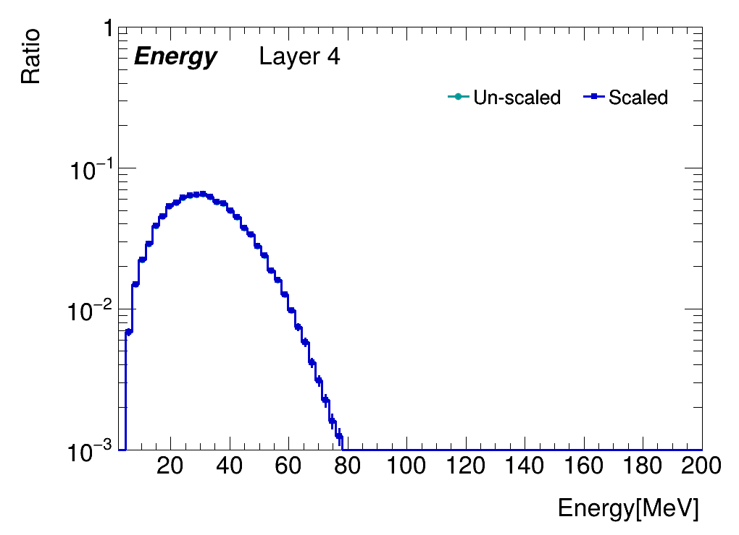
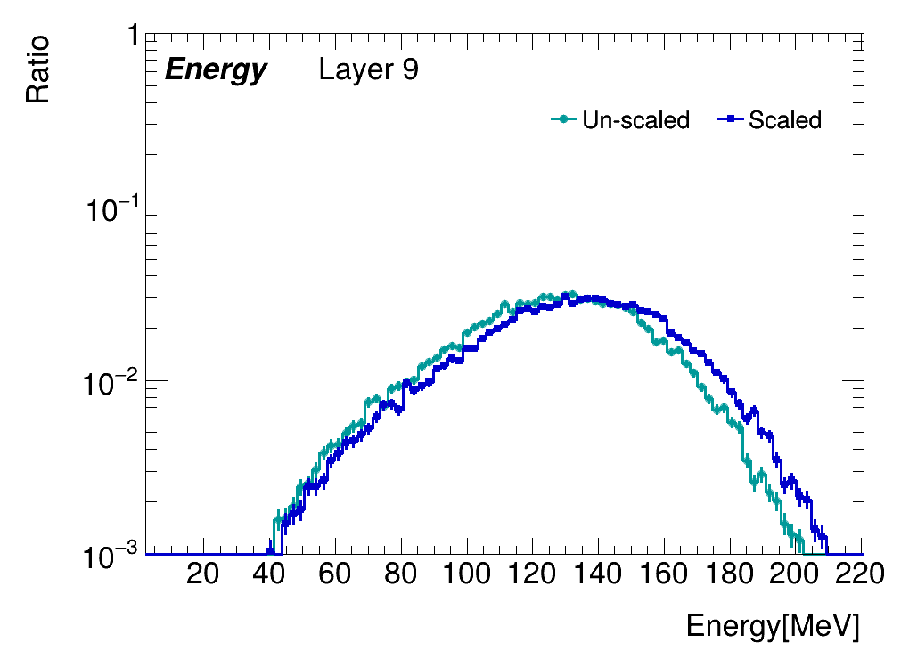
back up:sum_Energy

Slide 23
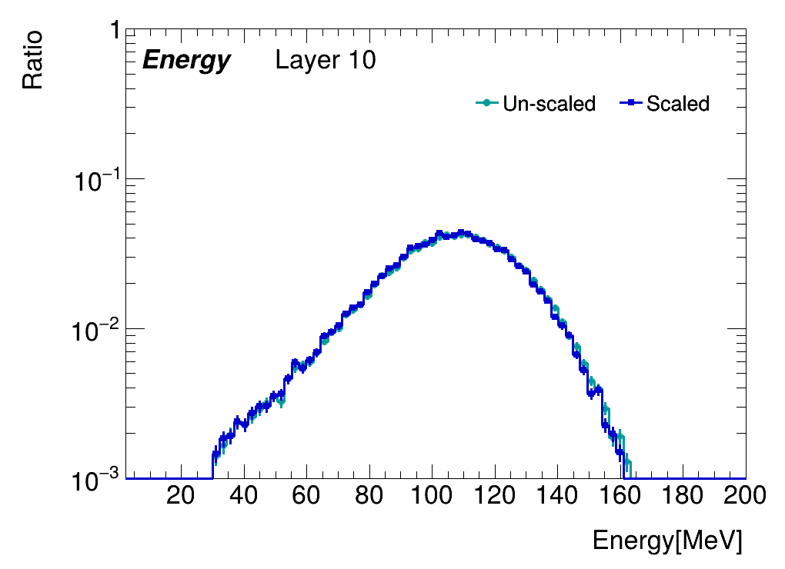
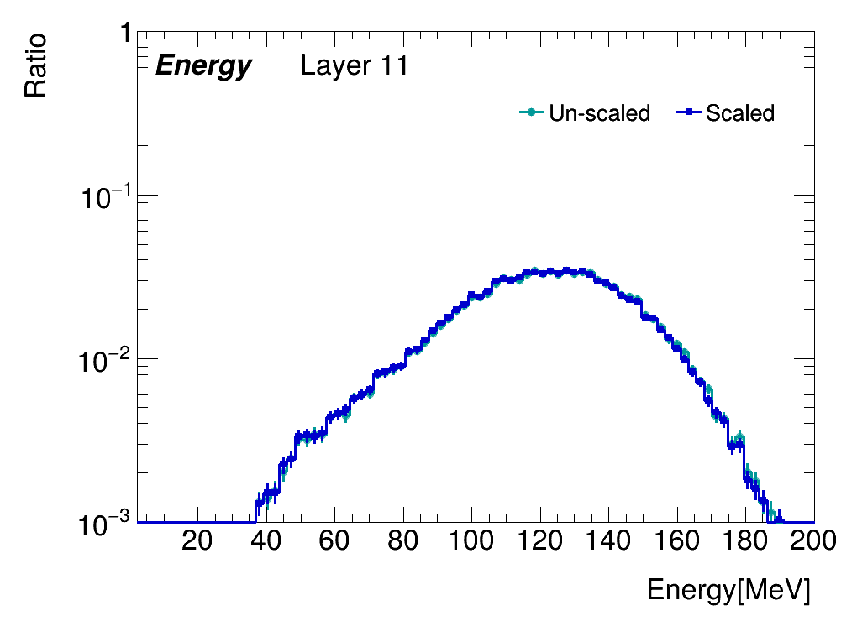
back up:sum_Energy

Slide 24
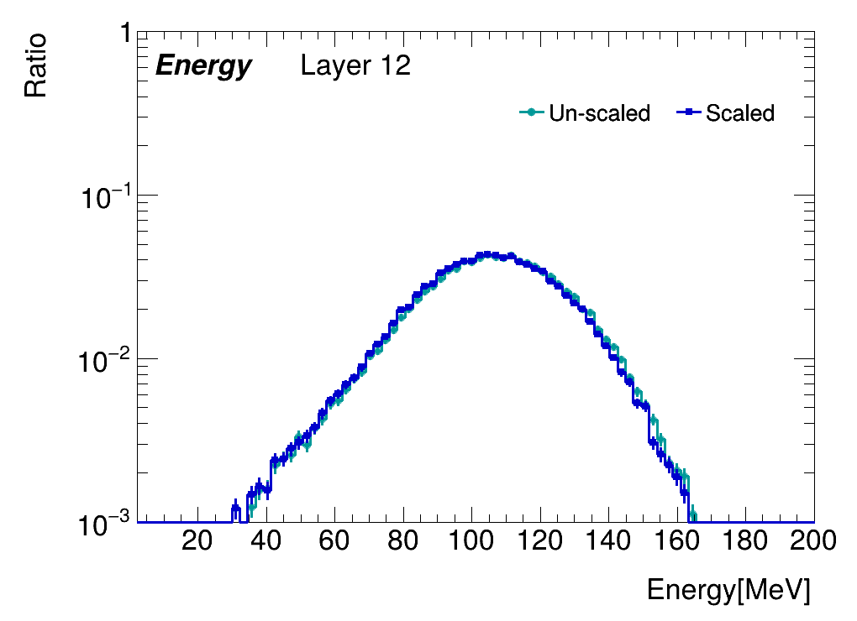
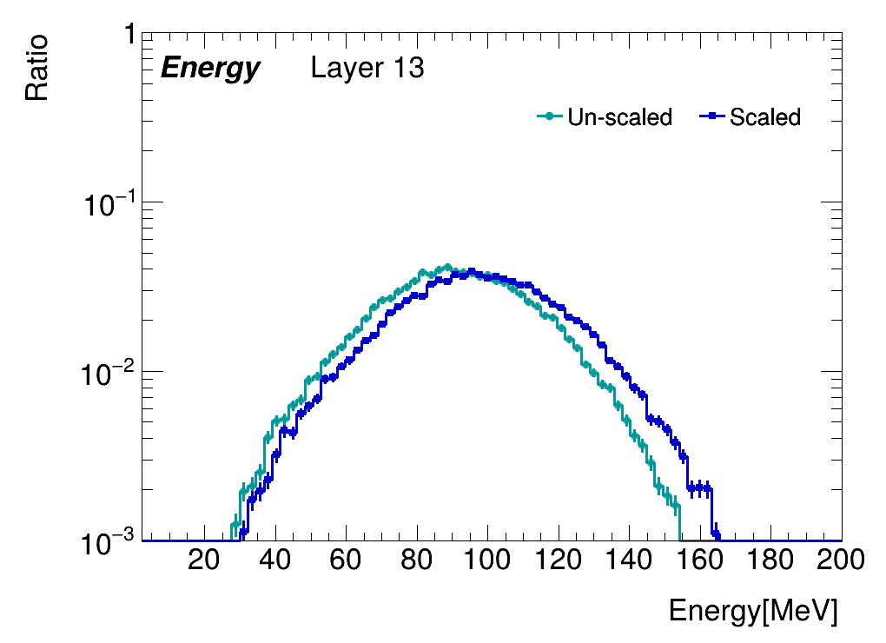
back up:sum_Energy

