Slide 1

STCF Software Status
Xingtao Huang, Xiaocong Ai
on behalf of STCF Software Working Group
2025 超级陶粲装置研讨会, 2025年7月3日，湘潭

Slide 2
STCF physics requirements

Slide 3
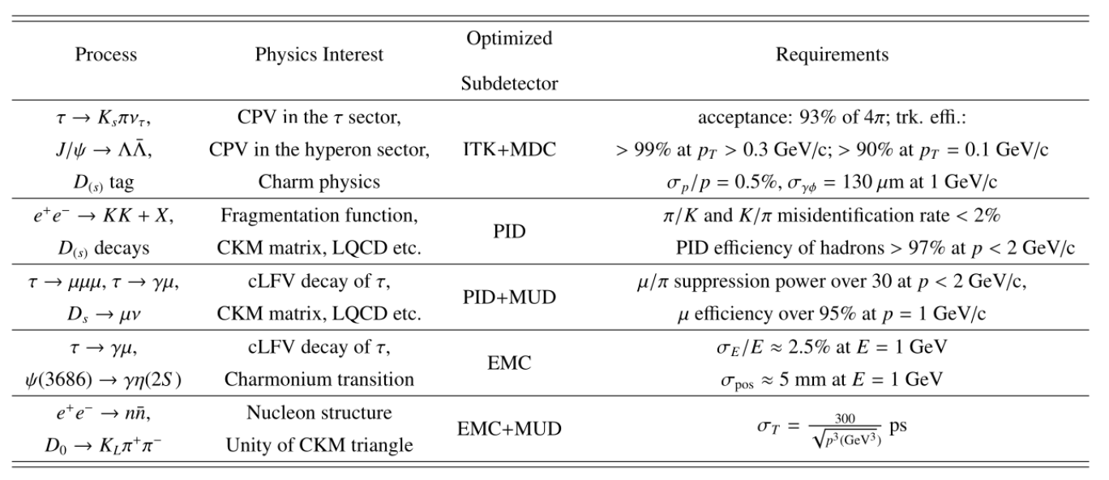
Requirements of oﬄine software at STCF
Higher event rate, background, CPU consumption at STCF than BESIII
  develop highly accurate and efficient detector simulation and digitization to meet the demands of high luminosity, high background for different detector options
  reconstruct the tracks and photon with good efficiency and resolution, and identify them at high accuracy, with good speed

Slide 4
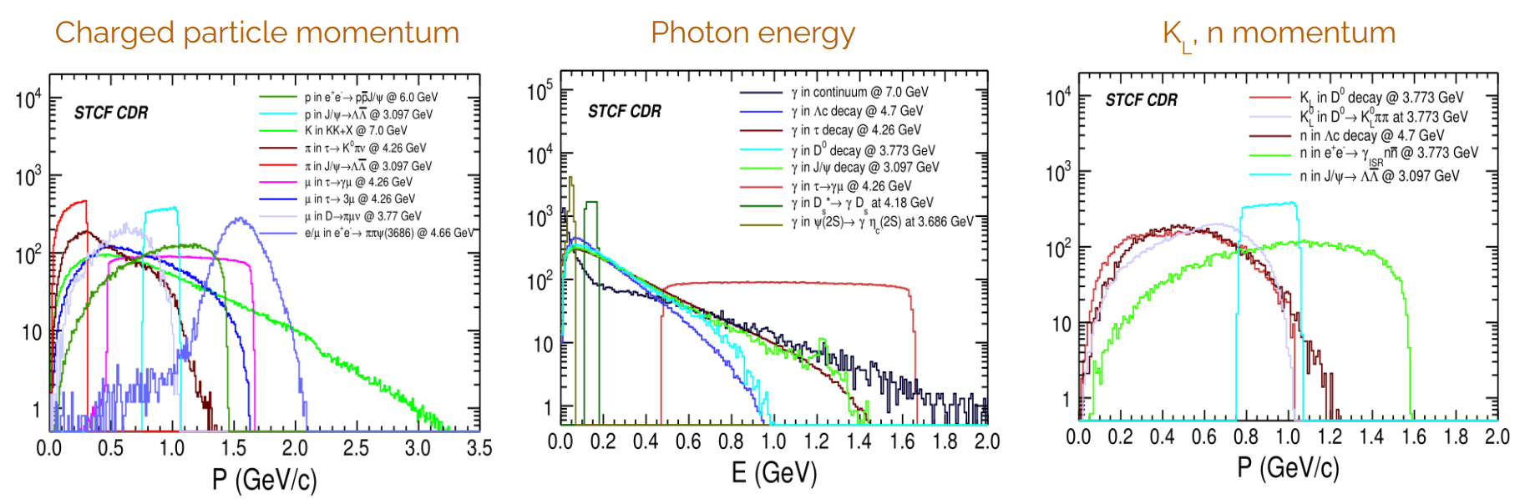
Particles at STCF
Charged particles
  e, μ, K, π, proton (most have p < 2 GeV, lots have p < 400 MeV)
Neutral particles
  γ (energy coverage: 25 MeV - 3.5 GeV) and KL, neutron (up to 1.6 GeV)

Slide 5
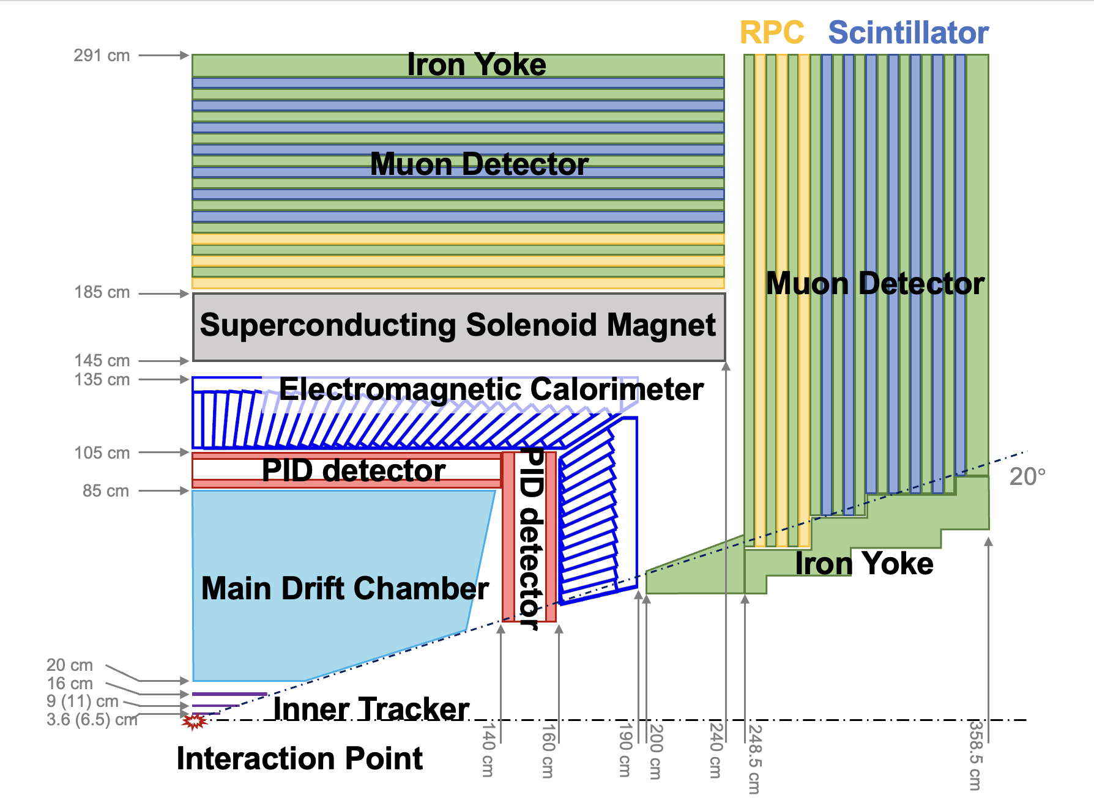
Detector performance requirements
ITK
Material < 0.01 X0, σxy < 100 um
MDC
Material < 0.05 X0
σxy < 130 um, σp/p < 0.5% at 1 GeV/c
dE/dx resolution < 6%
RICH/BTOF & DTOF
PID π/K PID efficiency > 97% up to 2 GeV/c @mis-ID rate 2%
EMC
σ_{E} < 2.5%, σ_{pos} < 5 mm, σ_{t} < 300 ps @ 1 GeV
MUD
μ PID efficiency > 95% with
π→ μ mis-ID rate < 3.3% @ p = 1 GeV/c

Slide 6
STCF Offline Software

Slide 7
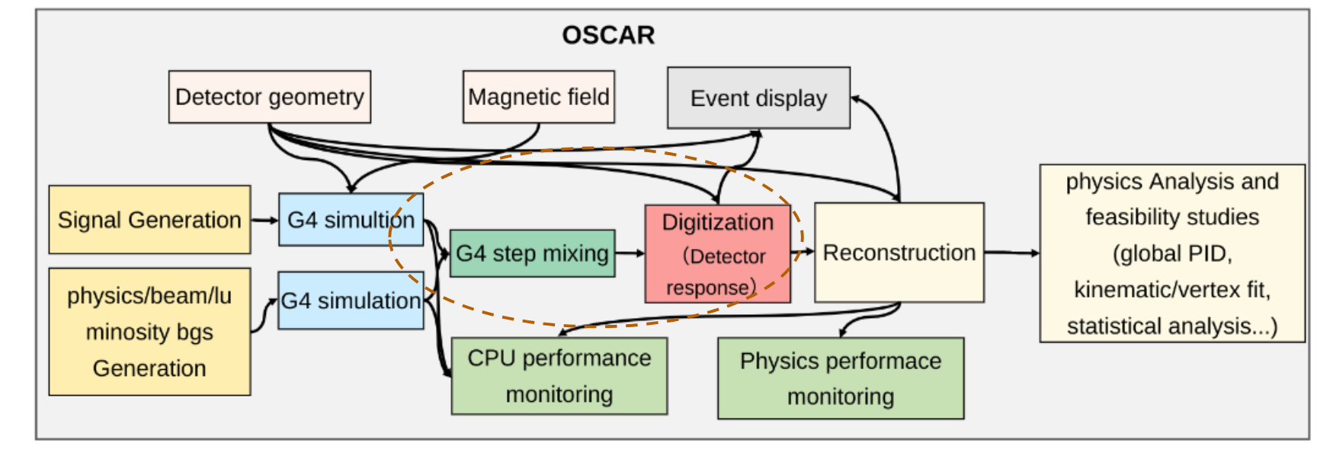
STCF offline software (OSCAR)
OSCAR is develeped to provide common functionalities for detector simulation, reconstruction, calibration and physics analysis at STCF
  A full chain of simulation + digitization + reconstruction + analysis has been established
  ML techniques exploited in simulation, reconstruction and analysis

Slide 8
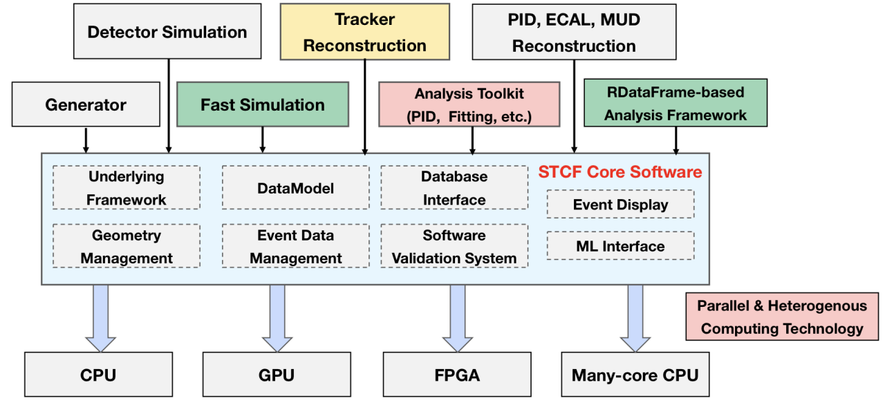
OSCAR core software features
The OSCAR core software is develop based on the SNiPER framework and the (partially) the Key4hep Stack, with lots of state-of-the-art techniques
  Event Data Model based on podio
  Geometry based on DD4hep
  Tracking with ACTS (as an option)
  Analysis framework with RDataFrame
  ML inference with ONNX
  Parellal computing with TBB
Many new features are being developed
  Fast simulation based on GAN
  Software deployment with Spack
  Support for heterogenous resources
  Support for AlmaLinux 9
Comput.Softw.Big Sci. 9 (2025) 1, 3
Mod.Phys.Lett.A 39 (2024) 40, 2440006
JINST 18 (2023) 03, P03004
J.Phys.Conf.Ser. 2438 (2023) 1, 012054

Slide 9
OSCAR major updates in 2025
Several new releases since FTCF 2025 in Guangzhou
  2.6.0, 2.6.1, 2.6.2 and a few pre-releases
Major updates include:
  Great optimization of disk consumption and running speed
  Optimization of geometry, digitization, reconstruction algorithms for each sub-detector (see talks of software session)
  Release of fast simulation software package
  Release of Global-PID based on weighted combined likelihood method
  Release of ACTS-based tracking
  Major updates of EventDisplay
  Lots of optimizations and fixes for various physics simulation studies, towards the release of TDR

Slide 10
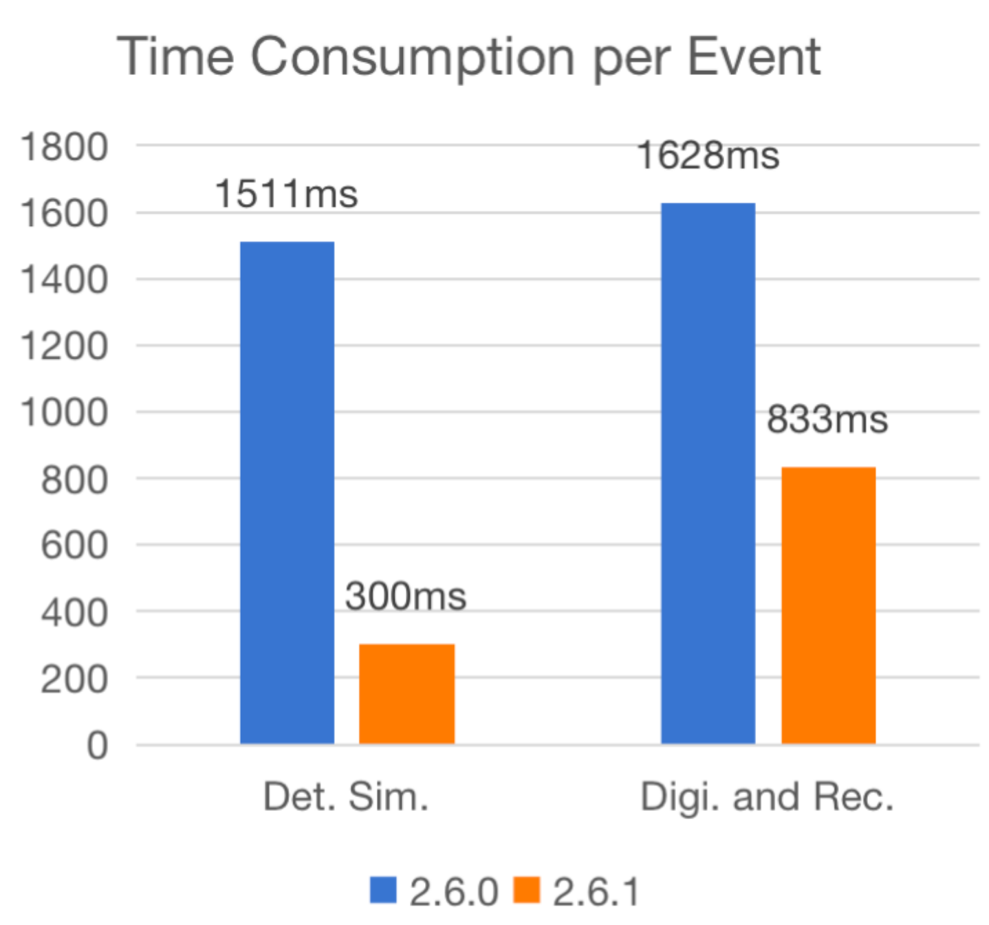
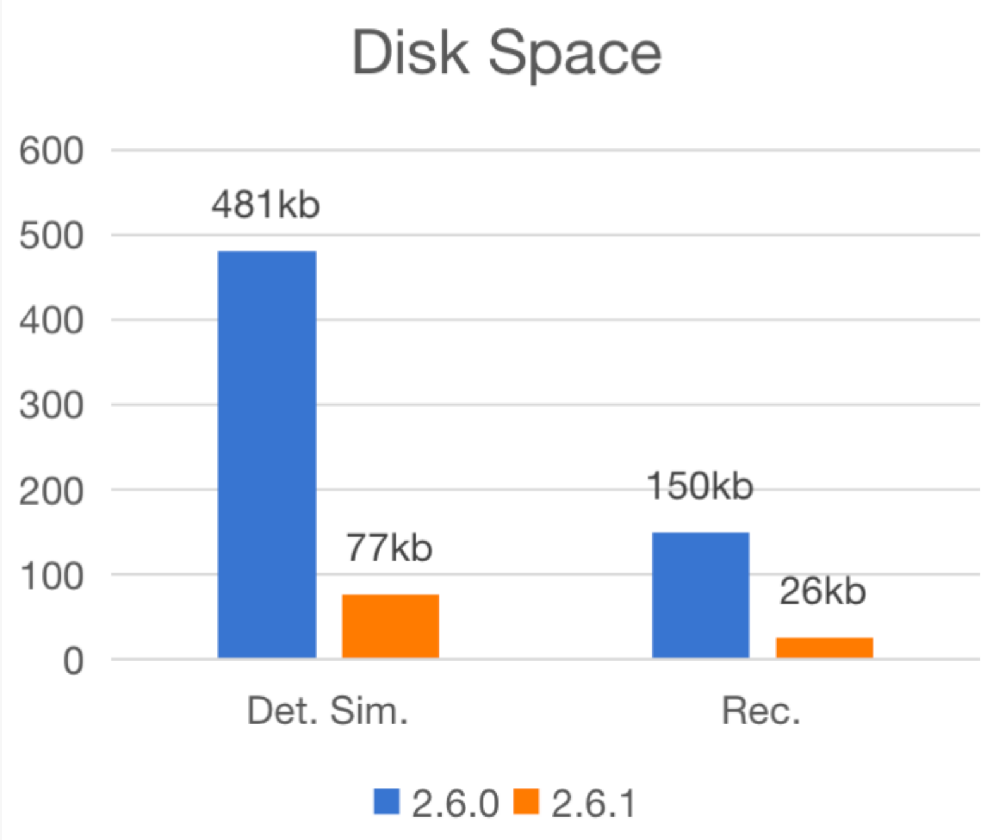
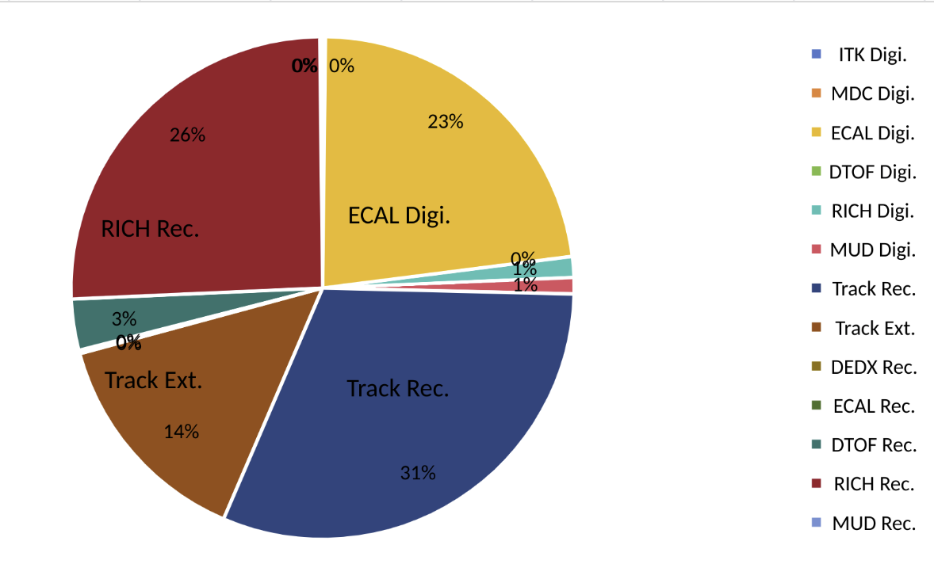
CPU performance status
Much improved CPU consumption and disk space (comparable to BESIII now)

Slide 11
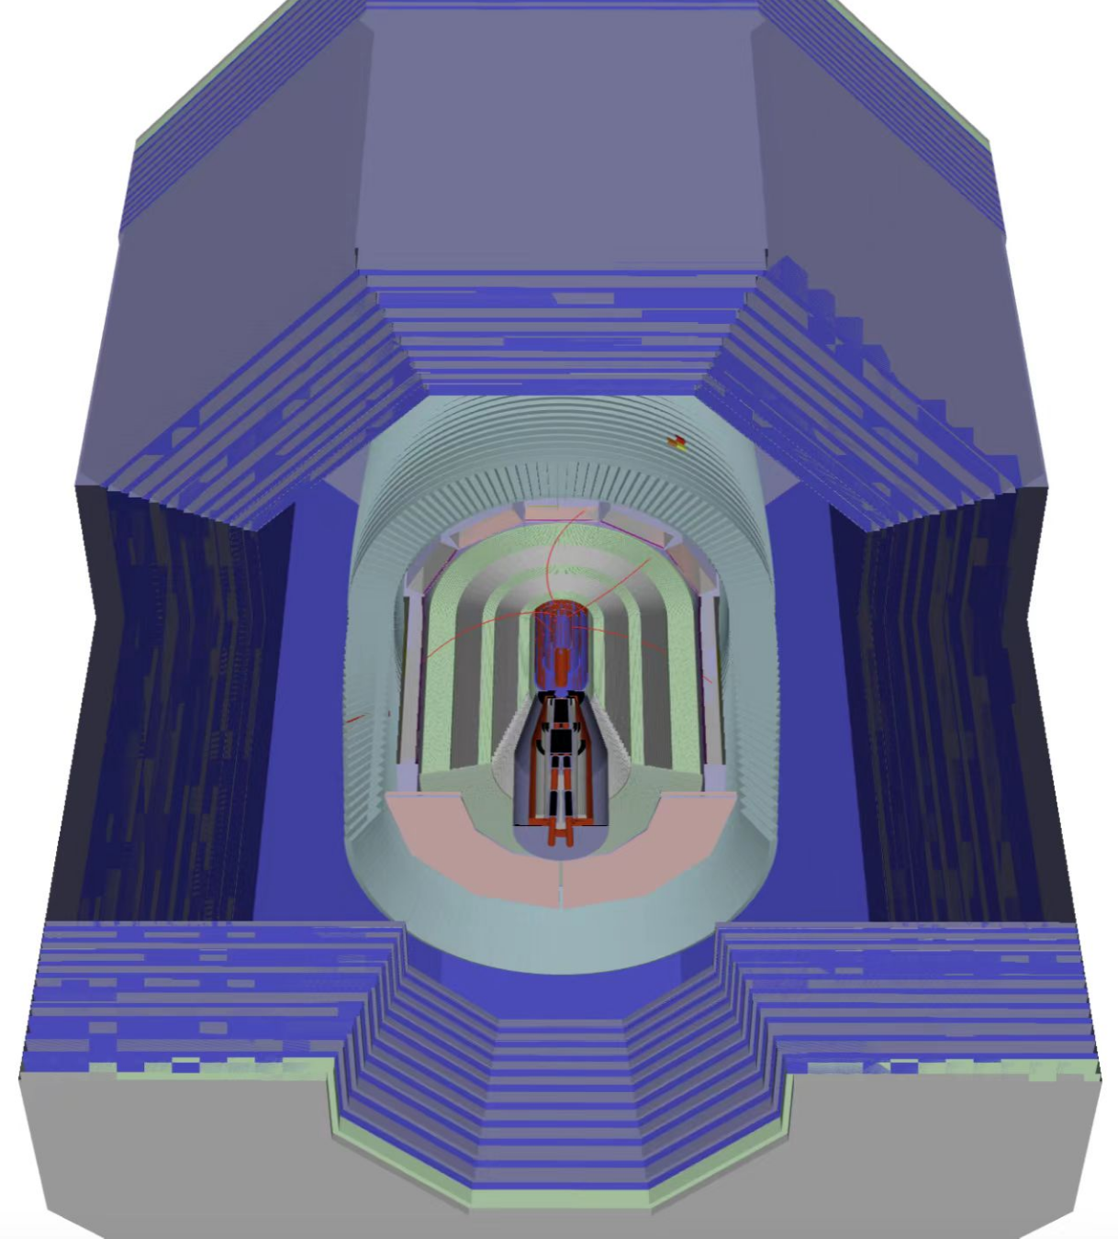
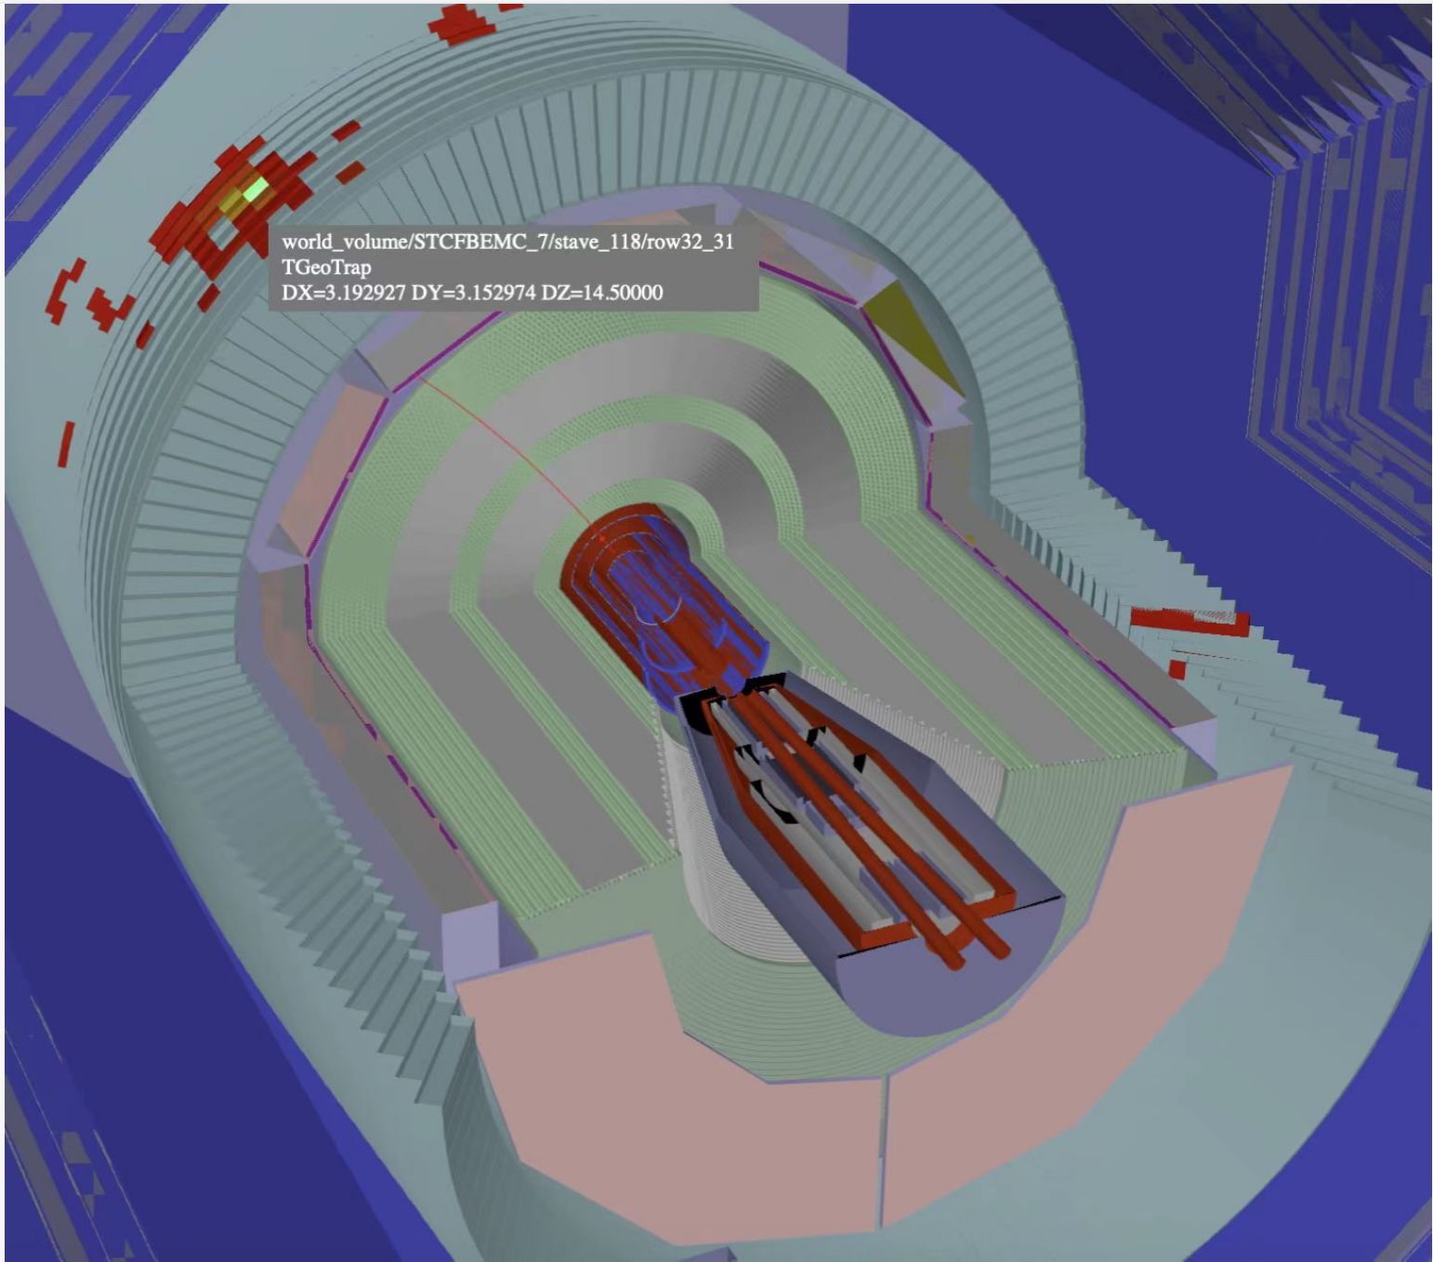
Event display
A common geometry and event display system is being developed
    Based on Web3D technology and the open-source JSROOT
    3D engine and graphic library based on Three.JS
    Using the Vue.js HTML5 development framework toimplement the Web interface

Slide 12
simulation, digitization, background mixing

Slide 13
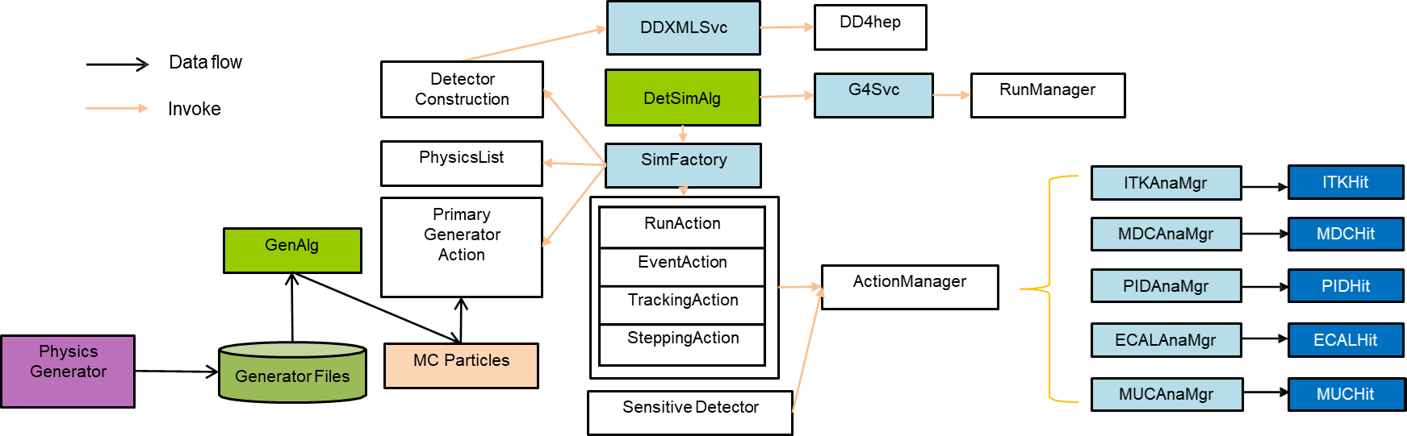
Full Simulation
Full chain of detector simulation from generator to simulated information is built
Providing flexible configuration for different purposes of detector simulation
  Generator for different physics topics i.e. Babayaga, KKMC, Phokhara, DIAG36, BBBrem …
  Geometry for different detector design options
  User actions for recording MC truth information, G4Step level

Slide 14
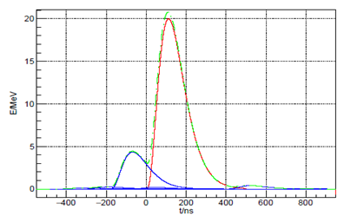
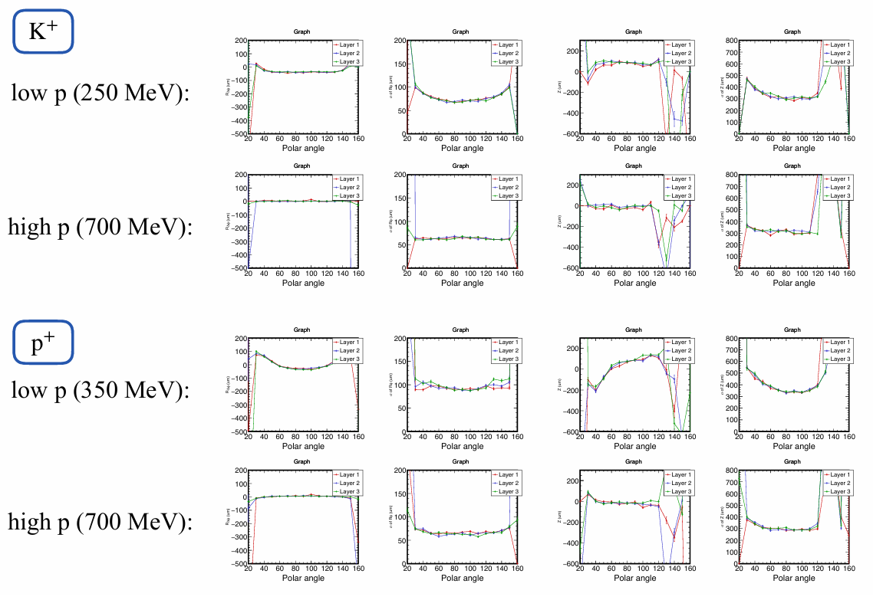
Digitization
Developed a unified digitization framework for all sub-detectors within OSCAR
All sub-detector moved to sampling method, including MDC dE/dx and hit position
Got breakthrough in the correction of offset for ITKW's reconstruction position
New waveform fitting stratege for ECAL, time with BKG mixing improved from ~20s to 10s
A more precise digital model of MUD, including aspects such as efficiency and time accuracy
ECAL pipeline fitting
offset and resolution of ITKW in rφ direction

Slide 15
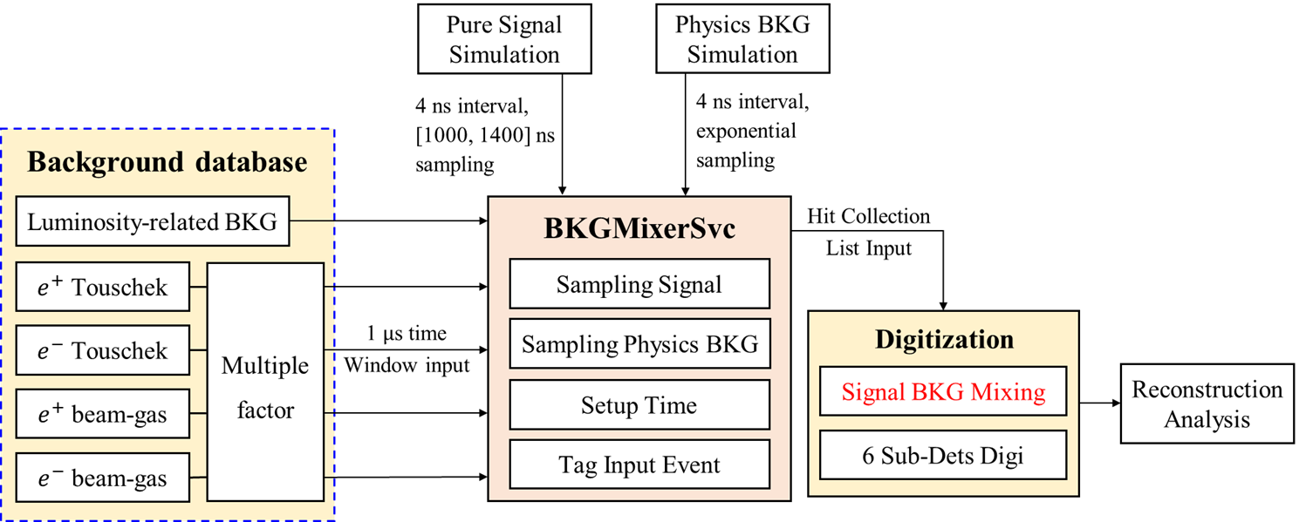
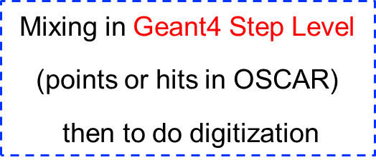
Background mixing
Event mixing with background at the Geant4 step level
  Simulated background particles as input, a unified algorithm applied to each sub-detector.
Raw hit data digitized to be same as the detector measurement
Considering electronic response, noise and other effects, as input for reconstruction and analysis
Another Mixing Framework
  Some or all hits mixing in digi. hit level, pre-digitize the Bkg raw hit to produce a Bkg digi. Database
  One order of magnitude time savings, but the digi merge methods is developing

Slide 16

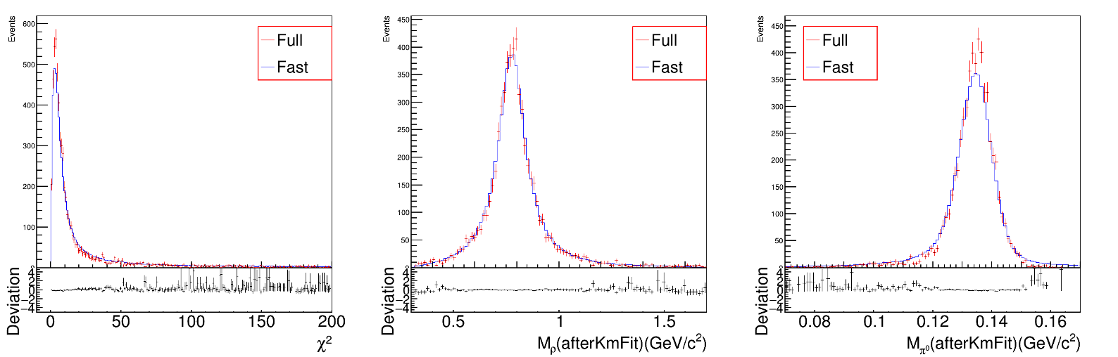
Fast simulation
Parameterizations updated to match detector responses of STCF
Performance checked using multiple channels:
Speed up and storage reduction:
  ~2ms per event, ~2kb storage for a 4prong J/ψ decay event

Slide 17
Tracking performance

Slide 18
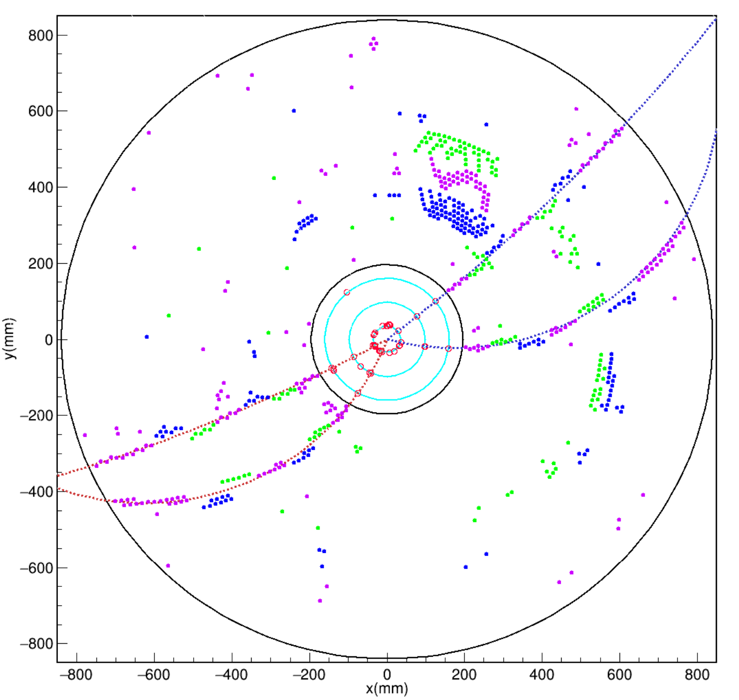
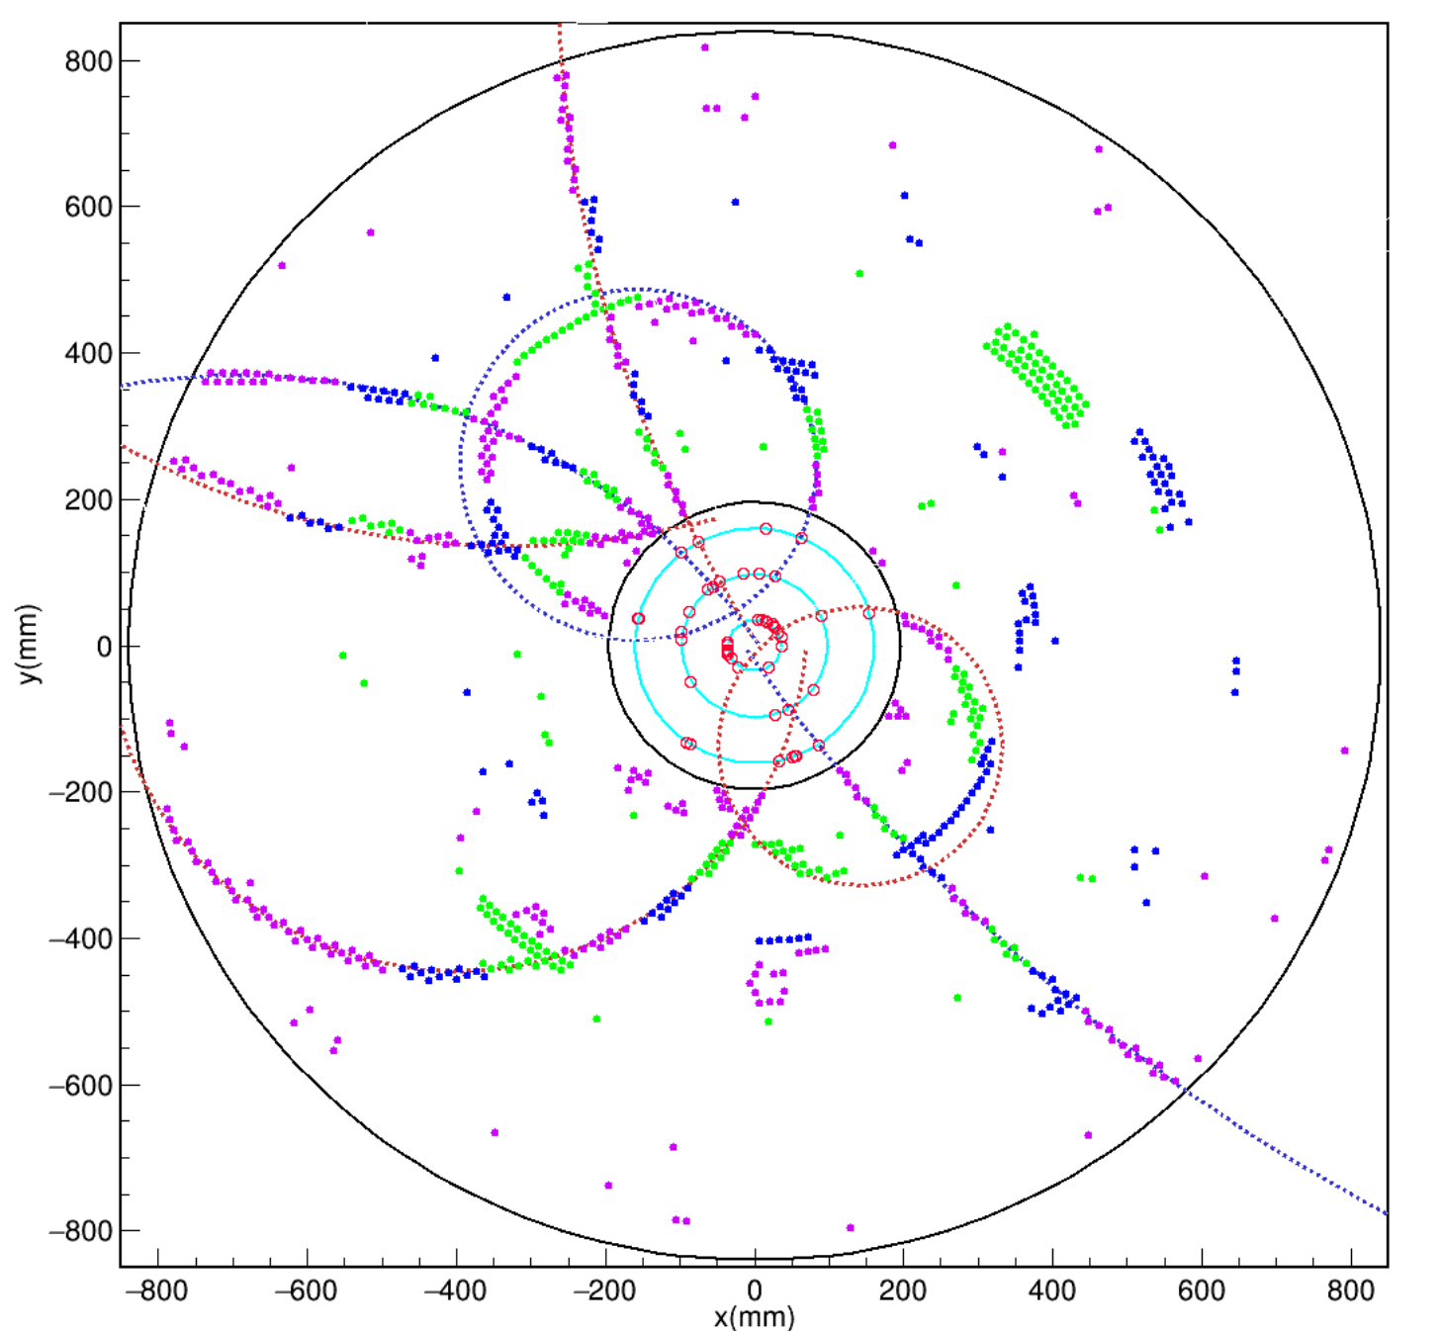
STCF tracking environment
Both prompt and displaced tracks with high beam backgrounds. Most tracks have p_{T} below 500 MeV.

Slide 19
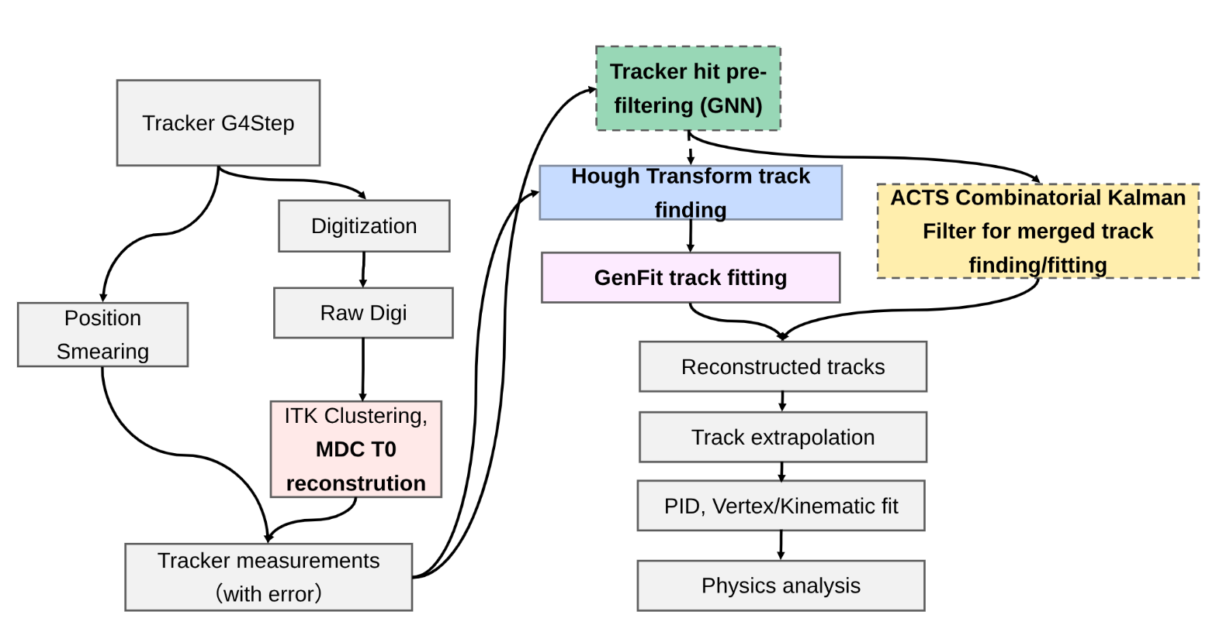
Tracking strategies
Hough transform + GenFit shows decent performance for both prompt and long-lived particles
ACTS is robust against beam backgrounds and superior in terms of CPU consumptions
GNN is very useful in terms of noise removal
H. Zhou et al., NIMA 1075, 170357 (2025)
H. Li et al., NUCL SCI TECH 36, 171 (2025)
X. Jia et al., Noise Filtering Algorithm Based on Graph Neural Network for STCF Drift Chamber (submitted to JINST)
More details in talks of H. Zhou, Z. N. Lu , H. Li and H. K. Mo this afternoon

Slide 20
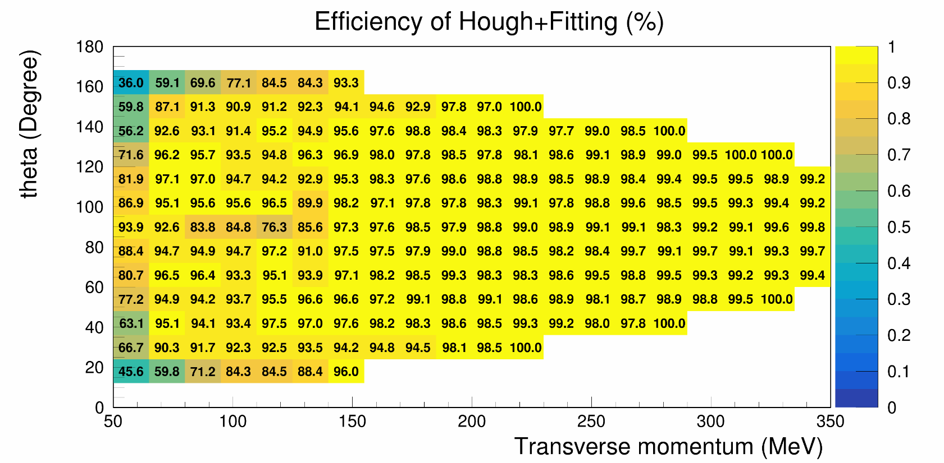
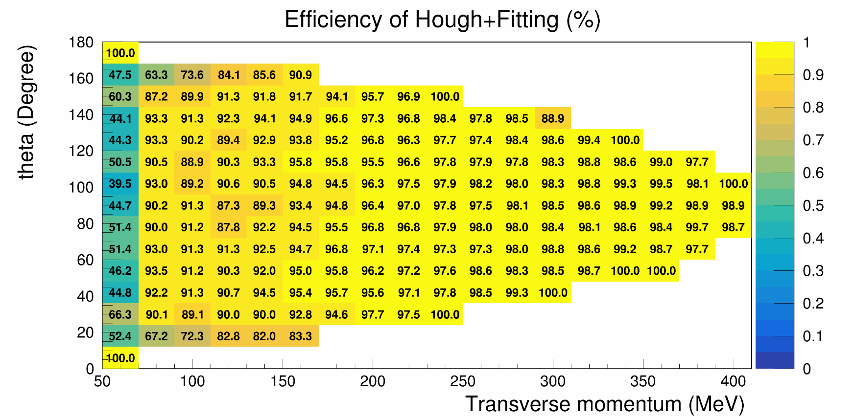
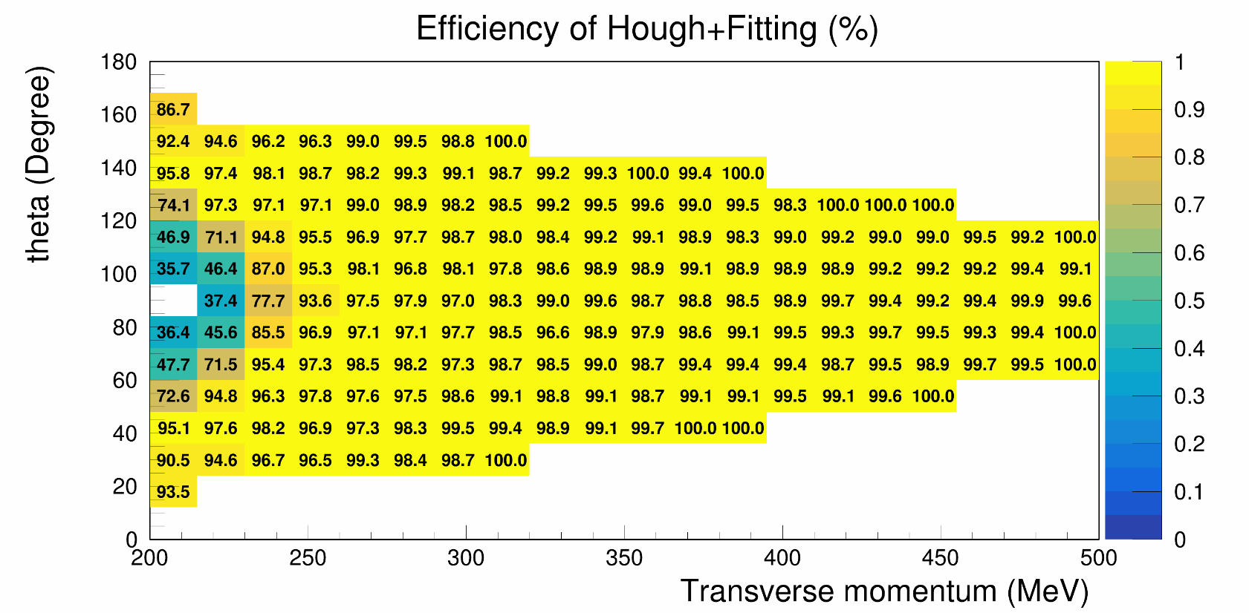
Tracking efficiency for prompt tracks
ITKM + MDC, W/ bkg, p in [50-350] MeV
Tracking performance for prompt tracks has been well consolidated
  Except detector edge, >90% tracking efficiency for p_{T} > 75 MeV
single e-
ITKM + MDC, W/ bkg
ITKM + MDC, W/ bkg, p in [30, 350] MeV
single proton

Slide 21
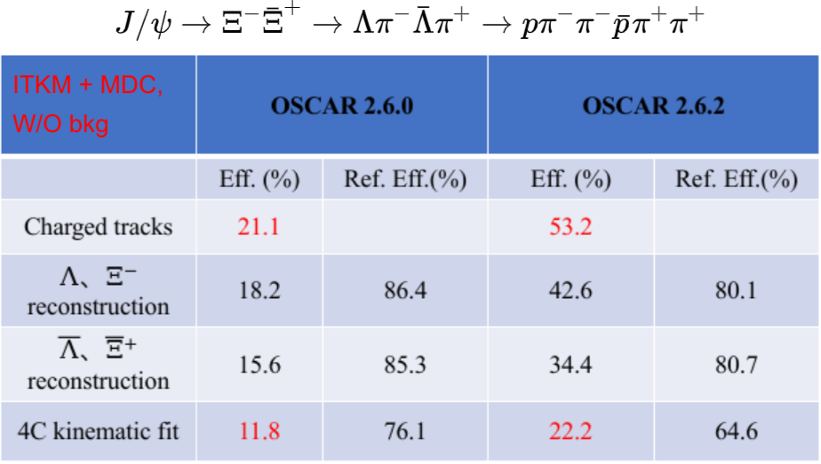
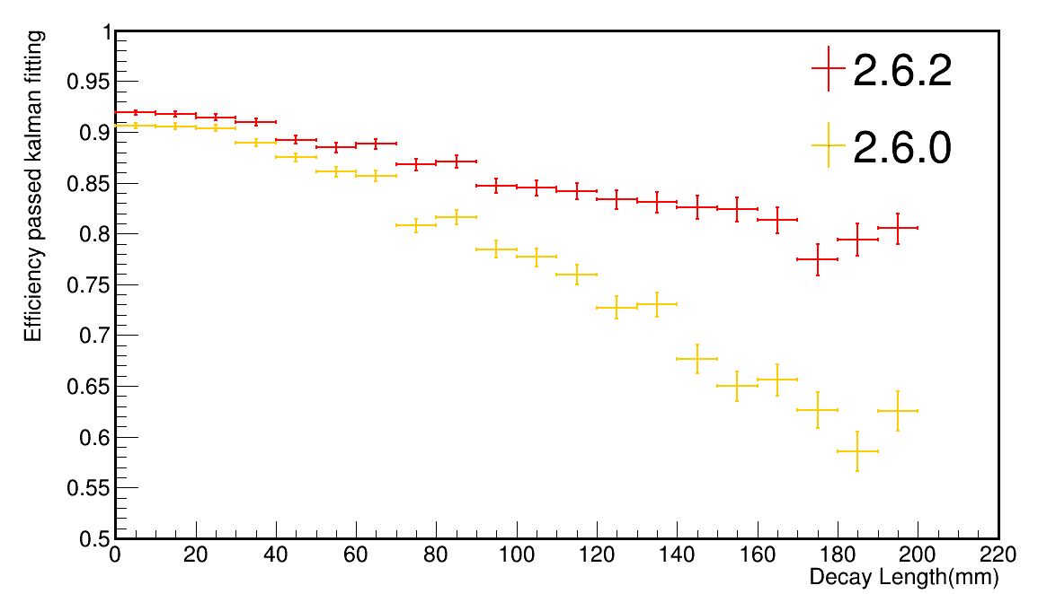
Tracking efficiency for displaced tracks
Much improved performance for long-lived particle (Lambda, Xi) products even in a complex scenario with low p_{T} and displaced tracks
  Addressing the issue by using additional Hough transfrom with displaced segment position as reference point
  >80% track efficiency with decay length up to 200 mm

Slide 22
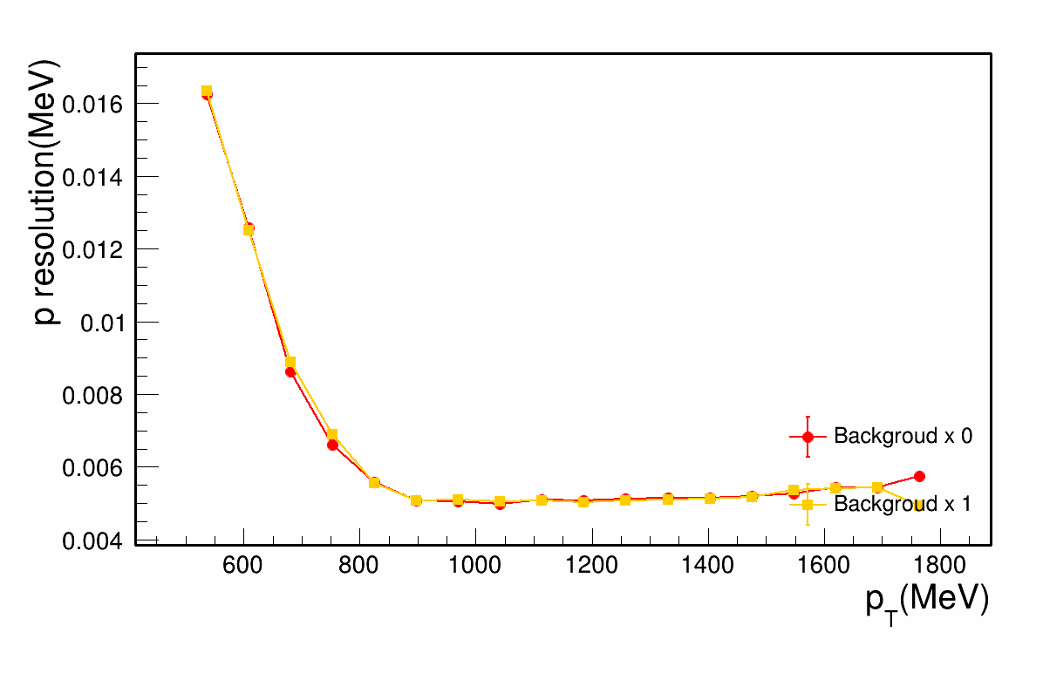
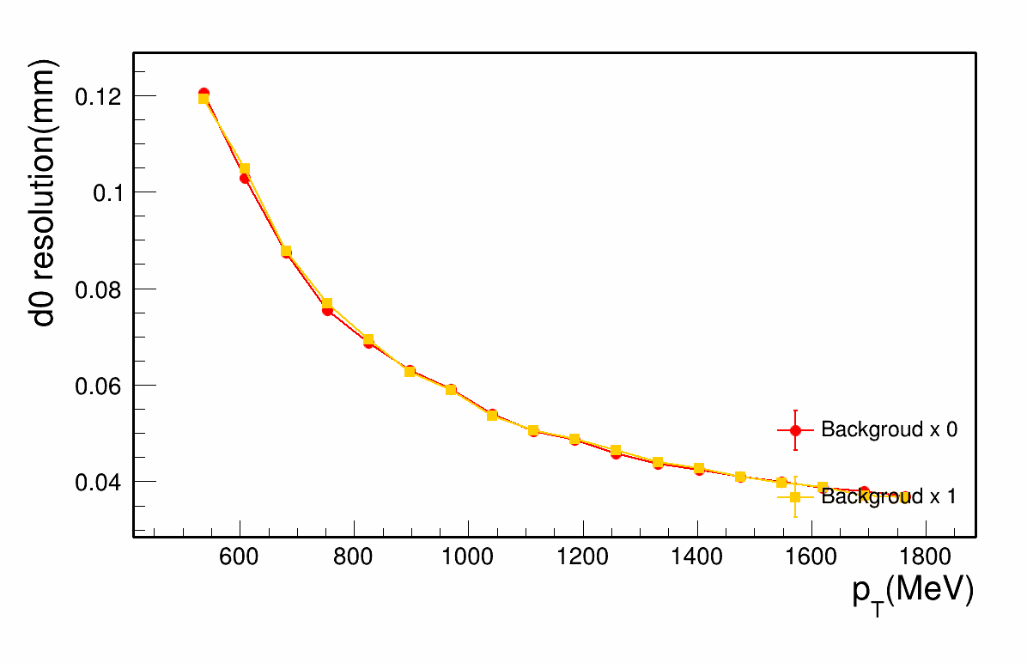
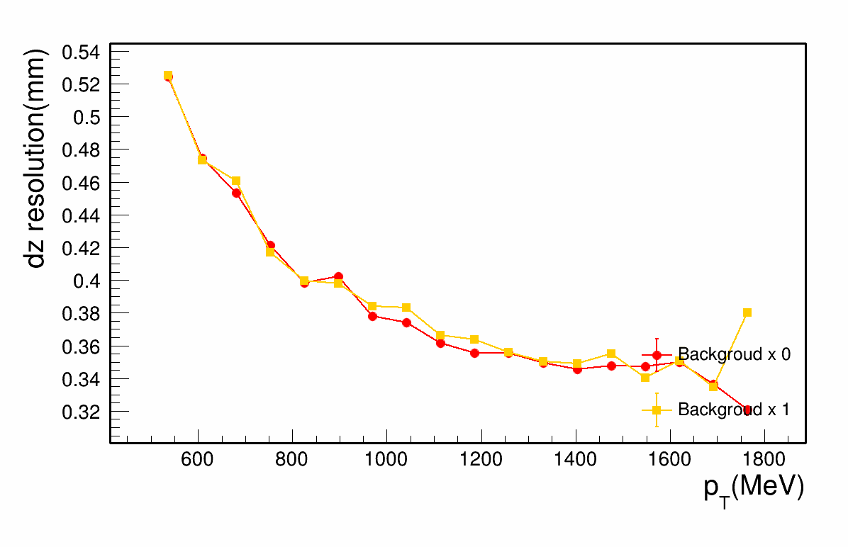
Tracking parameters resolution
p relative resolution is ~0.5% at p_{T} = 1 GeV
d0 (z0) has resolution down to 40 (350) um with p_{T} > 1.5 GeV
ITKM + MDC
ITKM + MDC
ITKM + MDC

Slide 23
Photon performance

Slide 24
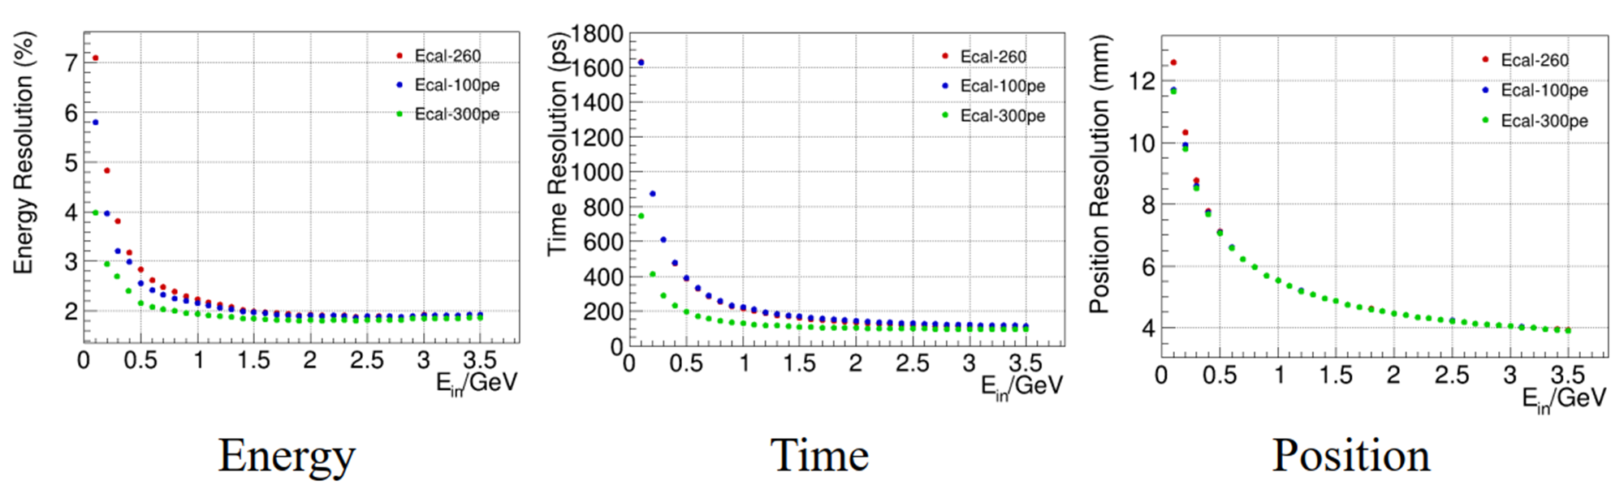
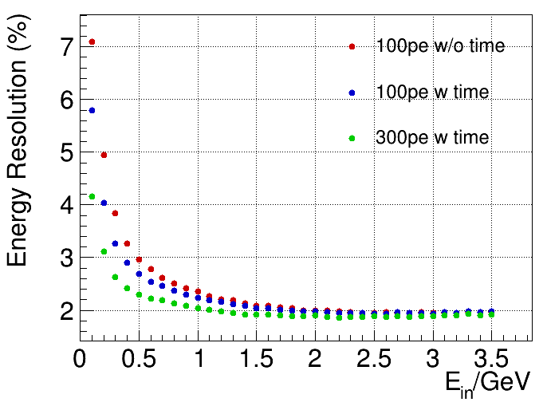
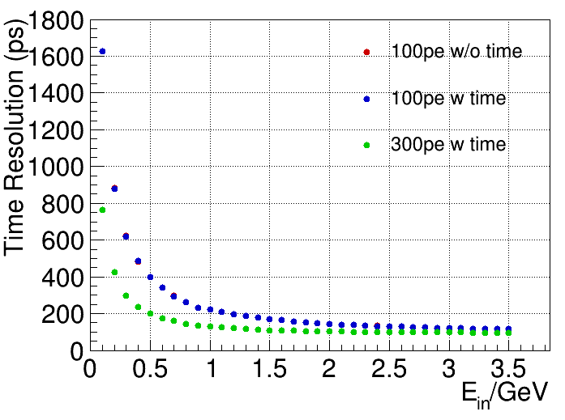
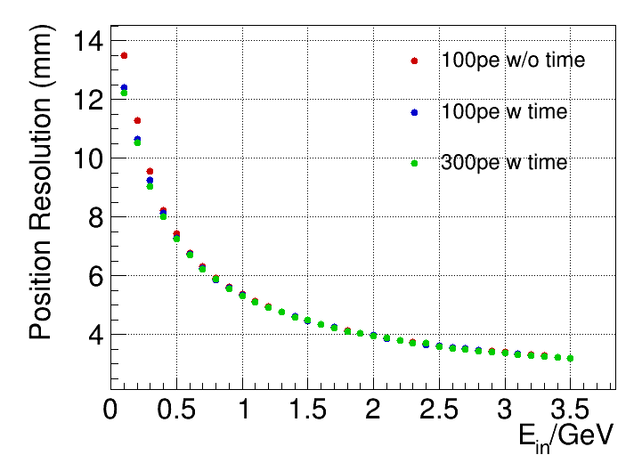
Photon reconstruction performance
EMC digitization algorithm has been optimized with 50% reduction of CPU consumption
Using realistic digitization parameters from beam test results
Single photon energy, time and position resoluton with backgrounds can meet physics requirements

Slide 25

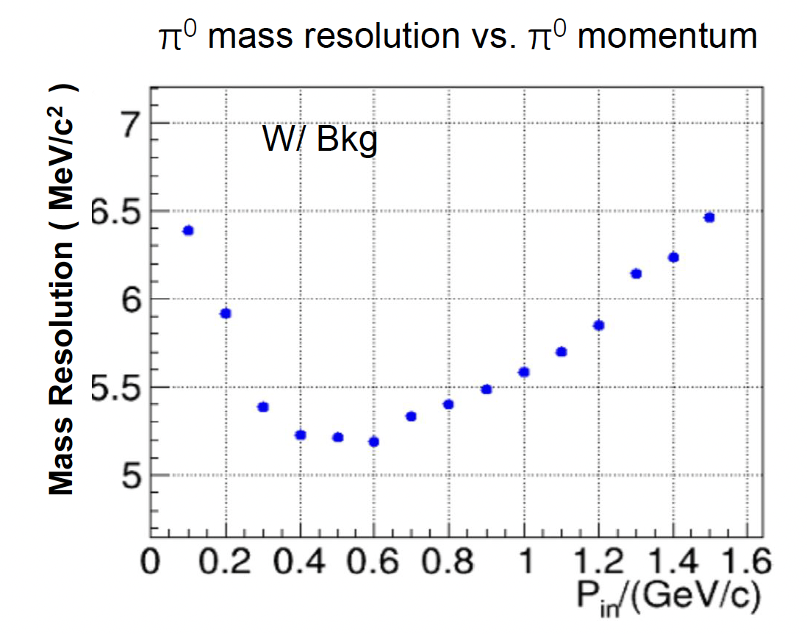
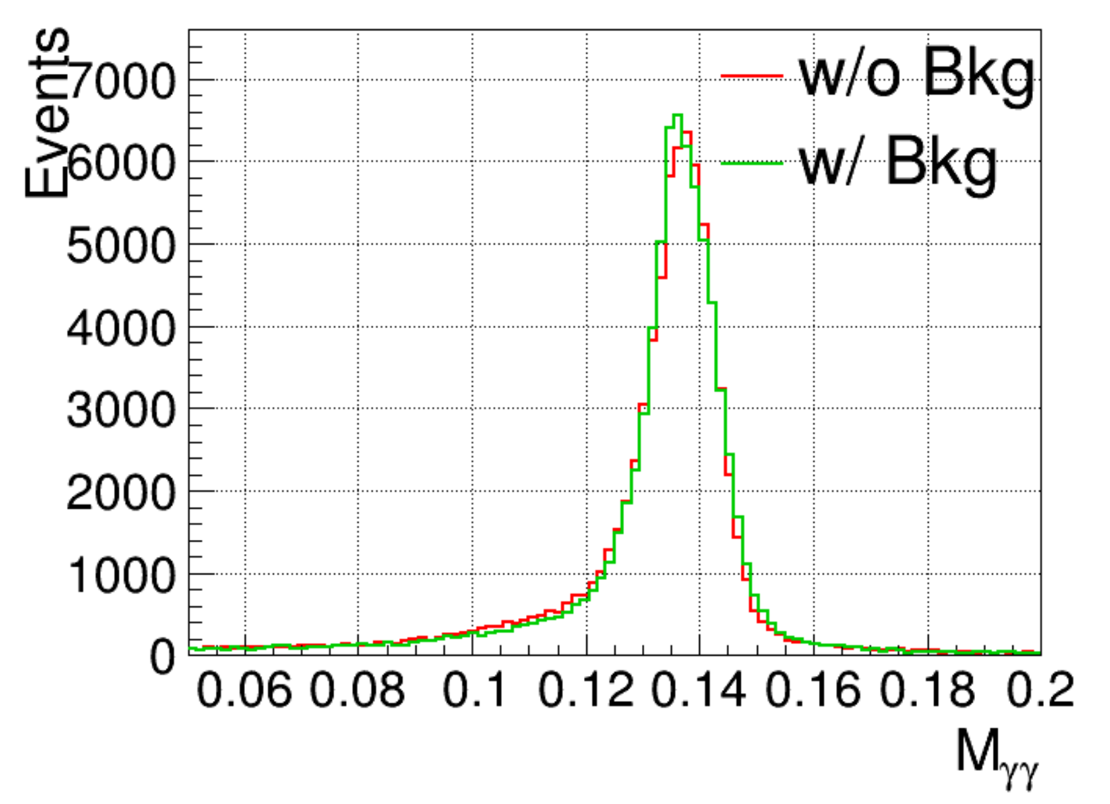
Photon reconstruction performance
Developed 4D EMC clustering algorithm to improve photon resolution against beam backgrounds
  No degration of π⁰ resolution with beam backgrounds
π⁰ mass resolution in

Slide 26
PID performance

Slide 27
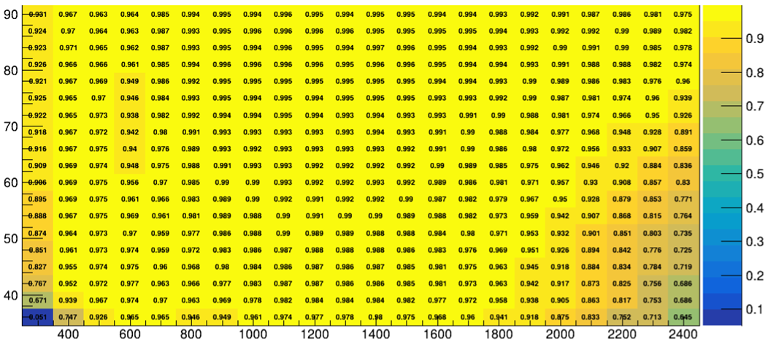
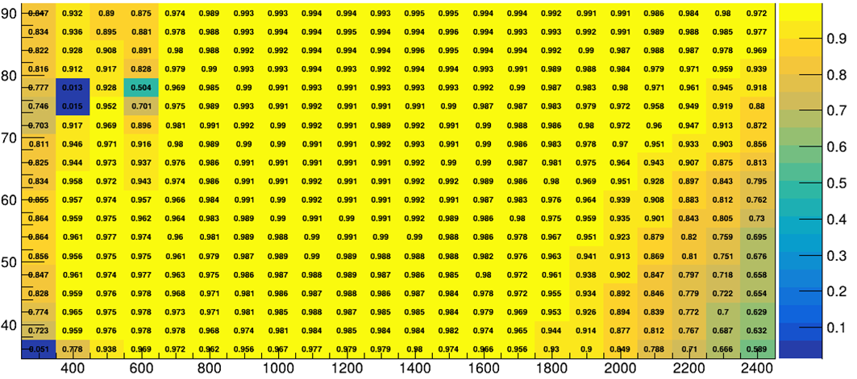
π/K PID performance (RICH)
π/K PID efficiency (PDF reconstrution algorithm_
Developed two new RICH reconstruction algorithms (PDF/thetaC reconstruction algorithms) ，achieving >97% π eff @ K mis-ID=2%
  PDF：better performance
  θc reconstruction：low CPU cost
π/K PID efficiency (θc reconstrution algorithm)
Notes:
BTOF has better performance at small theta but poorer performance at larger theta than RICH?

Slide 28
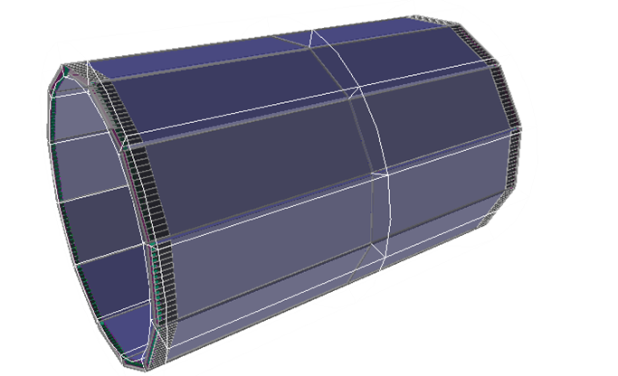
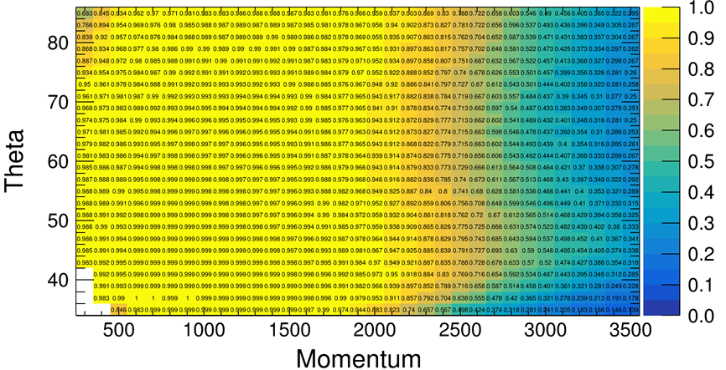
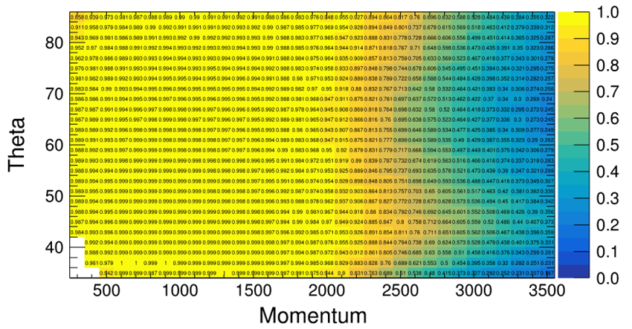
π/K PID performance (BTOF)
Developed the full simulation, digi and reco chain for BTOF (geometry parameters is under optimization), the performance fufills the STCF requirement (>97% π eff @ K mis-ID=2%)
TODO：optimize design to improve performance
Notes:
Better performance at low momentum and high Theta?

Slide 29
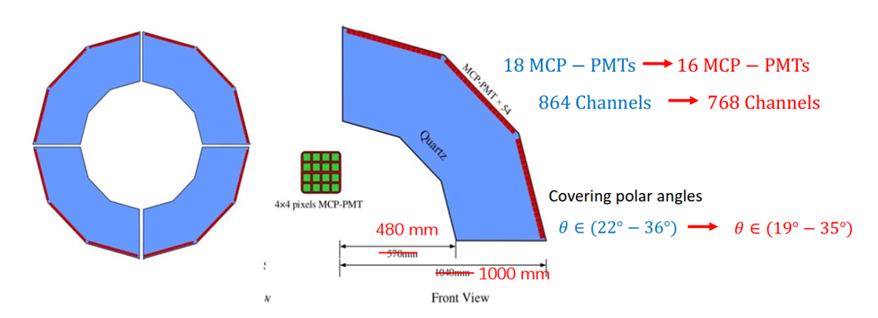

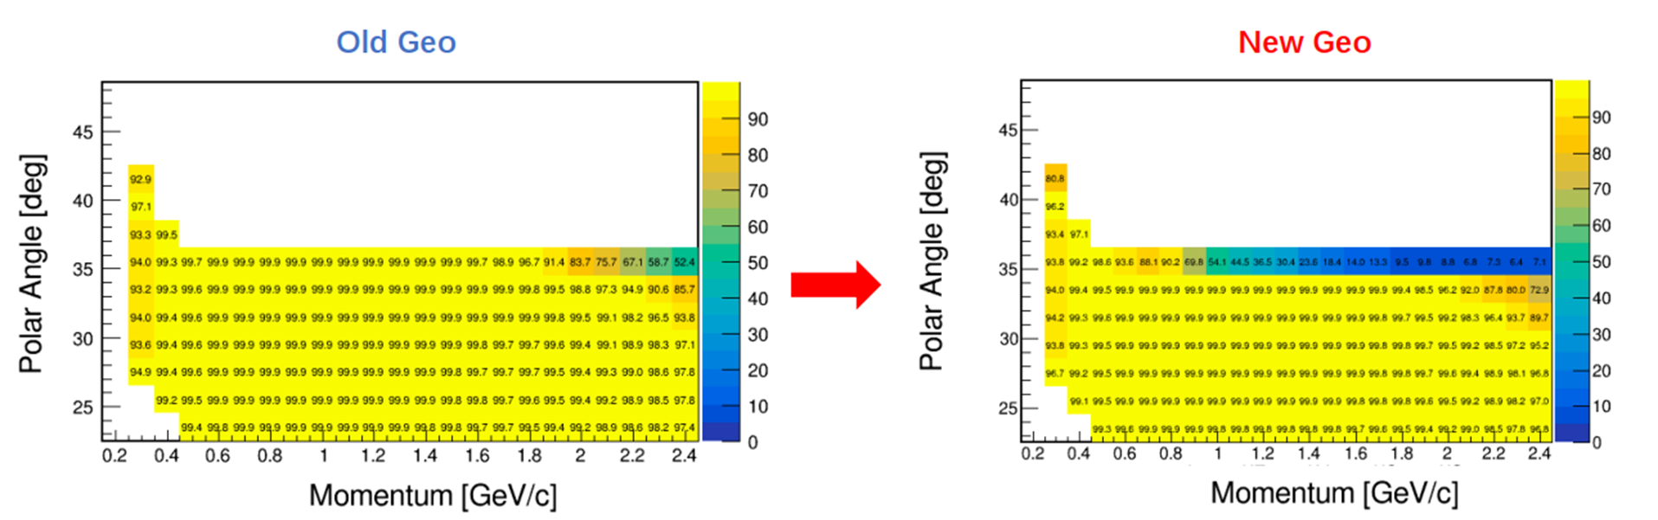
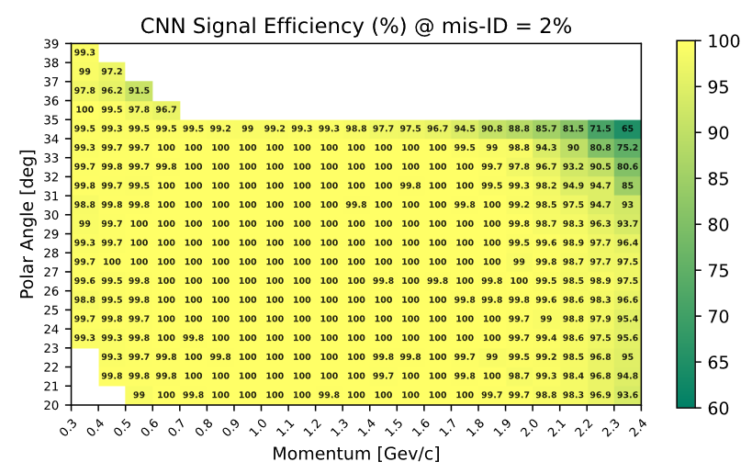
π/K PID performance (DTOF)
Performance with optimized geometry is validated
CNN is deployed to improve the performance in region with large theta and momentum
Imaging method
CNN

Slide 30
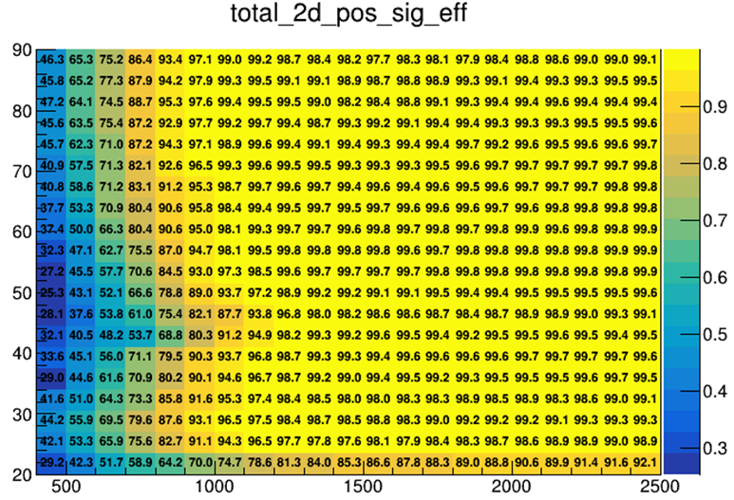
μ/π PID performance (MUD)
Obtained μ/π identfication efficiency using BDT on top of realistic simulation and digitization
  μ efficiency is above 95% @suppression = 30 with momentum above 1 GeV in barrel region
  Detector geometry is under optimization to improve the performance in barrel-endcap transition region
Identfication between neutral hadron (n, K_{L}) and photon is being optimized
Polar Angle [deg]
Momentum [GeV/c]

Slide 31
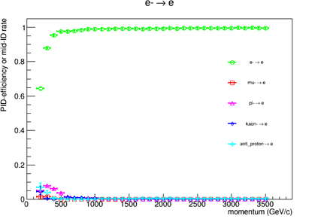
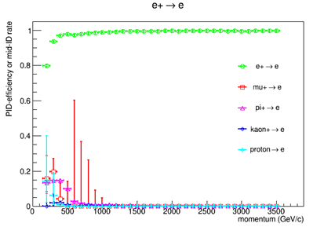
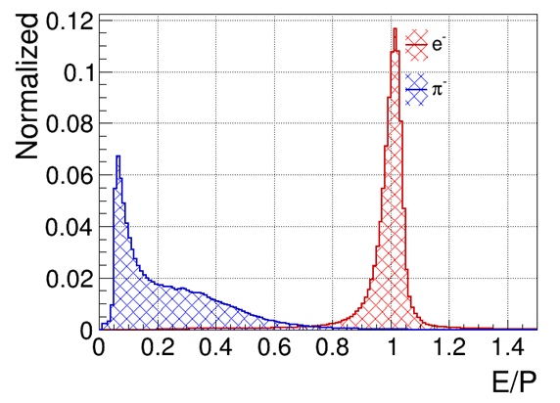
Electron PID (EMC)
E/P Ratio
  E: Energy of ECAL Shower
  P: Momentum from Track
  L(e)=ln(e)+0.001; L(other)=ln(other)+0.001
  Poor performance in low-momentum
BDT Methd
  Input variables: charge, P, E, E/P, T, |R_ext-R_shower|, N_hits, E_seed/E_shower, (E_3x3-E_seed)/E_shower, (E_5x5-E_3x3)/E_shower, second moment, kateral moment, A20 moment, A42 moment
  Distinguishing electrons from other charged particles
  Finally BDT Method used

Slide 32
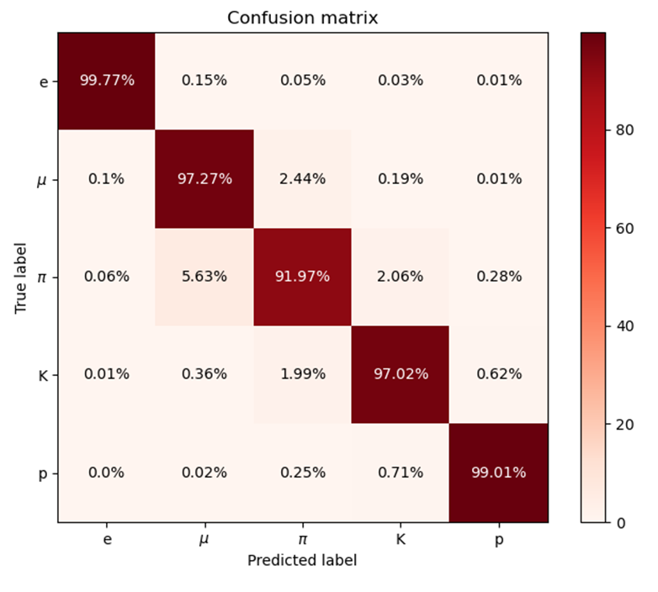
BDT-based global PID performance
Increased μ/π identification (μ±:+2.3%, π±:+6.17%) with updated BDT training:
    Larger statistics
    Added MUD information
  ~ 100% identification efficiency for e and proton
  >95% efficiency for K
  > 90% efficiency for μ ( >95% with momentum above 1.5 GeV)
  >90% efficiency for π in most regions

Slide 33
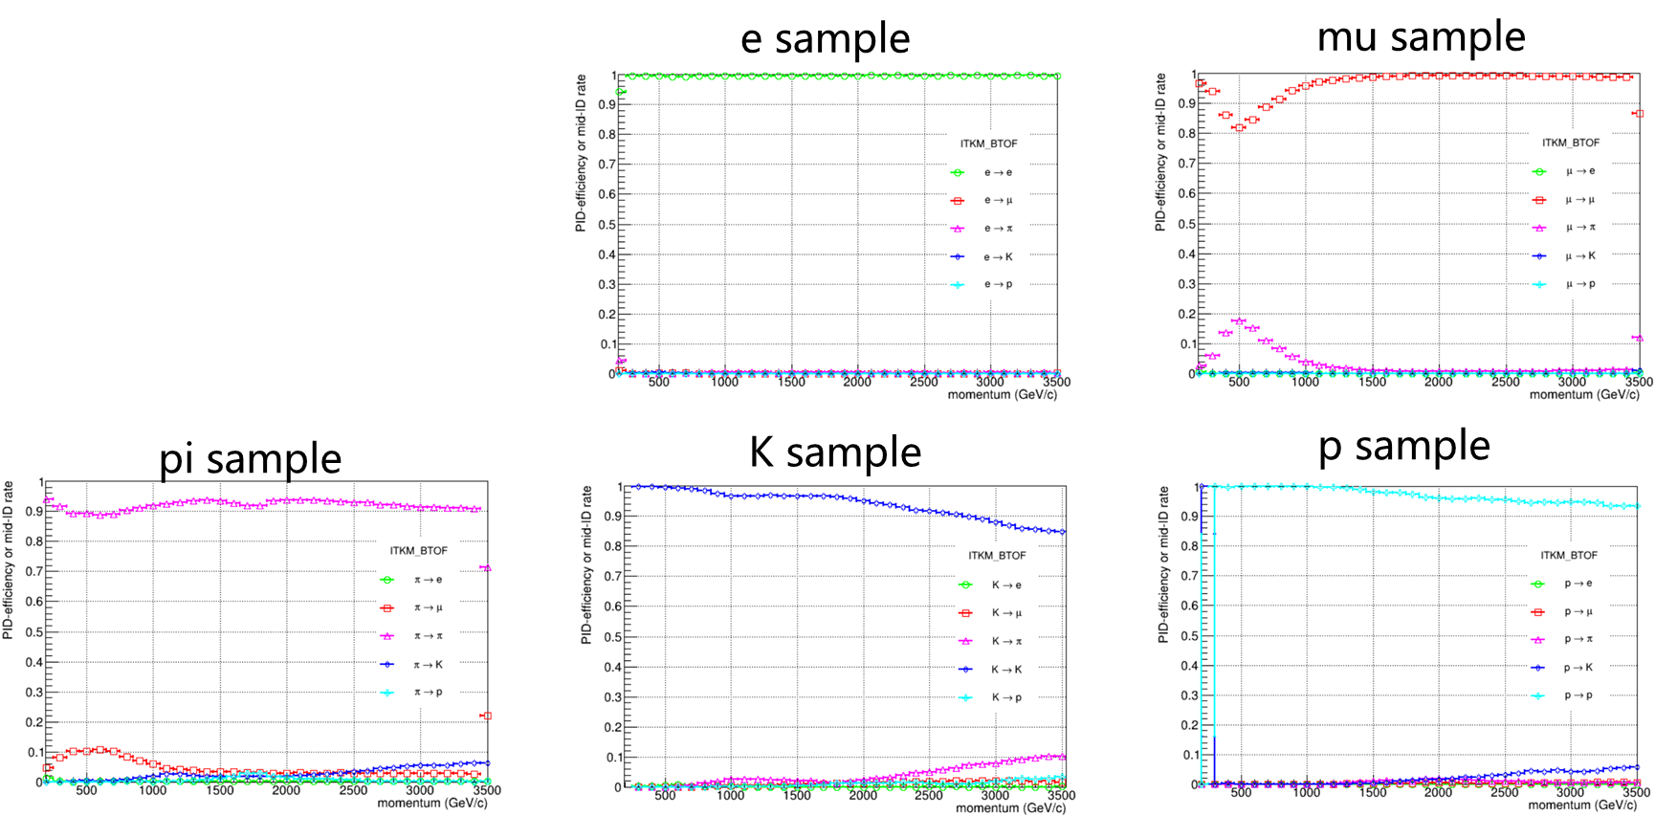
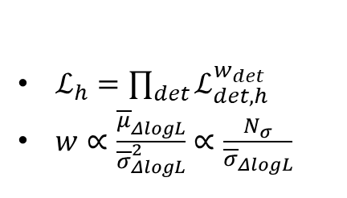
Traditional global PID performance
A combined likelihood with weight was applied to integrate all PID information.
Different PID information is assigned different weights in different pairwise particle comparisons.

Slide 34
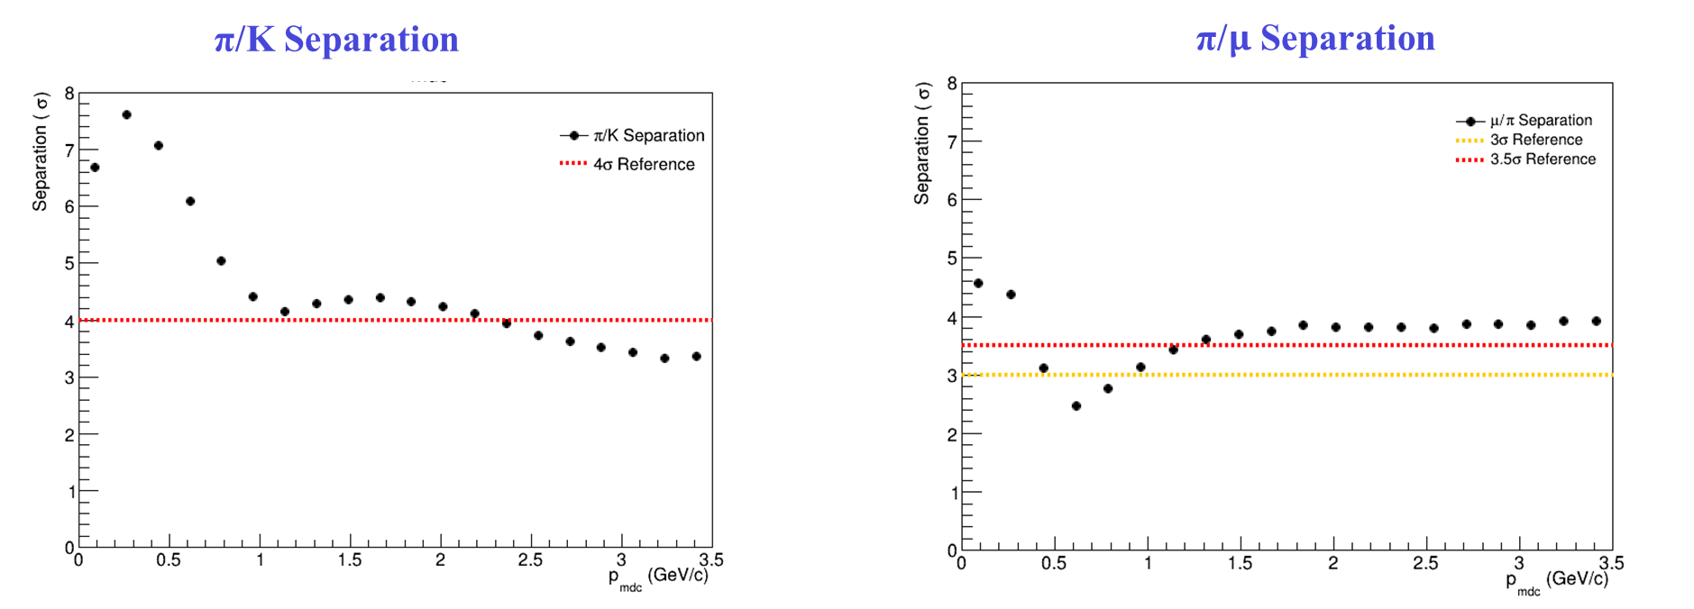
BDT-based global PID performance
The separation power of particle identification in different PID modes：
P < 2 Gev/c : Separate power >4σ
All range of momentum: Separation power > 3σ
P > 1 Gev/c: Separate power >3σ
P > 1.5 Gev/c: Separation power > 3.5σ

Slide 35
Analysis

Slide 36




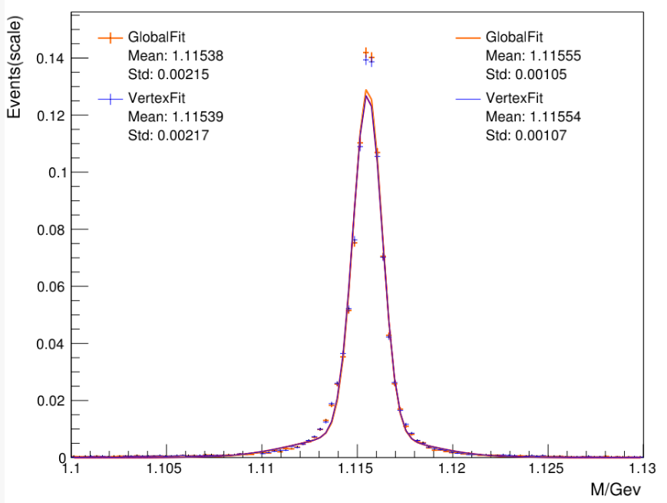


Vertex fit performance
Designed and developed the GlobalFit package for STCF based on the global vertex fitting algorithm of Belle II, showing better performance than previous vertex fit package (i.e. VertexFit) imported from BESIII
  Slightly better mass resolution $Λ/\overline{Λ}$ for and 1% higher efficiency
  Improved $Σ/\overline{Σ}$ resolution by including constraint for decayed photon vertex using ECAL information in the fit
Mean and RMS values
Parameters from
Gaussian fitting
Mean and RMS values
Parameters from
Gaussian fitting

Slide 37






RDataFrame analysis
The physical analysis results of process using 10 million events are consistent with the traditional methods.
Select the dataset and submit the job to test running time. The running speed of 16 parallel threads is 14 times that of the traditional method.
Higher performance will be achieved with the analysis EDM
dataset
total number of events
total size | 169GB
number of events per file
size per file | 3.38GB

Slide 38
Summary

Slide 39


STCF offline software status

Slide 40
STCF offline software status
Tasks |  |  |  | ITKW | ITKM | MDC | BTOF | RICH | DTOF | EMC | MUD
Simulation
Bkg mixing
Digitization
Reconstruction | Charged tracks
 | dE/dx
 | Photon
 | T0
PID | sub-detector PID
 | global PID | ML-based | Charged
 |  |  | Neutral
 |  | Likelihood-based | Charged
 |  |  | Neutral
Analysis | Vertex fit, Kinematic fit
Detector optimization
Event display
Calibration&Alignment
CPU&disk optimization
good state
under
optimization
Under
development
Irrelevant

Slide 41
Summary
Refined detector simulation and digitization for all subdetectors
Tracking performance for prompt tracks has been consolidated and that for long-lived particles has been much optimized
  >80% track efficiency with decay length up to 200 mm
Improved π/K and u/π performance
  π/K performance fulfills the STCF requirement (>97% π eff @ K mis-ID=2%)
  μ efficiency is above 95% @suppression = 30 with momentum above 1 GeV in barrel region
Developed and optimized STCF-dedicated global vertex fit package with better performance
  Better long-lived particle resolution and efficiency
Much improved CPU consumption and disk space, which are comparable to BESIII
Held first STCF software tutorial and developer‘s hackathon in Feb. 2025
Ongoing detector optimization and physics simulation for finalizing TDR

Slide 42
Thanks for your attentions!
Many thanks to all people of the software group!

Slide 43
backup

Slide 44





BDT-based global PID performance
Only dE/dx works at momentu below 100 MeV, and has poor performance for distinguishing between e and μ
Both dE/dx and MUD have relatively worse performance for distinguishing between π and μ in this region
e identification against K/μ/p/π
proton identification against e/K/μ/π
K identification against e/μ/p/π
π identification against e/K/μ/p
μ identification against e/K/p/π

Slide 45


Slide 46


STCF tracking environment
Both prompt and displaced tracks. Most tracks have pT below 500 MeV.
ITKW + MDC
ITKW + MDC

Slide 47
backup

Slide 48

Global PID
GlobalPID在OSCAR262下更新模型权重
基于OSCAR262的模拟和重建结果（ITKM+BTOF）
ParticleGun模拟产生单粒子MC数据
统计量(e±,μ±, π±, K±, p±) ：3^106
p∈(0.03,3.5)Gev/c,𝜃∈(0°,180°)，𝜑∈(0°,360°)
拉平处理
  Momentum(GeV/c):0 to 3.5 GeV/c, with 14 bins
  Angle (𝜃):-1to 1, with 20 bins
  Charge Distribution:Charge- : Charge+ = 1:1
  Number of particles in each bin :2000
增加MUD输入信息，muon/pion鉴别效率增加：μ±:+2.3%, π±:+6.17%

Slide 49
Global PID
模型性能
Election Sample ：动量大于400Mev，具有~100%的鉴别效率

Slide 50
Global PID
模型性能
Muon Sample ：高动量的muon鉴别，具有~100%的鉴别效率

Slide 51
Global PID
模型性能
Pion Sample

Slide 52
Global PID
模型性能
Kaon Sample

Slide 53

Global PID
模型性能
Proton Sample

Slide 54

Global vertex fit
Design and develop the GlobalVertexFit package for STCF based on the global vertex fitting algorithm of Belle II,the basic structure of the package is as follows:
The global vertex fitting algorithm constructs state vectors for all particles in the decay chain, including intermediate states.
Compared to traditional vertex fitting methods, it makes more comprehensive use of reconstruction information and ensures that the updated parameters after kinematic fitting can be consistently used in subsequent iterations of vertex fitting.

Slide 55


Global vertex fit
It gives a slight improvement to the invariant mass resolution of long-lived particles after fit, and achieves a 1% higher efficiency compared to the traditional method under the same event selection criteria.
Invariant mass of
Invariant mass of
Parameters after
Gaussian fitting
Parameters after
Gaussian fitting
GlobalVertexFit selection efficiency：44.303% VertexFit selection efficiency：43.15%

Slide 56



Global vertex fit
The traditional vertex fitting algorithm assumes that photons originate from the interaction point.
In contrast, the global vertex fit adds constraints using the vector triangle shown in the right figure, ensuring that photons originate from the decay vertex.This leads to a significant improvement in the resolution of long-lived particles such as the sigma.It also improves the efficiency of event selection.
Invariant mass of
Invariant mass of
Parameters after
Gaussian fitting
Parameters after
Gaussian fitting

Slide 57


Track finding
Improved performance for long-lived particles
共形变换
寻找共形平面上的直线径迹
匹配漂移室斜丝
对远离对撞点处产生的末态粒子效果不佳
新增针对远离对撞点径迹的重建补充算法，未使用或重建质量不佳径迹上的击中作为输入进行二次寻迹
寻找超层内径迹段
坐标变换
共形变换
寻找共形平面上的直线径迹

