Slide 1

STCF对撞环物理设计进展
邹野
代表STCF对撞环加速器物理组
2025年超级陶粲装置研讨会
2025.07.03

Slide 2

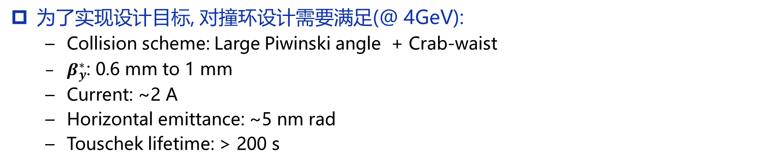
设计目标和挑战
核心设计目标:
  CoM energy: 2-7 GeV
  Luminosity: > 0.5×10³⁵ cm⁻² s⁻¹ @ 4 GeV
为了实现设计目标, 对撞环设计需要满足(@ 4GeV):
  Collision scheme: Large Piwinski angle + Crab-waist
  $β_{y}^{∗}$: 0.6 mm to 1 mm
  Current: ~2 A
  Horizontal emittance: ~5 nm rad
  Touschek lifetime: > 200 s
主要挑战:
  Very strong nonlinear effect: small dynamic aperture and momentum acceptance
  High current, low energy, small emittance: strong collective effect (Touschek effect, IBS, beam-beam, impedance, etc.)
  Interplay of multiple physical processes
  Very short Touschek lifetime: Large beam loss, large background and SC magnets quenching

Slide 3
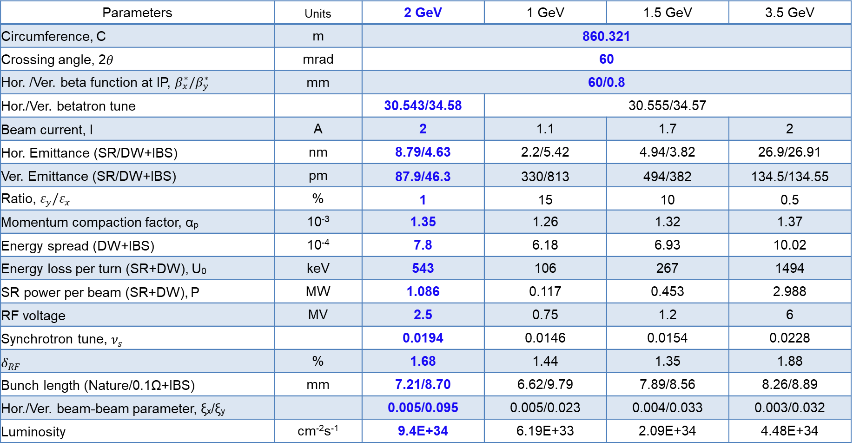
关键参数
Parameters | Units | 2 GeV | 1 GeV | 1.5 GeV | 3.5 GeV
Circumference, C | m | 860.321 |  | 868.719 | 868.719
Crossing angle, 2$θ$ | mrad | 60
Hor. /Ver. beta function at IP, $β_{x}^{∗}/β_{y}^{∗}$ | mm | 60/0.8
Hor./Ver. betatron tune |  | 30.543/34.58 | 30.555/34.57 | 32.555/34.570 | 33.555/34.570
Beam current, I | A | 2 | 1.1 | 1.7 | 2
Hor. Emittance (SR/DW+IBS) | nm | 8.79/4.63 | 2.2/5.42 | 4.94/3.82 | 26.9/26.91
Ver. Emittance (SR/DW+IBS) | pm | 87.9/46.3 | 330/813 | 494/382 | 134.5/134.55
Ratio, $ε_{y}/ε_{x}$ | % | 1 | 15 | 10 | 0.5
Momentum compaction factor, α_{p} | 10⁻³ | 1.35 | 1.26 | 1.32 | 1.37
Energy spread (DW+IBS) | 10⁻⁴ | 7.8 | 6.18 | 6.93 | 10.02
Energy loss per turn (SR+DW), U₀ | keV | 543 | 106 | 267 | 1494
SR power per beam (SR+DW), P | MW | 1.086 | 0.117 | 0.453 | 2.988
RF voltage | MV | 2.5 | 0.75 | 1.2 | 6
Synchrotron tune, $ν_{s}$ |  | 0.0194 | 0.0146 | 0.0154 | 0.0228
$$δ_{RF}$$ | % | 1.68 | 1.44 | 1.35 | 1.88
Bunch length (Nature/0.1Ω+IBS) | mm | 7.21/8.70 | 6.62/9.79 | 7.89/8.56 | 8.26/8.89
Hor./Ver. beam-beam parameter, ξ_{x}/ξ_{y} |  | 0.005/0.095 | 0.005/0.023 | 0.004/0.033 | 0.003/0.032
Luminosity | cm⁻²s⁻¹ | 9.4E+34 | 6.19E+33 | 2.09E+34 | 4.48E+34
Notes:
We have 4 energy point. Luminosity is around 10^35. large momentum compaction and energy spread. Other energy point lower No more than 1 orders of magnitude.

Slide 4
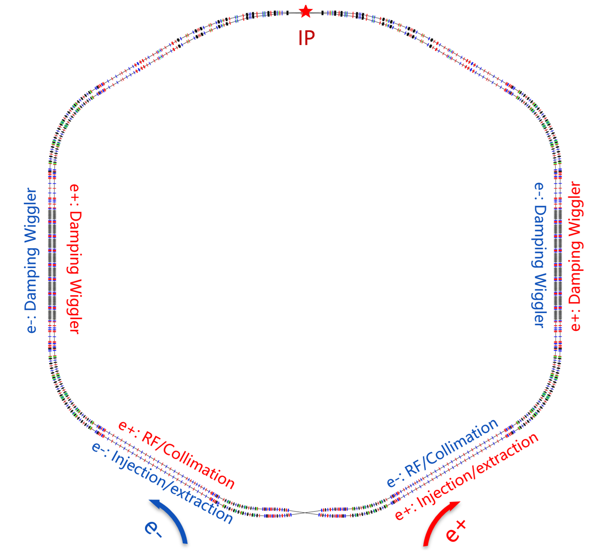
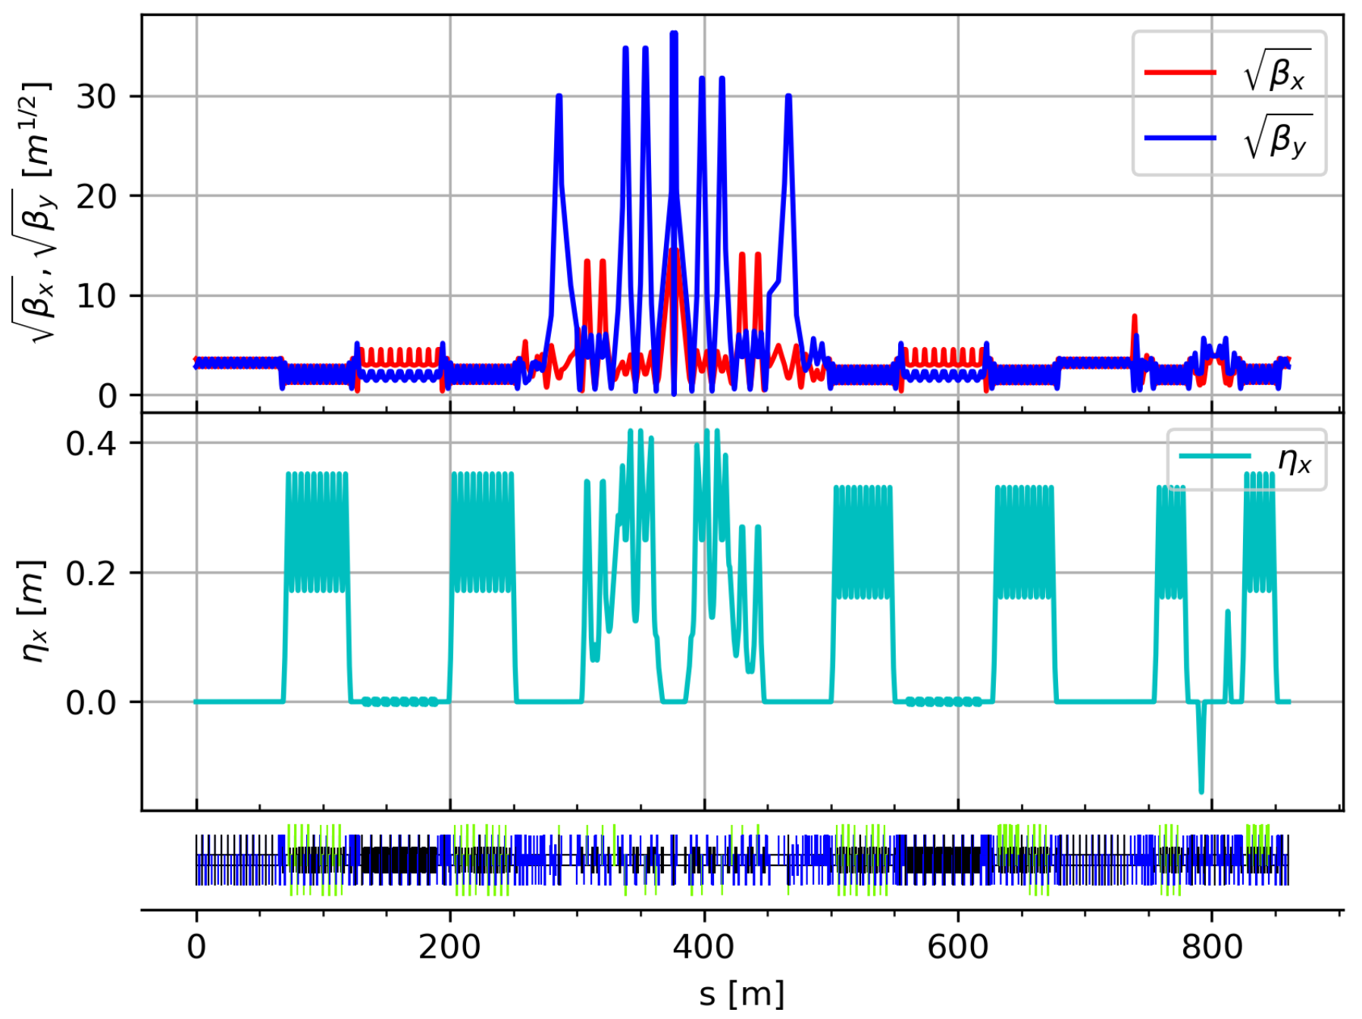

Lattice布局和光学函数 (V4.3)
周长: 860.321 m
对撞区: 2𝜃 = 60 mrad, L* =0.9 m,
  $β_{y}^{∗}$ = 0.8 mm， $β_{x}^{∗}$ = 60 mm
弧区：四个长弧区(60°) 和两个短弧区(30°)
阻尼扭摆器：降低阻尼时间，控制发射度
束流注入：离轴与置换注入，兼容性布局
高频系统：TM020高频腔
束流准直系统：减小本底，保护超导磁铁

Slide 5
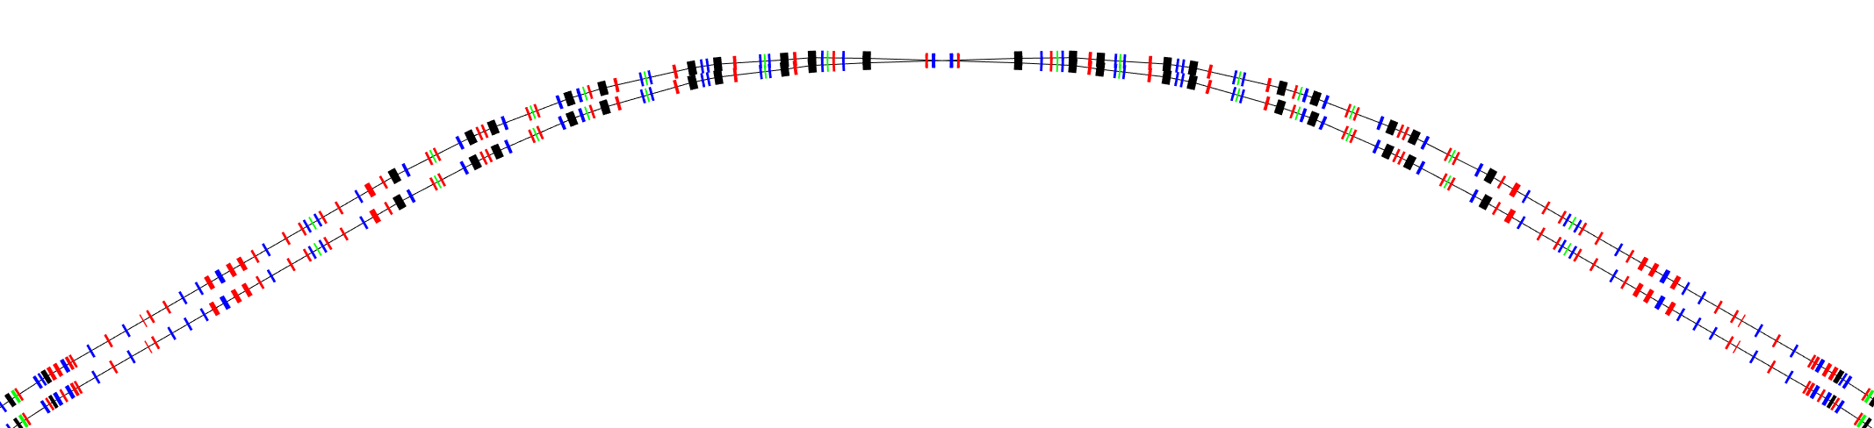
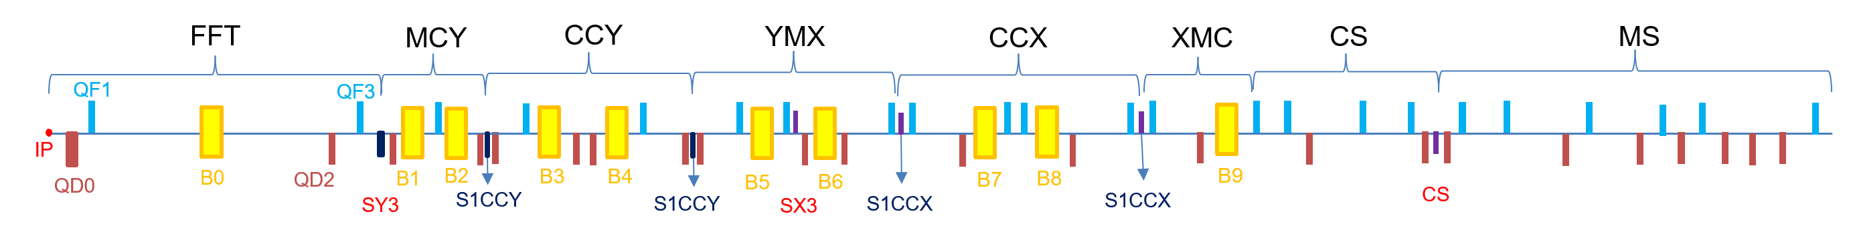


对撞区光学设计
详见张林浩报告
Modular design → flexible for optics adjustment and local chromaticity correction
  Final Focus Telescope (FFT), Chromaticity Correction (CCY、CCX), and Crab Sextupoles (CS)
  FFT: small β function ($β_{y}^{∗}$ =0.8 mm, $β_{x}^{∗}$=60 mm) and bunch size at IP ($σ_{y}$= 190 nm, $σ_{x}$=17 μm)
  CCY/CCX: sextupole pairs, large β, large dispersion, exact –I map →reduce sextupole strength
  CS: phase advance to IP (μ_{𝑥} = 6π, μ_{𝑦} = 5.5π); β_{y}>> β_{x} →reduce sextupole strength (k₂ =16.94 m⁻³)
  IR Bending angle 60°: weak bending magnet (B0) closest to IP, to avoid synchrotron radiation at IP
Crab sext.
Crab sext.
IP
$$K2L=±\frac{1}{2θβ_{y}^{∗}β_{y}}\sqrt{\frac{β_{x}^{∗}}{β_{x}}}$$

Slide 6
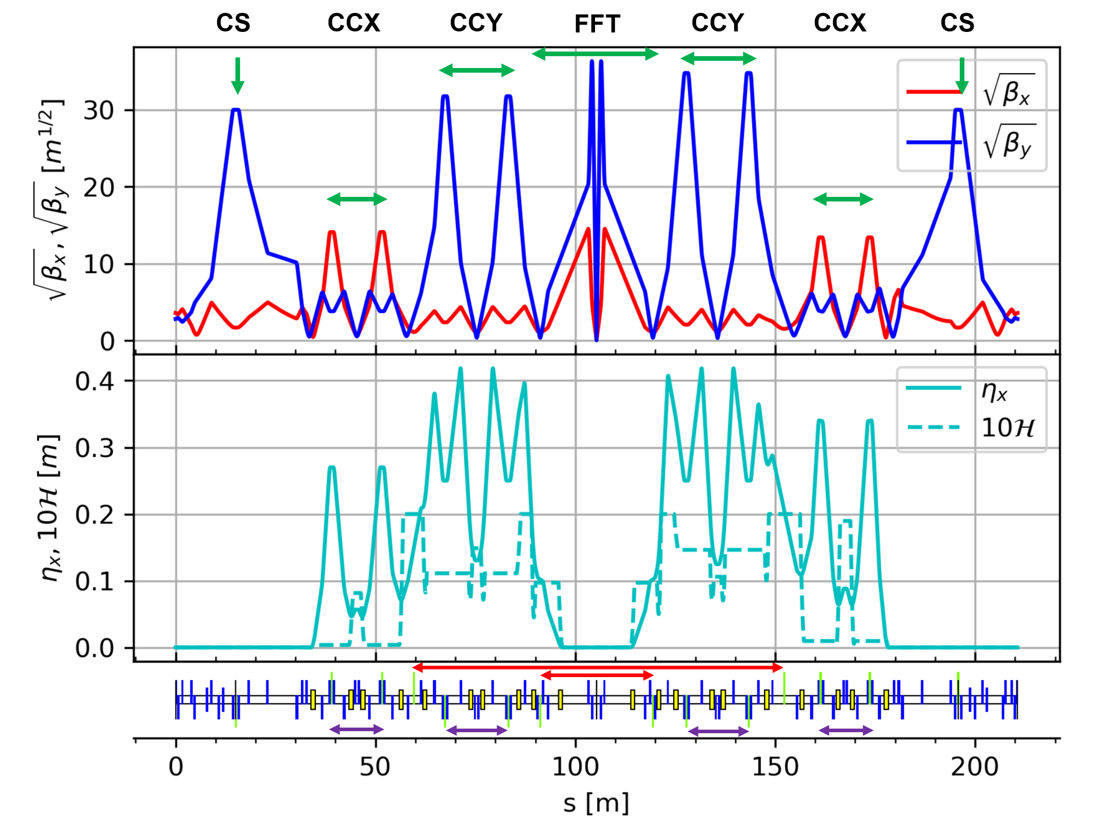
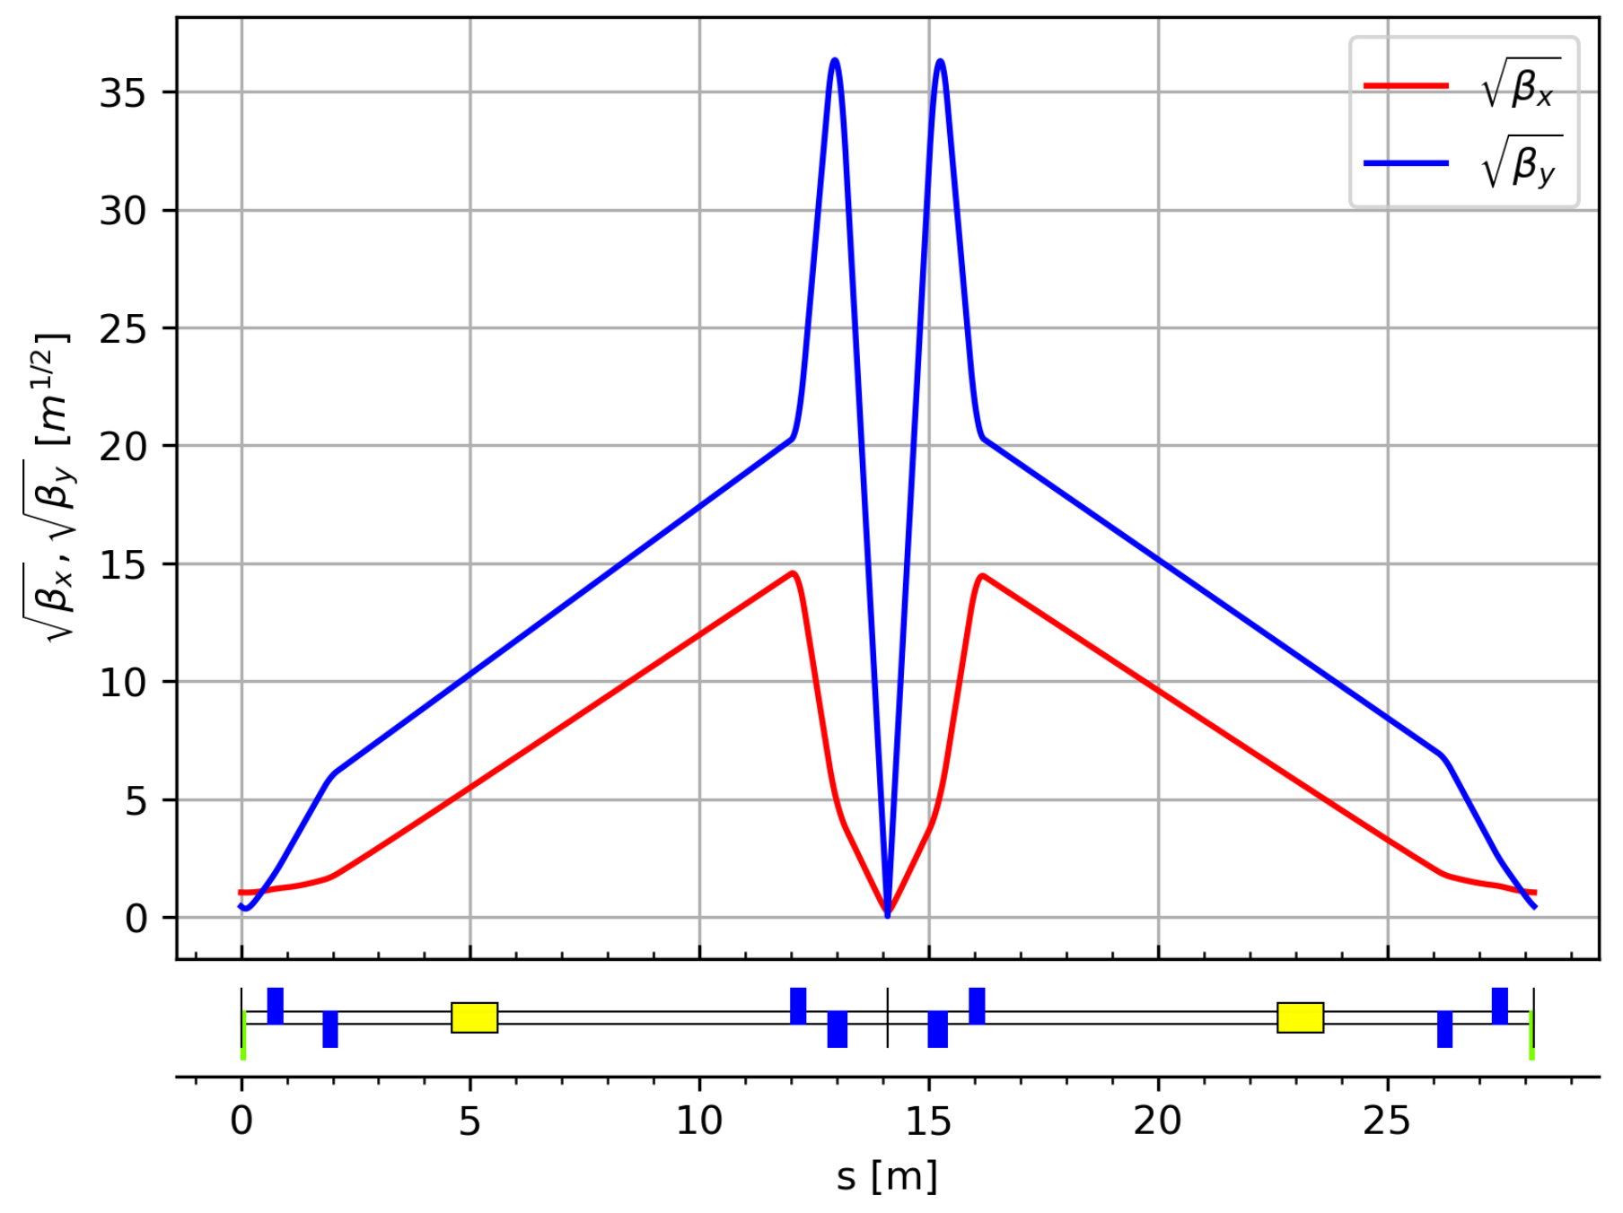

对撞区光学设计
详见张林浩报告
Modular design → flexible for optics adjustment and local chromaticity correction
  Final Focus Telescope (FFT), Chromaticity Correction (CCY、CCX), and Crab Sextupoles (CS)
  FFT: small β function ($β_{y}^{∗}$ =0.8 mm, $β_{x}^{∗}$=60 mm) and bunch size at IP ($σ_{y}$= 190 nm, $σ_{x}$=17 μm)
  CCY/CCX: sextupole pairs, large β, large dispersion, exact –I map →reduce sextupole strength
  CS: phase advance to IP (μ_{𝑥} = 6π, μ_{𝑦} = 5.5π); β_{y}>> β_{x} →reduce sextupole strength (k₂ =16.94 m⁻³)
  IR Bending angle 60°: weak bending magnet (B0) closest to IP, to avoid synchrotron radiation at IP
Final Focus Telescope

Slide 7
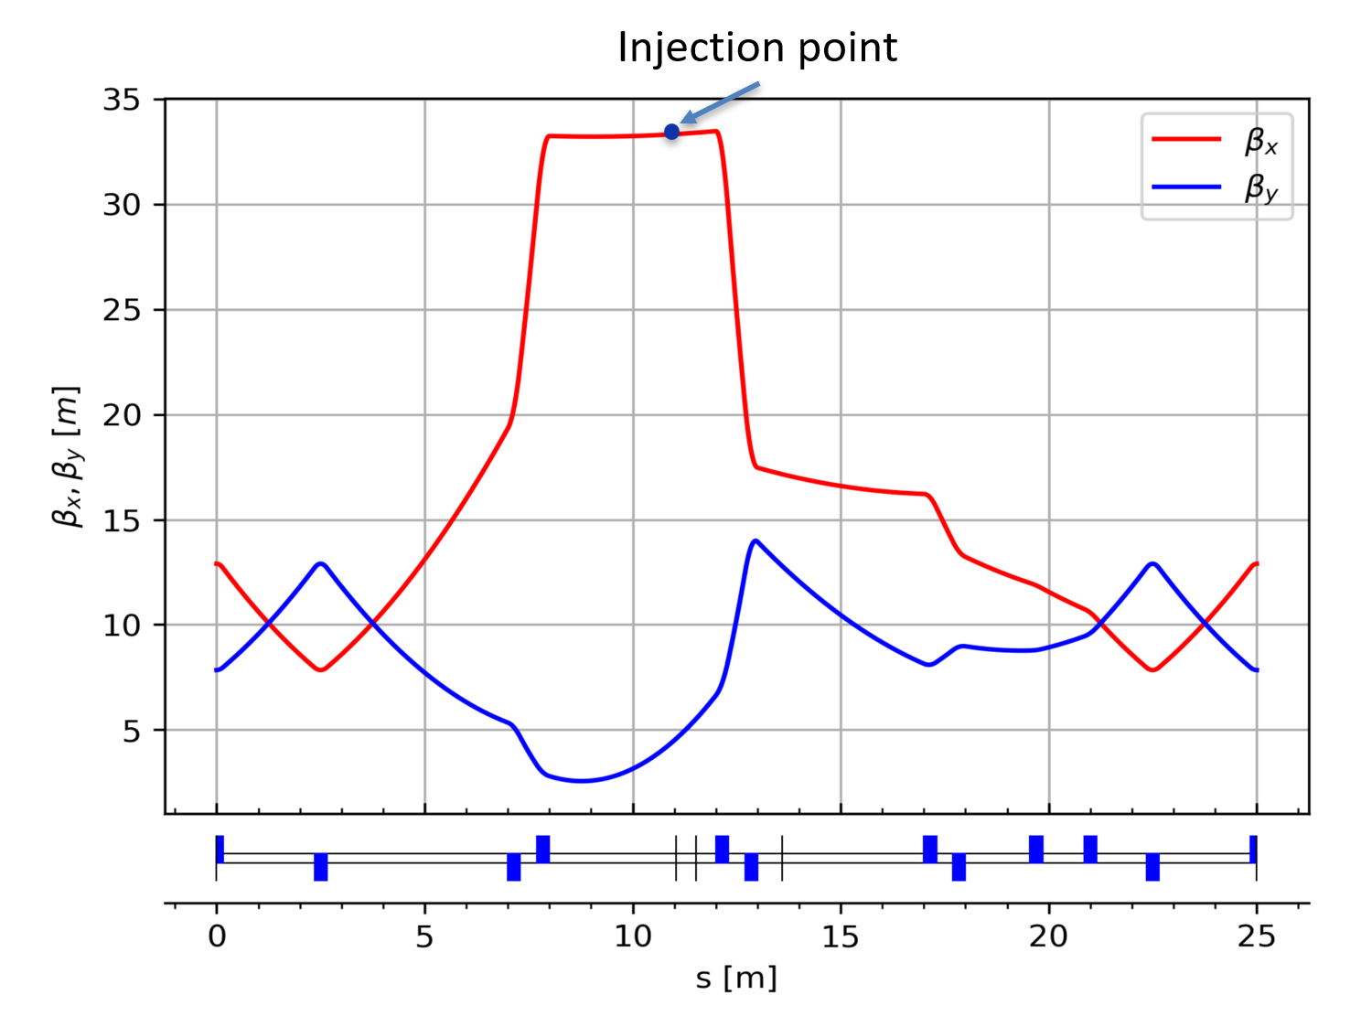
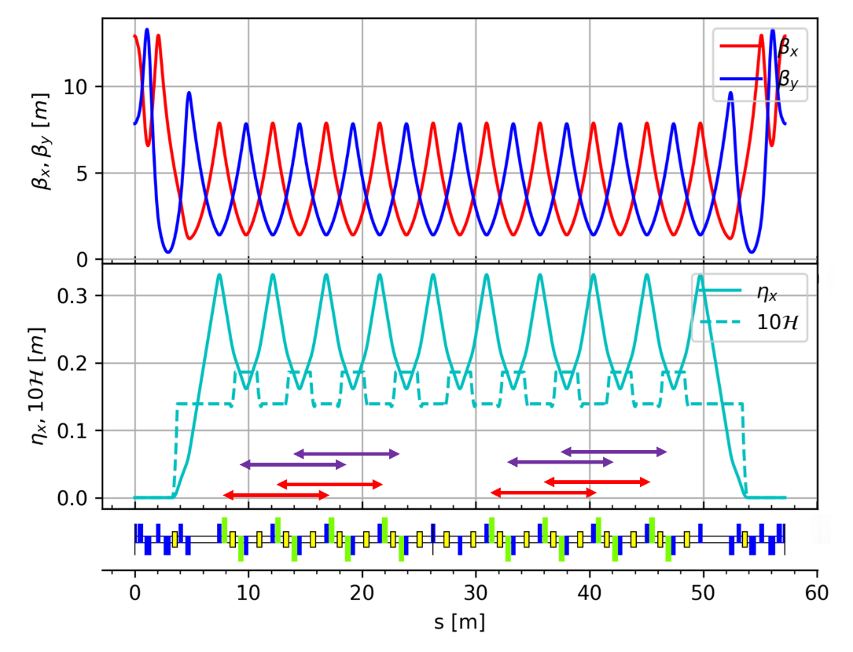
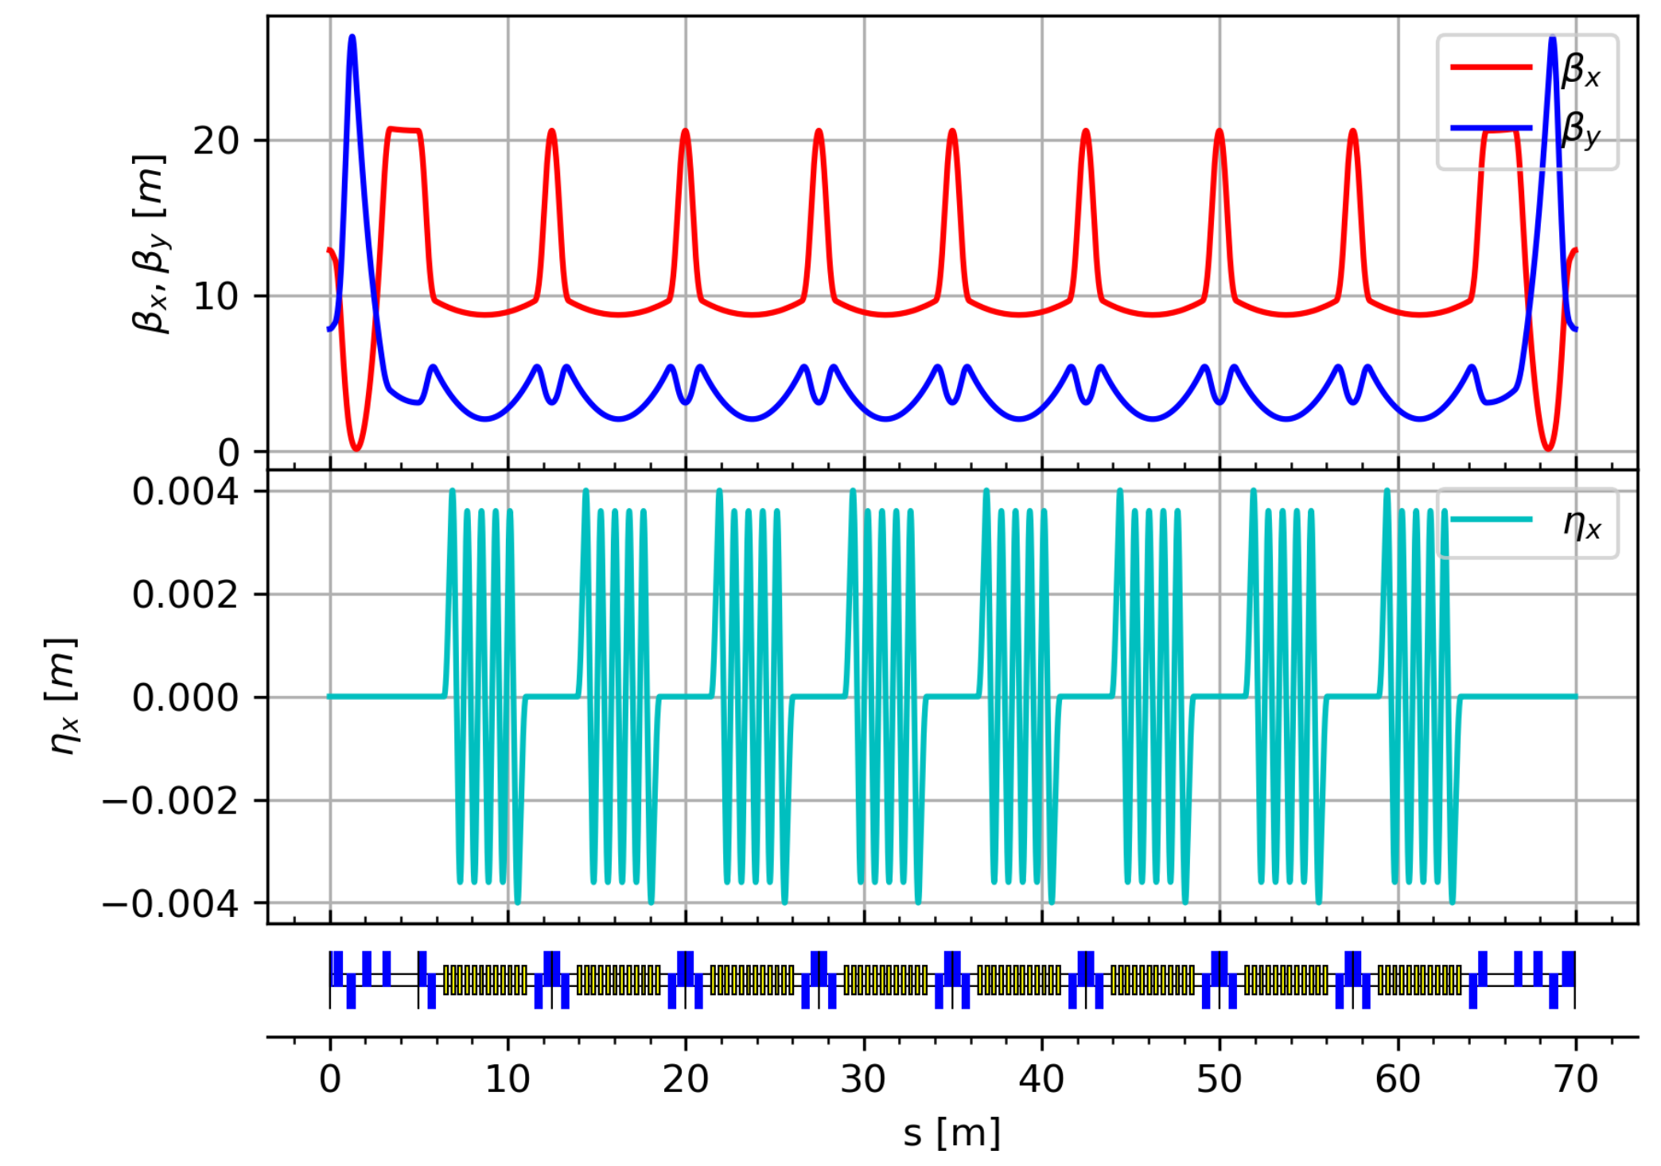
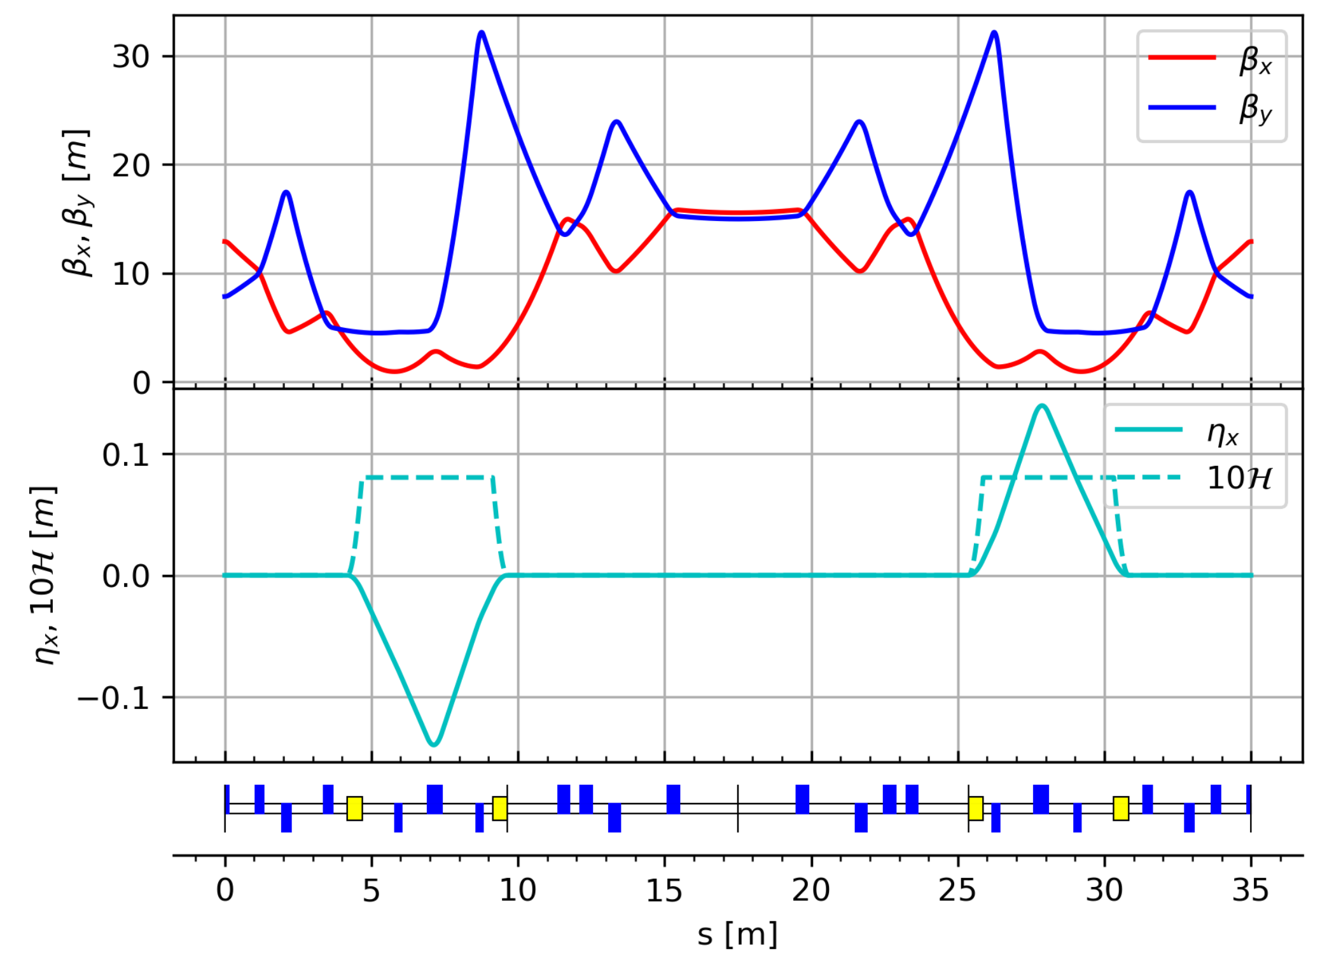
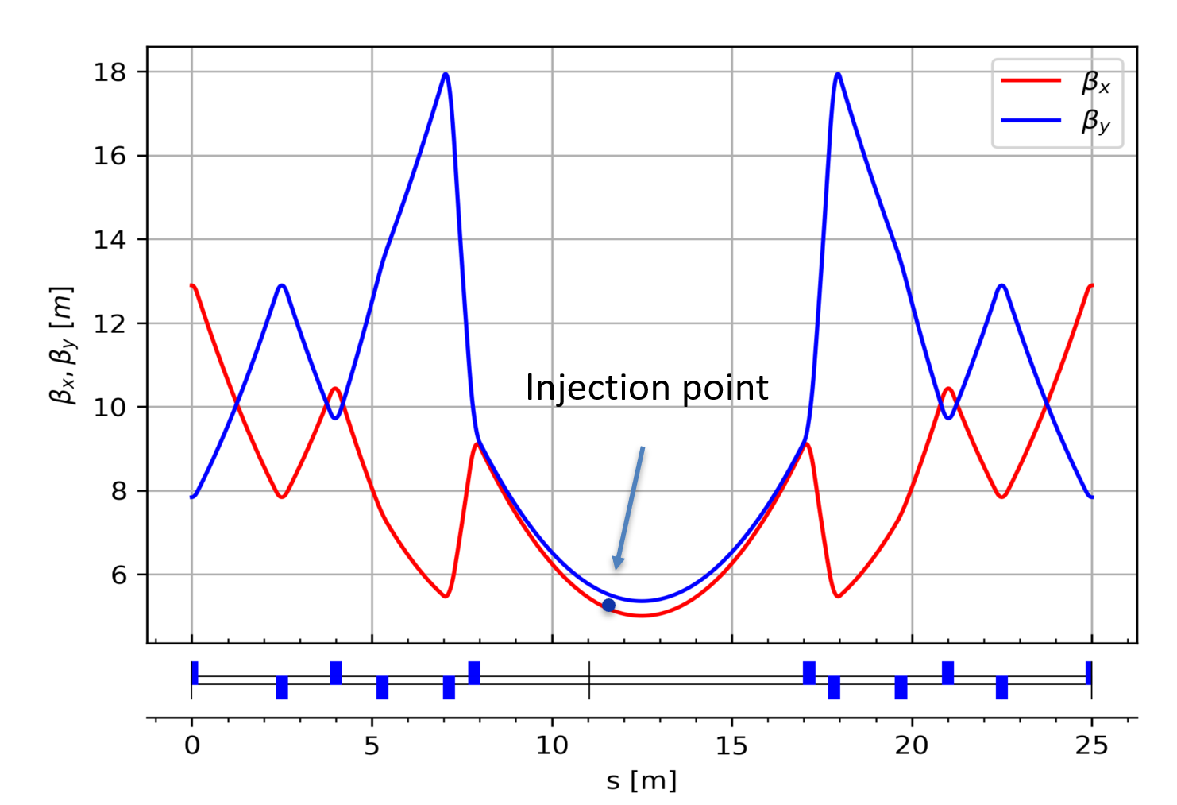
非对撞区光学设计
弧区采用标准 FODO 单元 → 90° phase advances, 40 pairs of sextupoles (20 SDs+20 SFs), exact -I map
  也在考虑具有更高灵活度的弧区结构（optional）: 可以在更大范围调节发射度和动量压缩因子
常温Damping wiggler：采用 triplet cell，可以灵活调节DW长度, beta X/Y
交叉段采用两组弯转磁铁, 水平分离约 2 m
注入段采用离轴与置换兼容的光学设计
弧区
Damping wiggler段
交叉段
上图：离轴注入
下图：置换注入

Slide 8
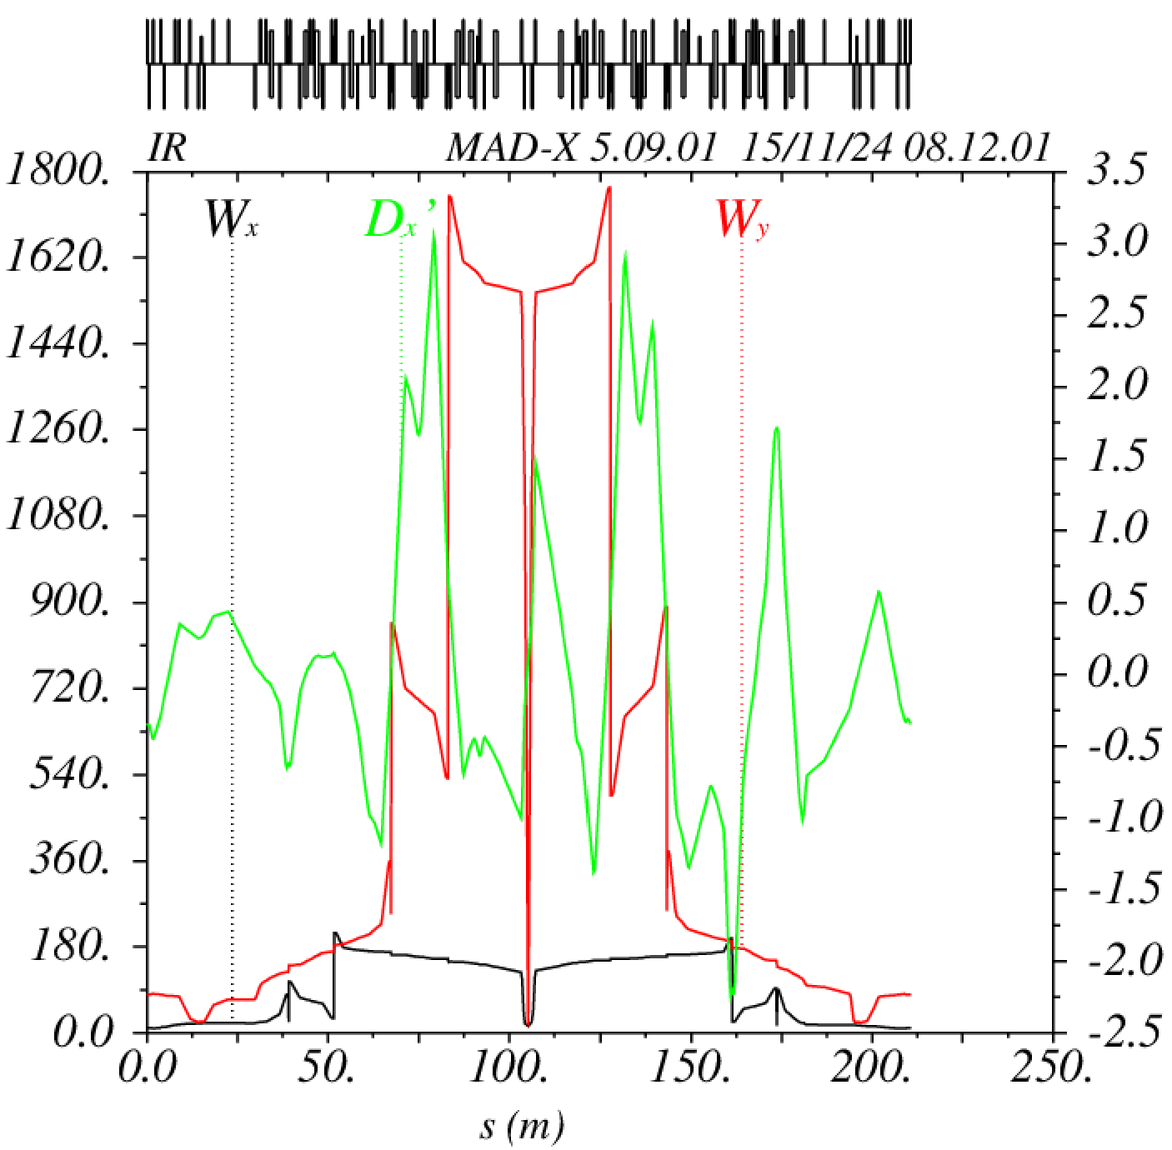
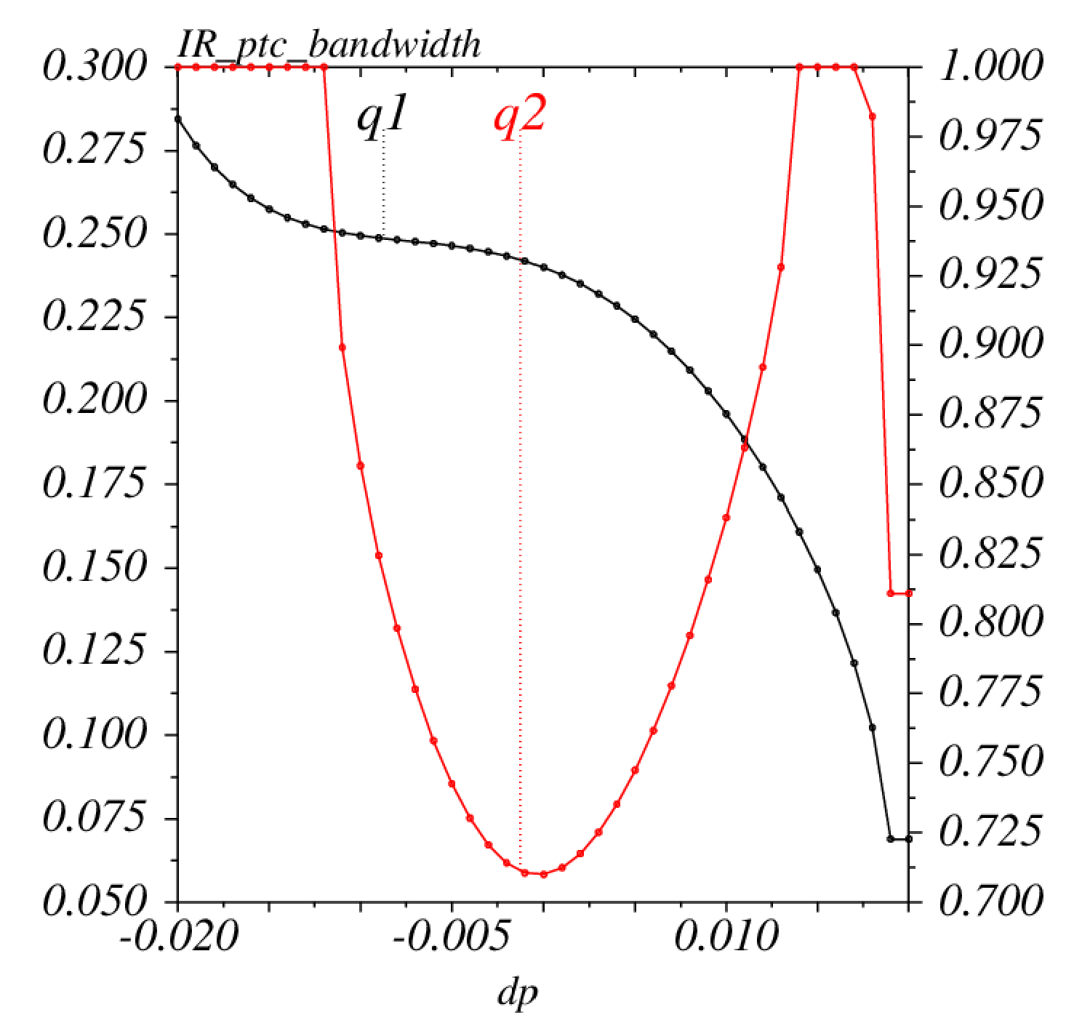
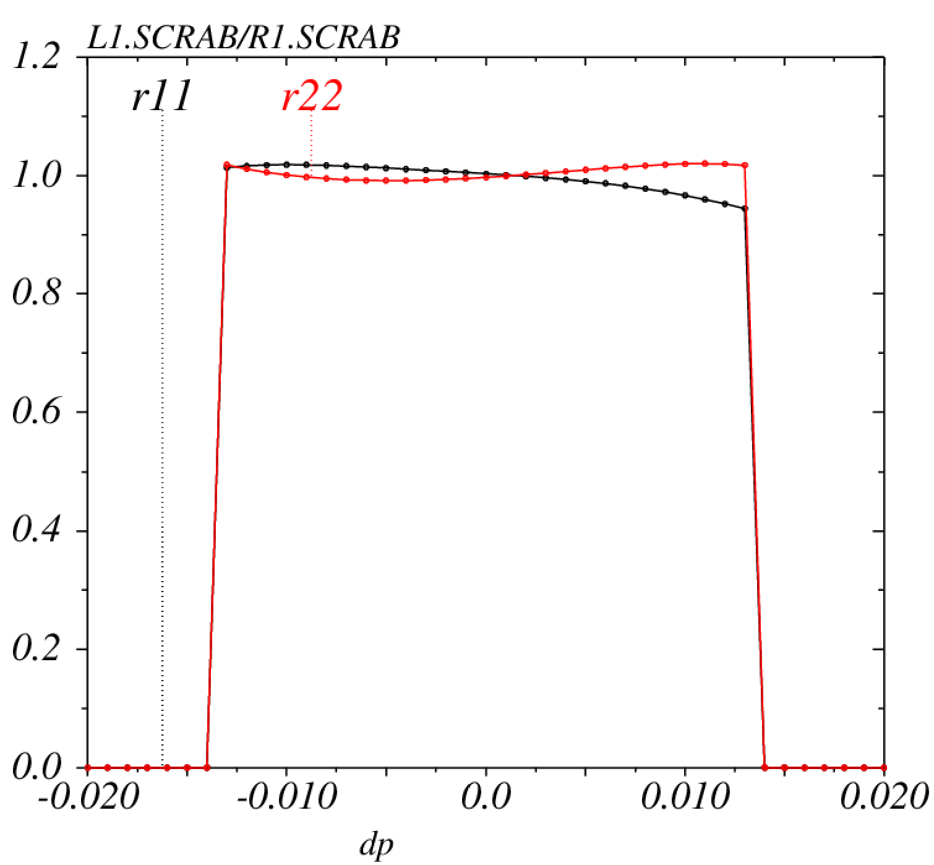
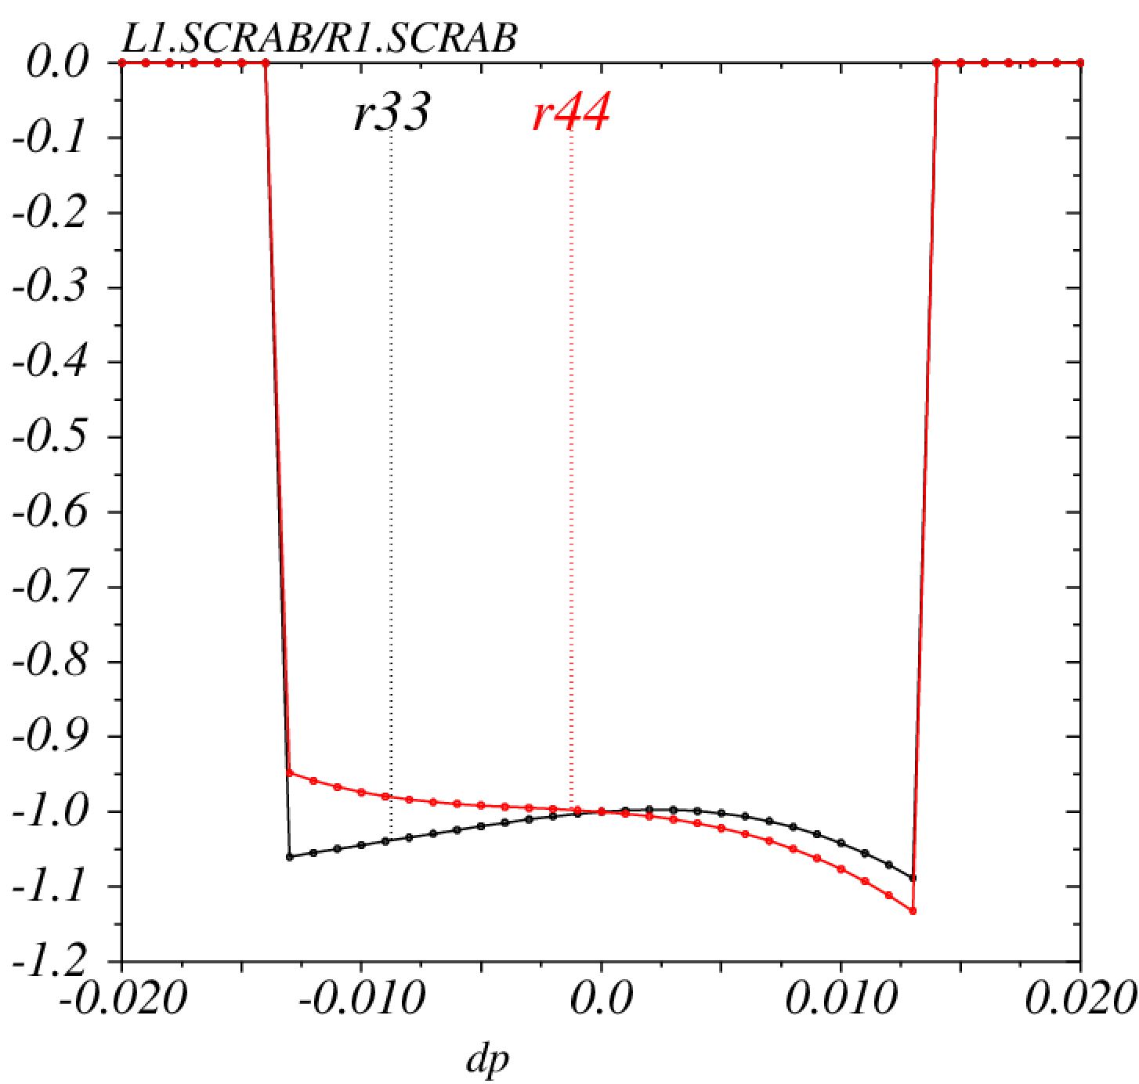
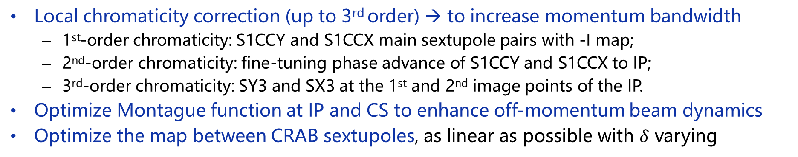
非线性优化策略
详见张林浩报告
Local chromaticity correction (up to 3rd order) → to increase momentum bandwidth
  1st-order chromaticity: S1CCY and S1CCX main sextupole pairs with -I map;
  2nd-order chromaticity: fine-tuning phase advance of S1CCY and S1CCX to IP;
  3rd-order chromaticity: SY3 and SX3 at the 1st and 2nd image points of the IP.
Optimize Montague function at IP and CS to enhance off-momentum beam dynamics
Optimize the map between CRAB sextupoles, as linear as possible with $δ$ varying

Slide 9
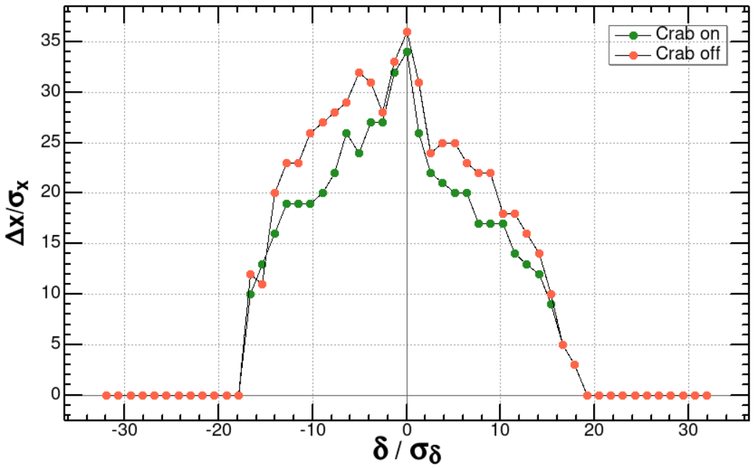
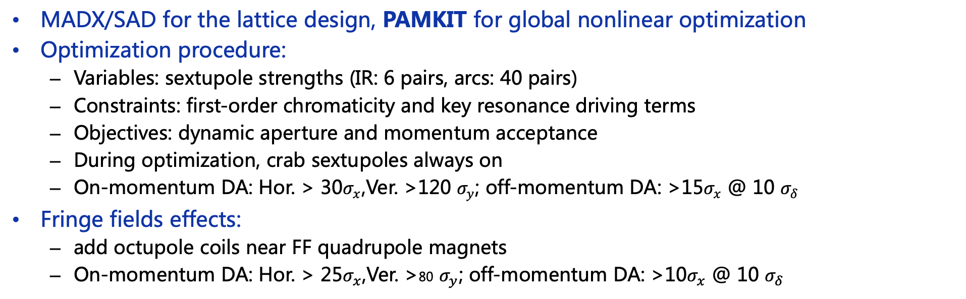
非线性优化
详见张林浩报告
MADX/SAD for the lattice design, PAMKIT for global nonlinear optimization
Optimization procedure:
  Variables: sextupole strengths (IR: 6 pairs, arcs: 40 pairs)
  Constraints: first-order chromaticity and key resonance driving terms
  Objectives: dynamic aperture and momentum acceptance
  During optimization, crab sextupoles always on
  On-momentum DA: Hor. > 30$σ_{x}$,Ver. >120 $σ_{y}$; off-momentum DA: >15$σ_{x}$ @ 10 $σ_{δ}$
Fringe fields effects:
  add octupole coils near FF quadrupole magnets
  On-momentum DA: Hor. > 25$σ_{x}$,Ver. >80 $σ_{y}$; off-momentum DA: >10$σ_{x}$ @ 10 $σ_{δ}$

Slide 10
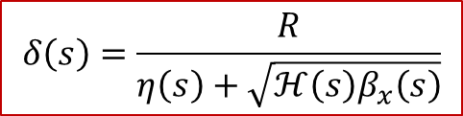
LMA 与 Touschek 寿命
$$δ\left(s\right)=\frac{R}{η\left(s\right)+\sqrt{ℋ\left(s\right)β_{x}\left(s\right)}}$$
Local momentum acceptance (LMA) evaluated by Elegant
Lower H function to increase LMA by linear optics design
Integration of FF quadrupole fringe fields significantly degrades LMA
With octupole compensation, the LMA recovers a lot
Touschek lifetime: > 300s with crab sextupoles on and fringe fields compensation with ideal lattice and >220s with errors
LMA
Touschek Lifetime (s) | Ideal lattice | with errors
w/o edge effect | 351 | 283
w/ edge effect | 242 | 166
w/ edge effect and octupoles | 309 | 226
Double-checked by Anton Bogomyagkov from BINP

Slide 11
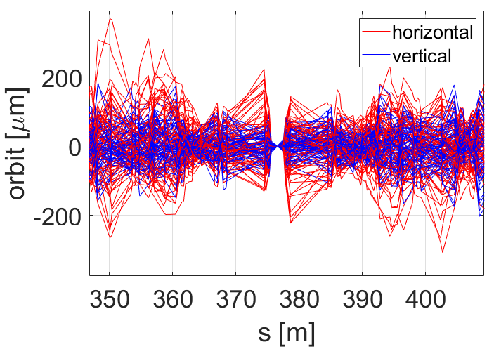
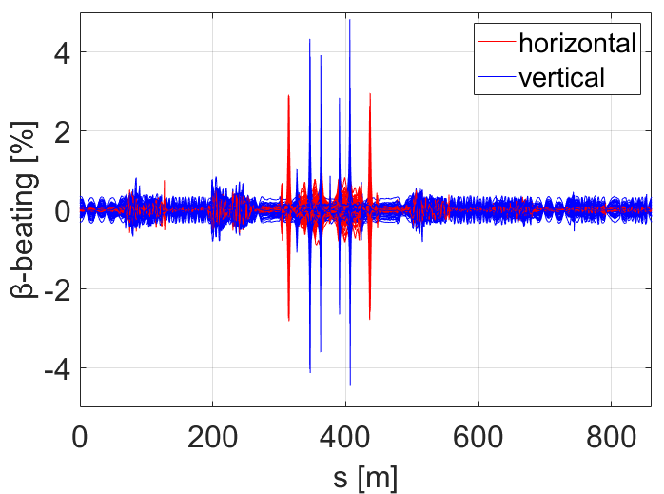
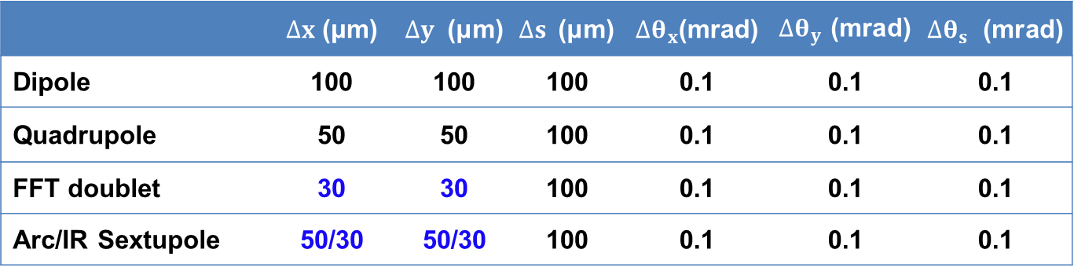
误差分析与校正
详见杨鹏辉报告
Analyze the errors of the ring and add BPMs and correctors for correction
BPM and corrector layout:
  Place BPMs and correctors next to quadrupoles; 405 BPM in each ring.
  QF: CORx; QD: CORy; Sextupole: double-plane corrector and skew quadrupole;
Misalignment Errors:
  FFT doublet: more strictly than other quadrupoles
  IR sextupoles: more strictly than sextupoles in the Arc
Correction strategy
  First turn trajectory correction
  Orbit and dispersion correction the whole ring and IP (SVD+DFS)
  Optics and coupling correction (LOCO)
  β_{y}* correction: K-modulation
 | $∆x$ (μm) | $∆y$ (μm) | $∆s$ (μm) | $∆θ_{x}$(mrad) | $∆θ_{y}$(mrad) | $∆θ_{s}$ (mrad)
Dipole | 100 | 100 | 100 | 0.1 | 0.1 | 0.1
Quadrupole | 50 | 50 | 100 | 0.1 | 0.1 | 0.1
FFT doublet | 30 | 30 | 100 | 0.1 | 0.1 | 0.1
Arc/IR Sextupole | 50/30 | 50/30 | 100 | 0.1 | 0.1 | 0.1

Slide 12
误差分析与校正
详见杨鹏辉报告
 | Global | @IP
Hor./Ver. orbit, MAX (μm) | 371/328 | 0.52/0.10
Hor./Ver. orbit, RMS (μm) | 48.3/47.6 | 0.17/0.034
Hor./Ver. dispersion deviation, MAX (mm) | 7.0/1.8 | 0.81/0.04
Hor./Ver. dispersion deviation, RMS (mm) | 0.48/0.17 | 0.35/0.014
Hor./Ver. β-beat, MAX (%) | 3.0/3.8 | 0.12/0.86
Hor./Ver. β-beat, RMS (%) | 0.13/0.17 | 0.04/0.29
Hor./Ver. tune shift, MAX (×10⁻⁴） | 0.21/2.5
Couling factor MAX/RMS (×10⁻⁵) | 7.9/2.8

Slide 13
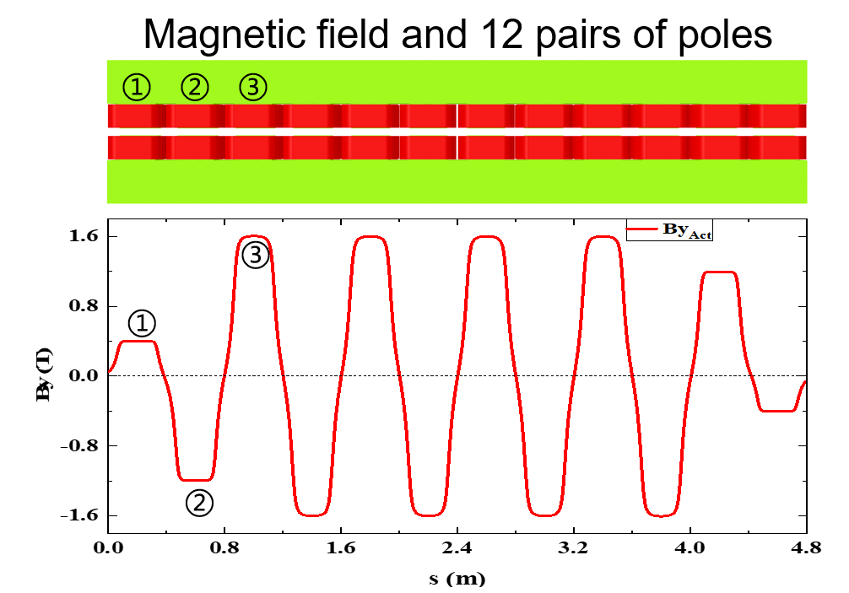
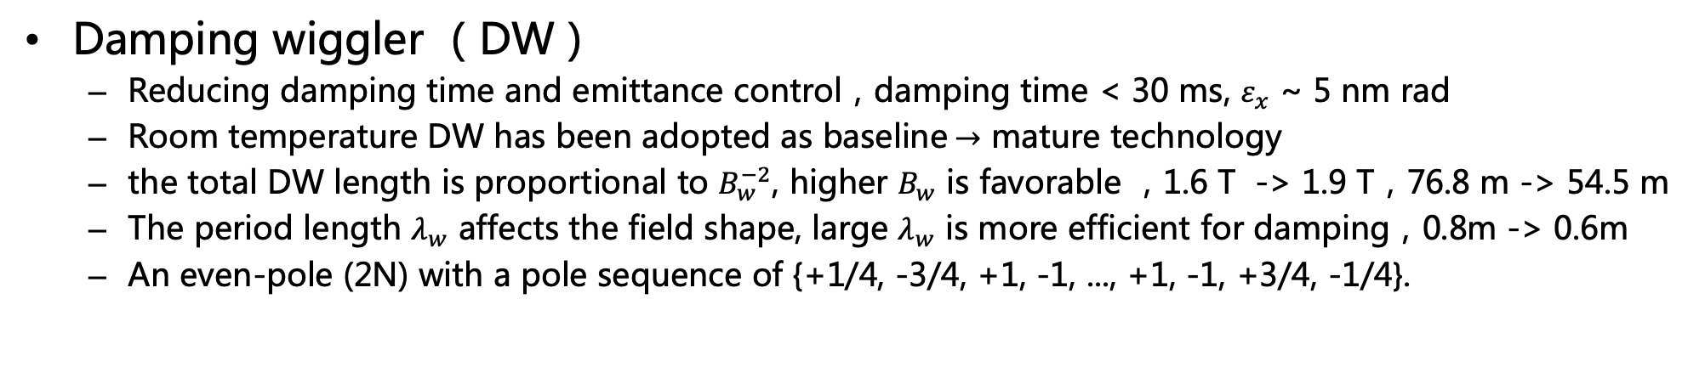
Damping wiggler 与发射度控制
Damping wiggler （DW）
  Reducing damping time and emittance control，damping time < 30 ms, $ε_{x}$ ~ 5 nm rad
  Room temperature DW has been adopted as baseline$→$ mature technology
  the total DW length is proportional to $B_{w}^{−2}$, higher $B_{w}$ is favorable ，1.6 T -> 1.9 T，76.8 m -> 54.5 m
  The period length $λ_{w}$ affects the field shape, large $λ_{w}$ is more efficient for damping，0.8m -> 0.6m
  An even-pole (2N) with a pole sequence of {+1/4, -3/4, +1, -1, ..., +1, -1, +3/4, -1/4}.
Parameter | Value
Beam energy (GeV) | 1.0 – 3.5
Wiggler length (m) | 4.8
Peak field (T) | 1.6
Period length (m) | 0.8
Magnetic gap (mm) | 50
Number of wigglers per ring | 16
Total wiggler length per ring (m) | 76.8

Slide 14
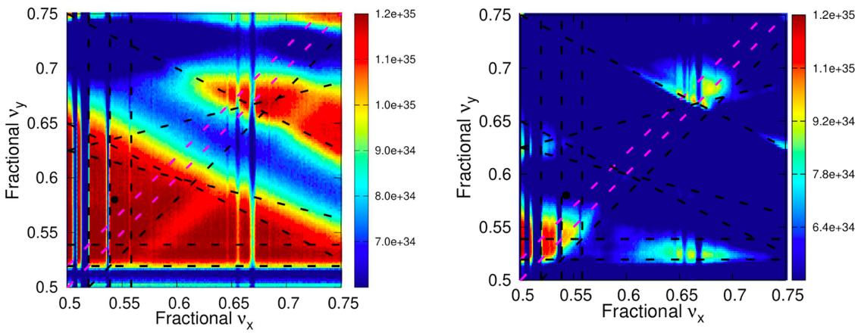
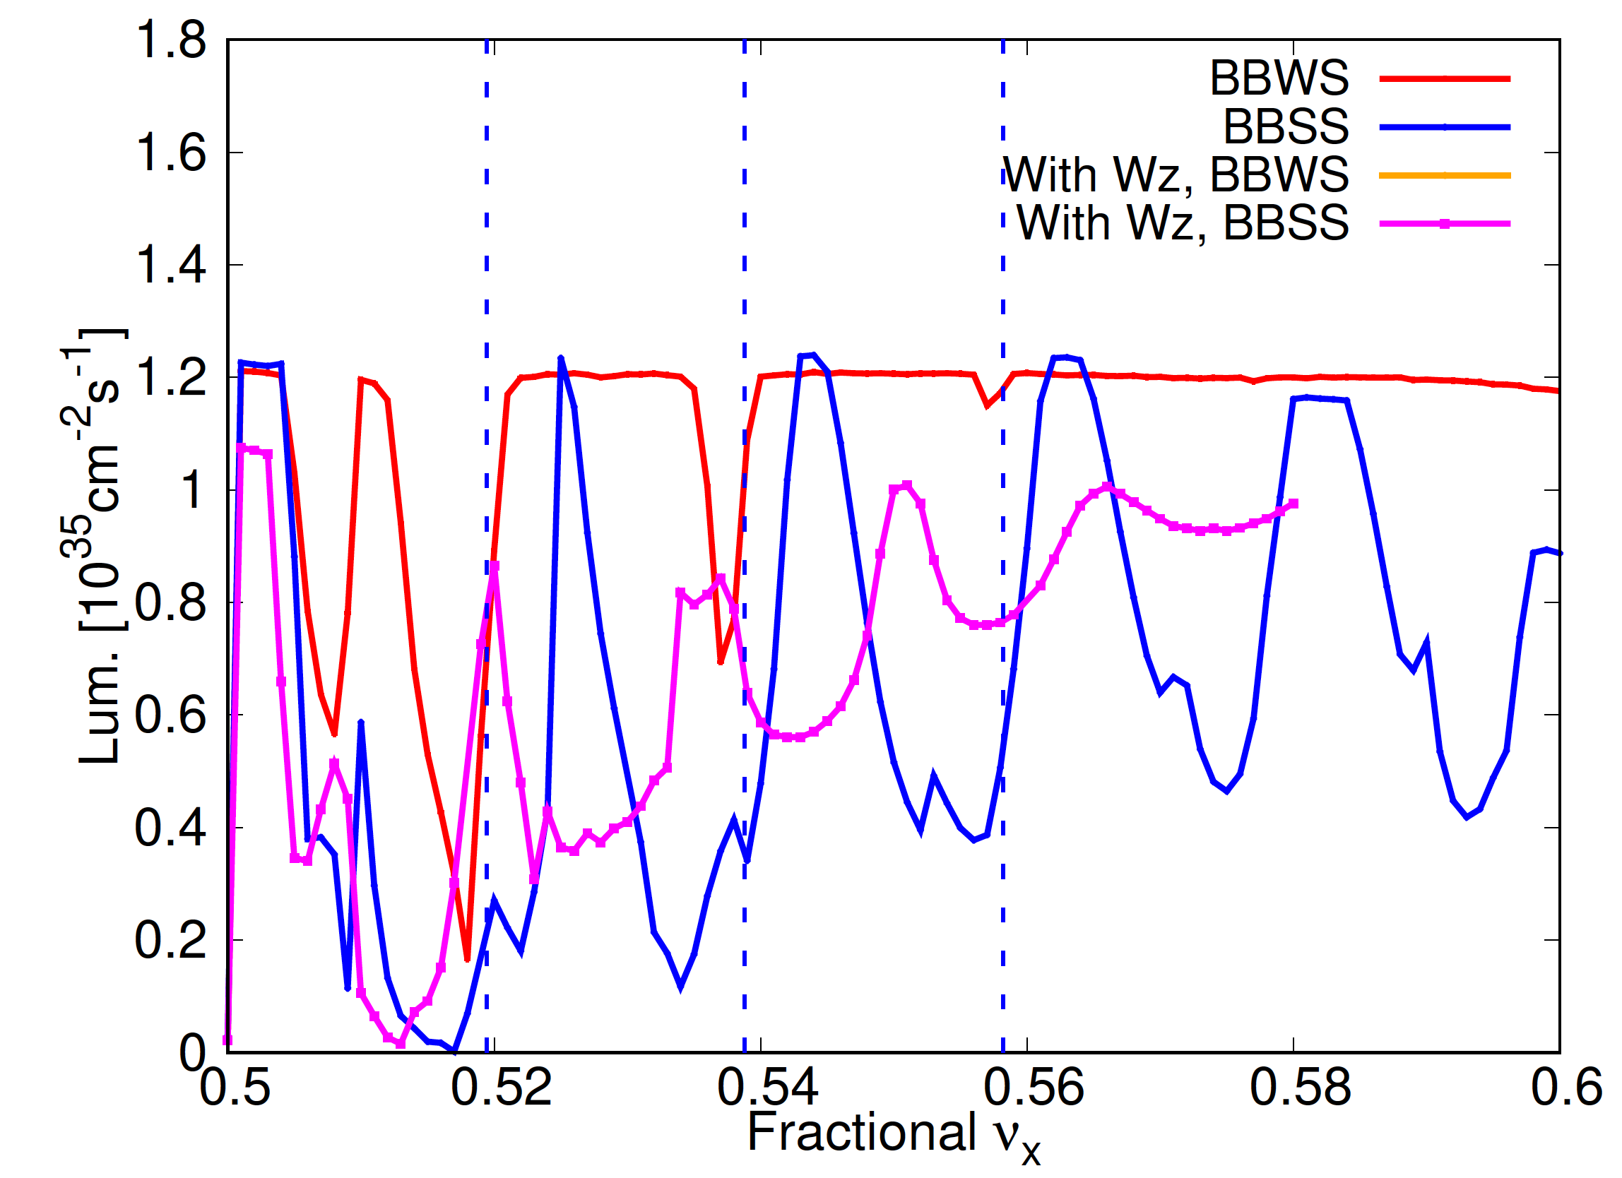
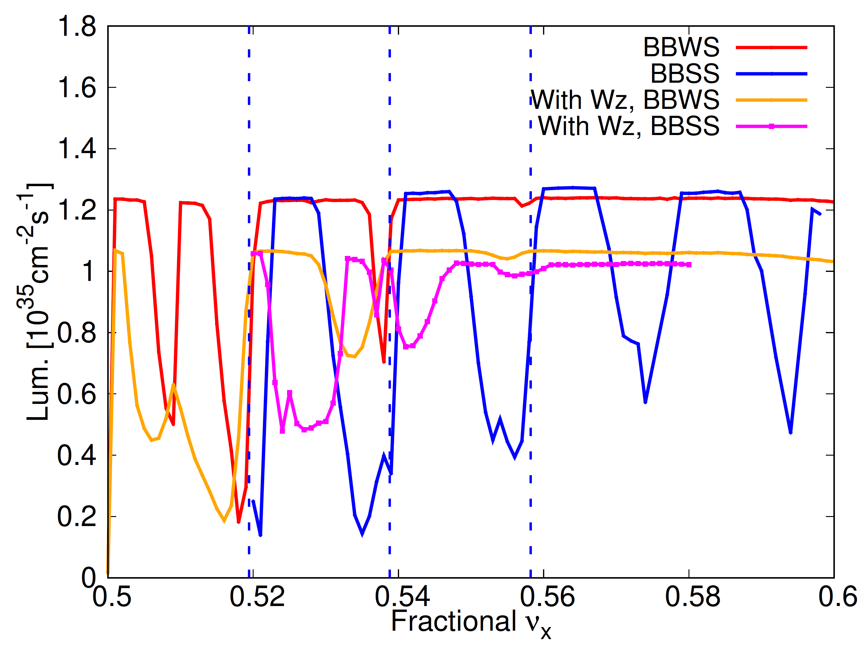
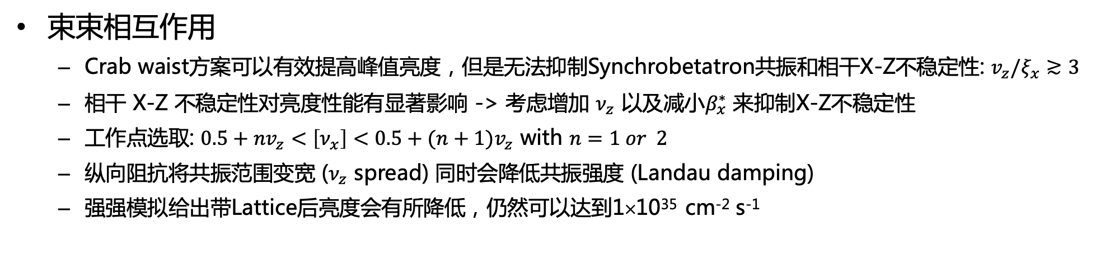


束-束相互作用
详见李桑丫报告
束束相互作用
  Crab waist方案可以有效提高峰值亮度，但是无法抑制Synchrobetatron共振和相干X-Z不稳定性: $v_{z}/ξ_{x}≳3$
  相干 X-Z 不稳定性对亮度性能有显著影响 -> 考虑增加 $ν_{z}$ 以及减小$β_{x}^{∗}$ 来抑制X-Z不稳定性
  工作点选取: ${0.5+nv}_{z}<\left[ν_{x}\right]<{0.5+(n+1)v}_{z}$ with $n=1 or 2$
  纵向阻抗将共振范围变宽 ($ν_{z}$ spread) 同时会降低共振强度 (Landau damping)
  强强模拟给出带Lattice后亮度会有所降低，仍然可以达到1×10³⁵ cm⁻² s⁻¹
Weak-strong simulations with and without CW
$β_{x}^{∗}$ = 60 mm
$β_{x}^{∗}$ = 40 mm

Slide 15
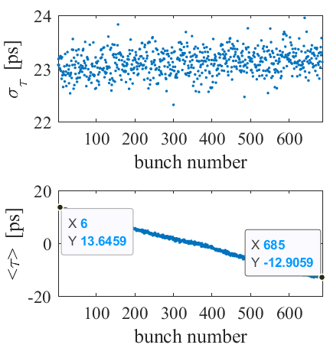
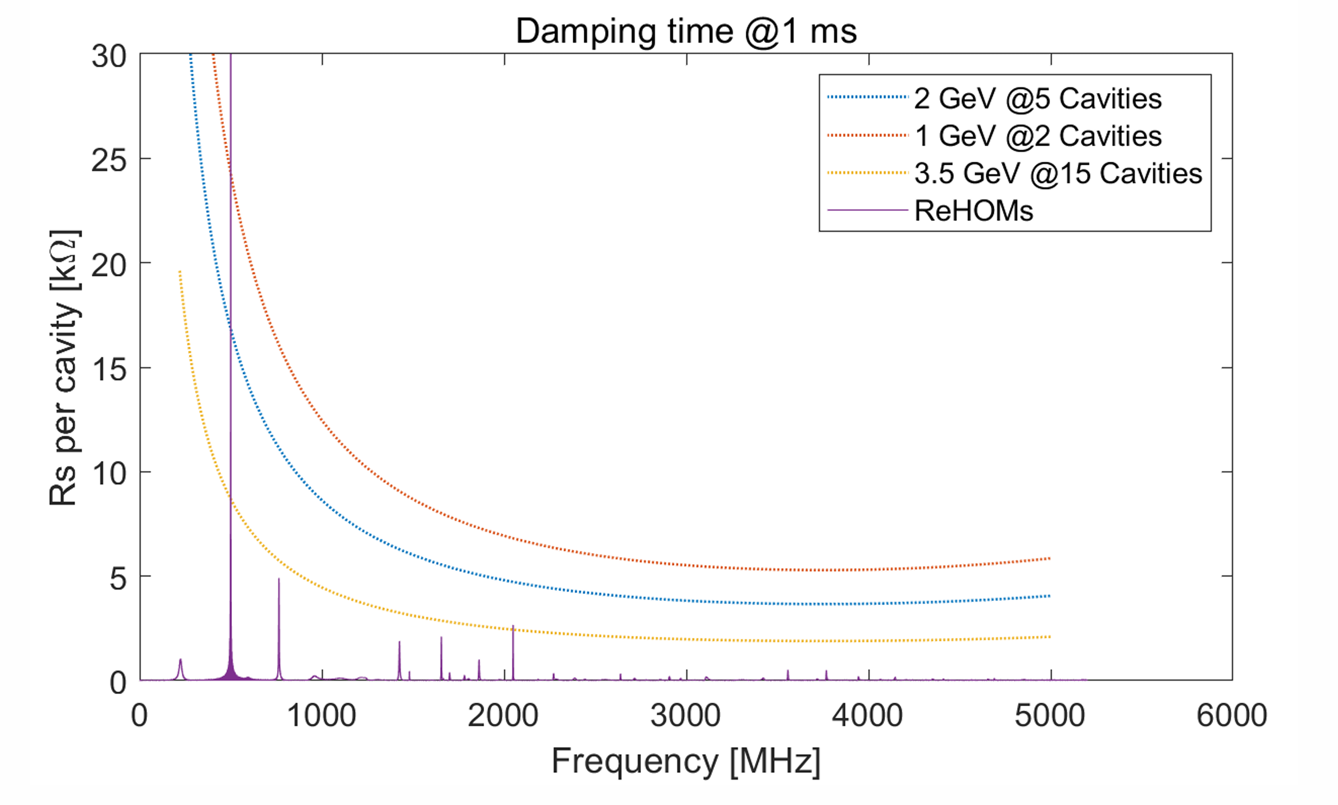
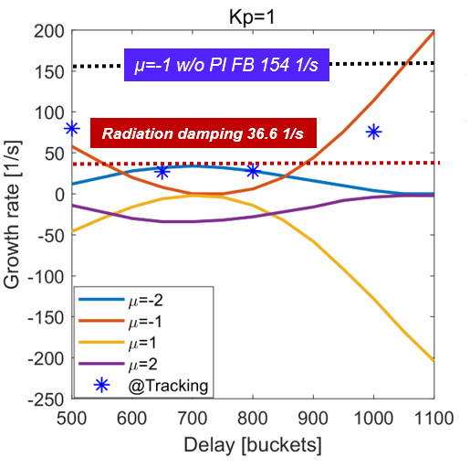
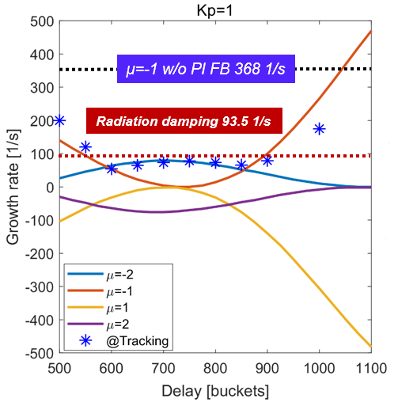
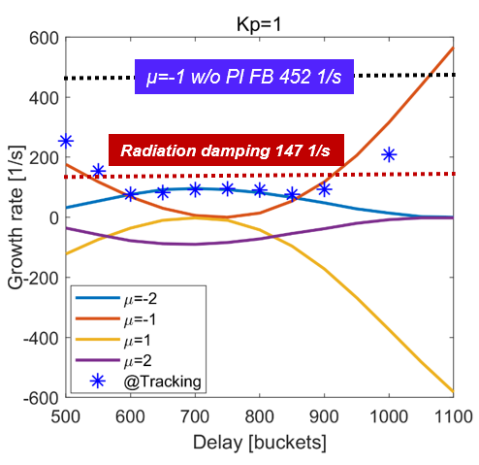
束-腔相互作用
详见李伟伟报告
STCF选择TM020高频腔，高品质因子（Q），低R/Q值
研究TM020腔基模和高次模产生的耦合束团不稳定性及其抑制措施
对于基模产生的耦合束团不稳定性，可以通过低电平PI反馈来进行充分抑制
高次模产生的耦合束团不稳定性增长率超过了阻尼率，需要通过纵向反馈来达到抑制效果（1ms）
瞬态束流负载效应导致束团质心位置变化约±13 ps：对亮度影响不大
1 GeV
2 GeV
3.5 GeV

Slide 16
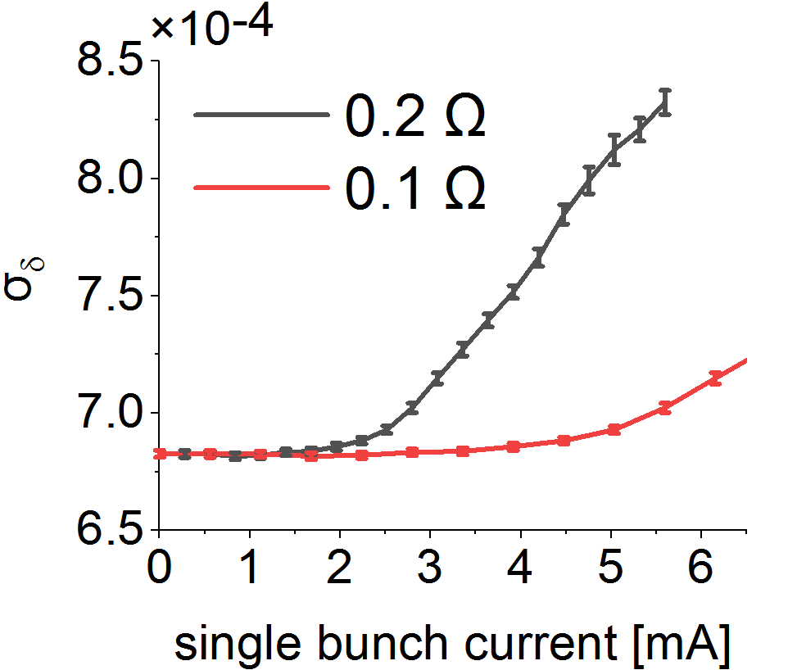
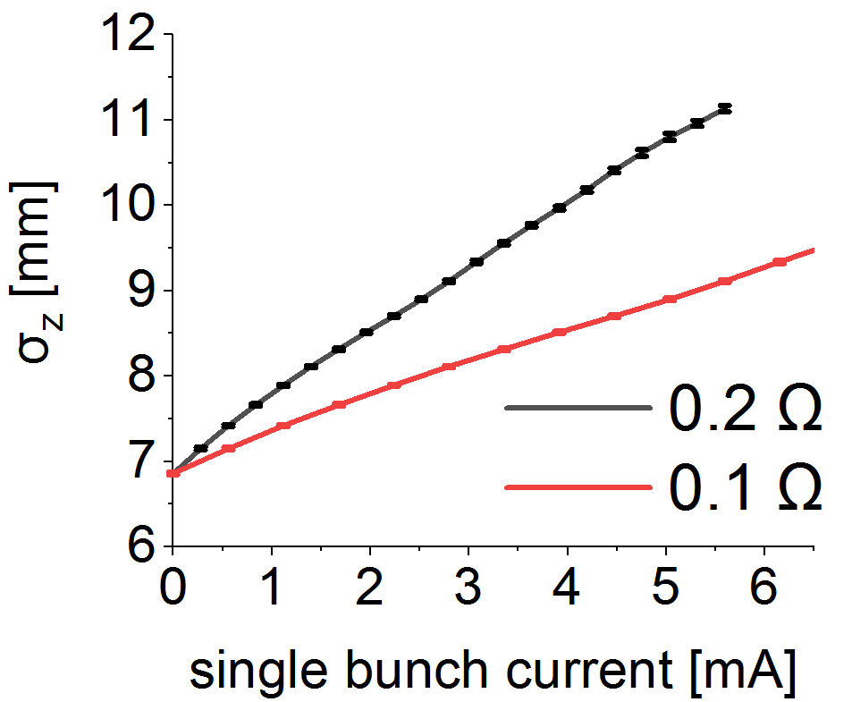
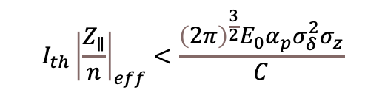
阻抗驱动的集体效应
详见李伟伟报告
纵向微波不稳定性
横向耦合模式不稳定性TMCI
采用简单的宽带谐振子（BBR）模型估算 @ 2 GeV
有效阻抗选取 0.2 Ω 和 0.1 Ω
准确计算依赖于具体阻抗建模
需严格控制阻抗预算
→
限制单束团流强阈值
准直器起主导作用
后面根据准直器的阻抗模型进行计算
Keil-Schnell-Boussard criterion:
$$I_{th}{\left|\frac{Z_{∥}}{n}\right|}_{eff}<\frac{{\left(2π\right)}^{\frac{3}{2}}E_{0}α_{p}σ_{δ}^{2}σ_{z}}{C}$$
电阻壁不稳定性
假设全环 25 mm半径铝制真空室 -> 不稳定增长率1.6 ms⁻¹
采用横向逐束团反馈进行抑制
Single bunch current [mA] @ 2 GeV

Slide 17
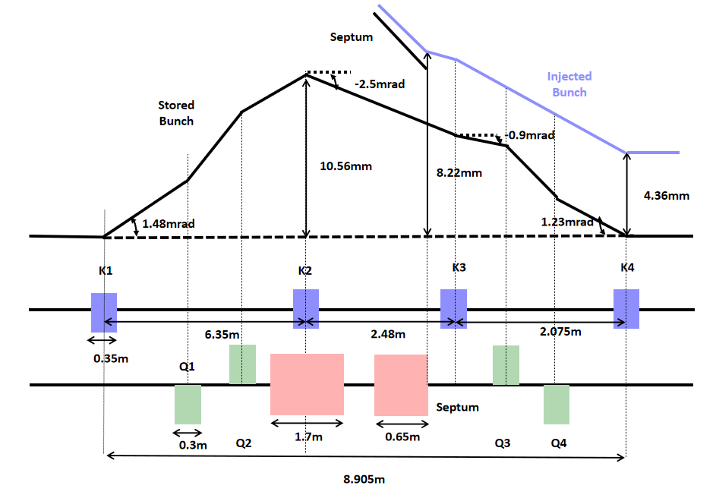
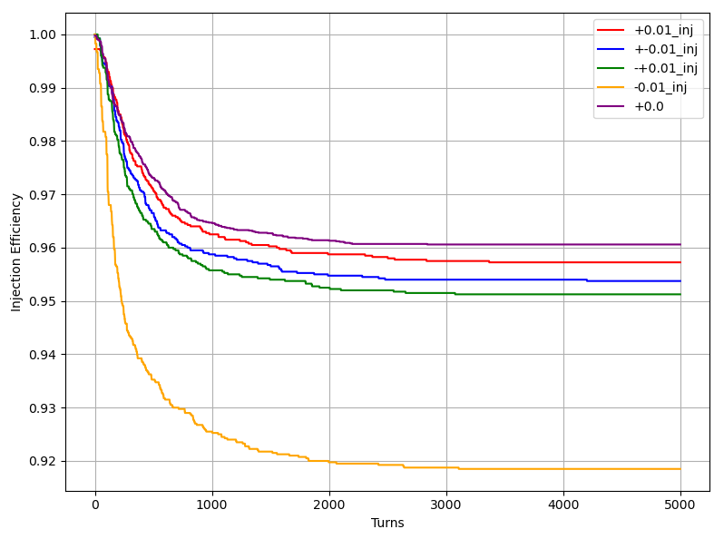
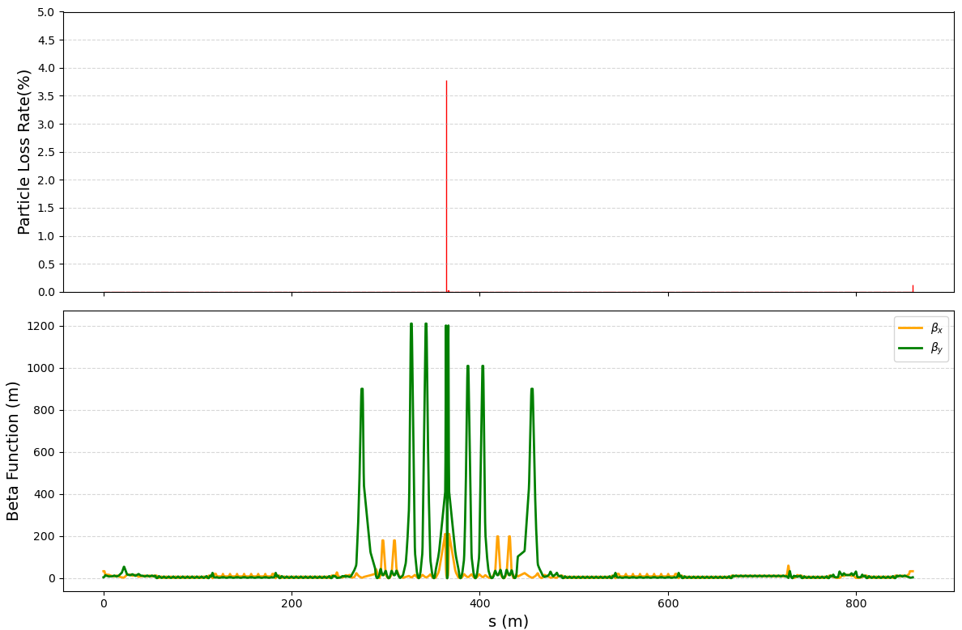
束流注入-离轴注入
兼容离轴与置换注入的光学设计，前期采用离轴注入，后期切换到置换注入
离轴注入: 技术成熟，注入器相对简单；需大动力学孔径，造成对撞区束流损失，增大本底
  切割磁铁+凸轨磁铁
  注入效率: ~95% (ideal) → ~70% (考虑septum漏场和注入位置误差)
  束流主要损失在对撞点上游超导四极铁处
  需通过束流准直系统准直丢失粒子
参数名称 | 数值
注入点环内/环外β_{x} [m] | 33.34/11.53
注入束角度 [mrad] | -2.45
注入点凸轨高度 [mm] | 3.86
注入点凸轨角度 [mrad] | -2.50
凸轨回落后注入束位置 [mm] | 4.36
凸轨持续时间 [圈] | 1
凸轨磁铁长度 [mm] | 350
凸轨磁铁最大偏转角度 [mrad] | <3.5
凸轨磁铁磁场强度 [Gs] | < 1167
薄切割板高度 [mm] | 5.54
薄切割板厚度 [mm] | 1.0
薄切割磁铁机械长度/有效长度 [mm] | 0.65/0.6
薄切割磁铁磁场强度 [Gs] | 5500
薄切割磁铁偏转角度 [mrad] | 28
厚切割板厚度 [mm] | 2.0
厚切割磁铁机械长度/有效长度 [mm] | 1.7/1.3
厚切割磁铁磁场强度 [Gs] | 9900
厚切割磁铁偏转角度 [mrad] | 110

Slide 18
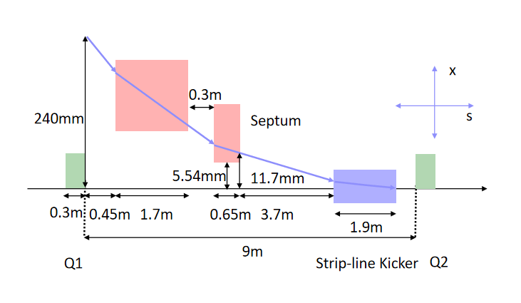
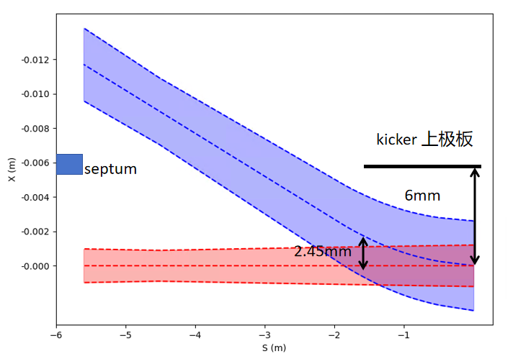
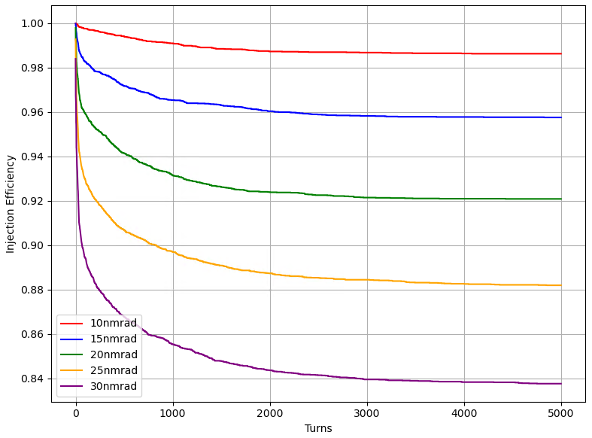
束流注入-置换注入
置换注入: 对动力学孔径需求低，束流本底噪声减少；注入器复杂且造价高
  切割磁铁+条带型超快冲击磁铁，与离轴注入采用相同的切割磁铁设计
  垂直发射度对注入效率影响较大，小于15 nmrad
参数名称 | 数值
冲击磁铁长度 [mm] | 300
冲击磁铁偏转角度 [mrad] | 0.5
冲击磁铁极板间距 [mm] | 12
模块数量 | 5
上升/平顶/下降时间 [ns] | 2/2/2
好场区 [mm] | ±5
注入束进入冲击磁铁的位置 [mm] | 2.45
电压幅值 [kV] | > 17.5
束团注入频率 [Hz] | 30
薄切割板高度 [mm] | 5.54
薄切割板厚度 [mm] | 1.0
薄切割磁铁机械长度/有效长度 [mm] | 0.65/0.6
薄切割磁铁磁场强度 [Gs] | 5500
薄切割磁铁偏转角度 [mrad] | 28
厚切割板厚度 [mm] | 2.0
厚切割磁铁机械长度/有效长度 [mm] | 1.7/1.3
厚切割磁铁磁场强度 [Gs] | 9900
厚切割磁铁偏转角度 [mrad] | 110

Slide 19
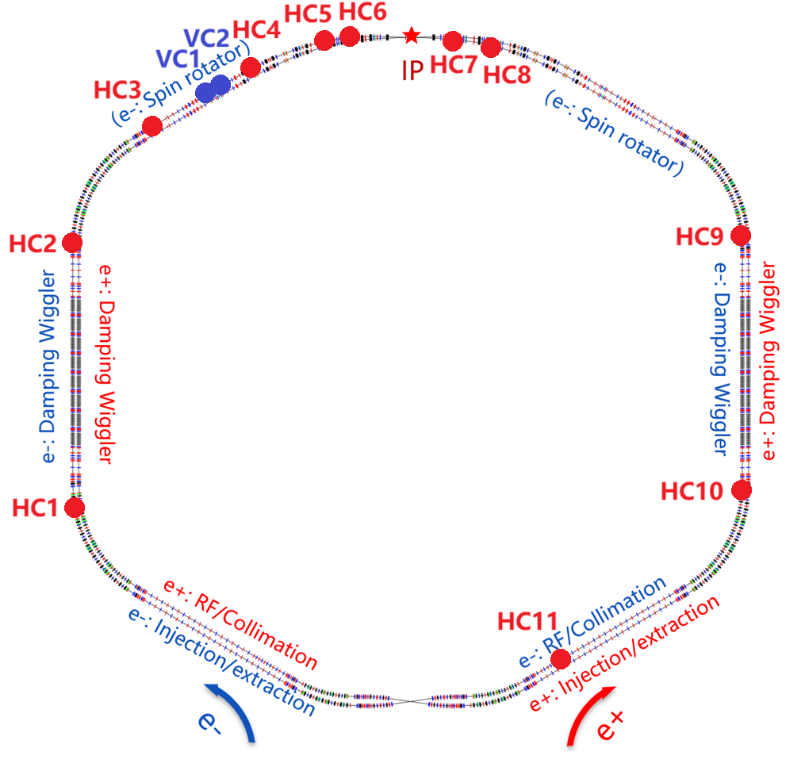
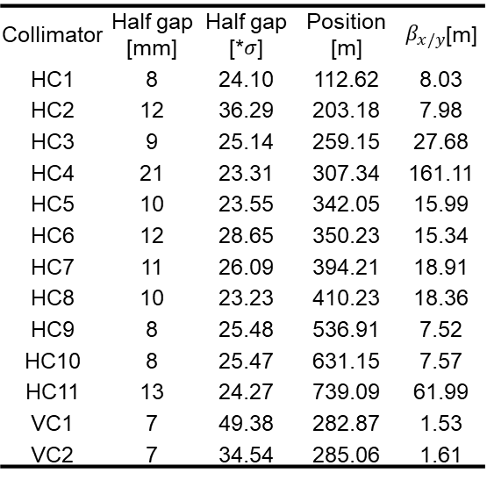
束流准直系统
束流损失问题具有非常大的挑战(high luminosity, short Touschek lifetime)
束流损失机制研究: Touschek scattering effect, beam injection, beam-beam effect, beam-gas effect, beam sudden loss
Touschek scattering effect: calculate off-momentum optical function and beam size → Collimators are favorable to set at large beam size, optimize collimator number, gaps, materials.
Each ring is equipped with 11 horizontal collimators and 2 vertical collimators.
The minimum half gap is 7 mm.
Collimator | Half gap [mm] | Half gap [*$σ$] | Position [m] | $β_{x/y}$[m]
HC1 | 8 | 24.10 | 112.62 | 8.03
HC2 | 12 | 36.29 | 203.18 | 7.98
HC3 | 9 | 25.14 | 259.15 | 27.68
HC4 | 21 | 23.31 | 307.34 | 161.11
HC5 | 10 | 23.55 | 342.05 | 15.99
HC6 | 12 | 28.65 | 350.23 | 15.34
HC7 | 11 | 26.09 | 394.21 | 18.91
HC8 | 10 | 23.23 | 410.23 | 18.36
HC9 | 8 | 25.48 | 536.91 | 7.52
HC10 | 8 | 25.47 | 631.15 | 7.57
HC11 | 13 | 24.27 | 739.09 | 61.99
VC1 | 7 | 49.38 | 282.87 | 1.53
VC2 | 7 | 34.54 | 285.06 | 1.61
Off-momentum beam size (-1%)

Slide 20
Touschek 散射准直模拟结果
Without collimators：
Approximately 58.2% of particle losses occur in IR (370 ~ 380 m);
About 11.2% of losses occur in the CCX section upstream of the IR (300 ~ 320 m);
Around 13.4% of particle losses happen near the crab sextupole magnet before the IR (270 ~ 290 m).
With collimators：
Beam loss within ±20 m of the IP is approximately 1.3%;
The remaining particles not intercepted by the collimators are uniformly distributed in the arc sections and DW regions;
The collimation efficiency reaches 97.3%.
Without collimators
With collimators
Beam loss distribution: (left) without collimators; (right) with collimators.

Slide 21
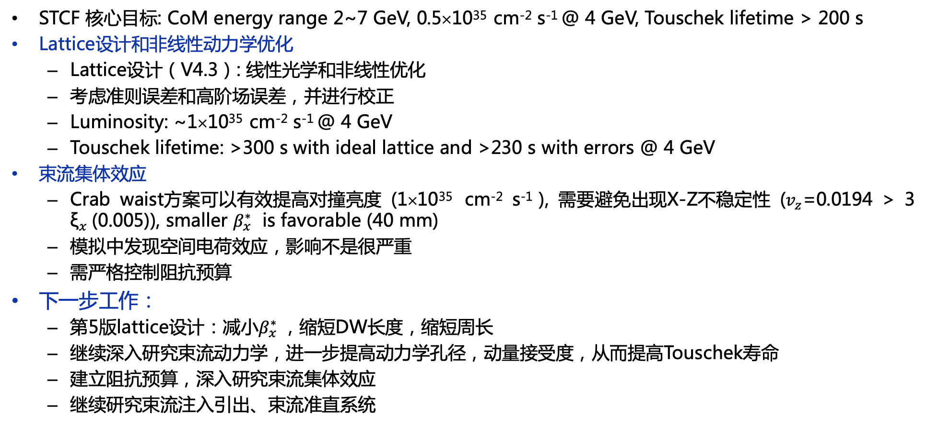
总结与展望
STCF 核心目标: CoM energy range 2~7 GeV, 0.5×10³⁵ cm⁻² s⁻¹ @ 4 GeV, Touschek lifetime > 200 s
Lattice设计和非线性动力学优化
  Lattice设计（V4.3）: 线性光学和非线性优化
  考虑准则误差和高阶场误差，并进行校正
  Luminosity: ~1×10³⁵ cm⁻² s⁻¹ @ 4 GeV
  Touschek lifetime: >300 s with ideal lattice and >230 s with errors @ 4 GeV
束流集体效应
  Crab waist方案可以有效提高对撞亮度 (1×10³⁵ cm⁻² s⁻¹ ), 需要避免出现X-Z不稳定性 ($v_{z}$=0.0194 > 3 ${\text{ξ}}_{x}$(0.005)), smaller $β_{x}^{∗}$ is favorable (40 mm)
  模拟中发现空间电荷效应，影响不是很严重
  需严格控制阻抗预算
下一步工作：
  第5版lattice设计：减小$β_{x}^{∗}$，缩短DW长度，缩短周长
  继续深入研究束流动力学，进一步提高动力学孔径，动量接受度，从而提高Touschek寿命
  建立阻抗预算，深入研究束流集体效应
  继续研究束流注入引出、束流准直系统

Slide 22



周例会

Slide 23





Acknowledgments

Slide 24
请各位专家批评指正！

