Slide 1

Electromagnetic Calorimeter
Software for Super Tau-Charm
Facility
Bo Wang
University of Science and Technology of China
State Key Laboratory of Particle Detection and Electronics
(On behalf of the STCF ECAL working group)
超级陶粲装置研讨会
7月4日, 2025, 湘潭

Slide 2
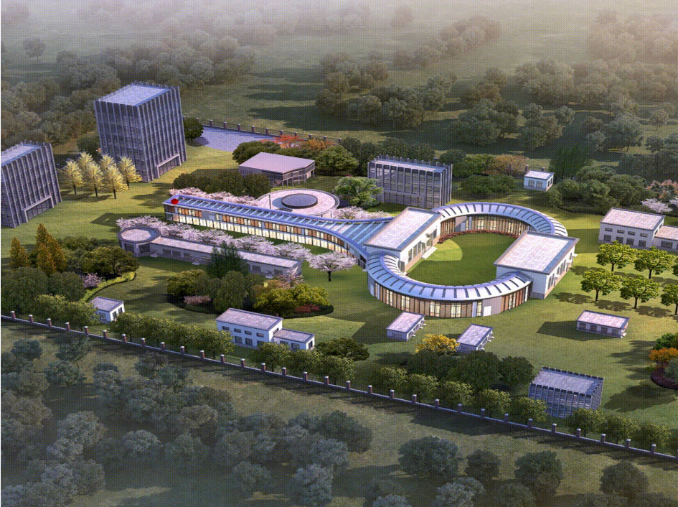
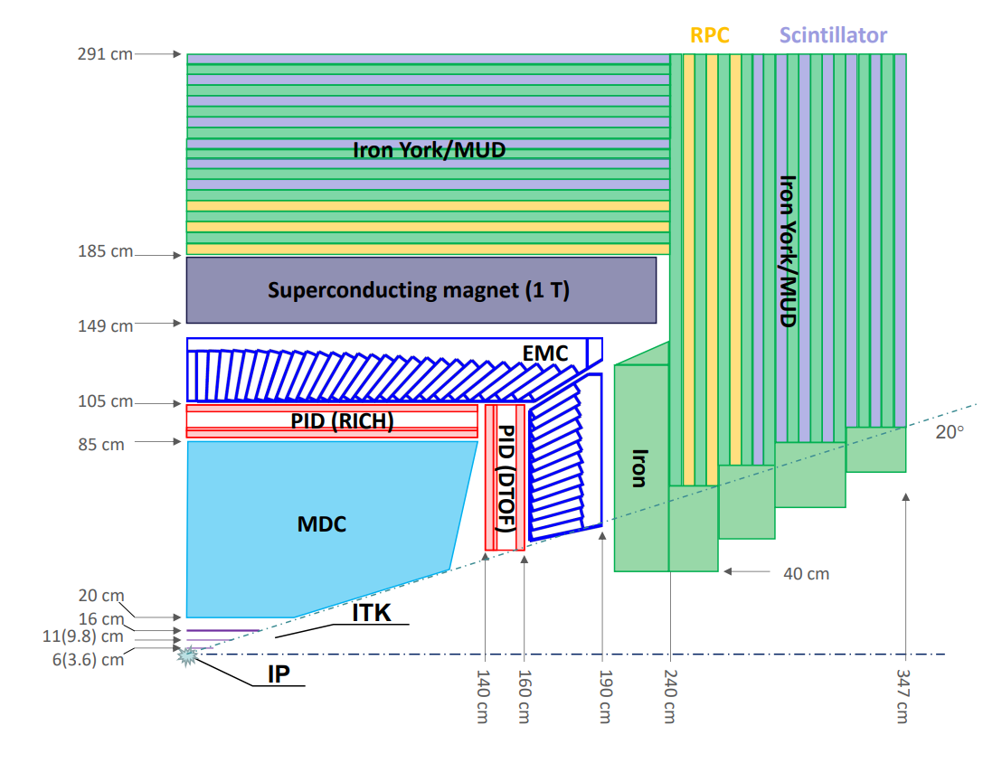

Super Tau-Charm Facility
Electron-positron collider experiment
High luminosity：beyond $0.5×{10}^{35}{ cm}^{−2}∙s^{−1}$ @ 4GeV
Wide energy region：center-of-mass energy range of 2~7 GeV

Slide 3
Requirements for ECAL
Fast response
  Challenge of high Luminosity
    High count rate
    Extremely high background
High precision
  Energy resolution
    Better than 2.5% @1GeV
  Position resolution
    Approximately 5mm @1GeV
  Time resolution
    Better than 300ps @1GeV
Energy distribution for photons

Slide 4
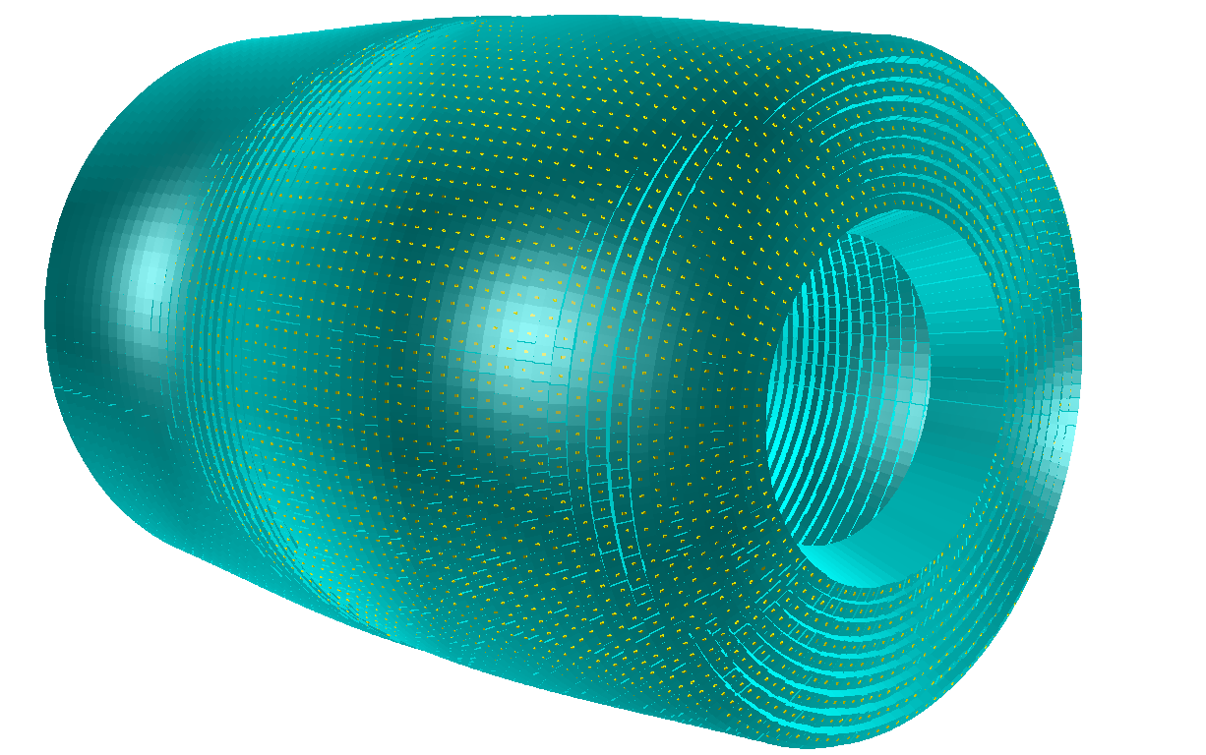
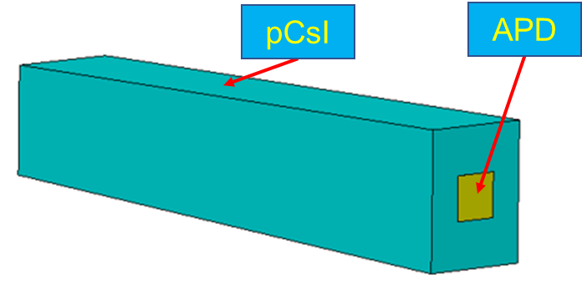
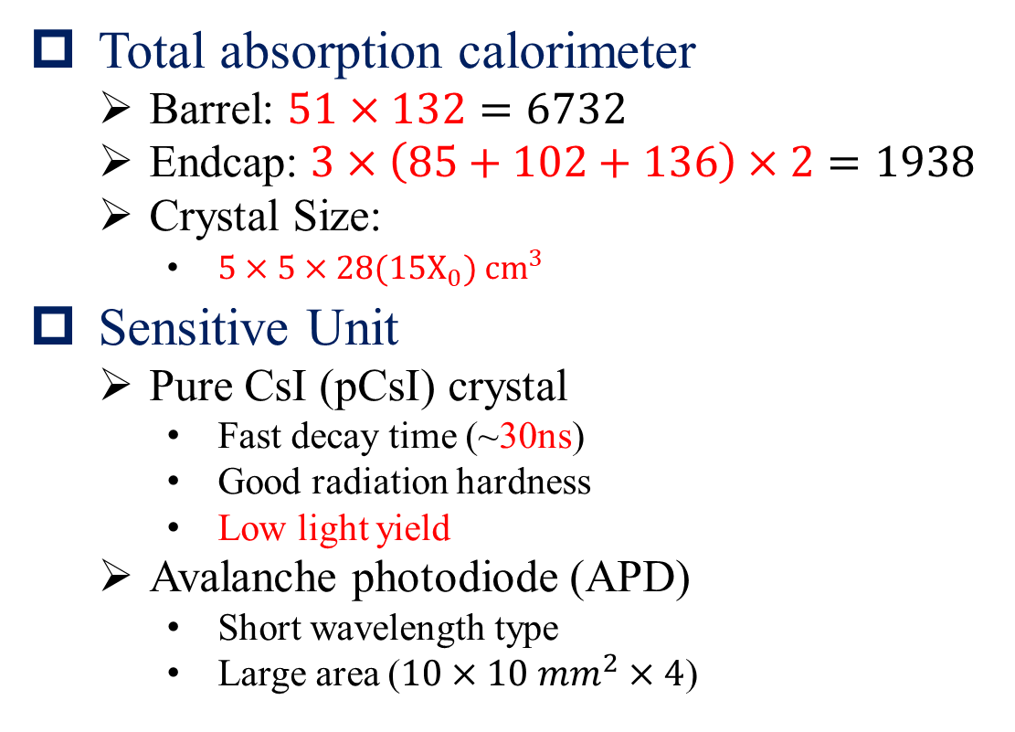
ECAL Design
Total absorption calorimeter
  Barrel: $51×132=6732$
  Endcap: $3×\left(85+102+136\right)×2=1938$
  Crystal Size:
      $5×5×28(15X_{0}) {cm}^{3}$
Sensitive Unit
  Pure CsI (pCsI) crystal
    Fast decay time (~30ns)
    Good radiation hardness
    Low light yield
  Avalanche photodiode (APD)
    Short wavelength type
    Large area ($10×10 mm^{2}×4$)

Slide 5
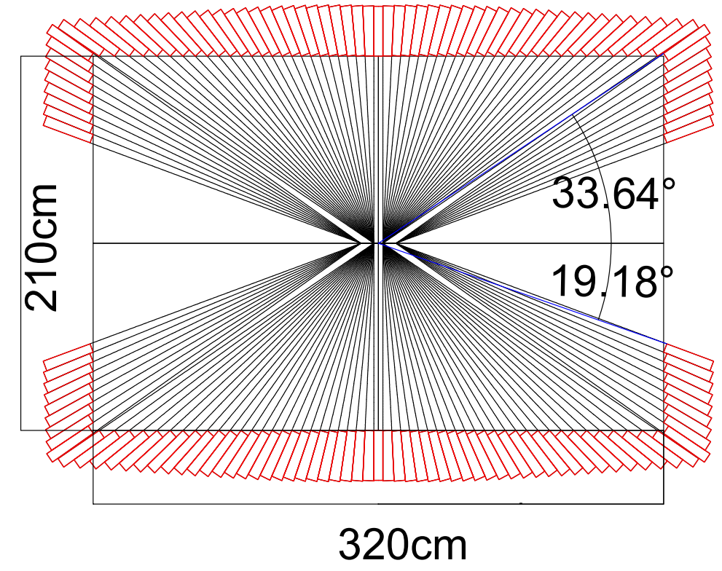
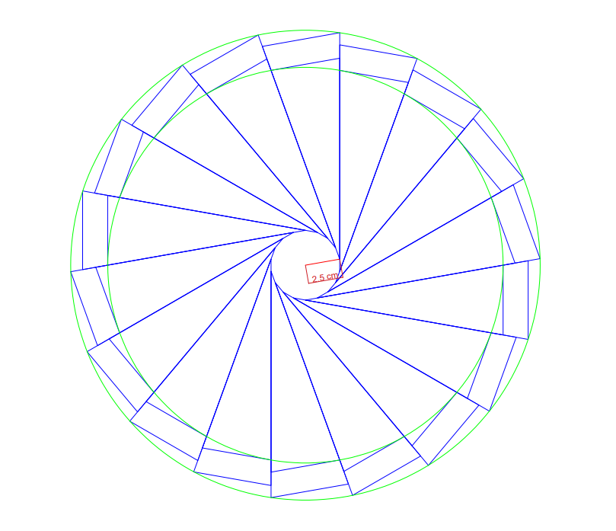
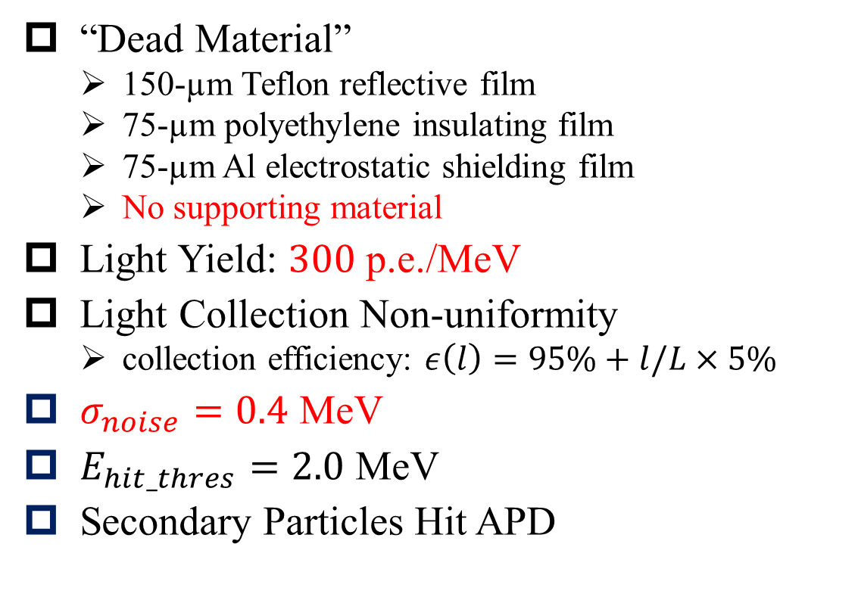
ECAL Setup
“Dead Material”
  150-µm Teflon reflective film
  75-µm polyethylene insulating film
  75-µm Al electrostatic shielding film
  No supporting material
Light Yield: $300$ p.e./MeV
Light Collection Non-uniformity
  collection efficiency: $ε\left(l\right)=95\%+l/L×5\%$
$σ_{noise}=0.4$ MeV
$E_{hit_thres}=2.0$ MeV
Secondary Particles Hit APD
2.5cm

Slide 6
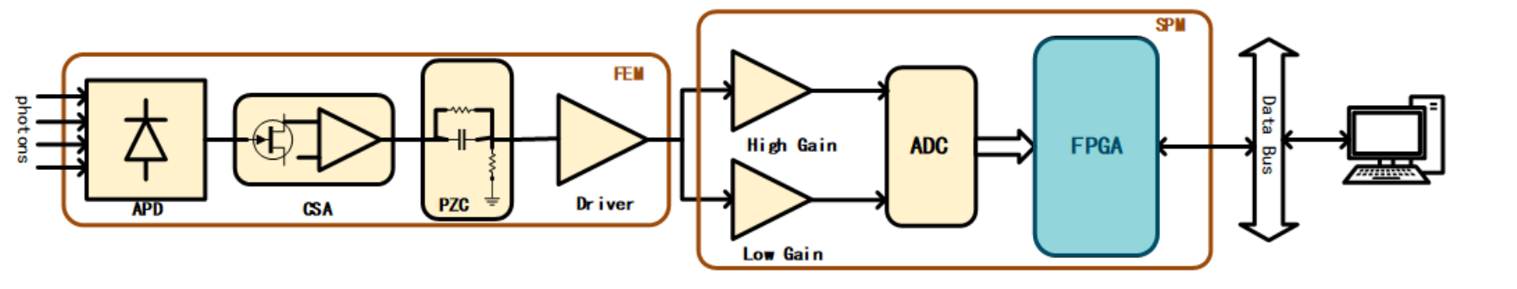
ECAL Electronics
Charge sensitive amplifier and pole-zero cancellation with shaping time 100 ns
High and Low Gain (300 MeV/3000MeV)
16-bit ADC (~16000 channels) with 80 MHz sampling rate

Slide 7
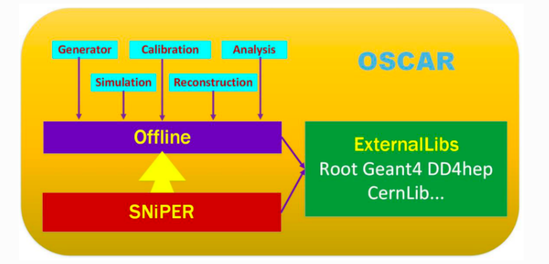
Based on OSCAR
OSCAR: Offline Software of Super Tau-Charm Facility
event
Simulation
ECAL Hit Slide
Digitization
ECAL Digi
OSCAR Framework Composition
Reconstruction
ECAL Shower

Slide 8
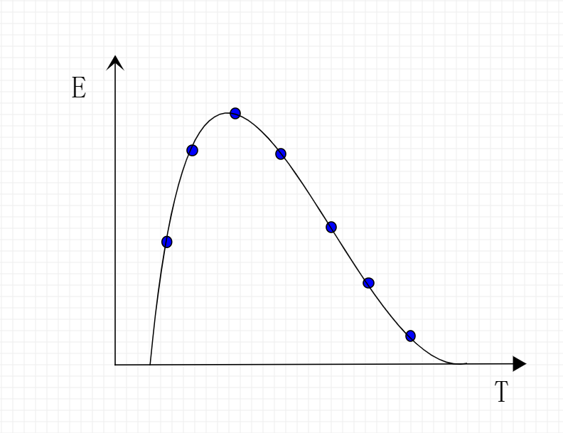
Simulation Algorithm
Based on Geant4 Simulation
  Process the information for each Geant4 step
Data Model (layer as a unit)
  Thickness 2cm as a layer unit
  Each unit with a energy-time distribution:
  points with (E,T)
  Bin width 500ps for energy-time distribution
  Save storage space
  Minimal loss of information
  Facilitate the Digitization
28cm
2cm

Slide 9
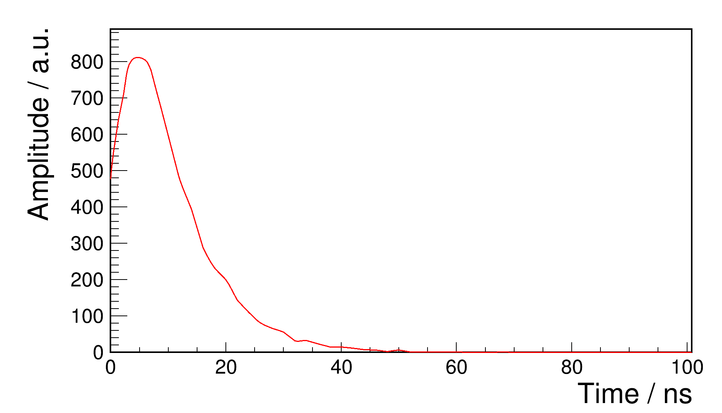
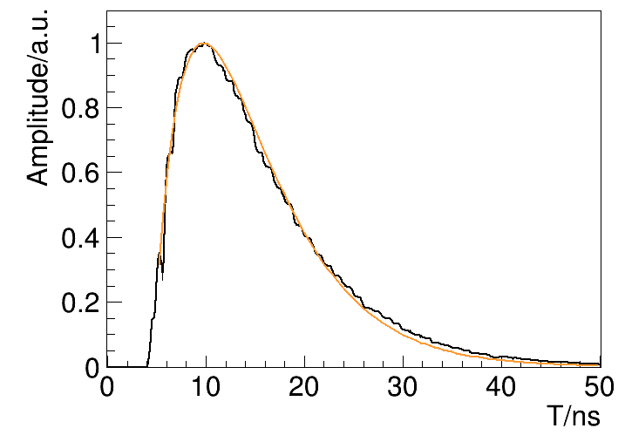
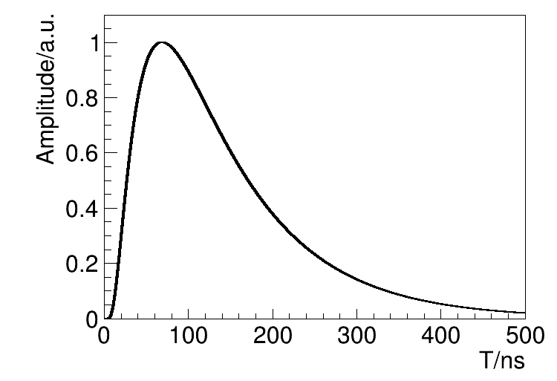
Digitization Algorithm
Waveform shaping
Geant4 optical simulation for each layer unit (standalone)
convolution
Electronic noise
Sampling
Scintillation process
Points (E-T) in each layer unit
Fluorescence transfer parameterized simulation
ADC (12.5ns)
Electronics response function
Light output nonuniformity
Output waveform

Slide 10
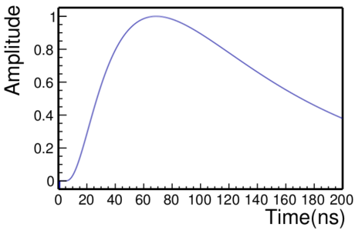
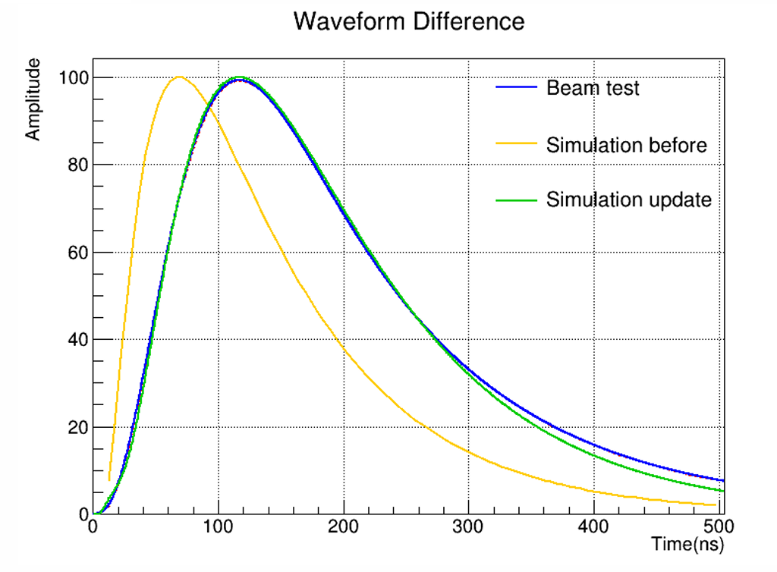

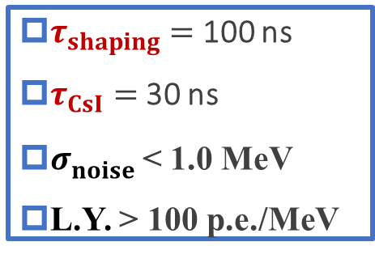
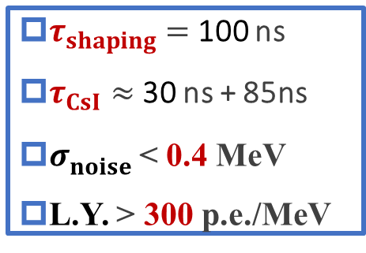


Digitization Algorithm
Waveform check
$$τ_{CsI}$$
$$τ_{shaping}$$
$$τ_{shower}$$
$τ_{shaping}=$ 100 ns
$τ_{CsI}=$ 30 ns
$σ_{noise}^{}$< 1.0 MeV
L.Y. > 100 p.e./MeV
$τ_{shaping}=$ 100 ns
$τ_{CsI}≈$ 30 ns + 85ns
$σ_{noise}^{}$< 0.4 MeV
L.Y. > 300 p.e./MeV

Slide 11
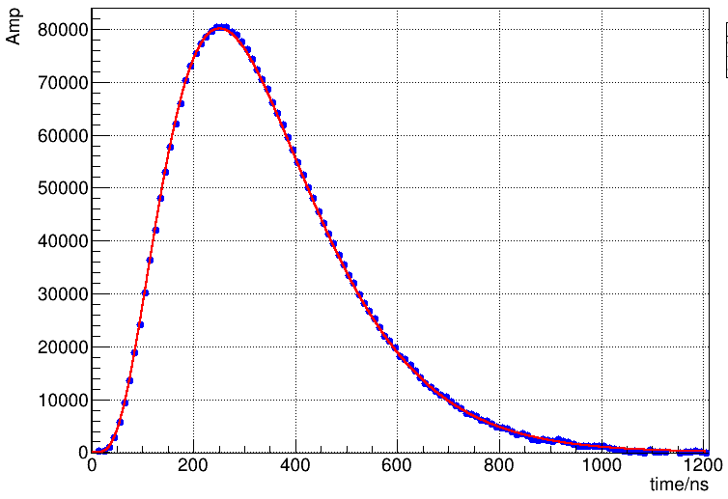
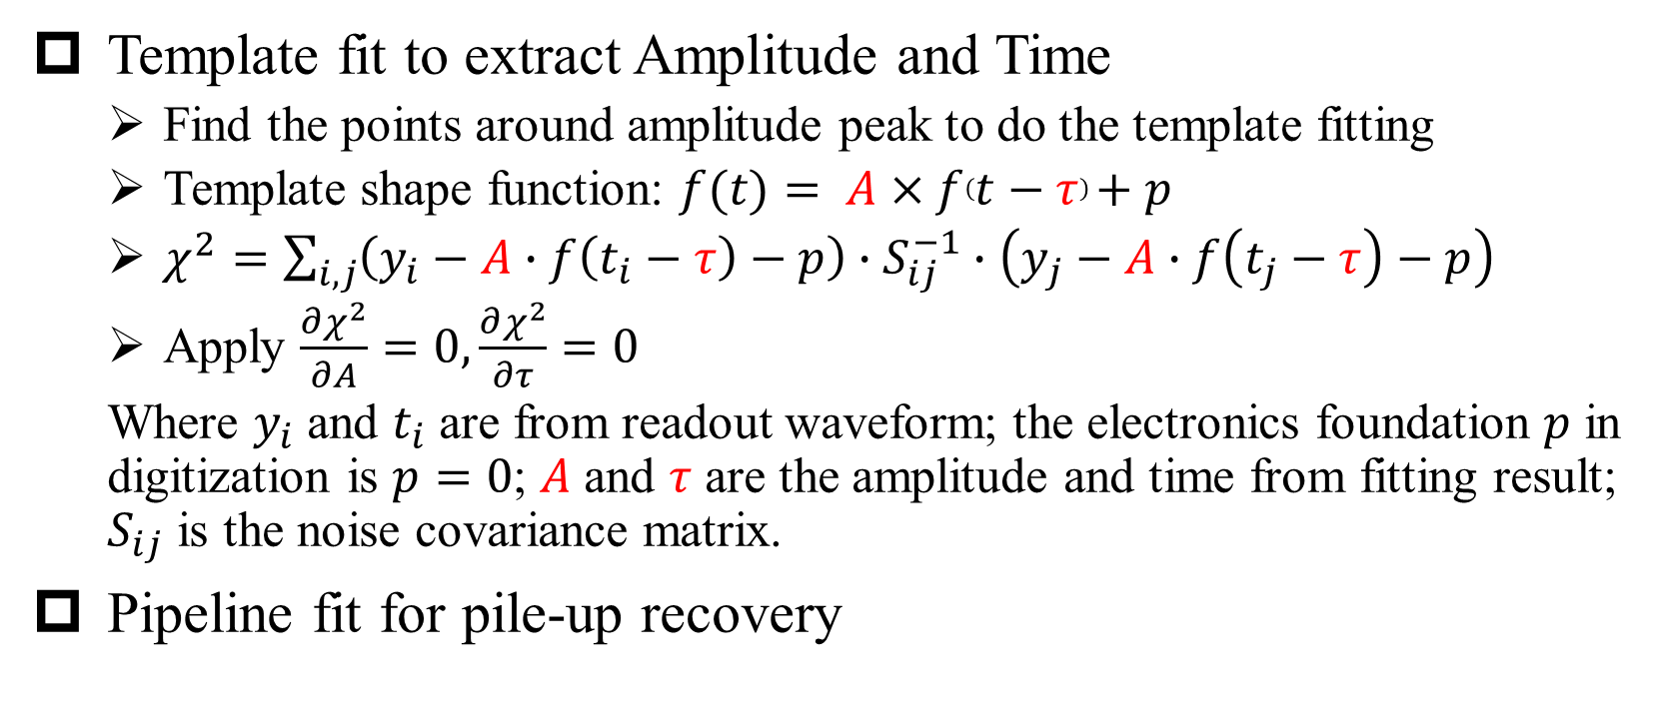
Digitization Algorithm
Waveform fitting
Template fit to extract Amplitude and Time
  Find the points around amplitude peak to do the template fitting
  Template shape function: $f(t)= A×f\left(t−τ\right)+p$
  $χ^{2}=\sum_{i,j}{\left(y_{i}−A∙f\left(t_{i}−τ\right)−p\right)∙S_{ij}^{−1}∙\left(y_{j}−A∙f\left(t_{j}−τ\right)−p\right)}$
  Apply $\frac{∂χ^{2}}{∂A}=0, \frac{∂χ^{2}}{∂τ}=0$
  Where $y_{i}$ and $t_{i}$ are from readout waveform; the electronics foundation $p$ in digitization is $p=0$; $A$ and $τ$ are the amplitude and time from fitting result; $S_{ij}$ is the noise covariance matrix.
Pipeline fit for pile-up recovery

Slide 12
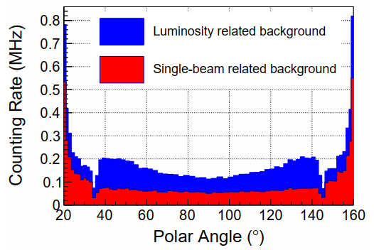
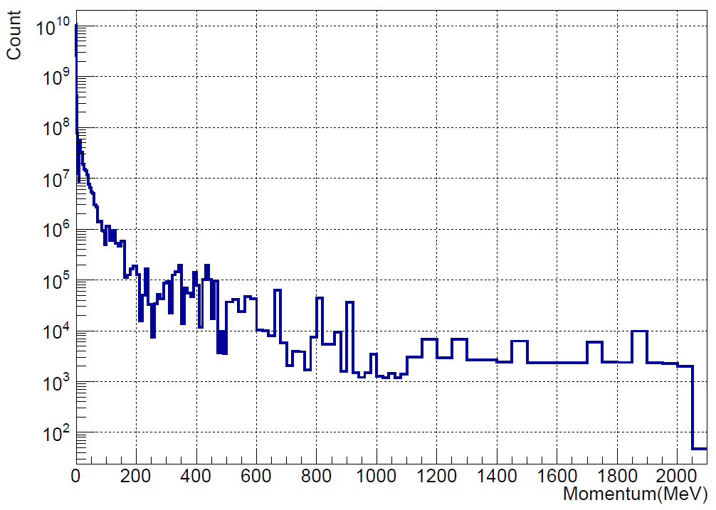
Challenges of high background
Luminosity-related Background
  Radiative BhaBha Scattering (RBB)
  Two Photon Process
  Variation of the background counting rate with polar angle
  Counting rate reaches the order of MHz
Single-beam related Background
  Thouschek Effect
  Coulomb Scattering
  Bremsstrahlung
  Momentum distribution of background particles
  Most background particles concentrate in the low momentum region

Slide 13
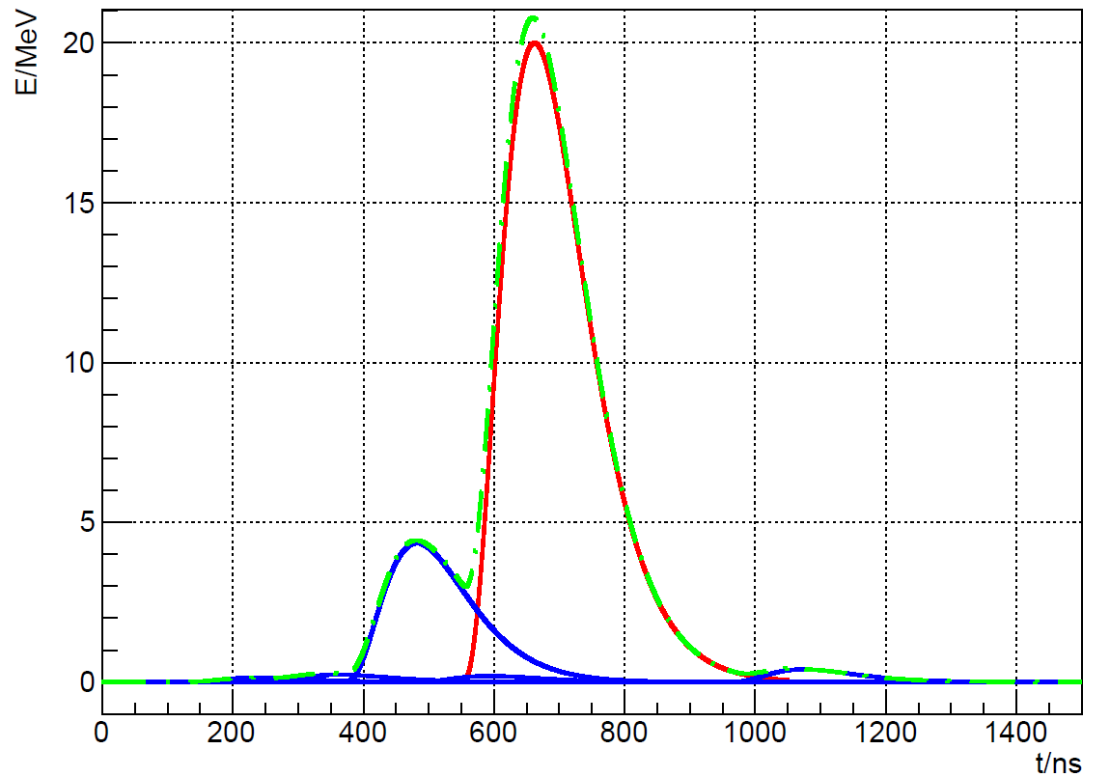
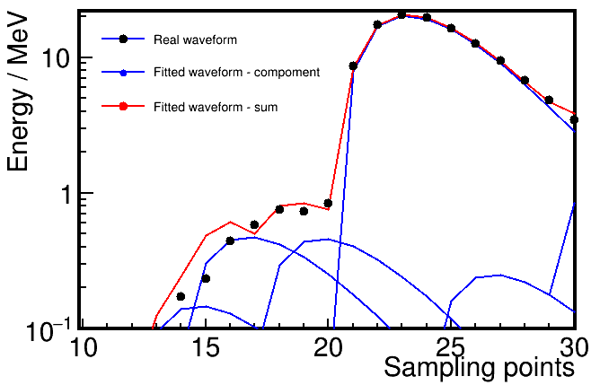
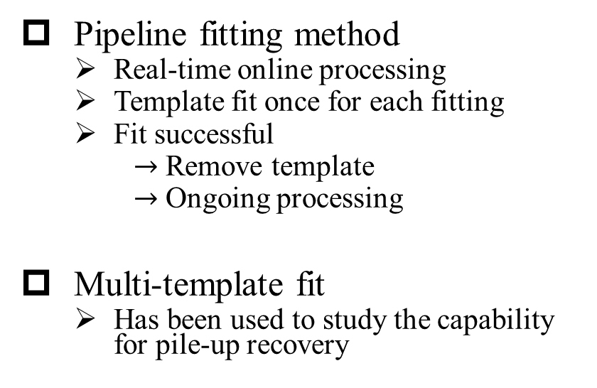
Digitization Algorithm
Pile-up recovery
Pile-up is superimposed on the signal waveform
  Inaccurate fit results of amplitude and time
  Larger resolution of energy and time
Pipeline fitting method
  Real-time online processing
  Template fit once for each fitting
  Fit successful
  $→$ Remove template
  $→$ Ongoing processing
Multi-template fit
  Has been used to study the capability for pile-up recovery
The amplitude of signal is distorted

Slide 14
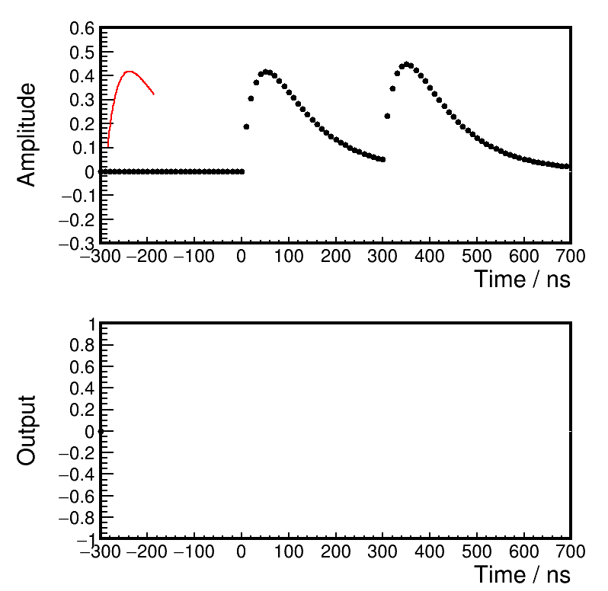
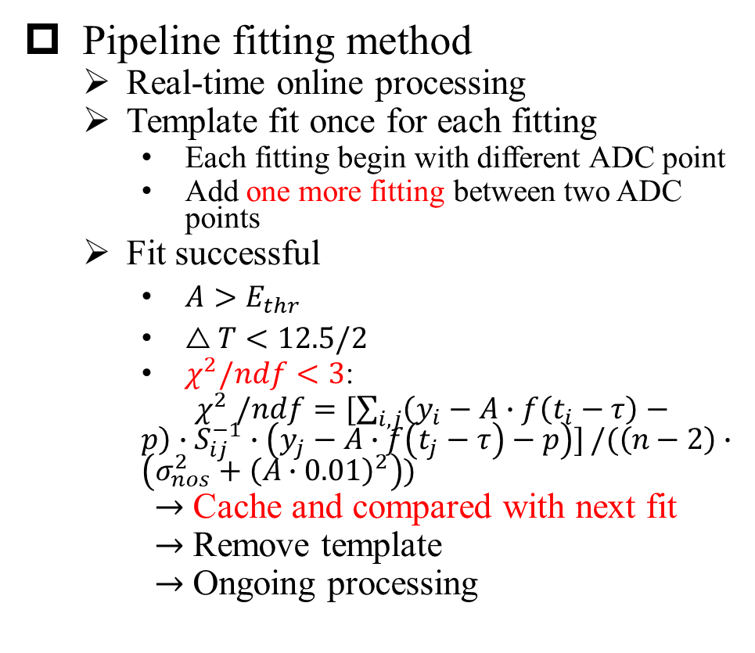
Digitization Algorithm
Pipeline fit
Pipeline fitting method
  Real-time online processing
  Template fit once for each fitting
    Each fitting begin with different ADC point
    Add one more fitting between two ADC points
  Fit successful
    $A>E_{thr}$
    $△T<12.5/2$
    $χ^{2}/ndf<3$:
    $χ^{2} /ndf=[\sum_{i,j}{\left(y_{i}−A∙f\left(t_{i}−τ\right)−p\right)∙S_{ij}^{−1}∙\left(y_{j}−A∙f\left(t_{j}−τ\right)−p\right)]}/(\left(n−2\right)∙\left(σ_{nos}^{2}+{\left(A∙0.01\right)}^{2}\right))$
  $→$ Cache and compared with next fit
  $→$ Remove template
  $→$ Ongoing processing

Slide 15
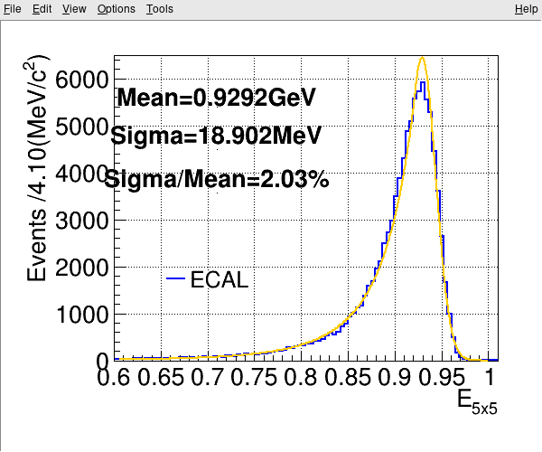
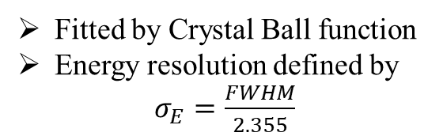

Reconstruction Algorithm
A complete reconstruction algorithm of ECAL is developed
Cluster search
ECALRecAlg
Seed search
Seed
Clusters split into Showers
Energy distribution of 1GeV $γ$ with background
Fitted by Crystal Ball function
Energy resolution defined by
$σ_{E}=\frac{FWHM}{2.355}$
Calculation and correction of shower energy and position
$π^{0}$Cluster (two photons)

Slide 16
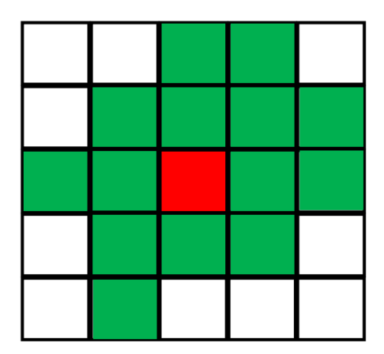
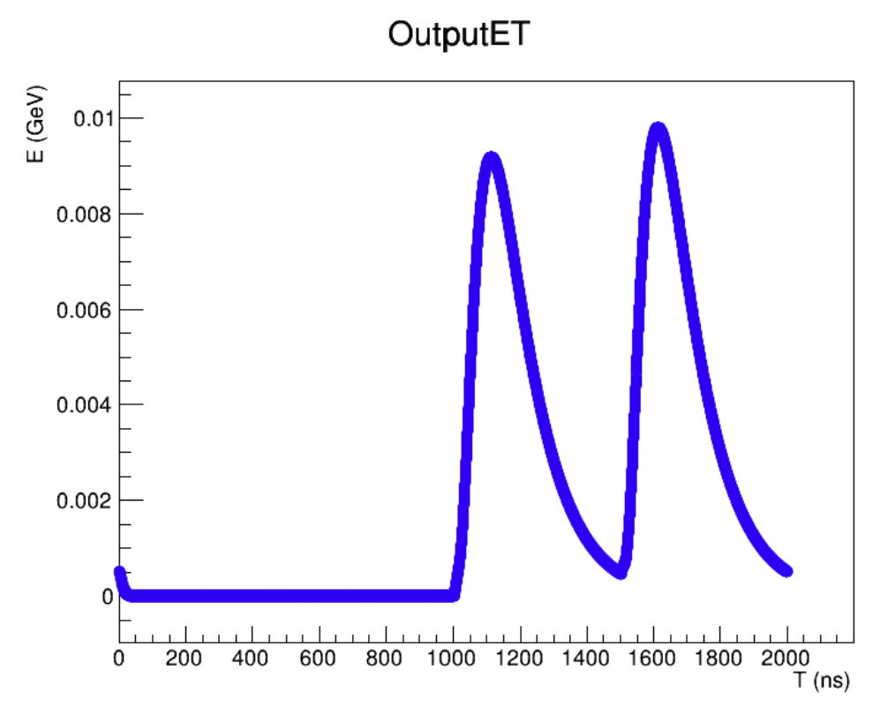
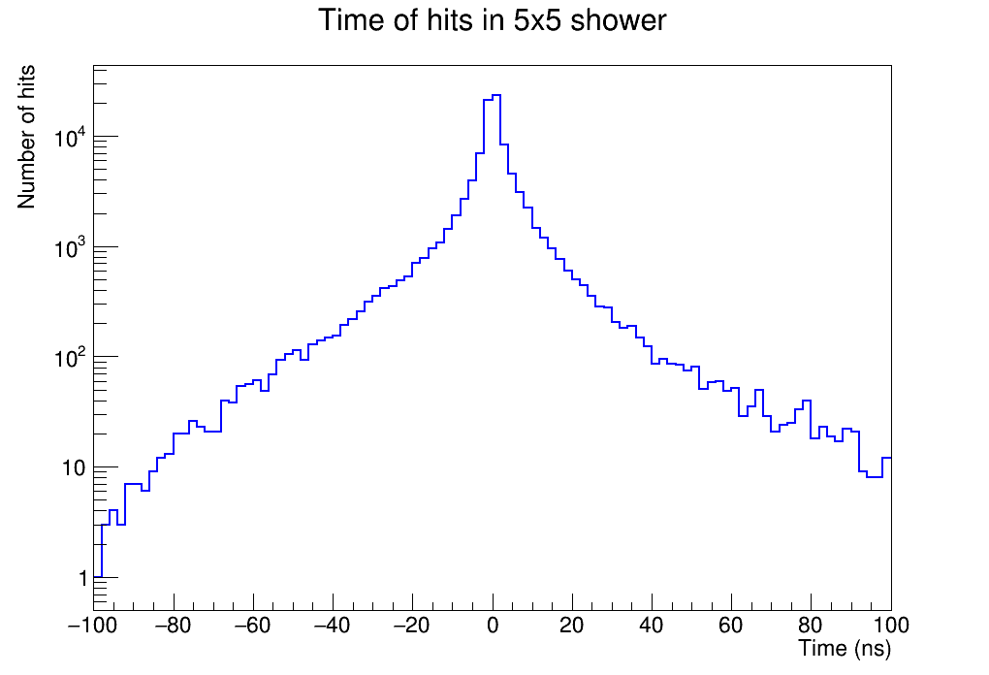
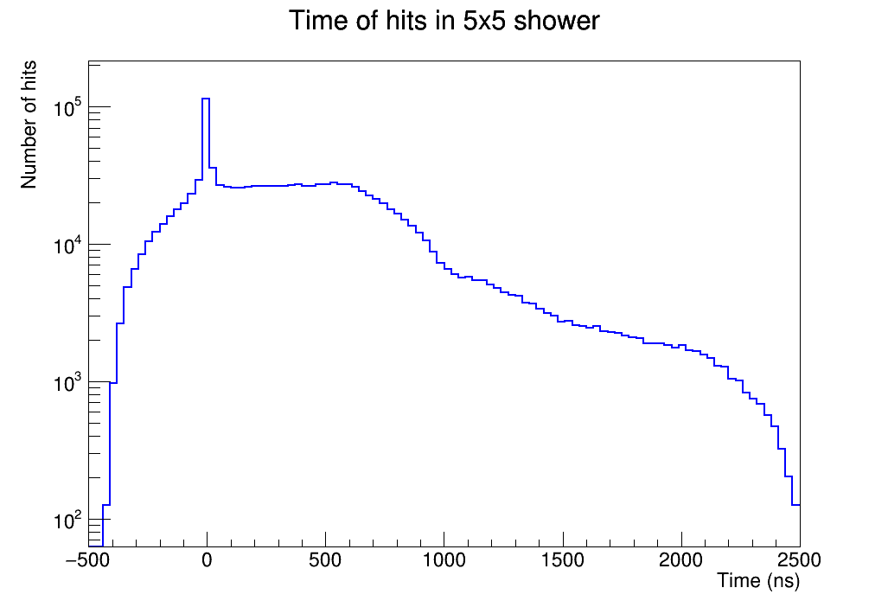
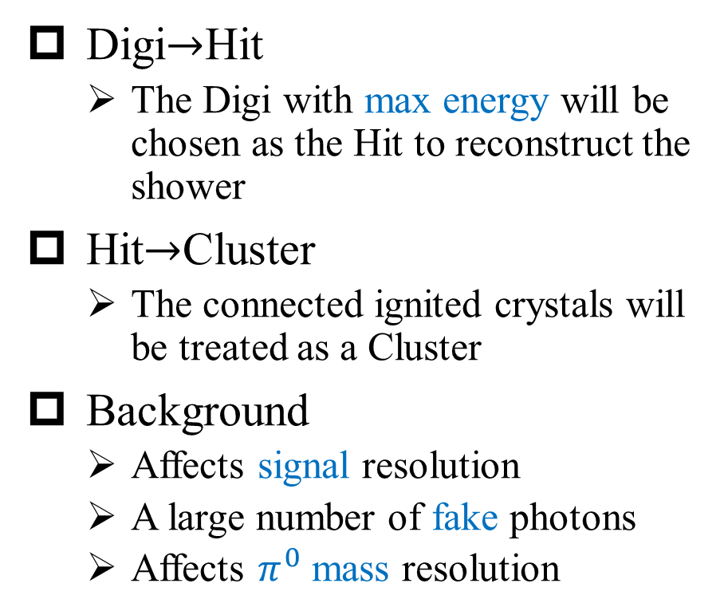
Reconstruction Algorithm
No Time information
Digi$→$Hit
  The Digi with max energy will be chosen as the Hit to reconstruct the shower
Hit$→$Cluster
  The connected ignited crystals will be treated as a Cluster
Background
  Affects signal resolution
  A large number of fake photons
  Affects $π^{0}$ mass resolution
w/o bkg
w bkg

Slide 17
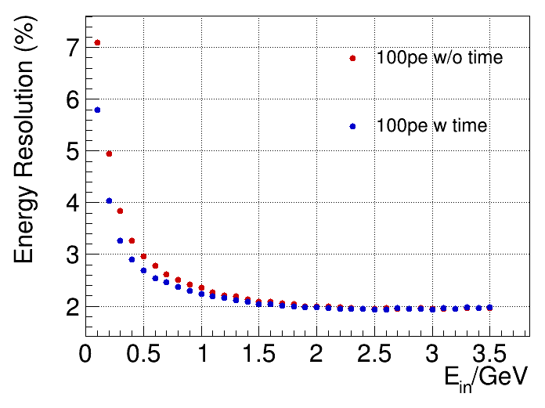
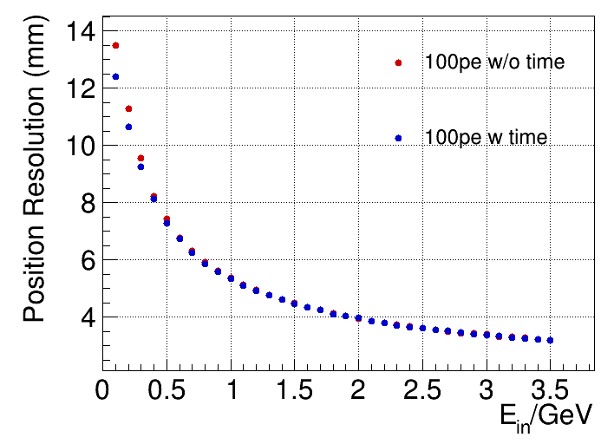
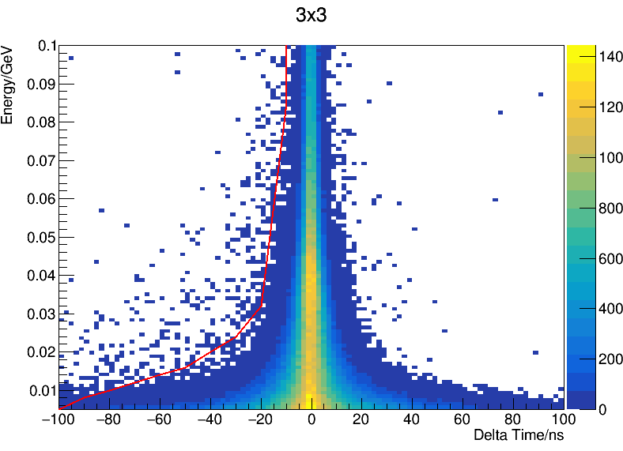
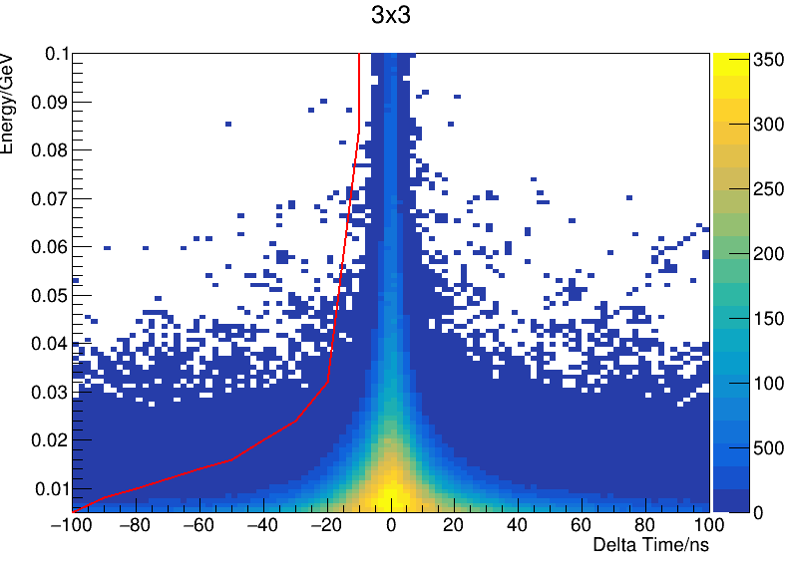
Reconstruction Algorithm
Add Time information of Digi
  Seed finding in 3D space with timing information
  Add time selection while reconstructing Cluster
w/o bkg
w bkg

Slide 18
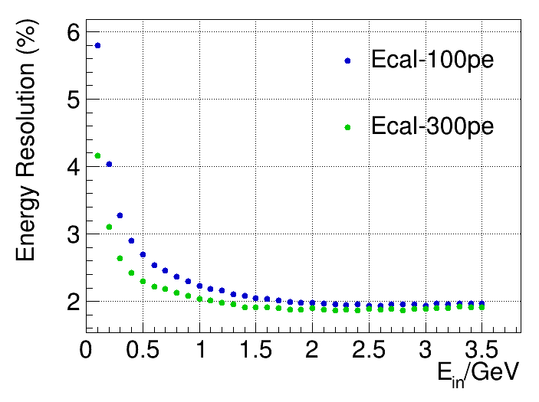
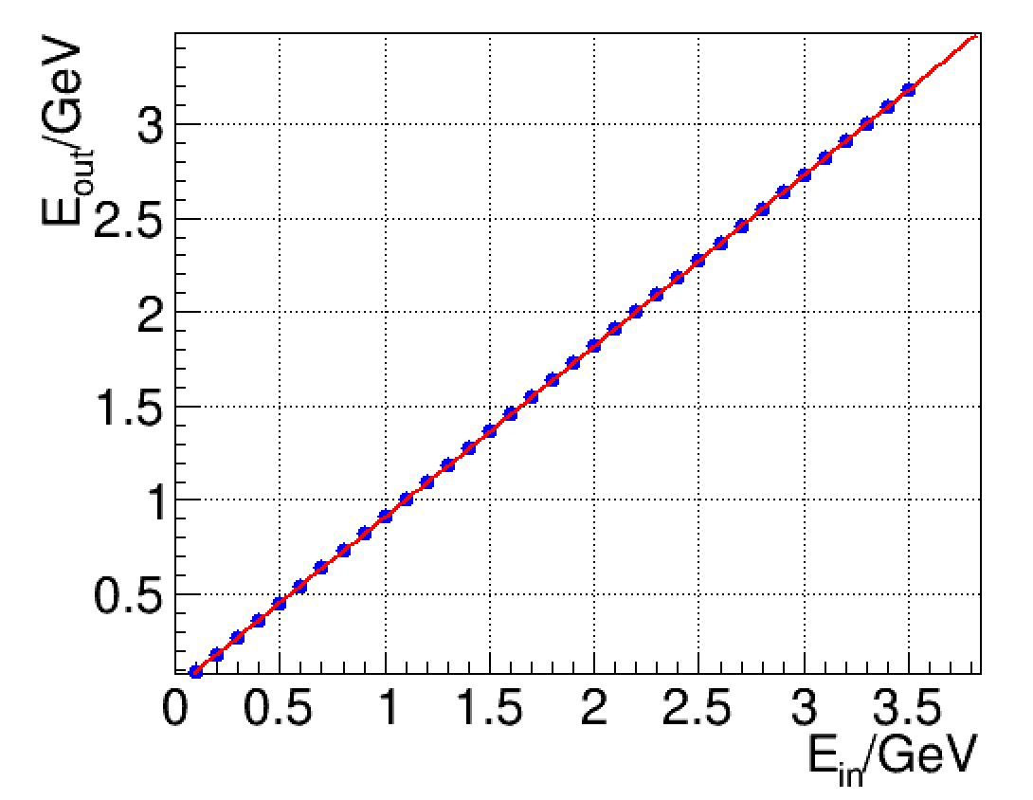
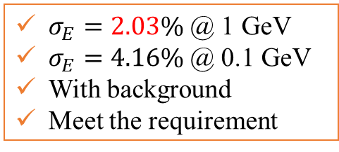
Reconstruction Performance
Energy Reconstruction
$σ_{E}=2.03\%$ @ 1 GeV
$σ_{E}=4.16\%$ @ 0.1 GeV
With background
Meet the requirement
Good energy linearity in the energy range of 100 MeV ~ 3.5 GeV

Slide 19
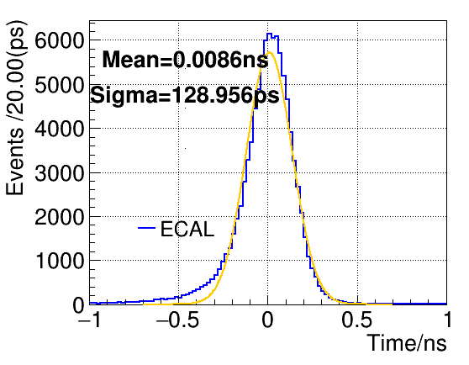
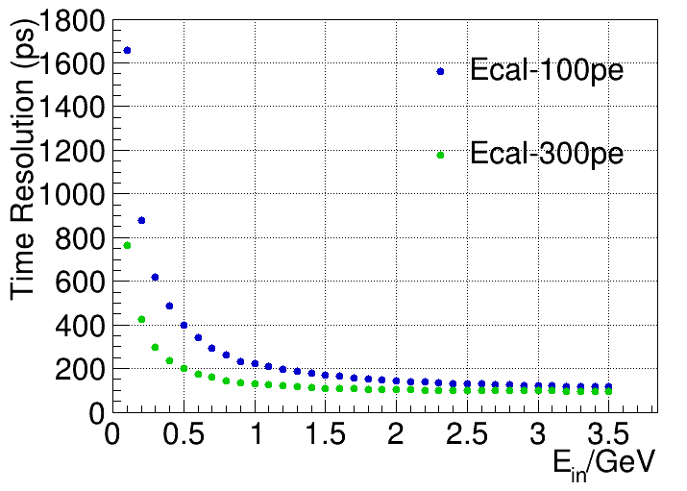
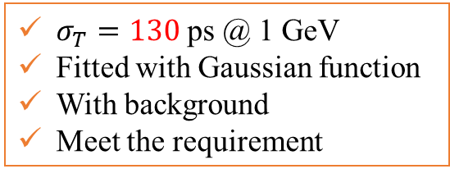
Reconstruction Performance
Time Reconstruction
1 GeV
$σ_{T}=130$ ps @ 1 GeV
Fitted with Gaussian function
With background
Meet the requirement

Slide 20
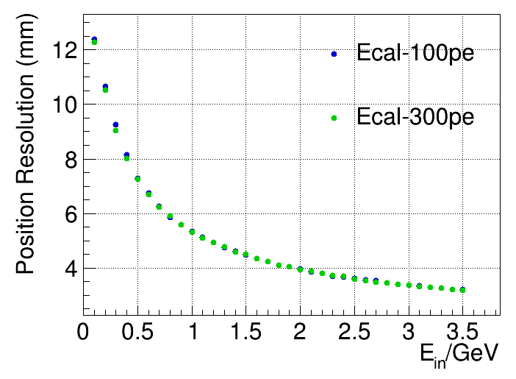
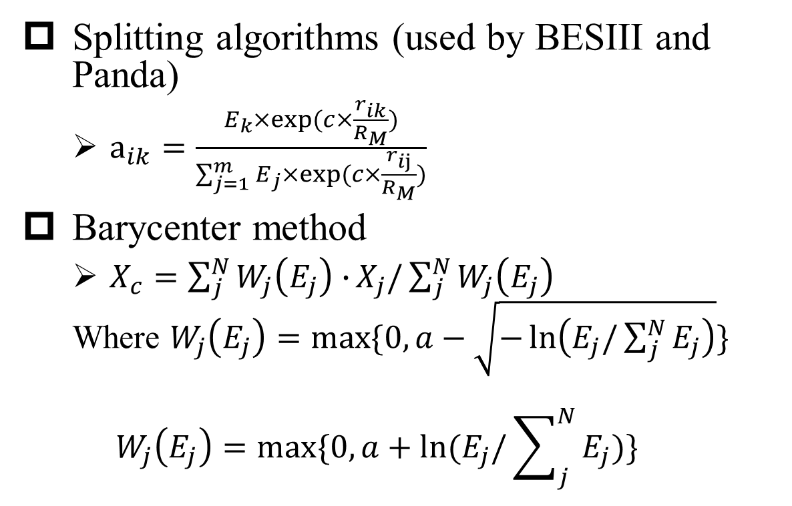
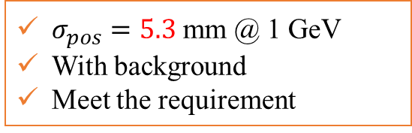
Reconstruction Performance
Position Reconstruction
Splitting algorithms (used by BESIII and Panda)
  $a_{ik}=\frac{E_{k}×exp⁡(c×\frac{r_{ik}}{R_{M}})}{\sum_{j=1}^{m}{E_{j}×}exp⁡(c×\frac{r_{ij}}{R_{M}})}$
Barycenter method
  $X_{c}=\sum_{j}^{N}{W_{j}\left(E_{j}\right)∙}X_{j}/\sum_{j}^{N}{W_{j}\left(E_{j}\right)}$
  Where $W_{j}\left(E_{j}\right)=max⁡\{0,a−\sqrt{−\ln\left(E_{j}/\sum_{j}^{N}{E_{j}}\right)}\}$
  $$W_{j}\left(E_{j}\right)=max⁡\{0,a+ln⁡(E_{j}/\sum_{j}^{N}{E_{j}})\}$$
$σ_{pos}=5.3$ mm @ 1 GeV
With background
Meet the requirement

Slide 21
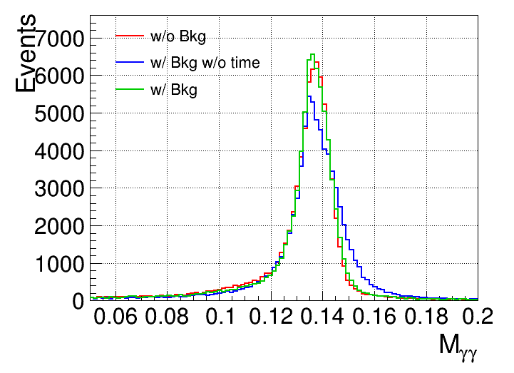
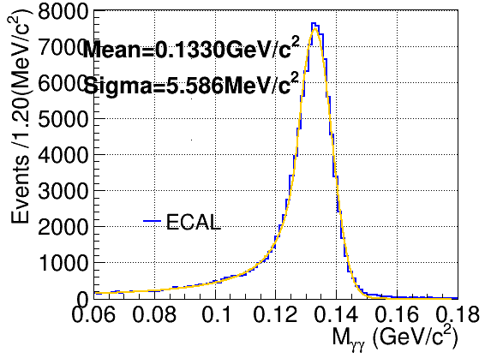







Reconstruction Performance
$π^{0}$ Reconstruction
$m_{π^{0}}=\sqrt{2E_{1}E_{2}(1−cosα)}$
~1 GeV
$$−10ns<T_{seed}<10ns$$
$π^{0}$ with the minimum $∆M$
Truth matched $π^{0}$
$J/ψ→ρπ$ sample
$σ_{π^{0}}=5.6$ MeV/$c^{2}$ @ 1 GeV
With background

Slide 22





Electron PID Algorithm
E/P ratio
  E: Energy of ECAL Shower
  P: Momentum from Track
  $L_{e}=\ln\left(e\right)+0.001$; $L_{other}=\ln\left(other\right)+0.001$
  Poor performance in low-momentum
BDT Method
  Input variables: charge, $P_{track}$, $E_{shower}$, E/P, $T_{seed}$, $|R_{ext}−R_{shower}|$, $N_{hits}$, $E_{seed}/E_{shower}$, $\left(E_{3x3}−E_{seed}\right)/E_{shower}$, $\left(E_{5x5}−E_{3x3}\right)/E_{shower}$, second moment, lateral moment, $A_{20}$ moment, $A_{42}$ moment
  Distinguishing electrons from other charged hadrons (or muon)
  BDT Method used

Slide 23

Summary
The software of ECAL has been established based on OSCAR
The simulated performance of ECAL meets requirements with the background concerned
  Energy measurement with 2.03% @ 1 GeV
  Time measurement with 130 ps @ 1 GeV
  Position measurement with 5.3 mm @ 1 GeV
  $π^{0}$ mass measurement with 5.6 MeV/$c^{2}$ @ ~1GeV
  Sufficient capability for electron identification
Prospect:
  Verify and update digitization to align with beam test data
Thanks for your listening!

Slide 24
Back up

Slide 25



ECAL Design —— Sensitive Unit
Pure CsI crystal + APD photo-device
  Pure CsI (pCsI) crystal
    Fast decay time
    Good radiation hardness
    Low light yield
  Crystal Size:
      Total radiation length
      15 $X_{0}$ (28 cm)
    End face size
  front end: ~$5×5 {cm}^{2}$
  back end: ~$6.5×6.5 {cm}^{2}$
  Avalanche photodiode (APD)
    Short wavelength type
    Large area ($10×10 {mm}^{2}×4$)
APD
pCsI
ECAL pCsI crystal unit

Slide 26


Simulation Algorithm
Data Model
Sizes of thickness and time bin width have been optimized
  No large difference of time distribution for different thickness
    Consider the non-uniformity may vary in the future : 2cm
  Different time bin width with different time resolution and central value
    Difference in central value approximately equivalent to a shift of the template
    Consider the resolution and the similarity to the template: 500ps

Slide 27



Simulation Algorithm
Data Model
Energy distribution and comparison with template

Slide 28

Template Fitting
  Template shape function：$f(t)= A×f\left(t−τ\right)+p$
  $χ^{2}=\sum_{i,j}{\left(y_{i}−A∙f\left(t_{i}−τ\right)−p\right)∙S_{ij}^{−1}∙\left(y_{j}−A∙f\left(t_{j}−τ\right)−p\right)}$
  Apply $\frac{∂χ^{2}}{∂A}=0, \frac{∂χ^{2}}{∂τ}=0, \frac{∂χ^{2}}{∂p}=0$:
$$\left\{\begin{aligned}\sum_{i,j}{f_{ki}∙S_{ij}^{−1}∙\left(y_{j}−Af_{kj}−Bf_{kj}^{′}−p\right)=0} \\ \sum_{i,j}{f_{ki}^{′}∙S_{ij}^{−1}∙\left(y_{j}−Af_{kj}−Bf_{kj}^{′}−p\right)=0} \\ \sum_{i,j}{1∙S_{ij}^{−1}∙\left(y_{j}−Af_{kj}−Bf_{kj}^{′}−p\right)=0}\end{aligned}\right.$$
$$\begin{matrix}\left(\begin{matrix}F_{k}∙S^{−1}∙F_{k}^{T} & F_{k}∙S^{−1}∙F_{k}^{′T} & F_{k}∙S^{−1}∙I \\ F_{k}^{′}∙S^{−1}∙F_{k}^{T} & F_{k}^{′}∙S^{−1}∙F_{k}^{′T} & F_{k}^{′}∙S^{−1}∙I \\ I∙S^{−1}∙F_{k}^{T} & I∙S^{−1}∙F_{k}^{′T} & I∙S^{−1}∙I\end{matrix}\right)∙\left(\begin{matrix}A \\ B \\ p\end{matrix}\right)=\left(\begin{matrix}F_{k}∙S^{−1}∙Y \\ F_{k}^{′}∙S^{−1}∙Y \\ I∙S^{−1}∙Y\end{matrix}\right) \\ \left(\begin{matrix}A \\ B \\ p\end{matrix}\right)={\left(\begin{matrix}F_{k}∙S^{−1}∙F_{k}^{T} & F_{k}∙S^{−1}∙F_{k}^{′T} & F_{k}∙S^{−1}∙I \\ F_{k}^{′}∙S^{−1}∙F_{k}^{T} & F_{k}^{′}∙S^{−1}∙F_{k}^{′T} & F_{k}^{′}∙S^{−1}∙I \\ I∙S^{−1}∙F_{k}^{T} & I∙S^{−1}∙F_{k}^{′T} & I∙S^{−1}∙I\end{matrix}\right)}^{−1}∙\left(\begin{matrix}F_{k}∙S^{−1}∙Y \\ F_{k}^{′}∙S^{−1}∙Y \\ I∙S^{−1}∙Y\end{matrix}\right)\end{matrix}$$

Slide 29

Nonnegative Least Square (NNLS)

Slide 30


Pile-up Recovery
Multi-template fit
Fit all the potential waveforms with template
Isolate signals by time
The fit minimizes the $χ^{2}$ defined as:
  $$χ^{2}={\left(\sum_{j=1}^{N}{A_{j}\vec{p_{j}}−\vec{S}}\right)}^{T}C^{−1}\left(\sum_{j=1}^{N}{A_{j}\vec{p_{j}}−\vec{S}}\right)$$
  Where:
  N is the number of templates;
  vector $\vec{S}$ comprise the readout samples;
  vector $\vec{p_{j}}$ is the waveform template;
  $A_{j}$ are the amplitudes, which are obtained by the fit;
  $C$ is the noise covariance matrix.

Slide 31



BDT Input

Slide 32







BDT Output
e
$$μ$$
$$π$$
K
p

