Slide 1



STCF Event Display
Speaker：Qiongbing Zhang

Slide 2
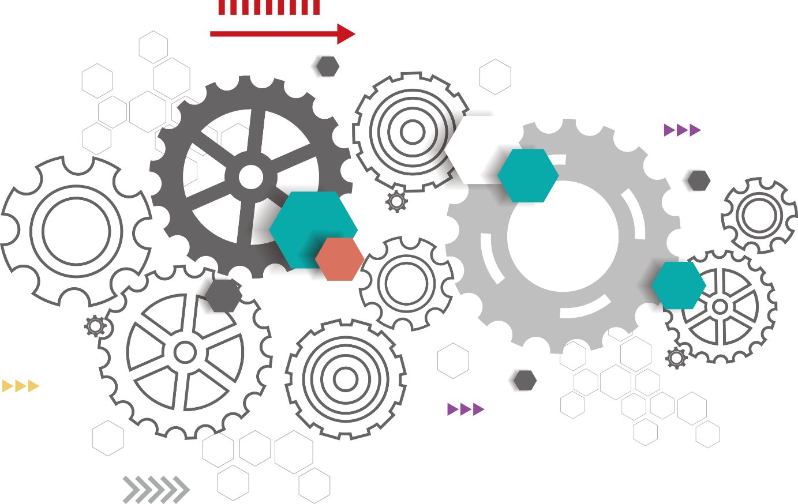
1
Background
CONTNETS
2
STCF Event Dispaly System
3
System optimization
4
Summary&Challenges

Slide 3
01
Background

Slide 4



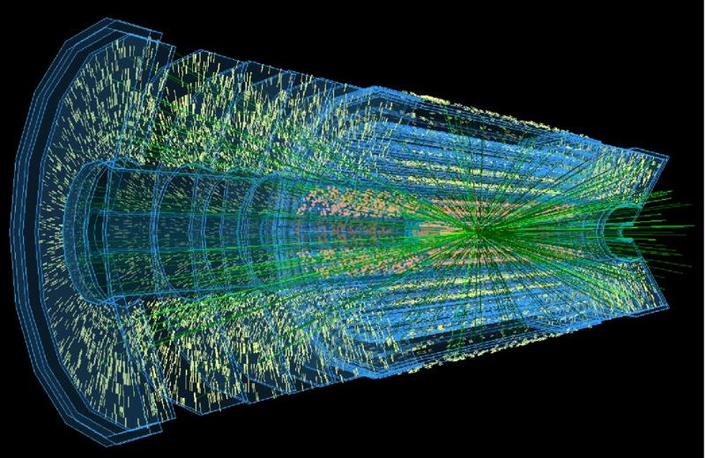
Background
Real experiments require expensive laboratory equipment
3D simulation;
Explore a web application to meet demands。
Uses 3D simulation technology to allow researchers to view designed detector structures and to analyse event data
Matching CMS, Phoenix, and Vis4hep;
Extending the display mode from 2D to 3D;
Accessing services from local to web services.

Slide 5
02
STCF event display system

Slide 6
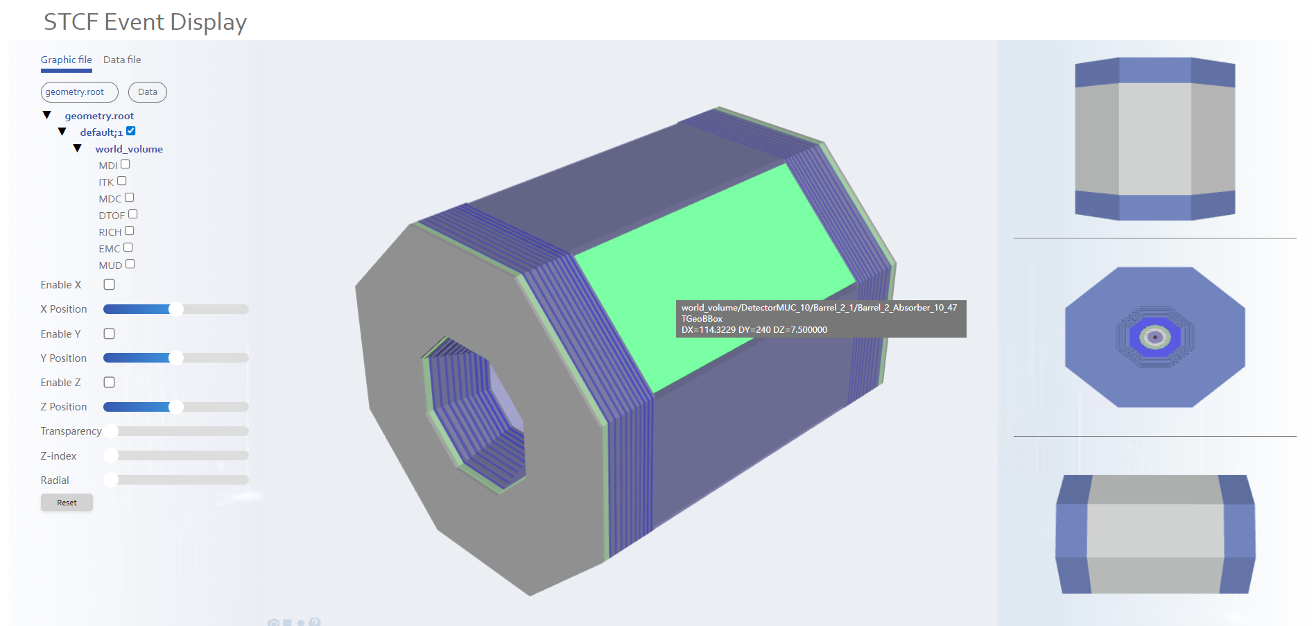
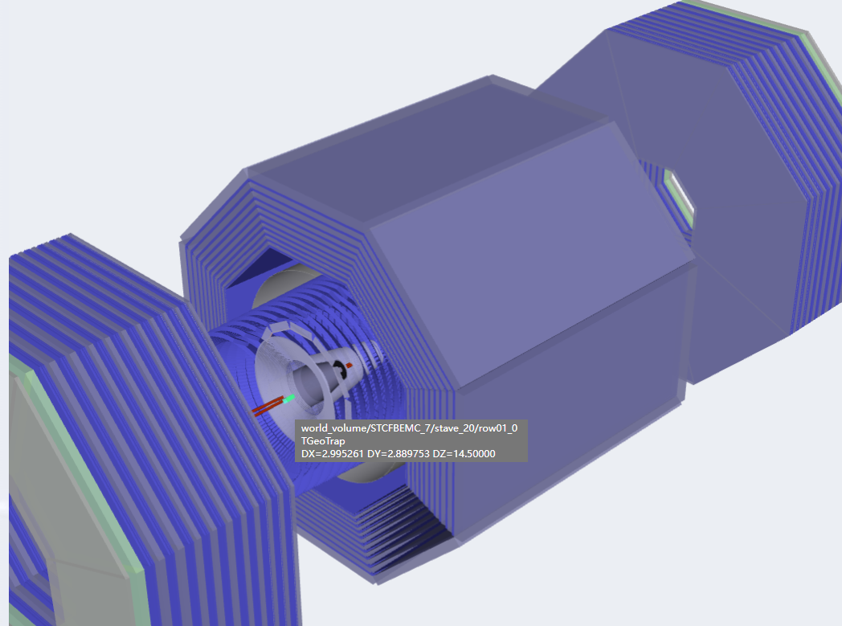
STCF event display system
The UI has become cleaner and more straightforward

Slide 7
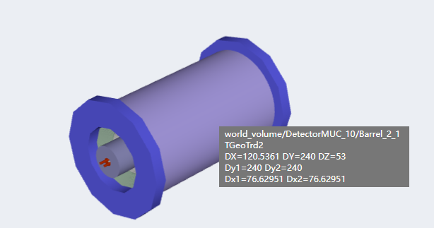
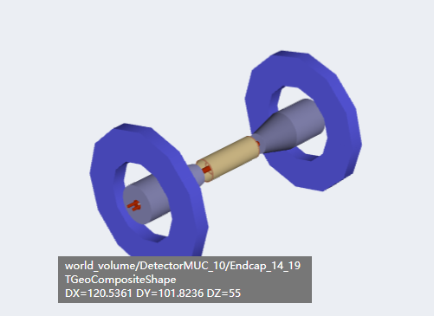
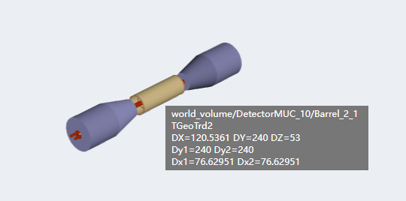
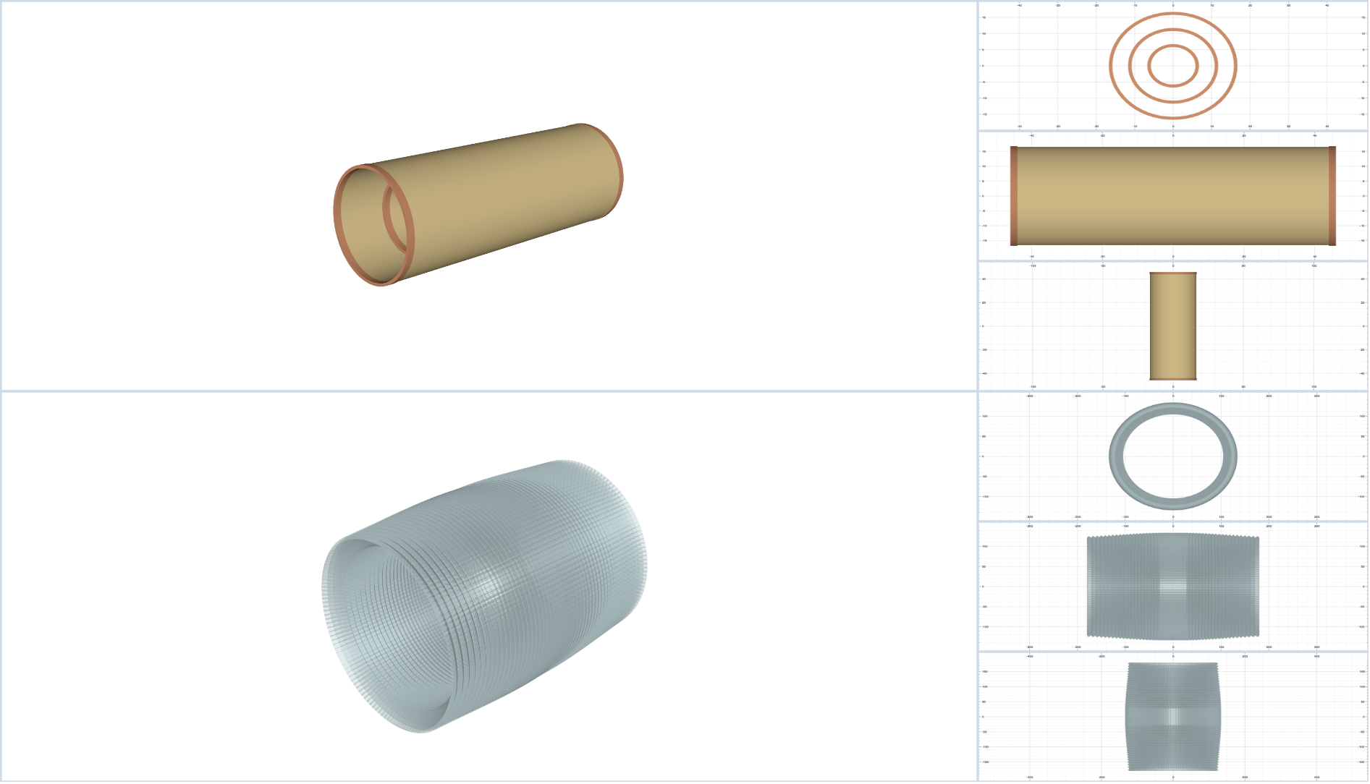
STCF event display system
The combination of Components
Multiple Windows

Slide 8
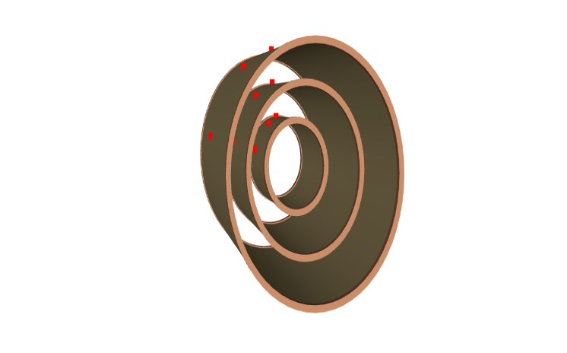
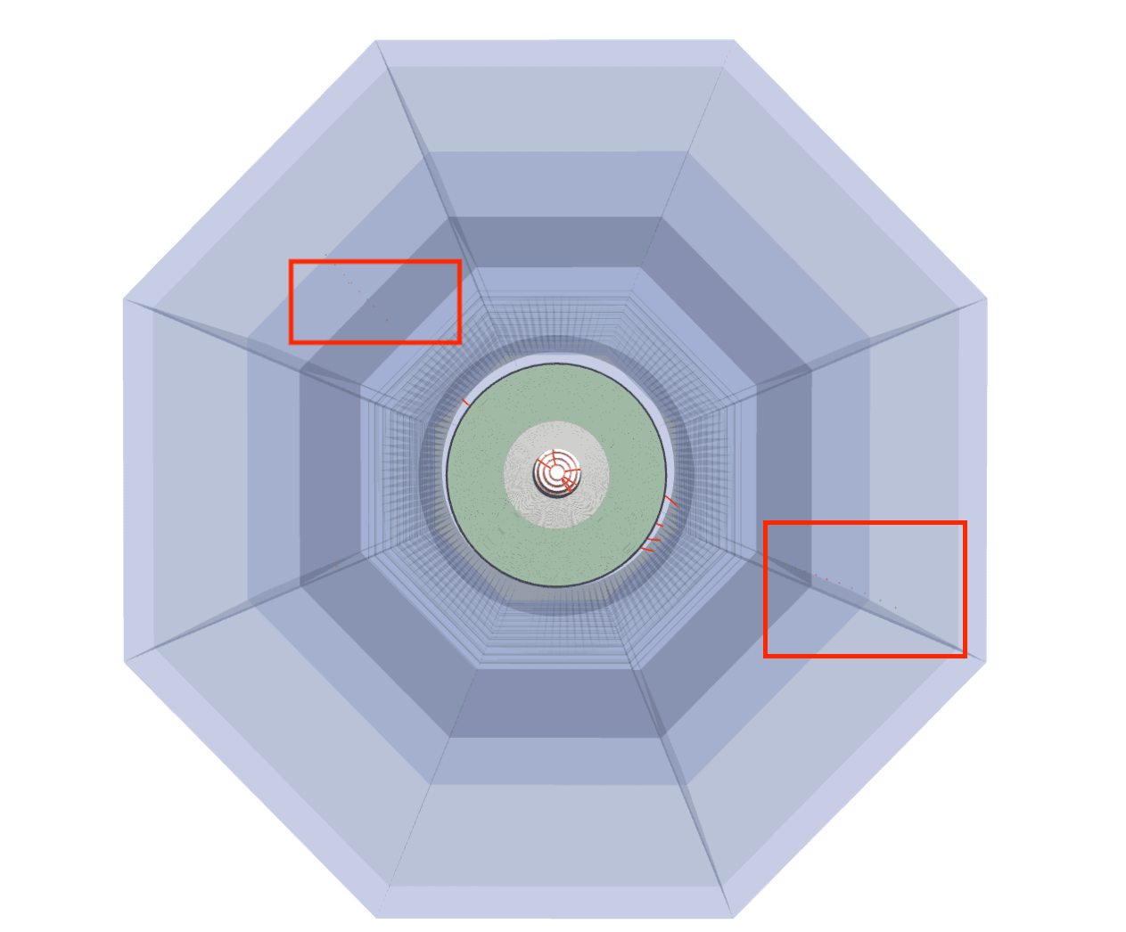
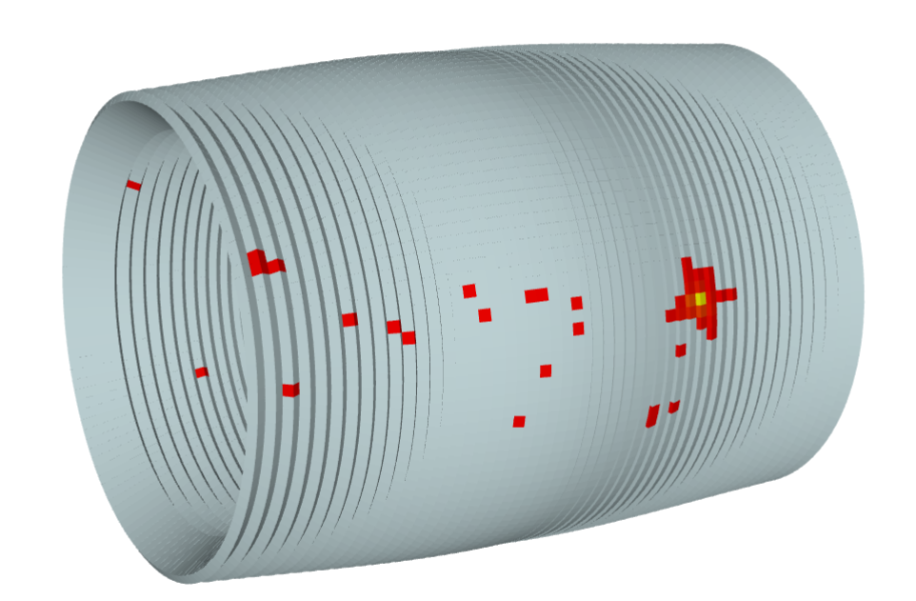
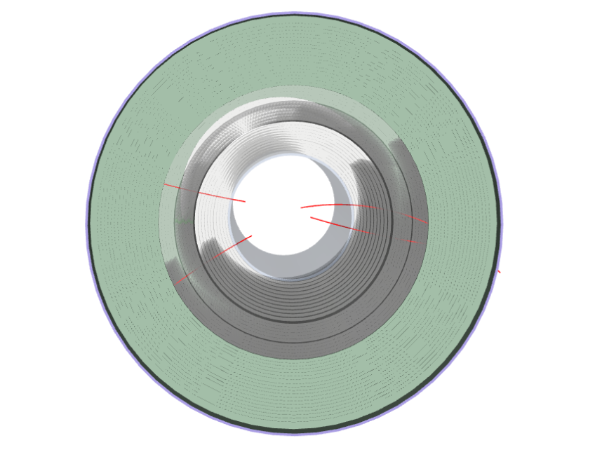
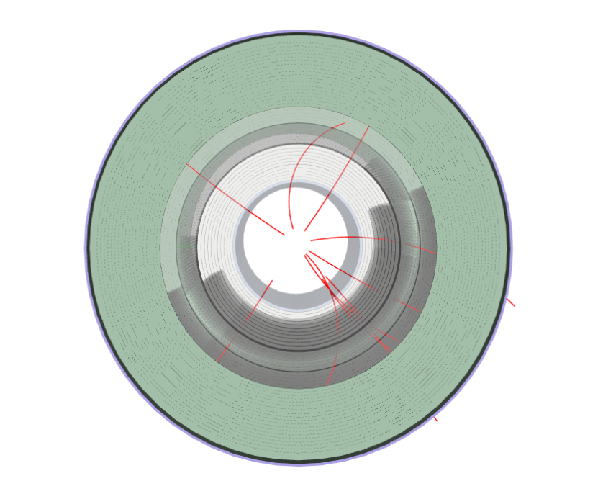
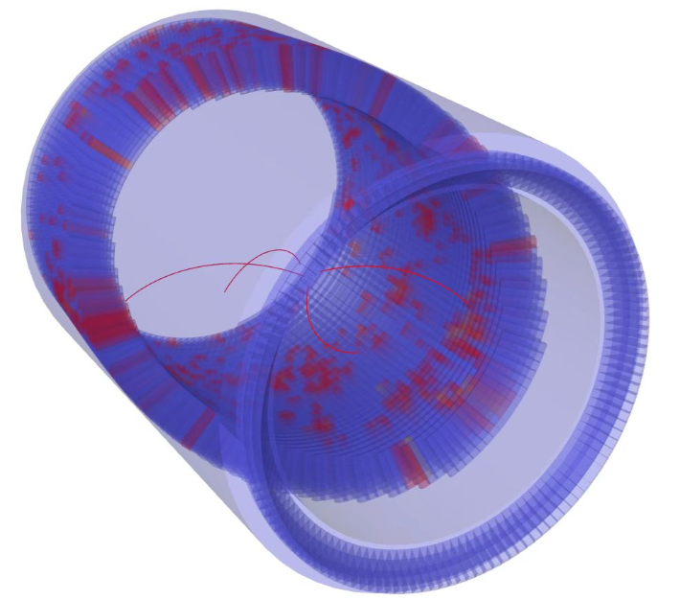
STCF event display system
Show the hits
Show the tracks

Slide 9
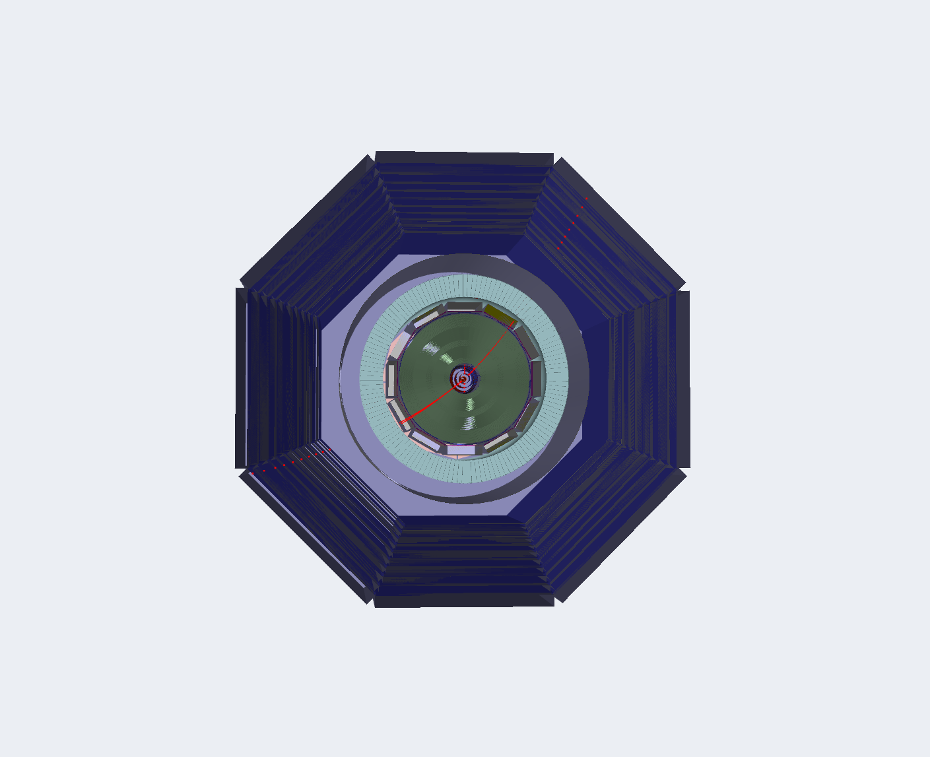
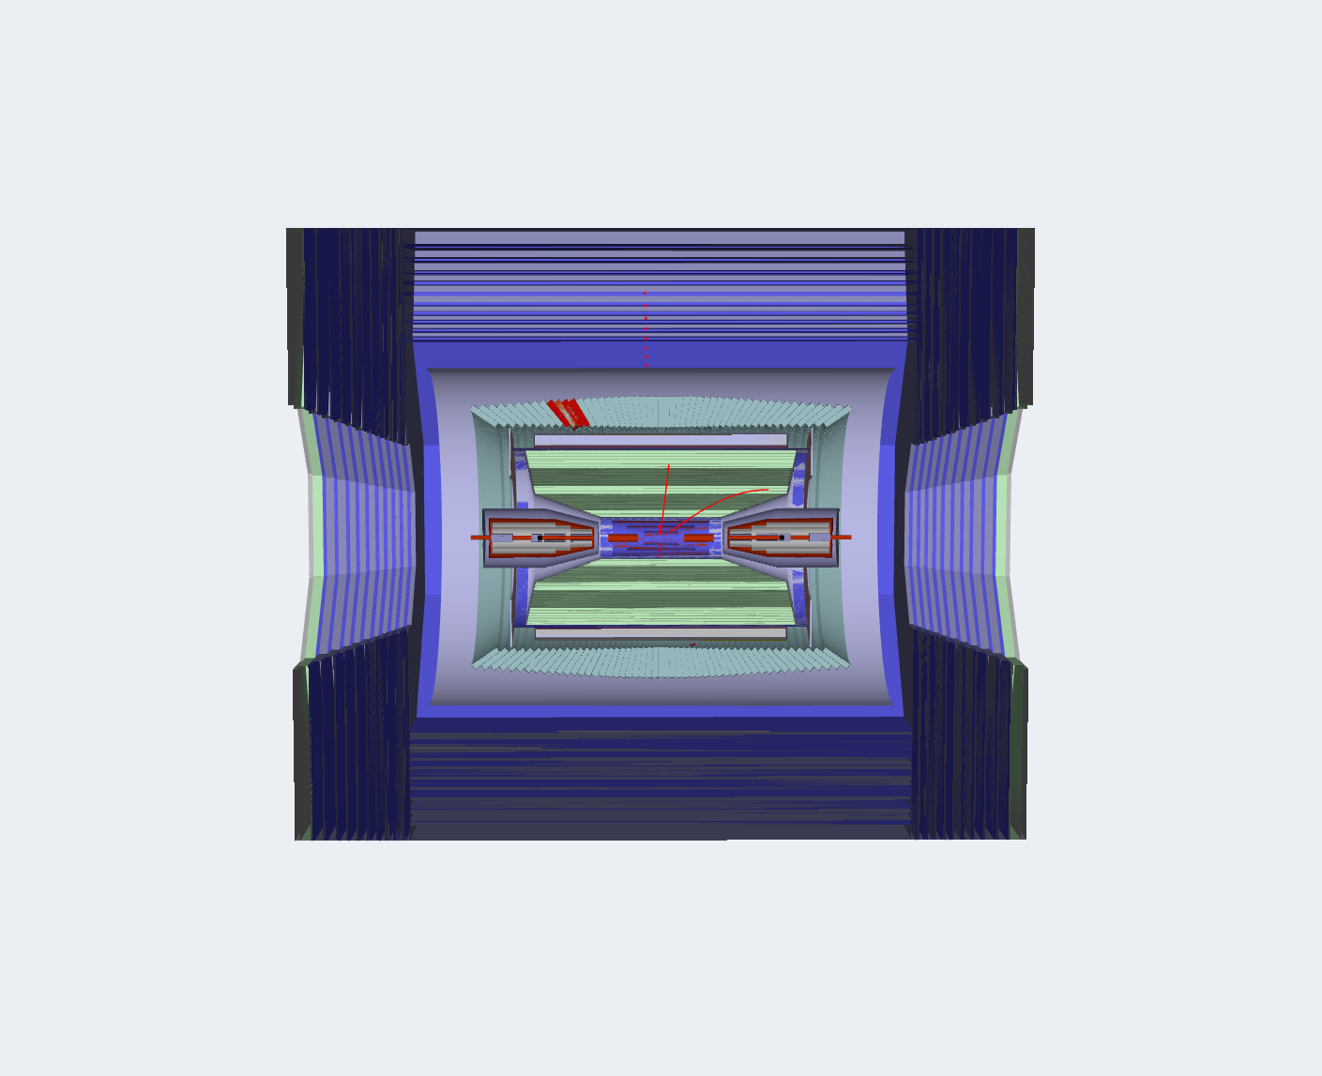
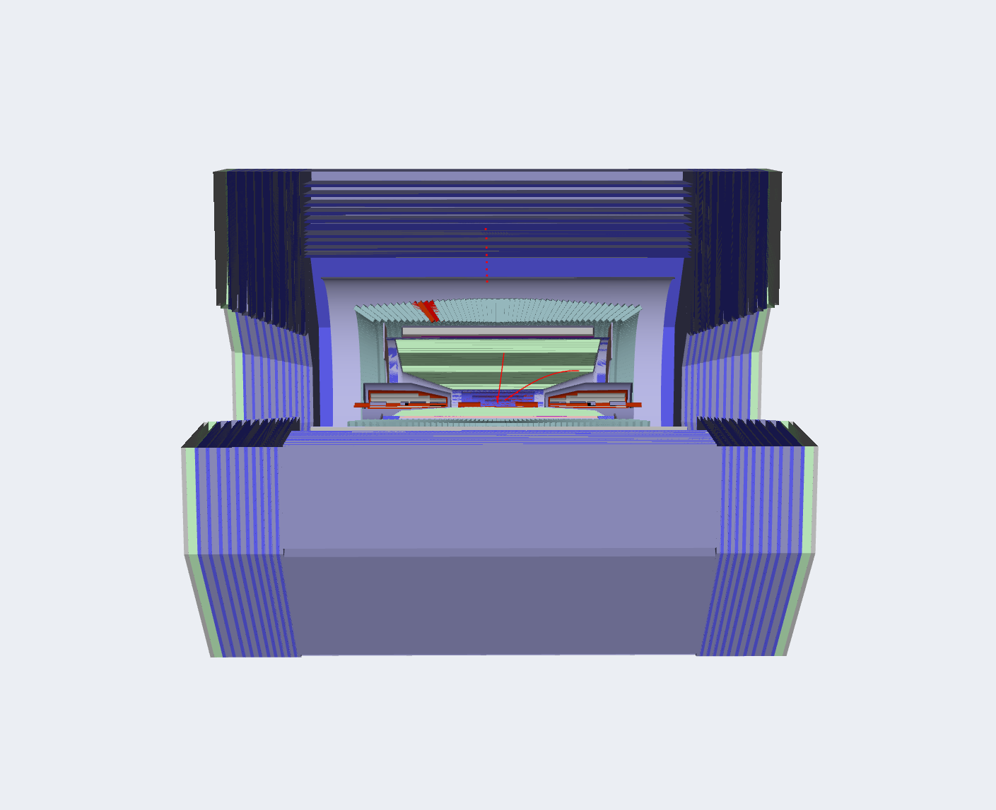
STCF event display system
Extendibility

Slide 10
03
System Optimization

Slide 11
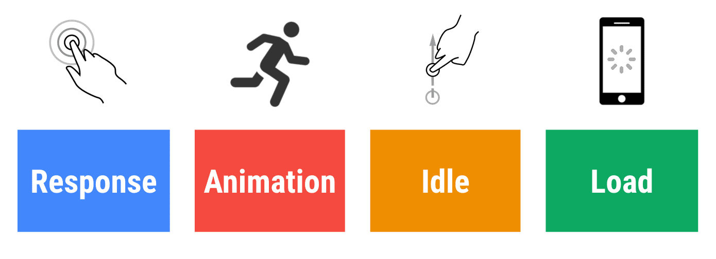
Google's RAIL model
Google's RAIL model is a framework designed to optimize web application performance by focusing on key aspects of the user experience.。
RAIL | Goal | Metrics
Response | 50ms | FID、INP、TBT
Animation | 16ms | FPS
Idle | keep tasks short and simple | LongTasks
Load | within 5s | FCP、LCP、CLS

Slide 12
System optimization
The analysis mainly focused on three aspects: performance metrics, memory usage, and frame rate. During the analysis, three primary issues were identified:
System lag caused by declaring large data as reactive data.
Memory leaks due to failure to promptly release memory when redrawing physical models.
Lack of caching mechanisms for handling large files, resulting in prolonged loading times when users refreshed the system.

Slide 13
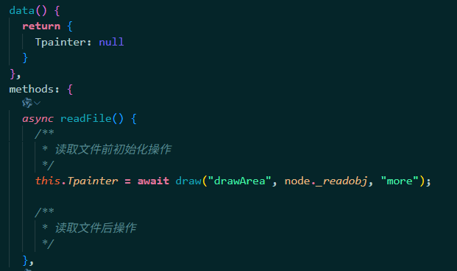
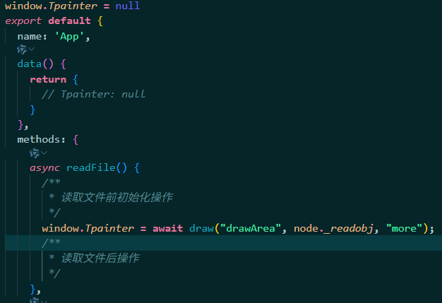
System optimization
Problem 1：declaring large data as reactive data
Analysis：The reactivity principle in Vue 2 involves traversing all properties of an object and adding data hijacking (via getter and setter methods). When the data changes, the change is intercepted, and Vue's internal view update function is triggered to refresh the UI. Therefore, when large datasets are declared as reactive data, the CPU spends a significant amount of time traversing the object's properties, which can lead to system lag or performance issues.。
Declare the large data model Tpainter as a member of regular global object Wndow
Solution： Declaring non-view-update data as regular global JavaScript objects

Slide 14
System optimization
Problem 1：declaring large data as reactive data
Analysis：The reactivity principle in Vue 2 involves traversing all properties of an object and adding data hijacking (via getter and setter methods). When the data changes, the change is intercepted, and Vue's internal view update function is triggered to refresh the UI. Therefore, when large datasets are declared as reactive data, the CPU spends a significant amount of time traversing the object's properties, which can lead to system lag or performance issues.。
Declare the large data model Tpainter as a member of regular global object Wndow
Solution： Declaring non-view-update data as regular global JavaScript objects

Slide 15
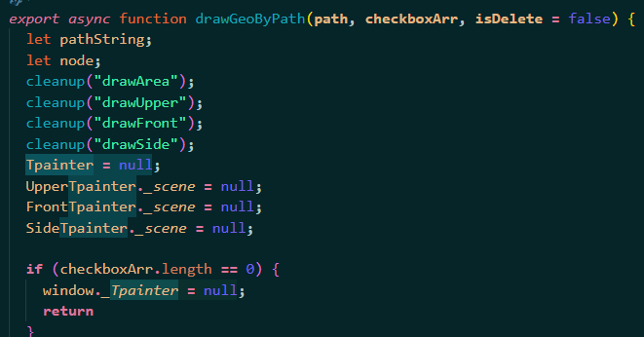
System optimization
Problem 2：Memory leaks due to failure to promptly release memory when redrawing physical models
Analysis：During the redrawing of physical models, if the memory space occupied by the previous physical model objects is not released in time, it can lead to increased memory usage and potential memory leaks. This issue emphasizes the importance of properly managing object lifecycles and ensuring that unused objects are appropriately disposed of to free up memory.
Solution： Before re-rendering, it is important to release the memory space occupied by the previous physical model objects.

Slide 16
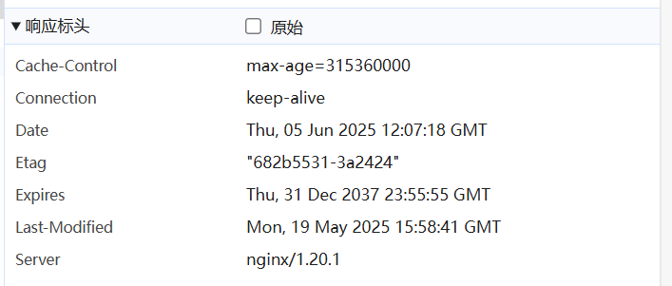
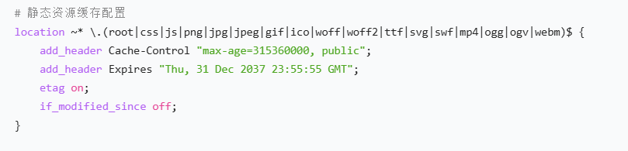
System optimization
Problem 3：Memory leaks due to failure to promptly release memory when redrawing physical models
Analysis：the system retrieves relatively large physical model files and re-fetches these files every time a user refreshes the page, it can result in prolonged blank screen times while the files are being loaded.
Solution： By leveraging HTTP caching strategies such as strong caching or validation caching (also known as negotiated caching).

Slide 17
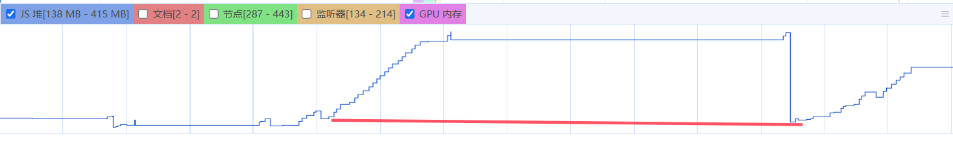
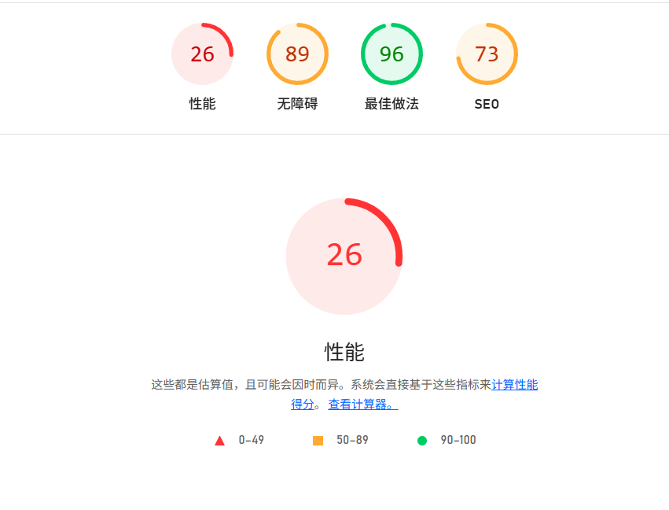
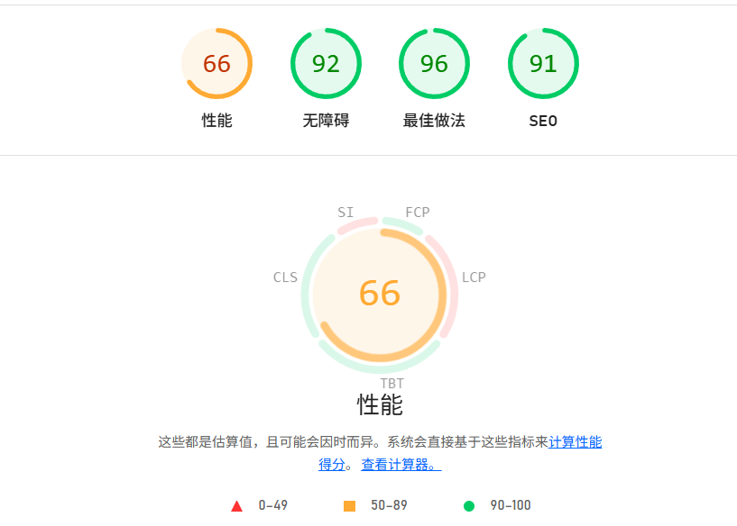
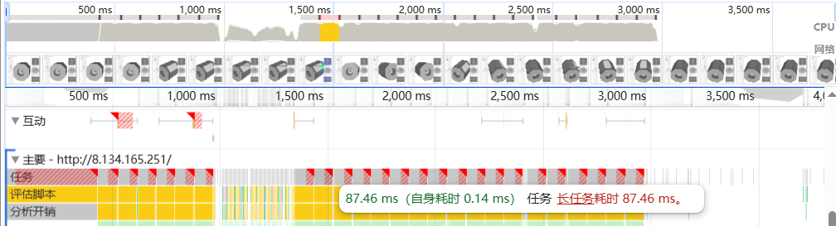
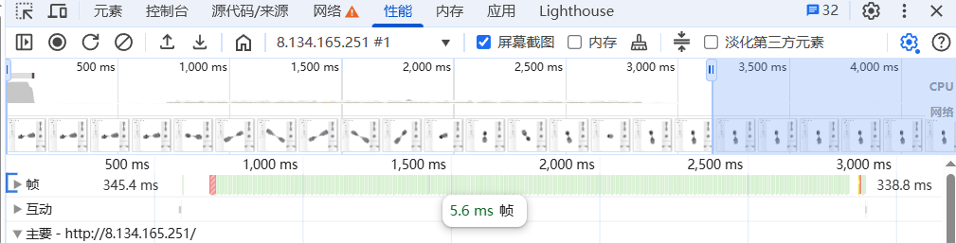
System optimization
Through a series of optimization measures, significant improvements were achieved in terms of memory usage, performance scores, and frame rate metrics

Slide 18
04
Summary&Challenges

Slide 19
Summary & Challenges
  2024.7
  Technology selection and demo verification；
  rendering demo for sample data and restructured data；
  UI and graphic design
  In order to complete independent intellectual property rights in the future, source code analysis was conducted on JSRoot.
  2025.7
  A software in beta testing (with users)；
  Multi-component detector rendering with event data；
  A better UI
  a series of software performance optimizations.
Challenges
There are not enough test cases available.
The demand is not fixed.

Slide 20
Thanks!

