Slide 1

Super Tau-Charm Facility
Progress in the Design of Superconducting Magnets for the STCF Detector
Presenter: Zhang Xiao Tao
Date: 04th Jul, 2025

Slide 2
Contents of STCF Detector Superconducting Solenoid Magnet
Timeline of Detector Superconducting Magnet Design
Physical Requirements and Magnetic Field Design
Research and Development of Superconducting Coil
Research and Development of Cryostat
Research and Development of Quench Protection Circuit
Summary and Future Work
Detector Superconducting Solenoid Magnet

Slide 3
1. Timeline of Detector Superconducting
Magnet Design
Detector Superconducting Solenoid Magnet team aligned @Aug.30th.2024
  CY
  CY
  STCF Detector Mechanical Design Seminar
  DSSM
  Prepare the project proposal_ Solenoid
  Zhang Xiaotao
  Prepare the project proposal _ Cryogenics
  He Chongchao
Optimization yoke poletip
  Zhang Xiaotao
Prepare the report for the FTCF workshop in November
  Zhang Xiaotao
  Lesson learn the relevant chapters of BES III, STCF CDR, CMS TDR.
  DSSM
  Prepare the STCF DSSM TDR
  DSSM
  Prepare the STCF Cryogenics TDR
  DSSM
  Project pre research_ Superconducting Cable
  Zhang Xiaotao/LP
  Project pre research _Cryogenics
  Chen Zibo
  Project pre research_ Suspension
  Liu Ping/ZXT
  Project pre research_ Quench protection and detection circuit
  Zhang Guoqing/ZXT
  Project pre research_ Cable joint and mapping device
  Zhang Xiaotao/LP
Today
Phase I
Phase II

Slide 4
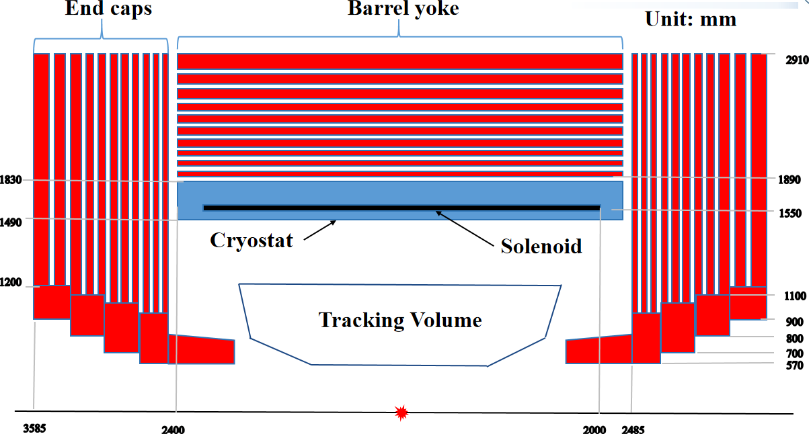
2. Physical Requirements and Magnetic Field Design
- Physical modeling and boundary conditions
Physical Requirements:
  Design value of the central magnetic field : 1.0 T
  Magnetic field measurement accuracy ≤ 0.3%
  Axial leakage magnetic flux ≤ 50Gs@5.1m
Boundary Condition
  End Yoke layer: 40, 40, 40, 45, 45, 60, 60, 60, 80, 80, 150 mm
  Barrel Yoke layer: 40, 40, 45, 45, 60, 60, 60, 80, 80, 150 mm
  Yoke octagon innner diameter: 3700 mm
  Yoke total length: 7170 mm
Cryostat
Inner radius | 1.450 m
Outer radius | 1.850 m
Length | 4.760 m
Coil
Mean radius | 1.565 m
Length | 4.000 m
Conductor dimension | 4.67×15.00 mm²
Electrical parameters
Central field | 1.0 T
Nominal current | 4380 A
Inductance | 1.68 H
Stored energy | 12.30 MJ
Cold mass | 4.60 t
Radiation | 1.90 X₀
Cool down time from room temperature | ≤7 days
Quench revocry time | ≤7 hours
Detector Superconducting Solenoid Magnet
Main parameters of the STCF detector superconducting magnet

Slide 5
2. Physical Requirements and Magnetic Field Design
- Comparison of Main Parameters of Superconducting Magnets for ATLAS, CMS, BES III, and STCF Detectors
Name | Parameters | ATLAS | CMS | BESIII | STCF
Cryostat | Inner radius /m | 1.15 | 2.97 | 1.38 | 1.45
 | Outer radius /m | 1.35 | 3.80 | 1.70 | 1.85
 | Length /m | 2.40 | 13.00 | 3.91 | 4.76
Superconducting coil | Nominal diameter/m | 2.46 | 4 layers | 2.95 | 3.10
 | Length /m | 5.30 | 12.48 | 3.52 | 4.00
Conductor size/mm*mm |  | 4.25*30 | 22.3*72 | 3.7*20 | 4.67*15
Electrical performance | Central magnetic field strength /T | 2.00 | 4.00 | 1.00 | 1.00
 | Nominal current /A | 7600 | 19500 | 3150 | 3820
 | Inductance /H | 1.35 | 14.15 | 2.10 | 1.69
 | Energy storage /MJ | 39.00 | 2700.00 | 9.50 | 12.30
 | Cold mass/t | 5.70 | 234.00 | 3.60 | 4.80
Detector Superconducting Solenoid Magnet

Slide 6
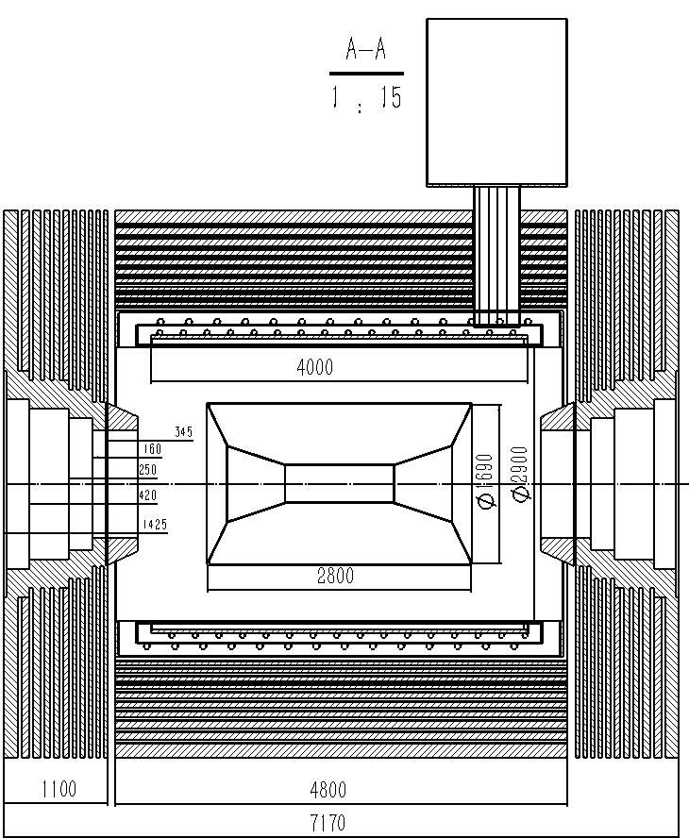
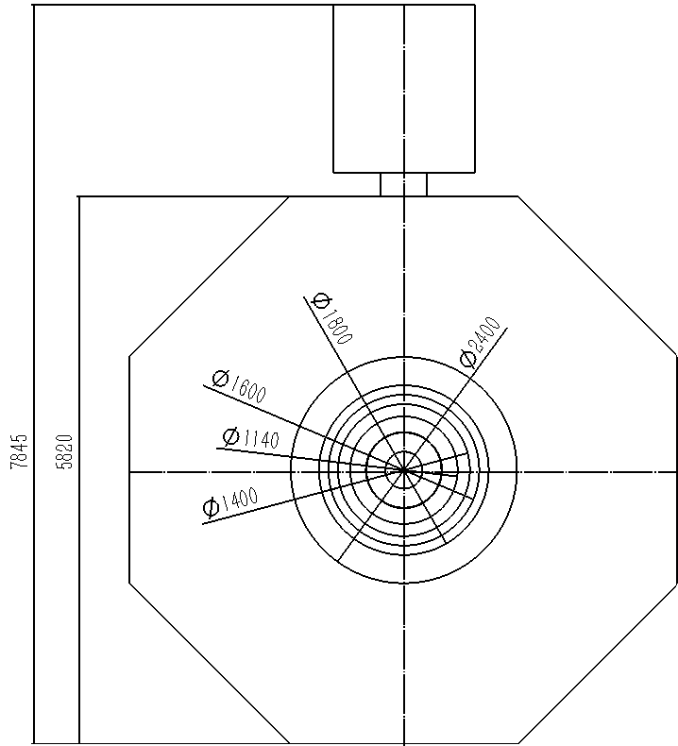
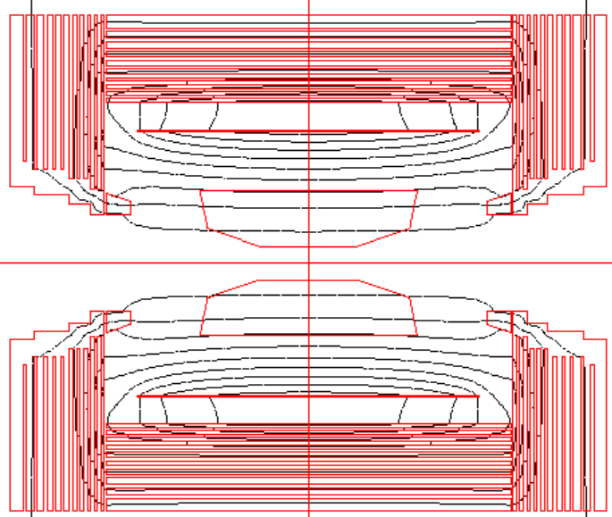
2. Physical Requirements and Magnetic Field Design
- Yoke prototype
Main parameters of the STCF detector
STCF superconducting magnet flux distribution
Detector Superconducting Solenoid Magnet

Slide 7
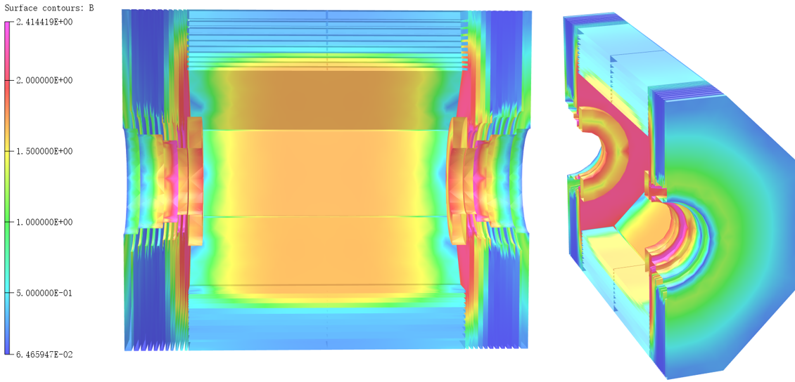
2. Physical Requirements and Magnetic Field Design
- Three dimensional magnetic flux strength distribution
Three dimensional magnetic flux strength distribution
Detector Superconducting Solenoid Magnet

Slide 8
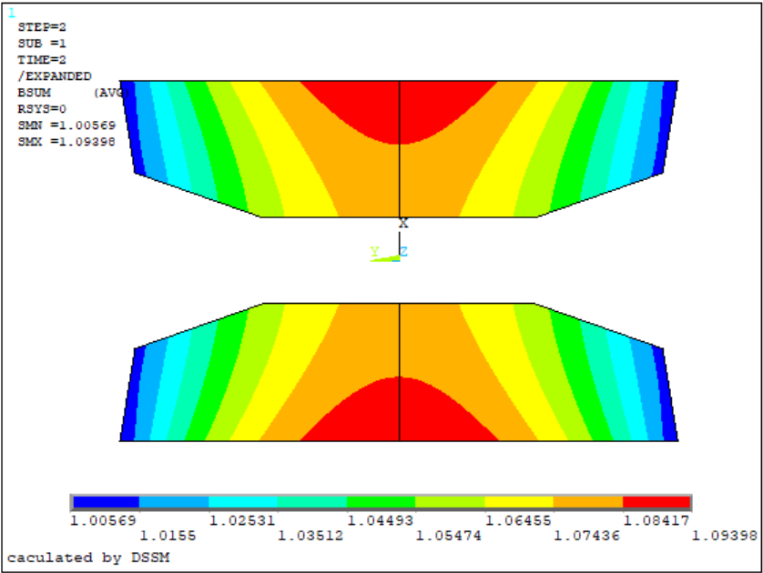
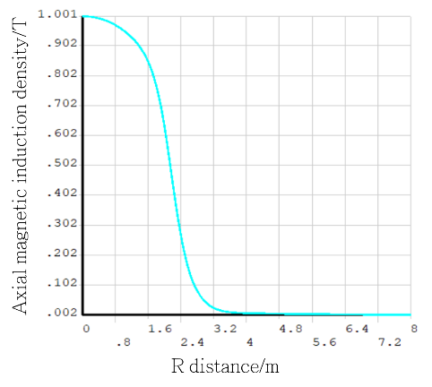
2. Physical Requirements and Magnetic Field Design
- Electromagnetic field finite element simulation results
STCF detector superconducting magnetic field distribution at tracking area
Distribution of magnetic field along the centerline
The uniformity and magnetic field distribution need further optimization to meet the requirements
Detector Superconducting Solenoid Magnet

Slide 9
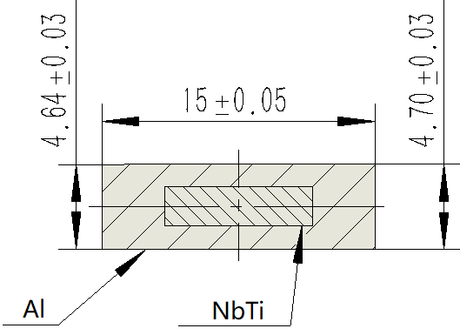
3. Research and Development of Superconducting Coil
- Superconductor, layout structure and parameters of superconducting coil
Conductor paraments
Conductor paraments
rated current | 4380 A
critical current at 4.2 k & 2 T | ≥15000 A
condutor length | 9.15 km
cable dimension | 4.67 mm *15 mm
Rutherford cable paraments
number of strands | 16
cable transposition pitch | 100±5 mm
Cu : NbTi | ~1:1
NbTi filament diameter | 30±5 μm
numbe of filaments | ≥600
n value@2T | ≥35
aluminum stabilizer paraments
RRR@0t,4.2K | ≥500
Yield strength@4.2k | ≥60MPa
Crosssection ratio of aluminum | >80%
Cross-sectional view of the superconductor for the STCF detector magnet
He cooling pipe
Superconductor cable
5083 Aluminum Support Cylinder
1000 RRR Aluminum Strip
Conceptual structure layout of the solenoid
Detector Superconducting Solenoid Magnet

Slide 10
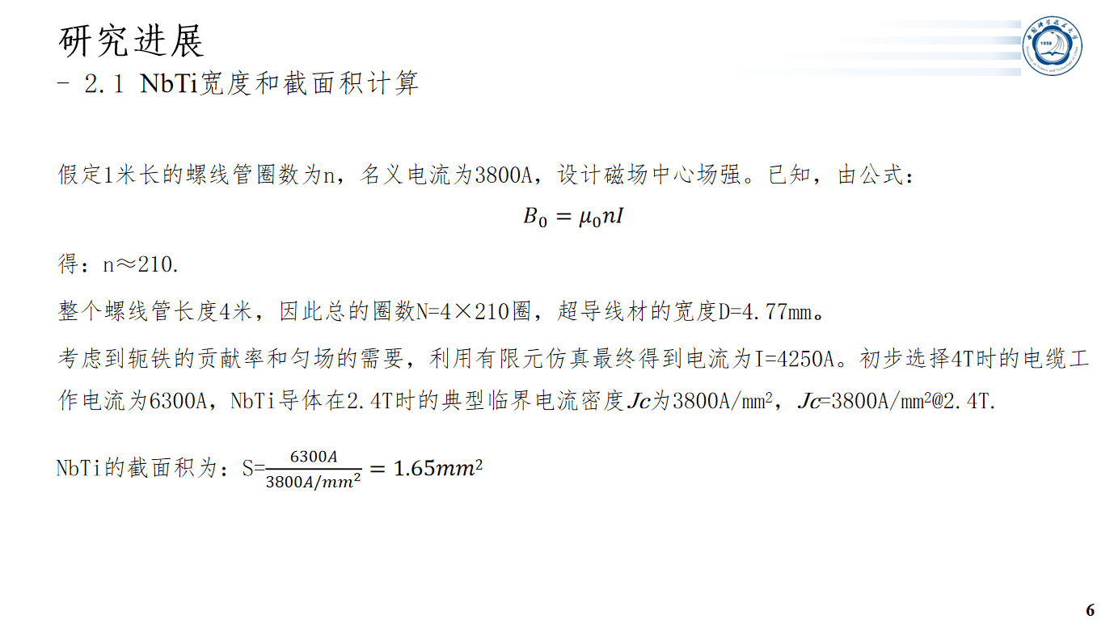
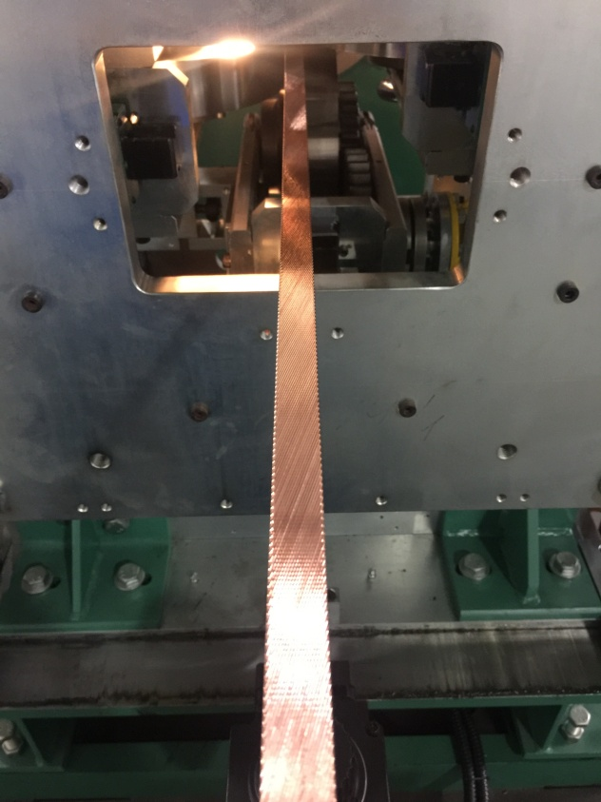
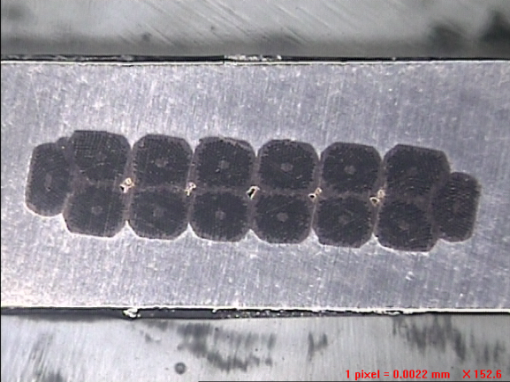
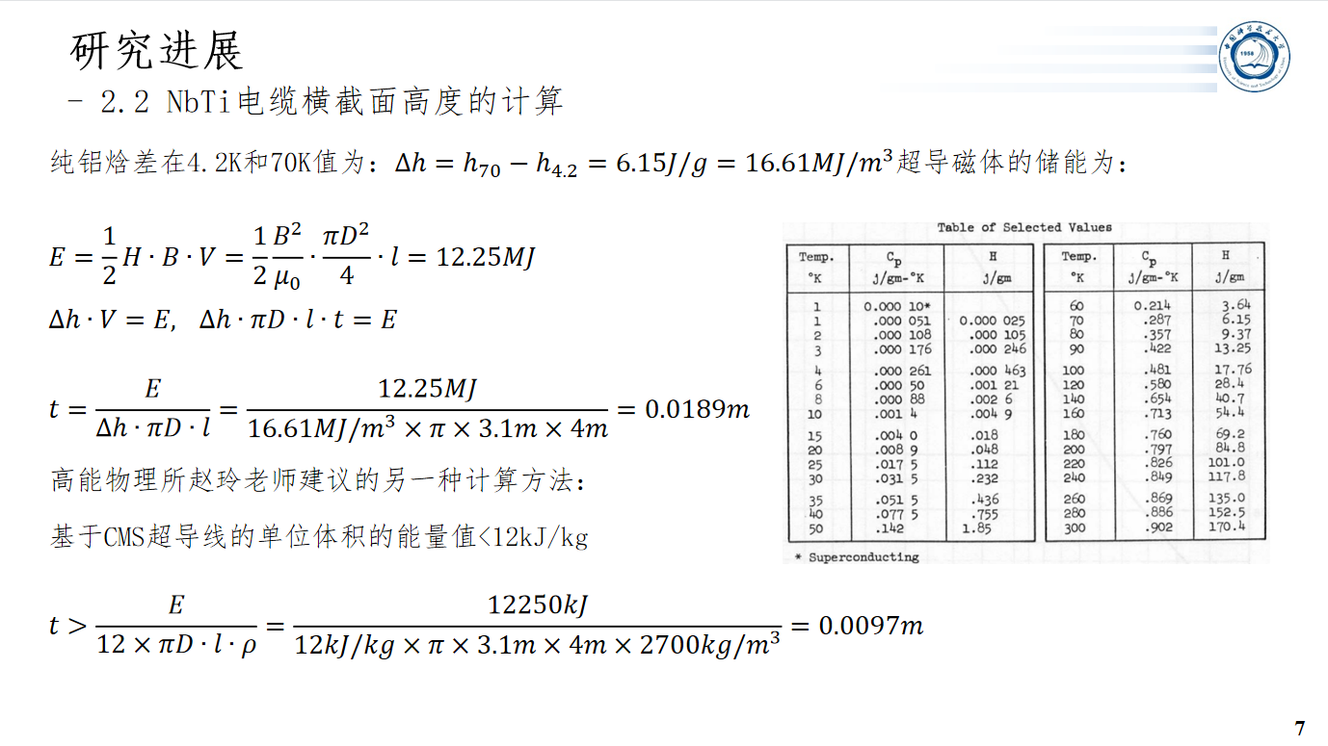
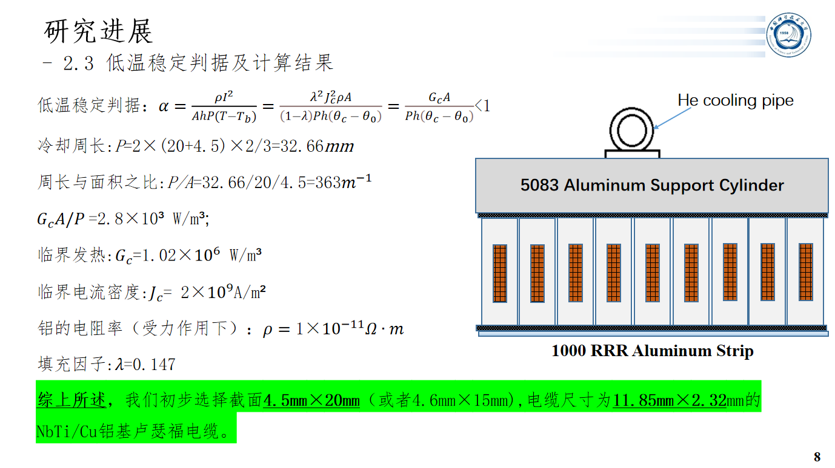
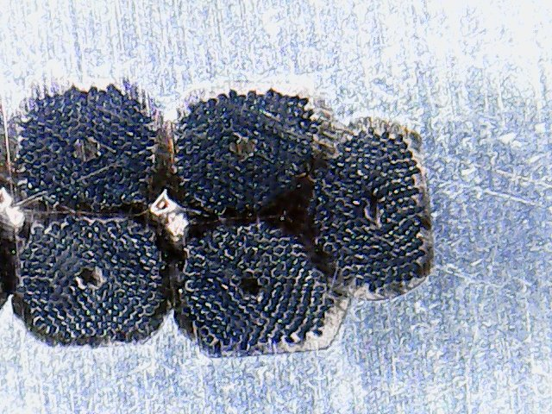
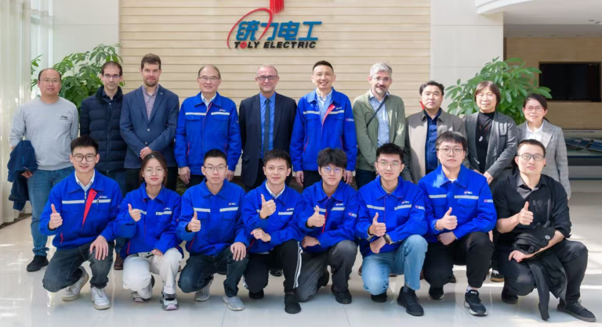
3. Research and Development of Superconducting Coil
- Superconductor, layout structure and parameters of superconducting coil
Detector Superconducting Solenoid Magnet

Slide 11
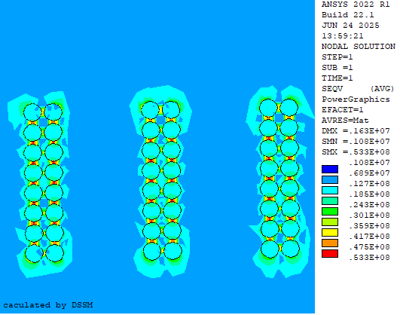
3. Research and Development of Superconducting Coil
- Stress coupling analysis and selection of superconducting coil
Magnetic thermal structural coupling analysis of STCF detector SC
Jc and B curves (B=2.6T) of reference case study on SC
1) The maximum stress obtained from the magnetic thermal structural coupling analysis of the SC is 53.3 MPa, which is lower than the σ _0.15=60 MPa of pure aluminum (0.15% specified plastic tensile strength);
2) The SC of 15x4.6 mm aluminum based Cu/NbTi wire produced by Wuxi Tongli meets the requirements of superconducting magnets for STCF detectors.

Slide 12
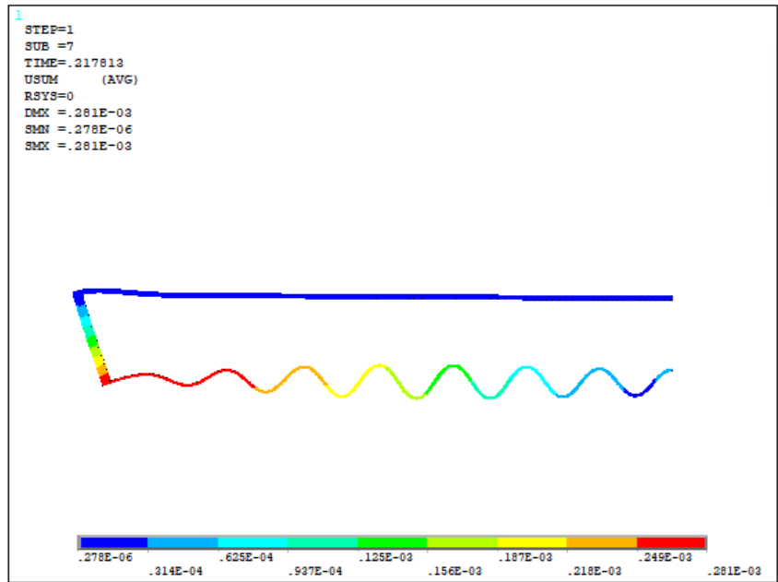
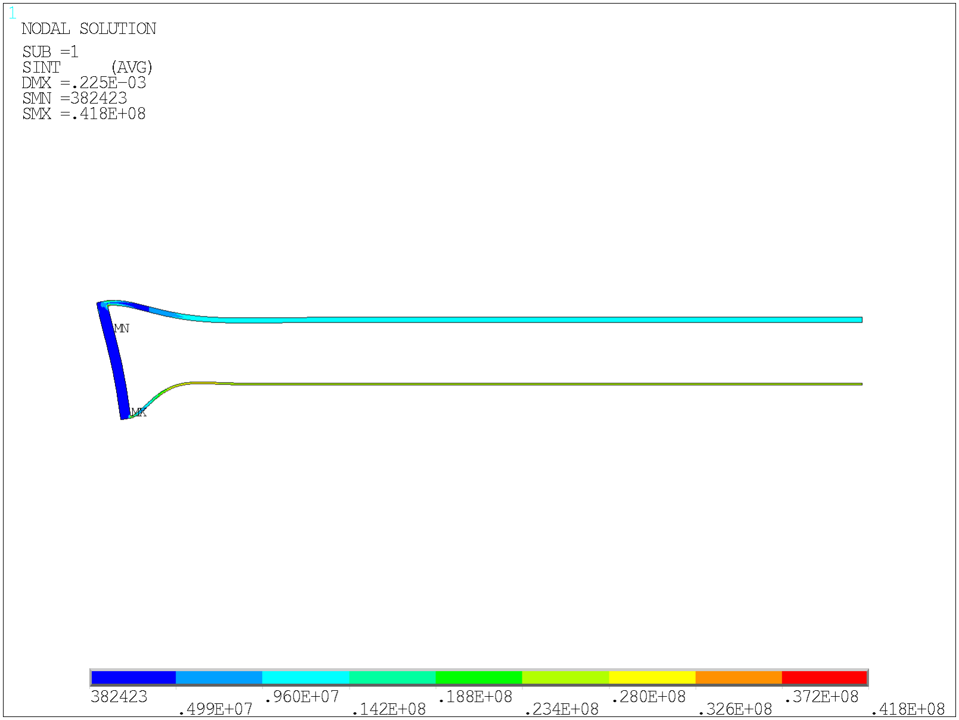
4. Research and Development of Cryostat
- FEA simulation of preliminary design cryostat
Cryostat dimension
Name | Parameter
Inner radius | 1.49m
Outer radius | 1.88m
Length | 4.76m
Inner cylinder thickness | 6mm
Outer cylinder thickness | 16mm
End plate thickness | 32mm
Buckling analysisl（2D 1/2 Model）
Conclusion: By simulating the buckling analysis of a cryostat using two FEA softwares, the selected dimensions can fully meet the design requirements.
Detector Superconducting Solenoid Magnet

Slide 13
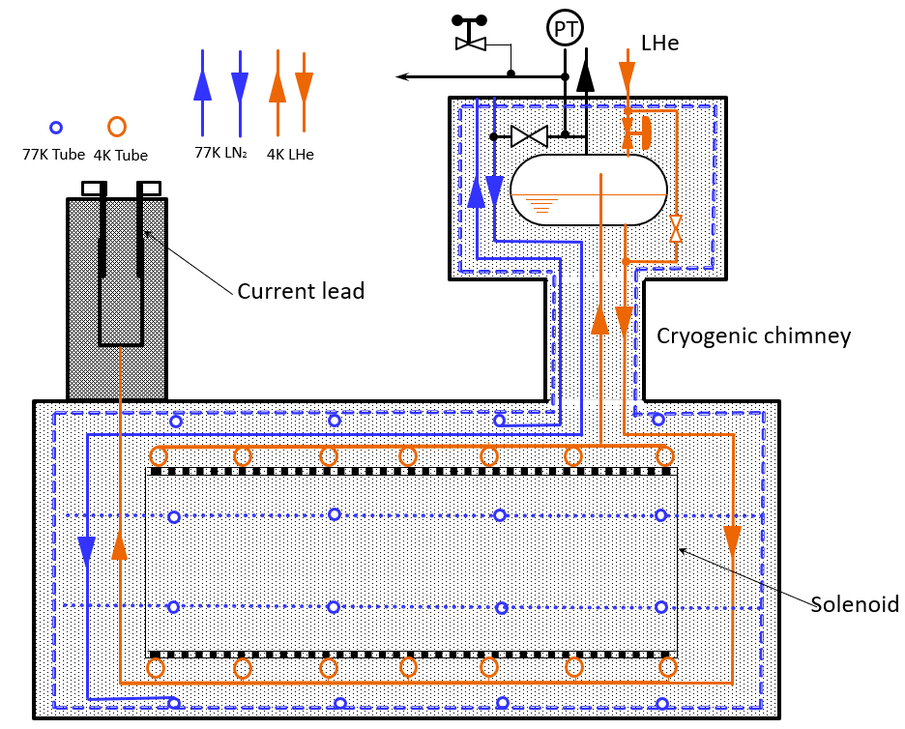
4. Research and Development of Cryostat
- STCF detector crystat heat load estimation
Heat load estimation
Items of Heat Load | 77 K | 4.5 K
Caused by the triangle support suspension in cryostat | 7.200 W | 7.410 W
Caused by the radiation in cryostat | 73.801 W | 3.236 W
Caused by the current leads | —— | 7.920 W + 0.421 g/s
Caused by the radiation in chimney & SP | 10.025 W | 0.407 W
Caused by the support rods in chimney & SP | 3.900 W | 0.022 W
Caused by the bayonet and valves in SP | 46.000 W | 13.000 W
Caused by the measuring wires | 5.311 W | 0.831 W
Total | 146.237 W | 32.826 W + 0.421g/s
Adopted heat load（×1.5） | 219.36 W | 49.24W + 0.63 g/s
STCF detector cryogenics sketch map
Preliminary plan: The 4.5K cold mass is cooled using thermosiphon liquid helium, while the 77K shield is cooled using forced flow liquid nitrogen.
Detector Superconducting Solenoid Magnet

Slide 14
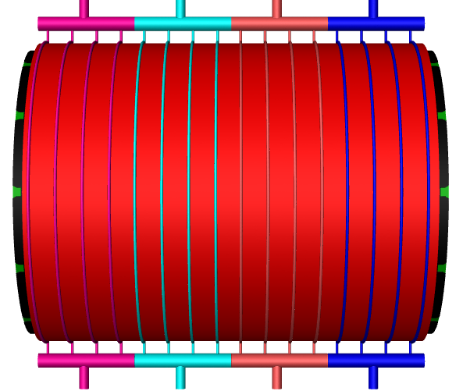
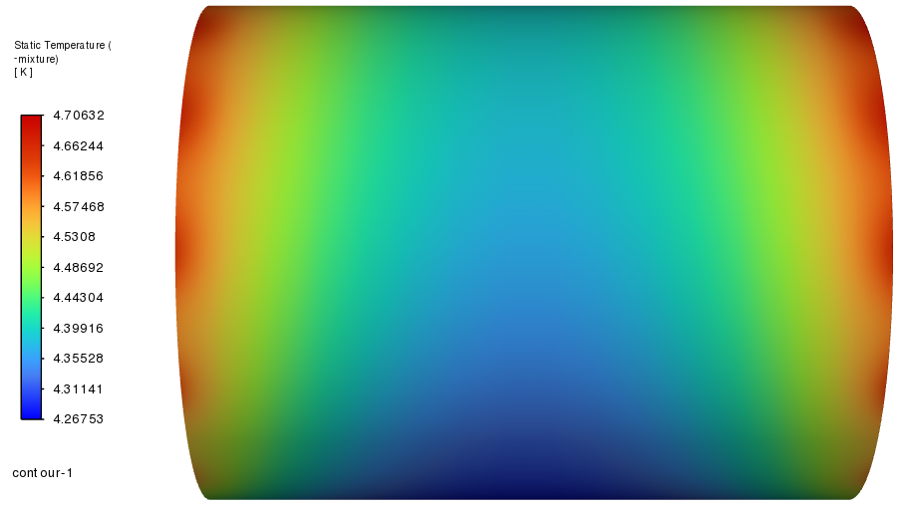
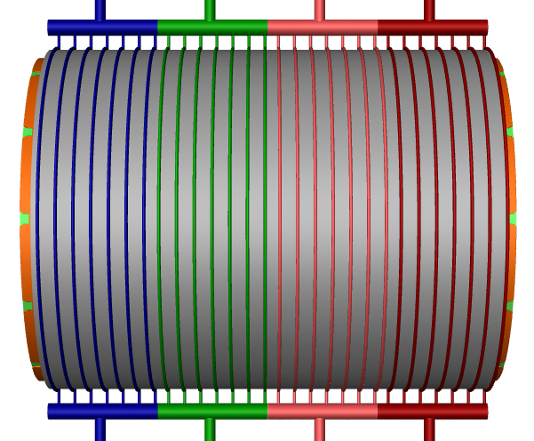
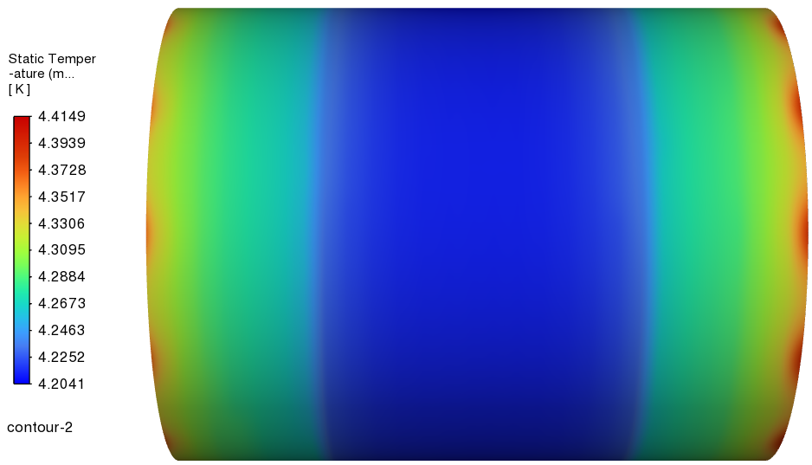
4. Research and Development of Cryostat
- STCF detector cryogenics sketch map
Boundary Condition
Inlet velocity | 0.0326m/s，4.2K
Exit velocity | /
Thermal radiation surface | 0.2W/m²
Triangle support suspension leaks heat | 98.6W/m²
Initial temperature | 4.2K
Conclusion:
1) The thermosiphon cooling method can meet the low-temperature requirements of superconducting magnets in STCF detectors
2) The spacing between the thermosiphon tubes needs further optimization
Steady state analysis of thermal siphoning of superconducting magnet in STCF detector

Slide 15
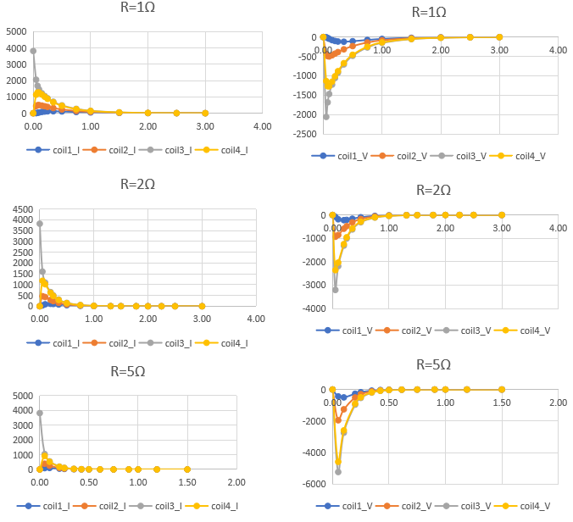
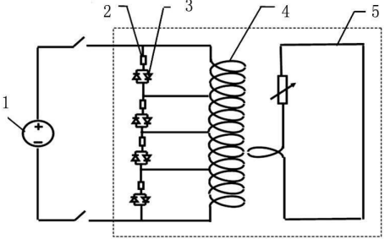
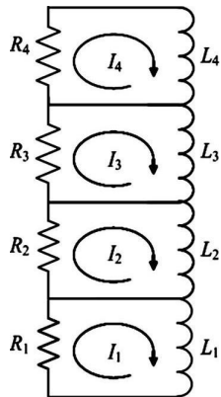
5. Research and Development of Quench Protection Circuit
- Multi-sectioned quench process circuit(Further discussion)
1- Power supply; 2-Cold resistor; 3-Cold diode; 4- Coil; 5-Hoop cylinder
Schematic of multi-sectioned quench process circuit
Conclusion: The external resistance of quench is inversely proportional to the current decay time and inversely proportional to the induced potential.

Slide 16
6. Summary and Future Work
- Future work plan
Summary:
  Development and Design of Magnetic Field Patterns
  Development and Calculation of Superconducting Coil
  FEA simulation of two different cooling methods (forced cooling and thermosiphon)
  Development and calculation of cryostat and suspension structures
  Design and numerical calculation of quenching protection circuit
Future:
  TDR Writing and finalizing

Slide 17
Thank you for your attention

Slide 18
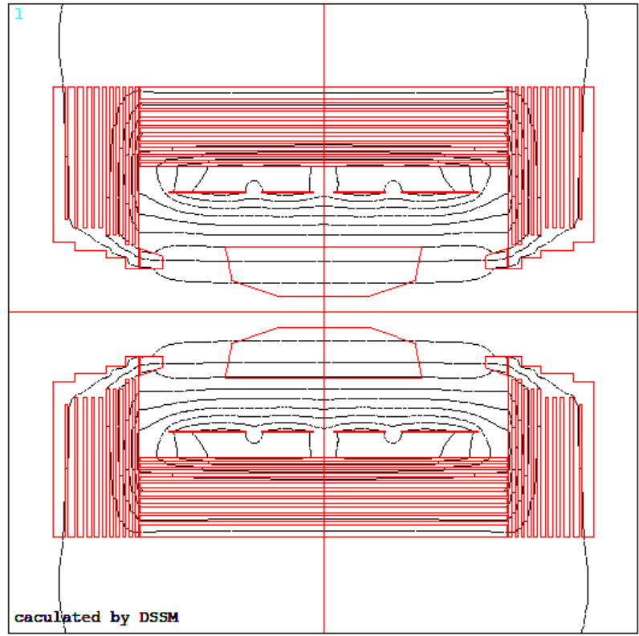
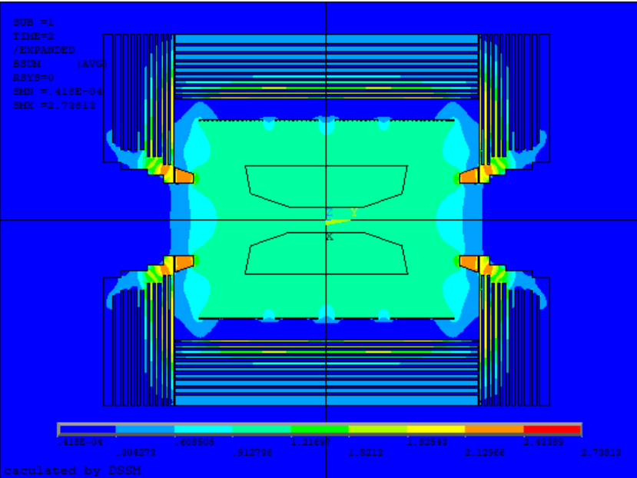
Backup information

Slide 19
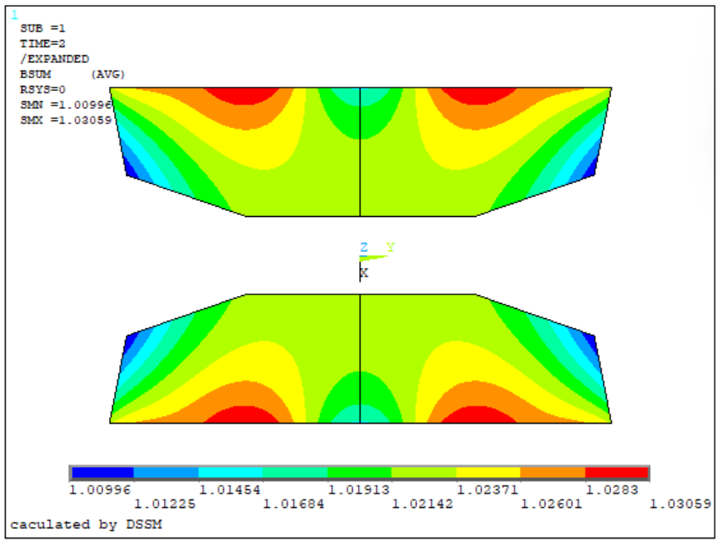
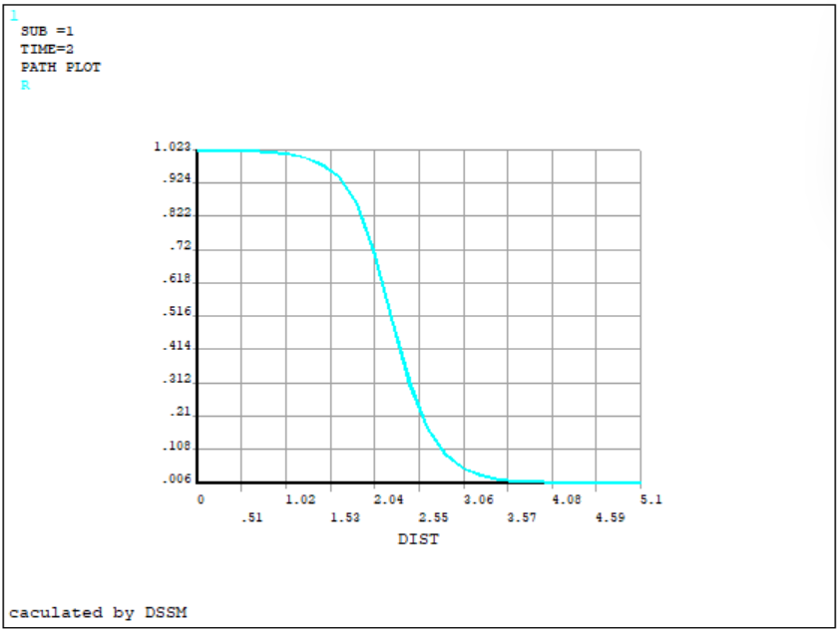
Backup information

Slide 20
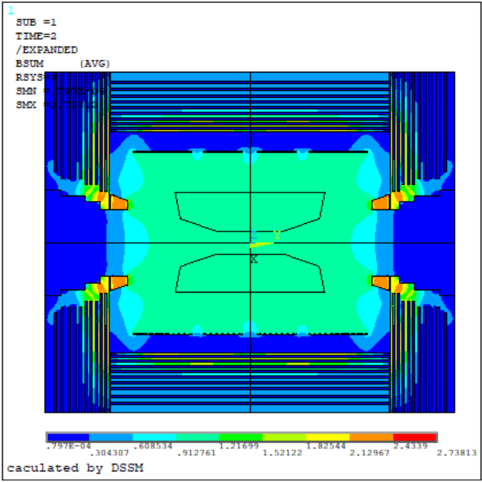
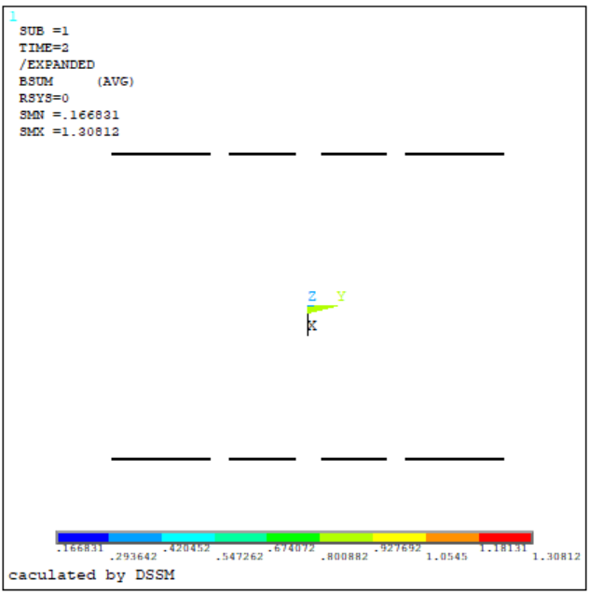
Backup information

Slide 21
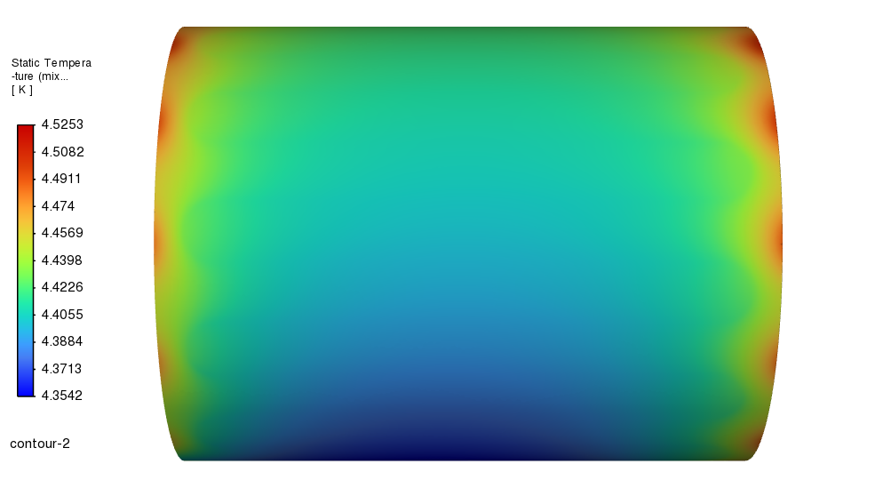
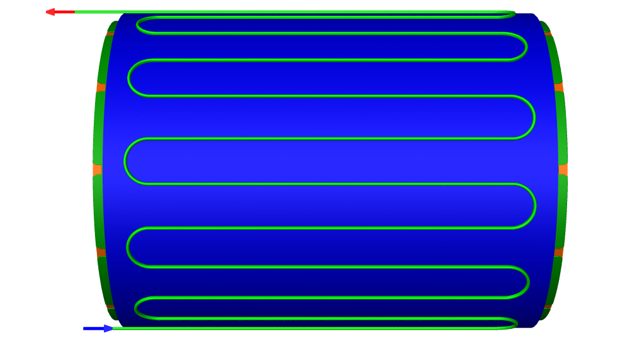
Backup information
Thermal steady-state analysis under forced flow of liquid helium

