Slide 1


Feasibility study of radiative decay τ → πyvτ at STCF
Hao−Lin Li¹, Xiao-Cong Ai¹, Xiao-Rong Zhou2, Zhi-Hui Guo3
1.Zheng Zhou University,
2.University of Science and Technology of China,
3.HeBei Normal University
2025超级陶粲装置研讨会 , July 3rd , 湘潭 1

Slide 2
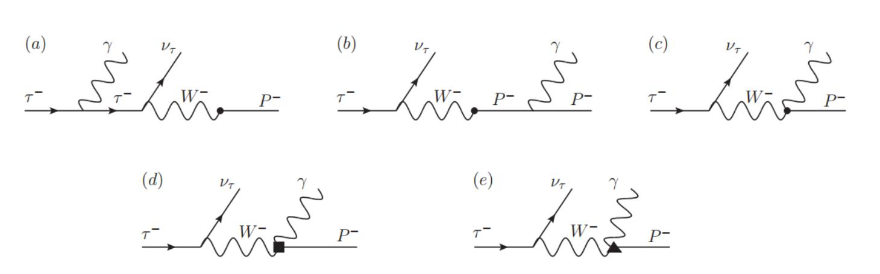

Motivation
Internal bremsstrahlung (IB)
Structure dependent (SD)
vector(p) w) vector(a1)
□ None of the radiative tau decays have been measured before.
□ Radiative correction becomes crucial for precision tau physics ,such as the lepton universality test in hadronic tau decays, calculation of muon g-2
using tau decays.
□ Our goal is to investigate the tau radiative decay τ → πyvτ .
□ Challenge : signal has much lower branching ratio than backgrounds
(Br(τ ^{一} → π ^{一}Yvτ)/ Br(τ ^{一} → π ^{一}vτ) ) ~ 10 ^{—2} .
□ ML technique is being explored to distinguish signal from backgrounds.
axial
2

Slide 3

1 BESIII Preliminary Study
目
录
2 STCF-BESIII Comparison
CONTENTS
3 Event Selection Optimization

Slide 4

BESIII Preliminary Study
l Sample generation l Event selection l Expected upper limit

Slide 5
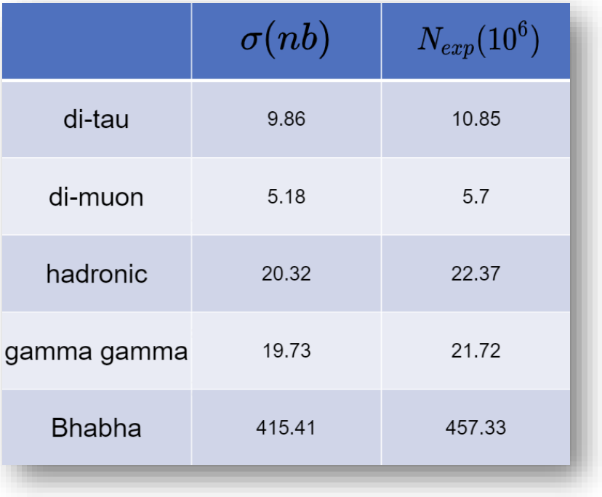
Sample generation
□ Boss Version : 7.0.3 s =4.23GeV
□ SignalMC sample :
generated via the DIY generator feature of BesEvtGen. ( Zhi-Hui Guo and Pablo Roig Phys.Rev.D 82, 113016
Published 28 Dec 2010 ).
□ InclusiveMC sample (used as background) :
□ di-tau samples : tau pair generated with KKMC ,
decay of tau with TAUOLA.
□ di-mu, gamma gamma, Bhabha samples:generated with BABAYAGA.
□ Hadronic samples : generated with LUNDARLW.
(4230) = 1100.91 pb^{—1}
Lumi
5

Slide 6

Event selection
□ Tag side : τ ⁺ → μ ⁺ τ vμ Prob side : τ — → π —Yvτ
□ Preliminary event selection with BESIII detector:
□ Two good charged tracks with zero total charge.
□ The two tracks are identified as a pion and a muon.
□ Two charged tracks have Valid Shower.
□ At least one good photon.
Further selection
E/p < 0.2
Angle(y)π) < 40
-140 < θ_{acop} < 140
M²_{miss} > 2 Gev2
N_{y} = 1
E_{y} > 0.4 GeV
□ E/P : E/P ratio of prob π — ( E is the deposited energy in EMC and p is the momentum of the track) .
□ Angle(Y,π) : Angle between Y and prob π — .
□ θ_{acop} : Acoplanarity angle ( the angle between the planes formed by the momenta of two particles involved in the interaction).
□ ^{M2}miss : Missing mass squared M iss = (σ Einitial — σ Efinal)² —(σ initial — ^{σ} final)².
□ N_{y} : Photon number .
□ E_{y} : The energy of the photon with the maximum energy .
2
p
→
p
→
m
6

Slide 7
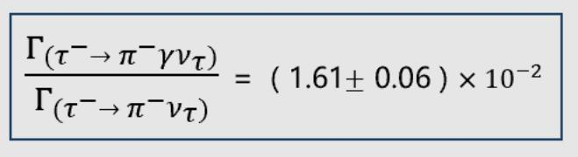
Expected upper limit
□ Theoretical articles give relational formulas : ( PHYSICAL REVIEW D 103, 056017(2021) )
Γ_{(τ} - _{→π} - _{ντ)} = 10.82% is given by the PDG.
□ Upper limit on the signal can be calculated by ： μ = Br(measured)/Br_{(tℎeoretical)}
= Br_{s} /（10.82% × 1.61 × 10 ^{—2} ） = Br_{s} / 0.00174.
u
p
si
g
up
up
ig
ig
 | Lumi(4.23Gev) | μ _{i} @95% C. L | Br_{s} @95% C. L | Expected signal significance
BESIII | 1100.81 pb^{—1} | 3.357 | 5.82 × 10 ^{—2} | 0.6σ
STCF(Assuming the same detection efficiency as BESIII) | 1 ab—1 (expected) | 0.108 | 1.94 × 10 ^{—3} | about 19.7σ
u
p
up
s
g
ig
A Bayesian-based maximum likelihood estimator, extended from the profile likelihood approach, is used to
determine the upper limit of the signal strength. Nucl. Instrum. Meth. A 551, 493–503(2005), arXiv:physics/0403059
□ BESIII results indicate that the research is limited by luminosity, or rather statistics ; thus, we have decided to pursue this work at STCF.
7

Slide 8
STCF-BESIII Comparison
l Selection efficiency l Comparison of Variables

Slide 9
Sample generation
□ Oscar Version : 2.6.2 S =4.26GeV
Default Geometry : ITKM + BTOF
Background mixing is not considered at the moment.
□ Signal MC sample : generated via the DIY generator feature of StcfEvtGen.
□ Inclusive MC sample (used as background) :
di-tau samples : tau pair generated with MadGraph, decay of tau with Pythia.
The estimated number of di-tau events (at 4.26 GeV) : Nexp = σ e + e 一 →τ + τ 一 × Lumi(exp)
= 3.557 nb × 1 ab-1
≈ 3.5 × 109 .
□ Only 60 million events have been generated.
9

Slide 10
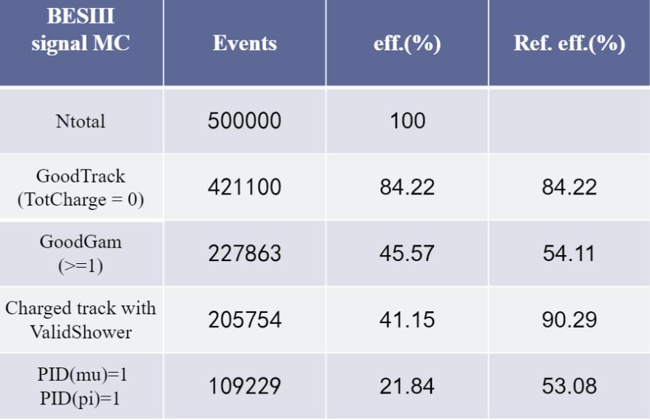
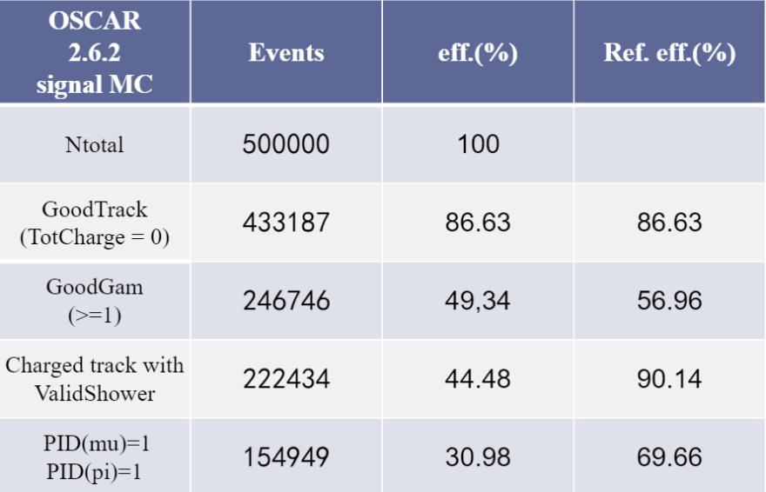
Selection efficiency
□ The Preliminary Event efficiency is roughly comparable between the two experiments,
whereas STCF outperforms BESIII mainly in the PID (Particle Identification) process.
10

Slide 11
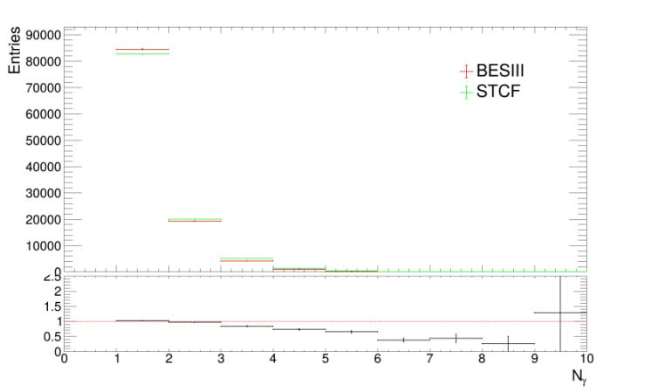
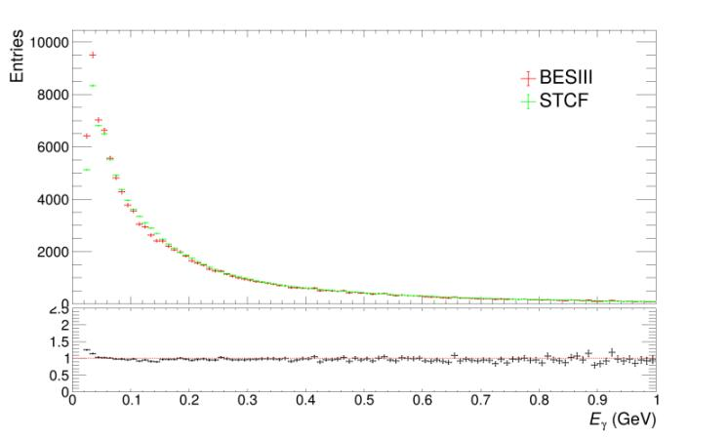
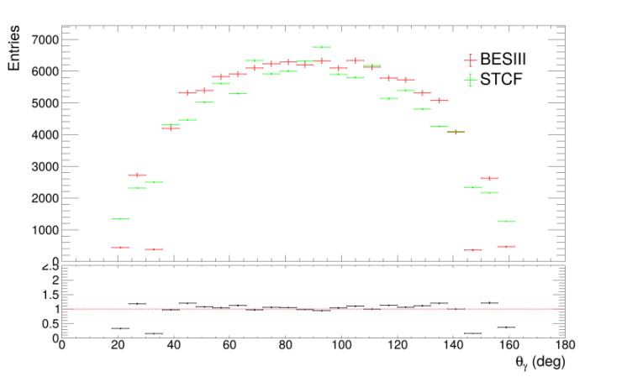
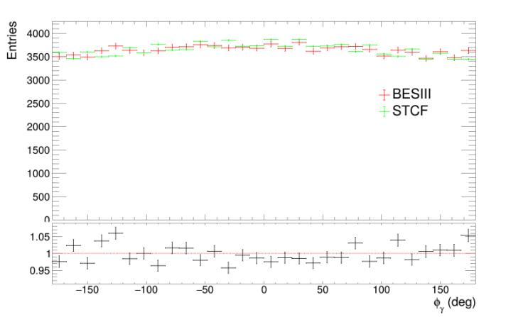
Photon variables
□ The number of events from BESIII is scaled to match that from STCF for comparison.
□ Bottom panels :
BESIII/STCF
Photon number distribution
The energy distribution of photon
The polar angle (θ) of the photon
The Azimuthal angle (φ) of the photon
11

Slide 12
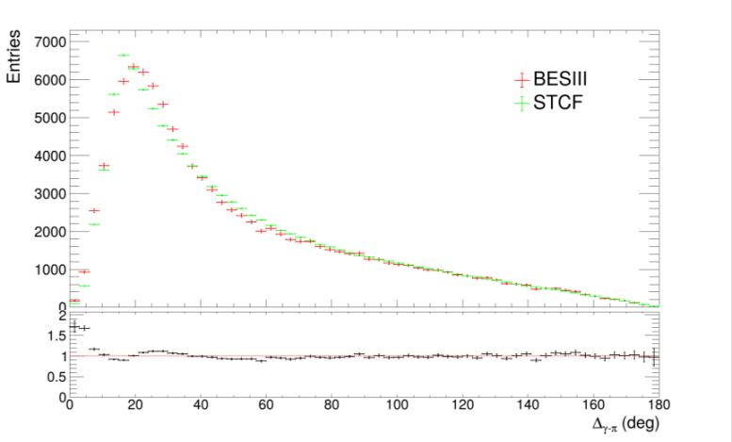
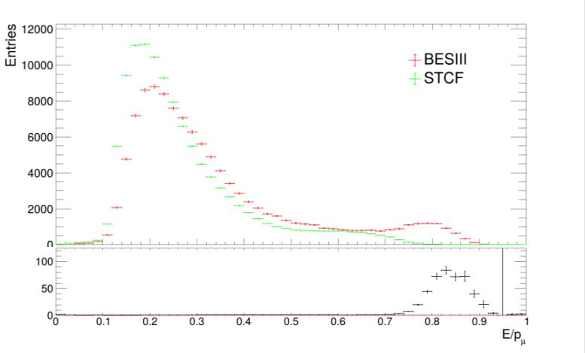
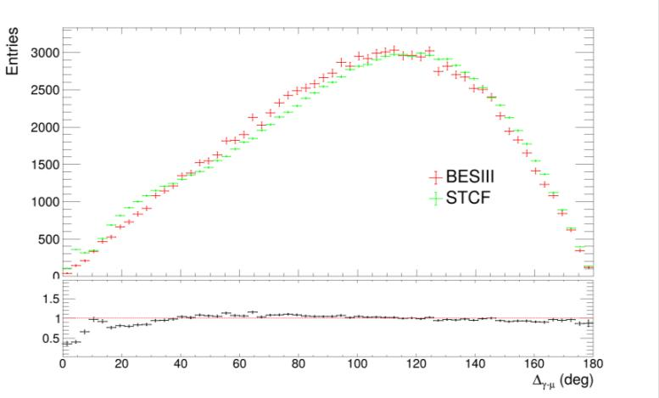
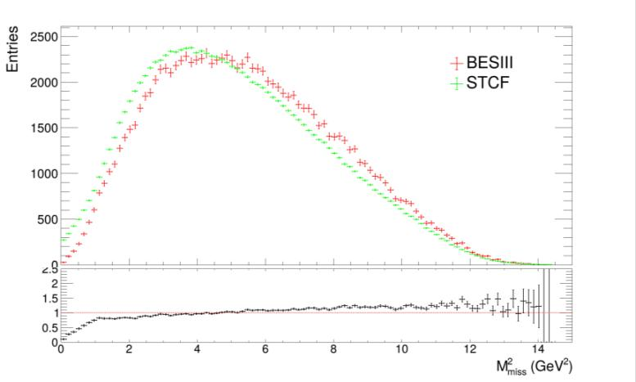
More variables
Angle between Y and prob π ⁻ E/P of tag μ ⁺
^{Angle} ^{between} ^{Y} ^{and} ^{tag} ^{μ} ⁺ Missing mass squared ₁₂

Slide 13
Event selection optimization
l Traditional selection l BDT method

Slide 14
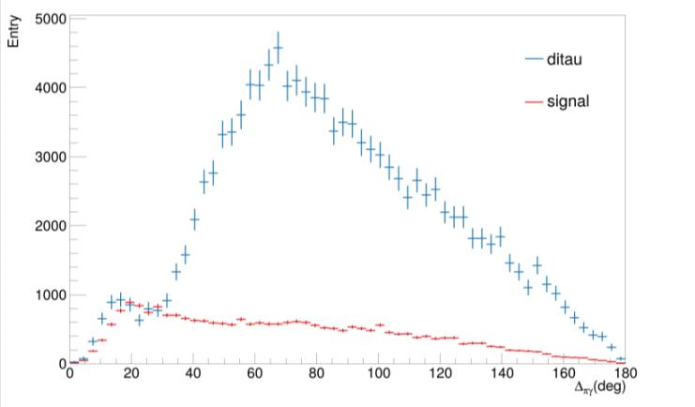
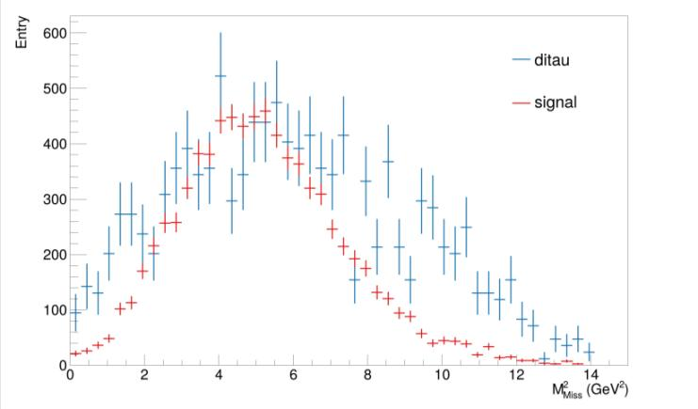
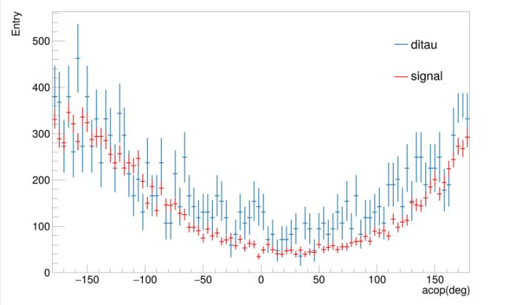
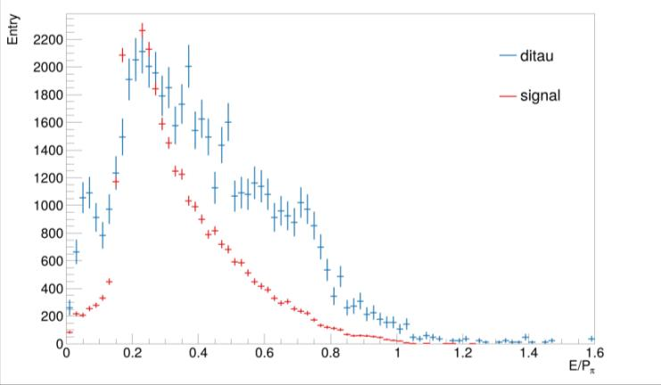
Cut-based method
□ Signal and ditau
sample are scaled to 1 ab-¹.
□ Ditau is additionally
scaled by 0.2 for
better visibility.
Angle between Y and prob π — Angle(y)π) < 40 Missing mass squared M _{iss} > 2 ^{Gev2}
2
m
Acoplanarity angle -140 < θ_{acop} < 140
E/P of prob π — E/p < 0.2 ₁₄

Slide 15
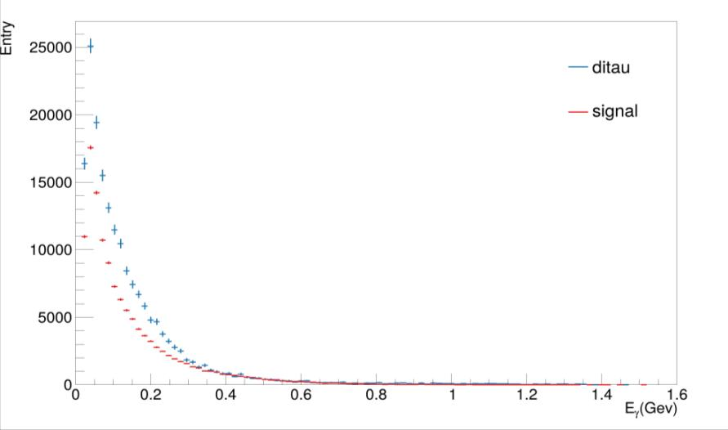
Cut-based method
The
energy E_{y}
distribution of > 0.4 GeV
photons
□ The same cut conditions as BESIII were applied to the variable cuts.
15

Slide 16
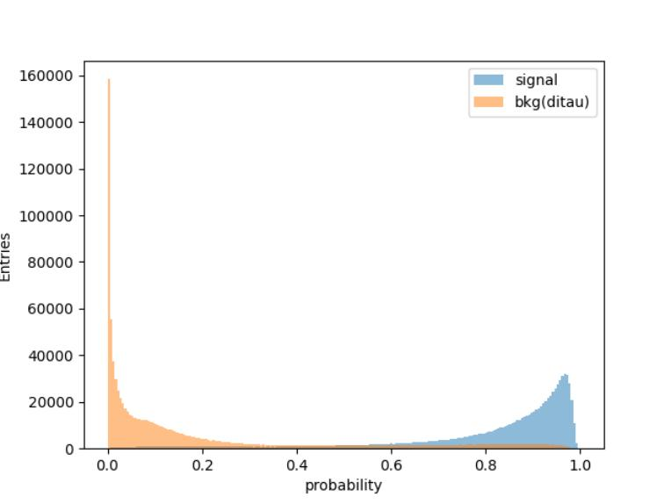
BDT method
□ 3 million di-tau samples and 3 million signal samples are merged, with 70% assigned to the training set and 30% to the test set.
Training is then performed using XGBoost.
□ BDT Input Variables:
□ Number of reconstructed photons.
□ Missing mass squared.
□ Deposited energy in 3 ×3 crystals around the Photon shower center.
□ Energy of the most energetic photon.
□ E/P ratio of π mesons.
□ Angle between photon and muon.
□ Total deposited energy of the π meson shower.
□ Deposited energy in 5 ×5 crystals around the Photon shower center.
□ Angle between photon and π meson.
……
16

Slide 17
BDT result
□ To evaluate the performance, four tentative working points are investigated.
 | BDT method |  |  |  | cut-based method
BDT prob Threshold | 0.5 | 0.9 | 0.93 | 0.98441
Signal Events | 1717036 | 942886 | 735056 | 31980 | 7487.12
Ditau Events | 58231614 | 10642170 | 6356045 | 51986 | 51896.2
Expected Significance | 1.47σ | 4.29σ | 28.15σ | 31.65σ | 10.01σ
Only statistical and lumi uncertainty (2% is assigned) is considered for now.
17

Slide 18
Summary
□ Simulation study of tau radiative decay τ → πyvτ is performed at both BESIII and STCF.
□ There is a good prospect for the study of tau rare decays at STCF.
□ BDT method is adopted to distinguish signal and backgrounds and shows much better performance than cut-based method, resulting in an expected signal discovery significance is 31σ .
□ Next step:
Include other backgrounds once the samples are ready; Consider backgrounds mixing in the signal sample;
Consider systematic uncertainty and derive the expected measurement precision for Br(τ → πyvτ) at STCF.
18

Slide 19

Thanks

Slide 20
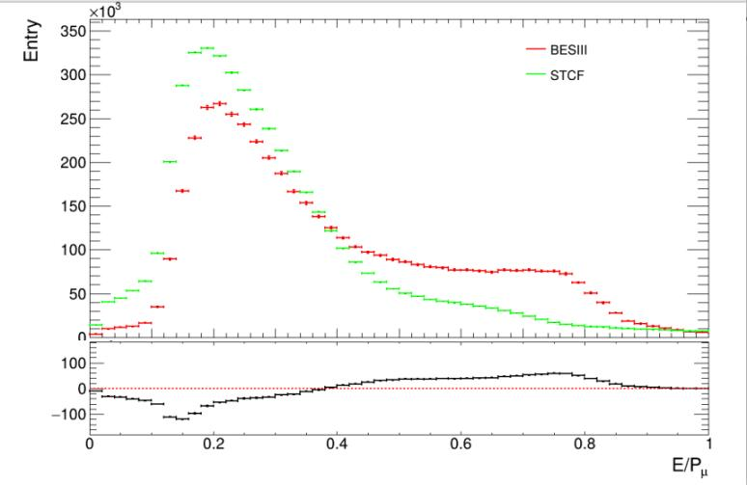
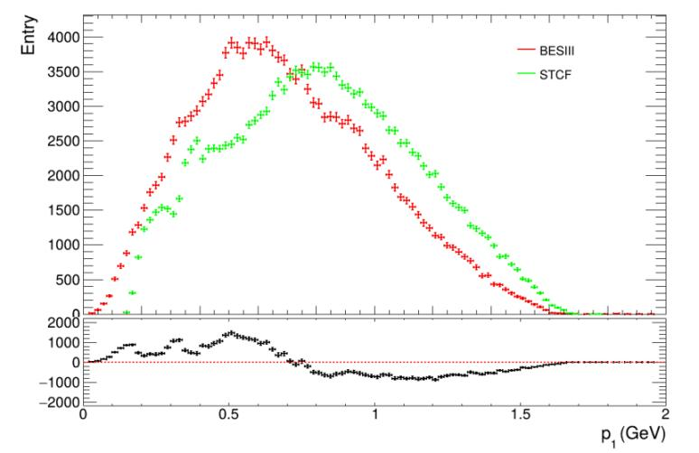
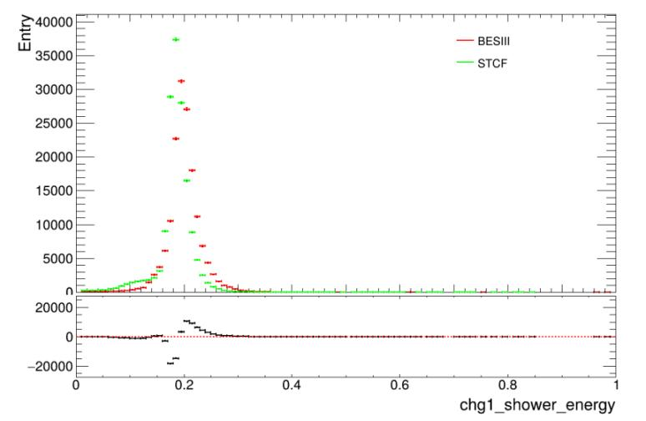
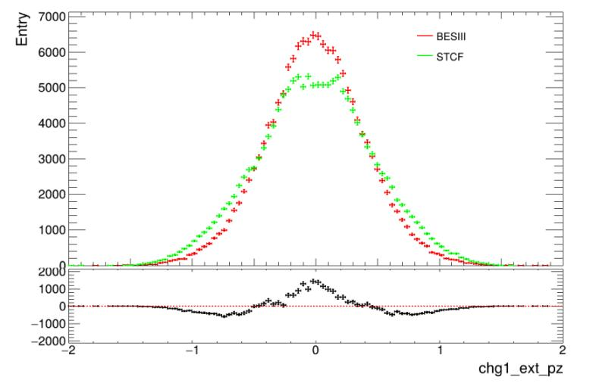
Muon EP ratio
口 Residuals: BES Ill entries - STCF entries (per bin)
20

Slide 21
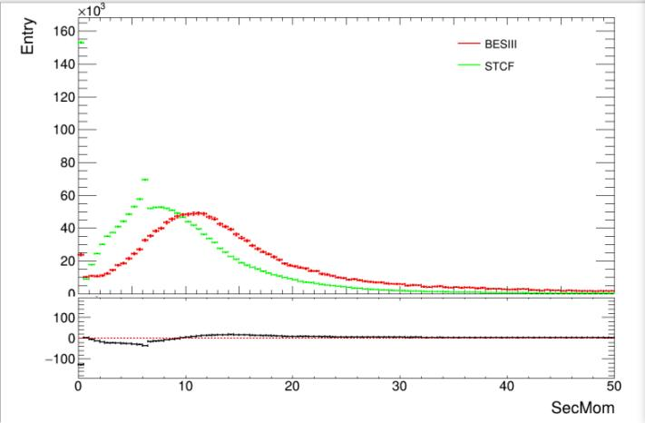
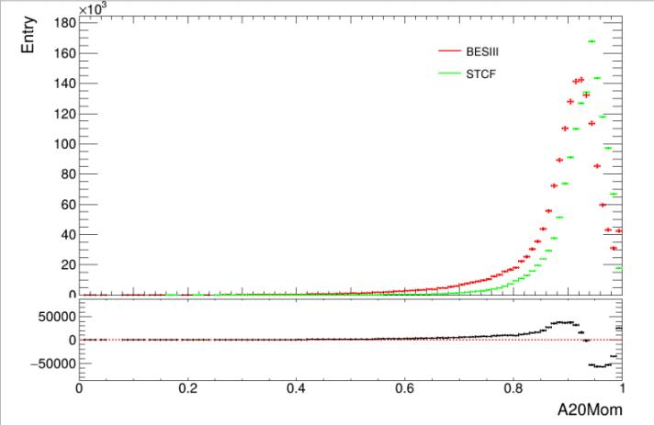
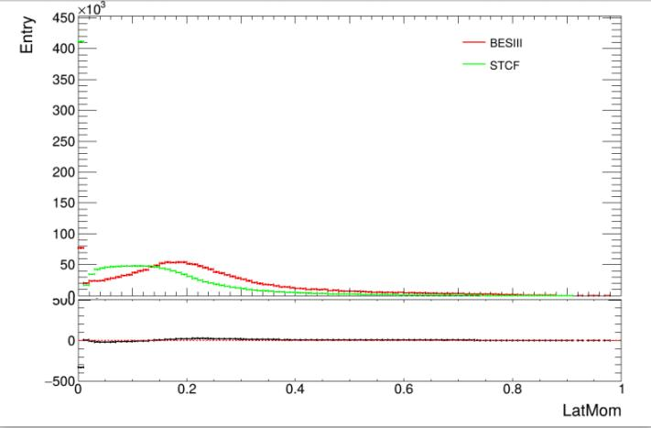
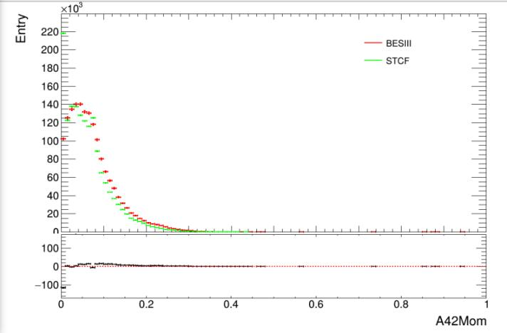
Gam shower para
21

Slide 22
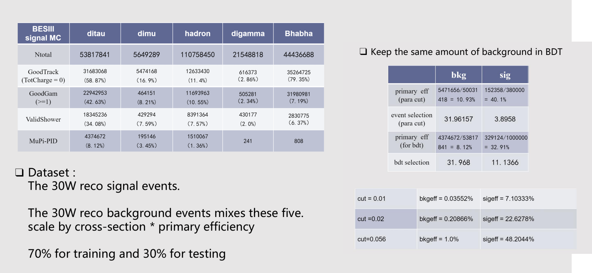
BESIII BDT
300k
300k
22

Slide 23
BESIII cut-based
sample | Bhabha | gamma gamma | di-mu | di-tau | Hadronic | Signal
Events | 0 | 0 | 1.62755 | 21.162 | 8.4662 | 3.88959
23

Slide 24
BDT result
□ To evaluate the performance, four working points were selected as thresholds.
 | BDT method |  |  |  |  | cut-based method
BDT prob Threshold | 0.5 | 0.9 | 0.93 | 0.98441 | 0.99222
Signal Events | 1717036 | 942886 | 735056 | 31980 | 1458.25 | 7487.12
Ditau Events | 58231614 | 10642170 | 6356045 | 51986 | 381.49 | 51896.2
Expected Significance | 1.47σ | 4.29σ | 28.15σ | 31.65σ | 31.65σ | 10.01σ
Expected Br(τ → πyvτ) Rel. Uncert. | 0.698 | 0.246 | 0.193 | 0.053 | 0.0487 | 0.162
Only statistical and lumi uncertainty (2% is assigned) is considered for now.
24

