Slide 1
VLAST-P on-orbit calibration plan
2025/01/15
Speaker : Jiaxuan Wang

Slide 2
Motivation
VLAST-P launch mission -> on-orbit calibration accuracy
Space cosmic ray main component is proton -> muon-like proton for calibration
Geomagnetic cutoff -> asymmetry proton spectrum

Slide 3
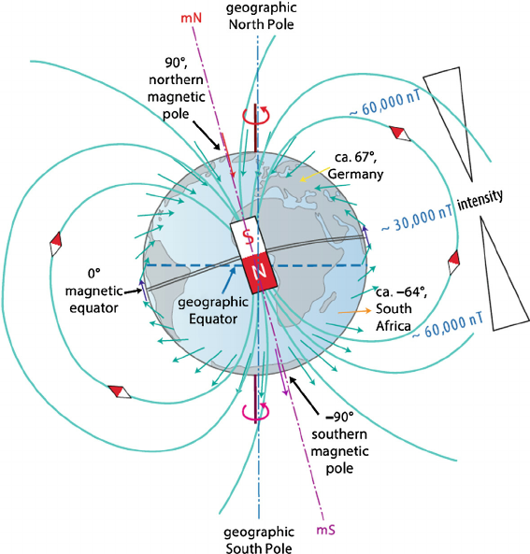
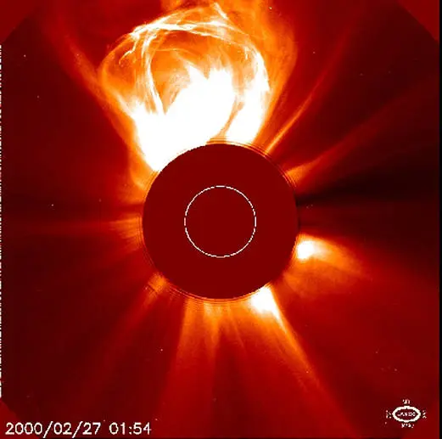
What is Geomagnetic Cutoff?
Earth's magnetic field's ability to block or filter charged particles
Magnetic latitude
Particle energy and type
Solar activities
Magnetic rigidity = momentum/charge
Ability of a particle to overcome the influence of the magnetic field
Cutoff rigidity: the minimum magnetic rigidity to penetrate the Earth's magnetic field.

Slide 4
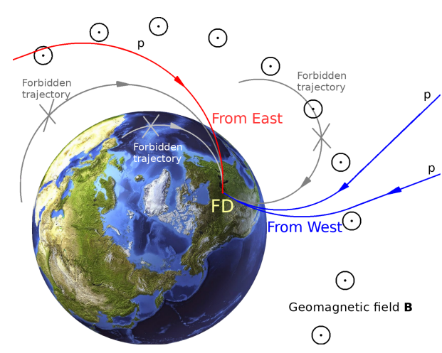
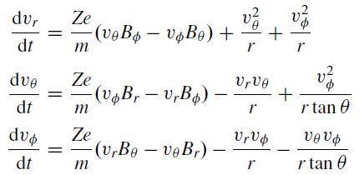
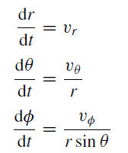
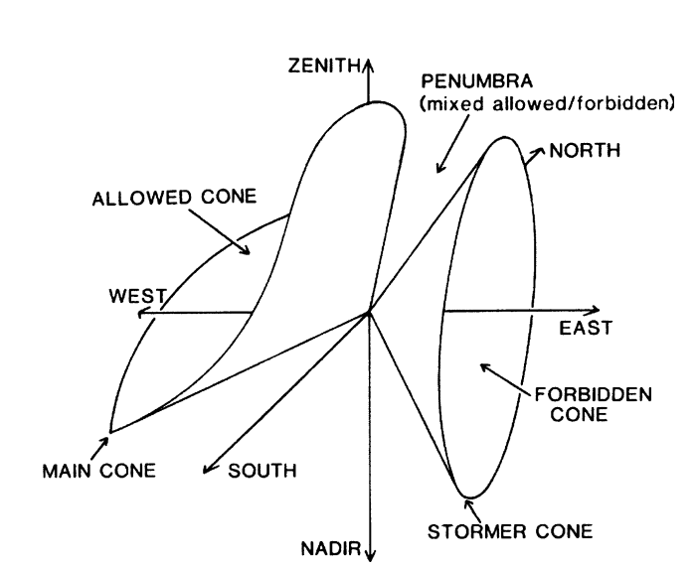
East-west Asymmetry
Spectrum discrepancy between from east and west
General equation for the motion of charged particles
Geomagnetic cutoff rigidities determined from the IGRF models

Slide 5
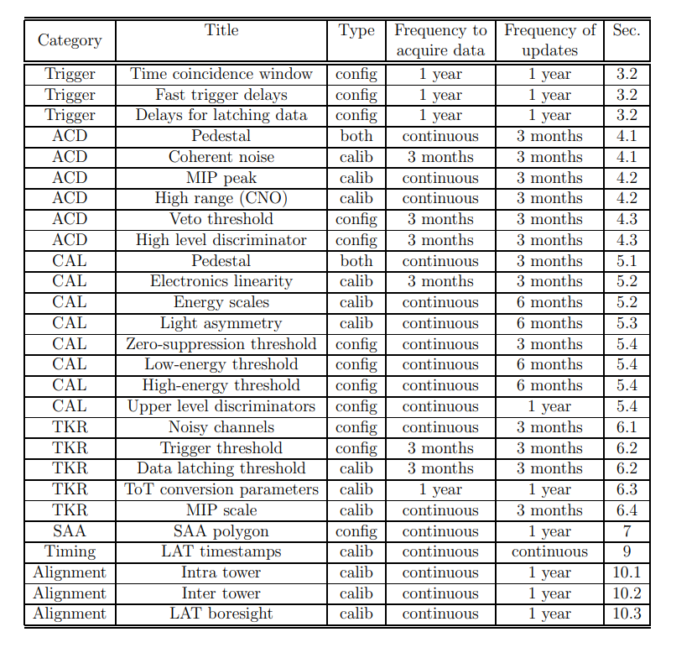
Fermi on-orbit calibration
Overview

Slide 6
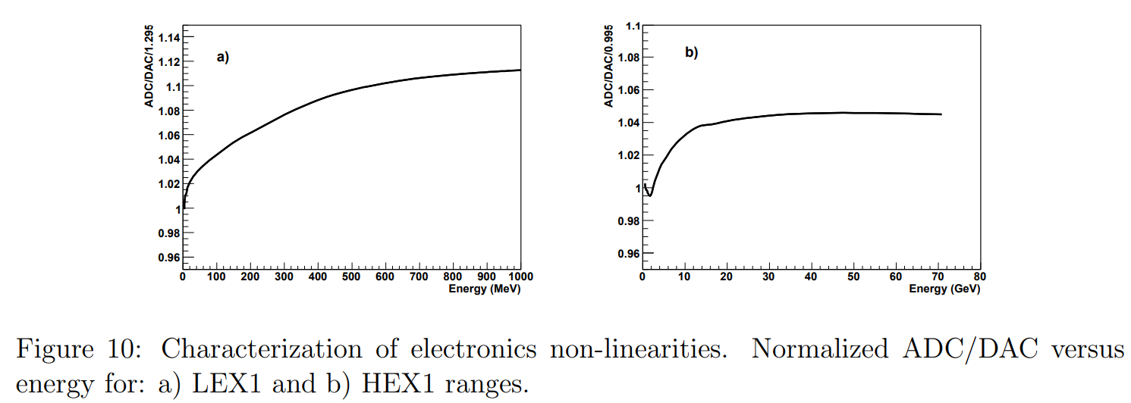
Fermi on-orbit calibration
Pedestal
Individual crystal energy scales

Slide 7
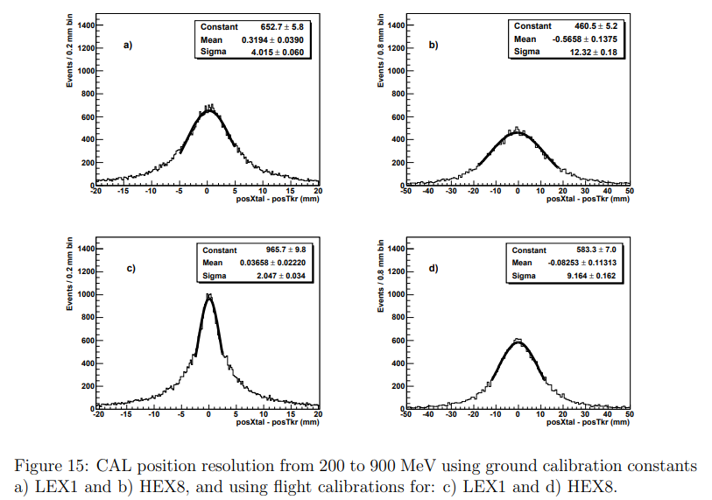
Fermi on-orbit calibration
Light asymmetry
Heavy nuclei event
12 evenly spaced bin
on the ground with sea-level cosmic muons, on orbit with GCRs.

Slide 8
Fermi on-orbit calibration
LAC Threshold (Log-Accept)
Typical Setting: ~2 MeV, roughly 10 times the electronic noise level.
Purpose: Discriminates very low-energy deposits (a few MeV) from noise.
Calibration and Stability: sets one crystal end to maximum threshold, the other end to the nominal threshold, and looks at the trigger rate (logical OR). A step-function fit then yields the actual threshold in MeV.
FLE / FHE Thresholds (Fast Low Energy / Fast High Energy)
Typical Values: ~100 MeV for FLE and ~1000 MeV for FHE.
Purpose: Provide quick triggering for moderate (FLE) and high (FHE) energy events
On-Orbit Calibration: Performed by dedicating runs to background events or using injected charge; the efficiency vs. deposited energy curve is fitted to extract each threshold.
ULD (Upper Level Discriminator)
Puropose: ensure signals do not saturate the ADC in three energy ranges (LEX8, LEX1, and HEX8)
Ground DAC calibration: ~5% below ADC saturation; On-orbit: slightly modified

Slide 9
DAMPE on-orbit calibration

Slide 10
VLAST-P on-orbit calibration
All detectors
About ECAL

