Slide 1
Study of CEPC ECAL Calibration
--Zhen Wang, Jiaxuan Wang, Xiang Li

Slide 2
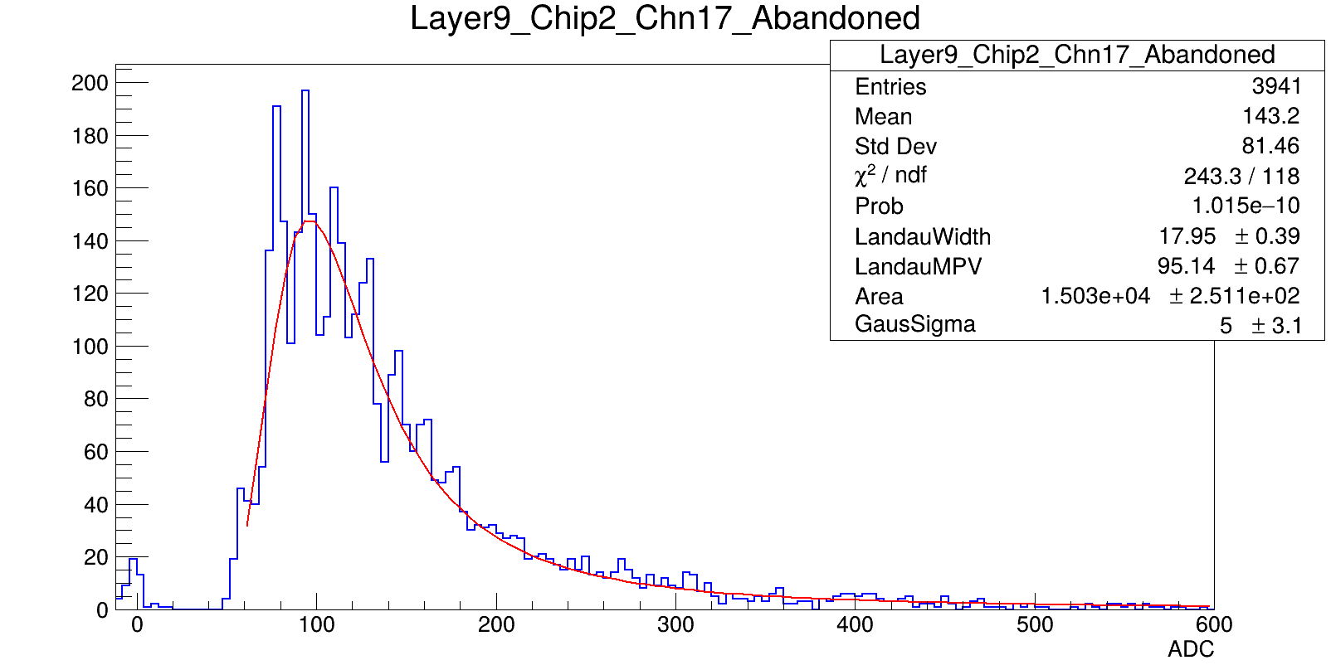
Motivation
MIP calibration does not work due to low signal-noise ratio
Need to find an alternative method for calibration

Slide 3
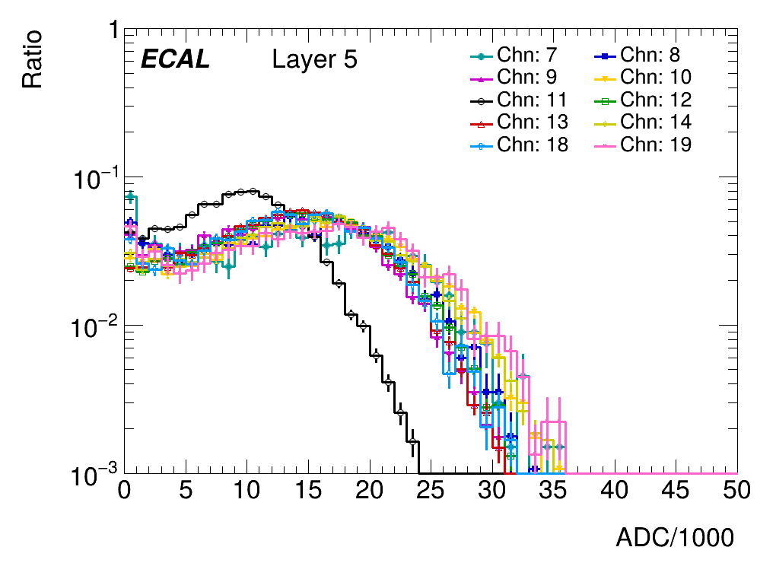
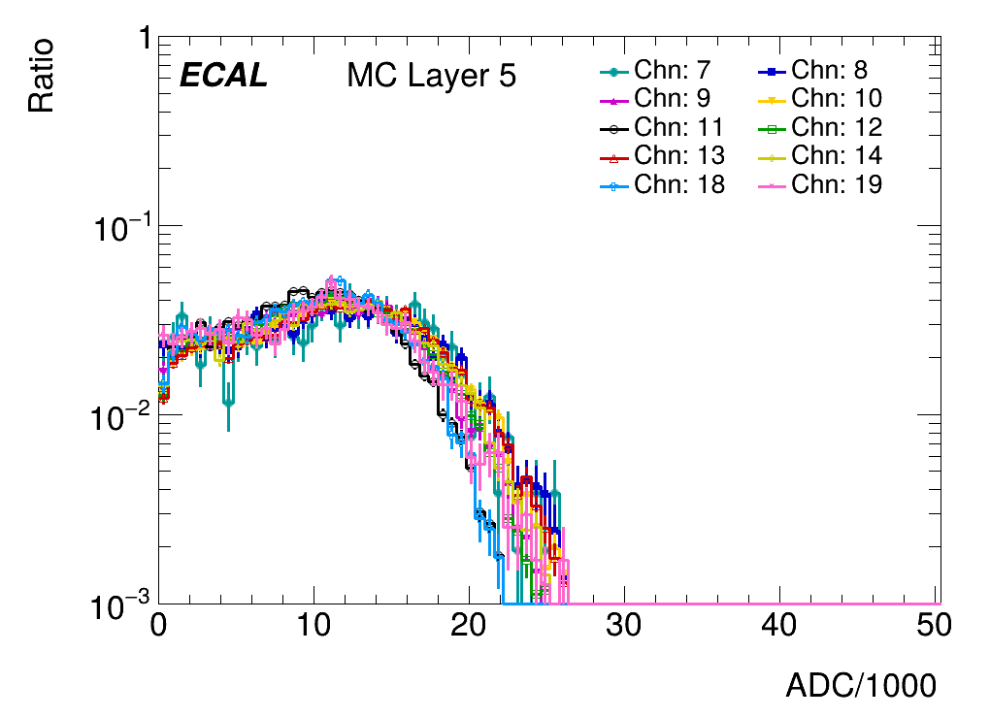
Strategy
Electron events as one of the substitutions
Look at the weighted energy(ADC) distribution of center cells
Find scale factors to scale channels back
Weighted filled energy

Slide 4
Histogram fitting
Standard channel selection:
MIP calibration histograms
Statistics
MC comparison
Denoted as hstd
For each remaining histogram:
Extract all values in hist
Loop over SFs to generate hnew
Calculate chi2 between hnew and hstd
Select SF that minimizes chi2

Slide 5
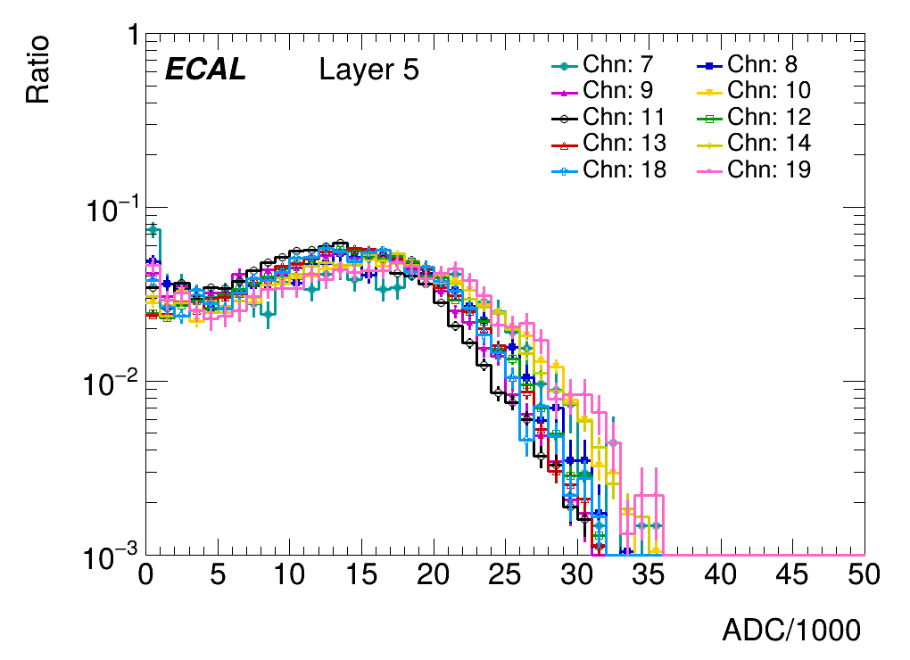
Performance –Layer 5
Standard channal:10
Before
After
Distributions are matching after the scaling

Slide 6
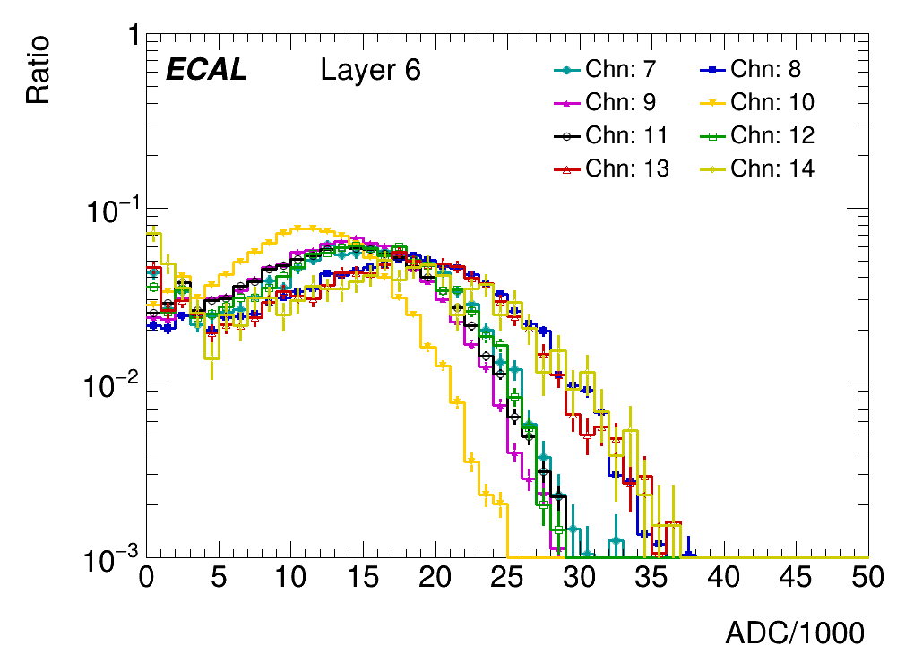
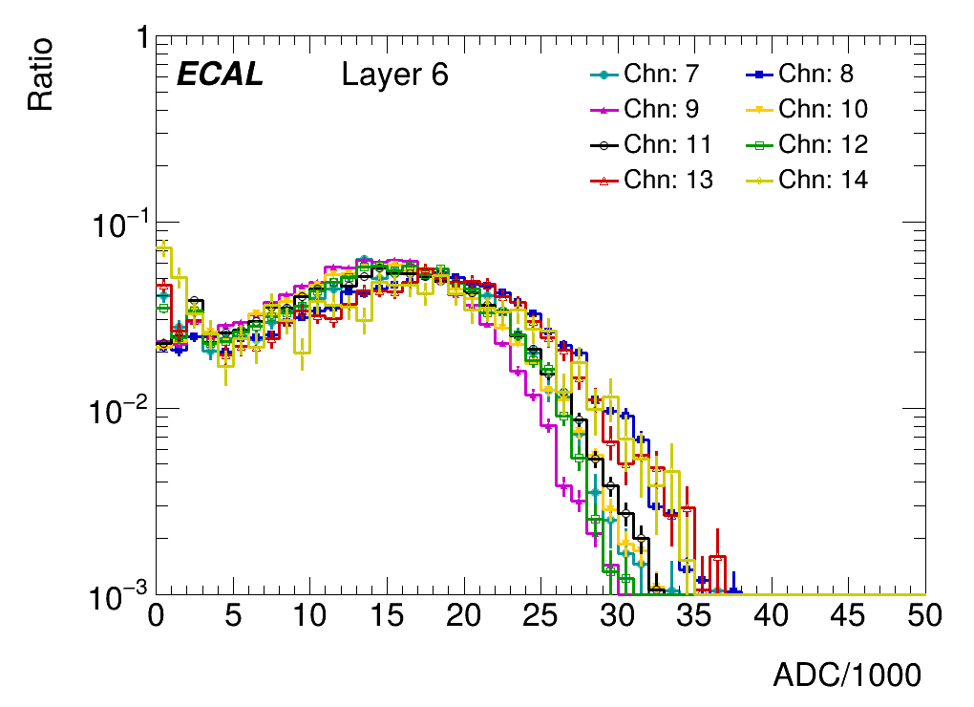
Performance –Layer 6
Standard channal:13
Before
After
Distributions are matching after the scaling

Slide 7
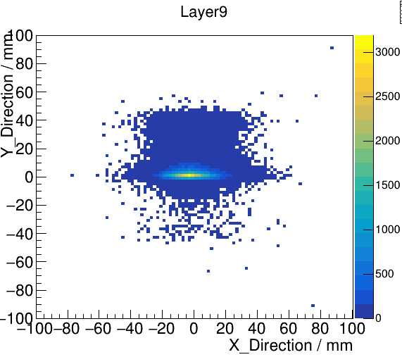
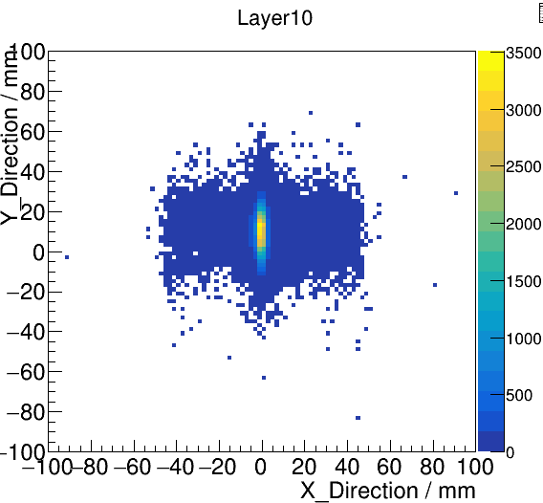
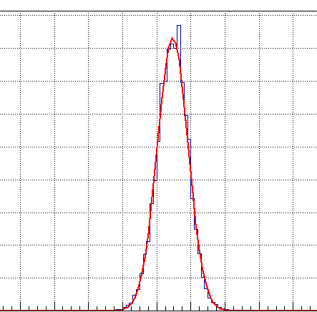
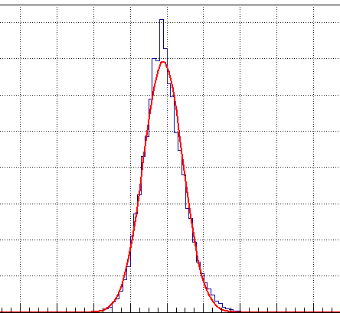
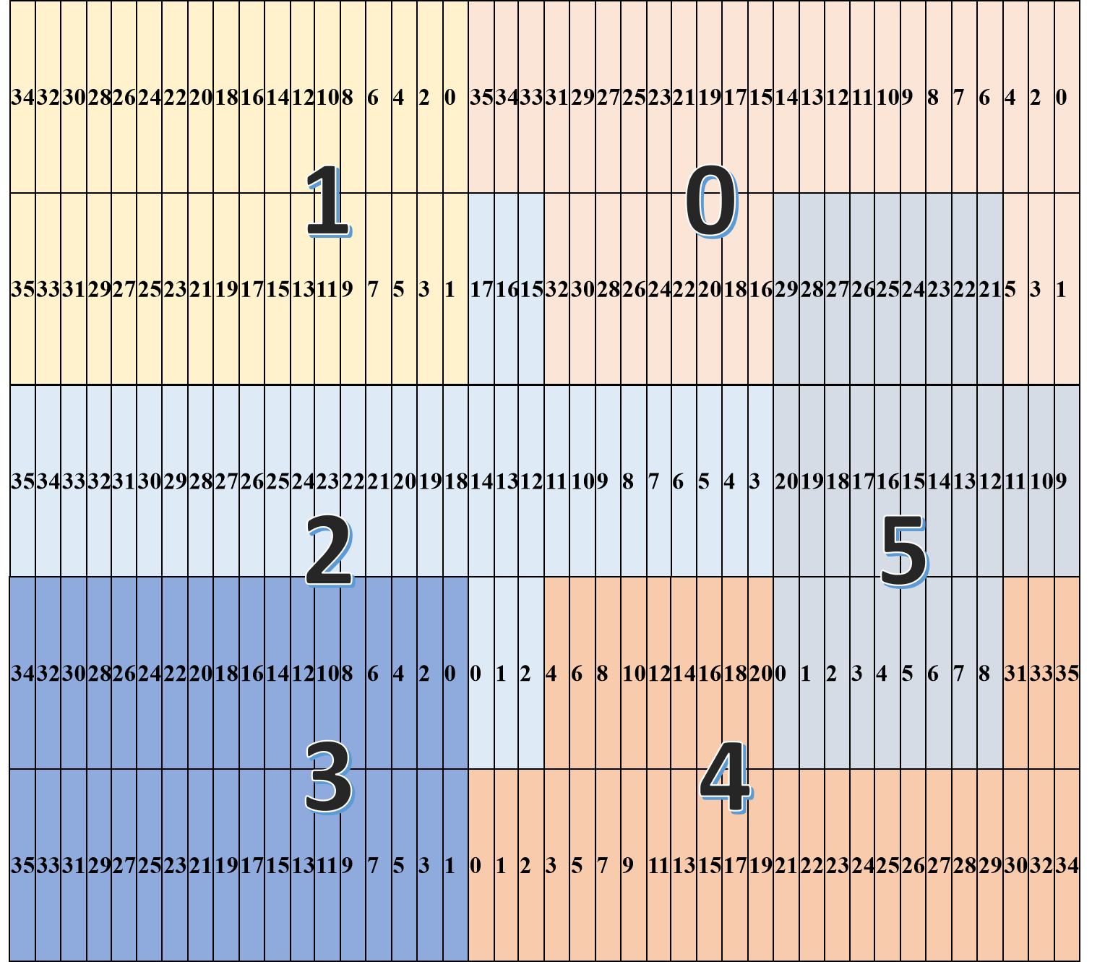
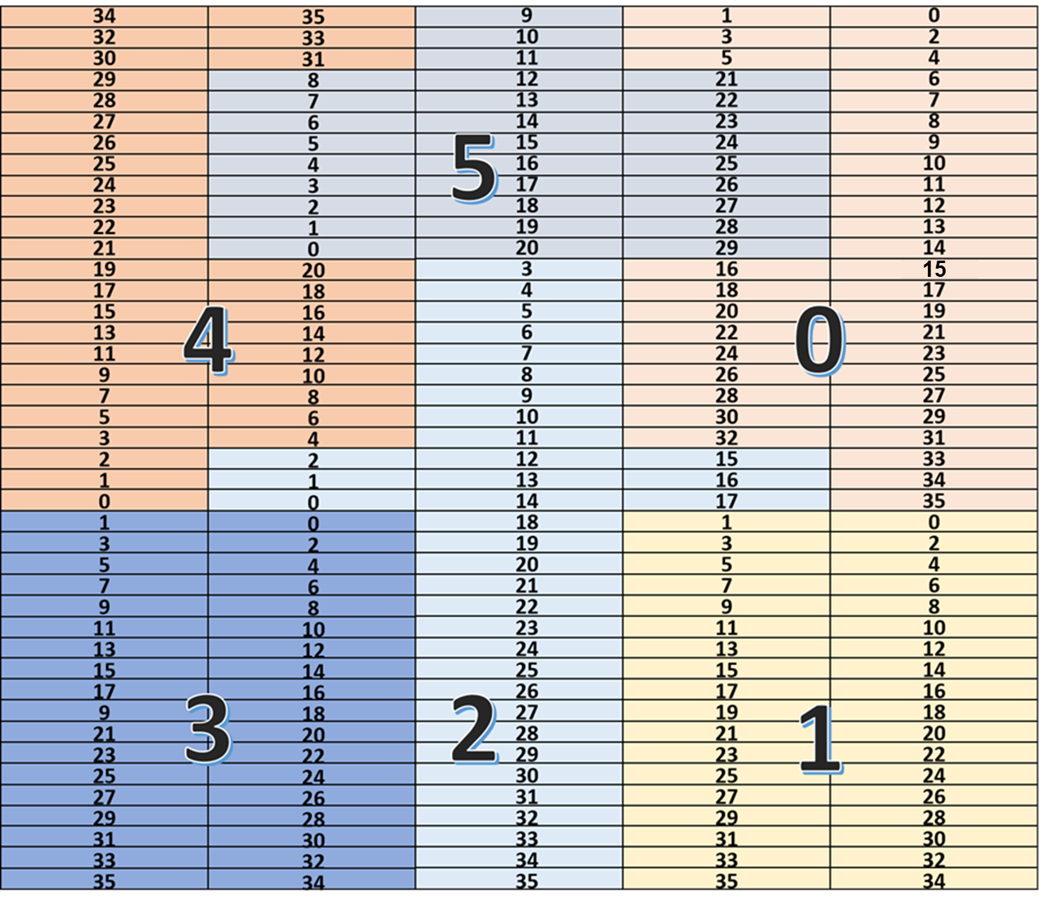
Calibration among layers
Target:
Calibrate ADC with respect to truth energy deposition
Methodology:
Reference shower energy deposition from MC
Compare ADC distribution with energy deposition
Channels:
Odd: 11 12
Even: 9 10

Slide 8
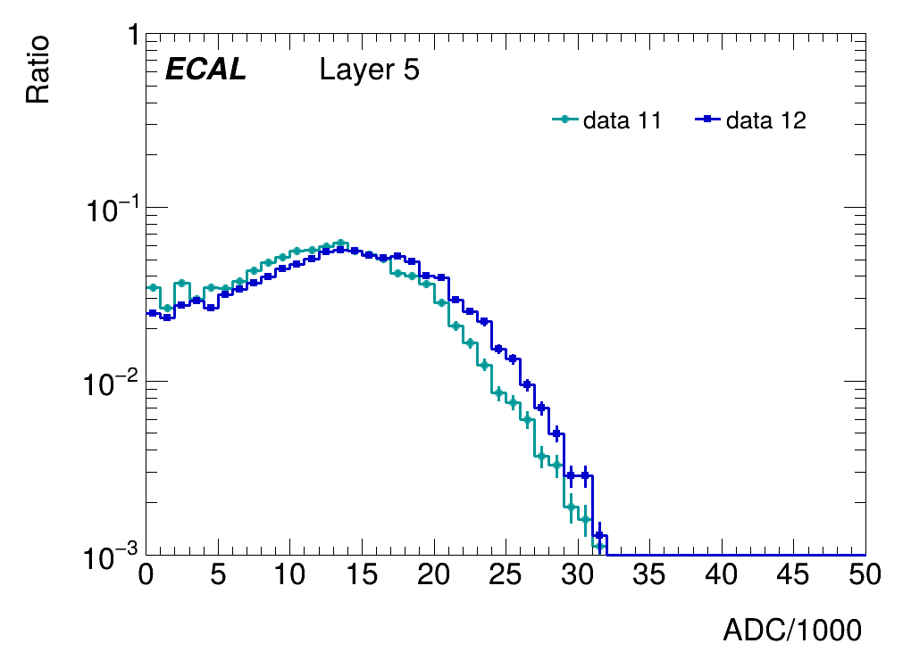
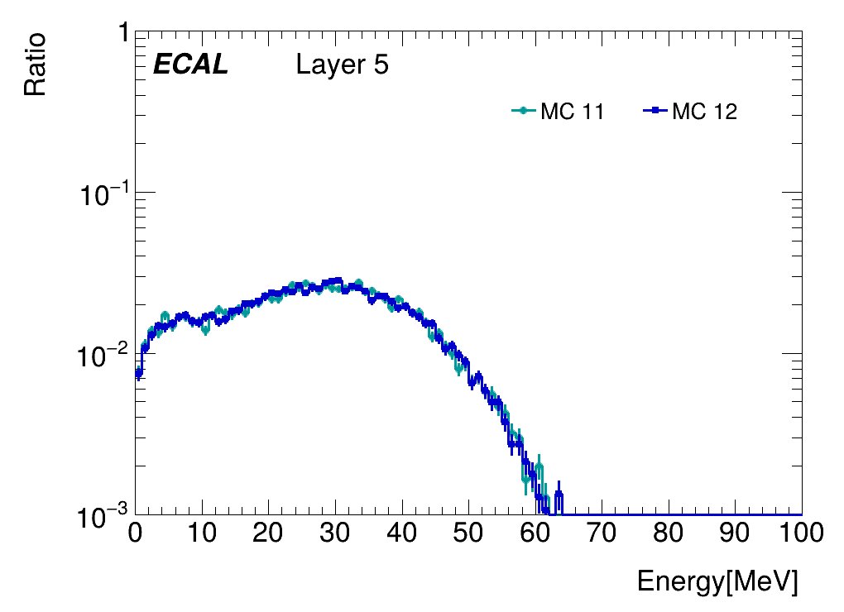
DATA vs MC –Layer5
Similar shapes

Slide 9
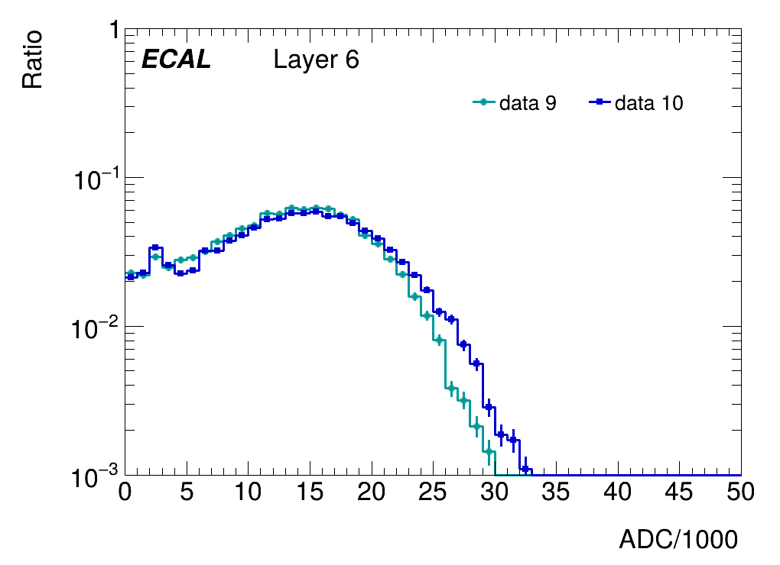
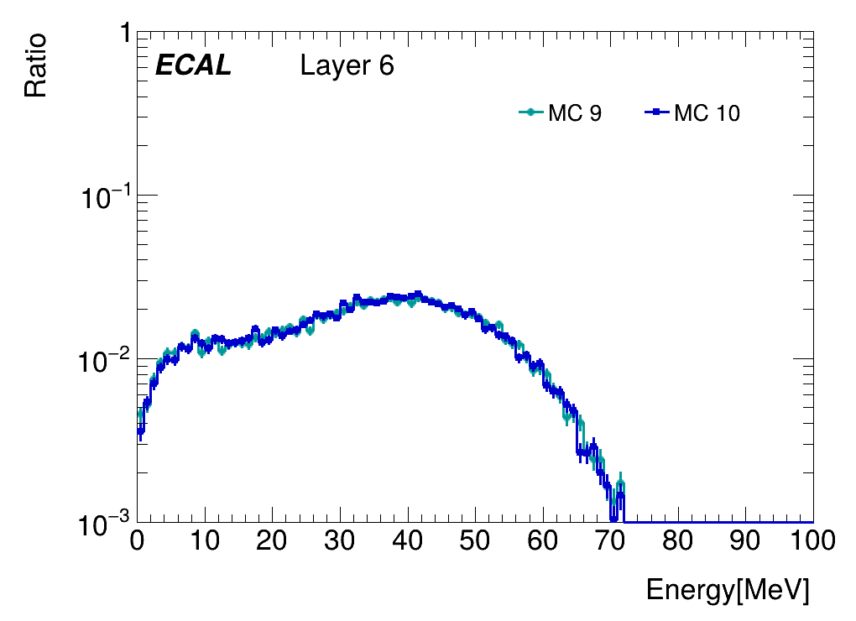
DATA vs MC –Layer6
Difference in shapes, histogram fitting?

Slide 10
Summary & Todos
Channels normalized with scale factors
Calibration factors estimated with MC
Apply these factors and estimate energy resolutions (Scripts ready from Jiaxuan?)

Slide 11
Backup

Slide 12
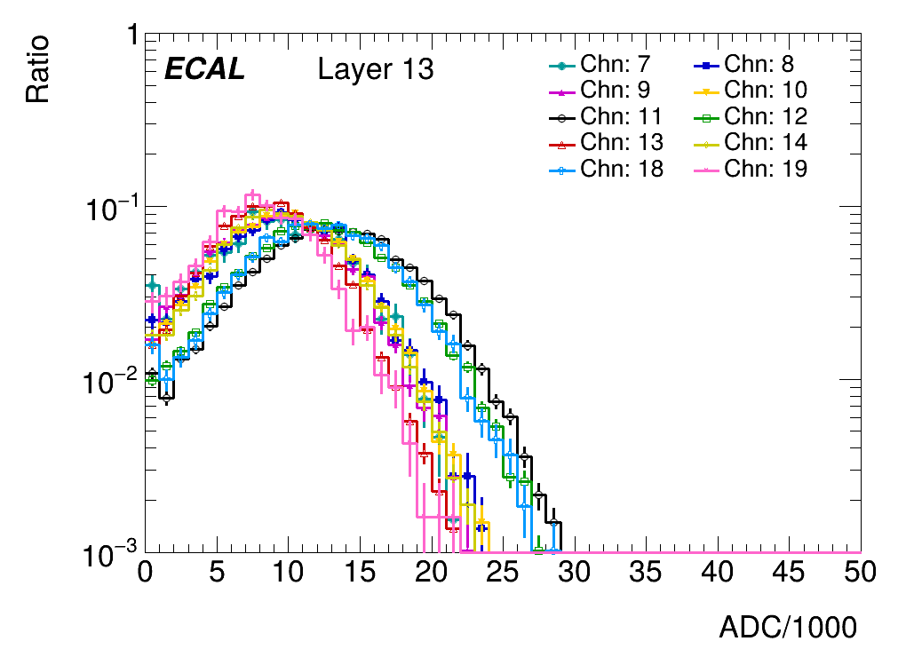
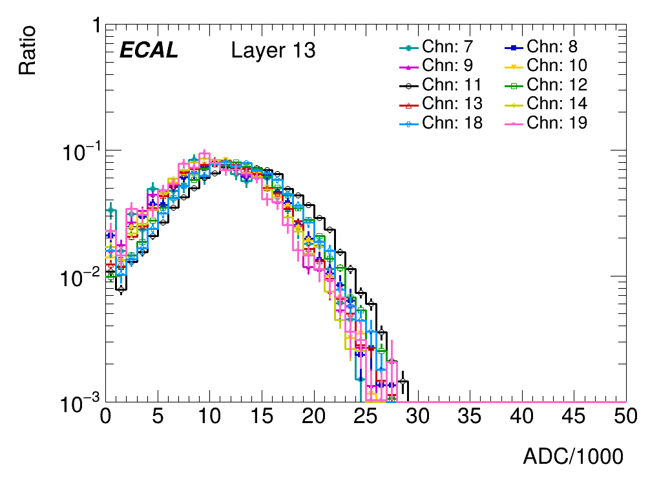
Performance --example
Standard channal:12
Before
After
Distributions are matching after the scaling

Slide 13
Data vs MC –layer5

Slide 14
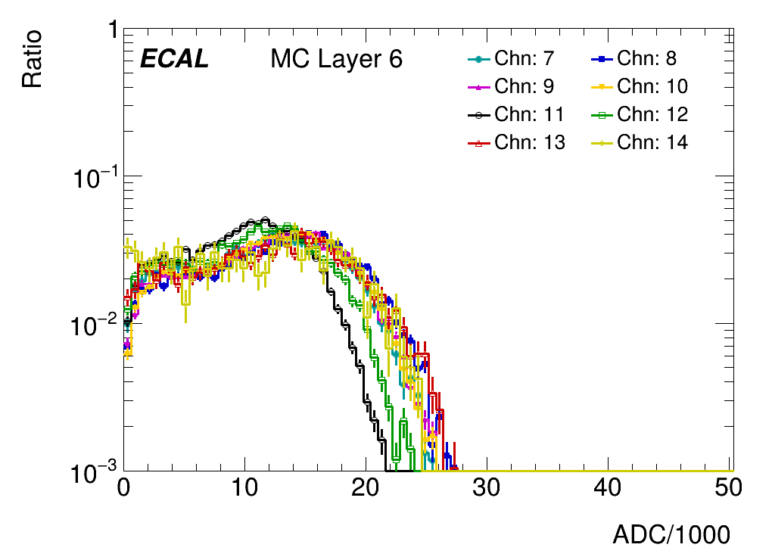
Data vs MC –layer6

Slide 15
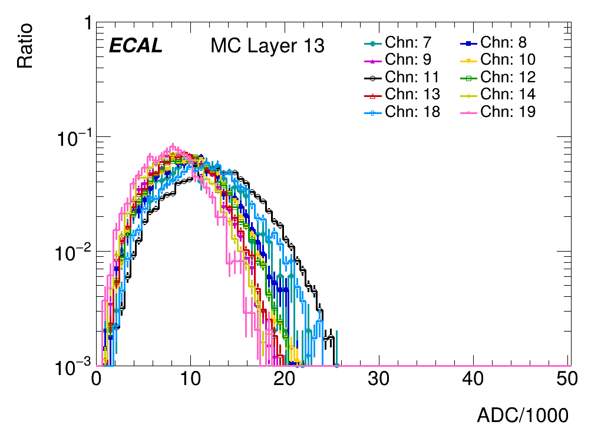
Data vs MC –layer13
MC underestimates data generally

