Slide 1
LightFCP
Rong Yi
2025/01/10

Slide 2
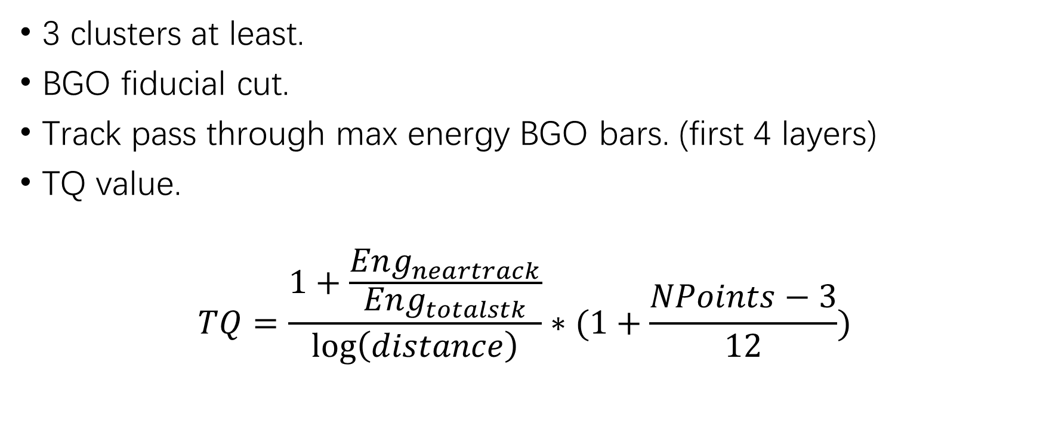
Good Track
3 clusters at least.
BGO fiducial cut.
Track pass through max energy BGO bars. (first 4 layers)
TQ value.
$$TQ=\frac{1+\frac{Eng_{neartrack}}{Eng_{totalstk}}}{\log\left(distance\right)}∗(1+\frac{NPoints−3}{12})$$

Slide 3
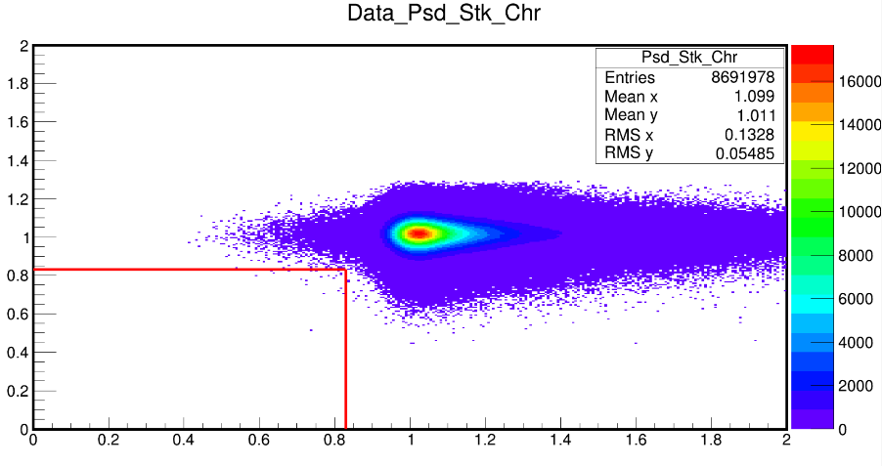
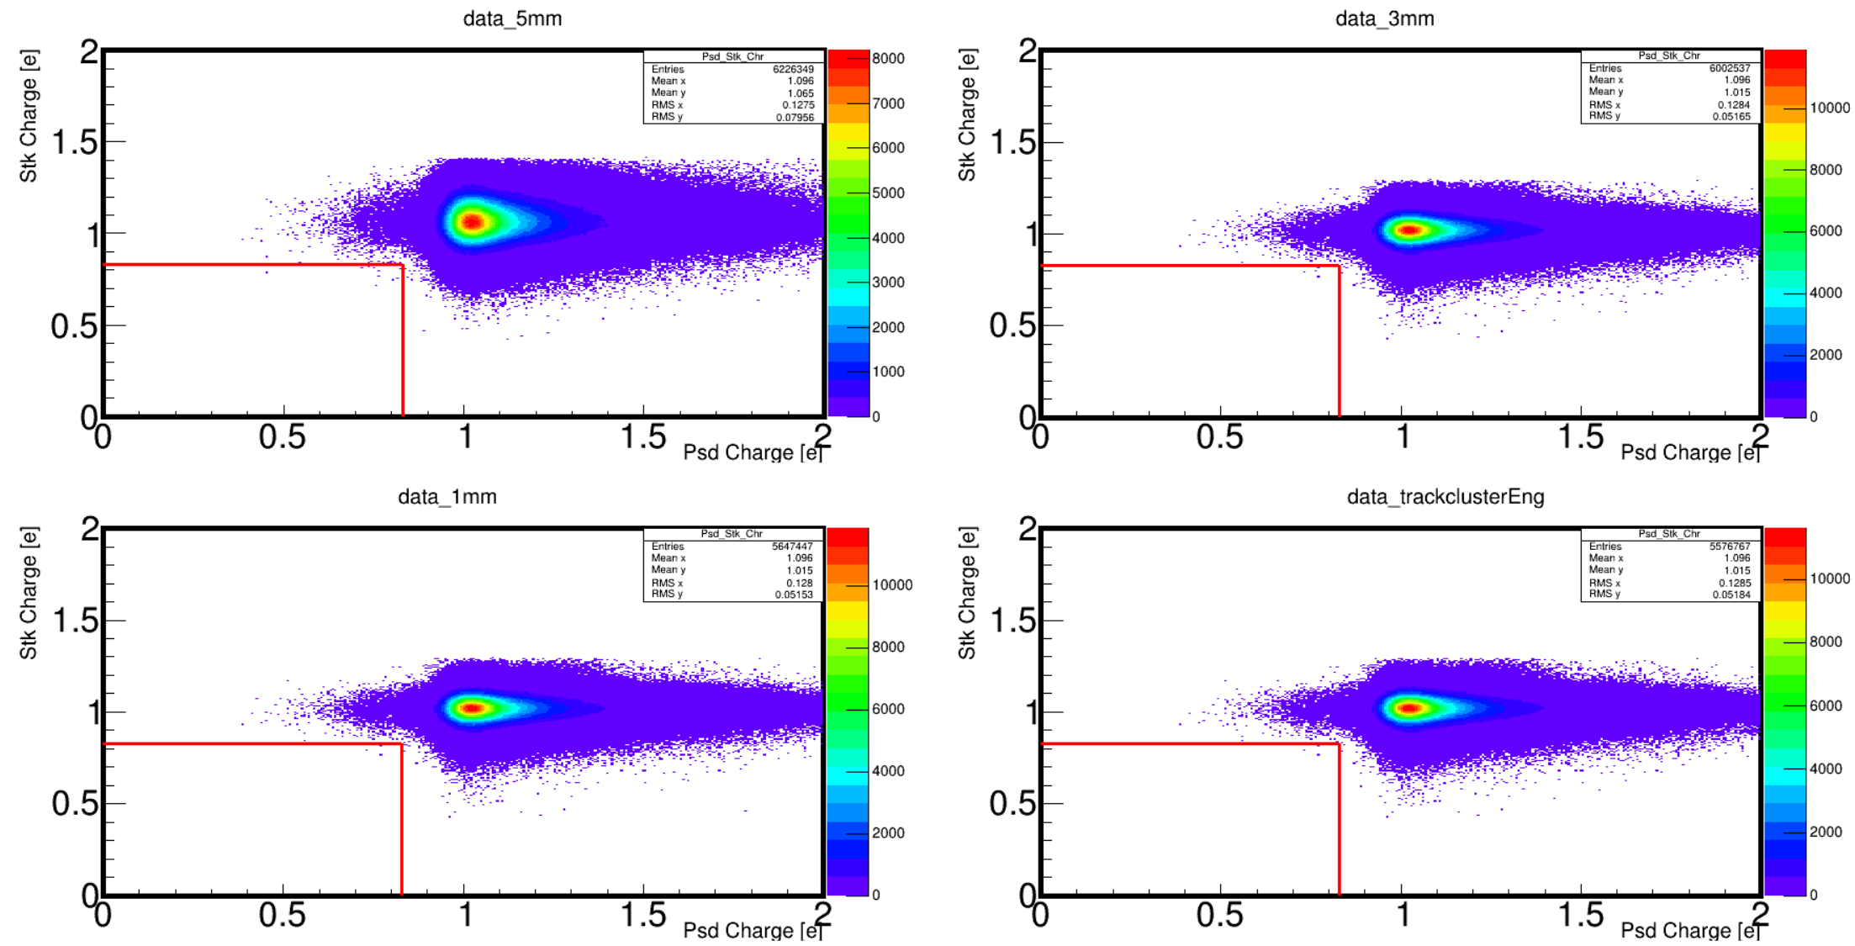
Charge spectrum

Slide 4
Backup

Slide 5
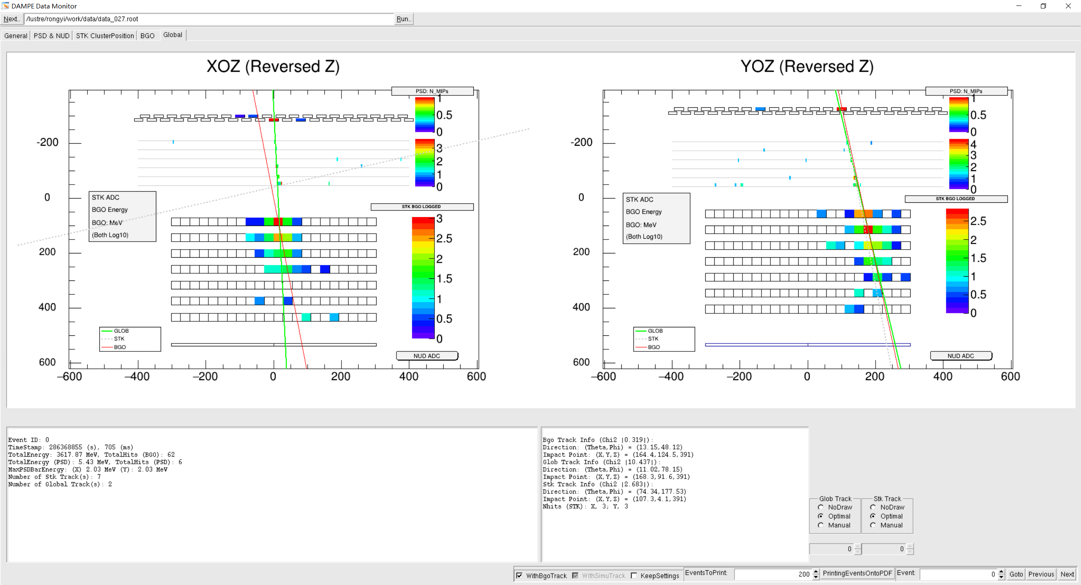
Backup

Slide 6
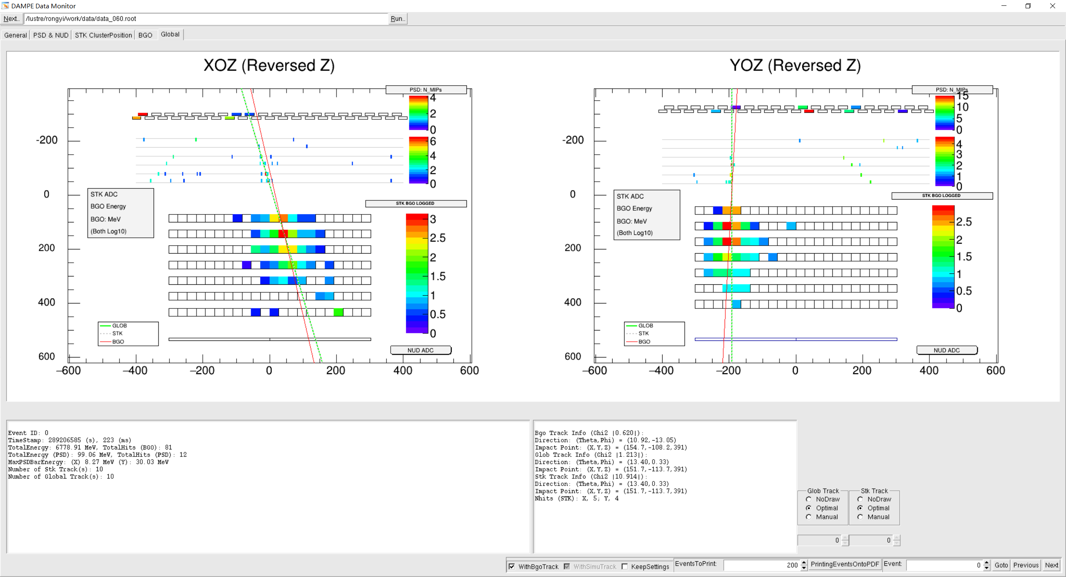

Slide 7
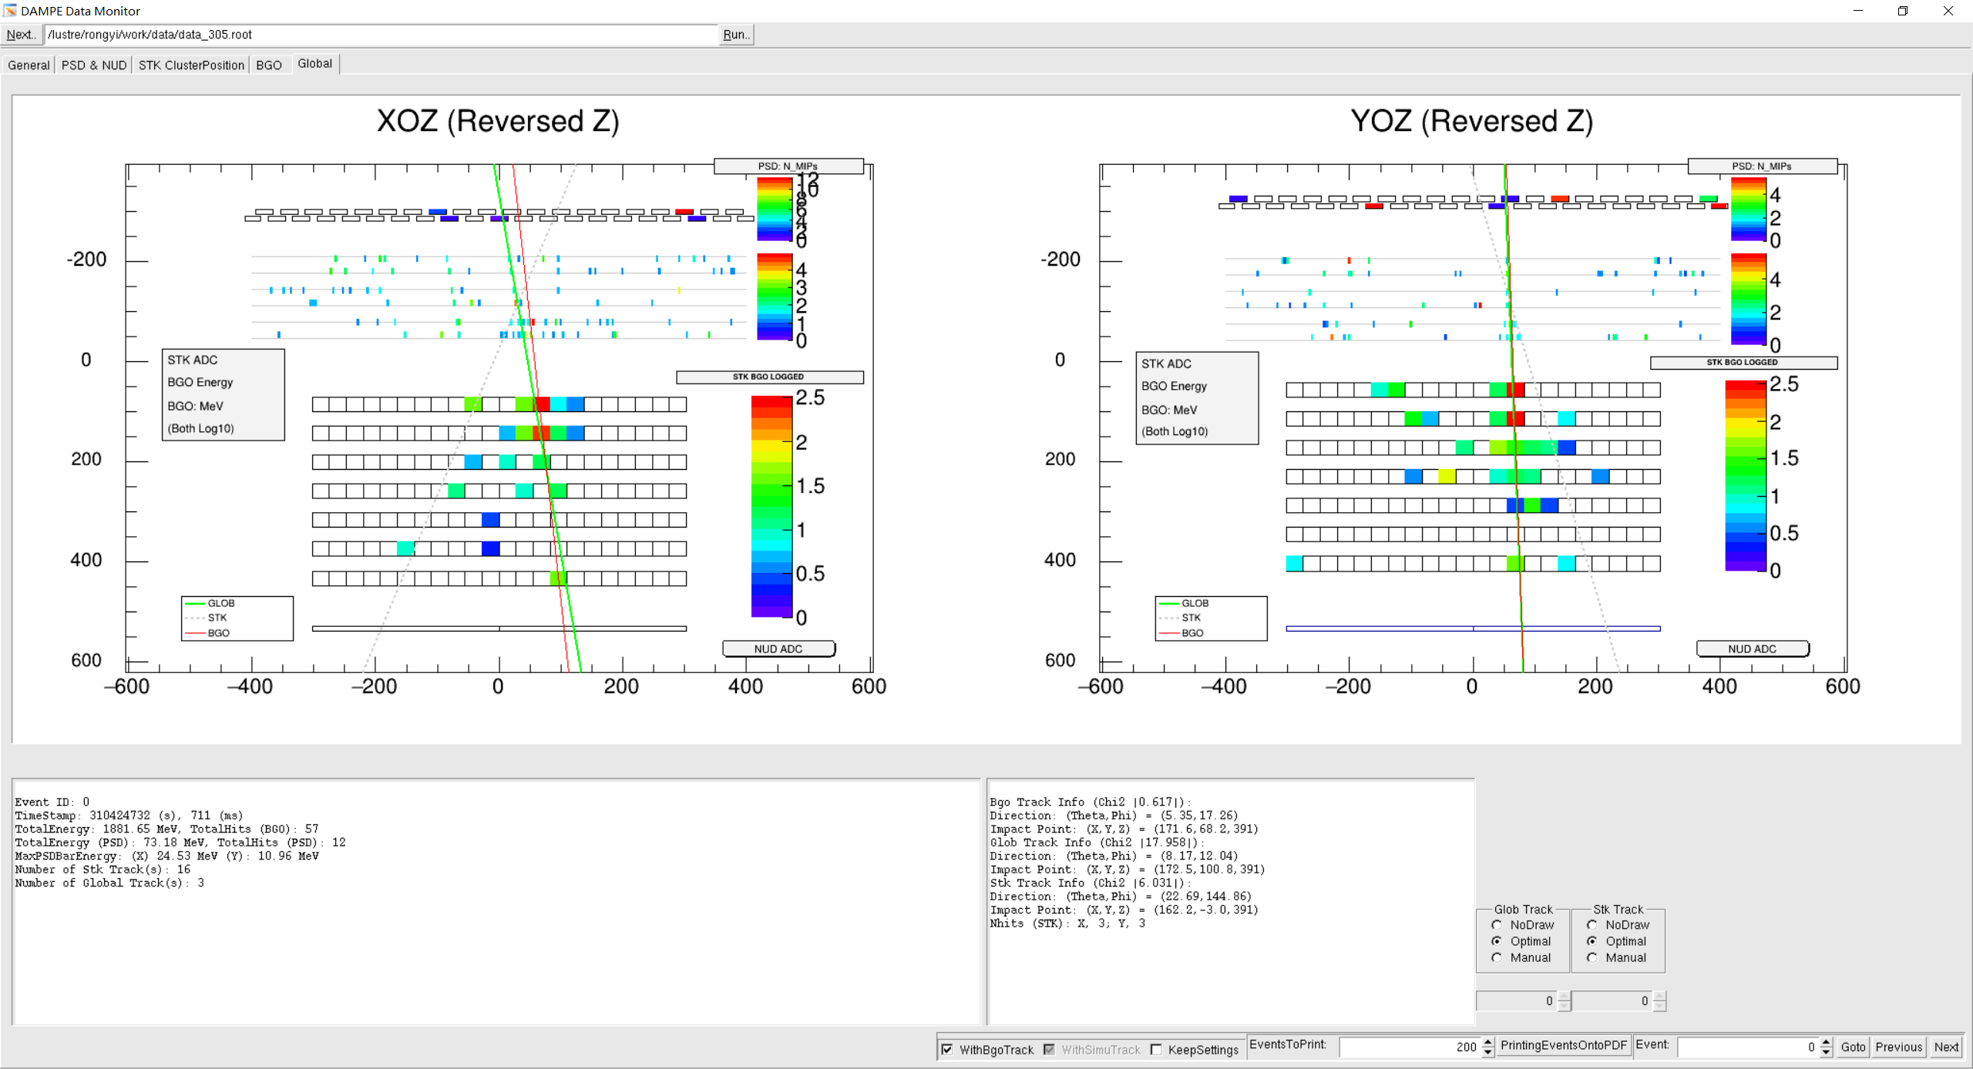

Slide 9
