Slide 1
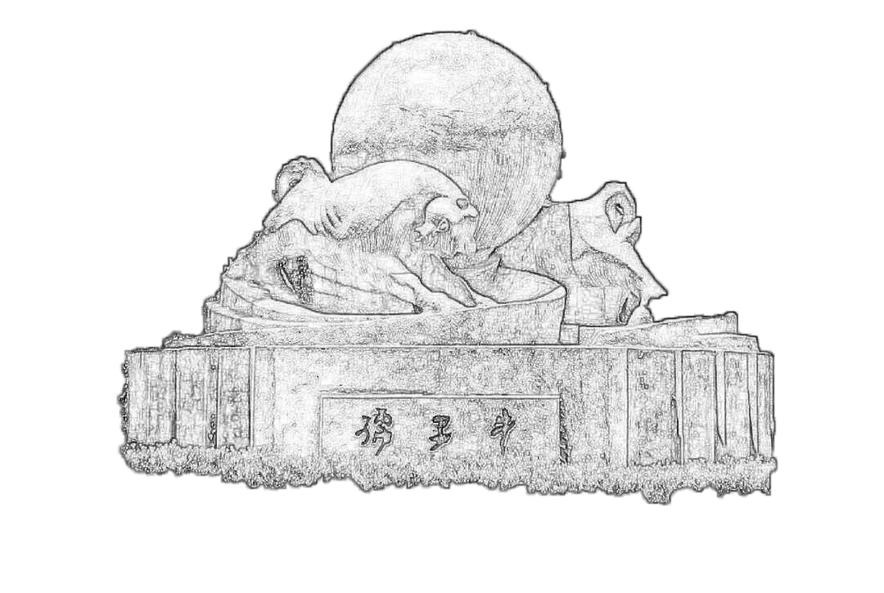
CEPC ECAL MIP spectrum issue overview
2024/12/23
Speaker : Jiaxuan Wang

Slide 2
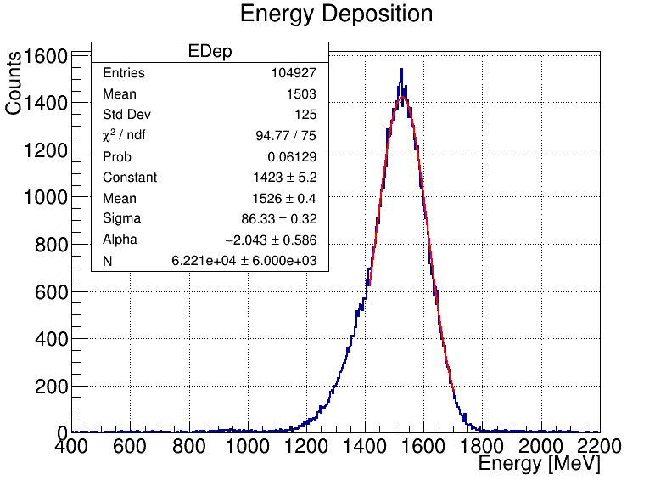
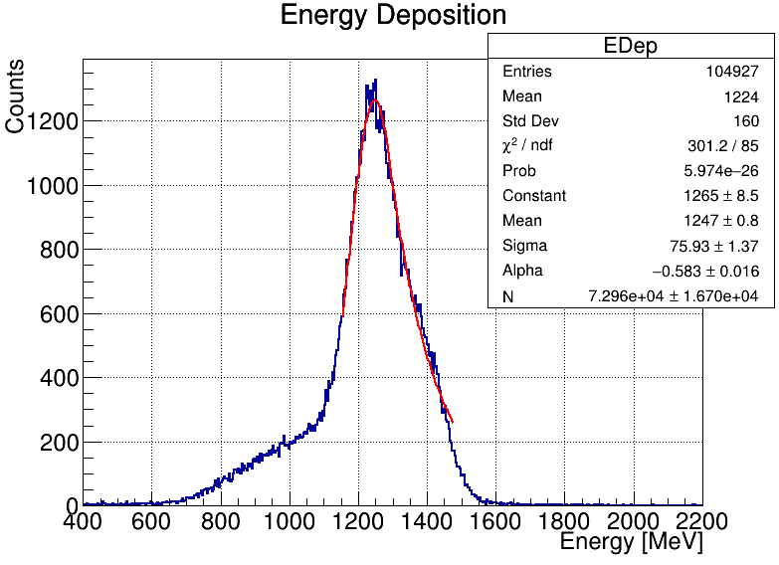
Energy reconstruction : bad channel excluded
All channels & Bad channels excluded
Threshold setting: 0.8MIP

Slide 3
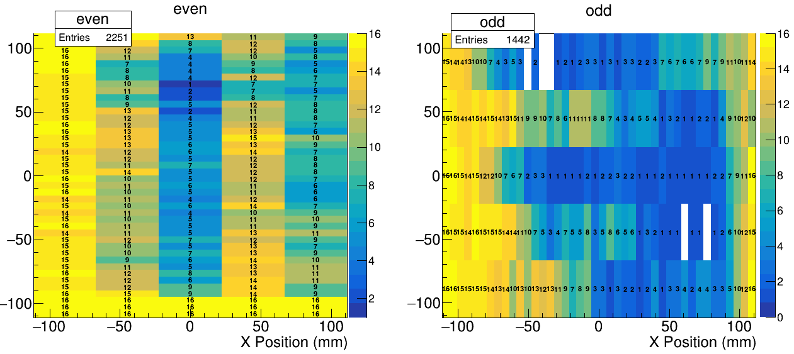
Bad channel position
Odd Layer much better than even layer

Slide 4
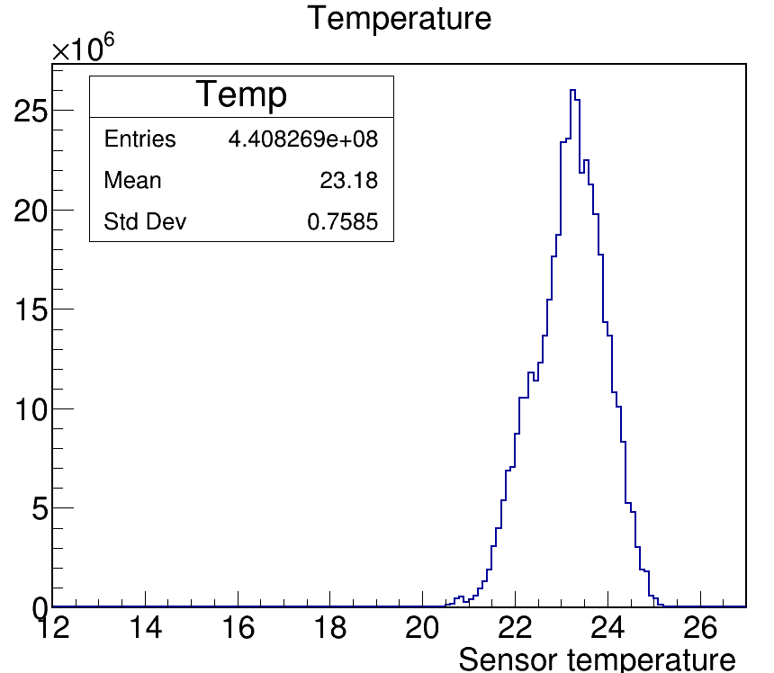
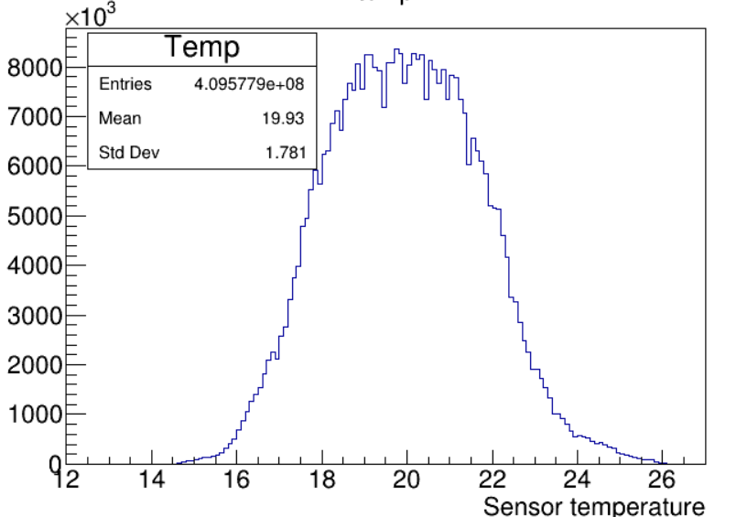
Temperature comparison
CR temperature is 3.2 degrees lower than TB on average
Cosmic ray test
Beam test

Slide 5
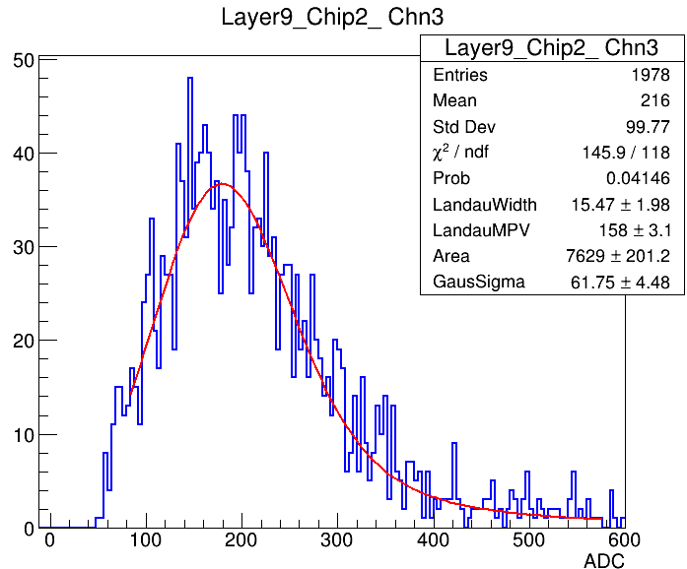
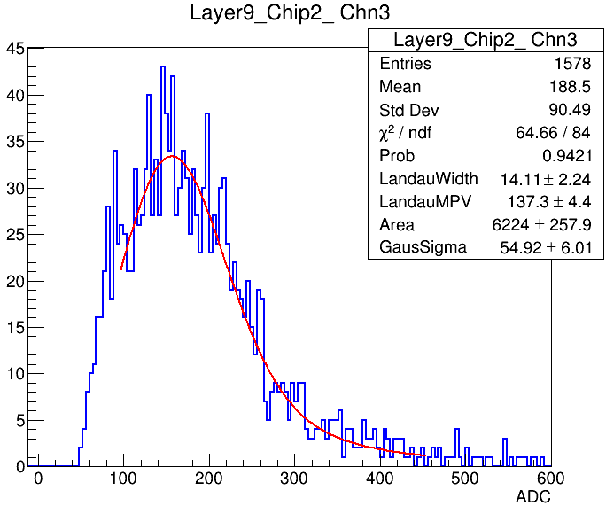
Cosmic ray temperature check
Temperature < 19 && Temperature > 22
Temp < 19
Temp > 22

Slide 6
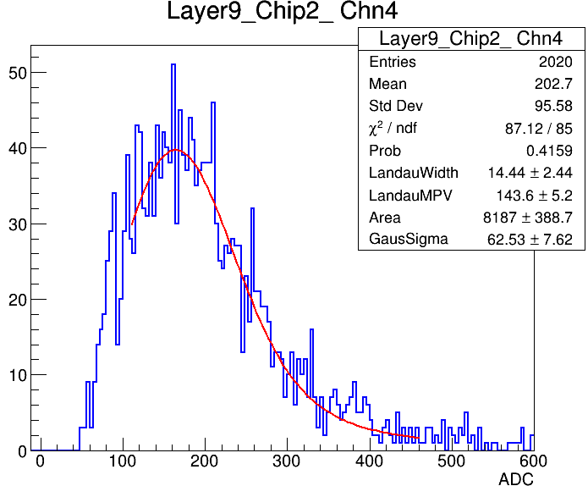
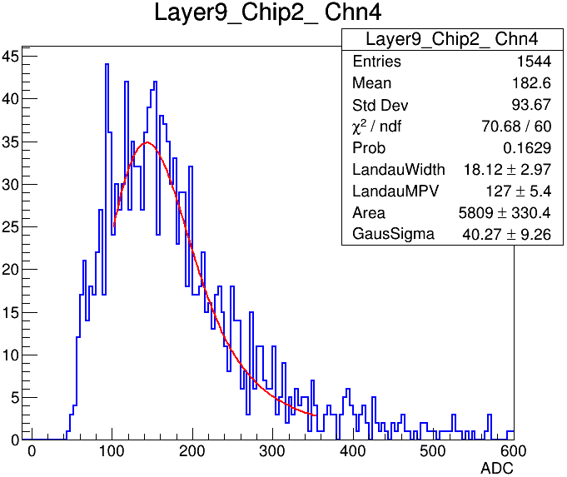
Cosmic ray temperature check
Temperature < 19 && Temperature > 22
Temp < 19
Temp > 22

Slide 7
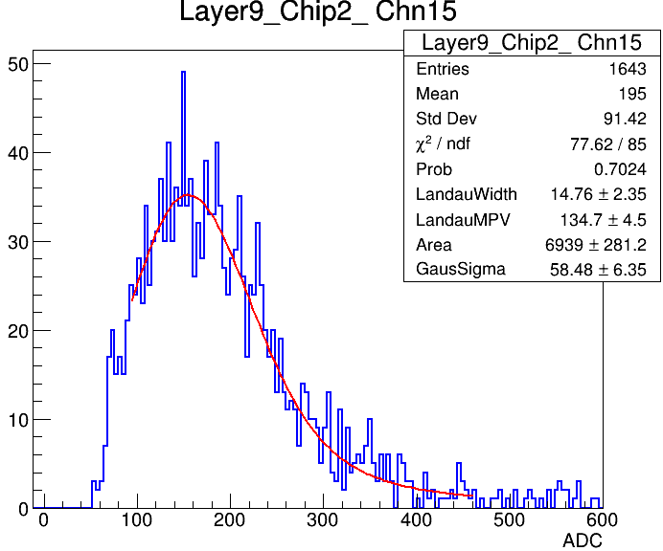
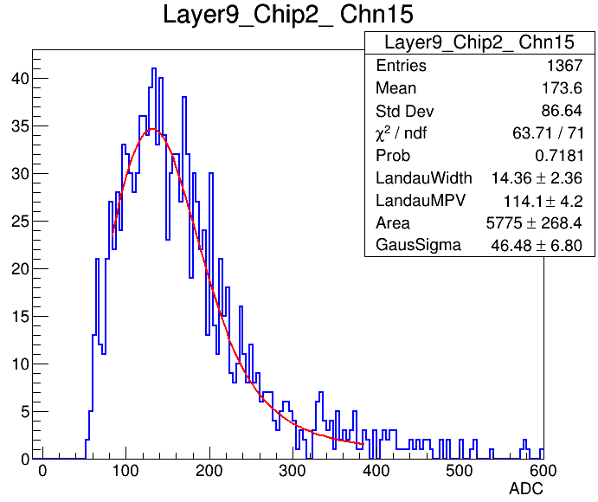
Cosmic ray temperature check
Temperature < 19 && Temperature > 22
Temp < 19
Temp > 22

Slide 8
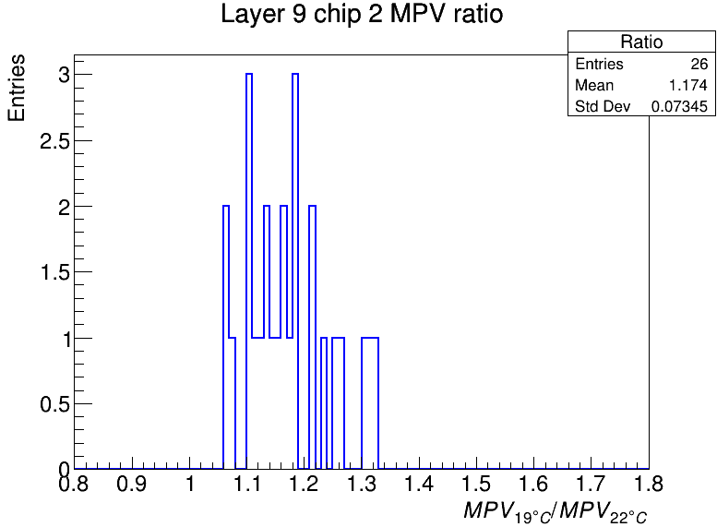
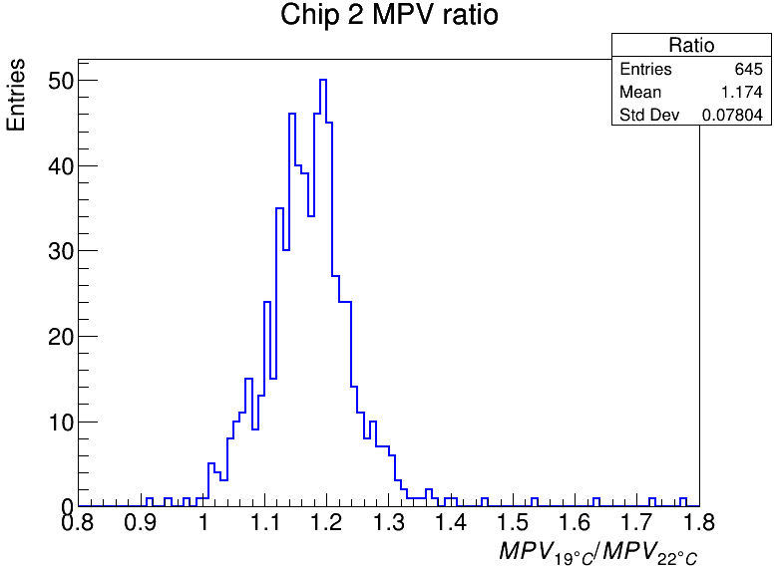
Cosmic ray temperature check
Layer 9 chip 2, all chip 2
Ratio: Temperature < 19 / Temperature > 22

Slide 9
Summary
Energy reconstruction concerns channels at central region, which may also have problem on MIP calibration.
Temperature DOES matter.
Correction on MIP, but how?

