Slide 1
Discussion on (New) Physics Directions into the Universe Yusheng Wu – Monthly Deep Space Meeting, Dec. 4, 2024
WIMP
Axions
Dark Photons
Sterile Neutrinos
Cosmic Ray
Photons
Neutrinos
Monopoles
Cosmic Strings
Domain Wall
Q-ball

Slide 2
Directions motivated by unresolved cosmological observations
Searches for WIMP, axion, sterile neutrinos, etc. via a variety of technologies, corresponding to a variety of BSM theoretical models
Considered as relatively classic approach by now, the focus point of contemporary efforts

Slide 3
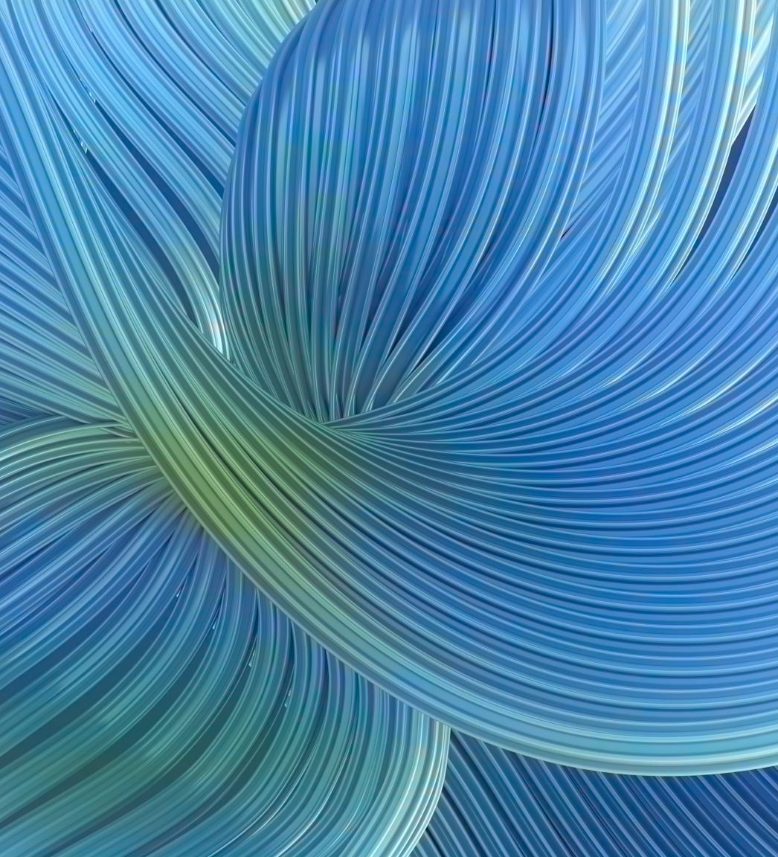
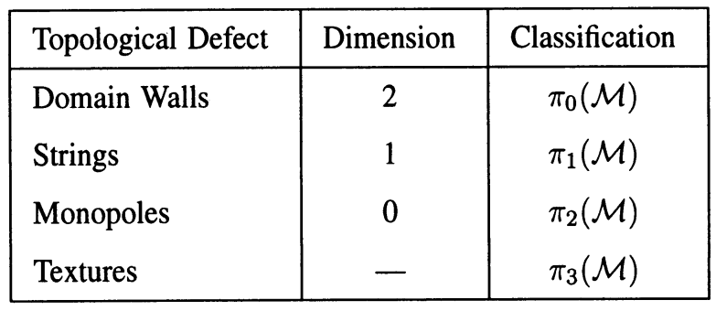
Directions from vacuum
New Physics (GUT, string, …) took place at extremely early Universe
Potential configuration, Phase transition
Spontaneously symmetry breaking
Topological defects (e.g., domain walls, monopoles), non-topological defect (Q-ball)
TOPOLOGICAL DEFECTS IN COSMOLOGY, E. P. S. Shellard

Slide 4
Directions from No Directions
Is there anything we can think about to approach beyond current theoretical imagination?
Brainstorming needed
Experimental approach:
fundamentally improve detection sensitivity in different dimensions (expose to unnoticed phenomena)

Slide 5
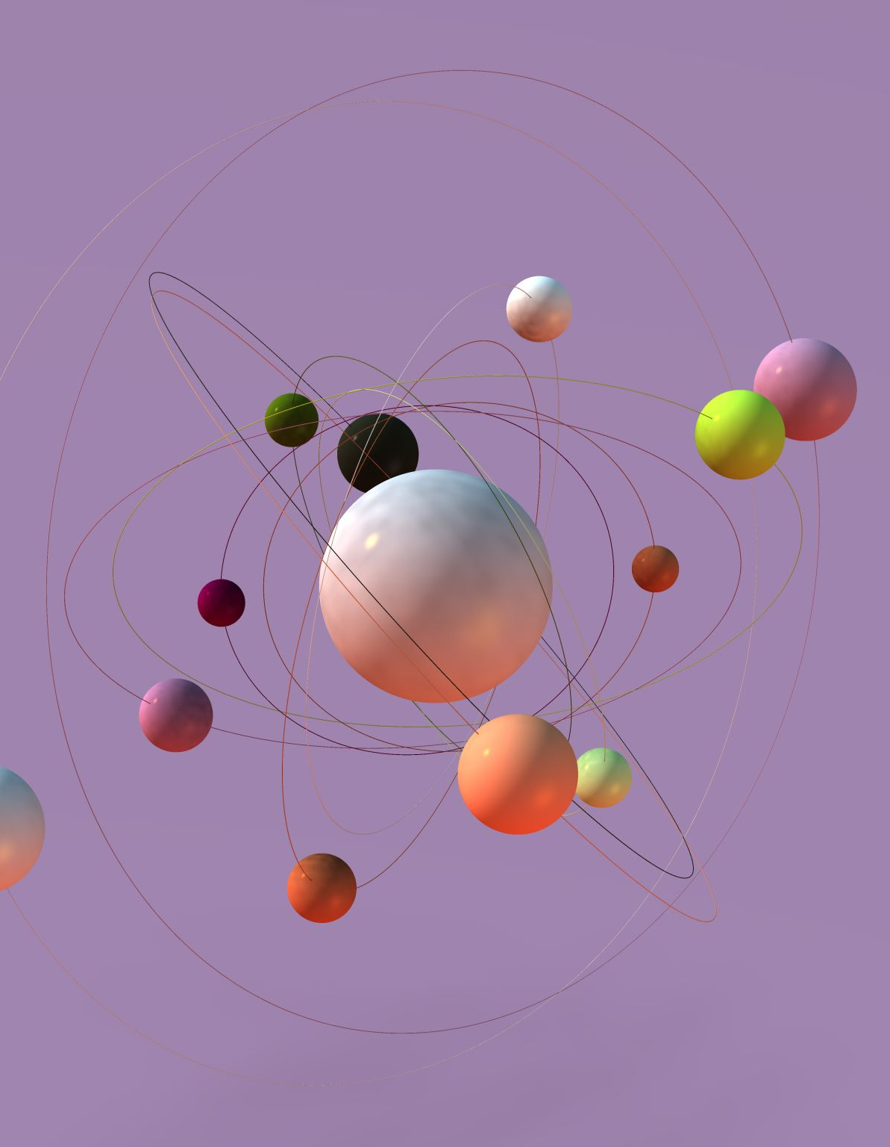
Potential Action Items
Science Mission of Deep Space Exploration is deeply connected with the abovementioned topics
Ask a few questions
What new information can we bring to classic topics (dark matter)? long-distance wave phase detection for Axions? others?
What can we do for (non-) topological defects?
Search for them systematically (underground, air shower, space, collider, table-top)
Deep collaboration with theorists for particle phenomenology (seminars, working together)
What can we do to approach unknown directions
What kind of detection dimensions we can improve by a factor of 10-100 in next 10 years?

Slide 6
phenomenology and simulation
We are in general lacking support to comprehensively study particle phenomenology (for mentioned topics)
We are beginning to explore simulation of EAS, CR, etc. Strong knowledge on that is essential for future exploration
May build up a pheno. and simulation platform/collaboration: from pheno models, CR propagation, EAS models, Geant4, etc.

Slide 7
An example of recent work to expand the search for topological defects (monopoles)
Undergraduate Student (Zhonghua Zhang), me, in collaboration with Ruizhi Yang, and Yanhong Yu
See next set of slides

