Slide 1
Spin alignment in local equilibrium
in Zubarev’s approach
Shi-Zheng Yang
University of Science and Technology of China
Collaborate with Xing-Qing Xie, Shi Pu, Qun Wang
USTC-PNP-Nuclear Physics Mini Workshop Series

Slide 2
Content
Introduction
Density operator and distribution function
The results of the spin alignment
Is spin alignment induced by shear tensor dissipative
Summary

Slide 3
Content
Introduction
Density operator and distribution function
The results of the spin alignment
Is spin alignment induced by shear tensor dissipative
Summary

Slide 4
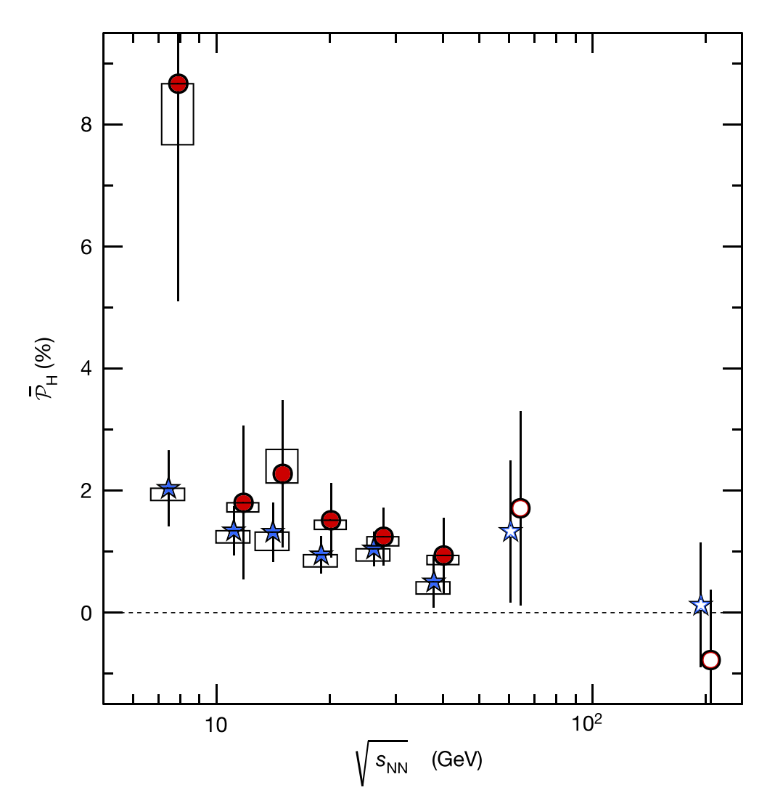
$Λ$ global polarization
Z.-T. Liang and X.-N. Wang, Phys. Rev. Lett. 94, 102301 (2005)
STAR, L. Adamczyk et al., Nature 548, 62 (2017),

Slide 5
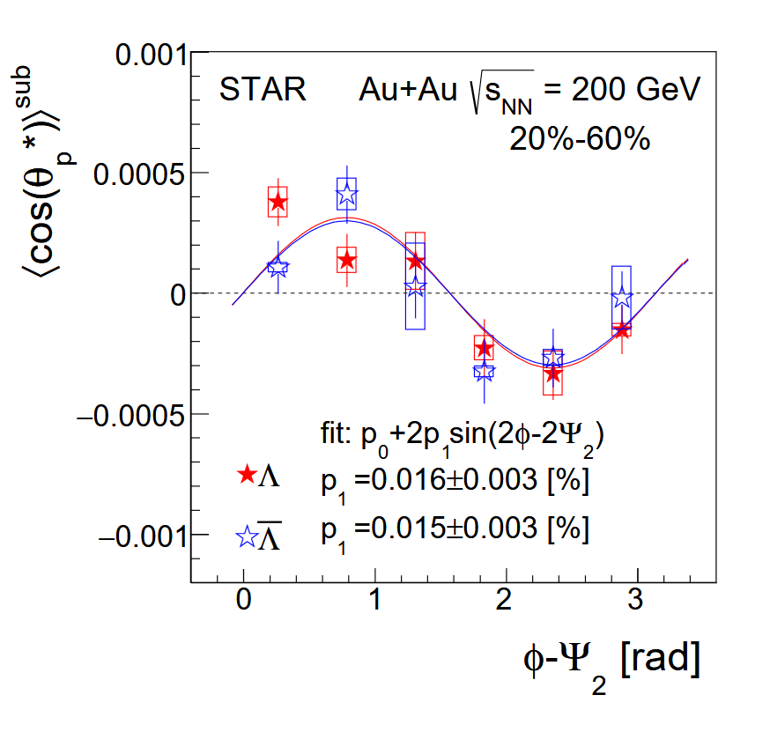
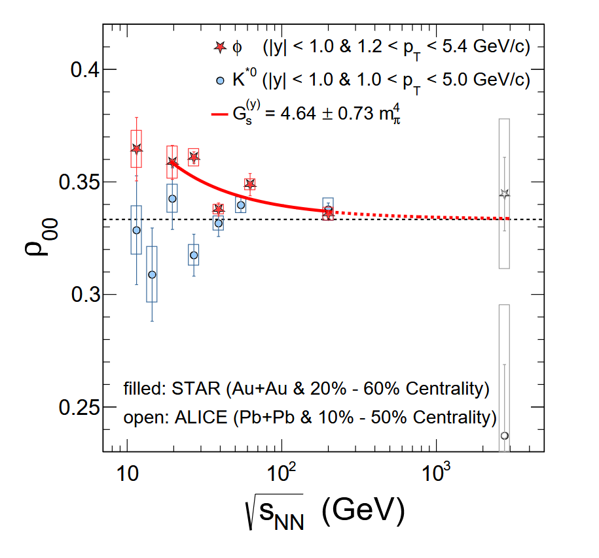
Polarization effects
$Λ$ local polarization $φ$, $K^{∗}$ spin alignment
STAR, J. Adam et al., Phys. Rev. Lett. 123, 132301 (2019)
STAR, M. S. Abdallah et al., Nature 614, 244 (2023)

Slide 6
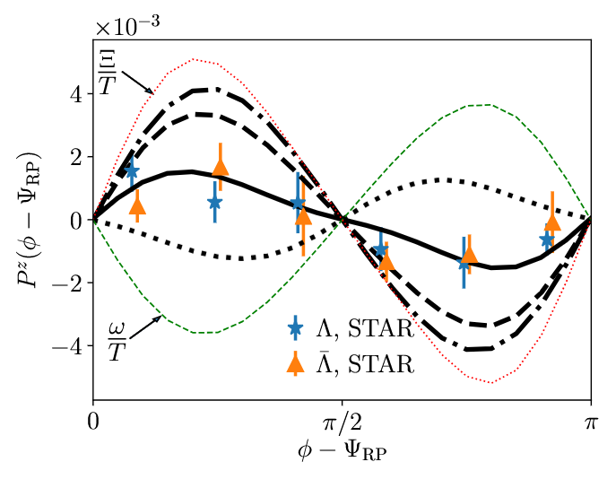
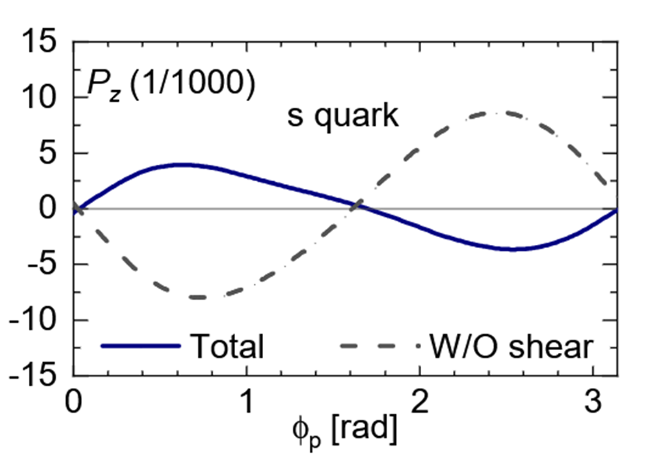
Thermal shear induced effect
Thermal shear contribution to polarization of $Λ$ particle
B. Fu, S. Y. F. Liu, L. Pang, H. Song, and Y. Yin, Phys. Rev. Lett. 127, 142301 (2021)
F. Becattini, M. Buzzegoli, G. Inghirami, I. Karpenko, and A. Palermo, Phys. Rev. Lett. 127, 272302 (2021)

Slide 7
Content
Introduction
Density operator and distribution function
The results of the spin alignment
Is spin alignment induced by shear tensor dissipative
Summary

Slide 8
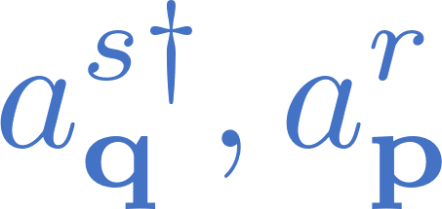
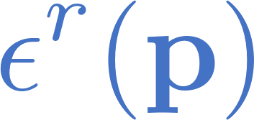
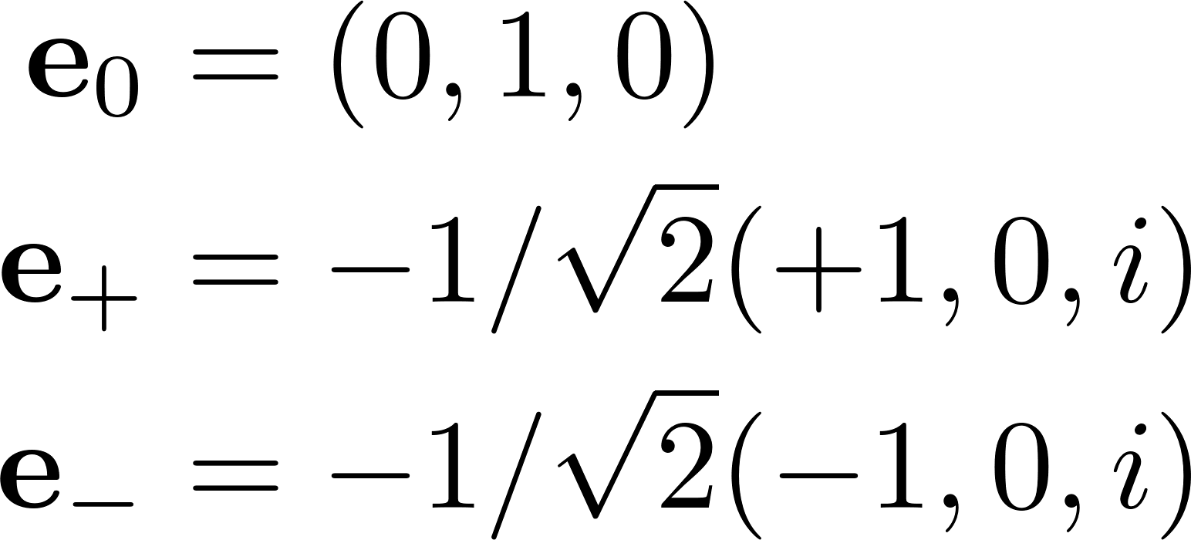
Lagrangian and field operator
The Lagrangian for neutral spin-1 particles
The field operator
The commutation rule for , the identity for
The polarization vectors in particle’s rest frame laboratory frame

Slide 9
Spin distribution function
The Wigner function for spin-1 particles
At leading order of $ℏ$, the Wigner function can be decomposed as
The are defined as (also be called matrix valued spin dependent distributions, MVSD)
The spin density matrix can be obtained from

Slide 10
Density operator
The Belinfante and canonical form of density operator
where the energy momentum tensor and spin tensor are
D. N. Zubarev, A. V. Prozorkevich, and
S. A. Smolyanskii, Theor. Math. Phys. 40, 821 (1979)

Slide 11
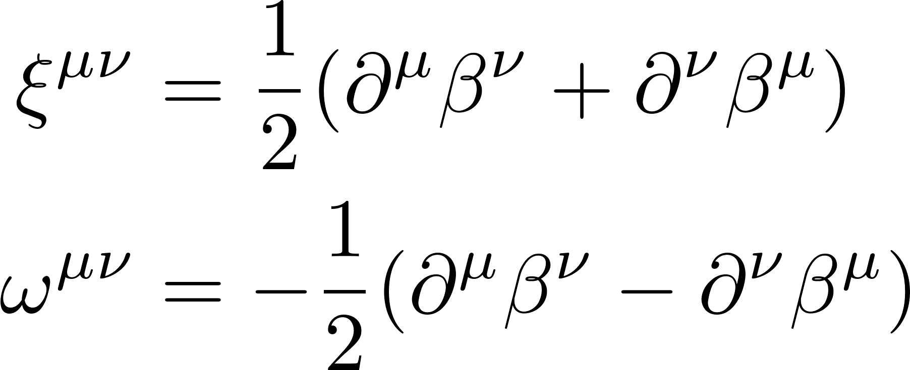
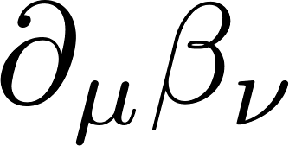
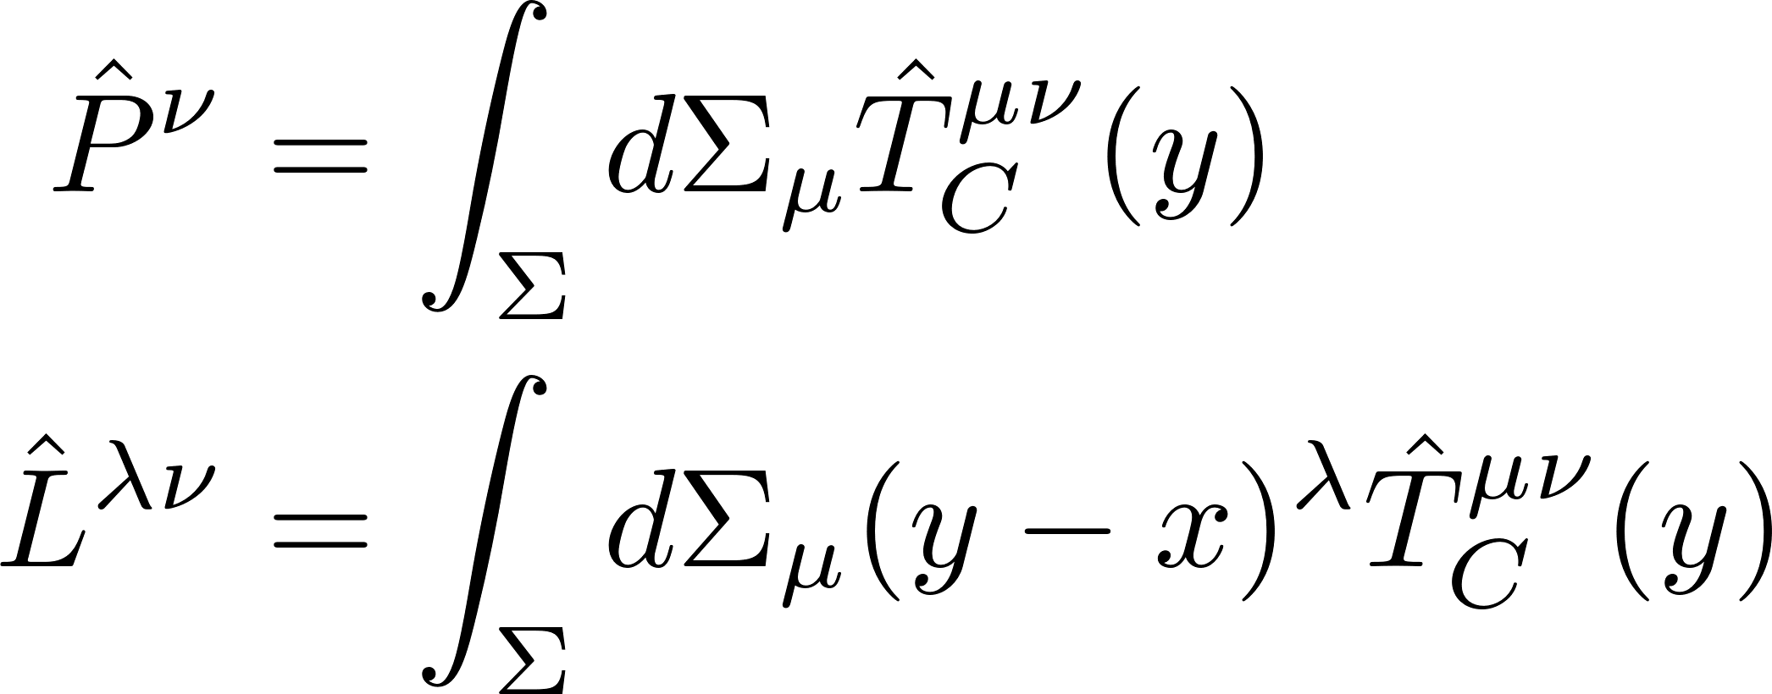
Gradient expansion of the density operator
When $β_{μ}(y)$ varies slowly, it can be expanded in gradient up to first order
The density operator in gradient expansion up to first order
Note that in our work we focus on effects related to $∂_{μ}β_{ν}$ and neglect the contribution of ${∂_{λ}∂}_{μ}β_{ν}$
The momentum, angular-momentum and spin operators are
decompose
F. Becattini, M. Buzzegoli, G. Inghirami, I. Karpenko, and A. Palermo, Phys. Rev. Lett. 127, 272302 (2021)
Notes:
neglect other possible second-order contributions

Slide 12
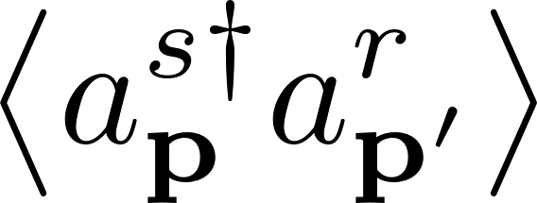
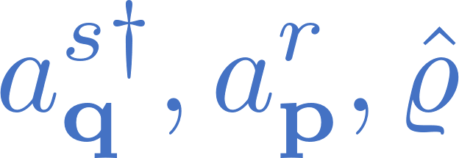
Equations for
The relations for
which lead to equations
The commutation rules for
=0 in global equilibrium

Slide 13
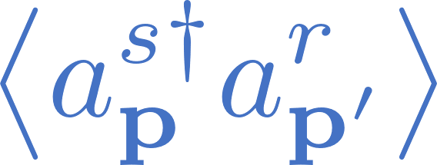
Spin distribution function
To solve the equations for , we obtain
where and $I$ is the unit matrix in spin space.
The spin distribution function are
Since $D_{++}$ and $D_{−−}$ contain $∂_{q}$, the integral can’t be calculate directly. We do the expansion again.
The zeroth-order spin distribution function are

Slide 14
First-order spin distribution function
The first-order spin distribution function
where the Belinfante and canonical form are
with
Both thermal vorticity and thermal shear tensor contribute to the first order-distribution function. In global equilibrium, and gives .

Slide 15
Second-order spin distribution function
The second-order spin distribution function
The $f^{\left(2\right)}(x,k)$ will cancel in $ρ_{00}$ and the third term are
with coefficients $Ξ$ depending on $k^{μ}$ and $ε_{r}^{μ}\left(k\right)$.

Slide 16
Content
Introduction
Density operator and distribution function
The results of the spin alignment
Is spin alignment induced by shear tensor dissipative
Summary

Slide 17
Spin density matrix up to first order
Spin density matrix up to first order, (we used )
the components of spin density matrix are
Cross section for the decay process of a vector meson into two pseudo-scalar mesons
=0

Slide 18
Spin density matrix up to second order
Spin density matrix up to second order, (we used )
The Belinfante form spin alignment up to second order
the $Ω_{σ}^{(B)}$ is
=0 in global equilibrium

Slide 19
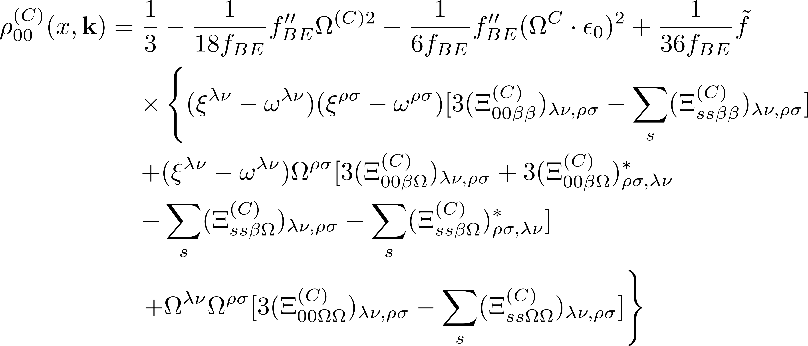
Spin density matrix up to second order
The canonical form spin alignment up to second order
the $Ω_{σ}^{(C)}$ is
In global equilibrium
0=

Slide 20
A new spin distribution function definition
The definition of spin distribution function
The $W_{+}^{μν}(x,k)$ is the positive energy part of Wigner function
After integrating over $x^{μ}$, two distribution function have relation
We can still define the spin density matrix as

Slide 21
Spin alignment from another definition
The Belinfante form of spin alignment
the $Ω_{W,σ}^{(B)}$ and $Ξ_{W}^{λν,ρσ}$ are
changed
unchanged

Slide 22
Spin alignment from another definition
The canonical form of spin alignment
the $Ω_{W,σ}^{(B)}$ is
changed
unchanged

Slide 23
Content
Introduction
Density operator and distribution function
The results of the spin alignment
Is spin alignment induced by shear tensor dissipative
Summary

Slide 24
Slide from
Becattini’s talk
7th Chirality

Slide 25
Discussion of dissipative or nondissipative
Under time reversal transformation, the quantities transform as
The spin density matrix can be parameterize as
The Wigner function can be decomposed into thermal shear tensor
From the table, we find that the transport coefficient a is T-odd, and b is T-even for $ρ_{00}$, which implies that the spin alignment induced by shear tensor in the first order of the gradient expan-sion is dissipative

Slide 26
Content
Introduction
Density operator and distribution function
The results of the spin alignment
Is spin alignment induced by shear tensor dissipative
Summary

Slide 27
Summary
1.In the first-order, we find the $ρ_{00}=1/3$ and nonzero off-diagonal components of the spin density matrix which canceled out in the cross section, yielding no observable effects at this order.
2.In the second-order, we find that
i. The $ρ_{00}$ include correction from both thermal vorticity and shear tensors.
ii. The $ρ_{00}$ is dependent on the pseudo-gauge, specifically, $ρ_{00}$ in the Belinfante
and canonical forms differ.
iii. We also compute spin density distribution using an alternative definition.
3. We discuss whether the spin alignment induced by the shear tensor is dissipative. We find that the effective coefficient for spin alignment induced by the thermal shear tensor in the first order is T-odd. It implies that such effect could be dissipative.

