Slide 1
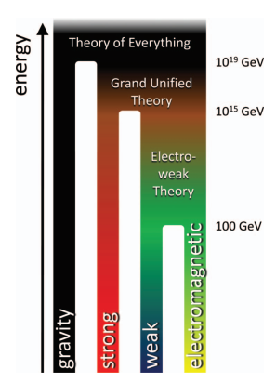
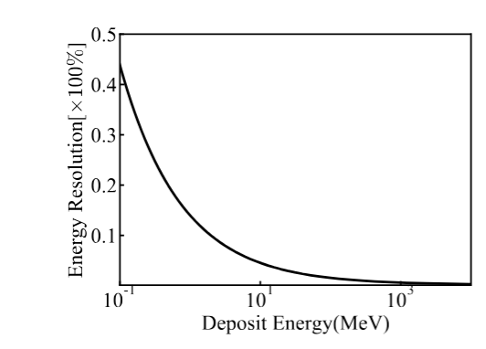
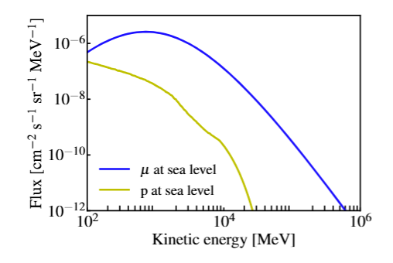
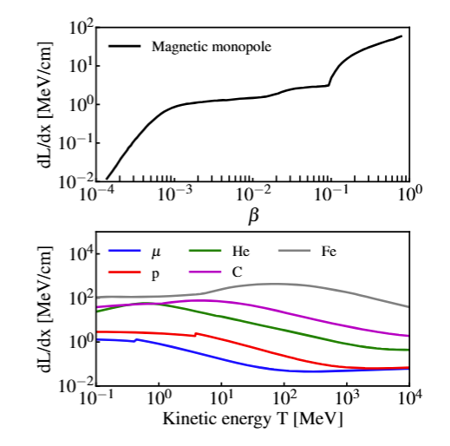
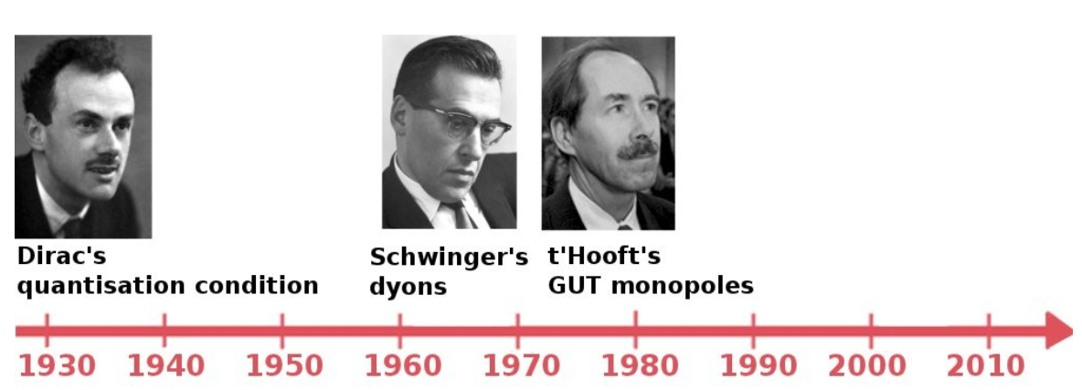
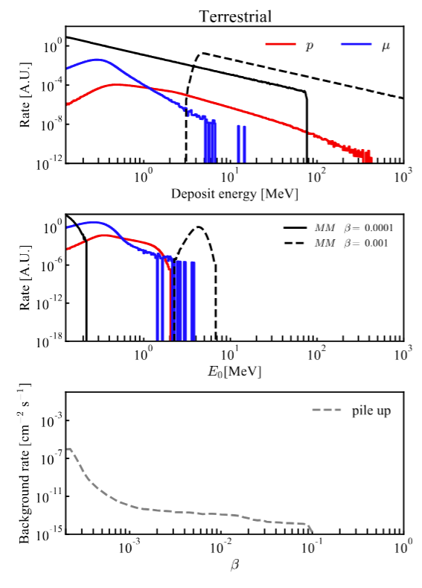
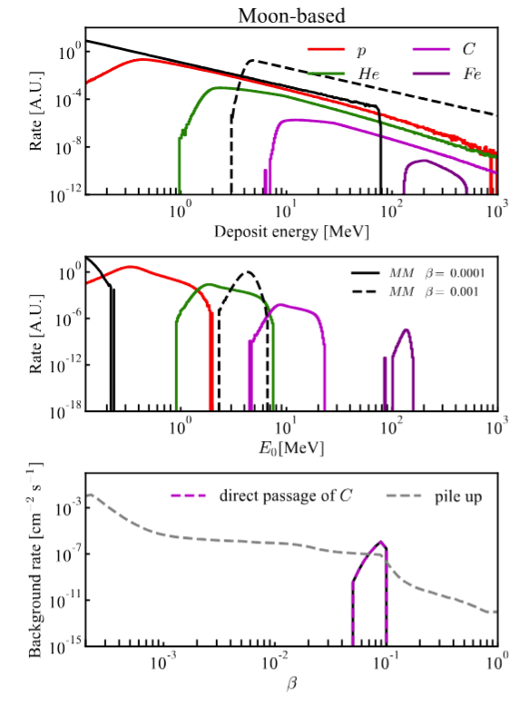
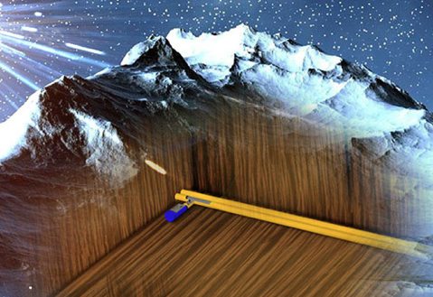
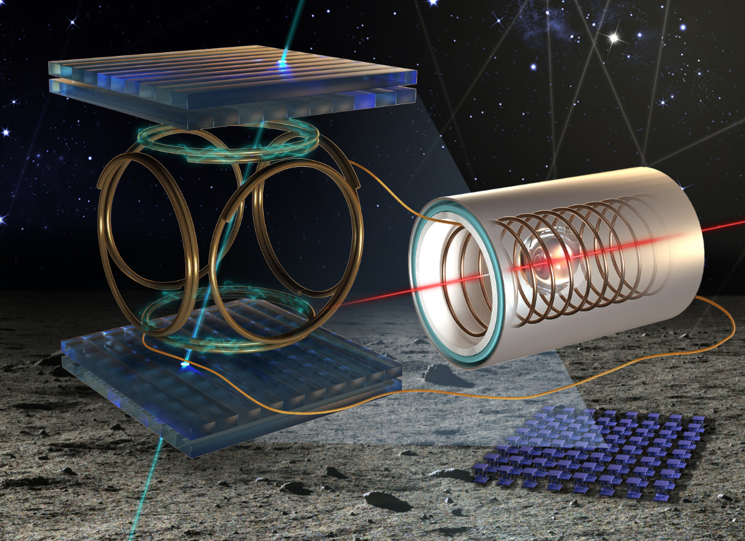
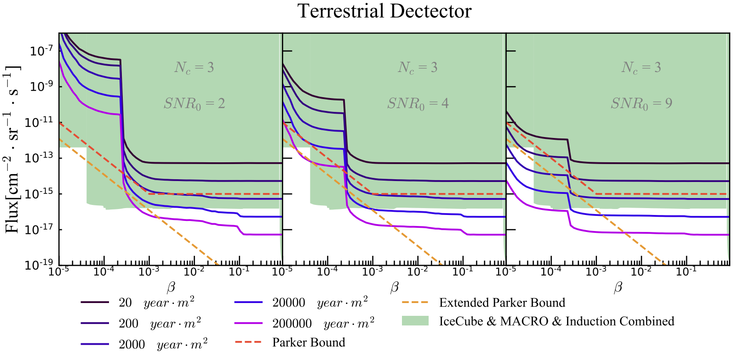
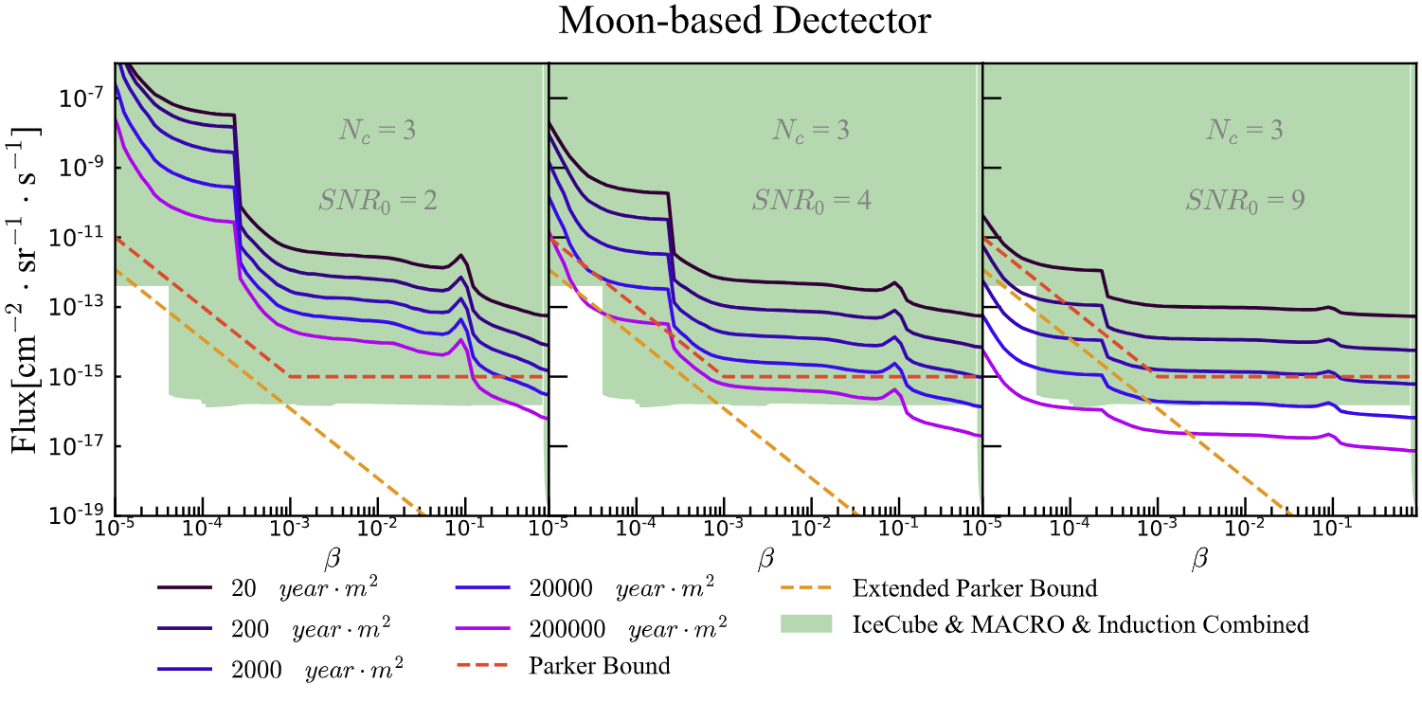
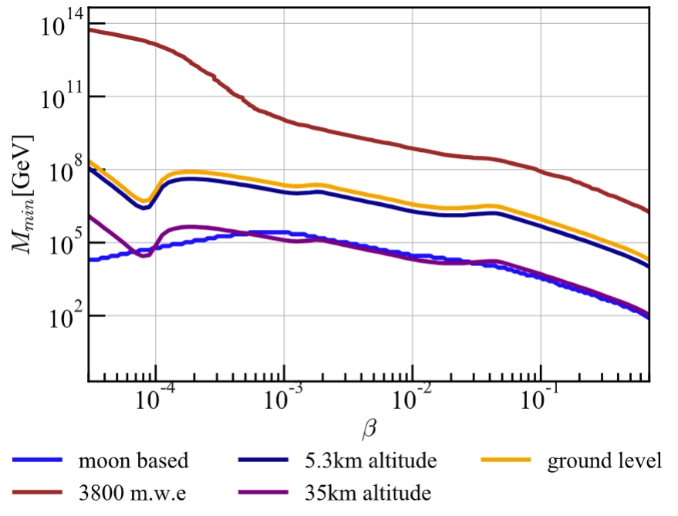
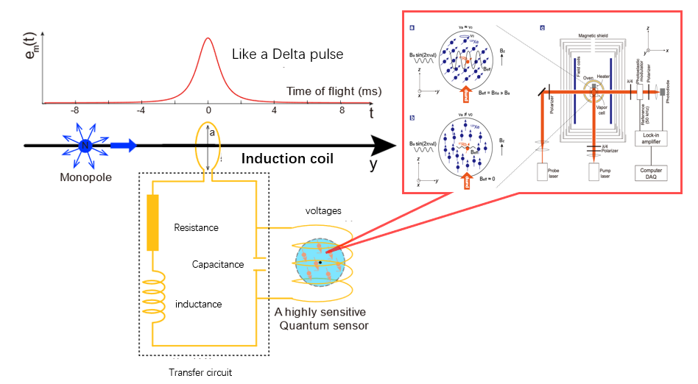
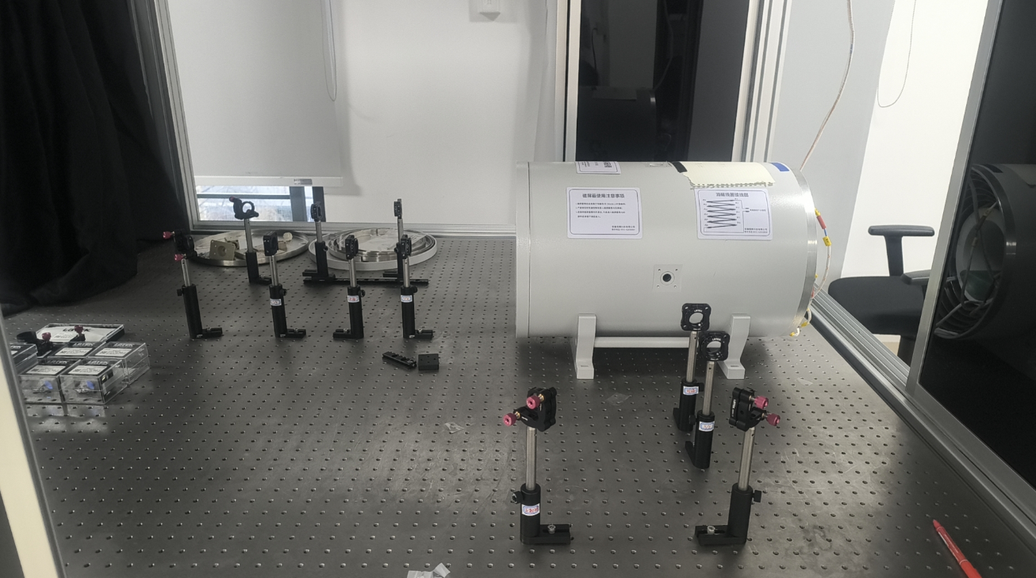
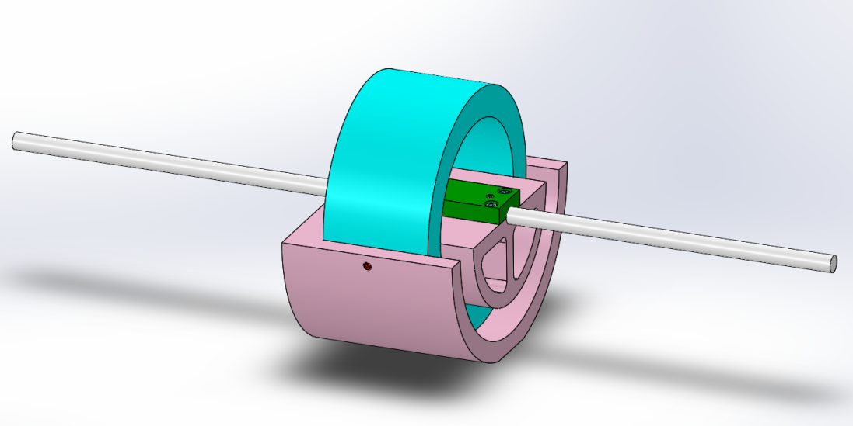
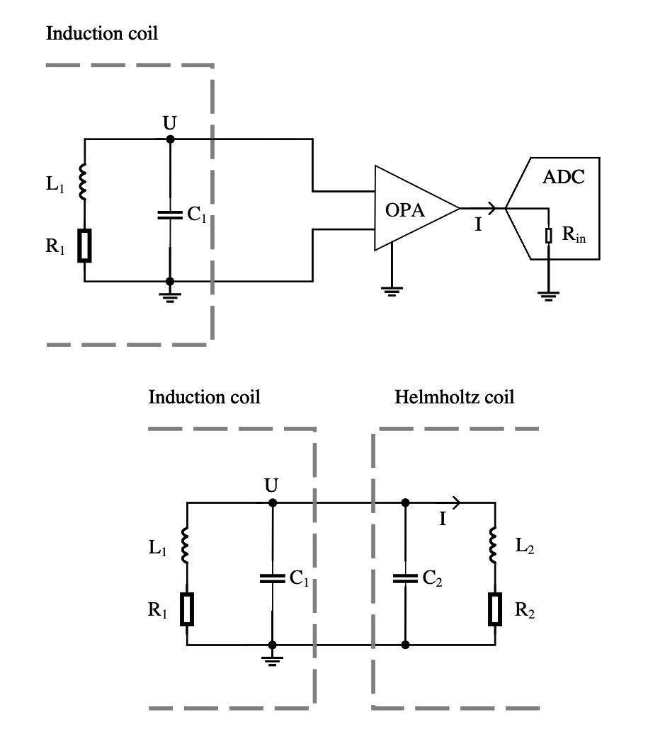
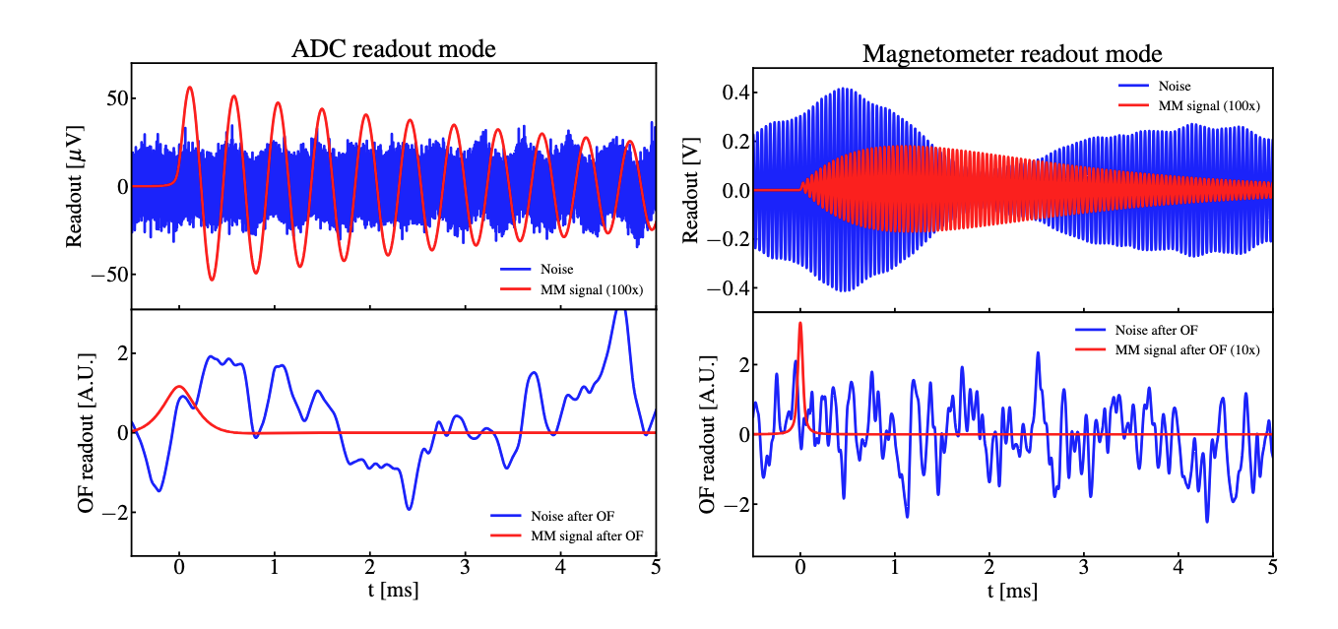
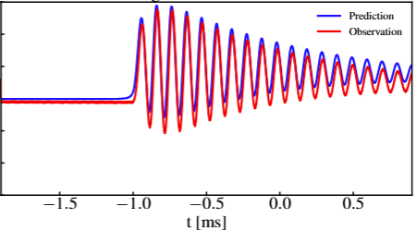
SCEP: a cosmic magnetic monopole search experiment using coincidence
measurement between quantum sensor and plastic scintillators
Beige Liu^{1,3}, Changqing Ye^{1,3}, Qing lin^{1,2,3} etc..
(SCEP Collaboration)
¹State Key Laboratory of Particle Detection and Electronics, University of Science and Technology of China, Hefei 230026, China
²Deep Space Exploration Laboratory, Hefei, 230022, China
³Department of Modern Physics, University of Science and Technology of China, Hefei 230026, China
⁴Hefei National Laboratory for Physical Sciences at the Microscale, University of Science and Technology of China, Hefei, 230026, China
⁵CAS Key Laboratory of Microscale Magnetic Resonance, University of Science and Technology of China, Hefei, 230026, China
⁶Synergetic Innovation Center of Quantum Information and Quantum Physics, University of Science and Technology of China, Hefei, 230026, China
Magnetic Monopole: a hypothesis from GUT
Background Estimation
Theoretical motivations of Magnetic monopole
Unsymmetric of Maxwell’s equations
Electron’s quantization
Grand unification theory’s prediction
Evidence for inflation theory
A massive, exotic particle that might
have been produced during the evolution of
the early universe
Ionization detection module: plastic scintillator coupled to SiPMs
Energy resolution
Curve(by simulation)
Background particle
Flux in terrestrial
Energy deposit curve
for MMs
Preliminary properties from simulation:
Energy resolution ~ 7%@1MeV
Time resolution ~ 10ns
Light yield of MM ~ 1MeV/cm @ $β=0.01$
Energy deposit curve
for backgrounds
Past Efforts & Challenges
Superconductivity
Underground experiments:
MACRO,IceCube..
 | Underground Experiments | Superconductivity
Signal | Ionization | Induction
Advantages | Low background Easy to scale up | Unique feature of signal No limits on speed
Disadvantages | No unique feature of signal Limited mass and speed range | Hard to scale up
Terrestrial
Moon-based
Two layers of PSs helps to measure energy and velocity at the same time
Environmental particles such as proton in cosmic ray, muon from the atmosphere are the main background
Background rate in moon environment is 3 order of magnitude larger than terrestrial environment due to the shielding of the atmosphere
Energy spectrum
Isolated background rate
Experimental challenges:
Large scale
Low background
Unique signal feature
Our Proposal
Projected Sensitivity
Coincidental measurement between plastic
scintillators and the atomic magnetometers
Basic Concept:
Plastic scintillator: a highly ionization signal
Atomic magnetometer: a pulse like magnetic signal
Advantages:
Easy to scale up by using induction coils
Low background events thanks to the coincidental measurement
Unique signal feature: a track-like pattern in the induction coils array
SMs
MMs
Reach the best constrain with ~20000 $m^{2}⋅year$ exposure and sufficient Signal-to-Noise Ratio(SNR) for a terrestrial detector.
Realize background free search with higher layers of induction coils
A steep appears at 𝛽~$2×{10}^{−5}$ is due to MM lower than that speed cannot produce enough light in PSs, an induction-only search is performed then
Although a moon-based detector suffers from higher background rate, it is still proposed due to its potential to probe into lower cosmic monopole mass
Thermal Noise
Minimal mass to reach at different sites
Induction detection module: induction coils coupled to atomic magnetometers
Future
Use the spin precession of Rb⁸⁷ atoms to detect RF magnetic field
Atomic magnetometers have $\sim 10\frac{fT}{\sqrt{Hz}}$ sensitivity
Operated at room temperature
Induction coils helps to search with large area
 | Induction module | Plastic Scintillator
Current | SNR ~ 1.92 | Time resolution ~10ns Energy resolution ~7%@1MeV Position resolution ~5cm
Requirement | SNR ~ 4.2 | Time resolution ~1ns Energy resolution ~5%@1MeV Position resolution ~1cm
Solutions | Use Iron core to enhance signal Reduce alternating resistance to lower background Read-out circuit optimization | Optical fiber helps to improve light collection Better arrangement SiPM base circuit optimization
Single Module optimization
Simulation & validation of the induction detection module
Array design & optimization
Single module physical run
Induction Voltages
Resonance Circuit shaping
Magnetometer Read-out
Validation set up
Long solenoid to simulate MM signal
Simulation and validation test signals match well. The total difference is within 10%.
Noise was also validated. The total difference is also within 10%
Optimal filter
Diagram of the simulation framework
Over-threshold triggering
Array-like physical run
Validation result

