Slide 1
Revision plan for the draft
Lei Xia for authors

Slide 2
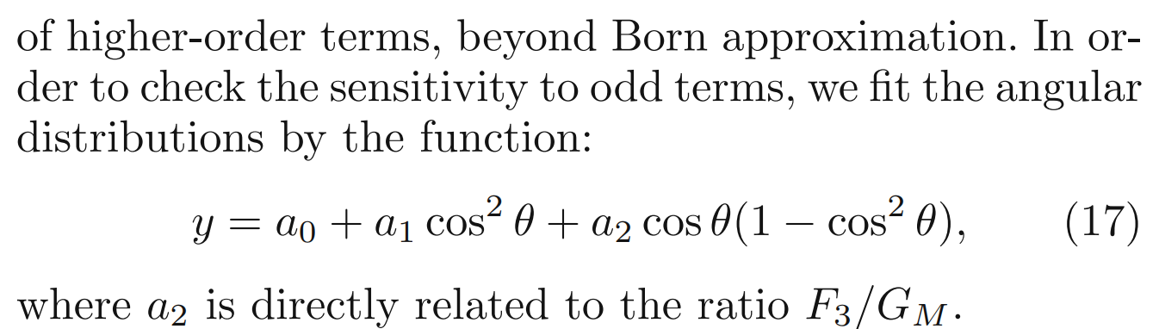

use your results to say more about EMFFs. —Fred Harris
$F_{3}$ is relaed to the antisymmetry term：

Slide 3
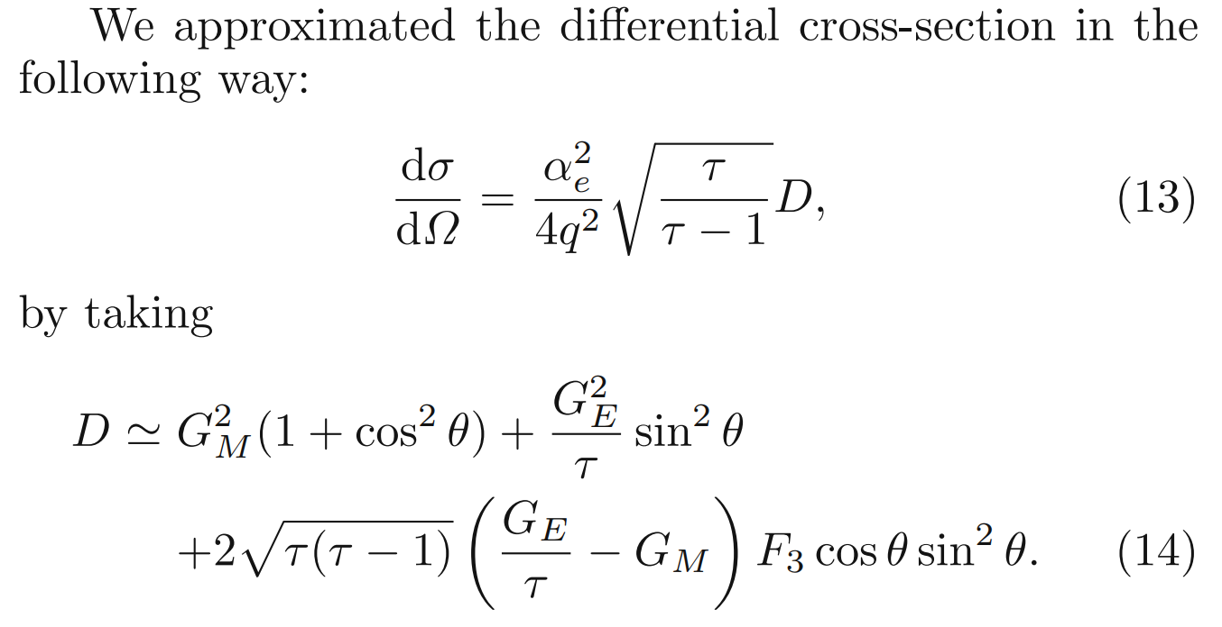

use your results to say more about EMFFs. —Fred Harris
$\text{The} \text{two}\text{−}\text{photon} exchange \text{hypothesis} \text{is} \text{at} \text{NLO}\text{, }\text{requiring} \text{the} \text{additional} \text{introduction} \text{of} \text{a} \text{form} \text{factor} F_{3}$ ﻿(Eur. Phys. J. A 44, 373 (2010)).
﻿$G_{E}$ ﻿, $G_{M}$ ﻿ and $F_{3}$ ﻿, their relative phases are not known!

Slide 4
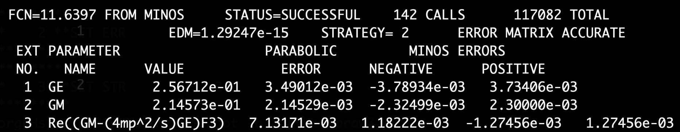

use your results to say more about EMFFs. —Fred Harris
Bingsong advises to give the $δ$(﻿Nucl. Phys. A 883, 49 (2012)).
It is recommended to consult Yonghui Lin to calculate these two phases using dispersion relations, David Gross also give a similar advice.
I have ask Yonghui Lin and Yang Li for help.

Slide 5
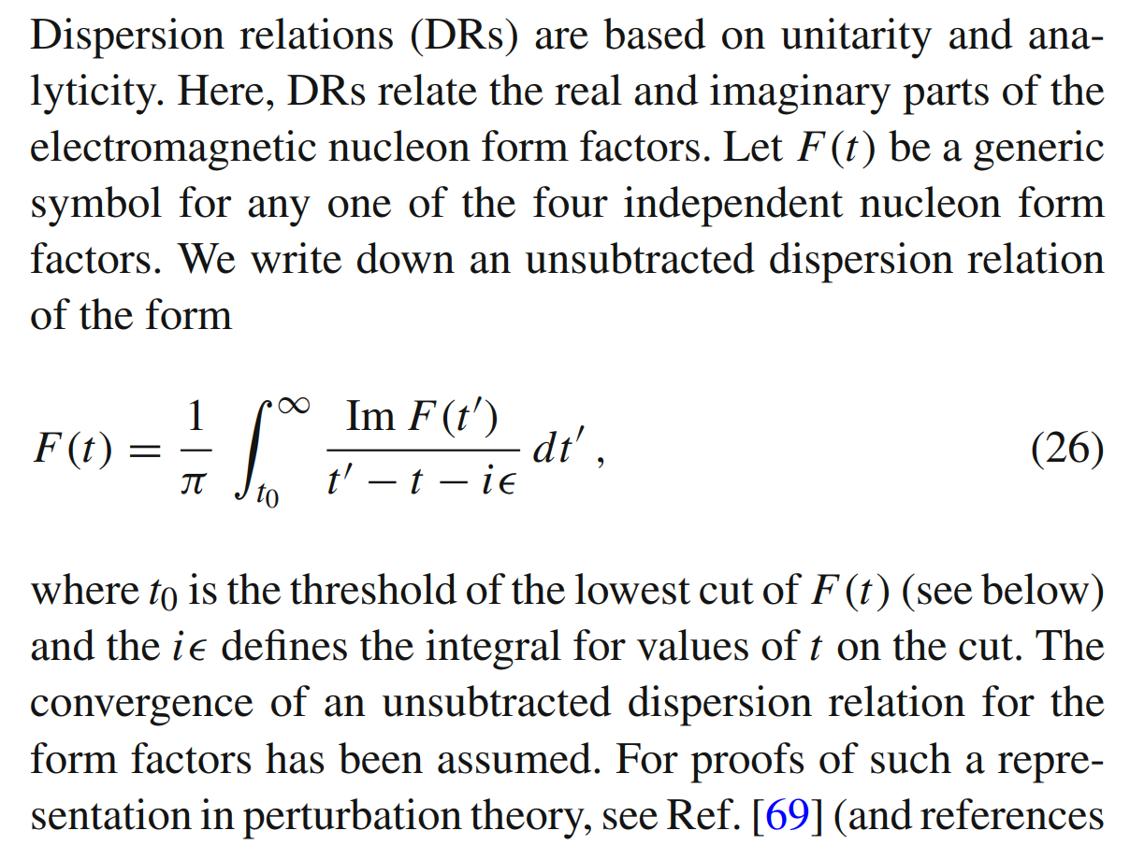
use your results to say more about EMFFs. —Fred Harris
﻿Dispersion relations (﻿﻿Eur. Phys. J. A 57, 255 (2021)).

Slide 6
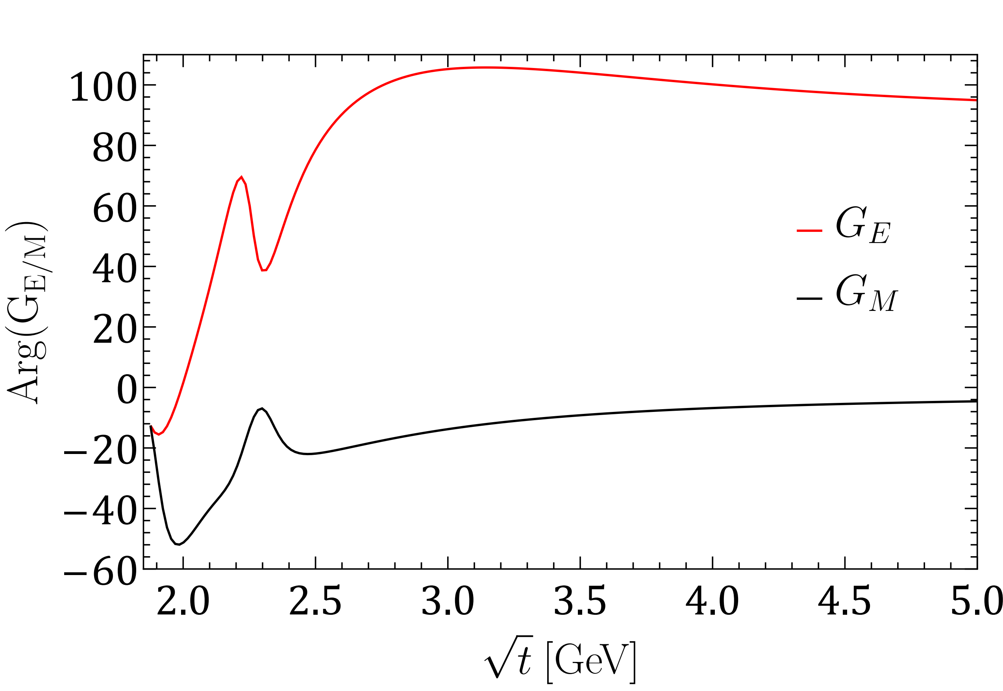
use your results to say more about EMFFs. —Fred Harris
﻿Yonghui’s result

Slide 7
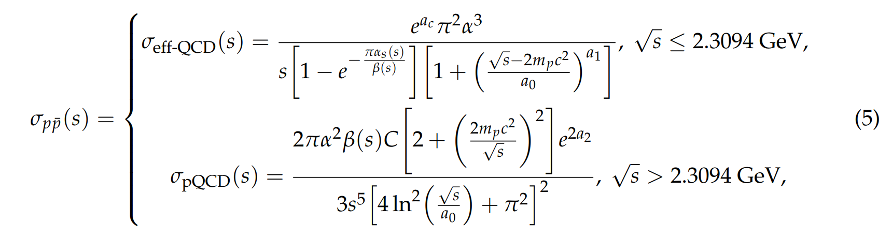
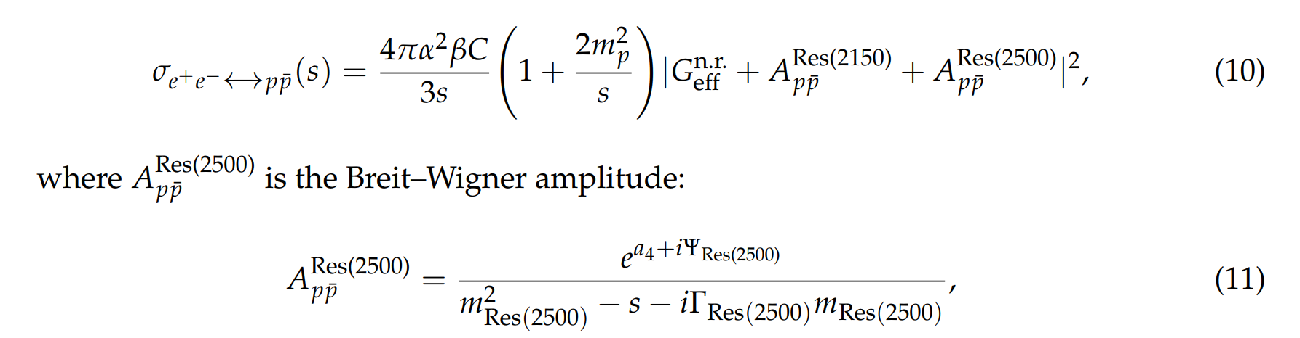
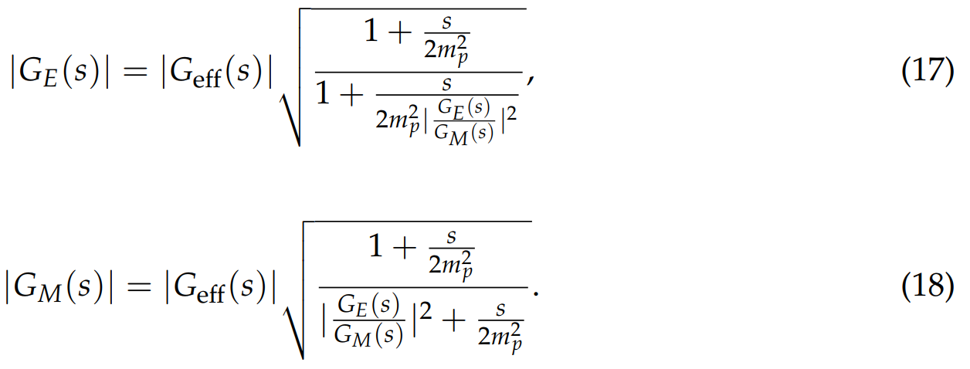
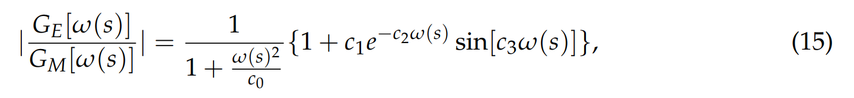
use your results to say more about EMFFs. —Fred Harris
My input (﻿﻿Symmetry 14, 231 (2022).).

Slide 8
use your results to say more about EMFFs. —Fred Harris
﻿Dispersion relations (﻿﻿Eur. Phys. J. A 57, 255 (2021)).

