Slide 1
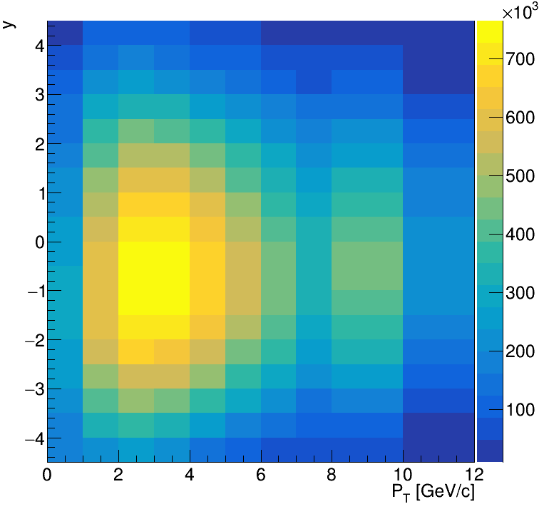
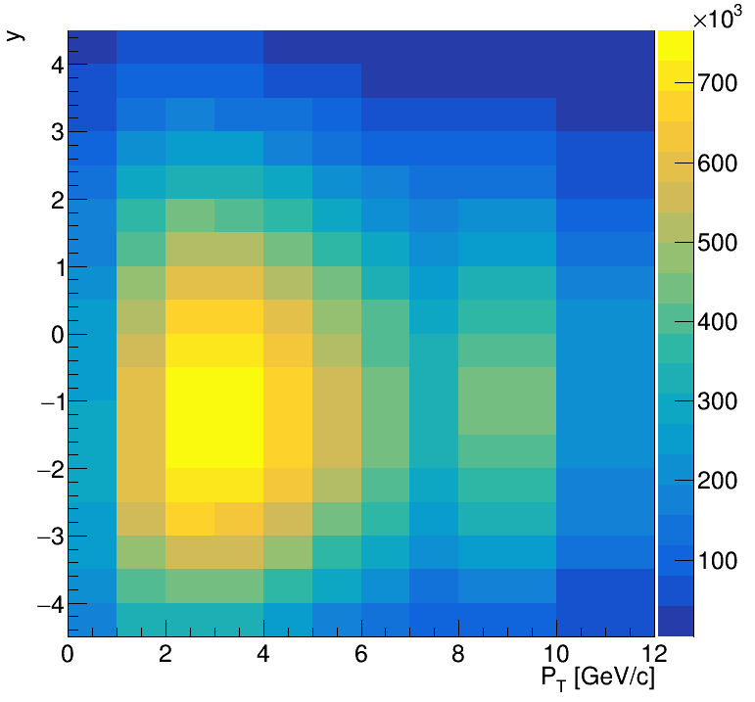
Distribution of b hadrons simulated by Pythia
the distribution of rapidity is affected.

Slide 2
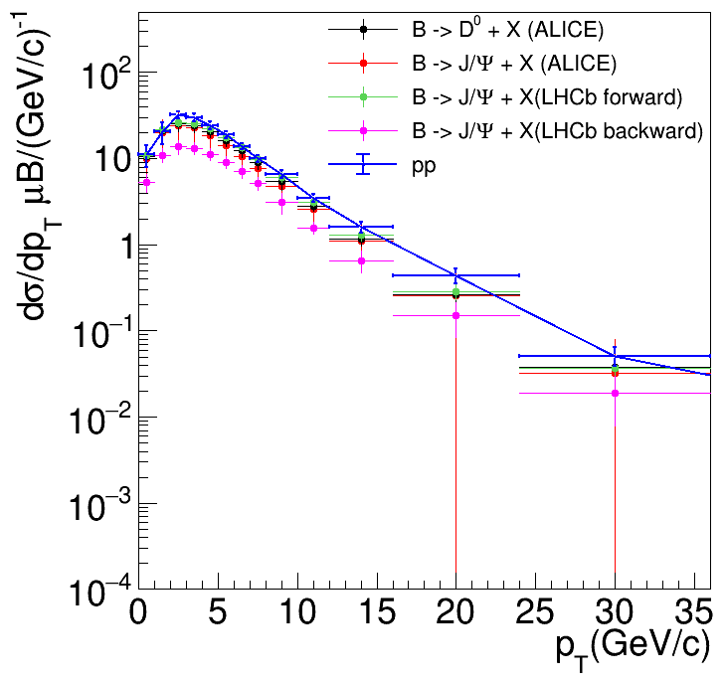
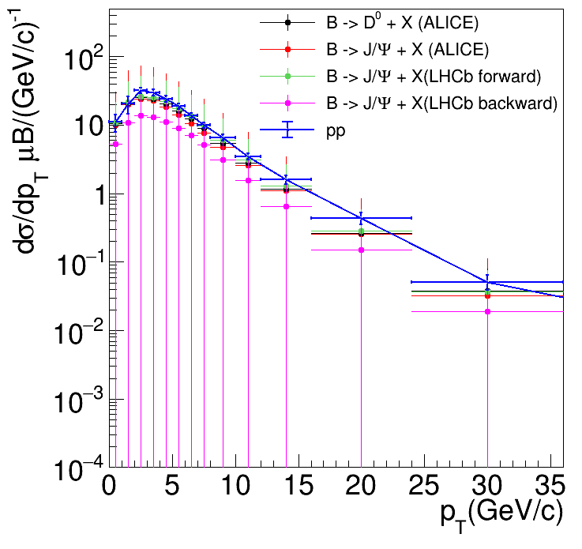
Unfolding result
without measured non-prompt data syst.
with measured non-prompt data syst.
The systematic error from measured non-prompt data accounts for the total error is about 90%.

Slide 3
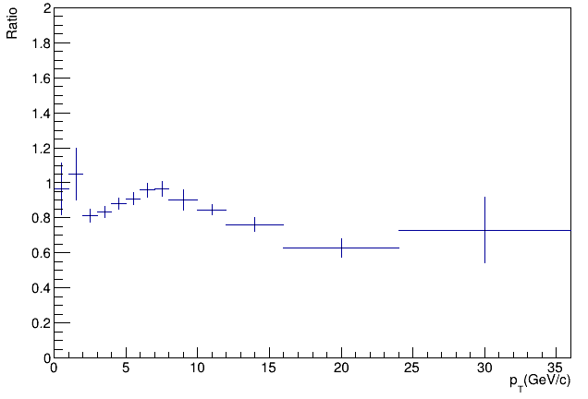
Combine ALICE D0 and LHCb jpsi（forward） and make a ratio with pp
without measured non-prompt data syst.
$P_{T}>10GeV/c$ drops too low.

Slide 4
Scale：$\frac{1}{A_{Pb}}=\frac{1}{208}=0.0048077$
$$=0.0049044$$

