Slide 1
Monte Carlo simulation
郭震
2024.10.30

Slide 2
Contents
Step
$ρπ$
$π^{+}π^{−}J/Ψ$(709)
$π^{+}π^{−}J/Ψ$(704)

Slide 3
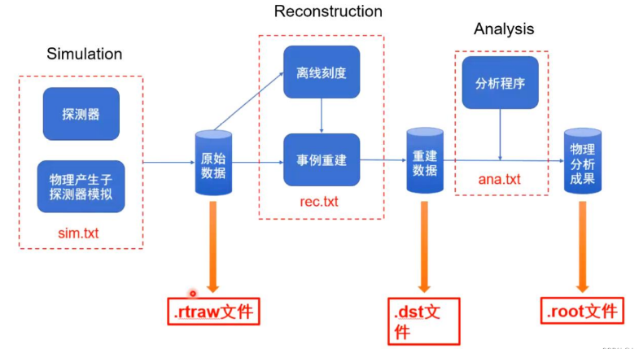
Step
Monte Carlo Method
Signal MC: Simulation → Reconstruction → Analysis
Notes:
p

Slide 4
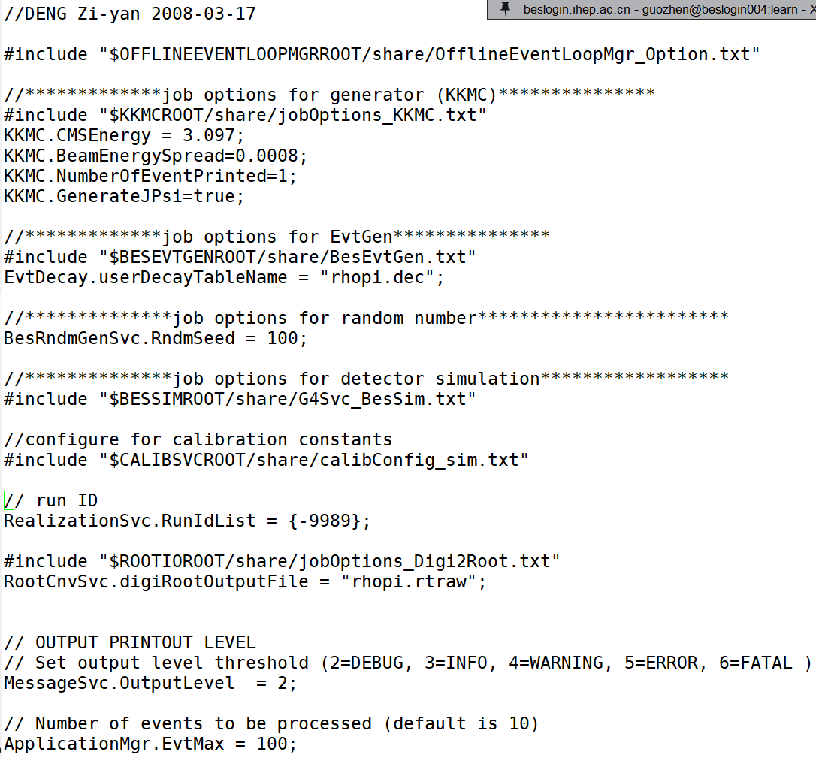
$ρπ$ Simulation
Notes:
p

Slide 5
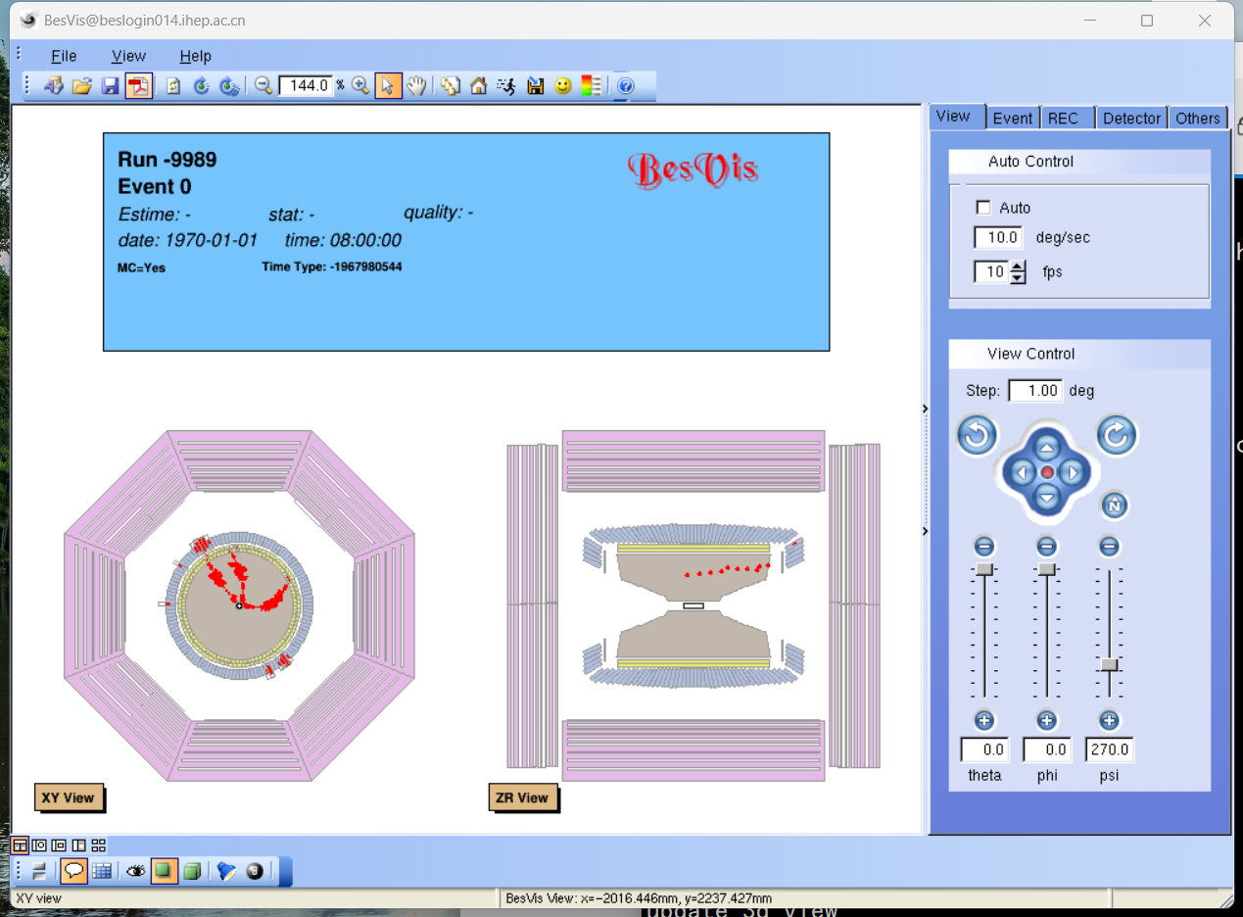
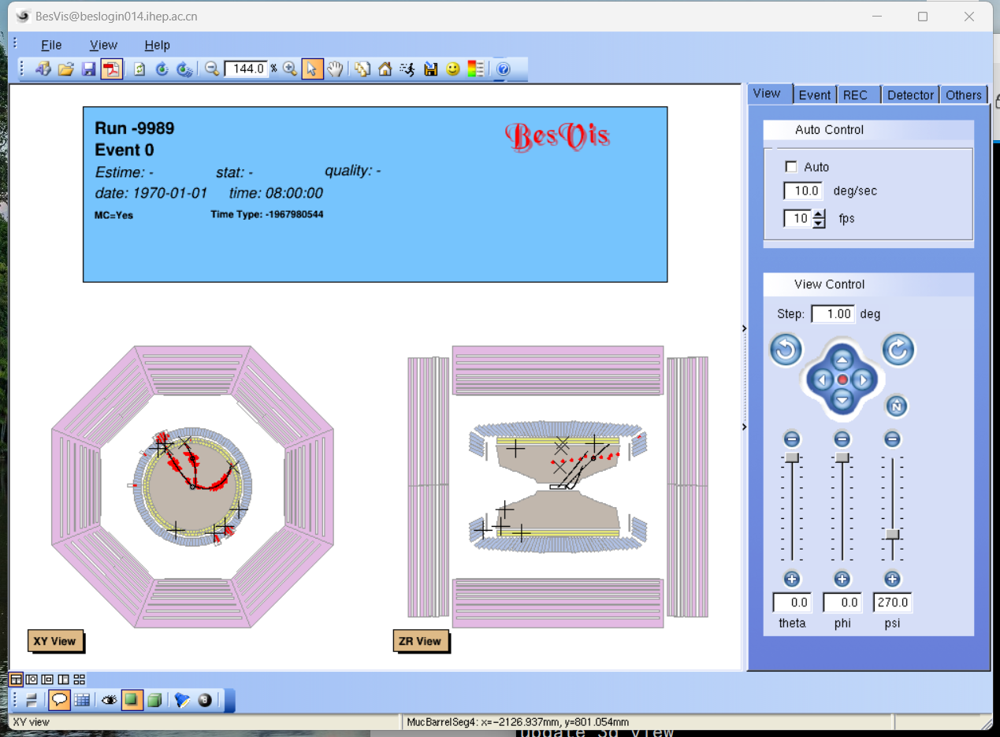
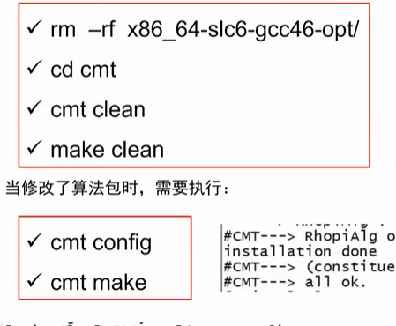
$ρπ$ Reconstruction Analysis

Slide 6
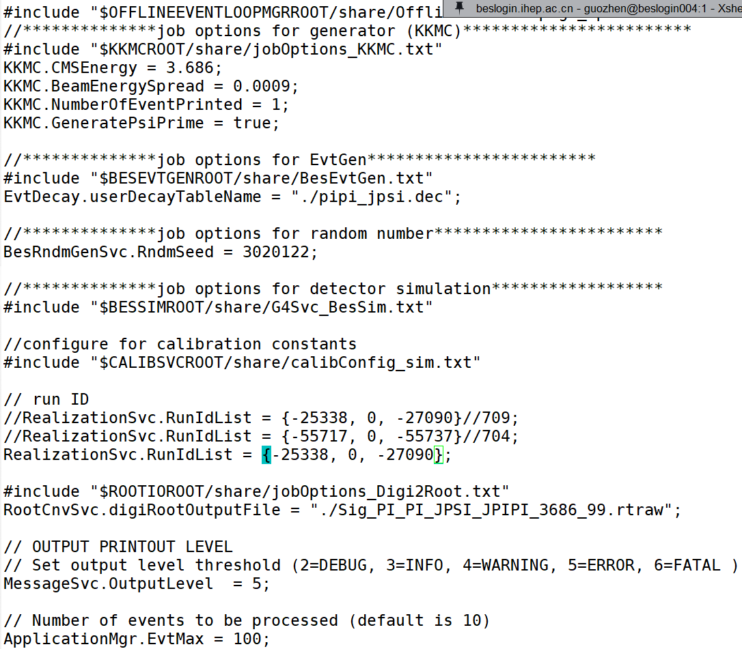
$π^{+}π^{−}J/Ψ$(709) Simulation
Notes:
p

Slide 7
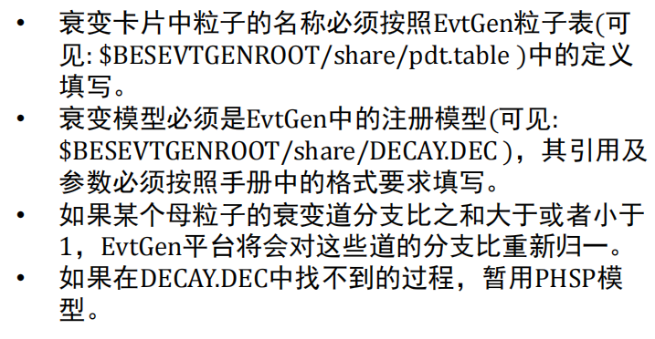
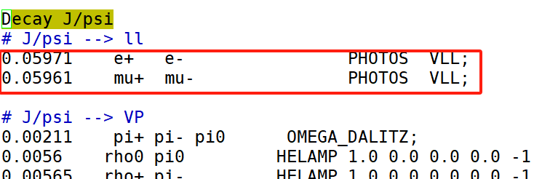
$π^{+}π^{−}J/Ψ$(709) Simulation
Notes:
p

Slide 8
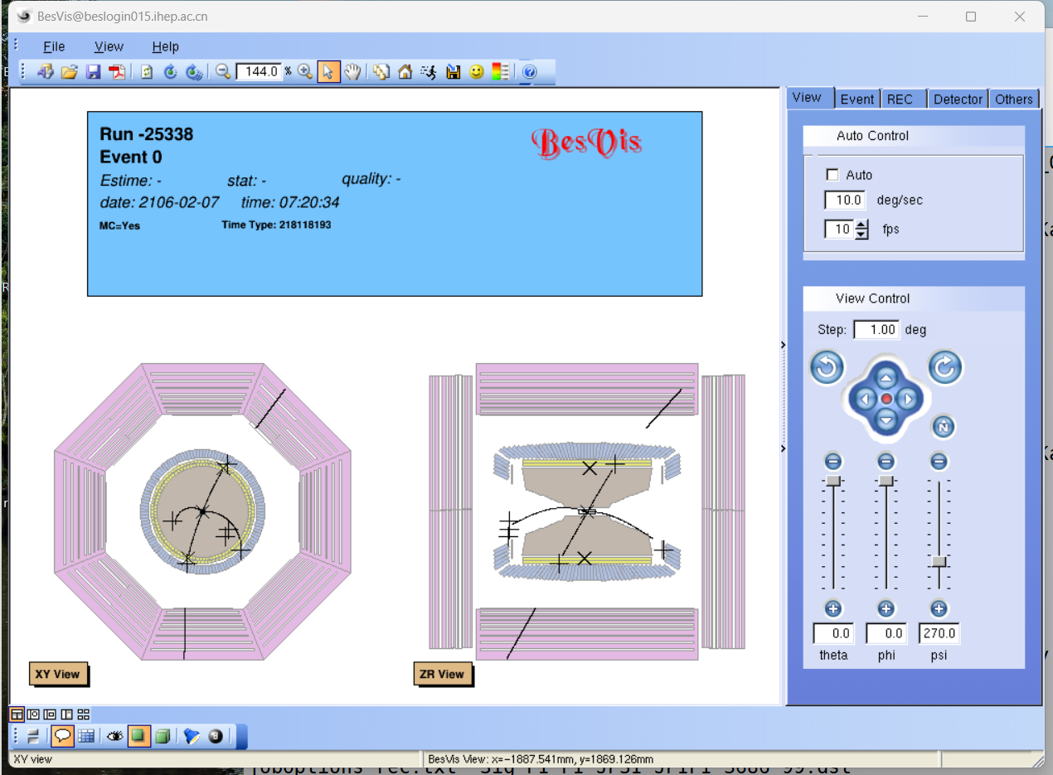
$π^{+}π^{−}J/Ψ$(709) Reconstruction

Slide 9
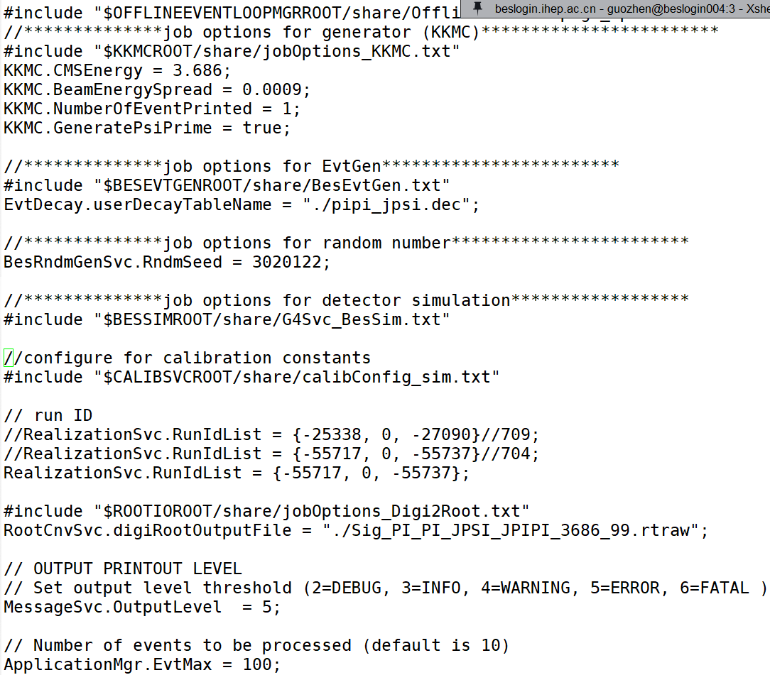
$π^{+}π^{−}J/Ψ$(704) Simulation
Notes:
p

Slide 10
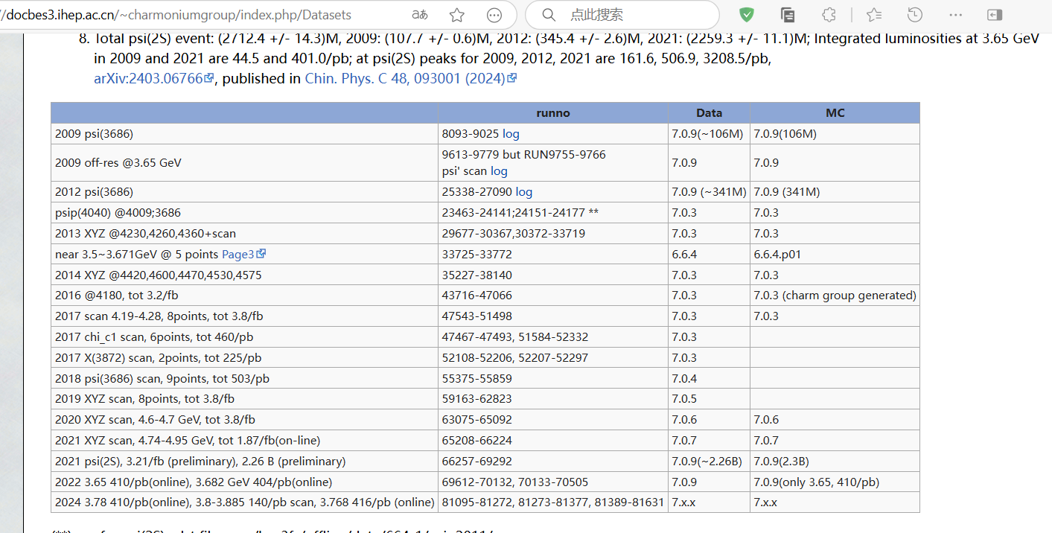
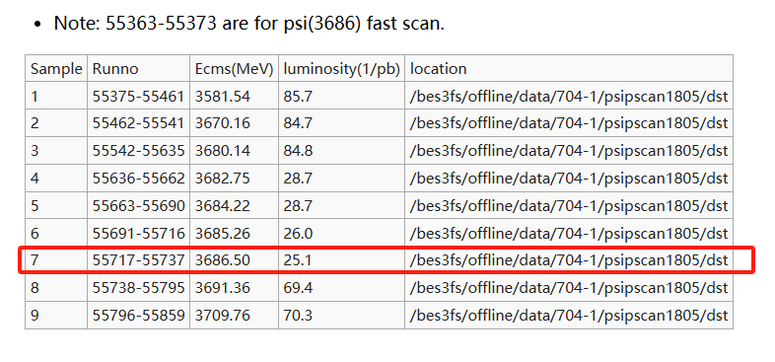
$π^{+}π^{−}J/Ψ$(704)Simulation
Notes:
p

Slide 11
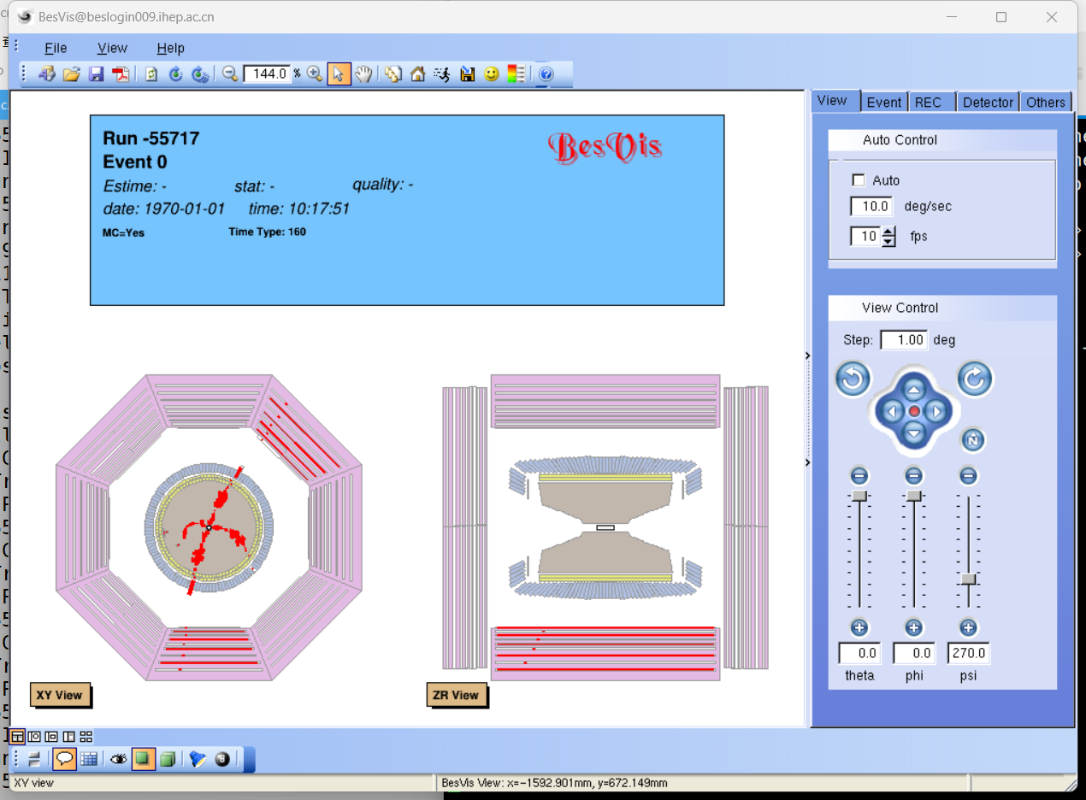
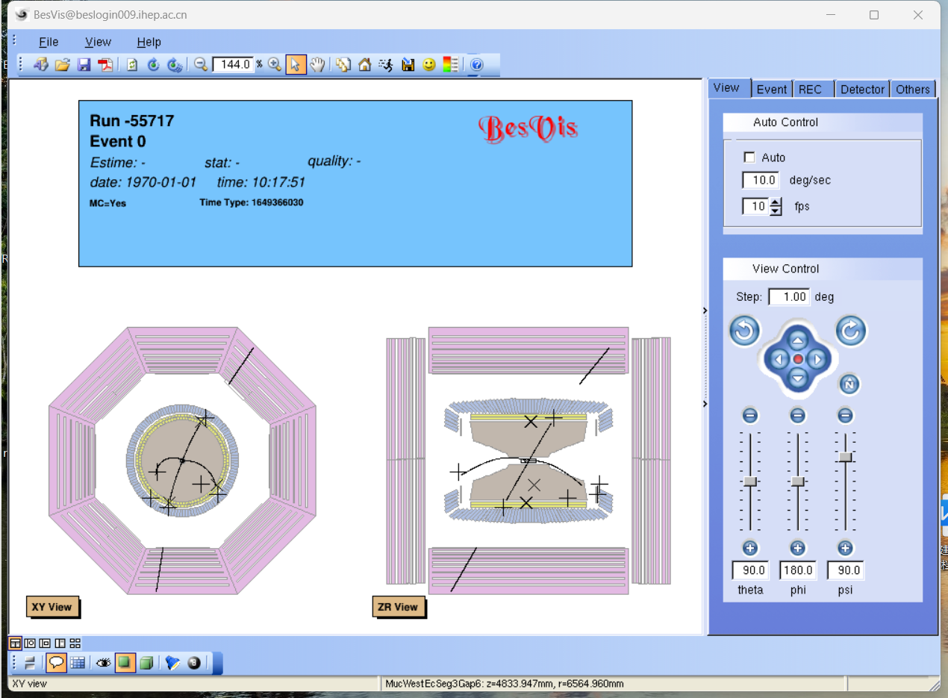
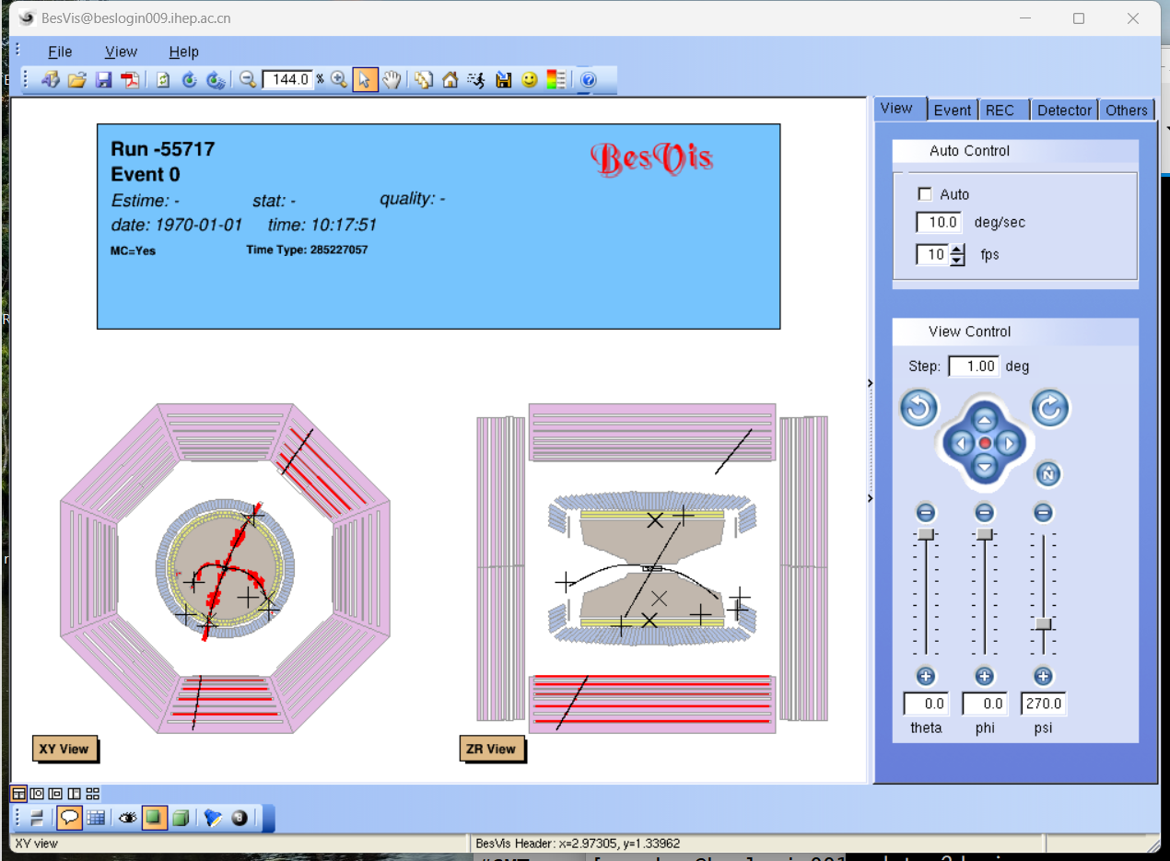
$π^{+}π^{−}J/Ψ(704)$ Reconstruction

