Slide 1
Background of KSKL
Huiliang Xia

Slide 3
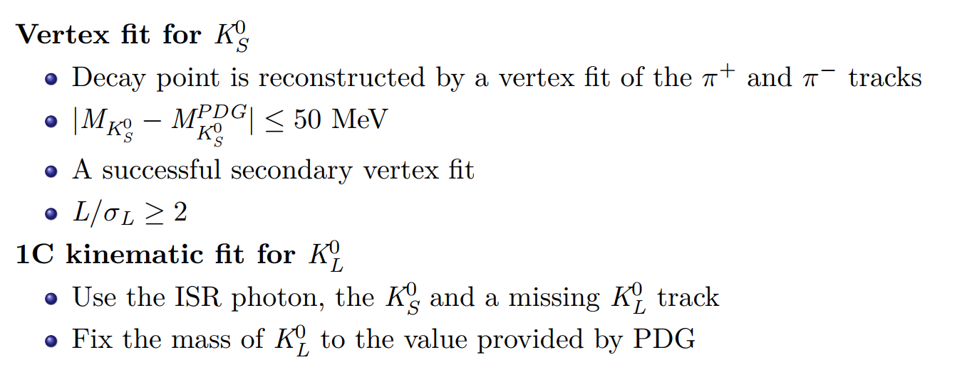
χ²(1C)<20
Use the ISR photon, the KS, the missing KL track and a photon.
|M(γγ)-M(pi0)|<30 MeV/c².
pklg<1.6 GeV/c.
Signal: 331480
326793
Sig/data=67.27%

Slide 4
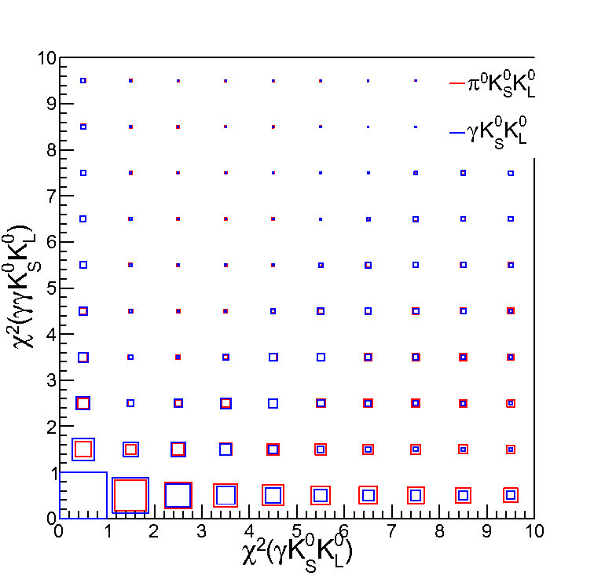
One of the gammas is ISR gamma
If we want to cut evnets of pi0KSKL, we will also cut lots of events of signal.

Slide 5
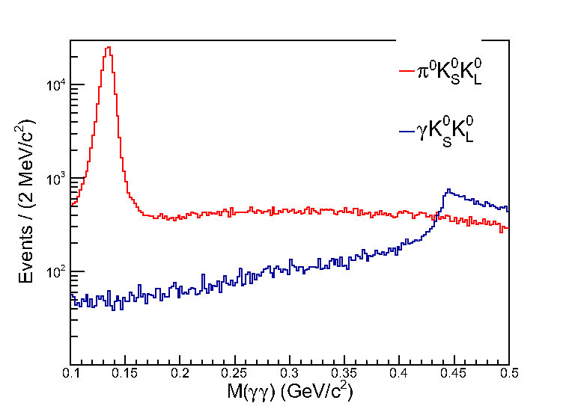
|M(γγ)-M(pi0)|<30 MeV/c².

Slide 6
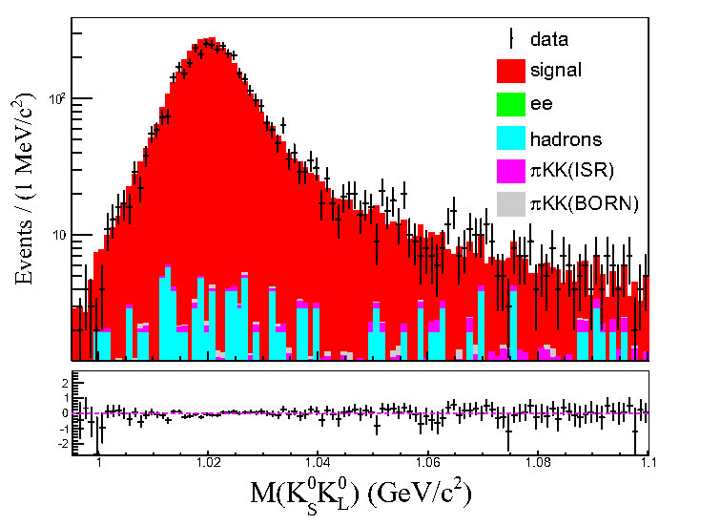
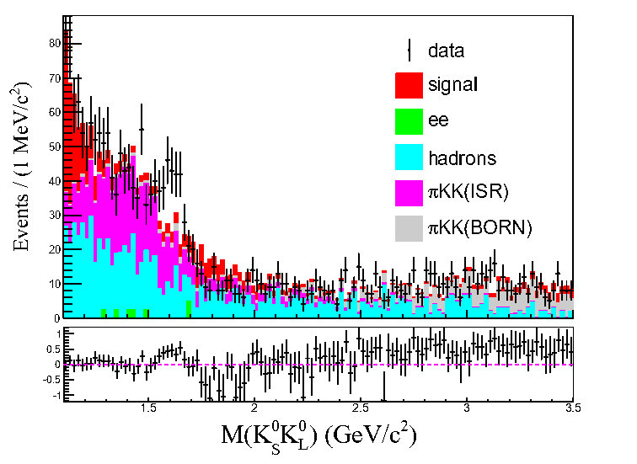
New
pipi and other backgrounds are not taken into account
Signal: 331480
PID
317307
χ²(1C)<10
293174
|M(γγ)-M(pi0)|<30 MeV/c²
291661

Slide 7
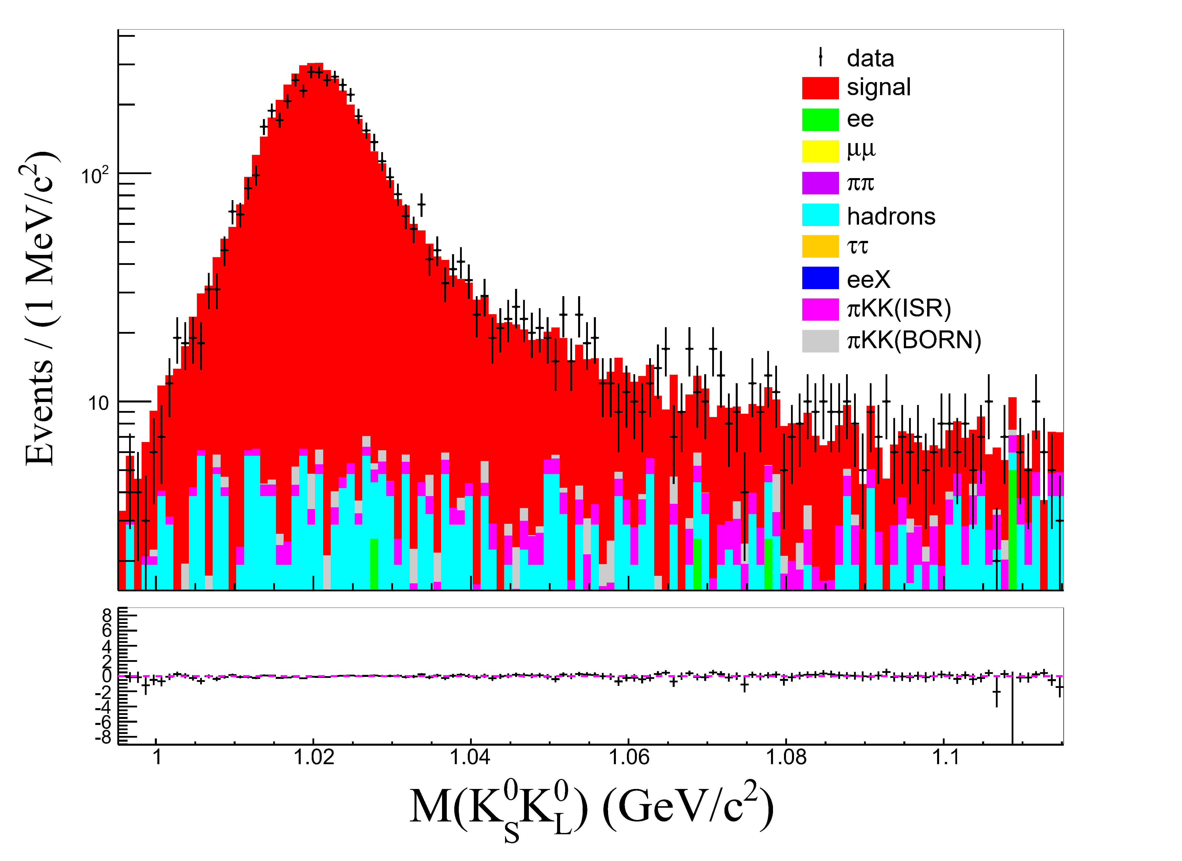
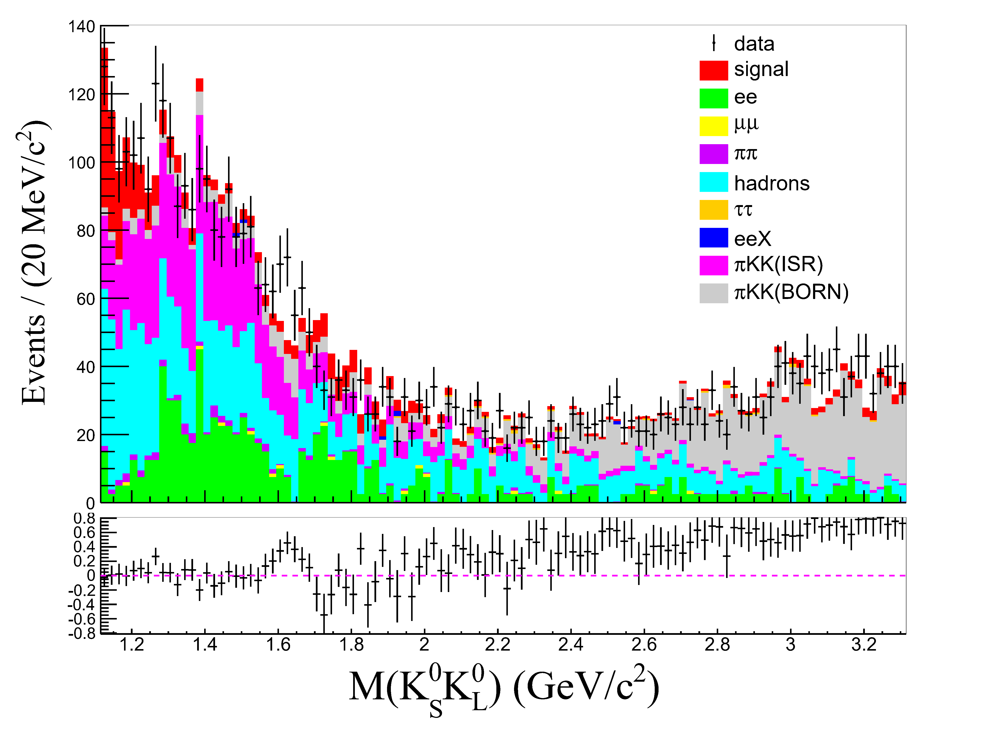
Old
There are fewer ee and pikk(Born) in new analysis

Slide 8
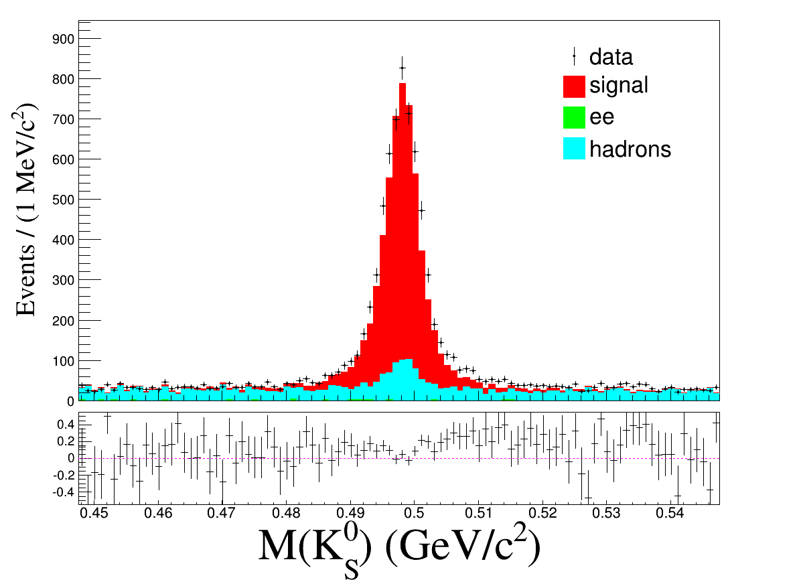
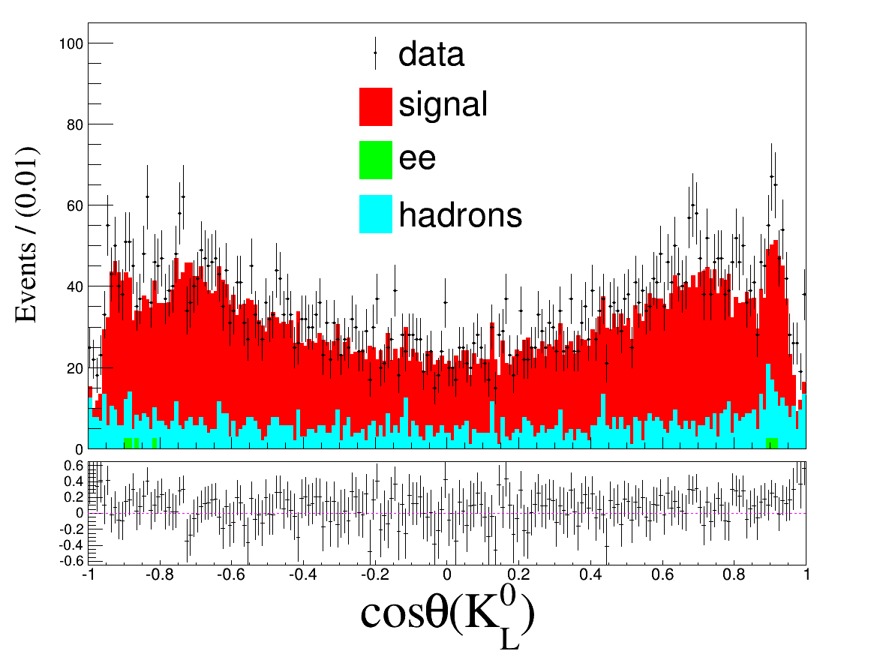
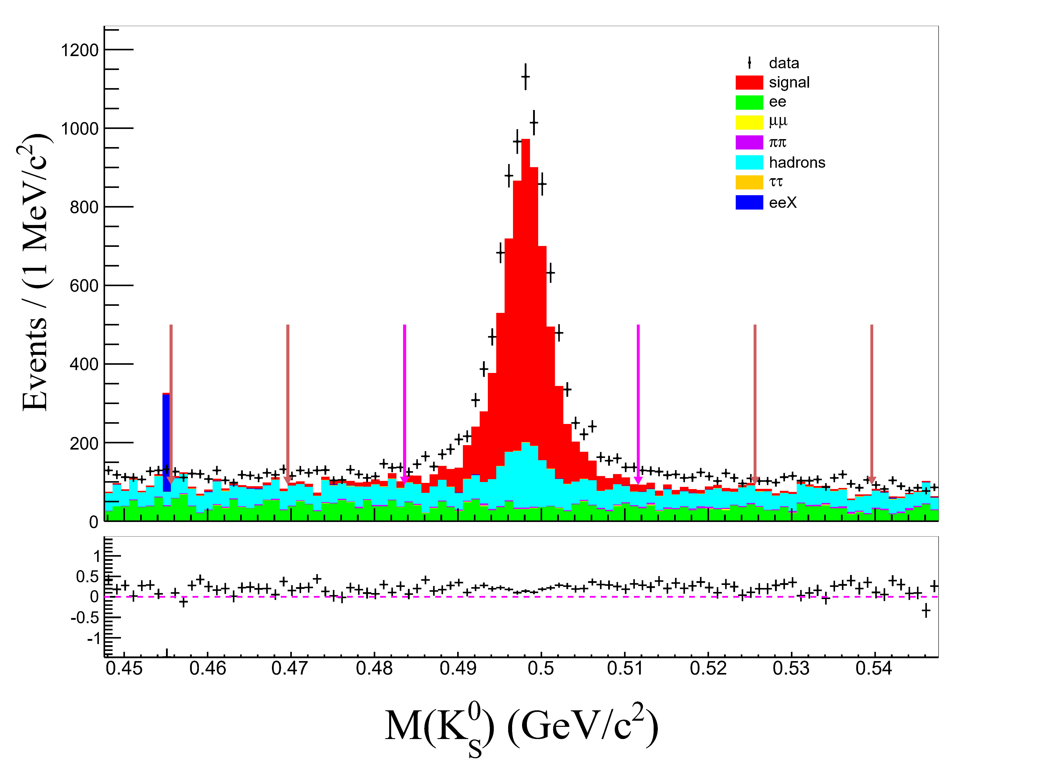
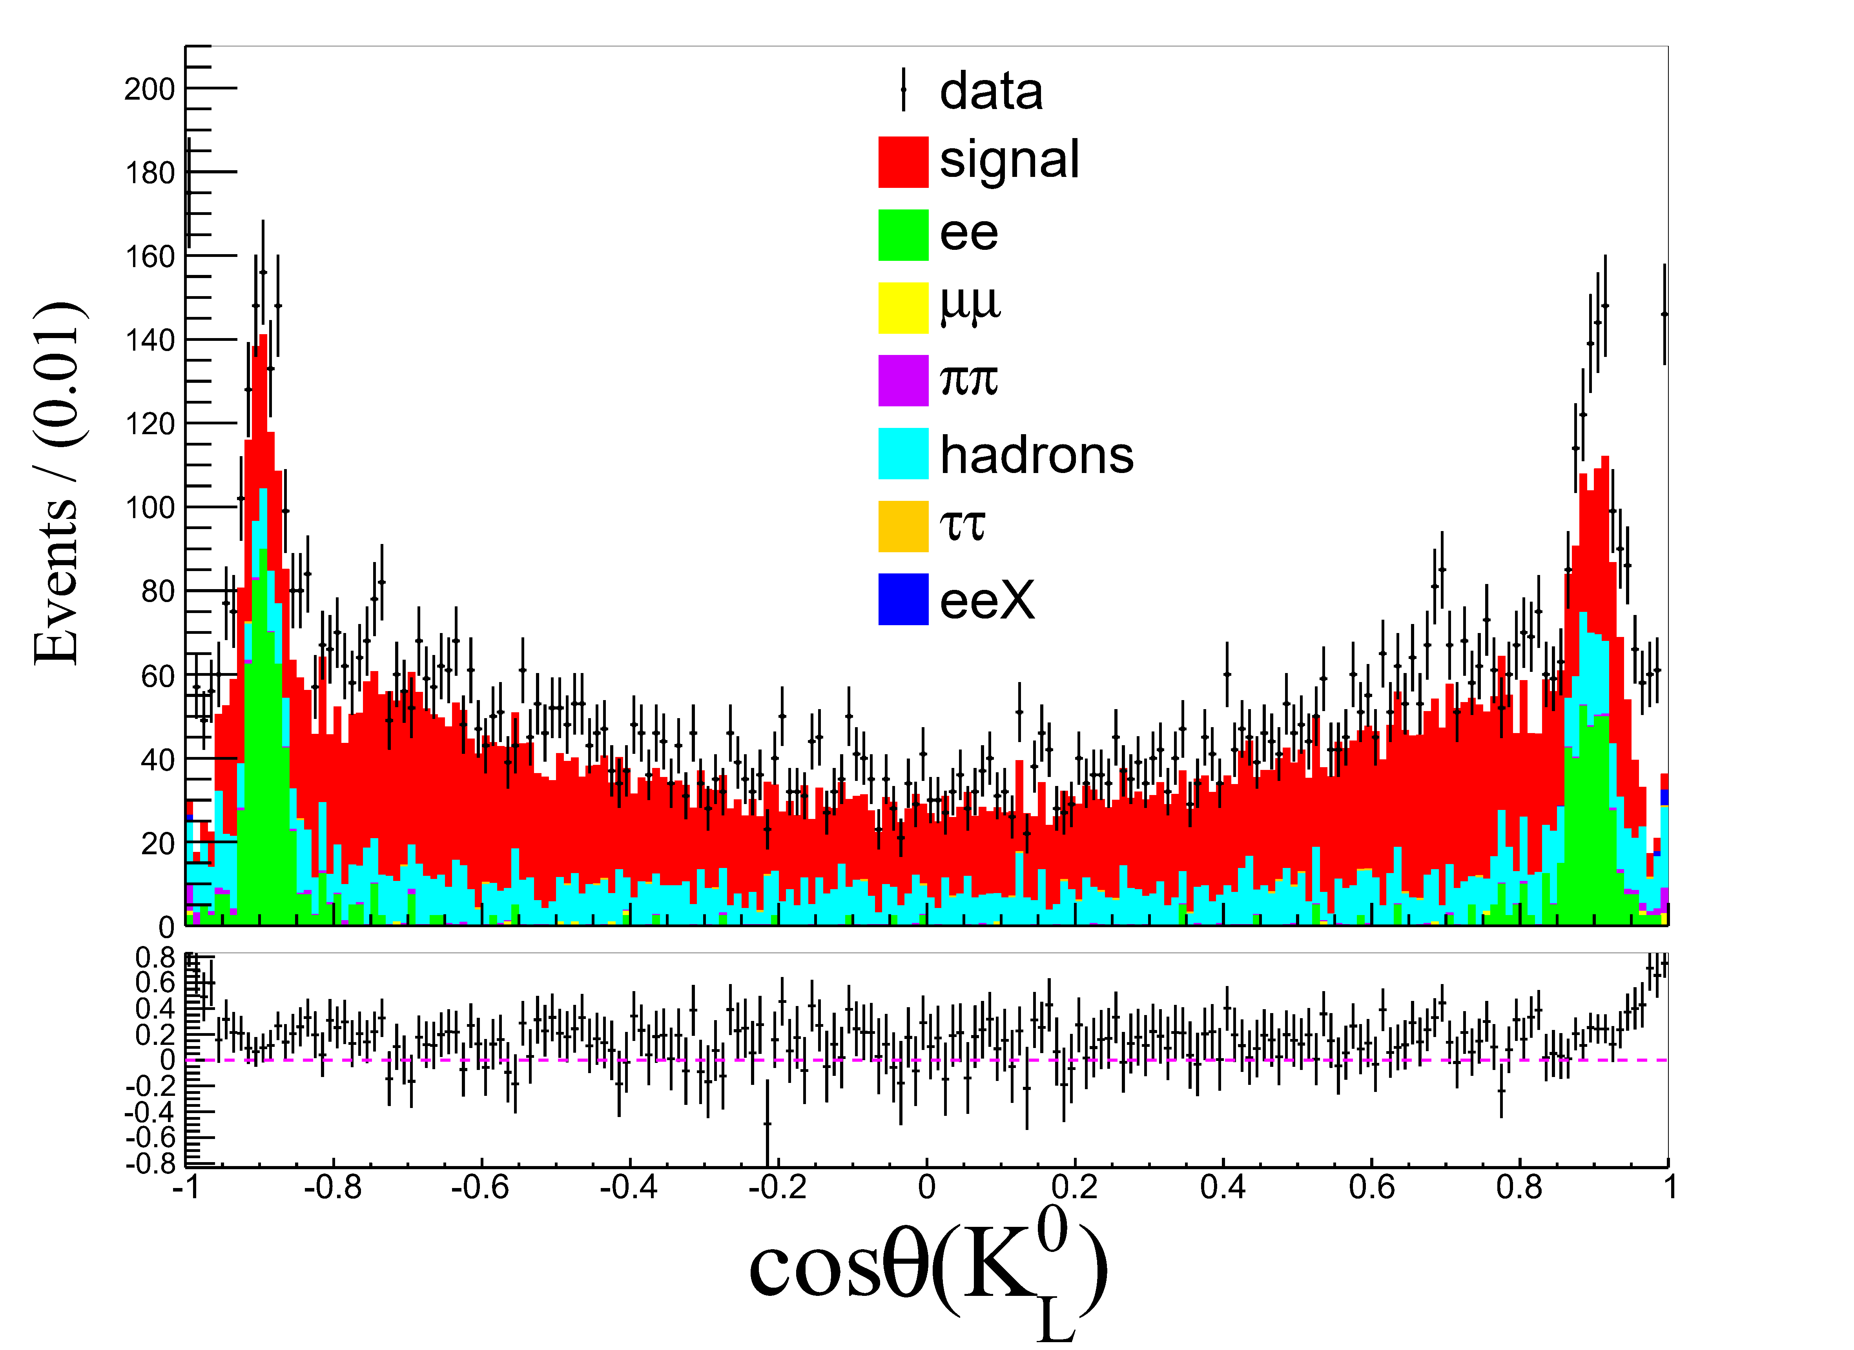

Slide 9
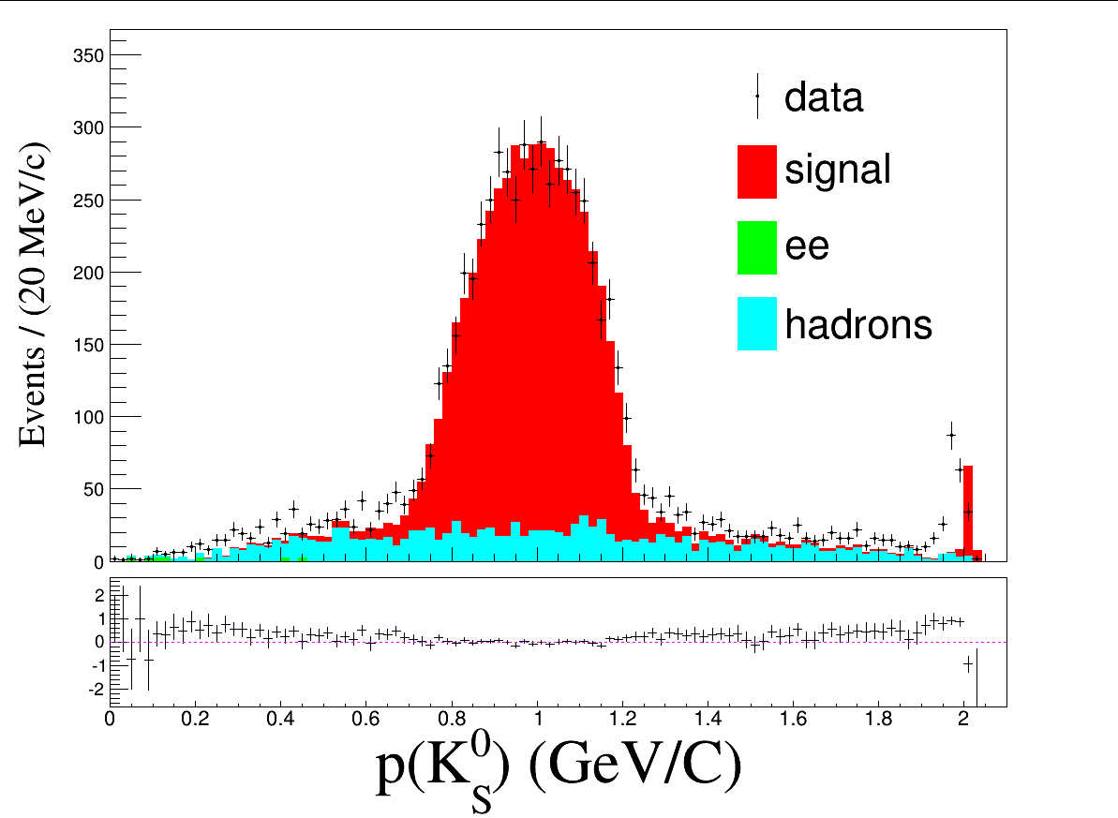
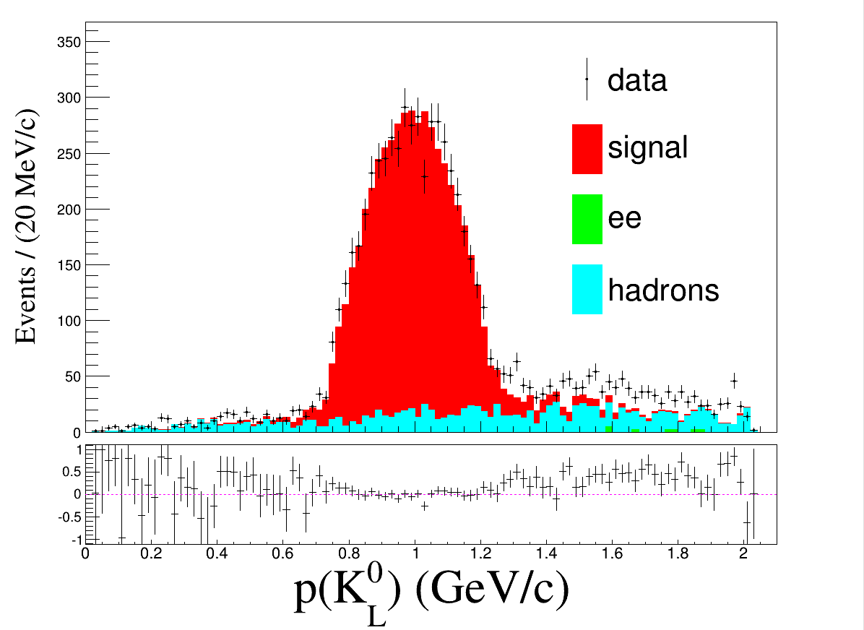
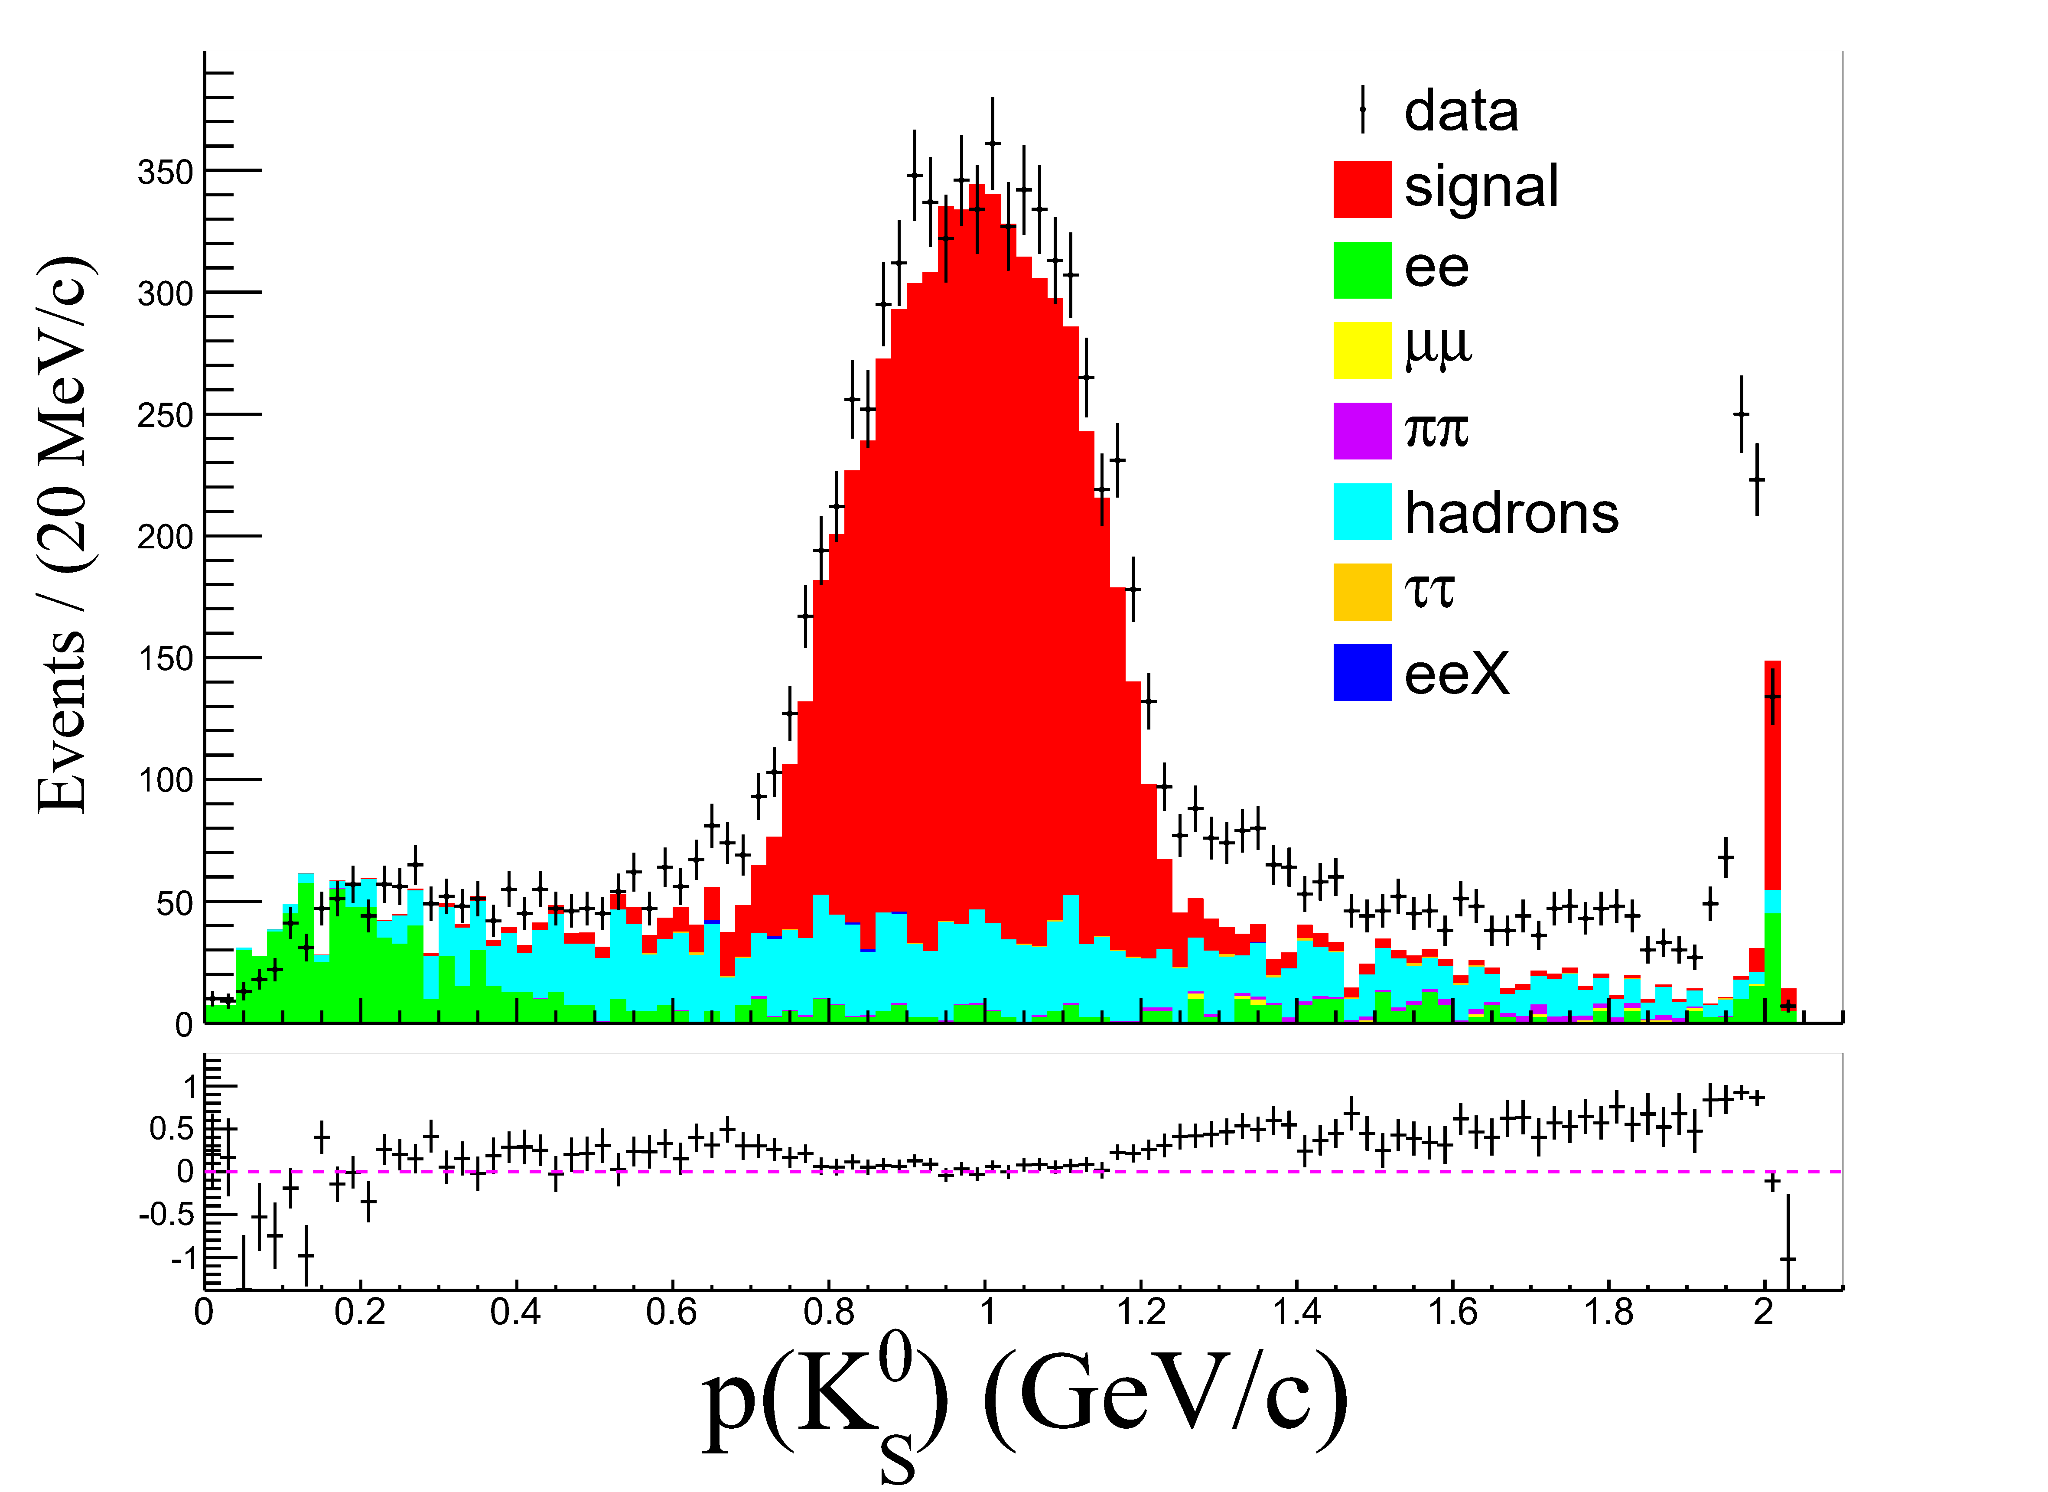
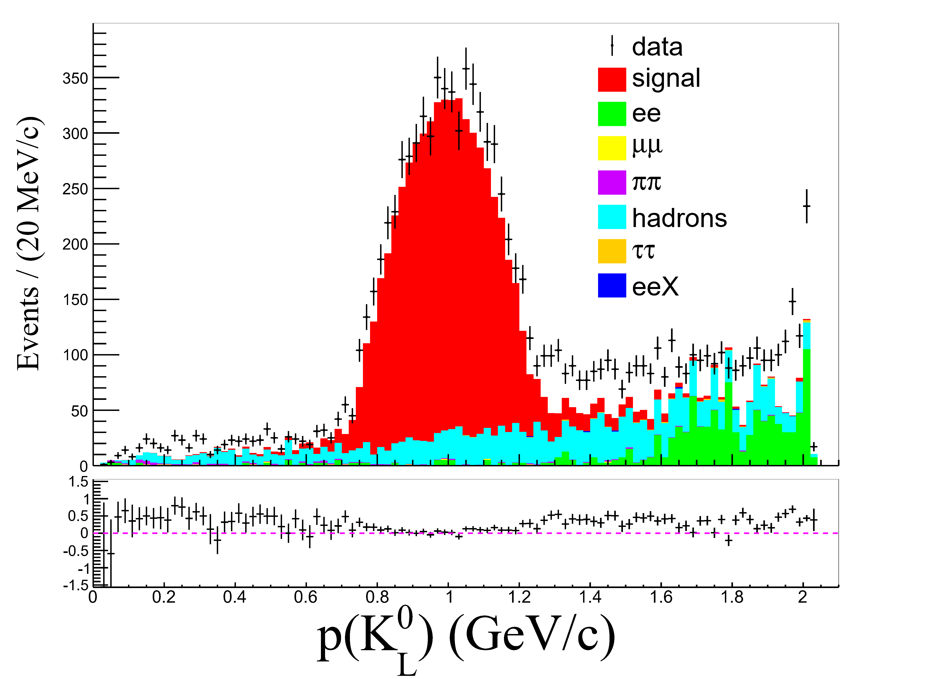

Slide 10
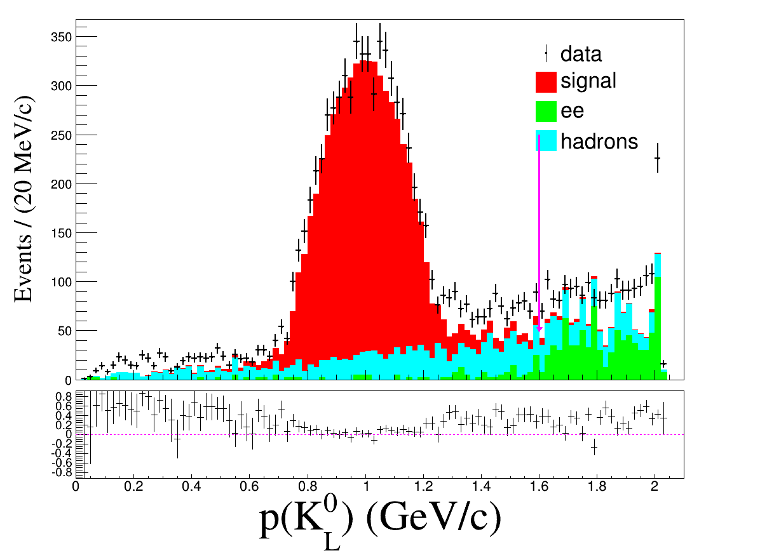
Brand new
Signal: 331480
|M(γγ)-M(pi0)|<30 MeV/c²
329671
p(klg) cut
326793

Slide 11
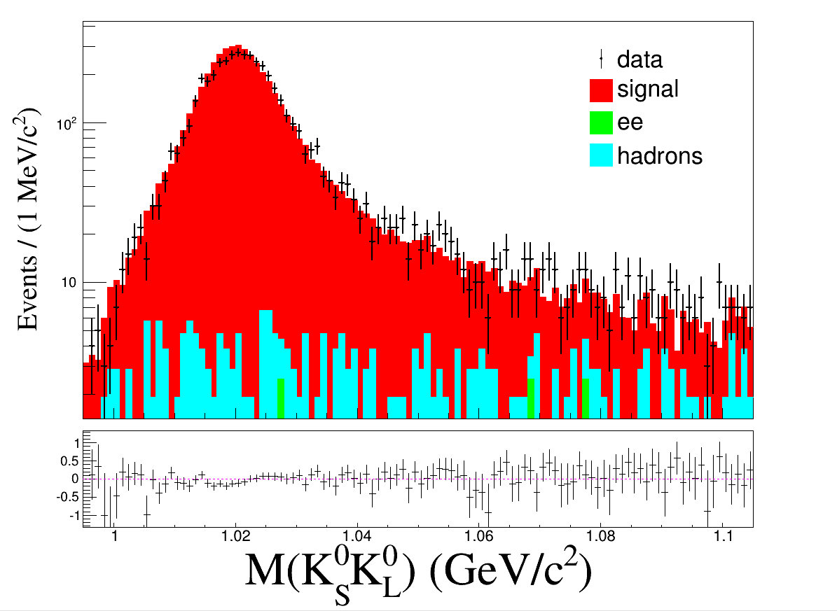
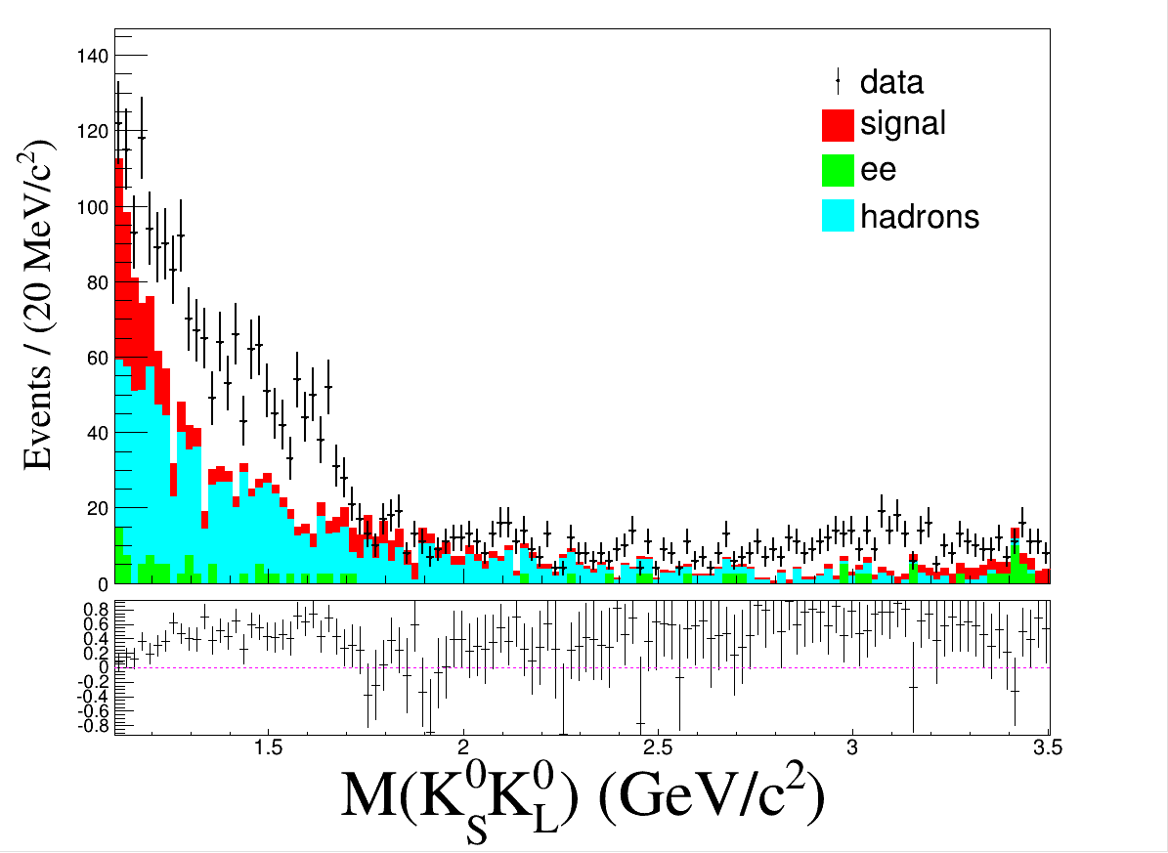
Brand new
pipi and other backgrounds are not taken into account
Signal: 331480
|M(γγ)-M(pi0)|<30 MeV/c²
329671
p(klg) cut
326793

Slide 12
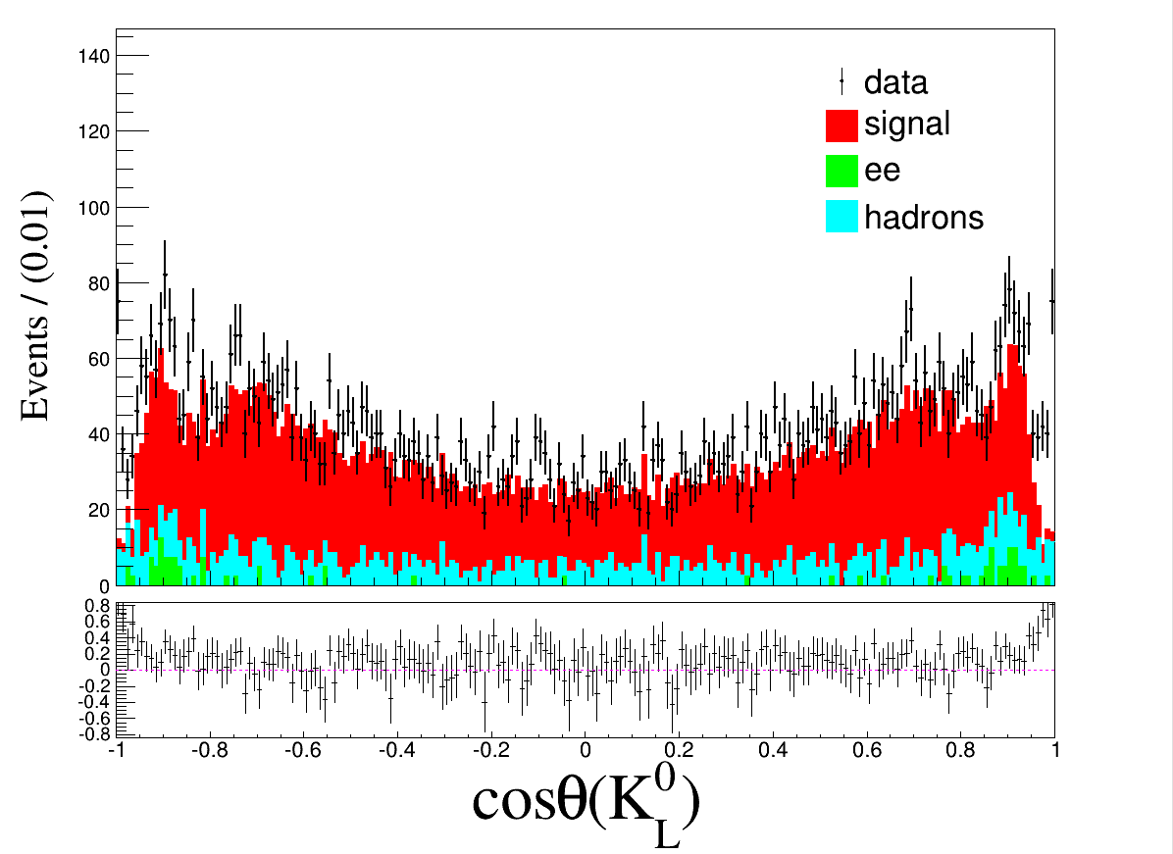
Brand new

Slide 13
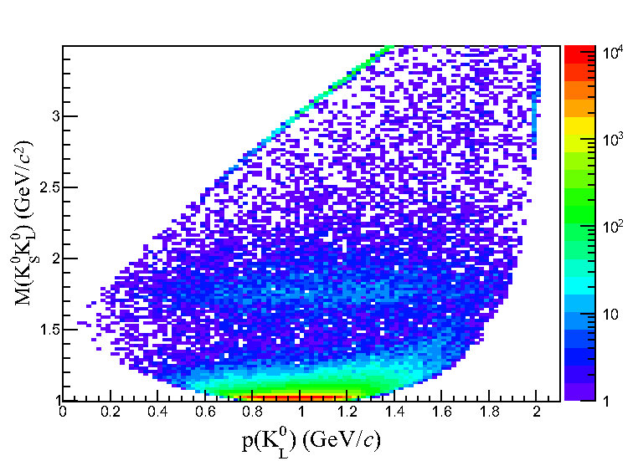
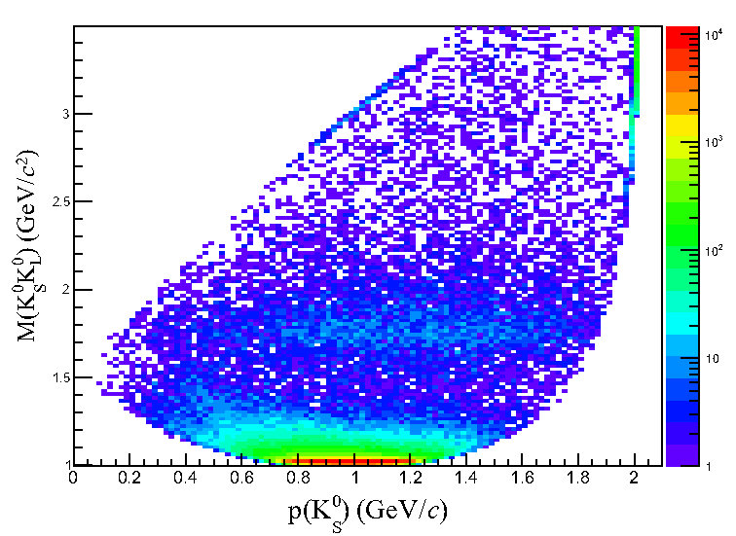
Comparison

Slide 14
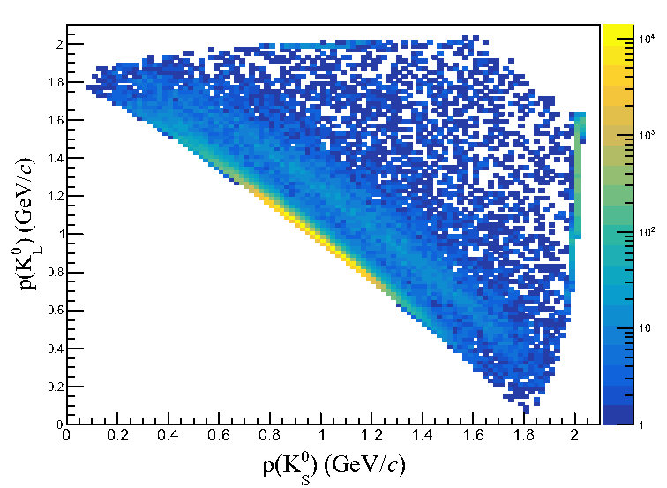
Comparison

Slide 15
Check

Slide 16
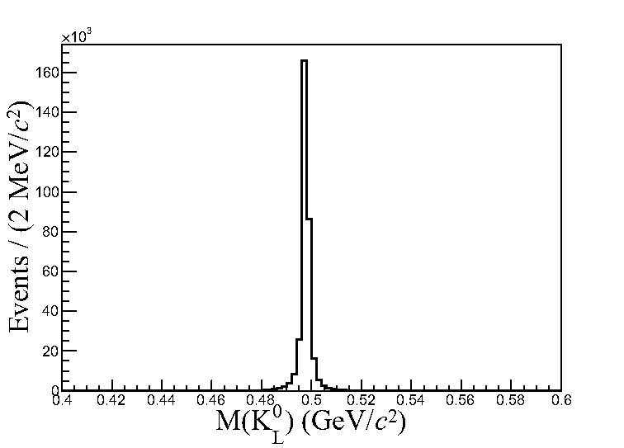
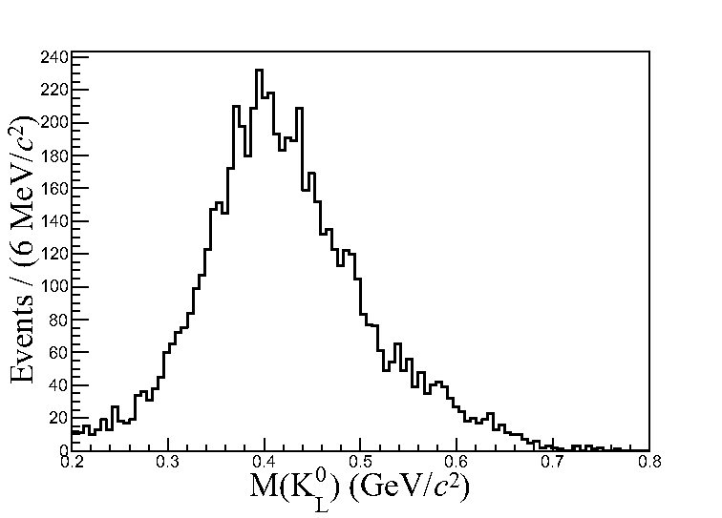
Check (Signal MC)
p(K_{S})<1.98 GeV/c
p(K_{S})>1.98 GeV/c

