Slide 1
CR & TB MIP results comparison
2024/11/25
Speaker : Jiaxuan Wang

Slide 2
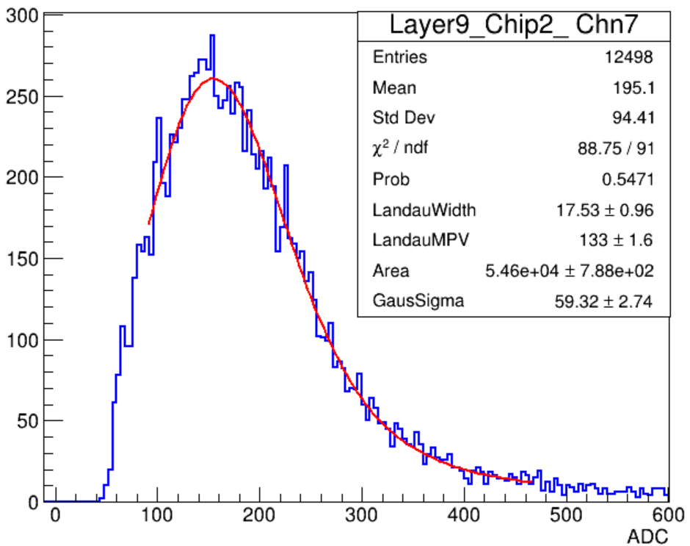
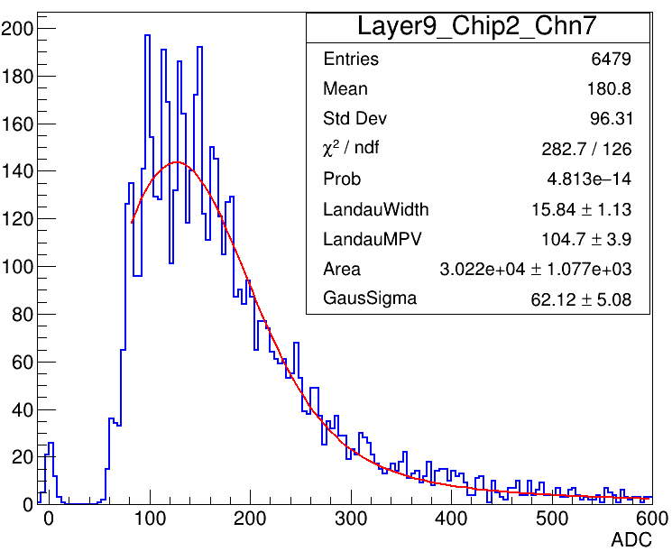
10um SiPM MIP spectrum
Cosmic ray test
Beam test

Slide 3
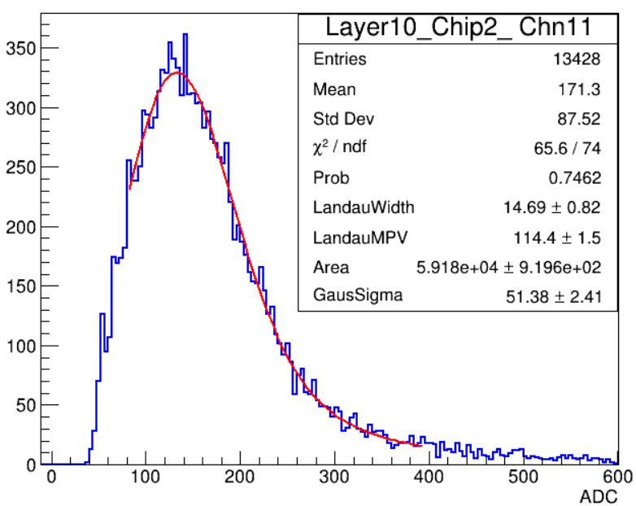
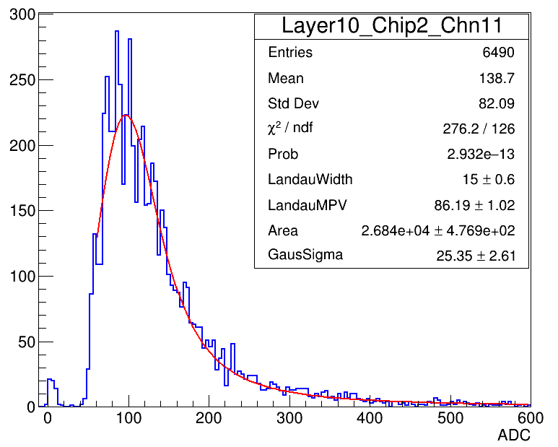
10um SiPM MIP spectrum
Cosmic ray test
Beam test

Slide 4
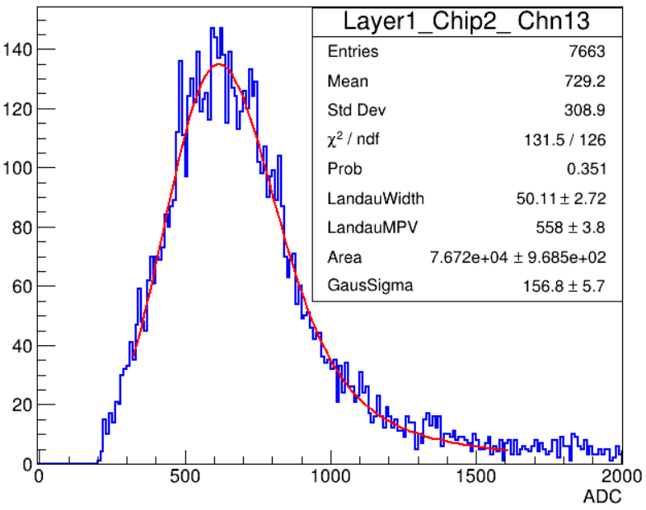
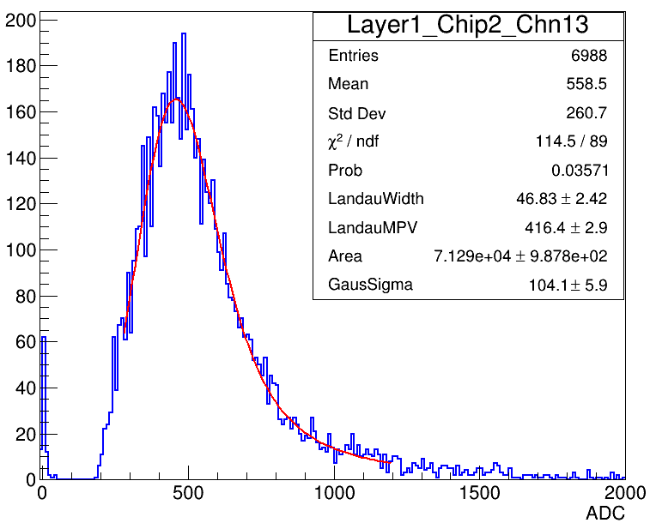
15um SiPM MIP spectrum
Cosmic ray test
Beam test

Slide 5
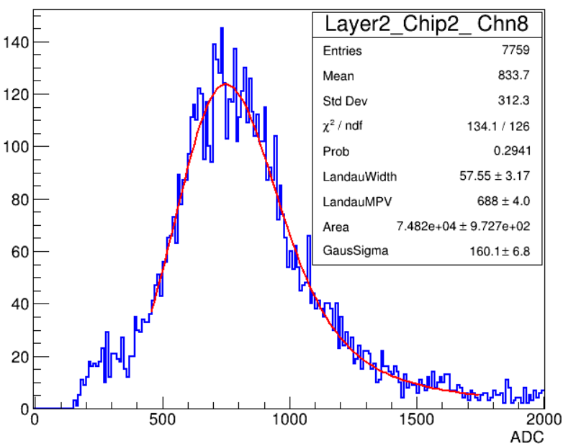
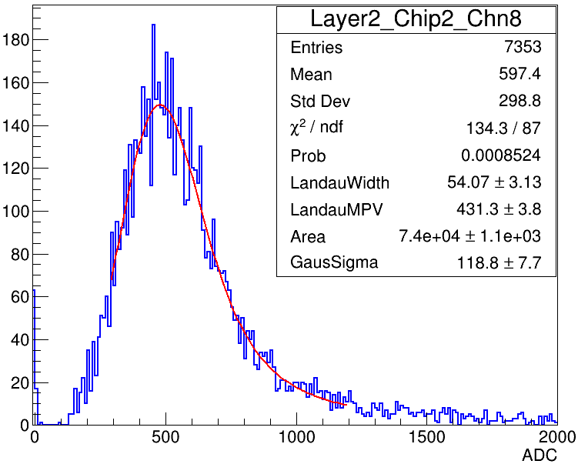
15um SiPM MIP spectrum
Cosmic ray test
Beam test

Slide 6
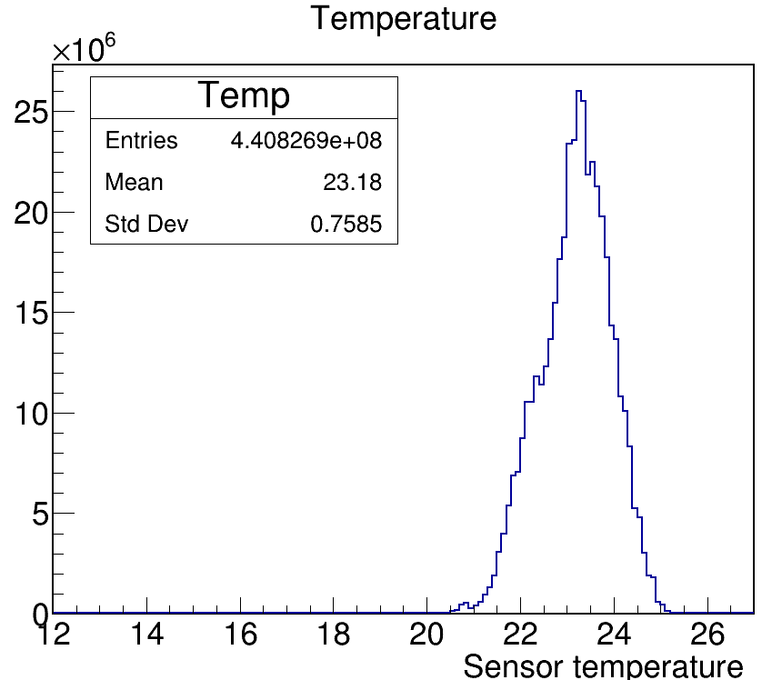
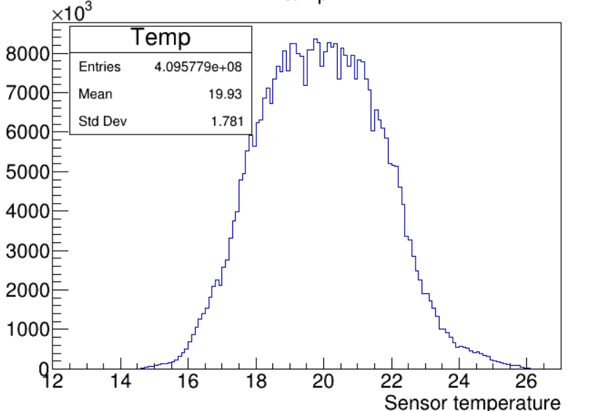
Temperature comparison
CR temperature is 3.2 degrees lower than TB on average
Cosmic ray test
Beam test

Slide 7
Summary
Significant single photoelectron spectrum on TB data
Temperature factor also influence the gain
Total 3783/6720 ~ 55% channels didn’t get well calibrated with strict selection

Slide 8
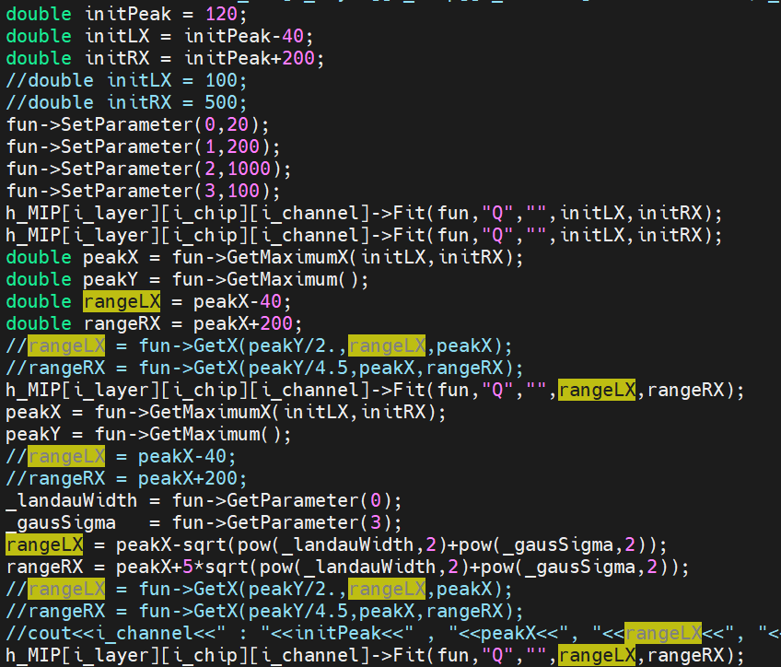
Backup

Slide 9
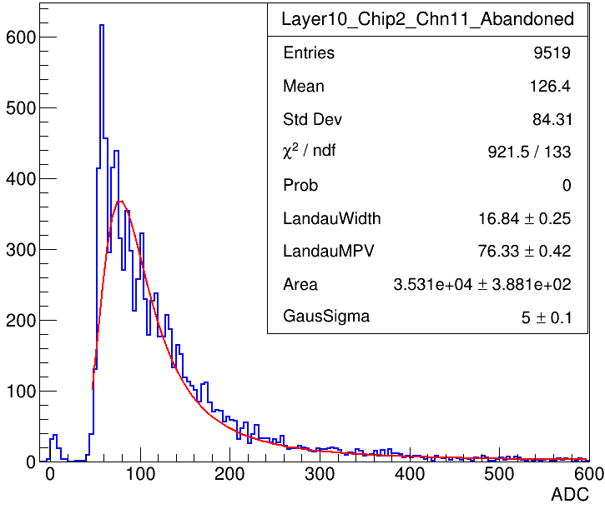
Dark noise
Beam test
w.o. track fit
Beam test
With track fit

Slide 10
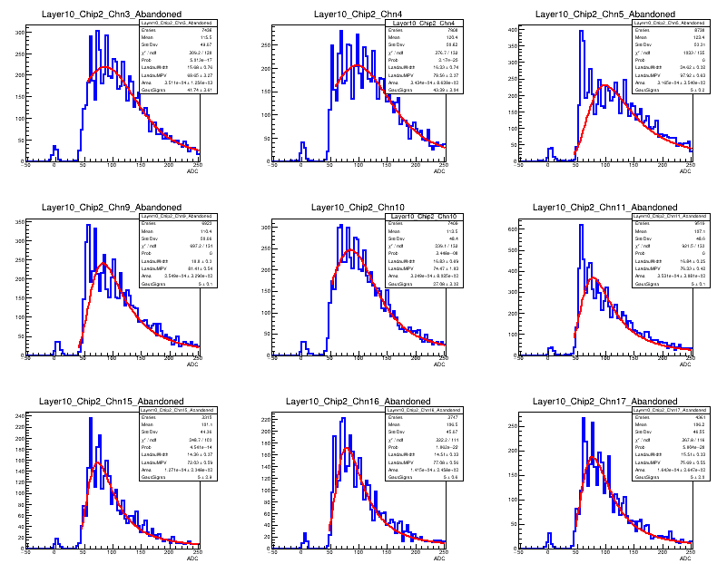
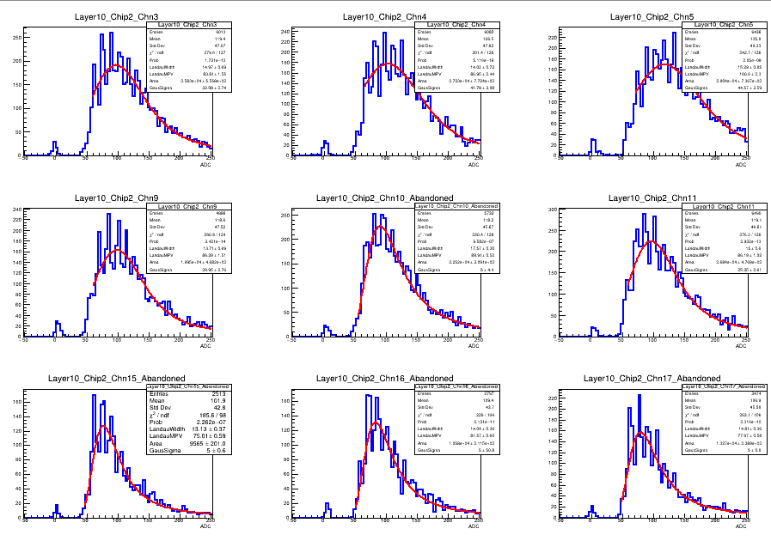
Dark noise
Beam test
w.o. track fit
Beam test
With track fit

Slide 11
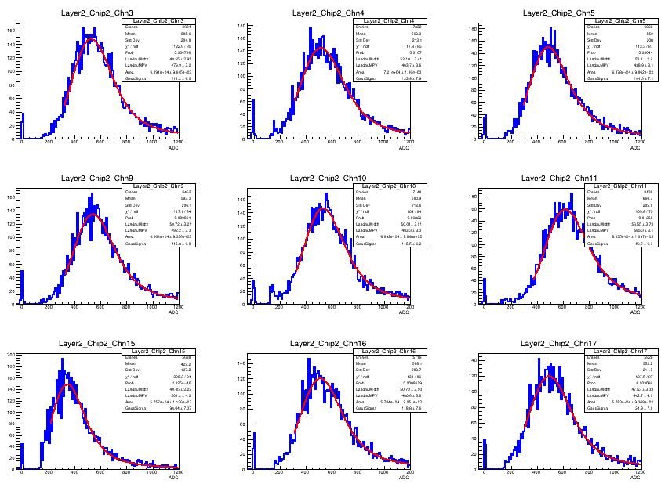
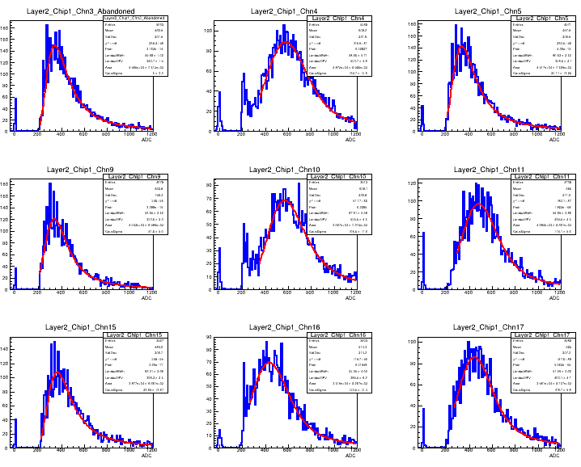
Dark noise
Beam test
w.o. track fit
Beam test
With track fit

