Slide 1
Toy MC for Landau Convoluted Gaussian Fitting method
2024/09/27
Speaker : Jiaxuan Wang

Slide 2
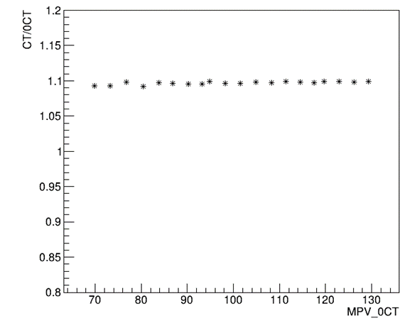
Motivation: which affect MPV
Toy MC
Get random hist from Landau function
MPV scanning: 10um(80-140); 15um(200-800)
Landau width: 10um 17; 15um 50
Photon Number: Division of random number by (SiPM Gain*PDE)
Poisson distribution
Light output uniformity
Pixel MC correction
Crosstalk = 0
ADC gaussian distribution
ADC gaussian smear

Slide 3
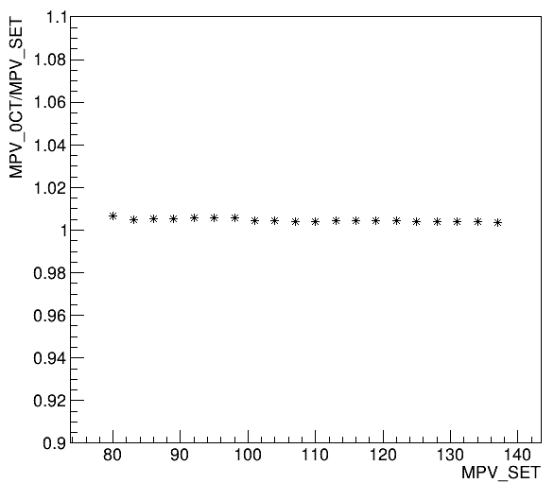
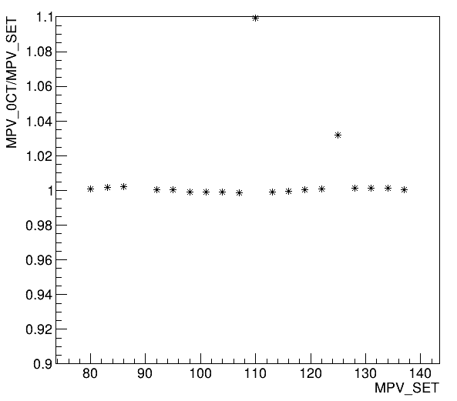
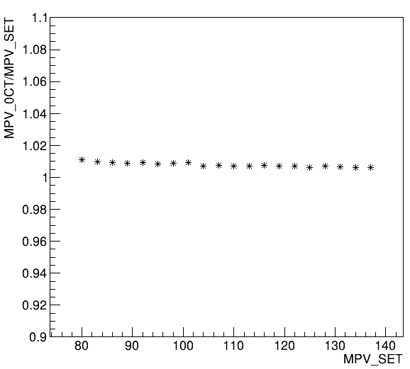
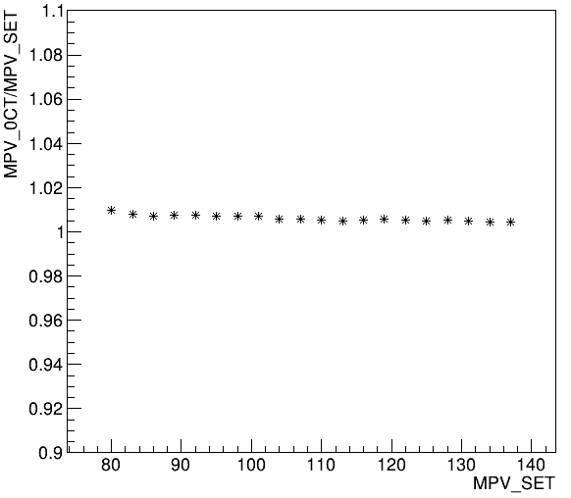
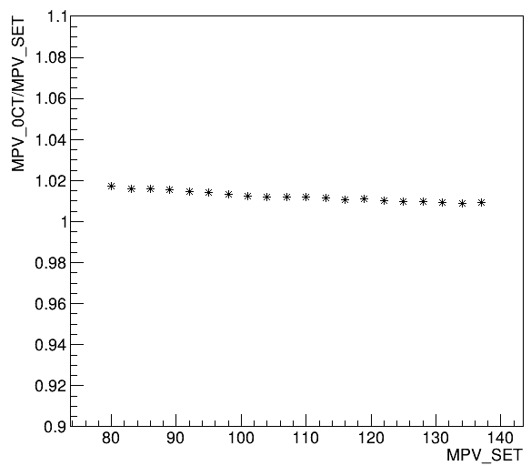
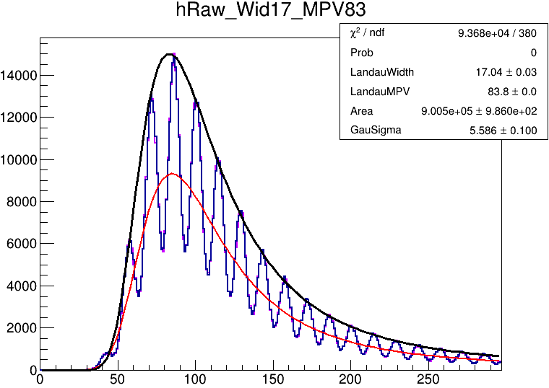
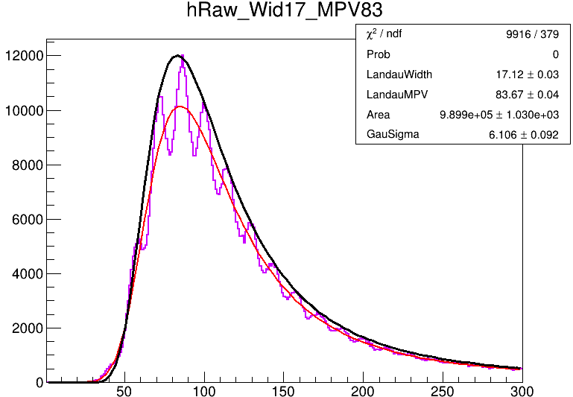
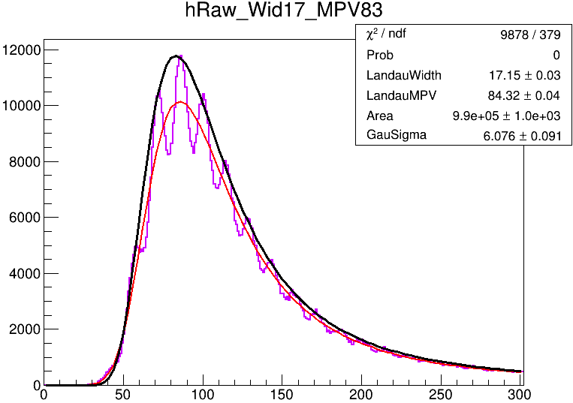
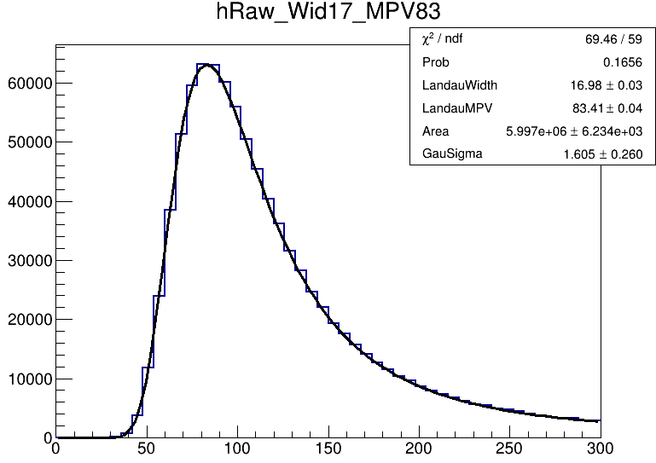
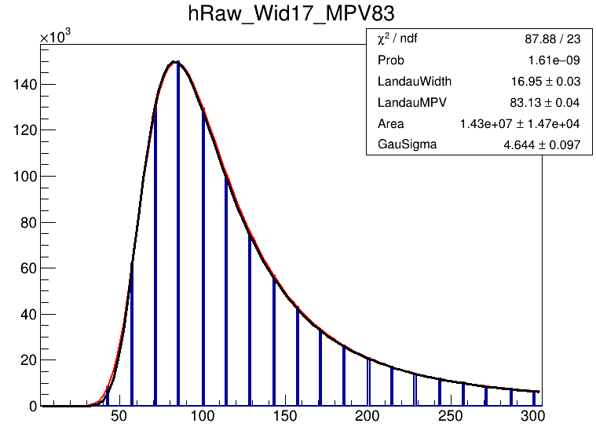
10um SiPM
低阶效应影响
数值计算+光电子数取整
+台基展宽
数值计算+光电子数取整+台基展宽+ SiPM uniformity 0.5$√N$
数值计算+光电子数取整+台基展宽+ SiPM uniformity 0.5$√N$
+光传输不均匀
仅数值计算
数值计算+光电子数取整
光电子数取整，台基展宽，相对台基较小的SiPM增益不均匀性，光传输不均匀性影响较小(<2%)

Slide 4
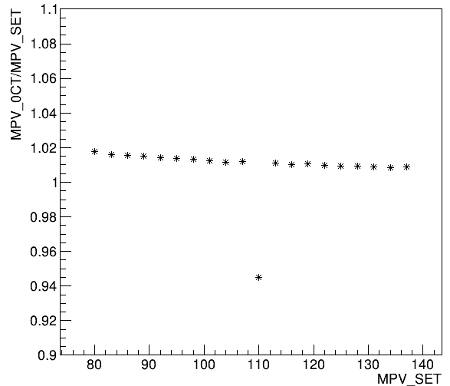
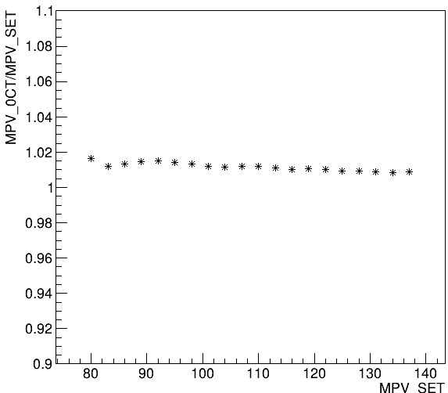
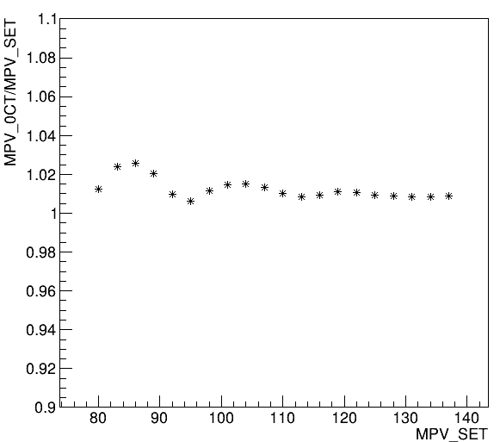
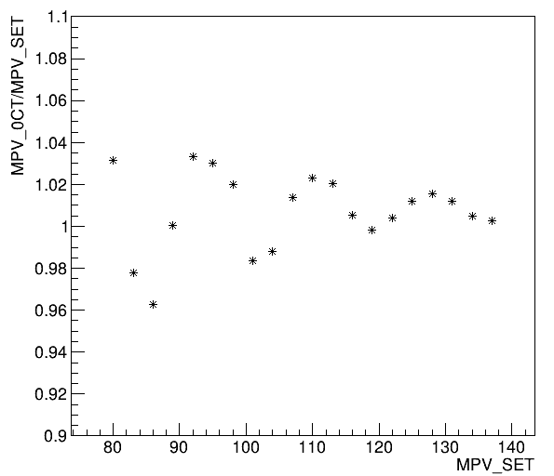
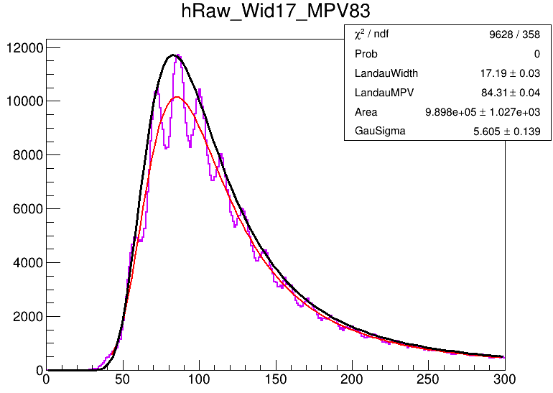
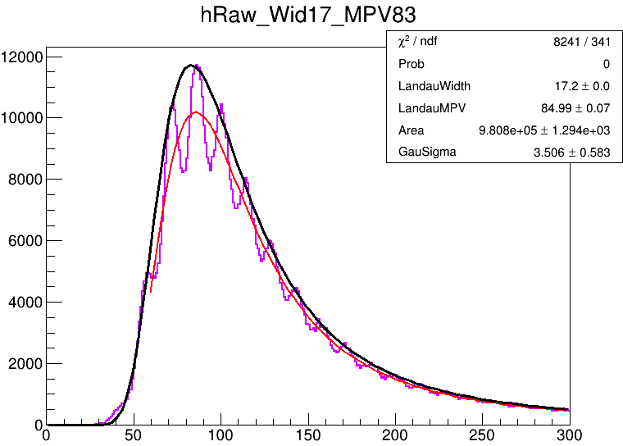
10um SiPM : threshold cut
SiPM增益不均匀性0.5$√N$ + threshold cut，这里threshold cut近似为改变拟合范围左界
SiPM uniformity 0.5$√N$
+ 0.5MIP cut
SiPM uniformity 0.5$√N$
+ 0.6MIP cut
SiPM uniformity 0.5$√N$
+ 0.7MIP cut
SiPM uniformity 0.5$√N$
+ 0.8MIP cut
MIP谱的单光电子峰可见，拟合范围选取(高阈值事例)会引起拟合结果的波动，MPV越小影响越大

Slide 5
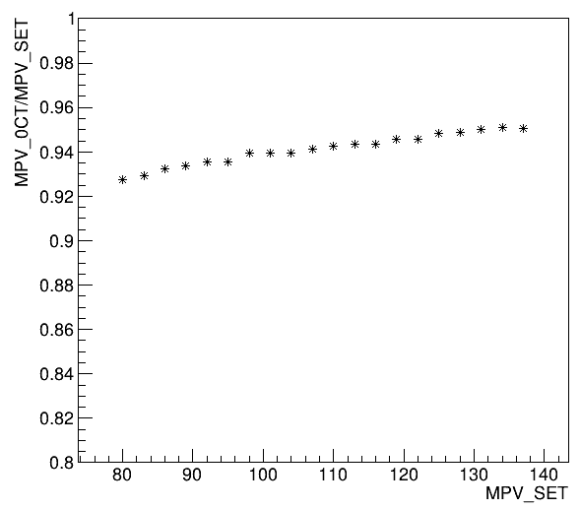
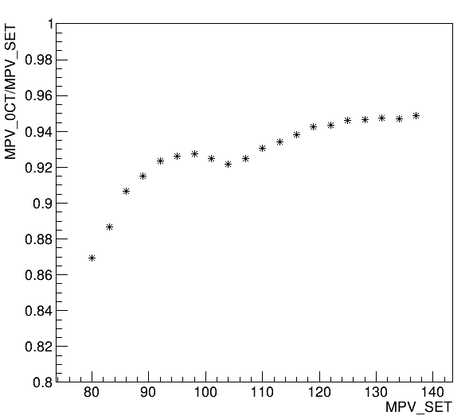
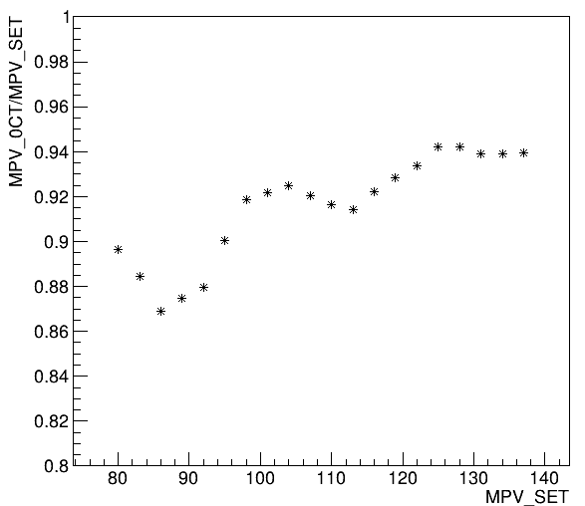
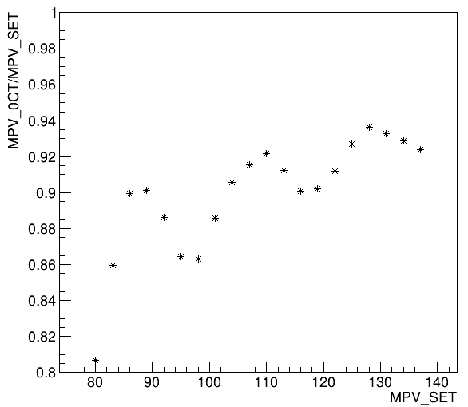
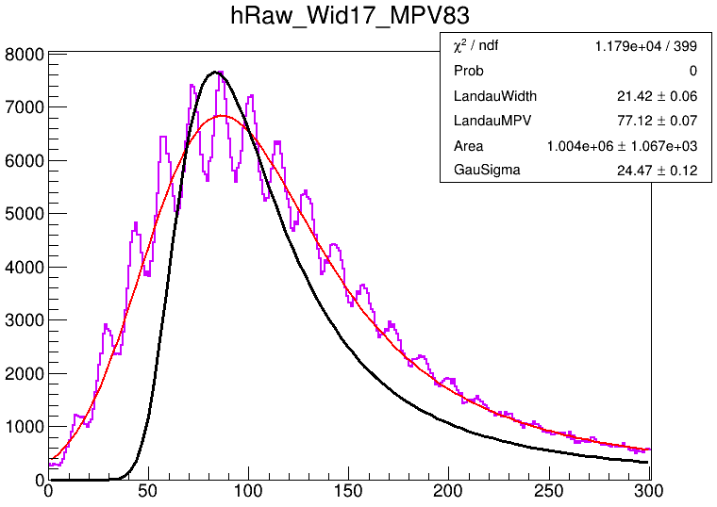
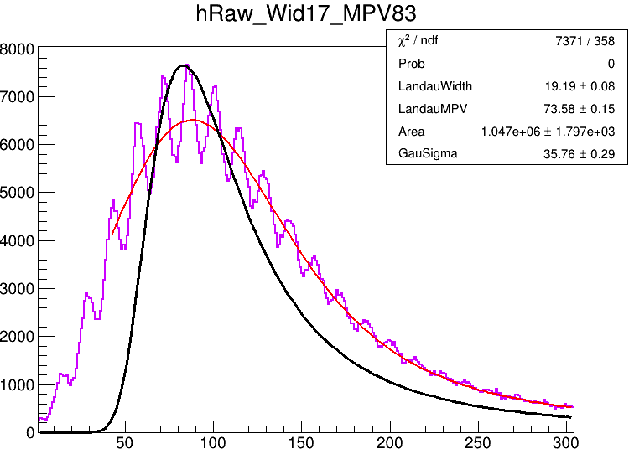
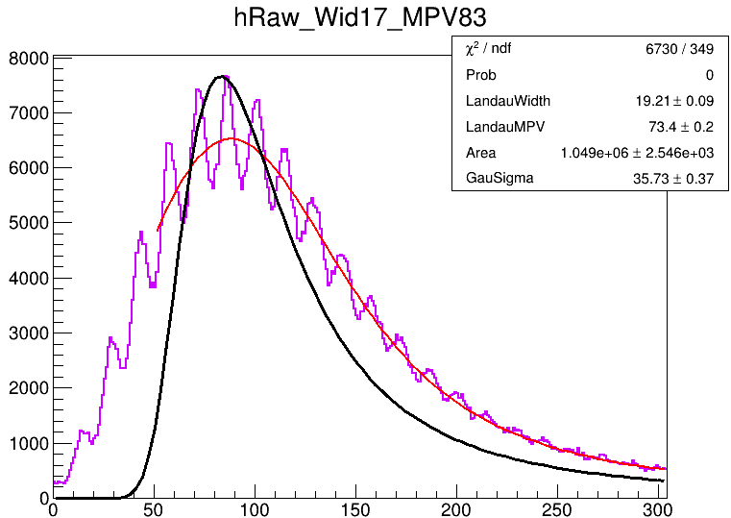
10um SiPM
SiPM增益不均匀性0.5$√N$ + 光电子Poisson分布 + threshold cut
Poisson分布
+ SiPM uniformity 0.5$√N$
+ no threshold cut
Poisson分布
+ SiPM uniformity 0.5$√N$
+ 0.5MIP cut
Poisson分布
+ SiPM uniformity 0.5$√N$
+ 0.6MIP cut
Poisson分布
+ SiPM uniformity 0.5$√N$
+ 0.7MIP cut
光电子的泊松分布会显著的影响，对于10um SiPM(光产额7~8p.e./MIP)，约有5~7%影响
此外，光电子的泊松分布对MIP展宽作用导致阈值影响更严重

Slide 6
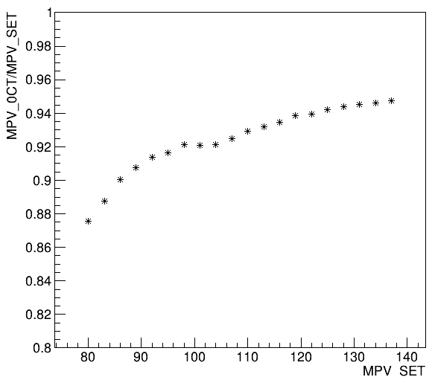
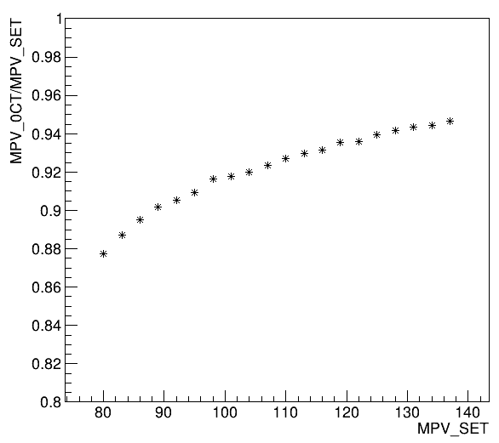
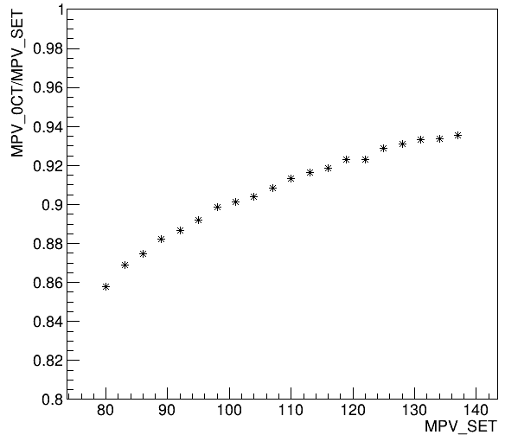
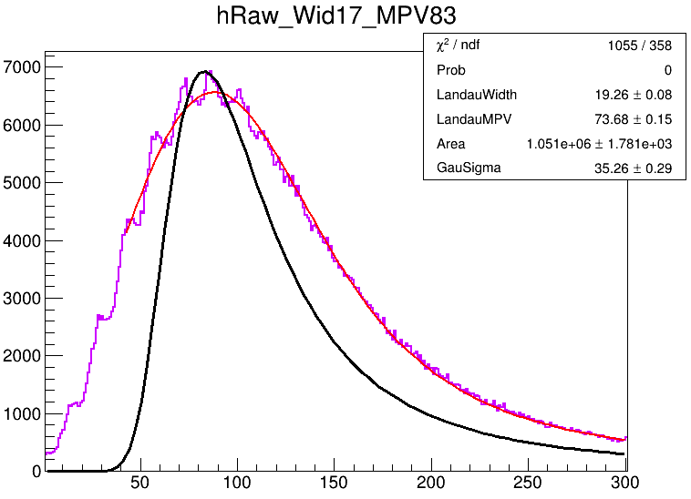
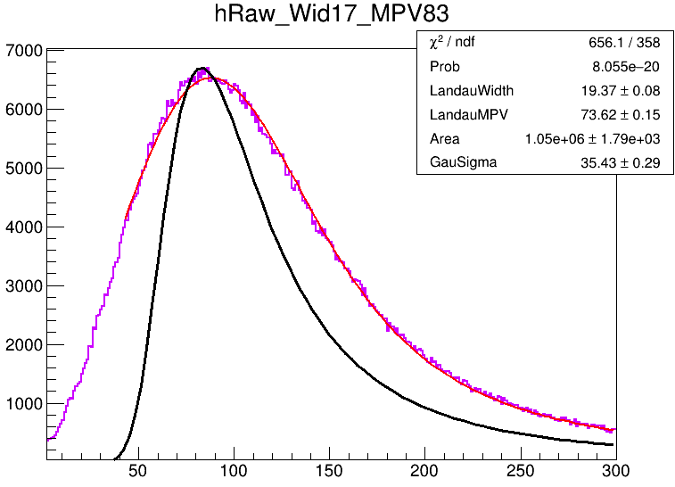
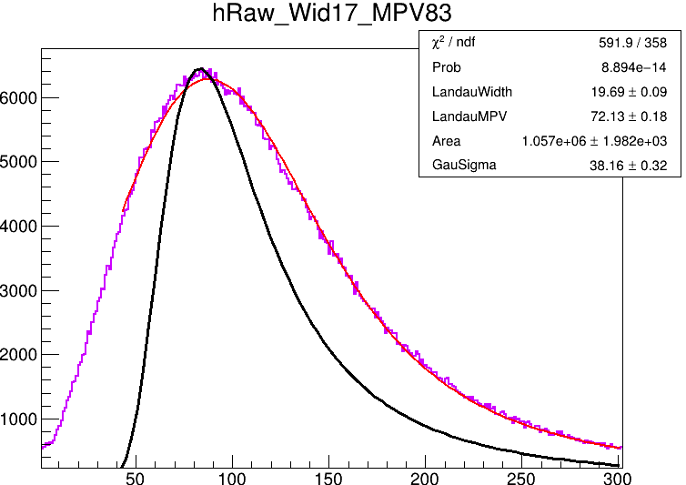
10um SiPM
SiPM Gain Non-Uniformity + 光电子Poisson分布 + threshold cut
Poisson分布
+ SiPM uniformity 0.5$√N$
+ 0.5MIP cut
Poisson分布
+ SiPM uniformity 1$√N$
+ 0.5MIP cut
Poisson分布
+ SiPM uniformity 2$√N$
+ 0.5MIP cut
Poisson分布
+ SiPM uniformity 5$√N$
+ 0.5MIP cut
随着SiPM不均匀性增大，高阈值导致的拟合波动消失，但此时由于Sigma随光电子数增大，拟合MPV缓慢减小

Slide 7
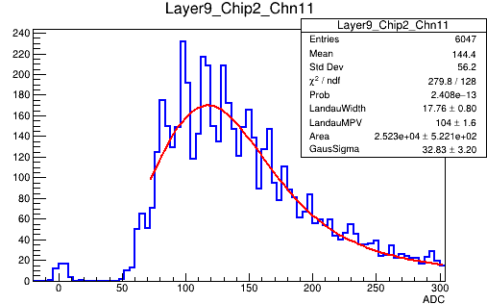
Summary for 10um SiPM
If single photoelectron peaks exists in MIP spectrum, fit range would lead to fluctuation of MIP value
Poisson would lead to the decrease of MPV, especially in low MPV situation
Compared with Pedestal sigma, if SiPM non-uniformity is too small in value, this part could be ignored
Poisson distribution
+ SiPM uniformity 0.5$√N$
+ 0.7MIP cut

Slide 8
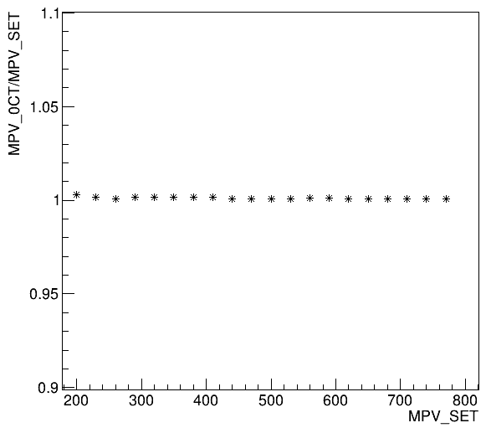
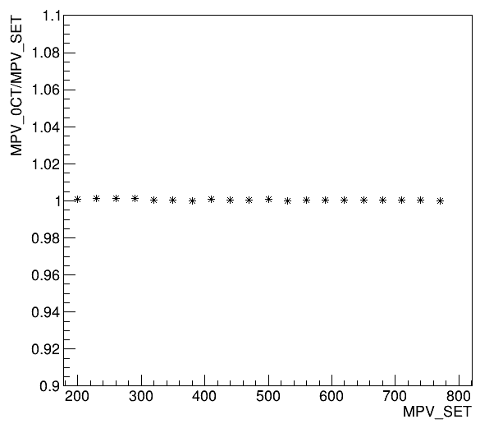
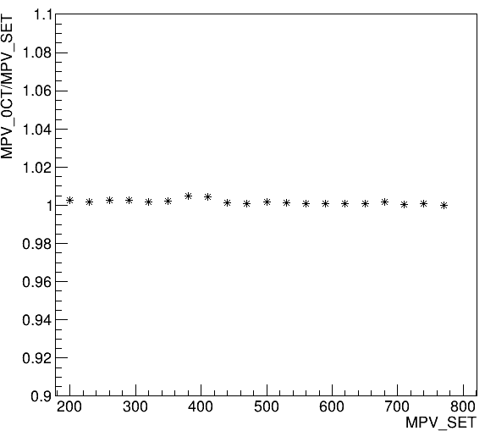
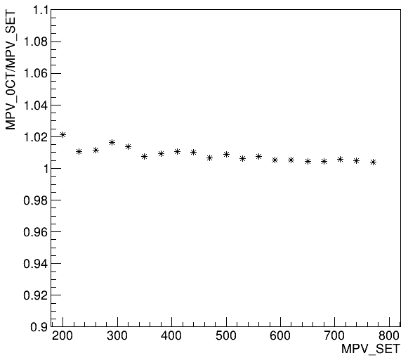
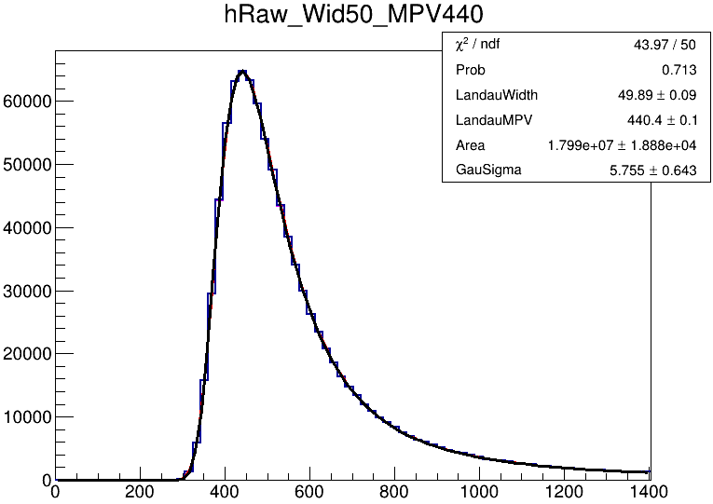
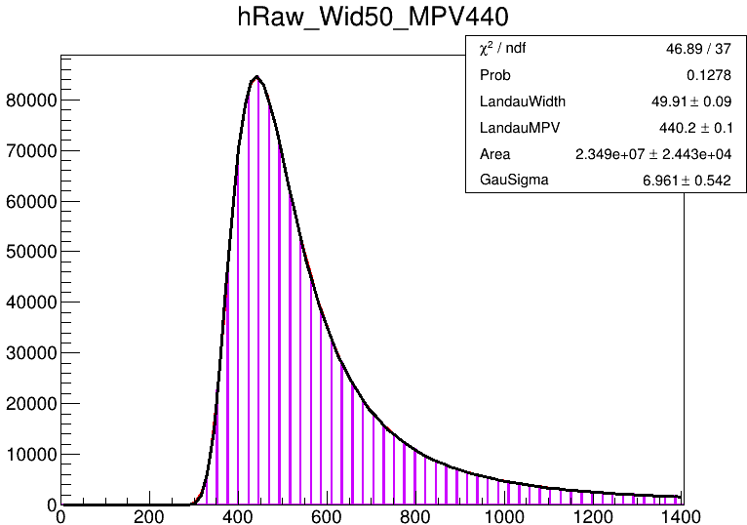
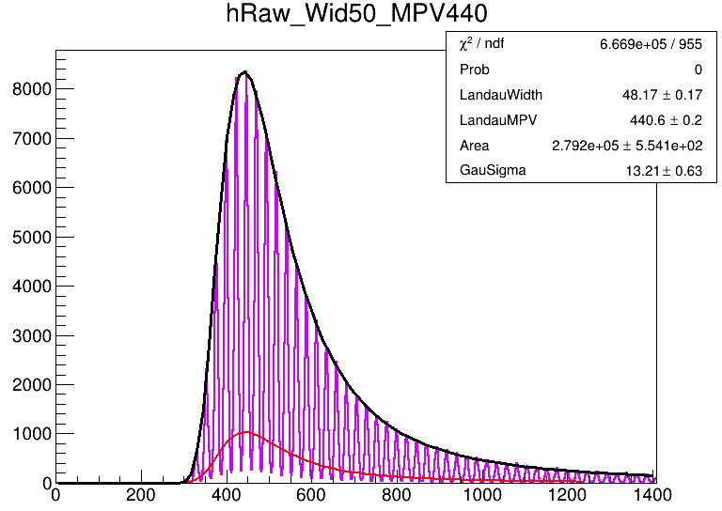
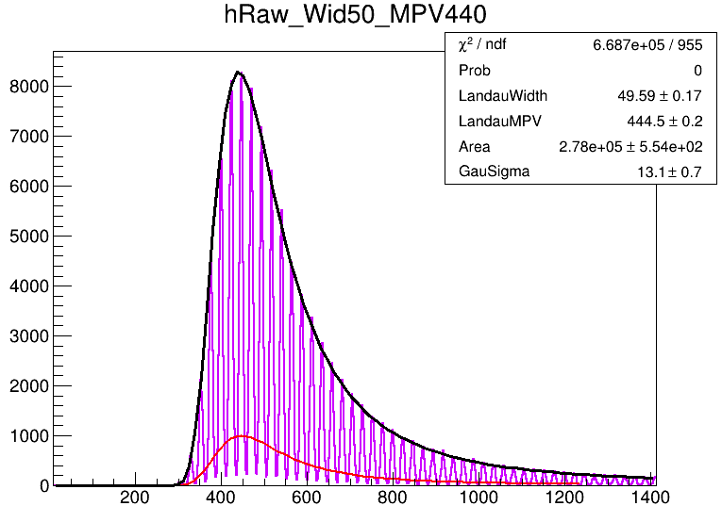
15um SiPM
低阶效应影响
仅数值计算
数值计算+光电子数取整
数值计算+光电子数取整
+台基展宽
数值计算+光电子数取整+台基展宽+光传输不均匀
光电子数取整，台基展宽，光传输不均匀性影响较小(基本<2%)

Slide 9
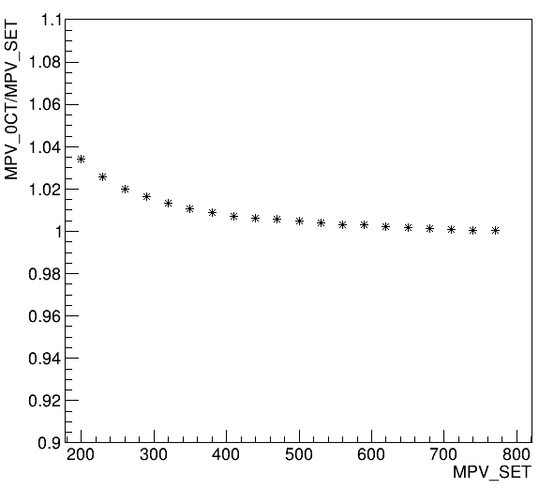
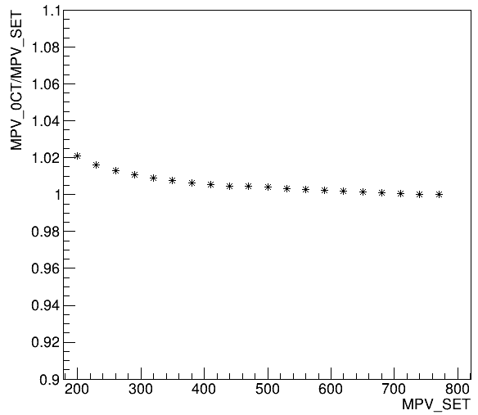
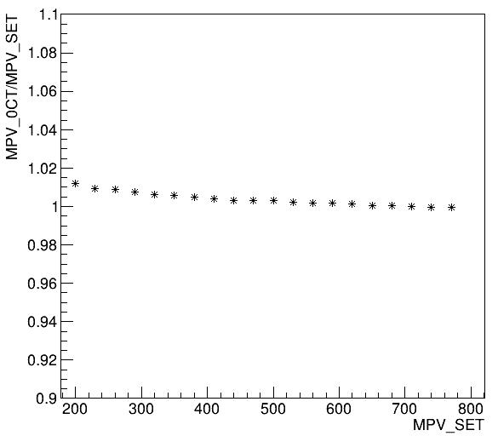
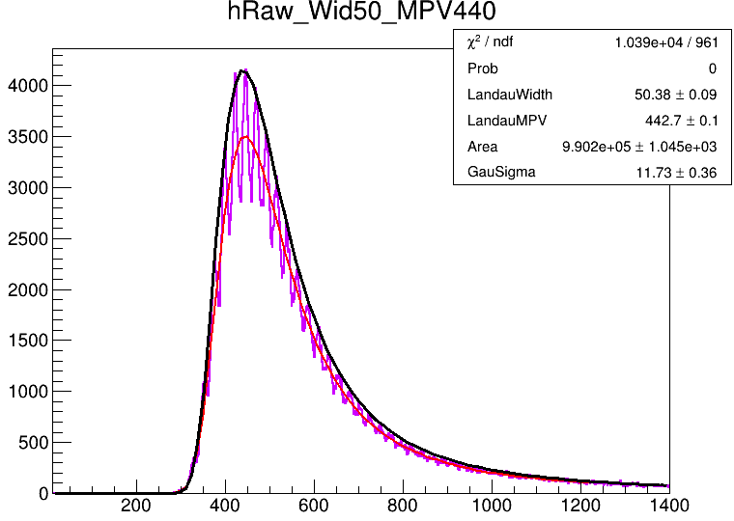
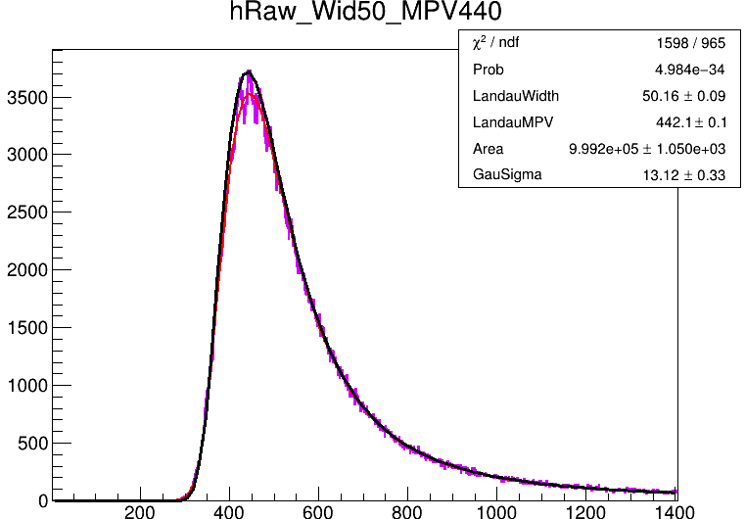
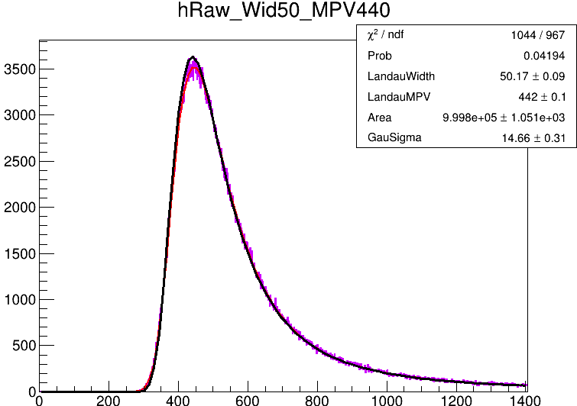
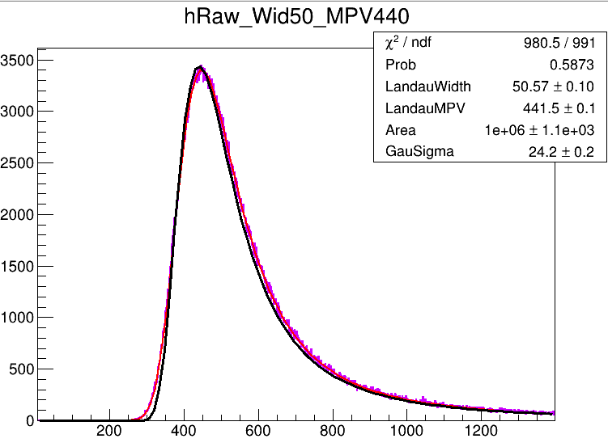
15um SiPM : threshold cut
SiPM增益不均匀性
SiPM uniformity $√N$
SiPM uniformity 1.5$√N$
SiPM uniformity 2$√N$
SiPM uniformity 5$√N$

Slide 10
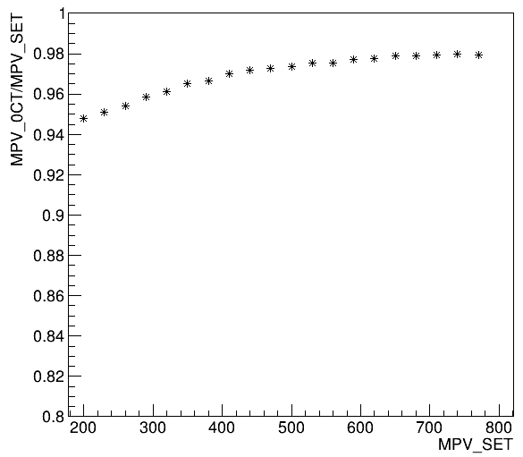
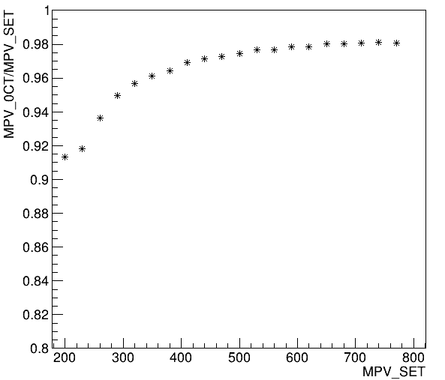
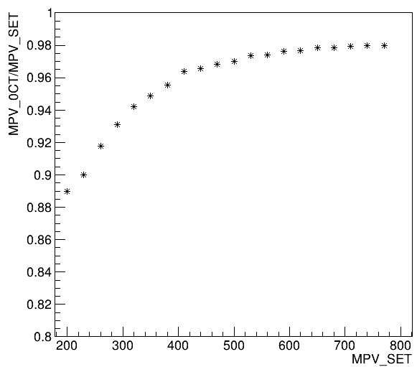
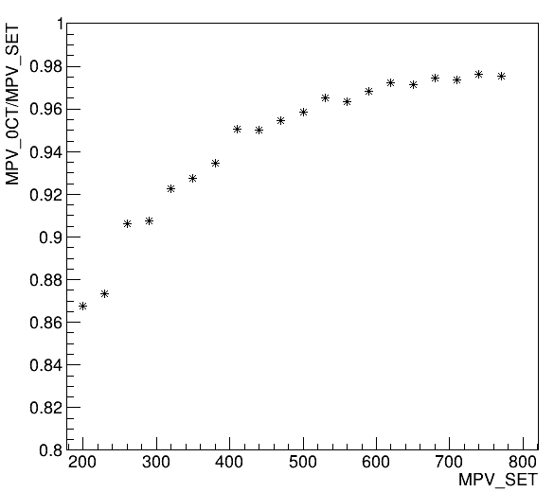
15um SiPM:
光电子Poisson分布 + Poisson分布 + threshold cut
SiPM uniformity 2$√N$
+Poisson分布
+no threshold cut
SiPM uniformity 2$√N$
+Poisson分布
+ 0.5MIP cut
SiPM uniformity 2$√N$
+Poisson分布
+ 0.6MIP cut
SiPM uniformity 2$√N$
+Poisson分布
+ 0.7MIP cut
光电子的泊松分布会显著的影响，对于15um SiPM(光产额~20p.e./MIP)，约有5~7%影响
此外，光电子的泊松分布对MIP展宽作用导致阈值效应更严重

Slide 11
Summary for 15um SiPM
If NO single photoelectron peaks exists in MIP spectrum, No fluctuation shows
Poisson would lead to the decrease of MPV, especially in low MPV situation
SiPM uniformity 2$√N$
+Poisson分布
+ 0.6MIP cut

