Slide 1
Issue Overview of Sci-ECAL Analysis
2024/11/08
Speaker : Jiaxuan Wang

Slide 2
Issue Overview
Energy asymmetry spectrum with large width
Probable reason check
Low gain value decrease
Low gain saturation
MIP spectrum calibration

Slide 3
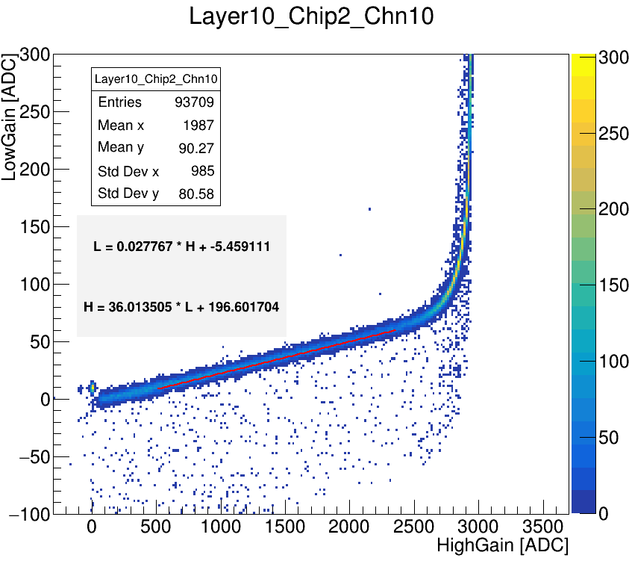
Low gain value decrease
Low gain ADC(pedestal excluded) below the fit line
40 GeV electron data @SPS H2
Basically on central channels
Suppose: only low gain value decrease
Low gain ADC decrease on most central channels
Large energy deposition
Large statistics quantities
These abnormal hits don’t belong to single event
Idea: implemented in digitization

Slide 4
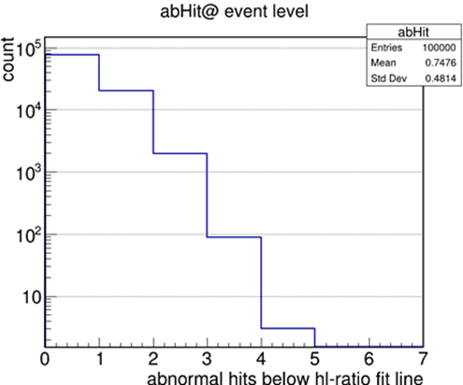
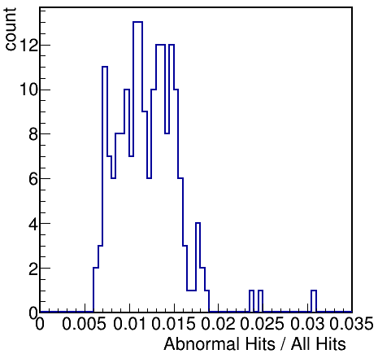
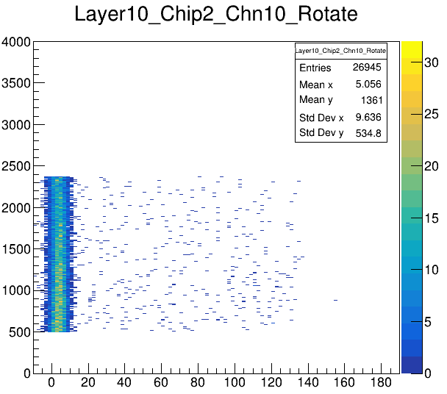
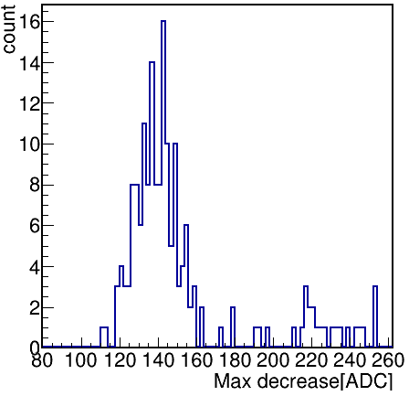
Point rotation
Evaluate the proportion of abnormal hit number
Points rotate anticlockwise by certain degrees
Rotate matrix
Points selection: only in the fit range
Evaluate the proportion of abnormal hits beyond 3 sigma of Gaussian distribution
Rotate Y axis
Evaluate the max decrease ADC value
θ
Fit the projectionX of the main band with Gaussian
Rotate X axis

Slide 5
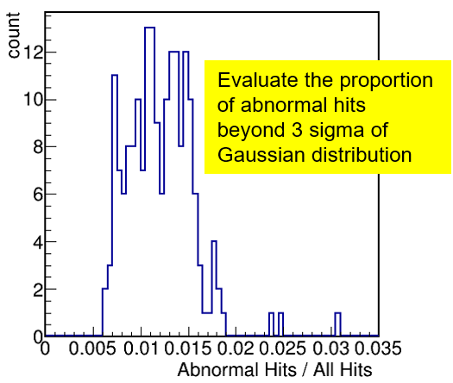
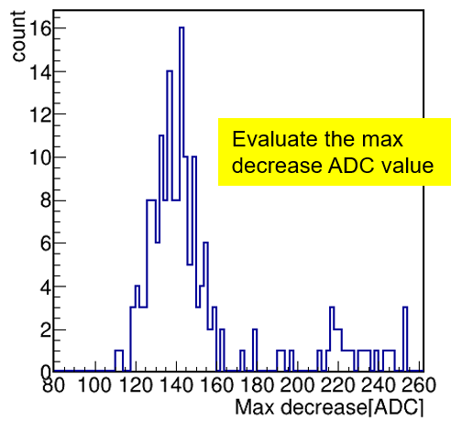
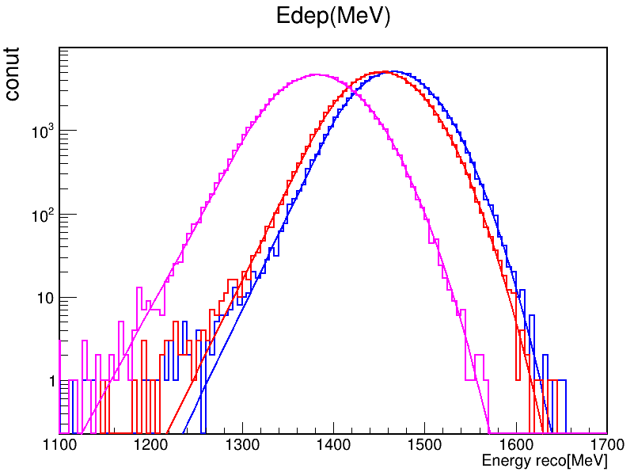
Digitization implementation
Affect on energy reconstruction
MC settings
Let central channels low gain decrease
Uniform distribution (0~140)
0, 1.5%, 5% hits low gain decrease
With the low-gain-decrease hitNo increase, the total energy will decrease
Until now, unfortunately, the reason is still unknown
0 hits low gain decrease
1.5% hits low gain decrease
5% hits low gain decrease

Slide 6
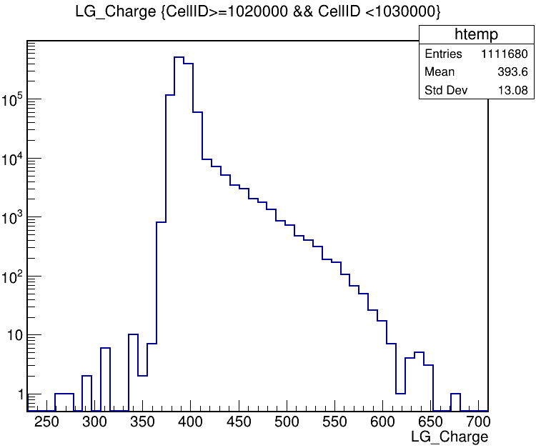
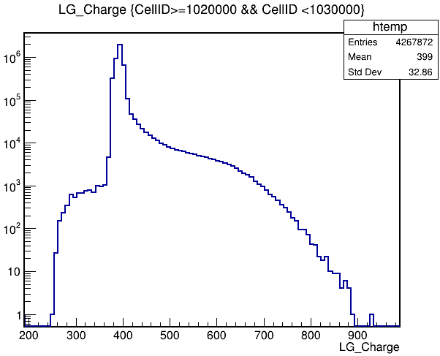
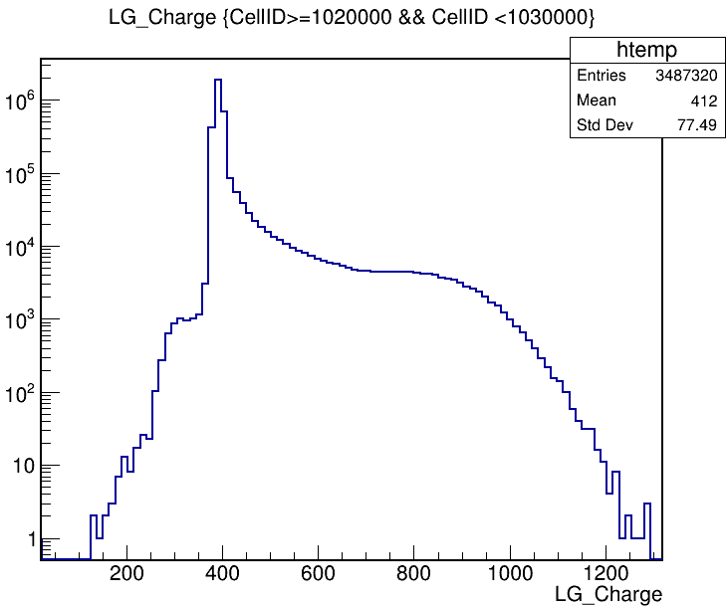
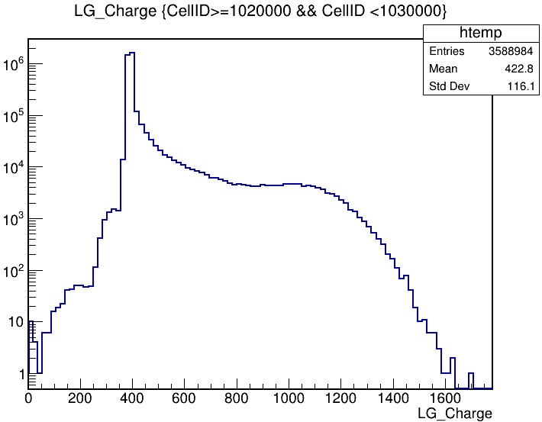
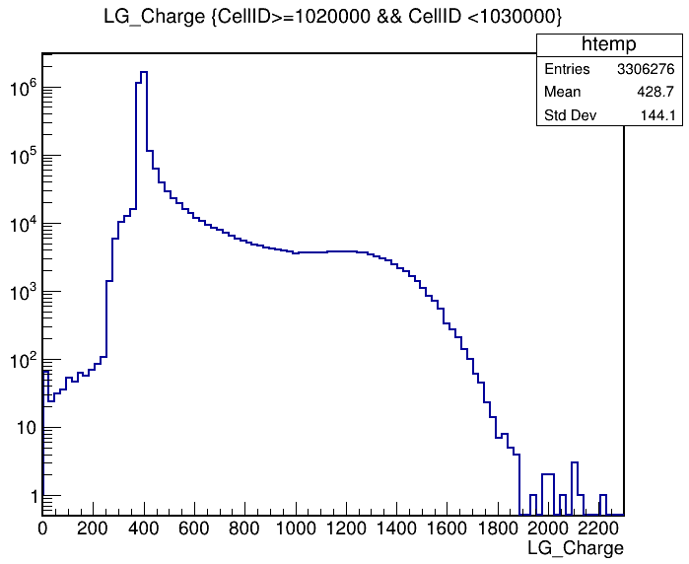
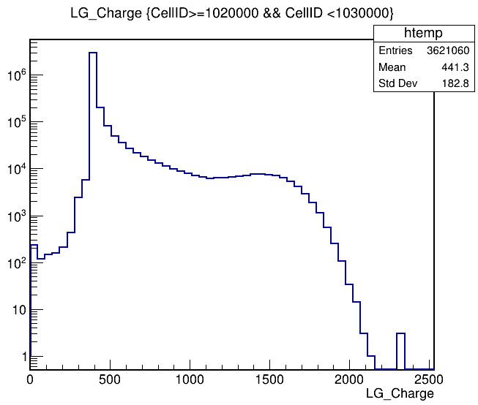
Low gain saturation
Low gain ADC statistics of 36 channels on the central chip
10GeV e-
Data
Preliminary
20GeV e-
Data
Preliminary
40GeV e-
Data
Preliminary
60GeV e-
Data
Preliminary
80GeV e-
Data
Preliminary
100GeV e-
Data
Preliminary

Slide 7
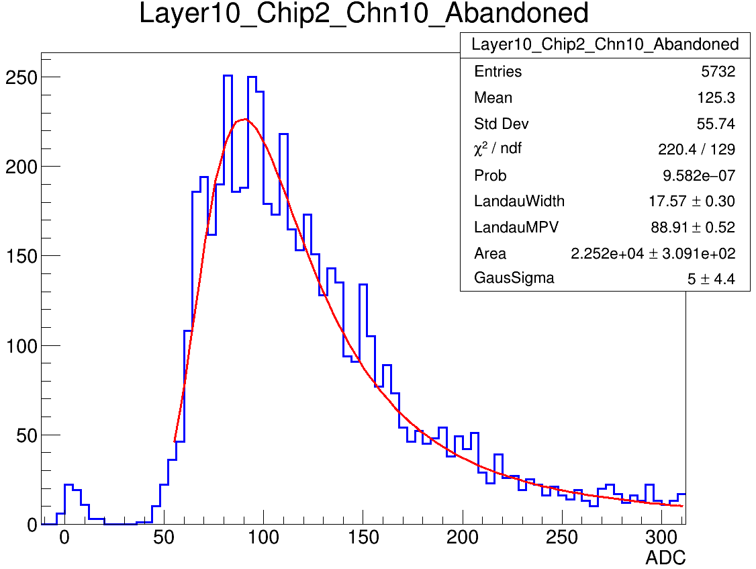
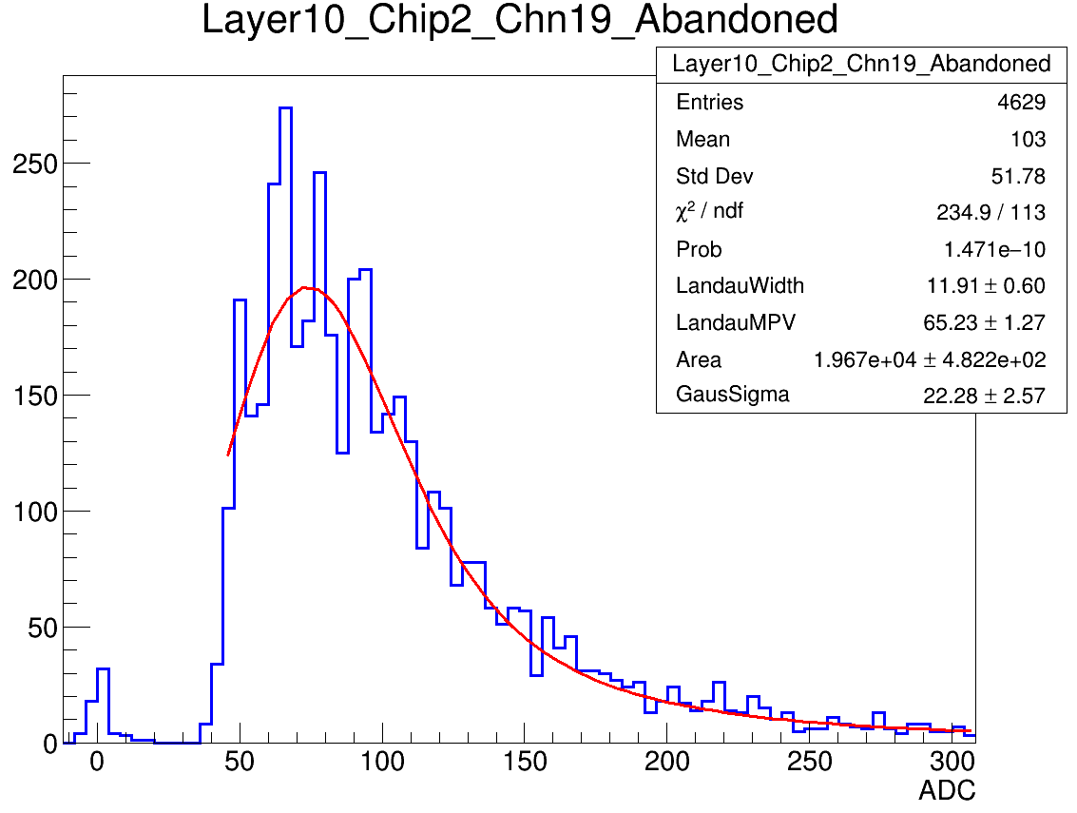
10um SiPM MIP spectrum status
10um SiPMs: low SNR
To exclude the dark count in MIP spectrum during TB , we set a strict threshold cut on each layer individually
Left missing part of the landau convoluted gaussian function heavily affect MPV calibration
Compared with 15um SiPMs whose MPV is around 400ADC, the typical value of 10um SiPM

Slide 8
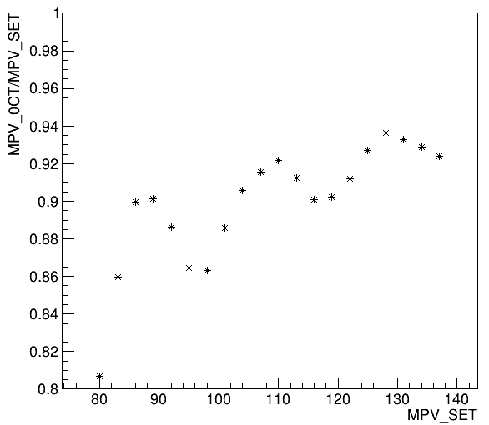
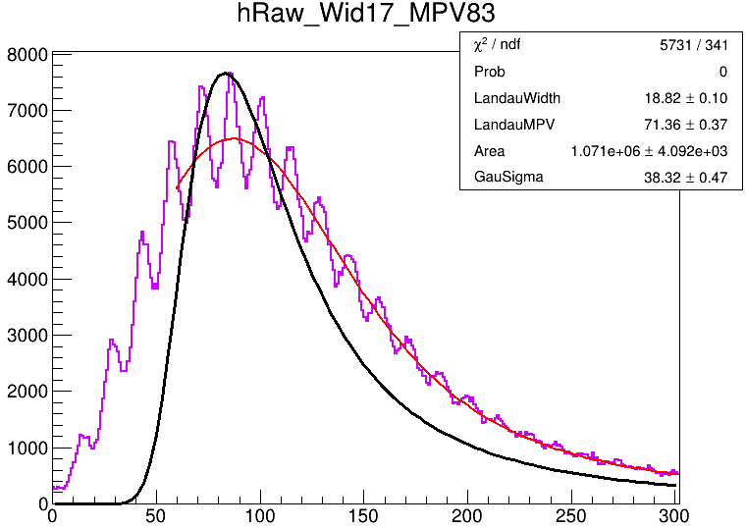
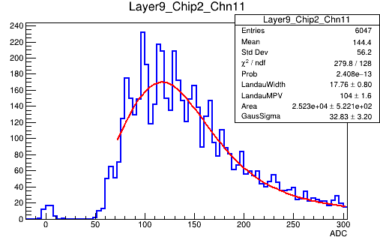
Toy MC for 10um SiPMs
Toy MC test for 10um SiPMs’ landau convoluted gaussian spectrum
Two main factors affect the MIP most probable value
Fit left limits -> MIP MPV fluctuation
Poisson -> MIP MPV decrease
Poisson distribution
+ 0.7MIP cut
Use Interpolation method by add more MPV points to do correction

Slide 9
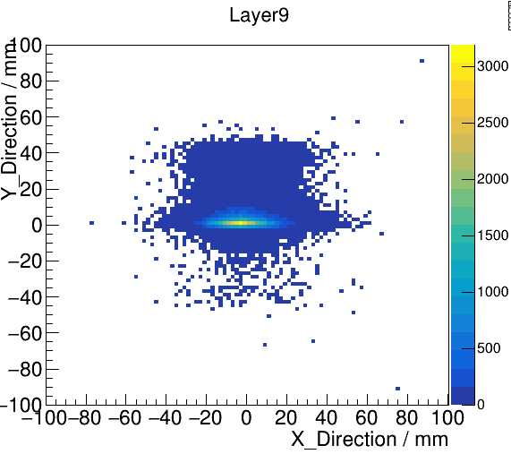
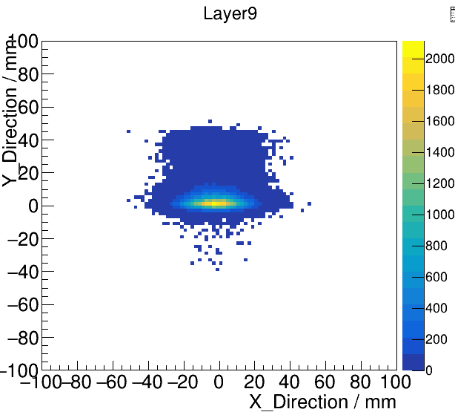
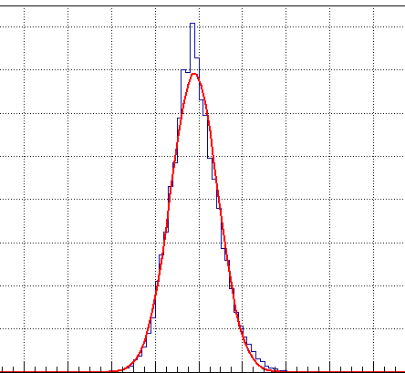
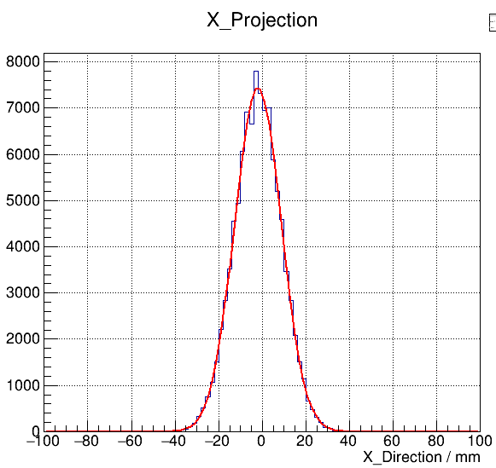
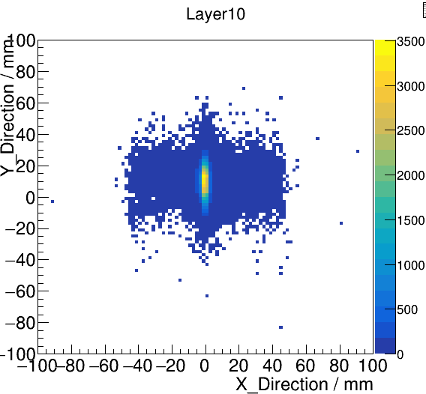
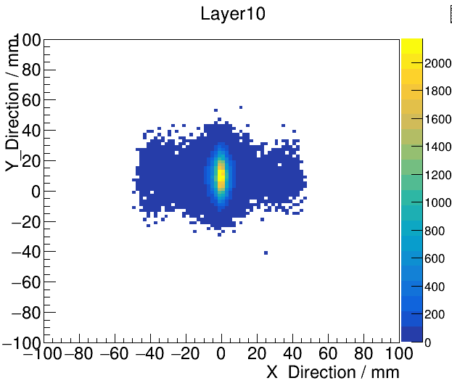
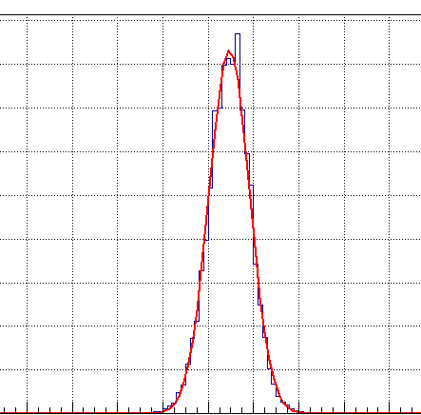
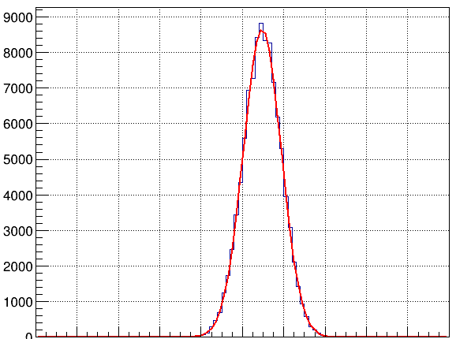
Layer energy gravity distribution
MC Beam size
Determined by shower max layer
40GeV electron: layer 9, 10
Energy gravity gaussian distribution
Digitization 2d-profile check
Mean and Sigma hardly change
In MC, the gravity distribution are much more concentrated indicated by fit parameter constant
The method to determine beam size or Digitization is not perfect or beam structure is more complicated
Some events should be excluded in certain way as not all the channels get calibrated very well
Data
Preliminary
Digit
Preliminary
Data
Preliminary
Digit
Preliminary

Slide 10
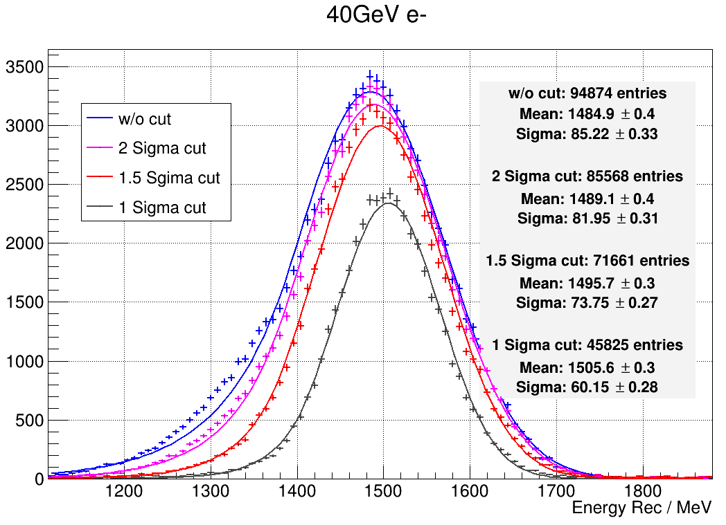
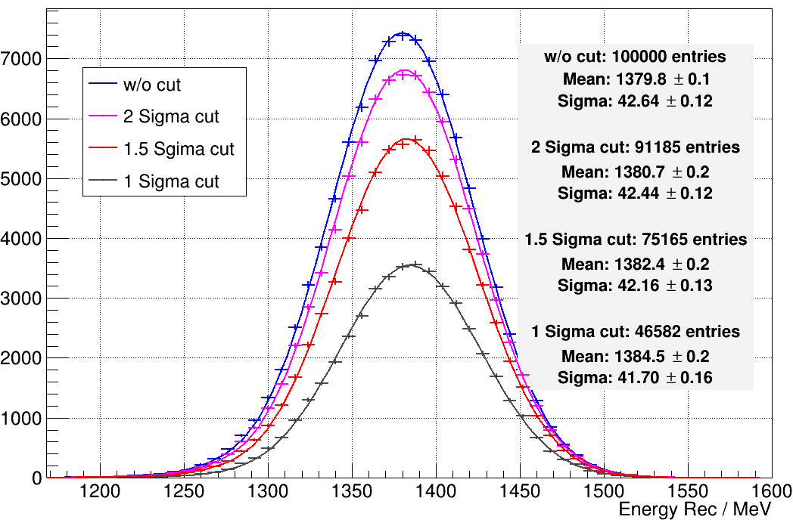
Position cut by Energy gravity
Events cut by the energy gravity on shower-max layer(layer 9,10)
Data
Preliminary
Digit
Preliminary

Slide 11
Summary && Prospect
For low gain decrease, 1.5% abnormal hits limitedly influence the energy reconstruction.
For low gain saturation, no evident show low gain saturation according to low gain spectrum
For MIP MPV correction, though we did correction both based on toy mc and cosmic ray MIP, The current ECAL performance is still to be improved.
Study on possibility of improvement of Sci-ECAL performance with current 10um SiPM MIP spectrum
Illustrate the limits of 10um SiPM

Slide 12
Backup

Slide 13
Motivation: which factor affect MPV
Toy MC
Get random hist from Landau function
MPV scanning: 10um(80-140); 15um(200-800)
Landau width: 10um 17; 15um 50
Photon Number: Division of random number by (SiPM Gain*PDE)
Poisson distribution
Light output uniformity
Pixel MC correction
Crosstalk = 0
ADC gaussian distribution
ADC gaussian smear

Slide 14
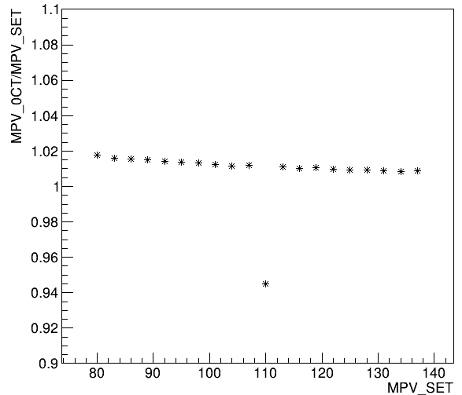
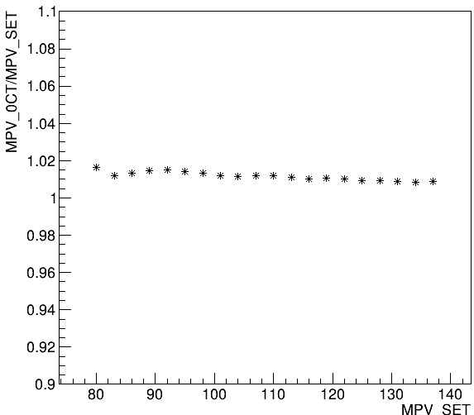
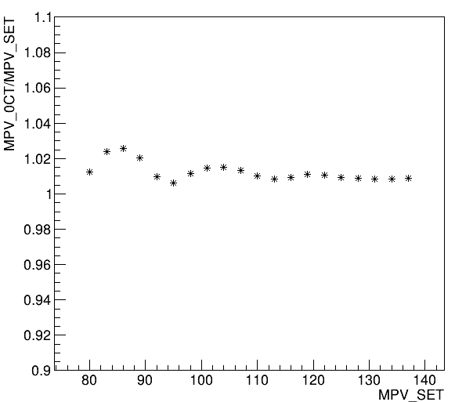
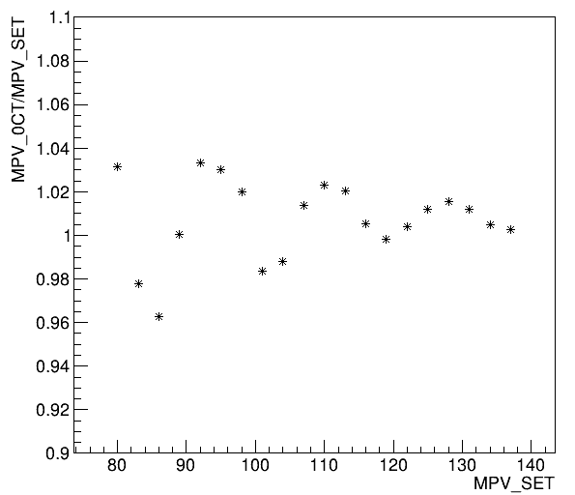
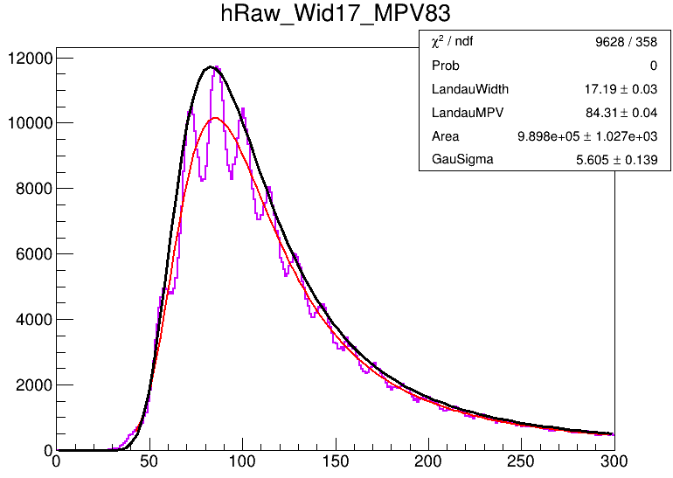
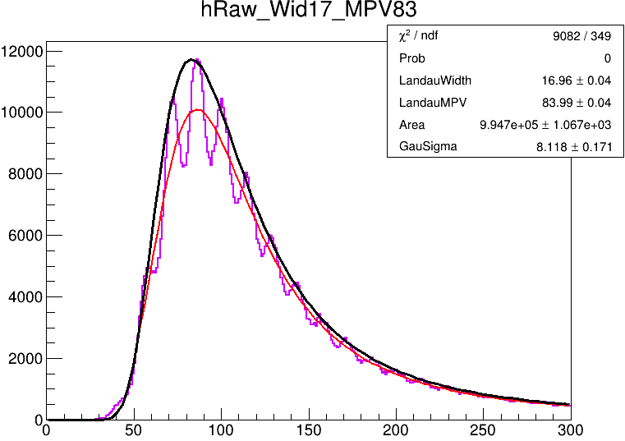
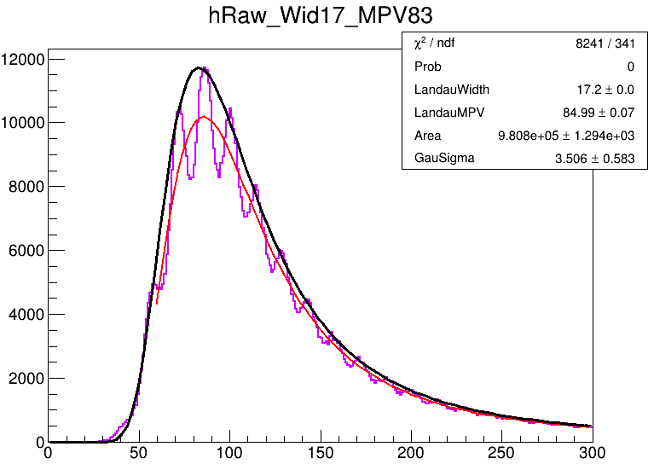
10um SiPM : threshold cut
SiPM增益不均匀性0.5$√N$ + threshold cut，这里threshold cut近似为改变拟合范围左界
SiPM uniformity 0.5$√N$
+ 0.5MIP cut
SiPM uniformity 0.5$√N$
+ 0.6MIP cut
SiPM uniformity 0.5$√N$
+ 0.7MIP cut
SiPM uniformity 0.5$√N$
+ 0.8MIP cut
MIP谱的单光电子峰可见，拟合范围选取(高阈值事例)会引起拟合结果的波动，MPV越小影响越大

Slide 15
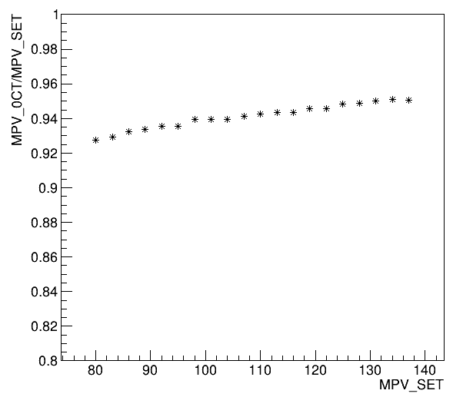
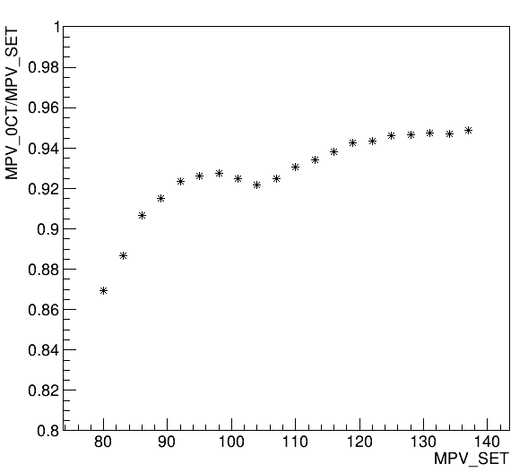
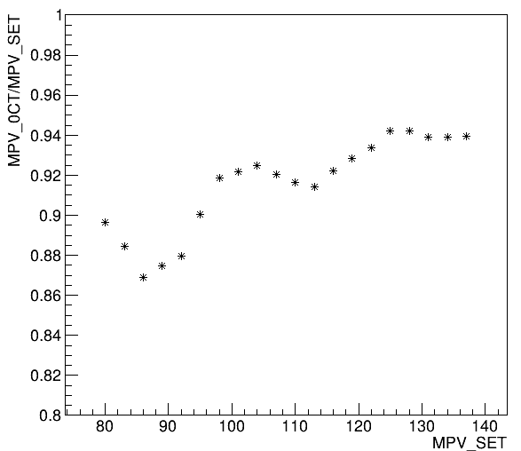
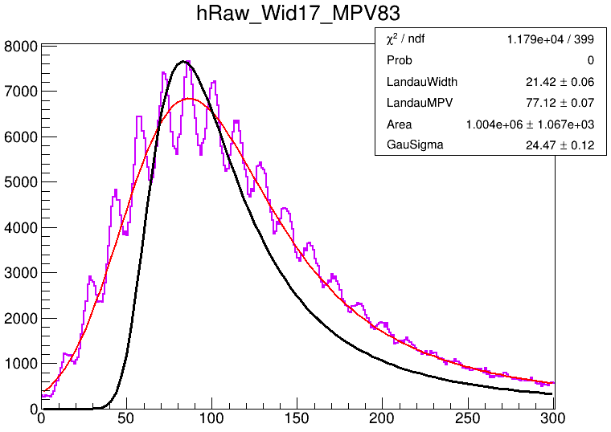
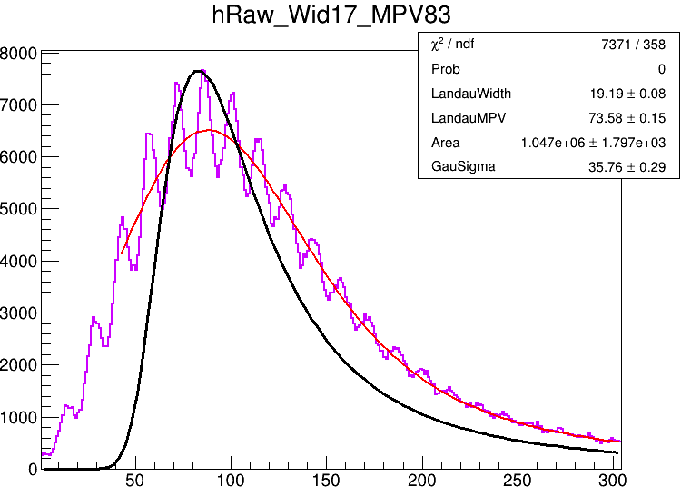
10um SiPM
SiPM增益不均匀性0.5$√N$ + 光电子Poisson分布 + threshold cut
Poisson分布
+ SiPM uniformity 0.5$√N$
+ no threshold cut
Poisson分布
+ SiPM uniformity 0.5$√N$
+ 0.5MIP cut
Poisson分布
+ SiPM uniformity 0.5$√N$
+ 0.6MIP cut
Poisson分布
+ SiPM uniformity 0.5$√N$
+ 0.7MIP cut
光电子的泊松分布会显著的影响，对于10um SiPM(光产额7~8p.e./MIP)，约有5~7%影响
此外，光电子的泊松分布对MIP展宽作用导致阈值影响更严重

Slide 16
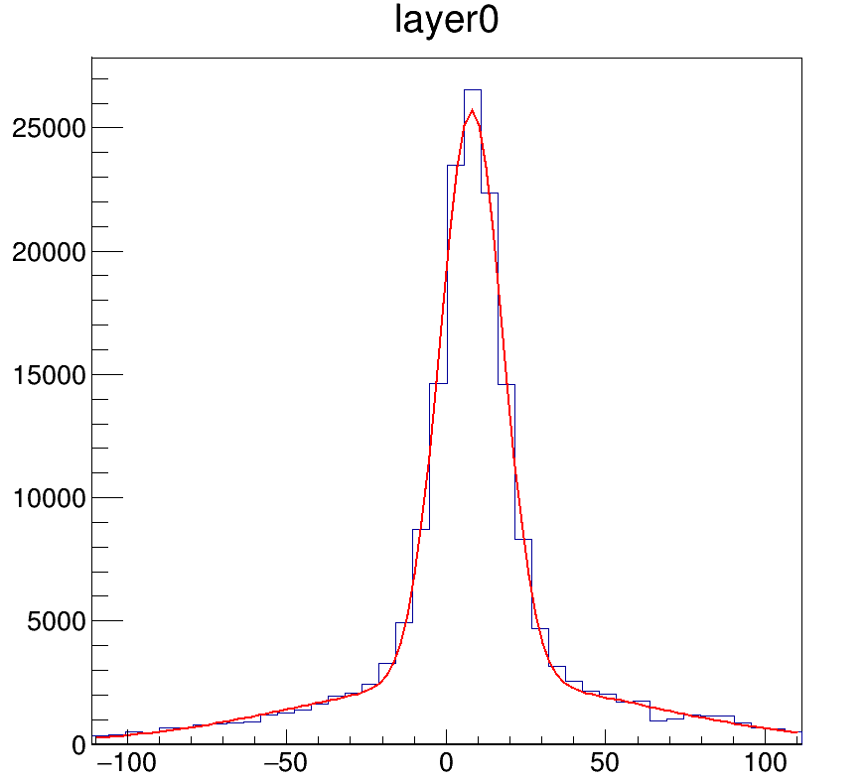
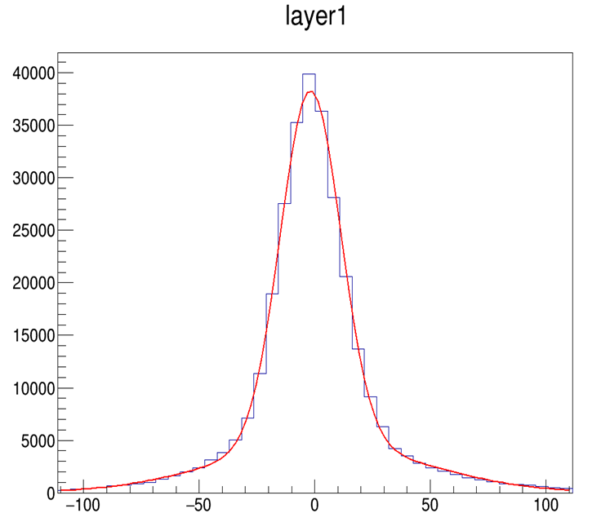
The first two layer hit no distribution
GausY1: 7.962, 9.838
GausY2: 8.792, 55.144
GausX1: -1.846, 12.954
GausX2: 2.181, 45.128

