Slide 1
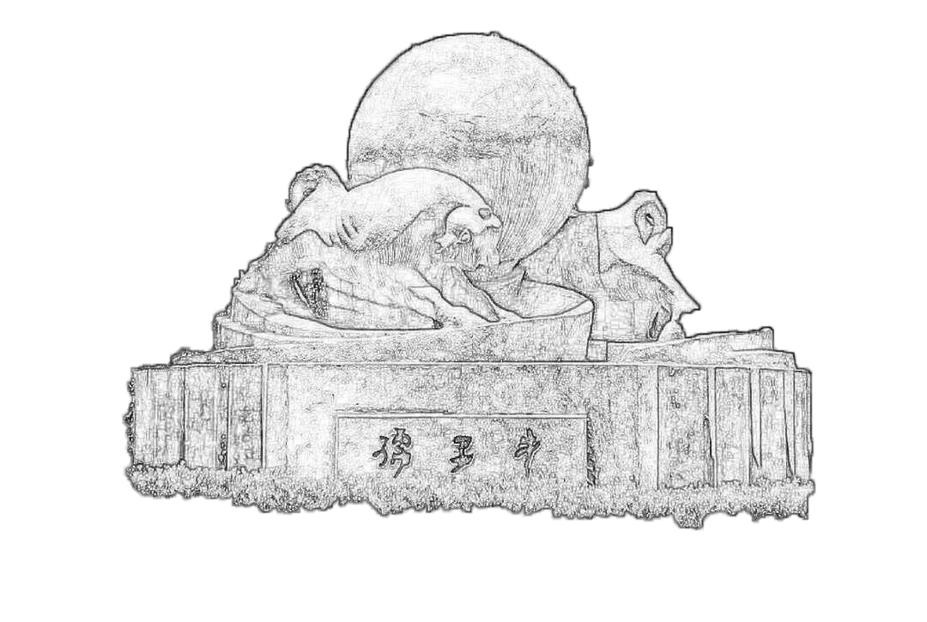
ECAL MIP MPV Correction Update
2023/10/21
Speaker : Jiaxuan Wang

Slide 2
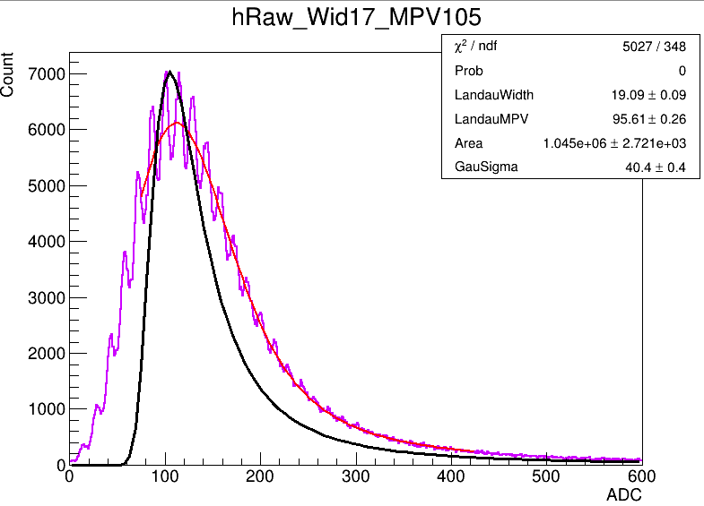
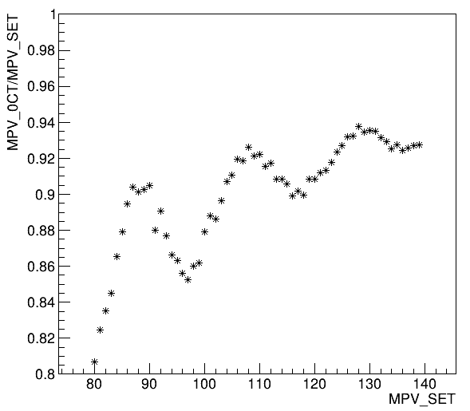
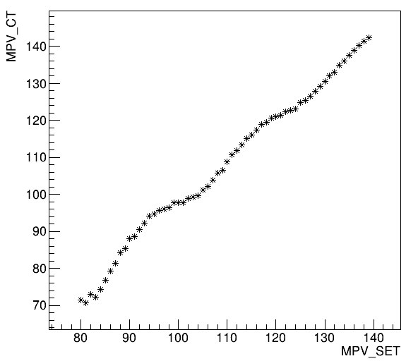
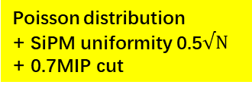
MIP correction for 10um SiPM
Fit range -> fluctuation of MIP value
Poisson -> decrease of MPV value
Correction

Slide 3
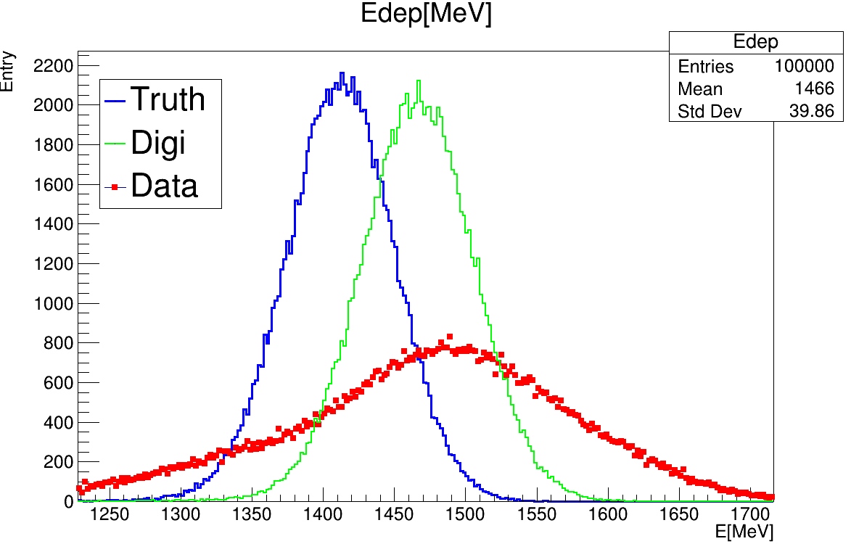
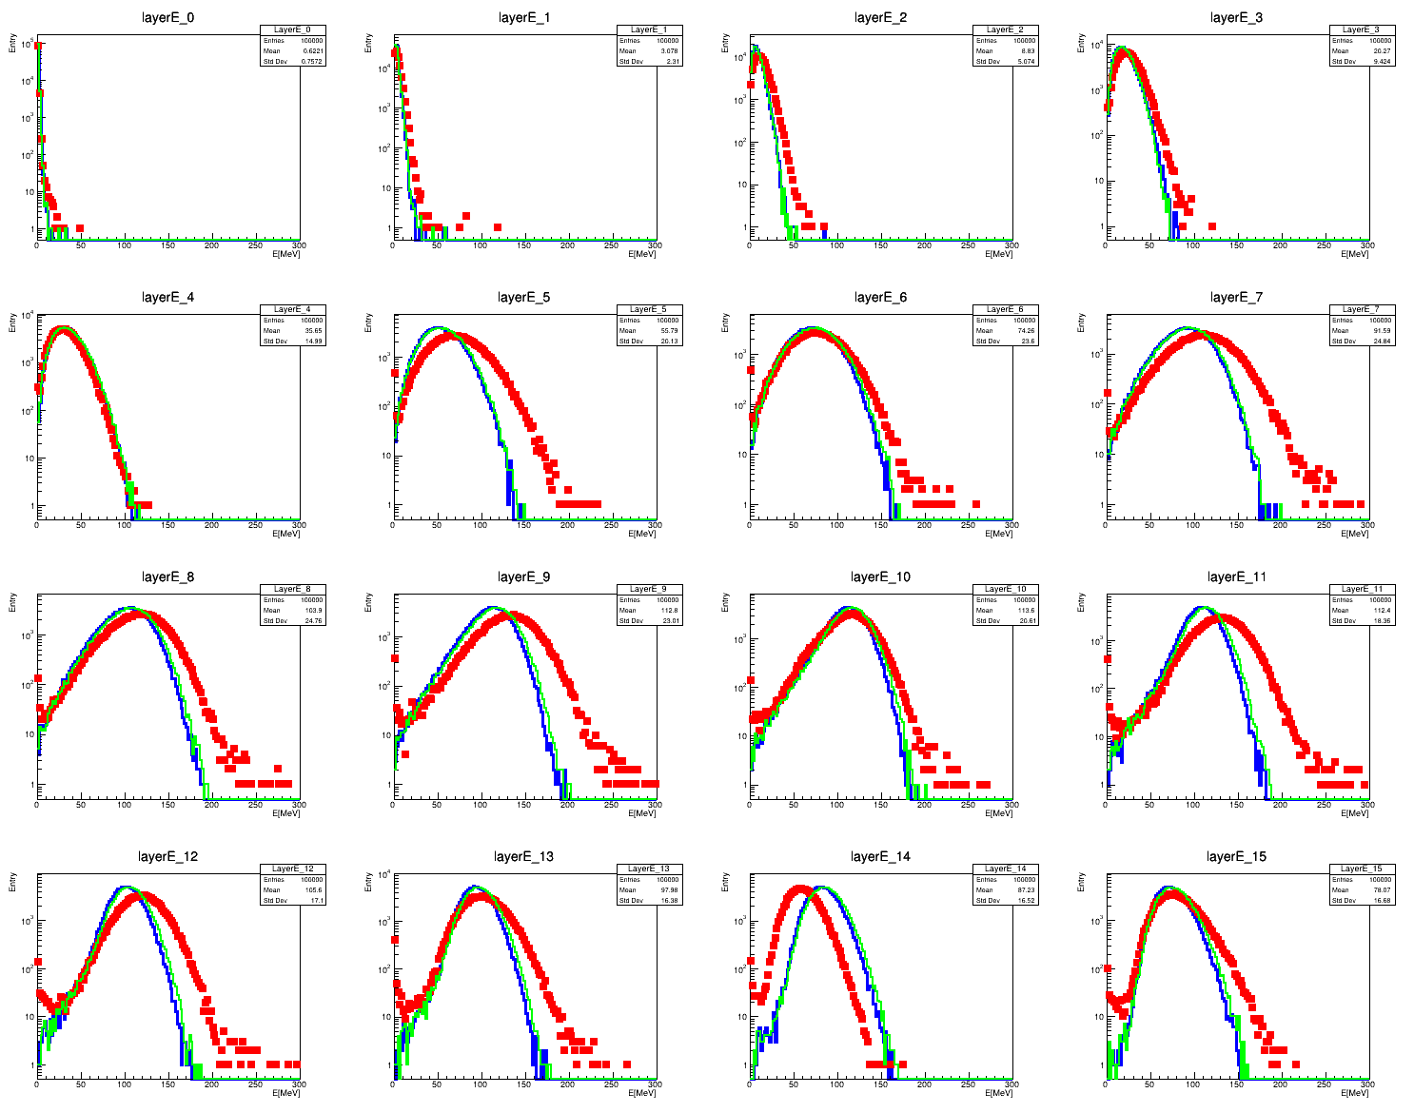
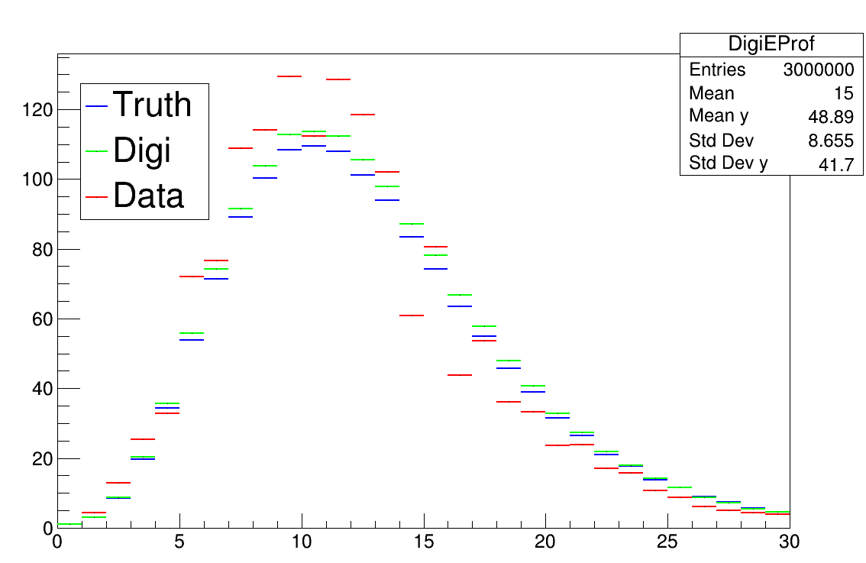
40GeV e-
40GeV e- energy comparison

Slide 4
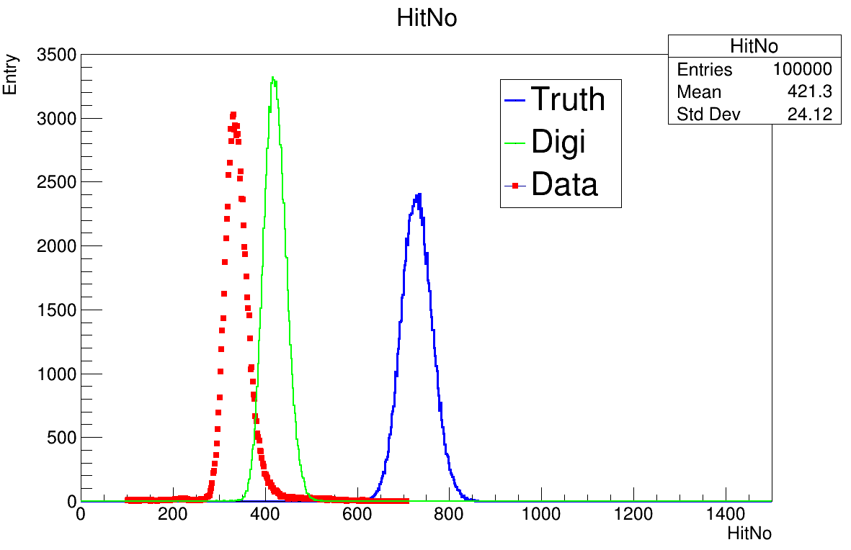
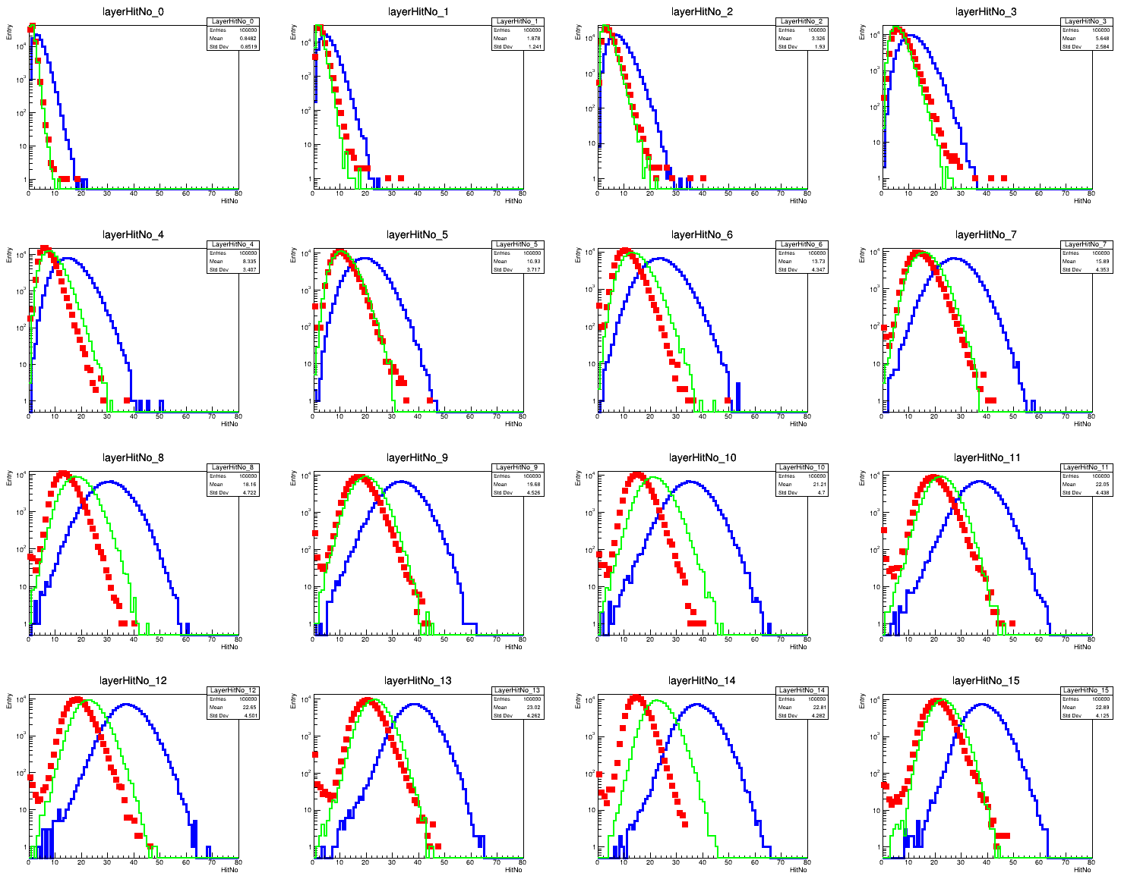
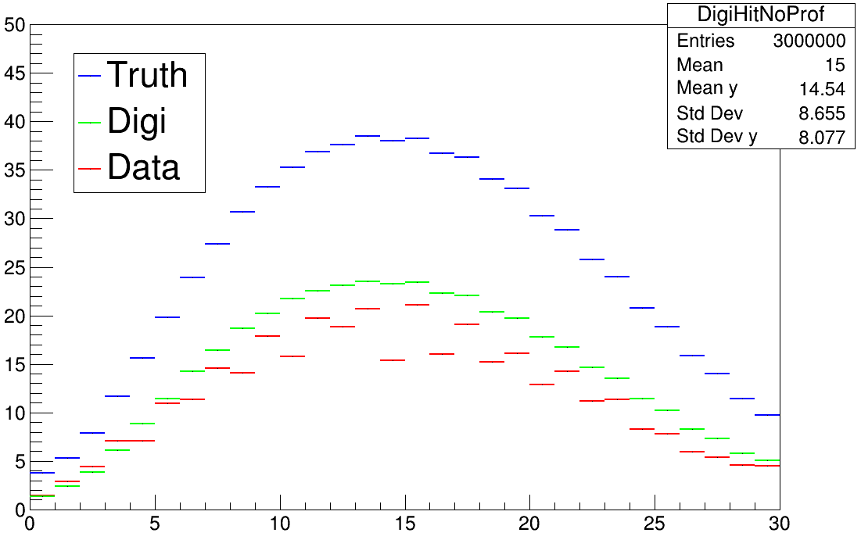
40GeV e-
40GeV e- hit No comparison

Slide 5
Summary
Simple MPV correction has been done which makes energy mean could match on 40GeV energy point
Issues
Still wide energy distribution
Still odd/even layer energy & hit-No leap

