Slide 1

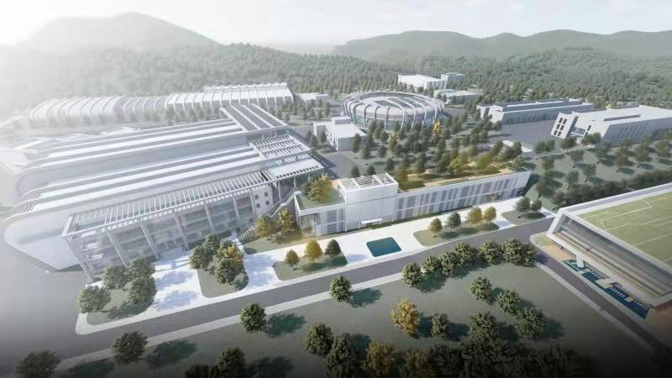
CSNS
Simulation Study of Imaging Widgets with CSNS Muon Beam
Hu Jifeng (胡继峰)
South China Normal University

Slide 2
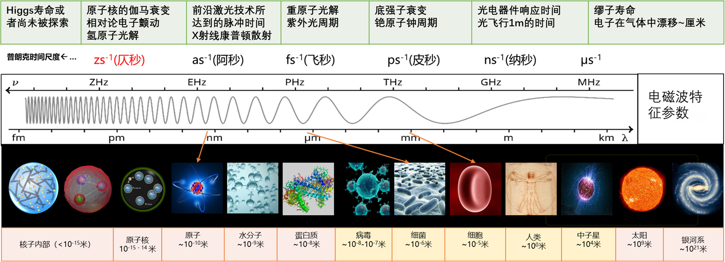
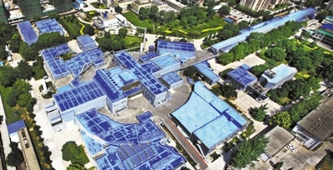
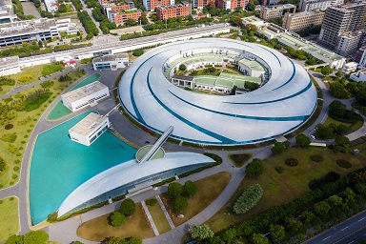
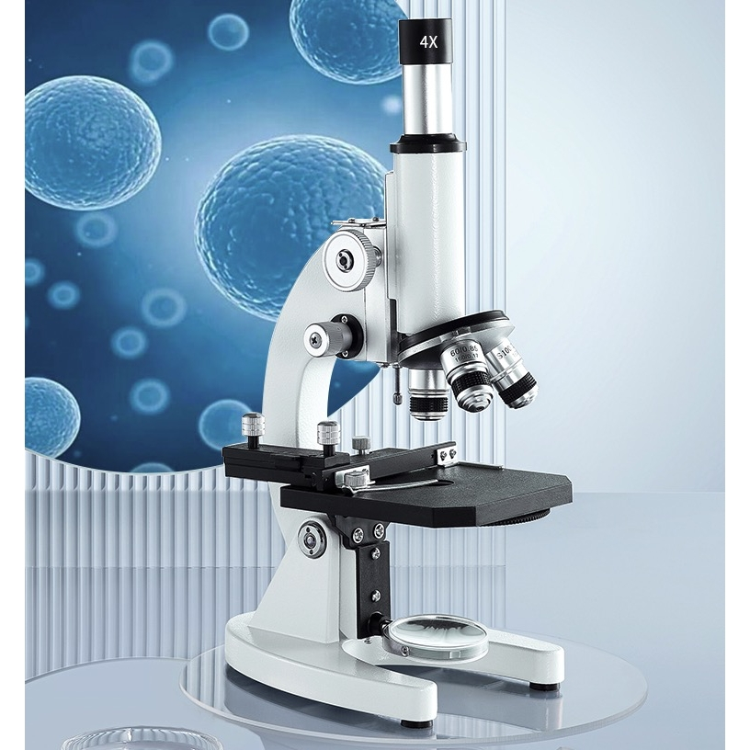
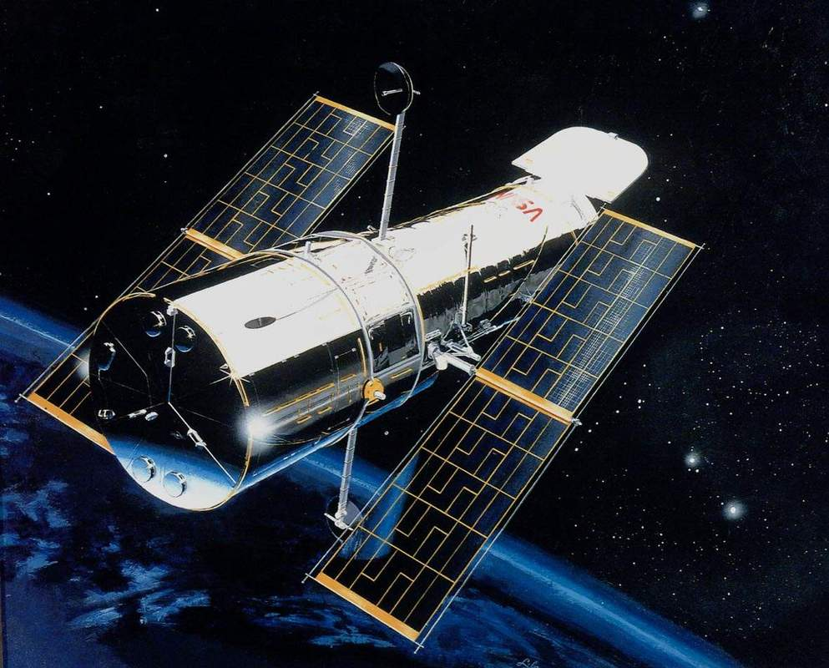
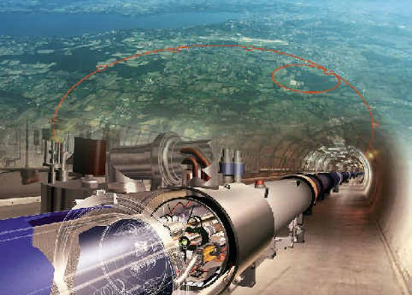
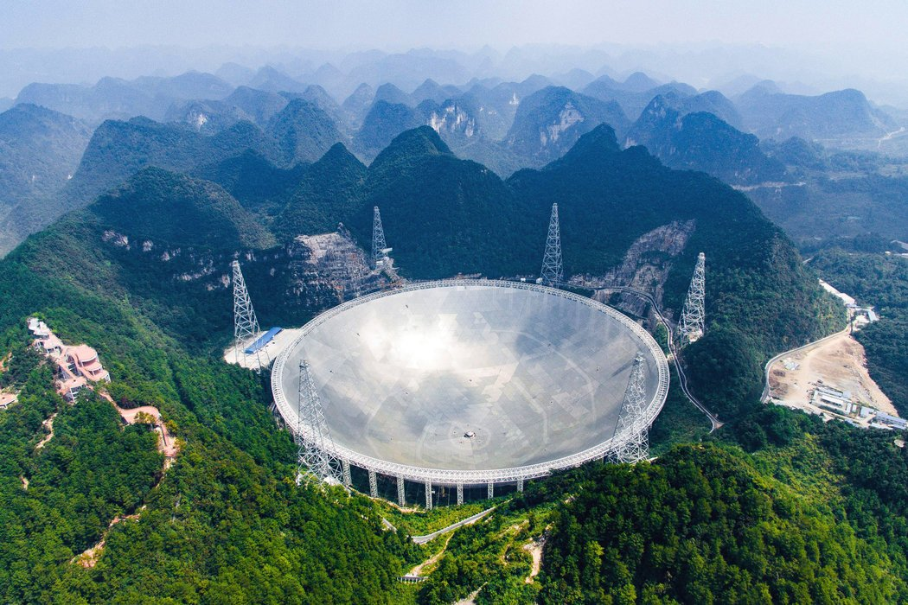
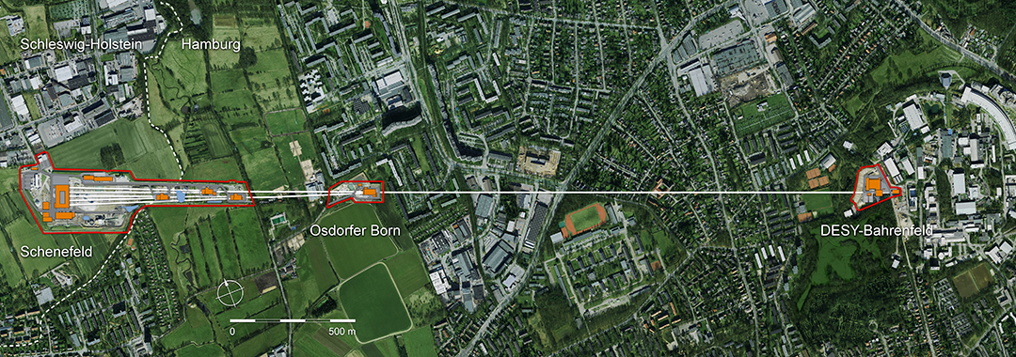
物质尺度与观测装置
哈勃望远镜
北京正负电子对撞机
CERN大型强子对撞机
上海光源
上海同步辐射光源
天眼
European XFEL
这里仅以部分大型装置为例

Slide 3
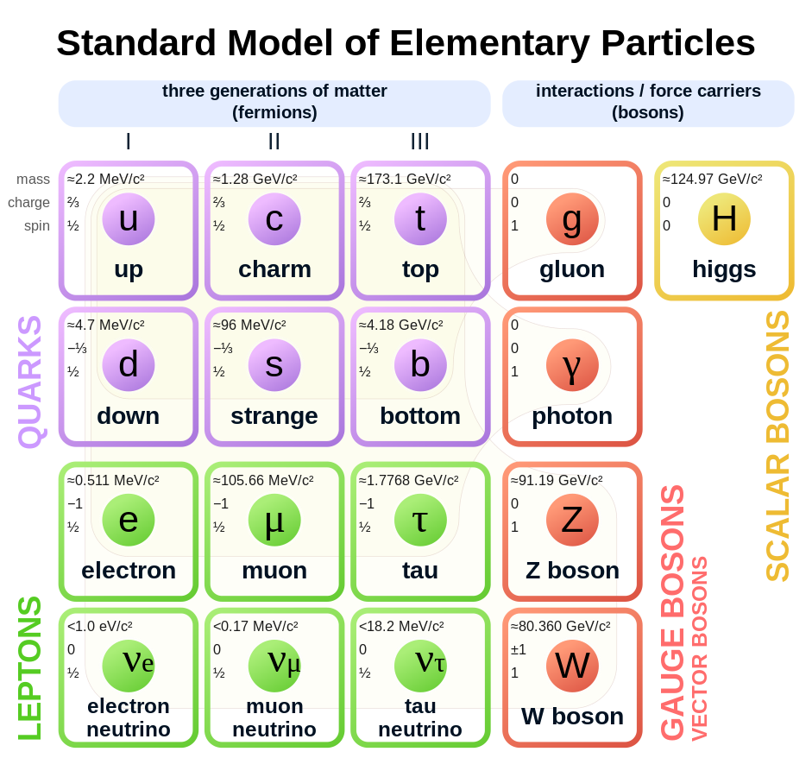
Muon as a natural probe
A fundamental particle, a lepton of the 2nd generation, 200 times heavier than electron.
Discovered in 1936 by Carl D.Anderson and Seth Neddermeyer. Twenty years later, muography was developed.
Science: an important probe in searching for new physics beyond the standard model
Technology: a novel probe to imaging objects of high density since its strong penetration power, as a distinctive method compared to other radiography: xCT, MRI, pCT, PET ...
Standard Model - Wikipedia

Slide 4
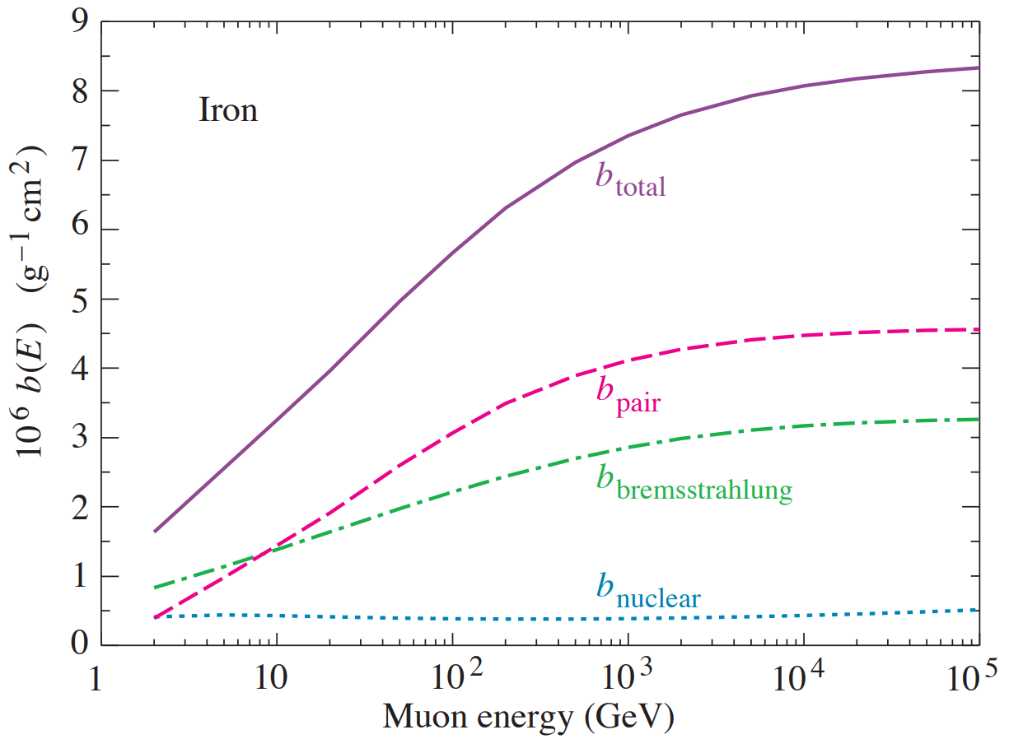

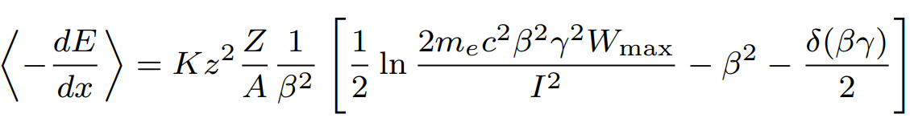
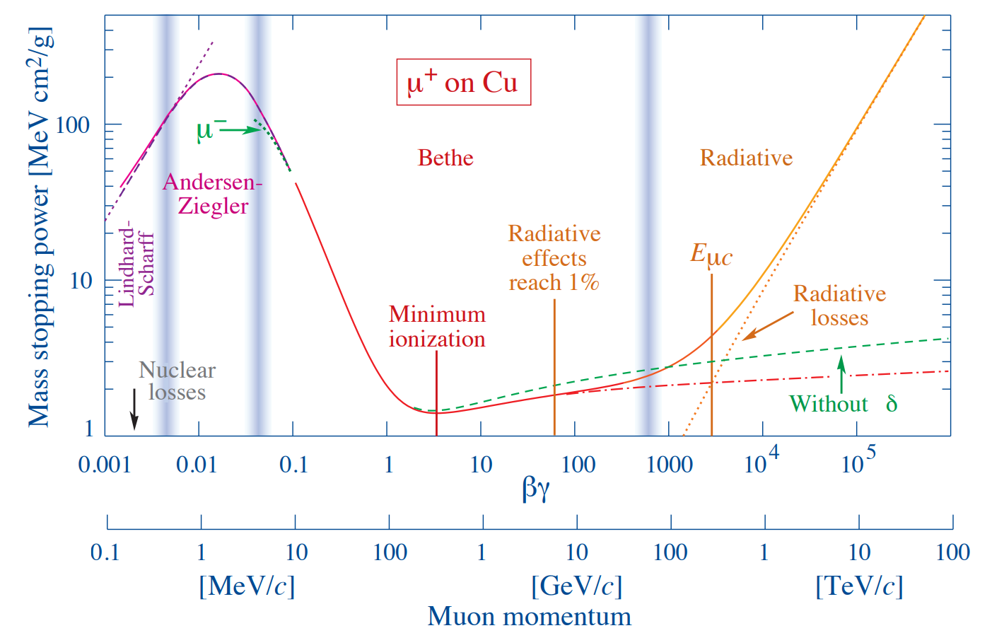
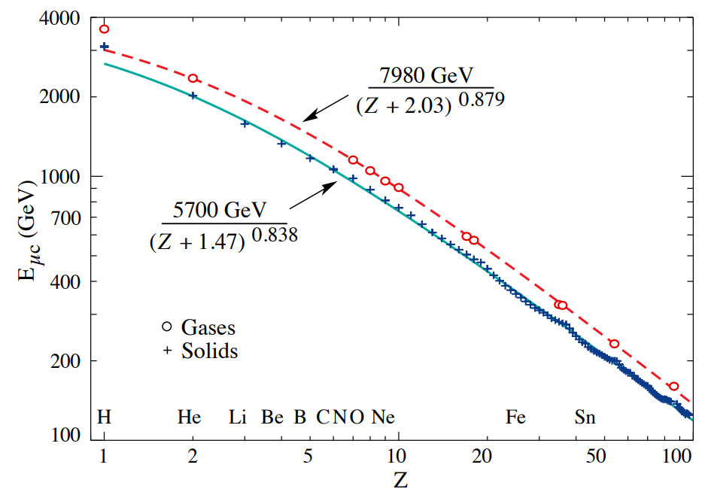
Muon passing through matter
https://pdg.lbl.gov/
pair production, bremsstrahlung, and photonuclear interaction.
ionization energy loss
Critical energy determines how muons lose their energy in matter by what kinds of interaction.
Unlike cosmic rays, at CSNS the momentum of muon+ beam is small, thus ionization energy loss dominates.
critical energy
CSNS

Slide 5
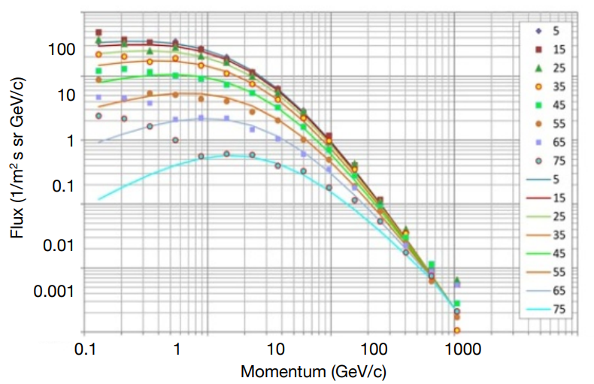
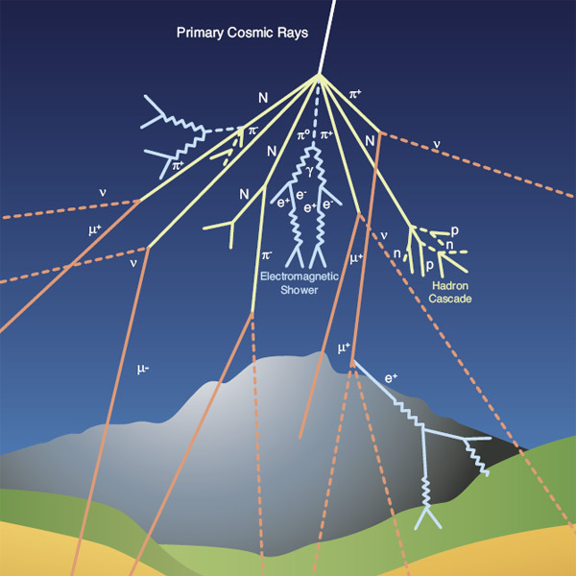
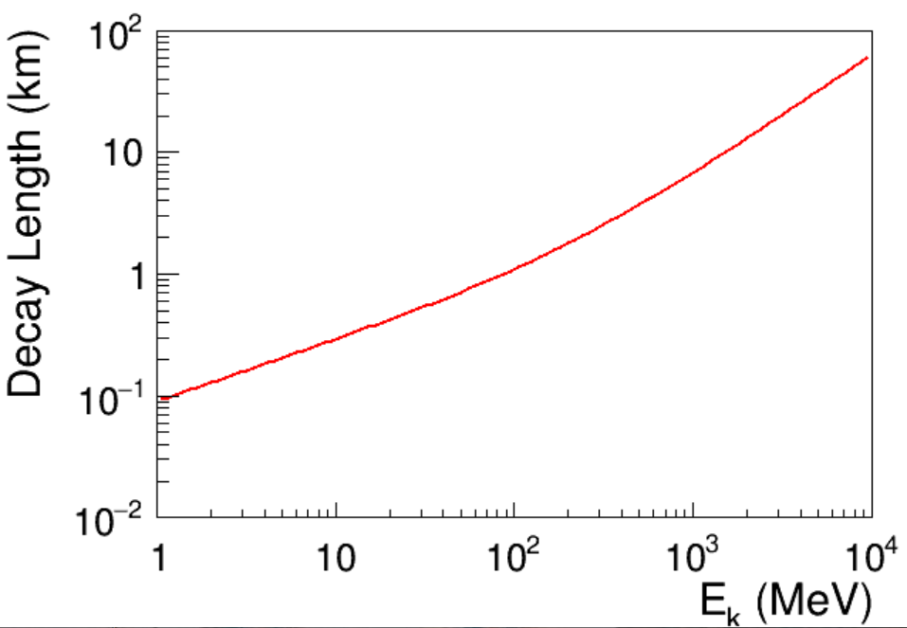
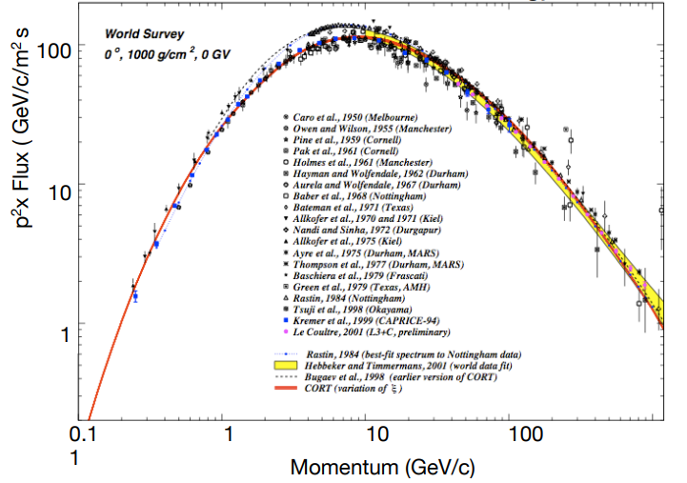
Imaging with cosmic muons (muography)
https://cds.cern.ch/images/CMS-PHO-GEN-2017-008-1
Primary cosmic rays 99% are hydrogen and helium nuclei from the sun.
Sea-level cosmic rays. At sea level most of the surviving rays are muons (μ) since their long lifetime (τ=2.2μs).
Advantages: rich production in nature, low cost, suitable for large volumes where physical access is not possible, such as ancient buildings, volcanoes , nuclear reactors, or deep underground (water).
Decay length @ vacuum
At Earth’s surface, muon rate ~ 10000 per square meter per minute!
Progress in muon tomography/EPS-2017
Notes:
添加右侧2图的引用

Slide 6
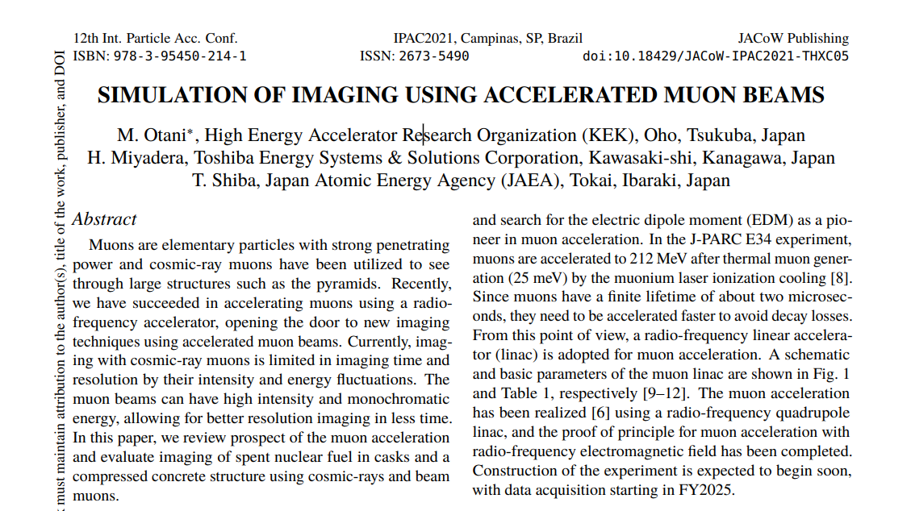
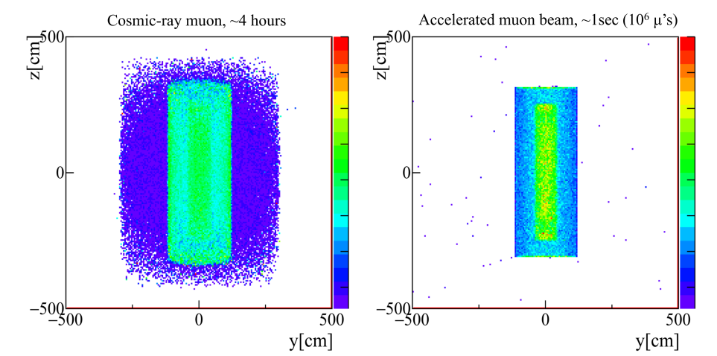
From cosmic muons to beam muons
https://cds.cern.ch/images/CMS-PHO-GEN-2017-008-1
simulation
Advantages: rich production in nature, low cost, suitable for large volumes where physical access is not possible, such as ancient buildings, volcanoes , nuclear reactors, or deep underground (water).
Advantages: fast, real-time, and high precision imaging, and so on.
Lot of developments recent years by many research groups.
Nuclear Inst. and Methods in Physics Research, A 1015 (2021) 165768
Notes:
Nuclear Inst. and Methods in Physics Research, A 1015 (2021) 165768

Slide 7
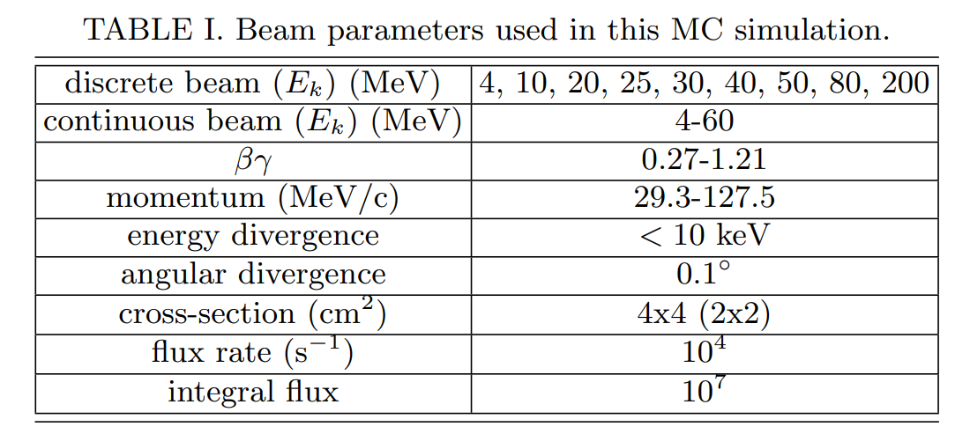
Imaging widgets with CSNS μ+ beam
We would like to answer the following questions:
  what kinds of objects (shape, material) are applicable ? ranges of density and thickness.
  requirements on detector performance ? (position, momentum and energy resolutions)
  technical solutions for a μCT prototype construction. (gas-based, silicon, scintillator, crystal ...)
Notes:
需要重新梳理文字

Slide 8
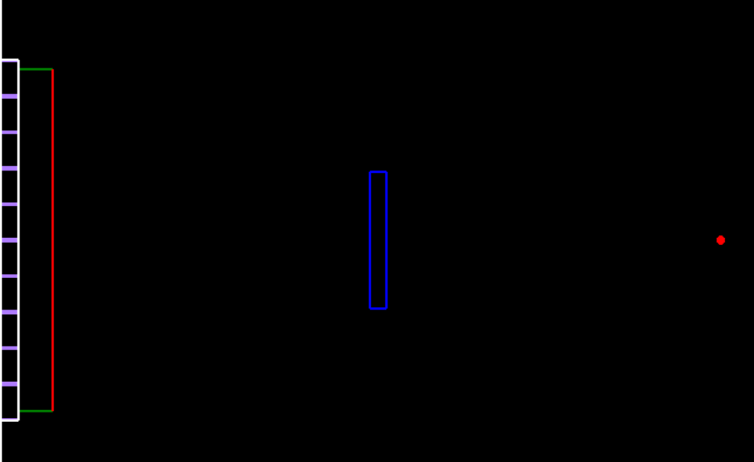
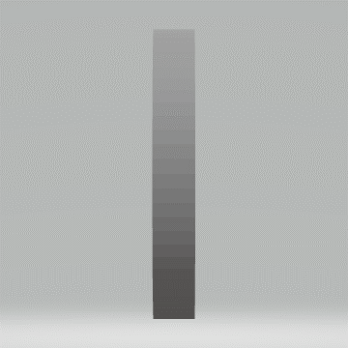
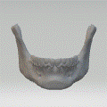
Simulation setup
Front Tracker
Tracker
Purpose:
Ingoing position (x_{i})
Ingoing energy (E_{i})
Back Detector
Tracker
Range detector
Timing detector
Purpose:
Outgoing position (x_{f})
Outgoing energy (E_{f})
Muon beam
parallel
8x8 cm²
10⁷ muons
Y-Z view
8x8 cm²
Cu
target
Ca
Distance detector to source 40 cm
Distance target to source 20 cm
A run consists of 10⁷ events, a collection of (x_{i}, p_{i}, x_{f}, p_{f}) records for next analysis. Either parallel beam or cone beam is fine.
Notes:
几何信息需要添加
μ 子探测技术方案(闪烁体探测器、核乳胶探测器、气体 探测器、切伦科夫探测器等)

Slide 9
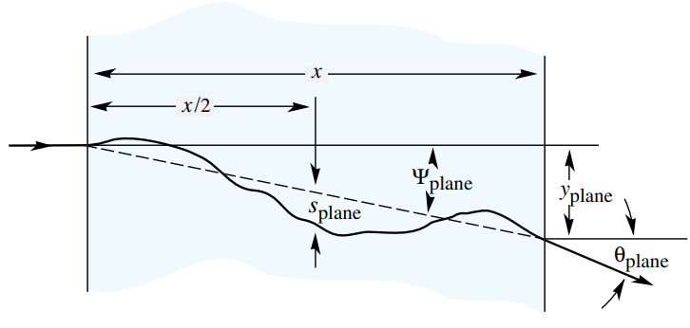
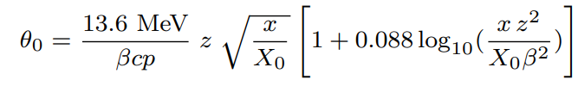
Muon scattering tomography
https://pdg.lbl.gov/
Energy loss
$EL≅E_{f}−E_{i}∝ρh,$matter density and thickness following Bethe equation.
𝐸𝐿≅𝐸_𝑓−𝐸_𝑖∝𝜌ℎ, matter density and thickness following Bethe equation.
A better decoding can be achieved with normalized EL .
Scattering angle
$SA∝\frac{1}{\sqrt{X_{0}}}$, radiation length which links to matter density and thickness.
𝑆𝐴∝1/√(𝑋_0 ), radiation length which links to matter density and thickness.
E_{i}
p_{i}
E_{f}
p_{f}
θ₀
Notes:
检查pdg 关于 x0的表达

Slide 10
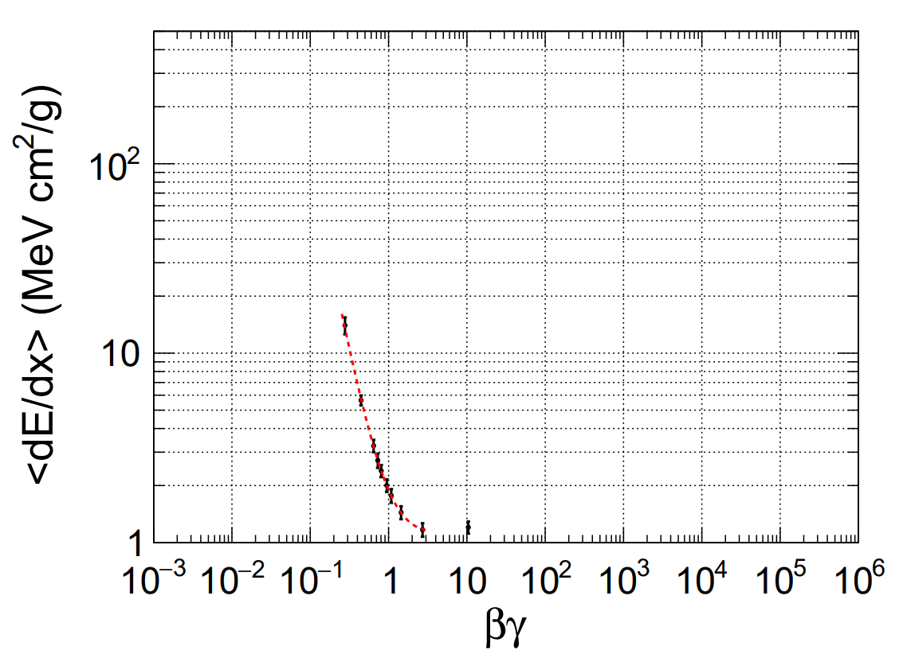
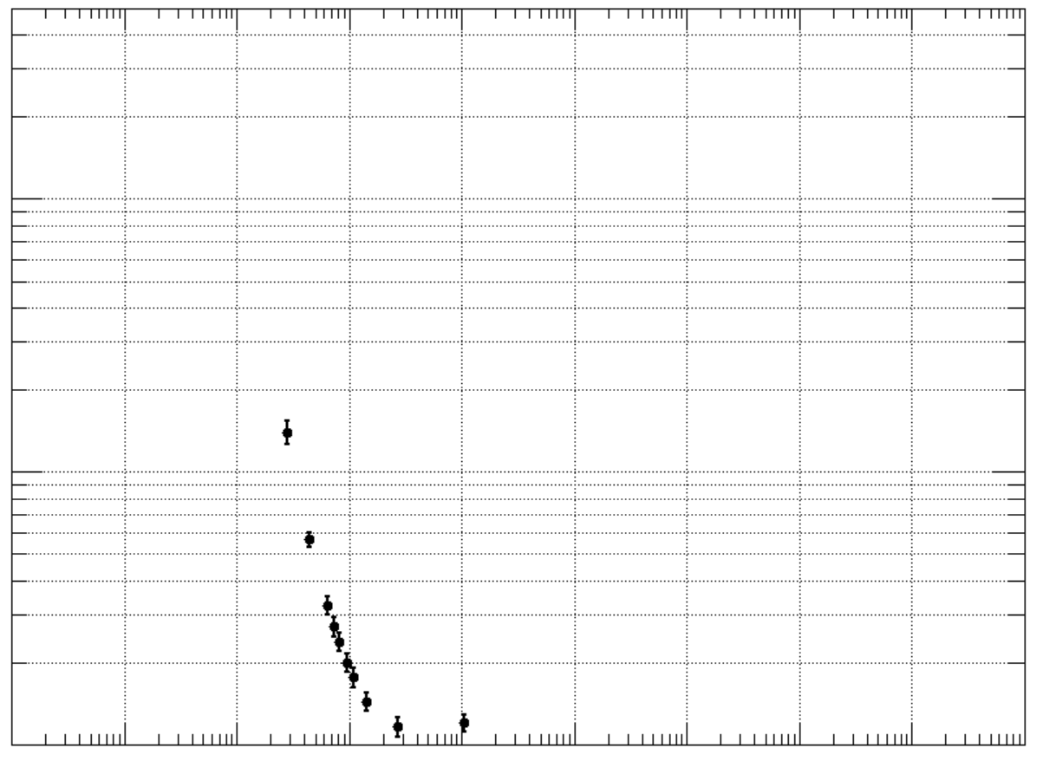
dE/dx validation through air
4 MeV
4 MeV
10 MeV
10 MeV
20 MeV
20 MeV
30 MeV
80 MeV
30 MeV
40 MeV
40 MeV
200 MeV
50 MeV
50 MeV
CSNS
Sampling 8 kinetic energies within air.
Well agreements within kinetic energy range of CSNS beam

Slide 11
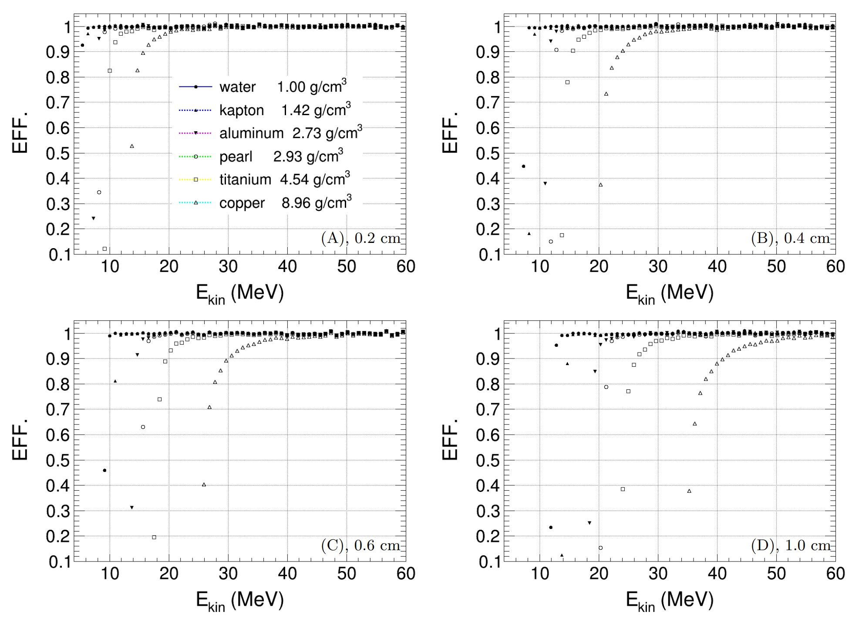
Penetration power (Flux Efficiency)
10⁷ events, continuous energy spectrum ranging from 30 MeV to 60 MeV

Slide 12
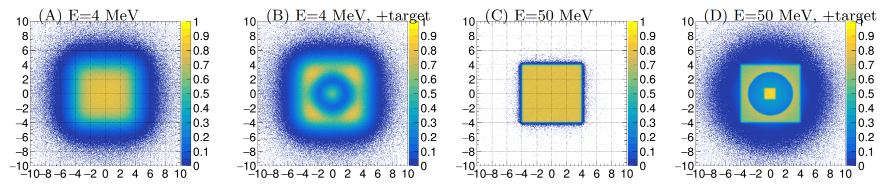
Flux image with mu+ beam (Muograph)
Beam parameters |  | Beam parameters
Kinetic energy | 4 MeV, 50 MeV | Energy spread | ~2 keV
Integrated flux | 10⁷ mu+ (100~1000 s) | Coverage area | 8x8 cm²
Direction | Z | Emittance diversity | degree level
cm
cm
Air background
Air background

Slide 13
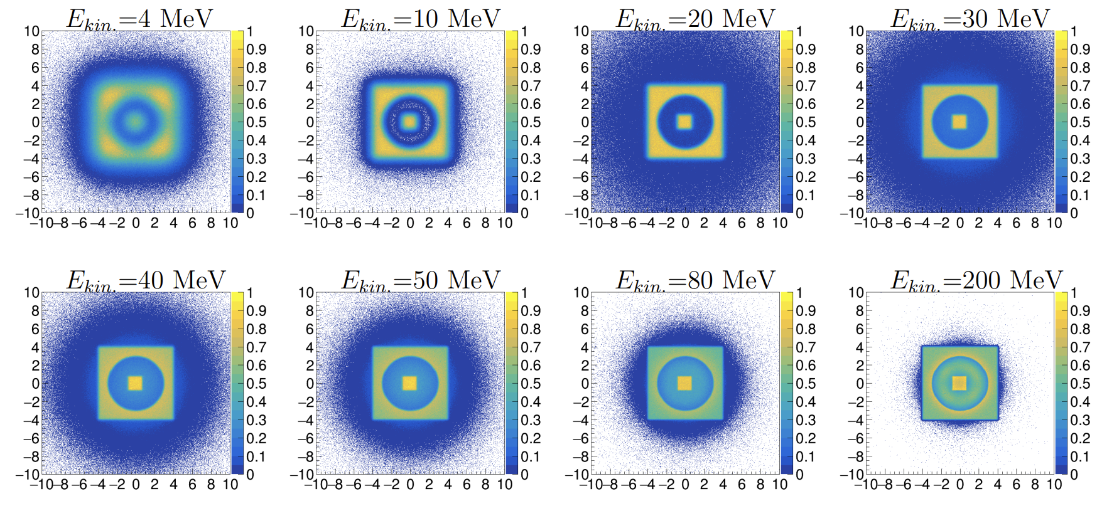
Flux image with 8 kinetic energies

Slide 14
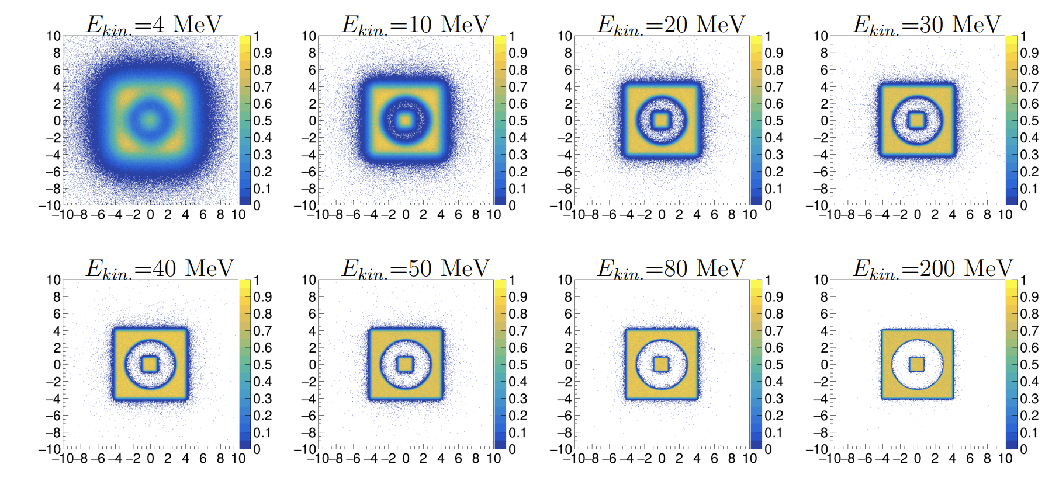
Flux image (low-energy-loss pass filter)
ΔE < 1.5 MeV

Slide 15
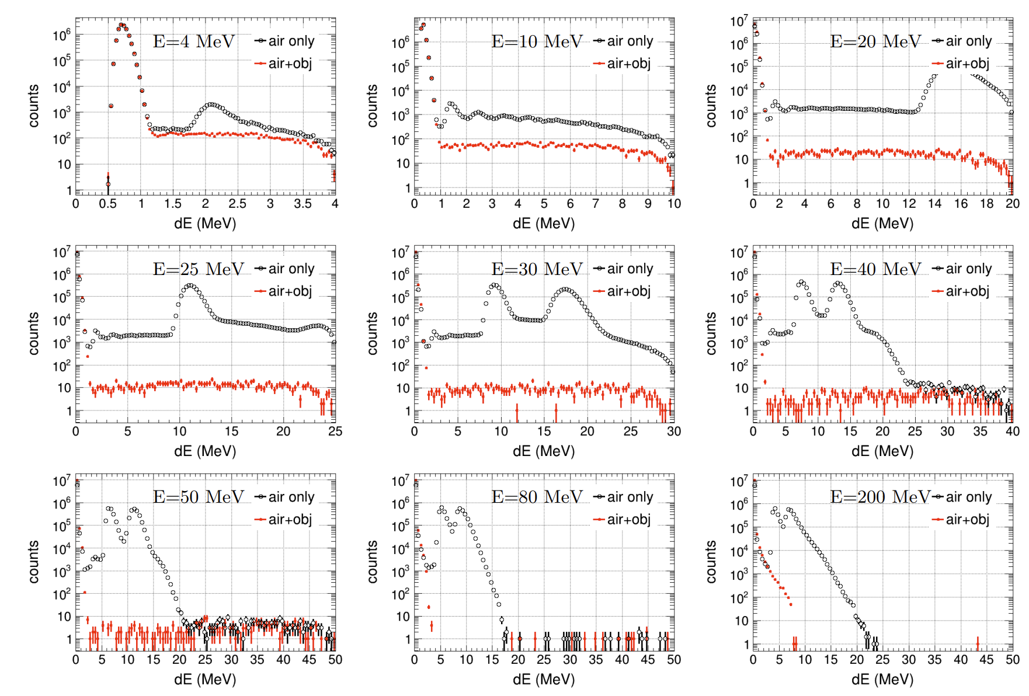
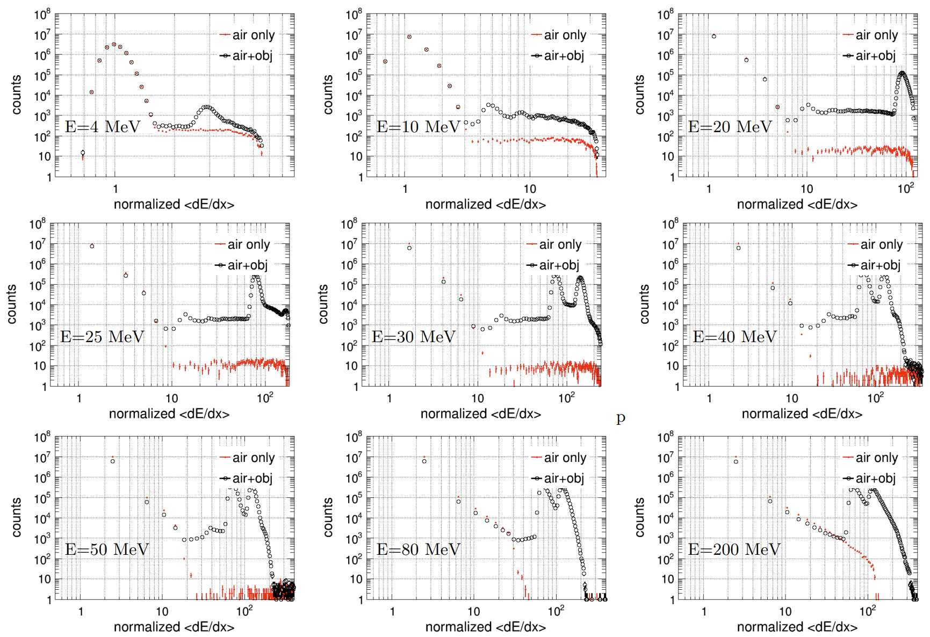
Ionization energy loss spectrum
Energy loss
Normalized energy loss with air
Two bumps reveal two different thickness in the coin.

Slide 16
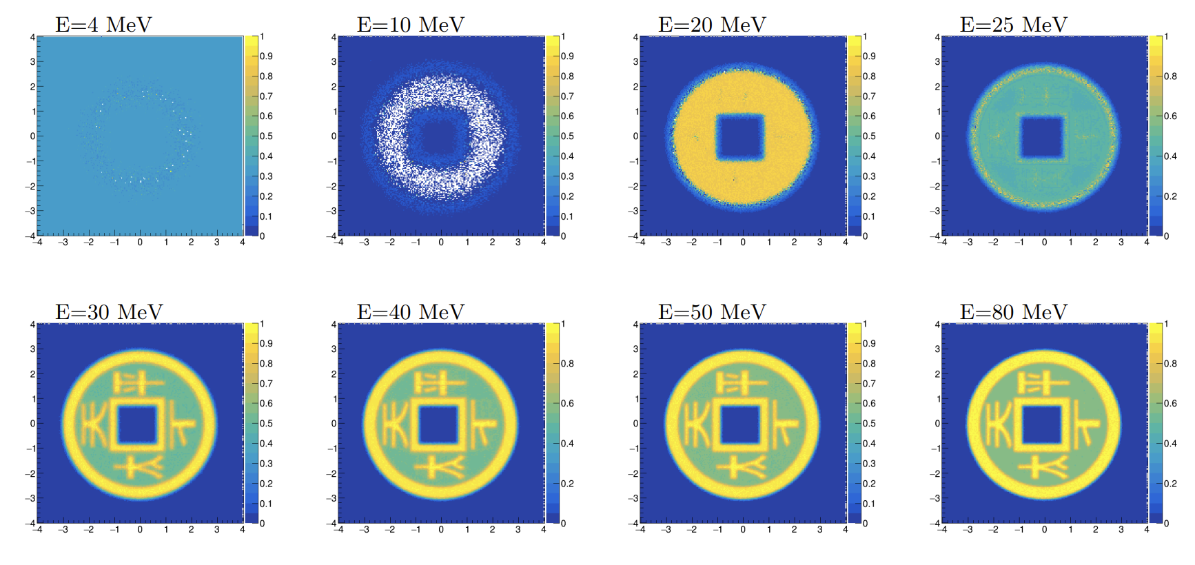
MST Image using the EL method

Slide 17
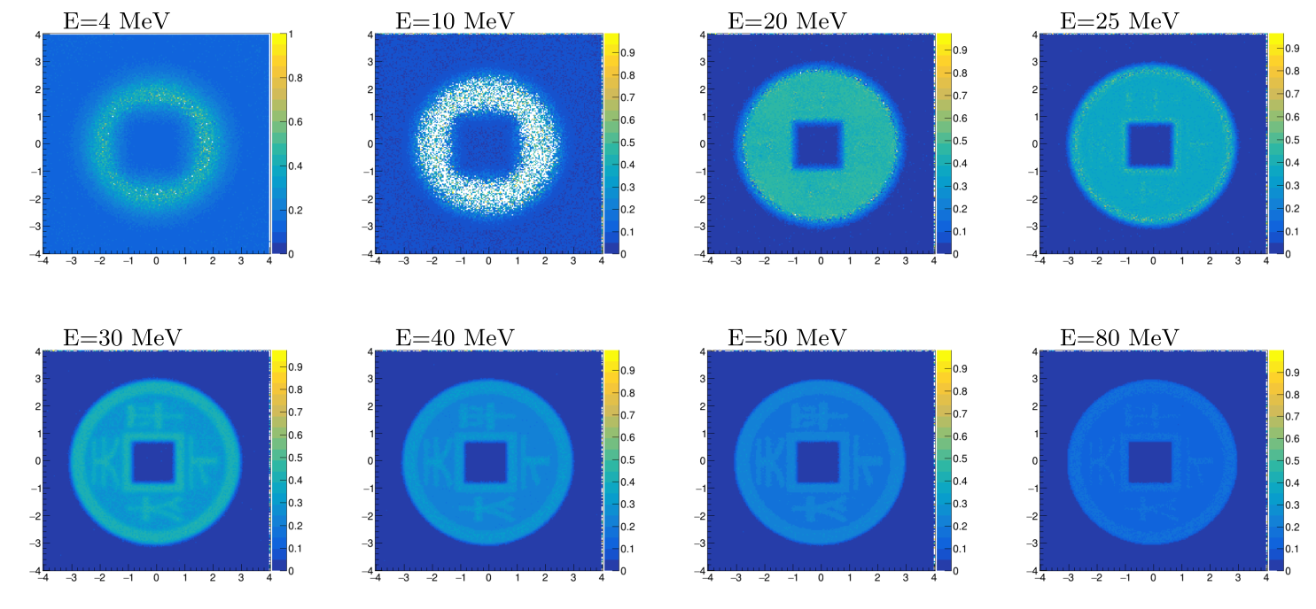
MST Image using the SA method

Slide 18
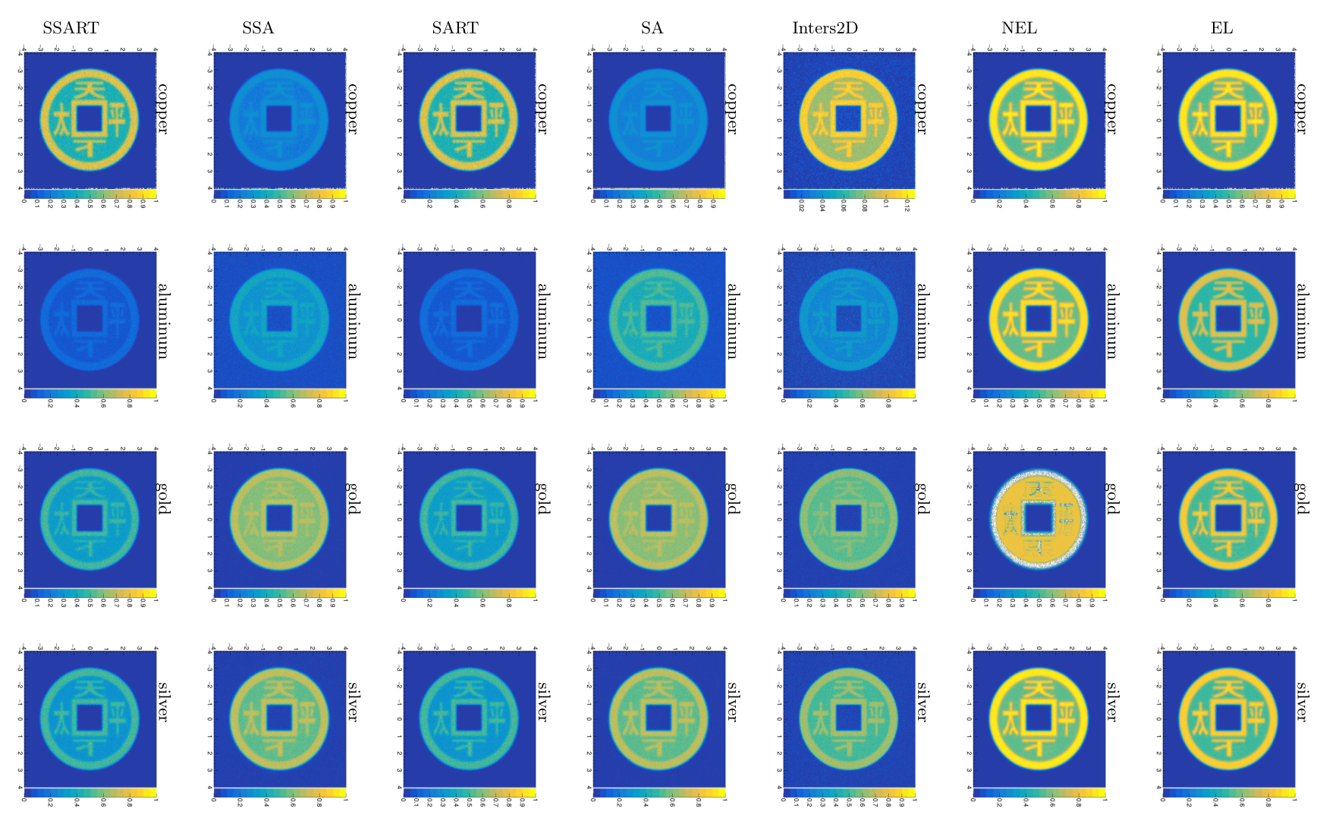
MST images (ideal cases)

Slide 19
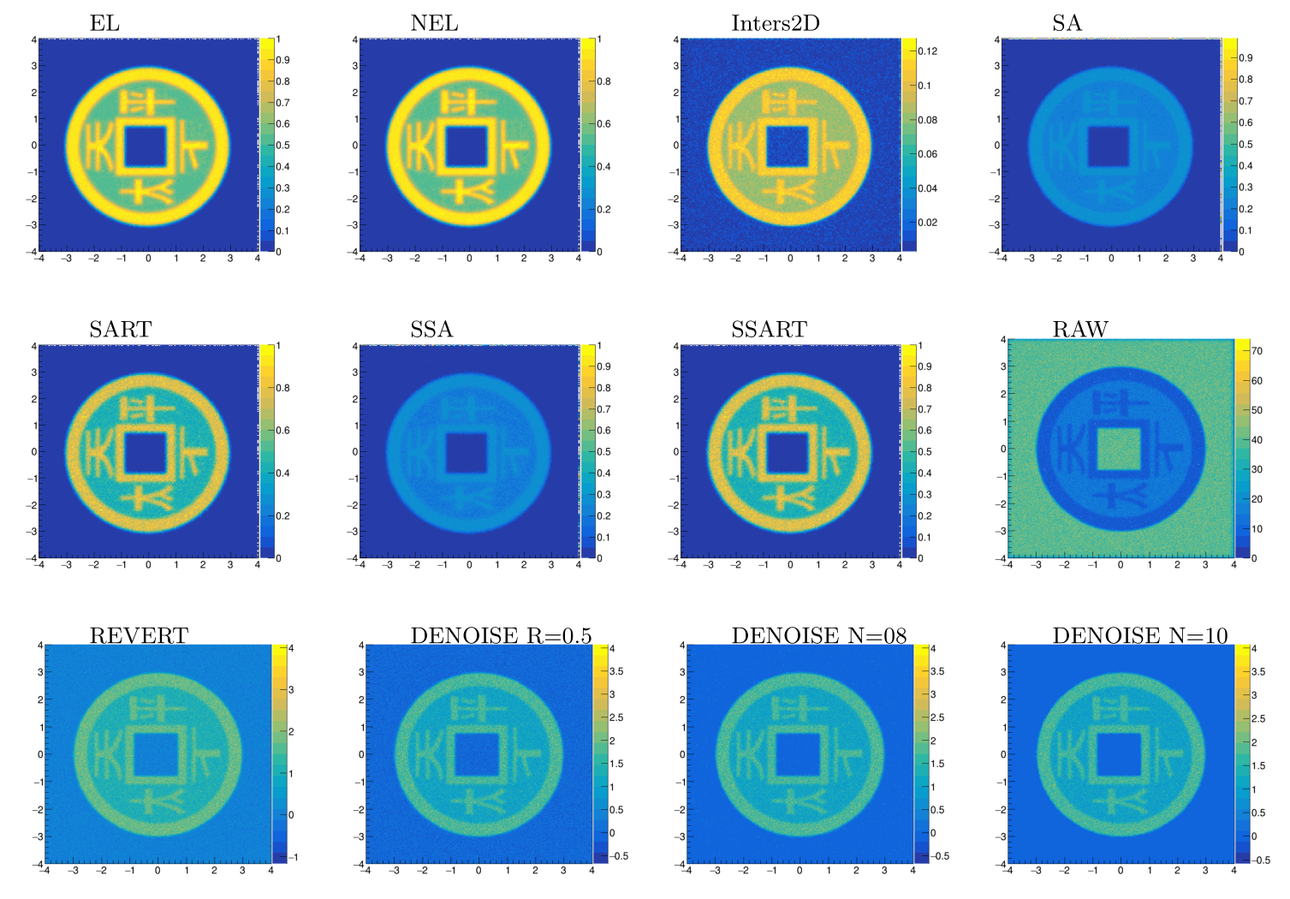
Comparison to X Image (copper coin)

Slide 20
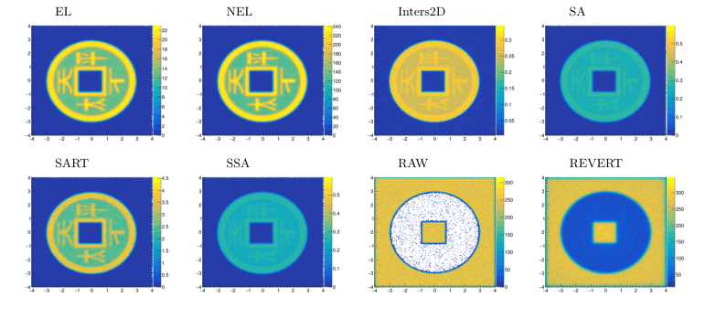
Comparison to X Image (gold coin)
Muon+ 30-60 MeV
MST
Xray 120 keV
does NOT work
Muon+ 30-60 MeV
muography

Slide 21
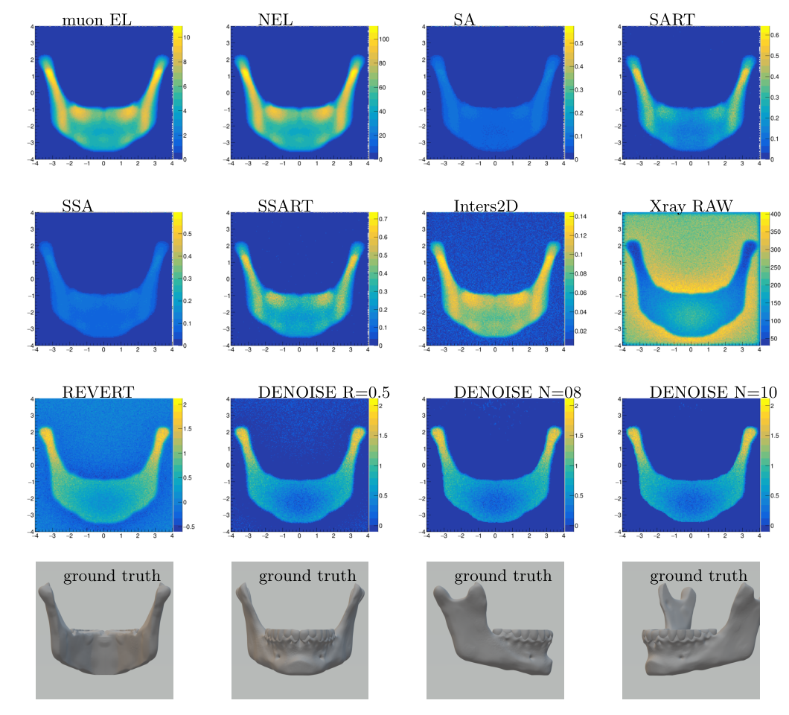
Comparison to X Image (chin)

Slide 22
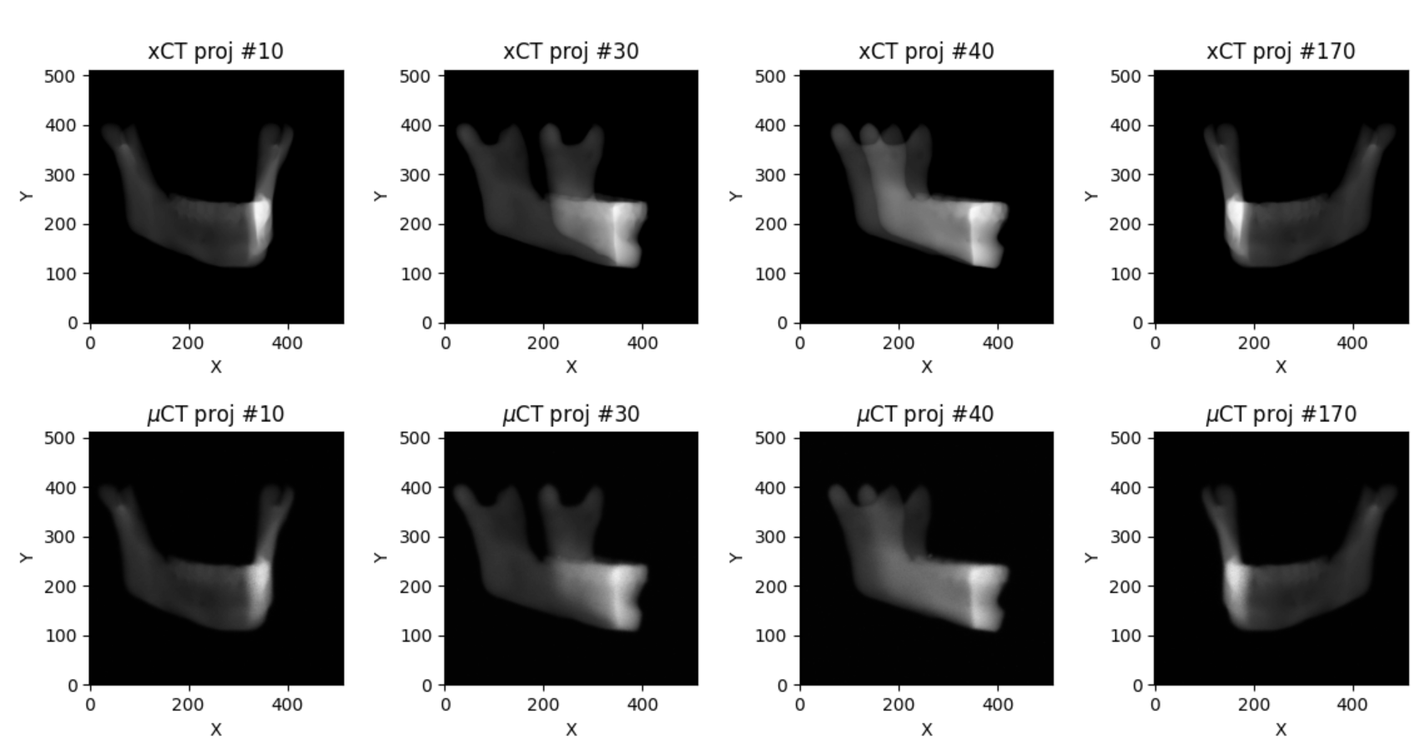
From 2D to 3D (parallel beam scan)
10¹⁰ X
10⁷ μ

Slide 23
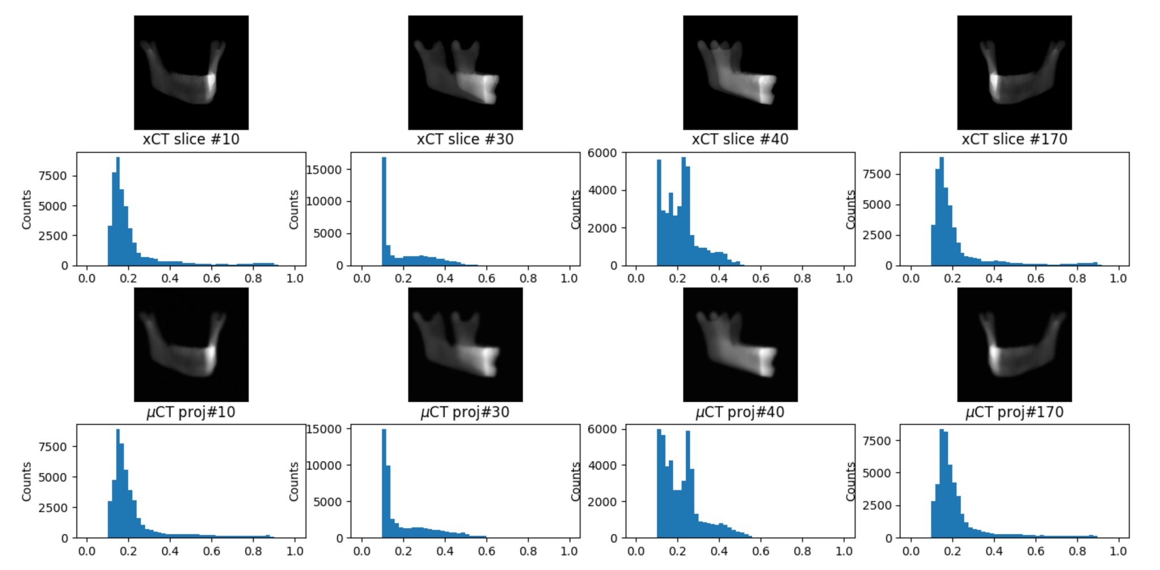
Projections and Density Spectrums

Slide 24
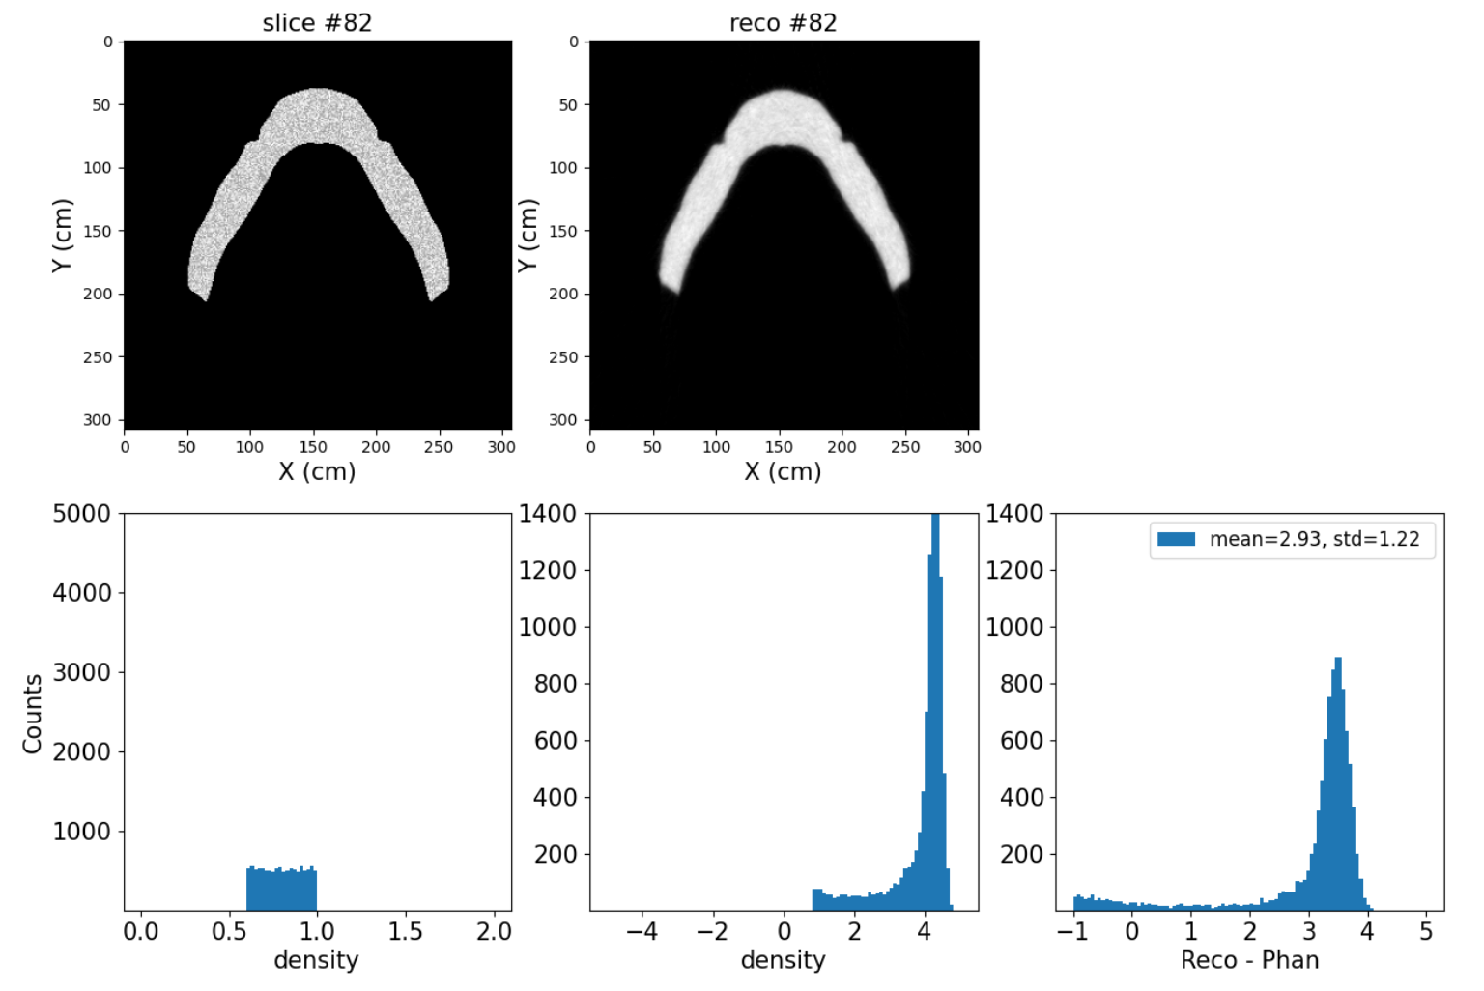
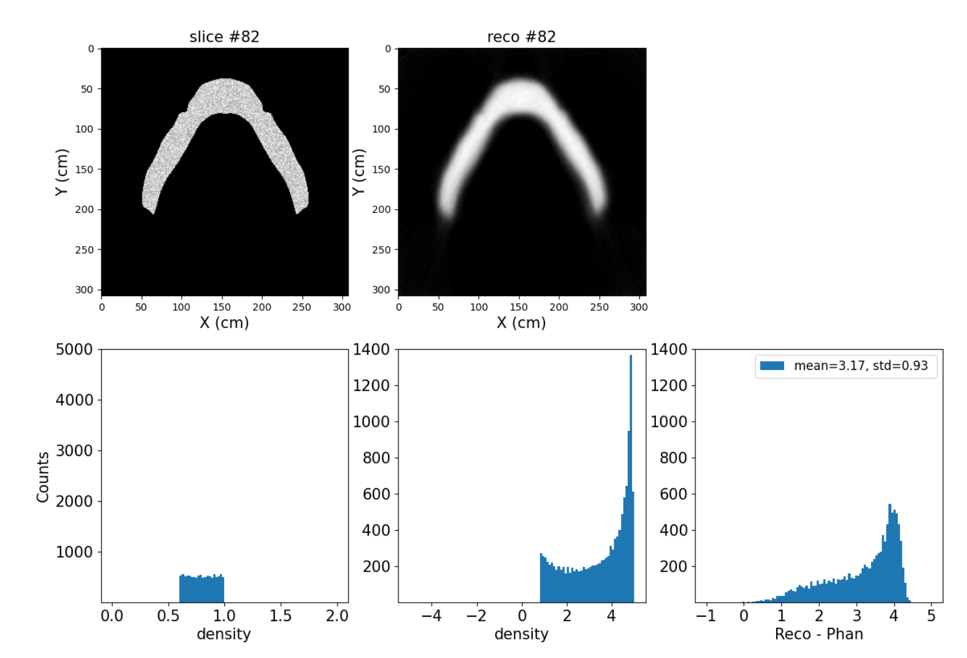
Reconstruction versus Original Phantom
The 82th slice reconstructed among 308 slices.
More quantitative measurements are under goging.
xCT
μCT

Slide 25
Summary and Outlook
We currently investigate some widgets, for example, a copper coin and a chin. We notice that, these results are obtained at an ideal case.
MST require a high performance spectrometer, tracker and range detectors are minimum.
Compared to XCT, 3D reconstruction needs be improved.
In future
  Investigate more uncertainties.
Thanks for your attention!

Slide 26
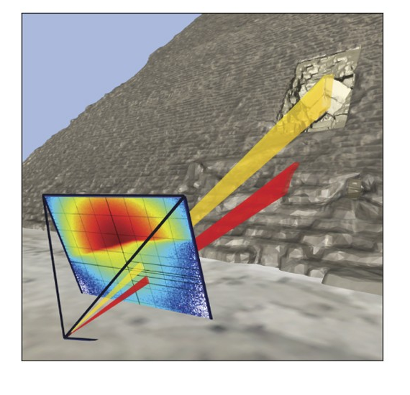
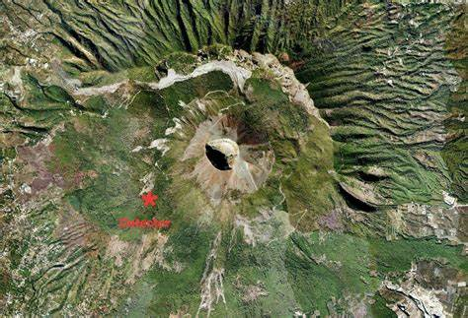
Developments in past decades
Early attempt: 1956, rock density with Geiger counter, without imaging (Australian)
First muograph: 1970, imaging Pyramid of Khafre (American)
Development: 2007, imaging active volcano (Japan)
Pyramid
Nature, 552, 386 (2017).
Volcano
https://doi.org/10.1098/rspa.2021.0320

Slide 27
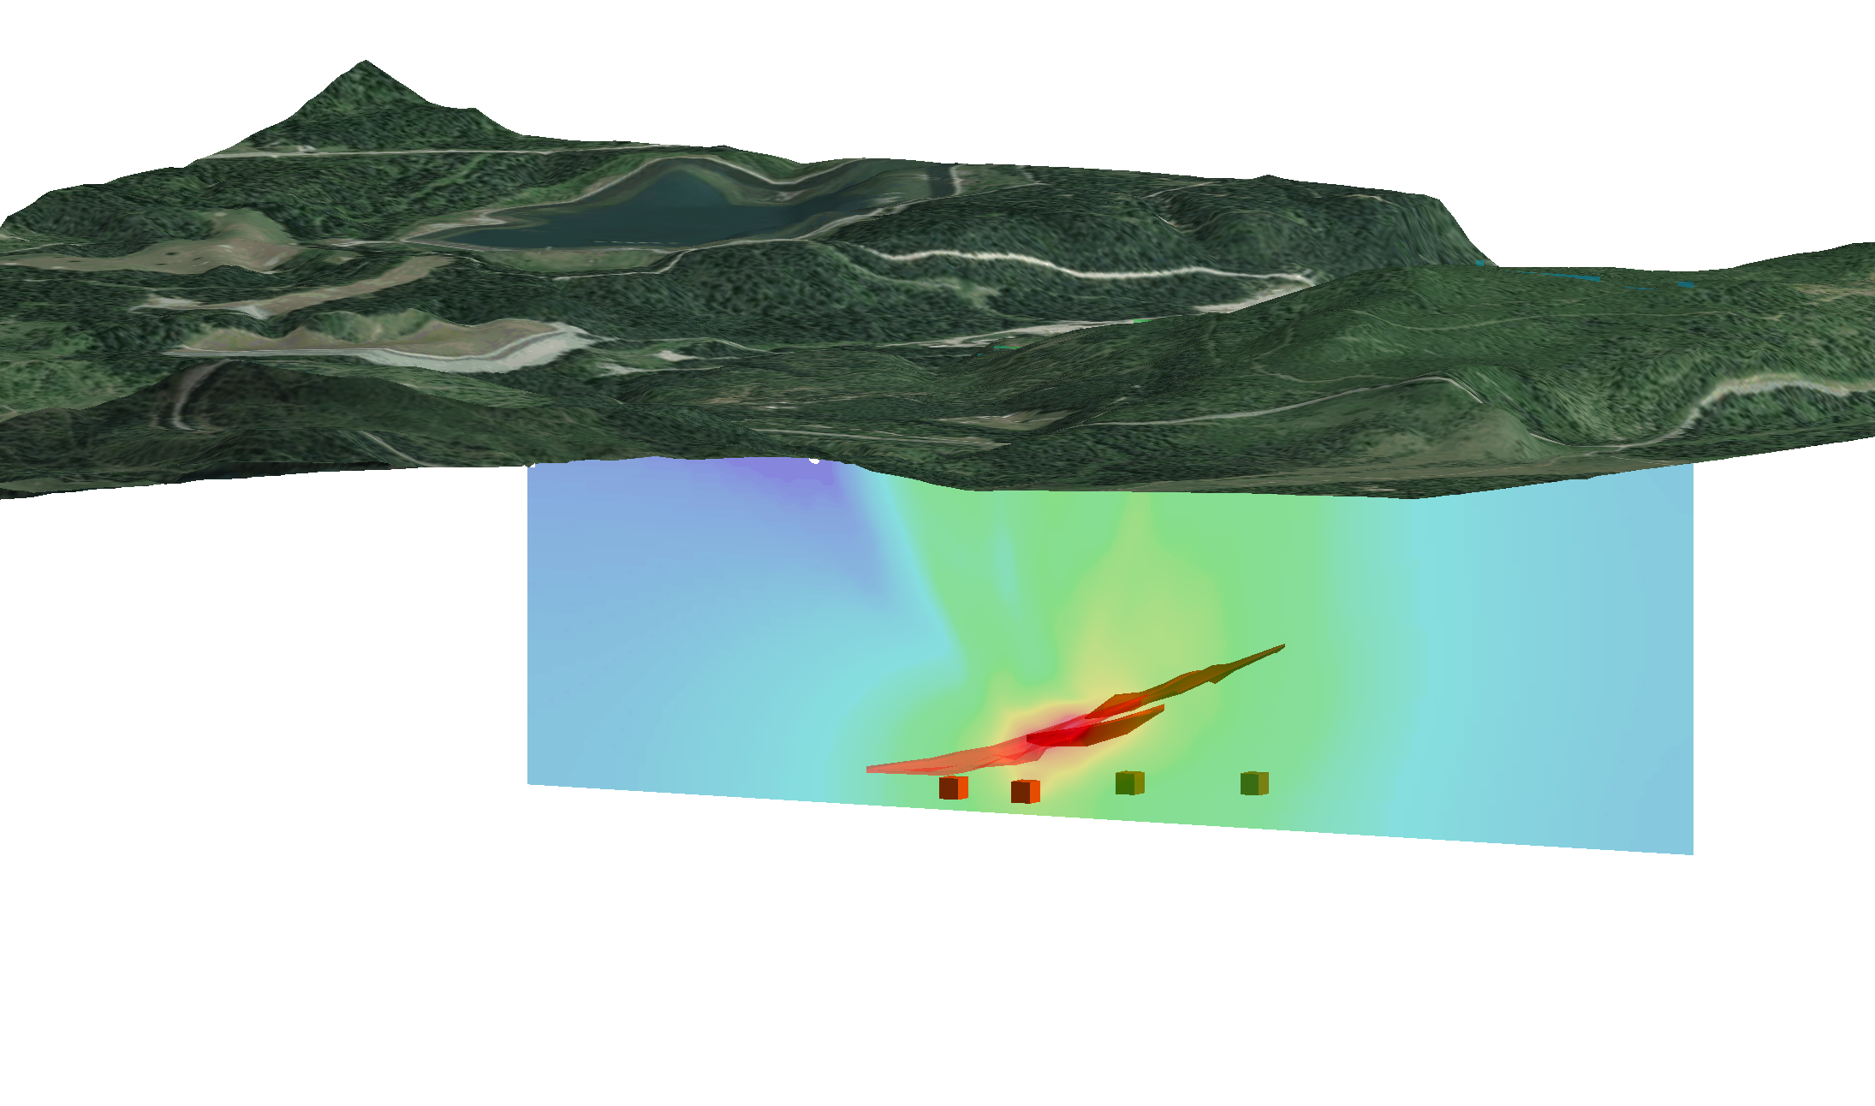
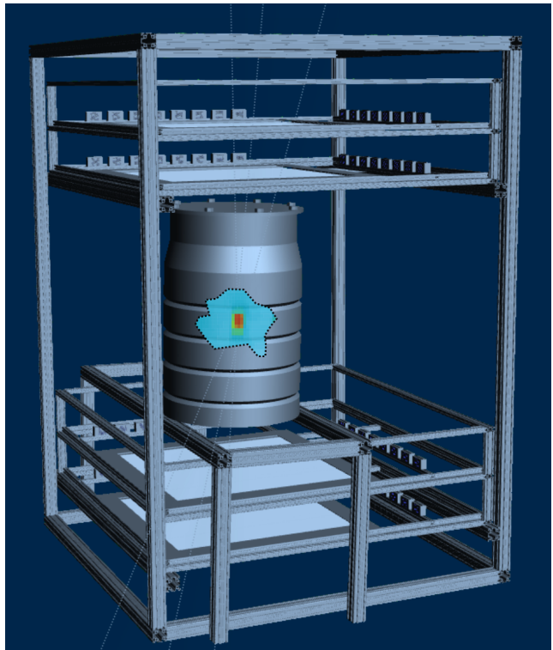
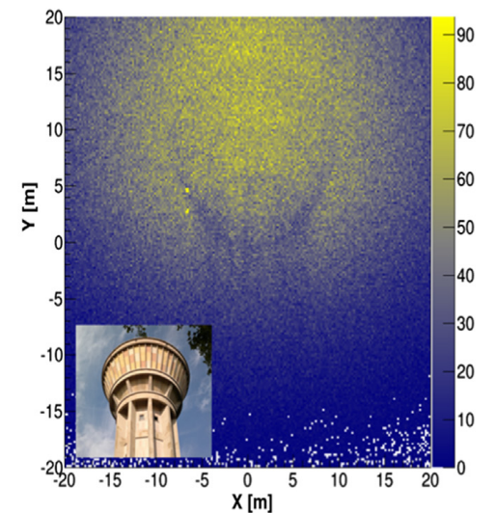
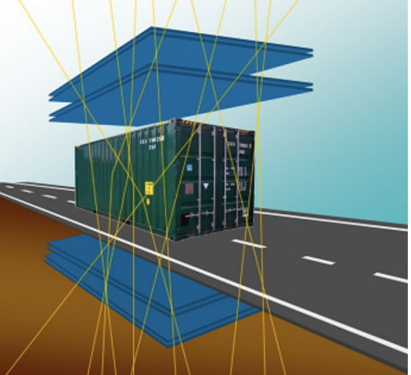
Recent years
Deep underground
Nuclear fuel
Huge Building
Phys. Rev. RESEARCH 2, 023017 (2020)
Shipment
Nuclear Instruments and Methods in Physics Research Section A, Volume 878 (2018)
Recorder Vol. 43, Issue No. 05 (2018)

