Slide 1
A Brief Sampling of Correlation Study at ALICE
裴 骅
华中师范大学

Slide 2
Correlation as a method or observable
In big collaborations at RHIC and LHC, people doing physics analysis claim multiple groups.
Such groups are often called PWG alike, Physics-Working-Group
Some PWG names are straight, you know what physics about:
PWG-HF: Heavy Flavor
PWG-LF: Light Flavor
PWG-JE: Jet
But what is PWG-CF about? It writes as "correlation function". Is this College Statistics 101?
Here I provide a brief sampling of ALICE PWG-CF work. Compiled from recent 2024 conferences: SQM, ICHEP, Hard Probes.

Slide 3
Exploring jet quenching effects

Slide 4
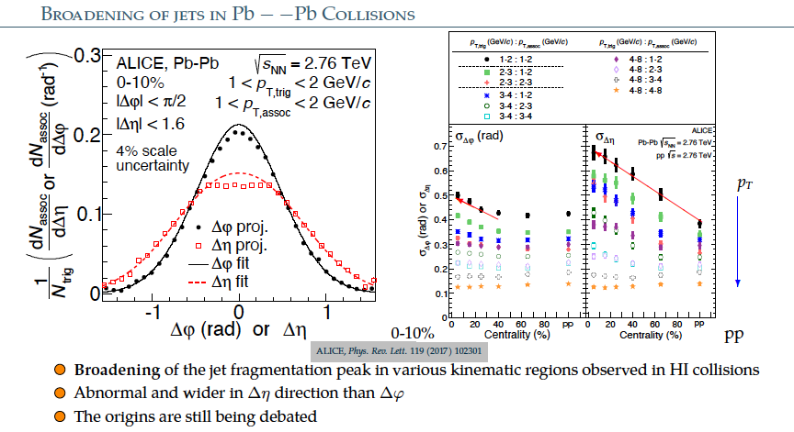
Exploring jet quenching effects

Slide 5
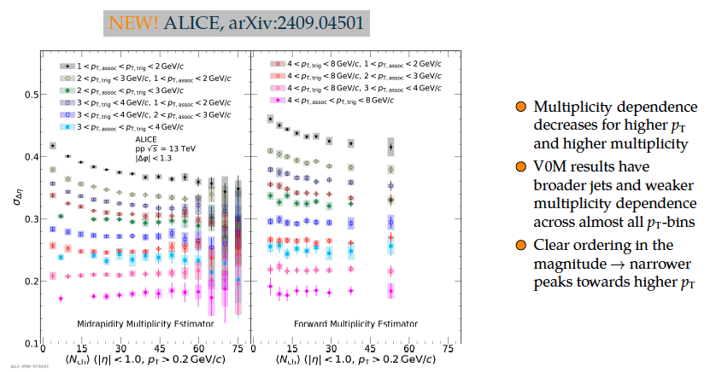
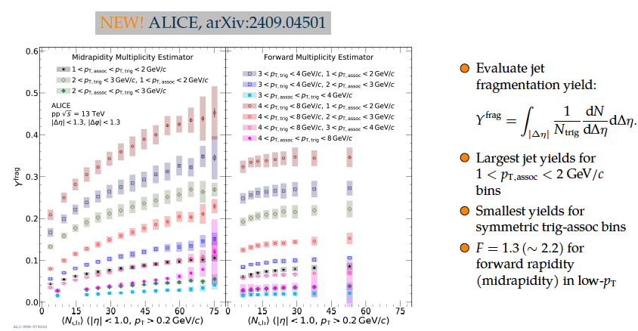
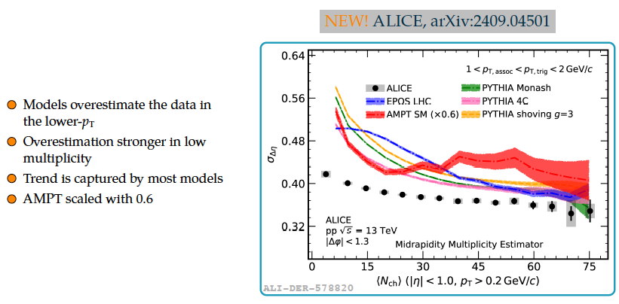
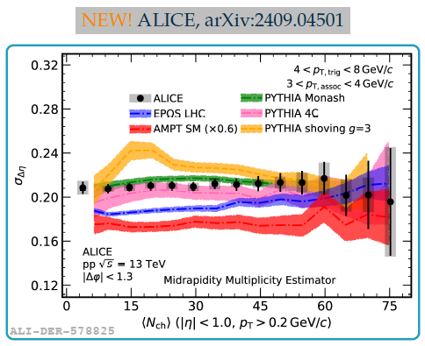
Exploring jet quenching effects

Slide 6
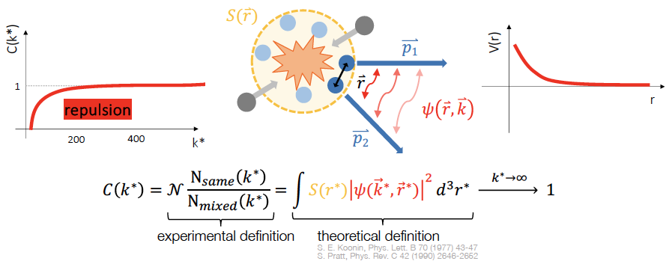
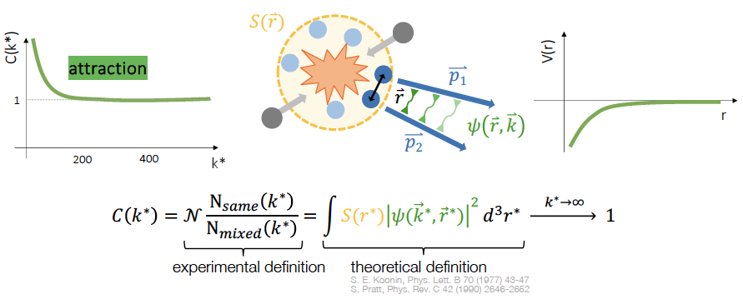
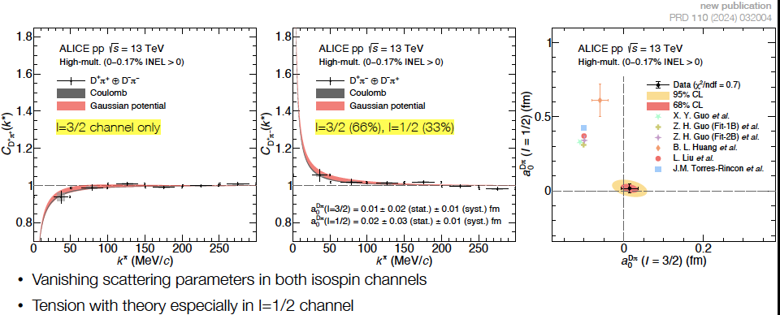
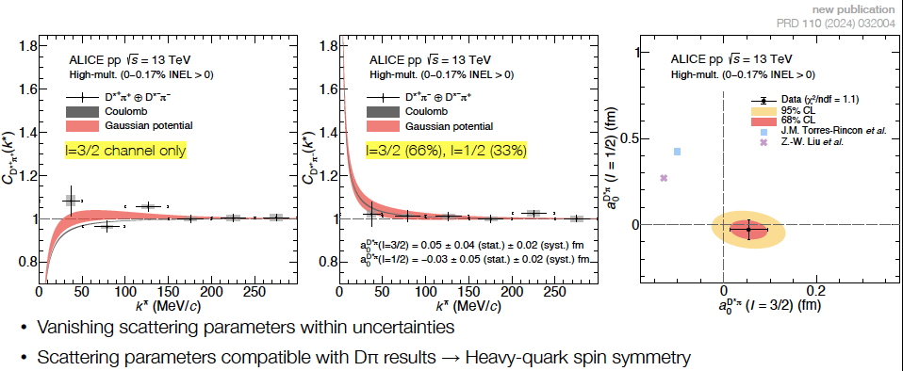
Interaction between charm and light particles

Slide 7
Interaction between charm and light particles

Slide 8
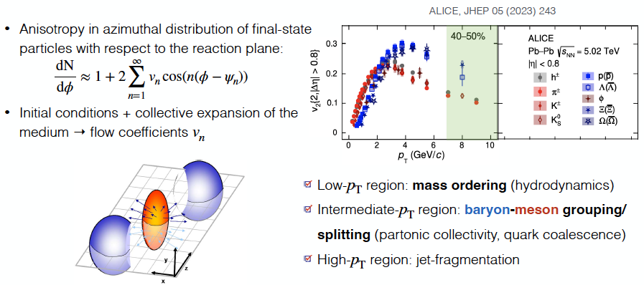
Origin of collectivity in pp and p-Pb

Slide 9
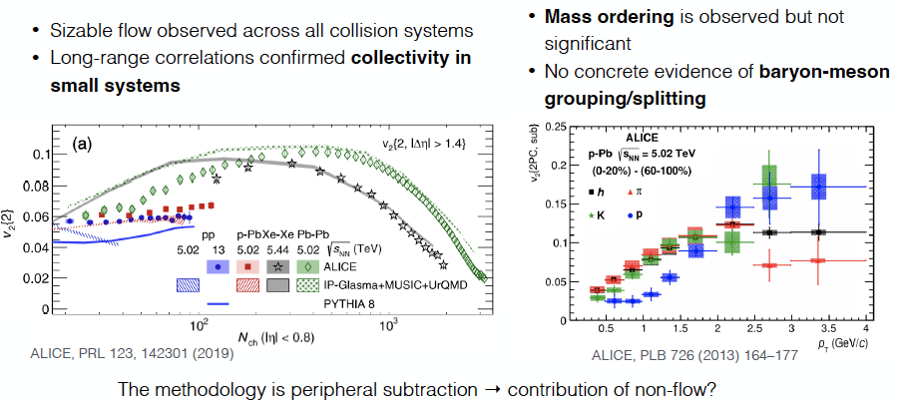
Origin of collectivity in pp and p-Pb

Slide 10
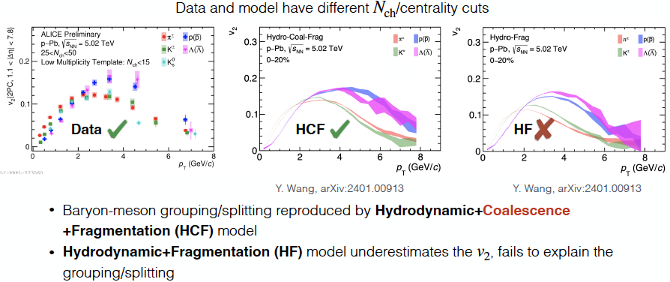
Origin of collectivity in pp and p-Pb

Slide 11
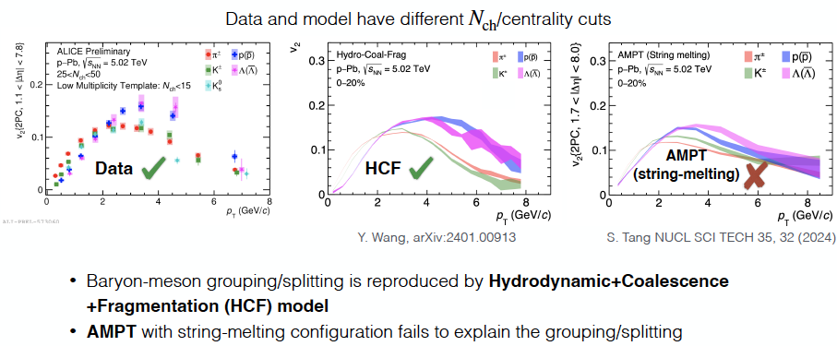
Origin of collectivity in pp and p-Pb

Slide 12
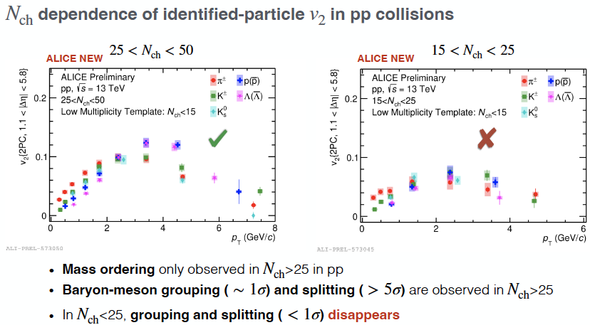
Origin of collectivity in pp and p-Pb

Slide 13
Origin of collectivity in pp and p-Pb

Slide 14
Probe the speed of sound

Slide 15
Probe the speed of sound

Slide 16
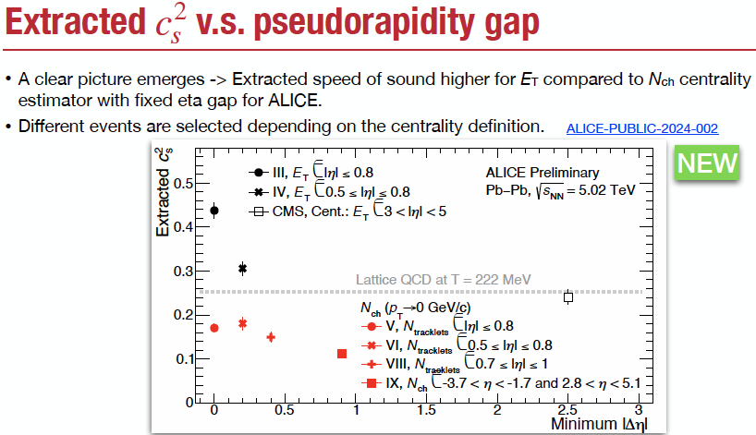
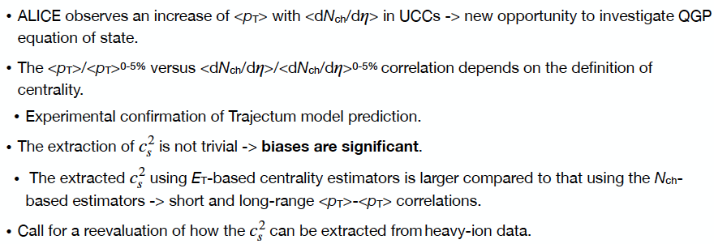
Probe the speed of sound

Slide 17
Jet axes differences

Slide 18
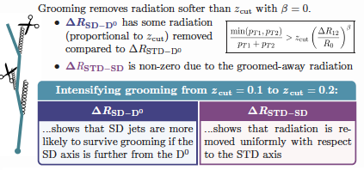
Jet axes differences

Slide 19
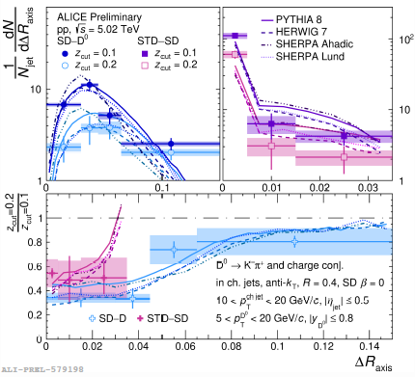
Jet axes differences

Slide 20
Jet axes differences

Slide 21
Jet axes differences

Slide 22
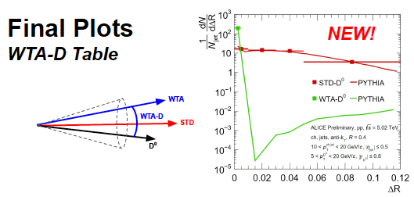
Jet axes differences

