Slide 1
Study of the $e^{+}e^{−}→γ^{∗}Λ^{0}Σ^{0}$ process using ISR method
Gaole Peng
2024.9.4

Slide 2
Outline
Data Samples
Event Selection
Background Analysis
Data Analysis
Cross Section Measurement

Slide 3
Data Sample
Notes:
p

Slide 4
Event Selection
PID
1. N_{π+} $≥$1 && N_{π-} $≥$1 && N_{p} $≥$1 && N_{p-} $≥$1
Vertex Fit:
1. Successful vertex fit for $p\overline{π}, \overline{p}π^{+}$, and $χ_{Tol}^{2}=$ $χ_{Pri}^{2}$ + $χ_{Sec}^{2}$ is minimal.
Kinematic Fit:
1. E_{γisr} > 400 MeV
2. χ²_{4C} < 200
3. $χ_{γΛΛ}^{2}$ < $χ_{γγΛΛ}^{2}$ < $χ_{γγγΛΛ}^{2}$
Good charge tracks：
1. |cos θ| < 0.93
2. |V_{z}| < 30 cm,V_{r} < 10 cm
3. $NGood≥4$
Good photons ：
1. |cos θ_{γ}| < 0.8 for the barrel and E_{γ} > 25 MeV;
0.86 < |cos θ_{γ}| < 0.93 for the endcap and E_{γ} > 50 MeV
2. d$θ_{min}>10°$ ,while for $\overline{p}$ d$θ_{min}>20°$
3. 10 $≥$ $N_{photon}≥2$
Notes:
p

Slide 5
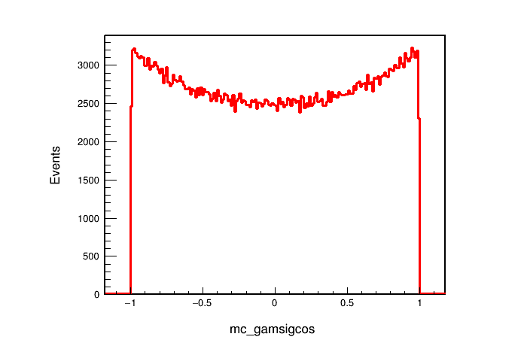
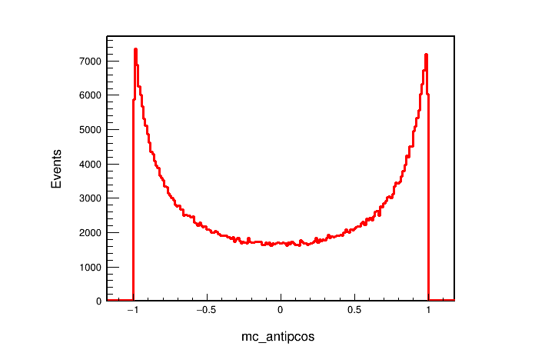
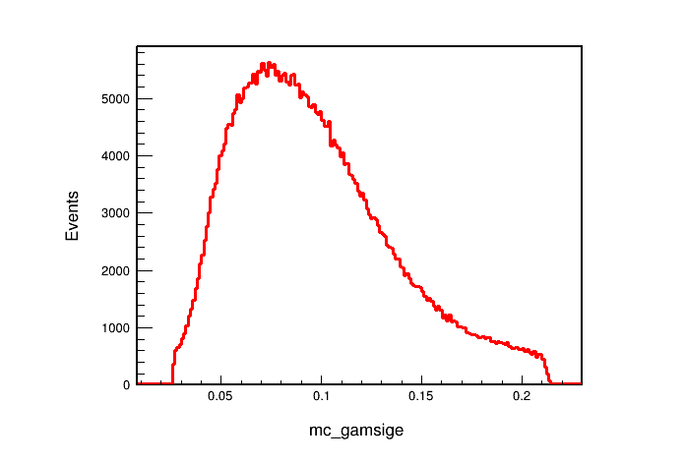
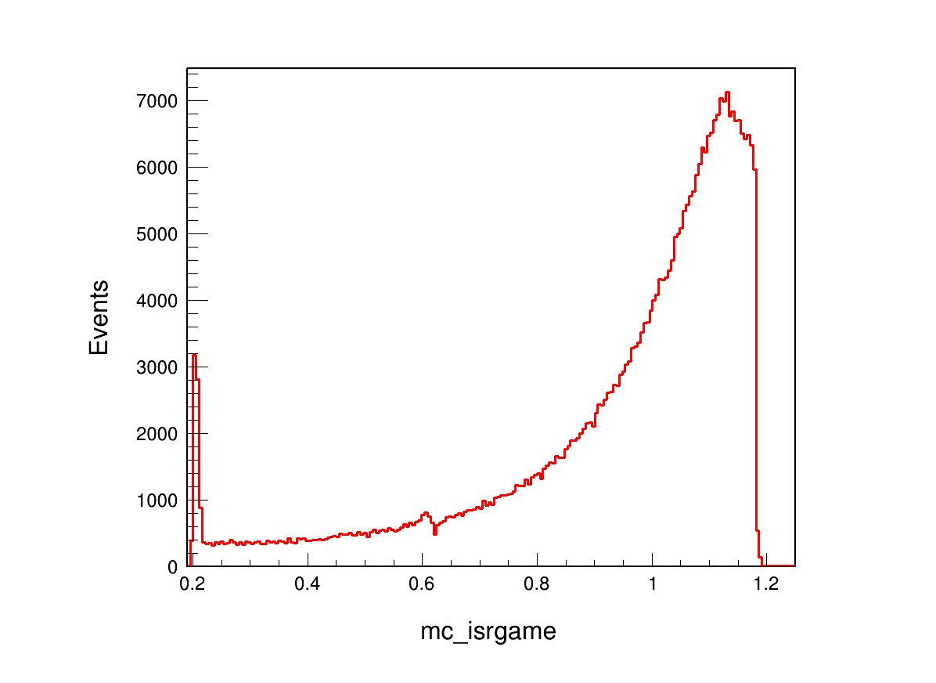
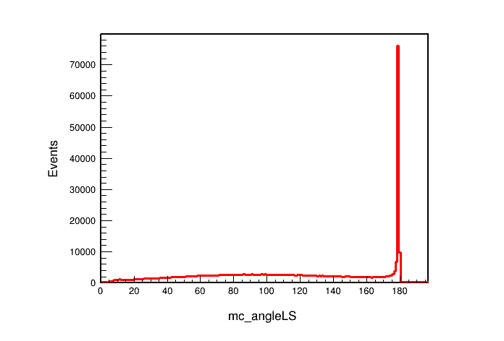
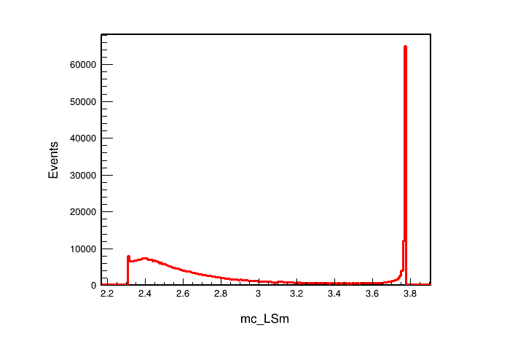
Truth Information
Polar angular of γ_{noISR}
Polar angular of $\overline{p}$
Energy of γ_{noISR}
Energy of γ_{ISR}
Angle difference between p_{Λ} and p_{Σ}
Mass of ΛΣ

Slide 6
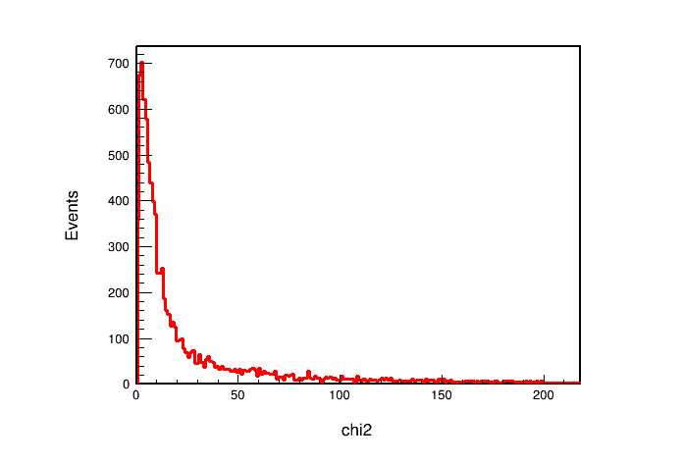
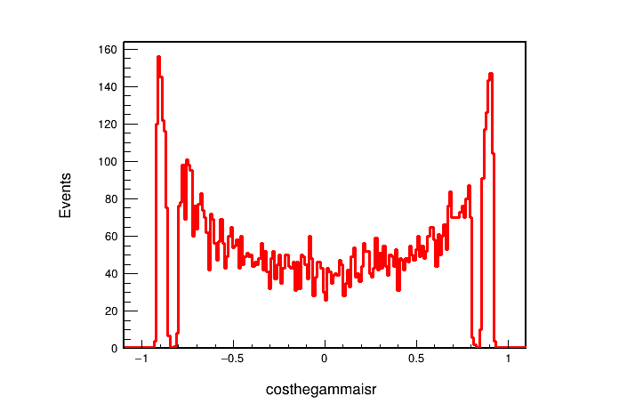
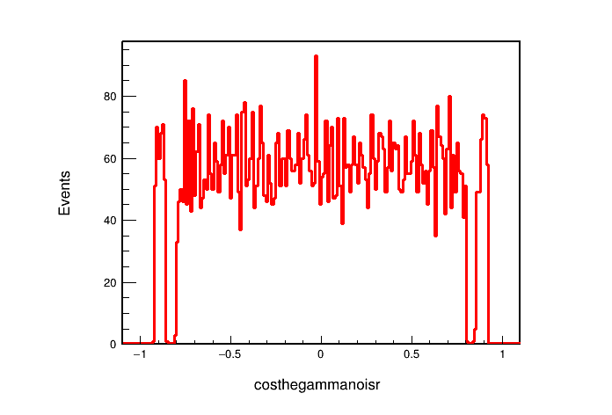
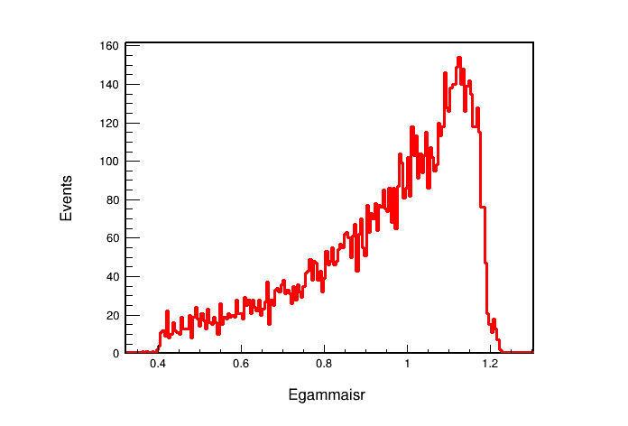
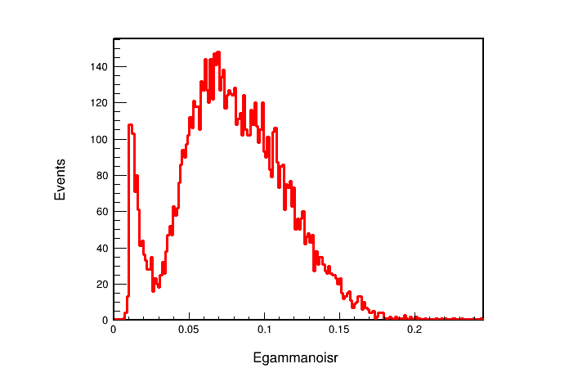
Output Information
χ²_{4C}
Polar angular of γ_{ISR}
Polar angular of γ_{noISR}
Energy of γ_{ISR}
Energy of γ_{noISR}

Slide 7
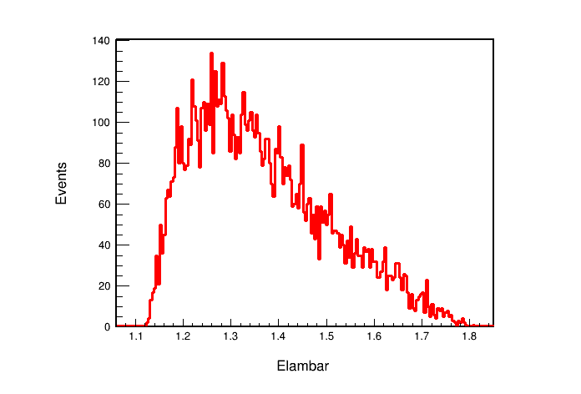
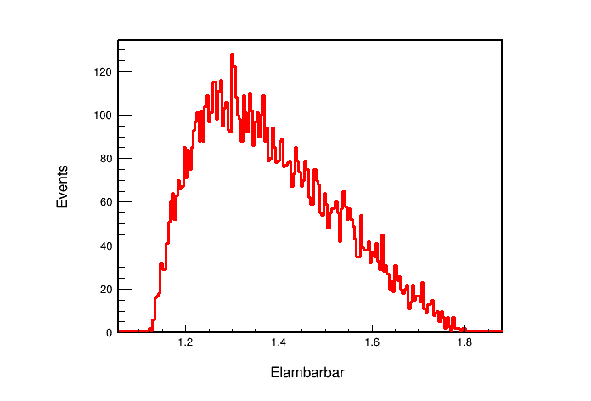
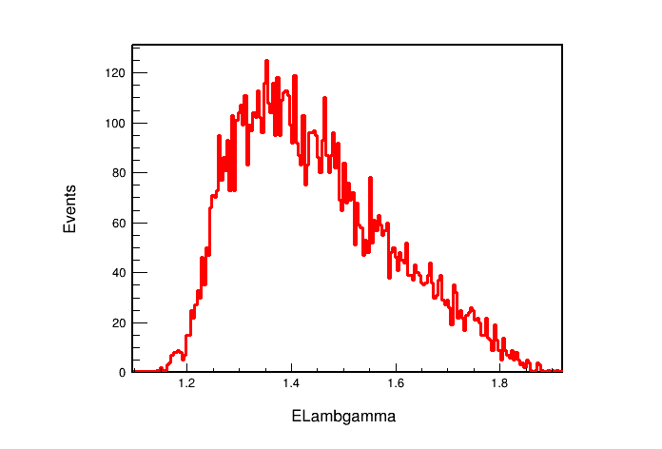
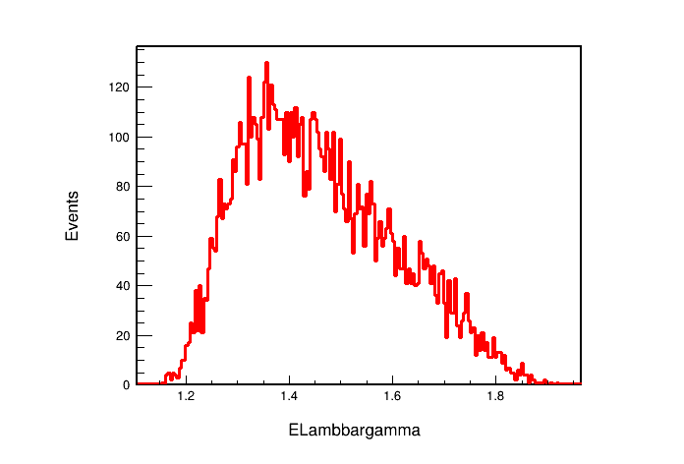
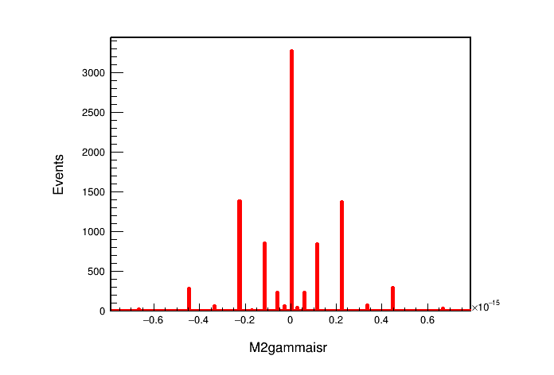
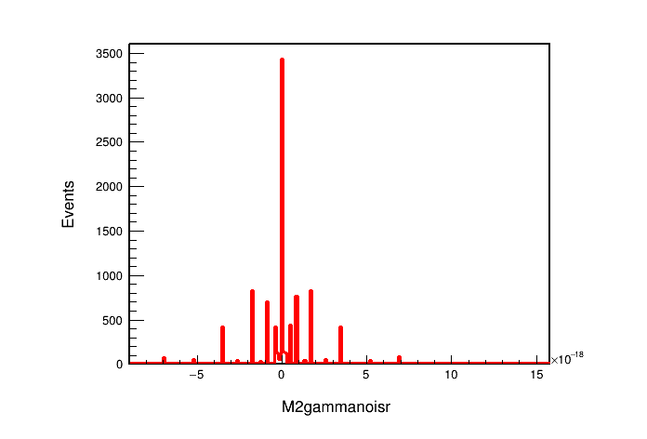
Output Information
Energy of Λ
Energy of $\overline{Λ}$
Energy of Λγ_{noISR}
Energy of $\overline{Λ}$γ_{noISR}
M² of γ_{ISR}
M² of γ_{noISR}

Slide 8
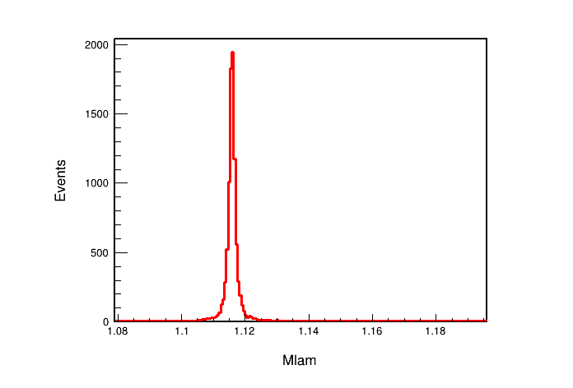
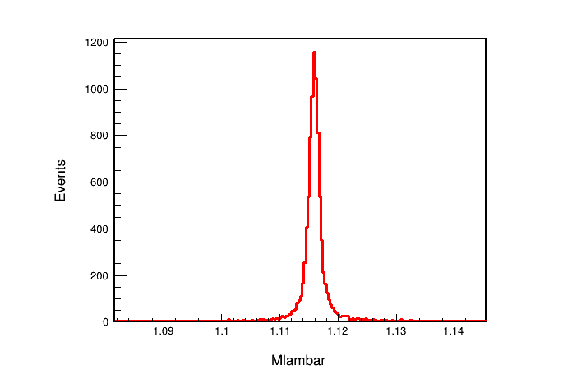
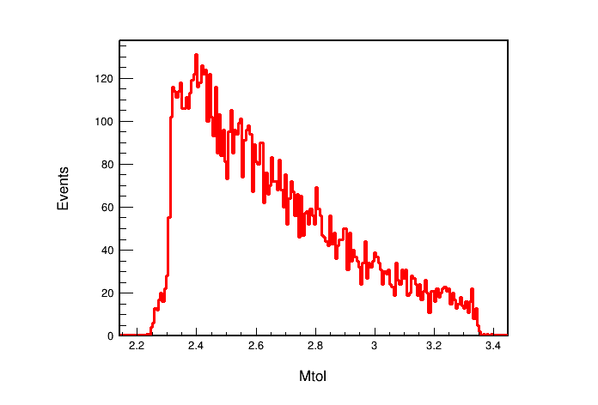
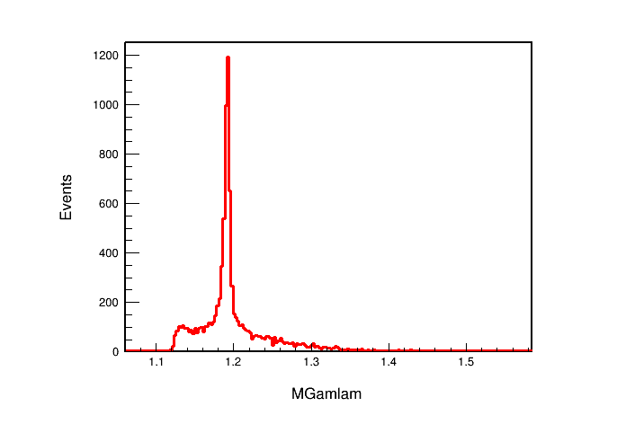
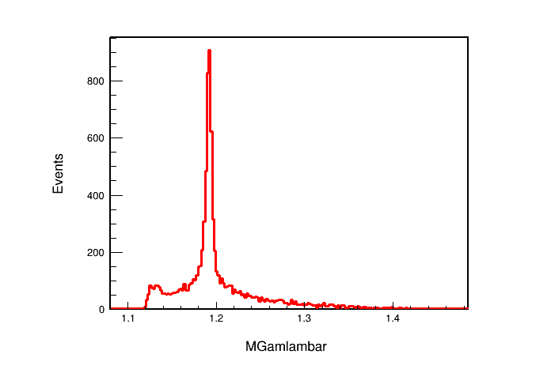
Output Information
Mass of Λ
Mass of $\overline{Λ}$
Mass of ΛΣ
Mass of Λγ_{noISR}
Mass of $\overline{Λ}$γ_{noISR}

Slide 9
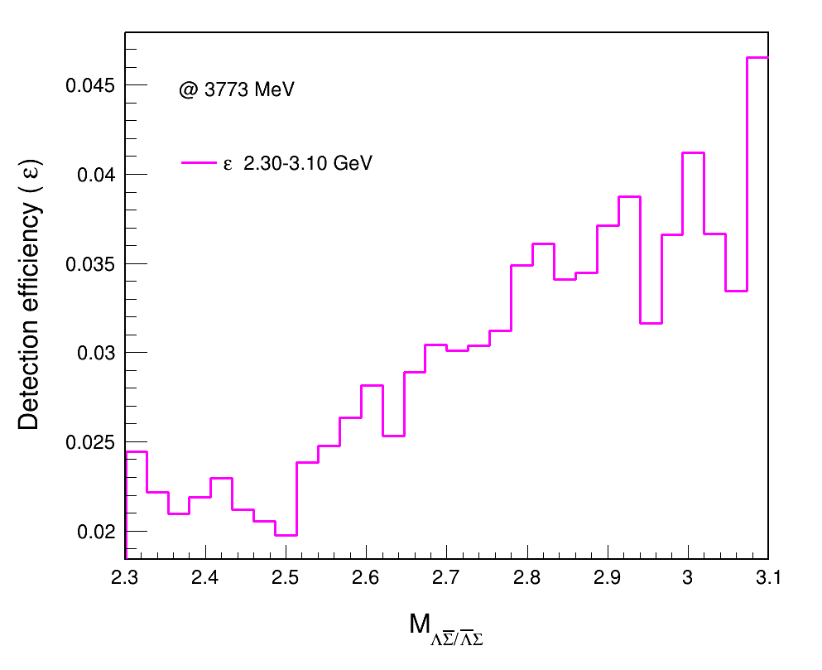
Signal MC

Slide 10
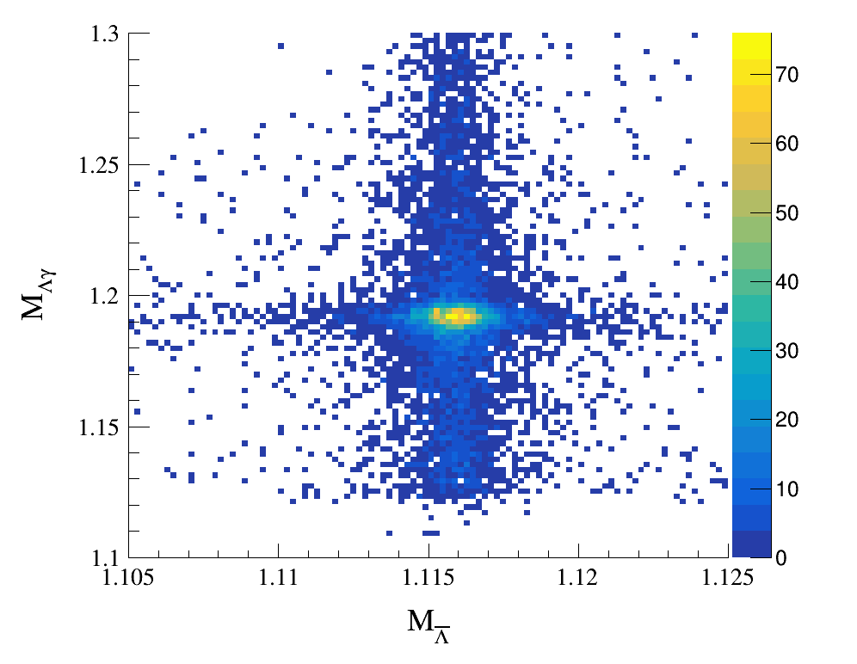
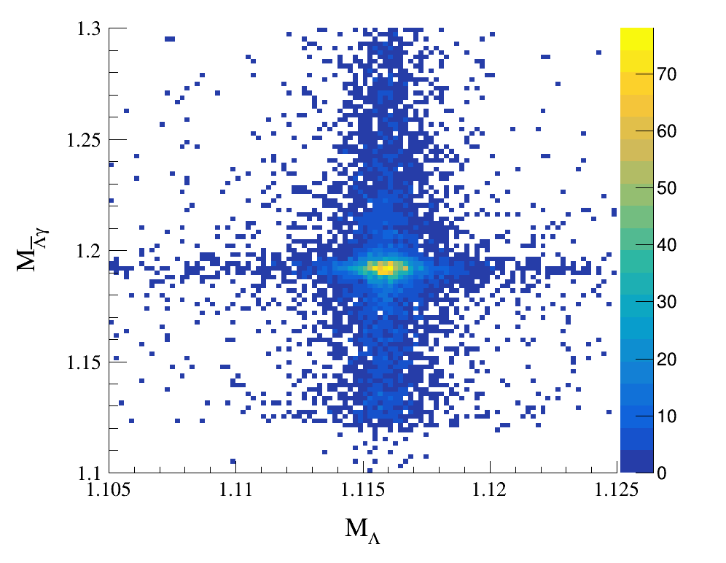
Signal MC
Before distinguishing two channels:

Slide 11
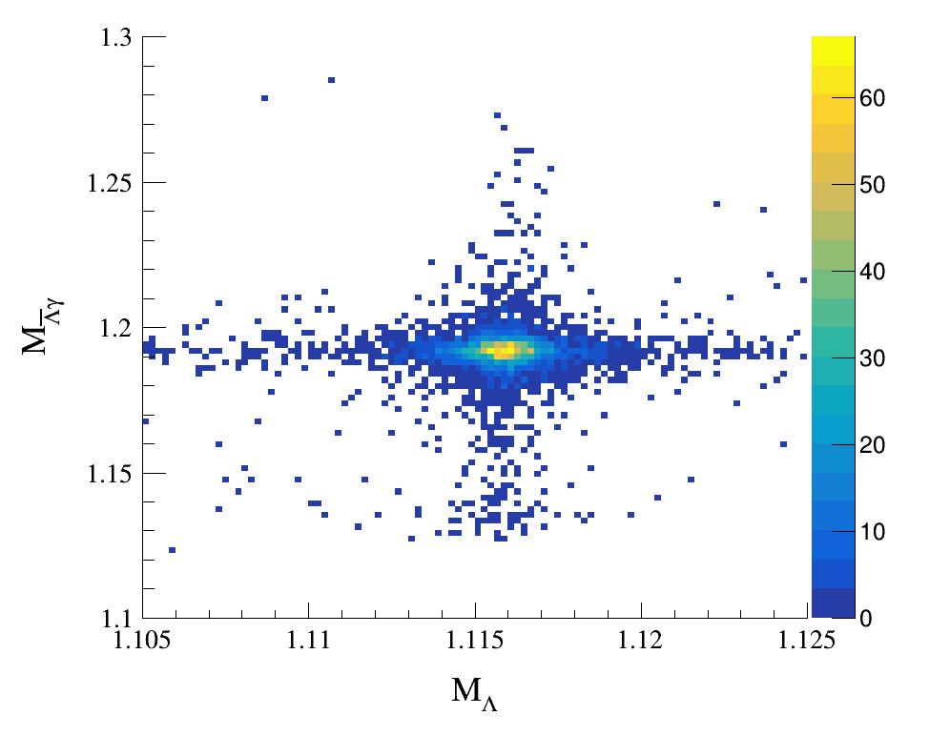
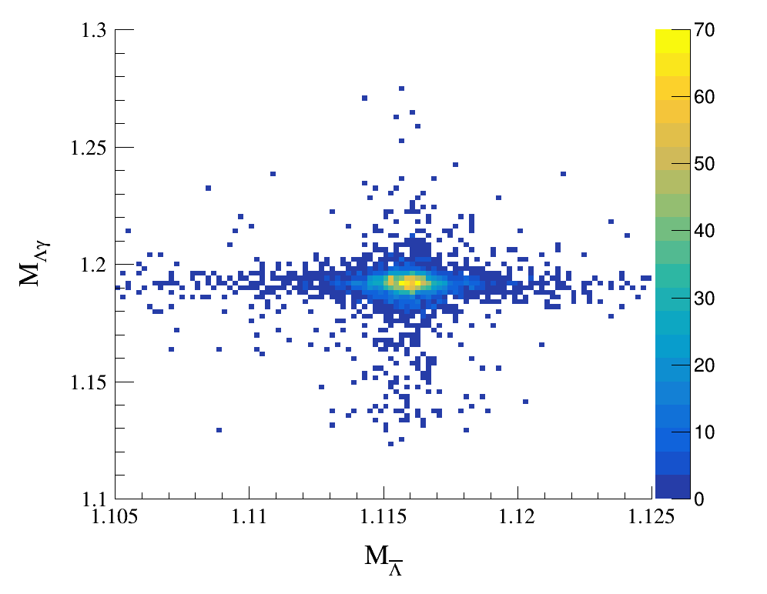
Signal MC
Distinguish two channels by comparing $M_{Λγ}$ , $M_{\overline{Λ}γ}$ with $M_{Σ/\overline{Σ}(PDG)}$

Slide 12
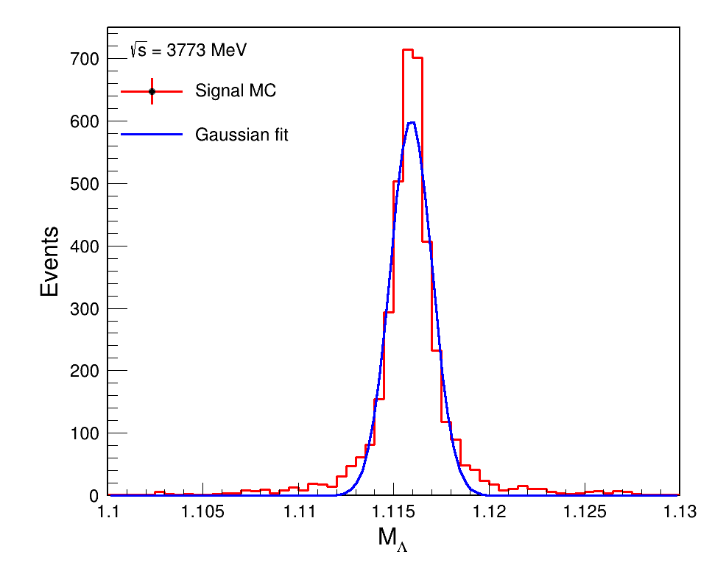
Further Selection
$$\left|M_{Λ/\overline{Λ}}−M_{PDG}\right|<5σ$$
$$\left|M_{Λ/\overline{Λ}}−M_{PDG}\right|<5.493 MeV$$

Slide 13
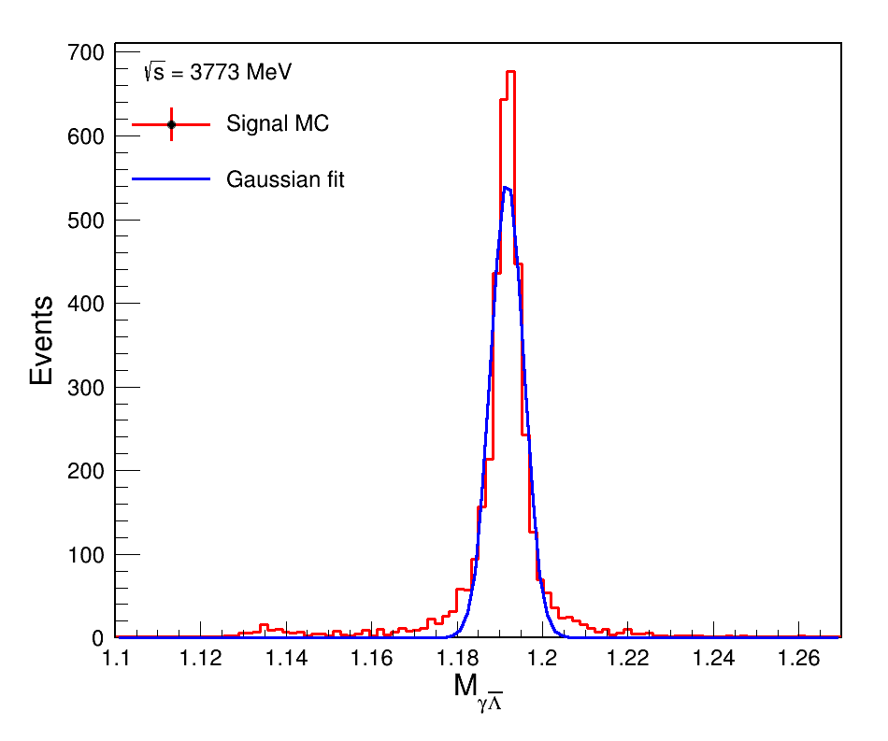
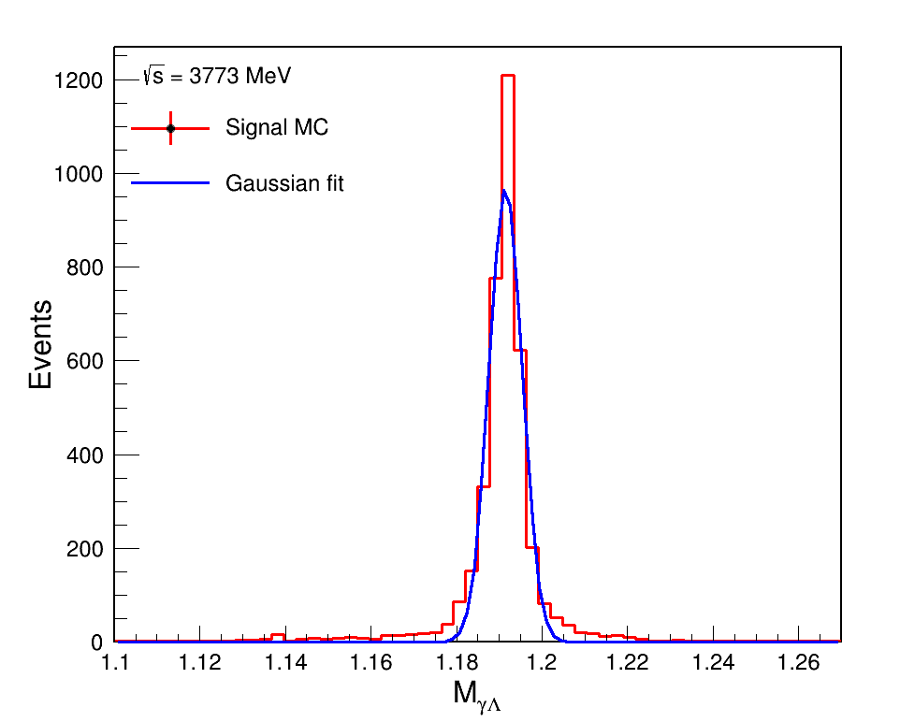
Further Selection
$$\left|M_{Σ/\overline{Σ}}−M_{PDG}\right|<5σ$$
$$\left|M_{Σ/\overline{Σ}}−M_{PDG}\right|<19.348 MeV$$

Slide 14
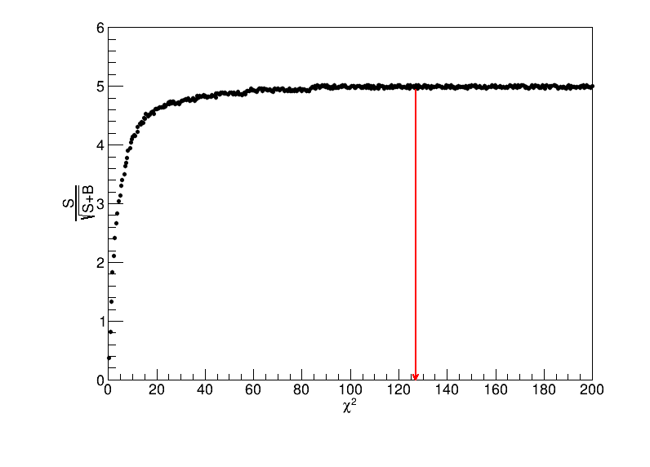
Further Selection
$$\left|M_{Λ/\overline{Λ}}−M_{PDG}\right|<5.493 MeV$$
$$\left|M_{Σ/\overline{Σ}}−M_{PDG}\right|<19.348 MeV$$
$$\text{χ}\text{2}\text{4}\text{C}\text{ < }127$$
$$\text{χ}\text{2}\text{4}\text{C}\text{ < }127$$

Slide 15
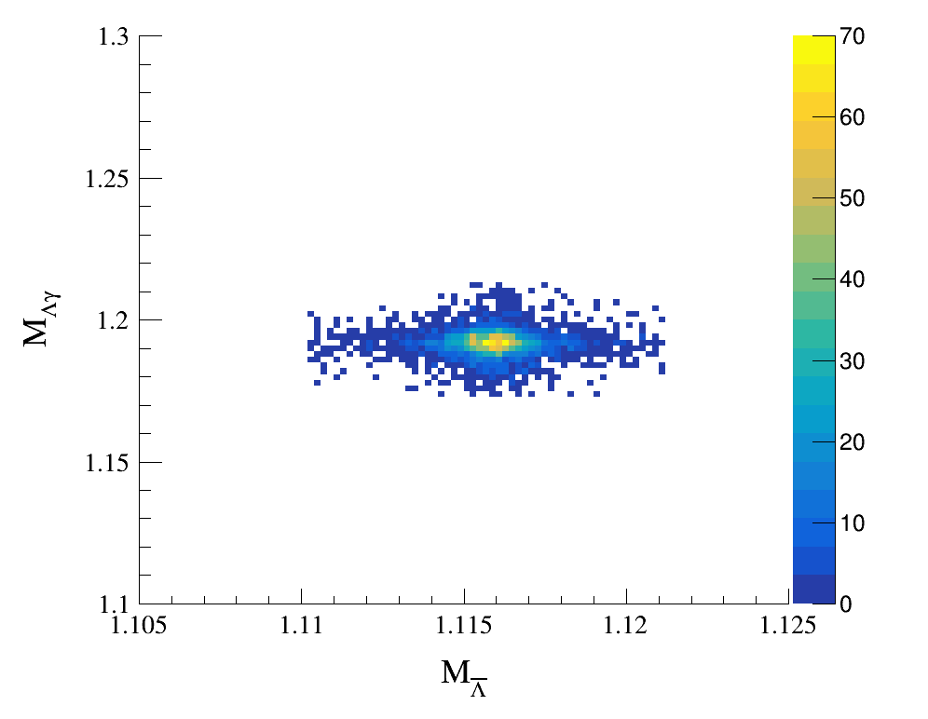
Further Selection

Slide 16
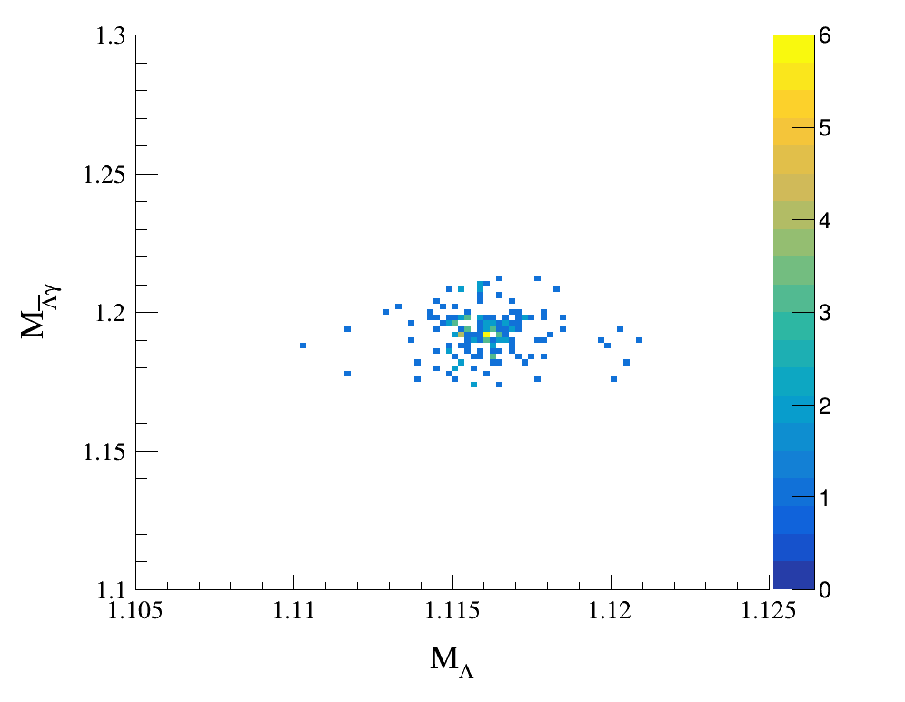
Data Analysis
N_{event} = 165

