Slide 1
Background of KSKL
Huiliang Xia

Slide 3
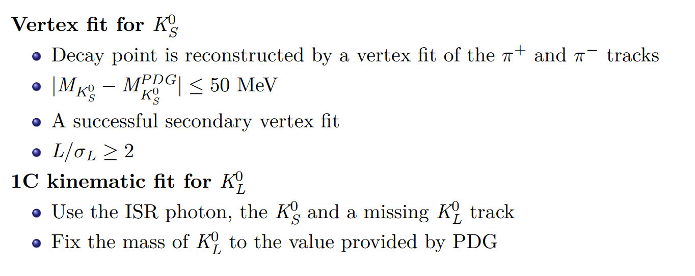
χ²(1C)<10
Use the ISR photon, the KS, the missing KL track and a photon.
|M(γγ)-M(pi0)|<30 MeV/c².
Signal: 331480
291661

Slide 4
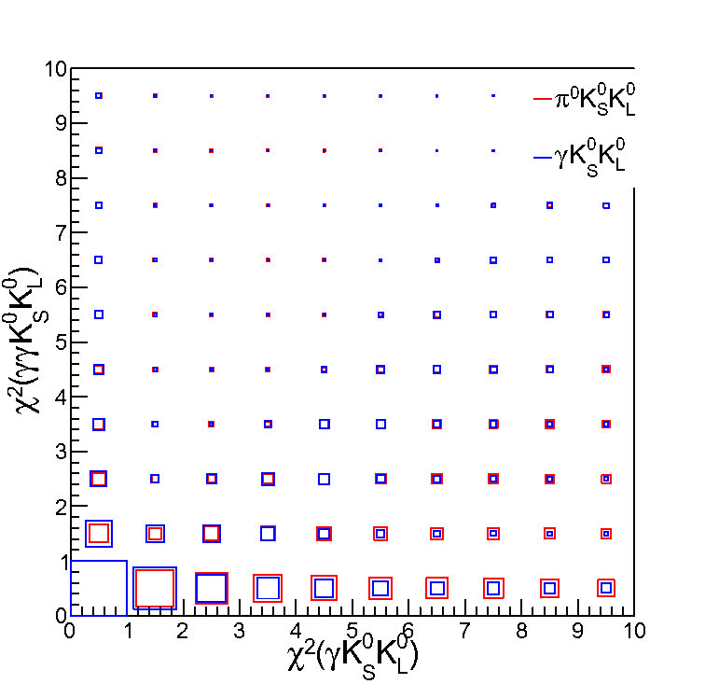
One of the gammas is ISR gamma
If we want to cut evnets of pi0KSKL, we will also cut lots of events of signal.

Slide 5
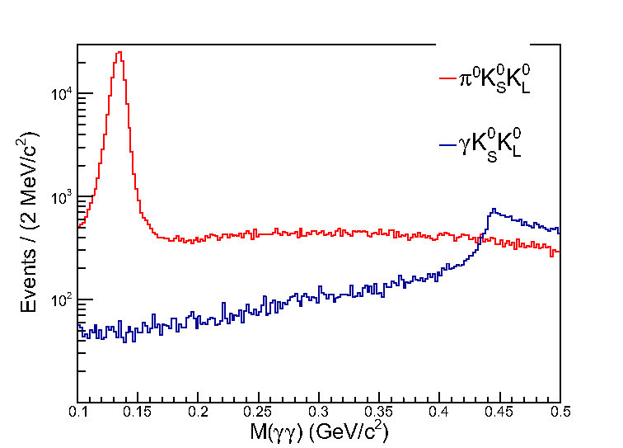
So, we try to cut mass of pi0, which seems good.

