Slide 1
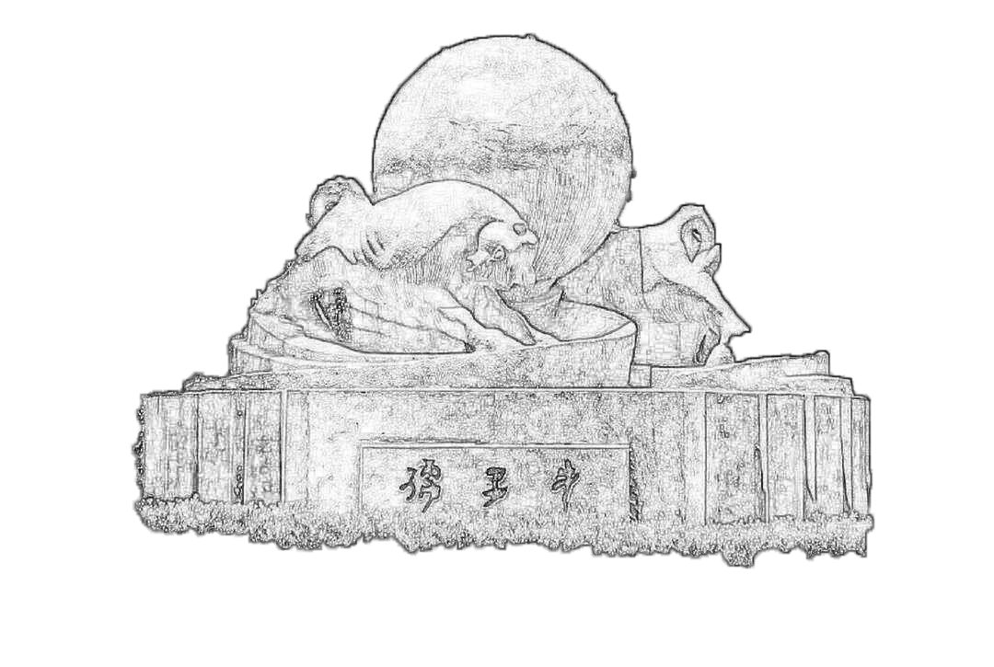
Crosstalk on MIP Spectrum
2023/09/23
Speaker : Jiaxuan Wang

Slide 2
Motivation: how does crosstalk affect MIP spectrum
Crosstalk: 10um-0.1 15um-0.15, MIP MPV also (1+p_ct) ?
Independent test
  Get random hist from Landau function
    MPV scanning: 10um(80-140); 15um(200-800)
    Landau width: 10um 15; 15um 50
  Photon Number: Division of random number by (SiPM_Gain*PDE)
    Poisson distribution
    Light output uniformity
  Pixel MC correction
    Crosstalk = 0 & crosstalk = 0.1, 0.15
  ADC gaussian distribution

Slide 3
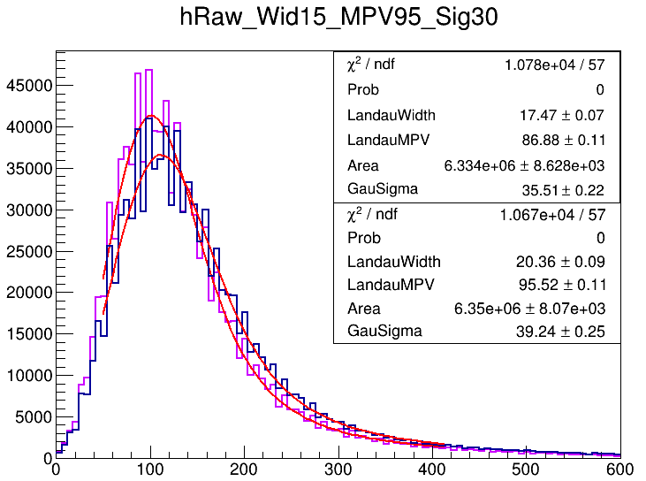
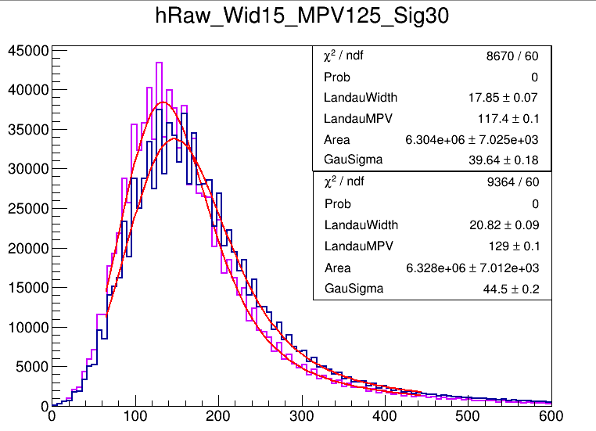
10um SiPM
MPV: 95, 125

Slide 4
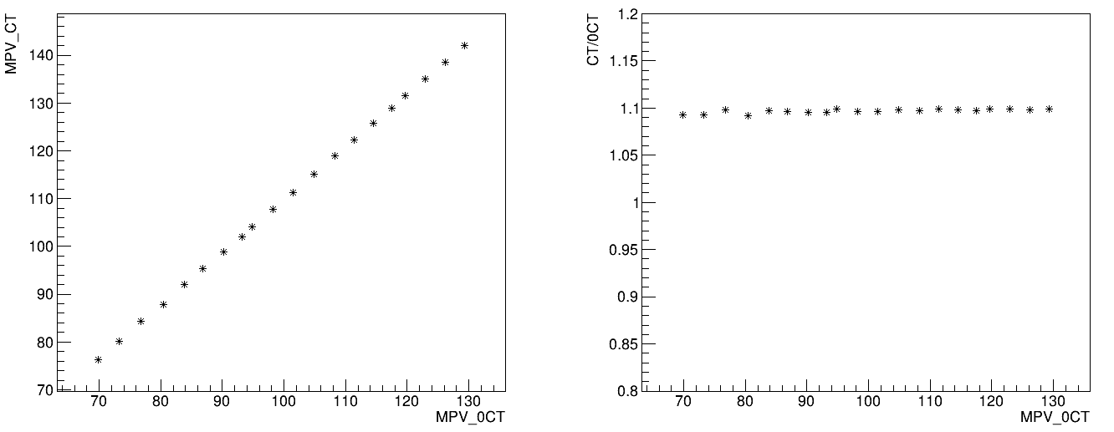
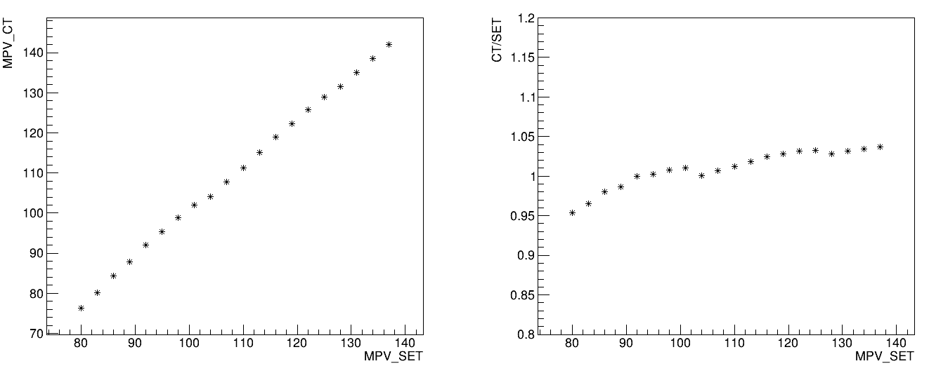
10um SiPM

Slide 5
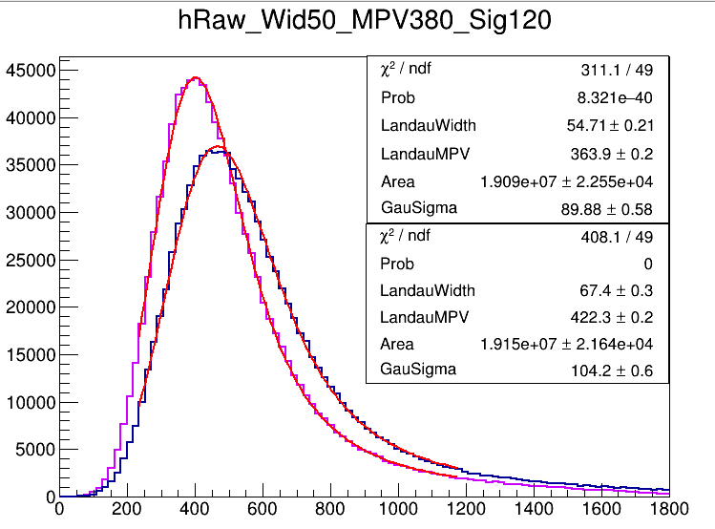
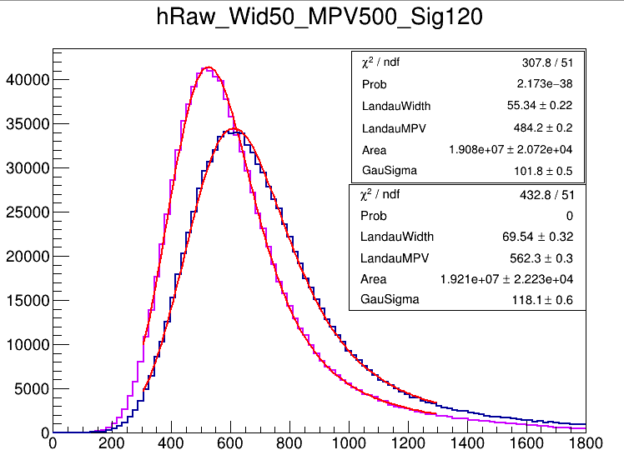
15um SiPM

Slide 6
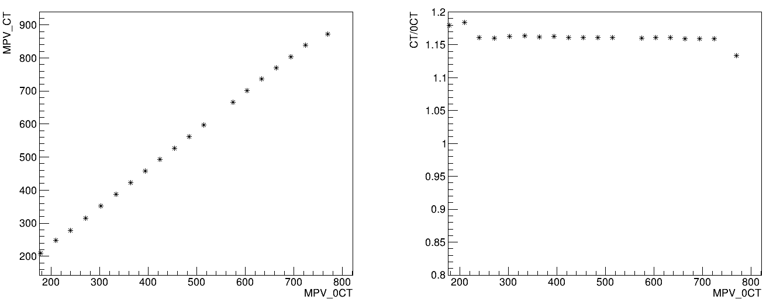
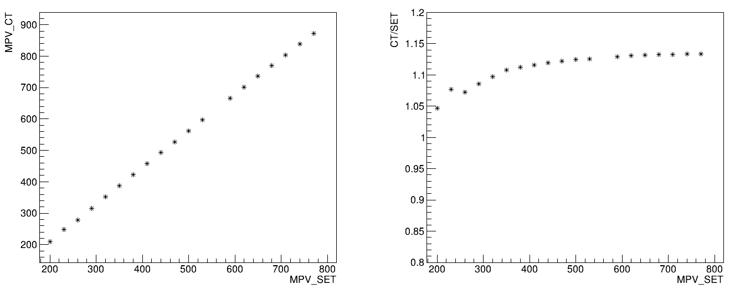
15um SiPM

Slide 7
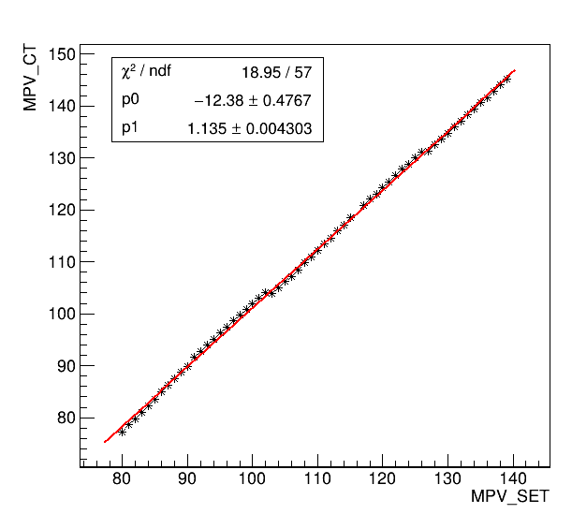
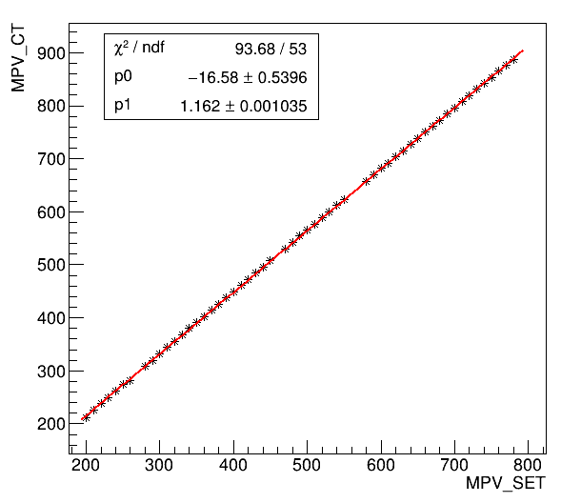

Slide 8
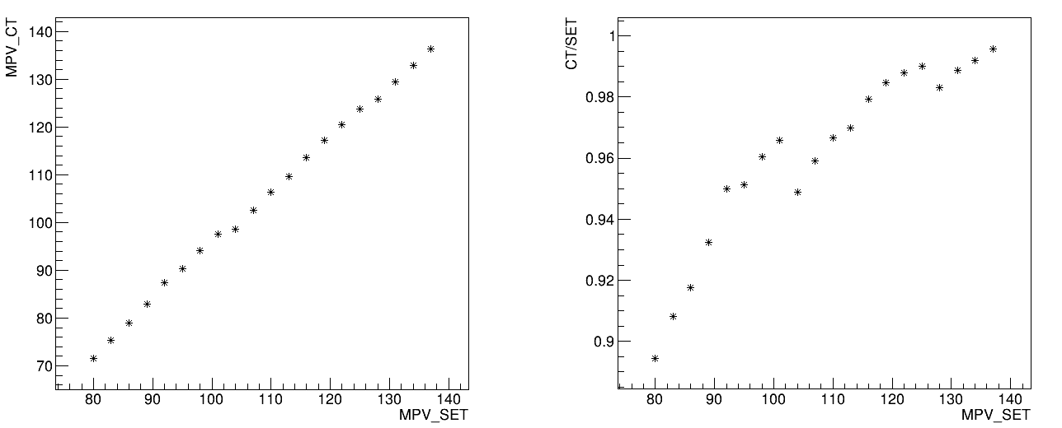
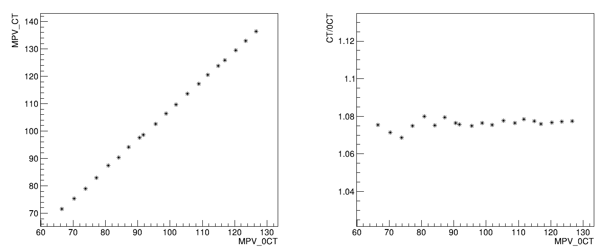
Landau MPV Scanning (10um, 0.5 threshold cut)
MPV_CT and MPV_SET non-linearity
~(1+p_crosstalk)
Wave-like
Fit method may introduce bias

Slide 9
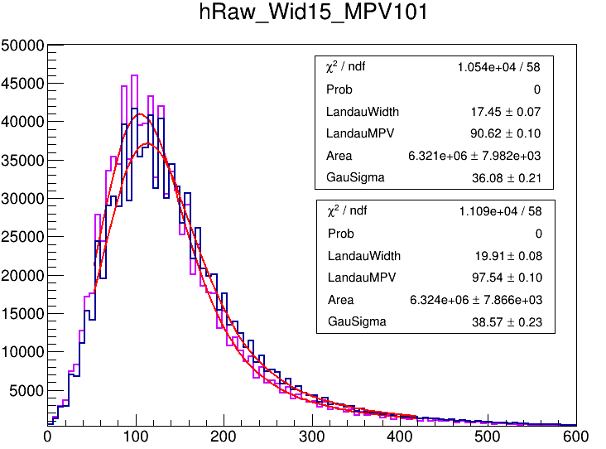
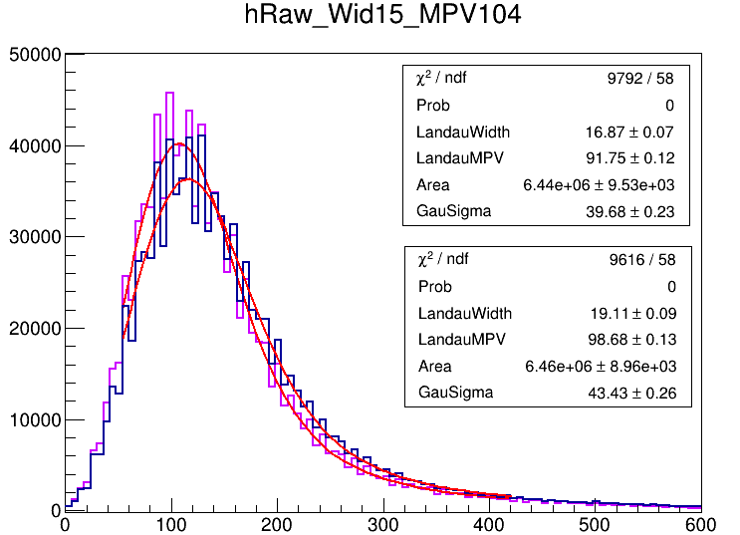

Slide 10
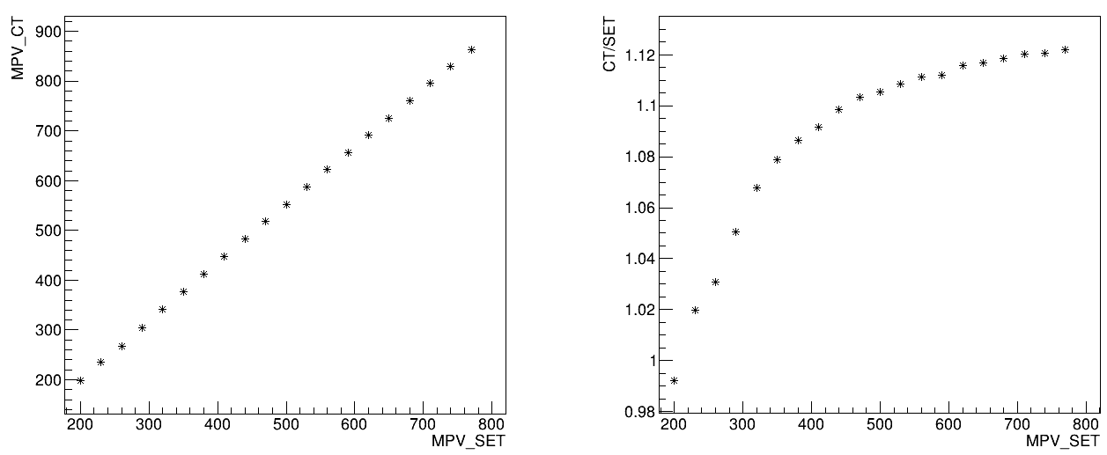
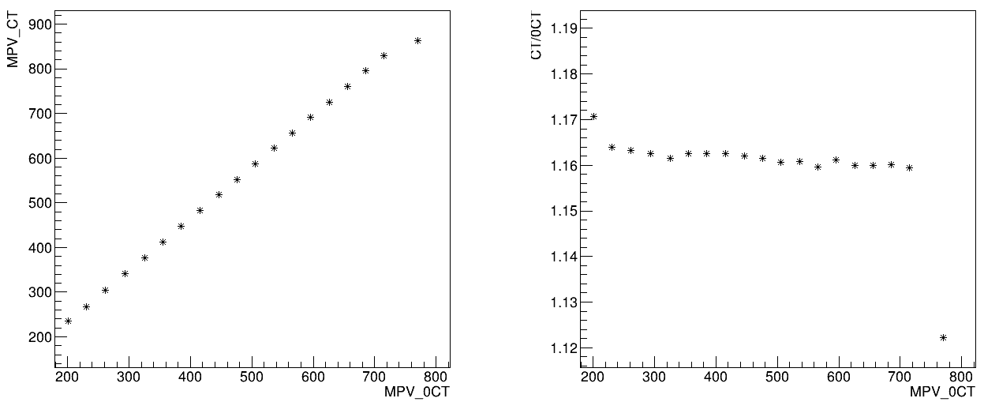
Landau MPV Scanning (15um, threshold cut)
Same situation on 15um

Slide 11
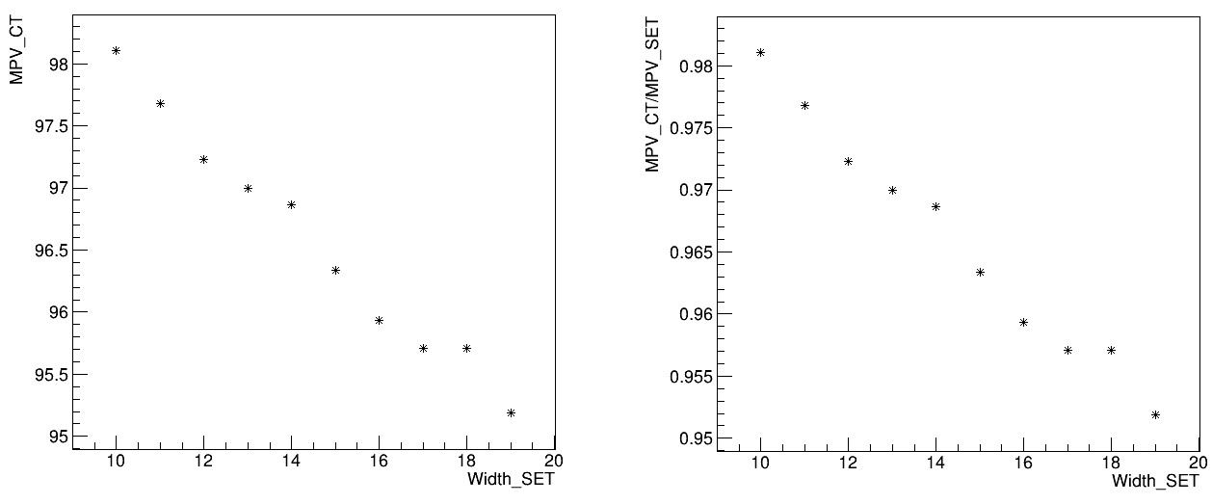
Landau Width Scanning (10um, threshold cut)
With width increase, MPV decrease
Fit method may introduce bias

Slide 12
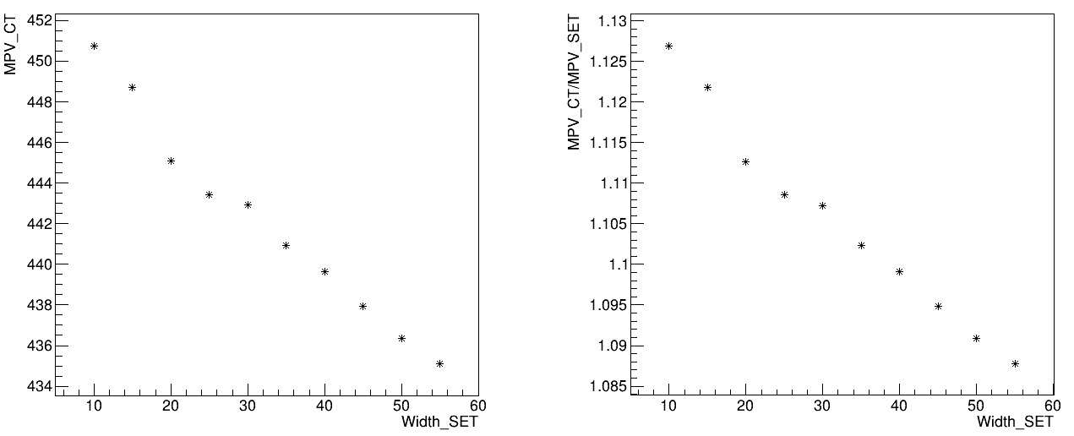
Landau Width Scanning (15um, threshold cut)
Same situation on 15um

Slide 13
Summary
Scanning of Landau MPV and Landau Width
MPV could be easily affected by current fitting method
Correction or new function?

