Slide 1
Study of $J/ψ→φφ$+X
Tiantian Lei
20240826

Slide 2
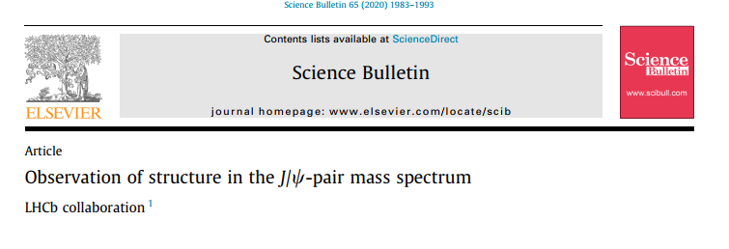
Motivation
LHCb discovered X(6900), a candidate of Tetraquark including ccbar, in Di-$J/ψ$ spectrum. And confirmed by CMS and Atlas.
Besides, lots of states between 2-3 GeV reported by BELLE, BaBar and BESIII, which also candidates of Tetraquark including ssbar, but not confirmed
Inspired by the X(6900), we try to search the candidate of Tetraquark by studying the $J/ψ→φφ$+X.

Slide 3
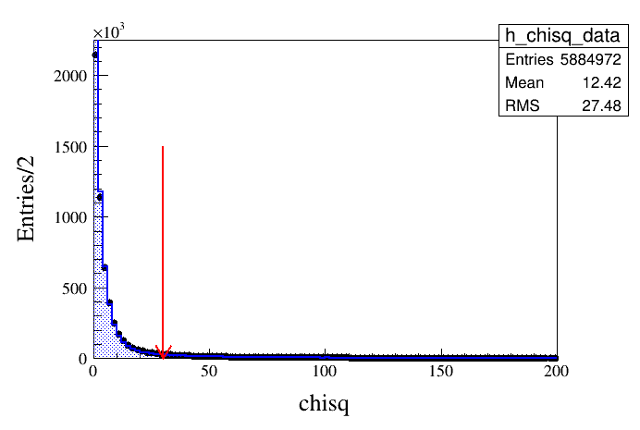
Event selection I
Normal criteria for selection of charged track. (nGood>=4);
Dedx and TOF to identify K, (nKp>=2, nKm>=2);
Vertex fit applied to KK pair, to reconstruct phi, two pairs of KK are selected, with the minimum $ΔM=\sqrt{\left(M_{KK1}−m\right)+\left(M_{KK2}−m\right)}$
Total chisq less than30

Slide 4
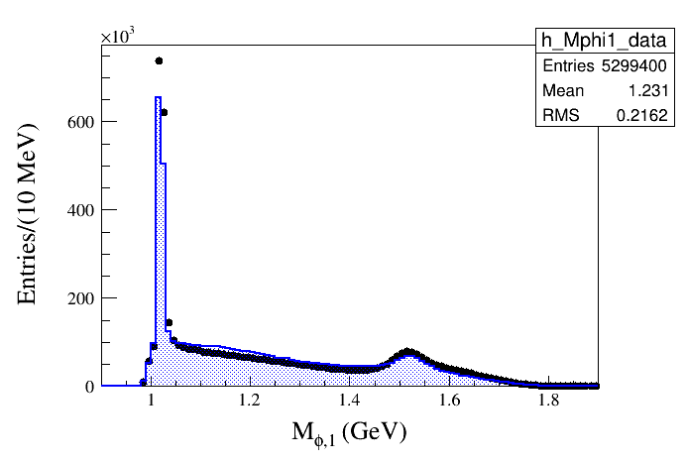
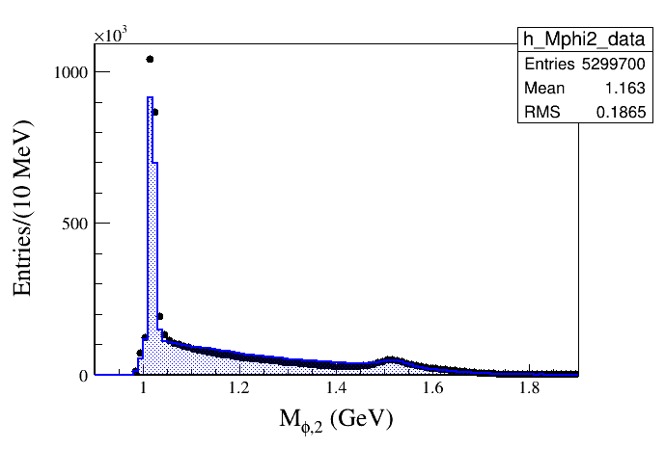
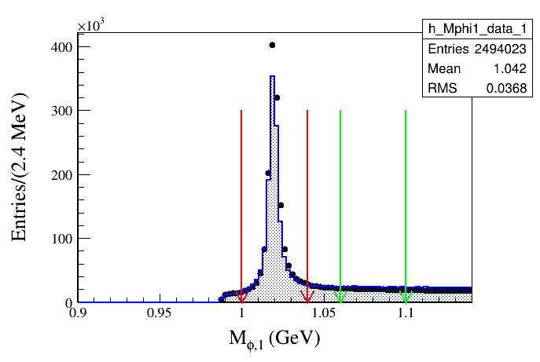
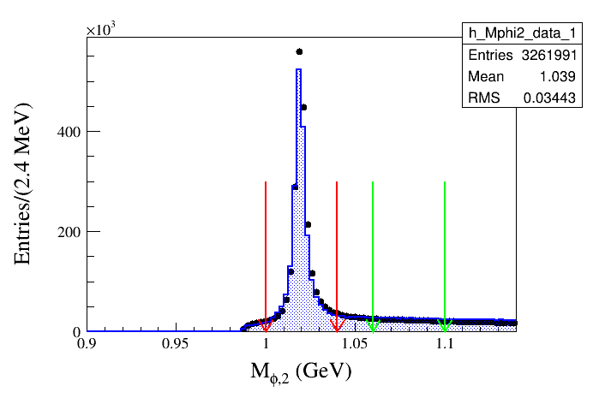
Event selection II
Signal region: 1.00<=Mphi(1)(2)<=1.04
Side band: 1.06<=Mphi(1)(2)<=1.10

Slide 5
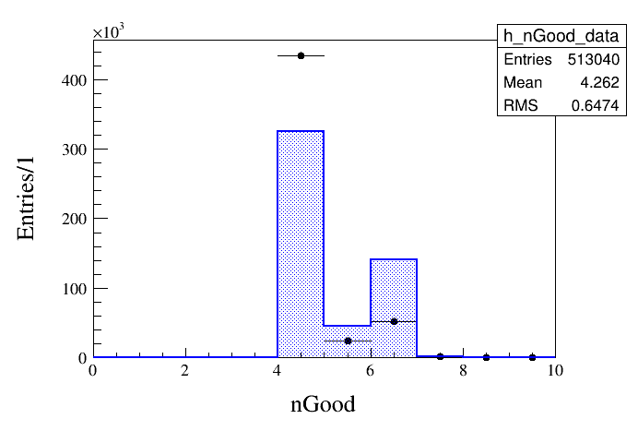
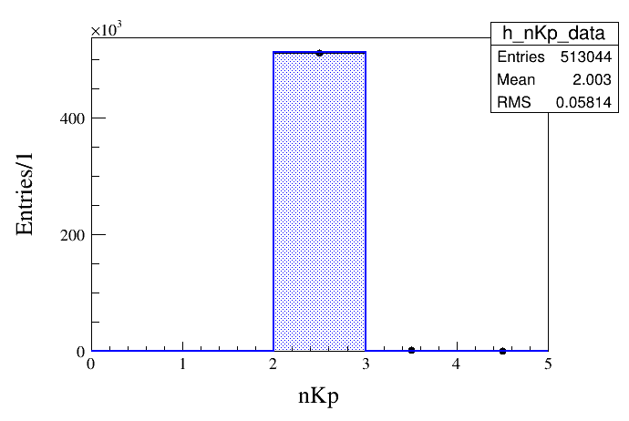
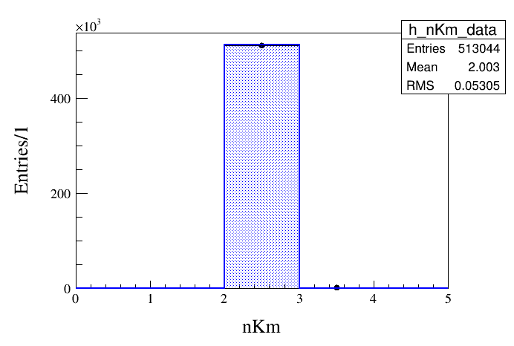
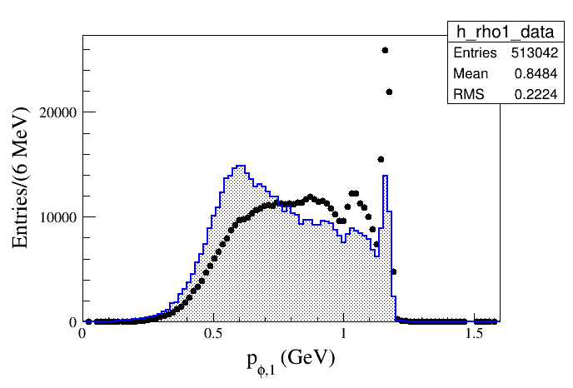
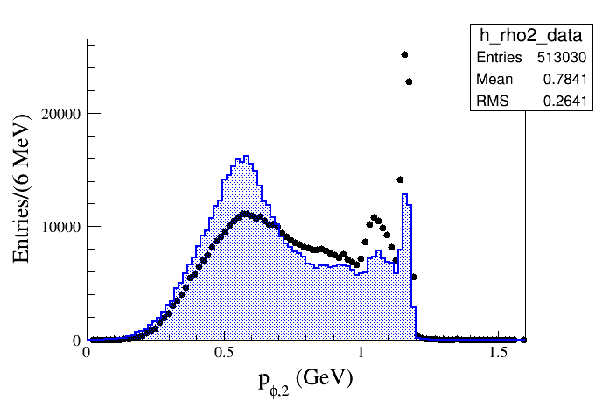
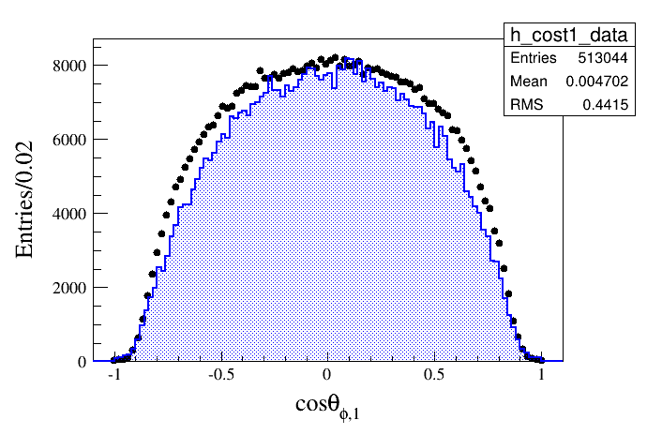
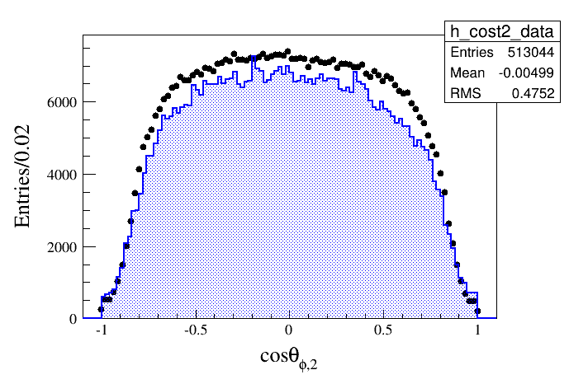
Some distributions

Slide 6
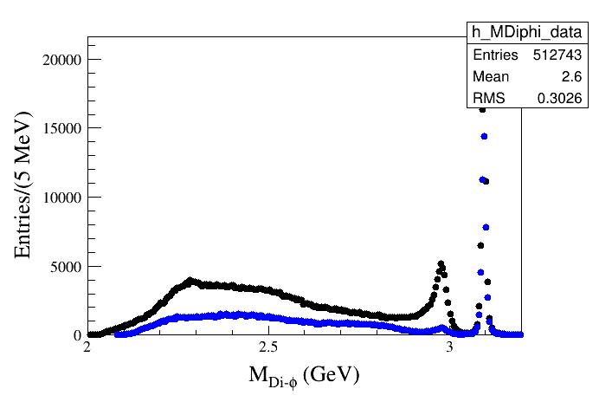
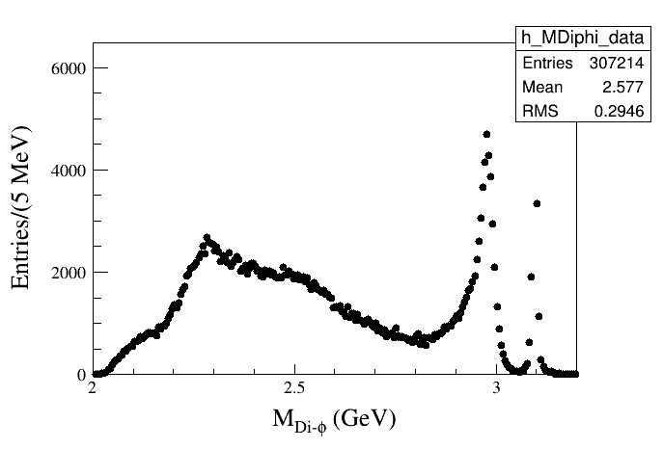
Invariant mass I (2.0-3.2 GeV)

Slide 7
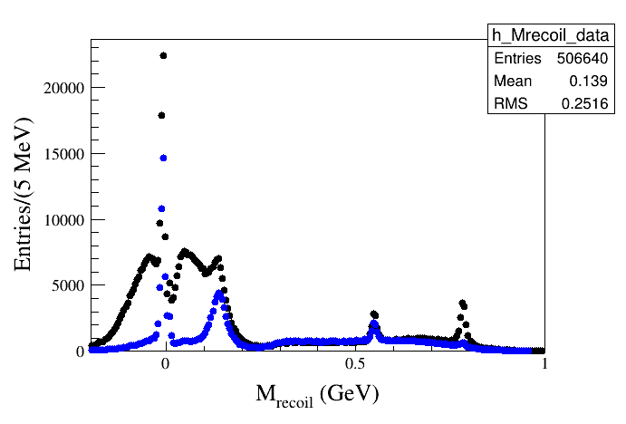
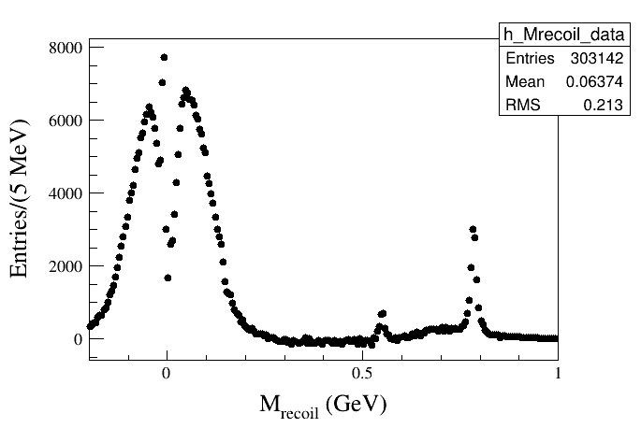
Recoil mass (-0.2-1.0 GeV)

Slide 8
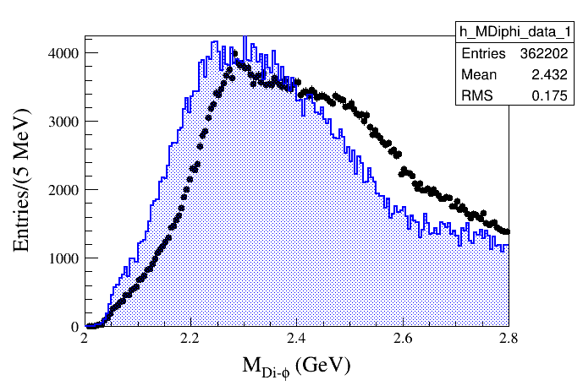
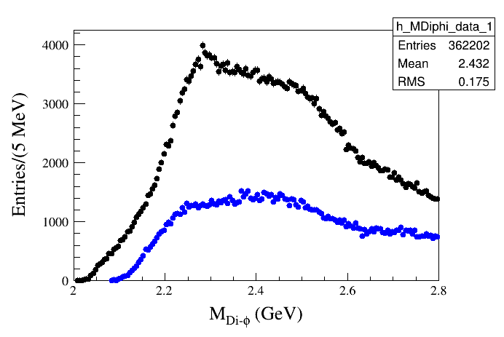
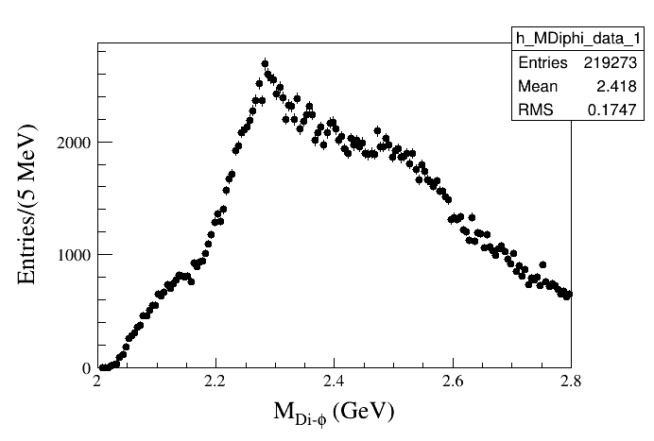
Invariant mass II (2.0-2.8 GeV)

Slide 9
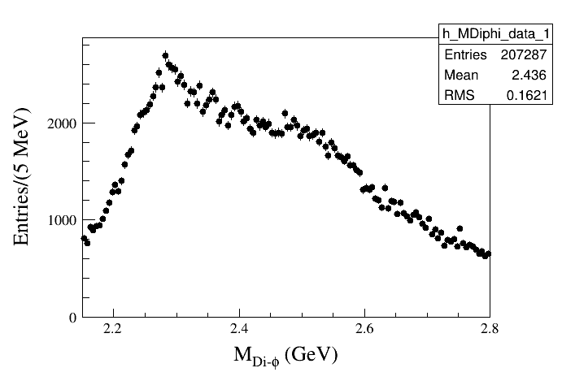
Invariant mass III (2.15-2.8 GeV)

Slide 10
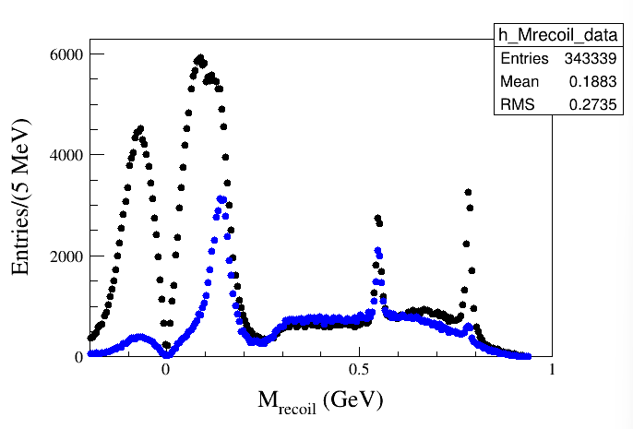
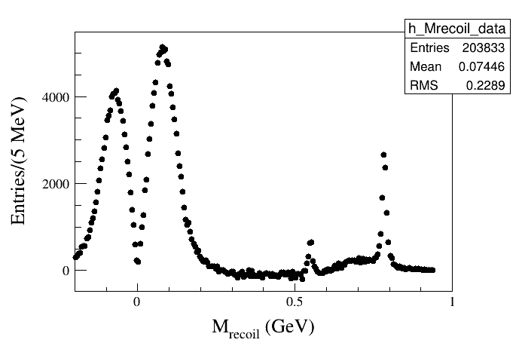
Recoil mass (-0.2-1.0 GeV) (MDiphi2.15-2.8 GeV)

Slide 11
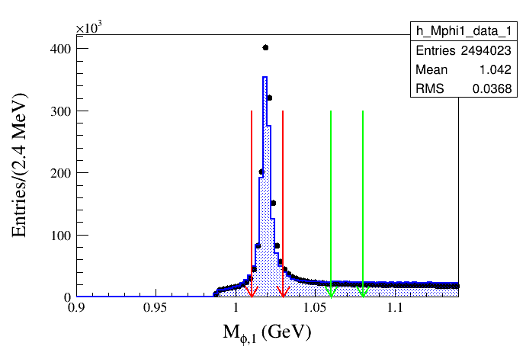
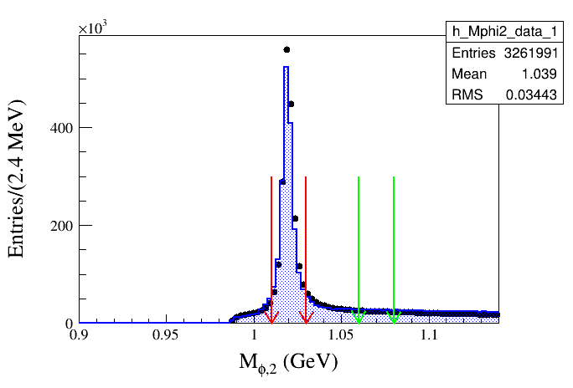
Try more strict Mphi cut
Signal region: 1.01<=Mphi(1)(2)<=1.03
Side band: 1.06<=Mphi(1)(2)<=1.08

Slide 12
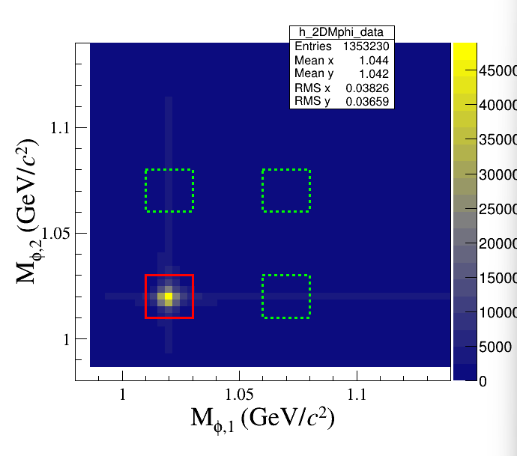
Try more strict Mphi cut
Signal region: 1.01<=Mphi(1)(2)<=1.03
Side band: 1.06<=Mphi(1)(2)<=1.08

Slide 13
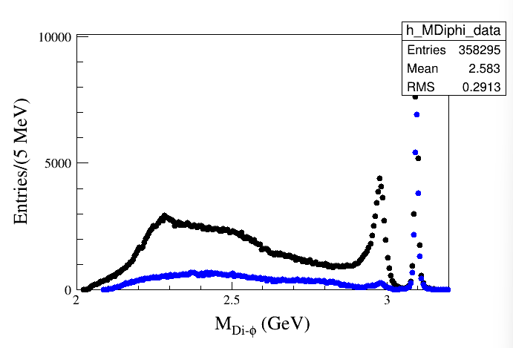
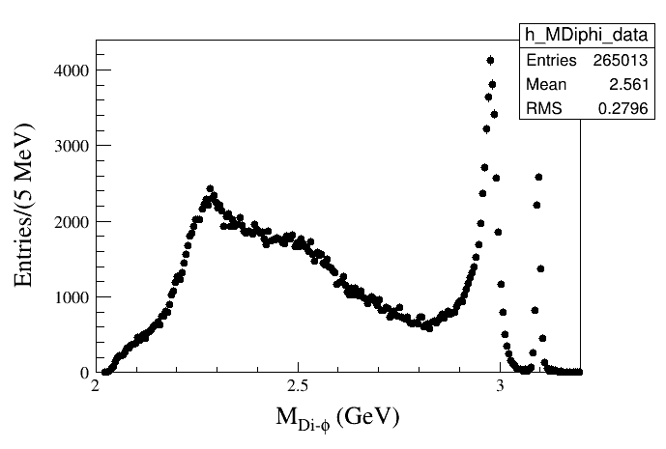
Invariant mass I (2.0-3.2 GeV)

Slide 14
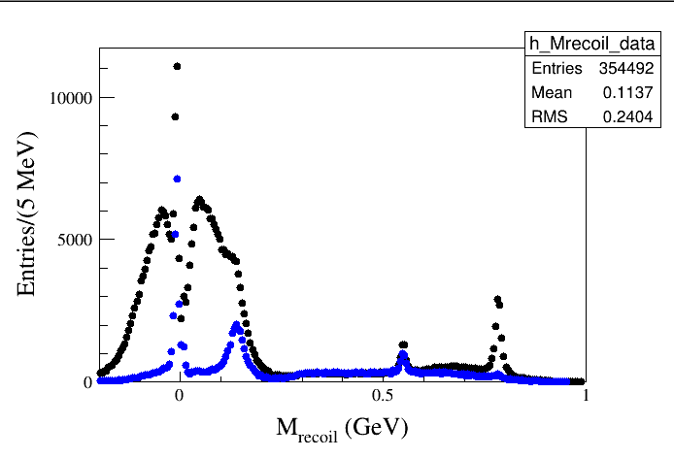
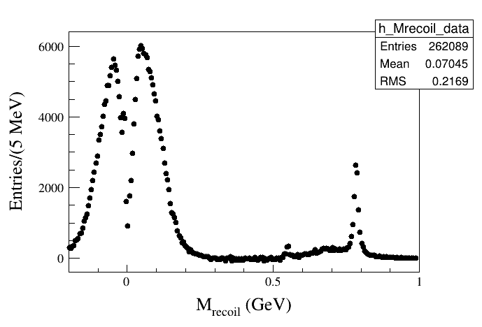
Recoil mass (-0.2-1.0 GeV)

Slide 15
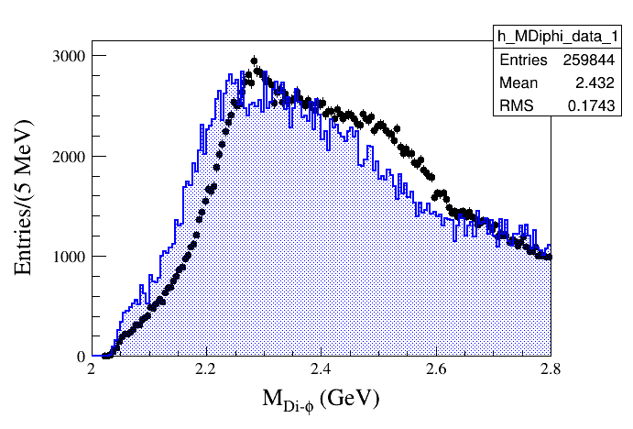
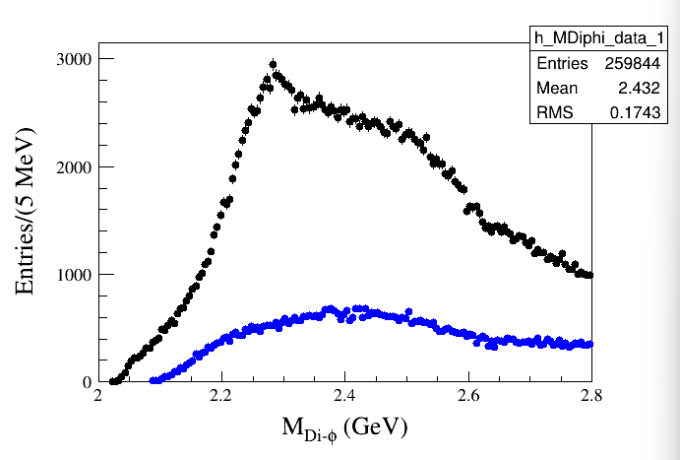
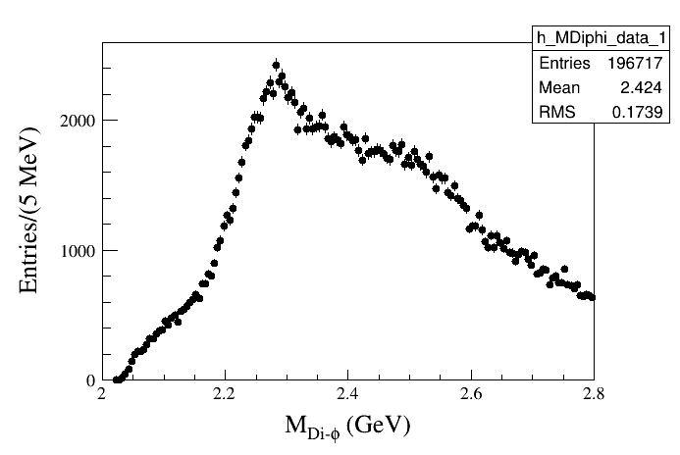
Invariant mass II (2.0-2.8 GeV)

Slide 16
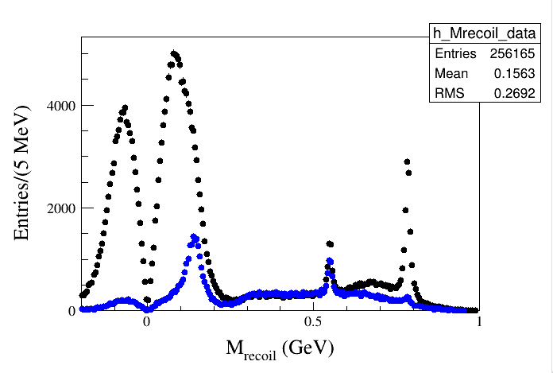
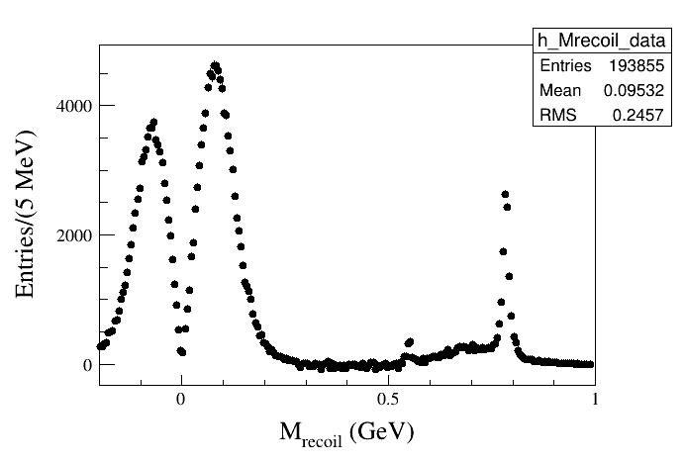
Recoil mass (-0.2-1.0 GeV) (MDiphi2.00-2.8 GeV)

Slide 17
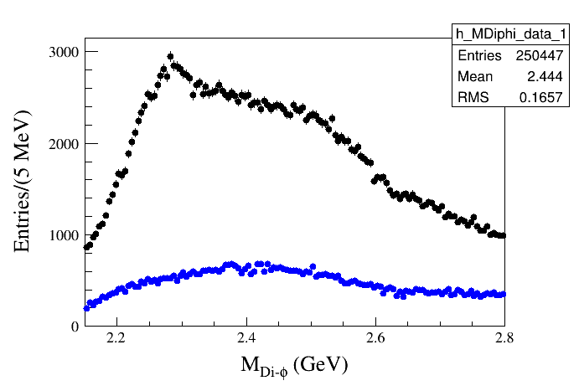
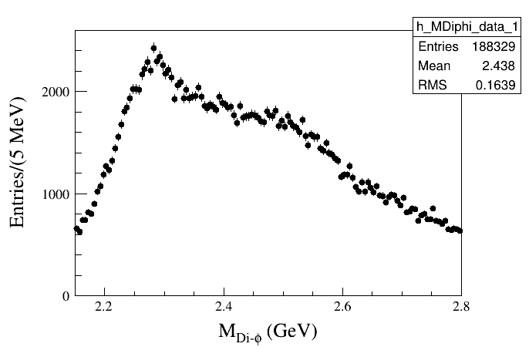
invariant mass III (2.15-2.8 GeV)

Slide 18
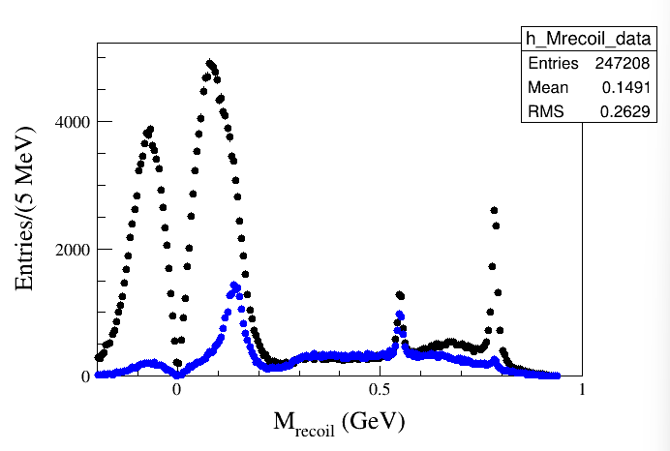
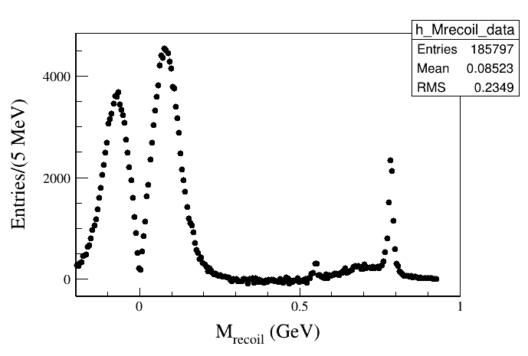
Recoil mass (-0.2-1.0 GeV) (MDiphi2.15-2.8 GeV)
$$γφφ$$
$$ωφφ$$
Remaining bkg of $ηφKK$ or $ηKKKK$

Slide 19
invariant mass (2.15-2.8 GeV)

Slide 20
invariant mass (2.15-2.8 GeV) M_recoil(-0.2,0.2)

Slide 21
invariant mass (2.15-2.8 GeV) M_recoil(0.5,0.6)

Slide 22
invariant mass (2.15-2.8 GeV) M_recoil(0.75,0.82)

Slide 23
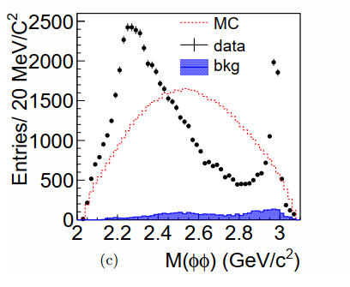
invariant mass (2-3 GeV) M_recoil(-0.2,0.2)
PRD 93, 112011 (2016)

Slide 24
invariant mass (2-3 GeV) M_recoil(0.5,0.6)

Slide 25
invariant mass (2-3 GeV) M_recoil(0.75,0.82)

Slide 26
Topology

Slide 27
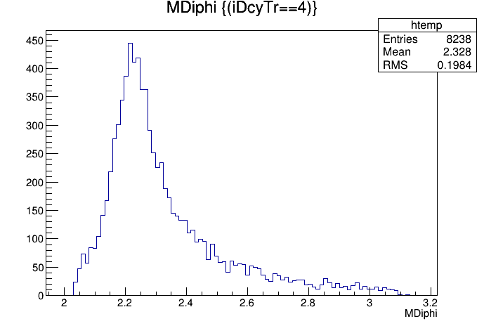
Topology

Slide 28
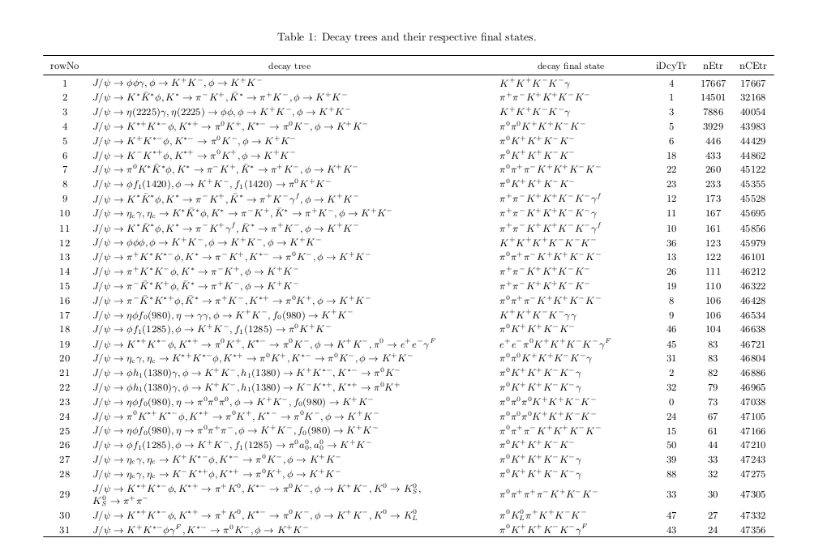
Topology Mdiphi: 2.0-2.8 GeV

Slide 29
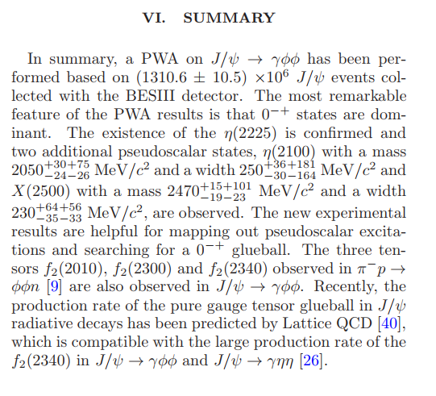
PRD 93, 112011 (2016)

