Slide 1
Status Report
Measurement of $Σ^{+}{\overline{Σ}}^{−}$ electromagnetic form factors using initial-state-radiation technique
2024.8.14

Slide 2
Electromagnetic Form Factors
The cross section for the process $e^{+}e^{−}→B\overline{B}$via one-photon exchange, where B is a spin 1/2 baryon, can be expressed in terms of the electric and magnetic FFs G_{E} and G_{M} by following formula:
$s$ is the invariant mass of the hadronic system
α =1/137.036 is the fine-structure constant
$β=\sqrt{1−4M_{B}^{2}/s}$ is the velocity
$τ=s/4M_{B}^{2}$, $M_{B}^{2}$ is the mass of the baryon.
Coulomb correction factor $C=\left\{\begin{aligned}1, for pairs of neutral baryons \\ y/\left(1−e^{−y}\right), y=πα\left(1+β^{2}\right)/β, for pairs of charged baryons\end{aligned}\right.$

Slide 3
Analysis Strategy
$$e^{+}e^{−}$$
$$γ^{ISR}Σ^{+}{\overline{Σ}}^{−}$$
$$γ^{ISR}pπ^{0}\overline{p}π^{0}$$
We use two method to select the signal events:
1、Untagged method: We select $pπ^{0}\overline{p}π^{0}$ and miss $γ^{ISR}$. By applying constraints on the recoil system of ($pπ^{0}\overline{p}π^{0}$), we can get signal events. This method has a high efficiency.
2、Tagged method: Selecting all final particles including $γ^{ISR}pπ^{0}\overline{p}π^{0}$. This method has lower efficiency compared to the untagged method, but the background is cleaner.

Slide 4
Data Sets
1、Data :
$$\sqrt{s} \left[GeV\right]$$ | Luminosity | Run number | Boss version
3.773 | 2931.8±0.2±13.8 | 11414-13988,14395-14604,20488-23454 | 706
2、Monte Carlo simulations(MC) ($\sqrt{s}=3.773$ GeV):
The signal MC:
The generator software package ConExc is used to simulate the signal MC samples.

Slide 5
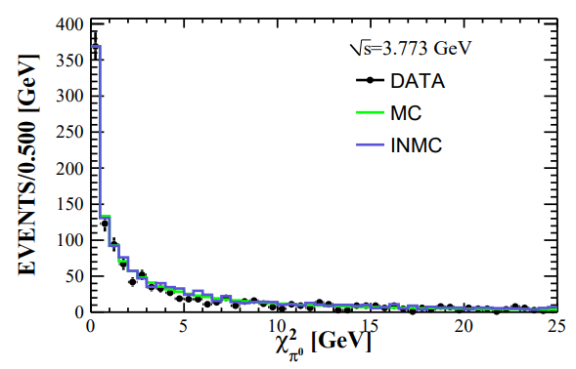
Event Selection
Good charged tracks：
$\left|cosθ\right|≤0.93 , \left|V_{xy}\right|≤2cm$ $,$ $\left|V_{z}\right|≤10cm$
PID：
$p:$prob($p$)$>$prob($π$)$\&$prob($p$)$>$prob($K$)
Photon：
$E_{γ}>25MeV\left(\left|cosθ\right|≤0.80\right)$
$E_{γ}>50MeV\left(0.86≤\left|cosθ\right|≤0.92\right)$
Time cut: $0≤T≤700ns$
The angle of photon and proton $>{10}^{°}$
The angle of photon and anti-proton $>{20}^{°}$
Other selections:
$\text{Numb}\text{er} \text{of} p=1 and \overline{p}=1$
For untagged method: $γ≥4 and π^{0}≥2$
For untagged method: $γ≥5 and π^{0}≥2$
Reconstruct$π^{0}$:
$\left|M\left(γγ\right)−M\left(π^{0}\right)\right|∈\left[−60,40\right]MeV$
A kinematic fit be used, $χ^{2}<25$

Slide 6
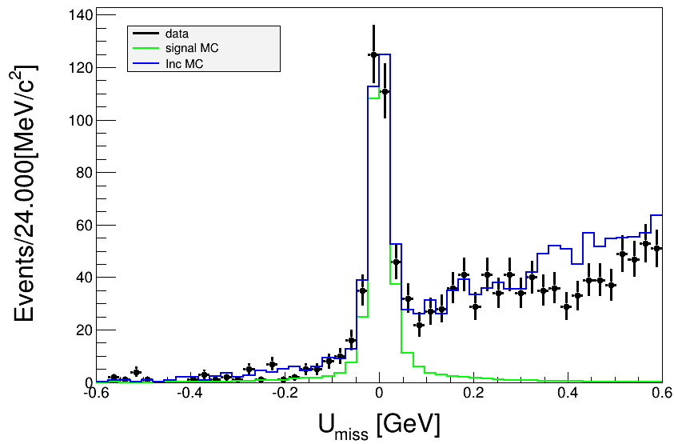
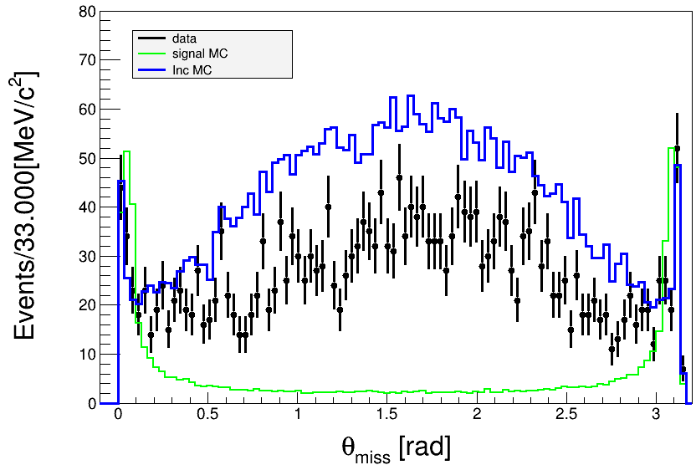
Event Selection
For Untagged Method：
Select minimum $σ_{m}=\sqrt{{\left(M_{pπ^{0}}−M_{Σ^{+}}\right)}^{2}+{\left(M_{\overline{p}π^{0}}−M_{{\overline{Σ}}^{−}}\right)}^{2}}$
Mass cut: $M_{Σ^{+}({\overline{Σ}}^{−})}∈\left[1.16,1.21\right] [GeV]$
$U_{miss}$ cut: $−0.14<U_{miss}<0.06 [GeV]$
$U_{miss}=E_{Σ^{+}{\overline{Σ}}^{−}}^{rec}−P_{Σ^{+}{\overline{Σ}}^{−}}^{rec}$
$θ_{miss}$ cut: $θ_{miss}<0.25 or θ_{miss}>2.90 [rads]$
$θ_{miss}$ means the angle between the momentum of the recoiling against the $Σ^{+}{\overline{Σ}}^{−}$system and beam direction

Slide 7
Event Selection
For Tagged Method：
A kinematic fit be used, there are $5γ, 1p and 1 \overline{p}.$
$4γ should be restrained to 2π^{0} resonance seperately.$
$all particles should be restrained to the center of mass energy$
$χ_{10C}^{2}<200 and select minimum χ_{10C}^{2}$
Select minimum $σ_{m}=\sqrt{{\left(M_{pπ^{0}}−M_{Σ^{+}}\right)}^{2}+{\left(M_{\overline{p}π^{0}}−M_{{\overline{Σ}}^{−}}\right)}^{2}}$
Mass cut: $M_{Σ^{+}({\overline{Σ}}^{−})}∈\left[1.16,1.21\right] [GeV]$
$θ_{miss}$ cut: $0.25<θ_{miss}<2.90 [rads]$
$$U_{miss}$$
kmfit
$$0$$

Slide 8
Event Selection
For Tagged Method：
Select minimum $σ_{m}=\sqrt{{\left(M_{pπ^{0}}−M_{Σ^{+}}\right)}^{2}+{\left(M_{\overline{p}π^{0}}−M_{{\overline{Σ}}^{−}}\right)}^{2}}$
$U_{miss}$ cut: $−0.14<U_{miss}<0.06 [GeV]$
A kinematic fit be used, there are $5γ, 1p and 1 \overline{p}.$
$$4γ should be restrained to 2π^{0} resonance seperately.$$
$$all particles should be restrained to the center of mass energy$$
$$χ_{10C}^{2}<200 and select minimum χ_{10C}^{2}$$
Mass cut: $M_{Σ^{+}({\overline{Σ}}^{−})}∈\left[1.16,1.21\right] [GeV]$
$θ_{miss}$ cut: $0.25<θ_{miss}<2.90 [rads]$
Why not perform
a kinematic fit first?
$$U_{miss}$$
kmfit
$$0$$
Making it impossible to
exclude background!
After testing, we have chosen the following sequence for event selection.

Slide 9
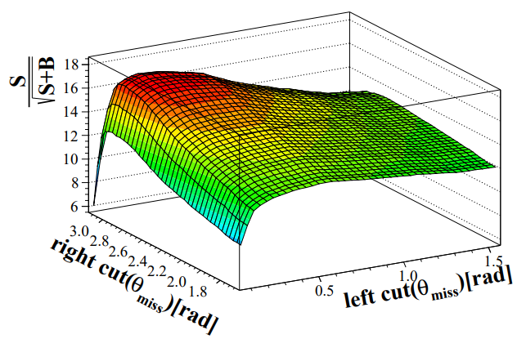
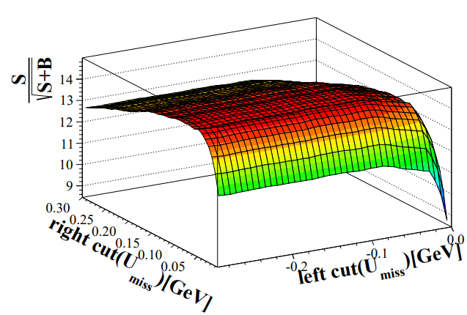
Study of Event Selection

Slide 10
Cut Flow
Untagged Method | Event Number | Step Efficiency | Efficiency
Total number | 400000 | ----- | -----
PID1: $p=1, \overline{p}=1$ | 272878 | 68.22% | 68.22%
Pass $γ≥4$ and angle restriction | 187383 | 68.67% | 46.85%
Pass $π^{0}≥2$ | 121629 | 64.91% | 30.41%
Select minimun $σ_{m}$ | 89310 | 73.43% | 22.33%
$pπ^{0}$ mass in range (1.16, 1.21) | 58871 | 65.92% | 14.72%
$$U_{miss} in range (−0.14, 0.06)$$ | 50143 | 85.17% | 12.54%
$$θ_{miss}<0.25 or θ_{miss}>2.90$$ | 30543 | 60.91% | 7.64%

Slide 11
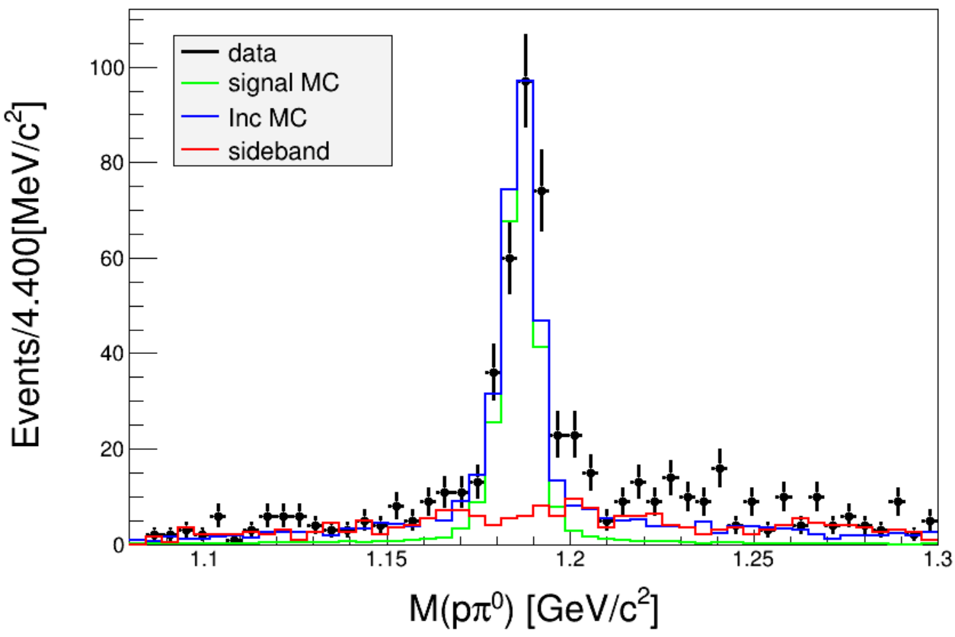
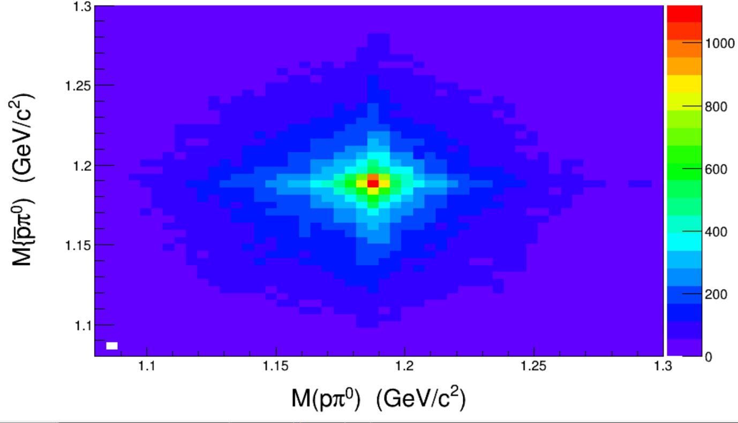
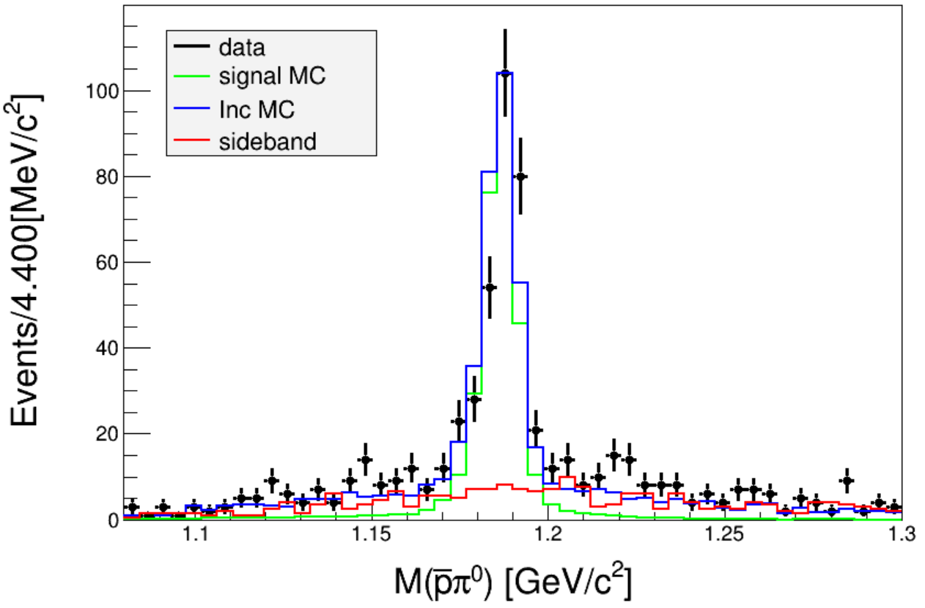
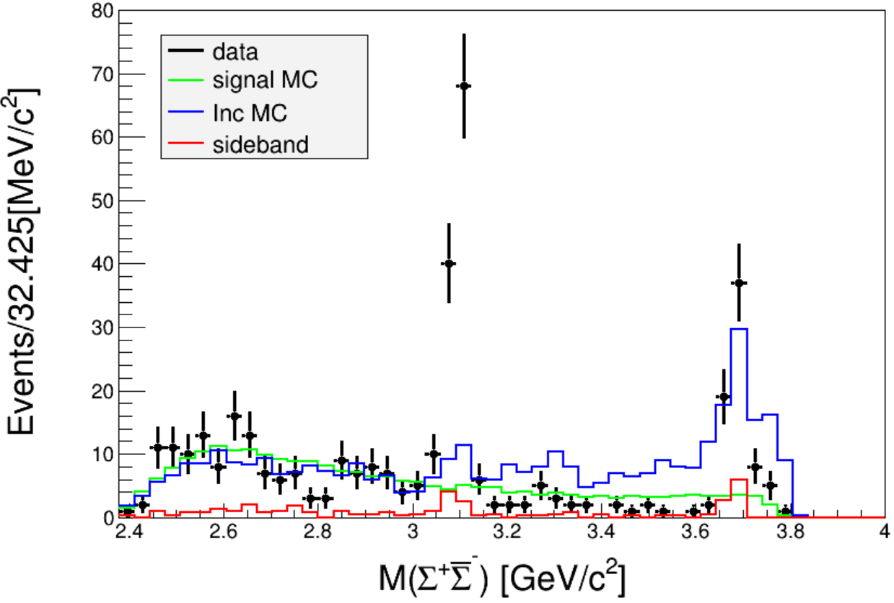
Untagged Results
Sideband Region:
For the untagged method, the results are consistent with BAM-683.

Slide 12
Cut Flow
All Reconstruction Method | $$\text{Event} \text{Number}$$ | Step Efficiency | Efficiency
Total number | 400000 | --- | ---
PID1: $p=1, \overline{p}=1$ | 272878 | 68.22% | 68.22%
Pass $γ≥5$ and angle restriction | 115836 | 42.45% | 28.96%
Pass $π^{0}≥2$ | 87926 | 75.91% | 21.98%
Select minimun kmfit $χ_{sig}^{2}$ | 12454 | 14.16% | 3.11%
$pπ^{0}$ mass in range (1.16,1.21) | 9454 | 75.91% | 2.36%

Slide 13
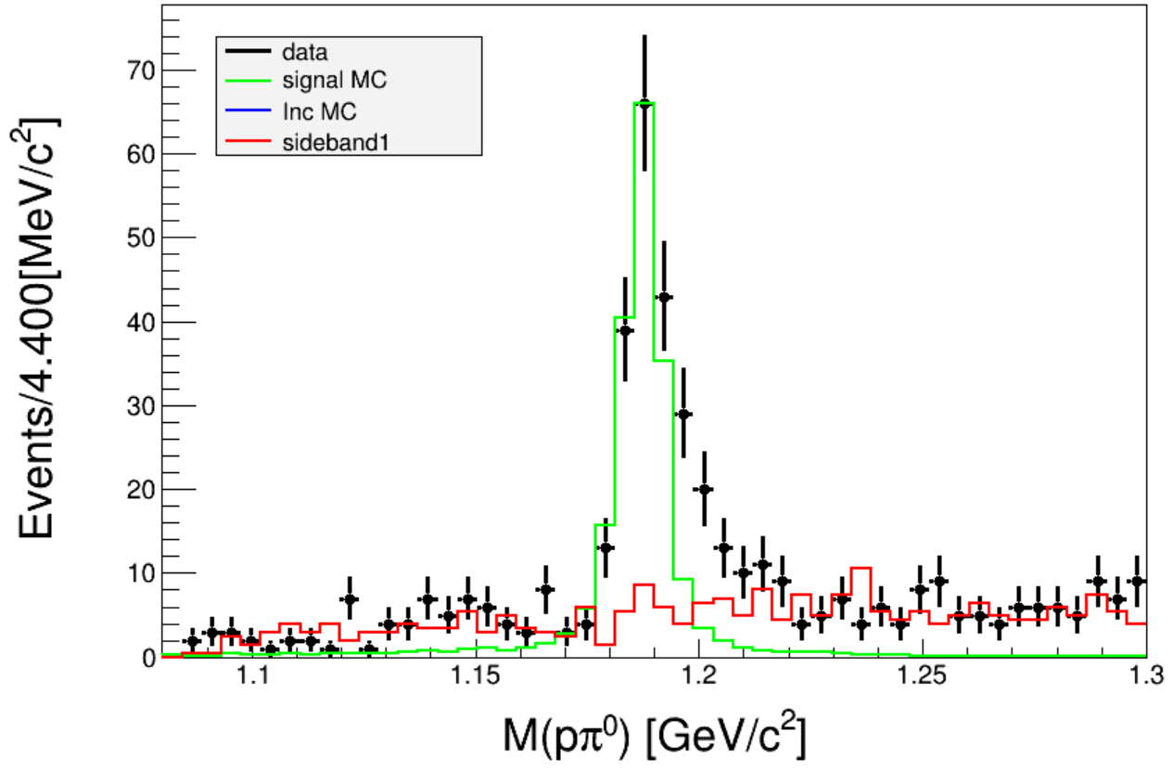
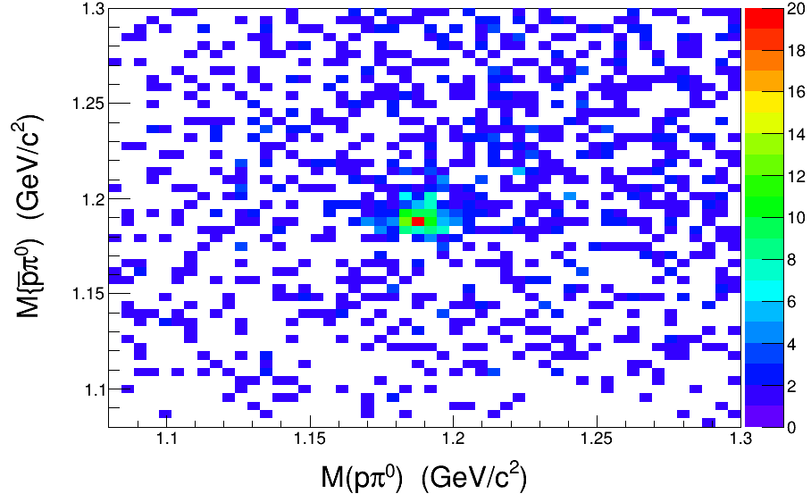
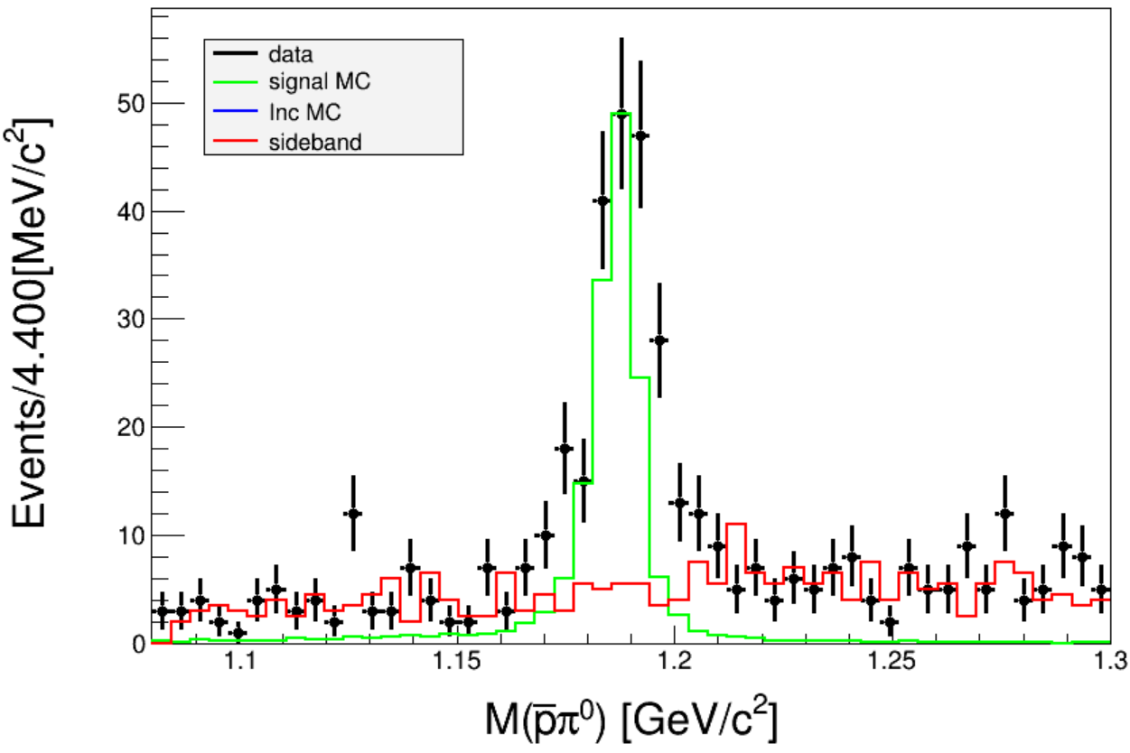
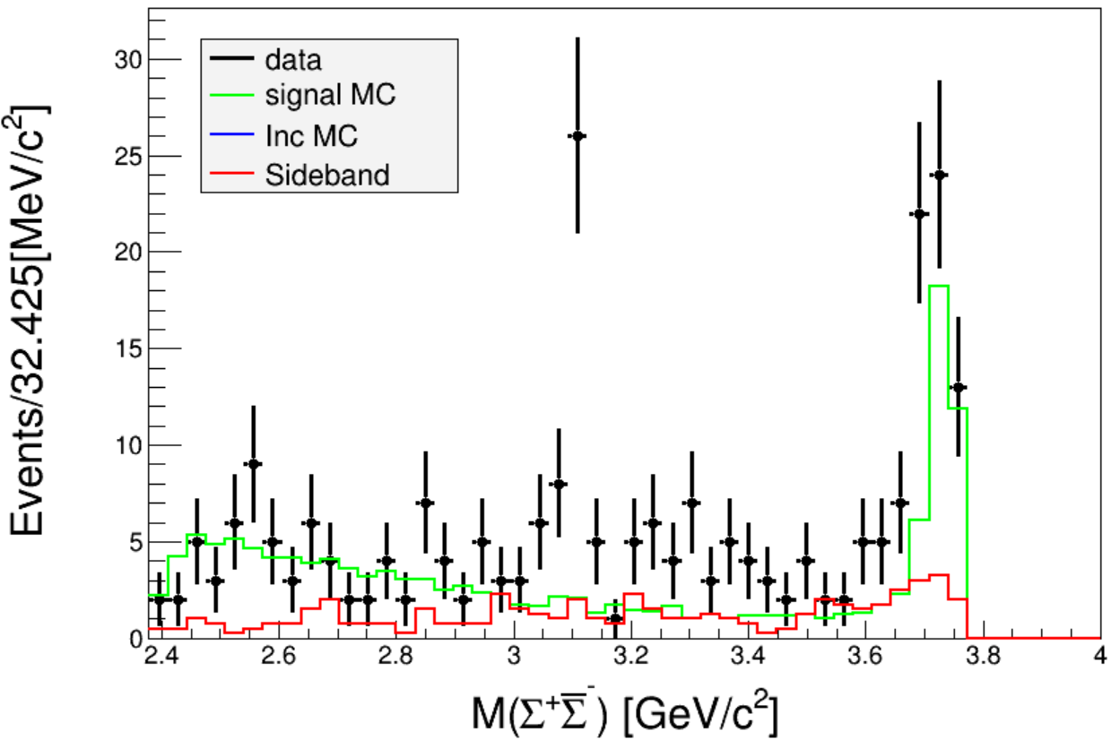
Tagged Results
Sideband Region:
For the tagged method, since the $θ_{miss}$ distribution complements that of the untagged method, we consider combining these two methods.

Slide 14
$θ_{miss}$ distribution of two methods
The distributions of the two methods do not overlap. Therefore, we can superimpose the data signal from both methods for analysis.
Tagged Method
Untagged Method

Slide 15
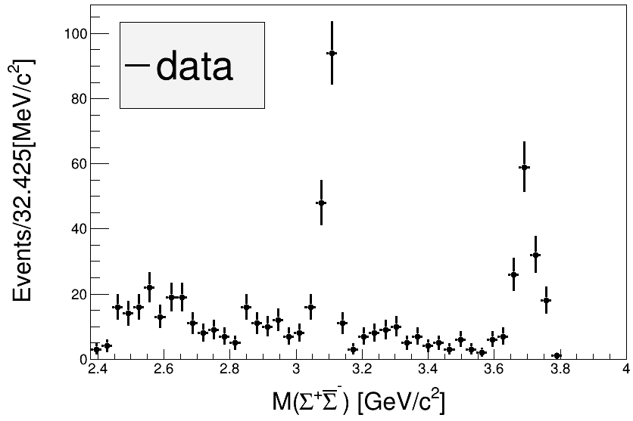
Combined Results
untagged tagged combine

Slide 16
Other Method
In addition, we also made other attempts, such as missing a $π^{0}$ track, but the background was high. We tried several methods to reduce the background, but the results were mediocre, so we abandoned this approach.
E>400MeV
Miss track
1、kmfit：γ^{ISR}、p、anti-p、γ₁γ₂(π⁰)，select minimum $χ^{2} (χ^{2} should less than 200)$
2、select minimum

Slide 17
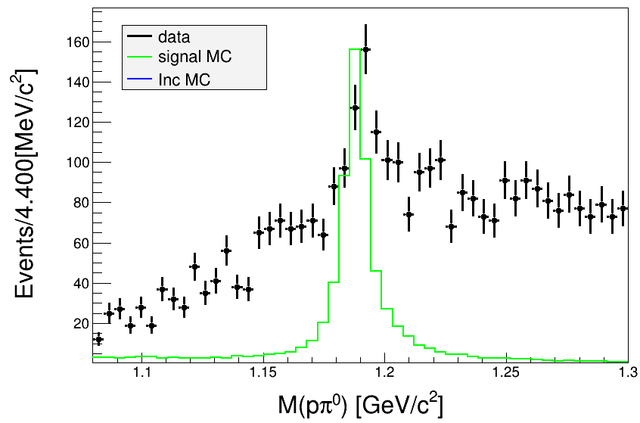
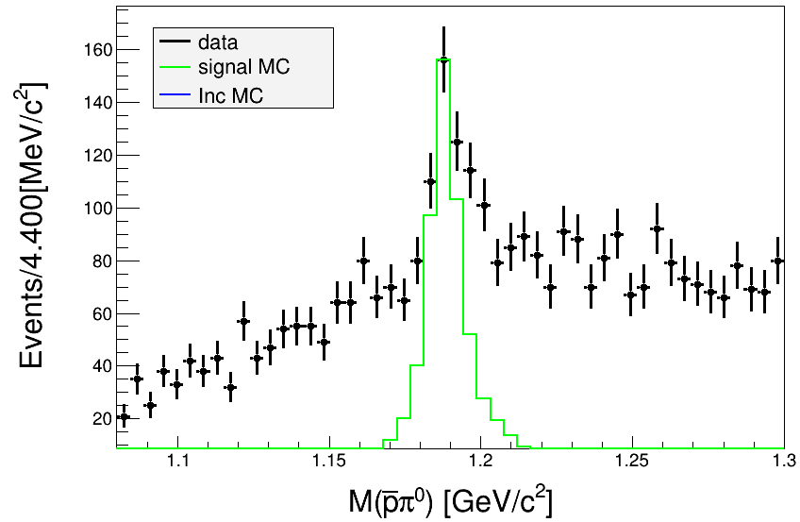
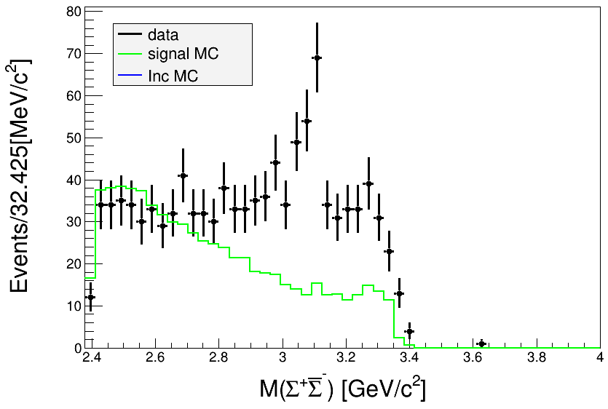
Results
For miss one $π^{0}$ tracking method, the background is very high. Furthermore, the efficiency was also relatively low, so we abandoned this method.

Slide 18
Cut Flow
Tagged Method (Miss one $π^{0}$) | $$\text{Event} \text{Number}$$ | Step Efficiency | Efficiency
Total number | 400000
PID1: $p=1, \overline{p}=1$ | 272878 | 68.22% | 68.22%
Pass $γ≥3$ and angle restriction | 245036 | 89.80% | 61.26%
Pass $π^{0}≥1$ | 211087 | 86.15% | 52.77%
Select minimun kmfit $χ_{sig}^{2}$ | 34558 | 16.37% | 8.64%
$pπ^{0}$ mass in range (1.16,1.21) | 17777 | 51.44% | 4.44%
E$xclude χ_{BG}^{2}<χ_{sig}^{2}$ events | 17048 | 95.90% | 4.26%
E$xclude χ_{BG2}^{2}<χ_{sig}^{2}$ events | 8525 | 50.01% | 2.13%

Slide 19
Thank you!
2024.8.14

Slide 20
Tagged method 1
E>400MeV
Miss track
1、kmfit：γ^{ISR}、p、anti-p、γ₁γ₂(π⁰)，挑选χ₁²最小的组合，且χ²小于200
2、kmfit_BG: π⁰、p、anti-p、γ₁γ₂(π⁰)，挑选χ₂²最小的组合，且χ²小于200，如果χ₂²<χ₁²则视为本底
3、计算 ，判断两个π⁰分别来自Σ⁺还是${\overline{Σ}}^{−}$，保留σ_{m}最小组合
去除$π^{0}Σ\overline{Σ}$本底

Slide 21
Tagged method 2
E>400MeV
Miss track
1、kmfit：γ^{ISR}、p、anti-p、γ₁γ₂(π⁰)，挑选χ₁²最小的组合，且χ²小于200
2、kmfit_BG: γ₁γ₂、p、anti-p、γ₃γ₄(π⁰)，挑选χ₂²最小的组合，且χ²小于200，如果χ₂²<χ₁²则视为本底
3、计算 ，判断两个π⁰分别来自Σ⁺还是${\overline{Σ}}^{−}$，保留σ_{m}最小组合
去除$γγΣ\overline{Σ}$本底

Slide 22
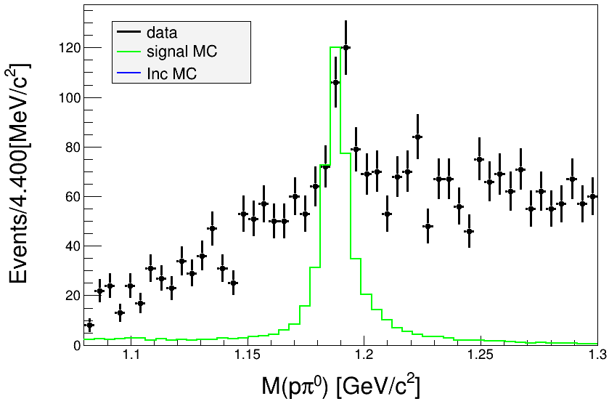
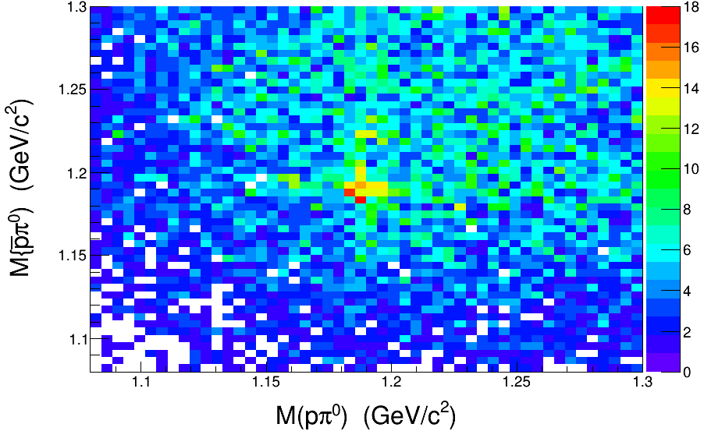
Method1 Result

Slide 23
Compare
We use two method to select signal:
1、先进行质量cut，再筛选最小的$σ_{m}$
2、先筛选最小的$σ_{m}$，再进行质量cut
区别：若存在一种组合，虽然$σ_{m}$最小，但是不落在Mass cut范围内，则该组合会被排除，那么程序就会跳过这一个事例。反之，如果先进行Mass cut再筛选最近的$σ_{m}$，那么程序就会储存这样的事例，因此先Mass cut再筛选最近的$σ_{m}会$使效率更高。

