Slide 1
Some preliminary thoughts
Tiantian Lei
2024.07.31

Slide 2
Some principles
Try to take the best advantages of the potential of data:
  Use data sets as more as possible (psipp and psipp scan, data sets above open charm with Lumi. greater than 400 or 500 pb), as statistical error dominants.
  To simplify the analysis, procedures should applied together to all data sets if possible. Or results of some data sets should inherit from the “core data set”(with large Lumi.) with similar c.m. energy.
Optimize the selection criteria to further improve efficiency. Such as only tag a single lambda(bar), maybe to much bkg…
Structure of line shape (possible resonance near Th., around 2.4 and 2.6~GeV)
G_E/G_M ratio and the relative phase…

Slide 3
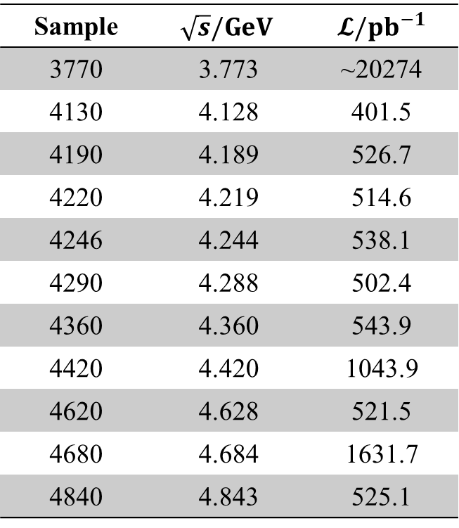
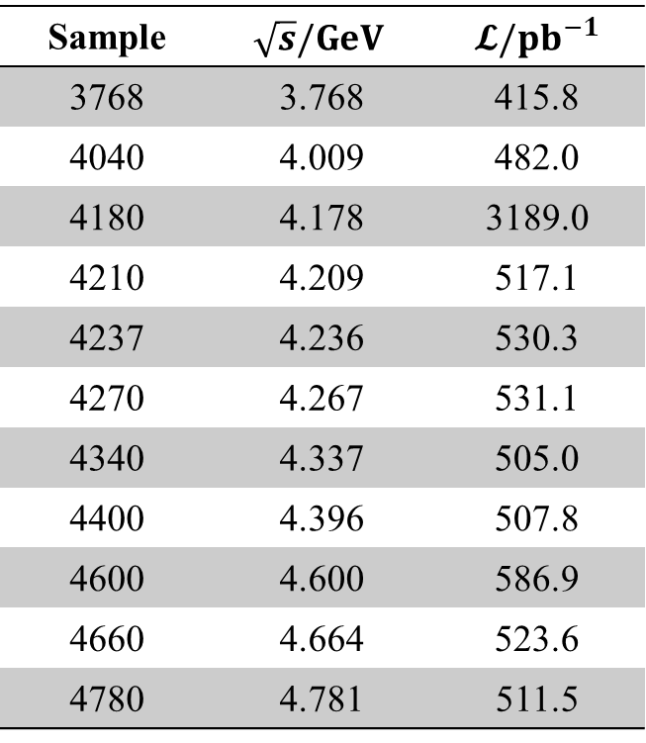
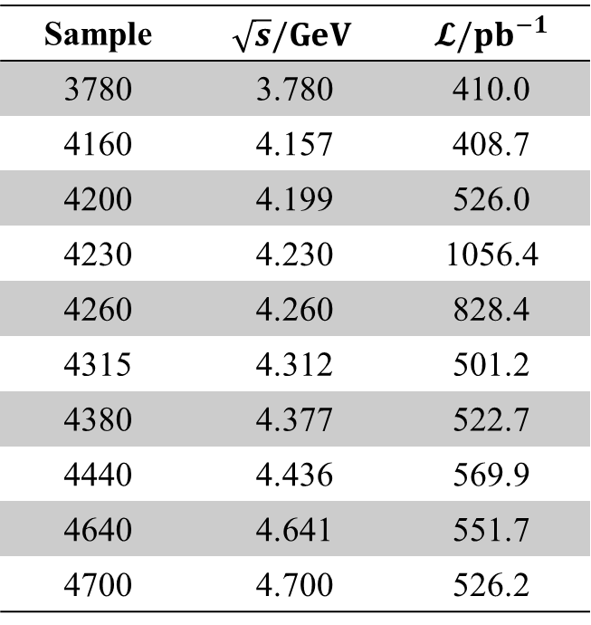
Possible data sets
Sample | $$\sqrt{s}/GeV$$ | $𝓛/{pb}^{−1}$
3768 | 3.768 | 415.8
4040 | 4.009 | 482.0
4180 | 4.178 | 3189.0
4210 | 4.209 | 517.1
4237 | 4.236 | 530.3
4270 | 4.267 | 531.1
4340 | 4.337 | 505.0
4400 | 4.396 | 507.8
4600 | 4.600 | 586.9
4660 | 4.664 | 523.6
4780 | 4.781 | 511.5
Sample | $$\sqrt{s}/GeV$$ | $𝓛/{pb}^{−1}$
3770 | 3.773 | ~20274
4130 | 4.128 | 401.5
4190 | 4.189 | 526.7
4220 | 4.219 | 514.6
4246 | 4.244 | 538.1
4290 | 4.288 | 502.4
4360 | 4.360 | 543.9
4420 | 4.420 | 1043.9
4620 | 4.628 | 521.5
4680 | 4.684 | 1631.7
4840 | 4.843 | 525.1
Sample | $$\sqrt{s}/GeV$$ | $𝓛/{pb}^{−1}$
3780 | 3.780 | 410.0
4160 | 4.157 | 408.7
4200 | 4.199 | 526.0
4230 | 4.230 | 1056.4
4260 | 4.260 | 828.4
4315 | 4.312 | 501.2
4380 | 4.377 | 522.7
4440 | 4.436 | 569.9
4640 | 4.641 | 551.7
4700 | 4.700 | 526.2
Total Lumi. 41.22 fb. With 12 fb data, 305 signal events obtained, simply scale, ~1100 signal events will be got, statistical error will be ~12-15%, similar to sys. One 8%~10%.

