Slide 1
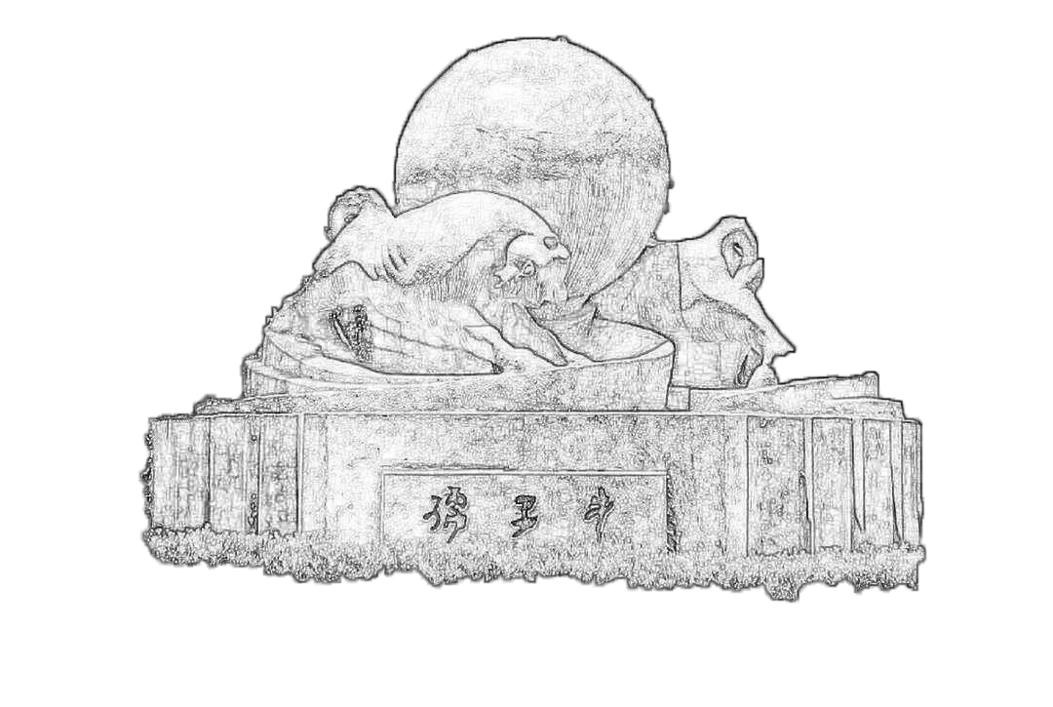
Crosstalk on MIP Spectrum
2023/07/22
Speaker : Jiaxuan Wang

Slide 2
Motivation: how does crosstalk affect MIP spectrum
Crosstalk: 10um-0.1 15um-0.15, MIP MPV also (1+p_ct) ?
Independent test
Get random hist from Landau function
MPV scanning: 10um(80-140); 15um(200-800)
Landau width: 10um 15; 15um 50
Photon Number: Division of random number by (SiPM_Gain*PDE)
Poisson distribution
Light output uniformity
Pixel MC correction
Crosstalk = 0 & crosstalk = 0.1, 0.15
ADC gaussian distribution

Slide 3
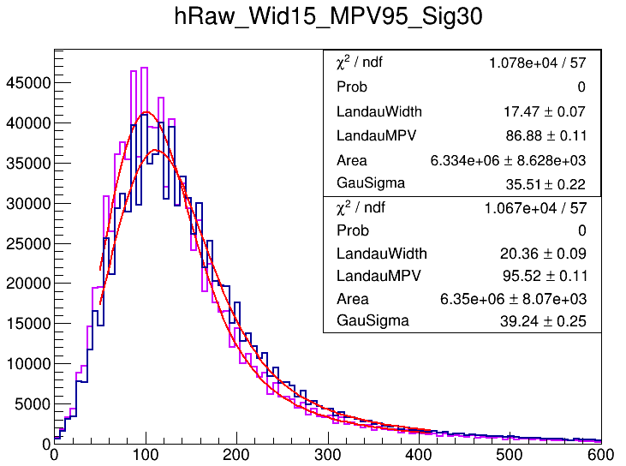
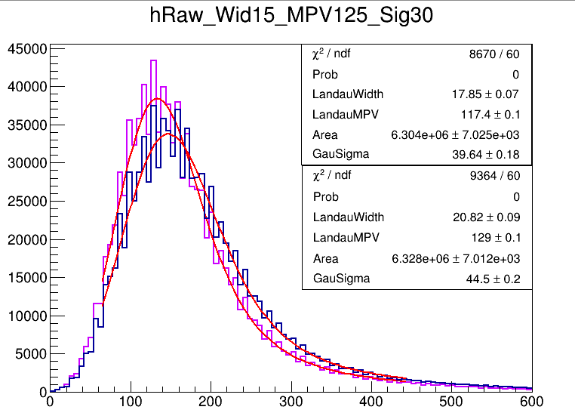
10um SiPM
MPV: 95, 125

Slide 4
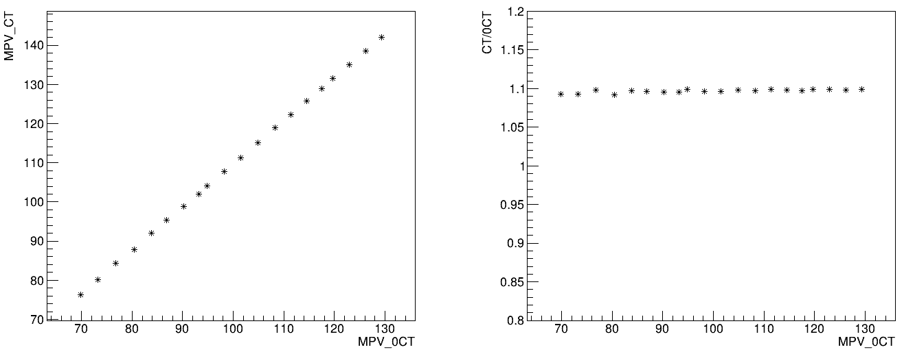
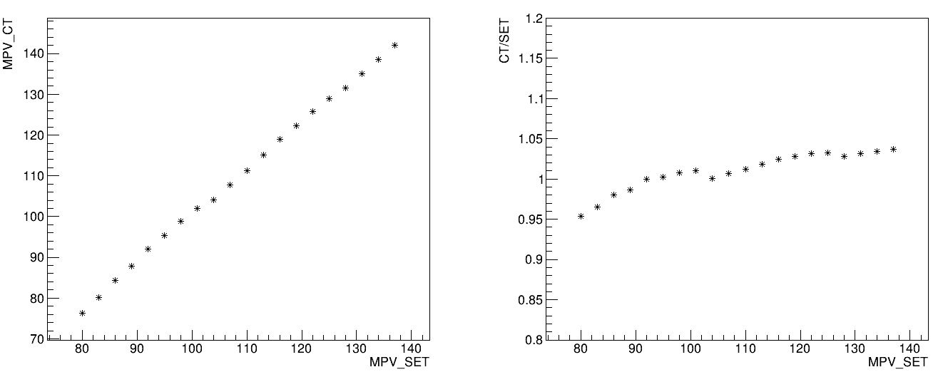
10um SiPM

Slide 5
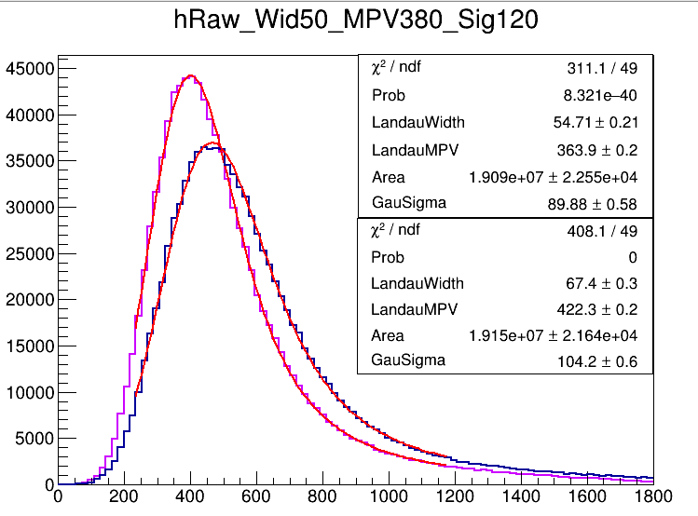
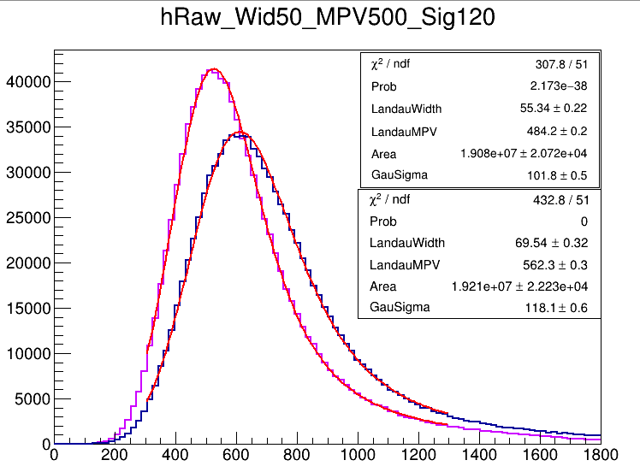
15um SiPM

Slide 6
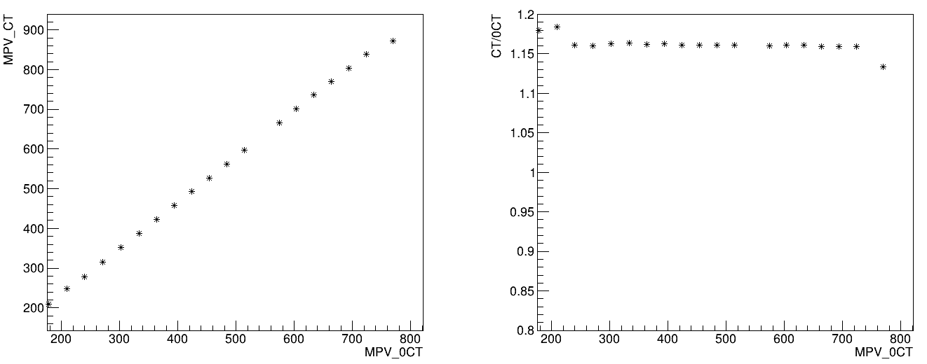
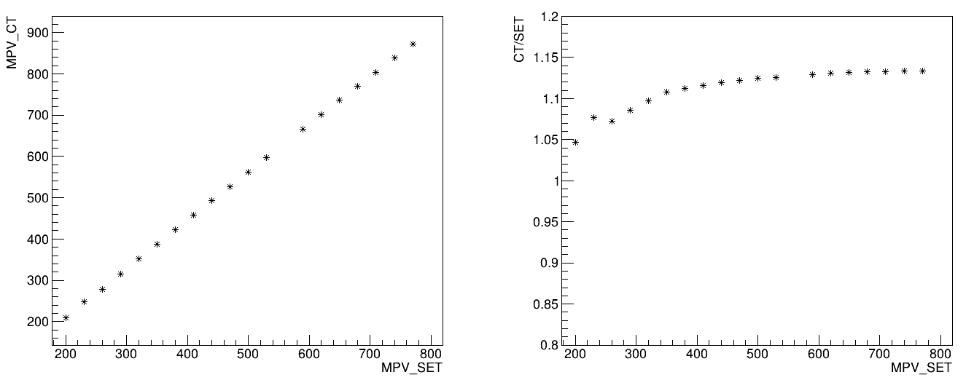
15um SiPM

