Slide 1
Study of propagation origin of knee structure in cosmic ray energy spectrum using large-scale anisotropy
Hua Yue, Wei Liu,
Weikang Gao, Yiqing Guo, Hongbo Hu
IHEP, CAS
2023.10.23

Slide 2
Outline
Introduction
Method
Results & Discussion
Summary

Slide 3
Introduction
The origin of the knee structure in cosmic ray (CR) energy spectrum remains unresolved.
To explain it, various types of models have been proposed:
Acceleration origin;
Propagation origin;
Interaction origin;
nearby source origin.
Our work focuses on the propagation origin by adopting a double power law rigidity-dependent diffusion coefficient.

Slide 4
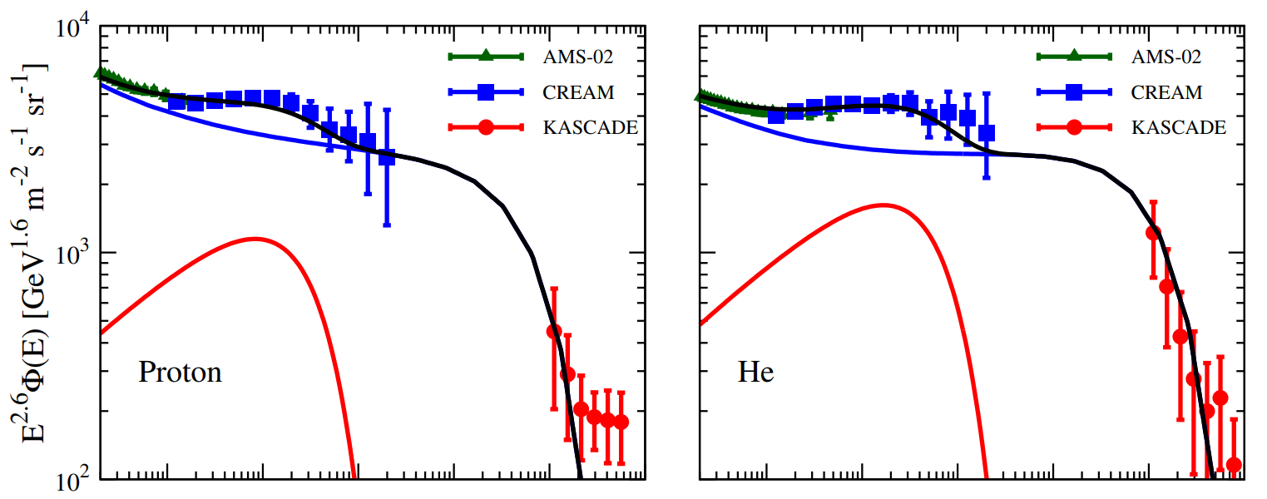
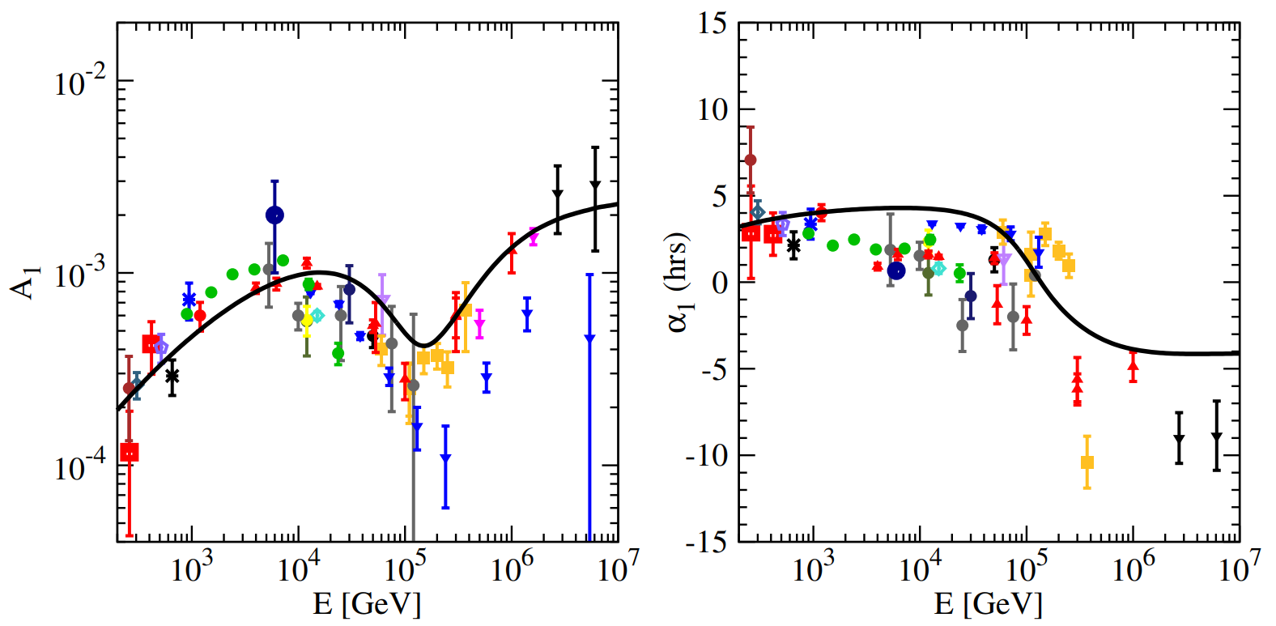
Spatially-dependent propagation and nearby source model
This model describes cosmic ray energy spectrum and anisotropy well with energy below 10PeV.
Based on it, a rigidity dependent double power law diffusion coefficient is adopted to explain the origin of the knee in our work.
10⁸
10⁸
Nearby source vs GC
Bing-Qiang Qiao et al JCAP12(2019)007
GC
Yi-Qing Guo and Qiang Yuan 2018 Chinese Phys. C 42 075103

Slide 5
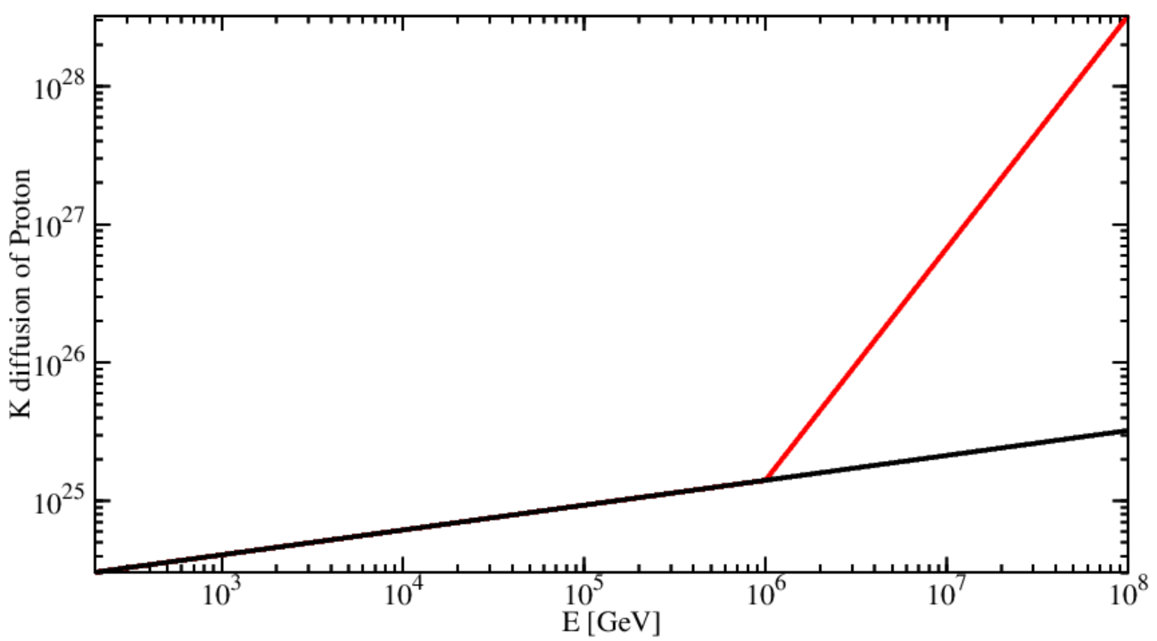
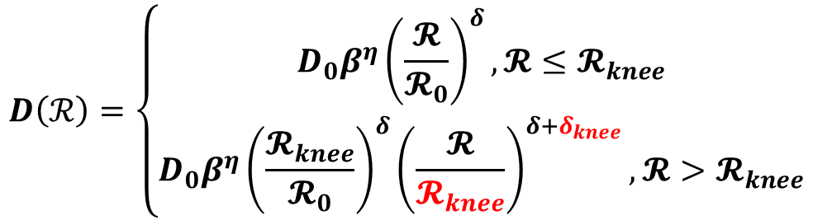
The Diffusion Coefficient
The knee structure can be attributed to the index change of diffusion coefficient.
A double power law rigidity-dependent diffusion coefficient is adopted as
our work
$$D\left(ℛ\right)=\left\{\begin{aligned}D_{0}β^{η}{\left(\frac{𝓡}{𝓡_{0}}\right)}^{δ},𝓡≤𝓡_{knee} \\ D_{0}β^{η}{\left(\frac{𝓡_{knee}}{𝓡_{0}}\right)}^{δ}{\left(\frac{𝓡}{𝓡_{knee}}\right)}^{δ+δ_{knee}},𝓡>𝓡_{knee}\end{aligned}\right.$$
Qiao et al
An example of Proton
Red：douple power law;
Black：single power law.
break rigidity
index change

Slide 6
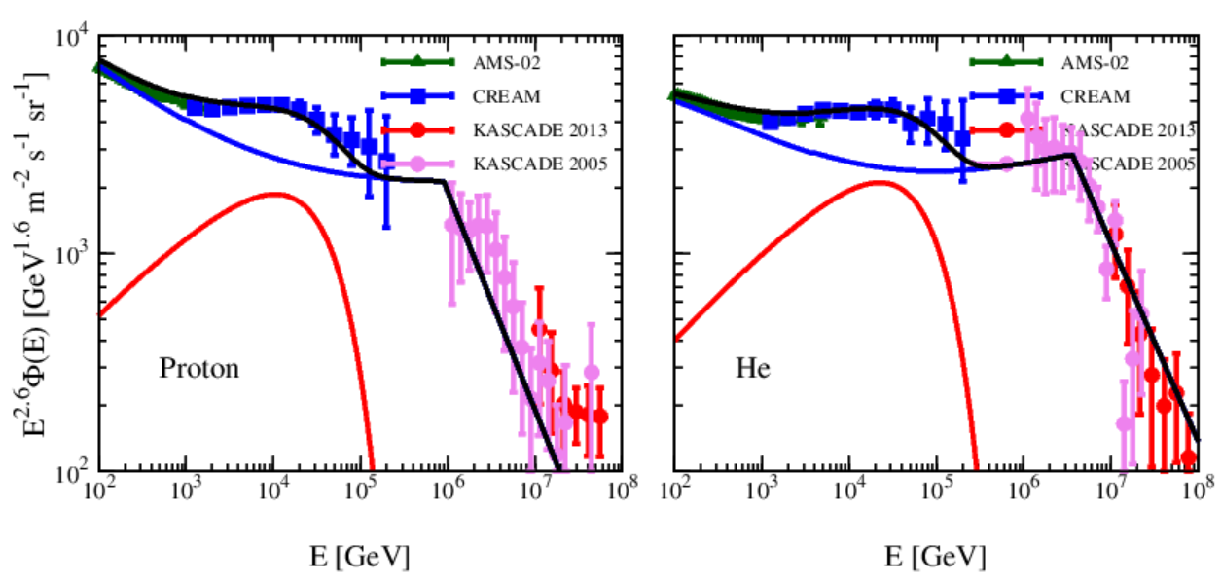
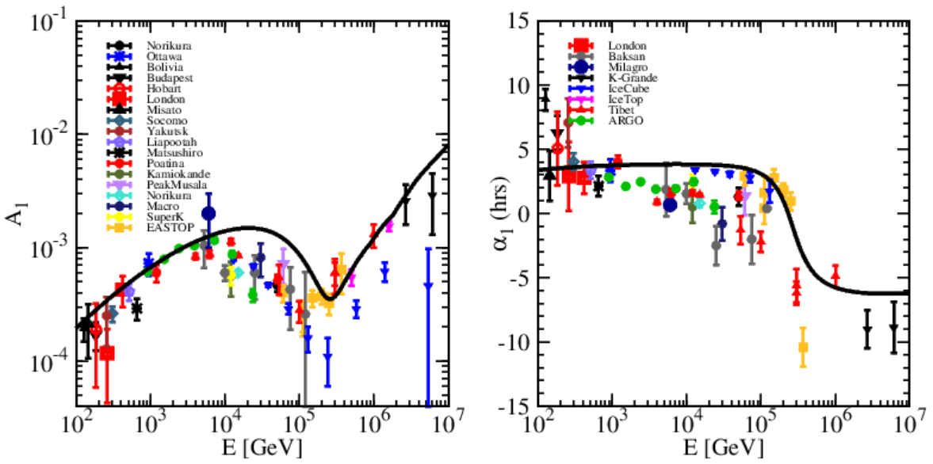
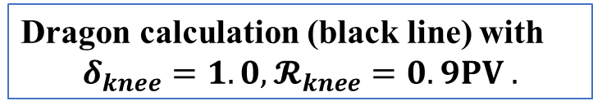
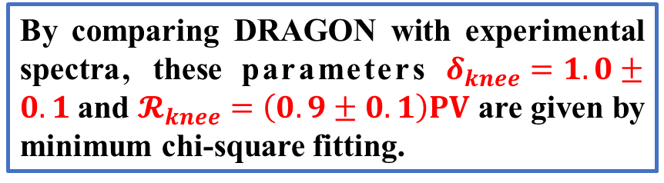
Spectra of Proton and Helium and Anisotropy
By comparing DRAGON with experimental spectra, these parameters $δ_{knee}=1.0±0.1$and $𝓡_{knee}=\left(0.9±0.1\right)PV$ are given by minimum chi-square fitting.
It’s found that the results of spectra and anisotropy with parameters given by spectra are consistent with experiment observations below 10⁷ GeV.
Dragon calculation (black line) with
$$δ_{knee}=1.0, 𝓡_{knee}=0.9PV .$$

Slide 7
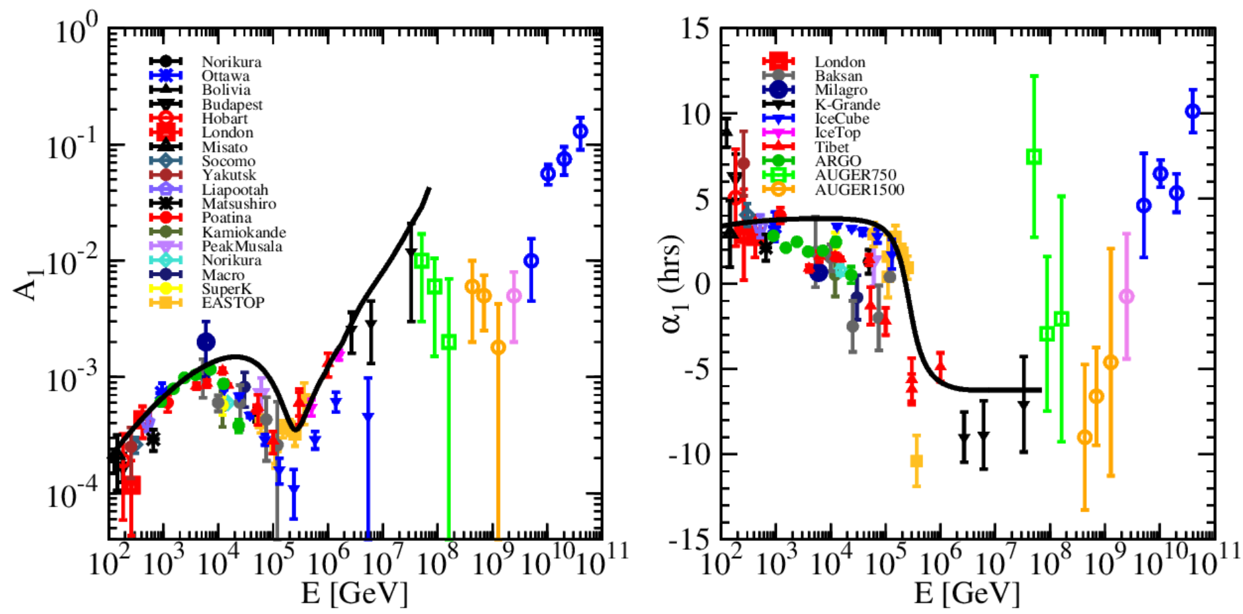
Disagreement of anisotropy above 100PeV
Anisotropy calculated by the diffusion coefficient in this work disagrees with anisotropy observed by experiments at energy above 100PeV.
Is the model feasible?
The similar dip around 1EeV indicates that the anisotropy of Galactic cosmic rays and Extra Galactic cosmic rays is opposite in phase near this energy, with the amplitude subtracted the most.
The “dip”
Contribution of Extra Galactic cosmic rays?

Slide 8
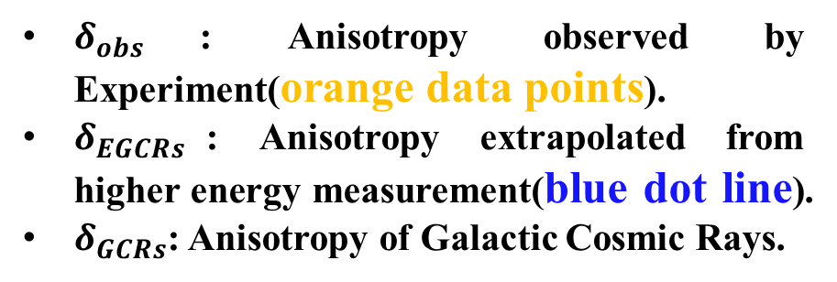
Galactic cosmic ray anisotropy near the dip
Near the dip, Galactic cosmic ray anisotropy can be calculated by
From Extra Galaxy
(the anisotropy)
VHE-CRs Diffusion
Outer Halo
Inner Halo
$${\vec{δ}}_{GCRs}\left(E_{dip}\right)={\vec{δ}}_{obs}\left(E_{dip}\right)−{\vec{δ}}_{EGCRs}\left(E_{dip}\right)$$
Earth
GC
UHE-CRs Diffusion
The Galaxy
$δ_{obs}$: Anisotropy observed by Experiment(orange data points).
$δ_{EGCRs}$: Anisotropy extrapolated from higher energy measurement(blue dot line).
$δ_{GCRs}$: Anisotropy of Galactic Cosmic Rays.
Therefore, anisotropy of Galactic cosmic rays can be completely obtained above the knee !

Slide 9
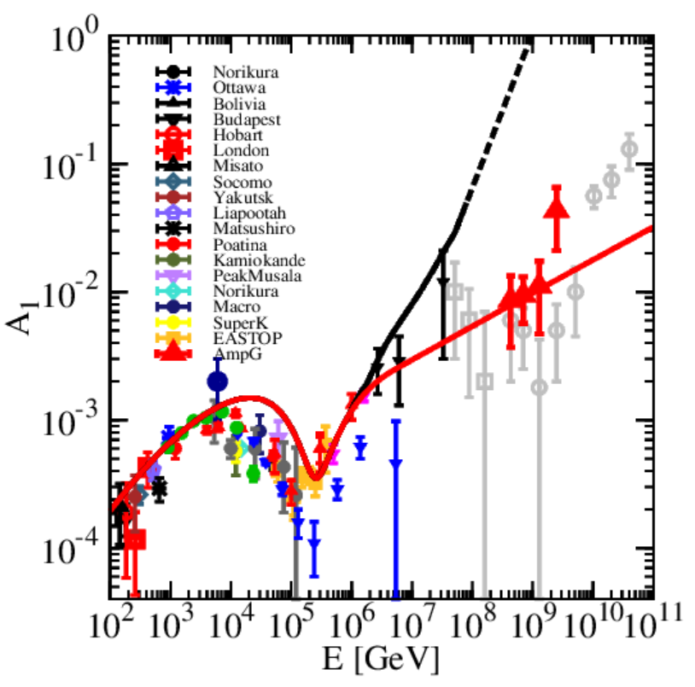
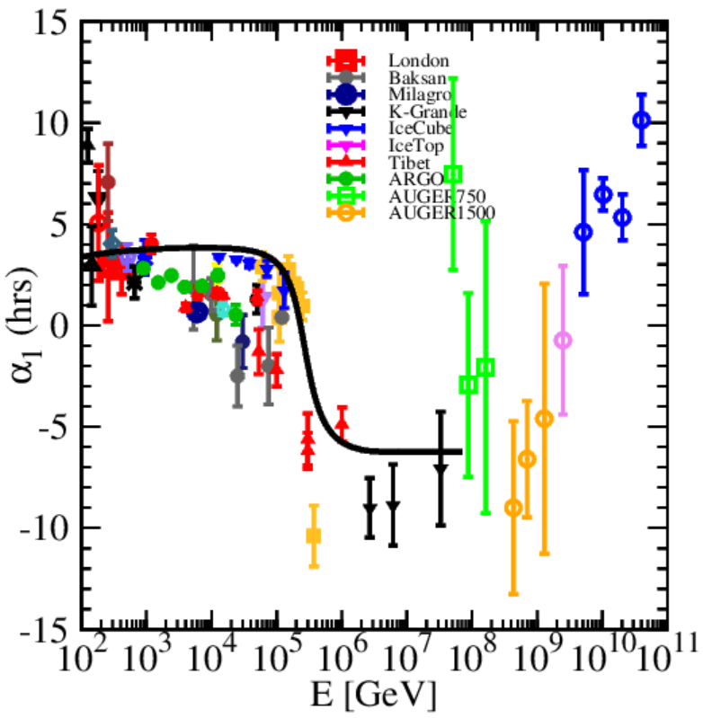
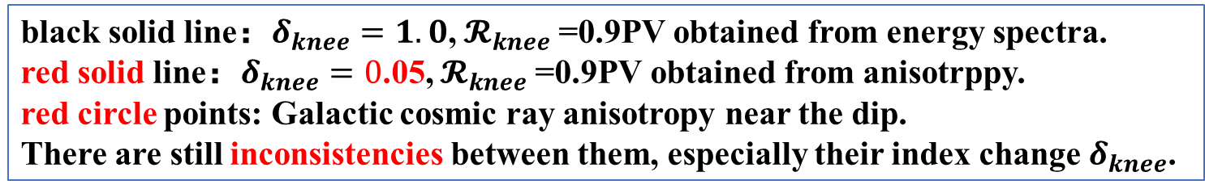
Cosmic Ray Anisotropy: Amplitude and Phase
black solid line：$δ_{knee}=1.0$, $𝓡_{knee}$=0.9PV obtained from energy spectra.
red solid line：$δ_{knee}=0$.05, $𝓡_{knee}$=0.9PV obtained from anisotrppy.
red circle points: Galactic cosmic ray anisotropy near the dip.
There are still inconsistencies between them, especially their index change $δ_{knee}$.

Slide 10
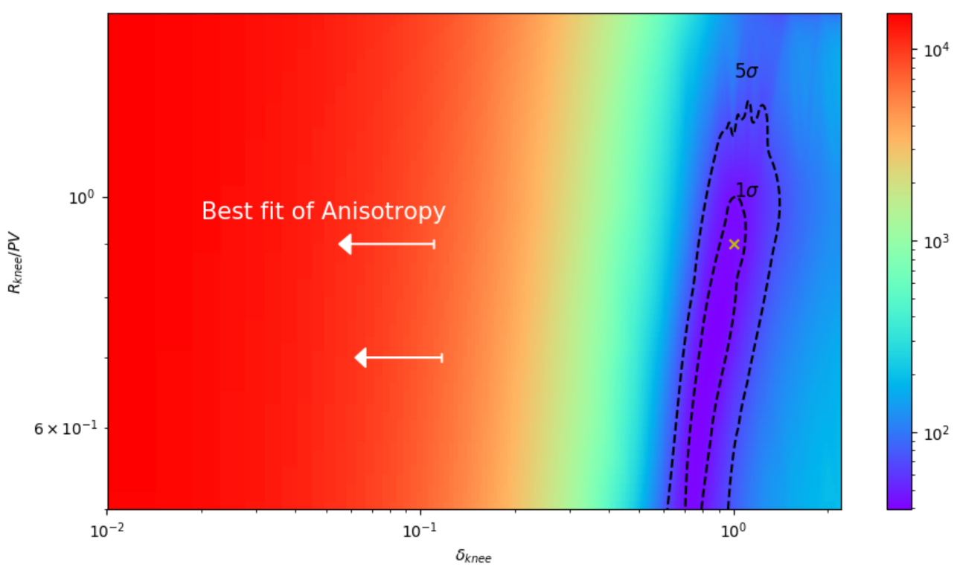
Chi-square fitting method
With detailed chi-square fitting, we get the best fit $δ_{knee}=0.05$ of anisotropy, which strongly disfavors the $δ_{knee}=1.0$ obtained from energy spectra.

Slide 11
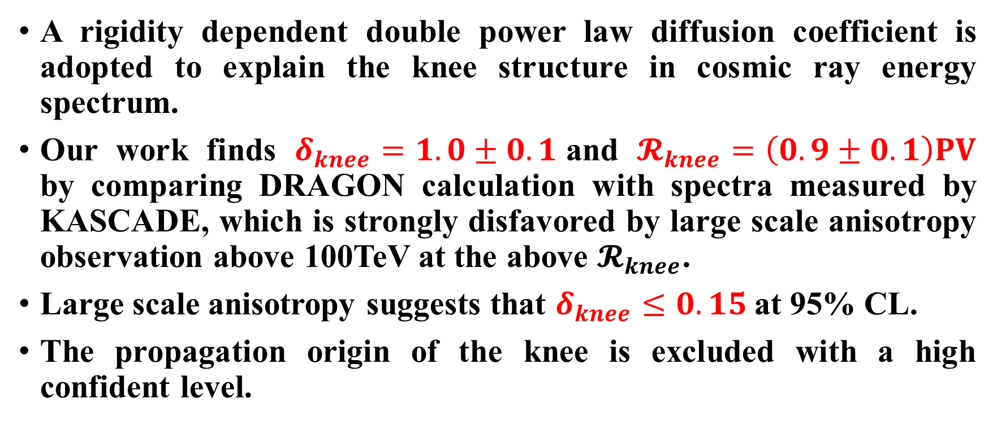
Summary
A rigidity dependent double power law diffusion coefficient is adopted to explain the knee structure in cosmic ray energy spectrum.
Our work finds $δ_{knee}=1.0±0.1$and $𝓡_{knee}=\left(0.9±0.1\right)PV$ by comparing DRAGON calculation with spectra measured by KASCADE, which is strongly disfavored by large scale anisotropy observation above 100TeV at the above $𝓡_{knee}$.
Large scale anisotropy suggests that $δ_{knee}≤0.15$at 95% CL.
The propagation origin of the knee is excluded with a high confident level.

Slide 12
backup

Slide 13
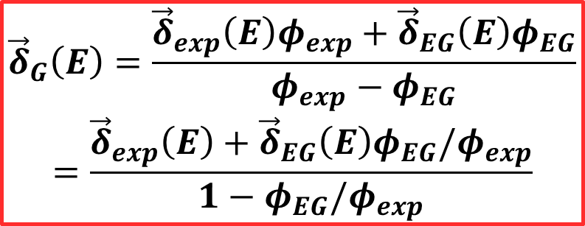
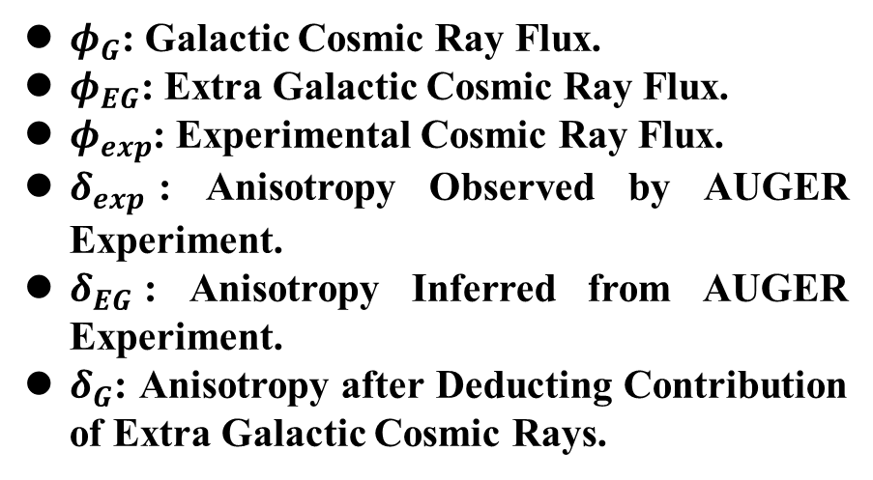
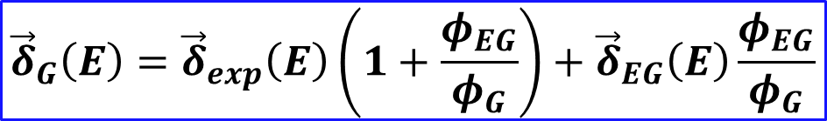
Cosmic Ray Modified Anisotropy
$${\vec{δ}}_{exp}\left(E\right)=\frac{3D}{v}\frac{∇φ_{G}−∇φ_{EG}}{φ_{G}+φ_{EG}}=\frac{{\vec{δ}}_{G}\left(E\right)φ_{G}−{\vec{δ}}_{EG}\left(E\right)φ_{EG}}{φ_{G}+φ_{EG}}=\frac{{\vec{δ}}_{G}\left(E\right)φ_{exp}−\left({\vec{δ}}_{EG}\left(E\right)+{\vec{δ}}_{G}\left(E\right)\right)φ_{EG}}{φ_{exp}}$$
$${\vec{δ}}_{G}\left(E\right)={\vec{δ}}_{exp}\left(E\right)\left(1+\frac{φ_{EG}}{φ_{G}}\right)+{\vec{δ}}_{EG}\left(E\right)\frac{φ_{EG}}{φ_{G}}$$
$φ_{G}$: Galactic Cosmic Ray Flux.
$φ_{EG}$: Extra Galactic Cosmic Ray Flux.
$φ_{exp}$: Experimental Cosmic Ray Flux.
$δ_{exp}$: Anisotropy Observed by AUGER Experiment.
$δ_{EG}$: Anisotropy Inferred from AUGER Experiment.
$δ_{G}$: Anisotropy after Deducting Contribution of Extra Galactic Cosmic Rays.
$${\vec{δ}}_{G}\left(E\right)=\frac{{\vec{δ}}_{exp}\left(E\right)φ_{exp}+{\vec{δ}}_{EG}\left(E\right)φ_{EG}}{φ_{exp}−φ_{EG}}$$
$$=\frac{{\vec{δ}}_{exp}\left(E\right)+{\vec{δ}}_{EG}\left(E\right)φ_{EG}/φ_{exp}}{1−φ_{EG}/φ_{exp}}$$
Notes:
不讲公式，物理上的解释

Slide 14
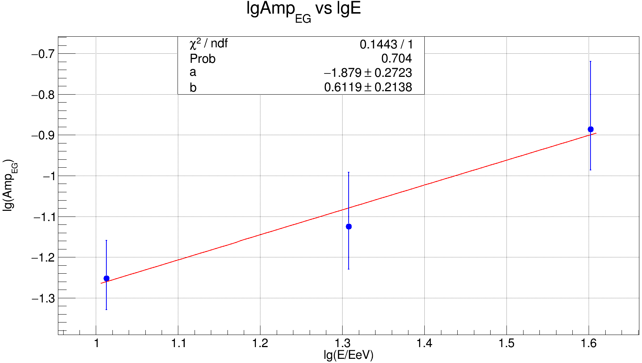
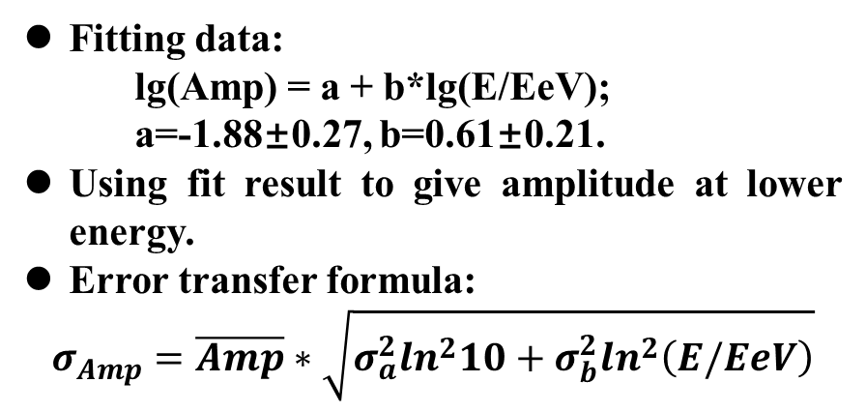
Cosmic Ray Anisotropy Observed By AUGER
A. Aab et al 2020 ApJ 891 142.
Fitting data:
lg(Amp) = a + b*lg(E/EeV);
a=-1.88±0.27, b=0.61±0.21.
Using fit result to give amplitude at lower energy.
Error transfer formula:
$$σ_{Amp}=\overline{Amp}∗\sqrt{σ_{a}^{2}\ln^{2}10+σ_{b}^{2}\ln^{2}\left(E/EeV\right)}$$
E/EeV | 0.43 | 0.70 | 1.28 | 2.48 | 5.1 | 10.3 | 20.3 | 40
Amp | 6.0e-3 | 5.0e-3 | 1.8e-3 | 5.0e-3 | 10.0e-3 | 5.6e-2 | 7.5e-2 | 13e-2
Error Amp | 4.0e-3 | 2.5e-3 | 2.4e-3 | 3.0e-3 | 5.5e-3 | 1.1e-2 | 2.0e-2 | 4.0e-2
Amp EG | 7.9e-3 | 10.6e-3 | 15.3e-3 | 2.3e-2 |  | $b=\frac{lg\left(\frac{0.13}{0.056}\right)}{lg\left(\frac{40}{10.3}\right)}=0.62$, $$a=lg\left(0.056\right)−0.62∗lg\left(10.3\right)=$$
Error Amp EG | 5.1e-3 | 6.6e-3 | 9.6e-3 | 1.5e-2
Notes:
更新，作为中间结果，误差保留两位有效数字

Slide 15
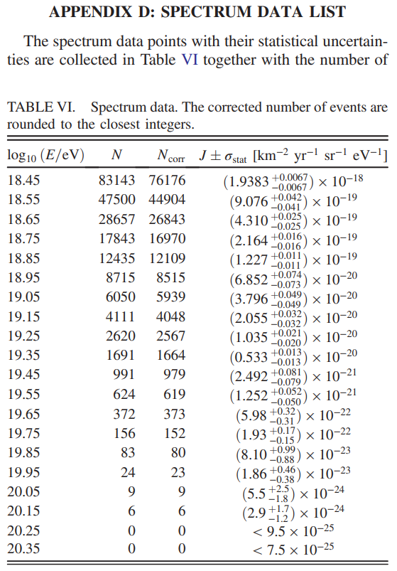
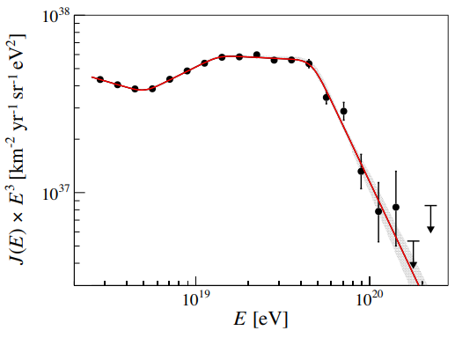
Extra Galactic v.s. Galactic CRs Observed by AUGER
PhysRevD.102.062005
FluxEG+FluxG
FluxEG

Slide 16
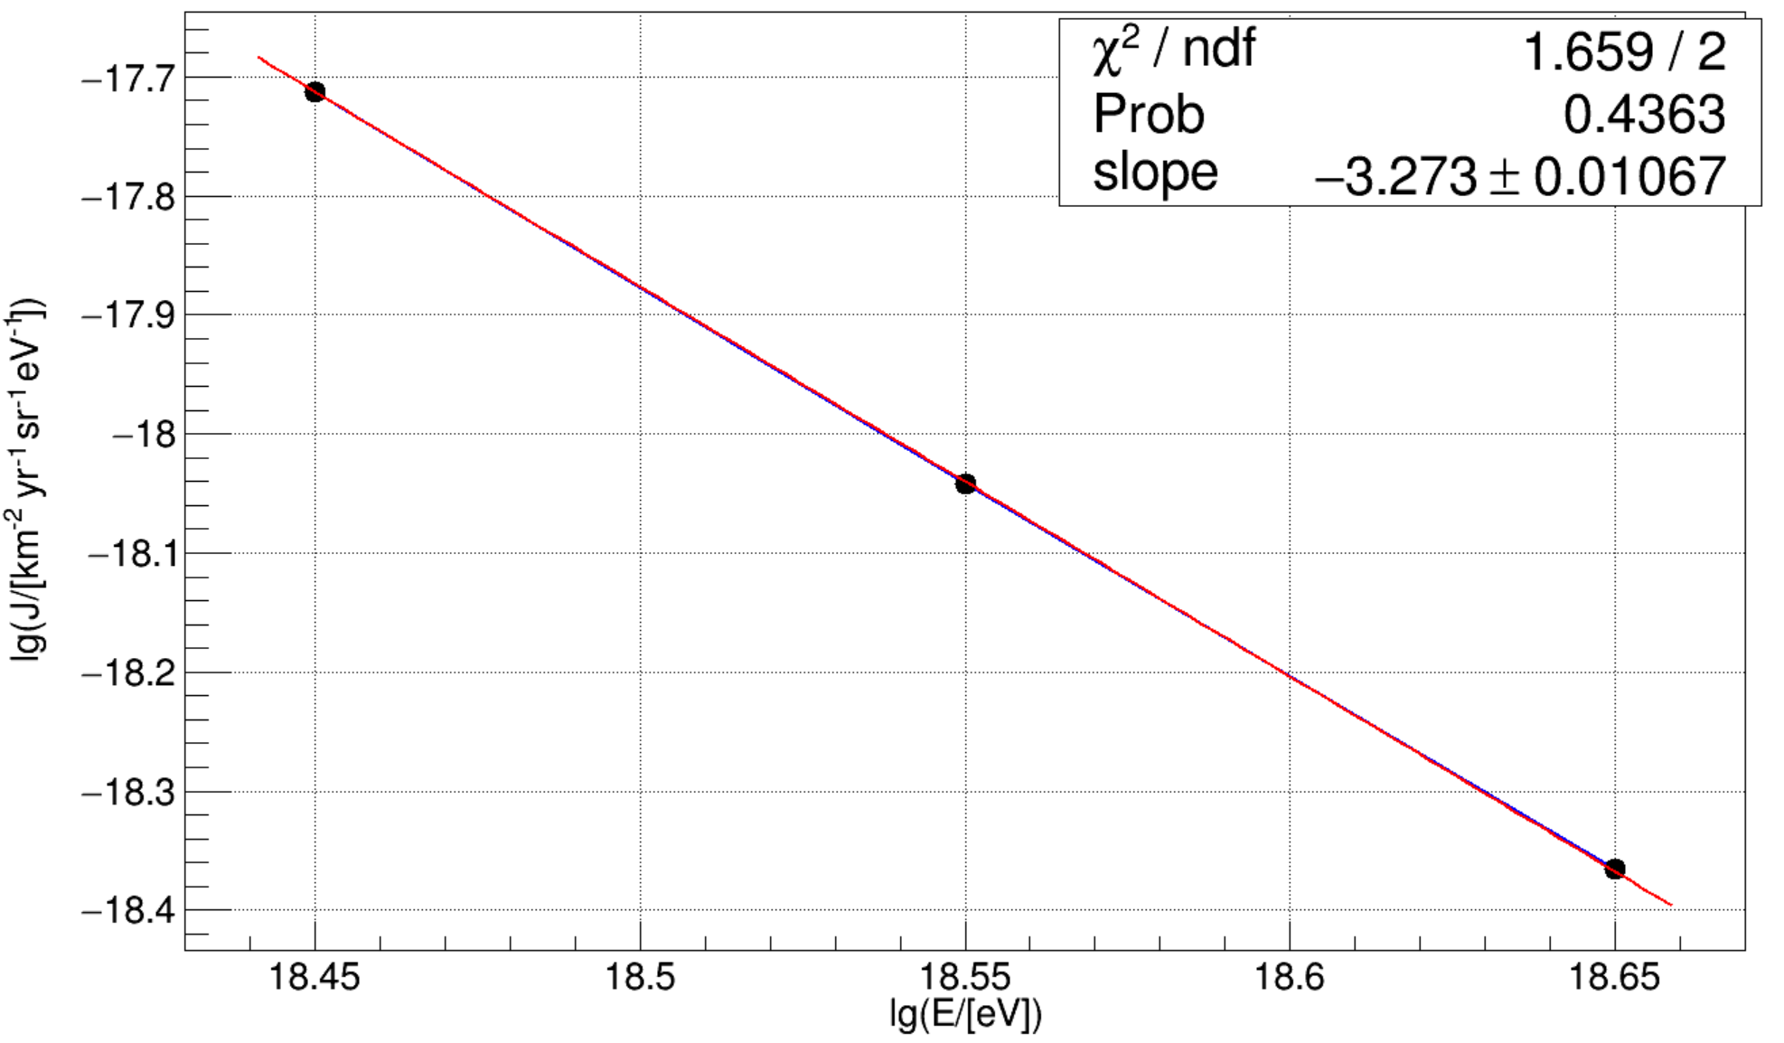
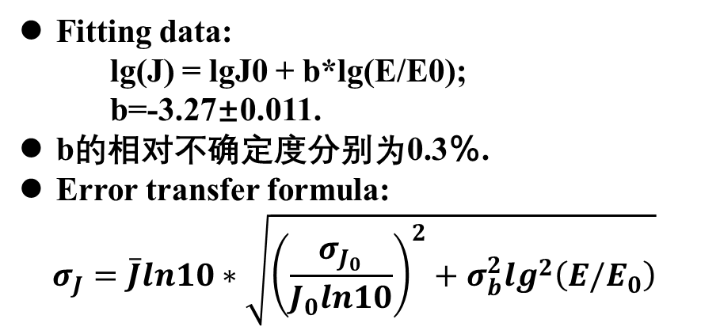
Extra Galactic + Galactic CRs Observed by AUGER
PhysRevD.102.062005
Fitting data:
lg(J) = lgJ0 + b*lg(E/E0);
b=-3.27±0.011.
b的相对不确定度分别为0.3％.
Error transfer formula:
$$σ_{J}=\overline{J}ln10∗\sqrt{{\left(\frac{σ_{J_{0}}}{J_{0}ln10}\right)}^{2}+σ_{b}^{2}\lg^{2}\left(E/E_{0}\right)}$$
E/EeV | 0.43 | 0.70 | 1.28 | 2.48 | Exp Data Points
lg(E/eV) | 17.633 | 17.845 | 18.107 | 18.394 | 18.45 | 18.55 | 18.65
J | 9.12e-16 | 1.851e-16 | 2.567e-17 | 2.946e-18 | 1.9383e-18 | 9.076e-19 | 4.310e-19
Error J | 0.18e-16 | 0.028e-16 | 0.023e-17 | 0.011e-18 | 0.0067e-18 | 0.042e-19 | 0.025e-19
Error down J |  |  |  |  | 0.0067e-18 | 0.041e-19 | 0.025e-19
σ/J | 2.0% | 1.5% | 0.90% | 0.37% | 0.3% | 0.5% | 0.6%

Slide 17
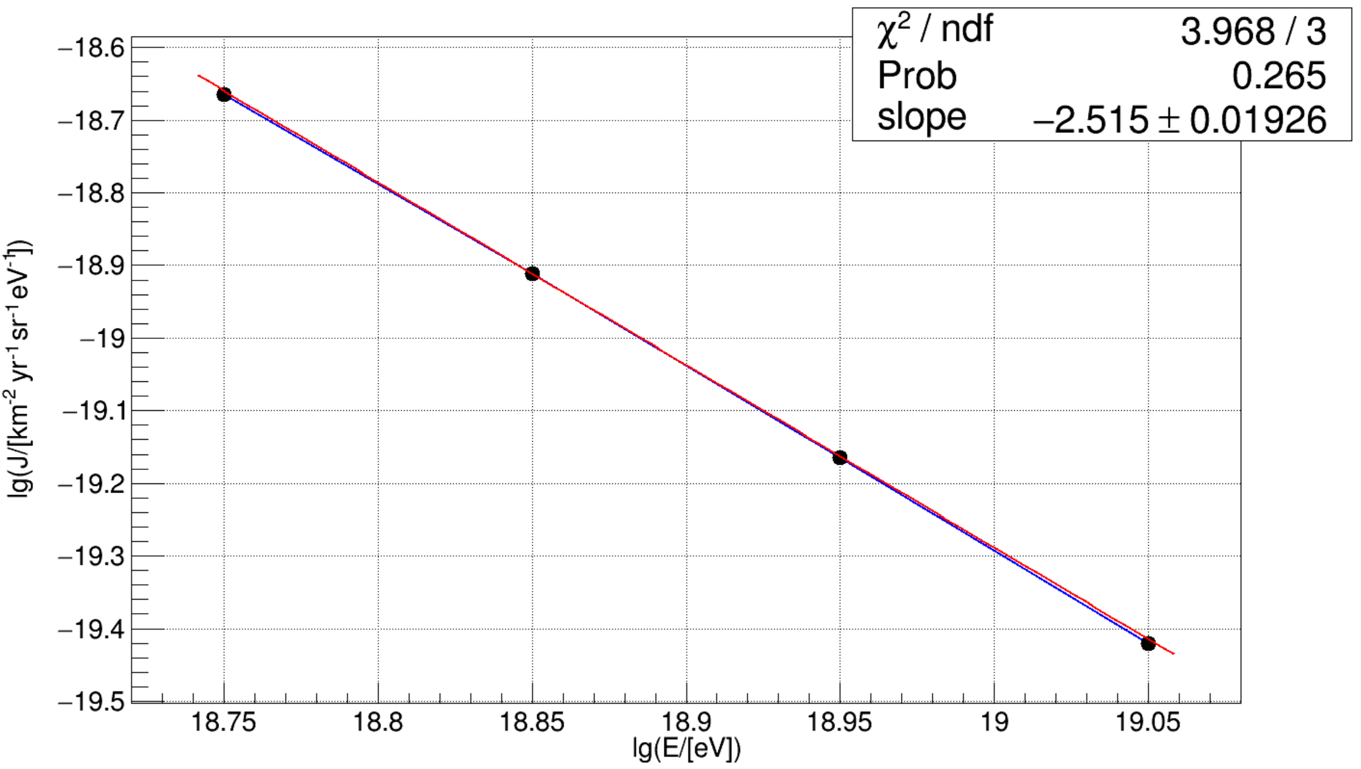
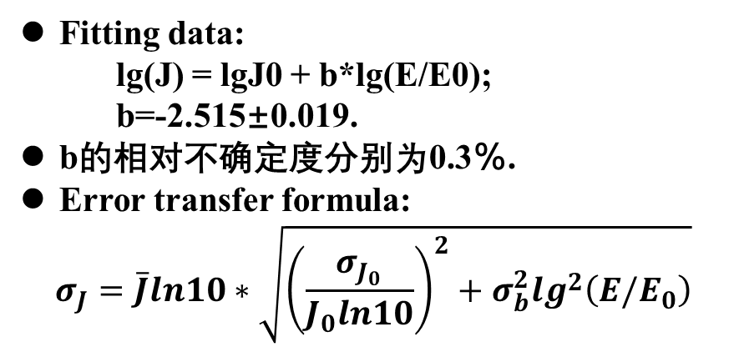
Extra Galactic CRs Observed by AUGER
PhysRevD.102.062005
Fitting data:
lg(J) = lgJ0 + b*lg(E/E0);
b=-2.515±0.019.
b的相对不确定度分别为0.3％.
Error transfer formula:
$$σ_{J}=\overline{J}ln10∗\sqrt{{\left(\frac{σ_{J_{0}}}{J_{0}ln10}\right)}^{2}+σ_{b}^{2}\lg^{2}\left(E/E_{0}\right)}$$
E/EeV | 0.43 | 0.70 | 1.28 | 2.48 | Exp Data Points
lg(E/eV) | 17.633 | 17.845 | 18.107 | 18.394 | 18.75 | 18.85 | 18.95 | 19.05
J | 1.390e-16 | 4.08e-17 | 8.95e-18 | 1.696e-18 | 2.164e-19 | 1.227e-19 | 6.582e-20 | 3.796e-20
Error J | 0.070e-16 | 0.17e-17 | 0.26e-18 | 0.030e-18 | 0.016e-19 | 0.011e-19 | 0.074e-20 | 0.049e-20
Error down J |  |  |  |  | 0.016e-19 | 0.011e-19 | 0.073e-20 | 0.049e-20
σ/J | 5.0% | 4.2% | 2.9% | 1.8% | 0.7% | 0.9% | 1.1% | 1.3%

Slide 18
Ratio of flux between ExtraGCRs and Experment
Log10(E/eV) | Jexp=JG+JEG | JEG | Ratio=JEG/Jexp | Error Ratio
(0.43EeV) 17.63 | (9.12±0.18)e-16 | (1.390±0.070)e-16 | 0.1524 | 0.0082
(0.70EeV) 17.85 | (1.851±0.028)e-16 | (4.08±0.17)e-17 | 0.2204 | 0.0098
(1.28EeV) 18.11 | (2.567±0.023)e-17 | （8.95±0.26)e-18 | 0.349 | 0.010
(2.48EeV) 18.39 | (2.946±0.011)e-18 | (1.696±0.030)e-18 | 0.576 | 0.010
流强的单位均为km⁻² yr⁻¹ sr⁻¹ eV⁻¹.
Notes:
汇总表格（拟合的结果）

Slide 19
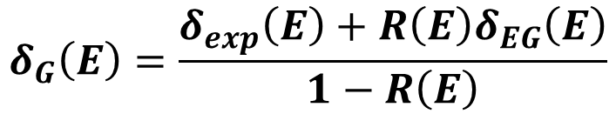
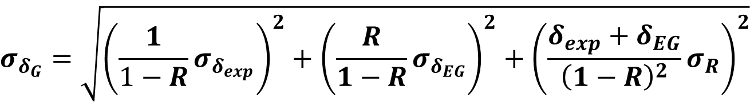
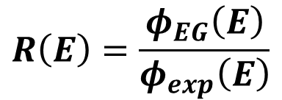
Galactic Cosmic Ray Anisotropy Calculation
Log10(E/eV) | Amp_exp | Amp_EG | Ratio=JEG/Jexp | Amp_G | Amp_G Error
(0.43EeV) 17.63 | (6.0±4.0)e-3 | (7.9±5.1)e-3 | 0.1524±0.0082 | 0.0085 | 0.0048
(0.70EeV) 17.85 | (5.0±2.5)e-3 | (10.6±6.6)e-3 | 0.2204±0.0098 | 0.0094 | 0.0037
(1.28EeV) 18.11 | (1.8±2.4)e-3 | (15.3±9.6)e-3 | 0.349±0.010 | 0.0110 | 0.0063
(2.48EeV) 18.39 | (5.0±3.0)e-3 | (23±15)e-3 | 0.576±0.010 | 0.043 | 0.022
$$δ_{G}\left(E\right)=\frac{δ_{exp}\left(E\right)+R\left(E\right)δ_{EG}\left(E\right)}{1−R\left(E\right)}$$
$$R\left(E\right)=\frac{φ_{EG}\left(E\right)}{φ_{exp}\left(E\right)}$$
$$σ_{δ_{G}}=\sqrt{{\left(\frac{1}{1−R}σ_{δ_{exp}}\right)}^{2}+{\left(\frac{R}{1−R}σ_{δ_{EG}}\right)}^{2}+{\left(\frac{{δ_{exp}+δ}_{EG}}{{\left(1−R\right)}^{2}}σ_{R}\right)}^{2}}$$

Slide 20
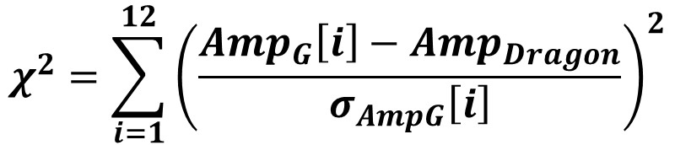
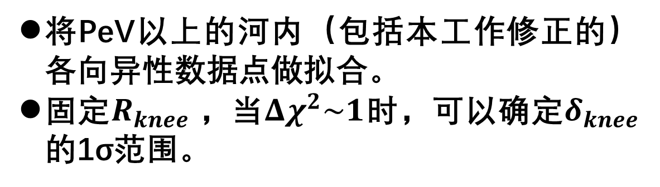
Chi2的构造
实验点 | 实验
1 | K-Grande
2
3
4 | IceTop
5 | Tibet
6 | Auger750
7
8
9 | Auger1500修正点 （河内点）
10
11
12
将PeV以上的河内（包括本工作修正的）各向异性数据点做拟合。
固定$R_{knee}$，当${Δχ}^{2}\sim 1$时，可以确定$δ_{knee}$的1σ范围。
$$χ^{2}=\sum_{i=1}^{12}{{\left(\frac{{Amp}_{G}\left[i\right]−{Amp}_{Dragon}}{σ_{AmpG}\left[i\right]}\right)}^{2}}$$
Notes:
不讲。得到δ

Slide 21
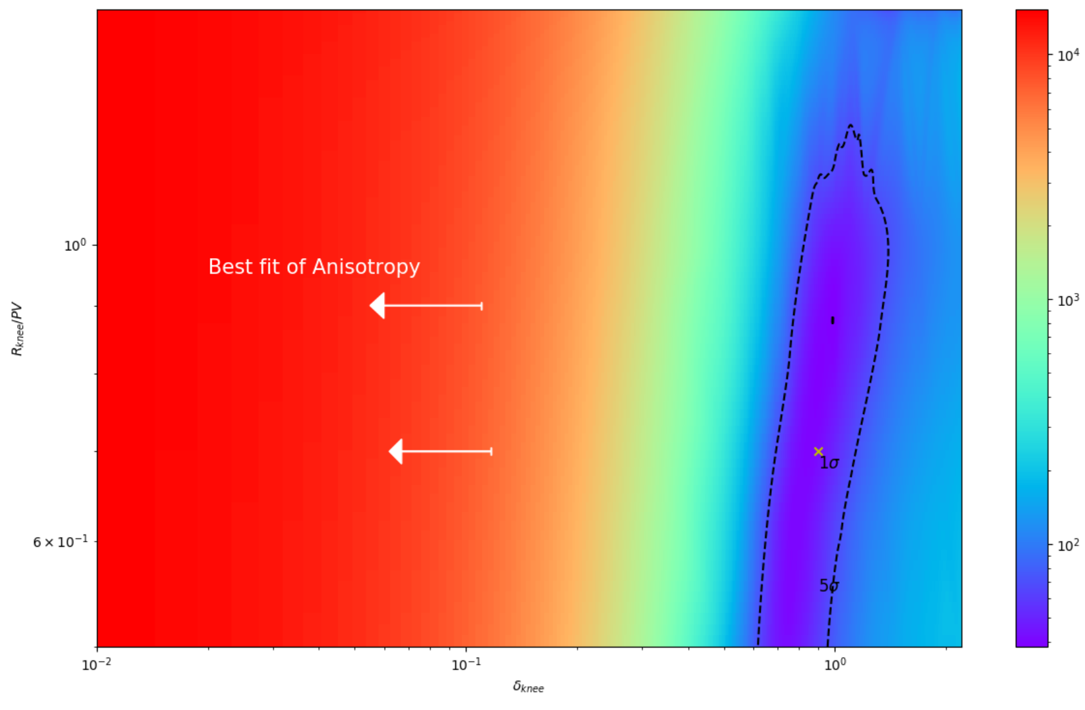

Slide 22
(Rknee, δknee)Chi²
(0.5PV, 0.01) 6.4313 | (0.7PV, 0.01) 6.4014 |  | (0.9PV, 0.01) 6.39004 | (1PV, 0.01) 6.38997 |  | (1.5PV, 0.01) 6.39138 | (2PV, 0.01) 6.40851 | (4PV, 0.01) 6.45812 | (6PV, 0.01) 6.485 | (8PV, 0.01) 6.50342 | (10PV, 0.01) 6.51759
(0.5PV, 0.05) 5.99914 | (0.7PV, 0.05) 5.70113 |  | (0.9PV, 0.05) 5.56496 | (1PV, 0.05) 5.53739 | (1.1PV, 0.05) 5.51685 | (1.5PV, 0.05) 5.45345 | (2PV, 0.05) 5.48588 | (4PV, 0.05) 5.6284 | (6PV, 0.05) 5.71388 | (8PV, 0.05) 5.7765 | (10PV, 0.05) 5.82711
(0.5PV, 0.08) 6.86303 | (0.7PV, 0.08) 6.12435 |  | (0.9PV, 0.08) 5.75795 | (1PV, 0.08) 5.66084 |  | (1.5PV, 0.08) 5.34876 | (2PV, 0.08) 5.29672 | (4PV, 0.08) 5.32608 | (6PV, 0.08) 5.37501 | (8PV, 0.08) 5.42381 | (10PV, 0.08) 5.47048
(0.5PV, 0.1) 8.32496 | (0.7PV, 0.1) 7.11135 | (0.8PV, 0.1) 6.70549 | (0.9PV, 0.1) 6.4844 | (1PV, 0.1) 6.30173 | (1.1PV, 0.1) 6.1514 | (1.5PV, 0.1) 5.70679 | (2.0PV, 0.1) 5.52276 | (4.0PV,0.1) 5.33732 | (6.0PV,0.1) 5.30324 | (8.0PV,0.1) 5.3096 | (10.0PV, 0.1) 5.33211
 |  |  | (0.9PV, 0.11) 7.08263 | (1PV, 0.11) 6.84098 | (1.1PV, 0.11) 6.64078 | (1.5PV, 0.11) 6.0508
(0.5PV, 0.12) 10.7754 | (0.7PV, 0.12) 8.87926 |  | (0.9PV, 0.12) 7.86744 | (1PV, 0.12) 7.55347 | (1.1PV, 0.12) 7.29208 | (1.5PV, 0.12) 6.52401 | (2PV, 0.12) 6.12126 | (4PV, 0.12) 5.56538 | (6PV, 0.12) 5.38484 | (8PV, 0.12) 5.31359 | (10PV, 0.12) 5.28955
(0.5PV, 0.15) 17.0133 | (0.7PV,0.15) 13.5358 |  | (0.9PV, 0.15) 11.6114 | (1PV, 0.15) 10.977 | (1.1PV, 0.15) 10.444 | (1.5PV, 0.15) 8.89018 | (2PV, 0.15) 7.93073 | (4PV, 0.15) 6.41914 | (6PV, 0.15) 5.86102 | (8PV, 0.15) 5.58754 | (10PV, 0.15) 5.44002

Slide 23
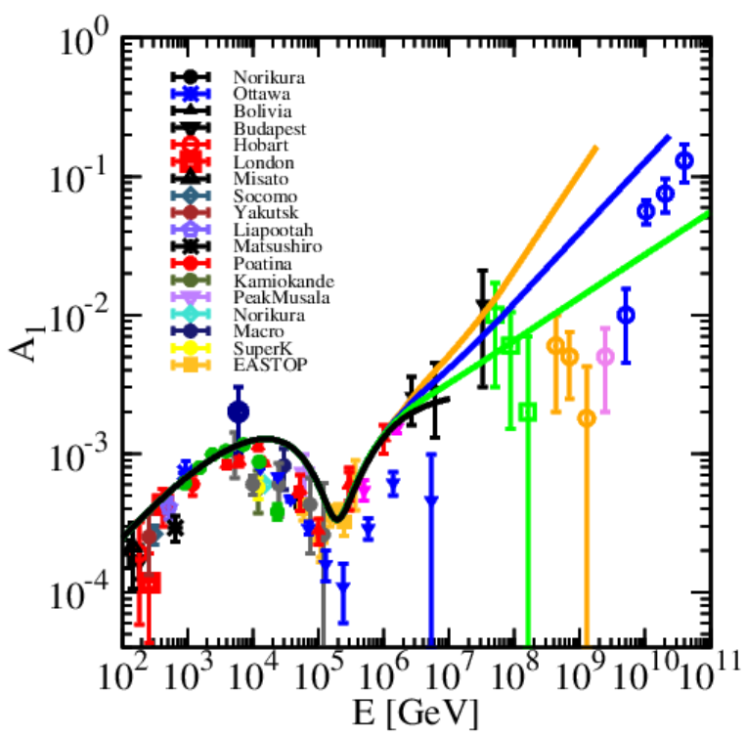
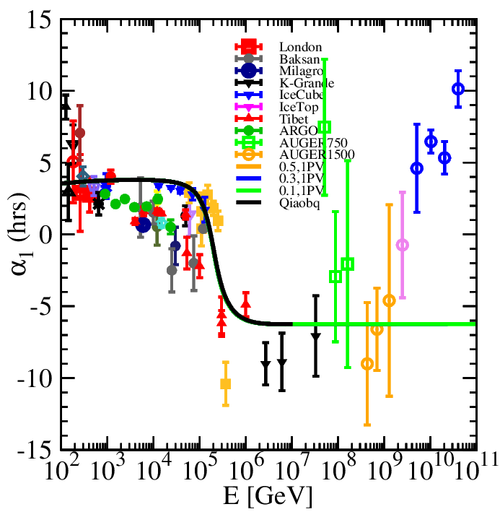
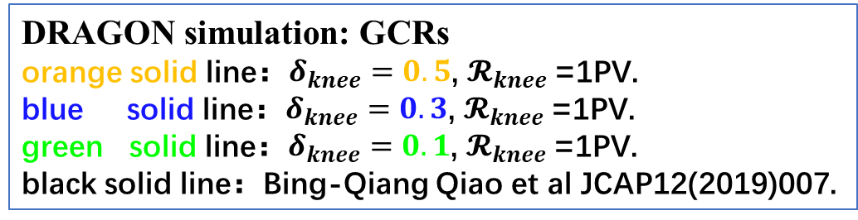
Cosmic Ray Anisotropy: Amplitude and Phase
GCRs
EG+G CRS
DRAGON simulation: GCRs
orange solid line：$δ_{knee}=0.5$, $𝓡_{knee}$=1PV.
blue solid line：$δ_{knee}=0.3$, $𝓡_{knee}$=1PV.
green solid line：$δ_{knee}=0.1$, $𝓡_{knee}$=1PV.
black solid line：Bing-Qiang Qiao et al JCAP12(2019)007.
Notes:
应该放在introduction中讲，EeV与100TeV的相似性，相互抵消的结构

Slide 24
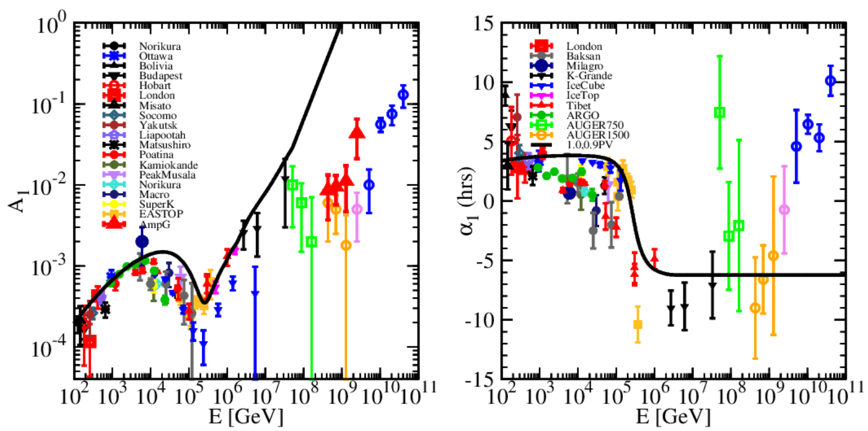

Cosmic Ray Anisotropy: Amplitude and Phase
在1.28EeV处，河外与实验流强之比为0.349，计算所得各向异性幅度为0.0110.
black solid line：$δ_{knee}=1.0$, $𝓡_{knee}$=0.9PV.
在100TeV，由于邻近源与银心方向的源相位相反，各向异性幅值相互抵消；
与此类似，河内河外宇宙线的转变在EeV附近，由于二者相位相反，幅值也会相互抵消。
Notes:
凸显修正的点

