Slide 1

Study of Galactic diffusion coefficient with the spectrum features of UHECR
Reporter：lidan
Gao Weikang, Yue Hua, Liu Wei, Hu Hongbo
Institute of High Energy Physics
2023.10.23

Slide 2
CONTENTS
Introduction
  Spectrum features of Auger
  Composition model and “dip” model
Dip model plus galactic propagation effect
  Changing from two-halo to one-halo diffusion
Result and discussion

Slide 3
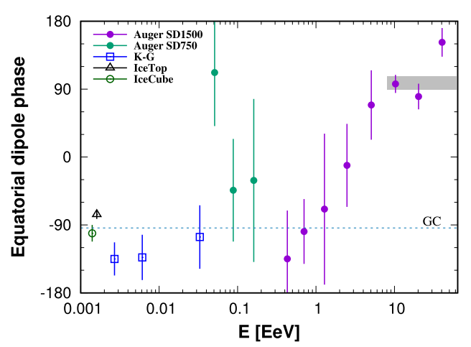
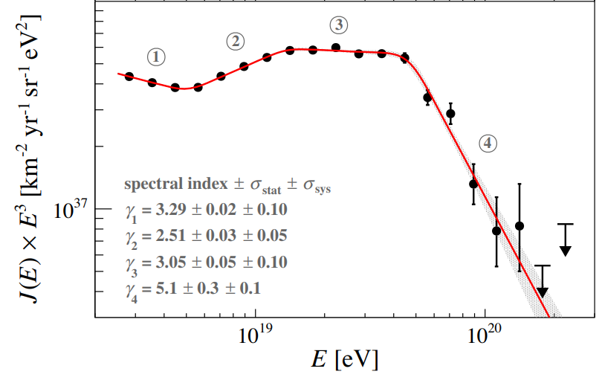

Spectrum features of Auger
Anti-GC
③
②
①
Galactic Center
Fig2: CR dipole phase from Aab et al
Extragalactic comic rays dominate above around around EeV.
②: “ankle”
③: “platform”
④: “GZK cutoff”
How to explain ②③④ ?
Fig1: CR Spectrum from Auger 2020
Notes:
Auger最新的极高能宇宙线的能谱如图一所示，从EeV开始，能谱结构大致分为4阶段，首先能谱先变软，在5eeV时变硬，然后再变平，最后在50EeV处有非，常强烈的压低。这四个结构对应到auger测量的偶极各向异性的相位图上，大约从eev开始，偶极相位逐渐从银心方向转向反银心方向，说明从eev开始，河外宇宙线占主导地位。到了2阶段，相位在反银心方向上，说明河内的宇宙线在这个能段以上没什么贡献了。那么，这里会有一个问题，要怎么解释来自于河外的234阶段？

Slide 4
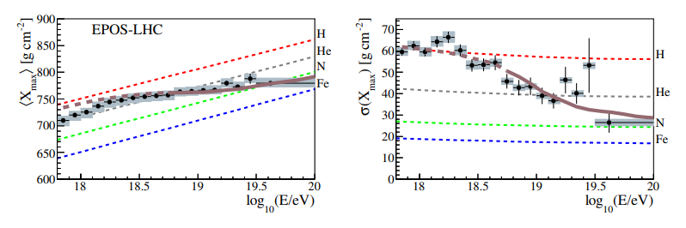
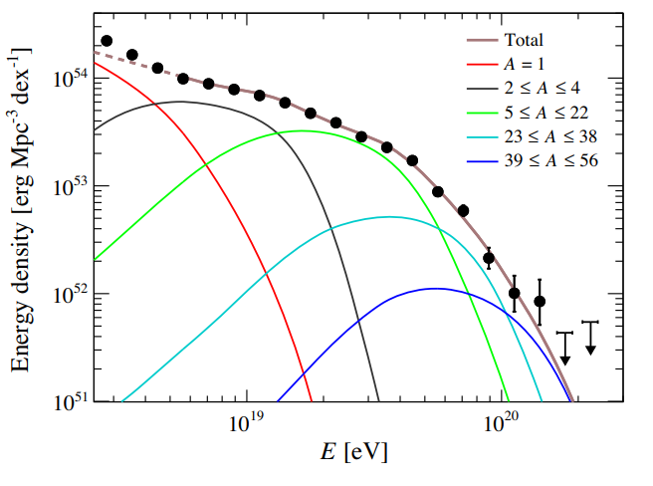
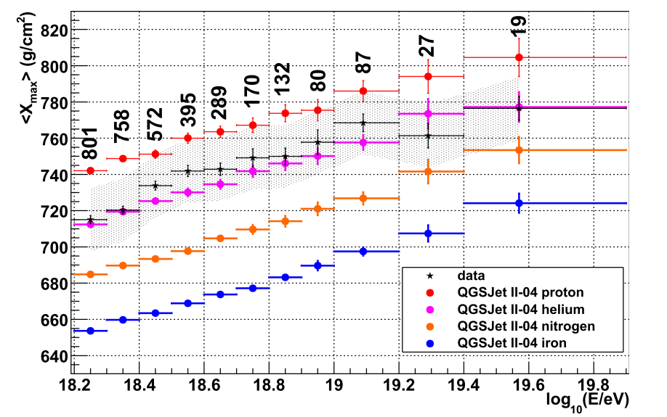
Compositions model
Observation of Auger and TA are incompatible!
From Auger
Based on compositions observation: heavier nuclei at higher energy
Z-dependence
Need a too hard spectral index!
Fig4: Mean Xmax from TA 2018
Fig3:Top: distribution of Xmax with energy from Auger arxiv 1612.07155
bottom: Fitting with Energy density using compositions model
Notes:
首先是多成分模型。不同核子加速的最大能量是z依赖的也就是刚度依赖的。所以每个核子截止的能量都不一样，不同盒子的谱的总和构成了观测的总谱。这种模型是基于实验测量的成分谱。如这个右图所示，这是Auger测量的成分谱。黑色是数据点，红色是青，蓝色是铁。随着能量的增加。实验点从轻核逐渐转向铁盒。也就是能量越高，重核的占比越大。但是用这个多成分模型去解释能普，有一个非常强烈的限制，就是需要一个非常硬的原项的能普指数。另一方面，auger测量的成分谱与ta测量的成分其实并不是很兼容。可以看到左图就是ta测量的成分谱，黑色是他们测的时间点，同样的红色是清河，然后蓝色是铁盒。Ta在高能的时候，并不显然的支持核子变重这一现象。

Slide 5
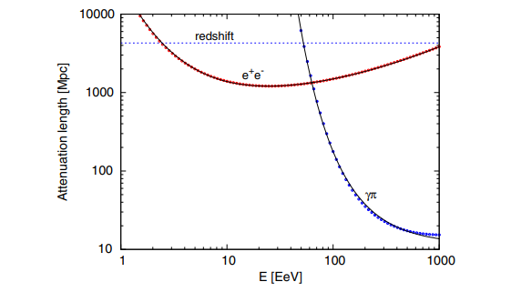


“Dip” model
Exgalactic propagation of UHECRs
  Consider red shift and energy loss
Two interactions of proton and CMB
Consistent with TA observation
at ~1EeV
at ~50EeV
Fig5: Proton attenuation length as a function of energy
Notes:
第二个模型是dip模型，也就是我们俗称的GZK模型。他描述的是极高能宇宙线在河外的一个传播效应。传播时主要考虑了红移和能损，这个能损主要是以质子和cmb光子的两种相互作用而产生。第一种是产生正负电子对，阈值能量大概是在一个eeV，第二种是产生pion介子，他的阈值能量大约是在50个eev。可以从图五可以看到。两种相互作用的衰减程度。在低能，主要是正负电子对。在高能pion的能损会使得能普非常迅速的压低。Dip模型主要考虑的是质子的相互作用，所以它与ta的成分普观测结果是符合的。

Slide 6
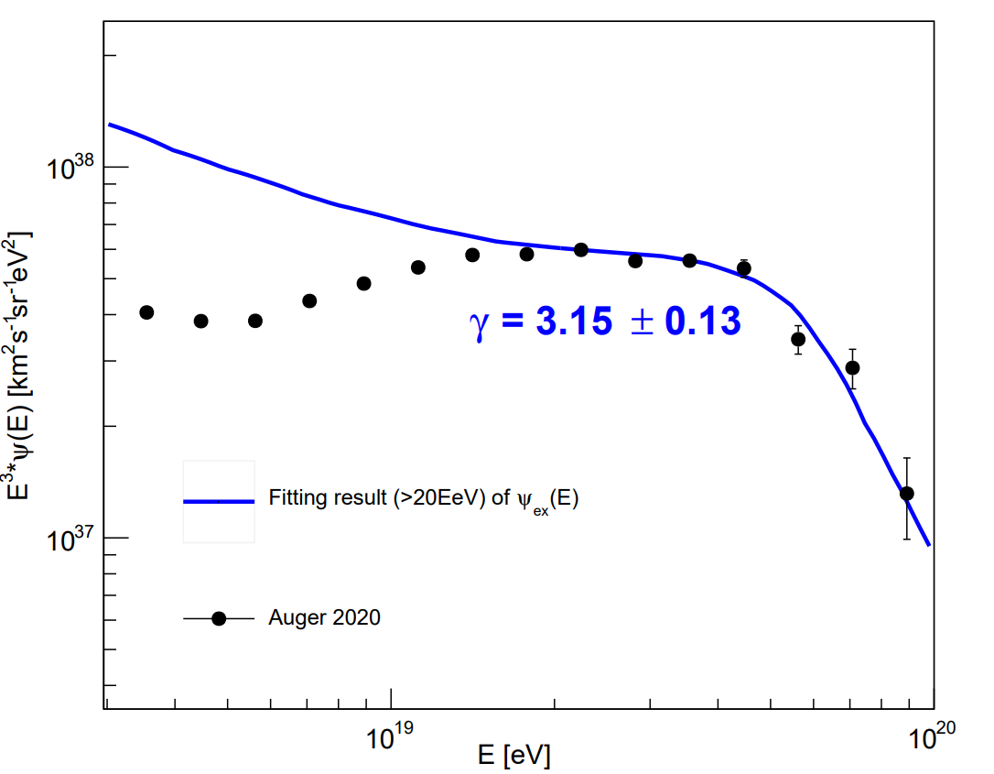
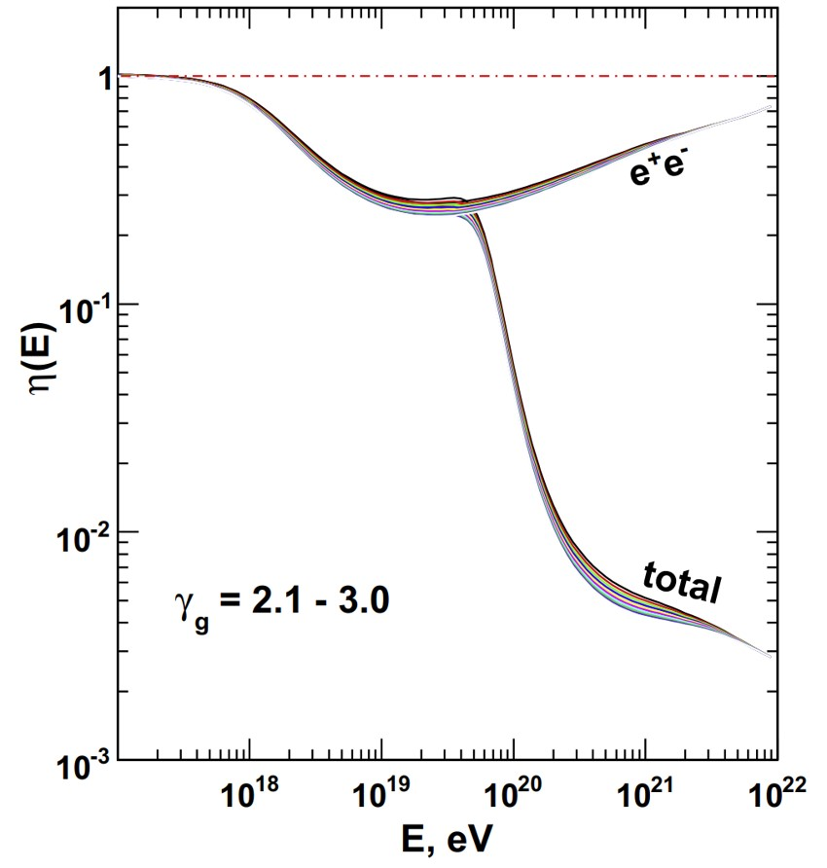


“Dip” model
Source spectrum
$$F\left(E\right)=κE^{γ_{g}}$$
Modification factor
$$η\left(E\right)=J\left(E\right)/F\left(E\right)$$
Incompatible blow 20EeV
insensitive to the spectral index
Fig7: fitting result of Auger 2020 using dip model
Due to dip model only describe exgalactic propagation effect, it needs a galactic propagation effect .
Fig6: modification factor for different generation index from R. Aloisio et al.
Notes:
Dip模型定义了一个修正因子，是观测谱与源处的能谱的比值。图6展示就是源的不同普指数下的修正因子。可以看到，修正因子对源的普指数并不敏感。如果我们给定一个幂律的源谱，乘上修正因子，就会得到观测区。拟合auger的数据，可以看到图7在20eev以下与数据是不符合的。这是因为dip仅仅描述了河外的传播效应，没有考虑银河系的作用。而在低能时又不得不考虑宇宙线在银河系内的相互作用。所以，在dip模型的基础上，加入了银河系的传播系效应。

Slide 7
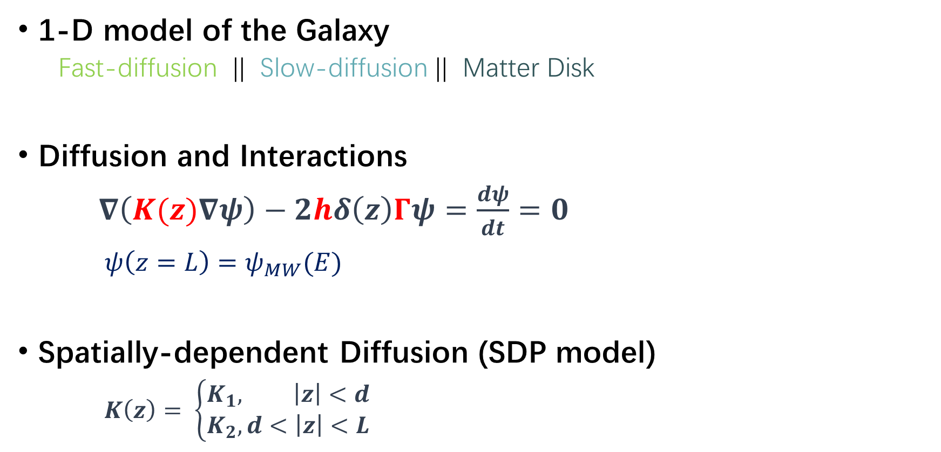
UHECRs in the Galaxy
Low Energy CRs
High Energy CRs
Outer halo(d<|z|<L)
Inner halo(|z|<d)
Disk(|z|<h)
Earth
1-D model of the Galaxy
  Fast-diffusion || Slow-diffusion || Matter Disk
Diffusion and Interactions
$∇\left(K(z)∇ψ\right)−2hδ\left(z\right)Γψ=\frac{dψ}{dt}=0$
$ψ\left(z=L\right)=ψ_{MW}(E)$
Spatially-dependent Diffusion (SDP model)
$K\left(z\right)= \left\{\begin{aligned}K_{1}, \left|z\right|<d \\ K_{2}, d<\left|z\right|<L\end{aligned}\right.$
Fig8:Diffusion in Galaxy
arXiv:1204.4492
Notes:
将银河系分为三个区域，银盘，银河系的内晕和外晕。相互作用主要是在银盘上，而宇宙线在银河系的扩散分为快扩散区和慢扩散区，内晕作为慢扩散区，外晕因为没有什么物质，大部分是湍流磁场，所以考虑为快扩散区。而银河系外的注入谱由dip模型给出

Slide 8
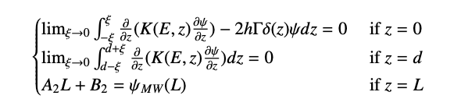
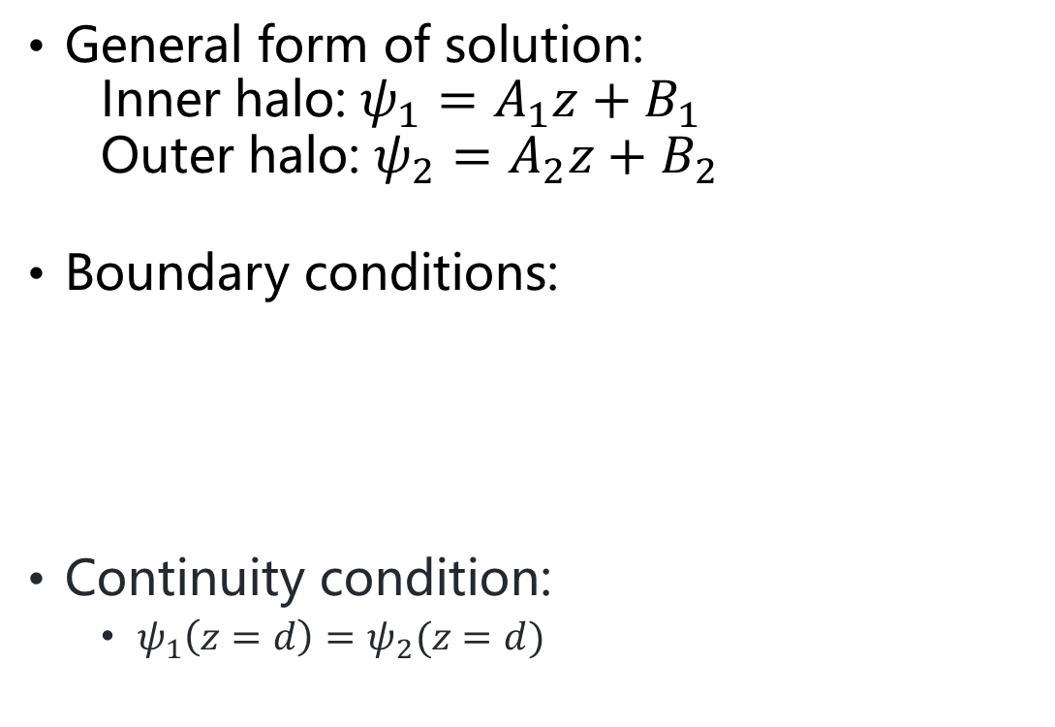
Stable Solution
Low Energy CRs
Outer halo(d<|z|<L)
High Energy CRs
Inner halo(|z|<d)
Disk(|z|<h)
General form of solution:
  Inner halo: $ψ_{1}=A_{1}z+B_{1}$
  Outer halo: $ψ_{2}=A_{2}z+B_{2}$
Boundary conditions:
Continuity condition:
  $ψ_{1}\left(z=d\right)=ψ_{2}(z=d)$
Earth
Fig8:Diffusion in Galaxy

Slide 9
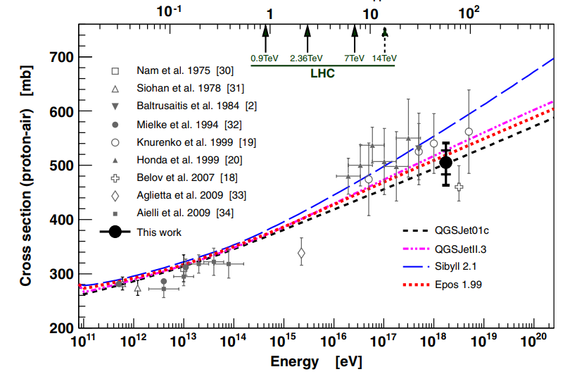
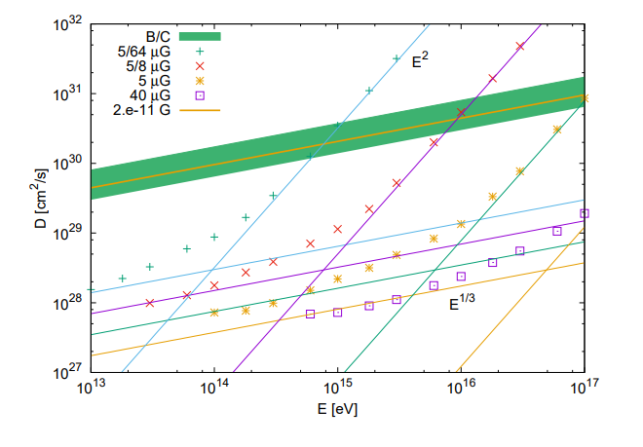
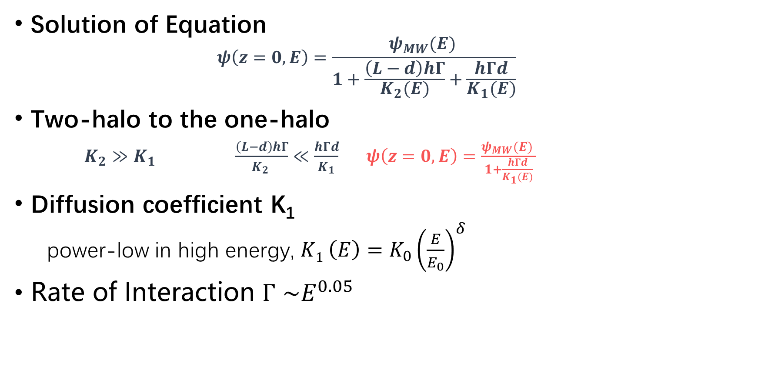


Simplification of the model
Solution of Equation
  $$ψ\left(z=0,E\right)=\frac{ψ_{MW}(E) }{1+\frac{\left(L−d\right)hΓ}{K_{2}(E)}+\frac{hΓd}{K_{1}(E)}}$$
Two-halo to the one-halo
$K_{2}≫K_{1}$ $\frac{\left(L−d\right)hΓ}{K_{2} }≪\frac{hΓd}{K_{1}}$ $ψ\left(z=0,E\right)=\frac{ψ_{MW}(E) }{1+\frac{hΓd}{K_{1}(E)}}$
Diffusion coefficient K₁
  power-low in high energy, $K1 \left(E\right)=K_{0}{\left(\frac{E}{E_{0}}\right)}^{δ}$
Rate of Interaction $Γ$ $\sim E^{0.05}$
Fig9:cross section of proton-air of Auger
$$E^{2}$$
$$E^{1/3}$$
Fig10:CR diffusion coefficient changes with energy

Slide 10
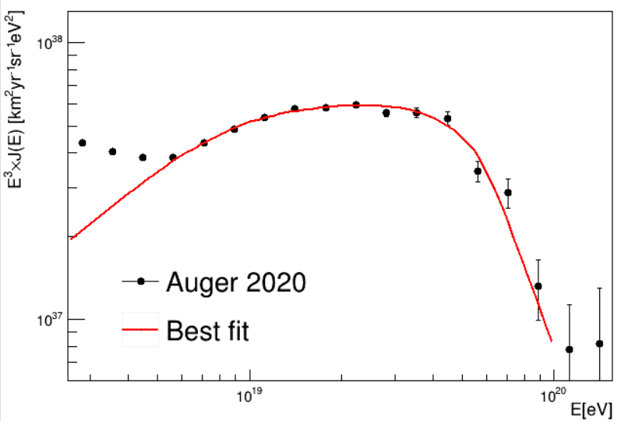

Fitting with Energy Spectrum
Energy dependent of $ψ\left(z=0,E\right)$
$ψ\left(E\right)$ = $\frac{ψ_{MW}(E) }{1+\frac{hΓd}{K_{1}(E)}} = \frac{Aη\left(E\right)E^{γ}}{1 + \frac{hdΓ_{5EeV}}{K_{5EeV}} {\left(\frac{E}{5 EeV}\right)}^{δ+0.05}}$
Loss Function
$χ^{2}=\sum_{i}{{\left(\frac{J_{exp}^{i}\left(E\right)−\frac{c}{4π}ψ(E)}{σ_{exp}^{i}}\right)}^{2}}$
Fitting Result
Fig11:Fitting with Auger 2020
$$\frac{hdΓ_{5EeV}}{K_{5EeV}}$$ | $$δ$$ | $$A [km^{2}yr^{−1}sr^{−1}eV^{−1}]$$ | $$γ$$ | $$χ^{2} /n.d.f.$$
3.17±14.6 | 1.89±0.13 | $$(1.48±0.26)×{10}^{−26}$$ | 3.36±0.1 | 16.3/(14-4)

Slide 11
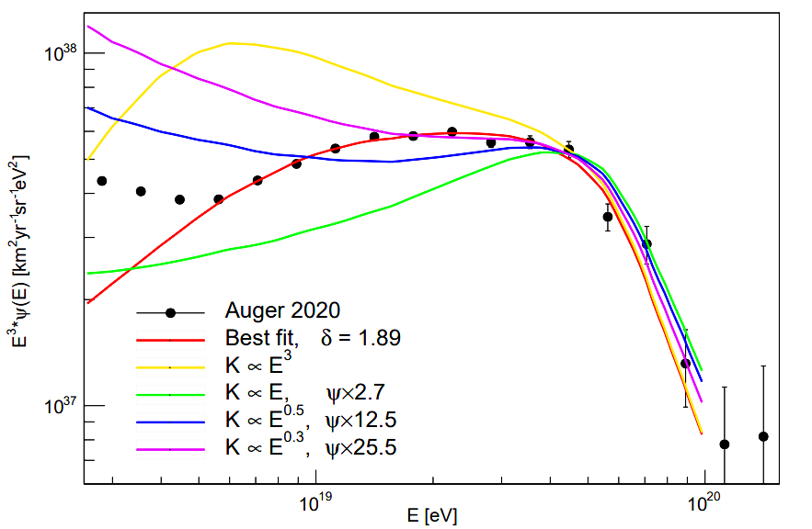
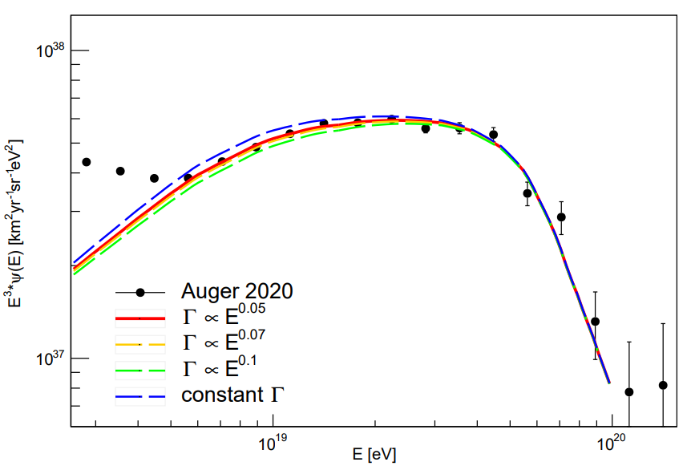


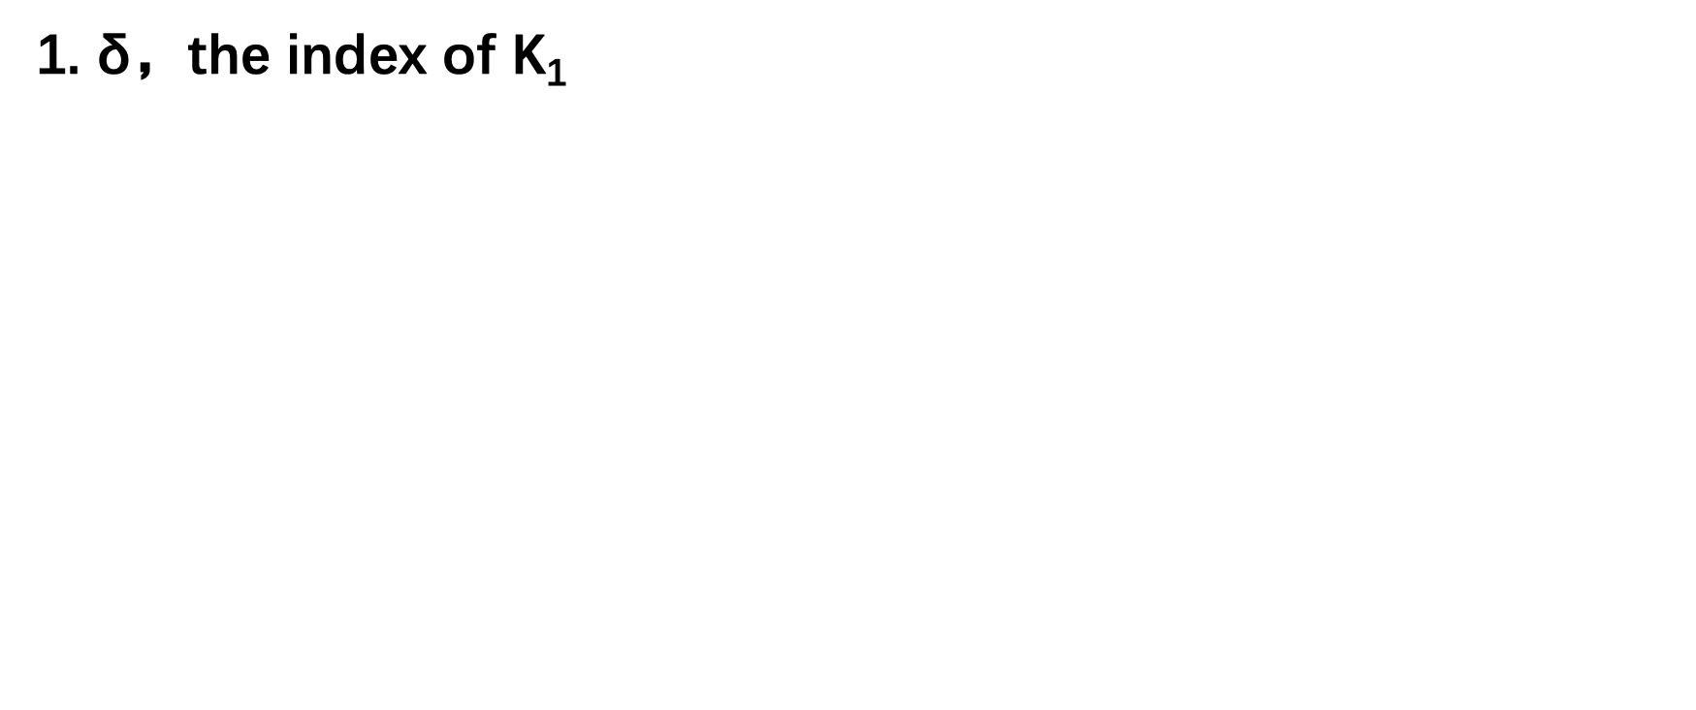
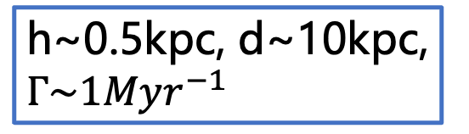
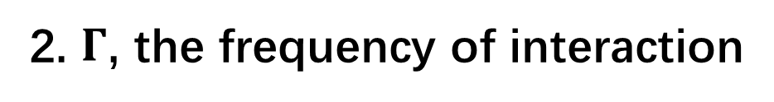

About the parameters
1. δ，the index of K₁
2. $Γ$, the frequency of interaction
3. Typical value
$$E^{0.23}$$
M. Kachelrieß et al. 2018
h~0.5kpc, d~10kpc, $Γ\sim 1Myr^{−1}$
$$K_{10GeV}\sim {10}^{24}m^{2}/s$$
$$K_{5EeV}\sim {10}^{26}m^{2}/s$$

Slide 12
Summary
Fine agreement with measurement above 5EeV using dip model plus galactic propagation effect
A spectral index 1.89 for the diffusion coefficient in the galaxy above 5EeV
An injection spectrum with a spectral index of 3.36
Further applied to explore the composition and anisotropy of UHECRs

Slide 13
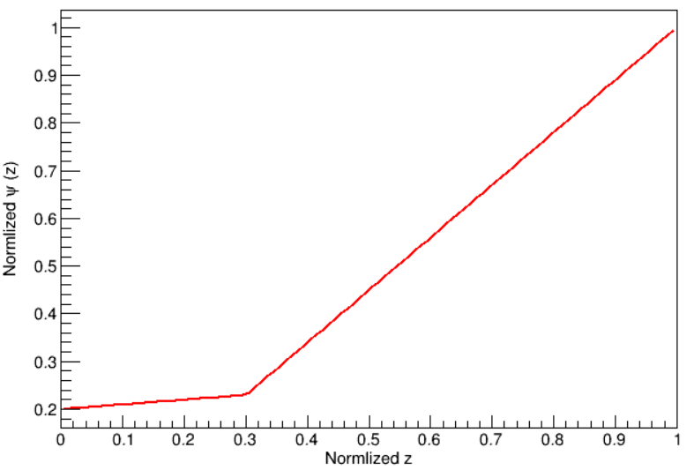

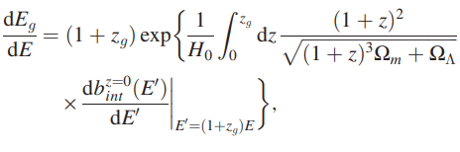


“Dip” model
Red shift
observed flux
CR density $ψ\left(z\right)$,with d = 0.3L
$$J\left(E\right)\sim F\left(E_{g}\right)\frac{dE_{g}}{dE}$$
source flux
energy loss

Slide 14
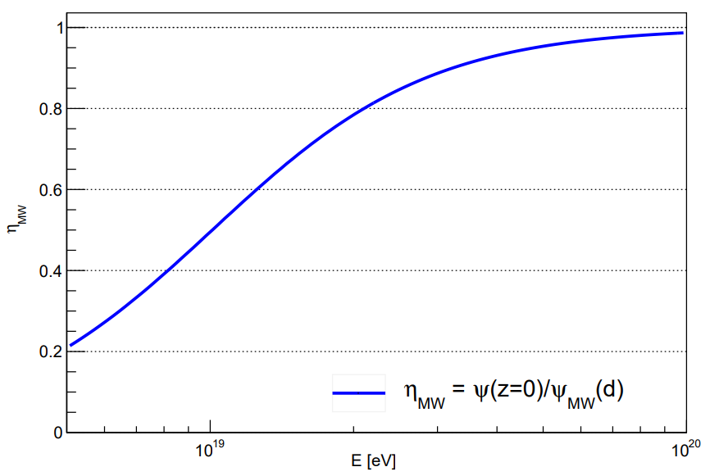
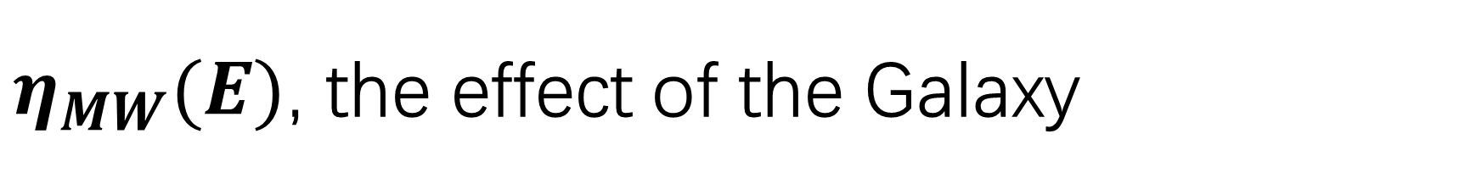
$η_{MW}(E)$, the effect of the Galaxy

