Slide 1
SEARCH FOR VHE GAMMA RAYS FROM THE NORTHERN FERMI BUBBLE REGION WITH LHAASO-WCDA
Speaker: 李思达(Shao)
  Collaborators： 姚志国(iHep), 查 敏(iHep), 胡世聪(iHep),
    郭福来(Shao), 项光漫(Shao)

Slide 2
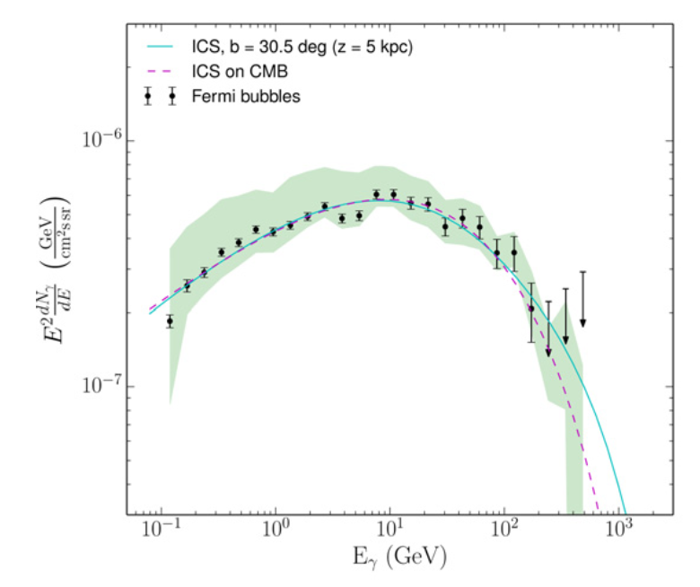
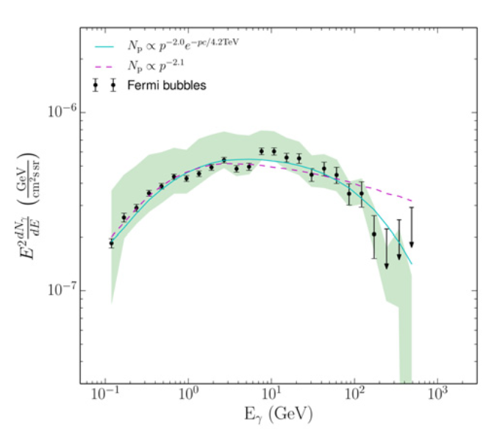
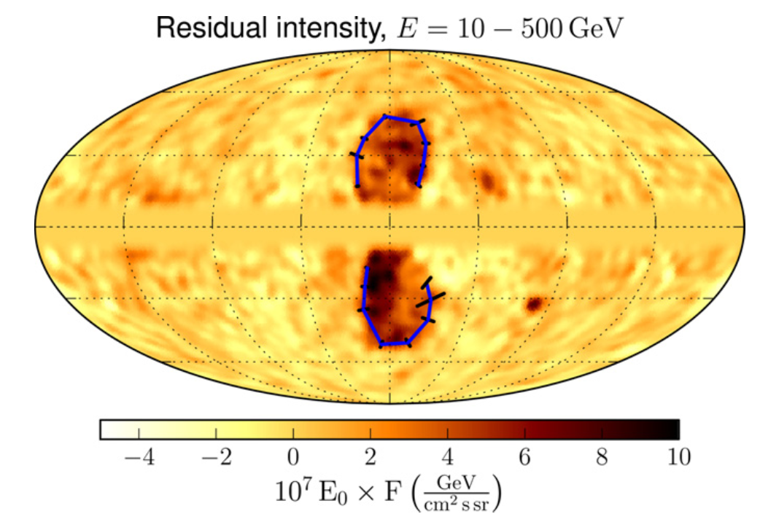
Background ----Fermi Bubble by Fermi-LAT
leptonic
hadronic
TeV observations are significant
Ackermann et.al 2014

Slide 3
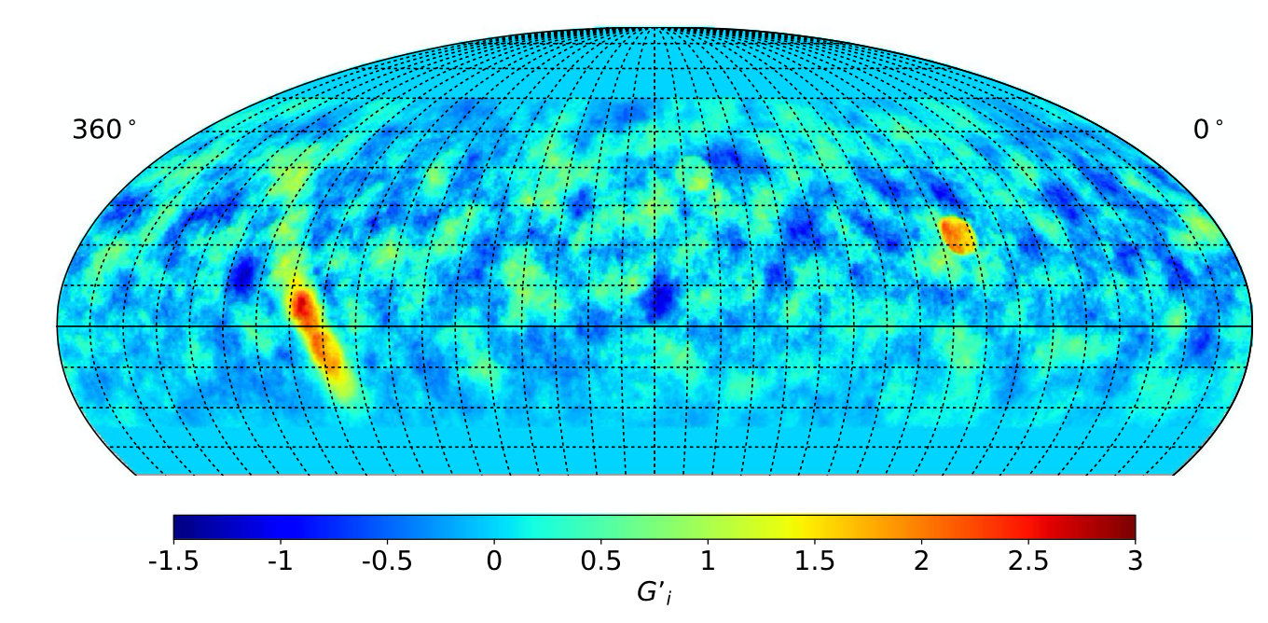
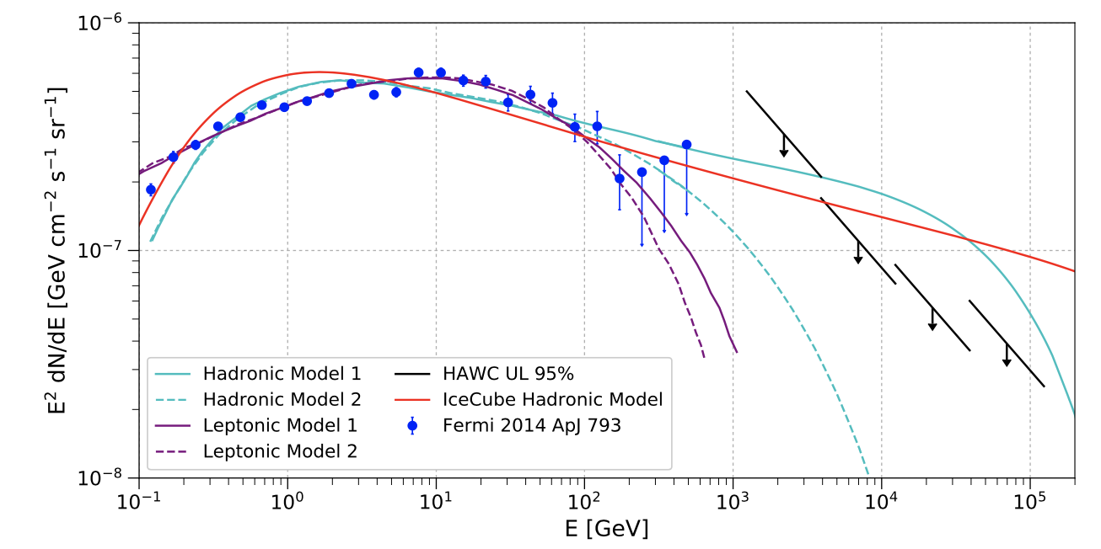
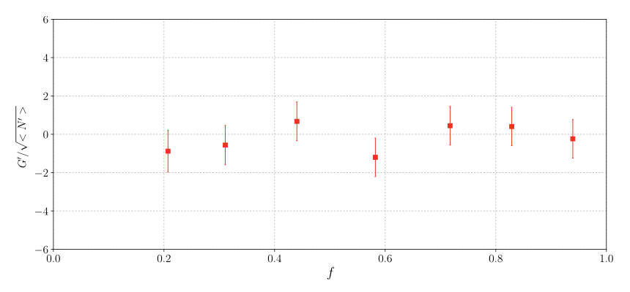
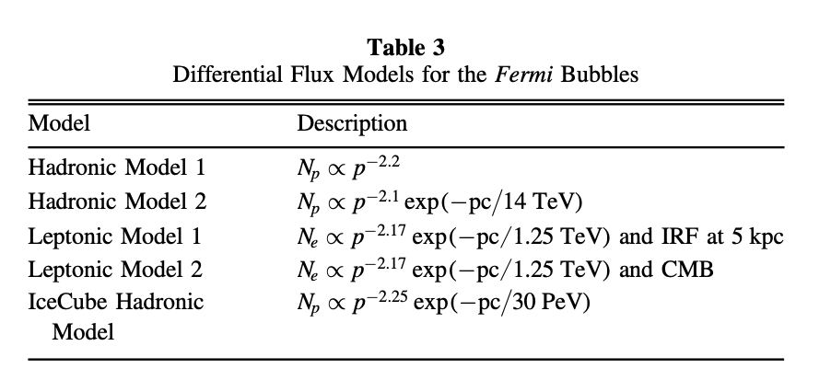
Background ---- Fermi Bubble by HAWC
Northern
Fermi Bubble
region
No significant excess
upper limits for gamma-ray flux

Slide 4
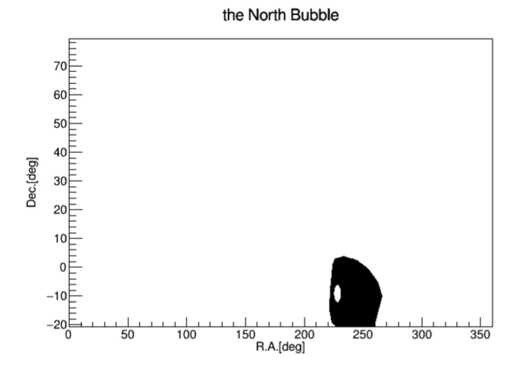
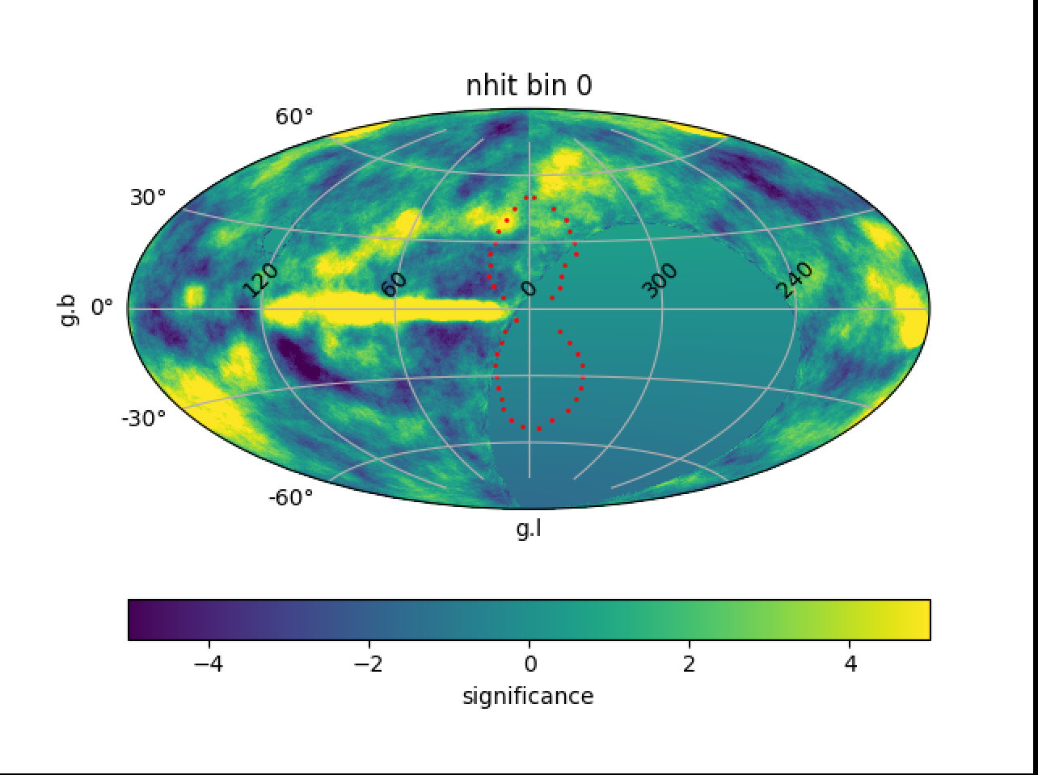
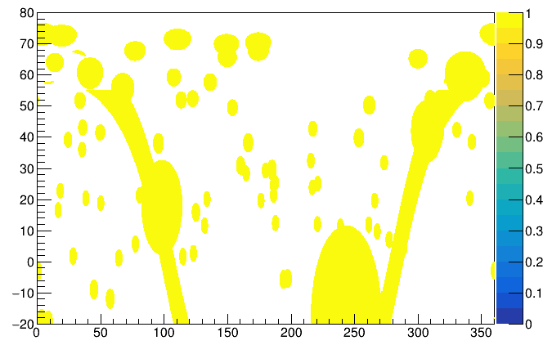
Analysis with WCDA
we analyze northern bubble region
no significant signals (significance < 3σ)
background estimation: 6h direct integration
solid angle: 0.25
time: 20210305 -- 20220930

Slide 5
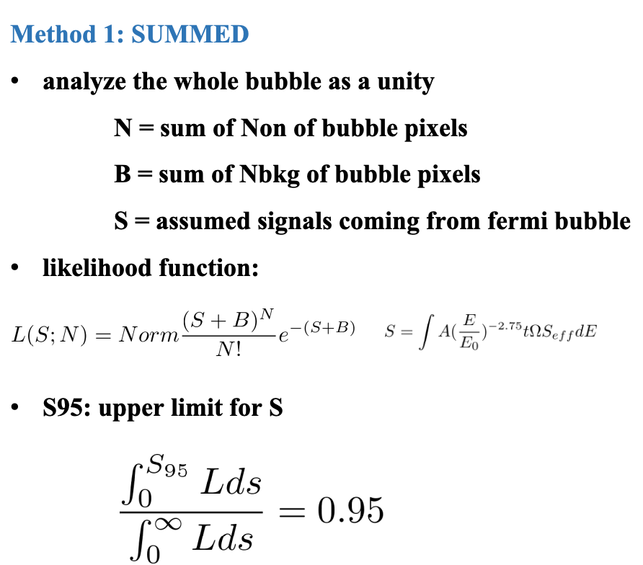
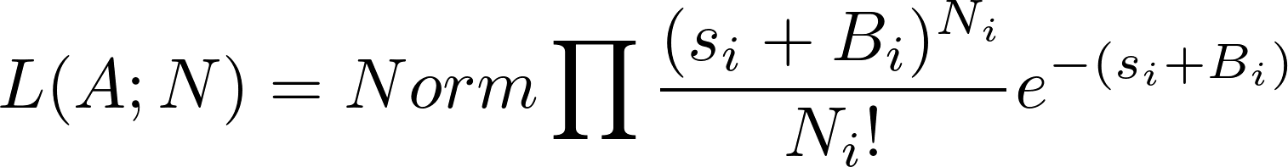
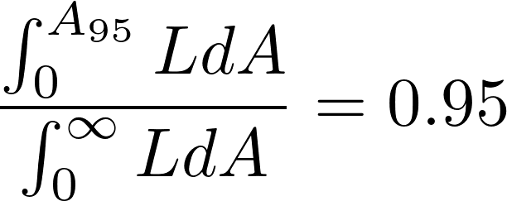
Analysis with WCDA ---- calculation of upper limits
Method 2: MULTIPLIED
analyze the whole bubble pixel by pixel
N = Non of a bubble pixel
B = Nbkg of a bubble pixel
S = assumed signals in a pixel
likelihood function:
S95: upper limit for S

Slide 6
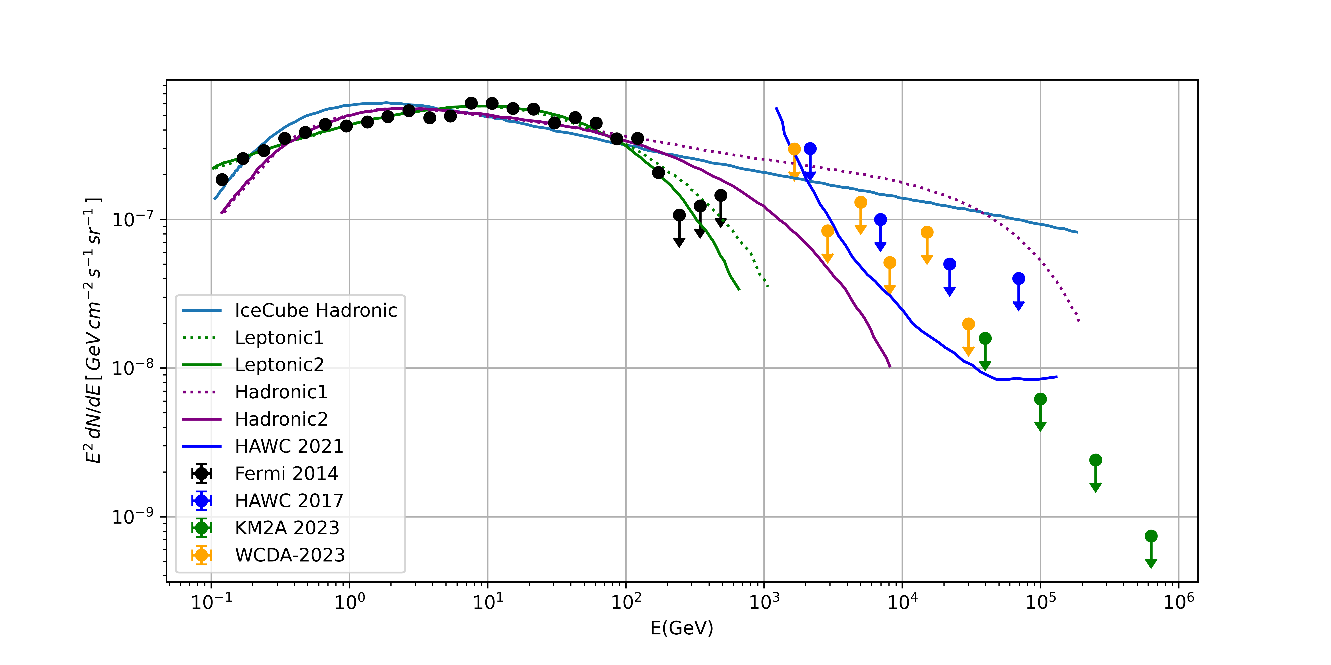
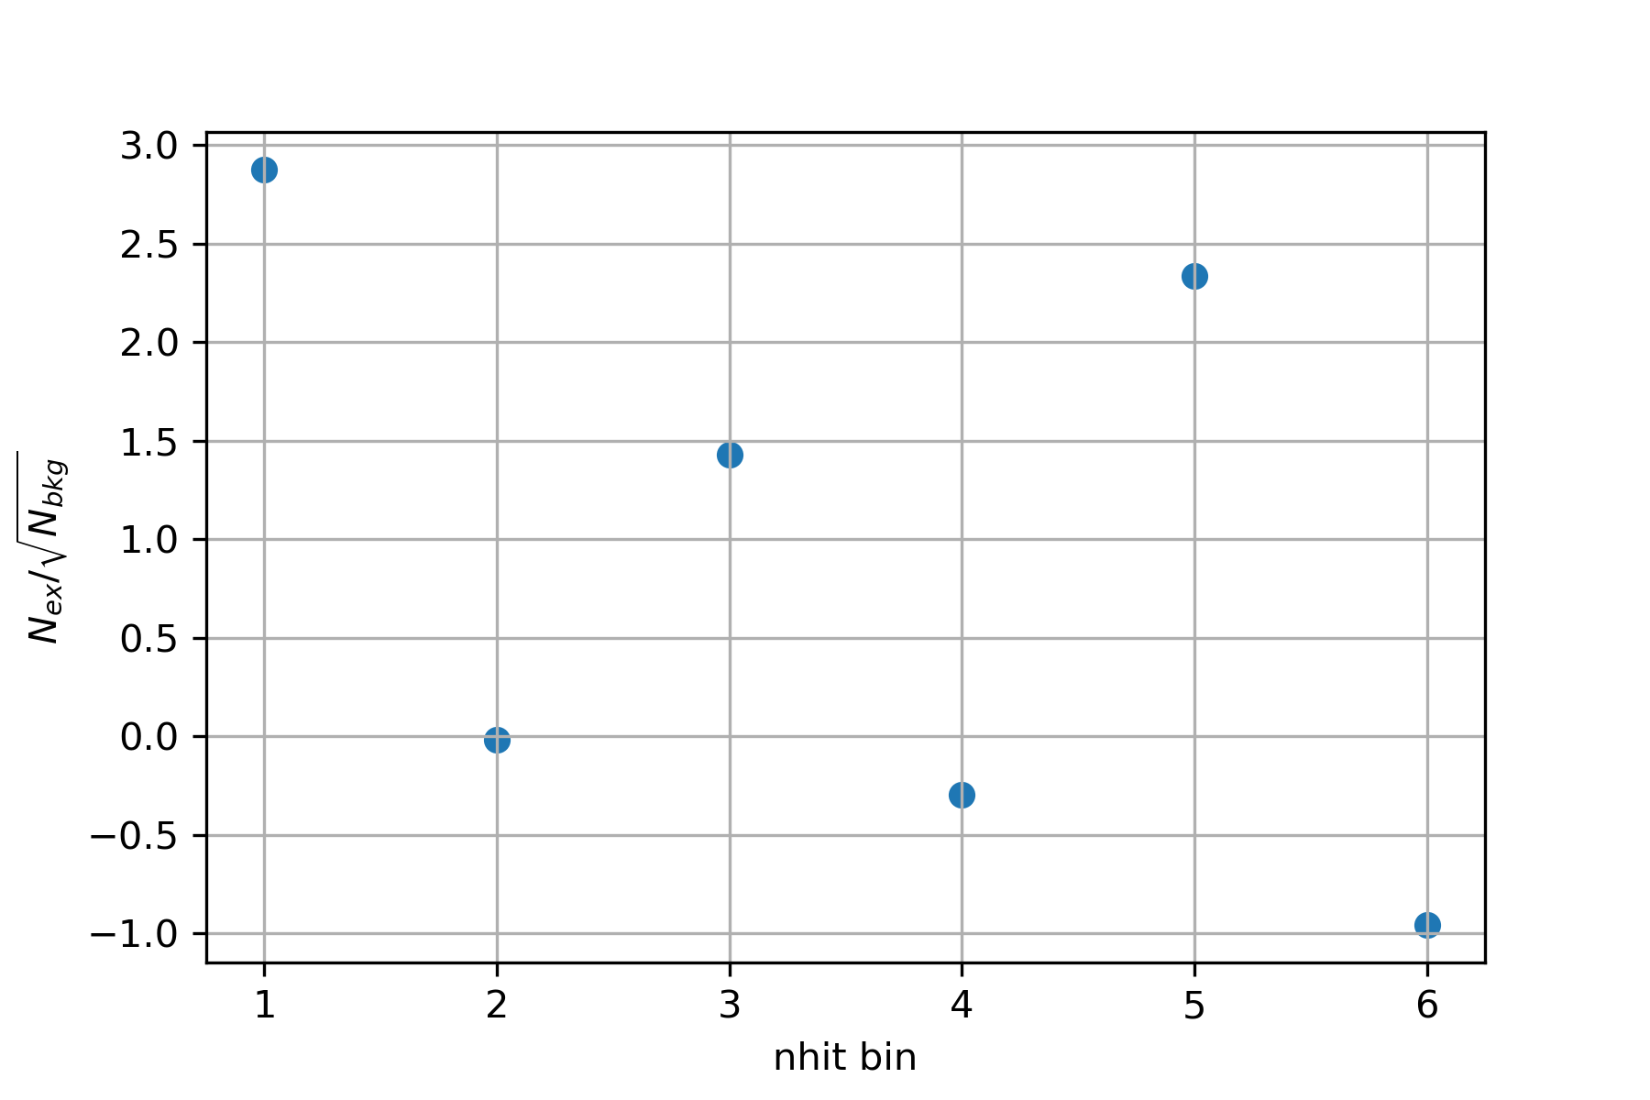
Analysis with WCDA ----(Assuming a spectrum $A{(\frac{E}{E_{0}})}^{−2.75}$)
KM2A results are from Jiayin He (PMO)
No significant excess

Slide 7
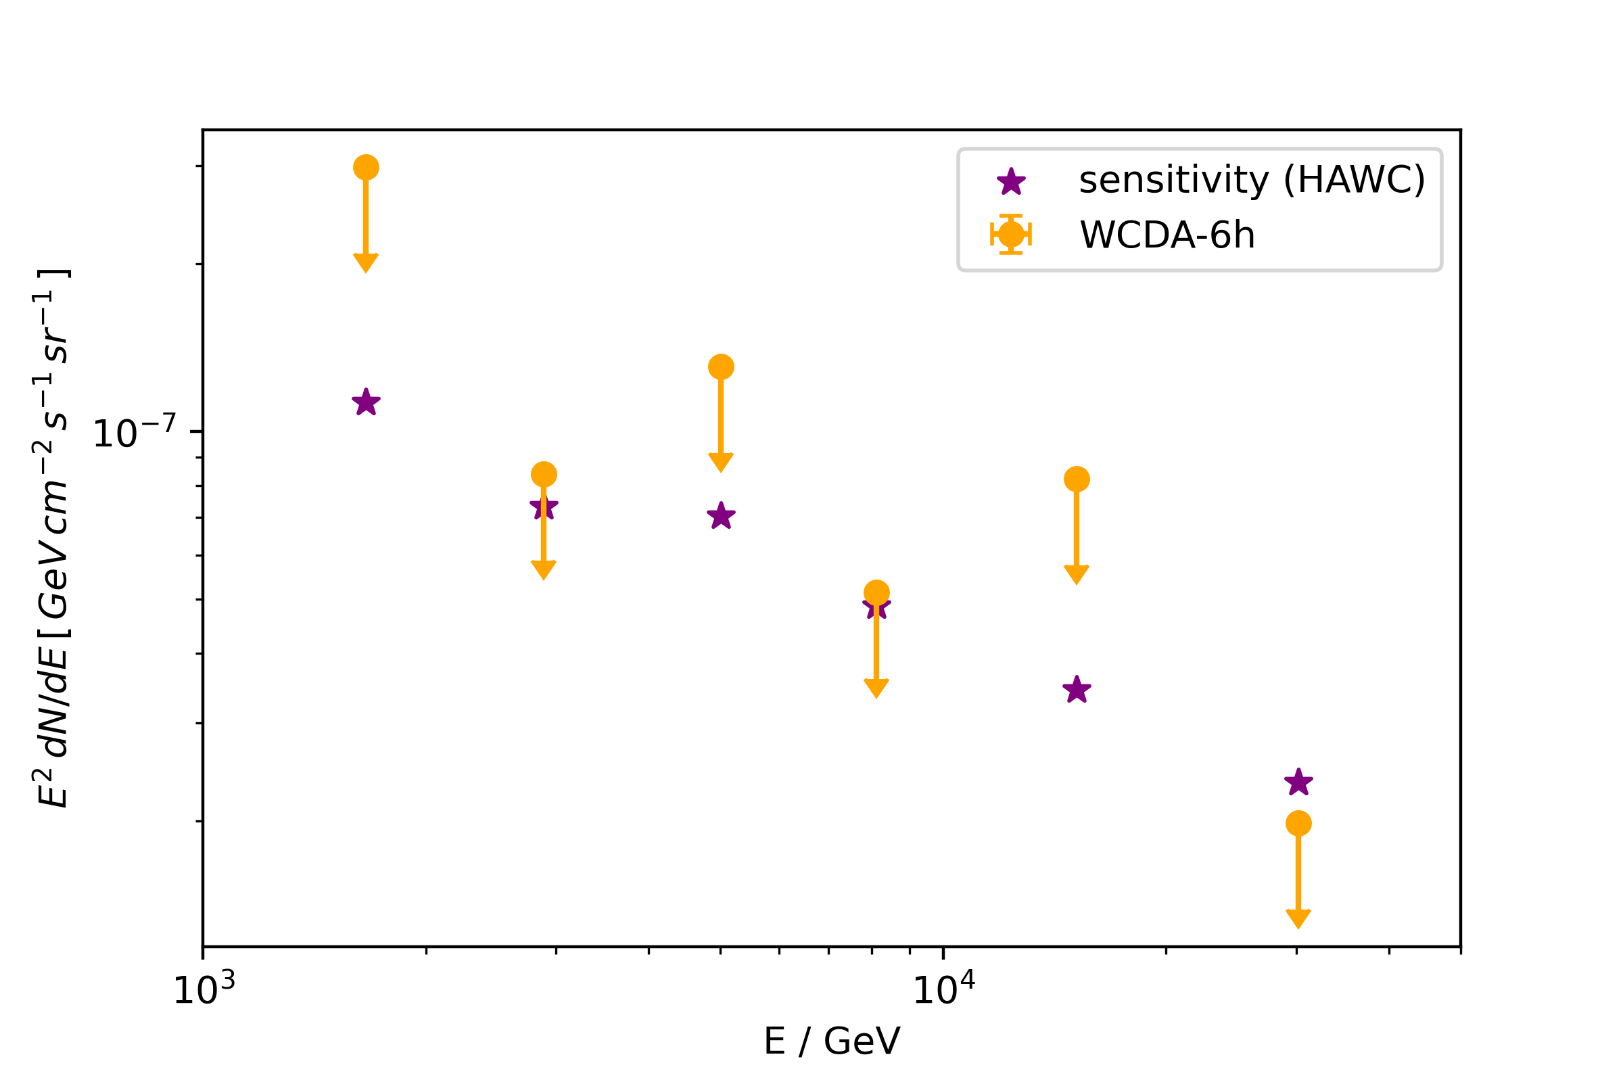
Analysis with WCDA ----(Assuming a spectrum $$A{(\frac{E}{E_{0}})}^{−2.75}$$)
sensitivity
false positive α=0.05 false negative β=0.5

Slide 8
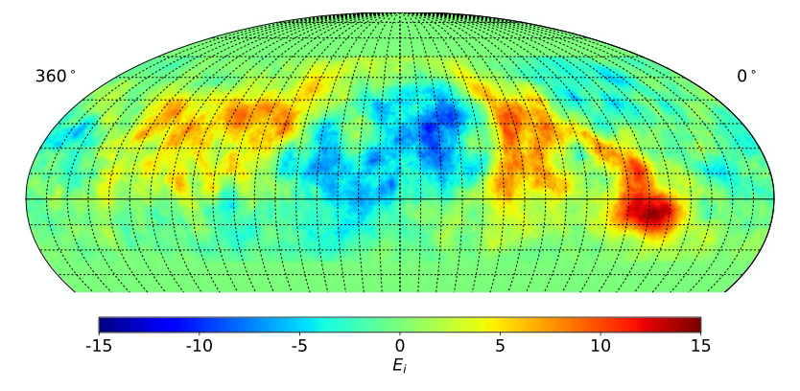
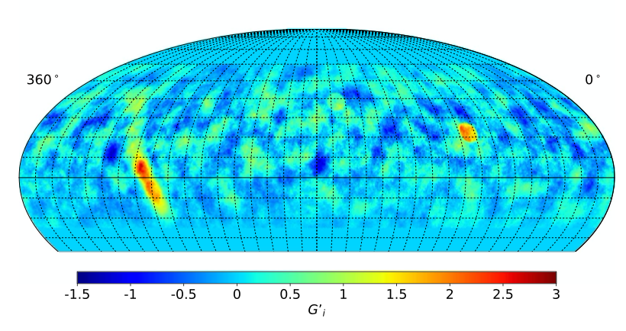


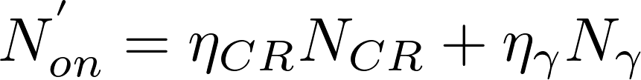
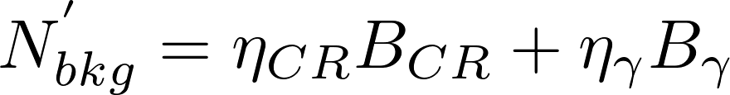
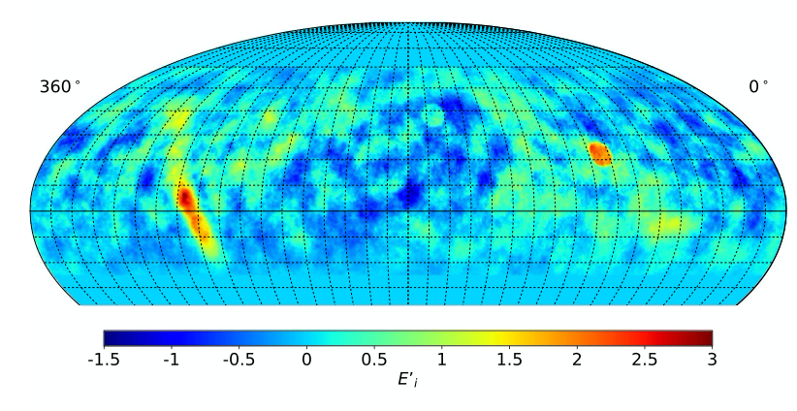
Dealing with CR anisotropy ---- HAWC method
before cut
after cut

Slide 9
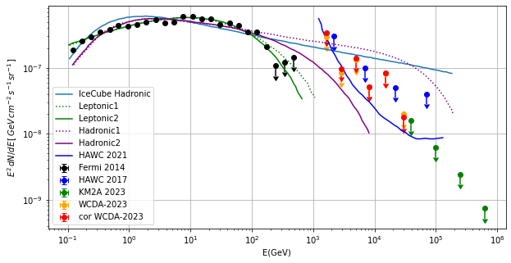
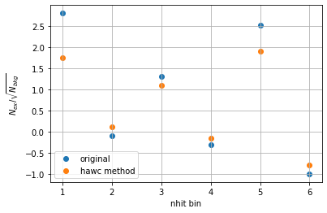
Analysis with WCDA ---- corrected results

Slide 10
Analysis with WCDA ---- summary and expectation
Summary:
no significant excess in the Northern Fermi Bubble region
CR effect exists
upper limits are higher than those from HAWC-ICRC2021.
Expectation:
more observation time
change pincness
fluctuation of background

Slide 11
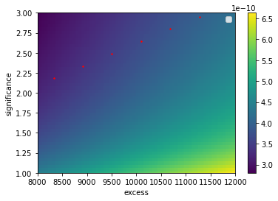

Slide 12
