Slide 1


Multi-messenger Study of Galactic Diffuse Emission with LHAASO and IceCube Observations
Reporter : Sujie Lin
Collaborators : Chengyu Shao
Lili Yang
arXiv:2307.01038
2023.10.22 Hefei

Slide 2
Contents
Observations
LHAASO Diffuse Gamma
IceCube Diffuse Neutrino
Explanations
Conclusion

Slide 3
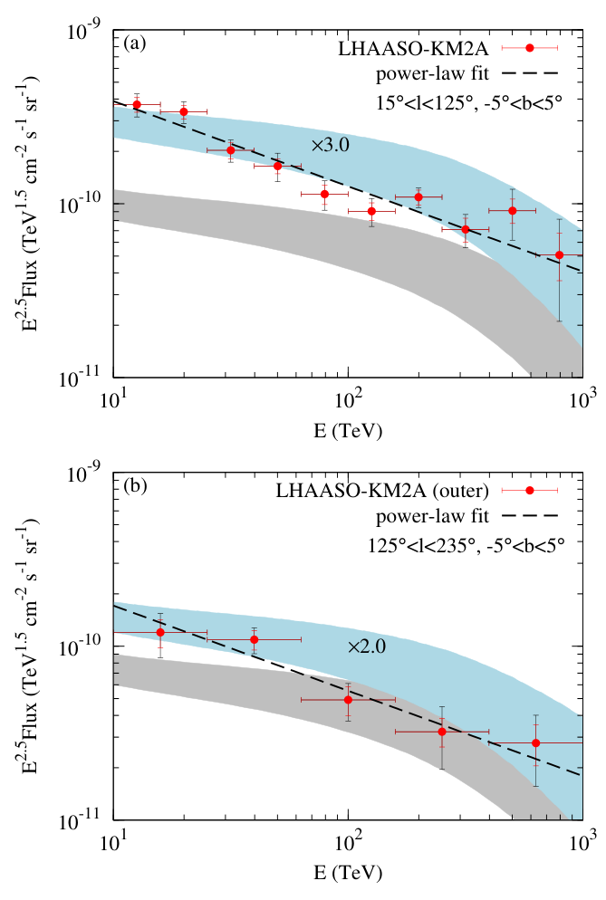
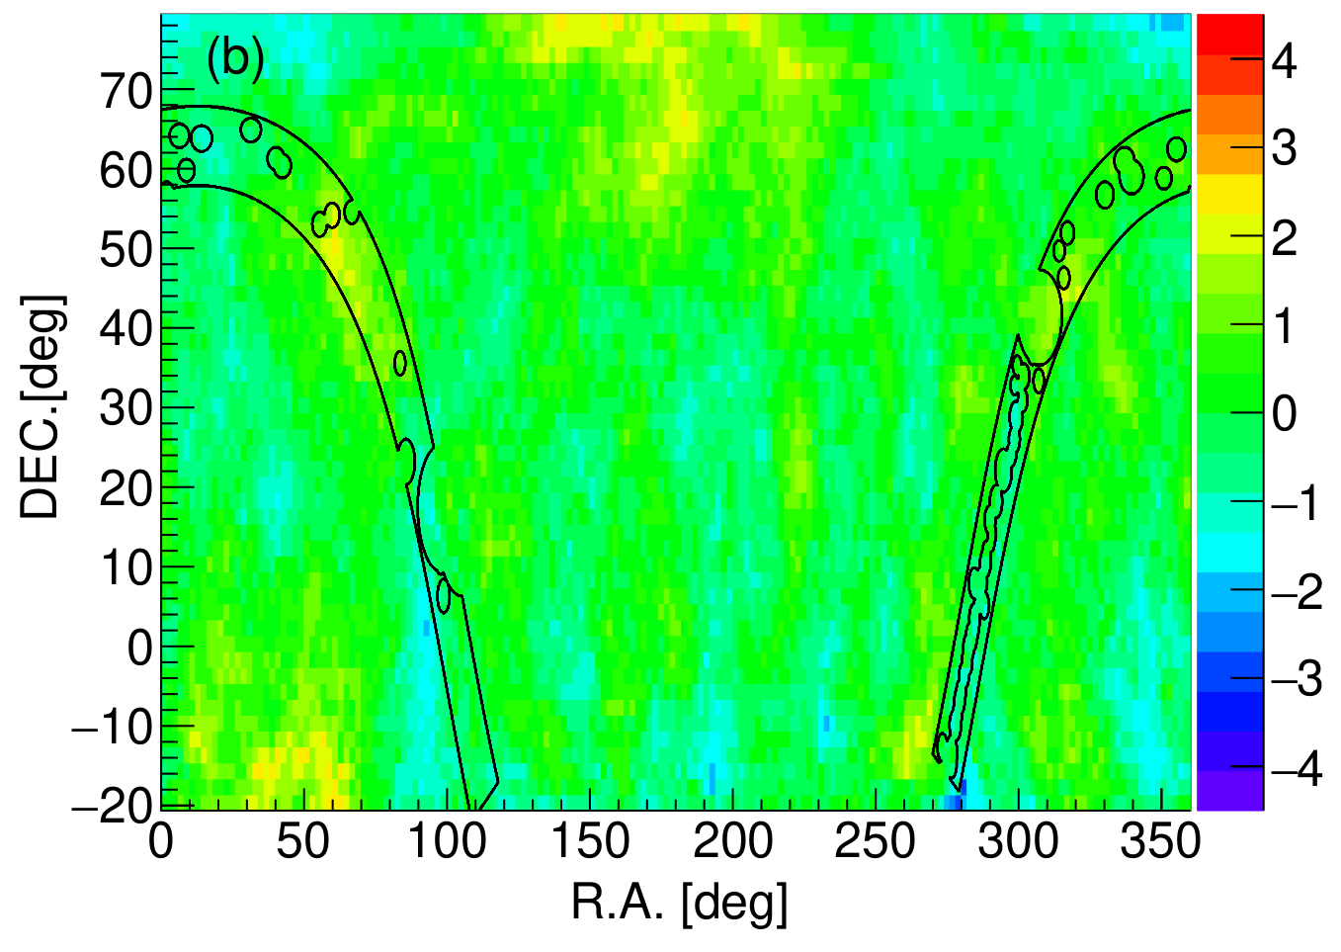
LHAASO Diffuse Gamma
LHAASO observed:
diffuse gamma along Galactic plane
[arXiv:2305.05372]

Slide 4
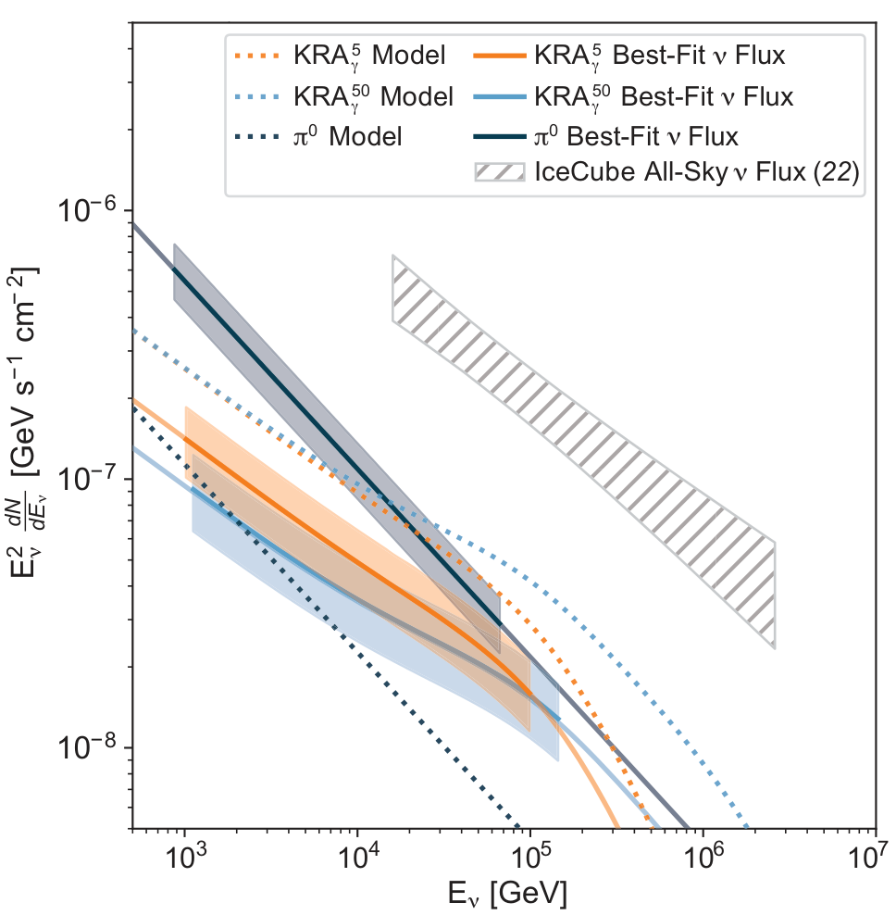
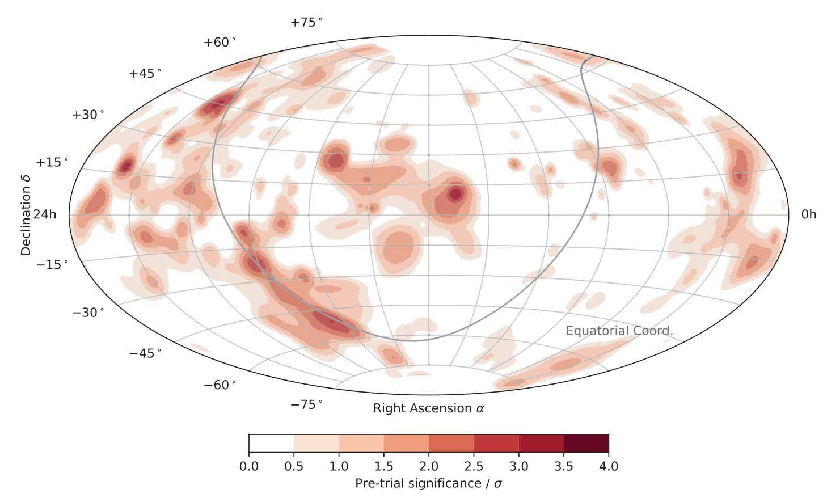
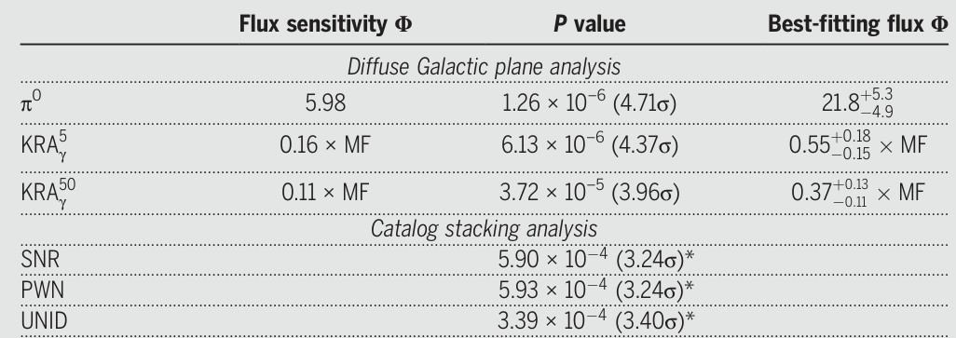
IceCube Diffuse Neutrino
IceCube observed:
diffuse neutrino along Galactic plane
Flux Varying with template
[Abbasi et al. 2023]

Slide 5
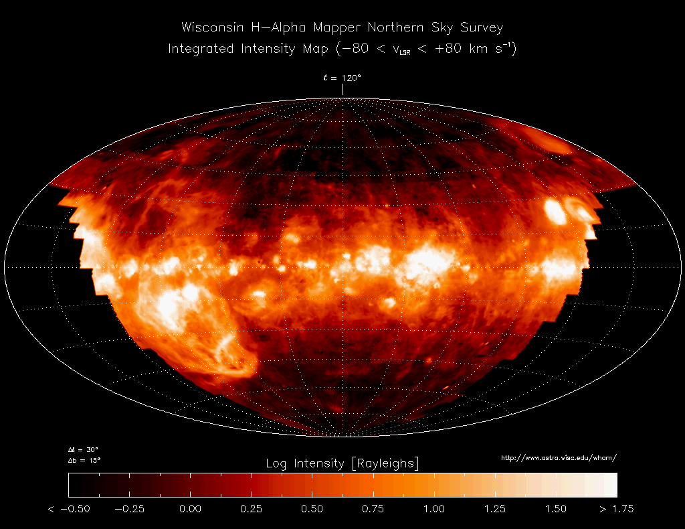
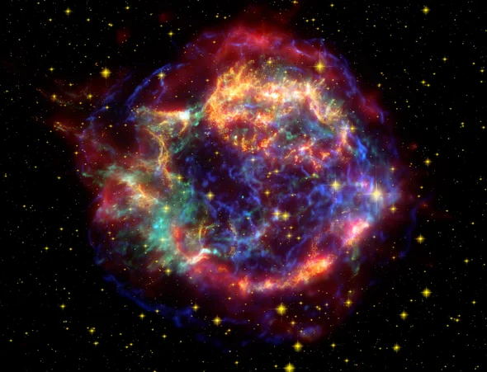
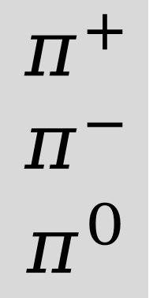


Source of Galactic Diffusion Emission
Interstellar medium
AAFrag
$$π^{+}$$
$$π^{−}$$
$$π^{0}$$
$$ν$$
SNR
CR
GALPROP
unresolvedhadronic sources....
$$γ$$
Inverse Compton
synchrotron
bremsstrahlung
......
unresolved leptonic sources....

Slide 6
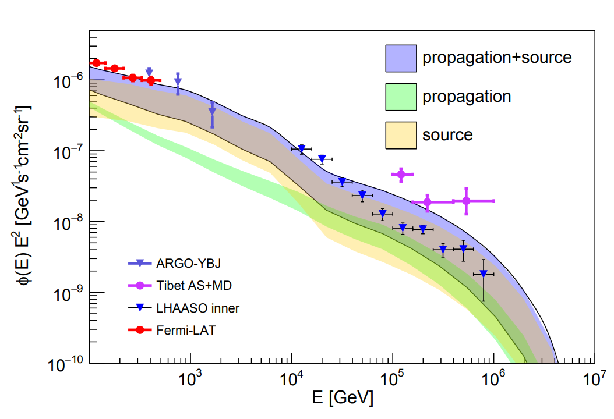
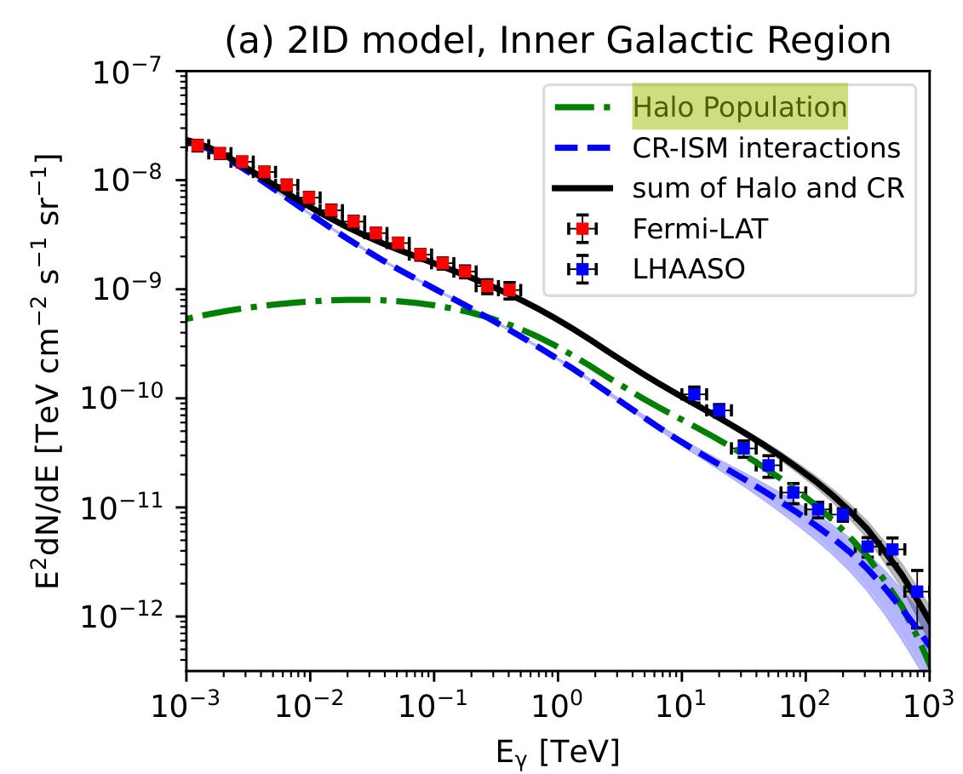
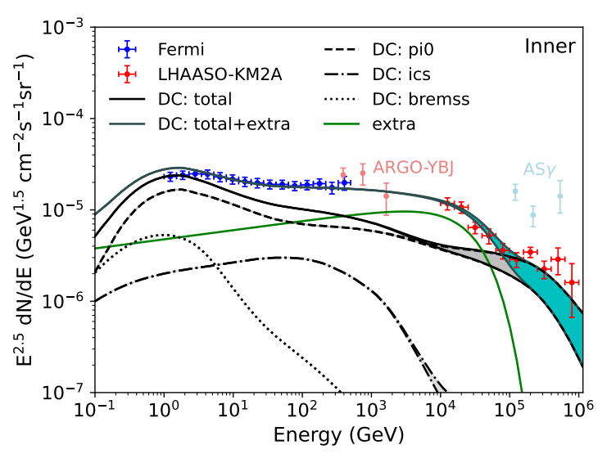
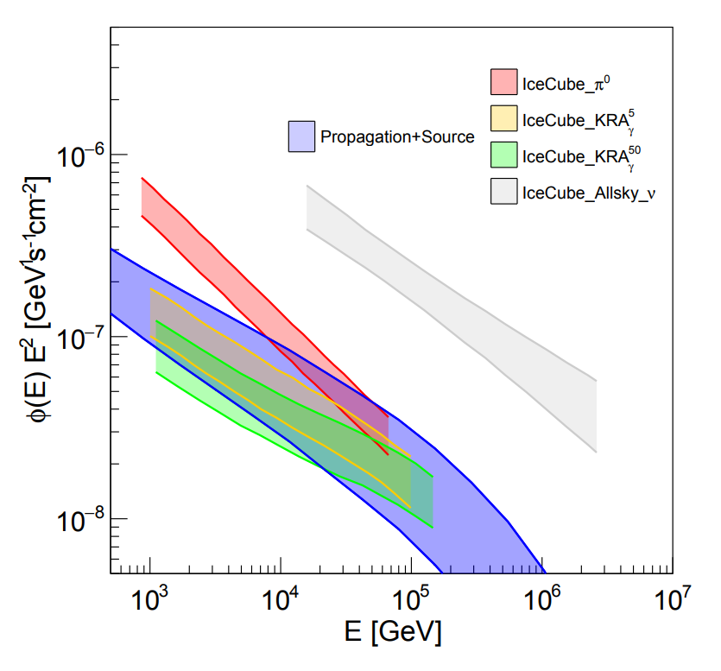
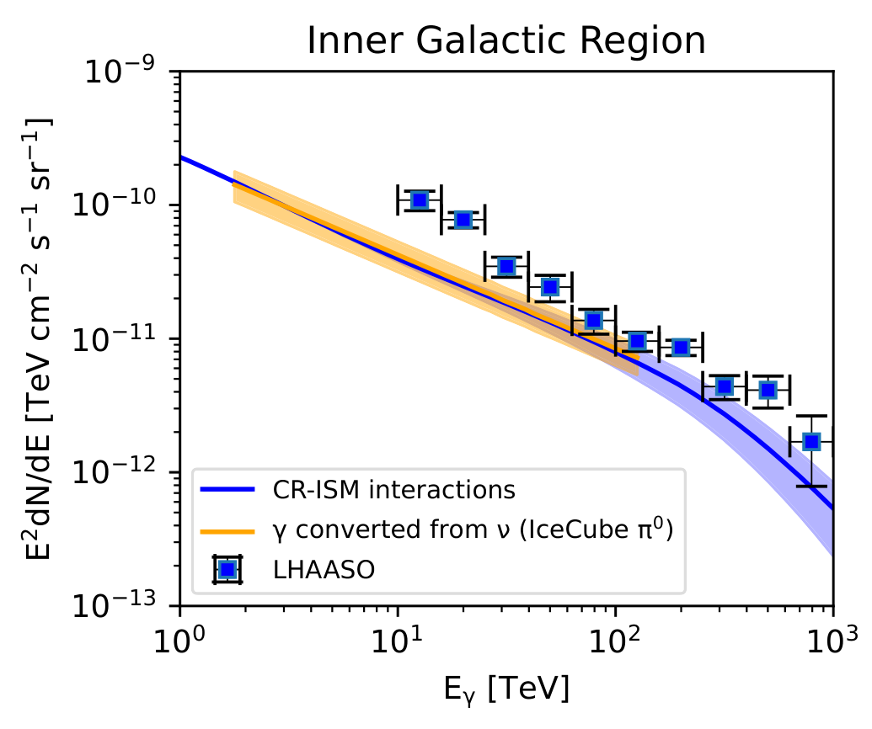
Source Contributions
[arXiv:2305.06948]
Extra unresolved source needed
[arXiv:2307.02372]
[arXiv:2307.12363]

Slide 7
Source Contributions
[arXiv:2305.06948]
Hadronic interaction around sources
[arXiv:2307.02372]
[arXiv:2307.12363]

Slide 8
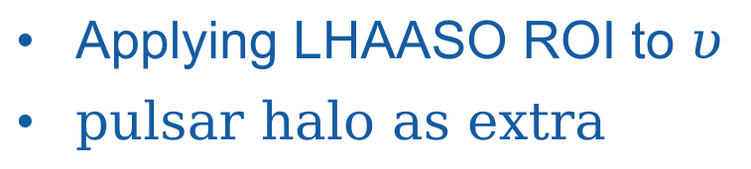
Source Contributions
Applying LHAASO ROI to $υ$
pulsar halo as extra
[arXiv:2305.06948]
[arXiv:2307.02372]
[arXiv:2307.12363]

Slide 9
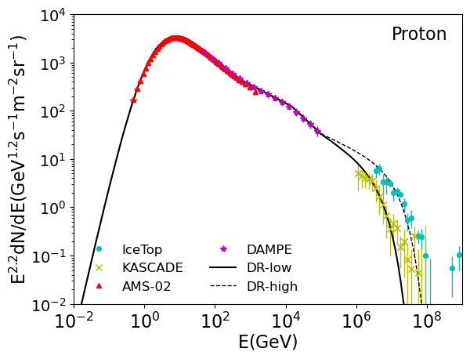
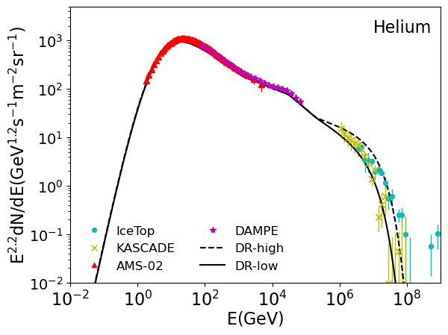
CR spectra
IceTop and KASCADE use different hardonic model.
Diffusion plus Reacceleration(DR)-low is fitted with KASCADE data;
DR-high is fitted with IceTop data.

Slide 10
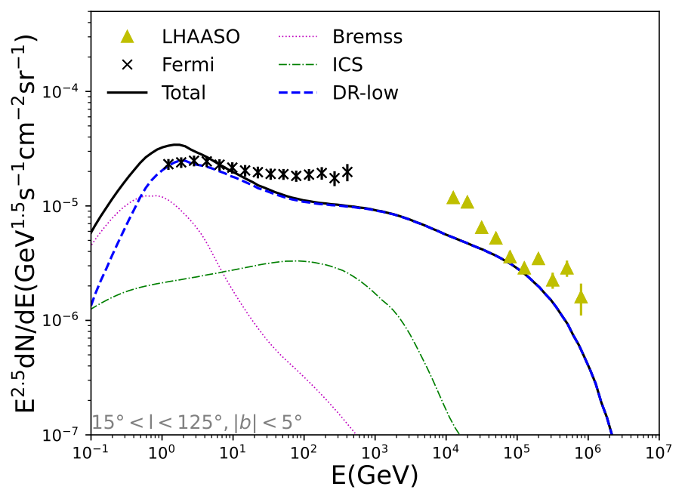
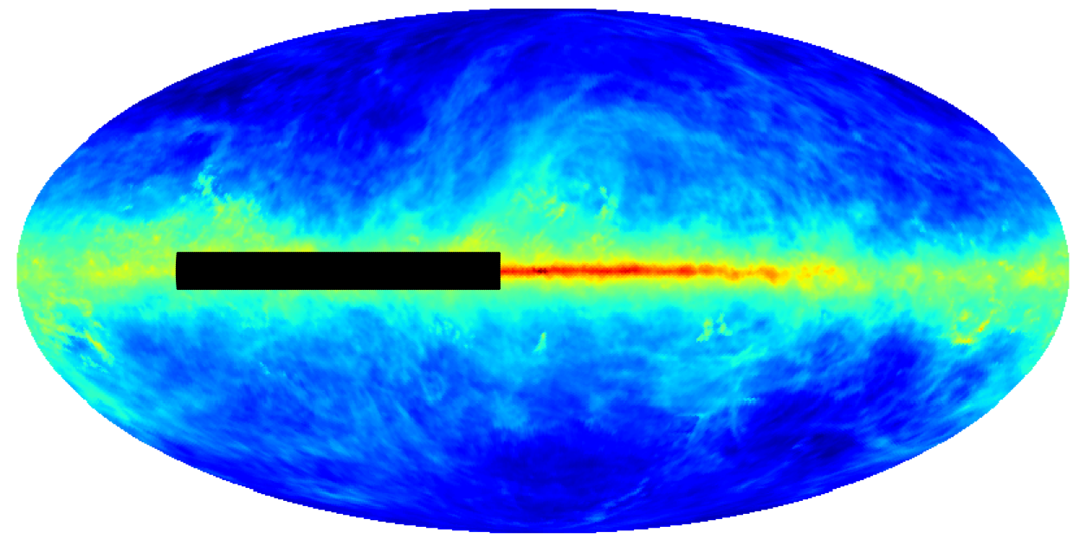
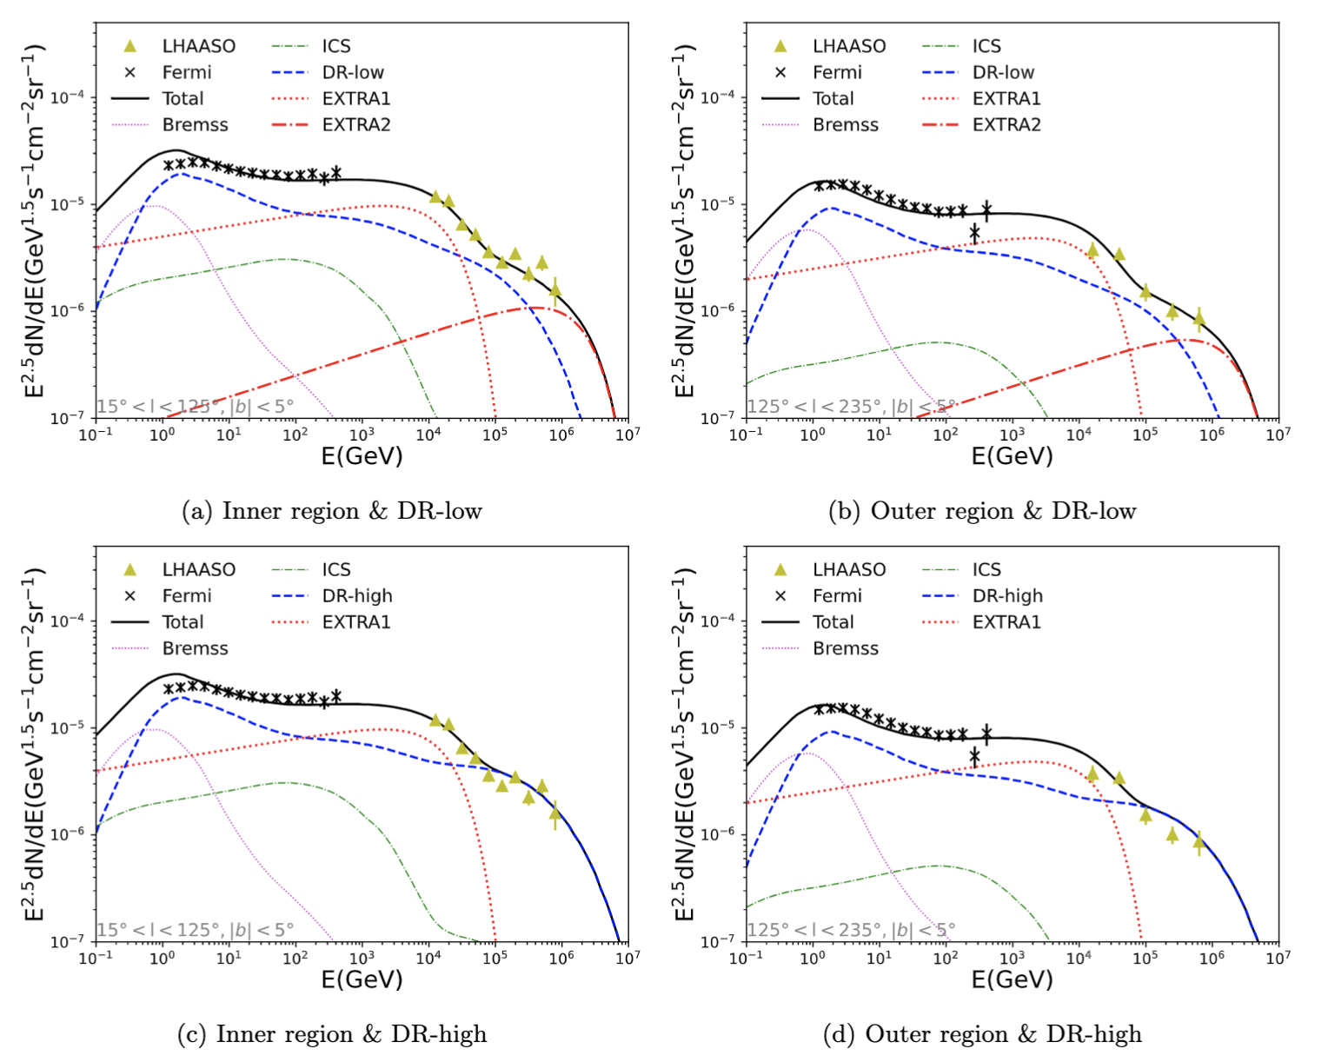
Gamma ray spectrum
add extra components
 | Index | Cutoff energy
EXTRA1 | 2.4 | 20TeV
EXTRA2 | 2.3 | 2PeV

Slide 11
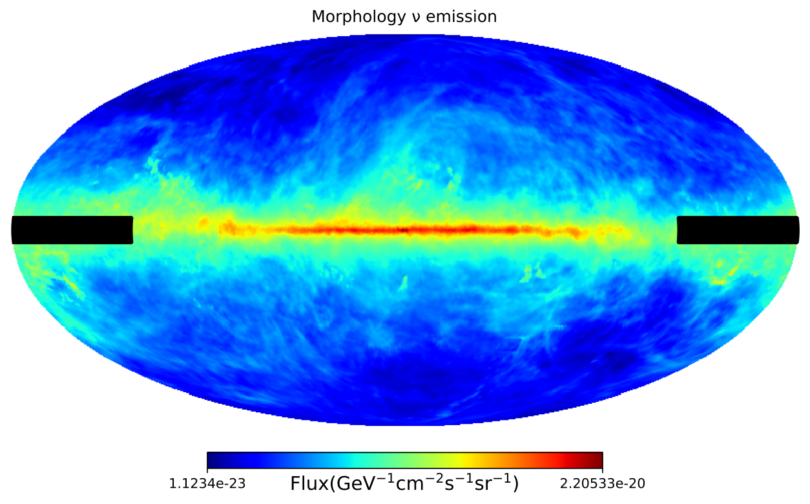
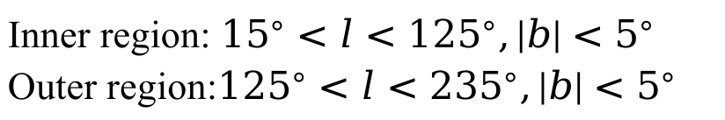
Gamma ray spectrum
Inner region: ${15}^{∘}<l<{125}^{∘},|b|<5^{∘}$
Outer region:${125}^{∘}<l<{235}^{∘},|b|<5^{∘}$
EXTRA2 required in DR-high Cases

Slide 12
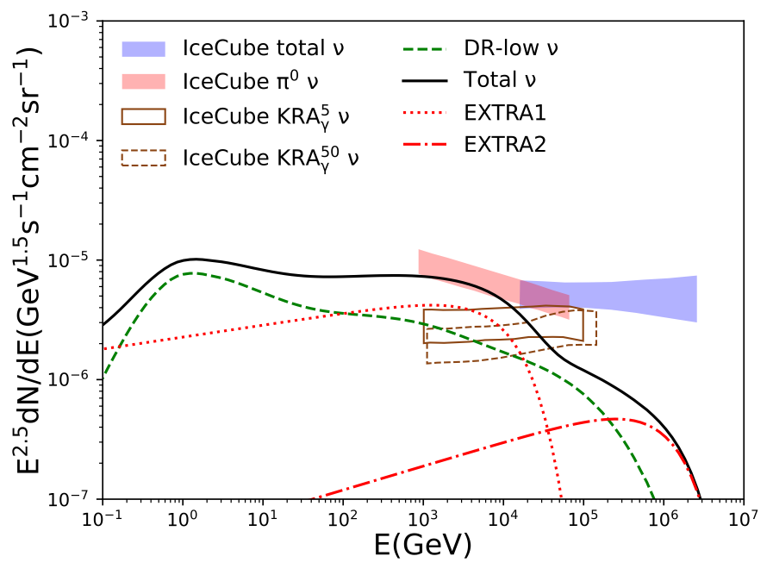
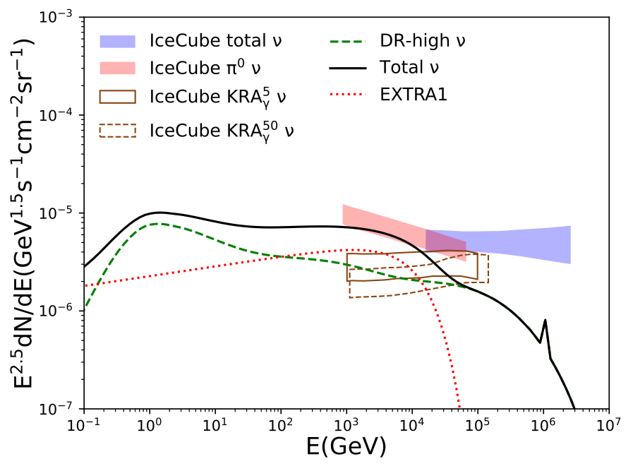
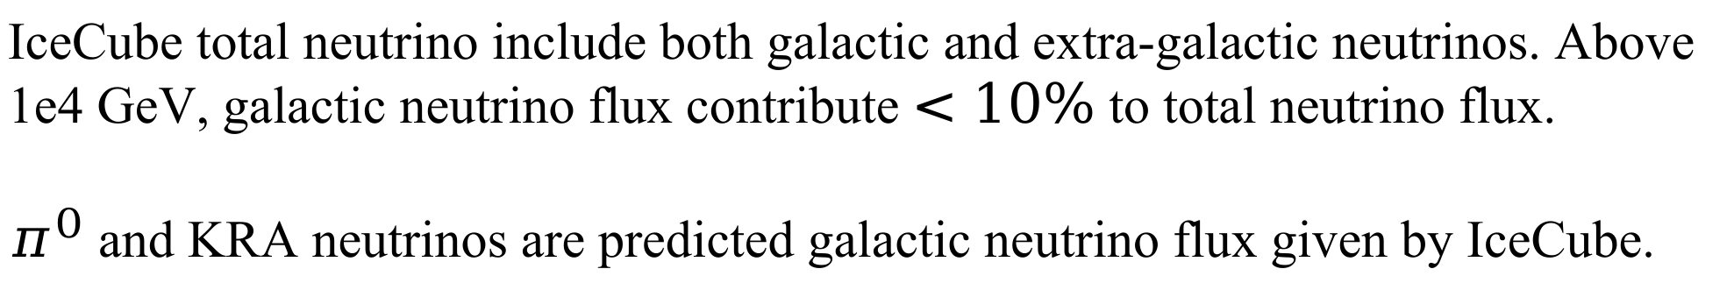
Neutrino spectrum
Data selected with different template
Glashow resonance
IceCube total neutrino include both galactic and extra-galactic neutrinos. Above 1e4 GeV, galactic neutrino flux contribute $<10\%$ to total neutrino flux.
$π^{0}$ and KRA neutrinos are predicted galactic neutrino flux given by IceCube.

Slide 13
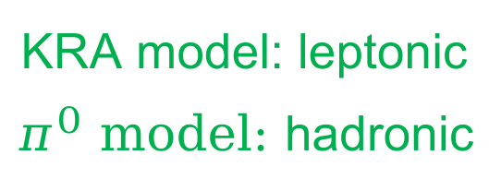
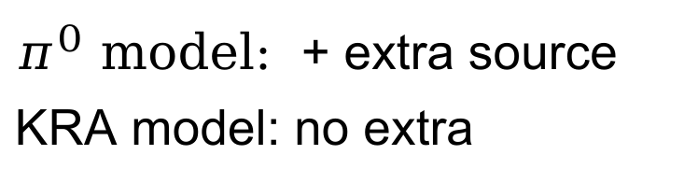
Discuss
CR
gamma
neutrino
$π^{0}$ model: + extra source
KRA model: no extra
No extra CR
+ extra source
leptonic
or
hadronic with few injection
leptonic
or
hadronic
KRA model: leptonic
$π^{0}$ model: hadronic

Slide 14


Origin of EXTRA components
Origin | proton& helium | Gamma | Neutrino
Leptonic |  |  | KRA model
Hadronic | Inject few P&He |  | model
EXTRA1
$$π^{0}$$
identification of neutrinos can reveal the origin of EXTRA1
High-energy neutrino emission is a unique diagnostic of hadronic content.
EXTRA2

Slide 15
Conclusion
Multi-messager study combining IceCube and LHAASO performed
The component of Galactic diffuse gamma and neutrino discussed
Origin | proton& helium | Gamma | Neutrino
Leptonic |  |  | KRA model
Hadronic | Inject few P&He |  | model
$$π^{0}$$

Slide 16
Thank you!

Slide 17
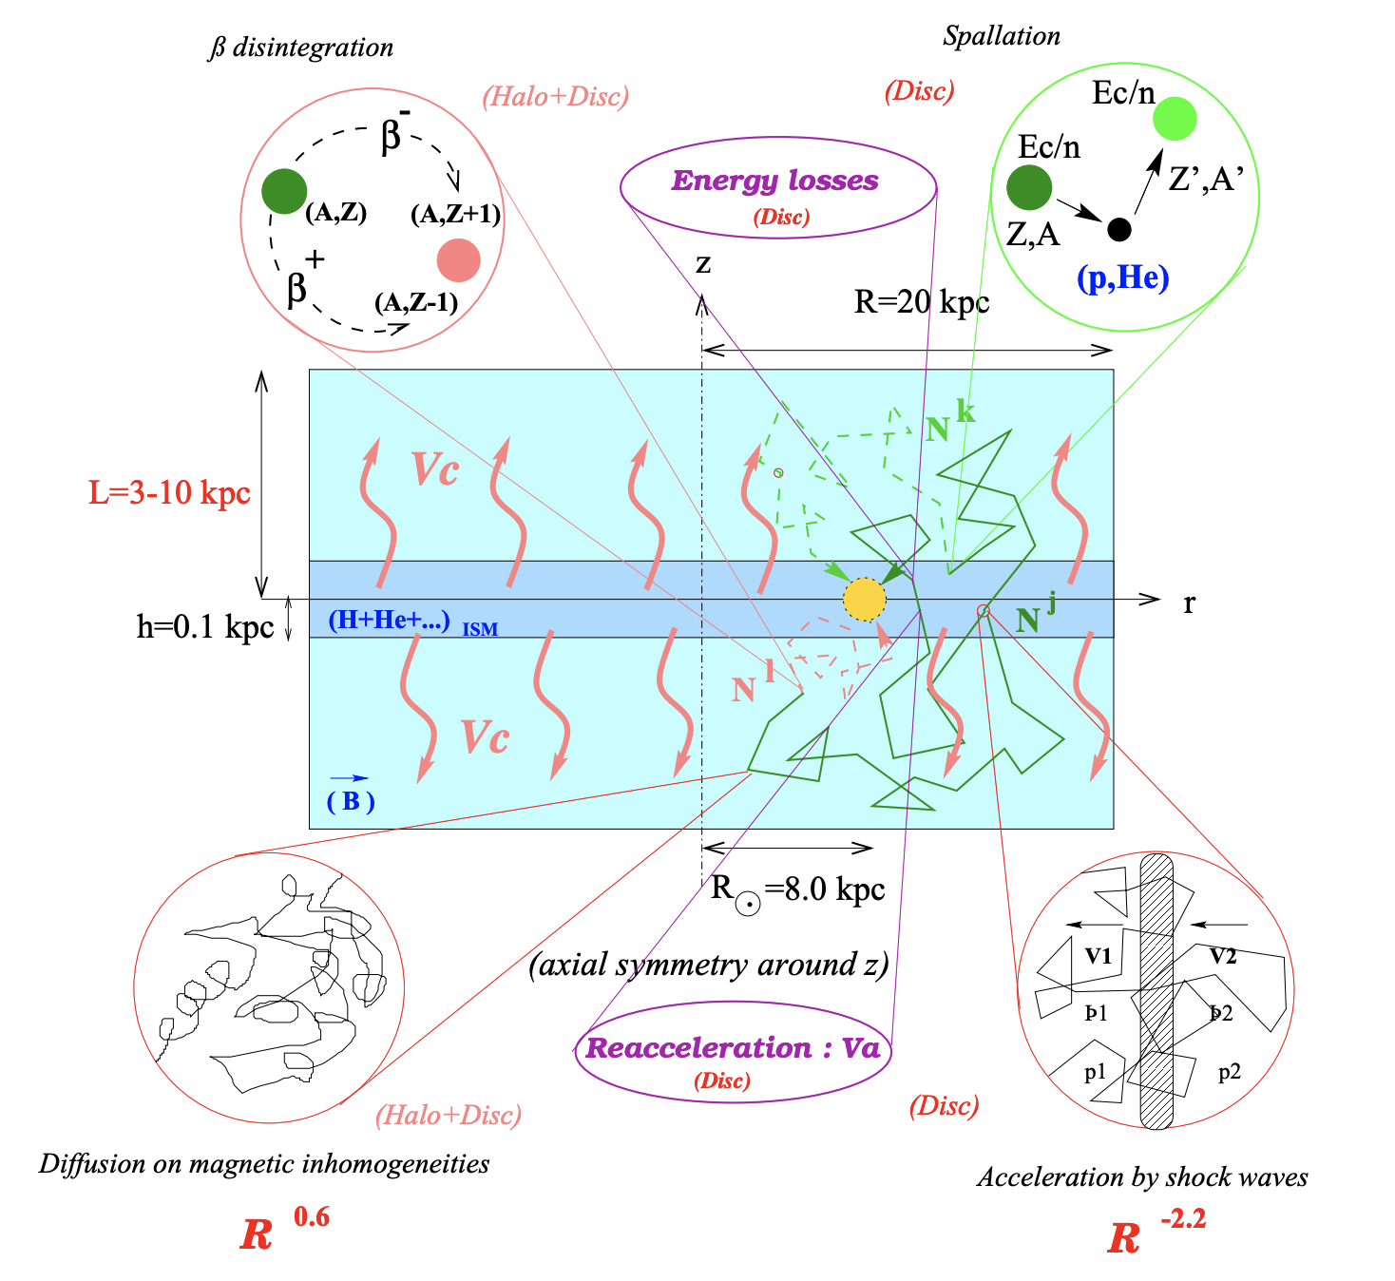
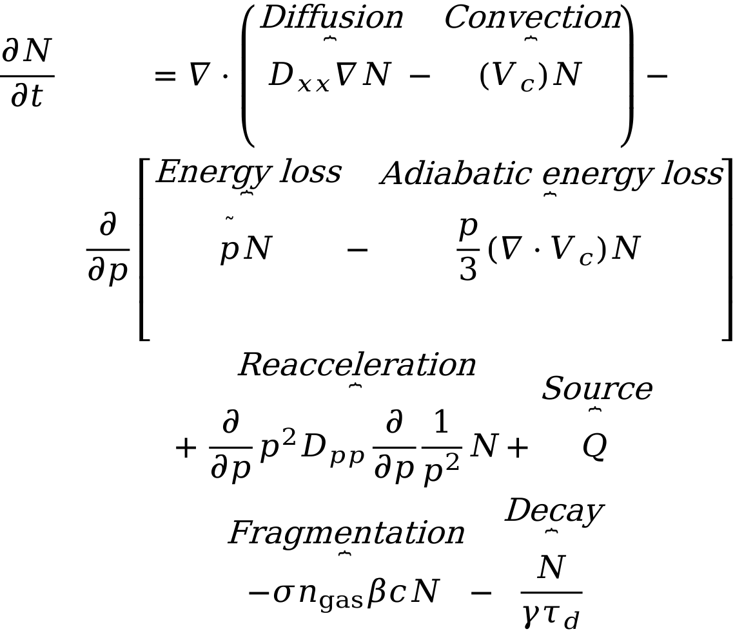
GALPROP
GALPROP is a software package for numerical Galactic cosmic-ray propagation and related emission processes.
$$\begin{matrix}\frac{∂N}{∂t} & =∇⋅\left(\overset{\text{Diffusion}}{\overset{⏞}{D_{xx}∇N}}−\overset{\text{Convection}}{\overset{⏞}{(V_{c})N}}\right)− \\ & \frac{∂}{∂p}\left[\overset{\text{Energy} \text{loss}}{\overset{⏞}{\overset{˜}{p}N}}−\overset{\text{Adiabatic} \text{energy} \text{loss}}{\overset{⏞}{\frac{p}{3}(∇⋅V_{c})N}}\right] \\ & +\overset{\text{Reacceleration}}{\overset{⏞}{\frac{∂}{∂p}p^{2}D_{pp}\frac{∂}{∂p}\frac{1}{p^{2}}N}}+\overset{\text{Source}}{\overset{⏞}{Q}} \\ & \overset{\text{Fragmentation}}{\overset{⏞}{−σn_{gas}βcN}}−\overset{\text{Decay}}{\overset{⏞}{\frac{N}{γτ_{d}}}}\end{matrix}$$
[1] https://arxiv.org/pdf/astro-ph/0212111.pdf

Slide 18
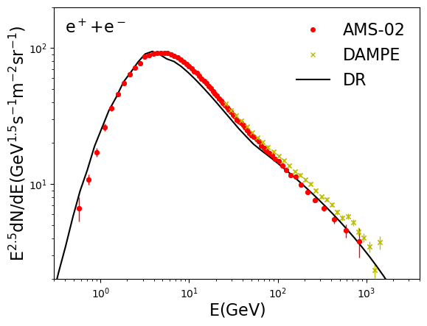
Supplement

Slide 19


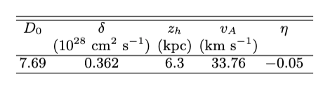
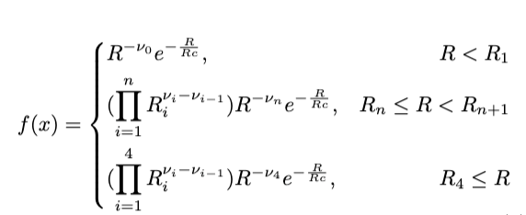
Supplement
SNR distribution
Diffusion parameter
injection spectra

