Slide 1
Spectral Analysis of Lithium, Beryllium and Boron Nuclides with DAMPE
Speaker：Chen ZhanFang
2024-7-9

Slide 2
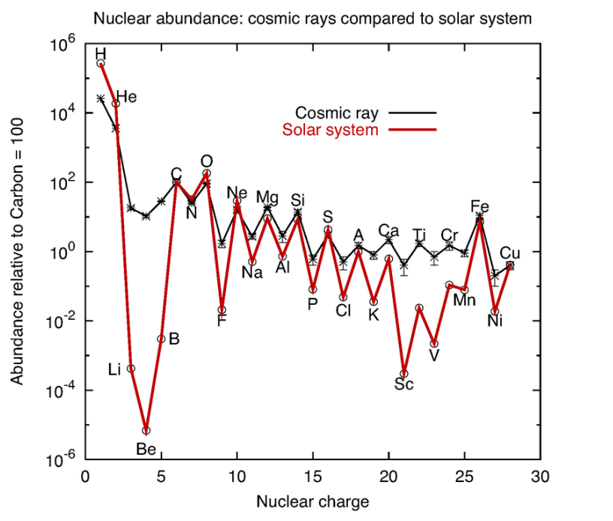
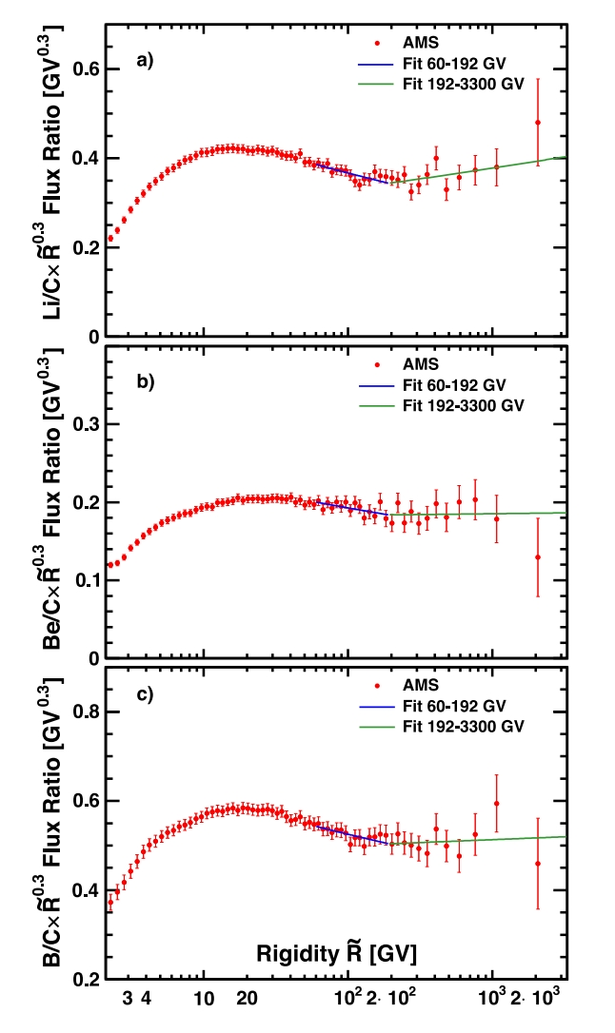
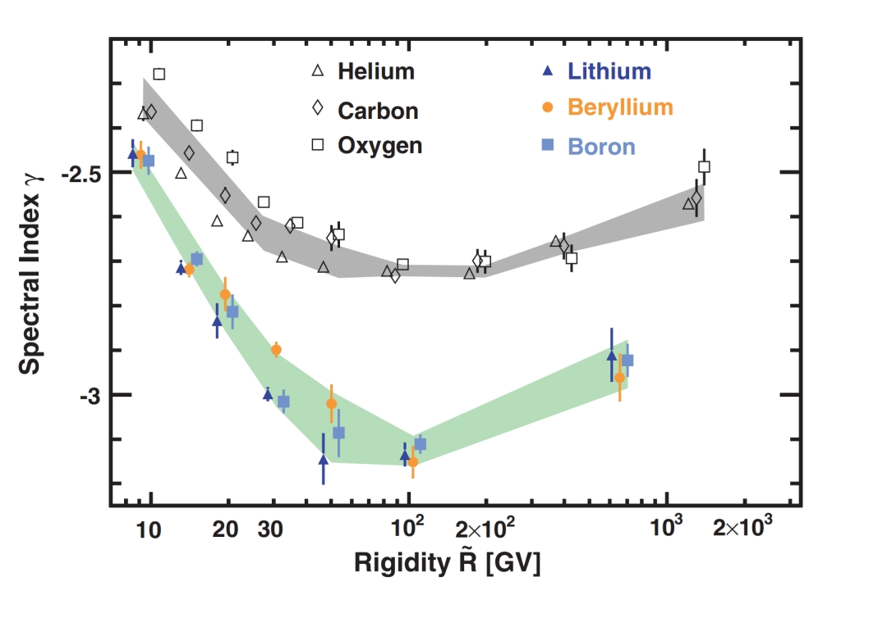
Primary/Secondary cosmic rays
(Mehrez et. al. 2015)
Secondary+Primary
Lithium, Beryllium and Boron Nuclides in cosmic rays are mainly produced by the fragmentation of heavier nuclei,e.g.C and O
Precise measurements of the Li(Be)/C flux ratio are crucial to constrain the CR propagation process
Primary
(AMS Coll., Phys. Rep., 2021)

Slide 3
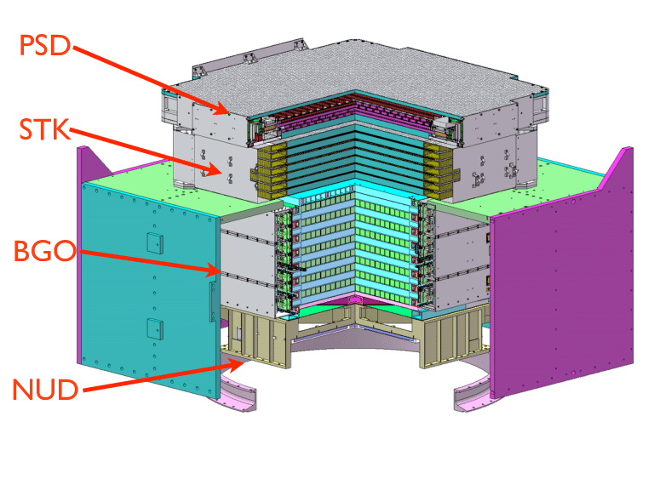
The DAMPE detector
Plastic Scintillator Detector (PSD):
Charge measurement
photon anti-coincidence
Silicon Microstrip Tracker (STK):
Charge measurement,
track measurement
Bismuth Germanate (BGO) Calorimeter:
Energy measurement
lepton/hadron identification.
Neutron Detector (NUD):
High-energy lepton/hadron identification.
Main scientific objectives: 1. Electrons and positrons, gamma photons. 2. Nuclei cosmic rays.
Main scientific significance: 1. Indirect detection of dark matter particles. 2. Origins, acceleration, and propagation of cosmic rays.
Advantages: Optimal energy resolution, leading particle identification, excellent angular resolution

Slide 4
PreSelction
Flight Data
8 years（2016-2023）
Simulation
Energy：10GeV-500TeV
Sampe：
Li6:Li7=1:1
Be7:Be9:Be10=5:3:2
B10:B11=3:7
Physical Model：
GEANT4v4.10.5（FTFP_BERT and EPOS-LHC）
Preselection:
Exclude events from the SAA region: where the detector operates anomalously.
High-energy trigger: Ensure reliable interactions between cosmic ray particles and detector materials.
Energy deposition above 50 GeV: Minimize the effects of geomagnetic cutoff.
The main axis of the shower should be within the BGO calorimeter as much as possible.

Slide 5
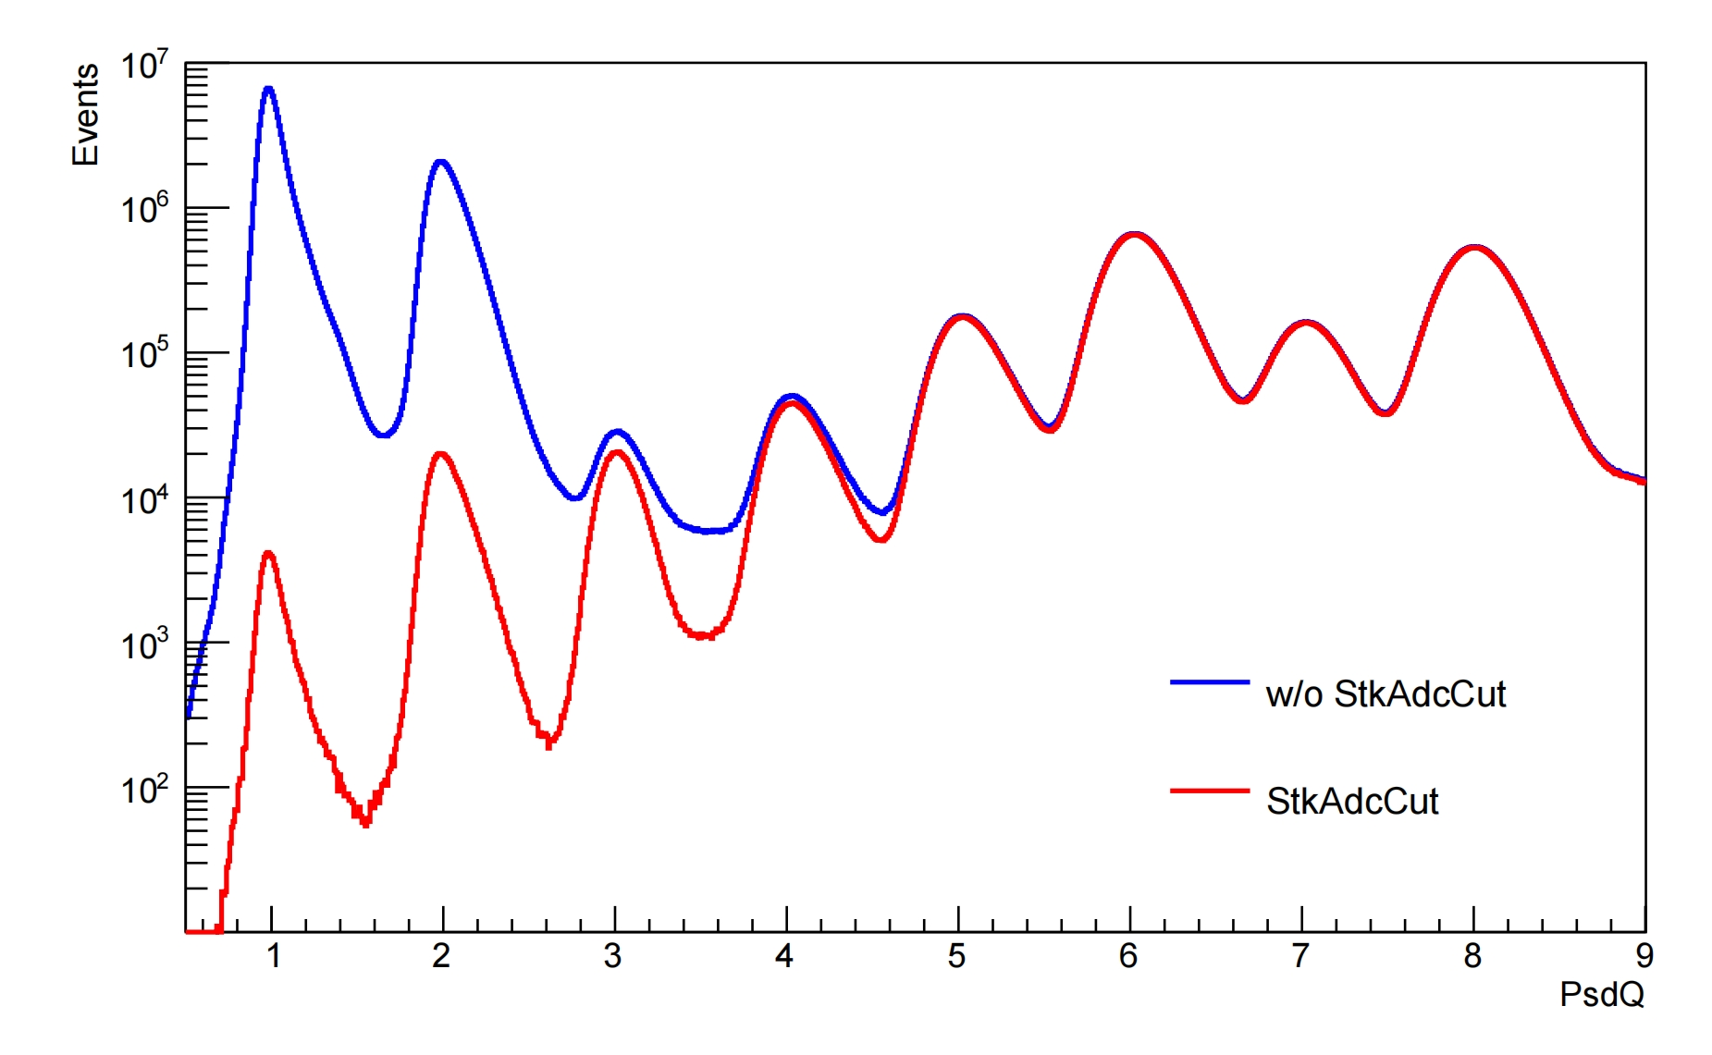
STK charge selection
Reduce the p,He contamination at high energies
Take the signal of the first STK plane(X,Y layers)
Apply a cut of StkAdcQ>400

Slide 6
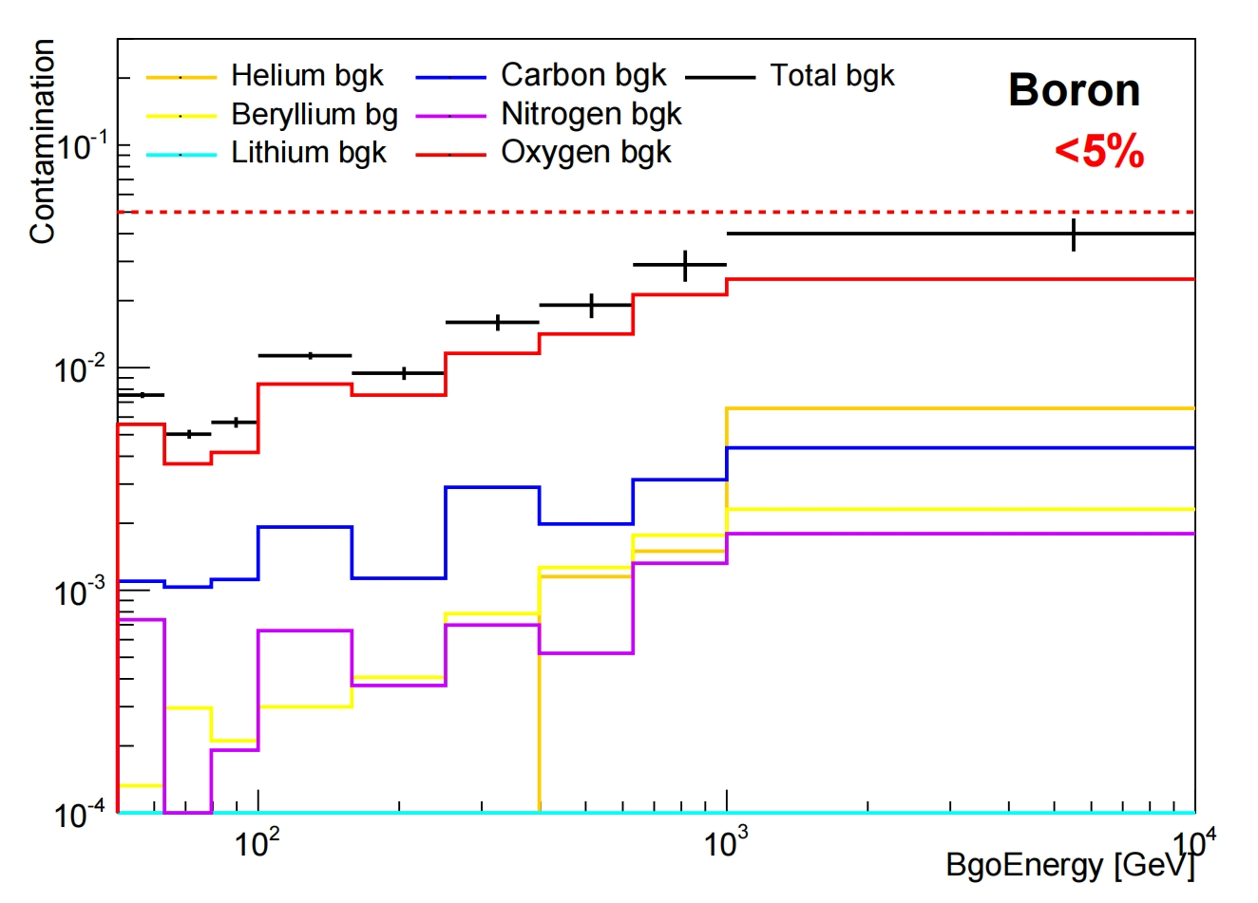
Background estimation
MC template fit is performed with elements from He to O estimate
Background fraction in different E_{Bgo} bins from 50 GeV to 10 TeV.
The proportion of Boron contaminated by nearby nuclides is less than 5%

Slide 7
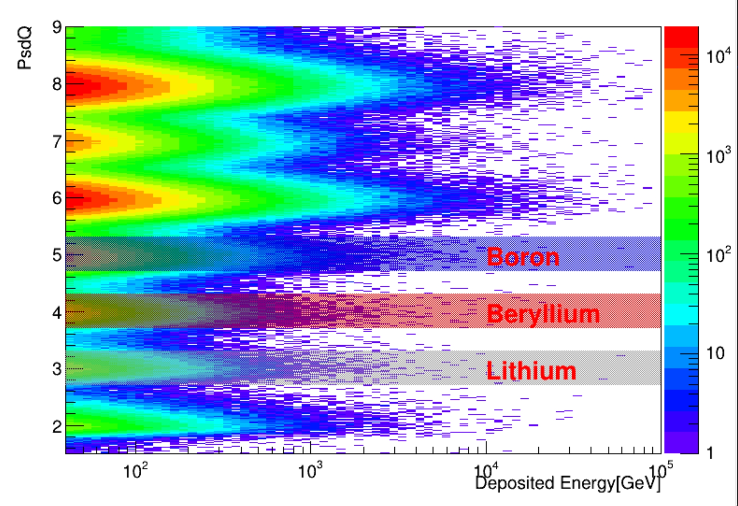
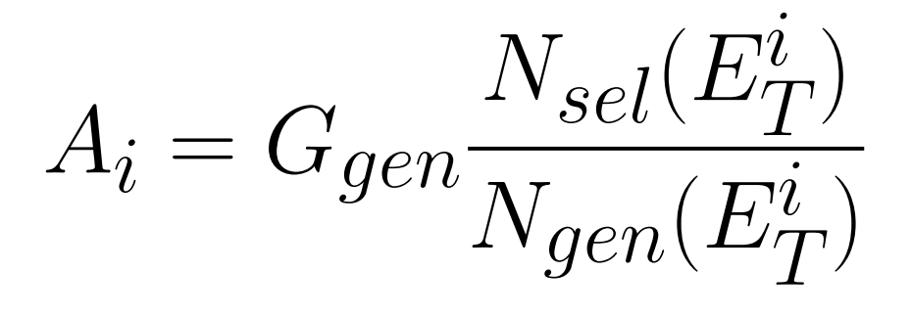
Charge Selction and Accepatnce
Lithium selection:2.7<Z<3.3
Berylium selection:3.7<Z<4.3
Boron selection:4.7<Z<5.3

Slide 8
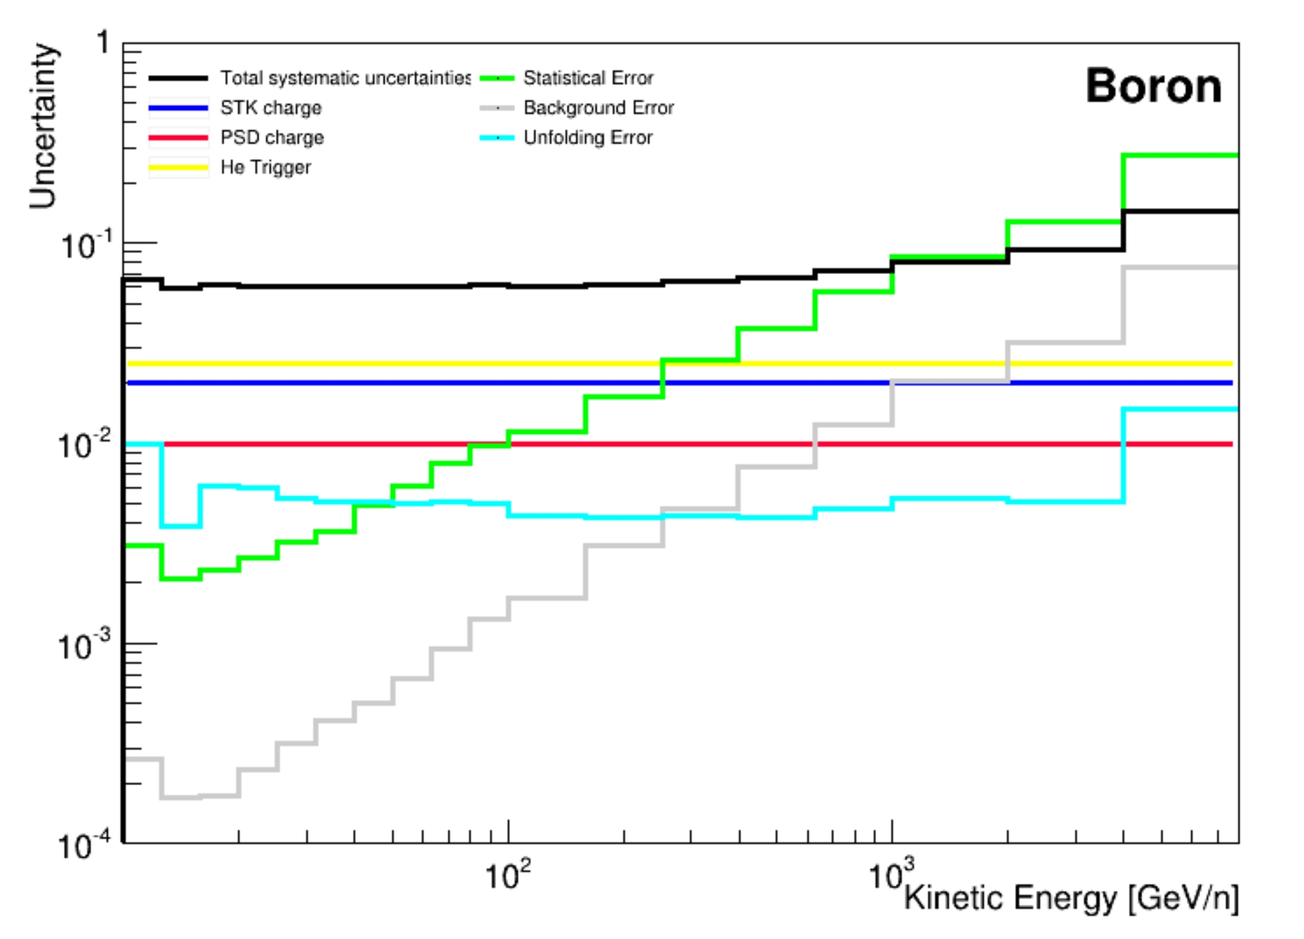
Unfolding and uncertainty estimation
Iterative Bayesian procedure is adopted to reconstruct
the primary energy of the events:
Statistical uncertainty dominant at higher energies
Many systematical contributions evaluated:
Background, Unfolding
Cuts efficieney validated with flight data

Slide 9
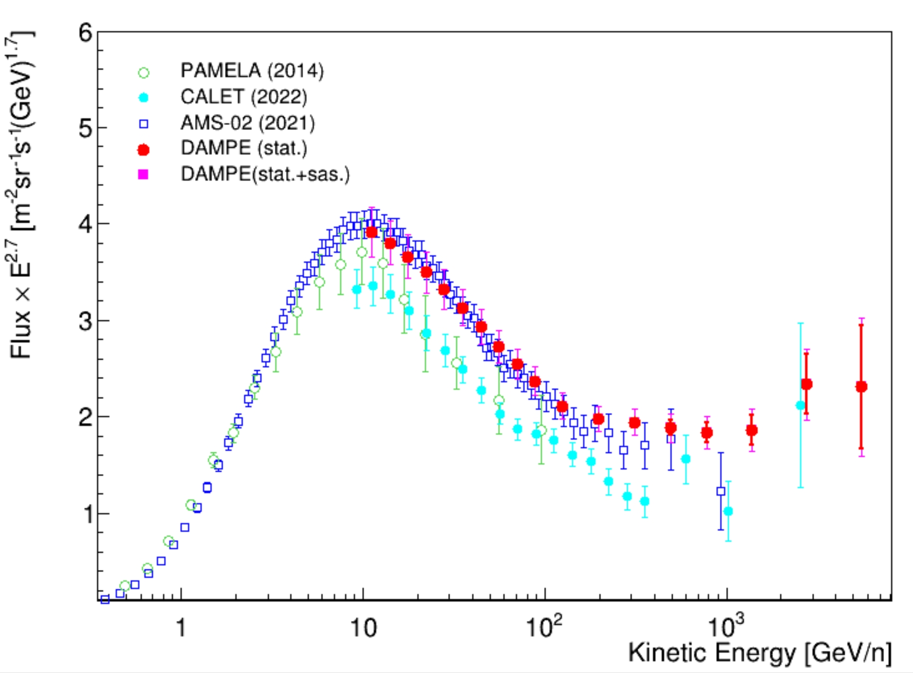
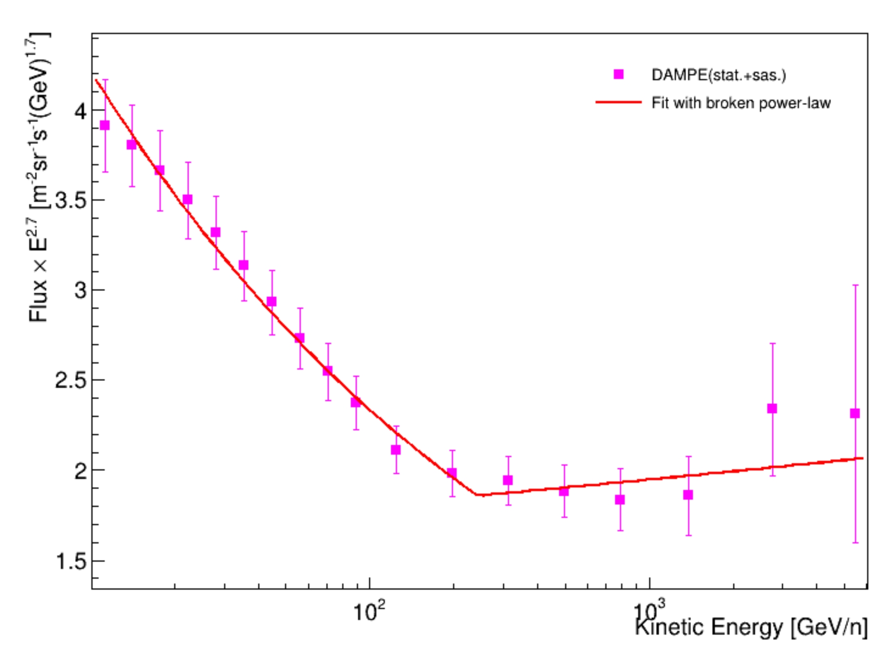
Boron Spectrum
DAMPE boron flux measured from 10 GeV/n to 5.5 TeV/n
Hardening at 243 GeV/n with spectral index going from -2.97 to -2.67

Slide 10
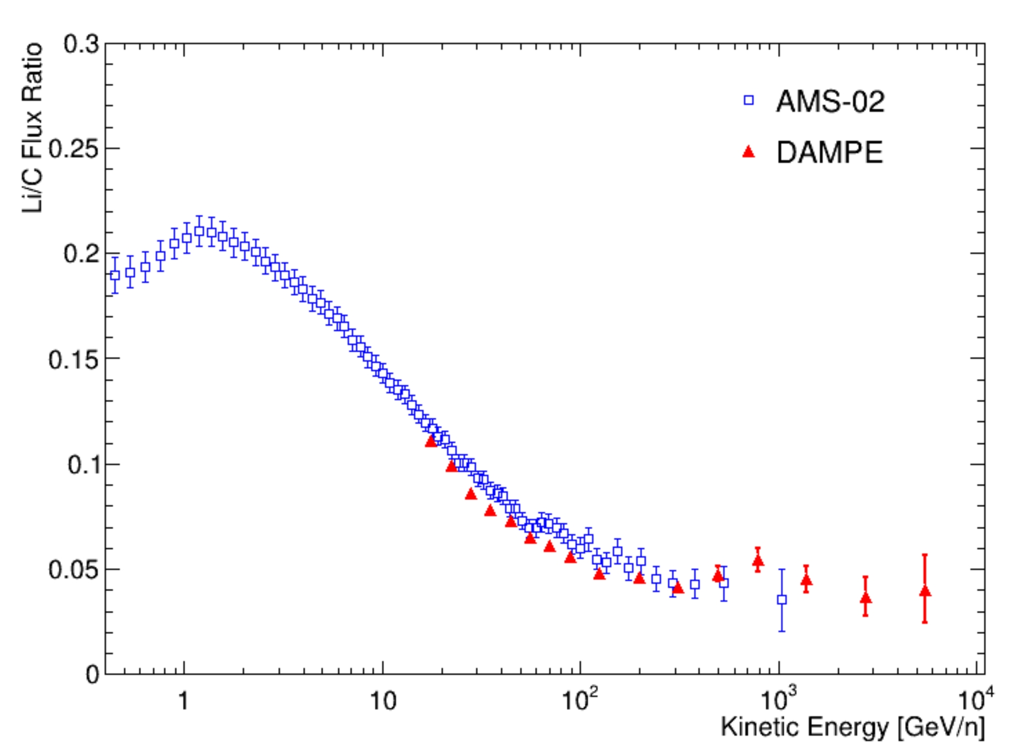
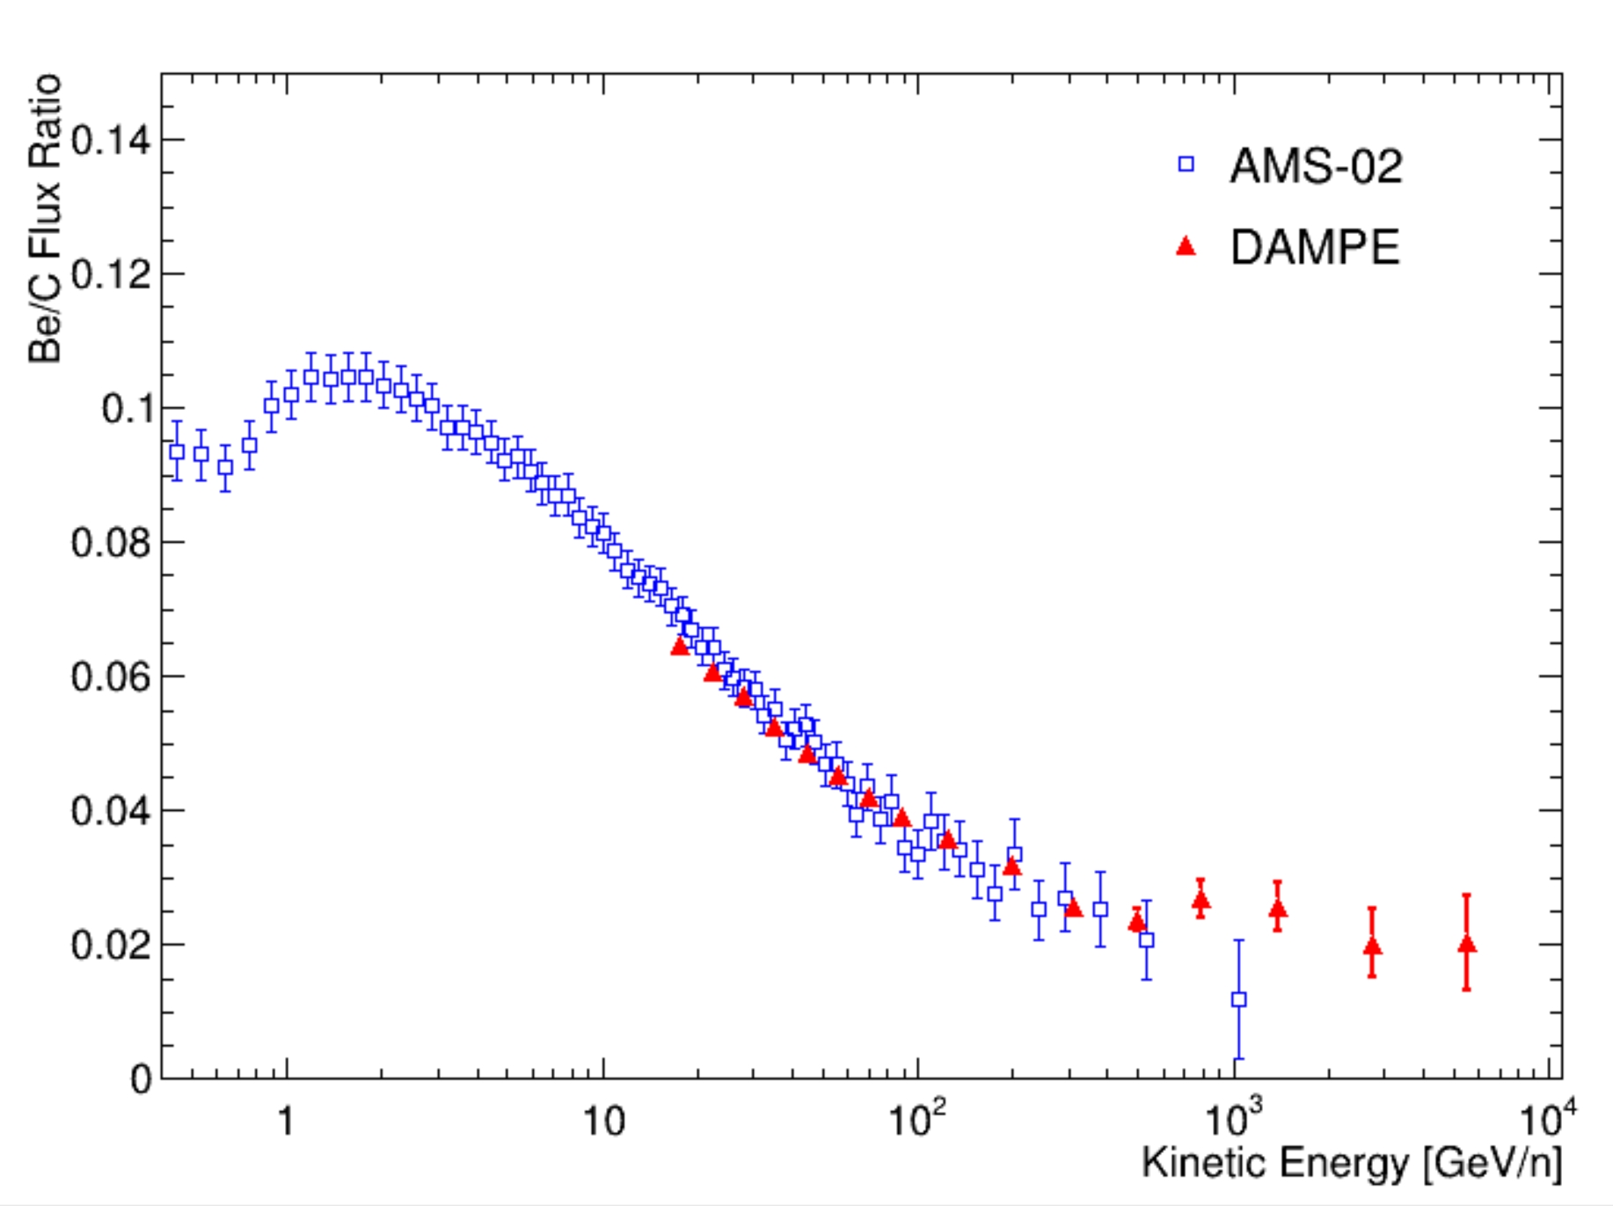
Ratio
Li/C Be/C
Preliminary measurement of Li/C and Be/C from 15.8 GeV/n to 5.5 TeV/n

Slide 11
Conclusion
Boron
Full sample selection and systematics evaluation
Preliminaryspectrum in the 10 GeV/n to 5.5 TeV/n energy range
Lithium, Beryllium
Preliminary Li/C and Be/C ratios in the 15.8 GeV/n to 5.5 TeV/n energy range

Slide 12
Backup

Slide 13
Boron Spectrum

Slide 14
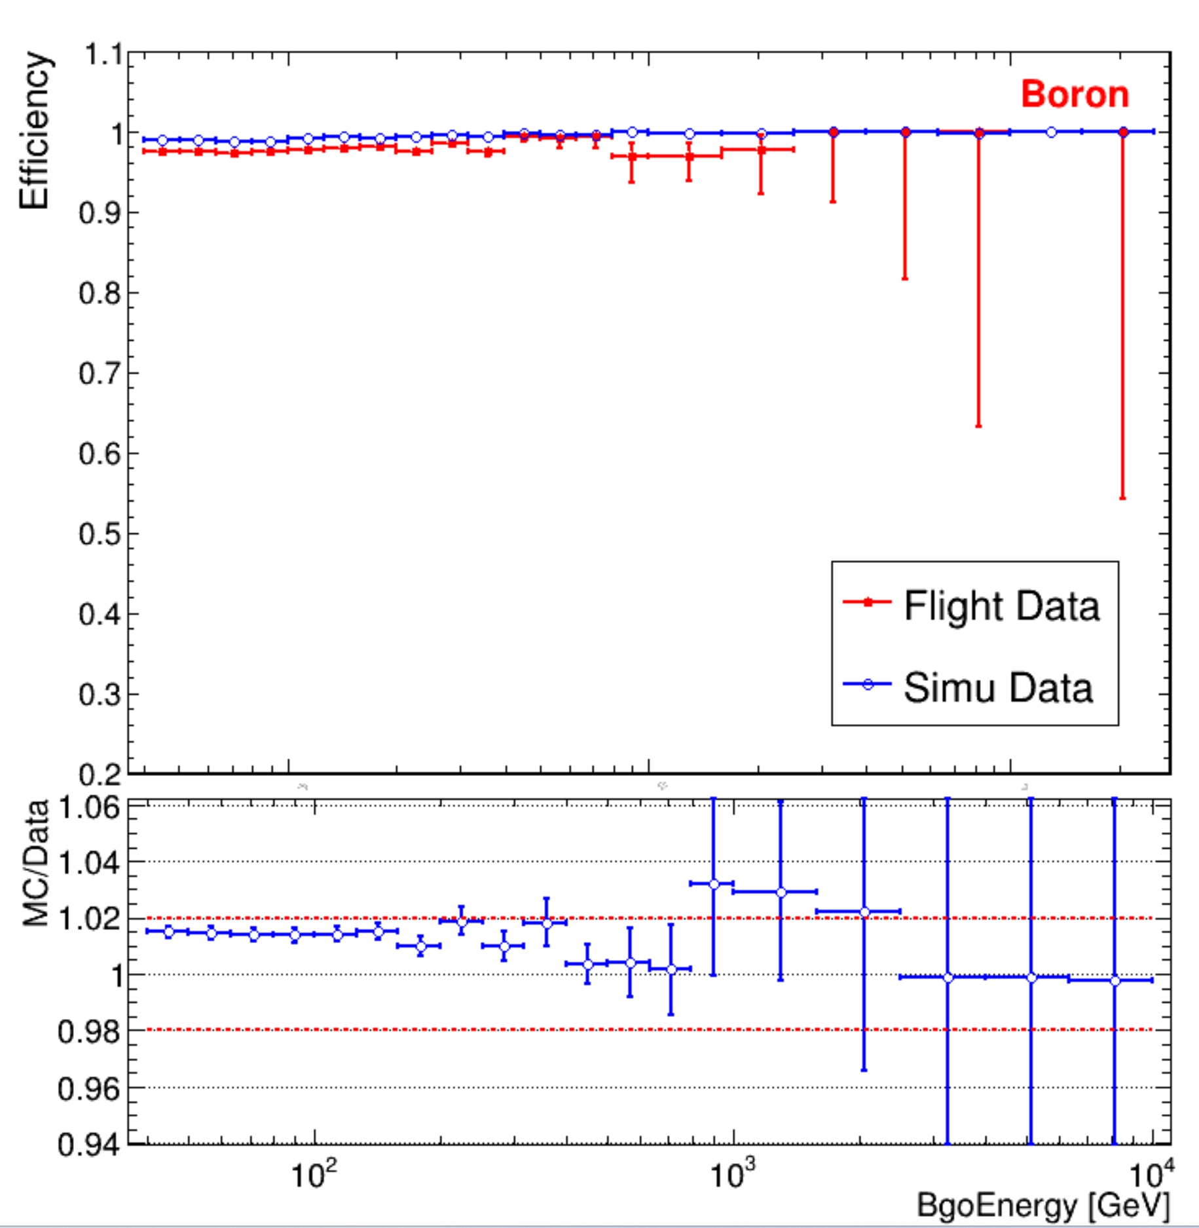
Efficiency
Psd
STK

Slide 15
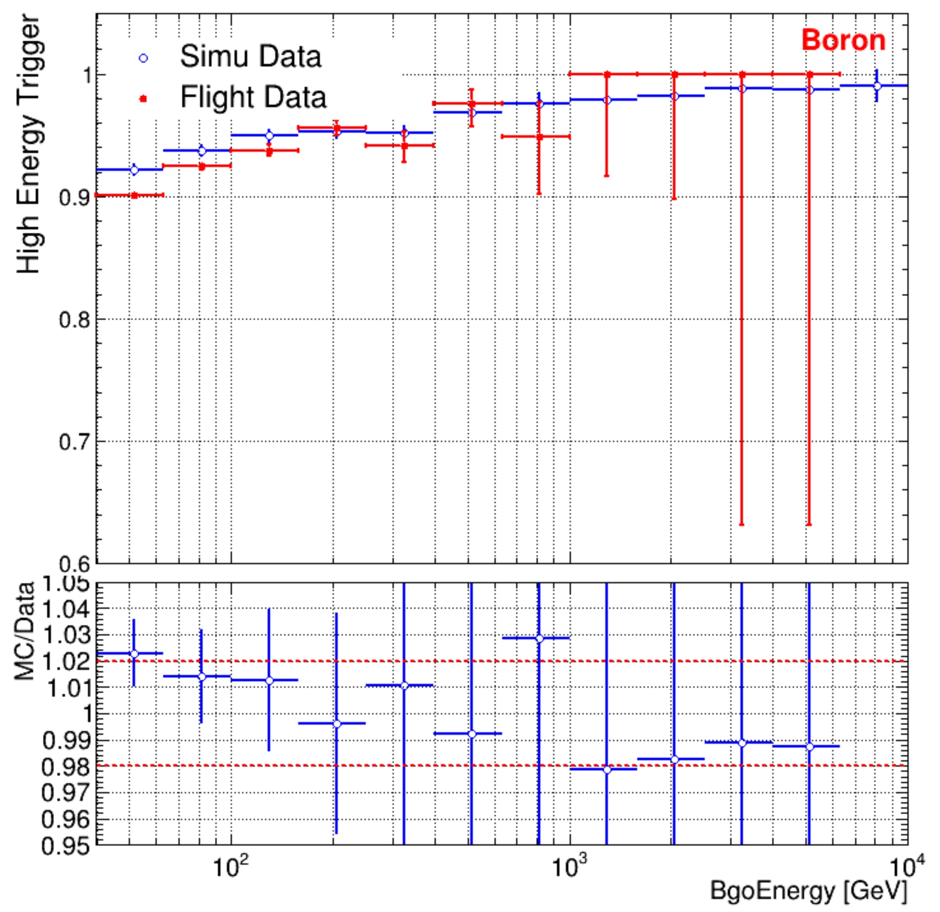
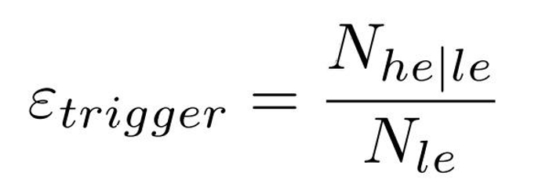
Efficiency
HE Trigger Efficiency:
High Triger

