Slide 1
Geant4 simulation & Threshold Optimize

Slide 2
2. Detector Construction
1. Simulation & Analyze Construction
Al
type
Kinetic
x
y
z
px
py
pz
.mac文件能谱输入
Geant4
.root 文件
Python分析，绘图
Simulation situation:
Direction: iso
Location: Plane , uniform
3. Flux model : data from DAMPE & NASA
5cm
4. Physics List model: FTFP_BERT
Hadronic: elastic, inelastic, capture and fission processes.
EM:

Slide 3
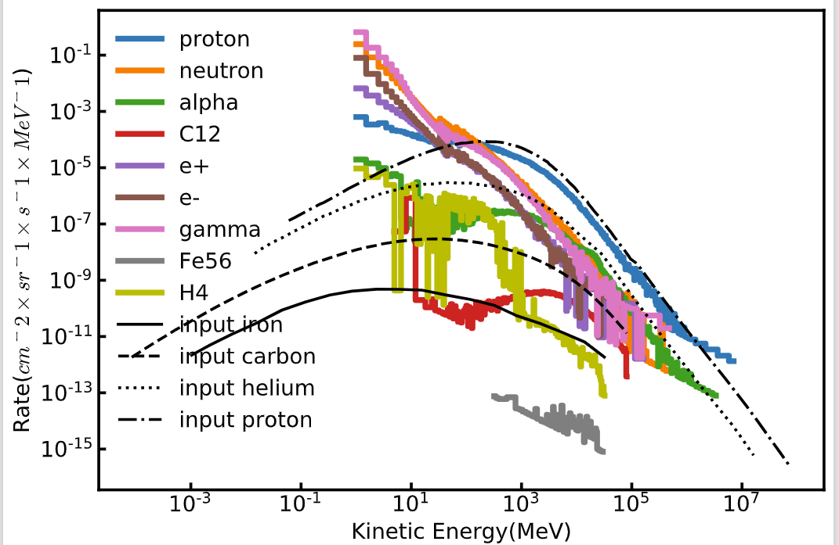
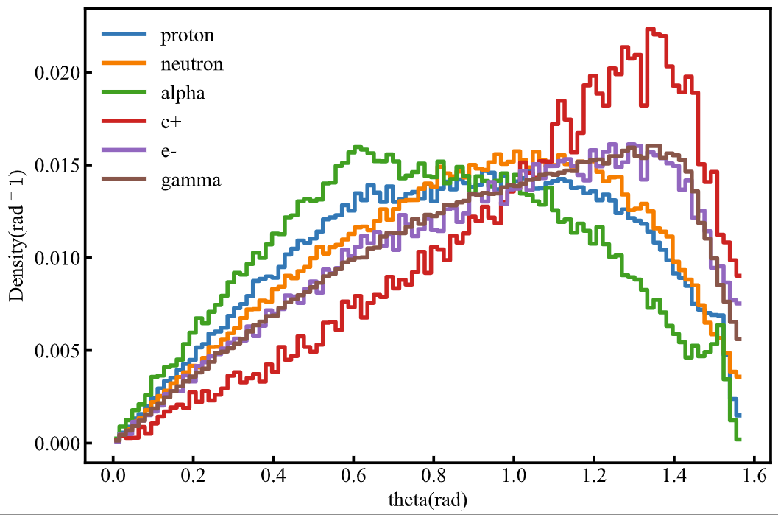
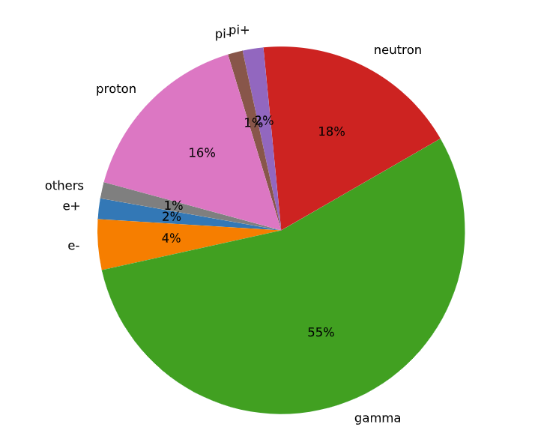
Al
Test result
Simulation situation:
Direction: iso
Location: Plane , uniform
Incidence particle: proton, helium, carbon, iron
Energy distribution
Angular distribution
Proportion of components
Total number of incidence events: 1599966,
Total number of secondary particles: 6546224
There is certainly a rise in particle number after shielding, most of the secondary particles are low energy gamma ray and neutron.

Slide 4
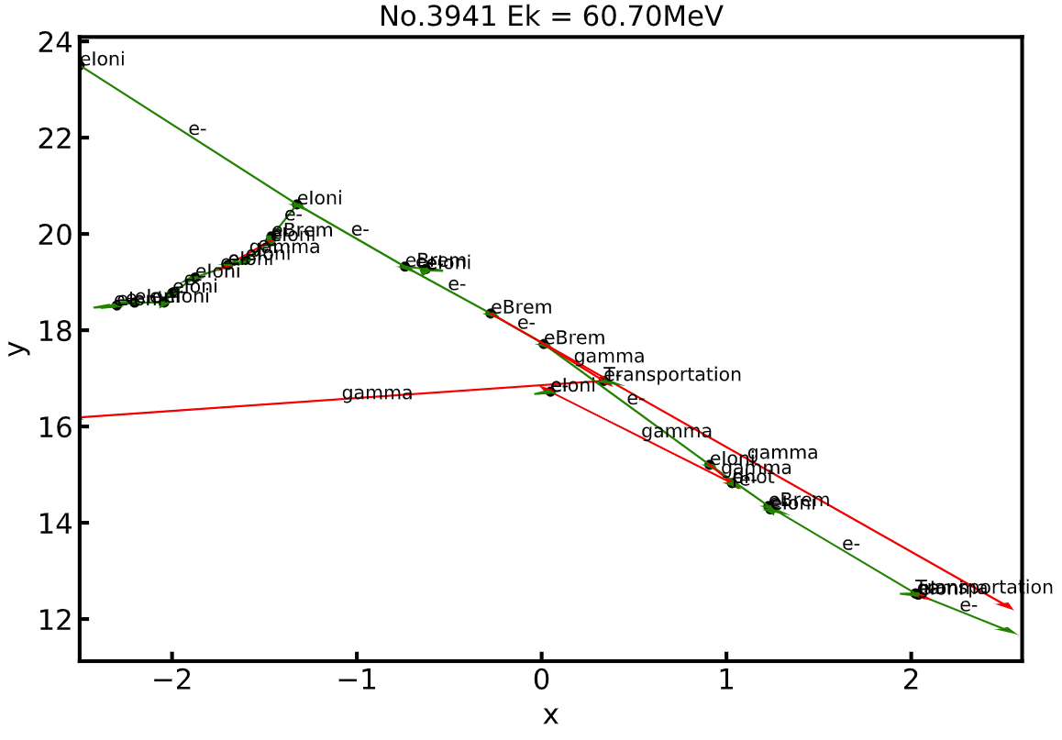
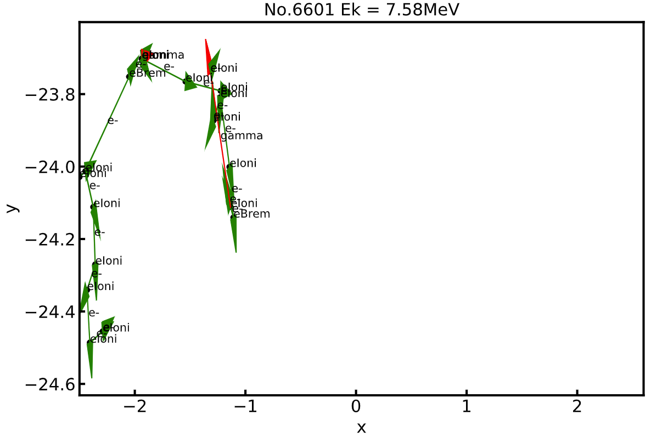
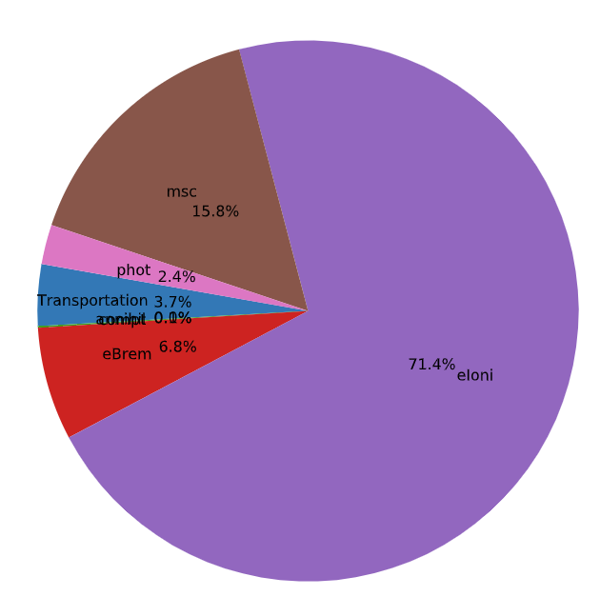
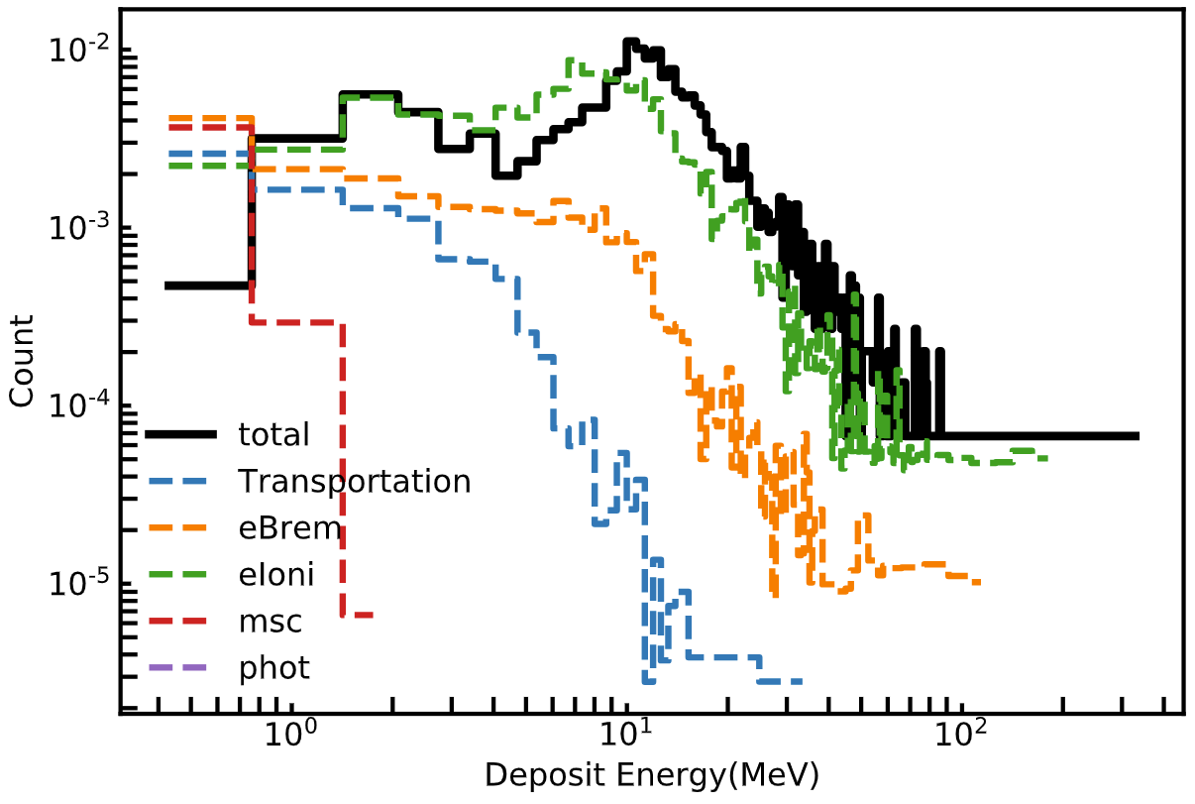
Energy Deposit of electron

Slide 5
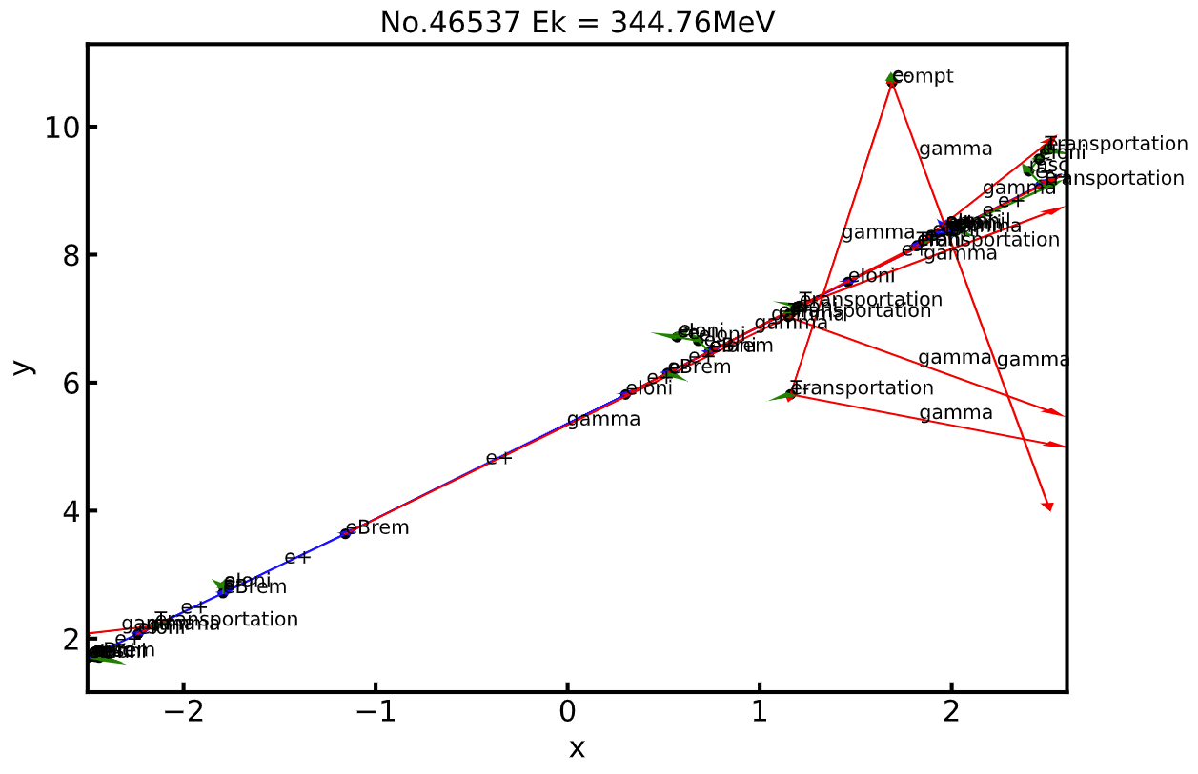
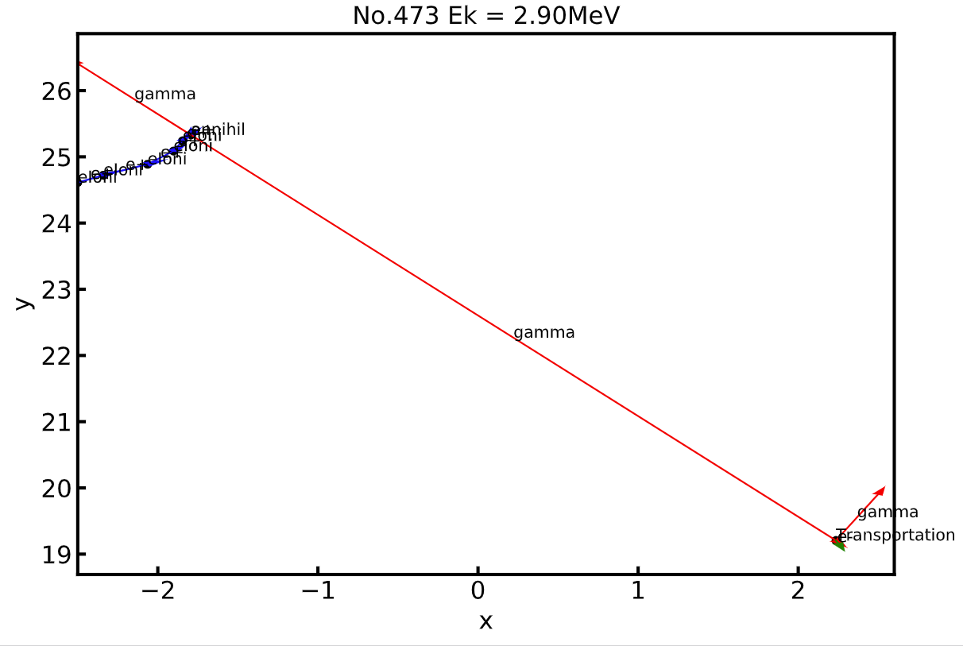
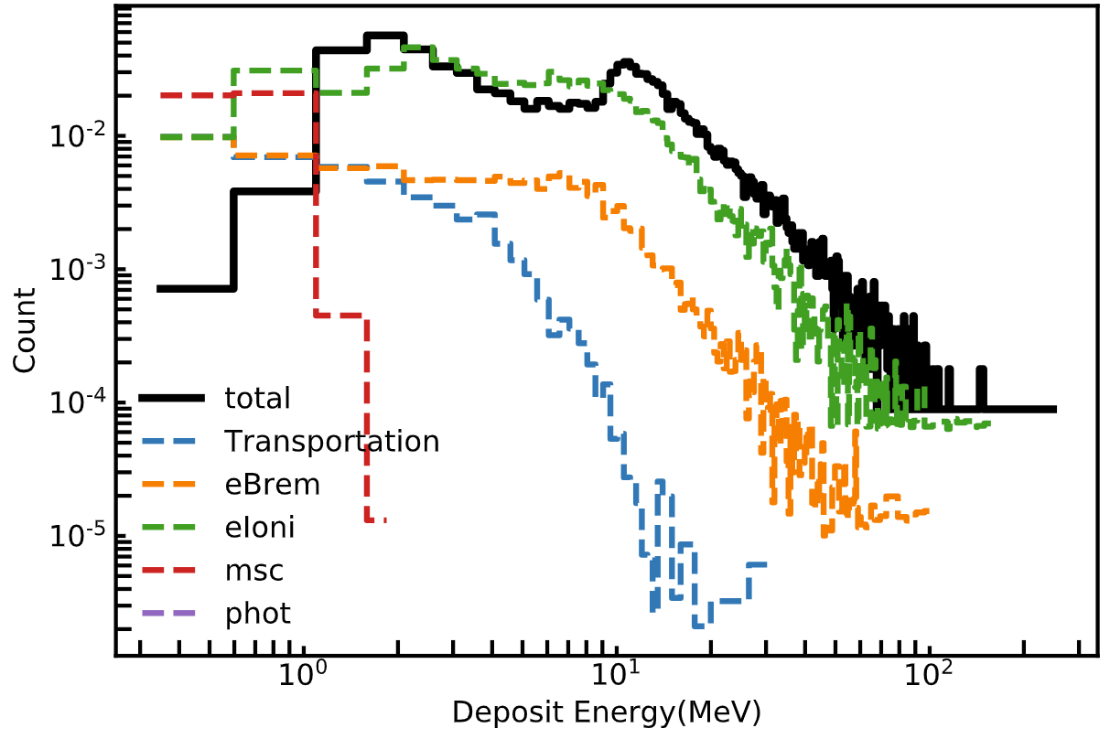
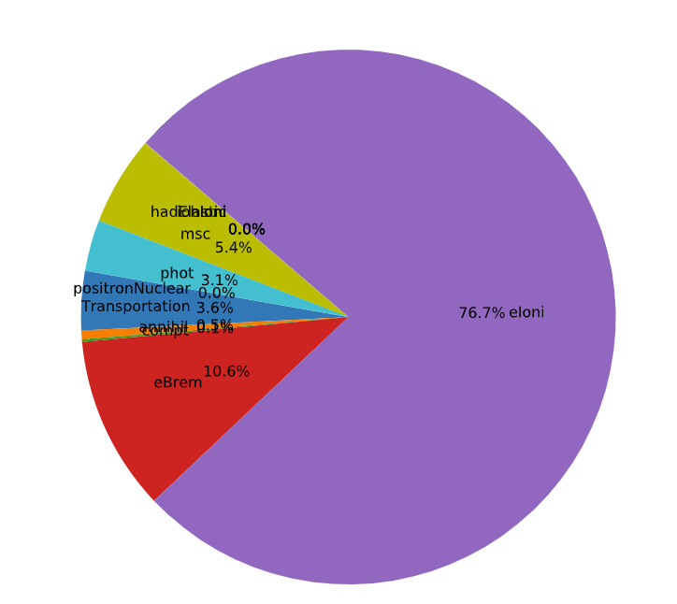
Energy Deposit of positron
Energetic positron
→ bremsstrahlung & electron ionization
Low energy positron
→ electron ionization and annihilation

Slide 6
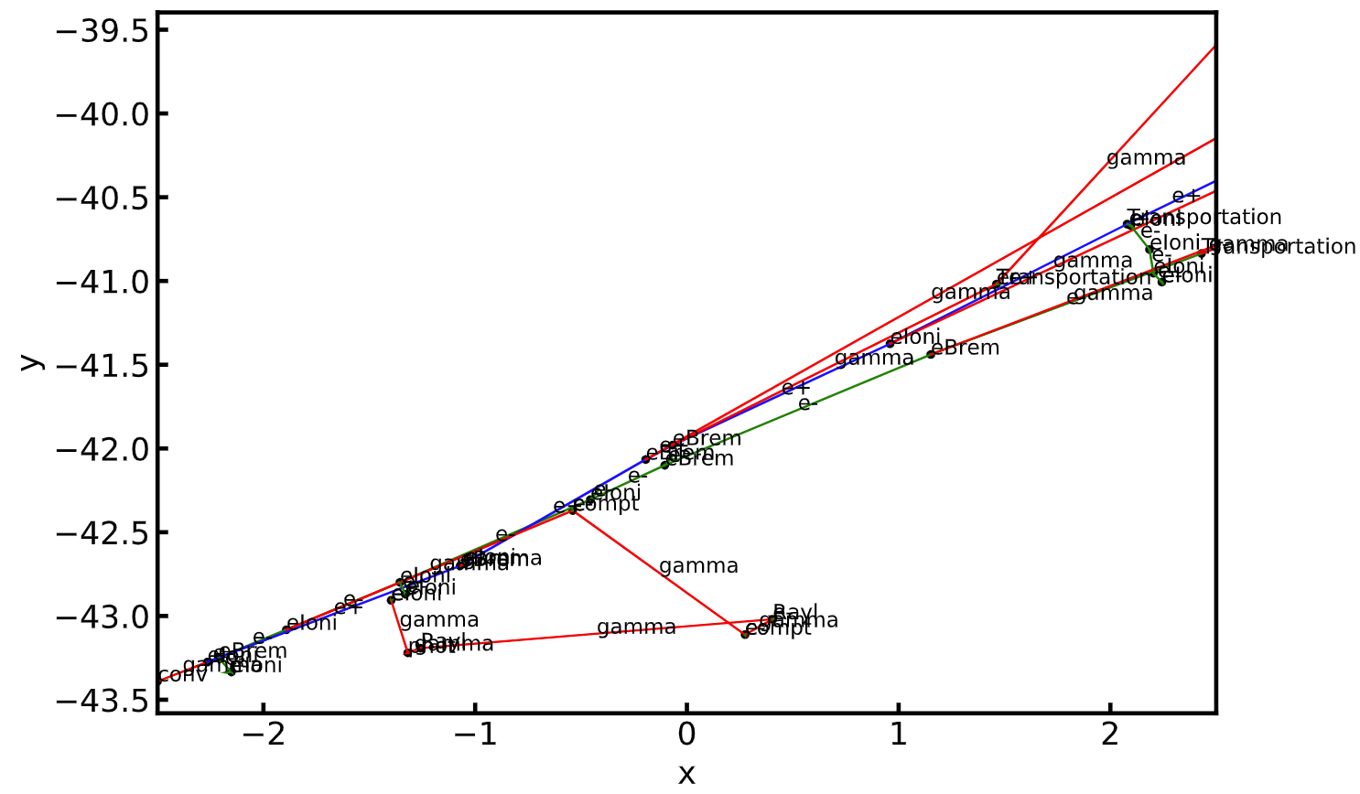
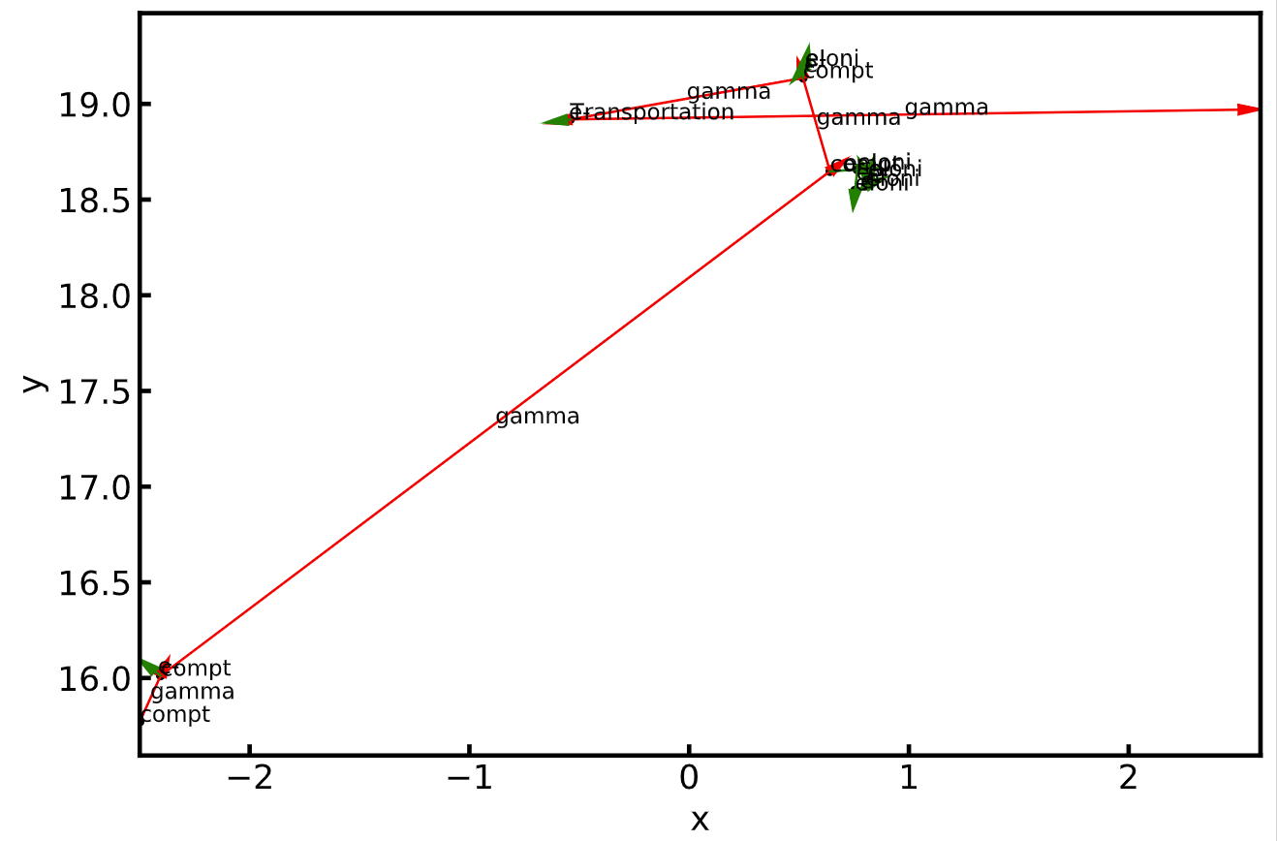
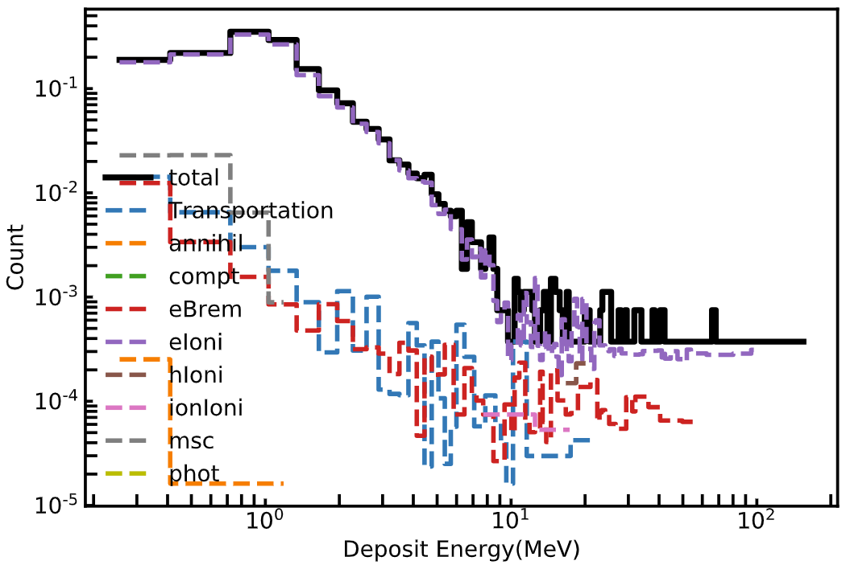
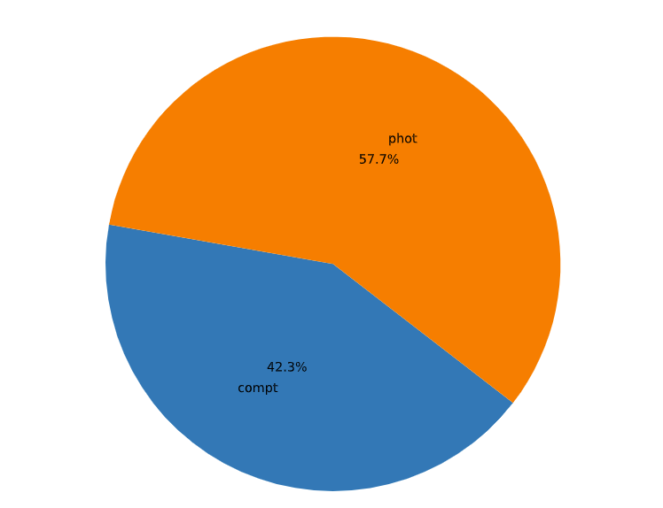
Gamma Energy Deposit
low energy gamma-Compton scatter and photon-electron effect
High energy gamma-pair production
First reactions
Follow-up reactions

Slide 7
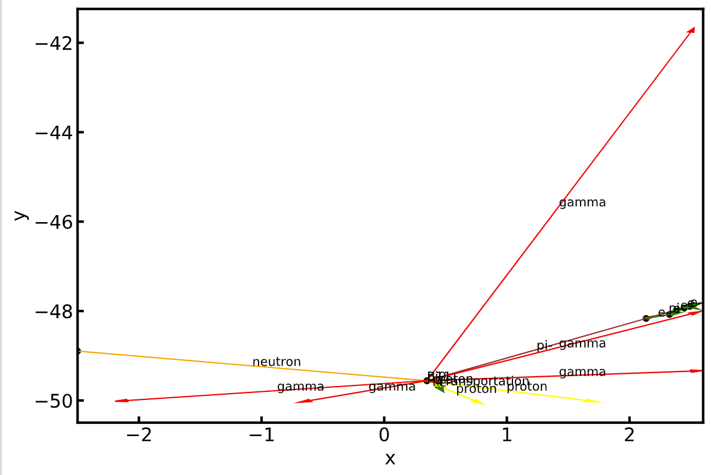
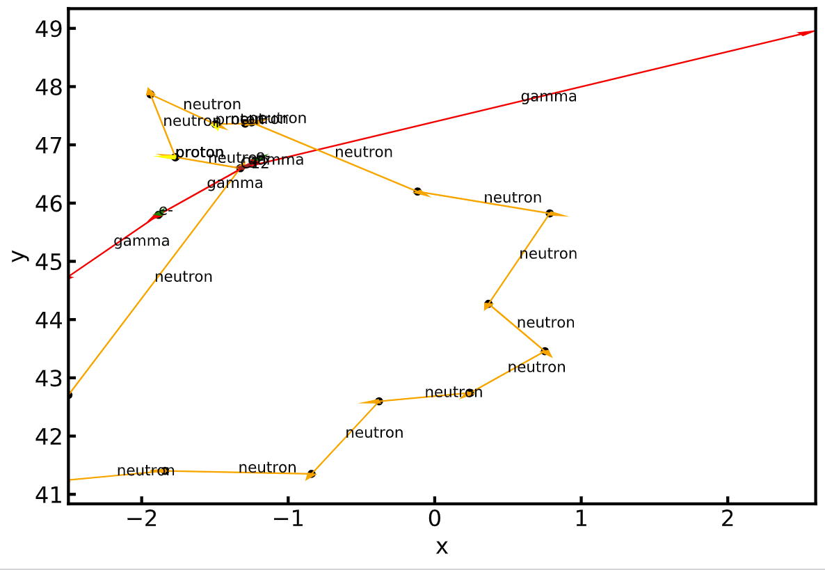
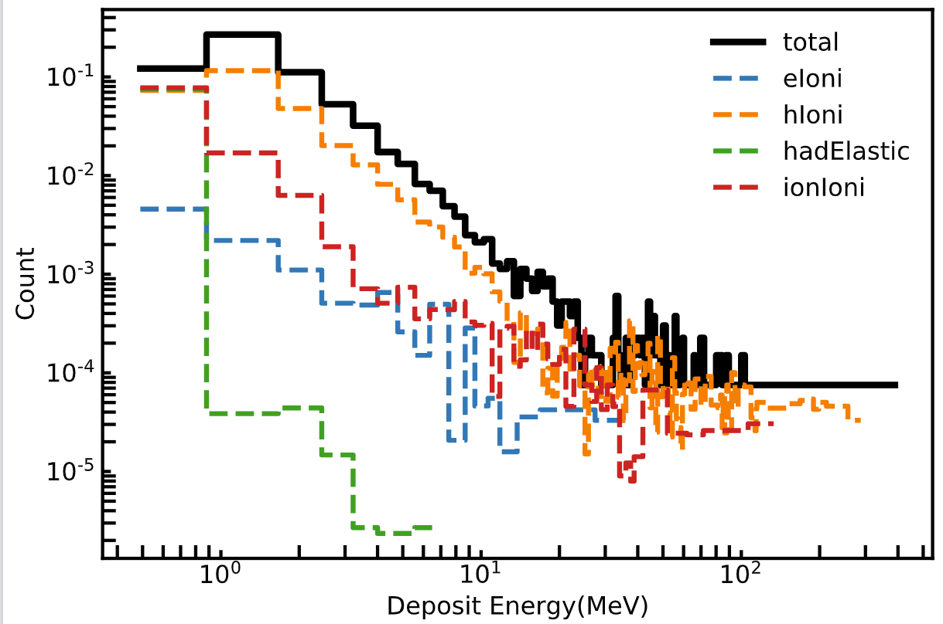
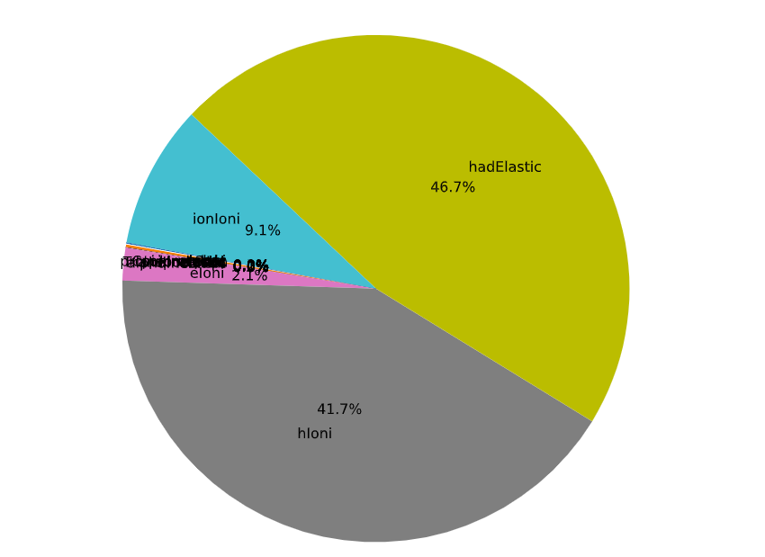
Neutron Energy Deposit
Low energy neutron
→multi-scatter, hadron ionization
High energy neutron
→nuclei reaction

Slide 8
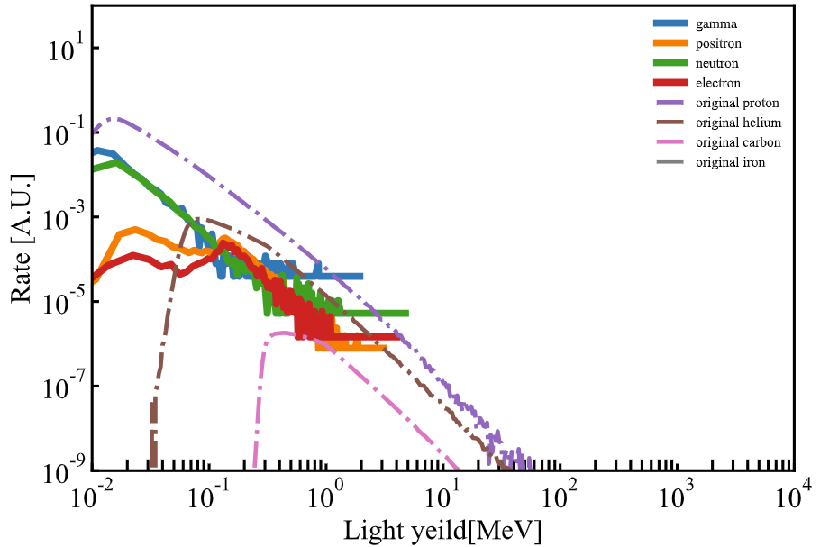
Secondary particle influence on PS
PS
Simulate the energy deposit of gamma,neutron,and electron using G4 toolkit.
The light yields are then be calculated by Birk’s law according to ref[1].
Checked if the secondary particle can pass at least 1 layer of PS
Need more checks
Simulation situation:
Direction: iso
Location: Plane , uniform
Energy: from the first step simulation
 | neutron | electron | positron | gamma
P(%) | 42.0 | 13.1 | 53.8 | 20.7
Rate($cm^{−2}sr^{−1}s^{−1}$) | 0.0381 | 0.00281 | 0.00474 | 0.0556
[1]https://www.sciencedirect.com/science/article/pii/S0927650598000607

