Slide 1
Secondary Particles of Cosmic ray

Slide 2
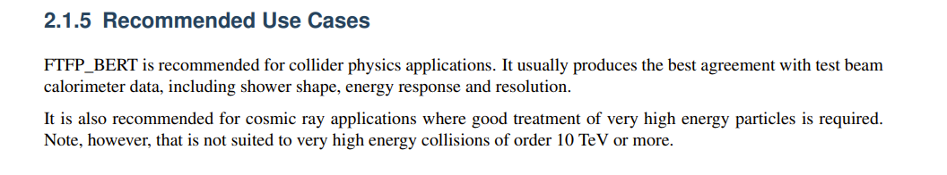
2. Detector Construction
1. Simulation & Analyze Construction
Al
type
Kinetic
x
y
z
px
py
pz
.mac文件能谱输入
Geant4
.root 文件
Python分析，绘图
Simulation situation:
Direction: iso
Location: Plane , uniform
3. Flux model : data from DAMPE & NASA
5cm
4. Physics List model: FTFP_BERT
Hadronic: elastic, inelastic, capture and fission processes.
EM:

Slide 3
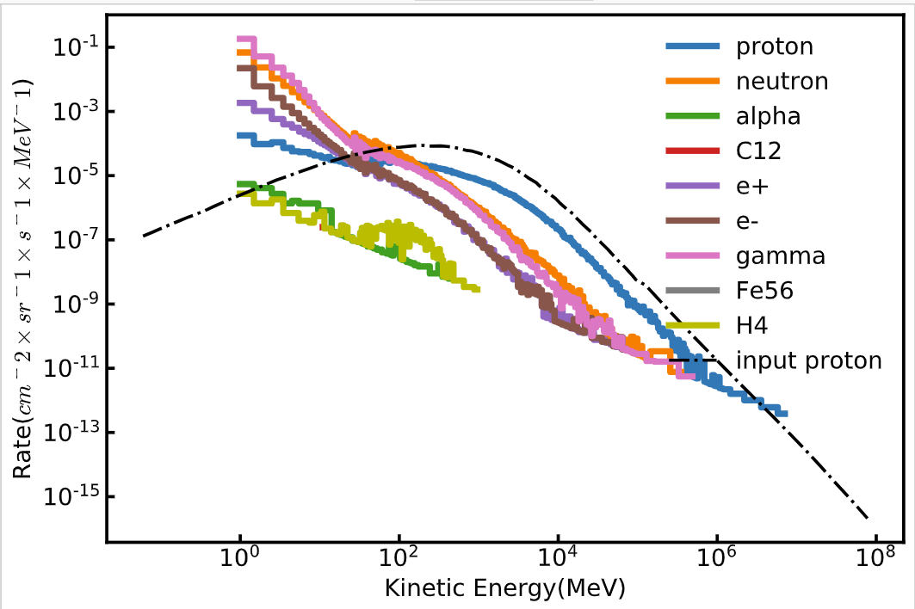
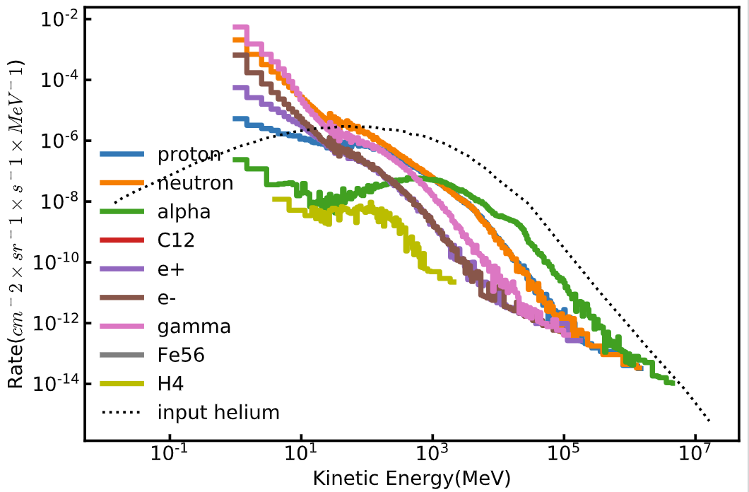
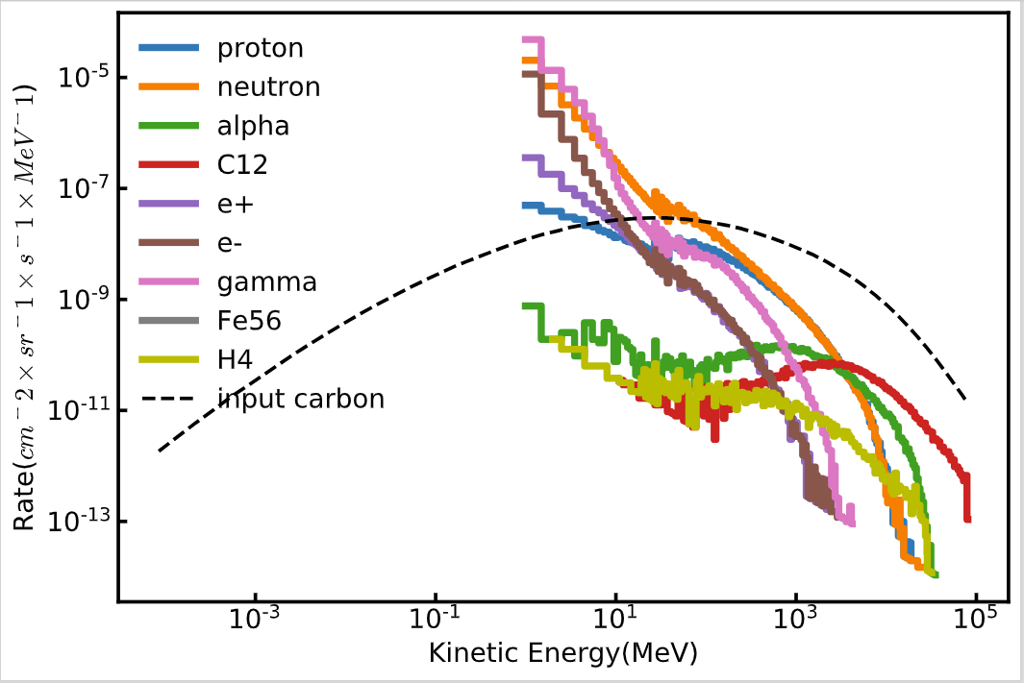
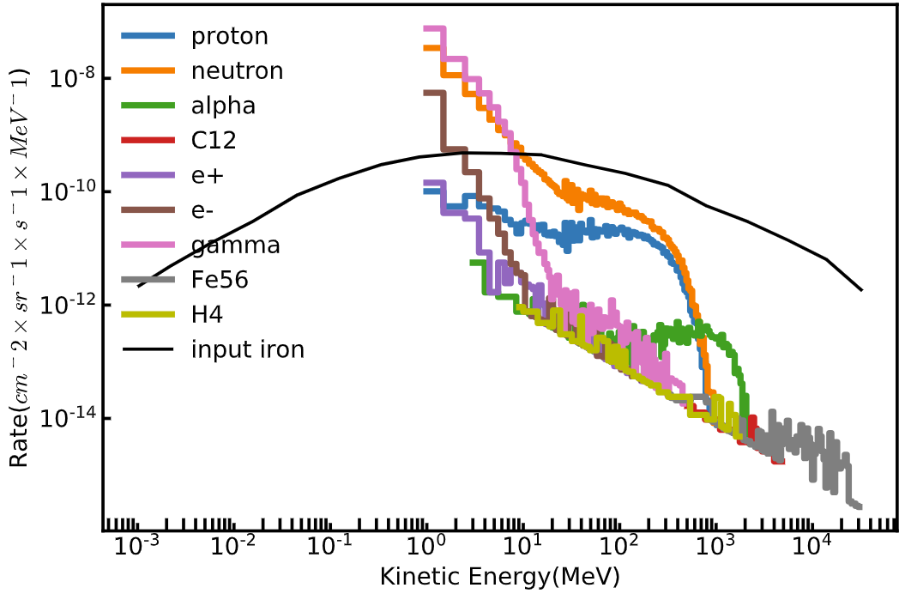
Result of Single Particle
Proton
Helium
carbon
iron

Slide 4
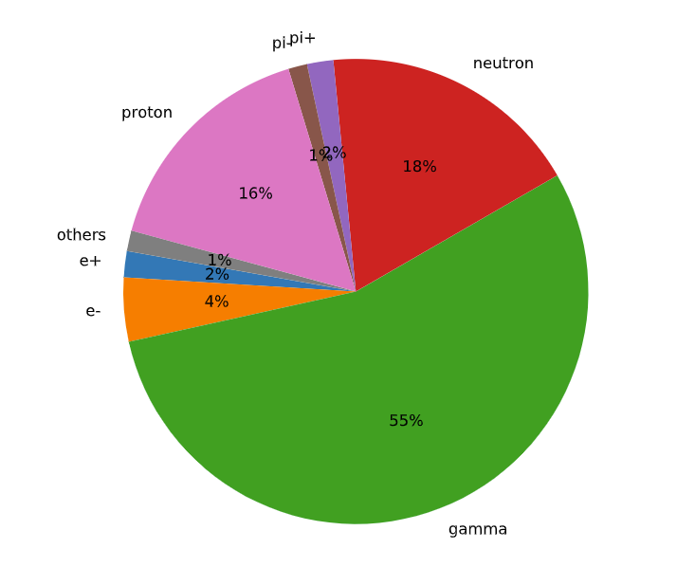
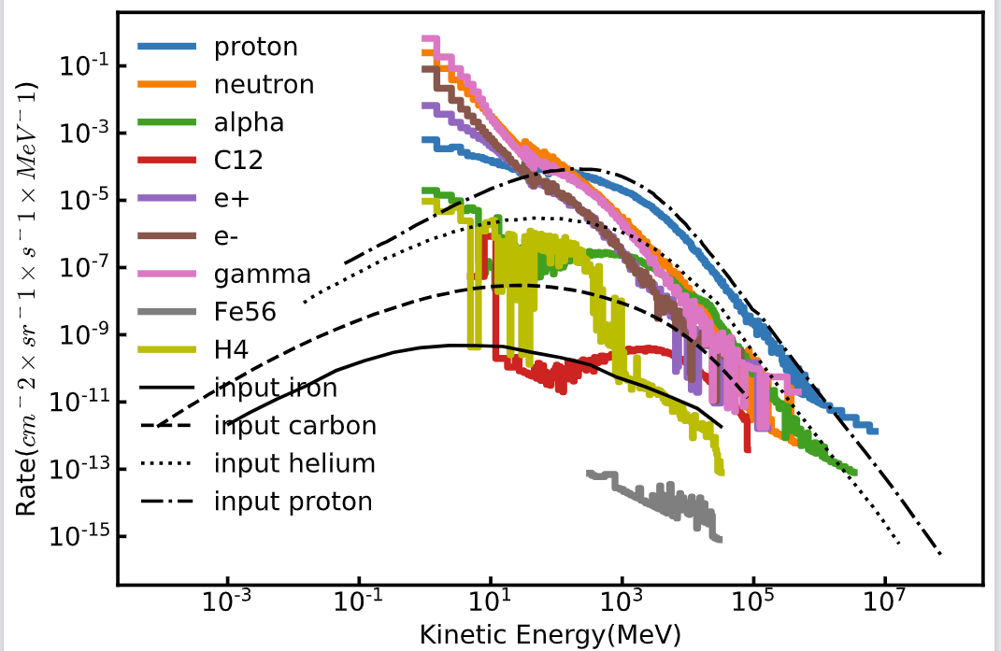
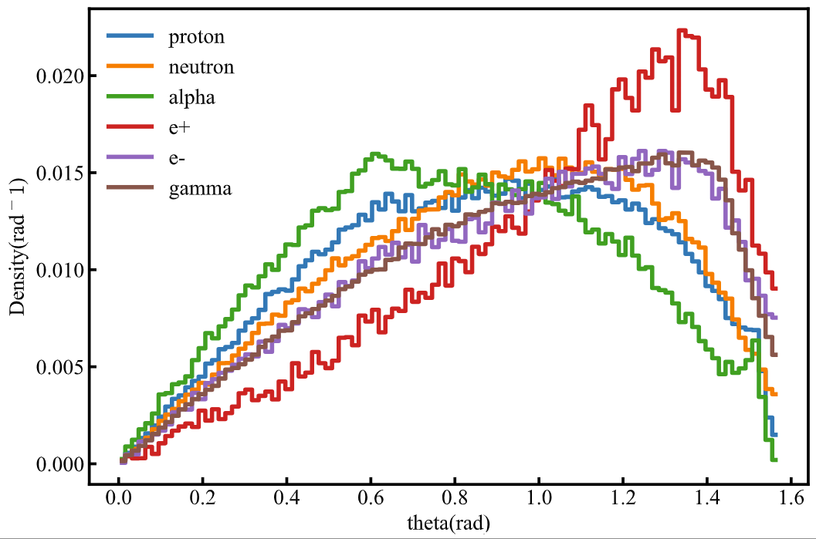
Al
Total Result
Simulation situation:
Direction: iso
Location: Plane , uniform
Incidence particle: proton, helium, carbon, iron
Energy distribution
Angular distribution
Total number of incidence events: 1599966,
Total number of secondary particles: 6546224
There is certainly a rise in particle number after shielding, most of the secondary particles are low energy gamma ray and neutron.
Proportion of components
Next Step：
1. How secondary particle influent PSs (gamma & neutron =>Geant4 )
2. Look into the details of the interaction in materials
3. Simulate different material

Slide 5
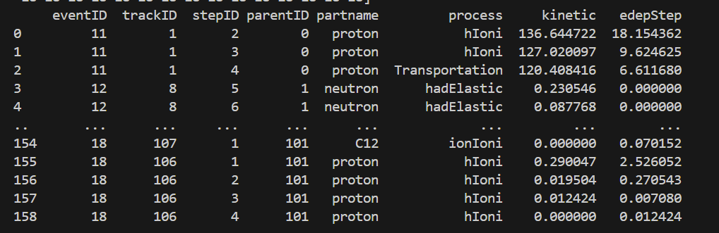
Status of Background simulation
Added the PS material into simulation framework
Read out the details of the process in PS
Next Step:
Further analyze the output
Compare the results with Al and without Al
Compare the result with previous benchmark simulation
Al
PS
Simulation situation:
Direction: iso
Location: Plane , uniform
Output of the process details in PS

