Slide 1
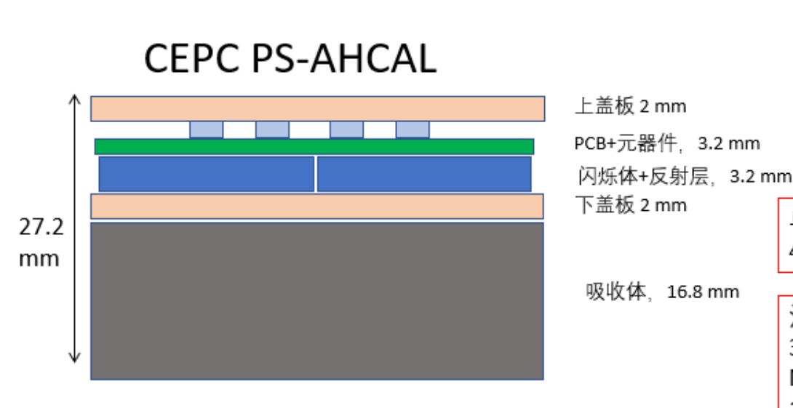
CEPCSW AHCAL Barrel Geometry
not to scale
one chamber
Steel235
Absorber: 16.8mm Steel235
Absorber: 2mm Steel235
PCB: 3.2mm PCB
Scintillator: 40*40*3mm G4_POLYETHYLENE
0.065mm G4_ESR
total distance in xy plane: 40.3mm
total thickness: 3.2mm
one sector

Slide 2
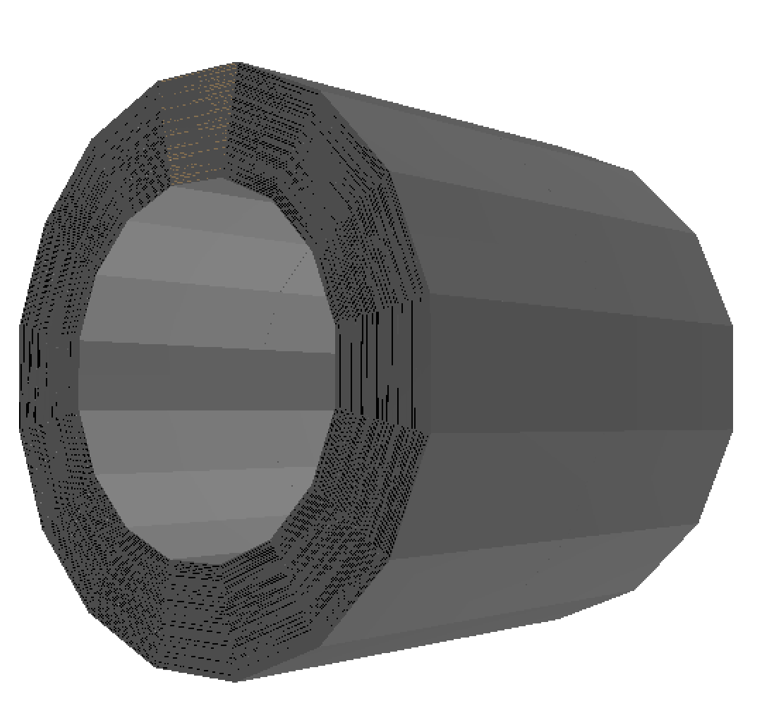
CEPCSW AHCAL Barrel Geometry
only two layers scintillator chamber
not to scale

