Slide 1
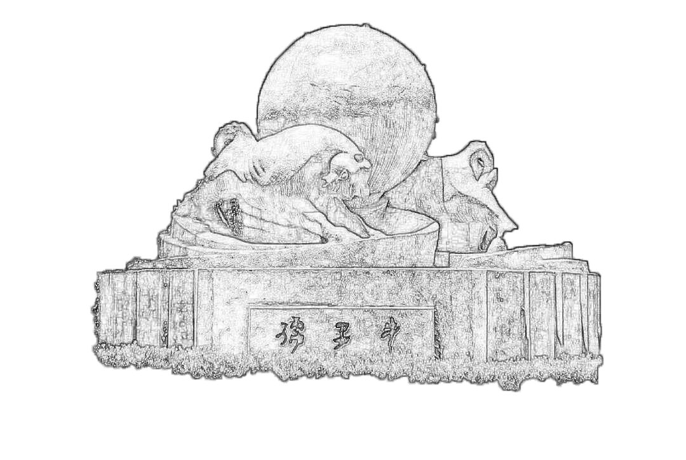
CEPC MIP analysis update
2023/06/24
Speaker : Jiaxuan Wang

Slide 2
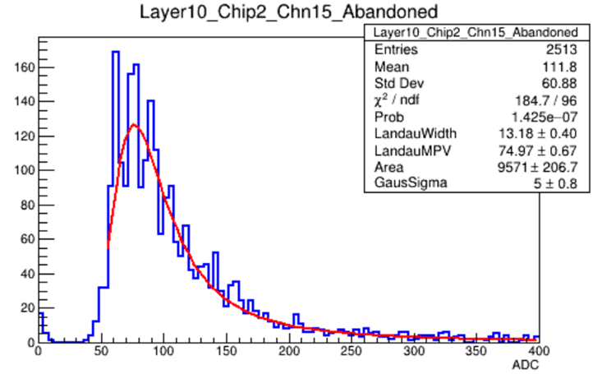
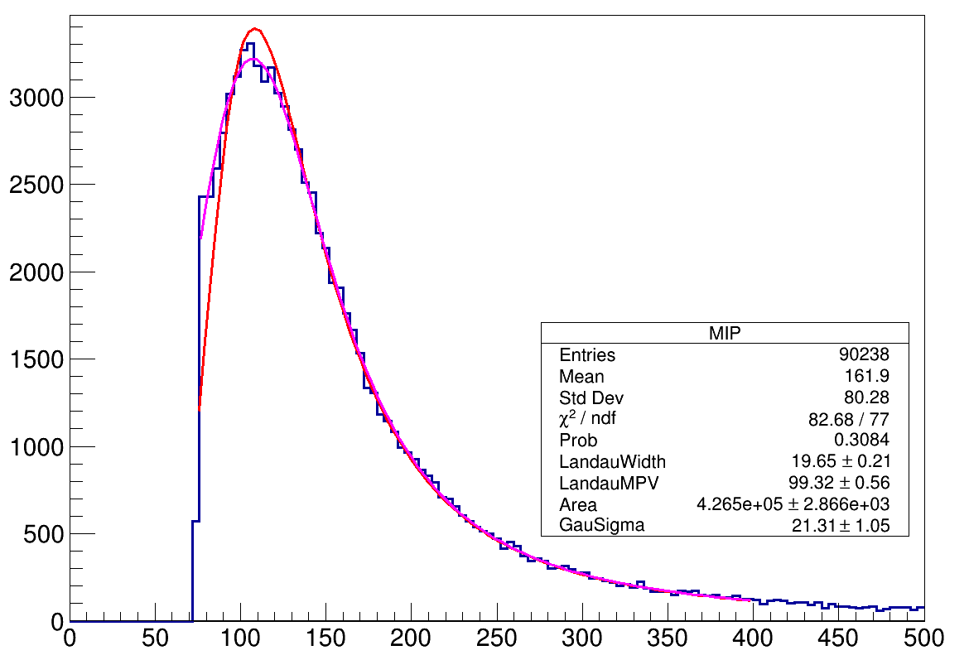
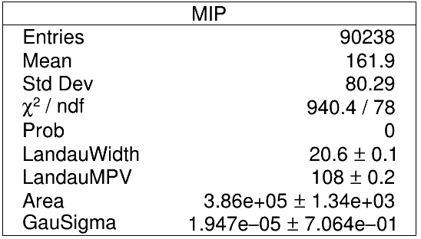
Motivation
MIP spectrum issues
  MIP spectrum of 1/3 channels get cut by high threshold
  Determination of fit range of landau convoluted gaussian function will affect the fitting results
  A small independent test
    Landau width: 20, Landau MPV: 100, Gaussian Sigma: 20
    Threshold : 0.8 MIP cut
    Two range settings (74,400) ,(75,400)
    Quite different fitting results
Correction with cosmic ray muon data
  One-to-one correspondence 2d histogram
  Linear fit
Test beam

Slide 3

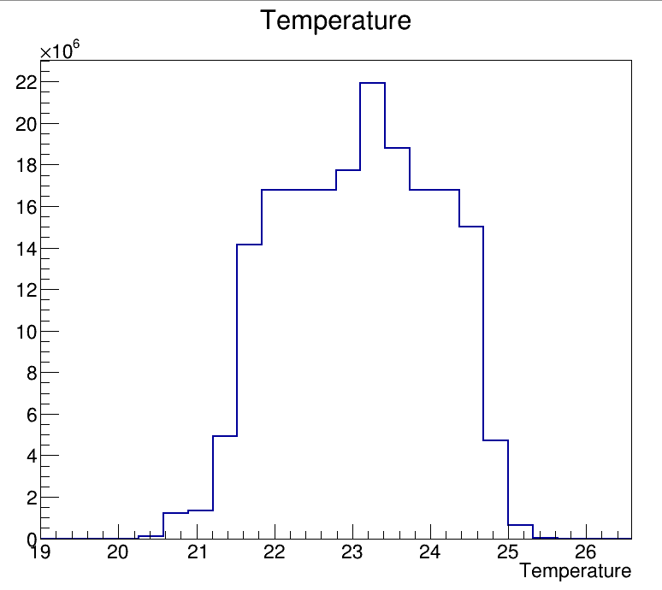
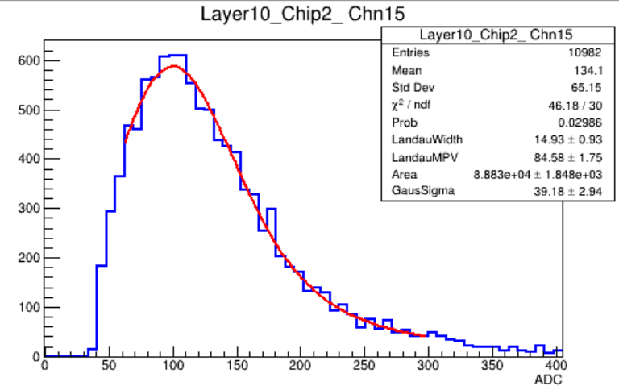
MIP spectrum
Comparison with cosmic ray results
  Test environment comparison
    Cosmic ray(CR) data: 15-25°C, 30°
    Test beam(TB) data: 21-24°C, basically parallel with Z axis
  MIP spectrum comparison: more distinct single photoelectron peak in TB data sets
Test beam
Test beam
Cosmic ray
Cosmic ray

Slide 4
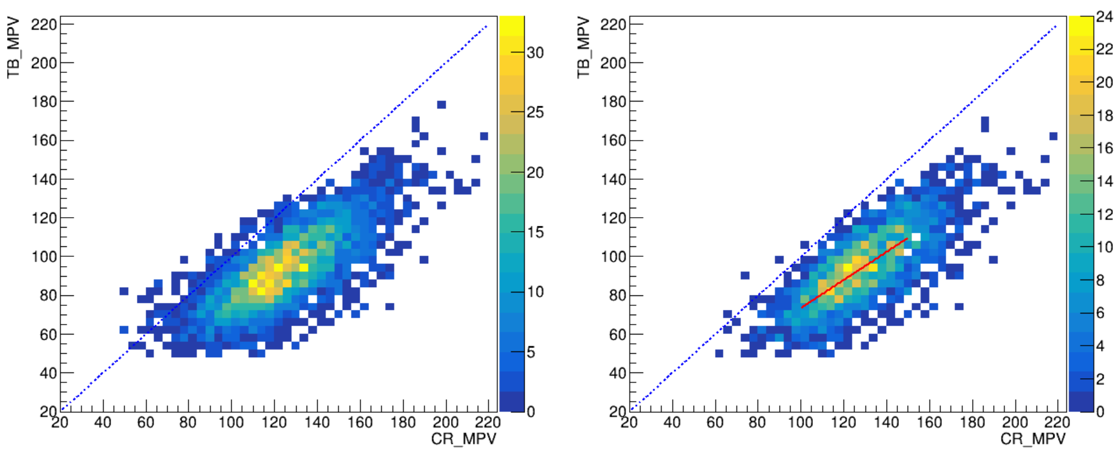
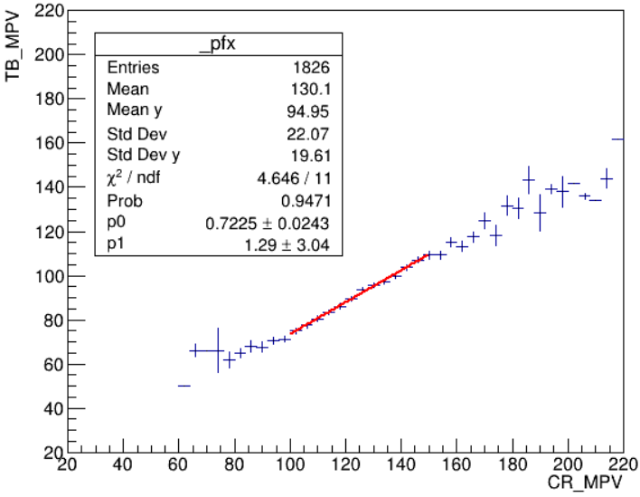
Correction 10um SiPM
MPV one-to-one correspondence between CR and TB results
The MPV of CR is greater than that of TB
Correction with data selection by linear fitting

Slide 5
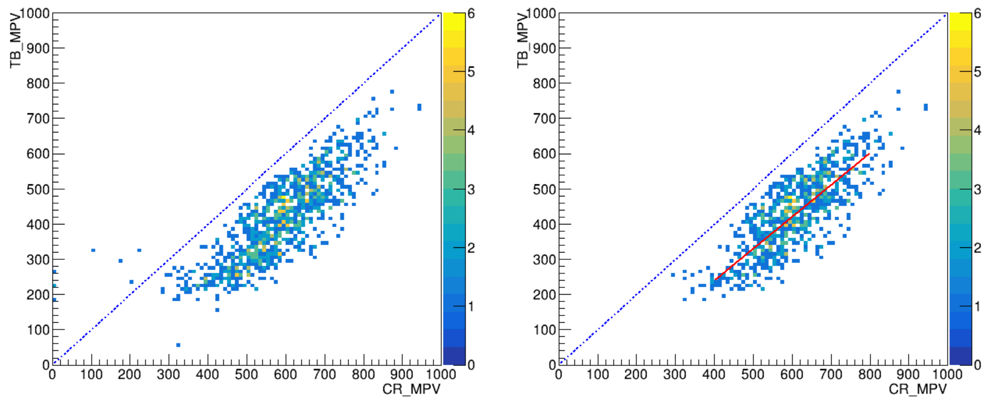
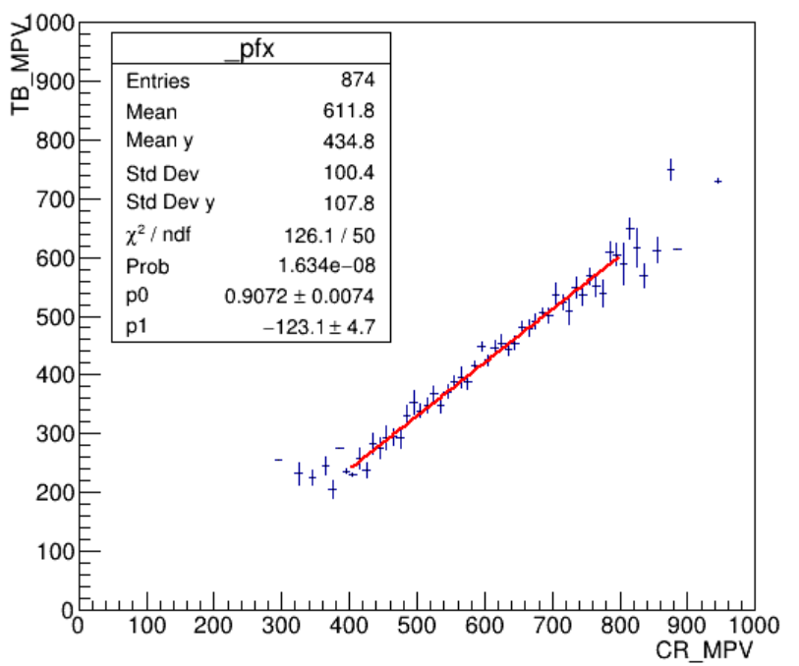
Correction 15um SiPM
MPV one-to-one correspondence between CR and TB results
The MPV of CR is greater than that of TB
Correction with data selection by linear fitting

Slide 6
Summary & plan
About 1/3 channels are in this high threshold situation
The left fitting range take matters in fitting results as the rise egde of spectrum contains the gaussian part information of fitting function
MPV value of beam test is lesser than that of cosmic ray test generally, and in more clearly single photoelectron peak shown in test beam
New MIP parameters applied for Digitization
MIP spectrum comparison before and after digitization

