Slide 1
Cosmic track and efficiency
Yukun Shi

Slide 2
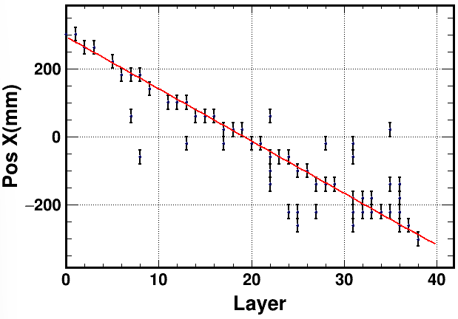
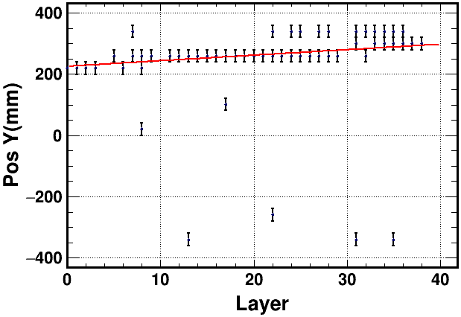
Track fitting
A Threshold of 100 ADC was applied
Only layers with a single hit were used in the track fitting
A minimum of 20 such layers were required, otherwise the event was rejected
Track fitting: Not all the points drawn are involved in the fitting, the error bar is set as 20mm, corresponding to half of the scintillator size

Slide 3
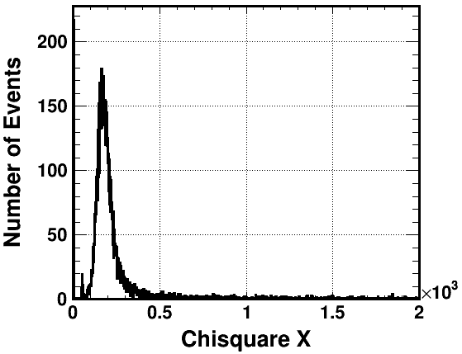
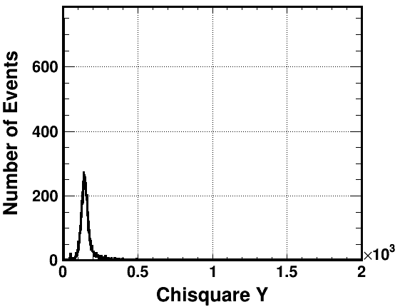
Fitting result
Events with both Chi square X and Chi square Y less than 300 were selected as cosmic ray events

Slide 4
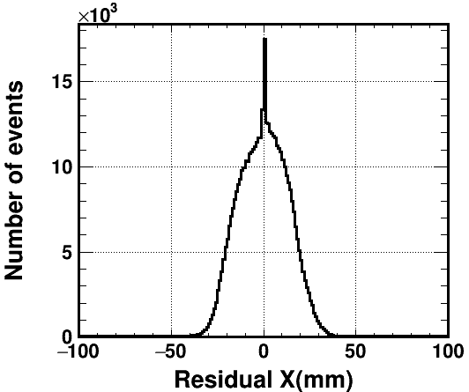
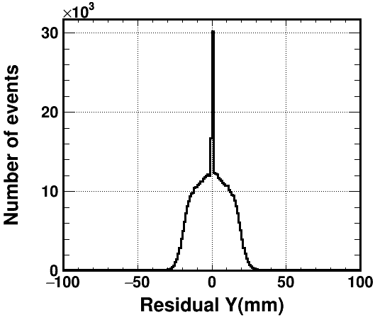
Residual
The majority of the residuals are within $±50 mm$

Slide 5
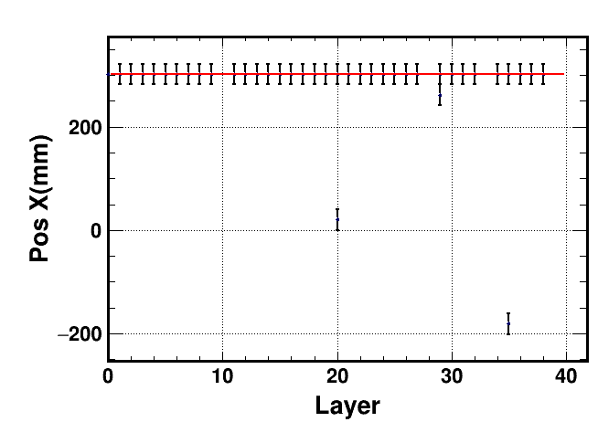
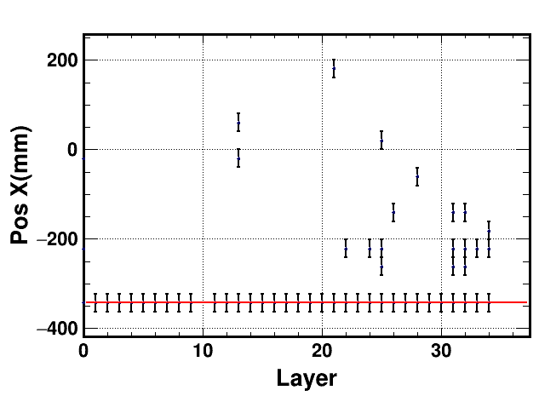
Events with low Chisquare
There is no event ChiX< 5 && ChiY
ChiX< 5 || ChiY<5 Events were selected: ~1000 events

Slide 6
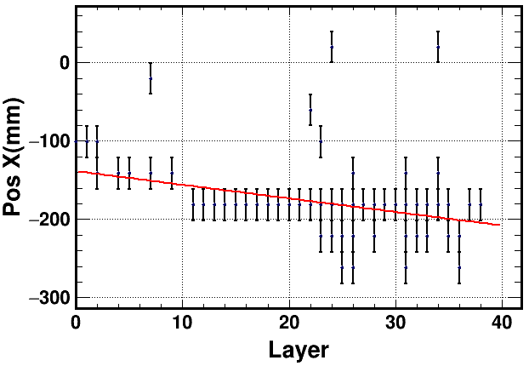
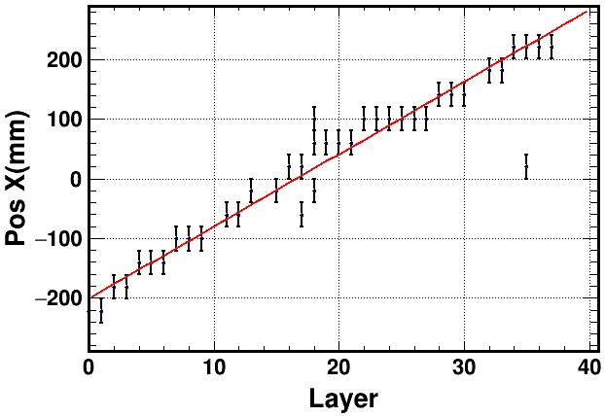
Display of Chi within 300-500
Chi-square within 300-500 only have about 1000 events
The noise hits in these events would be rejected
The change of the Chi-square cut doesn’t have an obvious influence

Slide 7
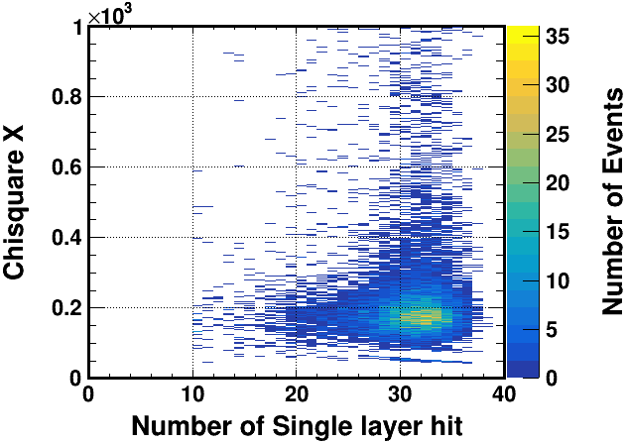
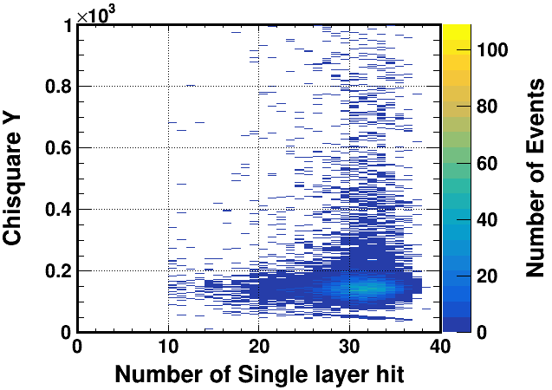
Hit Number Cut
The single layer hit was required exceeding 10
Such selection is reasonable, but doesn’t affect the results obviously
Single layer hit >15
Chi-square <400

Slide 8
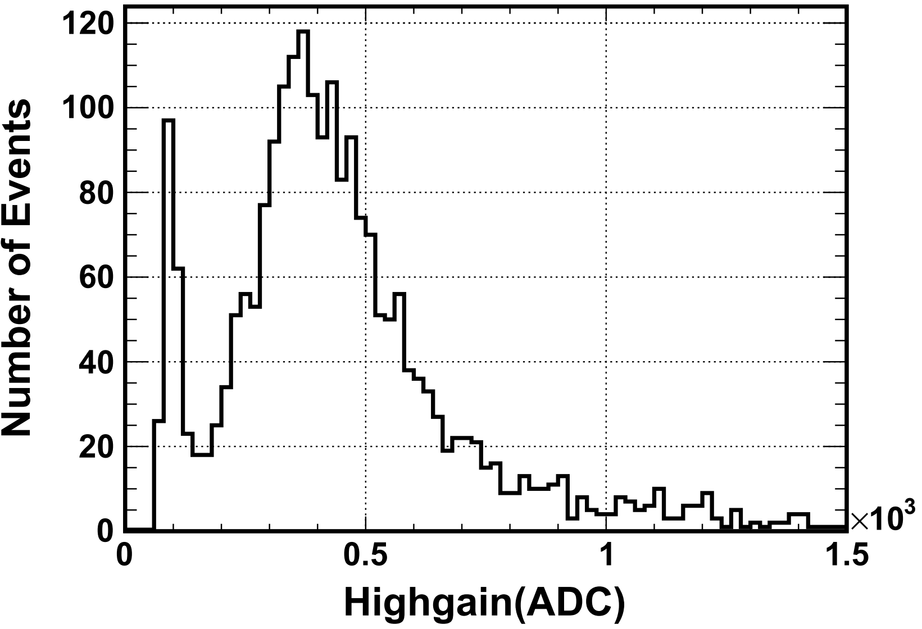
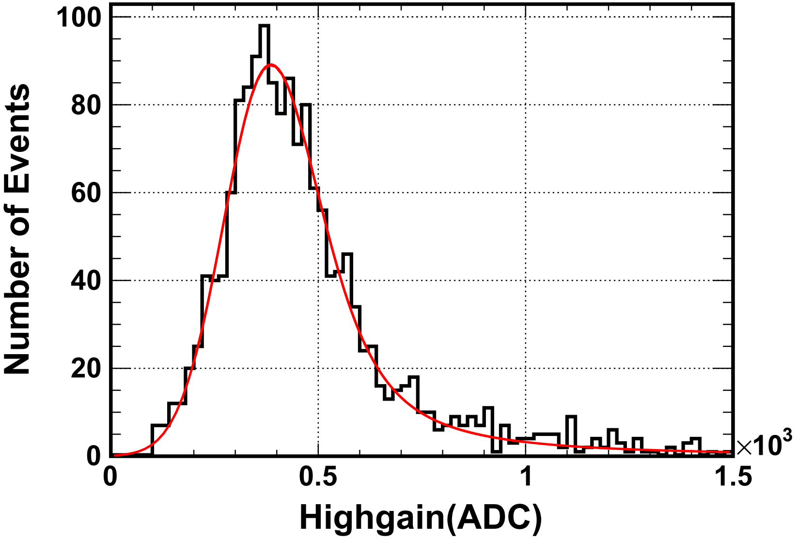
Hit Selection
The hits of which the distance to the fitting line is less than 120 mm were selected
The noise hits were rejected efficiently
MIP Spectrum before and after the hit selection

Slide 9
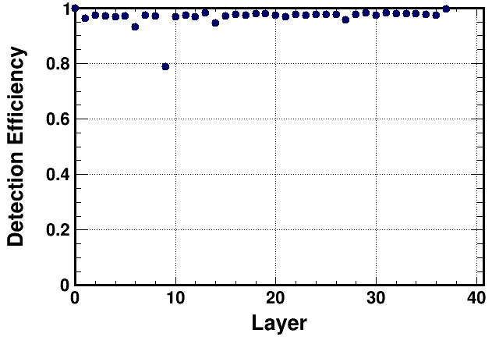
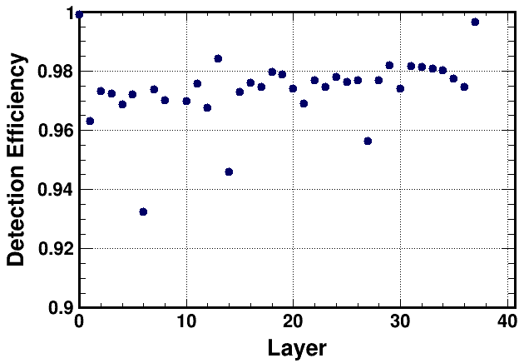
Efficiency
For a single track, the efficiency calculation considered the layers between the first hit layer and the last hit layer.
Most of the layers have an efficiency about 97% while the geometry factor counts for ~2%
The threshold, MPV value and the dark noise are also responsible for the efficiency

Slide 10
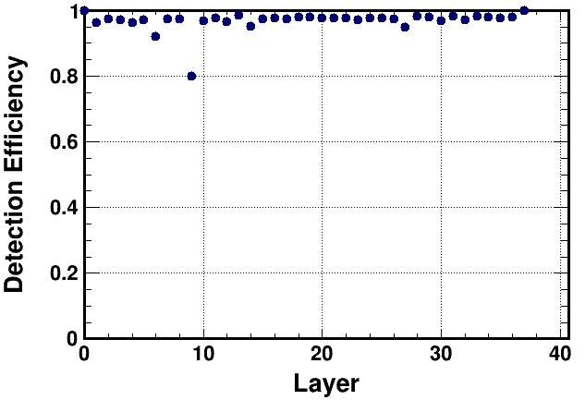
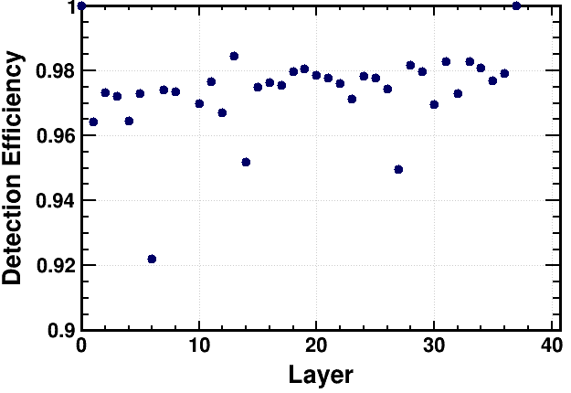
Trigger
Layer 1 and 38 were used as trigger
The efficiency was changed, but nothing was revealed

Slide 11
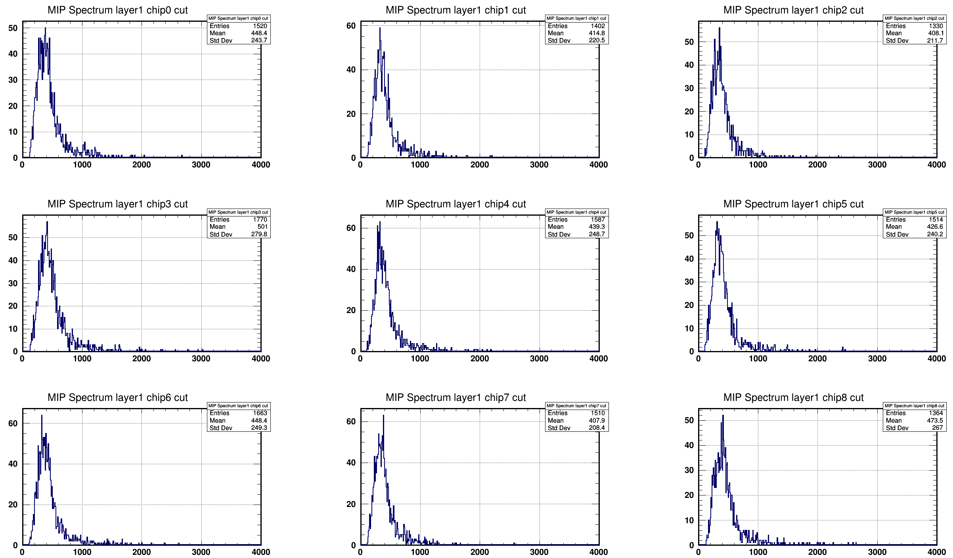
MIP Spectrum
Layer 1: 0.999504

Slide 12
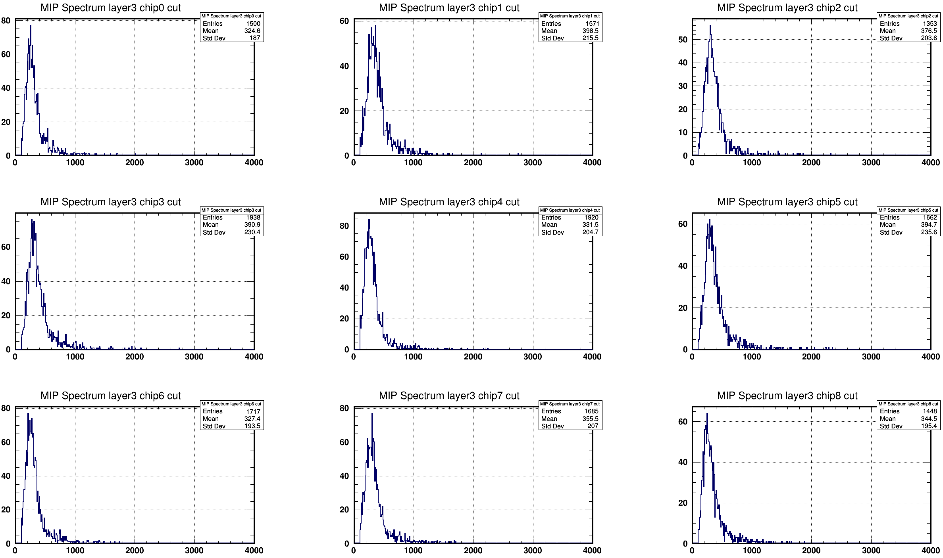
MIP Spectrum
Layer 3: 0.97

Slide 13
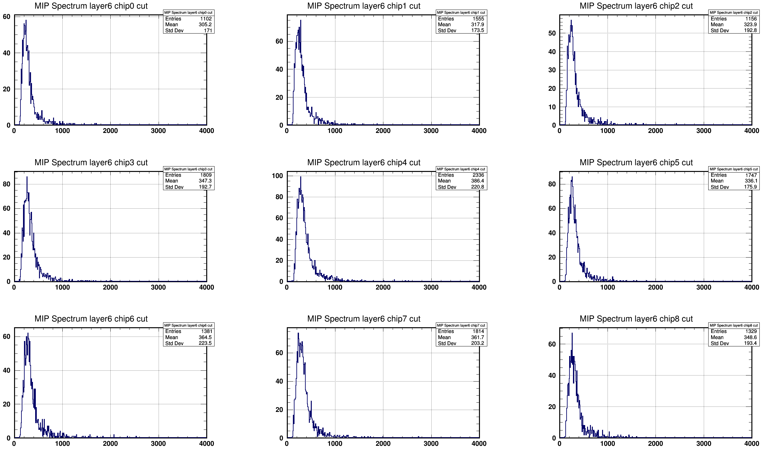
MIP Spectrum
Layer 6: 0.93
Low MIP value and mean value

Slide 14
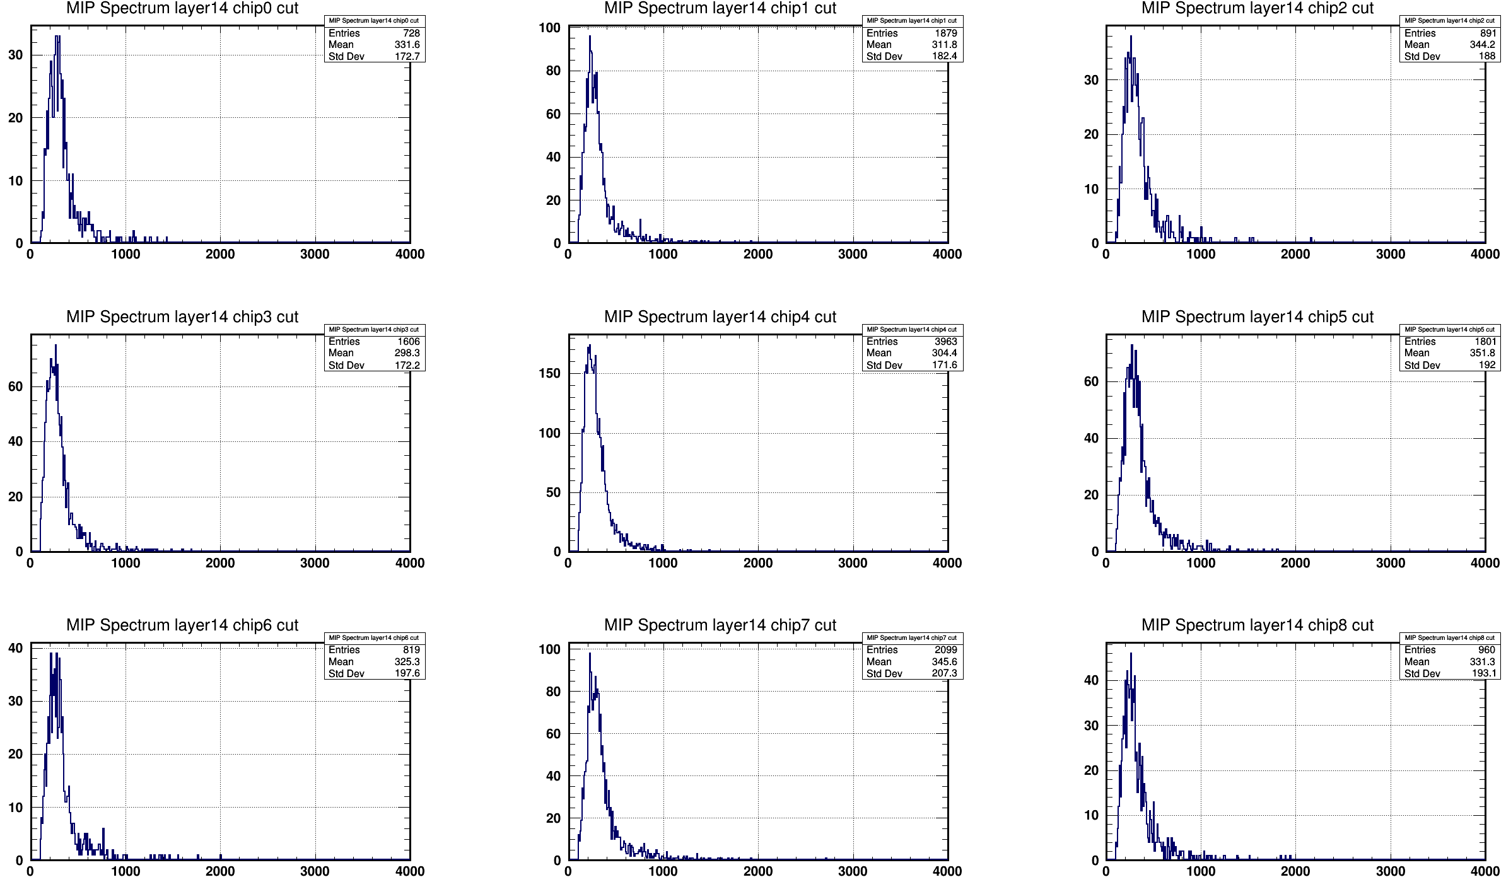
MIP Spectrum
Layer 14: 0.95
Low MIP value and mean value

Slide 15
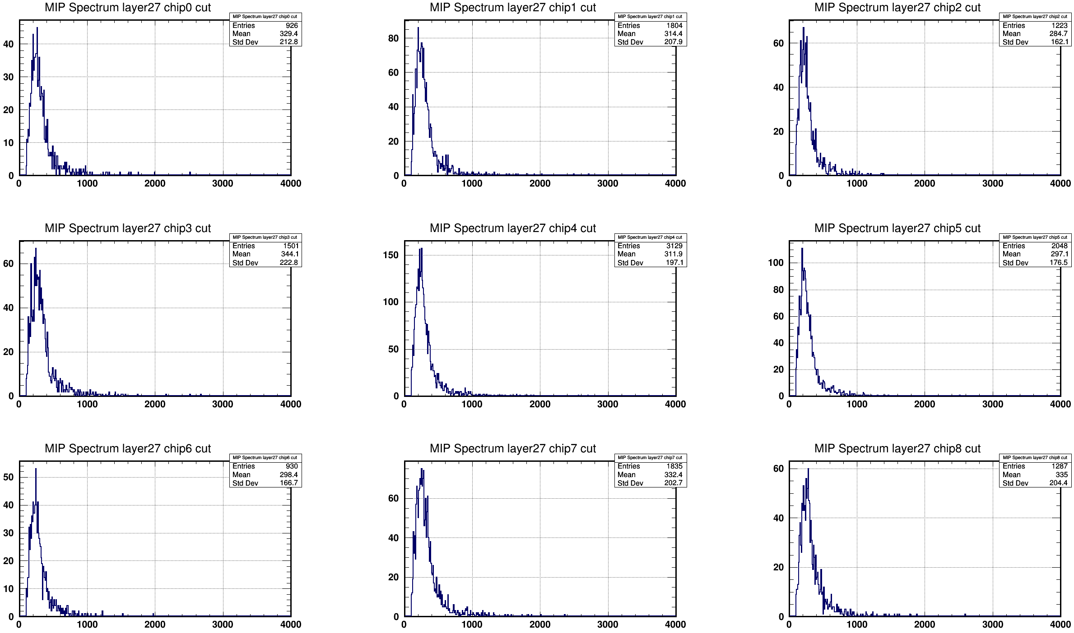
MIP Spectrum
Layer 27: 0.96
Low MIP value and mean value

Slide 16
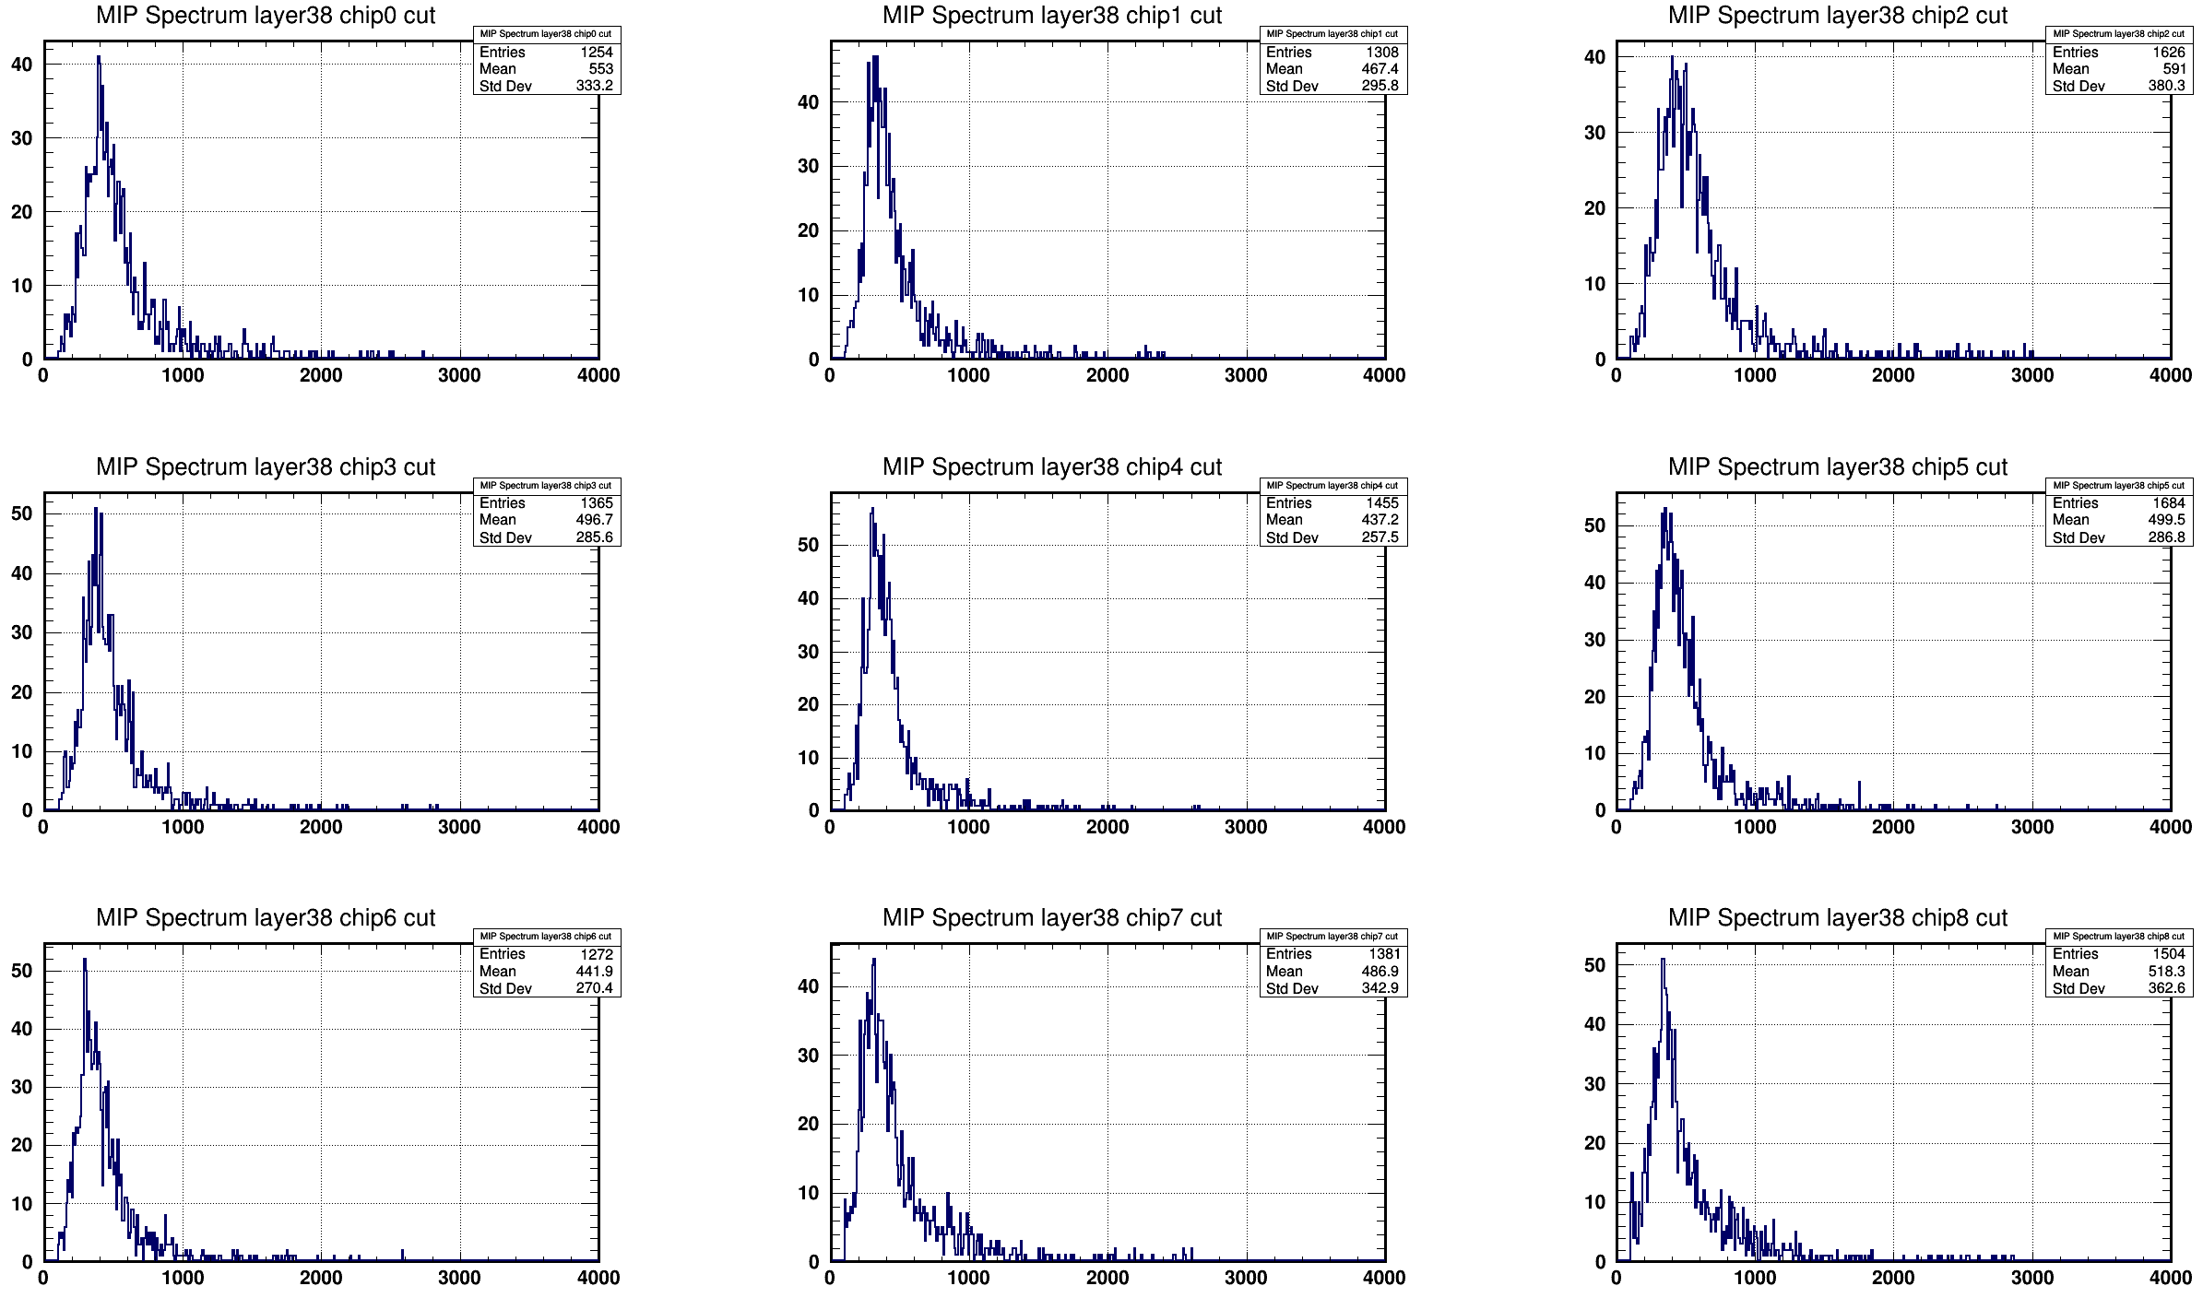
MIP Spectrum
Layer 38 Efficiency: 0.994737

Slide 17
Back up

Slide 18
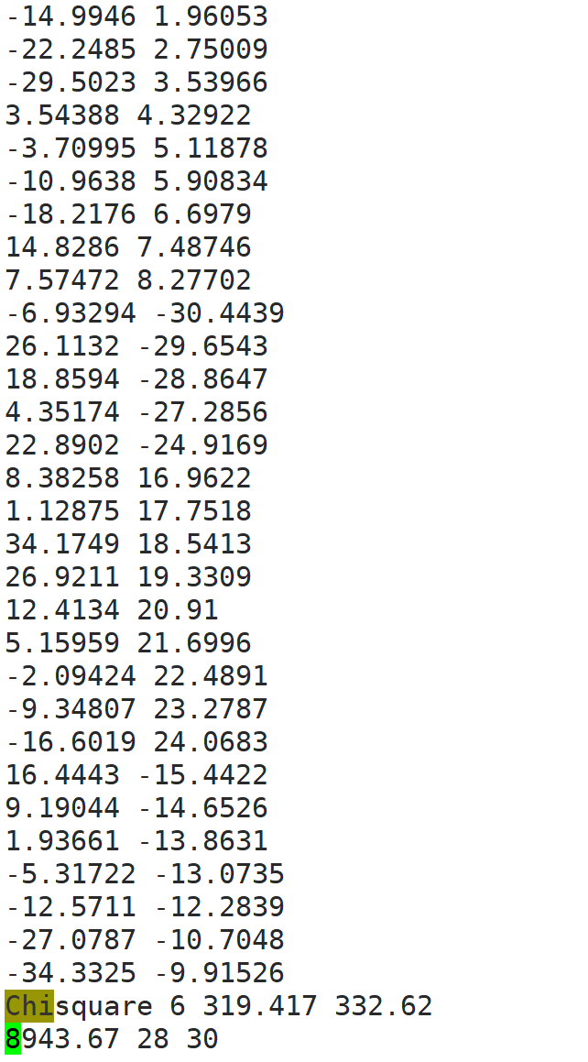
Residual

Slide 19
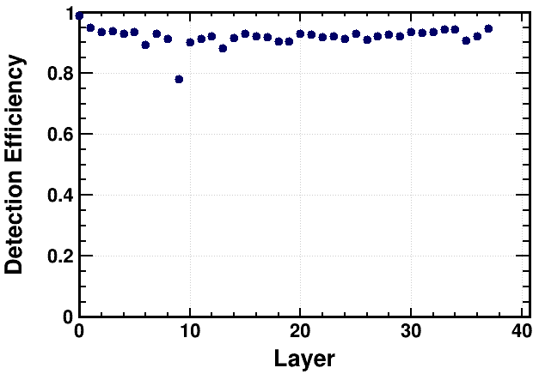
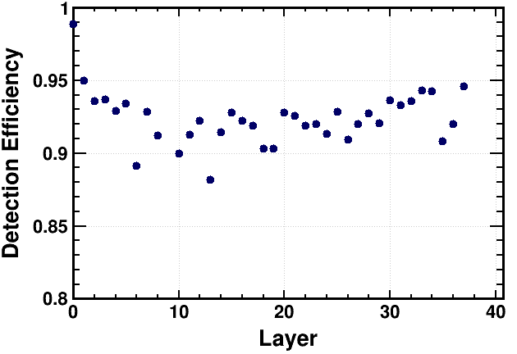
计算效率时要求单层仅一个击中

Slide 20
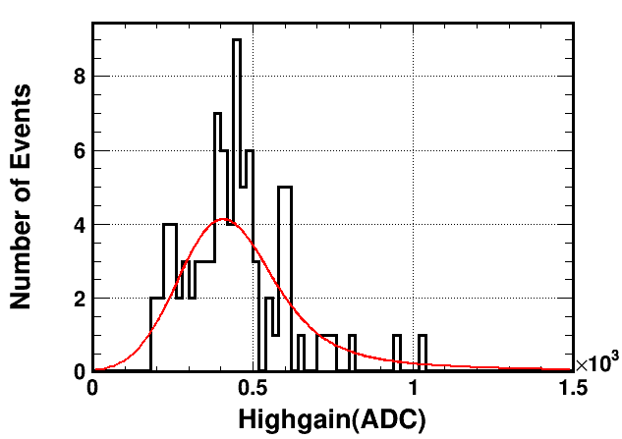
Fitting result

Slide 21
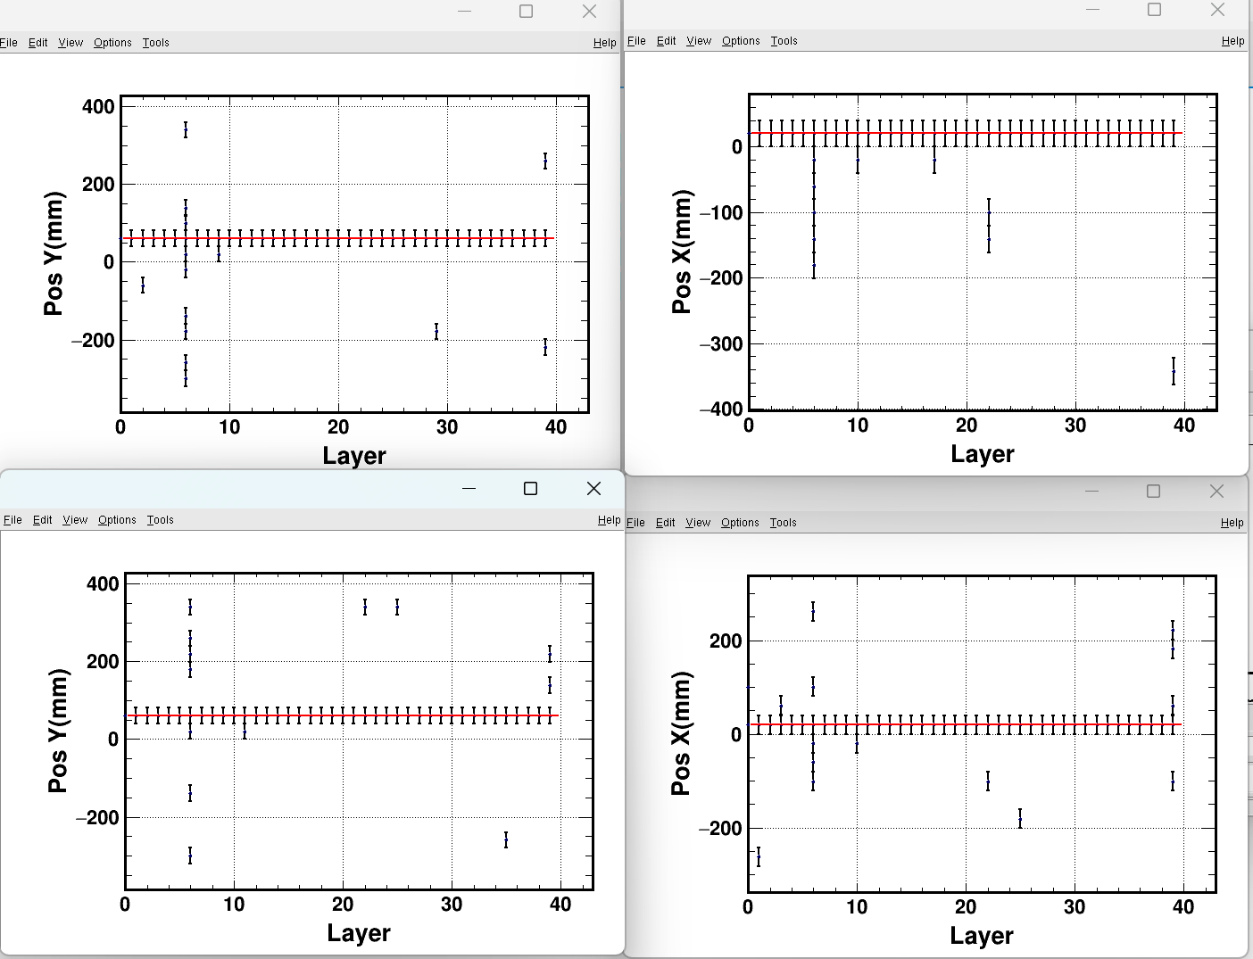
Beam data

Slide 22
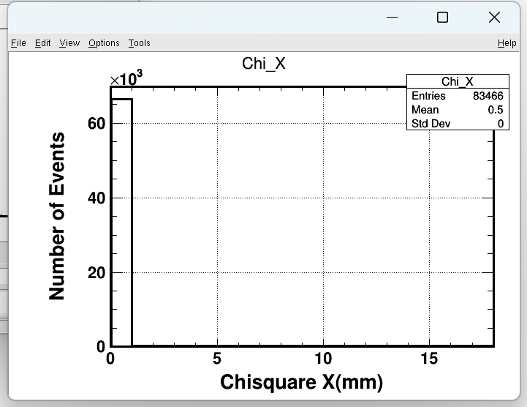
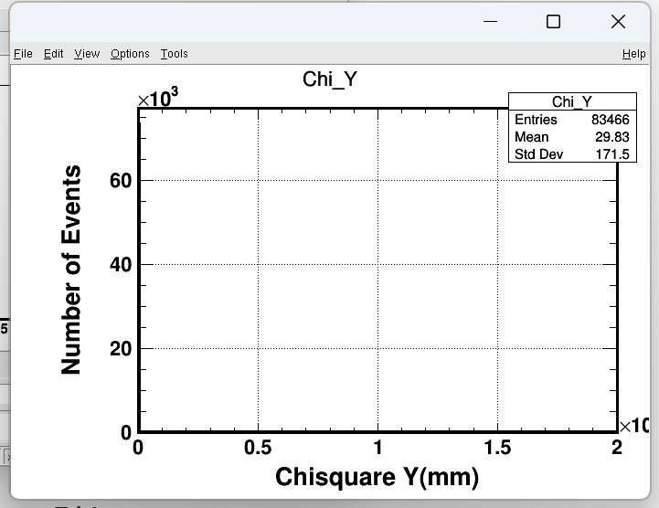
Beam data

Slide 23
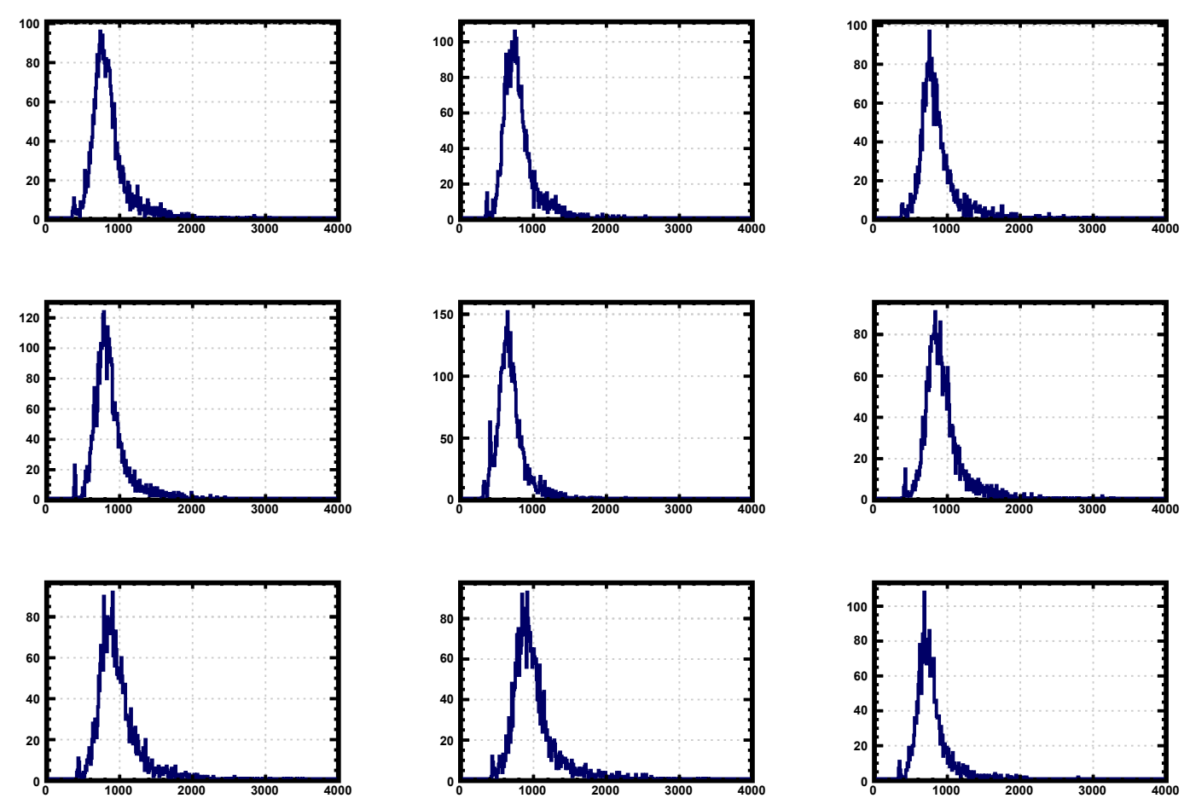

Slide 24
