Slide 1
Secondary Particles of Cosmic ray

Slide 2
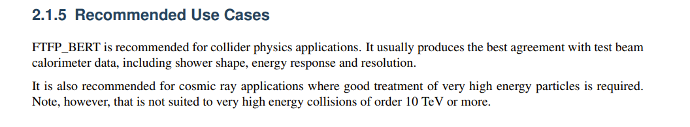
2. Detector Construction
1. Simulation & Analyze Construction
Al
type
Kinetic
x
y
z
px
py
pz
.mac文件能谱输入
Geant4
.root 文件
Python分析，绘图
Simulation situation:
Direction: iso
Location: Plane , uniform
3. Flux model : data from DAMPE & NASA
5cm
4. Physics List model: FTFP_BERT
Hadronic: elastic, inelastic, capture and fission processes.
EM:

Slide 3
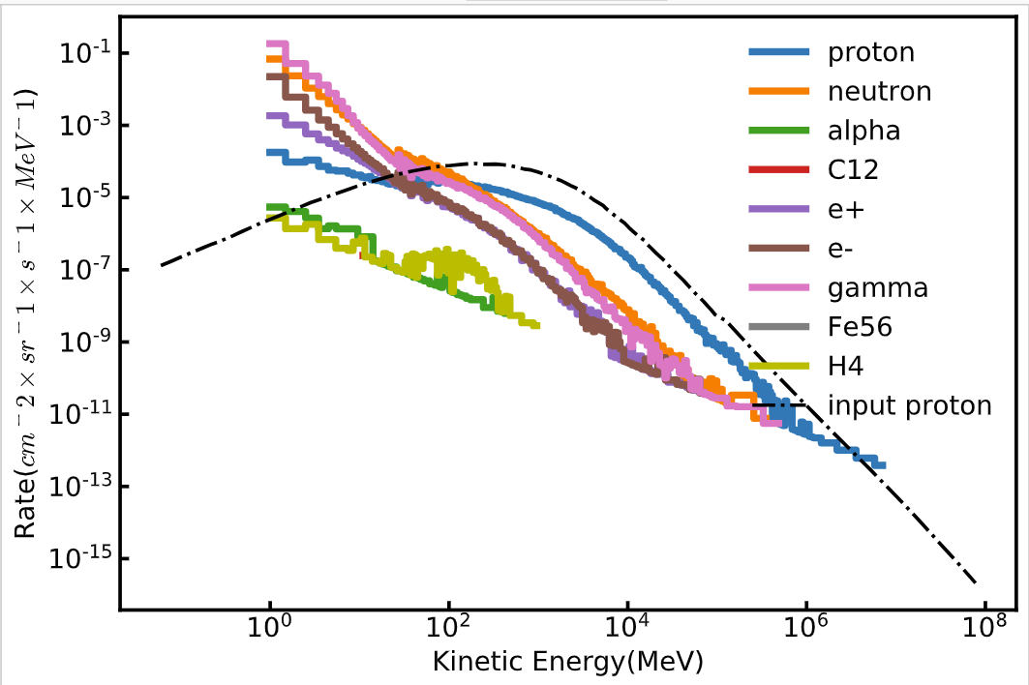
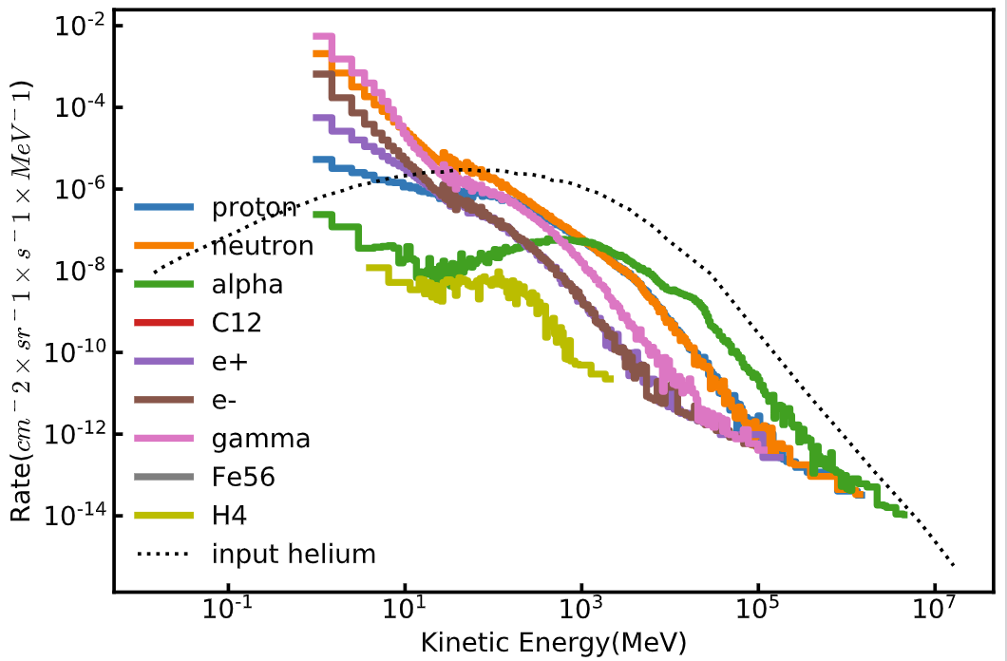
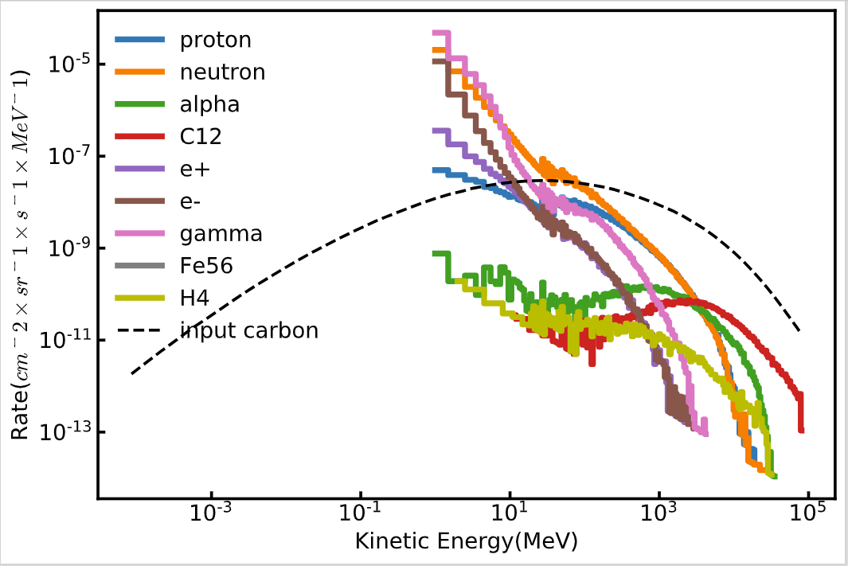
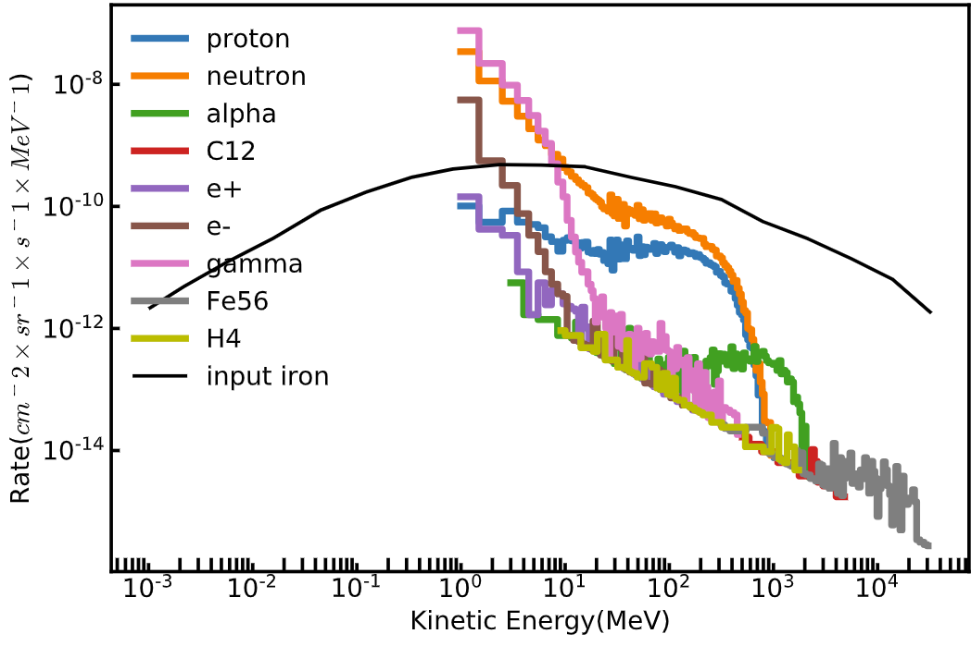
Result of Single Particle
Proton
Helium
carbon
iron

Slide 4
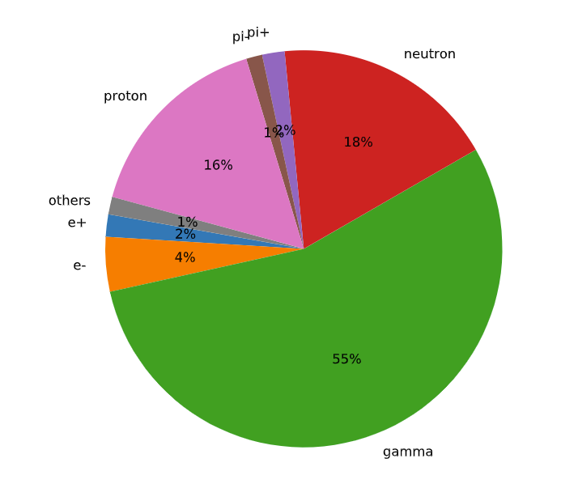
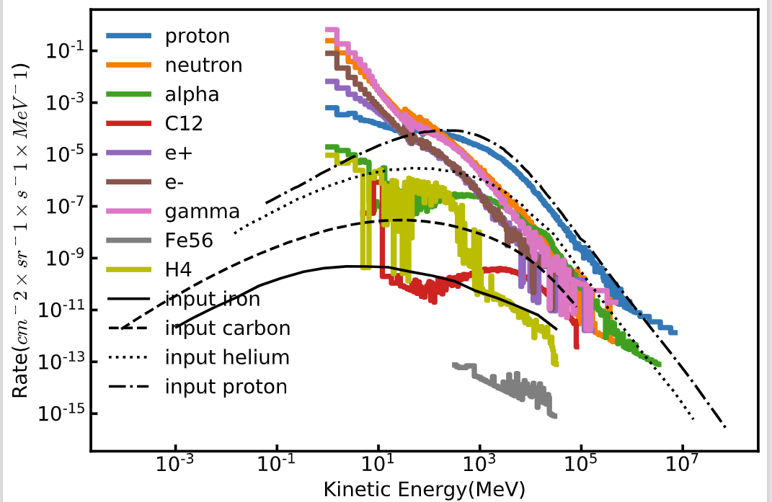
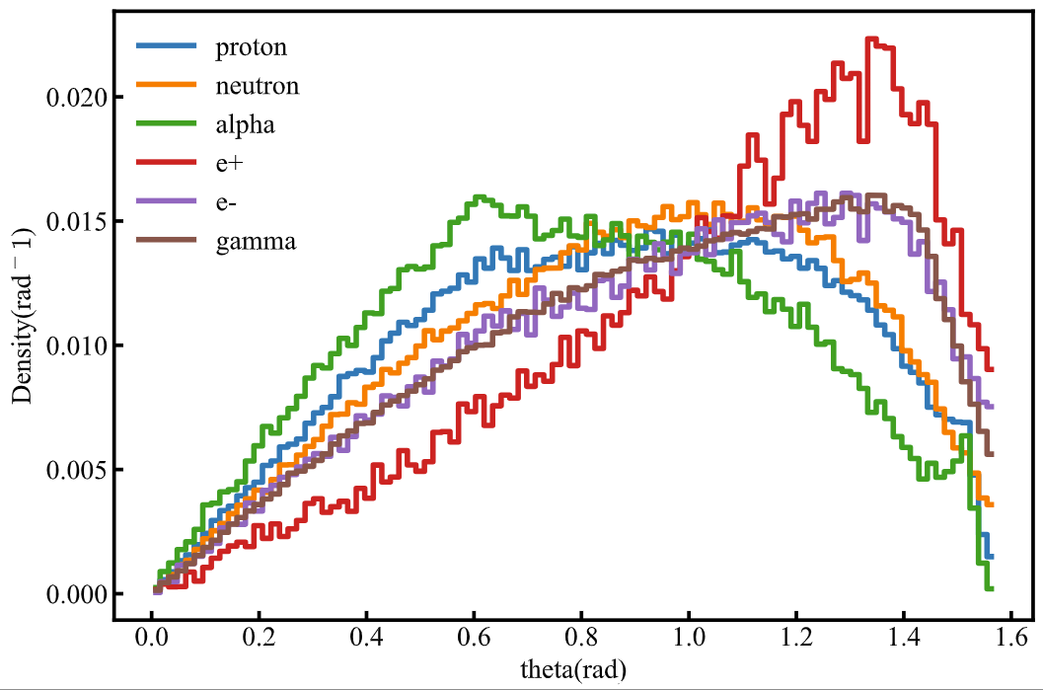
Al
Total Result
Simulation situation:
Direction: iso
Location: Plane , uniform
Incidence particle: proton, helium, carbon, iron
Energy distribution
Angular distribution
Total number of incidence events: 1599966,
Total number of secondary particles: 6546224
There is certainly a rise in particle number after shielding, most of the secondary particles are low energy gamma ray and neutron.
Proportion of components
Next Step：
1. How secondary particle influent PSs
2. Simulate different material

