Slide 1
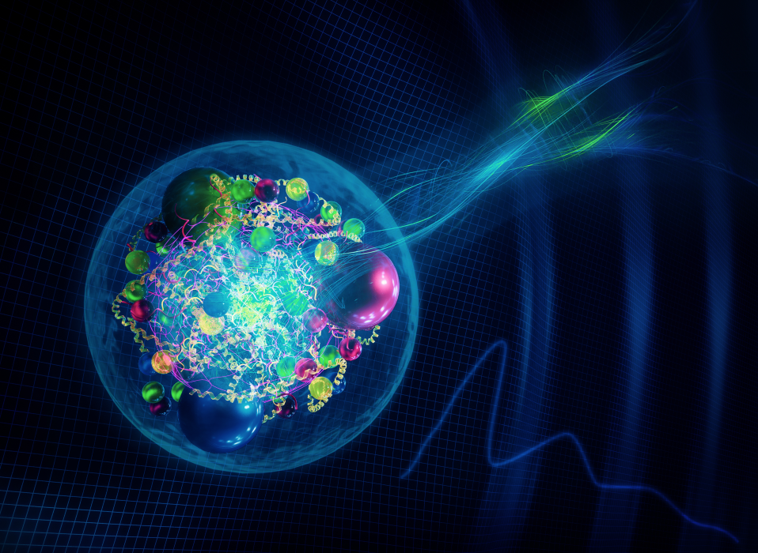
Anomaly effects observed in baryon EMFFs
周小蓉
中国科学技术大学
第八届BESIII R值与QCD强子结构研讨会
哈尔滨工程大学，2024年7月19-22日

Slide 2
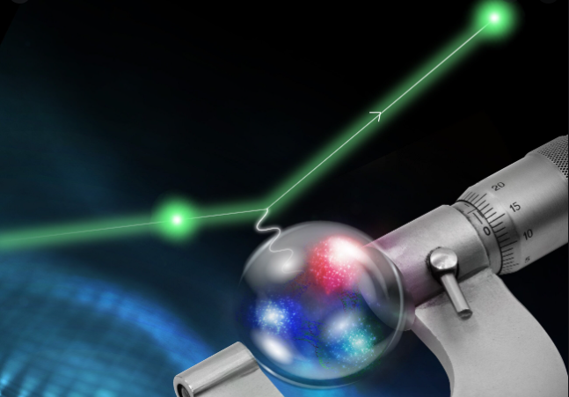
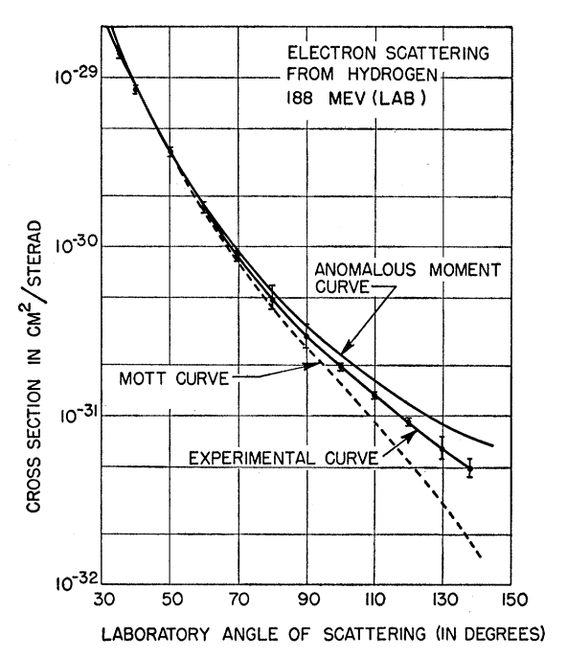
核子形状因子
R. Hofstadter
非点状散射截面 = 点状散射截面*形状因子
1961
$$\frac{dσ}{dΩ_{e}}={\left(\frac{dσ}{dΩ}\right)}_{Mott}F(Q^{2})$$
形状因子$F(Q^{2})$被提出，代表与点状粒子的偏离程度
历史上首次测量质子半径
$\sqrt{\left\langle r^{2}\right\rangle }=(7.4±2.4)×{10}^{−14}$ cm

Slide 3
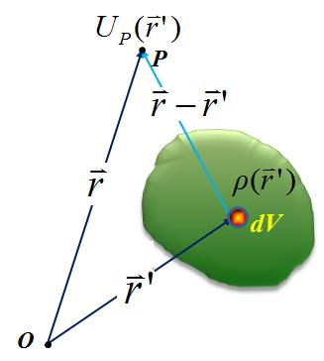
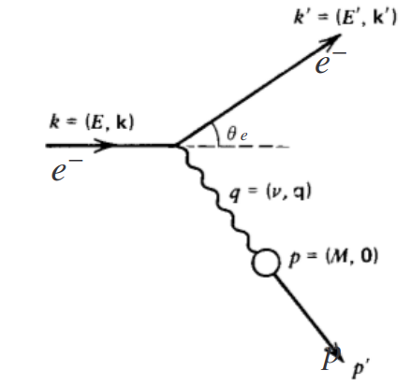
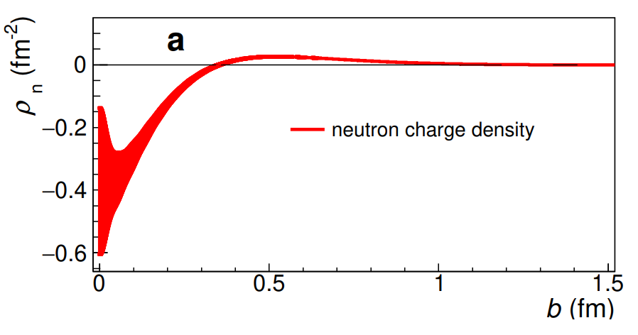
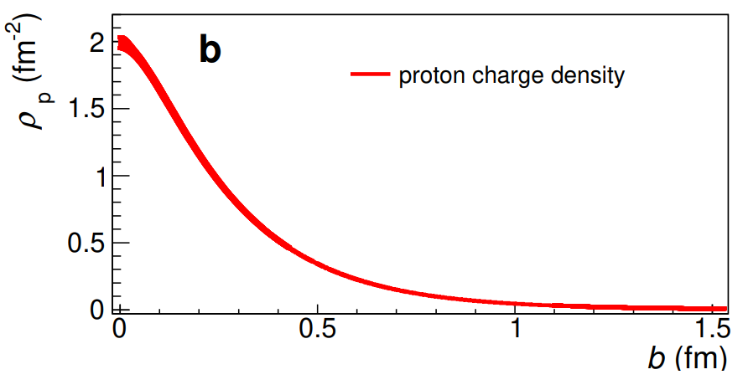
形状因子与电荷分布
具有一定电荷分布的粒子，其在某一点$\vec{r}$的电势为：
探针点粒子$e$在其势能上的散射为：
$$M_{fi}=\left\langle f | eU | i\right\rangle =\int{d^{3}r}e^{−i{\vec{k}}^{′}∙\vec{r}}eU\left(\vec{r}\right)e^{−i\vec{k}∙\vec{r}}=\int{d^{3}r}d^{3}r^{′}e^{i\vec{q}∙\vec{r}}\frac{e∙ρ({\vec{r}}^{′})}{4π|\vec{r}−{\vec{r}}^{′}|}\underset{→}{\vec{R}≡\vec{r}−{\vec{r}}^{′}}\int{d^{3}R}\frac{e∙e^{i\vec{q}∙\vec{R}}}{4π|R|} \int{d^{3}r^{′}e^{i\vec{q}∙{\vec{r}}^{′}}}ρ({\vec{r}}^{′})$$
形状因子定义为电荷分布的三维傅立叶变换，是四动量转移$\vec{q}$的函数
$$F\left(q^{2}\right)=\int{d^{3}r^{′}e^{i\vec{q}∙{\vec{r}}^{′}}}ρ({\vec{r}}^{′})$$
$$\left\{\begin{aligned}F\left(q^{2}\right)=1 （点电荷源） \\ F\left(q^{2}\right)=\frac{1}{1+q^{2}/a^{2}} （指数分布电荷） \\ F\left(q^{2}\right)=\frac{e^{−q^{2}}}{2a^{2}} （高斯分布电荷）\end{aligned}\right.$$
$$ρ(\vec{r})=\int{\frac{d^{3}q}{{\left(2π\right)}^{3}}e^{−i\vec{q}∙\vec{r}}F(q^{2})}$$

Slide 4
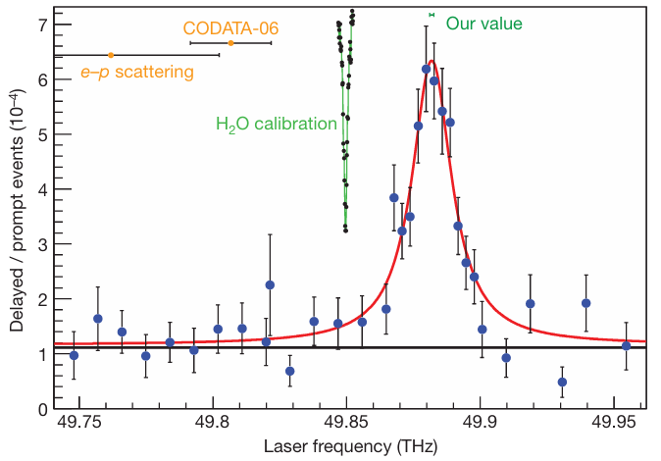
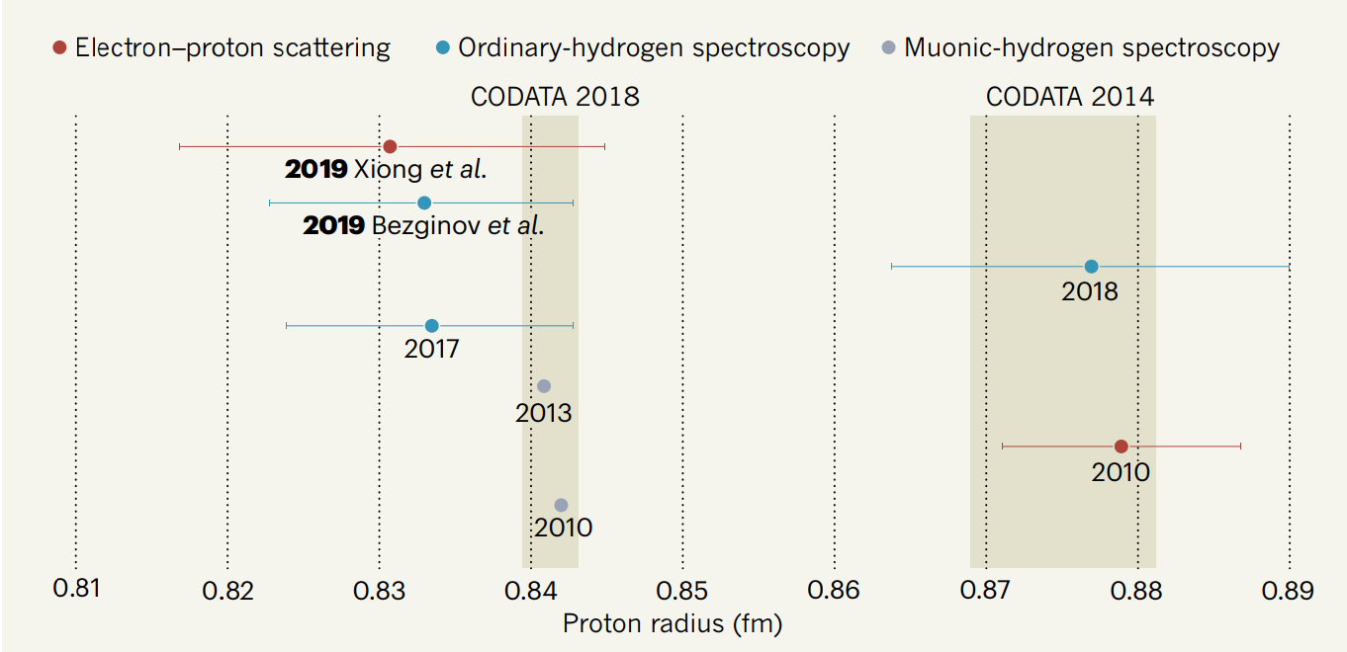
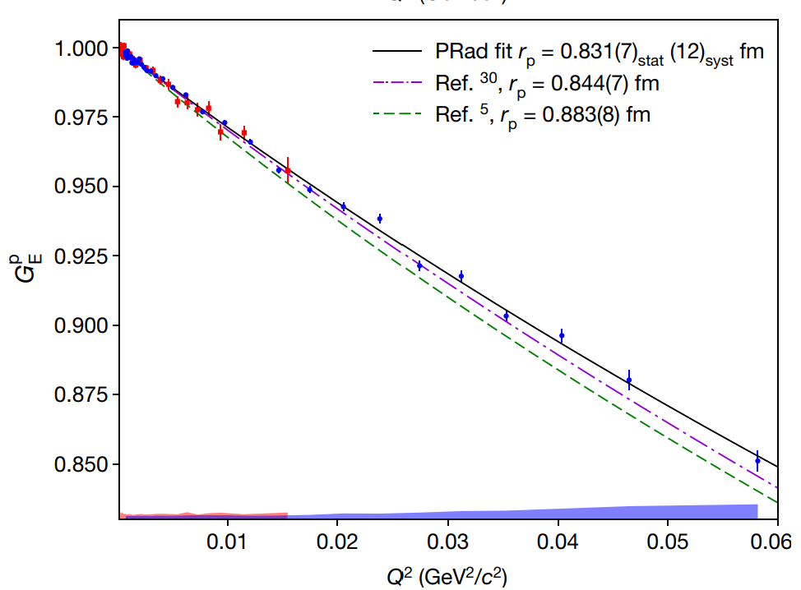
形状因子与电荷半径
电荷半径:$\left\langle r^{2}\right\rangle =\frac{\int{r^{2}ρ(\vec{r})d^{3}r}}{\int{rρ(\vec{r})d^{3}r}}=−6\frac{F^{′}\left(0\right)}{F\left(0\right)}≡−6\frac{dF(−q^{2})}{dq^{2}}|_{q^{2}=0}$
兰姆移位：氢原子，muonic-氢原子
（关键：测量精度、玻尔半径）
Nature 466, 213–216 (2010)
5$σ$
电子-质子散射（关键：$Q^{2}$）
Nature 575, 147–150 (2019)
4

Slide 5
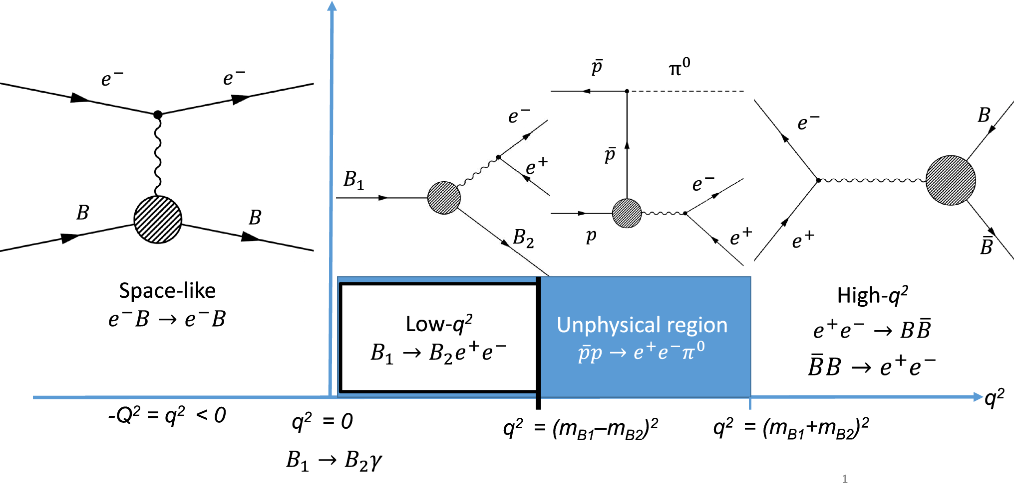
类空空间和类时空间
$$Γ_{μ}\left(p^{′},p\right)=γ_{μ}F_{1}\left(q^{2}\right)+\frac{iσ_{μν}q^{ν}}{2m_{p}}F_{2}\left(q^{2}\right)$$
Sachs FFs: $G_{E}\left(q^{2}\right)=F_{1}\left(q^{2}\right)+τκ_{p}F_{2}(q^{2}$)
$G_{M}\left(q^{2}\right)=F_{1}\left(q^{2}\right)+κ_{p}F_{2}(q^{2})$
电子-核子散射
需要稳定的核子束流
四动量转移$q^{2}=−Q^{2}$为负
$Q^{2}$能够无限接近0（0.00021 GeV²)
正负电子湮没到重子对或逆过程
核子成对产生
四动量转移$q^{2}$为正
$q^{2}$从阈值（$M_{B\overline{B}}$）开始

Slide 6
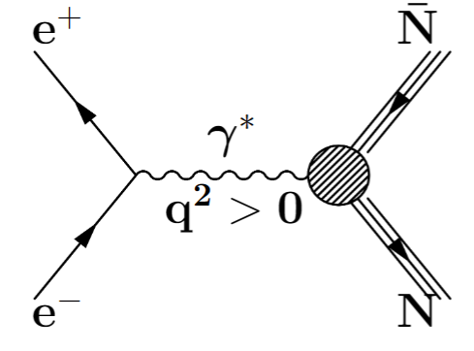
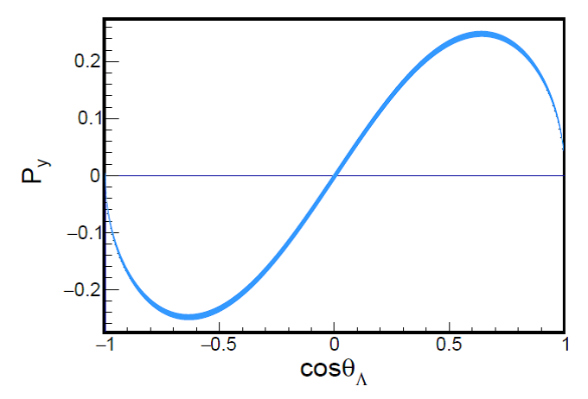
类时电磁形状因子：理论简述
N. Cabibbo and R. Gatto 给出$e^{+}e^{−}→B\overline{B}$ (自旋1/2) 的产生截面
Phys.Rev. 124 (1961) 1577-1595
根据索末菲效应，末态相互作用会导致带电重子对阈值的非零截面,
Sov. Phys. Usp. 34 375(1991)
$\frac{dσ_{B\overline{B}}}{dcosθ}=\frac{πα^{2}Cβ}{2q^{2}}\left[\left(1+\cos^{2}θ\right){\left|G_{M}\right|}^{2}+\frac{1}{τ}{\left|G_{E}\right|}^{2}\sin^{2}θ\right],$ $τ=\frac{q^{2}}{4m_{B}^{2}}$
总截面：$σ_{B\overline{B}}=\frac{4πα^{2}Cβ}{3q^{2}}\left[{\left|G_{M}\right|}^{2}+\frac{1}{2τ}{\left|G_{E}\right|}^{2}\right]$
$$\underset{⇒}{\left|G_{E}\right|=|G_{M}|}σ_{B\overline{B}}=\frac{2πα^{2}Cβ}{q^{2}}|G_{eff}|^{2}$$
类时电磁形状因子的虚部会导致重子出现横向极化
Nuov Cim A 109, 241–256 (1996)
$$P_{y}=−\frac{\sin{2θ}Im\left[G_{E}G_{M}^{∗}\right]/\sqrt{τ}}{\frac{{\left|G_{E}\right|}^{2}\sin^{2}θ}{τ}+{\left|G_{M}\right|}^{2}(1+\cos^{2}θ)}$$

Slide 7
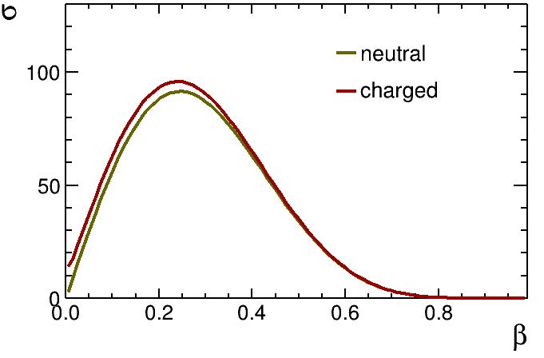
类时电磁形状因子：理论简述
很多低能区有效理论模型预言了类时空间电磁形状因子，包括但不限于：ChEFT, VMD, RCQM, parton model, pQCD等。
pQCD预言高能区形状因子随能量的演化:
$F_{1}∝q^{−4}, F_{2}∝q^{−6}$
pQCD预言高能区形状因子随能量的演化:
𝑭_𝟏∝𝒒^(−𝟒), 𝑭_𝟐∝𝒒^(−𝟔)
考虑低能区的非微扰修正: $\frac{q^{2}F_{2}}{F_{1}}∝ln(\frac{q^{2}}{Λ^{2}})$, $Λ≈0.3$ GeV
考虑低能区的非微扰修正: (𝒒^𝟐 𝑭_𝟐)/𝑭_𝟏 ∝𝐥𝐧(𝒒^𝟐/𝜦^𝟐 ), 𝜦≈𝟎.𝟑 GeV
VMD模型考虑矢量介子的贡献 $\left|G_{eff}\right|=\frac{𝓐}{q^{4}[\ln^{2}\left(\frac{q^{2}}{Λ^{2}}\right)+π^{2}]}$ or $\left|G_{eff}\right|=\frac{𝓐}{\left(1+\frac{q^{2}}{m_{a}^{2}}\right)[1−q^{2}/q_{0}^{2}]^{2}}$
VMD模型考虑矢量介子的贡献 |𝑮_𝐞𝐟𝐟 |=𝓐/(𝒒^𝟒 [〖𝐥𝐧〗^𝟐 (𝒒^𝟐/𝜦^𝟐 )+𝝅^𝟐]) or |𝑮_𝐞𝐟𝐟 |=𝓐/((𝟏+𝒒^𝟐/(𝒎_𝒂^𝟐 ))[𝟏−𝒒^𝟐/𝒒_𝟎^𝟐 ]^𝟐 )
形状因子参数化：
类时电磁形状因子测量的其中一个重要意义即为检验低能区有效理论

Slide 8
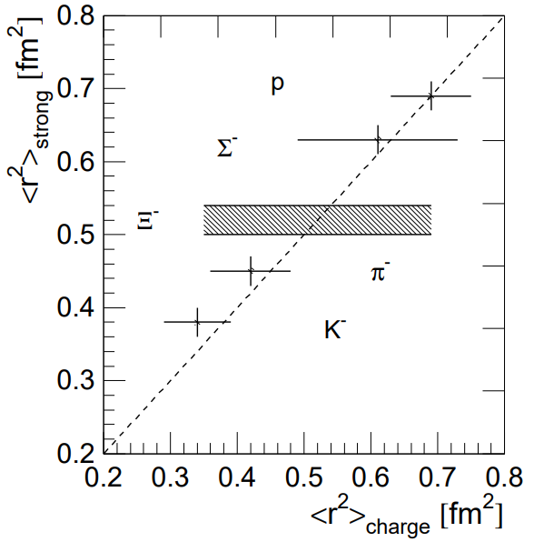
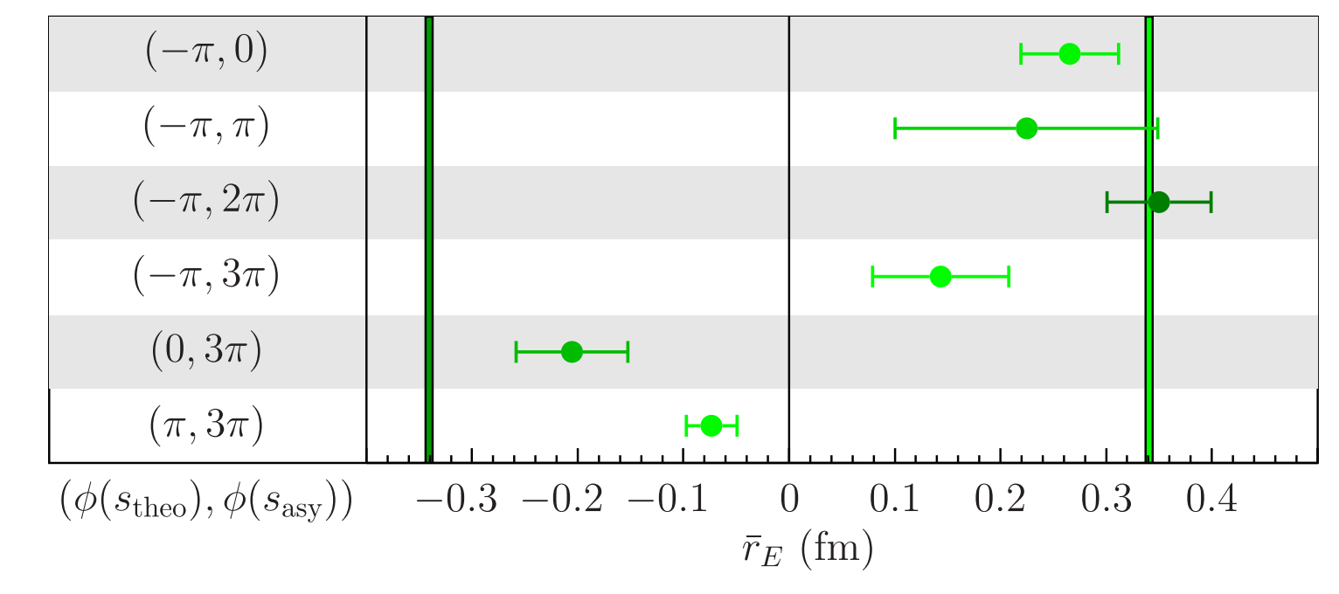
利用类时电磁形状因子确定超子电磁半径
由于超子不稳定，很少有类空的超子电磁形状因子结果。
研究超子的电磁结构对于理解强子半径的味道依赖有重要意义。
利用类时电磁形状因子比值及其相位角信息，结合色散关系和渐进自由特性等约束，能够确定超子的电磁半径信息
PRD 104, 116016 (2021)
(SELEX Collaboration) PLB 522, 233 (2001)

Slide 9
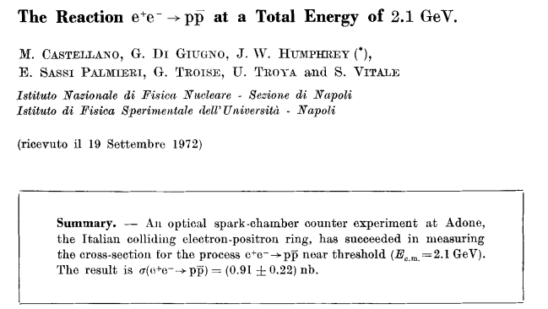
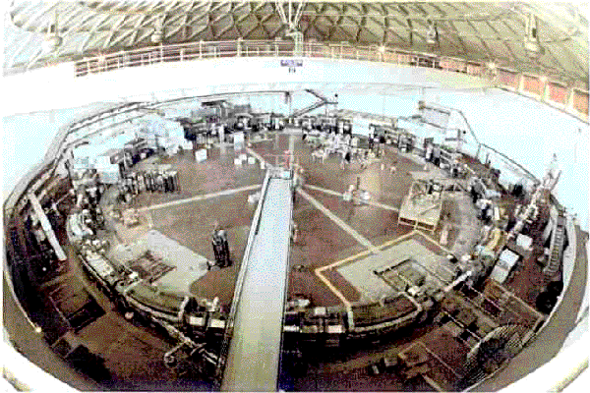
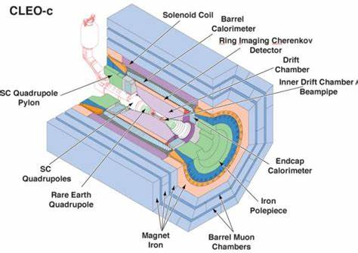
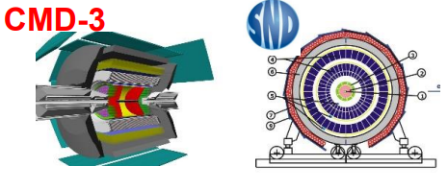
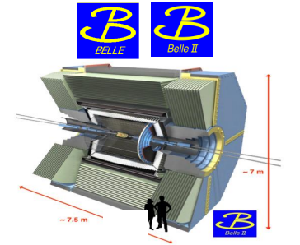
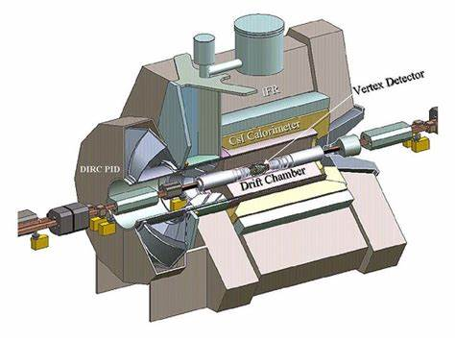
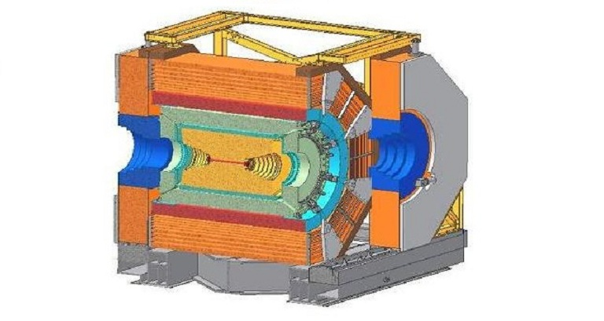
类时电磁形状因子：实验测量
ADONE实验（1972）
从21901张照片中找出约25个信号事例
CLEO-c
CLEO-c
产生截面
有效电磁形状因子
电磁形状因子比值
极化，电磁形状因子相位

Slide 10
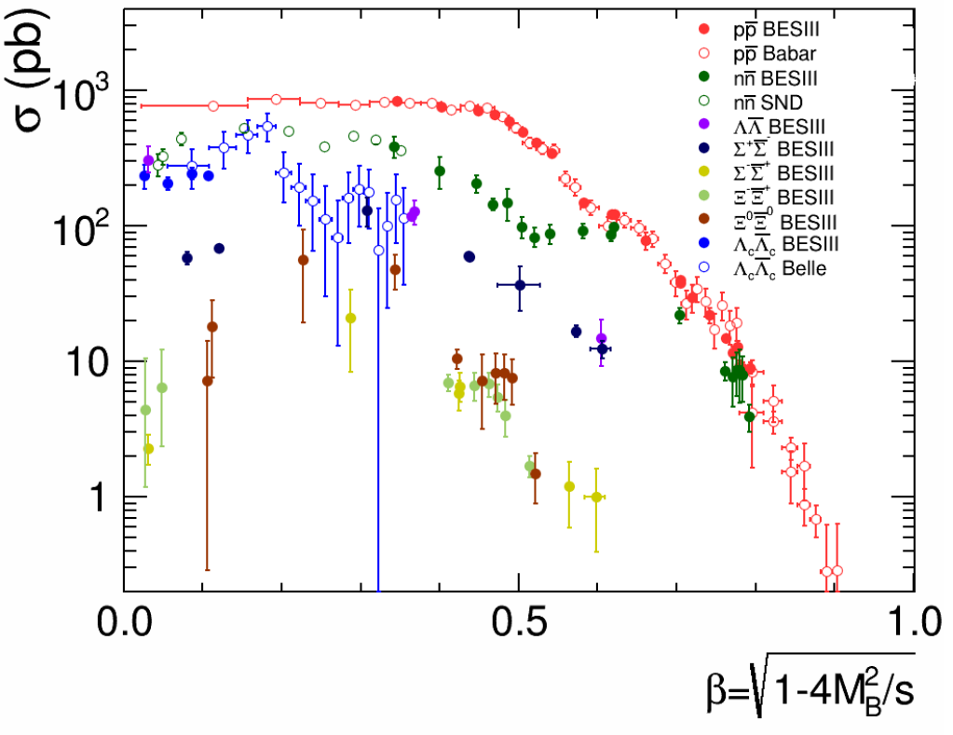
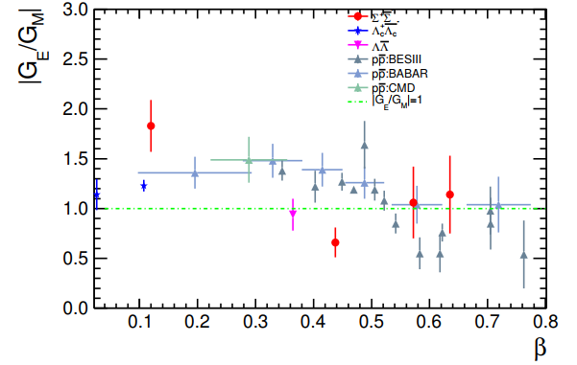
类时电磁形状因子：实验测量
Nat.Sci.Rev. 8 (2021) 11, nwab187
Abnormal threshold effects observed in various baryon pair production: $p\overline{p}, Λ\overline{Λ}, Λ_{c}^{+}{\overline{Λ}}_{c}^{−}$ …
Oscillation structures observed in $p\overline{p}$, n$\overline{n}$
|G_{E}/G_{M}| ratio significantly larger than 1 at low beta for $p$, $Λ_{c}^{+}$, $Σ^{+},$ indicating large D-wave near threshold
Relative phase angle of form factor $∆φ$(sin$∆φ)$ measured for $Λ$, $Λ_{c}^{+}$

Slide 11
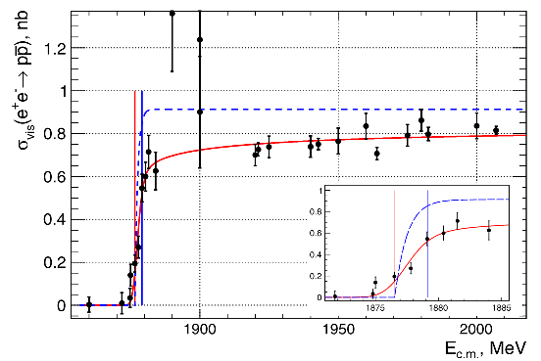
Cross section of $e^{+}e^{−}→p\overline{p}$
CMD-3
Cross section of $e^{+}e^{−}→p\overline{p}$ near threshold shows very sharp step-like behavior.
The plateau indicates anomaly threshold effect in the production cross section.
PLB 794, 64-68 (2019)
The Born cross section is described with

Slide 12
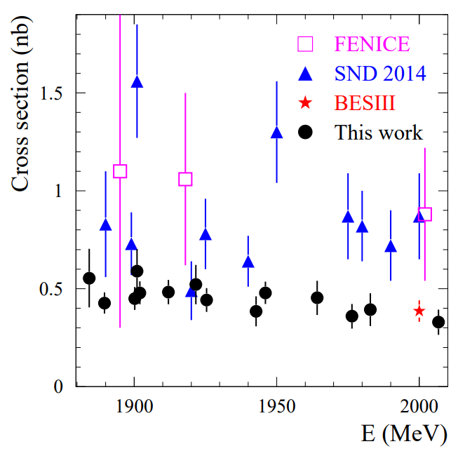
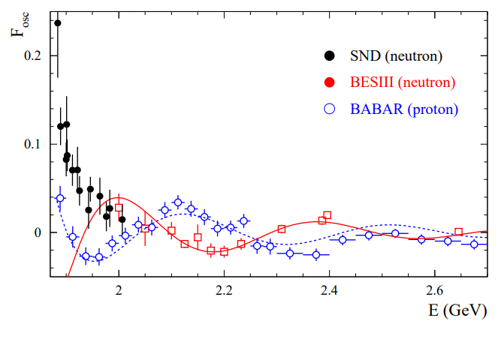
Cross section of $e^{+}e^{−}→n\overline{n}$
$e^{+}e^{−}→n\overline{n}$ from $\sqrt{s}=$1.884 to 2.007 GeV, ~30 pb⁻¹
$σ≈$ 0.4 nb below 2 GeV. Similar plateau as in $e^{+}e^{−}→p\overline{p}$.
Reduced-|G| contracts the common proton /neutron oscillation frequency.
Eur.Phys.J.C 82 (2022) 8, 761

Slide 13
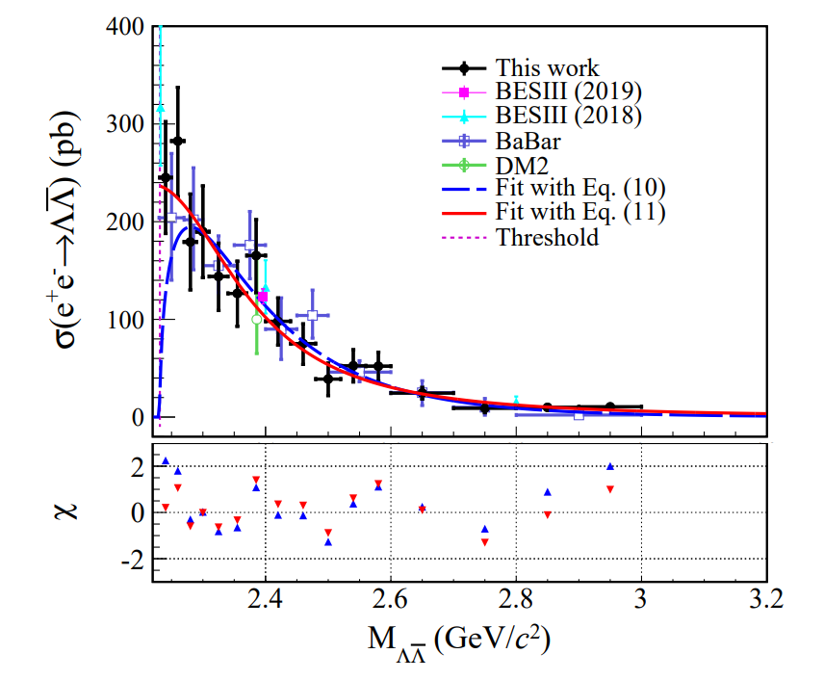
Cross section of $e^{+}e^{−}→Λ\overline{Λ}$
Cross section of $e^{+}e^{−}→Λ\overline{Λ}$ is measured with 11.9 fb⁻¹ data collected from $\sqrt{s}=$3.773 to 4.258 GeV by ISR method.
The non-zero cross section is consistent with previous measurement.
PRD 107.072005 (2023)

Slide 14
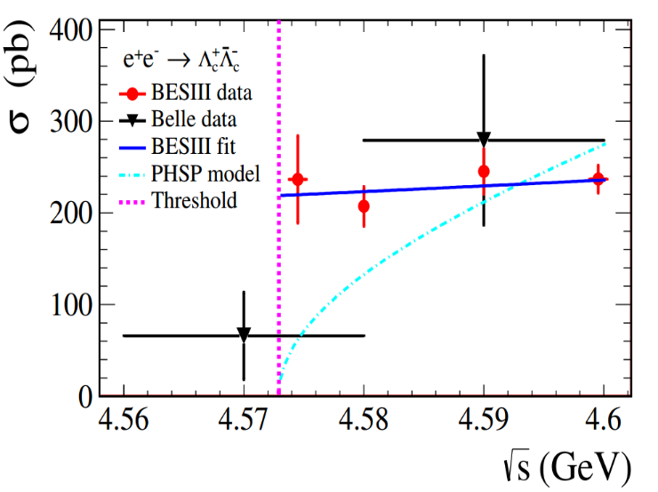
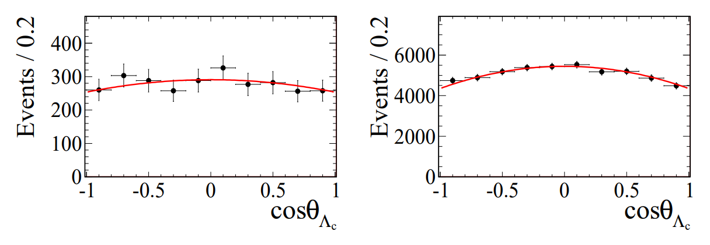
Cross section of $e^{+}e^{−}→Λ_{c}^{+}{\overline{Λ}}_{c}^{−}$
The BESIII measurements indicate that there is indeed a step in $e^{+}e^{−}→Λ_{c}^{+}{\overline{Λ}}_{c}^{−}$, similar to $e^{+}e^{−}→p\overline{p}$, followed by a plateau.
Cross section of first energy point (1.5 MeV above threshold) is $236±11±46$ pb.
PRL 120, 132001 (2018)

Slide 15
Question 1: 阈值反常结构的来源是什么？
This is what we expect
These are what we got

Slide 16
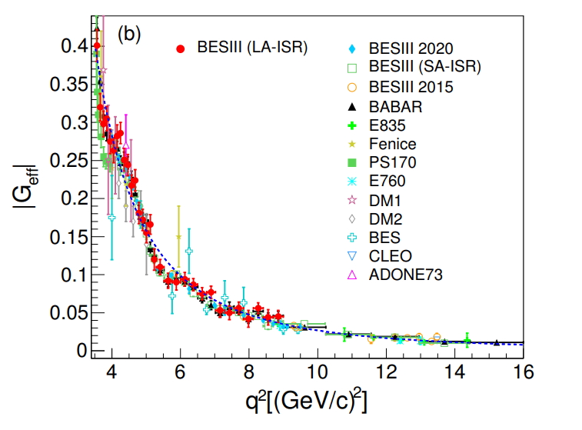
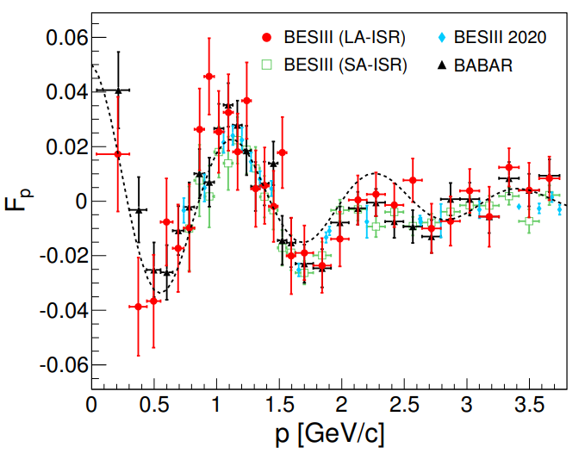
Proton EMFFs: effective FF
ISR method with detected photon and undetected at BESIII.
Damped oscillation distribution after subtracting the modified dipole.
PLB 817, 136328 (2021)
Blue dashed:
Black dashed:

Slide 17
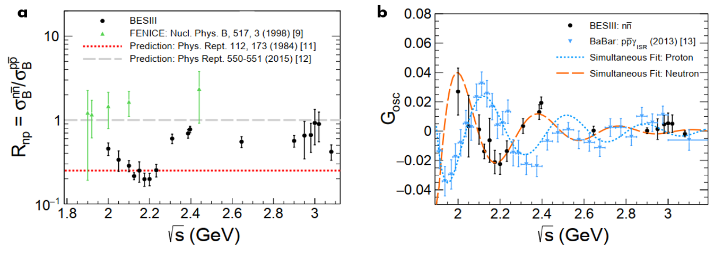
Neutron EMFFs: effective FF
$e^{+}e^{−}→n\overline{n}$ from $\sqrt{s}=$2.0-3.08 GeV, 647.9 pb⁻¹.
$γ−p$coupling larger than $γ−n$coupling => consistent with theoretical limits from VMD, Skyrme etc.
Oscillation of reduced-|G| observed in neutron with a phase orthogonal to that of proton.
Nat. Phys. 17, 1200–1204 (2021)

Slide 18
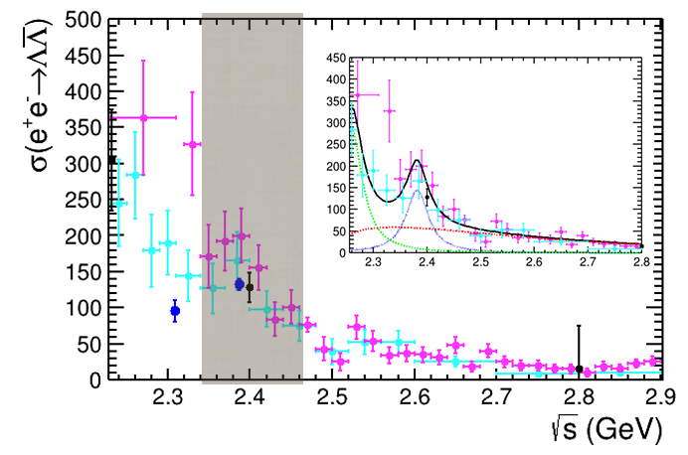
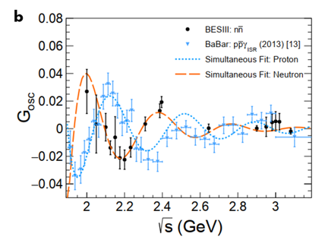
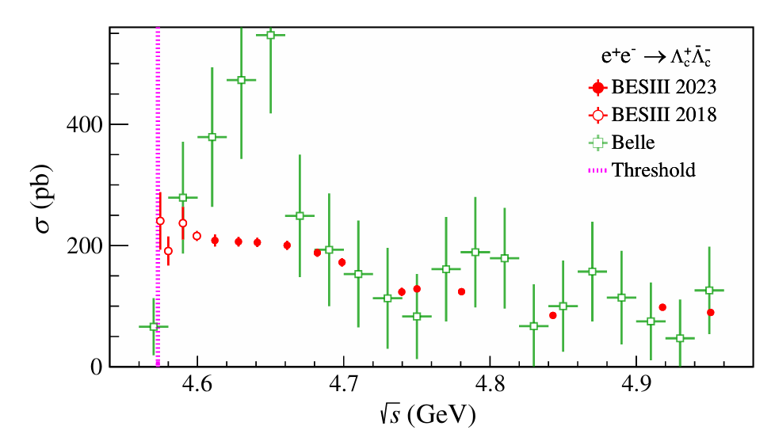
Question 2: 有效形状因子振荡的机制是什么？

Slide 19
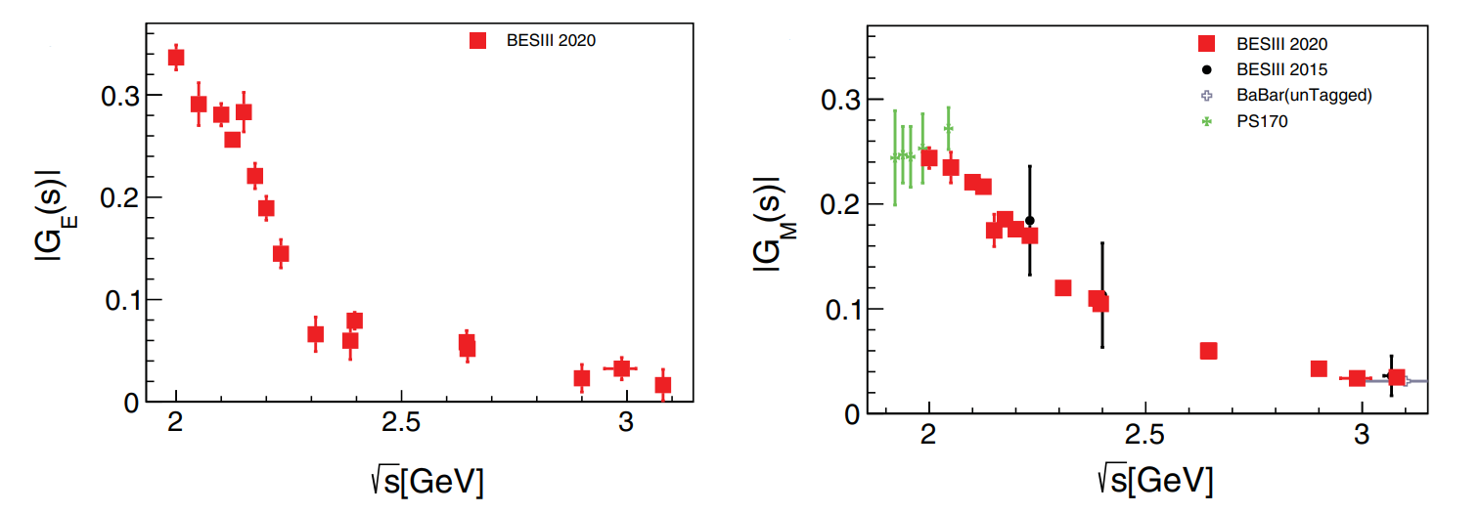
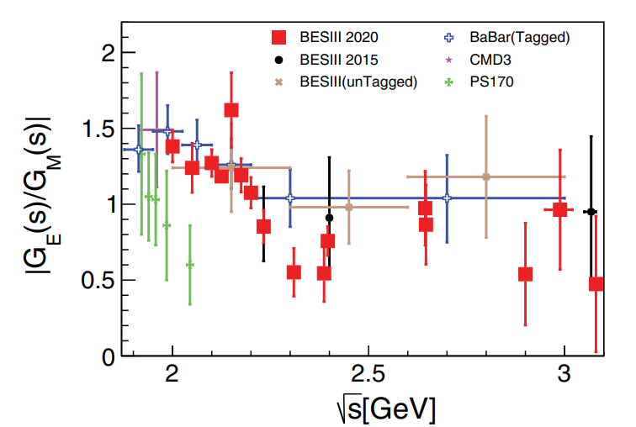
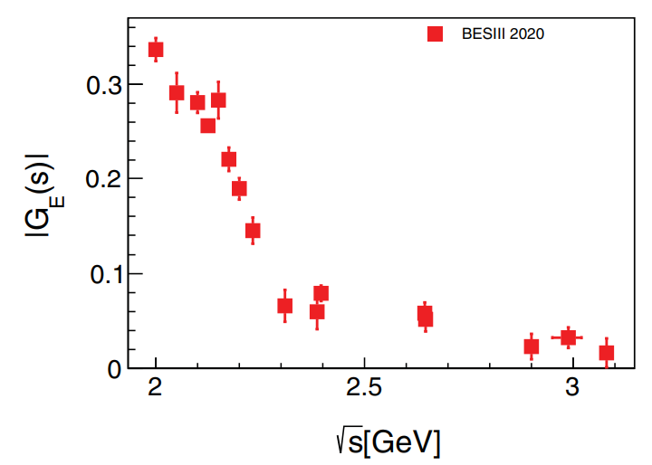
Proton EMFFs: |G_{E}/G_{M}|
Scan technique from $\sqrt{s}=$2.0 to 3.08 GeV, using 688.5 pb⁻¹ integrated luminosity.
|G_{E}/G_{M}|, |G_{M}| are determined with high accuracy, |G_{E}| is measured for the first time.
PRL 124, 042001 (2020)

Slide 20
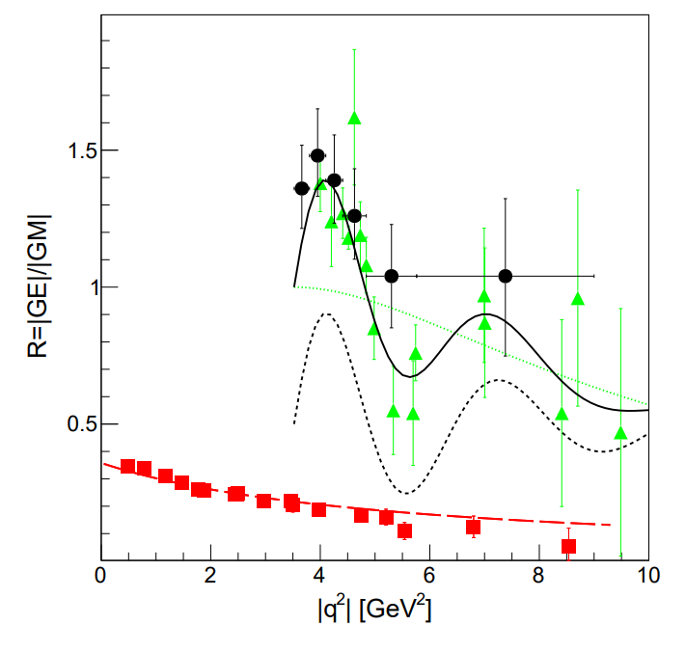
Analyticity of proton EMFFs
SL data shows a monotone decrease from ${1/μ}_{p}$ at $q^{2}=0$.
TL data decreases from 1 at threshold $q^{2}={4m}_{p}^{2}$.
Damped oscillation feature of |G_{E}/G_{M}| in Time-like
Perturbative domain has not been reached.
E. Tomasi-Gustafsson et al., PRC 103, 035203 (2021)

Slide 21
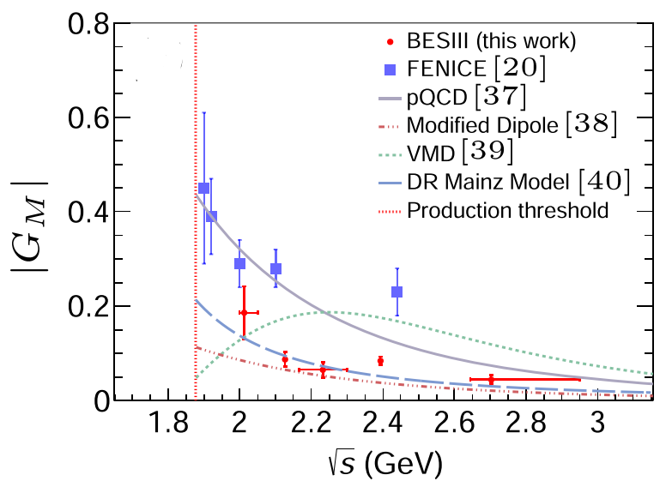
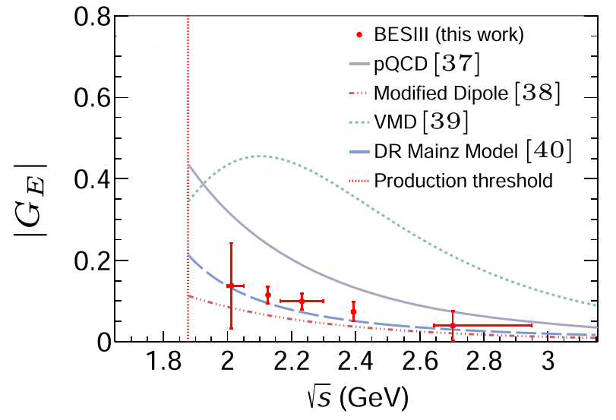
Neutron EMFFs: |G_{E}/G_{M}|
Compared with the FENICE results, the values for |G_{M}| from this work are smaller by a factor of 2-3.
Results is compared with various models: pQCD, modified dipole, VMD and dispersion relations (DR), and DR model gives good consistency.
PRL 130, 151905 (2023)

Slide 22
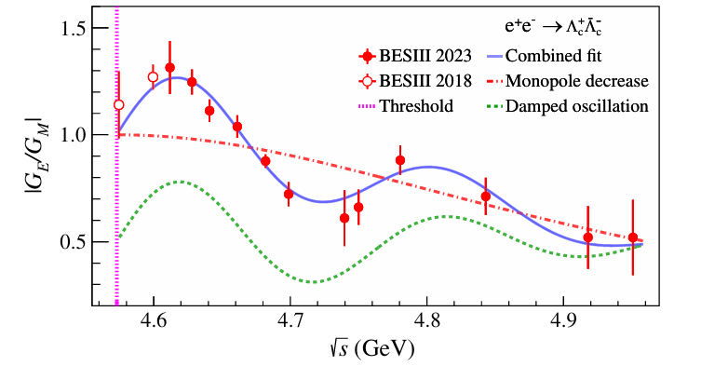
Cross section of $e^{+}e^{−}→Λ_{c}^{+}{\overline{Λ}}_{c}^{−}$
Phys. Rev. Lett. 131, 191901 (2023)
No oscillatory behavior in effective form factors as in proton/neutron, but damped oscillation on |GE/GM| observed, as in proton, with 3.5 times greater frequency.

Slide 23
Question 3: 电磁形状因子比值振荡的机制是什么？

Slide 24
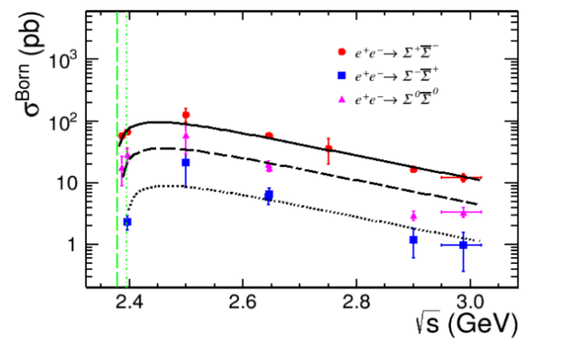
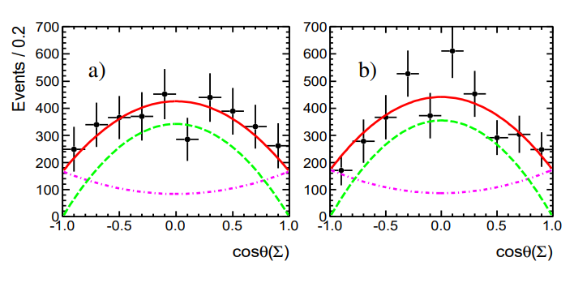
Cross section of $e^{+}e^{−}→Σ\overline{Σ}$
Born cross sections of $e^{+}e^{−}→Σ^{+}{\overline{Σ}}^{−},$ $Σ^{−}{\overline{Σ}}^{+},$ $Σ^{0}{\overline{Σ}}^{0}$ are measured from threshold to $\sqrt{s}=$3.02 GeV
The cross sections can be well described by pQCD-motivated functions
An asymmetry in cross sections for $Σ$ isospin triplets: $9.7±1.3 : 3.3±0.7 : 1$ =>related with valence quark?
$Σ^{±}{\overline{Σ}}^{∓}$:PLB 814, 136110 (2021)
$Σ^{0}{\overline{Σ}}^{0}$:PLB 831, 137187 (2022)
$\left|\frac{G_{E}}{G_{M}}\right|=\text{1.83 ± 0.26}$, $Σ^{+}$@ 2.396 GeV

Slide 25
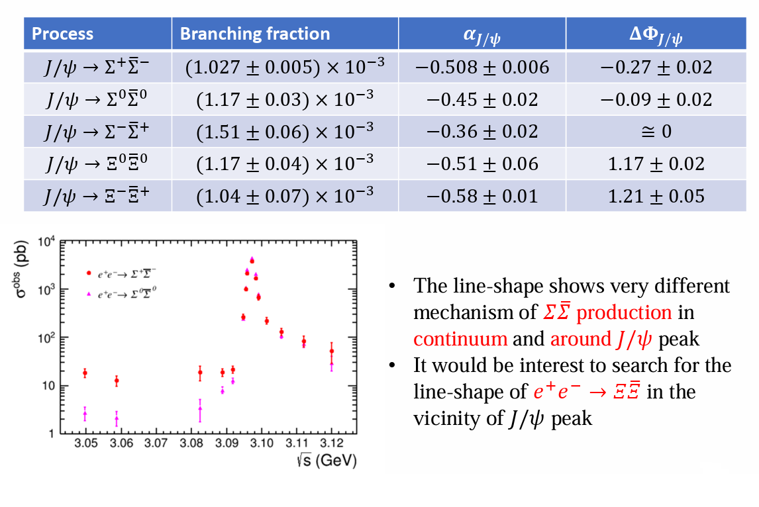
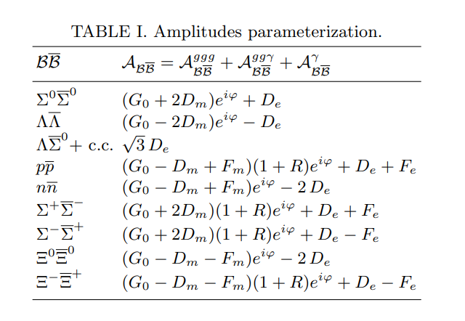
Question 4: $Σ$三重态的SU(3)破缺是什么导致的？

Slide 26
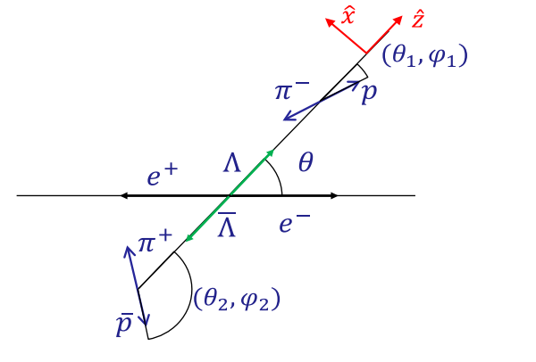
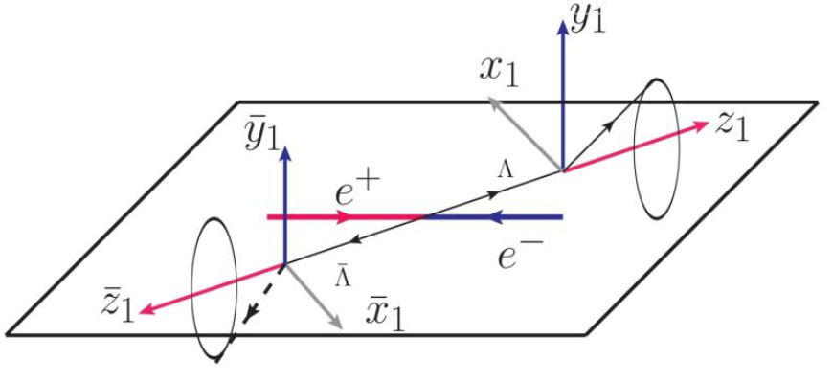
Complete measurement of $Λ$ EMFFs
An event of the reaction $e^{+}e^{−}→Λ(→pπ^{−})\overline{Λ}(→\overline{p}π^{+})$ is formalized by joint angular distribution:
$$\left|\frac{G_{E}}{G_{M}}\right|=0.96±0.14\left(stat.\right)±0.02\left(sys.\right)$$
$$∆Φ={37}^{°}±{12}^{°}\left(stat.\right)±6^{°}\left(sys.\right)$$
(Confirm the complex form of EMFFs)

Slide 27
Complete measurement of $Σ^{+}$ EMFFs
|G_{E}/G_{M}| and $ΔΦ$ line-shape is compared with $\overline{Y}Y$ model (J. Haidenbauer, U. G. Meißner, and L. Y. Dai, PRD 103, 014028 (2021)), different tendency in $ΔΦ$.
$ΔΦ$ distribution indicates there are integer multiples of π radians, from threshold to cross point.
The still increasing relative phase indicates the asymptotic threshold has not yet been reached.
arXiv:2307.15894

Slide 28
Question5: 渐近自由能区何时抵达？

Slide 29
总结
类时空间电磁形状因子对低能QCD有效理论具有检验作用，帮助理解强相互作用在低能区面临的问题。
类时空间超子的实验积累为核子的结构提供更多维的信息，并且能够帮助确定超子的电磁半径。
随着实验的积累，出现了越来越多的谜团有待理论和实验的共同努力：
阈值反常结构的来源是什么？
有效形状因子振荡的机制是什么？
电磁形状因子比值振荡的机制是什么？
$Σ$三重态的SU(3)破缺是什么导致的？
渐近自由能区何时抵达？
谢谢！

