Slide 1
Introduction of BESIII Computing Platform
On Behalf of IHEP-CC
Jingyan Shi
shijy@ihep.ac.cn
第八届 BESIII R 值与 QCD 强子结构研讨会

Slide 2
Outline
1
Brief overview of HEP Computing
2
BESIII Computing Platform
3
Use BESIII Computing Platform Efficiently
4
Summary

Slide 3
Quick View of HEP Computing
The success of HEP Research depends on the development of computing technology
  Big Data, HPC, HTC, AI4Science 。。。
A powerful computing platform is critical for HEP Experiment
  From online data acquisition to offline data analysis
Different task needs different computing model
  Computing-intensive, data intensive
The development of HEP Computing platform has been driven by experimental needs
  International collaboration → Grid computing
  Large computing jobs volumes→ High throughput computing
  Heavy IO → distributed file system (EOS)
  .。。。。。。

Slide 4
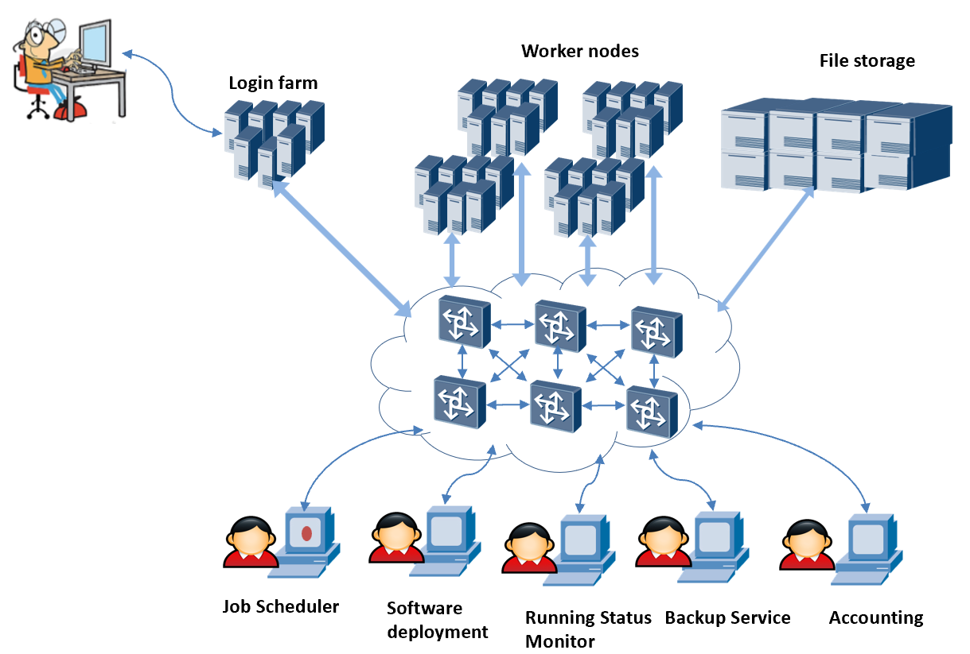
A Typical HEP Offline Computing Platform

Slide 5
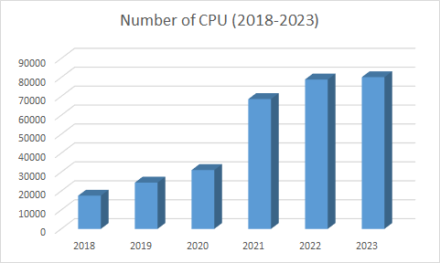
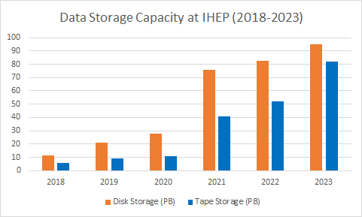
Computing Center of IHEP
Distributed centers
  Beijing, Huairou, Dongguan,
  Daocheng, Jiangmen, …
Provides and Supports:
  HTC, HPC and Grid for 28 experiments / projects
  Data archive and sharing for HEP projects of China
Quantity of resources grew exponentially
  ~100K CPU cores
  ~100 PB Disk Storage
  ~137 PB Tape Storage

Slide 6
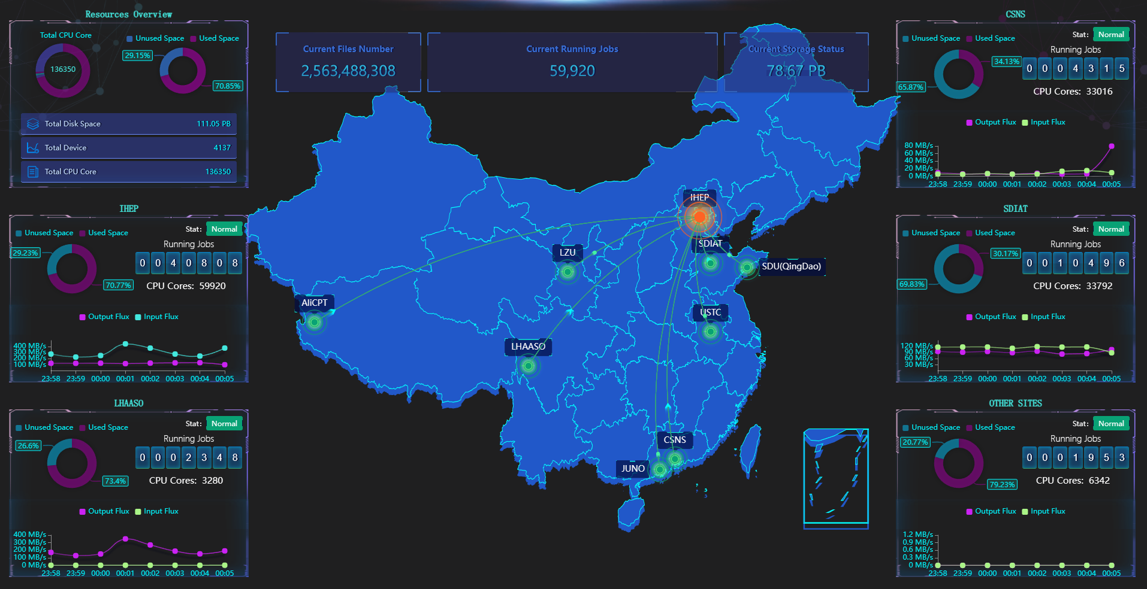
HEP Computing Platform – Multi Exp. and Multi Sites

Slide 7
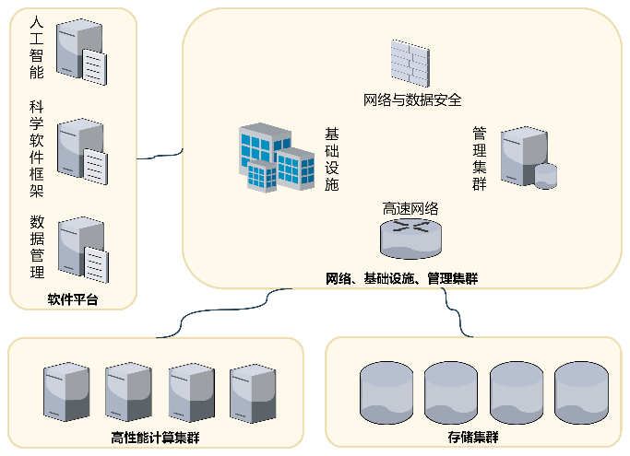
Computing Platform Supports Science Research
Large-scale scientific facility
Fundamental physics Research
Large-scale facility (CEPC) technology
pre-study
Other Scientific Activities
Computing
Data Storage
Network
Support
Software
Security
AI Empower
Distributed Computing Platform ( One Platform, Multi Centers)
Edge Site
Facility Site
Edge Site
Facility Site
Data Center of CSNS at Dongguan
Computing Center of IHEP at Beijing

Slide 8
Outline
1
Brief overview of HEP Computing
2
BESIII Computing Platform
3
Use BESIII Computing Platform Efficiently
4
Summary

Slide 9
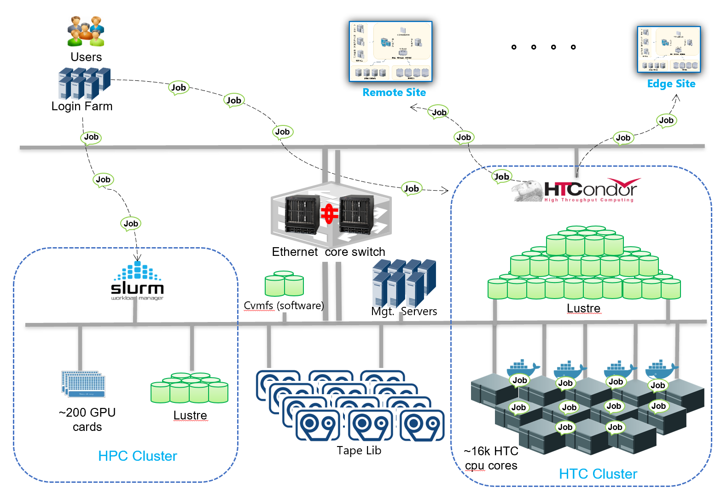
BESIII Computing Platform

Slide 10
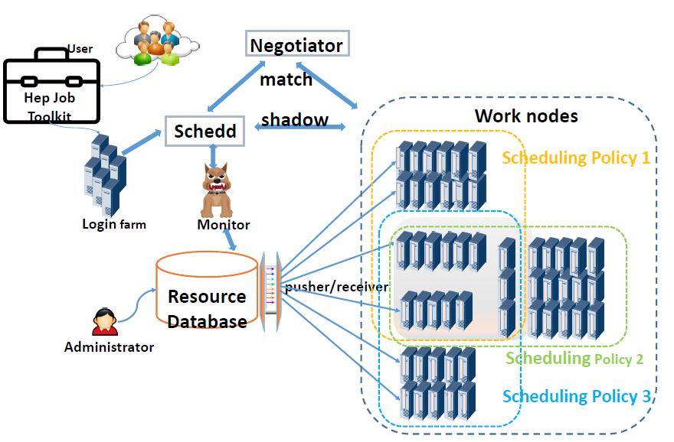
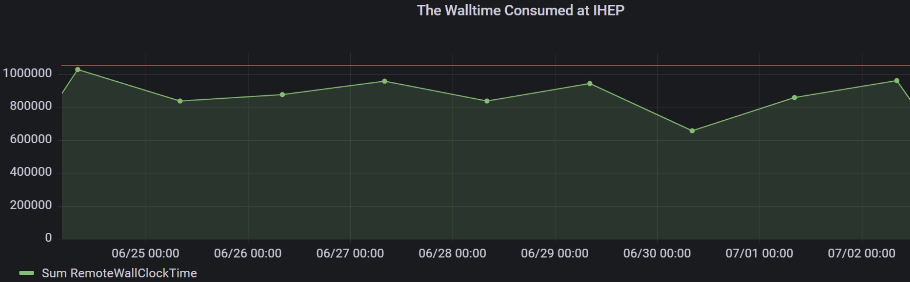
Provides More CPU Times Inside HTC Cluster
“Resource Sharing Pool” at local HTC cluster: ~40k CPU cores
  CPUs contributed by all Exp.
  Let the jobs from busy Exp. run on the job slots of unbusy Exp.
  Fairshare policy guarantee the higher priority for the unbusy Exp. jobs
  Monitor tool developed guarantees the quick error reaction
>85% CPU utilization and stable worker nodes
Walltime consumed at HTC of IHEP

Slide 11
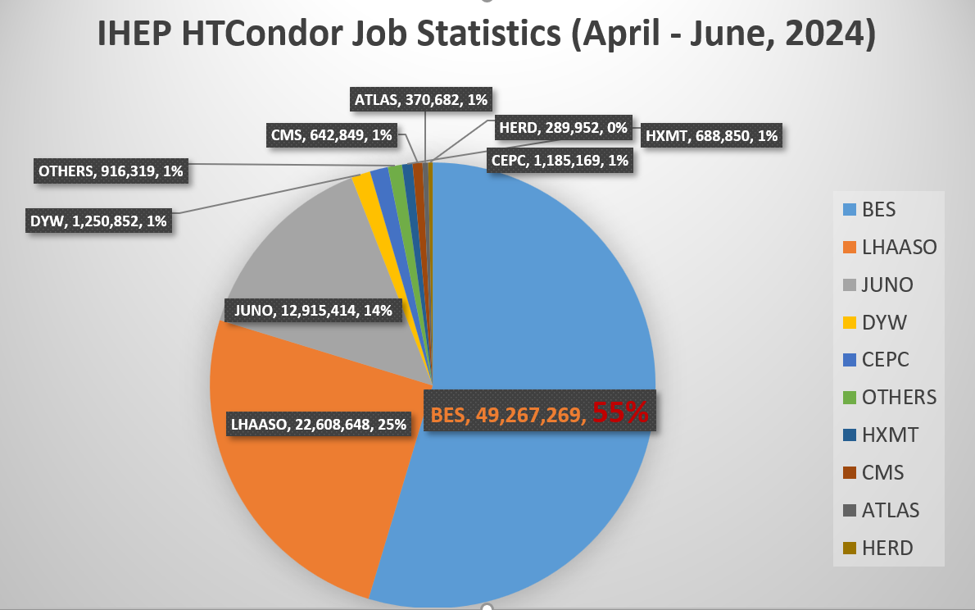
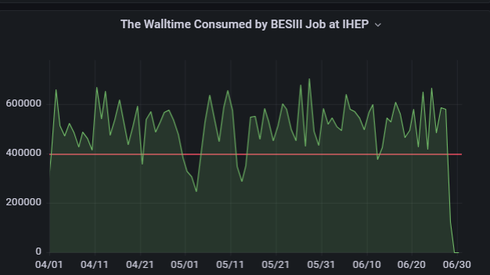
Job Statistics of HTCondor Cluster
IHEP HTCondor Local cluster serves 18 Experiments and Applications
  The amount of CPU cores: 39,972
    BESIII contributed 16,568 CPU cores, 41.4%
Job Statistics of IHEP HTCondor from April to June, 2024
  Shared pool provides BESIII extra 36% CPU time
BESIII CPU Resource

Slide 12
Distributed Computing -- Local Cluster Expansion
Local cluster is the main place of the data processing for some Exp.
Local cluster expansion
  IHEP-centered, and Computing resource extension on-demand
  Classification to jobs and sites
    Dispatch the suitable jobs to the suitable remote site
  Transparent data access / transfer
    Token-based user authentication
Keep the original user cluster way
Design of Local Cluster Expansion

Slide 13
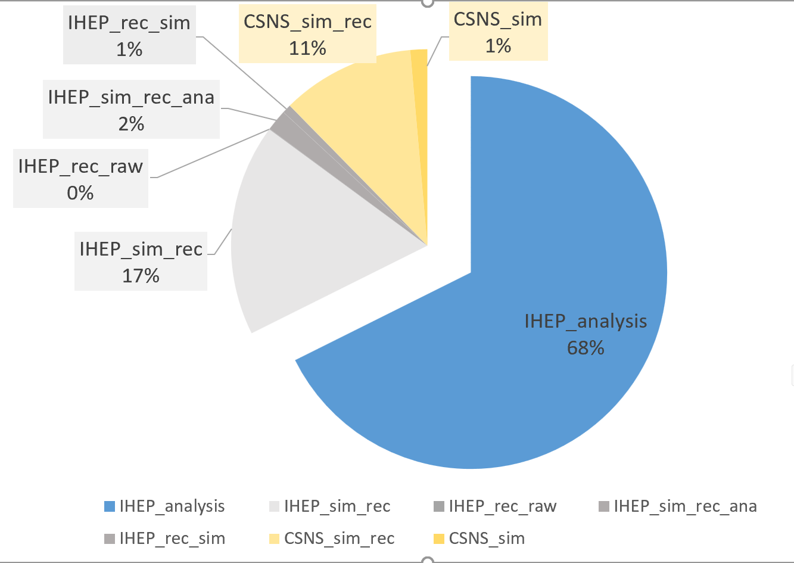
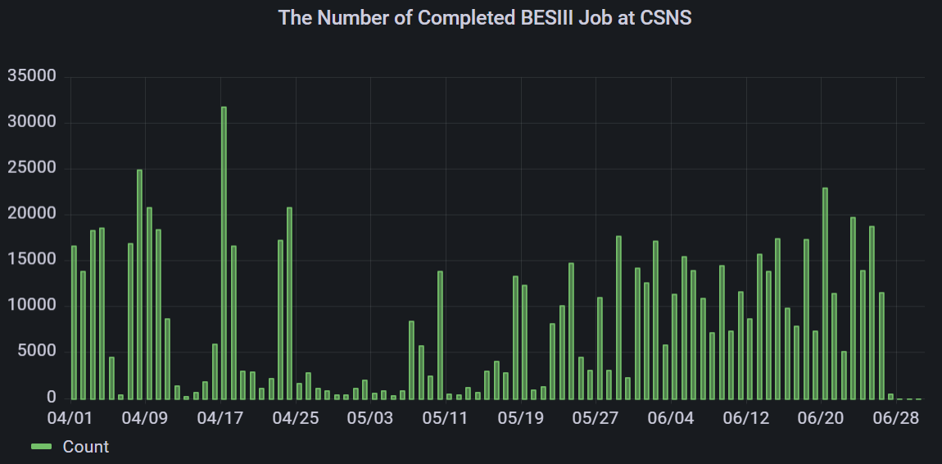
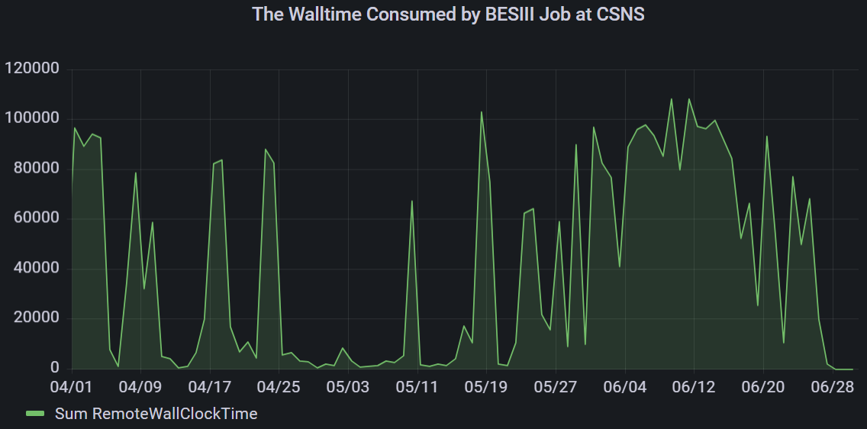
BESIII Cluster Expansion (Ongoing)
Aim: Dispatch more jobs run on more remote resource
Study and development keeps going
  Dispatch 20%-30% BES jobs to the remote resource transparently
    Simulation and reconstruction
  Sim and small part of rec jobs have been run remotely.
  Statistics of BESIII jobs submitted last three months
    Completed dHTC Jobs: 2,495,129
    Consumed CPU Hours: 14,161,868 7.6% of CPU time of BESIII jobs at IHEP cluster
More study focus on:
  Random trigger access
  How to use the resource inside close network
  Performance optimization
Statistics of BESIII jobs in 2024

Slide 14
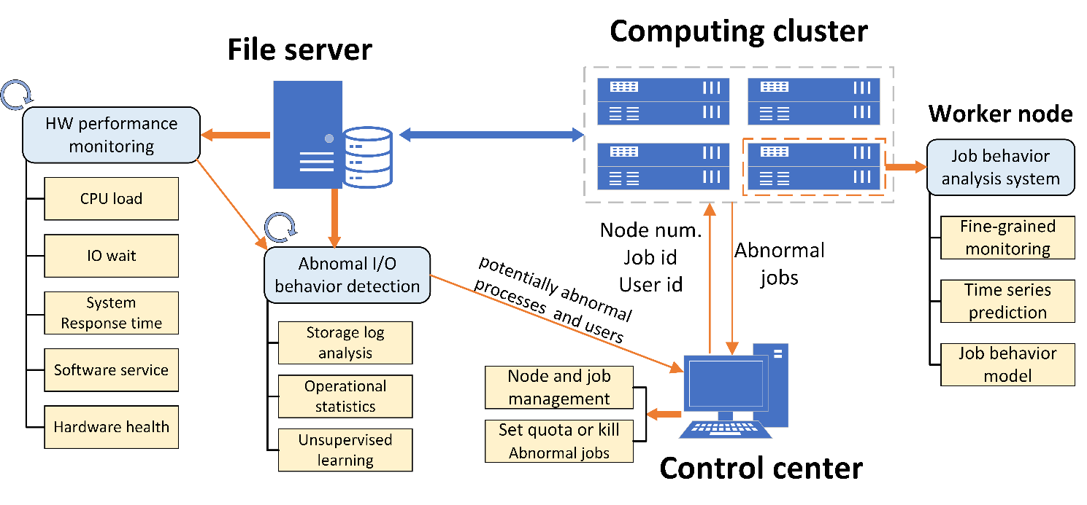
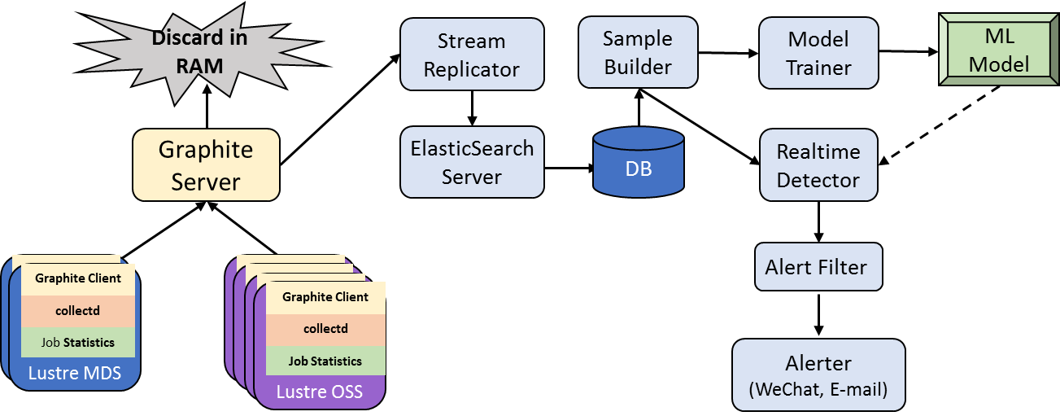
The Intelligent Operation System (ongoing)
Detect abnormal I/O behavior of user processes from the file system
  Near real-time statistics of the file system resources consumed by user processes
  Score and rank the user’s I/O behaviors
    Using unsupervised machine learning algorithm
  Identify the potentially abnormal worker nodes
Analysis job behavior from the worker node
  Identify the abnormal job inside potentially abnormal worker nodes
Adjust the available resource scale for each user dynamically
  Limit resource usage of abnormal user
Notes:
So ,we design and develop the …
Focusing on the adjustment of the available resource scale for each user dynamically
The first,
Second is Control Center, which identify …
The third,
Finally we return to the Control Center to …s
Next is the details

Slide 15
Outline
1
Brief overview of HEP Computing
2
BESIII Computing Platform
3
Use BESIII Computing Platform Efficiently
4
Summary

Slide 16
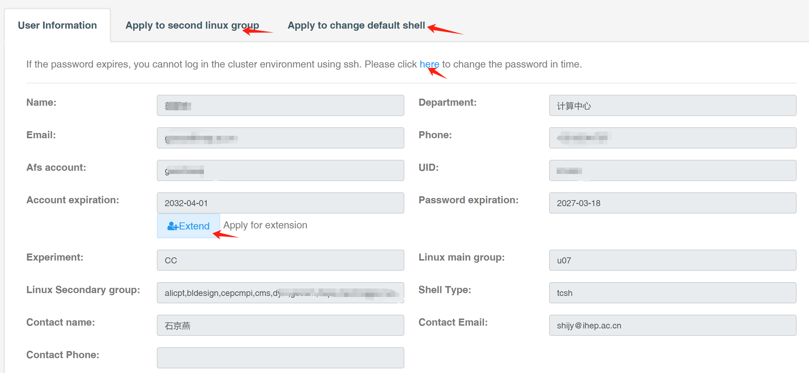
Self Services Provided
Password is same as the one of IHEP SSO
User dashboard:
  http://ccsinfo.ihep.ac.cn
    Job and storage statistics
    Self services
      Account extension
      Default Bash change
      Secondary group apply
Helpdesk: helpdesk@ihep.ac.cn

Slide 17
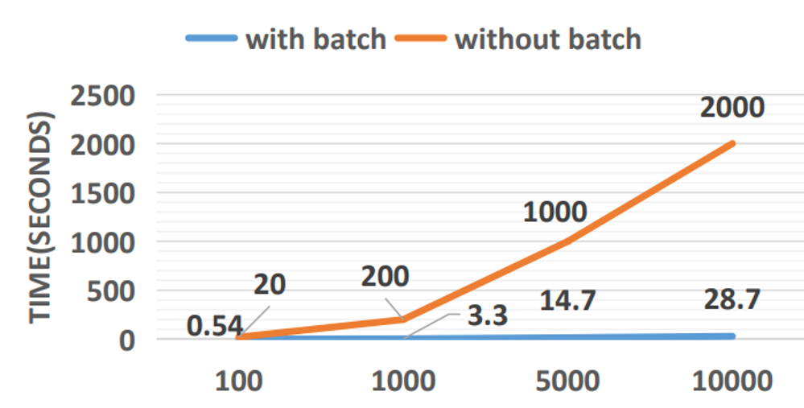
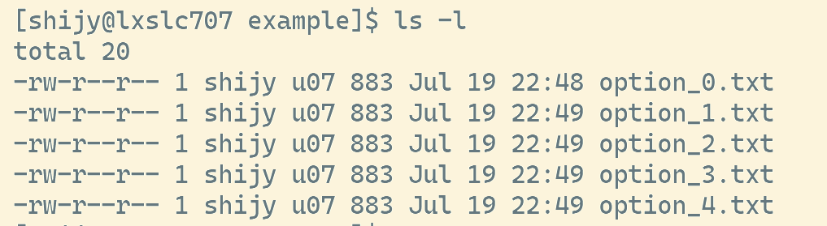
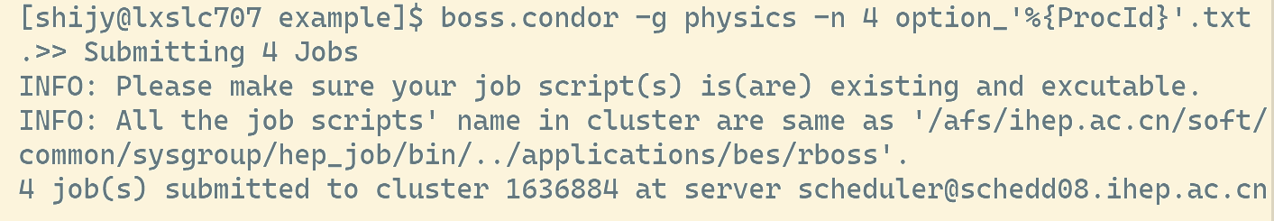
批量作业提交 (1 / 2)
非常推荐批量作业提交
  大部分BESIII作业可以“批量作业”
  可以极大减少用户作业提交时间
  可以极大减轻调度器的负载压力
简单的批量作业提交示例
  Option文件名字格式相同:
  %{ProcId}用于替换升序数字

Slide 18
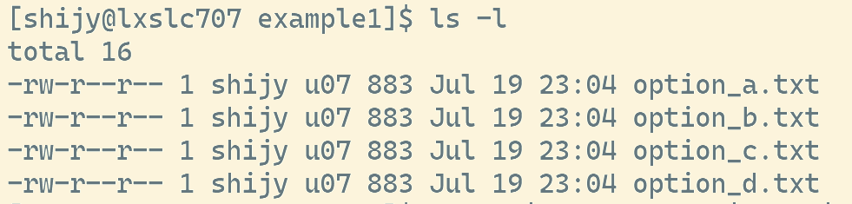
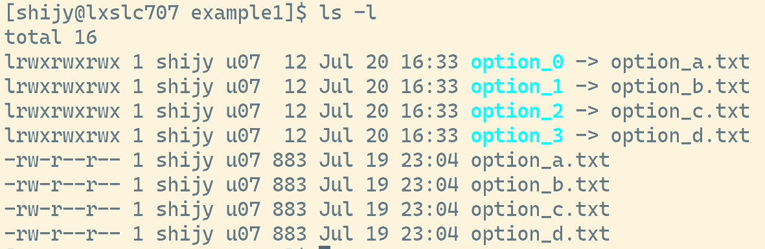
批量作业提交 (1 / 2)
同格式，非数字的option文件，可以增加有数字的链接文件后再提交

Slide 19
文件存储
用户可以自己授权，向指定人员开放目录/文件的访问
  http://afsapply.ihep.ac.cn/cchelp/zh/local-cluster/storage/Lustre/#%E8%AE%BE%E7%BD%AE%E7%9B%AE%E5%BD%95%E7%9A%84acl%EF%BC%9A
尽量避免在单个目录下存放过多的数据文件
  建议单目录下文件数量控制在3000以内
  如果避免不了，可以生成一个文件列表，之后的数据处理直接访问该列表，而不要直接使用ls *, rm * 等命令
  文件数量很大的目录，用ls –color=never， 响应会更快
不要把文件系统当成消息通信管道
  会给Lustre带来额外的负载
  考虑MPI等数据通信和同步协议
程序中打开了文件一定要关闭

Slide 20

IHEP School of Computing 2024 is coming!
IHEP School of computing 2024 will be held in Yanqing, Beijing from the 21th to the 24th of August 2024
2.5 days, 21 lectures, and 4 hours of hands-on
Indico: https://indico.ihep.ac.cn/event/22917/
The course covers
  Data processing in the field of high-energy physics,
  AI technology for high-energy physics,
  Computing technology for high-energy physics
  Hands-on practice on computational platform

Slide 21
Summary
BESIII computing platform is a important components of the Experiment
The scale of BESIII computing platform continue to grow, and demand for data processing is also becoming diverse
Try the efficient way to run jobs and access files on BESIII computing platform

Slide 22
Thank you!
Question?

