Slide 1
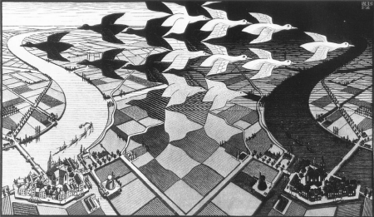
Introduction to CP violation
-Lecture 4-
Stephen Lars Olsen
May 16, 2024
M.C. Escher

Slide 2
1st: a few comments related to last week’s lecture

Slide 3


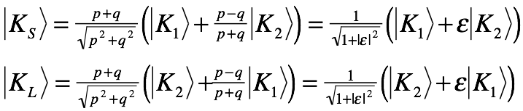
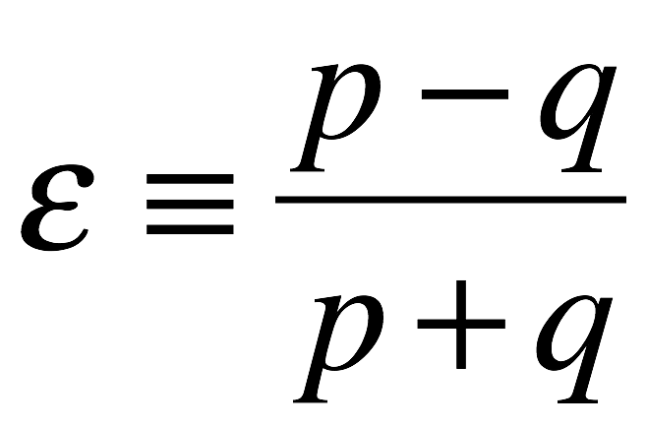
Solutions for the K_{S} and K_{L}eigenstates:
Lect. 3, slide 46:
eigenvalues
eigenstates
≡ΔM
≡ΔΓ
2 more sign conventions !
in terms of the
CP eigenstates
and using

Slide 4



Same solutions apply for D_{H}D_{L}, B_{dH}B_{dL} & B_{sH}B_{sL}
c^{+2/3}
b^{-1/3}
b^{-1/3}
u^{-2/3}
d^{+1/3}
s^{+1/3}
_
_
_
“Heavy”
“Light”
eigenvalues
eigenstates
≡±ΔM_{P}
≡±ΔΓ_{P}
convention-dependent signs

Slide 5


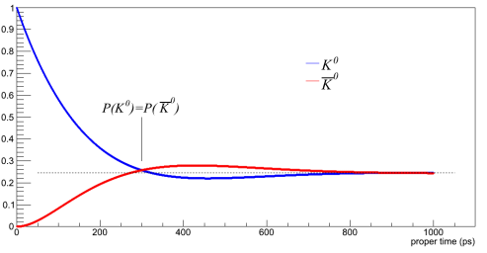





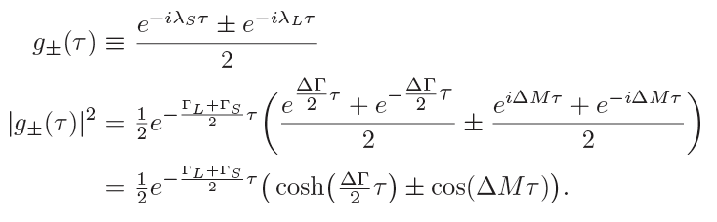
K⁰ → K⁰ survival and K⁰ → K⁰ oscillation
_
neutral kaons flavor-tagged as a K⁰ at τ=0
K⁰→K⁰ survival:
_
K⁰→K⁰ oscillation:

Slide 6
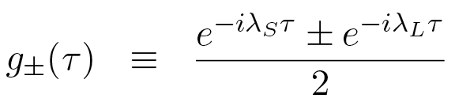
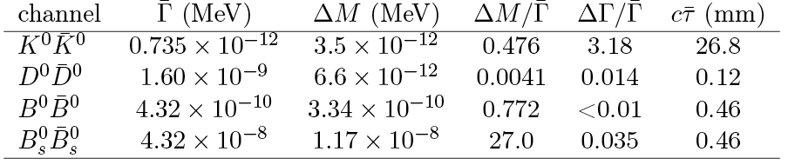
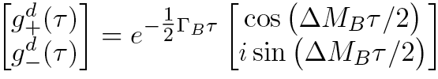


g±(τ) functions are common to K_{S}K_{L}, D_{H}D_{L}, B_{dH}B_{dL} & B_{sH}B_{sL}
but the ΔΓ and ΔM parameters are very different
K-mesons
D-mesons
B_{d}- & B_{s}-mesons
_
ΔM & ΔΓ << Γ
ΔM, ΔΓ & Γ have
similar magnitudes
ΔΓ << Γ & ΔM_{B}>>ΔM_{K}
⇒ mixing effects are tiny
need all terms
B_{d}:
linear approximation is sufficient
B_{s}:

Slide 7
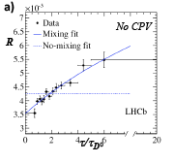
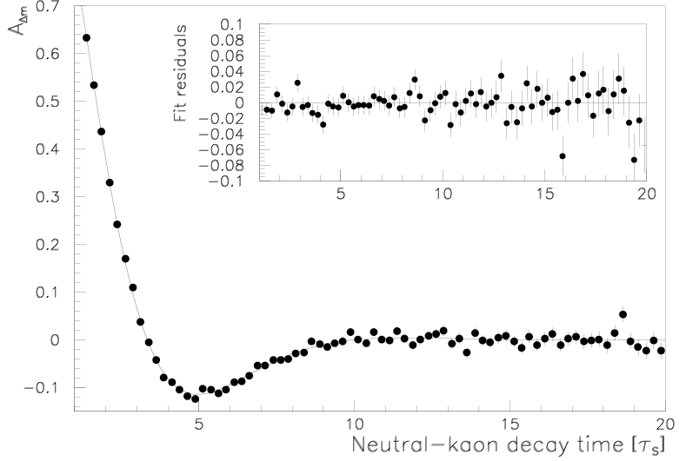
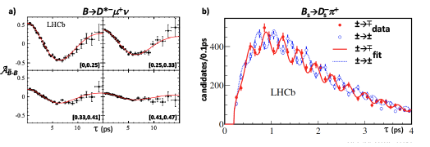
K-K, D-D, B_{d}-B_{d} & B_{s}-Bs mixing all seen
_
_
_
_
_
D⁰→D⁰

Slide 8



neutral meson systems: 3 different basis systems
P⁰-P⁰
Flavor States
These have well defined flavor
and are orthogonal:
P⁰
ε_{P}K₂
P_{L}
P_{H}
ε_{P}P₁
not 90º
P₂
P₁-P₂
CP eigenstates
P₁
These have well defined
CP values
and are orthogonal
not the same
_
P⁰
P_{H}-P_{L}
Mass eigenstate
These have well defined
lifetime & mass
but are not orthogonal

Slide 9
Comment on K⁰-K⁰ mixing
_

Slide 10








Measuring K⁰ → K⁰ oscillations
_
K⁰(τ)➝ π⁻l⁺ν
K⁰(τ)➝ π⁺l⁻ν
_
≈1
Γ≈Γ_{S}/2
“same flavor”
SF
_

Slide 11




Four K⁰_{l3} asymmetries
SF: same flavor & OF: opposite flavor
SF
_
OF
OF
_
SF

Slide 12
Corresponding relations for K⁰(τ)
_
g₊(τ)
g₋(τ)
neutral kaons flavor-tagged as a K ⁰ at τ=0
_

Slide 13

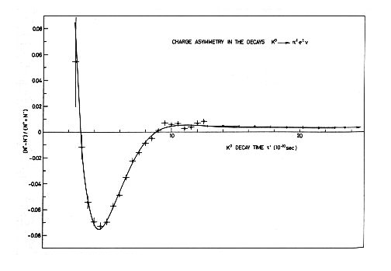

Effect of the “opposite-sign” K⁰(τ) decays
opposite in sign to the
A ^{SF} oscillation
these have the same sign
K_{l3}
⁰
CERN-Heidelberg expt measured:
2Reε
oscillation
amplitude
is diluted
τ→∞ offset
is unaffected

Slide 14
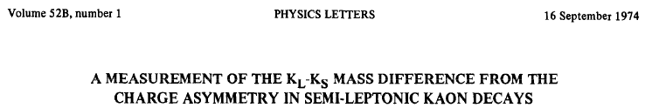
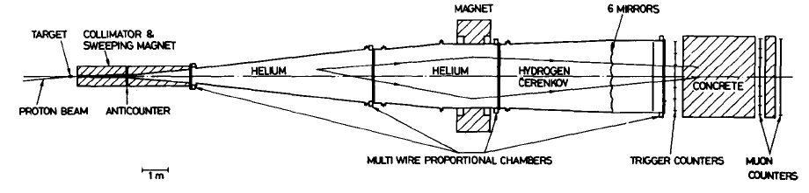
CERN-Heidelberg experiment at CERN
not NA31!
50 years ago
_
start with ≈75% K⁰ and ≈25% K⁰
K⁰(τ)
l±
π∓
p=24 GeV/c
~20 m

Slide 15


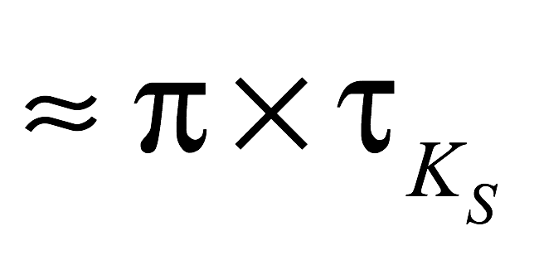
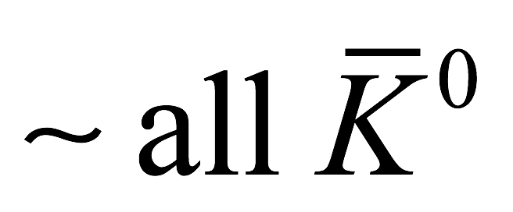
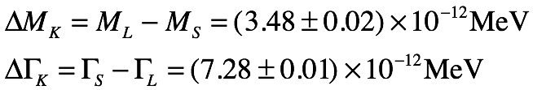

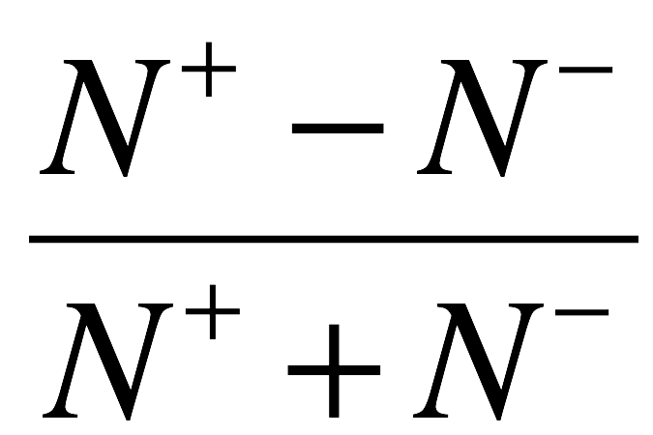
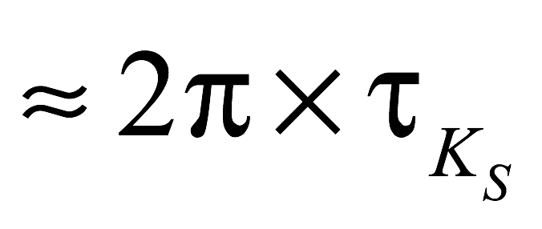
K⁰→π⁻l⁺ν vs. K⁰→π⁺l⁻ν asymmetry in a (mostly) K⁰(τ) beam
_
_
start with ≈75% K⁰ and ≈25% K⁰
CERN Heidelberg experiment
2Reε
≈25%
wrong-sign
dilution factor
≈ 0.5
-0.074

Slide 16
CPLEAR experiment at CERN
_
p_{stop} p→K±π∓K⁰(K⁰)
_
π⁺
low energy p beam
K⁻
_
π⁻
l⁺
High pressure H₂ gas target

Slide 17
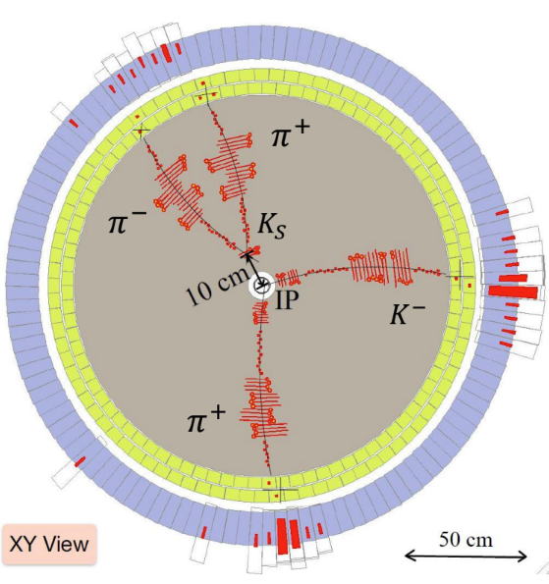

CPLEAR & BESIII: event-by-event K⁰ flavor-tagging
E_{cm}=1.876 GeV
E_{cm}=3.097 GeV
K⁰(τ)
BESIII

Slide 18




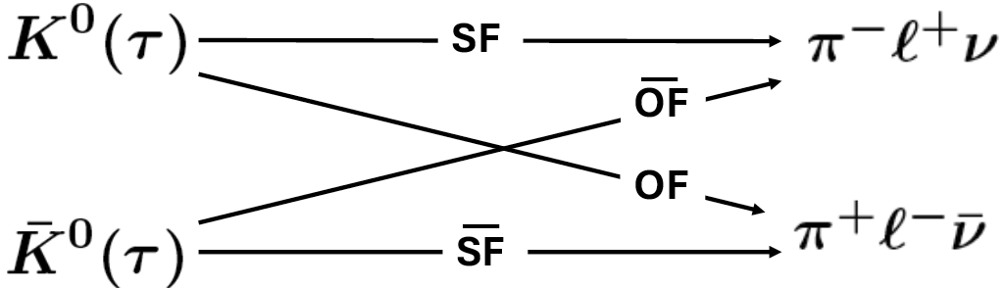

Use SF+SF mixing to measure ΔM =M_{KL}-M_{KS}
_
CPLEAR
ΔM=(3.485 ±0.013)×10⁻¹² MeV
≈1%
dilution factor≈98%
measured asymmetry
~2x that in NA31
-0.13

Slide 19
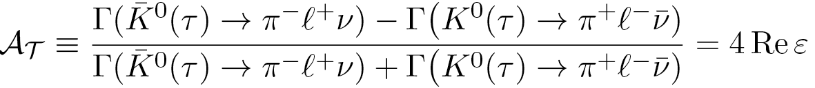
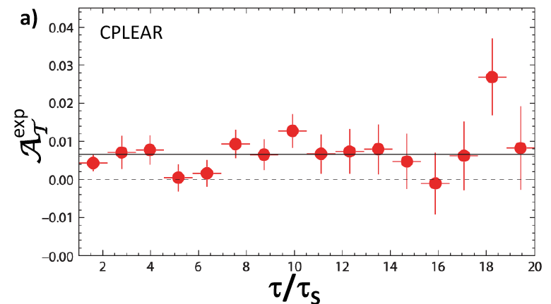
Use OF-OF mixing to test T invariance
_
oscillating
terms cancel
4Reε

Slide 20
some comments on SU(3), weak interactions, & the ΔS =ΔQ rule

Slide 21
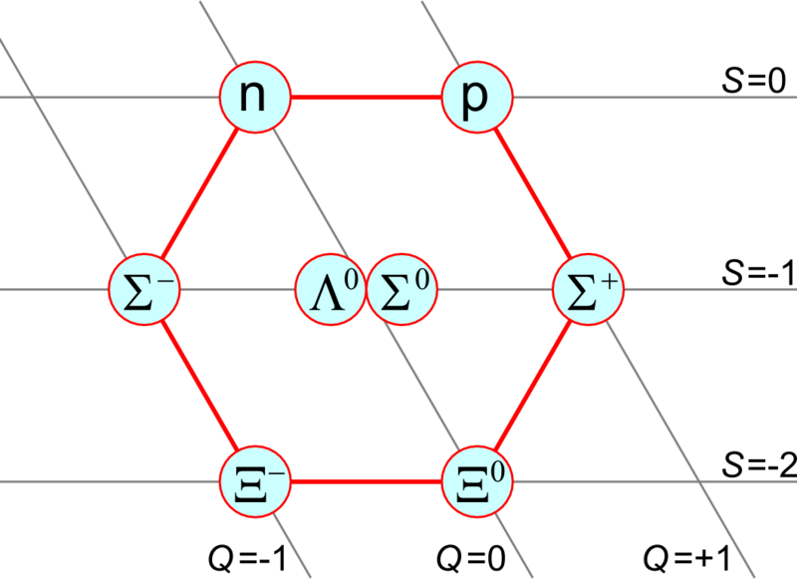
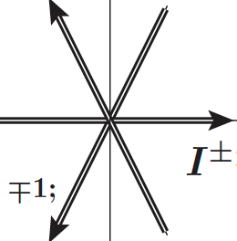
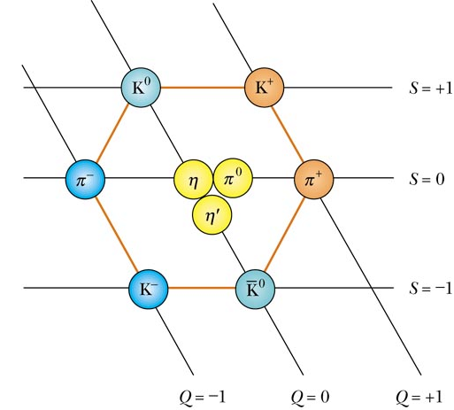
I-spin, U-spin, V-spin and strangeness vs. hypercharge
Y
U₃
S
Y=+1,
Y=
U-spin
I-spin
Y=0,
I₃
Y=
Y=−1,
V-spin
Y=
V₃
SU(3) uses “hypercharge,” Y=S+B, rather than strangeness

Slide 22
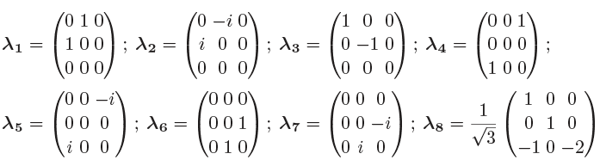

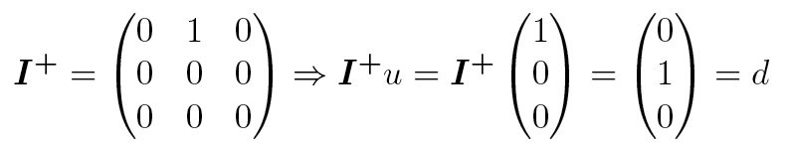



SU(3) and the weak interactions
Y
U-spin
these are the Pauli SU(2) matrices
SU(3) matrices
I-spin
ΔS=0
ΔQ=±1
V-spin
ΔS=±1
ΔQ=±1
ΔS=ΔQ
ΔS=0, ΔΙ=±1, ΔQ=±1
➝
ΔS=±1, ΔΙ=±1/2, ΔQ=±1
➝

Slide 23
comments on SU(3), weak interactions, and the ΔS =ΔQ rule
K⁰→π⁻l⁺ν
K⁰→π⁺l⁻ν
Y
Σ⁻→ne⁻ν
Σ⁺→ne⁺ν
U-spin
Y=+1,
ΔS=±1
ΔQ=0
Y=
ΔS=ΔQ
ΔS=ΔQ
V⁻
ΔS=−ΔQ
V⁻
ΔS=−ΔQ
Y=0,
Y=
I-spin
ΔS=0
ΔQ=±1
Y=−1,
Y=
V-spin
ΔS=±1
ΔQ=±1
ΔS=ΔQ

Slide 24
some comments about ε

Slide 25
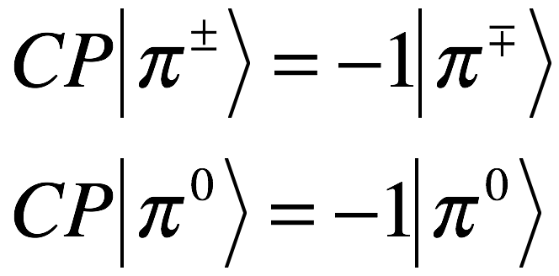
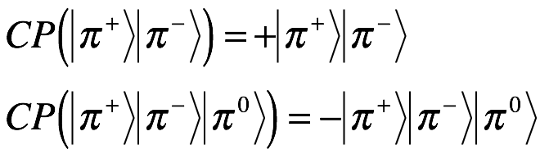
K_{S} and K_{L} decays to ππ and πππ final states
CP even
This is called “mass-matrix” CP violation
CP odd
K_{S}=K₁+εK₂
K_{L}=K₂+εK₁
ε
1
ε
1
ππ
πππ
πππ
ππ
The eigenstates violate CP, but the decays are CP conserving

Slide 26

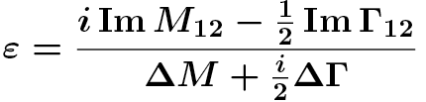


ε
if Im M₁₂≫Im Γ₁₂
Im
2ΔM
ε
φ_{ε}
ΔΓ
Re

Slide 27
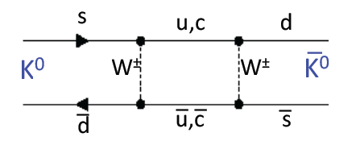
ImM₁₂ ? … ImΓ₁₂ ? … both?
Mass Matrix: “short-distance processes” (circa 1970)
ImM₁₂ ?
Prior to the KM 6-quark model, i.e., the 3-quark, maybe 4-quark era, there were no CP phase in SM mixing

Slide 28
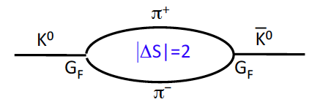

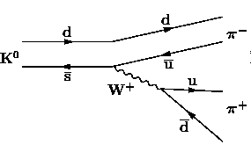
ImM₁₂ ? … ImΓ₁₂ ? … both?
ImΓ₁₂ ?
on-mass-shell pions
Decay Matrix: “long-distance processes”
sinθ_{c}
sinθ_{c}
this diagram has no CP phase
in the 3-quark (4-quark) SM
if it had a non-zero phase, CP violations
would show up in Λ→pπ⁻, K→πlν, etc.
direct CP violations
mass-matrix
direct)
CP violations
K_{S}=K₁+εK₂
K_{L}=K₂+K₁
and would produce direct CP-violating
K₁→πππ and K₂→ππ decays
ε’
ε’
ε
1
ε
1
ππ
πππ
πππ
ππ

Slide 29
If only Im M₁₂≠ 0 & Im Γ₁₂=0: φ_{ε}= φ_{SW} and there are no direct K_{L}→ ππ decays
If only & Im Γ₁₂ ≠ 0 Im M₁₂ =0: φ_{ε} ≠ φ_{SW} and there are direct K_{L} → ππ decays

Slide 30
Characterizing the observed K_{L}→π⁺π⁻ CP violation

Slide 31
What is causing CP violation?
Lots of proposals:
Milliweak models: Small O(10⁻³) terms added to the I± and V± operators mentioned earlier:
R. Sachs: ΔS=−ΔQ operators with a δ_{CP}=90% CP phase difference from the standard ΔS=+ΔQ V± one.
➔ predicted violations of the ΔS=+ΔQ rule that were not seen.
S. Glashow: Additional weak-interaction terms that were different for Vector and Axial vector currents.
➔ predicted a large CP-violating K_{S}→π⁺π⁻π⁰ decay branching fraction that wasn’t seen.
N. Cabbibo: A CP -violating ΔS=±1 term
➔ predicted a large T-violation in K→πμν decays that wasn’t seen

Slide 32
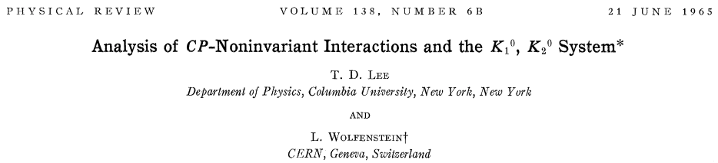
What is causing CP violation? (continued)
C- and T -violating E&M processes: P-symmetry in E&M was well established, but not C or T
T.D. Lee and Wolfenstein: a version of E&M that violated C but not P, thereby violating CP
➔ predicted a a difference between the π⁺ and π⁻ energy spectra in η→π⁺π⁻π⁰ decays

Slide 33
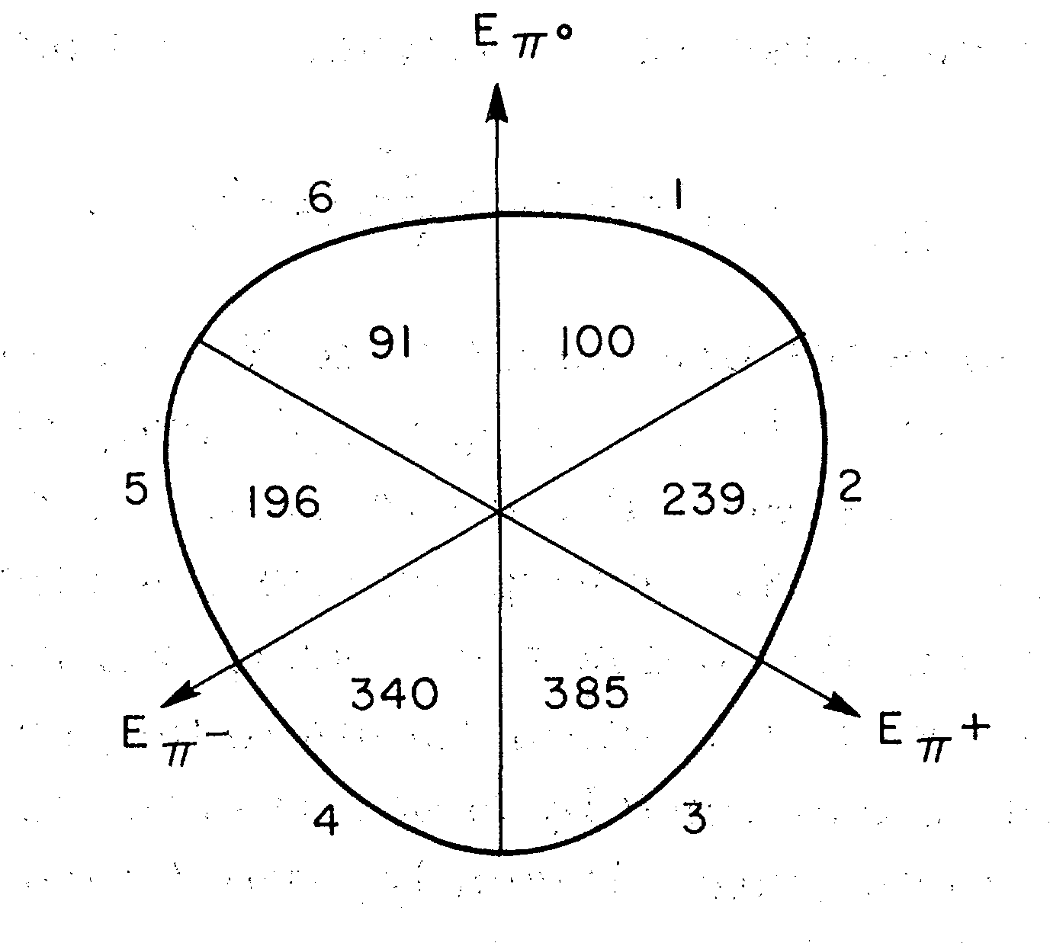
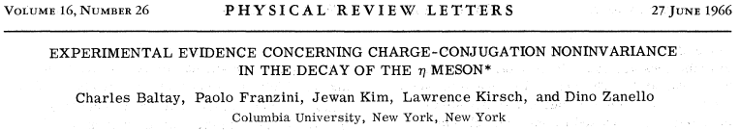
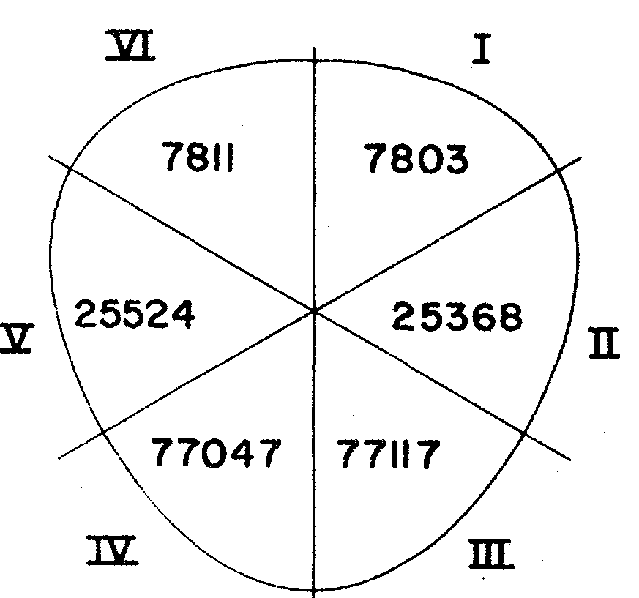
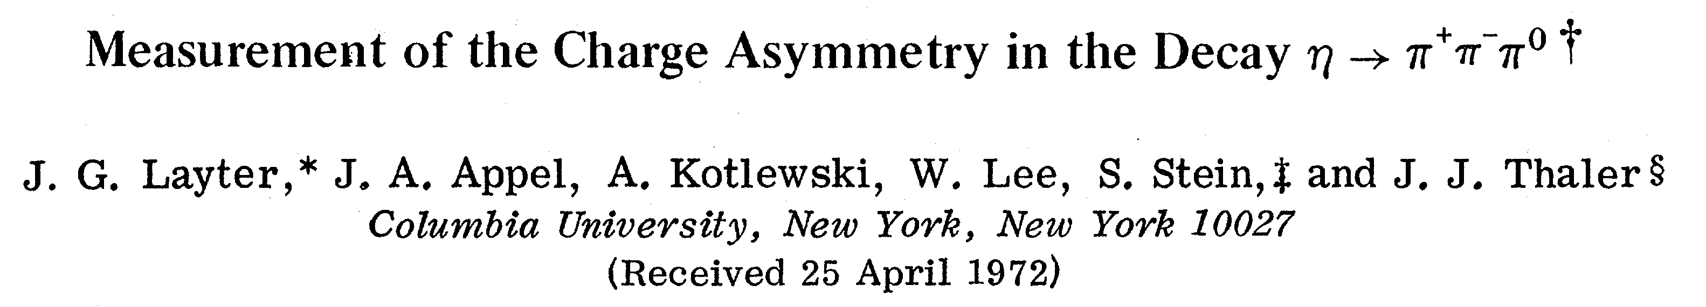
This was seen!
E_{π}−>E_{π}+
E_{π}+>E_{π}−
627 evts
724 evts
A= 0.072±0.028
But was later unseen
110,382 evts
110,288 events
A= 0.0005±0.0022

Slide 34
What is causing CP violation? (continued}
C- and T -violating E&M processes: P-symmetry in E&M was well established, but not C or T
T.D. Lee and Wolfenstein: a version of E&M that violated C but not P, thereby violating CP .
➔ predicted a difference between the π⁺ and π⁻ energy spectra in η→π⁺π⁻π⁰ decays
Millistrong models: Likewise, P-symmetry was well established for strong ints. but not C or T
Prentki and Veltman: an O(10⁻³) strange sector strong interaction term that violated C but not P.
➔ predicted C and T violations in hyperon decays that were not seen
Superweak model: a ΔS=+2 interaction that influenced short-distance K⁰-K⁰ mixing
Wolfenstein: a ΔS=+2 interaction with a “superweak” O(10⁻⁸)xG_{F} coupling strength and a CP-phase.
➔ causes mass-mixing CP violating K_{S} & K_{L} eigenstates (i.e., ε) but no other measurable effects
_

Slide 35
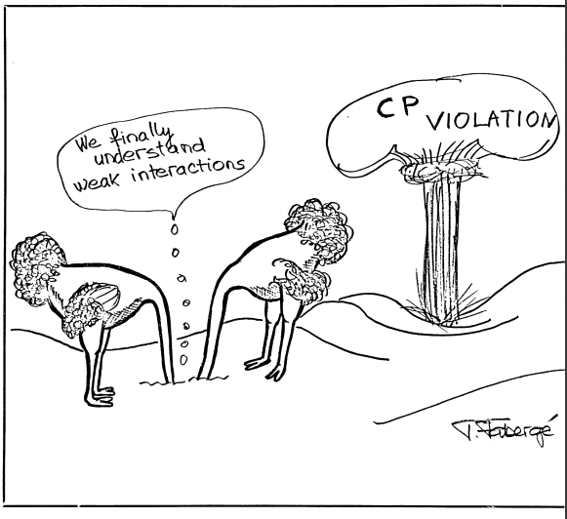
Theoretical physics in the 1960s

Slide 36
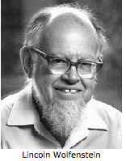
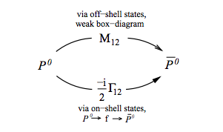
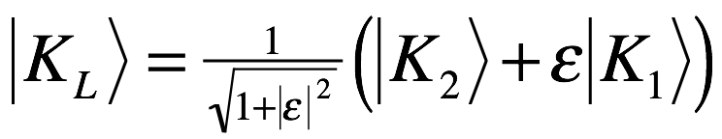
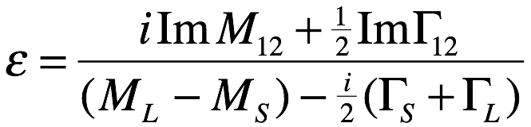
Superweak model for CP violation
CP V is very small, ~10⁻³G_{F}²: is there a new “superweak,” very
short-ranged ΔS=2 interaction that directly couples K⁰ to K⁰?
_
K⁰
ΔS =2
K⁰
This interaction has a coupling strength ~10⁻⁸ G_{F} and is only strong enough to produce ImM₁₂, i.e. ε, and nothing else. It
is seen in K_{L} decay because ΔM_{K} (~10⁻¹² MeV) is so small.

Slide 37

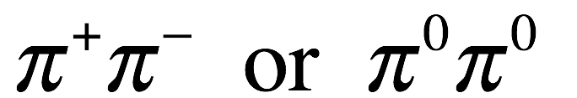
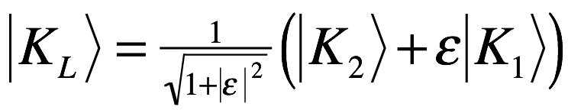
Decay of the K_{L} to ππ and πππ final states
CP odd
CP even
direct CPV?
OK
OK
indirect CPV
CP odd
CP even
Is there a direct decay K_{CP-odd} to π⁺π⁻ or π⁰π⁰?
The Superweak model says no!

Slide 38
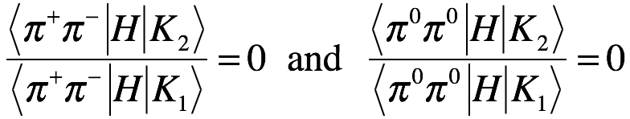

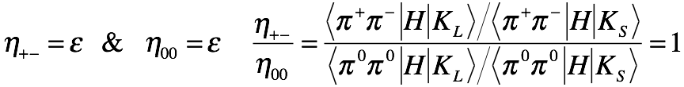

Direct decays and the η₊₋ and η₀₀ parameters
direct
indirect
direct
If Superweak is correct, and
there are no direct CPV terms:
Then

Slide 39
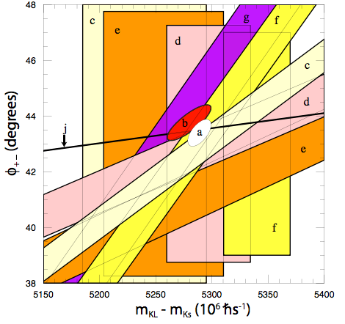

Predictions of Superweak model
All CP V is due to influence of ε, no other measureable results
43º
different φ₊₋ measurements
SW phase

Slide 40
Direct-CP violation in K_{L}→π⁺π⁻ & π⁰π⁰ decays?

Slide 41





direct K₂ →ππ decays affect π⁺π⁻ & π⁰π⁰ differently
since we use CP(K⁰)=+K⁰
_
_
+
K⁰(K⁰)→ππ Ispin amplitudes:
+
π⁺π⁻ & π⁰π⁰ Ispin amplitudes:
Clebsch-Gordon coefficients
K₂→ π⁺π⁻ & π⁰π⁰ Ispin amplitudes:
−
repeat for K₁→ π⁺π⁻ & π⁰π⁰ amplitudes:
Wu-Yang phase
convention:
Physics is in the phase difference between A₀ & A₂. Wu & Yang* chose A₀ to be real, i.e., Im A₀=0 .
results
*

Slide 42
from previous
slide
define:
direct CPV term
direct CPV term
ΔI=1/2 rule →
different

Slide 43



ΔI=1/2 rule
phase space is same for both modes
Ispin=0
π⁺π⁻
Ispin=2
π⁺π⁻
Ispin=2
π⁺π⁻

Slide 44

Phase of ε’: φ_{ε’} = π/2−(δ₀−δ₂)= 42.3º+1.5º
nearly the same as φ_{SW}≈ 43º, the phase of ε
ππ S-wave
m_{K}
δ₀−δ₂≃47.7º ±1.5º
2
m_{ππ}
m_{π}
2

Slide 45
Nature has been kind!
Wu-Yang Triangle
Here φ_{ε’} – φ_{ε} is exaggerated by a
factor of ~10 for display reasons
|ε’ | is exaggerated by a factor
of ~100, also for display reasons
η₀₀= ε +ε’
ε’ and ε are very nearly parallel,
which maximizes |η₊₋|-|η₀₀|.
If they were nearly perpendicular,
then |η₊₋|≈|η₀₀| and ε’ would not
be measurable
η₀₀= ε -2ε’
φ_{ε} : short-distance Electro-Weak physics
φ_{ε’} : long-distance QCD physics

Slide 46



The 21st-century CP phase-convention:
2nd rotate θ₁₃ around s’, include CP phase
1st rotate θ₁₂
around b
3rd rotate θ₂₃
around d’’
b
d”
b
b”
b’
d”
θ₁₃
d’
b’
d’
d
Ling-li
Chau
Wai Kee
Keung
s
θ₁₂
s”
θ₂₃
s’
s’
s’
s_{ij}: all small
c_{ij}: all ≈1
ij | s_{ij} | c_{ij}
12 | 0.226 | 0.974
23 | 0.040 | 0.999
13 | 0.004 | 1.00

Slide 47

Wolfenstein approximation:
Similar to Chau-Keung’s “exact” parametrization
--- this phase convention is especially convenient for studies of CP violation in B-meson decays

Slide 48


ε’ with no phase-convention constraint
with the Wu-Yang constraint
with no constraint

