Slide 1
Heavy Flavors in Nuclear Collisions
Pengfei Zhuang
Physics Department, Tsinghua University
J/ψ Suppression by Quark-Gluon Plasma Formation,
T.Matsui, H.Satz, Phys.Lett.B178, 416(1986), 3576 citations!
After 38 years,
What is the new physics?
Magnetic field effect on quarkonia! S.Chen, J.Zhao, P.Zhuang, JHEP 09, 111(2024)
2) What is the open question?
The suppression mechanism!
S.Shi, K.Zhou, J.Zhao, S.Mukherjee, P.Zhuang, Phys.Rev.D105, 014017(2022)

Slide 2
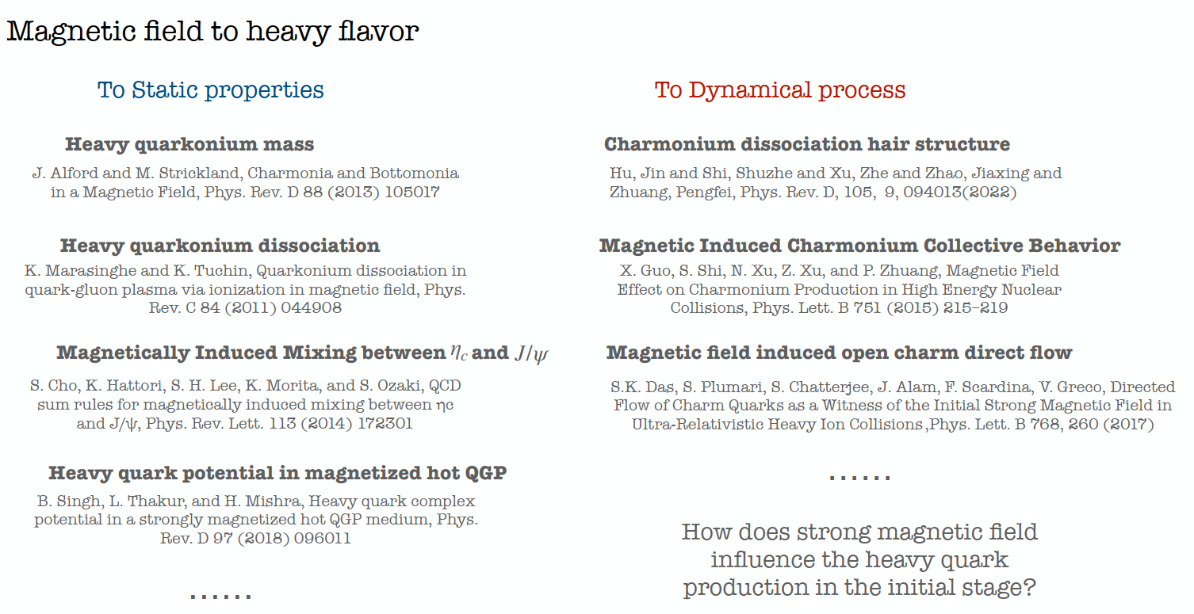

Slide 3
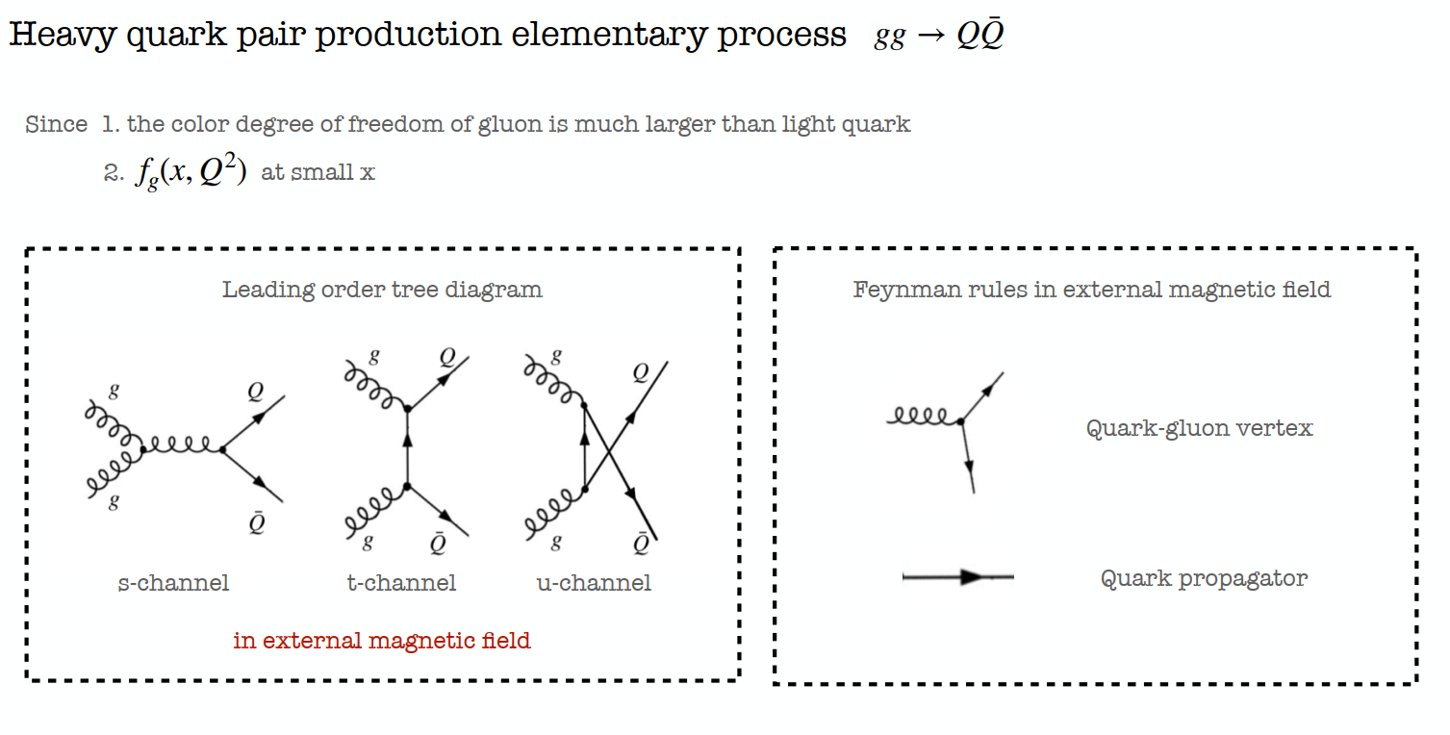
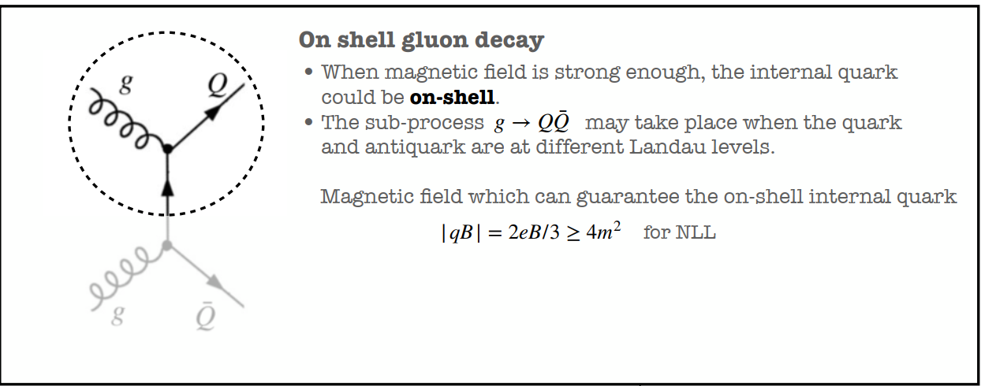
Not included in this talk,
See S.Chen, J.Zhao, P.Zhuang, e-Print: 2407.03586
This talk

Slide 4
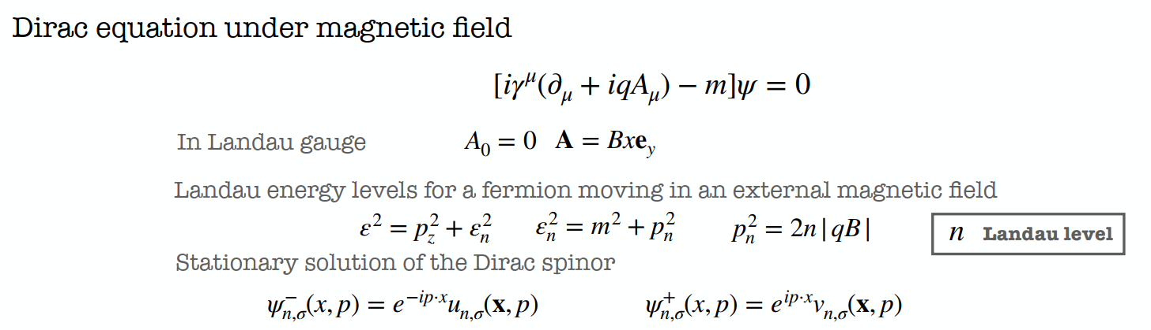
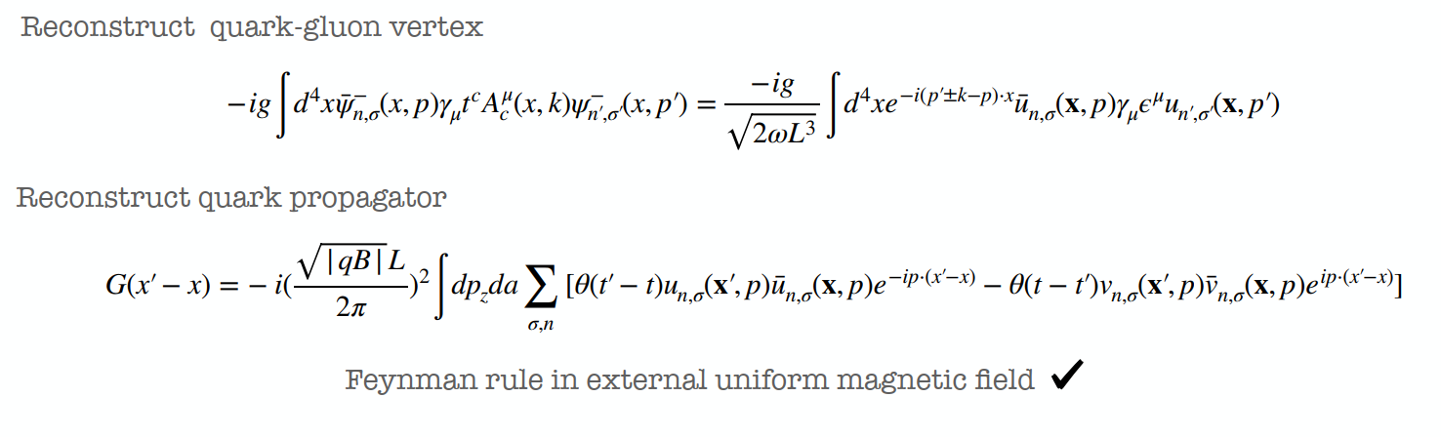

Slide 5
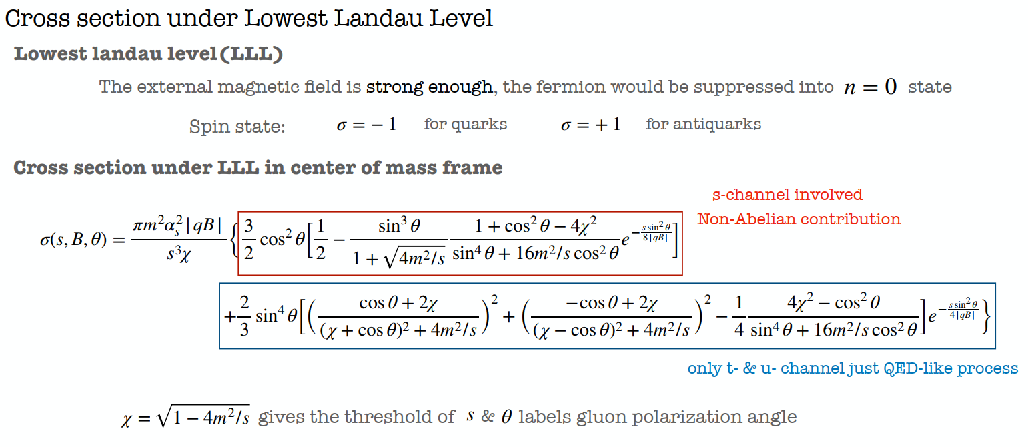
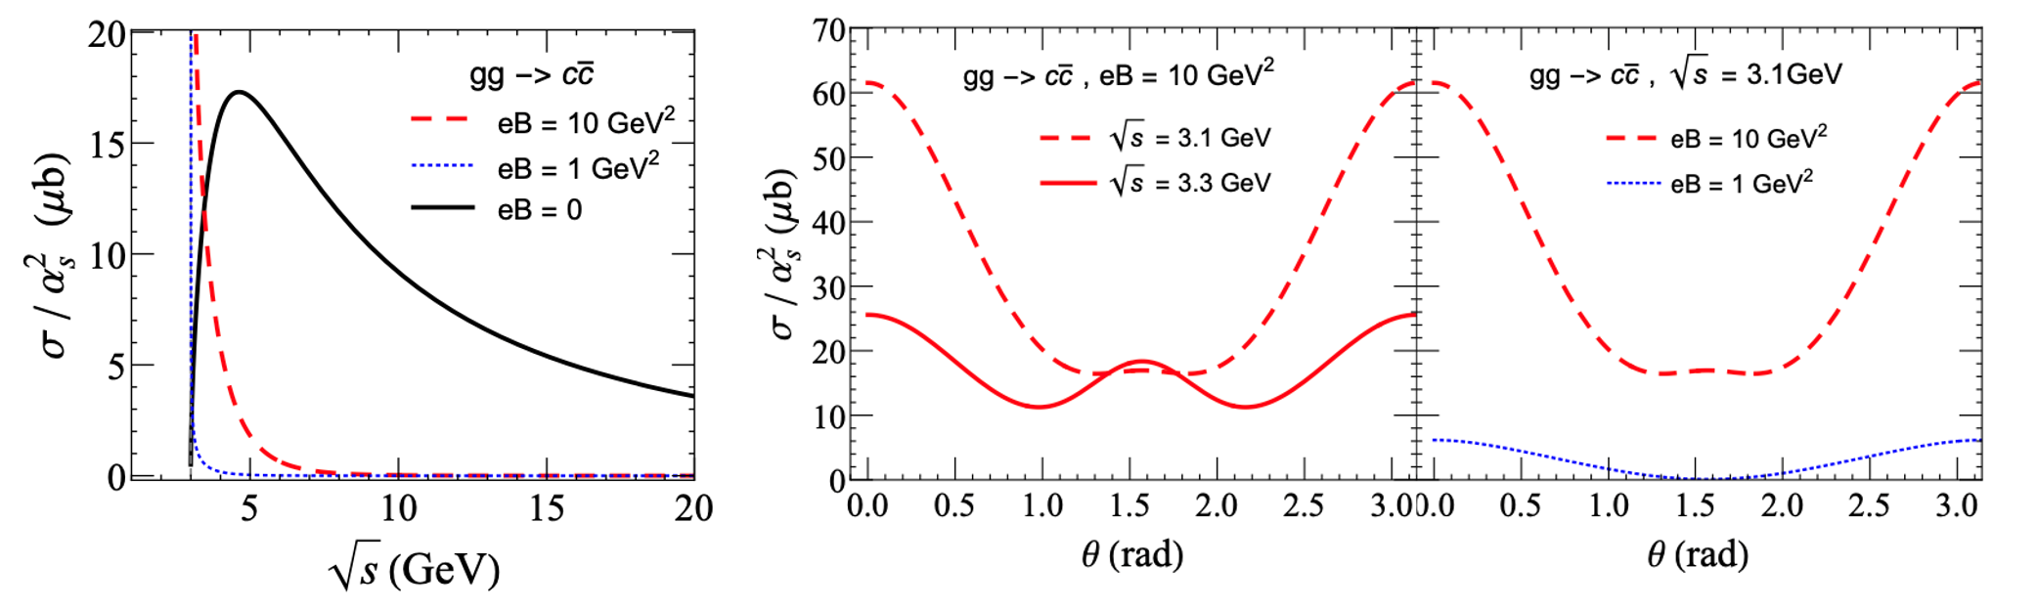

Slide 6
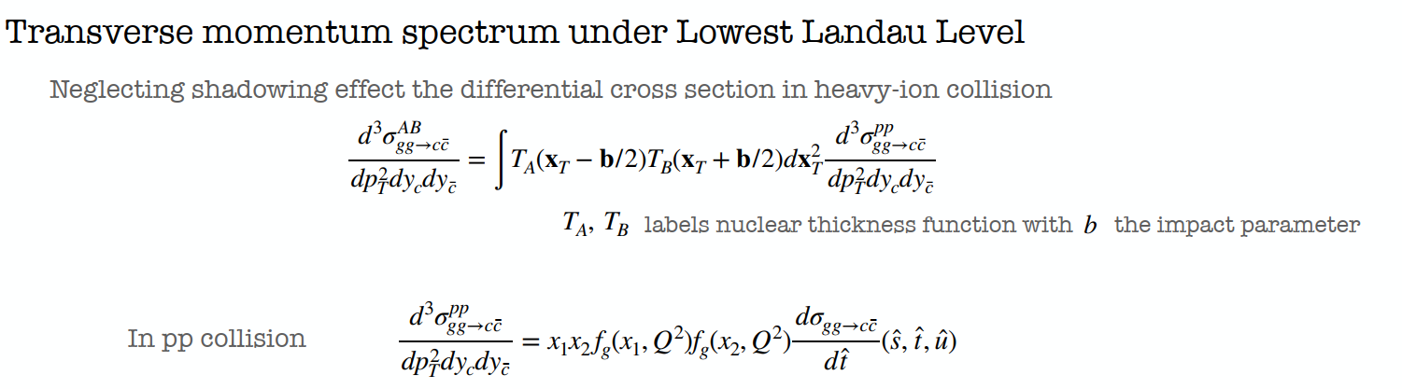
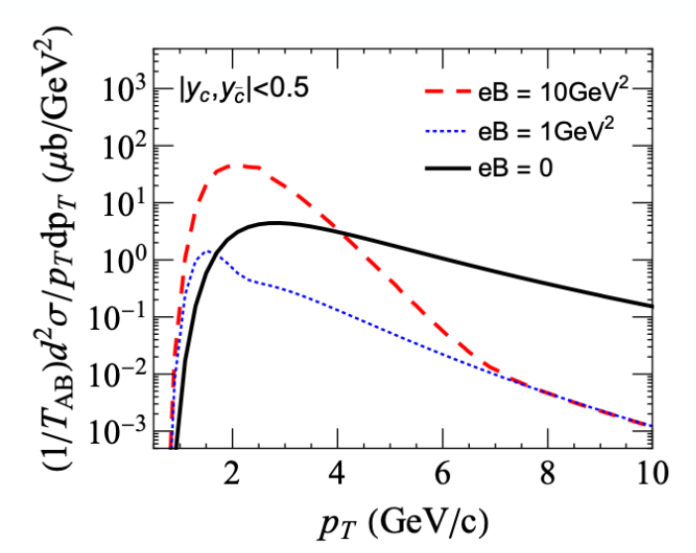
Low momentum enhancement and high momentum suppression

Slide 7
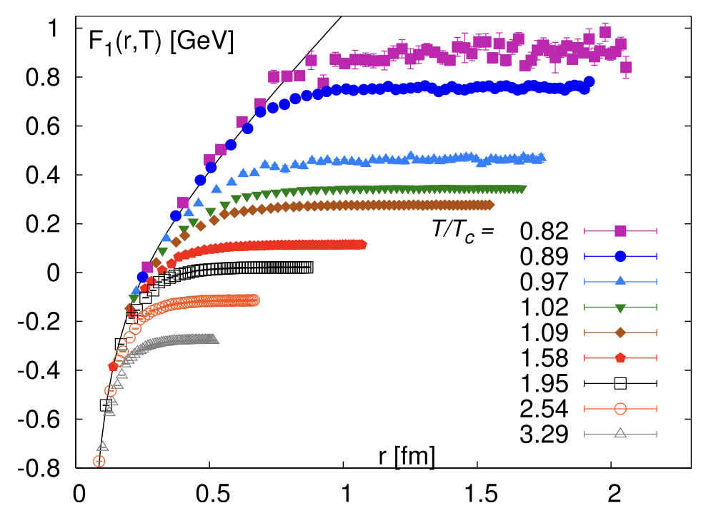



Mechanisms for Quarkonium Dissociation
● Mechanism I
P. Petreczky, J. Phys. G 37 (2010) 094009.
$$T_{diss}(ψ^{′})$$
$$T_{diss}(χ_{c})$$
$$T_{diss}(J/ψ)$$
● Mechanism II
Singlet-octet thermal break up $→$ gluon-dissociation
N. Brambilla, M. Escobedo, J. Ghiglieri, M. Laine, O. Philipsen, P. Romatschke, M. Tassler, P. Petreczky, et al,
JHEP 03, 054 (2007). PRD 78, 014017 (2008). JHEP 09, 038 (2010). JHEP 1112 (2011) 116…
Which mechanism is the dominant one ?

Slide 8
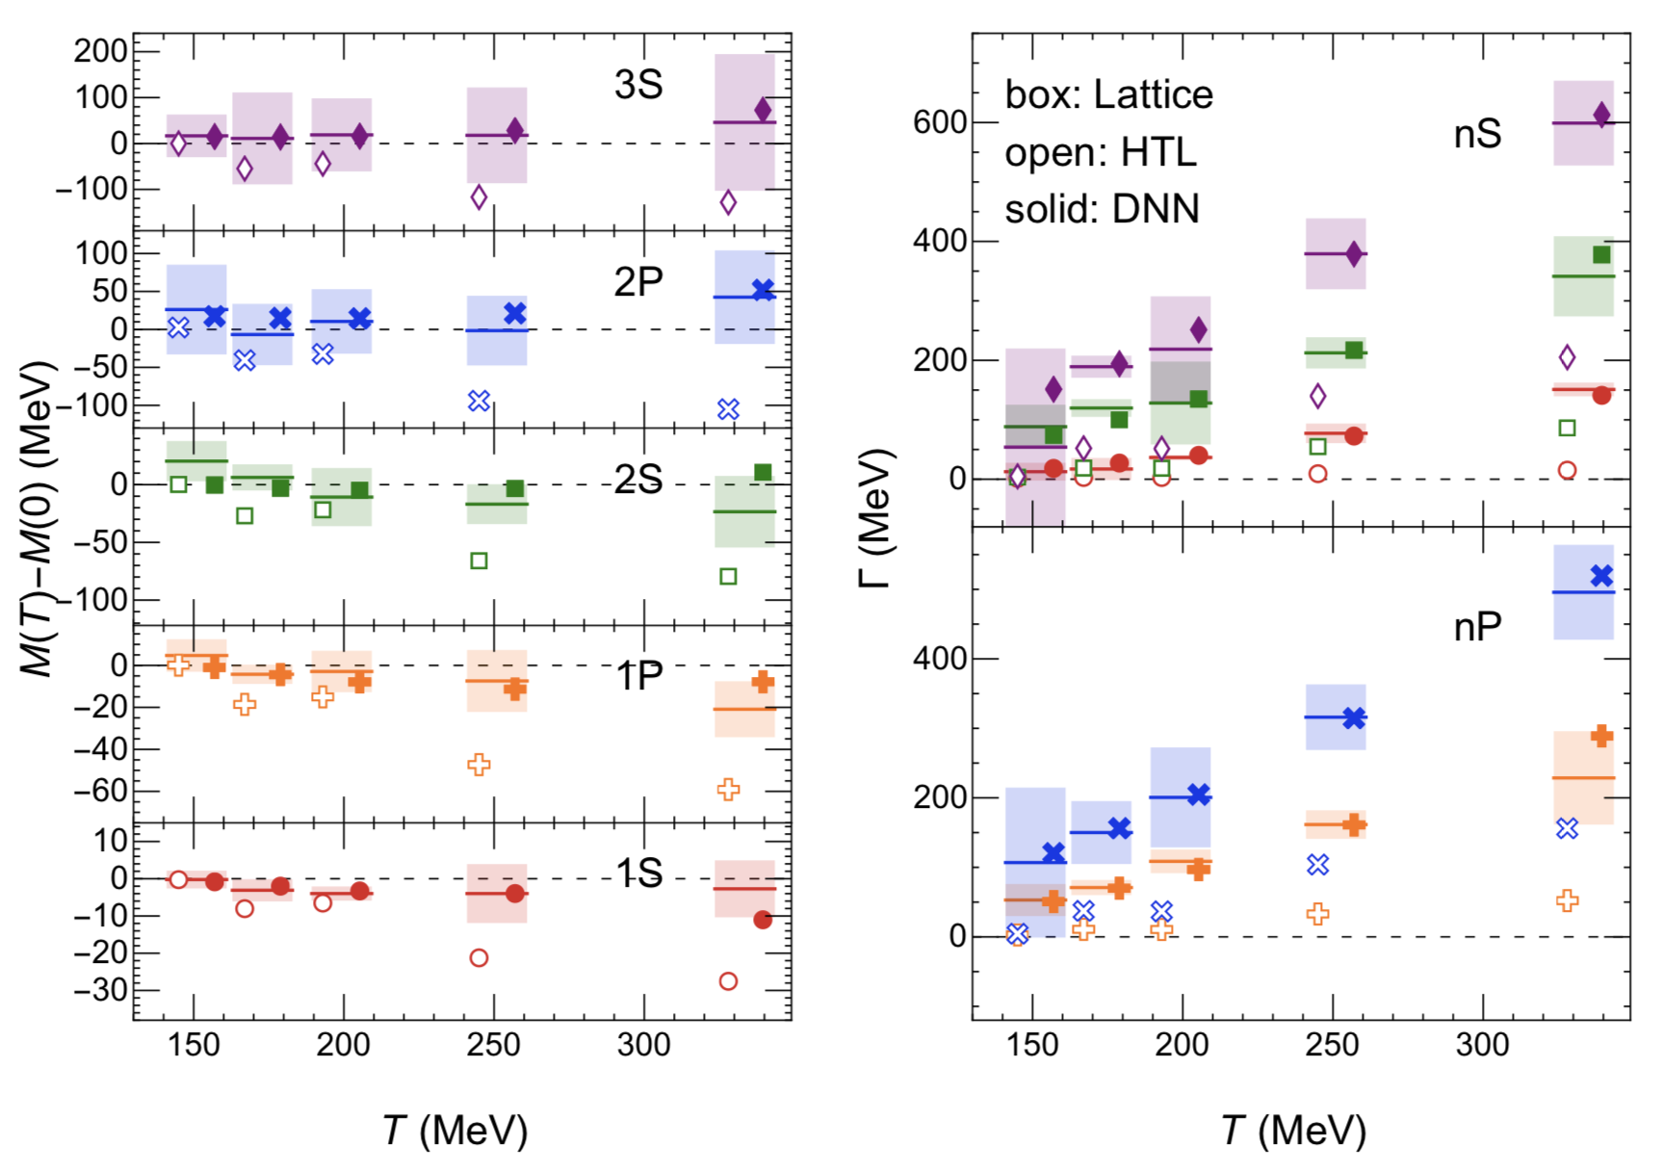

Inverse Problem of Quantum Mechanics
●LQCD simulated $Υ$ mass and width
$Υ$ mass $M(T)$ is almost a constant, but the width $Γ(T)$ strongly depends on $T$!
● Our method: inversely solving the Schroedinger equation
$$m(T), Γ(T) → V(r,T)$$
$$−\frac{{\vec{∇}}^{2}}{2m_{μ}}ψ_{n}+V\left(r,T\right)ψ_{n}=ε_{n}ψ_{n}, V\left(r,T\right)=V_{R}\left(r,T\right)+iV_{I}\left(r,T\right)$$
$$M=2m_{Q}+Re\left[ε\right], Γ=−Im\left[ε\right]$$
R.Larsen, S.Meinel, S.Mukherjee and P.Petreczky, PLB 800, 135119(2020)

Slide 9
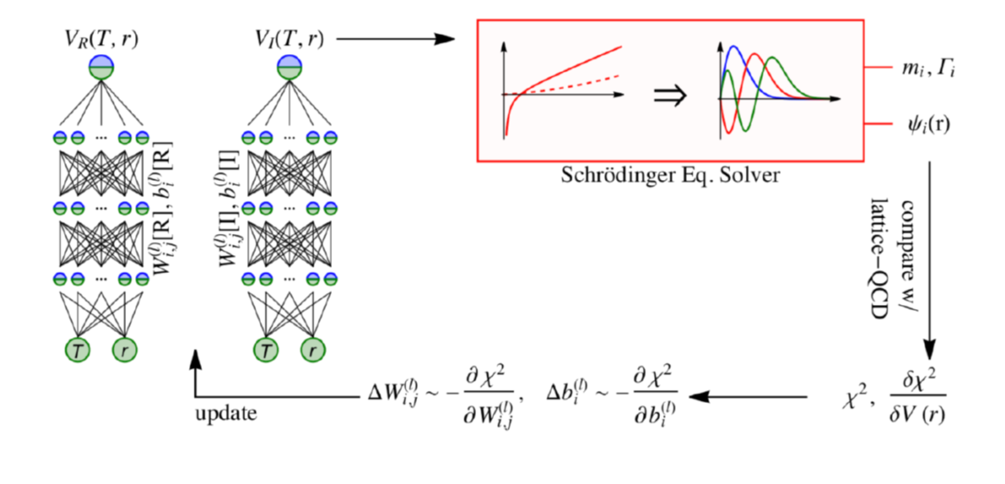
Machine learning meets LQCD
Strong T-dependent imaginary part but very small screening effect!

Slide 10
Summary
1:
The strong magnetic field in the initial stage will enhance low momentum quarkonia in high energy nuclear collisions.
2:
The quarkonium suppression in QGP is mainly due to the decay from color singlet to octet states.
Thank you for your attention!

